Slide 1
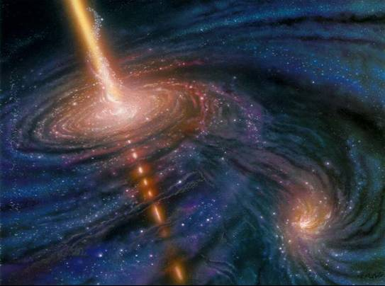
VHE Gamma Ray Astronomy Present results and future prospects
ICRR, University of Tokyo
Max-Planck-Institute for Physics
Masahiro Teshima

Slide 2
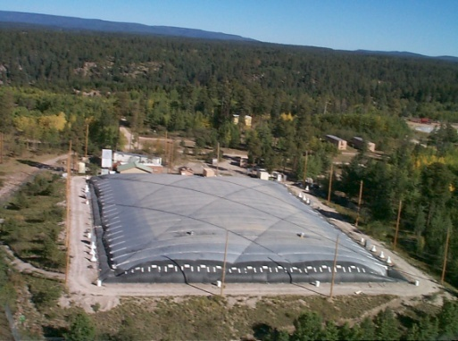
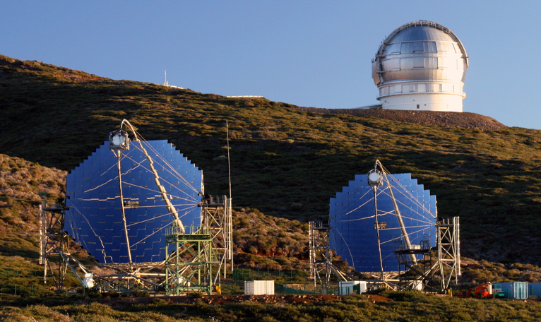
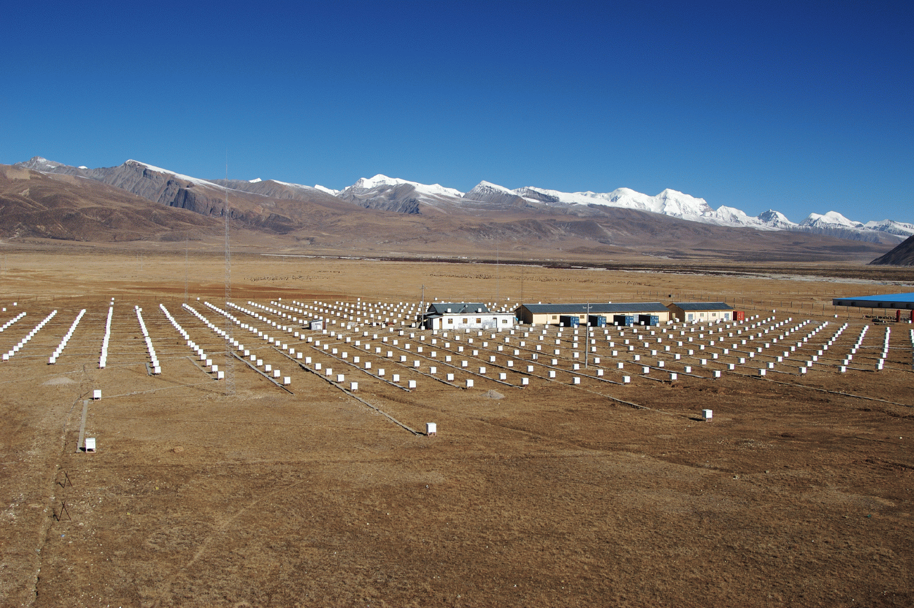
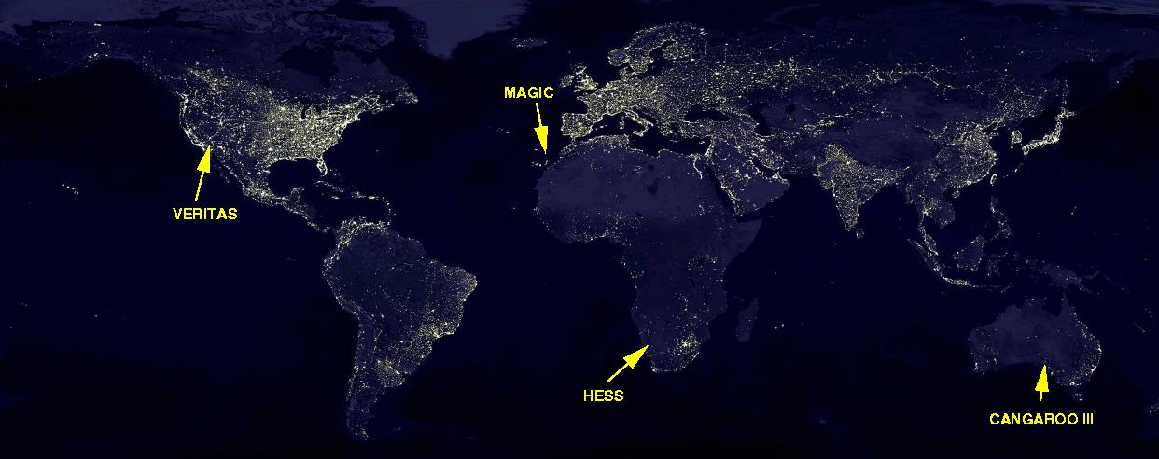
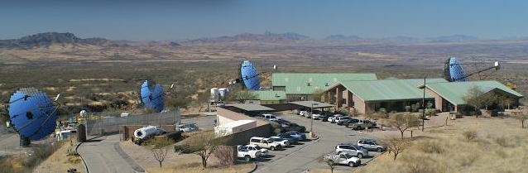
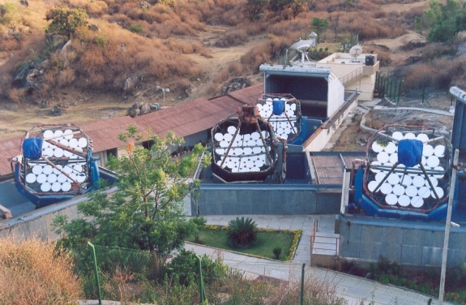
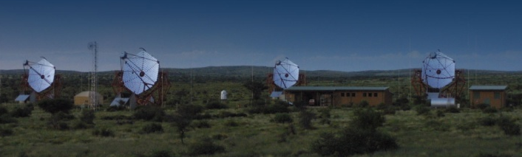
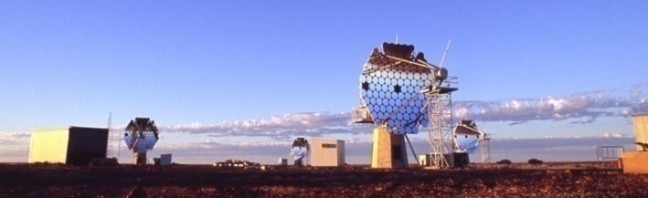
VHE Instruments
MILAGRO
MAGIC
TIBET
TIBET
ARGO-YBJ
MILAGRO
STACEE
TACTIC
VERTAS
PACT
GRAPES
TACTIC
HESS
CANGAROO
Notes:
2

Slide 3
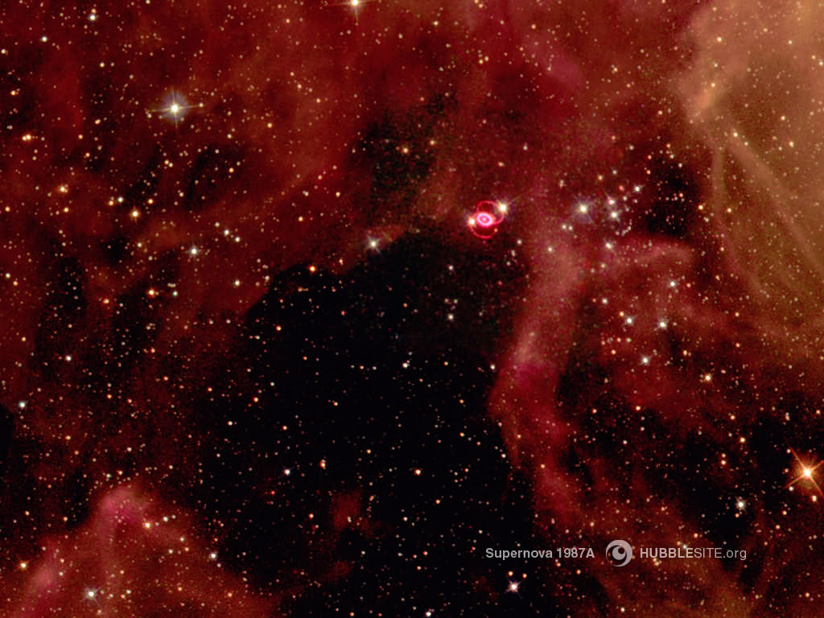


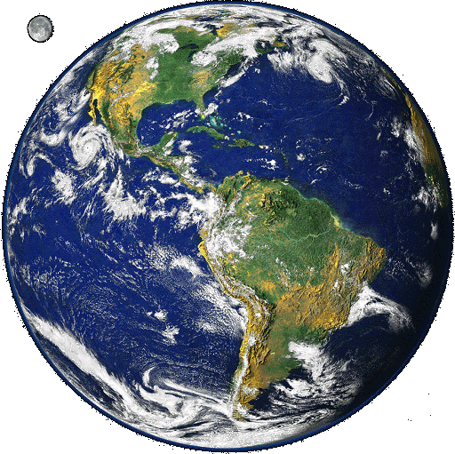

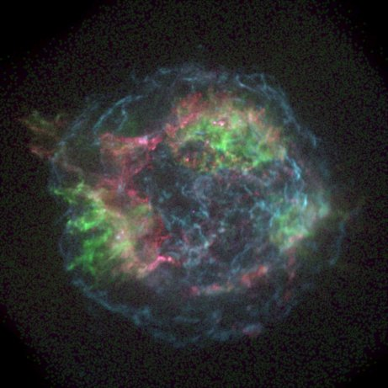
apparent
source
direction
Origin of cosmic rays
charged
particle
Gamma
Cosmic Rays + X -> π + X‘
π⁰ -> γγ
π± -> μ + ν
μ -> e + νν

Slide 4
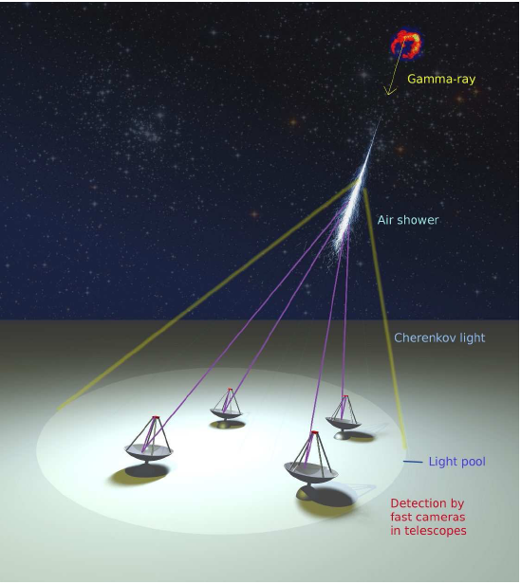
Imaging Air Cherenkov Telescope
Cherenkov Light
50photons/m² (5 pe/m²) at 1TeV
➔ MAGIC 2 x240 m², HESS 4 x106 m²
T1
T２
T３
T４
Typical parameters
Energy range 50GeV ~ 10TeV
CR rejection power >99%
Angular resolution ~0.1 degrees
Energy resolution ~20%
Detection area ~10⁵m²
Sensitivity ~1% Crab Flux (10⁻¹³ erg/cm²s)

Slide 5

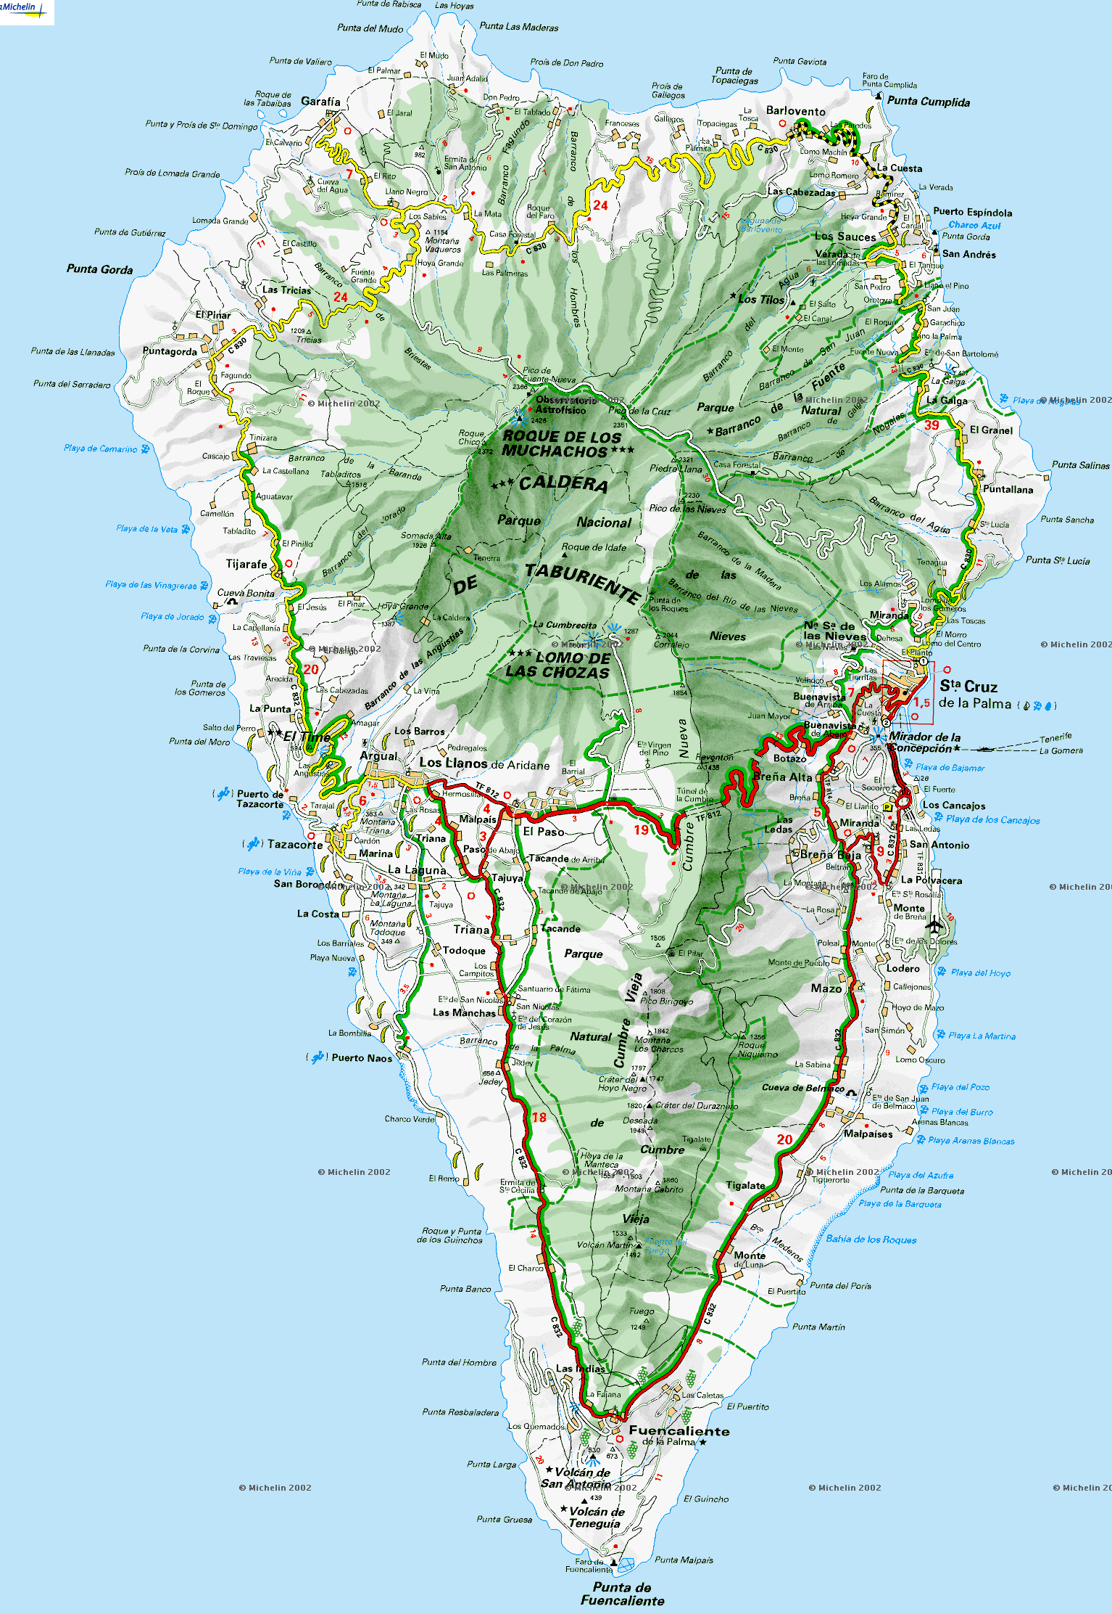
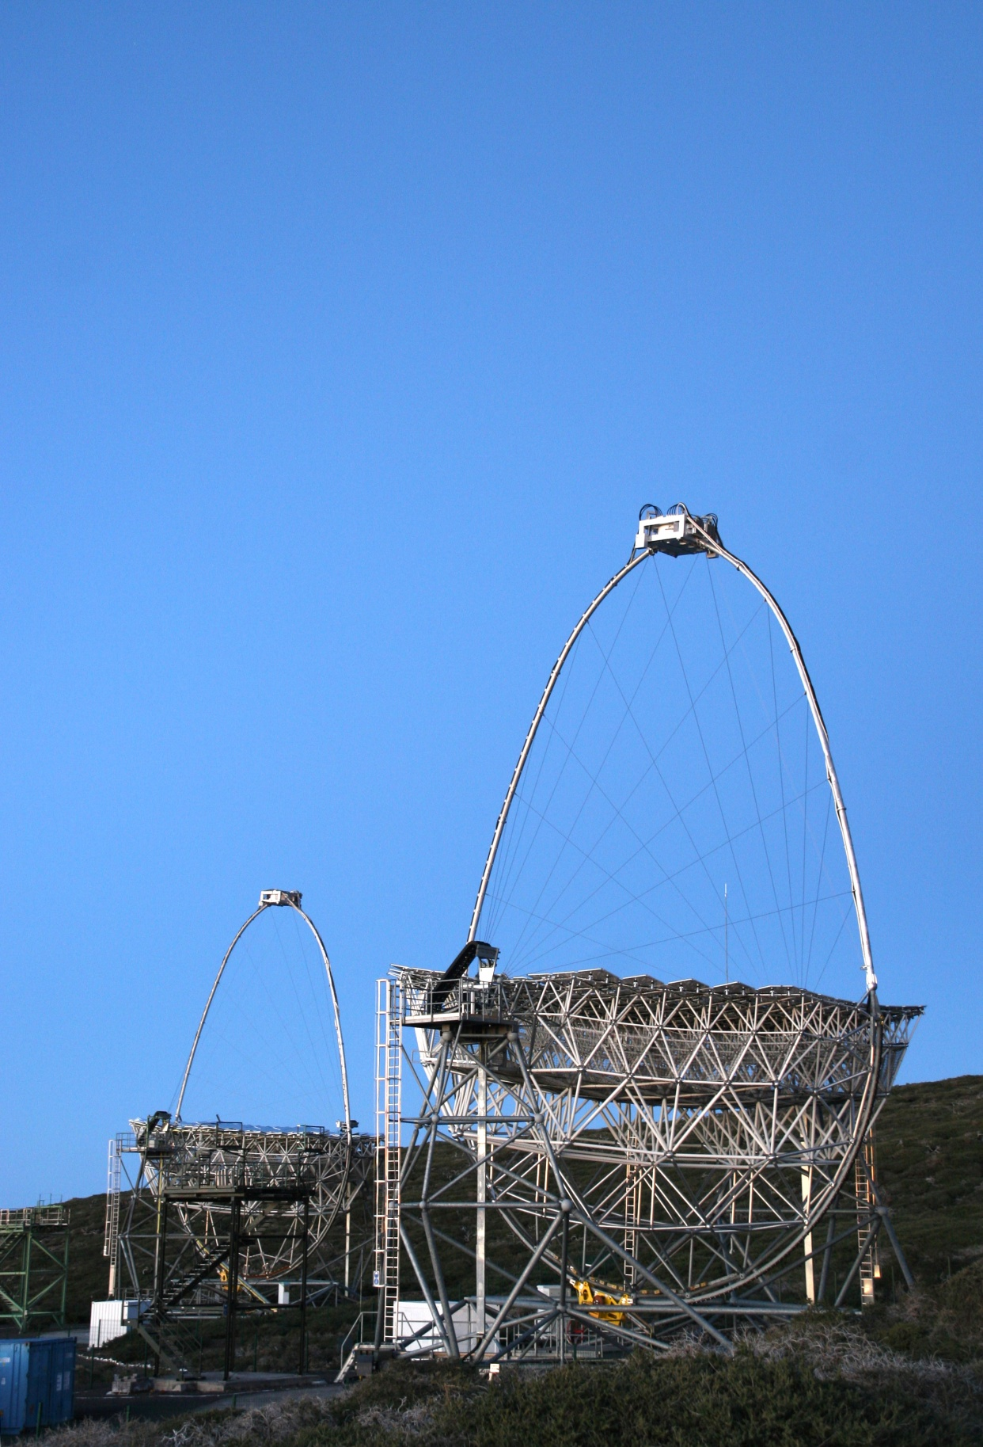
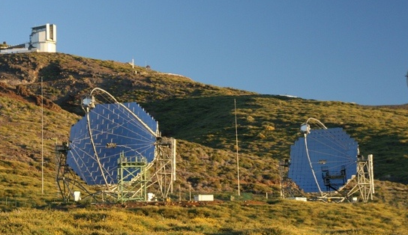
MAGIC Telescopes
New technologies
to lower the threshold energy
17m diameter world largest Cherenkov tel.
0.1°High resolution camera
Hemispherical High QE PMT
Optical fibre analogue signal transmission
2GS/sec Ultra Fast FADCs
Fast rotation for GRB ~20secs/180deg.
Trigger threshold ~50GeV ➔ ~25GeV
Upgrade from MAGIC to MAGIC Stereo
Regular operation since September 2009
Sensitivity 1.6% Crab ➔ ~0.6% Crab (50hrs)
Angular resolution 1.0 deg ➔ 0.06 deg
Energy resolution 25% ➔ 15%
85m

Slide 6
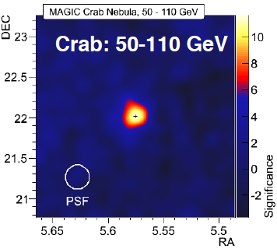
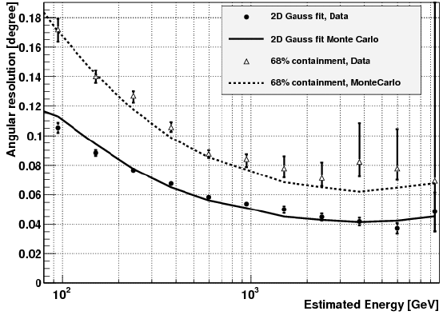
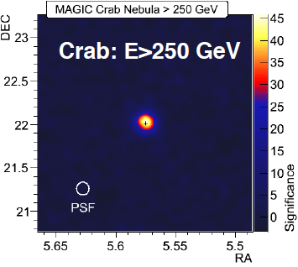
Angular Resolution in MAGIC Stereo
Data and MC agrees very well !!
~ 0.1 degrees at 100GeV
~ 0.5 degrees at 1000GeV

Slide 7
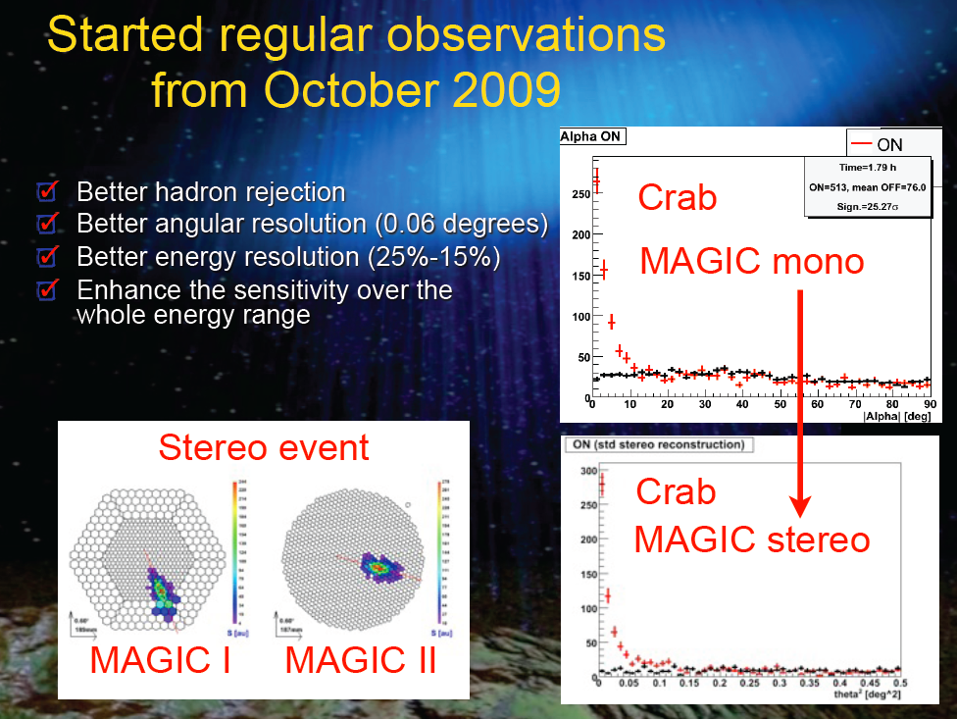

Slide 8
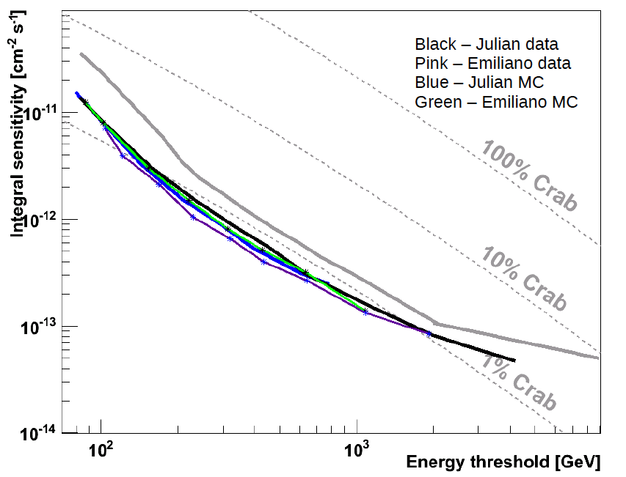
Sensitivity of MAGIC Stereo achieved (~0.6% Crab), factor 3 better than mono
1.6%Crab MAGIC Mono
0.6%Crab MAGIC Stereo

Slide 9
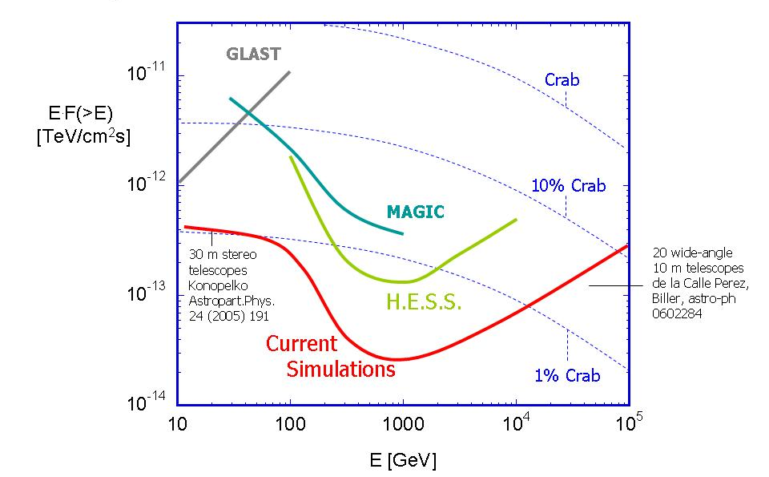
Sensitivity of MAGIC Stereo achieved (~0.6% Crab)
(1yr)
1.6%Crab
50hrs
MAGIC-stereo
AGNs, Pulsars
GRBs
0.6%Crab
Cosmic ray sources
Knee in gamma
Background Limited
Deep TeV Survey
~1 mCrab
Signal Limited

Slide 10

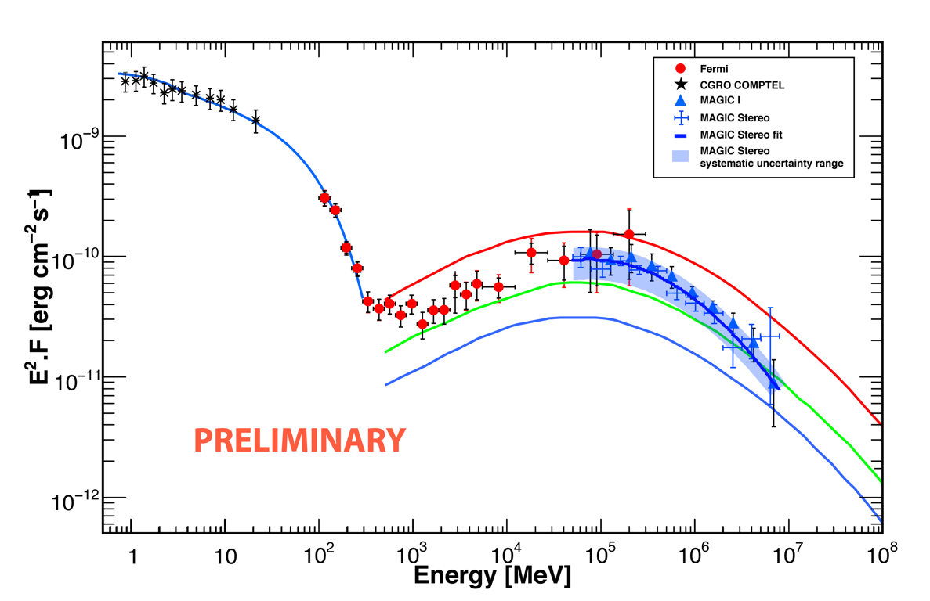
Crab Nebula 3.5hr observation with MAGIC-Stereo
Smaller error bars
in only 3.5 hours

Slide 11
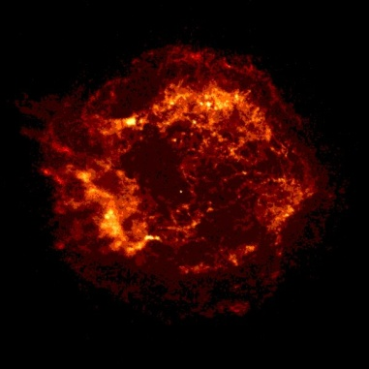
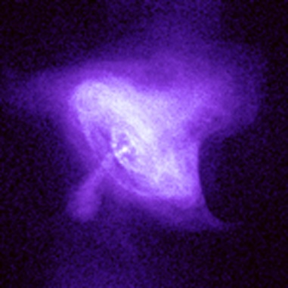
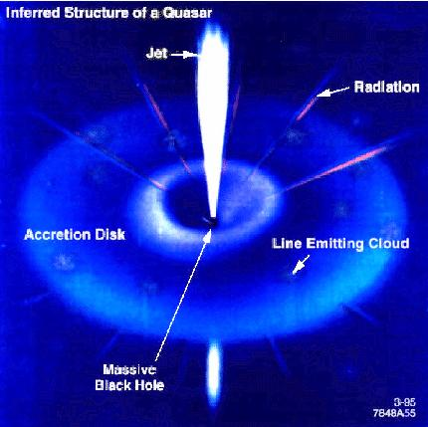
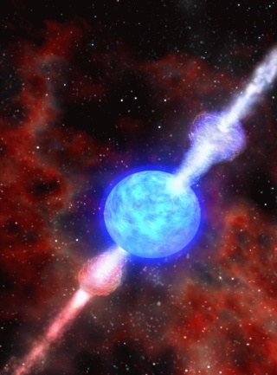
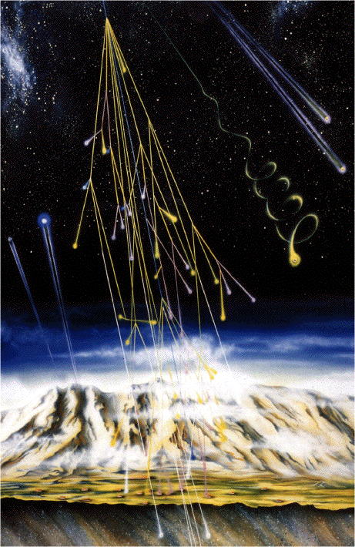
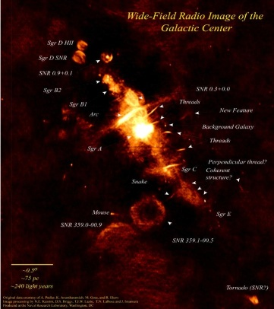
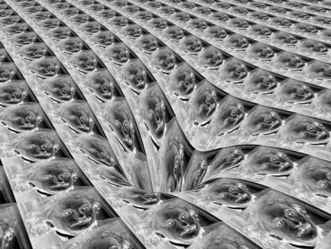
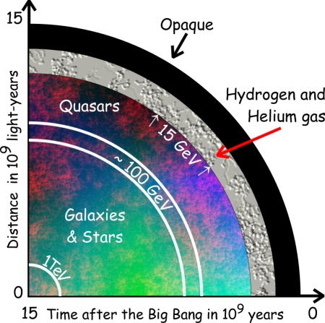
Physics objectives
SNRs
Pulsars
and PWNe
Micro quasars
X-ray binaries
AGNs
GRBs
Origin of
cosmic rays
Space-time
& relativity
Dark matter
Cosmology

Slide 12
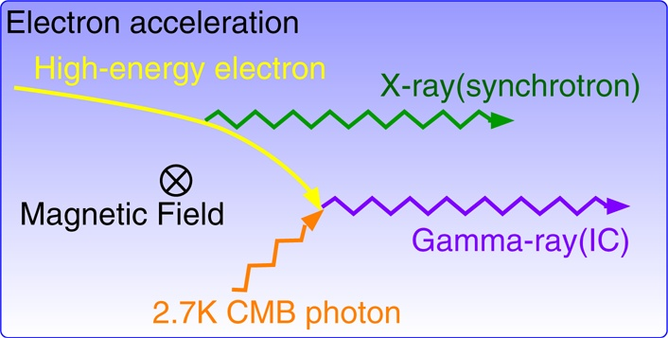
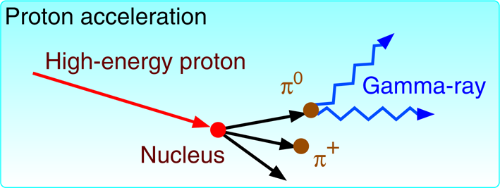
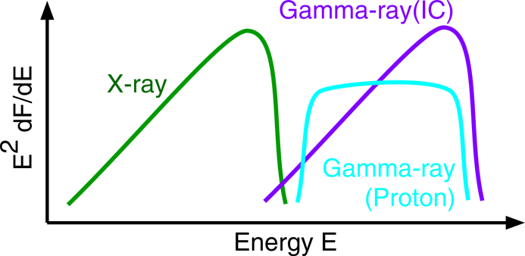
Gamma-Ray Emission Processes(1)
Astrophysical process

Slide 13
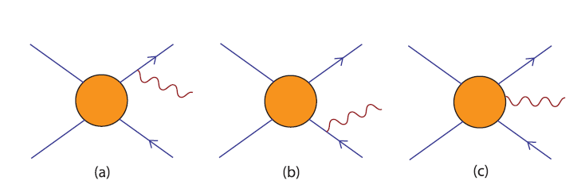
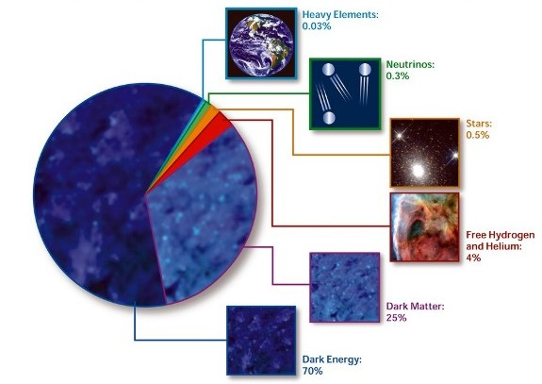
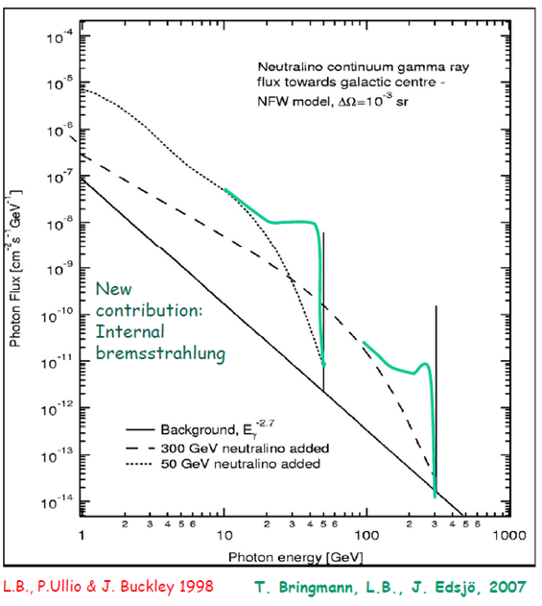
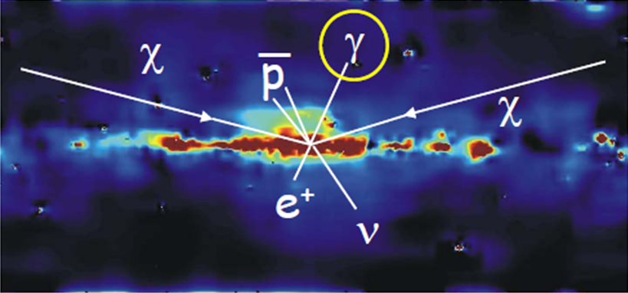
Gamma ray emission process from DM Annihilation
Dark Matter Annihilations
Bergstrom et al.

Slide 14
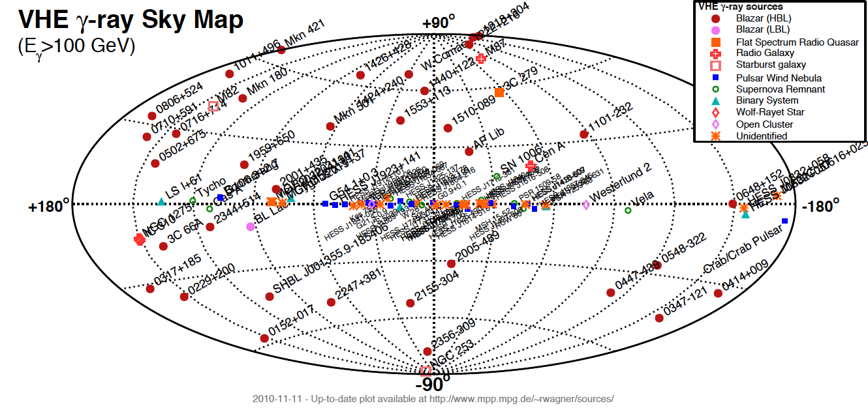
VHE Skymap
106 sources (45 Extragalactics + 61 Galactics) in Nov 2010
Blazars, FSRQs, FR-I, Starburst galaxies SNRs, PWNe, Pulsar, Binaries, un-IDs

Slide 15
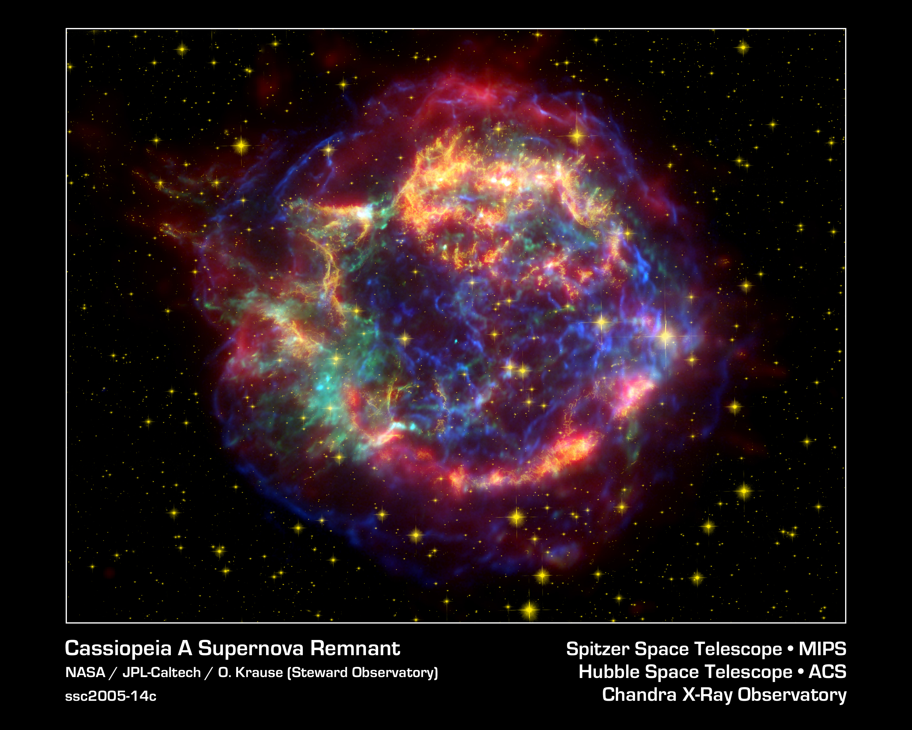
Galactic Sources
SNRs, PWNe

Slide 16
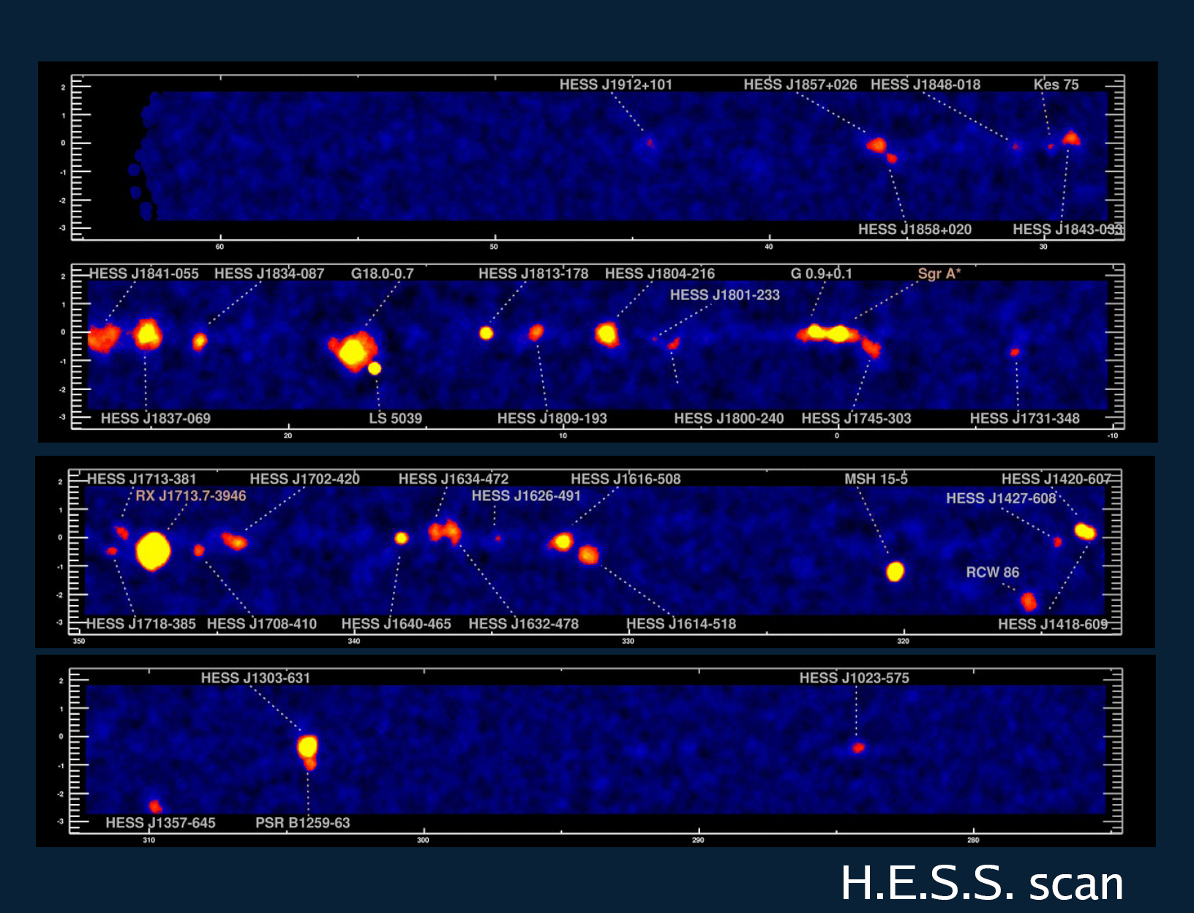
Great success!! HESS galactic plane survey
PWNe, SNRs, Binaries, un-IDs

Slide 17
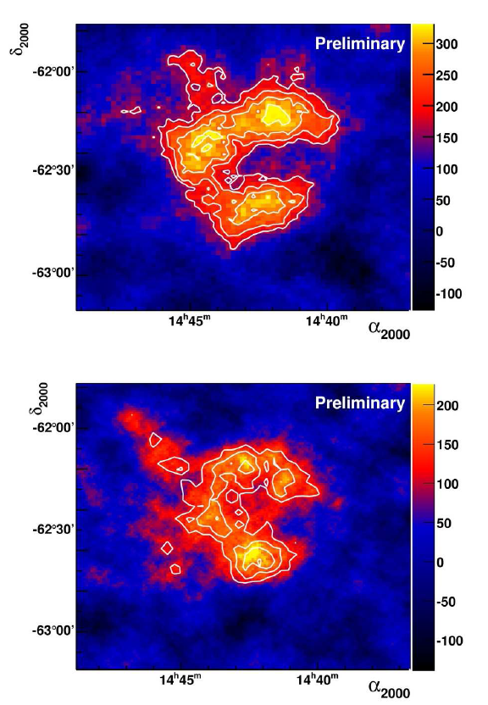
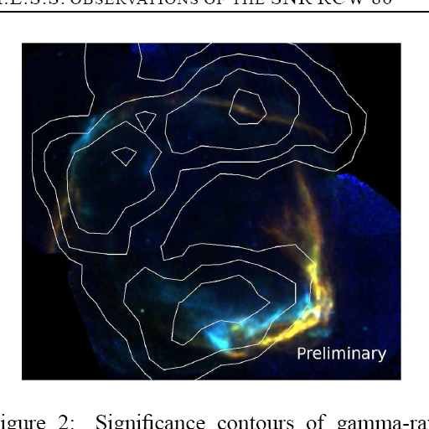
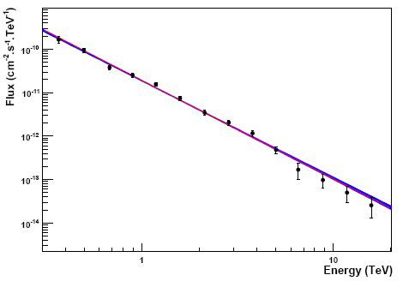
HESS: Shell type SNRs
RX J1713, RX J0852, RCW86
HESS
HESS
HESS RCW86
Index ~2.0
Break ~20TeV
Index ~2.2
XMM-Newton, HESS

Slide 18
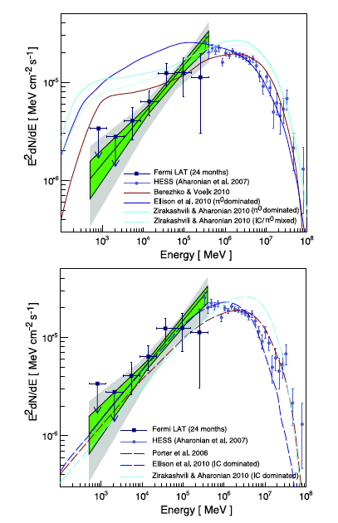
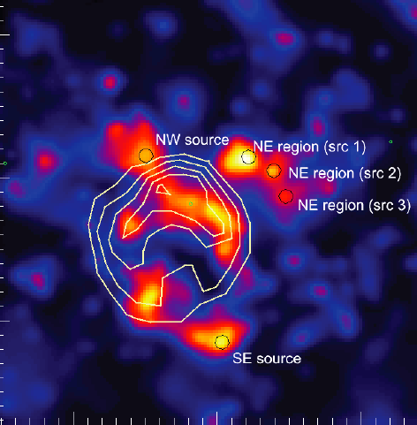
SNR Study
RX J1713 HESS + Fermi
Color HESS observation
Contour Suzaku X-Ray
Fermi

Slide 19
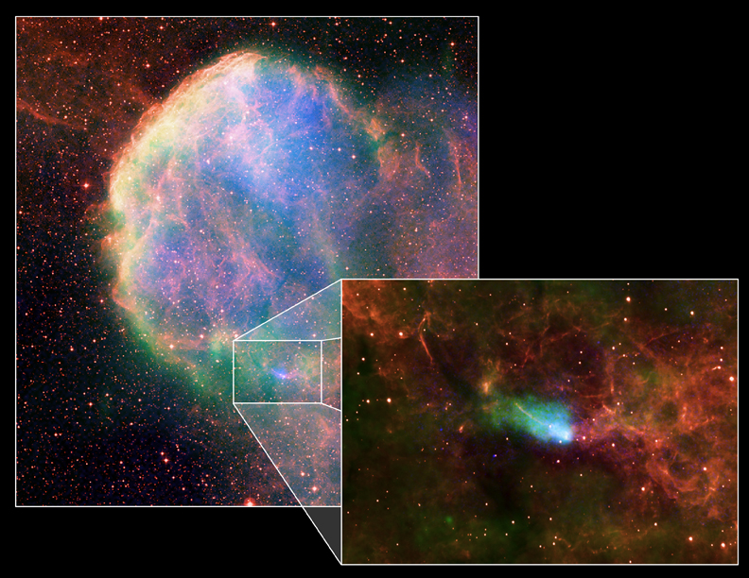
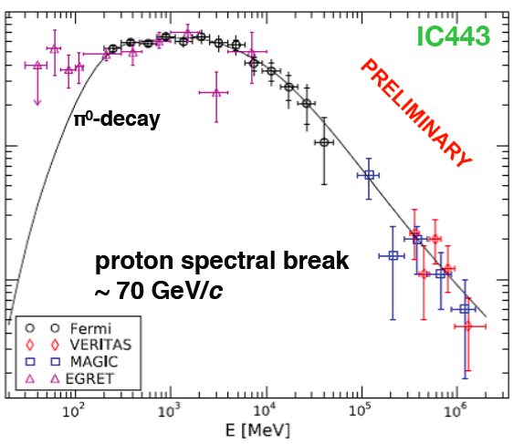
MAGIC: Shell type SNRs
IC443(MAGIC J0616)
Composite image
With X(Chandra),
Radio(VLA),
Optical (DSS)
MAGIC J0616
CXOU J061705.3+222127
index~3.1
Molecular Cloud
Radio
X-ray
EGRET 3EG J0617+2238
Pulsar CXOU J061705.3+222127

Slide 20
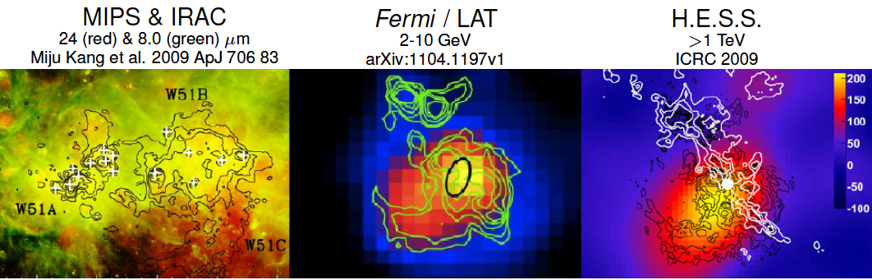
SNR W51
One of the most luminous star forming region (distance ~ 6kpc)
W51C is a medium age (~30kyr) Super Nova Remnant
Shell of the remnant is interacting with surrounding molecular cloud
Discovery by Fermi/LAT (GeV) and HESS (4.4 σ at 1TeV)
Promising candidate SNR to test and study cosmic ray acceleration

Slide 21
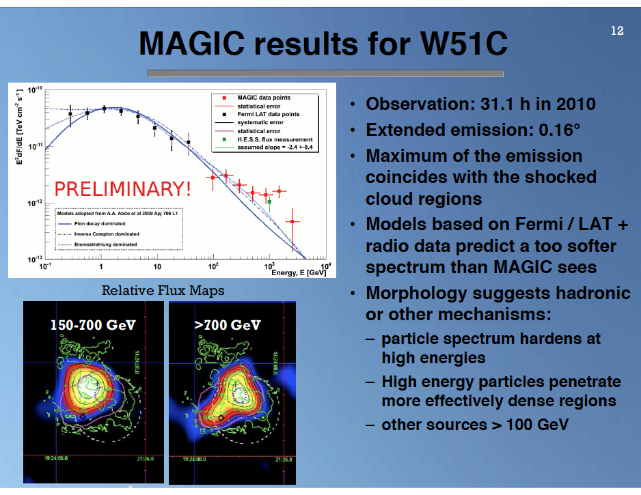

Slide 22


SNRs in different evolutionary stages
10-30kyr
We can study SNRs in different
evolutionary stages
2kyr
0.3kyr
Courtesy of S.Funk

Slide 23

Pulsar Wind Nebulae observation by HESS
Major galactic TeV source population
  Associated with relatively young (<10⁵ year old) and energetic pulsars
Generally believed that we see inverse Compton emission of 1-100 TeV electrons
1% of Spin-down energy goes to VHE gamma rays
Funk 2006
Notes:
23

Slide 24

Pulsar Wind Nebula HESS J1825-137
Energy Dependent Morphology
Major galactic TeV source population
  Associated with relatively young (<10⁵ year old) and energetic pulsars
Generally believed that we see inverse Compton emission of 1-100 TeV electrons
1% of Spin-down energy goes to VHE gamma rays
Clear evidence for cooling of electrons in the Nebula
Notes:
24

Slide 25
Crab Nebula spectrum
Fermi and MAGIC-Stereo
Smaller error bars
in only 3.5 hours

Slide 26


Pulsar Study
MAGIC result: Published in Science in 2008
By measuring the spectrum around cutoff
or at high energies is important to distinguish
the emission model
Polar cap: double exponent
Outer gap: simple exponent

Slide 27


Crab Pulsar
Fermi
Cut off feature of Spectrum: Exponent or Power-Law
Fermi
EGRET
MAGIC
MAGIC
PhD Thesis of Takayuki Saito 2010

Slide 28
Extragalactic sources

Slide 29


Number of extragalactic VHE Sources (45)
HESS
MAGIC
VERITAS
MAGIC
Whipple
HEGRA
HESS
FERMI
VERITAS
1ES1959
PKS2155
M87
Mrk 421
Mrk 501
1H1426
1ES2344
Fermi

Slide 30


Cosmic Ray accelerator
Active Galactic Nuclei
FRI, FRII
Blazars
Gamma factor ~10
SMBH 10⁷-10¹⁰ M◎
M87 (HST)

Slide 31

Extra-galactic sources
45 sources ( 3 x FR-I, 2 x Starburst galaxies, 4 x FSRQs, 36 BL Lacs )

Slide 32

PKS 2155−304 (HESS Observation)
Spectral Energy Distribution
Time-averaged SED is well described by a single zone SSC model:
Fermi
ATOM
RXTE
FERMI
Swift
HESS
Highest energy electrons (γ_{e}>2×10⁵) produce the X-ray emission, but contribute relatively little above 0.2 TeV

Slide 33

Mrk421 MWL SED
Synchrotron
Inverse Compton

Slide 34






FSRQ 3C279 (z=0.536) MAGIC
Most distant 100GeV AGN
January 16, 2007

Slide 35






EBL (Extragalactic Background Light)
Extragalactic Background Light
blazar
IACT
γ_{VHE}
γ_{EBL}
e⁺
e⁻

Slide 36

EBL upper limit by MAGIC and HESS observations

Slide 37



Second most distant 100GeV source
FSRQ PKS1222 (4C +21.53) (z=0.436)
>10 sigma
in 30min
~10mins doubling time
maybe inconsistent with EC model

Slide 38



M87 flare in 2008:
MAGIC, VERITAS, HESS, VLBA
Model of 43GHz Radio flux
using the measured VHE gamma flux

Slide 39


M87 flare in 2008:
MAGIC, VERITA, HESS, and VLBA
2.5mas (0.25pc)
20” (2kpc)
30mas (3pc)

Slide 40


Morphological studies of UHECR potential sources
Cen A (3.4Mpc) & Cen B (56Mpc)
Moskalenko et al. 0805.1260v1

Slide 41


Cen A: HESS detection
Distance: 3.8Mpc
Flux: 0.8% in Crab Unit
Spectral Index: -2.7
Cross: the best location (COG)
Circle: 95% C.L. VHE extension limit
L_{VHE} ~ 2.6 x 10³⁹ erg s-1
L_{UHECR} ~ 10⁴⁰ erg s-1

Slide 42




IC310 (FR-I Radio galaxy) is discovered, when observing Perseus cluster / NGC1275
Fermi
Too bright as an off-axis blazar

Slide 43



Gamma ray bursts
Hypernova!
Binary neutron stars
GRB Blast shock wave
After glow
γ
X
γ
Optical
Radio

Slide 44





10 GRBs observed by Fermi
GRB090902B
➔ 71 GeV (16.54s)
➔ 59 GeV (0.829s)
➔ 93 GeV (82s)
GRB080916C
GRB090510(short burst)
GRB090902B

Slide 45


Slide 46




CTA Monte Carlo:
Expected Light curve for GRB at z=4.3
CTA performance study by S.Inoue, Y.Inoue, T.Yamamoto, et al

Slide 47
Summary of VHE gamma ray astronomy
The VHE gamma ray astronomy started with the discovery of VHE emission from Crab by Whipple observatory in 1989
The third generation telescopes, HESS, MAGIC and VERITAS are increasing the number of VHE sources very rapidly (1-2 sources/months)
More than 100 of VHE gamma ray sources
  SNRs, Pulsar, PWNe, Binaries / BL Lacs, FSRQs, FR-I, Starburst Galaxies
Galactic sources: SNRs
  We can see several SNRs in different evolutionary stages with the different energy spectra
Galactic sources: PWNe
  Most popular galactic sources, asymetric morphologies, energy dependent morphology
Nearby bright BL Lacs show the intensity variation of x 50
  Mkn421, Mkn501, PKS2155
  Very fast time variations of a few minutes are found in Mkn501 and PKS2155
Distant sources:3c279, PKS1222
  The room for the extra component (Pop-III) in EBL is now very slim

Slide 48


CTA

Slide 49
~23m telescopes
4 - 6° FoV
0.08 - 0.12° pixels
Parabolic/Hybrid f/D~1.2
12m telescopes
7 - 8° FoV
0.16 - 0.18° pixels
Hybrid f/D =1.35
4-7 m telescopes
8 - 10° FoV
0.2 - 0.3° pixels
DC or SO f/D 0.5-1.7

Slide 50

Possible array configuration
Configuration E:
LST x 4, MST x 23, SST x 32
Acceptance 3km2

Slide 51

Kifune Plot
(expectation from log S - log N)
~3000 sources
by GLAST, AGILE
GLAST
AGILE
~1000 sources
by CTA

Slide 52

All sky observatory
(2 stations in North and South)
One observatory with two sites operated by one consortium
~ 50MEuro
Canaries: La Palma, Tenerife 2400m
Mexico: San Pedro Martir 2800m
Mainly
extragalactic
science
~ 100MEuro
Namibia: Kohmas Highland 1800m
Chile: La Silla 2400m
Argentina: El Leoncito 2600m
Argentina: Puna Highland 3700m
Galactic plus
extragalactic
science

Slide 53


Galactic sources
Galactic sources
200~400 sources with CTA
Where is PEVATRON???

Slide 54


Slide 55


Slide 56




Specification and Physics
DM
Sensitivity x10 (10⁻¹⁴erg cm⁻²s⁻¹)
Energy Res. x2 (10% @ 1TeV)
SNRs
New sources
Angular Res. x3
(2 arcmin @1TeV)
Low Threshold E x2 (20-30GeV)
Morphology
Distant AGNs
cosmology
Large Accept. x30 (3x 10⁶m² >1TeV)
Fast rotation
20 sec/180°
Origin of CR
GRBs
Better S/N x3
>99.9%
High Time Res. x10 (~1sec)
Space and Time
All Sky Observatory
Flexible modes
Scan / Monitor
TeV - All sky map
Galactic diffuse

Slide 57

23m Large size telescope and
12m Middle size telescope
23m LST designed by MPI group
12m MST designed by DESY group

Slide 58



4-7m Small Size Telescope
Italian Design 7m
UK Design 4m

Slide 59






Recommendations and supports
ASTRONET Roadmap
ASPERA Roadmap
High Priority project
Ground based projects
8 Infrastructures
from Physics and eng
Magnificent Seven

Slide 60

Decadal Survey in Astronomy and Astrophysics in US
Ground-based projects ranked in order:
Large-scale
Large Synoptic Survey Telescope (LSST)
Innovations Program
Giant Segmented Mirror Telescope (GSMT)
Atmospheric Čerenkov Telescope Array (ACTA)

Slide 61


Slide 62
Summary: CTA
CTA will provide
  10 times better sensitivity
  wider energy coverage (10GeV-100TeV)
  All sky observation
  ~1000 VHE sources
High quality data will be delivered
  Better energy resolution (10%)
  Better angular resolution (2arc min)
Time schedule
  Preparatory Phase until 2014
  Construction phase: 2015-
Cost ~200MEuro
  Contribution from CTA-Japan ~20% of total cost
Expected contribution from CTA Japan
  LST Camera
  GHz sampling readout electronics
  Large size mirrors
よろしくご支援をお願いいたします。

Slide 63
Thanks

