Slide 1
Laboratory Astrophysics
(1) Laser Experiment on Collisionless Shock and Origin of Cosmic Ray
H. Takabe
ILE, Osaka University
Dep. Physics, Dep. Space and Earth Science
and International Physics Course, Graduate School of Science, Osaka University
Seminar at Institute of Cosmic Ray Research, University of Tokyo, Kashiwa Campus,
June 29 (Wednesday), 2012

Slide 2
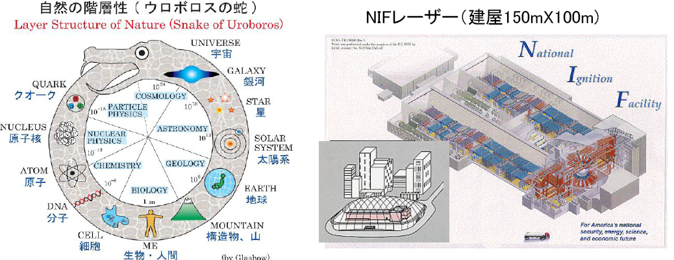
Laser Astrophysics: High-Mach Collionlsess Shock and Particle Acceleration (and Vacuum Breakdown with Lasers)
超新星残骸に代表される高速無衝突衝撃波と波面での荷電粒子加速の物理を解明すべく、巨大レーザーを用いた模擬実験を行っている。一本が40cmX40cm口径のレーザーを１９２本備えた上記のＮＩＦレーザーによる、外磁場がない元で、レーザー噴射プラズマの対向流でWeibel不安定に起因する、無衝突衝撃波生成実験を計画している。その理論的根拠と予備的実験の紹介をする。超高強度レーザーが真空の崩壊による超相対論的ファイアーボールの模擬実験を可能とし、素粒子の集団現象の実験研究を可能とする。大型レーザーによるウロボロスの蛇の頭と尾をカバーする「レーザー宇宙物理・素粒子物理」の開拓を紹介をする。

Slide 3
Outline
What is the Laboratory Astrophysics
Topics (1)
Collisionless Shocks in Universe
Particle Accelerations
Laboratory Experiment with NIF
Topics(2)
Pair Production via Vacuum Breakdown with Ultra-intense Lasers
Development of Ultra-intense Lasers in the World.

Slide 4
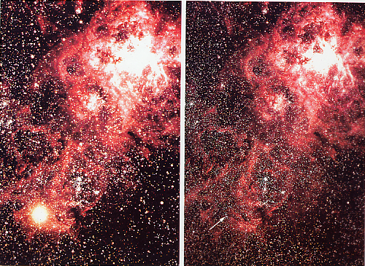
Supernova 1987A
After
Before

Slide 5
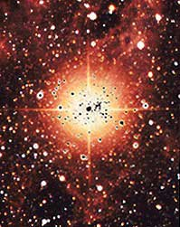
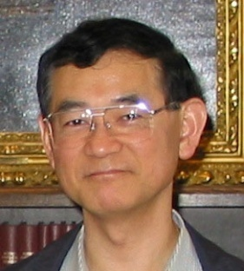

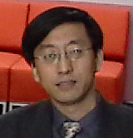
80
独マックスプランク研究所
米アリゾナ大学
激光XII号完成(83)
第2次オイルショック
核融合中性子１０兆個(86)
超新星1987A爆発観測(87)
野本（東大）
90
ソ連の崩壊
「実験室宇宙物理」提唱(92-93)
米実験開始(95)
実験宇宙国際会議開始(96)
レミントン（米）
日実験(99)
00
ITER議論
日中仏英共同研究開始(02)
国立大学法人化
「レーザー核融合」から「レーザーエネルギー学」へ(04.4)
全国共同利用研究施設化(06.4)
「レーザー宇宙物理」プロジェクト開始(07.4)
張（ザン、中）

Slide 6
Scaling Parameters Controlling Physics
1. Hydrodynamics
3. Plasma Shocks
4. Rel. Pair Plasmas
2. Atomic Process

Slide 7
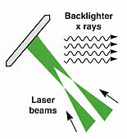


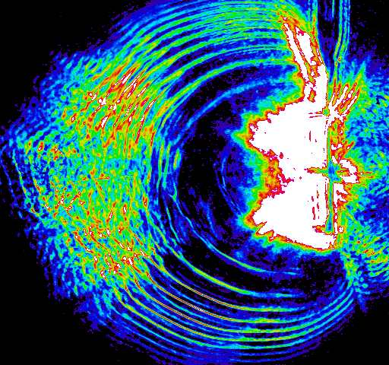
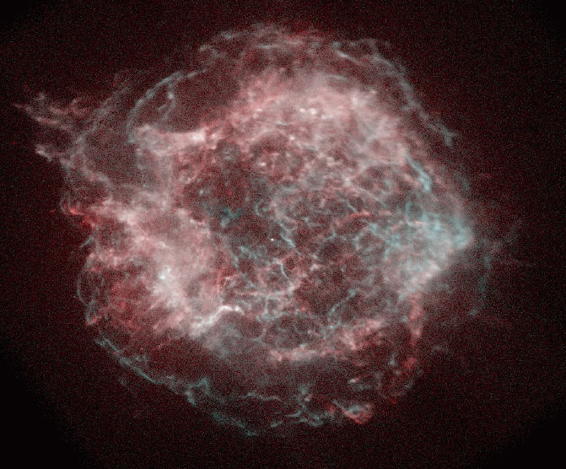
Active
Passive only
X-rays
Laser
Photons
Particles
Passive

Slide 8
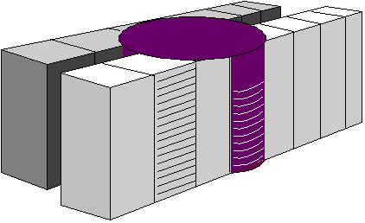
What is Laboratory Astrophysics ?
Exciting discovery-driven research that has high scientific merit should be funded
Test bed for Numerical Astrophysics
New Finding of Physics not Expected
Prediction of Astrophysical Phenomena
Provid Challenging Plasma Physics
Model Experiment
Supercomputer
Space & Time
Supernova

Slide 9
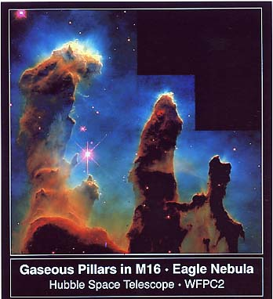
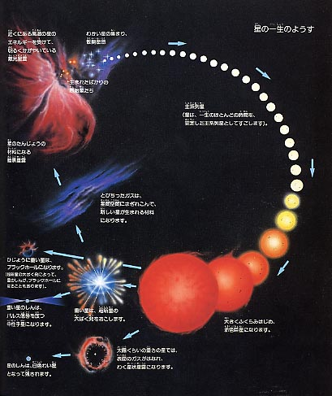
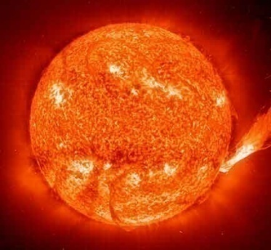
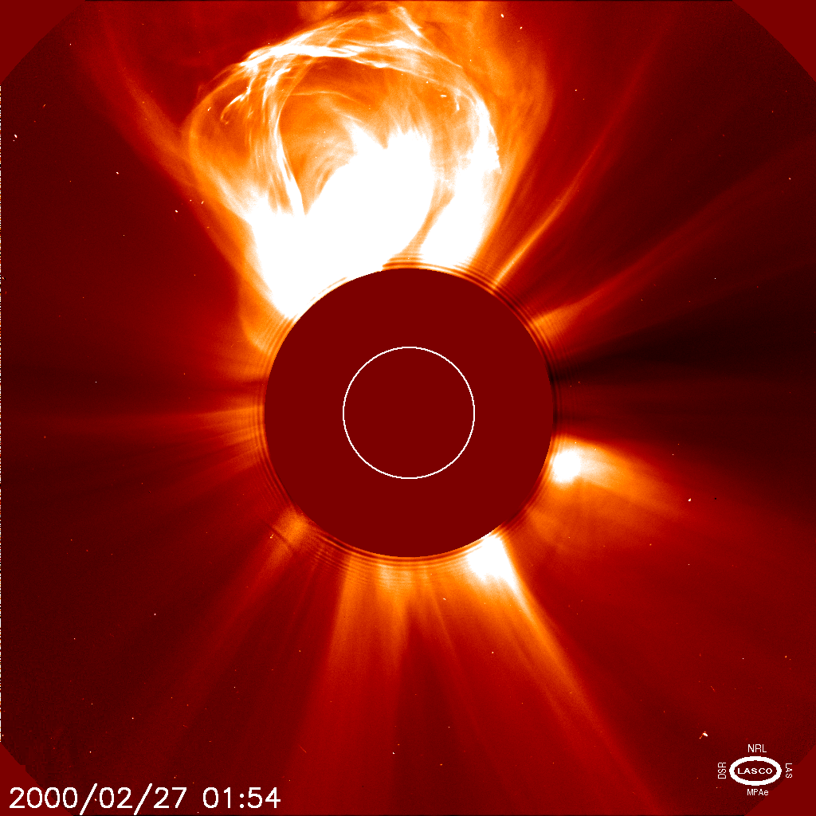
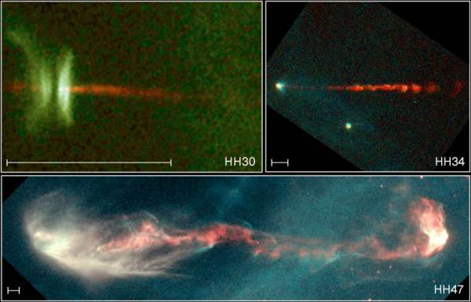
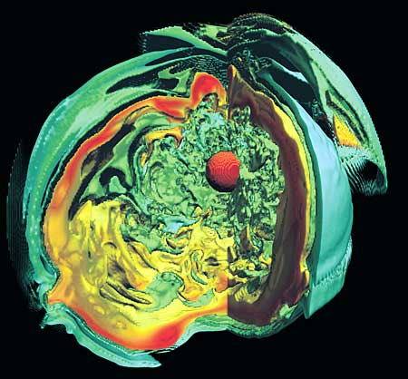
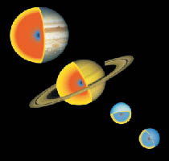
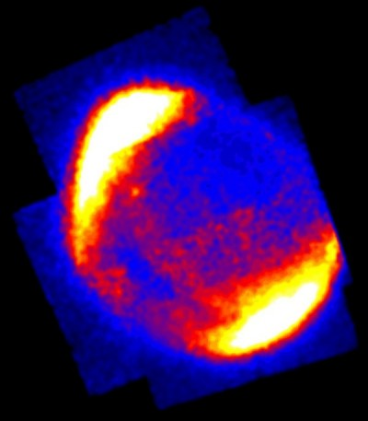
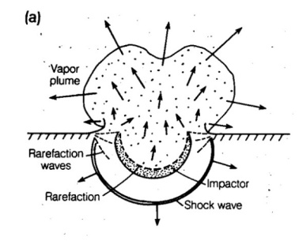
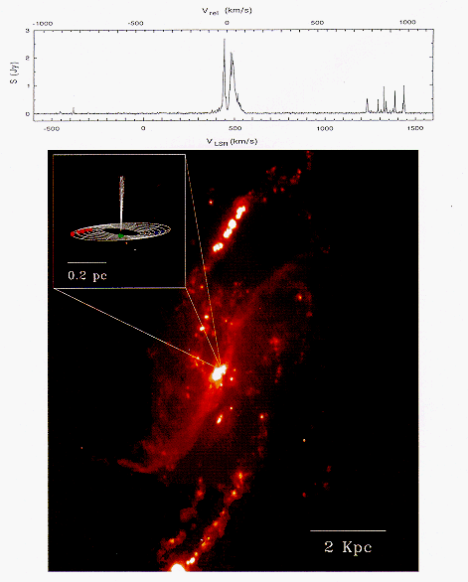
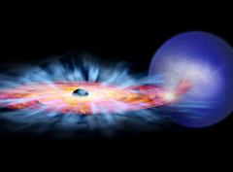
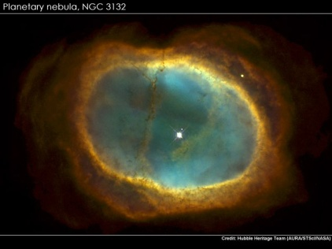
Life of a star

Slide 10
Topic(1). High-Mach Number Collisionless Shock Formation and Origin of Cosmic-Rays
Test bed for Numerical Astrophysics
New Finding of Physics not Expected
Provide Challenging Plasma Physics
Predict Astrophysical Phenomena

Slide 11
1.1 Collisionless Shocks in Universe
  Collisional Shock and CL Shock
  Example of CL shocks
  Experimental Data (T. Morita)
  CL Shock in no-External B-filed(2,3-D)
  CL Shock mediated by Weibel Instability

Slide 12
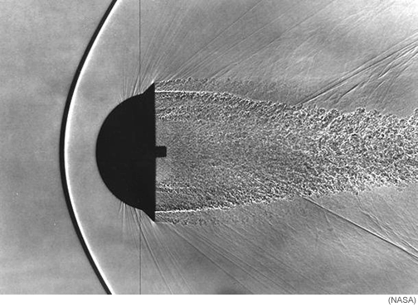
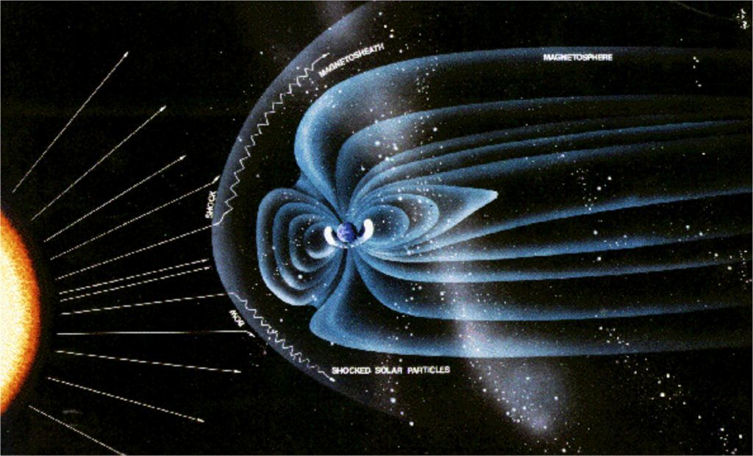
Two Different Types of Shocks
Hydrodynamic Shock
（Molecular Viscocity）
Plasma Shock
（Collisionless）
Supersonic Projectile（WT Exp.）
Solar Wind and Magnetosphere
Shock
Shock

Slide 13
Blast Waves
E=10⁹ J
1 Ton TNT
100 m
1cm
Laser Driven
E=100 J

Slide 14
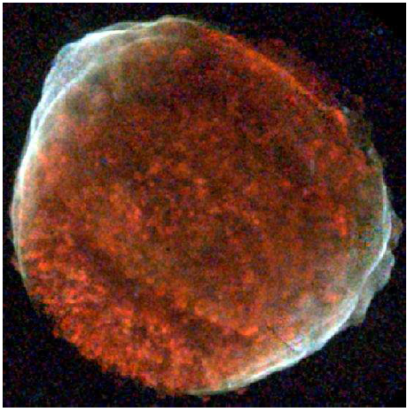
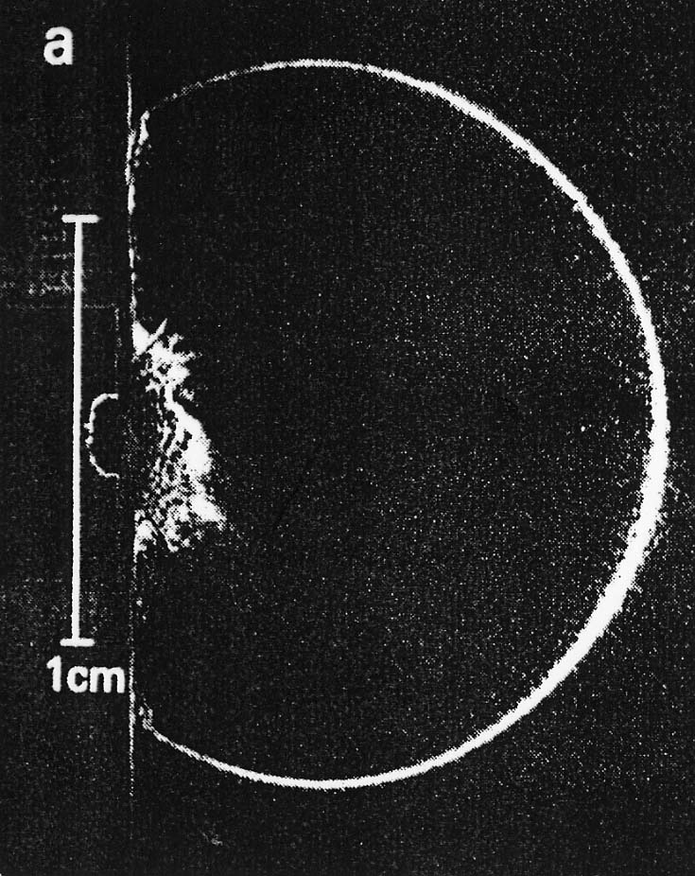
Supernova Remnant
SN1006 (Newton X-ray S)
Big difference is
not the energy
E=10⁴⁴J
But the physics
E=100 J
Synch. X-rays
(blue: tracing ~10TeV e⁻)
B. Ripin et al.
Cassam-Chenai et al.(‘08)

Slide 15
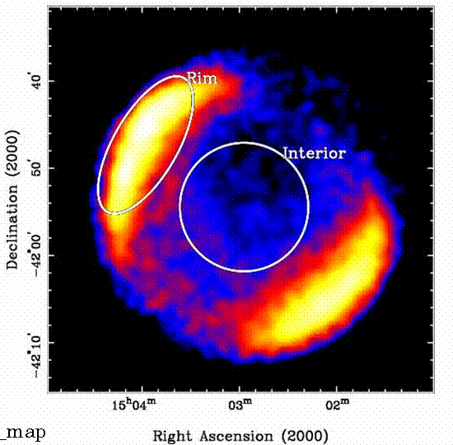
Global Structure is Given by SSS of Hydrodynamic Equations, but Shock Front Physics is very different
~10 ly

Slide 16

Image of
SN Explosion and SN Remnant

Slide 17
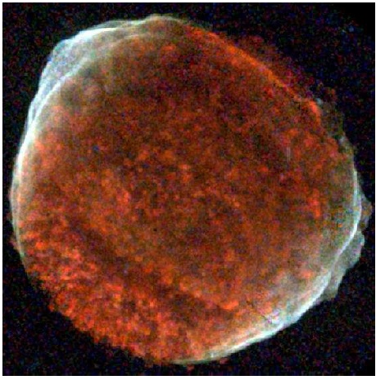
Typical Example of Collisionless Shocks (SNR)
Shock front
X-ray Image of SN1006, exploded 1003 years ago
40 LY
n = 1 cm⁻³
T = 15 keV
Mean-free-path: 40 ly
Diameter of SNR: 30 ly
Effect of EM wave（？）
Accelerated electrons emitting X-ray
30 LY
Cassam et al. ApJ 680, 1180 (2008)

Slide 18
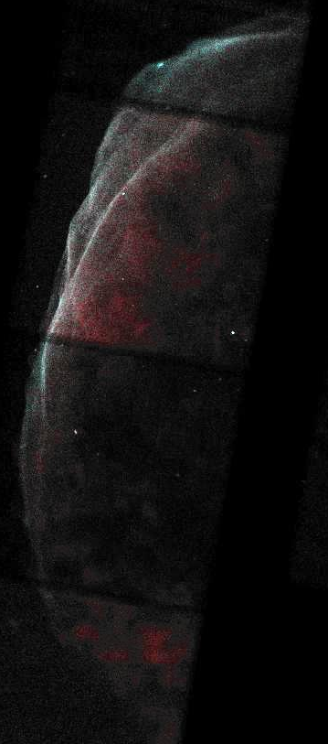
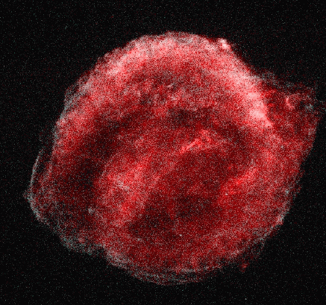
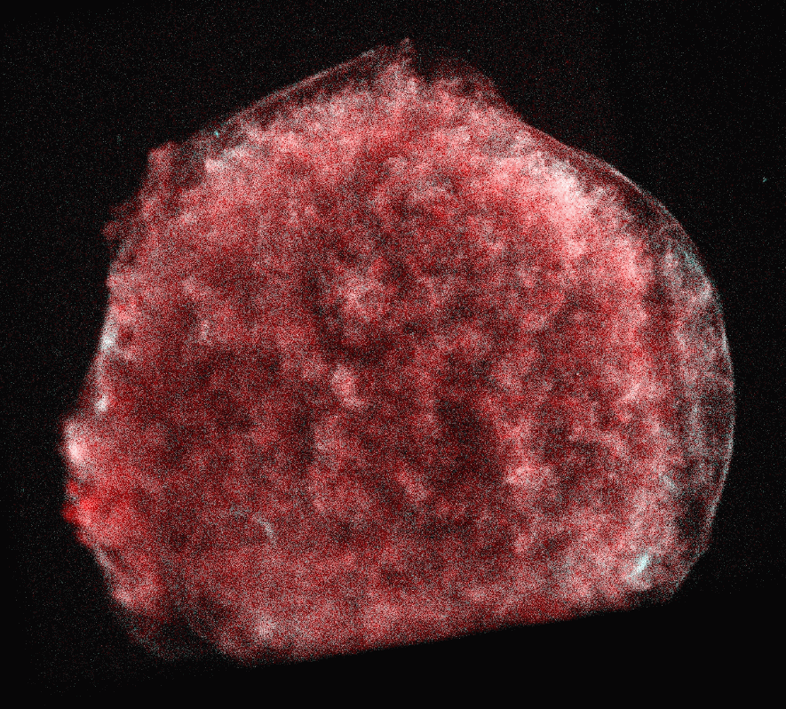
Thin Synch. X-ray filaments tell large-B.
Cas A (AD1680)
Kepler (AD1604)
1 ‘= 1 pc
30“ = 0.7pc
Tycho (AD1570)
SN 1006 (AD1006)
2.5‘ = 1.2 pc
SN 1006
(AD1006)
30“ = 0.3pc
Bamba, RY et al. 2003, 2005

Slide 19
  Collisionless Shocks without External Magnetic Fields

Slide 20
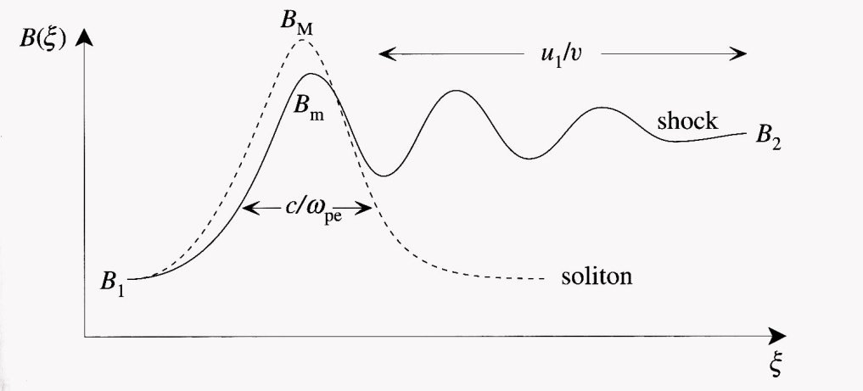
Collisionless Shock ?
Ion Acoustic Wave
Dispersion and Nonlinearity
K-dV Equation
Soliton Solution
M < 3
距離

Slide 21
Maxwell Equations
Faraday’s Law
Ampere’s Law
Poisson Equation
Absence of Magnetic Monopole

Slide 22
Boltzmann Equation
f(t,r,v): Velocity distribution function
Vlasov Equation

Slide 23
Particle-in-Cell (PIC) Simulation
Particle in Cell Method
Particles: calculating individual trajectory
Electromagnetic field: solving Maxwell’s equations on grid
Particle
Steps of calculation
Grid
Basic Equations
Field
Maxwell’s equations
Particle
Equation of motion

Slide 24
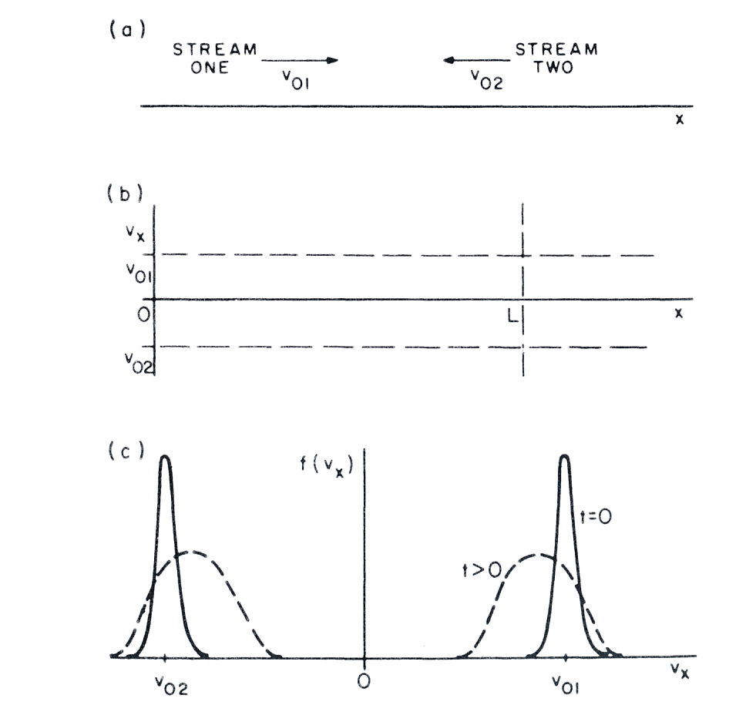
Two Stream Instability(TSI)

Slide 25
Weibel Instability
Proton
Y
Proton
J
B
Electron
F
X
Electron
J
B
F
Lorentz Force: F = qv×B

Slide 26
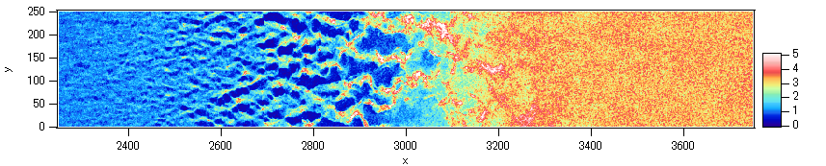
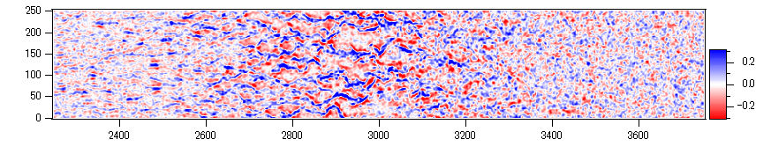
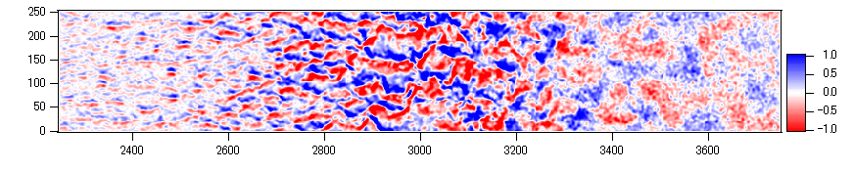
Generation of Magnetic Field
Number Density
n
Current
Density
J_{x}
Magnetic
Field
B_{z}
Current filaments generates strong magnetic fields
within the transition region

Slide 27
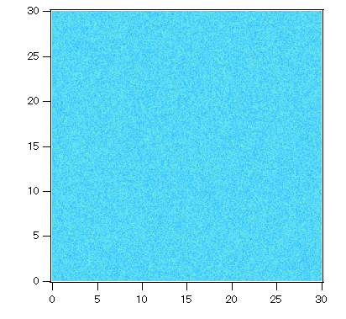
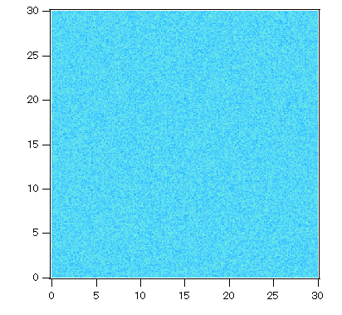
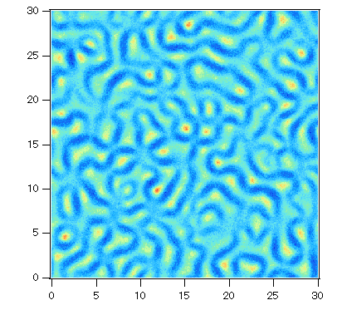
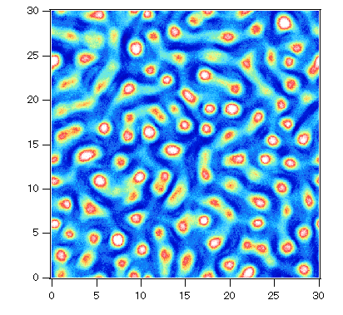
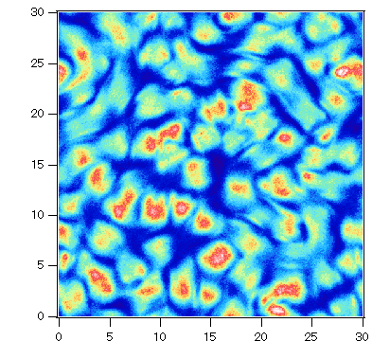
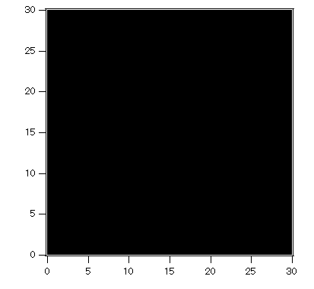
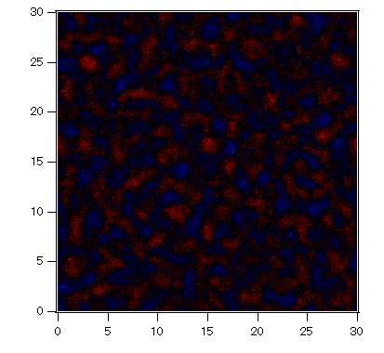
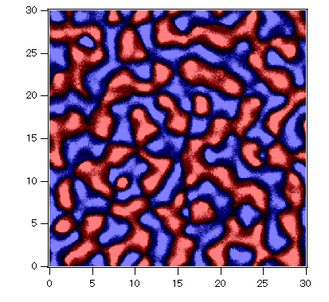
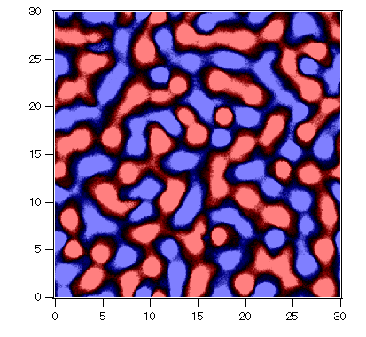
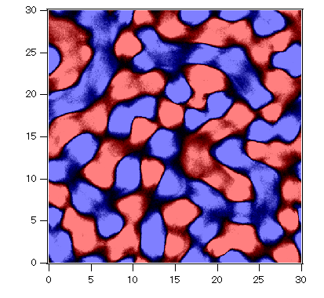

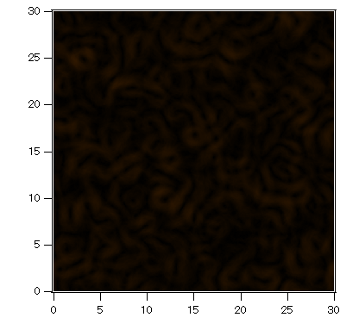
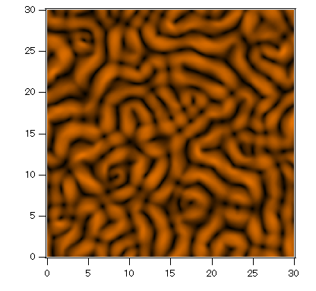
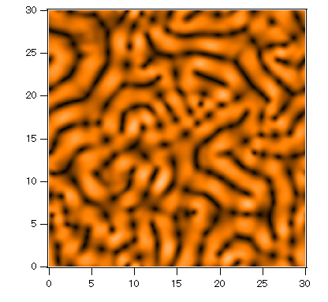
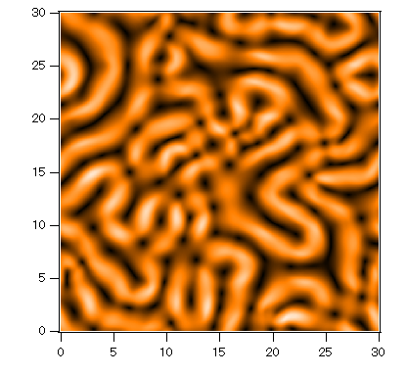
Weibel Instability in y-z Plane
m_{i}/m_{e}=20, V_{z}=0.05c, T=100eV
w_{pe}t = 0
125
250
375
500
n_{i}
J_{z}
|B|

Slide 28
Video
Ion Density and Magnetic field
Density
Tsunehiko N. Kato and Hideaki Takabe
Astrophysical Journal 681, L93 (2008)
H. Takabe, T. N. Kato , Y. Sakawa, et al.
Plasma Physics and Controlled Fusion 50, 124057 (2008)

Slide 29
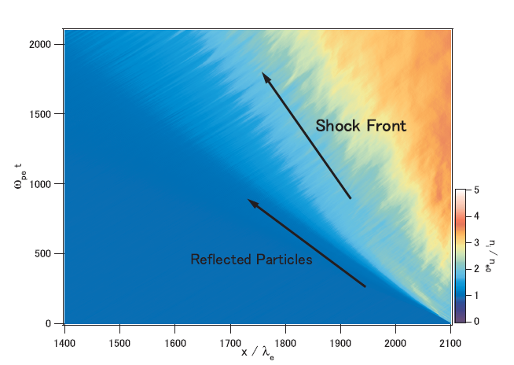
NON-RELATIVISTIC COLLISIONLESS SHOCKS IN UNMAGNETIZED ELECTRON-ION PLASMAS
Tsunehiko N. Kato and Hideaki Takabe
ApJ 681, Issue 2, Page L93–L96, Jul 2008
Very New even as Astrophysics Subject
Time
Space

Slide 30





Shock Wave Formation and Profiles
Transition Region
X-ray intensity (SN1006)
Number Density
Mean Velocity V_{x}
Magnetic Field
Electric Field
T. N. Kato
x

Slide 31


Ion Number Density
ω_{pe} t = 8000
Upstream
Downstream
Shock Transition Region
B₀
V=0.25c, σ=10⁻⁴, θ=90˚
|B|/B₀ ~ 15
|B|/B₀ ~ 40
Magnetic field normal to B₀

Slide 32






Phase Space Plots
Ions
Electrons
u_{x}
u_{x}
u_{y}
u_{y}
u_{z}
u_{z}
Both electrons and ions are isotropically thermalized in the downstream region
Dissipation (thermalization) would be due to mainly magnetic field and partly Buneman instability (for electrons)

Slide 33


Shock Formation Mediated by Weibel Instability
Density
Y-direction
B-field
Y-direction
X-direction
0. No external B-field, Counter Plasma Flow
1. Linear Growth of Weibel Instability
2. Current Filament Coallisence in Nonlinear Stage
3. Magnetic Field Strength and Size Increase
4. Ion Larmor Radius becomes comparable to B-island
5. Shock wave is produced (Structure formation)
T. N. Kato and H. Takabe, Astrophys. J 681, L93 (2008)
Exp. Data (example)

Slide 34
  Experimental Data by T. Morita et al.

Slide 35
How to make such counter streaming ultra-high speed plasmas
Cosmic-rays
B
A
A
B
A: Ablation
B: Shocks
Laser

Slide 36



Shengguang-II (SG-II)
Nd:glass laser, 8 beams, 3kJ@0.35μm, 1ns. (over 3000 shots)
The 9th beam (4.5kJ@1μm, 3ns), for backlighter source.
• to be updated to ~20kJ@0.35μm, 3ns (2009)
• to be updated to PW (1.5kJ，2ps)

Slide 37



Slide 38
大阪大学・レーザー研・激光XII号装置
ILE, Osaka University
Gekko XII Laser

Slide 39



Laser Fusion Reactor Design
時間
照射
爆縮
点火
燃焼

Slide 40


Slide 41




In a double-plane target after 10 ns, emission intensity profile becomes steeper; a collisionless shock is generated.
2 ns
0
4mm
5
10
10 ns
15
Emission Intensity ( arb. units )
20
25
13 ns
(ns)
10 (mm)
0
5
0
X ( mm )
4
Ion mfp λ_{ii} >> Shock width (< 100 μm)
→ Collisionless shock is generated
Shock →
Morita et al, PoP , Submitted

Slide 42


Y. Kuramitsu, Phys. Rev. Lett. 106, 175002 (2011)

Slide 43


OMEGA Laser at U of Rochester, NY, USA

Slide 44





“Astrophysical Collisionless Shock Generation in Laser Driven Experiments” OMEGA Facility, Dec. 14, 2010
Participating collaborators
Hye-Sook Park (PI), Steve Ross (LLNL)
Youichi Sakawa, Yasuhiro Kuramitsu
(Osaka University, Japan)
Dustin Froula (LLE)
Chris Gregory (York University, UK)
Anatoly Spitkovsky (Princeton, USA)
Alessandra Ravasio (LULI, France)
LLNL (USA): Hye-Sook Park, D. Ryutov, B. Remington, S. Pollaine,
S. Ross, S. Glenzer, N. Kugland, C. Sorce
Osaka University (Japan): Y. Sakawa, Y, Kuramitsu, H. Takabe
Oxford University (UK): G. Gregori, A. Bell
Princeton University (USA): A. Spitkovsky, L. Gargate, L. Sironi
LLE, Univ. of Rochester (USA): D. Froula, J. Knauer, G. Fiskel
Ecole Polytechnique (France): M. Koenig, A. Ravasio
ETH Zurich (Switzerland): F. Miniati
York University (UK): N. Woolsey, C. Gregory
Rice University (USA): E. Liang
University of Rochester (USA): R. Betti
University of Michigan (USA): E. Rutter, M. Grosskopf, C. Kuranz
University of Nevada, Reno (USA): R. Presura

Slide 45
  Collisionless Shock in E-M Turbulence
  (Most important to be consistent with Cosmic-Ray accelaration)
  (Multi-dimensional mechanism)

Slide 46
Collisionless Shock in E-B Turbulence
Shock Wave

Slide 47
Collisionless Shock of Supernova Remnants
Shock surface
SN1006
40 light y
High Mach Number
Plasma is not fluids
Particle-field interaction
3-dimensionality
Mean free path
Laser ablation plasma can be used to generate a high-Mach collisionless shock
Cassam et al. ApJ 680, 1180 (2008)

Slide 48
1.2 Particle Accelerations
  Cosmic-Ray
  Surfing Acceleration Mechanism
  Diffusive Shock Acceleration (Fermi accl.)
  In-coherent wake-field acceleration
  Power-law in laser acceleration experiment

Slide 49



What is Cosmic-Ray?
2011/6/29
49

Slide 50

Cosmic Rays
Bow Shock of Earth
Bow Shock by CME
Pulsar Driven BS
Supernova Remnants
Cosmological Jets
Gamma-ray Bursts
…..
…..
SNRs
50

Slide 51
  Evidence of Particle Acceleration in Universe

Slide 52


Slide 53
Supernova Explosion
(Animation Movies)

Slide 54

Non-Thermal Shells
Koyama et al., 1995

Slide 55



SNR is Accelerator in Universe
１．Relativistic Syclotoron Emission
２．Shock Thickness (Observation)
W_{X} = 1×10¹⁷ cm (=1/400 l_{mfp})
upstream downstream
W_{X}

Slide 56
  Acceleration Mechanism (1)

Slide 57

Ion “Shock Surfing” Acceleration
shock front
upstream
downstream
Lorentz Transformation
E₁
E₁
B_{z,1}
v₁
B_{z,2}
v₂
ion
shock potential φ due to
polarization electric field
Sagdeev (1966), Sagdeev and Shapiro (1973), Katsouleas and Dawson (1983),
Lembege et al. (1983), Ohsawa (1990),…Lee et al. (1996), Zank et al. (1996),….

Slide 58





Acceleration Mechanism
3D Simulation
2D (Case 1)
Surfing acceleration
Trapped in the
transition region
x
Accelerated particle
x
Accelerated particle
going in the
upstream region
un-accelerated particle
Surfing acceleration
γ
2D (Case 2)
Drift acceleration
Drift acceleration
un-accelerated particle
x
z
Accelerated particle
t
time
Both of the acceleration mechanisms (surfing + drift) work

Slide 59
  Acceleration Mechanism (2)

Slide 60


Fermi acceleration
Diffusive Shock Acceleration
(Fermi Acceleration)
Surfing acceleration
Widely Accepted in Astrophysics

Slide 61


Non-thermal Emission of X-ray by Chandra
(Bamba et al. 2003)
2.0-10.0 keV
The Chnadra clarified think filament structure of X-ray emission from SNRs
Thickness of the filament can be related to the strength of magnetic field
Magnetic field probably be enhanced at Shock Front, Whya?

Slide 62







Thin filaments are obserbed in Many SNRs
SN1006
Cas A
Tycho’s SNR
Kepler’s SNR
RCW 86
RX J0852.0-4622 (Vela Jr.)
RX J1713.7-3946
(Hwang et al. 2002; Bamba et al. 2003, 2005; Uchiyama et al. 2003)

Slide 63
Filament Structure and Particle Acceleration
Accelerated Particle Distribution
Up stream
定常解
クーリングが
効く場合
Shock Acceleration (Fermi accel.)
Up
Downstream
2.0-10.0 keV
Electron are cooled down by radiation

Slide 64
  Acceleration Mechanism (3)

Slide 65

(by M. Hoshino)

Slide 66


April, 2011 issue

Slide 67


Incoherent Wakefield Acceleration
⇨ Energy > 10^{15.5} eV （Extra Galactic Cosmic-rays）
A possible acceleration mechanism
→ Incoherent Wakefield acceleration
Kuramitsu et al, APJ (2008)
Kuramitsu et al, PoP Lett (2011)
Kuramitsu et al, PRE (2011)
Energy distribution
of cosmic-ray
Extra Galactic
Cosmic-rays
Galactic Cosmic-rays
DSA at SNRs
Kuramitsu et al, PoP18, 010701 (2011)

Slide 68



Slide 69


Slide 70


Slide 71
1.3 Laboratory Experiment with NIF
  Scaling Laws from PIC simulations
  Shock formation time and width
  Necessity of NIF Class Lasers
  Science on NIF Committee
  International Teams

Slide 72
Collisionless Shock in E-B Turbulence
Shock Wave

Slide 73


Scaling Laws from PIC Simulations
1. Shock width
2. Coulomb mean-free-path
5mm
3. Energy of counter-streaming plasma
n₂₀=n/10²⁰cm⁻³
V₈=V/10⁸cm/s
E = 1/2Zm_{p}n_{i}V²L³
= 35 kJ
H. Takabe et al., Plasma Physics and Controlled Fusion 50,124057 (2008)

Slide 74


Slide 75


Slide 76


Slide 77


Slide 78


Slide 79


Slide 80
National Ignition Facility
Lawrence Livermore National Laboratory(LLNL), CA, USA
(~5 minutes)

Slide 81


Slide 82


Slide 83


Slide 84


Slide 85


Slide 86

External User Perspectives
Experimental Interests at NIF at a High Level
What I believe it will Take to Make NIF a Success as User Facility
Hideaki Takabe (Aki)
Institute of Laser Energetics,
Osaka University, Japan
NIF-JUPITER User Group Meeting
Sept. 6, 2009
Hotel InterContinental San Francisco, CA, USA

Slide 87

Science on NIF Committee just after the Evaluation
July 15, 2010 at LLNL
David Arnett*, University of Arizona
Riccardo Betti, University of Rochester
Roger Blandford, Stanford University
Nathanial Fisch, Princeton University
Ramon Leeper, Sandia National Lab.
Christopher McKee, UC Berkeley
Mordecai Rosen, LNL
Robert Rosner, The Univ. of Chicago (Chair)
John Sarrao, Los Alamos National Laboratory
Hideaki Takabe, ILE, Osaka University
Justin Wark, University of Oxford
Choong-Shik Yoo, Washington State University

Slide 88



Slide 89


Slide 90

Collisionless Shock Experiment with NIF
Drive beam
10 kJ/ beam x 64 beams
for each foil, 10 ns
D-He³ implosion beam
1.5 kJ / beam x 64 beams, 1 ns
2 x Proton backlighter
2 x 32 beams, 1 ns
Double-foil target
64 beams
for each foil,
10 ns
protons
10 mm
D-³He filled glass
shell capsule
(500-mm diam,
2-mm thick)
CH or CD
(3 x 3 mm²)

Slide 91


Slide 92


Slide 93

I
International Collisionless Experiment Group on OMEGA and NIF
Together Photo at APS-DPP at Chicago, November 19, 2010

Slide 94
Seminar Chair: Prof. Shaoping Zhu
Starting time : 10:00AM, July 1st, 2011
Talks (listed by time sequence):
1. Computer simulation for astrophysical collisionless shock and particle acceleration, grand challenge in plasma physics an astrophysics (I) Prof. H. Takabe
2. Parallel computation of particle simulations based on JASMIN Prof. Xiaolin Cao
3. Recent progress of our laser fusion integration simulation Prof. Jinghong Li
4. Computer simulation for astrophysical collisionless shock and particle acceleration, grand challenge in plasma physics an astrophyiscs (II) Prof. H. Takabe
5. Atom process in bon-perturbative laser field and its applications Prof. Jie Liu
6. Collimation of fast electrons by generation of magnetic field in overdense plasma
Dr. Hongbo Cai
7. Commucation & Discussions

Slide 95
Laboratory astrophysics tests your ability of imagination to create the stars in the laboratory
Hideaki Takabe

Slide 96
Laboratory Astrophysics
(2) Laboratory Cosmology with Relativistic Pair Plasma via Vacuum Breakdown with Ultra-Intense Lasers

Slide 97
4. Relativistic Electron-positron Pair Plasmas
Test bed for Numerical Astrophysics
New Finding of Physics not Expected
Provide Challenging Plasma Physics
Predict New Astrophysical Phenomena

Slide 98


(by G. Mourou)

Slide 99
Experimental Maximum of Focused Laser Intensity
I = 2x10²²W/cm²
E = 1.4x10¹² V/cm
V. Yanofsky et al., Opt. Express 16, 2109n(2008)

Slide 100

High Energy Phenomena induced by Relativistic Electrons
T. E. Cowan et al., Press Release (2000)

Slide 101


Proposal to “Science on NIF Committee”
K. Nakashima and H. Takabe, “Numerical Study of Positron Energy Spectrum Produced by Ultra-intense Lasers”, Phys. Plasmas 9, 1505-1512 (2002).
Hui Chen, S. C. Wilks et al., “Relativistic Quasi-monoenergetic Positron Jets from Intense Laser-Solid Interactions”, Phys. Rev. Lett. 105, 015003 (2010)

Slide 102
Highly Rel. Pair Plasmas
(I = 10²⁴ ~10²⁵ W/cm²)
Vacuum Breakdown due to Pair Avalanche Triggered by Induced Pair Production (Ipp)
Advanced Physics with Large Scale Ultra-Intense Lasers

Slide 103



Quantum Vacuum
Heisenberg’s
Uncertainty Principle

Slide 104

Schwinger Limit E-field
E = 1.3x10¹⁶ V/cm
I = 4x10²⁹W/cm²

Slide 105

A
C
γ-ray
e⁻
e⁻
γ-ray
e⁺
E-field
B
D
e⁻
e⁻
e⁺
γ-ray
2mc²
e⁺
E-field
Dirac Sea

Slide 106





Nonlinear QED Avalanche is Key Physics (Prolific Pair Production)
γ-ray
e⁻

Slide 107


We can produce highly relativistic pair plasma
with γ = 1000 (HE Astro. AGN-jet, BH-jets, GRBs)
0.1 EW
Laser(s)
We may also be able to create Pion-pair plasma to study collective phenomena like wave and turbulence in strong force
1 μm = 10⁸ fm
1 fs = 3x10⁷ x 1fm/c

Slide 108
N. Gehrels et al., Scientific American, December (2002)

Slide 109



EU decided to construct 3 ELI Modules (10PW) in East Europe (Total cost = 800 M Euro)
Site selection:
decision on Oct. 1, 2009
Czech Republic
Prague
Overall cost: ≈800M€
Hungary
Szeged
Romania
Bucharest - Magurele

Slide 110

I propose NIF-Super ARC for Vacuum Breakdown
Present
10 kJ/10 ps
1PW
(10²⁰ W/cm²)
I propose
100kJ/10fs:
10EW
(10²⁵ W/cm²)
NIF-ARC (LLNL)

Slide 111
Nonlinear QED plasma
Nonlinear QCD plasma
1 μm = 10⁷ fm
1 fs = 3x10⁷ x 1fm/c
10 fm
10fm/c = 30 x 1fm/c
10⁶
EXA-Laser
LHC, RHIC

Slide 112


Slide 113

Poem by Edward Teller
A fact without a theory
is like a ship without a rail,
is like a boat without a rudder,
is like a kite without a tail.
A fact without a theory
is like an inconclusive act.
But if there’s one thing worse,
it’s a theory without a fact
Edward Teller
(Nuclear Physicist and Founder of LLNL)

