Slide 1
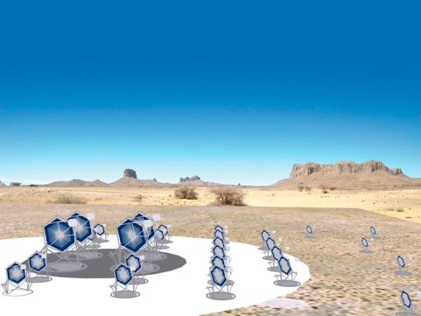
Cherenkov Telescope Array (CTA) Project

Slide 2
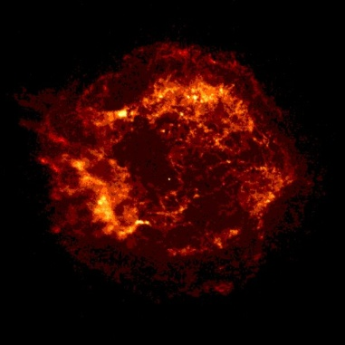
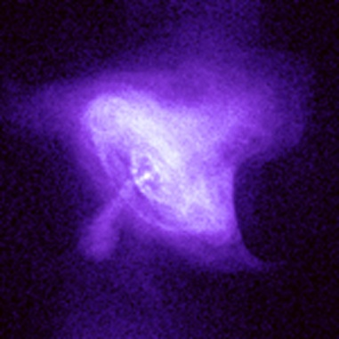
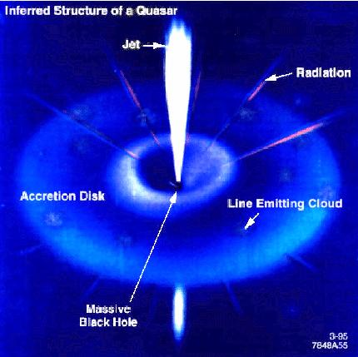
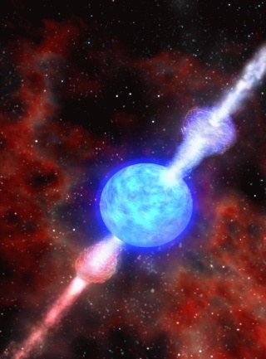
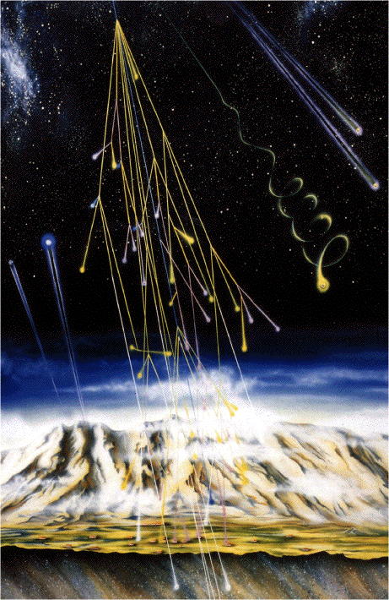
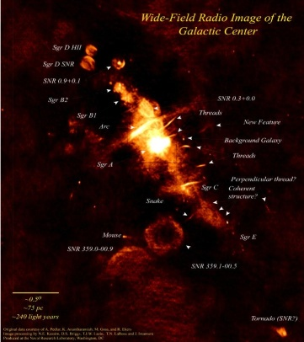
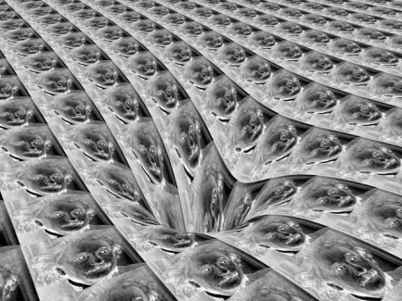
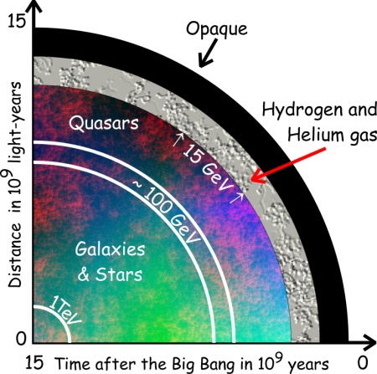
観測対象 ＆ 物理目的
SNRs
Pulsars
and PWNe
Micro quasars
X-ray binaries
AGNs
GRBs
Origin of
cosmic rays
Space-time
& relativity
Dark matter
Cosmology

Slide 3
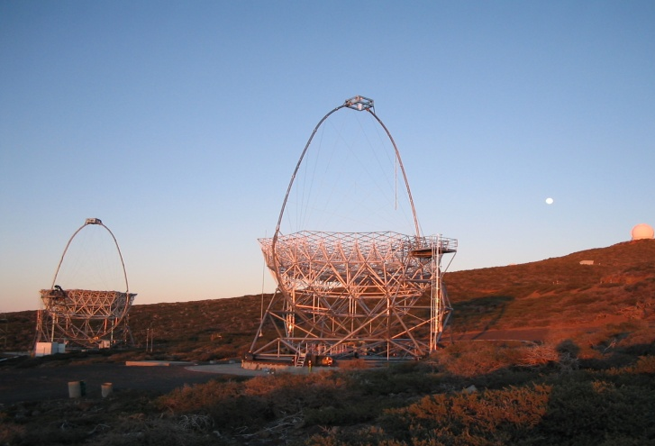
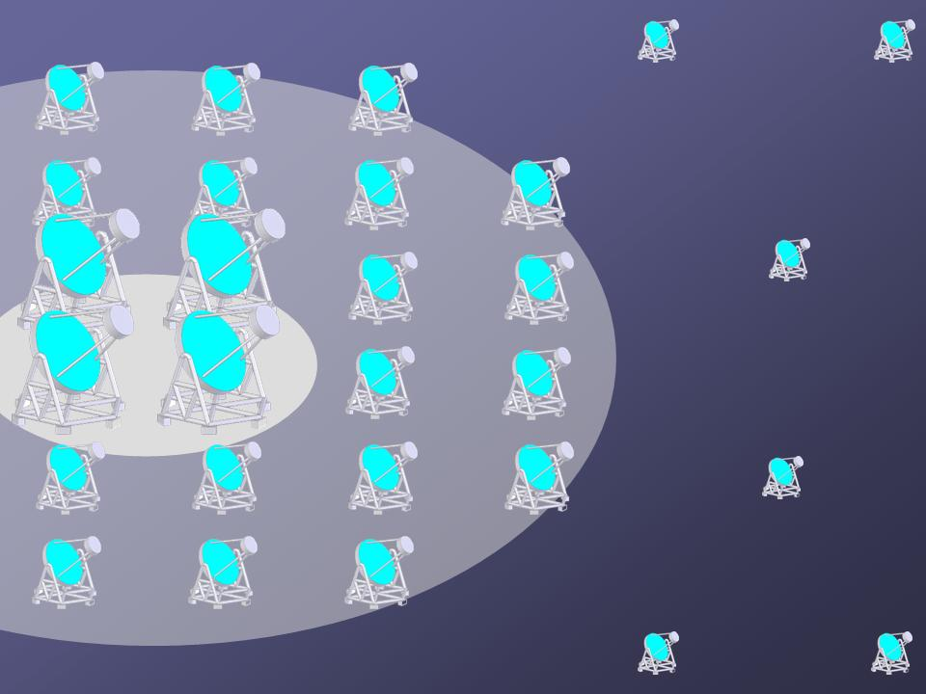
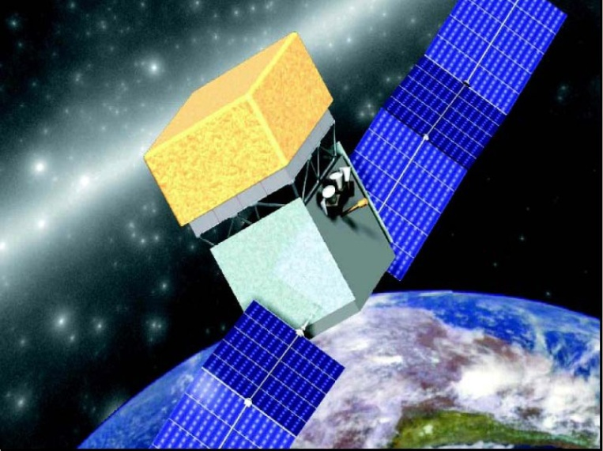
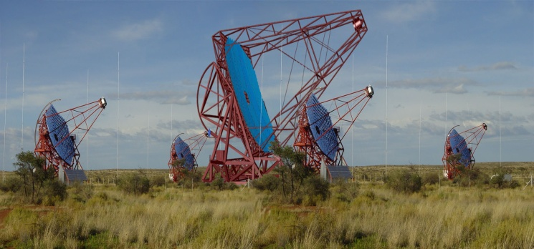
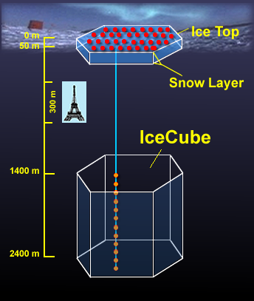
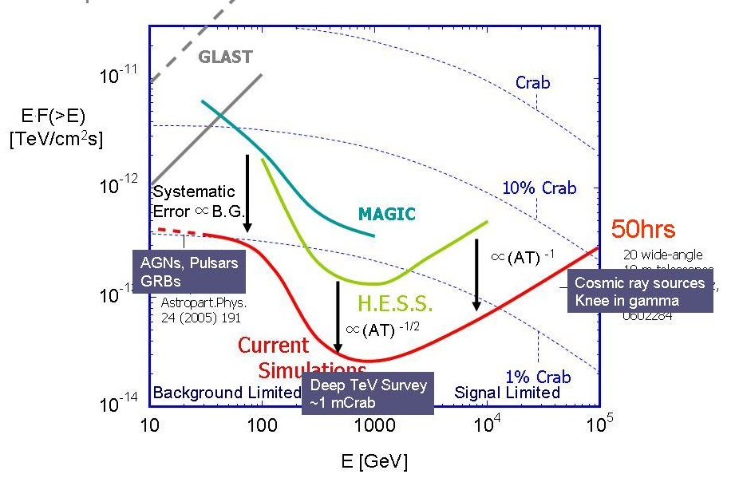
ＣＴＡに向けて
次世代 高エネルギーガンマ線観測施設
MAGIC Phase II (MAGIC-I + MAGIC-II) in 2009
>1000 sources will be discovered
CTA
FERMI
HESS Phase II (HESS + 28m Telescope) in 2010
Astronomers in EU
JAPAN(EoI), US

Slide 4

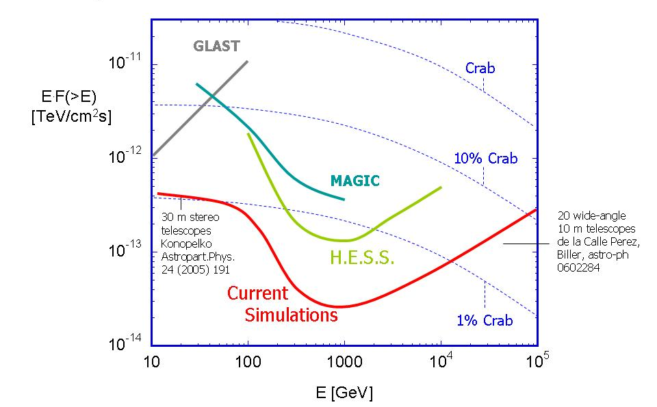
目標達成感度
Systematic
Error ∝B.G.
50hrs
MAGIC-II
∝(AT) ⁻¹
AGNs, Pulsars
GRBs
Cosmic ray sources
Knee in gamma
∝(AT) ^{-1/2}
Background Limited
Deep TeV Survey
~1 mCrab
Signal Limited

Slide 5
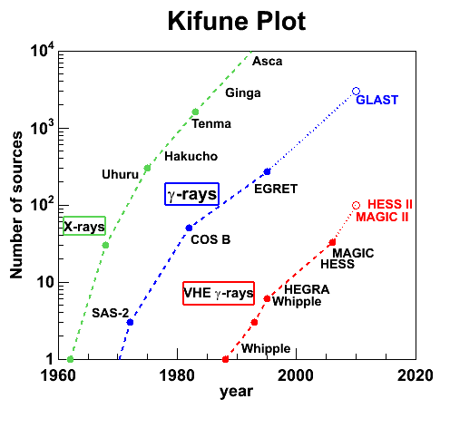
Kifune Plot
(expectation from log S - log N)
~3000 sources
by GLAST, AGILE
GLAST
AGILE
~1000 sources
by CTA

Slide 6
ＣＴＡ 仕様・パラメーター
観測エネルギー領域: 20-30GeV ~ 100TeV
  20-30GeV ➔ 遠方の活動銀河核(z<2)の研究、系外宇宙線起源、EBL 背景放射光密度の測定(星形成史）
  100TeV ➔ 銀河宇宙線源の研究
10倍の感度向上 (HESS, MAGICから）
  観測される天体数30倍(1000-2000)
  感度 ~1mCrab
3倍の角度分解能
  Better morphological study
全天観測
  北半球：20-30GeV ~ 1TeV (mainly extragalactic science)
    Several 23m class telescopes + some 12m class telescopes
  南半球：20-30GeV ~ 100TeV (galactic + extragalactic science)
    Several 23m class telescopes + many 12m class telescopes + some 6m telescopes

Slide 7

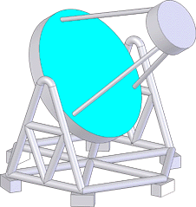
A possible option:
Mixture of telescope types
Some central big telescopes
Many Medium + Small Telescopes

Slide 8
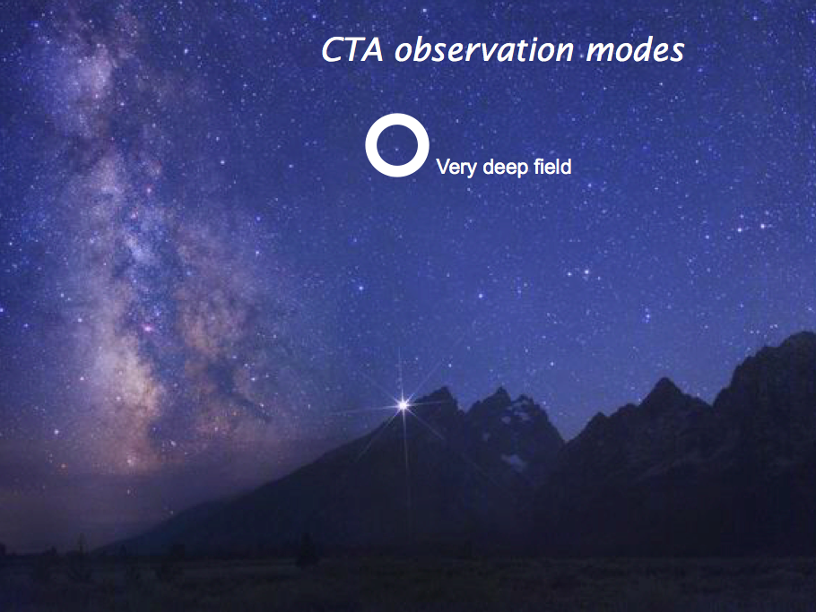

Slide 9
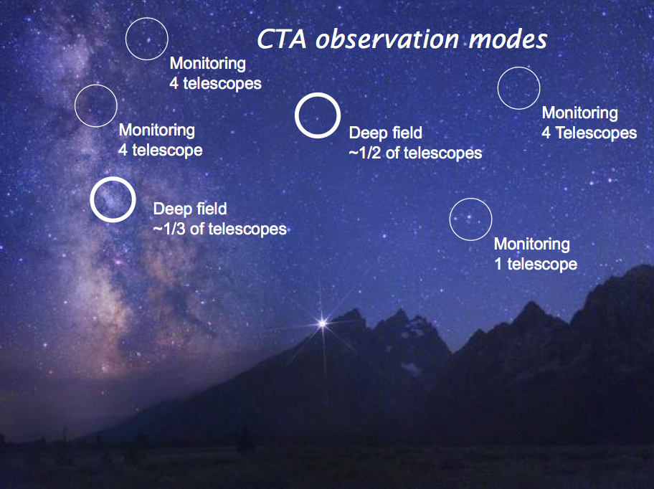

Slide 10
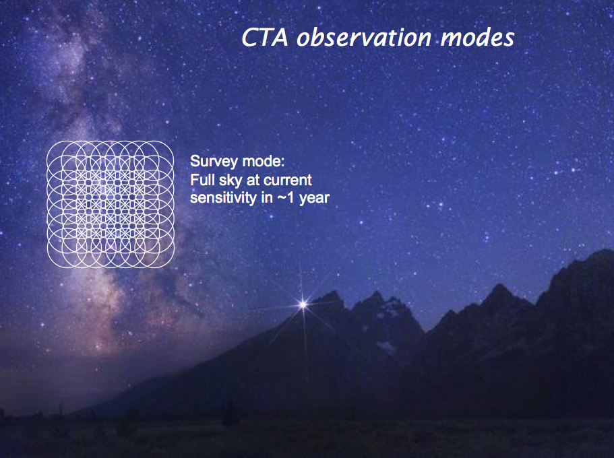

Slide 11

ＣＴＡ候補地 （北、南 2 stations）
One observatory with two sites
operated by one consortium
Mainly
extragalactic
science
Galactic plus
extragalactic
science

Slide 12
Design Study started in Jan. 2008
Milestones, tasks are defined in each WP
WP1 MNG Management of the design study
WP2 PHYS Astrophysics and astroparticle physics
WP3 MC Optimization of array layout, performance studies and analysis algorithms
WP4 SITE Site evaluation and site infrastructure
WP5 MIR Telescope optics and mirror
WP6 TEL Telescope structure, drive, control
WP7 FPI Focal plane instrumentation, mechanics and photo detectors
WP8 ELEC Readout electronics and trigger
WP9 ATAC Atmospheric monitoring, associated science & instrument calib.
WP10 OBS Observatory operation and access
WP11 DATA Data handling, data processing, data management and access
WP12 QA Risk assessment and quality assurance, production planning

Slide 13
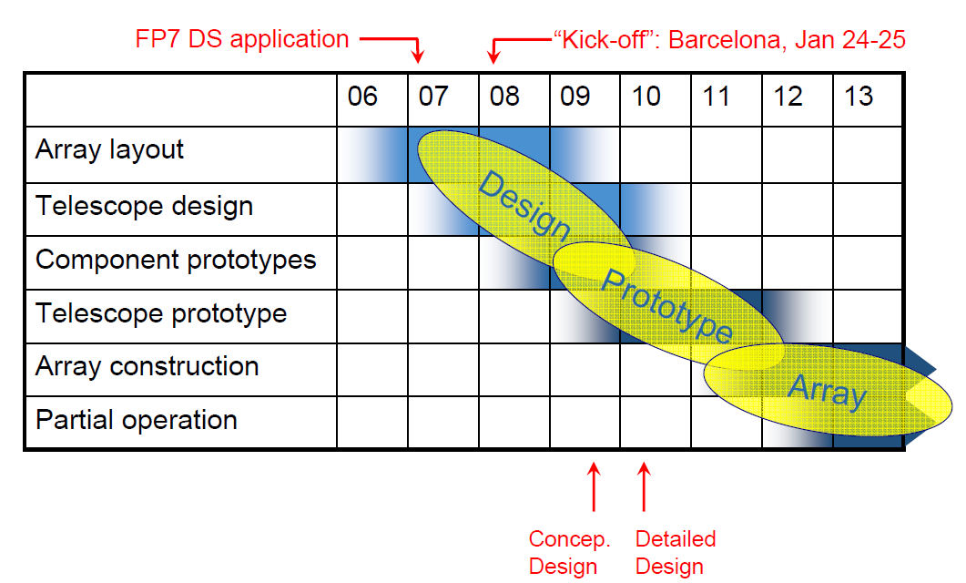
タイムスケジュール

Slide 14
CTA preliminary M.C. Study

Slide 15
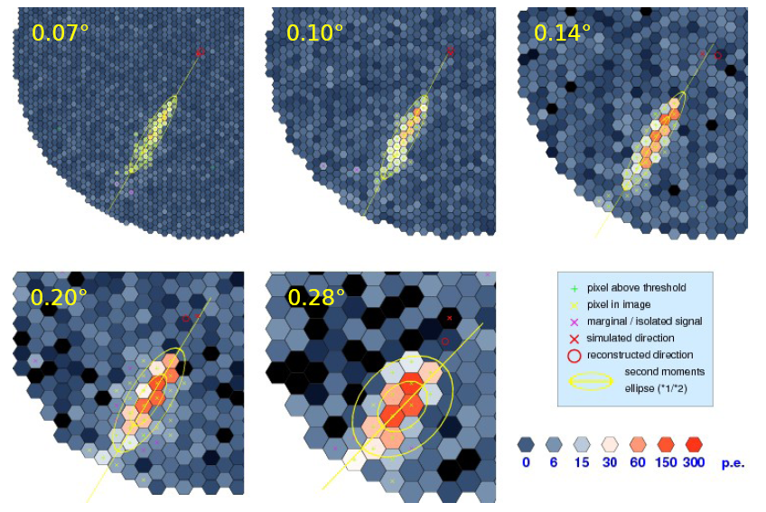
Impact of Pixel size to the Angular resolution
1~2 arcmin

Slide 16
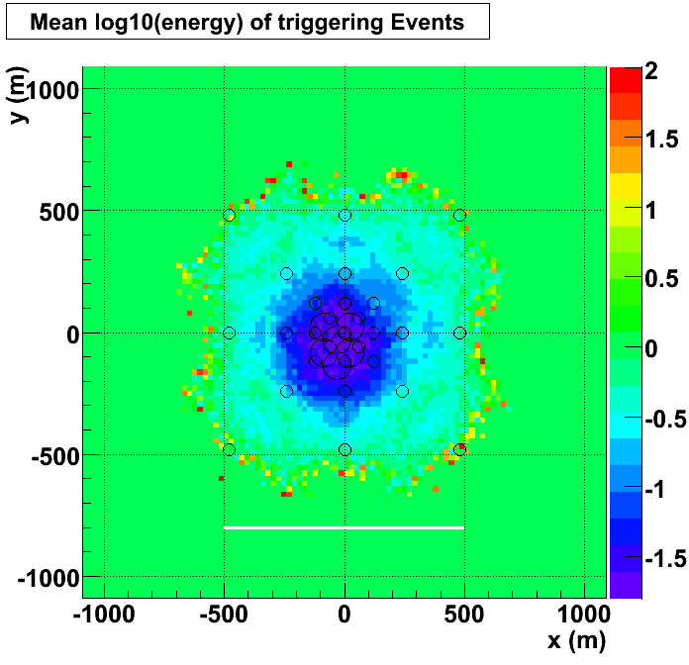
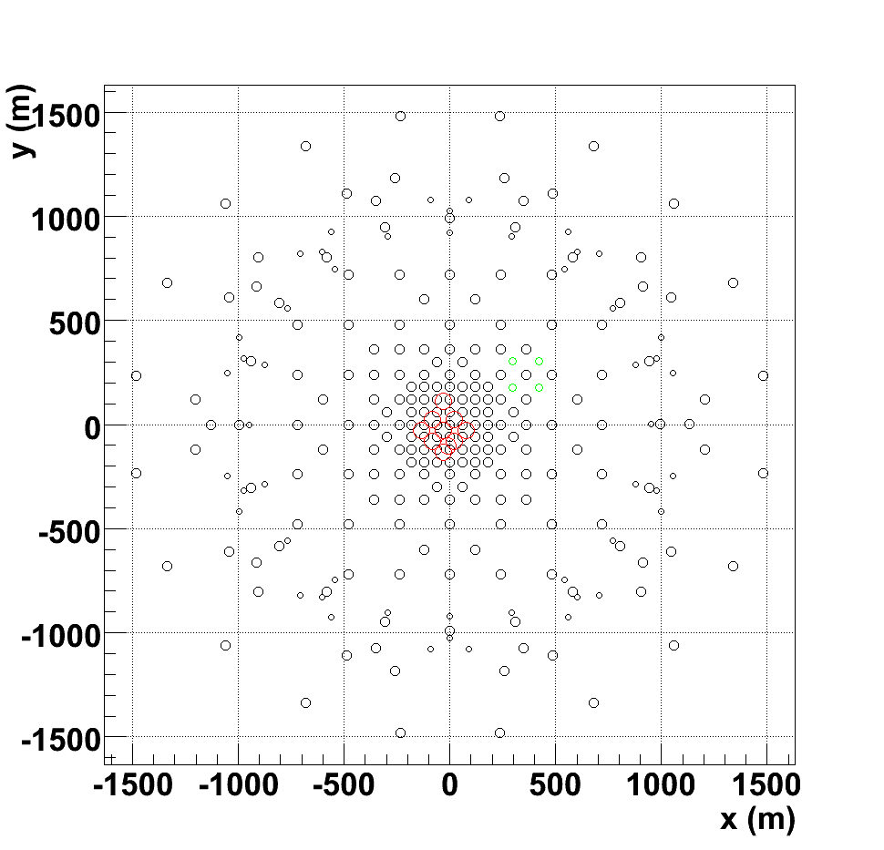
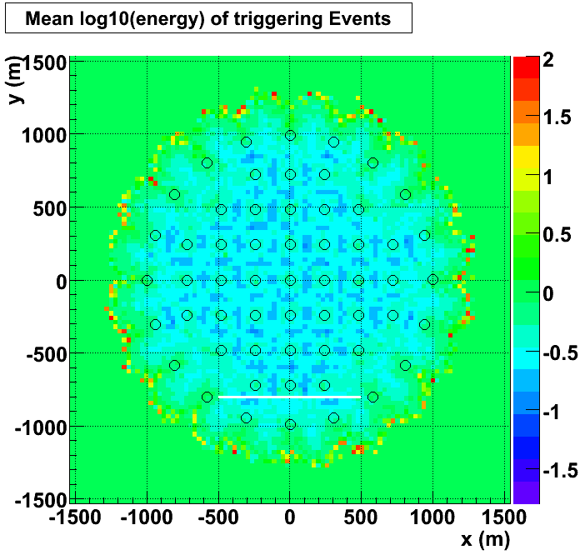
Optimization is on-going
275 telescopes

Slide 17
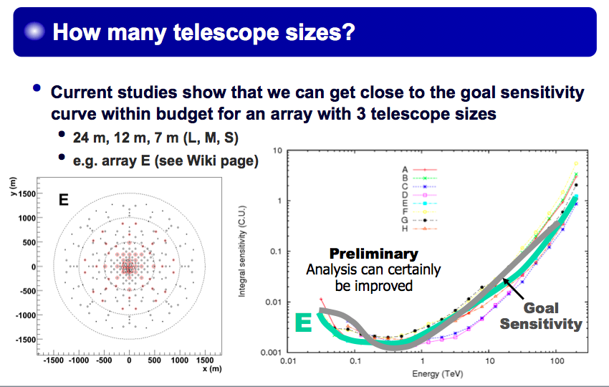
Report from M.C. group

Slide 18
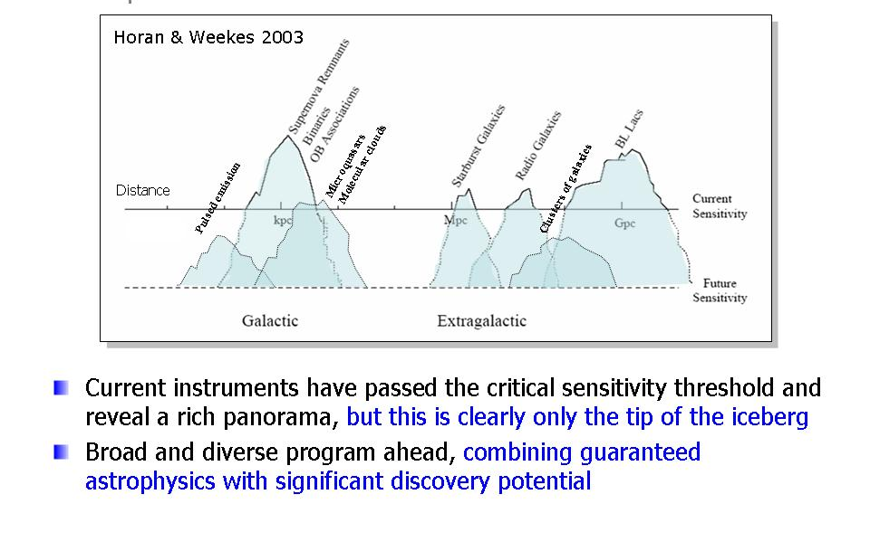
Scientific potential of CTA
About 30 sources are now identified as VHE gamma sources.
  GLAST will see ~3000 of GeV sources around 2010
  Our target in VHE Energy
    ~100 VHE sources in 2010 by HESS-II and MAGIC-II
    ~1000 VHE sources in 2020 by CTA
  CTA Sensitivity must be 10 times better than HESS, and MAGIC
Importance of all sky observatory ➔ full sky survey ➔ relatively large FOV is favored
  Extend HESS galactic plane survey to entire sky

Slide 19
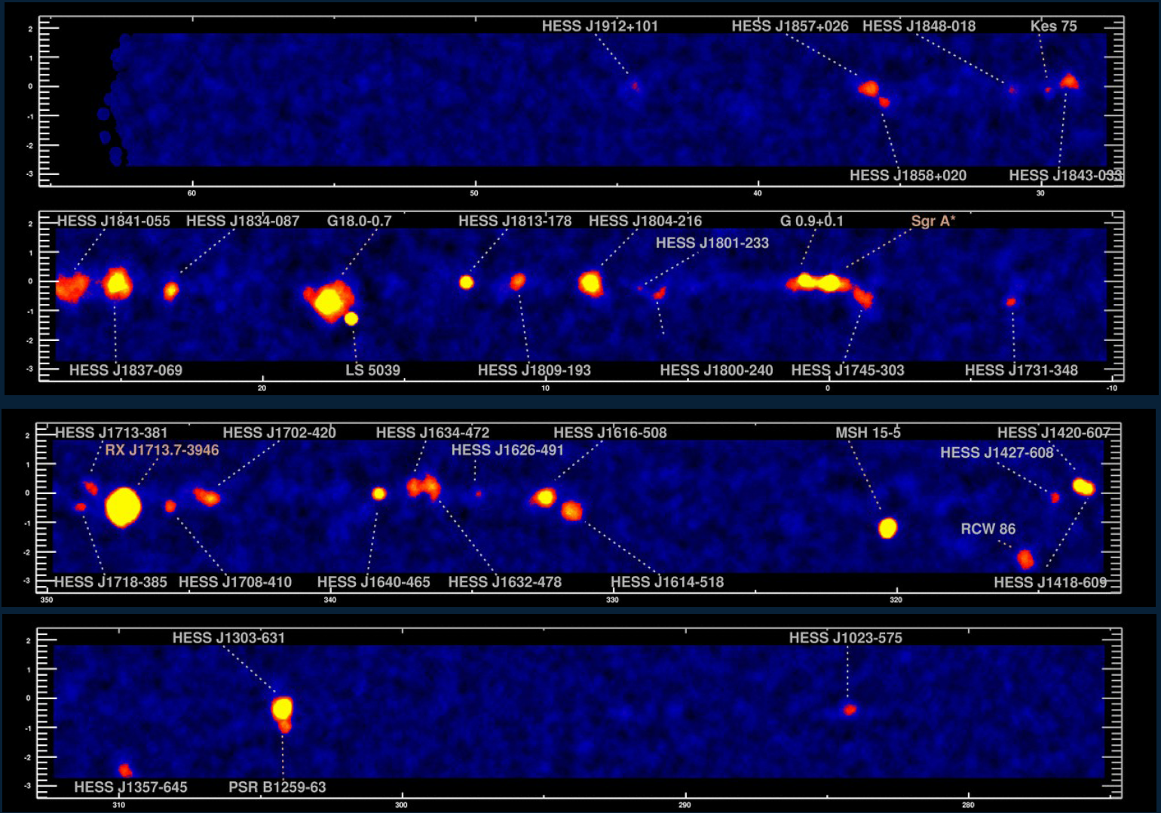
Great success!!
HESS の銀河面サーベイ

Slide 20
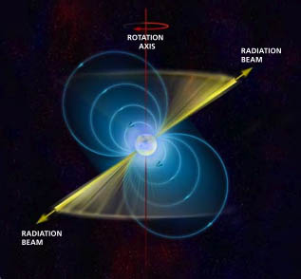
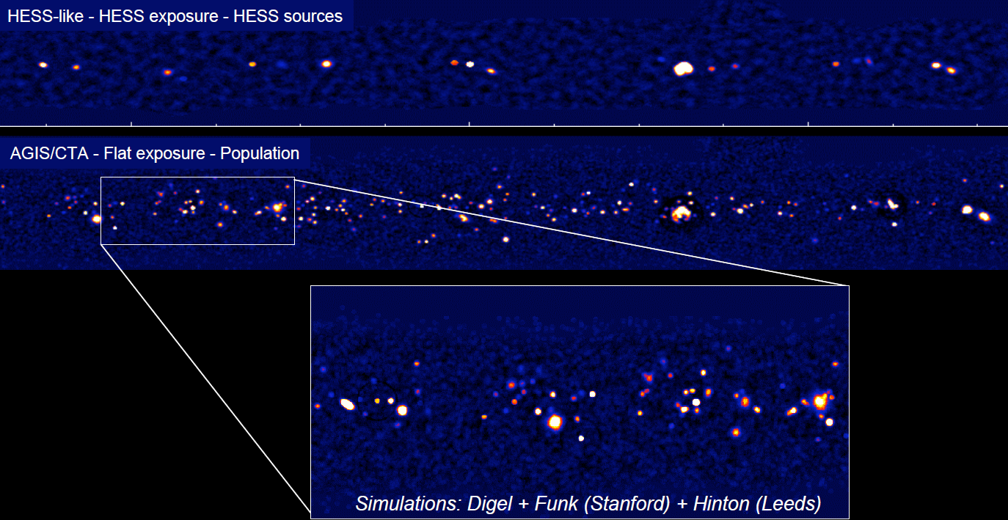
Guaranteed sources
Galactic sources
?
SNRs
Micro quasars
X-ray binaries
Un-ID sources
Dark Sources
PWNe
Pulsars
Galactic sources
200~400 sources with CTA
Where is PEVATRON???

Slide 21
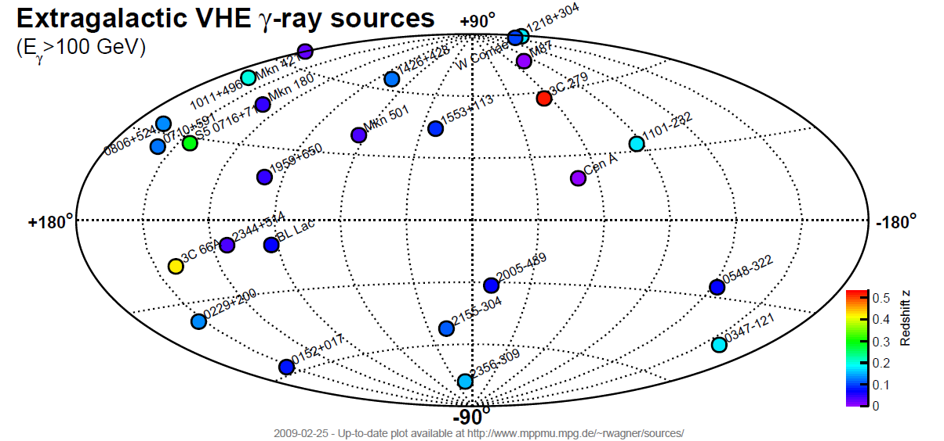
Guaranteed sources
Extragalactic sources
27 sources (2 x FR-I, 24 BL Lac(HBL, IBL, LBL), 1 x FSRQ)
~800 sources with CTA

Slide 22
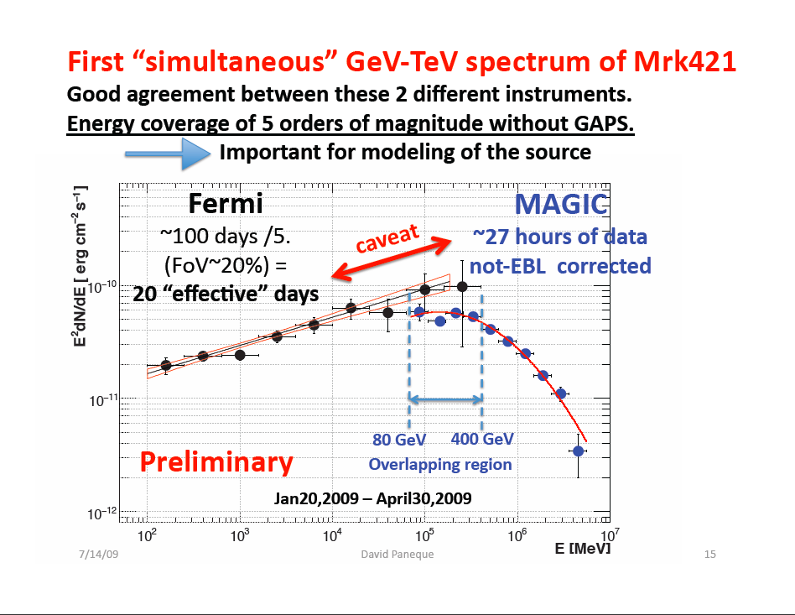

Slide 23
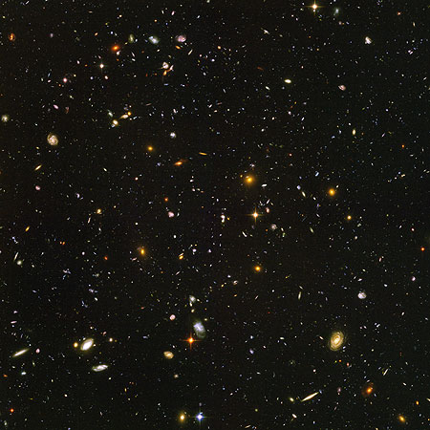
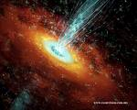
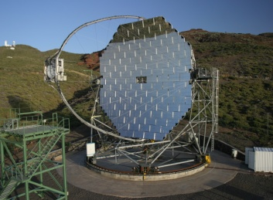
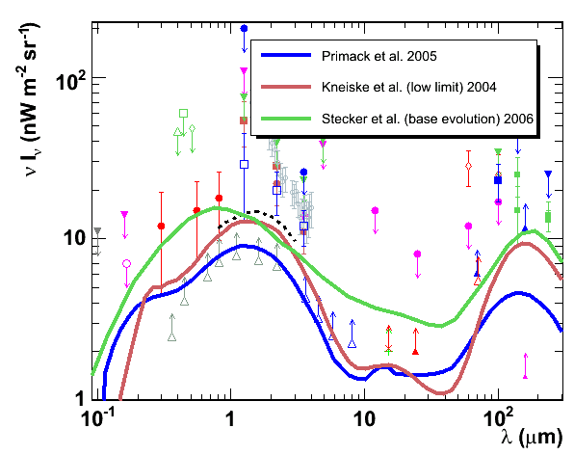
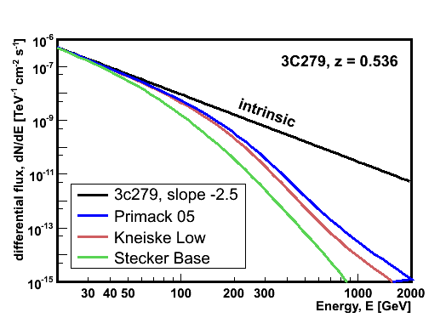
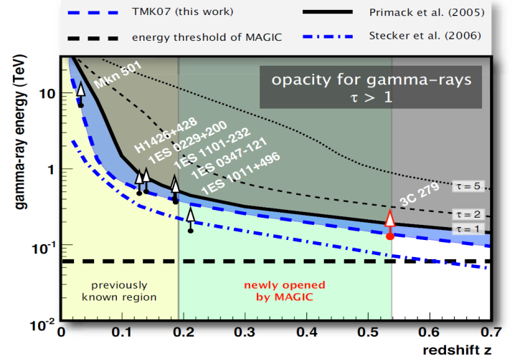
ＥＢＬ（背景輻射）との衝突によるガンマ線吸収
Extragalactic Background Light
blazar
IACT
γ_{VHE}
γ_{EBL}
e⁺
e⁻

Slide 24
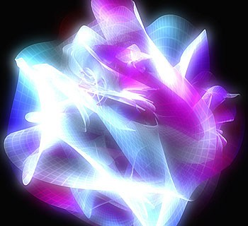
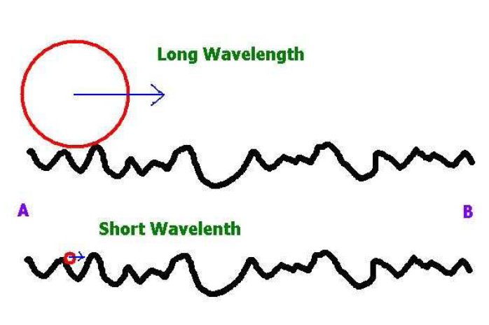
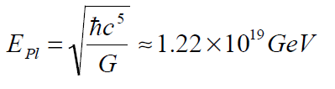
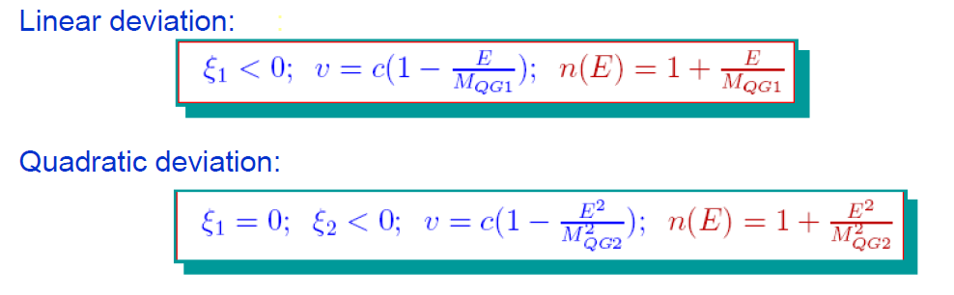
相対論・量子重力理論の検証
高エネルギー光子 ｘ 長い伝搬距離
If Gravity is a Quantum theory,
at a very short distance it may show a very complex
“foamy” structure due to quantum fluctuation.
Use gamma ray beam from AGNs/GRBs
to study the space-time structure
Energy 1000GeV ~ 10⁻¹⁶E_{Pl}
Distance 100~1000Mpc (10¹⁶⁻¹⁷sec)
Visible time delay ~ 1 - 10 sec

Slide 25
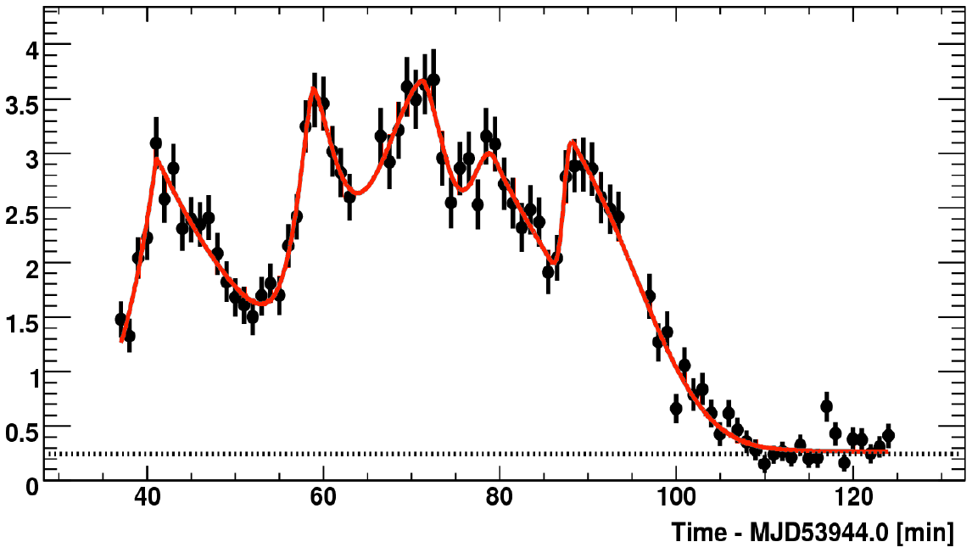
AGN からのガンマ線短時間変動
Mrk501 by MAGIC, PKS 2155 by HESS
Mrk501(z=0.03) MAGIC observation
M_{QG1} > 0.26 x 10¹⁸GeV
PKS2155(z=0.116) HESS observation
M_{QG1} > 0.72 x 10¹⁸GeV
250-600GeV
600-1200GeV
>1200GeV
With CTA, we can have ~10sec time resolution
for the fast variation

Slide 26
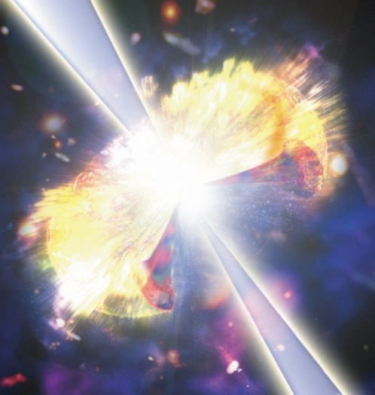
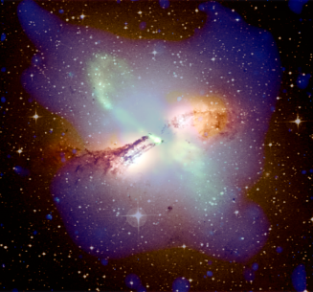
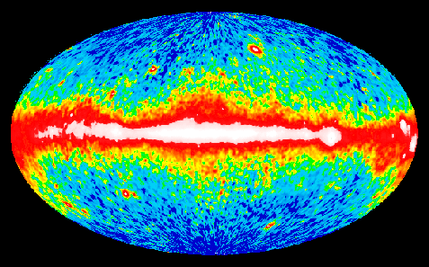
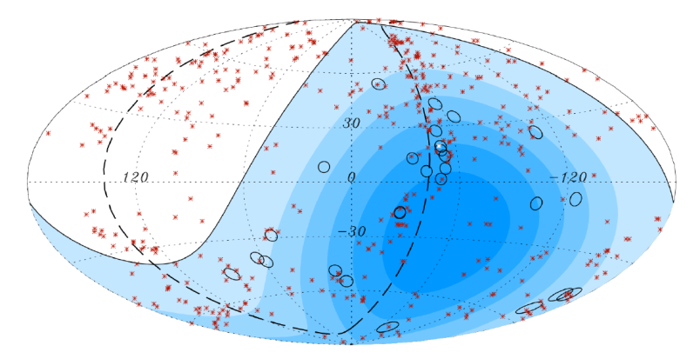
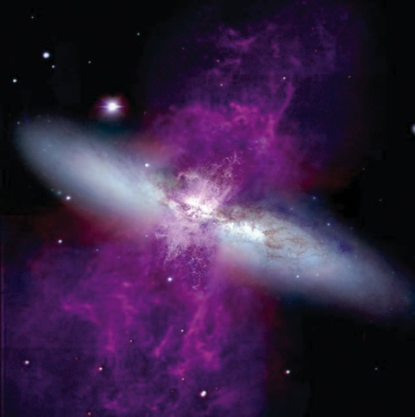
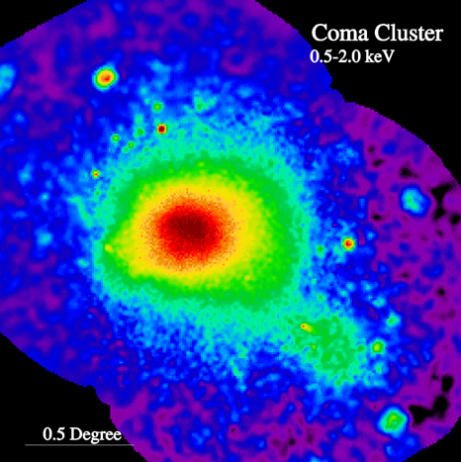

Possible New Classes of Sources
Galactic Diffuse
GRBs
UHECR Sources
Starburst galaxies
Galaxy mergers
Clusters of galaxies
Dark Matter Annihilation

Slide 27


For pulsar studies the low threshold energy is essential
Published in Science
MAGIC result: Published in Science in 2008
By measuring the spectrum around cutoff
or at high energies is important to distinguish
the emission model
Polar cap: double exponent
Outer gap: simple exponent

Slide 28



Gamma ray bursts
Hypernova!
Binary neutron stars
GRB Blast shock wave
After glow
γ
X
γ
Optical
Radio

Slide 29




Gamma ray emission process from DM Annihilation
Dark Matter Annihilations
Bergstrom et al.

Slide 30

Complimentarity with the direct search experiment
Expected sensitivity
by Fermi

Slide 31



Telescope structures:
HESS / MAGIC / HEGRA as prototypes
MAGIC: 17m
HESS II: 28m
H.E.S.S. 12m
HEGRA: 4m

Slide 32


TEL/MIR: MST mouting scheme

Slide 33


24m telescope design

Slide 34


24m telescope design

Slide 35


SST Options

Slide 36


Mirrors must be cheap and good quality
BACKING SHEET
Replication techniques probably
more promising for large-scale
low-cost production, compared
to grinding / milling of mirrors
HONEYCOMB
REFLECTING SHEET
MOLD

Slide 37






High QE photosensors
Hamamatsu
4 x 5x5 mm²
MPI+ MEPhI
MPI Halbleiterlabor Munich
Hamamatsu &
Photonis reach
45% QE
==> 40% PDE
GaAsP HPD:
50% PDE
SiPM
About 60% effective PDE will be realistic

Slide 38


Analogue Ring Samplers economic high performance readout
DRS3 (--> DRS4)
12 x 1024 samples
up to 5 Gsamples/s
11.5 bit effective range
450 MHz bandwidth
25 mm²
SAM
2 x 256 samples
up to 2 Gsamples/s
12 bit effective range
350 MHz bandwidth
11 mm²

Slide 39

Data center and operation center for CTA
Challenges
  Huge data rates
  (~PBytes/yr)
  Observatory
  Automatic calibration and analysis for users
Organization structure
  Array operation center
  Data handling and analysis center
  Science operation center
Lots of man power (local technician, operation crew, professional data analyzers for the science operation)
European space operations center

Slide 40





Recommendations and supports
ASTRONET Roadmap
ASPERA Roadmap
High Priority project
Ground based projects
Magnificent Seven
CTA is newly added
in 2008 update
8 Infrastructures
from Physics and eng

Slide 41
Summary
高エネルギーガンマ線天文学のめざましい発展
IACT 技術の熟成 ➔ CTA == 究極の IACT Array
  国際協力による次世代のインフラの構築
  目指す性能：
    Broad band: 20-30GeV ~ 100TeV
    感度10倍： 10mCrab ➔ ~1mCrab
    角分解能3倍： 1~2 arcmin
高エネルギー天文学の今後
  未だ多くの謎、銀河系内外宇宙線起源、ジェットでの粒子加速 (例えば、短時間変動）
  高い時間分解能による フレアー時間変動
  EBL の z 依存性
  新しいクラスの天体：パルサー、ＧＲＢ、クラスター、未知天体、他
  基礎物理：相対論・量子重力効果、暗黒物質、宇宙論
タイムスケジュール
  2009 末、Array Design を決定
  2010-2013 プロトタイプ
  2013- 2018 建設
  AGIS 合流 in some day？
  Community, Funding Agency, EU からの強い支援

