Slide 1
Cosmic-Ray Positrons from
Astrophysical Sources:
GRBs, Pulsars and SNRs
Kunihito Ioka (KEK)
KI, arXiv:0812.4851
Kawanaka, KI & Nojiri, arXiv:0903.3782
Fujita, Kohri, Yamazaki & KI, arXiv:0903.5298

Slide 2
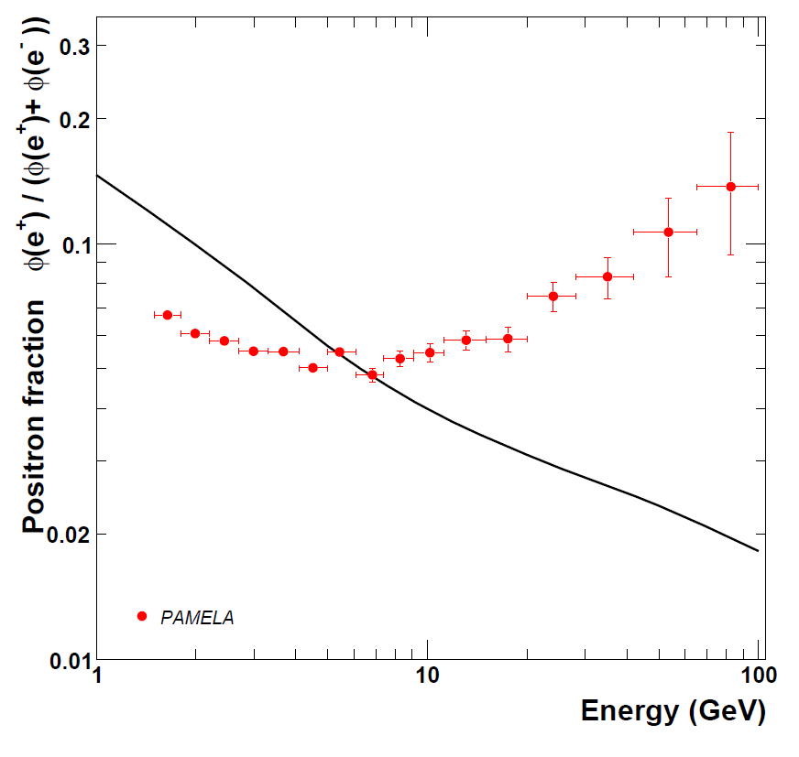
PAMELA
Positron excess above the predicted secondary
⇒ Primary sources
- Dark matter?
- Astrophysical?
⇒ Many papers
>100
Positron
Excess
Solar
modulation
Expected
Secondary
Jul 06 - Feb 08
151672 e-, 9430 e+
Adriani+ 08

Slide 3
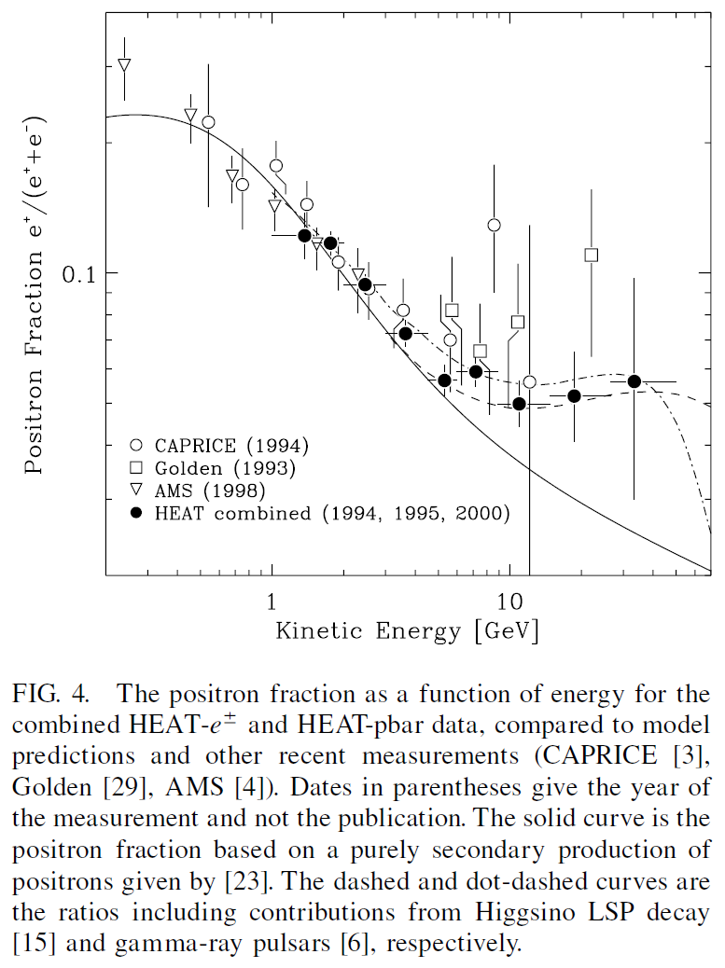
A hint was provided
previously by
AMS, HEAT etc.,
though not conclusive
Beatty+ 04

Slide 4
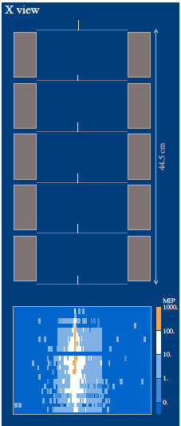
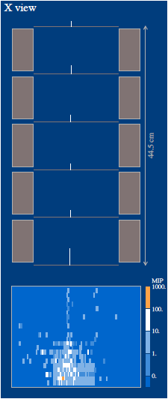
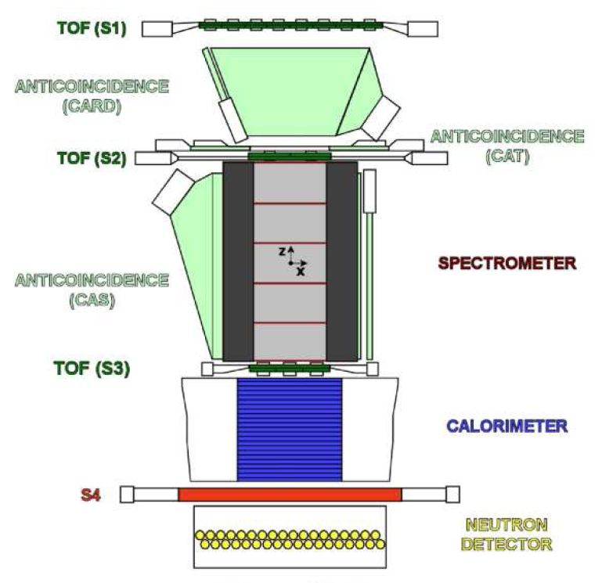
Principle of detection
Magnet ⇒ Rididity (pc/Ze),
charge sign, value (dE/dx)
e+/-
Proton
B
electron/hadron separation
- Shower starting point
- Longitudinal profile
PAMELA
Adriani+ 07

Slide 5
Secondary positrons
Flux
Injected primary
Observed
primary
Observed
secondary
ε
This is robust if
cooling/escape is faster
for higher energy.

Slide 6
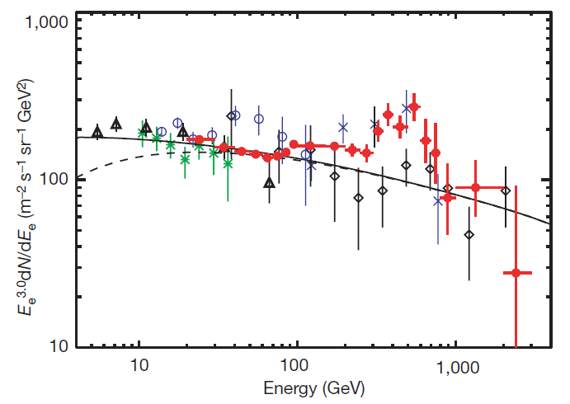
ATIC/PPB-BETS
An Excess also in (e⁺ + e⁻) Spectrum
Balloon exp.
PPB-BETS (04)
ATIC-1 (01)
ATIC-2 (03)
No charge sep.
Primary +
Secondary
Background
Chang+ 08, Torii+ 08

Slide 7
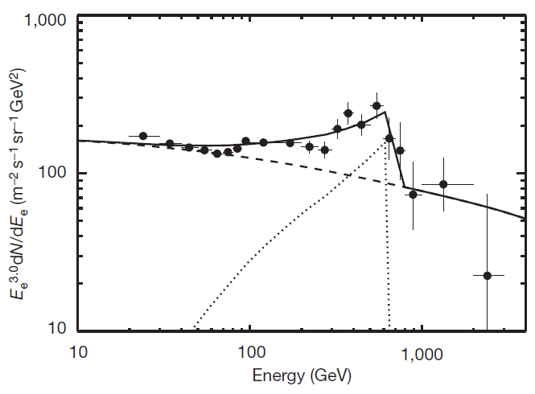
ATIC/PPB-BETS
Dark Matter (DM) Signal?
Peak +
Cutoff?
Sharp cutoff
is difficult to
explain by
astrophysical
sources??
~600GeV
DM?
Chang+ 08, Torii+ 08

Slide 8
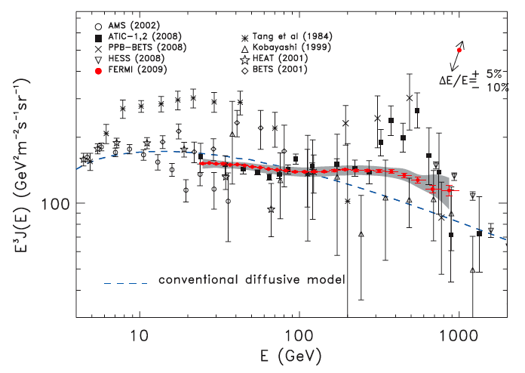
Fermi
An Excess (but Not Peak) in (e⁺+e⁻) Spectrum
ATIC/PPB-BETS
Fermi
Smooth
∝ E⁻³
Aug 08 – Jan 09
4M e-
Abdo+ 09

Slide 9
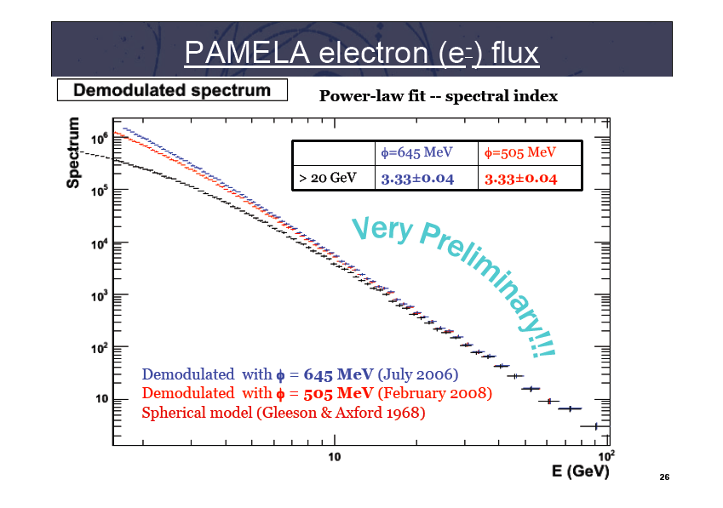
Mocchiutti PAMELA RICAP09

Slide 10
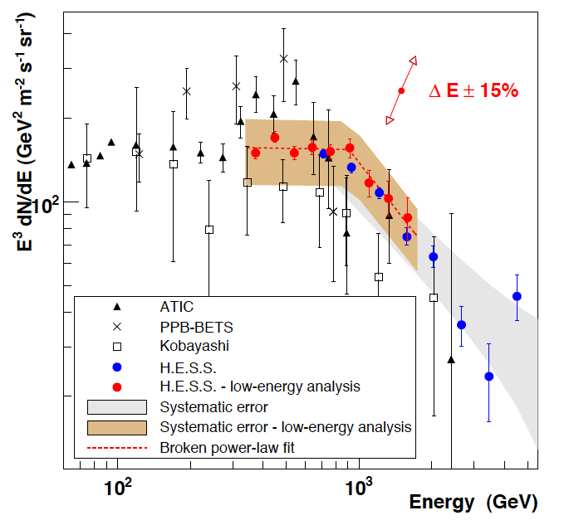
HESS
Consistent
with Fermi
No ATIC peak
(but not rule out)
Steep at >1TeV
Differences between
ATIC/PPB-BETS
& Fermi/HESS
are controversial
Primary sources
Aharonian+ 09

Slide 11
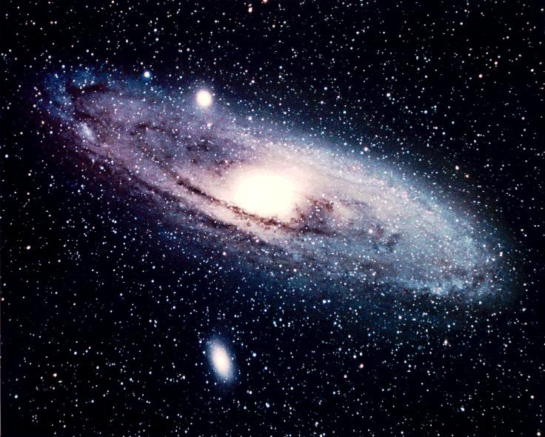
e± cooling
We are here
Our galaxy
e± lose energy (cool)
via inverse Compton
and synchroton
Positron source
d<~1kpc

Slide 12
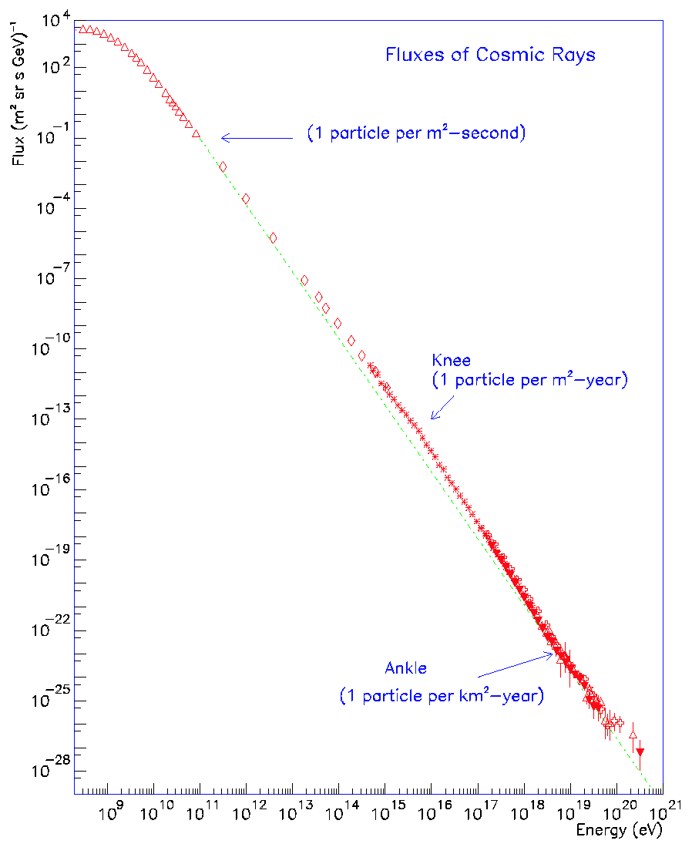
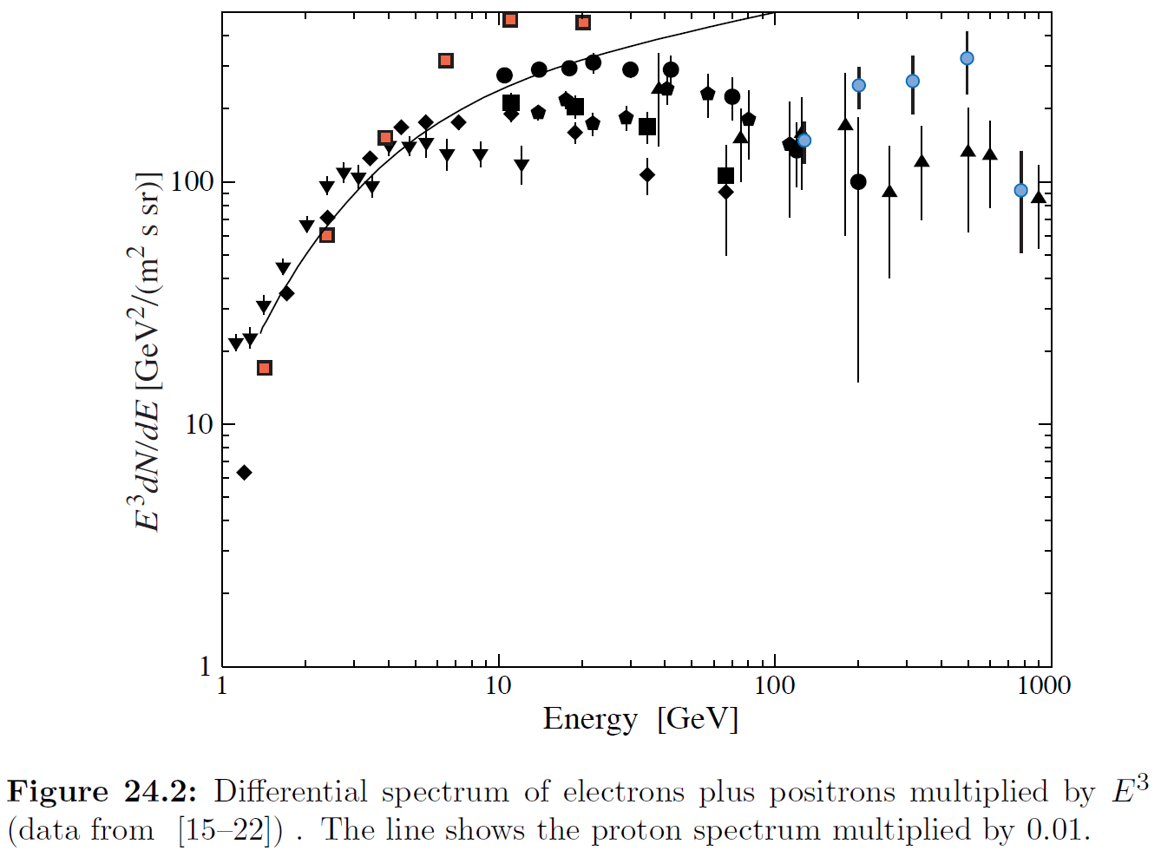
Energetics
Flux
Cosmic-Ray
Electrons
1% x Proton
Cosmic-Ray
Nuclei (Proton)
ρ(proton)~1eV/cm³
ρ(electron)~10⁻²eV/cm³
ρ(positron)~10⁻³eV/cm³
~ 0.1% of p
Energy

Slide 13
Dark Matter?
Annihilation
Decay
e
DM
e
DM
DM
e
χ
Q ~ n²
E_{cut} ~ m_{DM}
<σv>~3x10⁻²⁴cm³/s
>3x10⁻²⁶cm³/s
boost factor ~100
Q ~ n
E_{cut} ~ m_{DM}/2
τ_{decay}~10²⁶sec (>H⁻¹)

Slide 14
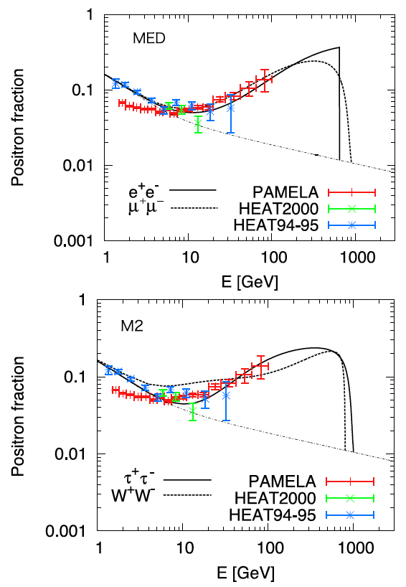
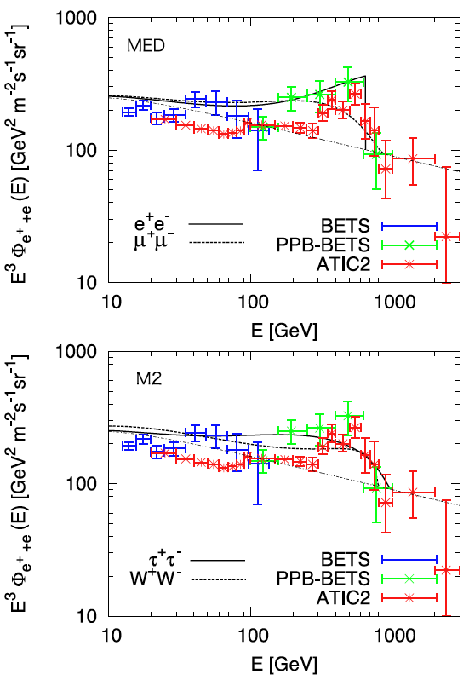
Hisano+ 09

Slide 15
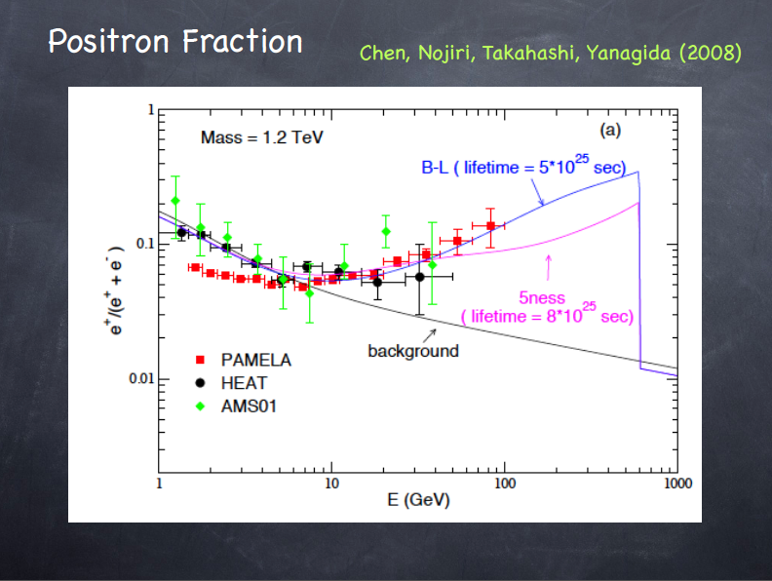
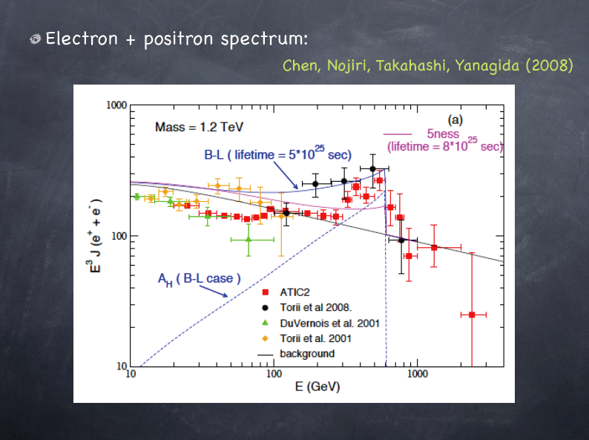

Slide 16
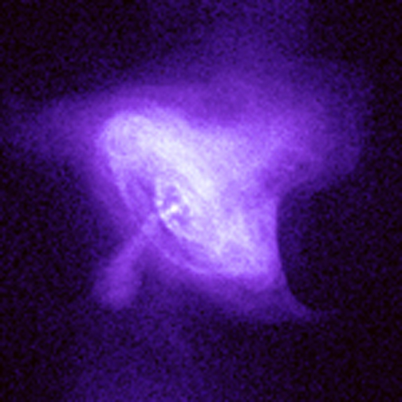
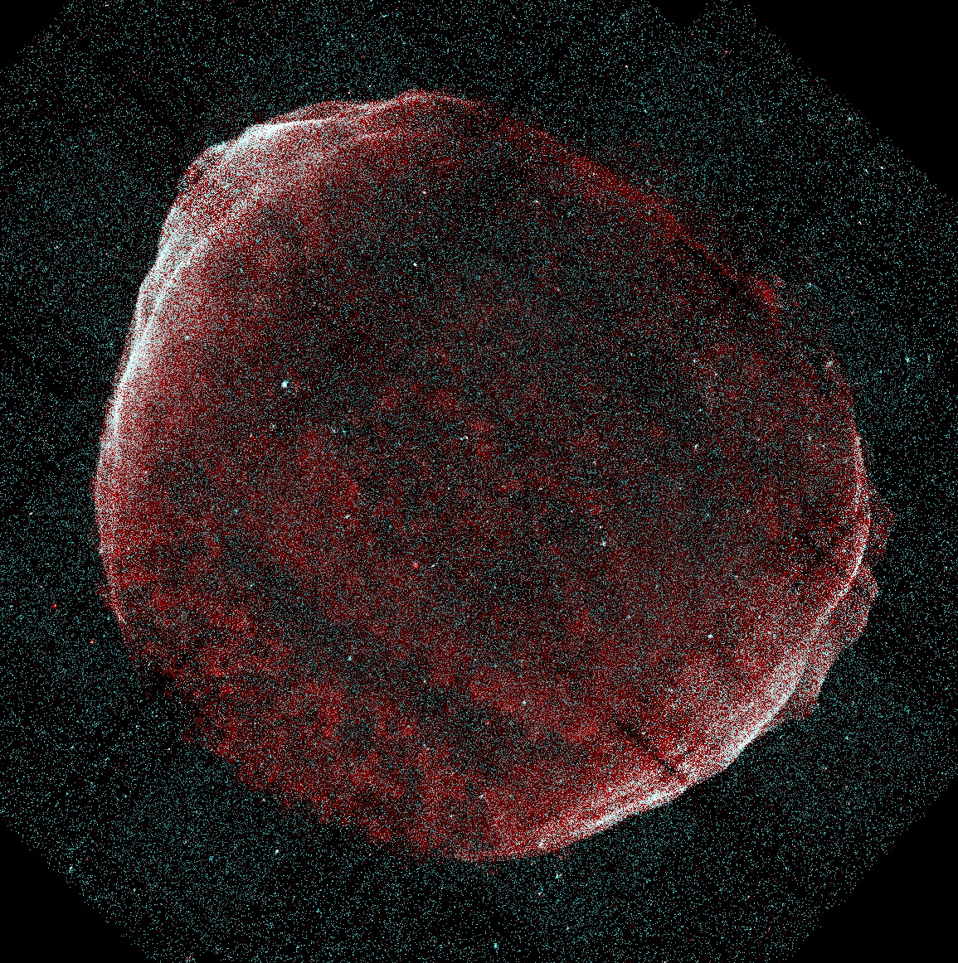
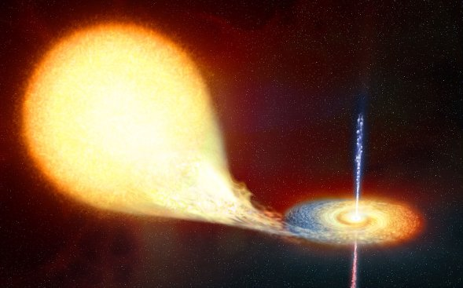
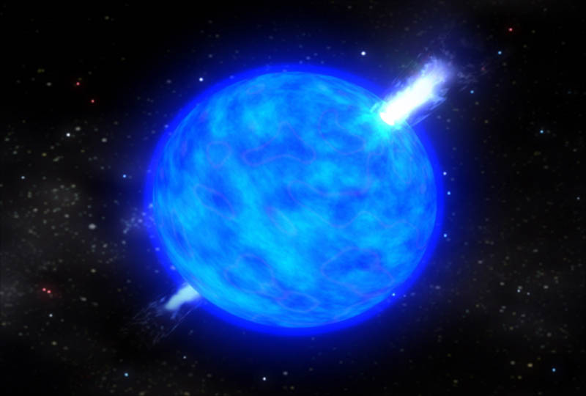
Astrophysical Origin?
Pulsar
SNR
Microquasar
Heinz &
Sunyaev
02
GRB
KI 08
Shen & Berkey 68;
Pohl & Esposito 98;
Kobayashi+ 04;
Shaviv+ 09; Hu+ 09;
Fujita+KI 09; Blasi 09;
Blasi & Serpico 09;
Mertsch & Sarkar 09;
Biermann+ 09
Shen 70; Aharonian+ 95;
Atoyan et al. 95; Chi+ 96;
Zhang & Cheng 01;
Grimani 07; Yuksel+ 08;
Buesching+ 08;
Hooper+ 08; Profumo 08;
Malyshev+ 09; Grasso+ 09
Kawanaka, KI & Nojiri 09;
Cosmic-ray Nuclei energy
10⁻³ x 10⁵⁰erg/SN
~ (1sec pulsar)/SN
~ 10⁵⁰erg/10³SN
Propagation
Delahaye+ 08;
Cowsik & Burch 09
Proton Comtami.
Fazely+ 09; Schubnell 09

Slide 17
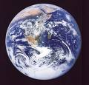
Simple model
Power-law Spectrum
Burst-like
injection
B
Whatever
ε_{max} is!

Slide 18
e± Propagation
Diffusion
Injection
Energy loss by
IC & synchro.
← B/C ratio
For a single burst with
Power law spectrum
Atoyan+ 95, Shen 70

Slide 19
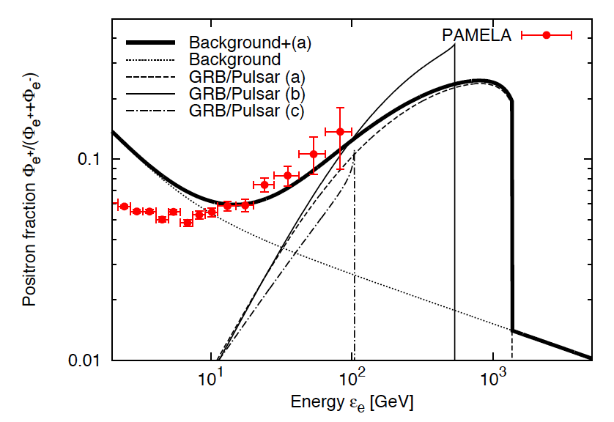
Positron
We can fit the PAMELA data well
d=1kpc
(a)
0.9d50 erg
2d5 yr
α=2.5
(b) Harder
0.8d50 erg
5.6d5 yr
α=1.8
(c) Older
3d50 erg
3d6 yr
α=1.8
Ioka 08

Slide 20
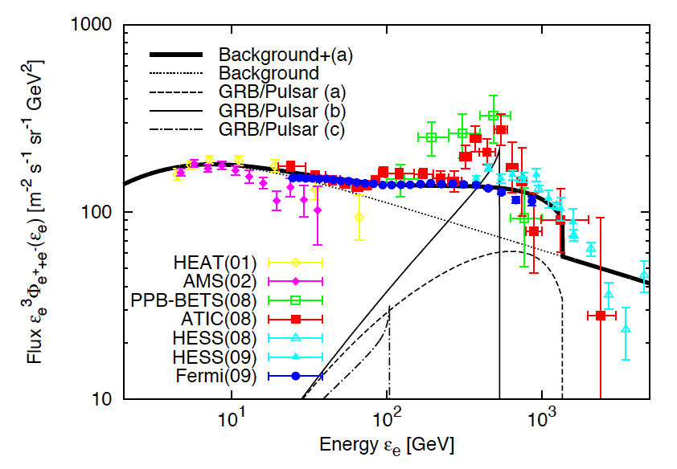
Electron
ATIC/PPB-BETS & Fermi/HESS
d=1kpc
(a)
0.9d50 erg
2d5 yr
α=2.5
(b) Harder
0.8d50 erg
5.6d5 yr
α=1.8
(c) Older
3d50 erg
3d6 yr
α=1.8
Ioka 08

Slide 21
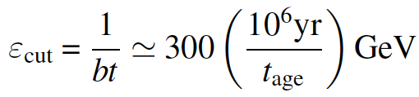
DM-like Sharp Cutoff
Due to cooling
ATIC peak
HESS cutoff
Independent
of initial ε_{max}
Ioka 08

Slide 22
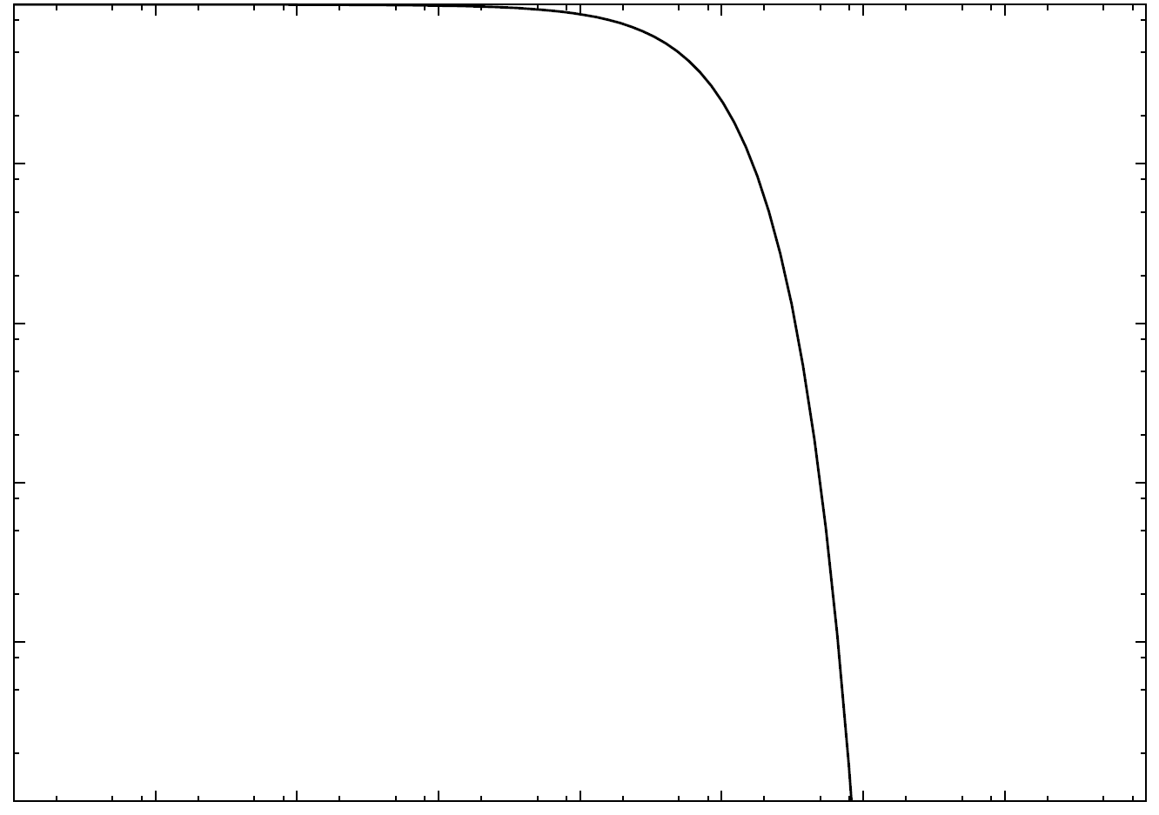
Continuous injection
Case 1: pulsar-type decay
Case 2: exponential decay

Slide 23

Continuous Injection
Cutoff width Δε_{cut}
⇒ Model
selection
(CALET)
Δt~10⁵yr
e^{-t} decay
Cutoff width
Δt~10⁵yr
t⁻² decay
Δt~10⁴yr
t⁻² decay
Kawanaka+ 09

Slide 24
Astrophysical Models
Pulsar
SNR
Microquasar
Heinz &
Sunyaev
02
GRB
KI 08
Shen & Berkey 68;
Pohl & Esposito 98;
Kobayashi+ 04;
Shaviv+ 09; Hu+ 09;
Fujita+KI 09; Blasi 09;
Blasi & Serpico 09;
Mertsch & Sarkar 09;
Biermann+ 09
Shen 70; Aharonian+ 95;
Atoyan et al. 95; Chi+ 96;
Zhang & Cheng 01;
Grimani 07; Yuksel+ 08;
Buesching+ 08;
Hooper+ 08; Profumo 08;
Malyshev+ 09; Grasso+ 09
Kawanaka, KI & Nojiri 09;
~10⁵⁰erg e±
~10⁵⁻⁶yr ago
Propagation
Delahaye+ 08;
Cowsik & Burch 09
Proton Comtami.
Fazely+ 09; Schubnell 09

Slide 25
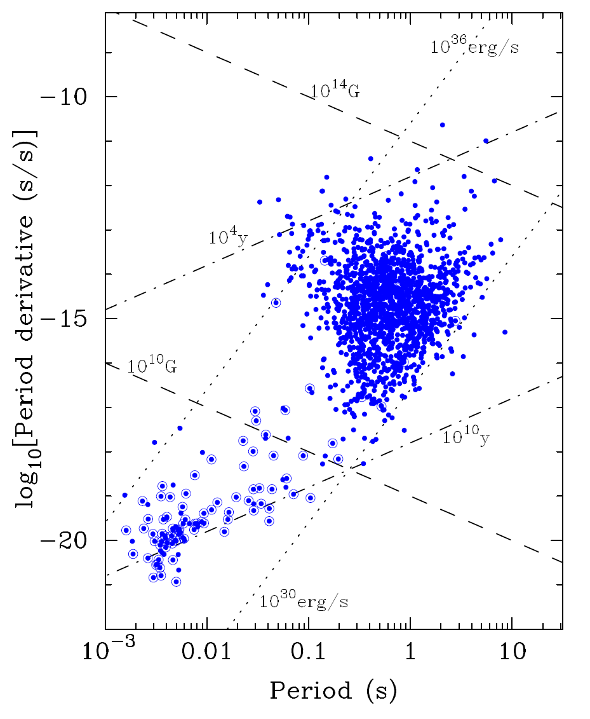
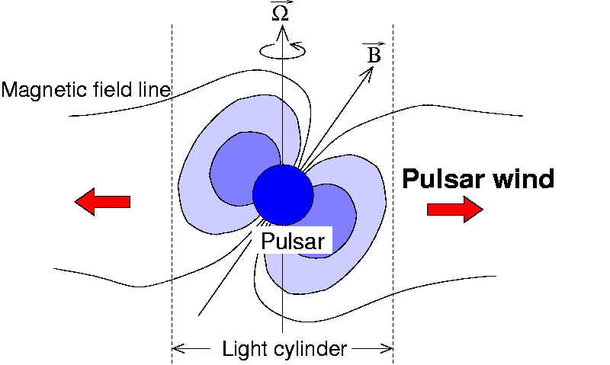
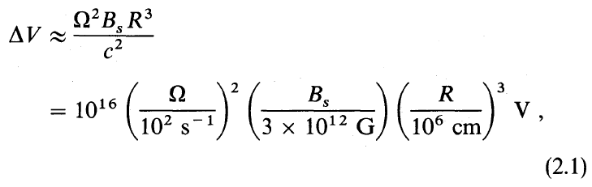
Pulsar
R. Romani’s talk
e±
PWN
©Mori
Lorimer 08
Goldreich&Julian 69

Slide 26
Multiple Injection (e⁺)
⇒ Smooth Spectra & Reasonable Energy
Average spectrum
Birth rate:
one per
1.5x10⁵ yr
(including
off-axis
pulsars)
E~10⁴⁹erg
α~1.7
Kawanaka+ 09

Slide 27
Multiple Injection (e⁻+e⁺)
Average spectrum ~ Fermi but ≠ATIC
ATIC peak
requires
energetic
source
ATIC
~3x10⁴yr
~10⁴⁸erg
⇒ Young
source
is less
energetic
Kawanaka+ 09

Slide 28
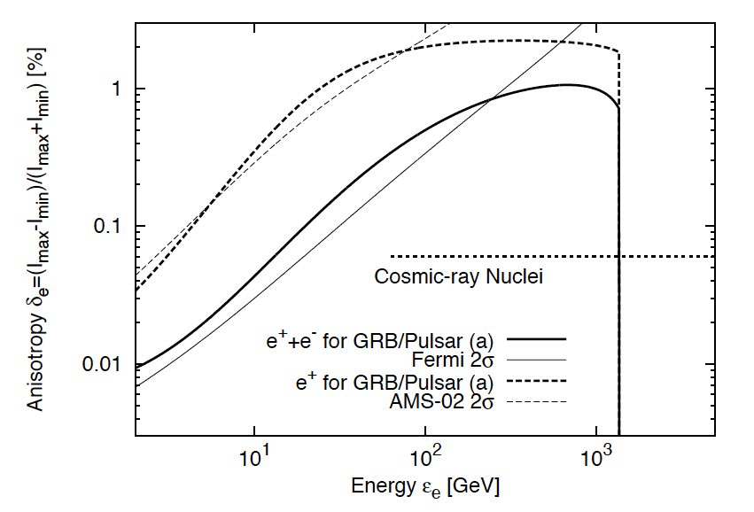
Single v.s. Multiple
A single source ⇒ A relatively large anisotropy
Challenging
DM clump
Ioka 08; Mao & Shen 72

Slide 29
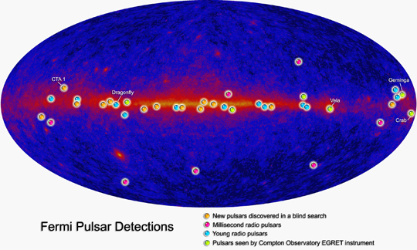
Gamma-ray pulsars

Slide 30
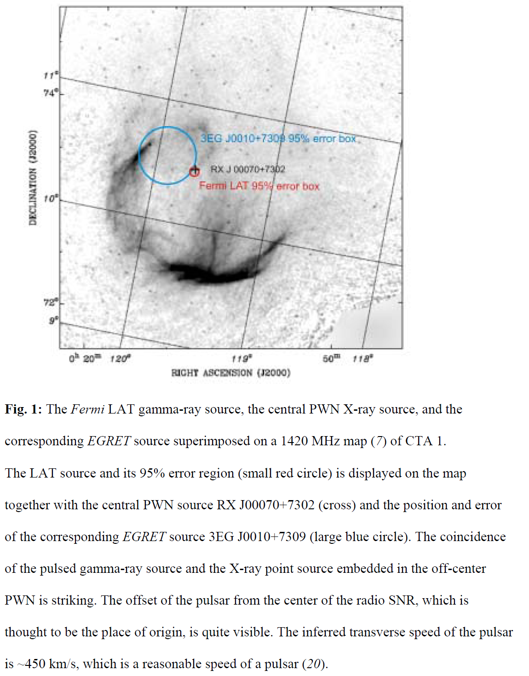
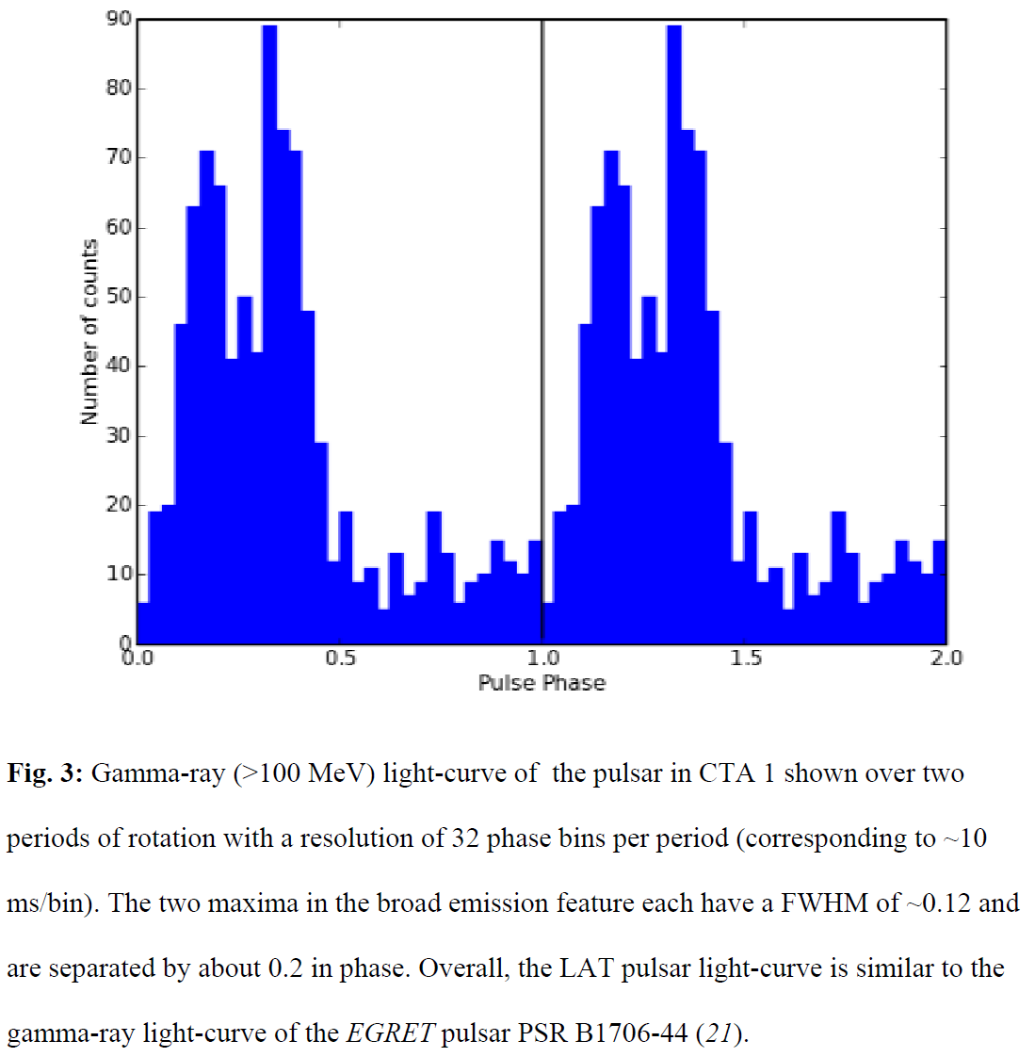
γ-ray only pulsar CTA1
Abdo+ 08
Pulsar and PWN
⇔ GeV-TeV unID sources

Slide 31
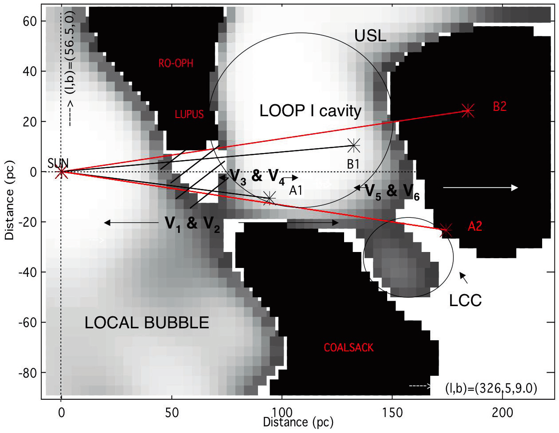
SNR
Local bubble
Loop I, …
← 20-40 SNe
at ~100 pc
Nearby SNRs
surely affect
the solar
environments
Welsh & Lallement 05

Slide 32
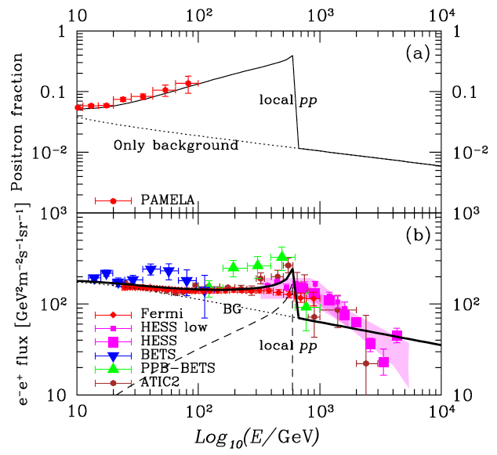
SNR model (ATIC)
Massive stars
born in
Dense Clouds
⇒ Supernova
⇒ Shock acc.
⇒ pp → e⁺e⁻
R~40pc,
n~100cm⁻³,
d=200pc
s=1.4,
t_{pp}=5x10⁵yr,
E_{p}=3x10⁵⁰erg
Fujita+ 09

Slide 33
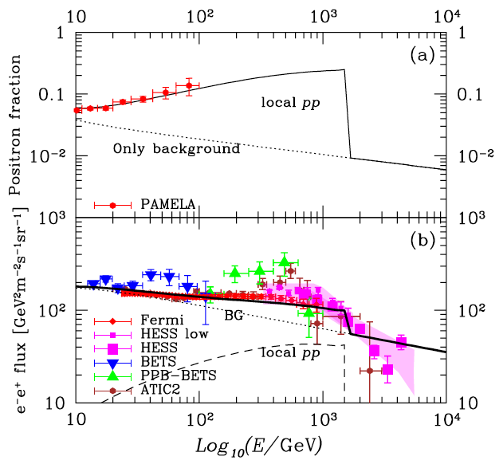
SNR model (Fermi)
Massive stars
born in
Dense Clouds
⇒ Supernova
⇒ Shock acc.
⇒ pp → e⁺e⁻
R~40pc,
n~50cm⁻³,
d=200pc
s=1.75,
t_{pp}=2x10⁵yr,
E_{p}=3x10⁵⁰erg
Fujita+ 09

Slide 34
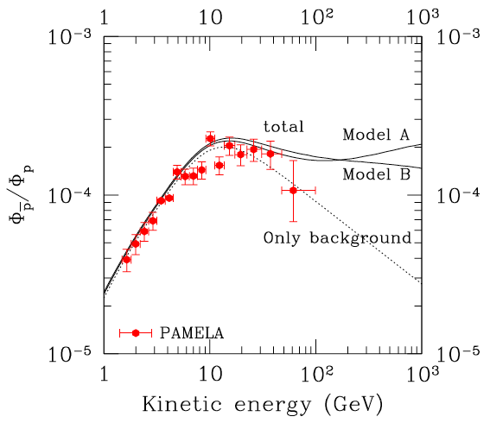
Hadronic v.s. Leptonic
SNR model:
pp → π⁺ → e⁺e⁻
(w/ ISM/DC)
Inevitably
⇒ anti-proton
excess above
~100 GeV
⇒ PAMELA
Anti-proton
fraction
Fujita+ 09

Slide 35
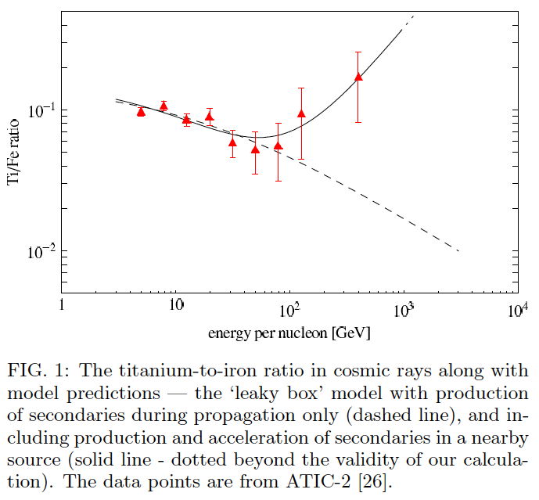
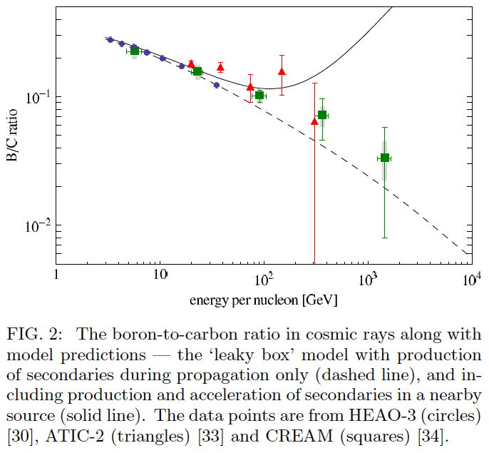
2nd Nuclei for Hadronic
Hadronic models ⇒ Secondary Nuclei Excesses
Titanium-to-iron ratio
Boron-to-carbon ratio
Mertsch and Sarkar 09

Slide 36



SNR model features
Hard spectrum for e⁺e⁻
Radiative phase
Low Gamma-ray and Neutrino Signals
The SNR destroyed the Dense Cloud
Anti-proton and Secondary Nuclei excess
above ~100GeV
<2

Slide 37
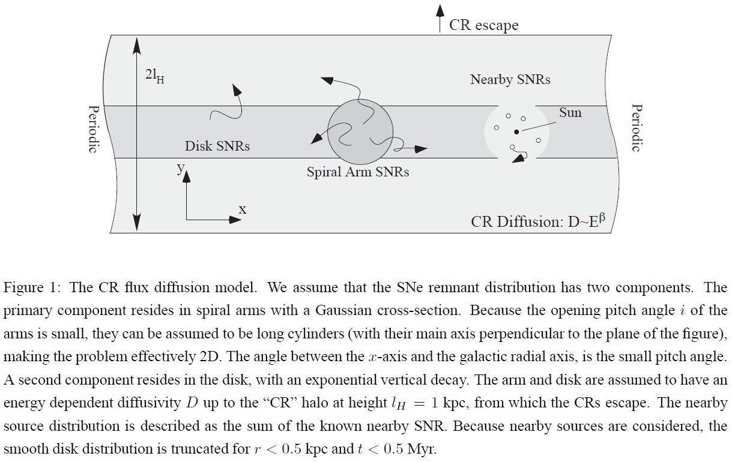
Inhomogeneous SNRs?
Shaviv+ 09

Slide 38
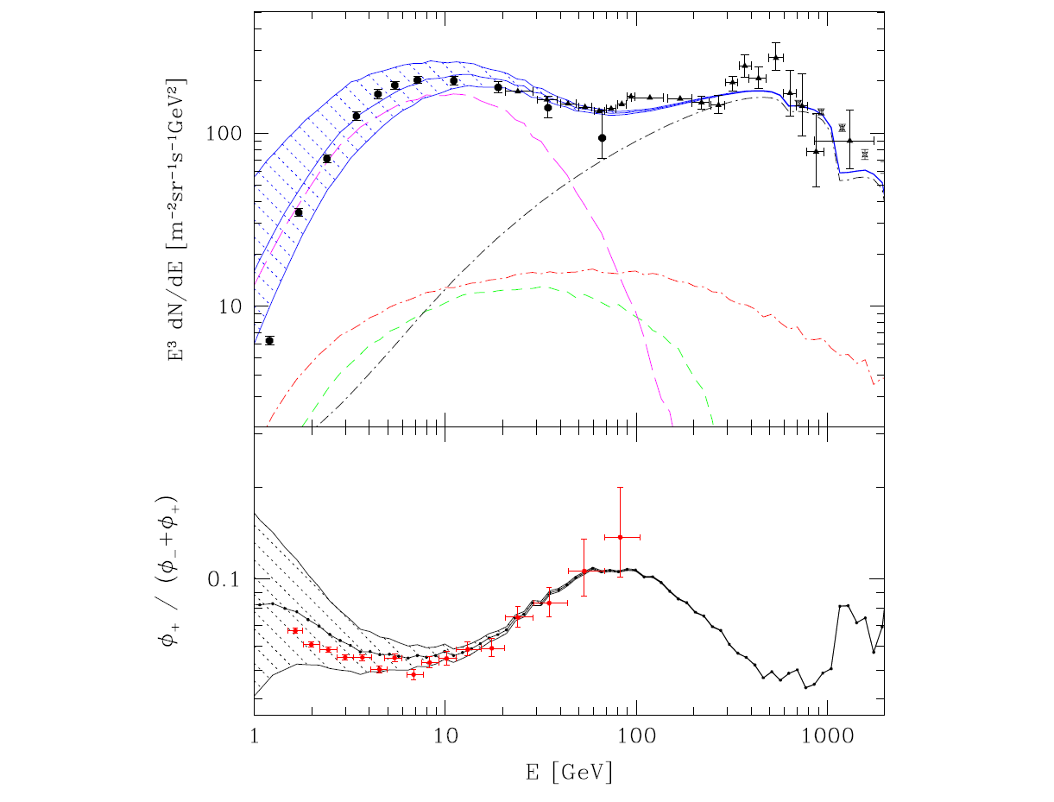
arm
primary
nearby
primary
Secondary
disk
primary
Shaviv+ 09

Slide 39
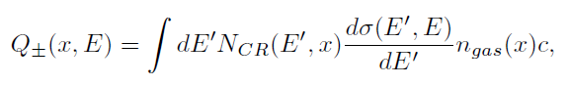
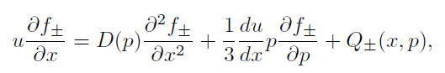
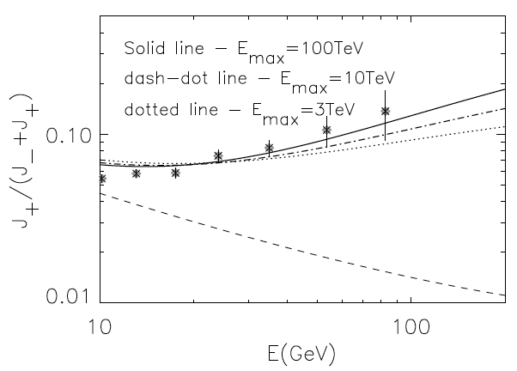
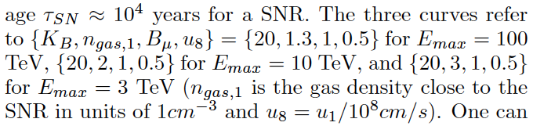
SNR w/ Reacceleration
pp → π → e⁺e⁻
Transport eq.
large p → large D
→ More return to
the shock
Blasi 09

Slide 40
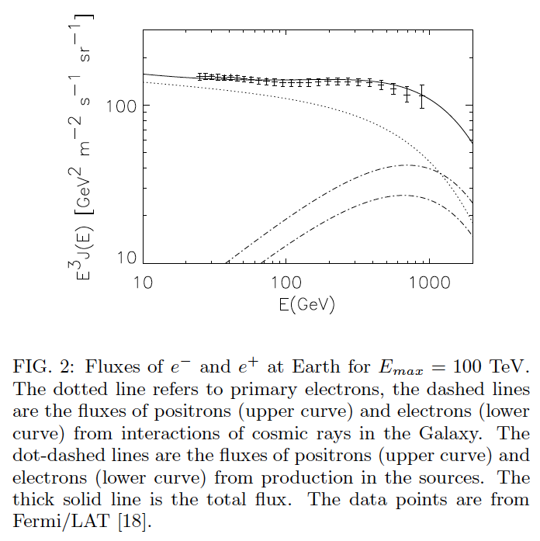
Blasi 09

Slide 41
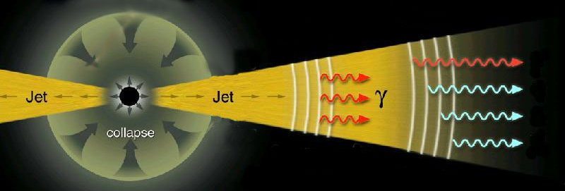
GRB summary
Luminosity: ~10⁵¹erg/s (most luminous)
Energy: E_{iso}~10⁵³erg, E~10⁵¹erg
Spectrum: ε_{peak}~200keV, Flat to TeV?
Event rate: ~1/10⁵yr/galaxy
Optical flash: in some GRBs, why so rare?
Dark GRB: ~1/2 GRBs, dust absorption?

Slide 42
Galactic GRB
Energy: E~10⁵¹erg
E(MeV)~E(GeV-TeV)
Event rate: ~1/10⁵yr/galaxy
Proton
Synch.
νF_{ν}
Observed γ
Inverse Compton
e±
Power-law
Fermi LAT
ε
MeV
GeV
TeV

Slide 43
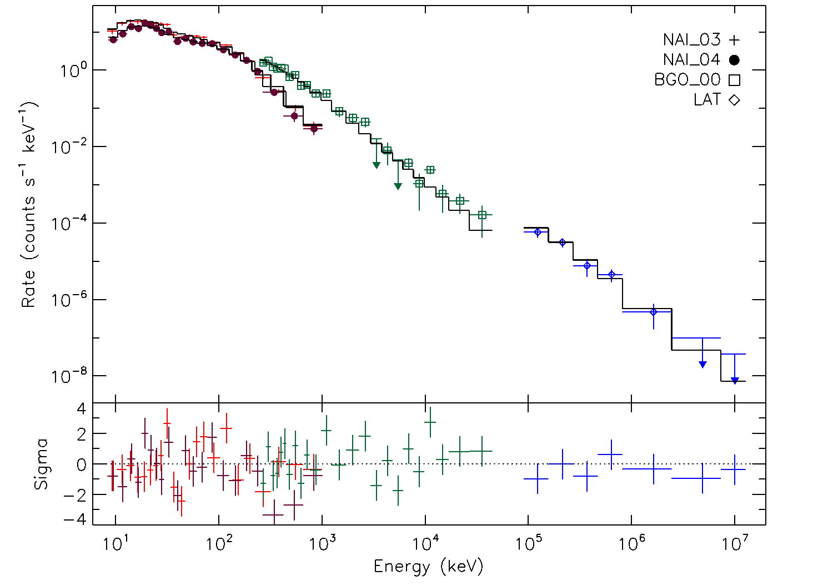
GRB 080916C
α = -1.02 +/- 0.02
β = -2.21 +/- 0.03
Epeak = 1170 +/- 142 keV
Band function over 6 decades in energy

Slide 44
Adiabatic cooling
Important for compact sources
Trapped e± have
adiabatic invariant
⇒ e± lose energy
⇒ Old (>10⁵yr) pulsars
How about GRBs?

Slide 45
Possible mechanism
e± production far outside the remnant
High energy photon ε_{g}
Target photon ε_{t}
ε_{g} ε_{t} > (m_{e}c²)²
It needs many target photons
t(expansion)~t(diffusion)
R~10¹⁸cm~0.3pc
~ GRB energy

Slide 46
Dust echo
e± production far outside the remnant
High energy photon ε_{g}>1TeV
Target photon ε_{t}~1eV
ε_{g} ε_{t} > (m_{e}c²)²
Dust scattering
t(expansion)~t(diffusion)
R~10¹⁸cm~0.3pc
Typical for molecular cloud

Slide 47
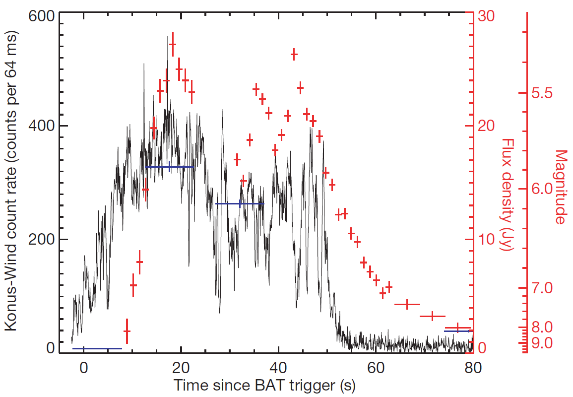
Naked-eye GRB
Racusin+ 08
GRB080319B peaked at V_{mag}~5.3, E_{eV}~10%E_{MeV}

Slide 48
e± spectrum
e± production far outside the remnant
High energy photon ε_{g}>1TeV
Target photon ε_{t}~1eV
ε_{g} ε_{t} > (m_{e}c²)²
KN effect
t(expansion)~t(diffusion)
R~10¹⁸cm~0.3pc
~TeV

Slide 49
Spectral conversion
To isotropic distribution
B
Scatter afterglow photons
⇒ e± cooling & creaction
~TeV

Slide 50
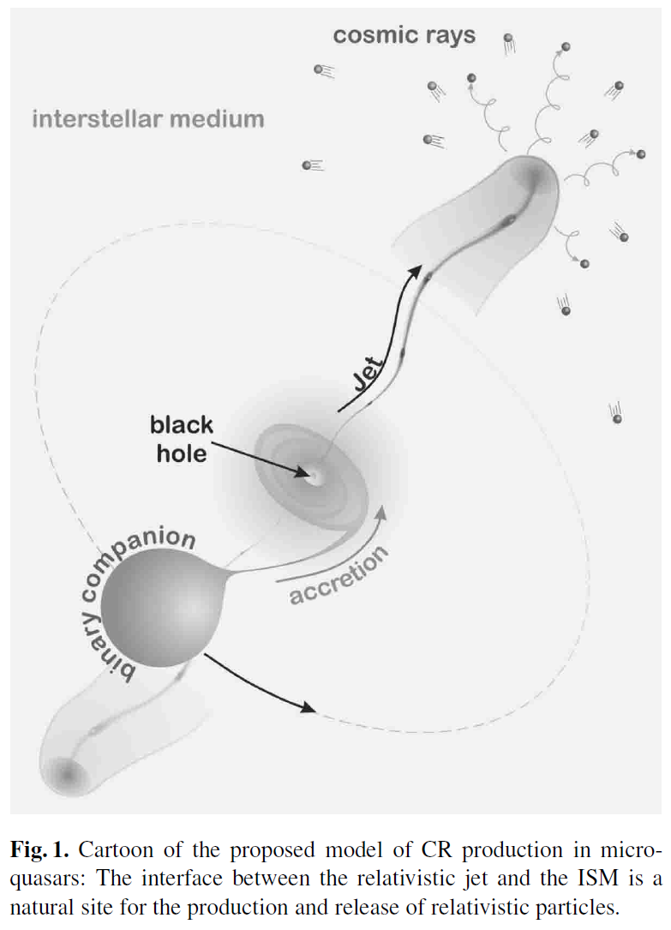

Microquasar
L_{Eddington} (10³⁸erg/s) x 10⁵yr ~ 10⁵⁰erg
Heinz & Sunyaev 02

Slide 51

Theoretical uncertainty
Theoretical
uncertainty
~1 order-of-mag.
⇒ It could be
just secondary
Delahaye+ 08

Slide 52


Nested Leaky Box
CRs spend
some time
τ_{s}(E) near
the source
After that,
residence time
in ISM is const.
Cowsik & Burch 09

Slide 53

Cowsik & Burch 09

Slide 54


Diffuse γ-ray background
Locally obs. electron
⇒ Minor role of IC
:conventional model
~10-10³ GeV γ
←Inverse Compton
by ~10²-10³ GeV e
Strong+ 04
π⁰
IC

Slide 55

©Torii

Slide 56

CALET
©Torii

Slide 57
Summary
Electron/Positron excess
Dark Matter?
Pulsar? SNR: pp? GRB: TeV γ + dust eV γ?
Astrophysical sources
~10⁴⁹⁻⁵⁰erg e± ~10⁵⁻⁶yr ago
Fit spiky ATIC as well as Smooth Fermi
Spectral cutoff similar to DM case (⇒CALET)
Anisotropy (CR & Diffuse γ)
Anti-proton, 2nd Nuclei: Hadronic models

Slide 58


γ of Pulsar Wind
e±
γ_{w}
©Mori
Suzaku
So far only γ_{w}~10⁶ for Crab
γ_{w}~4x10⁵ for PSR B1259
Uchiyama+ 09

Slide 59


Remnants of e± Sources
~10⁵⁰erg e± ~10⁵⁻⁶yr ago ⇒ Old remnant
⇒ X-ray dim via cooling ~ TeV unID
Ioka & Meszaros (09)
Matsumoto+ 07
Bamba+ 07
Many TeV unIDs
GRB/Hypernova Remnants
~ 10 ~ Observed TeV unID
HESS J1616: TeV/X>55 (Matsumoto+ 07)
HESS J1804: TeV/X>13 (Bamba+ 07)
Westerlund 2: TeV/X>2.7 (Fujita+ 09)
Bamba: GeV ~ pion?

Slide 60


Metal in SNR
CasA
W49B
Keohane+(07)
Laming+(06)
“Jet” region
X-ray Spec.⇒2x10⁵²erg
~7° Jet⇒10⁵⁰erg?
barrel-shaped
Ni & Fe in the jet
⇒ GRB-like jet?

Slide 61
Candidates
Dark Matter
Astrophysical Model
Cosmic-ray energy
Annihilation
<σv>~3x10⁻²⁴cm³/s
>3x10⁻²⁶cm³/s
boost factor ~100
Decay
τ_{decay}~10²⁶sec (>H⁻¹)
Many (>100) papers
10⁻³ x 10⁵⁰erg/SN
~ 10⁴⁷erg/SN
~ (1sec Pulsar)/SN
~ (10⁻³ x SNR)/SN
~ (1 GRB)/10³SN
~ (1 Microquasar)/10³SN
~30 papers

Slide 62





Cutoff width by inhomo.
δb
d_{b}

Slide 63
Short Summary
Electron/Positron excess
PAMELA
ATIC/PPB-BETS ⇔ Fermi/HESS
Dark matter? Astrophysical sources?
Astrophysical source
~10⁵⁰erg e± ~10⁵⁻⁶yr ago
Fit spiky ATIC as well as Smooth Fermi
Spectral cutoff similar to DM case
Cutoff energy ~ 300GeV(10⁶yr/t)
Cutoff width Δε/ε~Δt/t

Slide 64

PAMELA e/h separation

Slide 65


Antiproton as predicted
No excess for antiproton
Adriani+(PAMELA) 08

Slide 66

Fermi Δε_{e}
Abdo+ 09

Slide 67

Fermi e/h separation
Abdo+ 09

Slide 68


Fermi e/h separation
Be careful at >300GeV
Moiseev+ 07

Slide 69

HESS 08

Slide 70


Polarcap
Goldreich&Julian 69
Ruderman&Sutherland 75

Slide 71


Outergap
Chen,Ho & Ruderman86

Slide 72
High Energy γ
Proton
Synch.
νF_{ν}
Observed γ
Inverse Compton
Power-law
Fermi LAT
ε
MeV
GeV
TeV
If extrapolate to TeV ⇒ E(MeV)~E(GeV-TeV)
Other components are also expected
Fermi LAT: 080825C (<35sec, 14γ <GeV),
080916C (14γ >GeV), 081024B (Short, <3GeV)
090510 (short, high Epeak)

Slide 73
e± cutoff and line
1. e± cutoff energy ⇒ Jet velocity
2. e± line ⇒ e± abundance
(⇒ Jet properties ⇒ Central engine)
Luminosity
KI+ 07
Murase&KI 08
Photon spectrum
energy

Slide 74
Low Energy γ
Proton
Synch.
νF_{ν}
Observed γ
Inverse Compton
Power-law
Optical
flash
Fermi
ε
eV
MeV
GeV
TeV
Some GRBs have ~eV photon (optical) flashes
Optical flash was theoretically expected
⇒ Absorption/Scattering by dust?
(~1/2 GRBs are dark without optical afterglow)

Slide 75

Dust sublimation
Scattering only
at the outside
Waxman&Draine 00

Slide 76

Old SNR
SN in
Dense Cloud
R~40pc,
n~100cm⁻³,
d=200pc,
s=1.6,
t_{pp}=10⁶yr,
E_{p}=3x10⁵⁰erg

Slide 77

Cowsik & Burch 09

Slide 78

Cowsik & Burch 09

Slide 79
Other possibilities
Simple model ⇒ E~10⁵⁰erg~(GRB)
10msec pulsar has a rotational
energy of E~10⁵⁰erg (Kawanaka,KI+09)
2. L_{Eddington} (10³⁸erg/s) x 10⁵yr ~ 10⁵⁰erg
e.g., Black hole + Disk + Jet
(Microquasar)
3. Supernova remnant (Fujita+KI 09)
pp → π → e⁺

Slide 80

e± cooling
Lavalle+ 07
e± lose energy (cool)
via inverse Compton
and synchroton
Sources should be
within R_{d}~kpc
< Galactic disk~10kpc
Diffusion time
~R_{d}²/K~10⁷yr
⇒ Galactic Rate
>1/10⁵yr

Slide 81
Cosmic Ray
E<10¹⁵⁻¹⁶eV (Knee)
F∝E^{-2.7}
Probably Galactic SNR
L_{CR}~10⁴¹erg/s~0.1E_{SN}/t_{SN}
No direct evidence
10¹⁵⁻¹⁶<E<10¹⁸eV (Ankle)
F∝E^{-3-3.2}
Galactic origin??
Simple SNR: E<10¹⁴eV
10¹⁸eV<E
F∝E^{-2.7}
Extragalactic AGN? GRB?
~1eV/cm³
~(CMB)
1 particle/km²/century
Bhattacharjee&Sigl(00)

Slide 82

Cutoff/Line at ~600 GeV
Due to
cooling
600GeV
⇔t~10⁶yr
Ioka 08

Slide 83

Multiple pulsars
d=1kpc, E_{e}=1.3x10⁴⁹erg, α=1.9
K₀=2x10²⁸cm²/s, δ=0.6, τ~10⁴yr
Event rate ~ 1/10⁴⁻⁵yr
Average spectrum has
no ATIC peak

Slide 84

Positron Fraction
Multiple pulsars
⇒ Smooth &
Energetically reasonable

Slide 85

Expected Performance of LAT
LAT will be able to precisely reconstruct the e-spectrum in 20 GeV –1 TeV.
(still working on extending this range in both directions).
LAT should detect > 10⁷ electrons above 20 GeV per year of operation.
LAT will be able to check at much better statistics and with much smaller
systematic errors on various spectral features !
©Kataoka
LAT
Possible feature
Claimed by ATIC.
Nearby
Sources?

Slide 86

Anisotropy
GRB case (b)
⇔ DM case (~0?)

Slide 87


290pc

Slide 88

157pc

Slide 89



Slide 90



Slide 91



Slide 92



Slide 93




Slide 94


Composition
Advanced Composition Explorer (ACE)
Li, Be, B: spallation of C, O
PDG 08

