Slide 1
Blazar Physics
Katsuaki Asano
(Institute for Cosmic Ray Research,
The University of Tokyo)

Slide 2
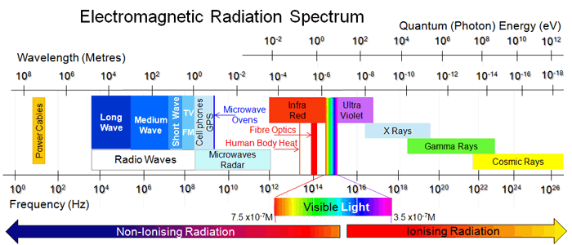
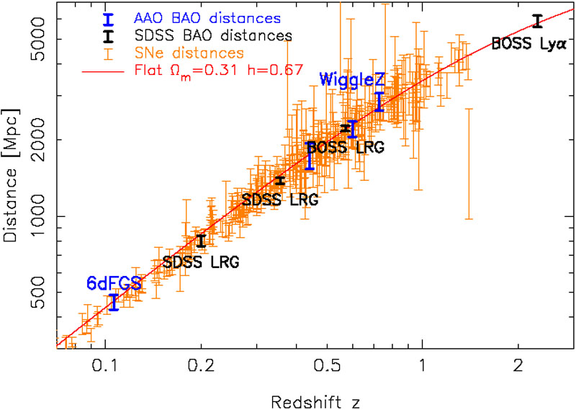
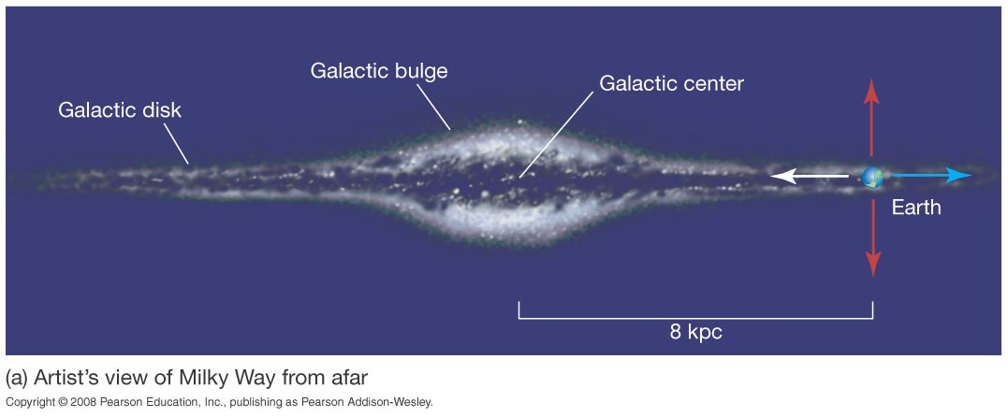
Unit

Slide 3
Contents Day 1
Introduction
Active Galactic Nuclei (Super Massive Black Hole)
Blazar and Radio Galaxy
Relativistic Jet
Accretion Disk
Blandford-Znajek Process
Magnetic Jet Acceleration
Magnetic Reconnection

Slide 4
Contents Day 2
Blazar Emission Spectrum (Radio-Gamma)
Particle Acceleration by Shock Wave
Relativistic Effects on Emission
Leptonic Model
Hadronic Model
Implication from Spectral Modeling
Alternative Models

Slide 5
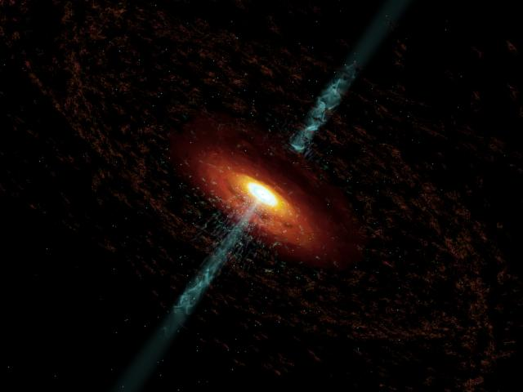
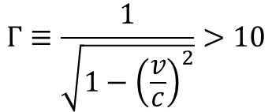


Introduction
Blazar: Relativistic Jet from Super Massive Black Hole.
Lorentz Factor
$$Γ≡\frac{1}{\sqrt{1−{\left(\frac{v}{c}\right)}^{2}}}>10$$
Black Hole Mass
$$M={10}^{6}−{10}^{9}M_{⊙}$$
Jet Power
$$L_{j}>{10}^{10}−{10}^{13}L_{⊙}$$
Non-thermal Emission:

Slide 6
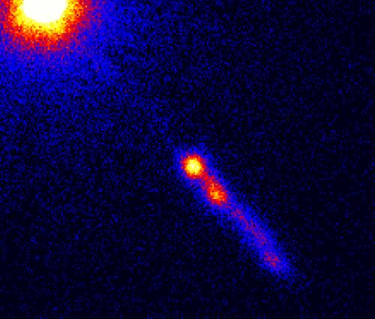
History
3C Catalogue of Radio Sources published in 1959
159 MHz Observation with Cambridge Interferometer
directed by Martin Ryle and Antony Hewish.
3C 273
BL Lacertae
(optical, Oke and Gunn 1974)
Confirmed as extragalactic source in 1963.
(redshift z=0.16)
power-law spectrum

Slide 7
History (X-ray)
1970 Bowyer+ reported X-ray detection of 3C 273 and M87 with rocket
observation.
Ginga observation of 3C 279 (Makino+ 1989)

Slide 8
History (gamma-ray)
3C 279
EGRET Detection (Hartman+ 1992)
Whipple (IACT) detected TeV photons
Gamma-ray dominant in Emission Power!
Punch+ 1992

Slide 9
Non-thermal Emission
3C 279 (Hayashida+ 2015)
Mrk 421(Acciari+ 2011)

Slide 10
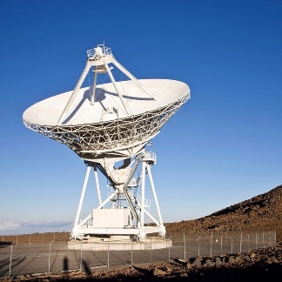
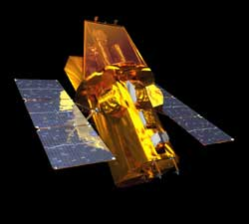
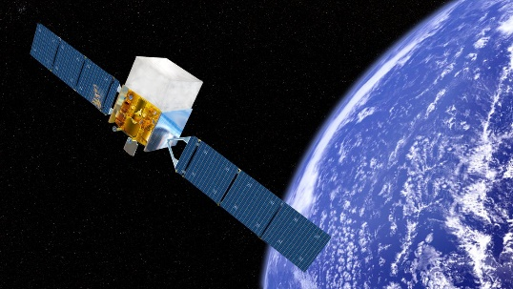
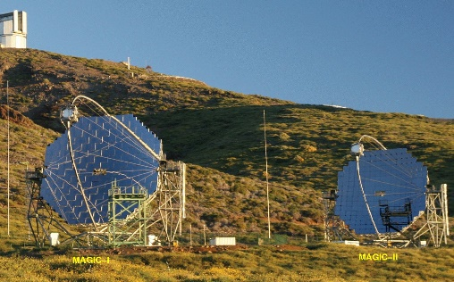
Multi-Wavelength Observation
Mrk 421 (Abdo+ 2011)

Slide 11
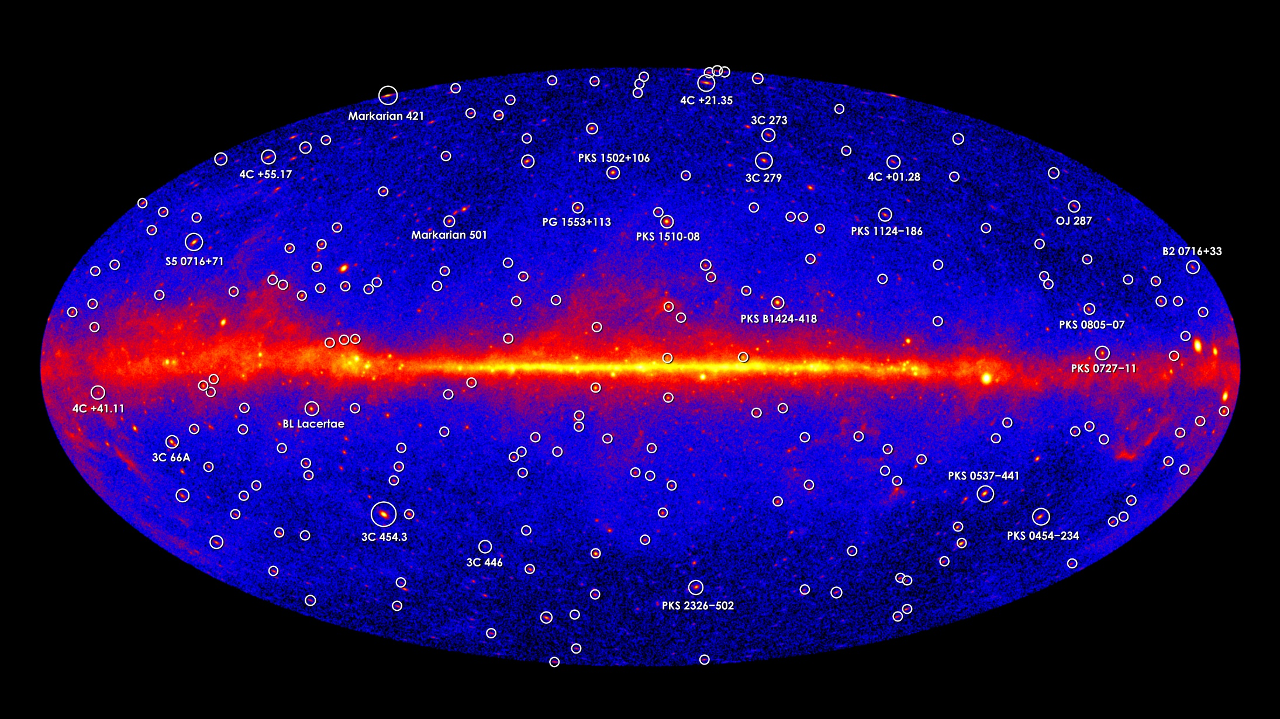
Gamma-ray Sky
Most of Extra Galactic Sources are Blazars

Slide 12
Enigmatic Problems
How to launch and accelerate relativistic jets?
  Energy Source
    Gravitational Energy of Accreting Matter
    Rotational Energy of Black Hole
  Acceleration
    Magnetically driven
    Alternative (radiation pressure, electric field)
  Plasma Component
    Usual Electron-Proton Plasma
    Electron-Positron Plasma
    Poynting Flux Dominated

Slide 13
Enigmatic Problems
How to emit non-thermal radiation?
  Energy Source
    Kinetic Energy Dissipated by Shock
    Magnetic Field
    Turbulence
  Particle Acceleration
    Shock
    Magnetic Reconnection
    Turbulence
  Gamma-ray Emission
    Inverse Compton by Electrons
    Hadronic (Proton Synchrotron, Pion Decay)

Slide 14
Active Galactic Nuclei
Luminous Emission due to Super Massive Black Hole

Slide 15
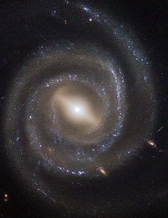
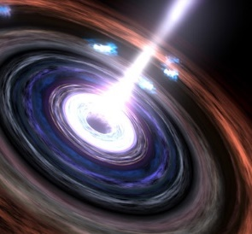
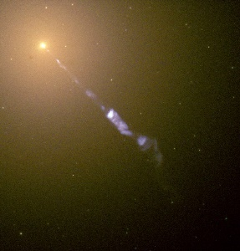
Active Galactic Nuclei
Active Galactic Nuclei (AGN)
Seyfert Galaxy
Quasar
Jet from BH
Blazar
Radio Galaxy

Slide 16
Classification
AGN
(a few % of all galaxies)
Radio-quiet
(85-95%)
Radio-loud
(5-15%)
Seyfert
Quasars
Blazar
Radio Galaxy
5-10% radio-loud
Type I
Type II
Flat Spectrum Radio Quasar
BL Lac
FR1
FR2

Slide 17
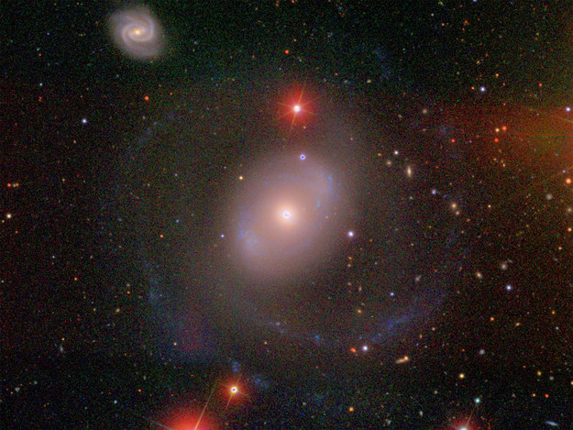
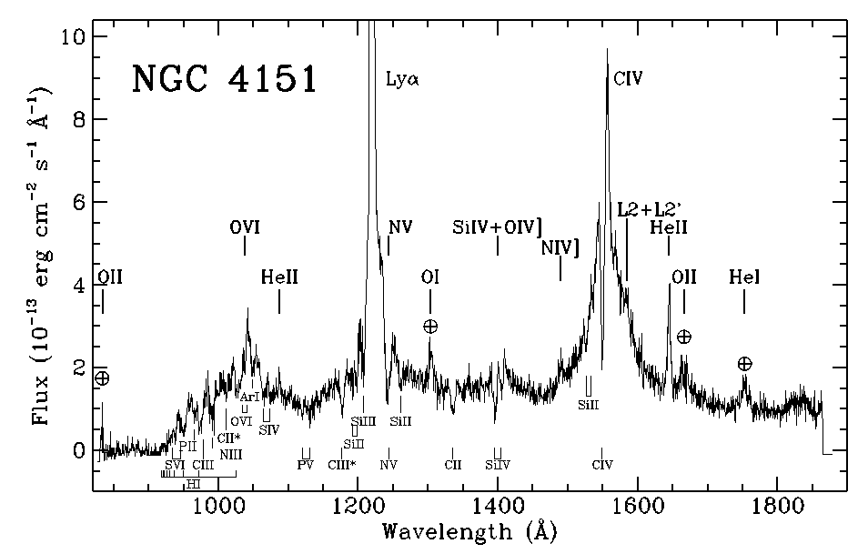

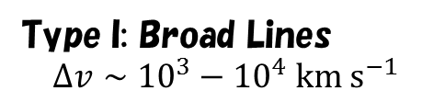
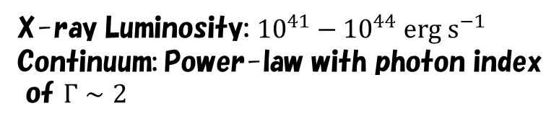
Seyfert Galaxy
NGC 4151
X-ray Luminosity: ${10}^{41}−{10}^{44} erg s^{−1}$
Continuum: Power-law with photon index
of $Γ∼2$
Type I: Broad Lines
$$Δv∼{10}^{3}−{10}^{4} km s^{−1}$$
Number density of galaxies ($L>{10}^{7}L_{⊙}$): $∼0.07 Mpc^{−3}$
Seyfert galaxies: $∼{10}^{−4} Mpc^{−3}$

Slide 18
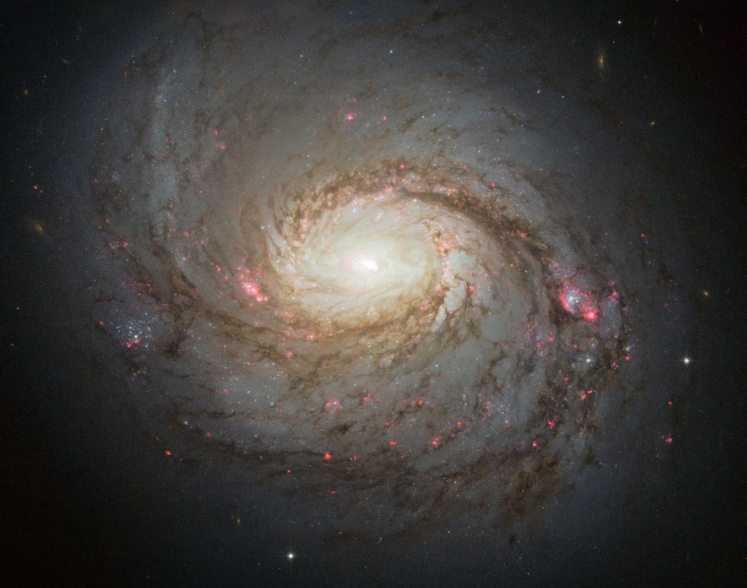
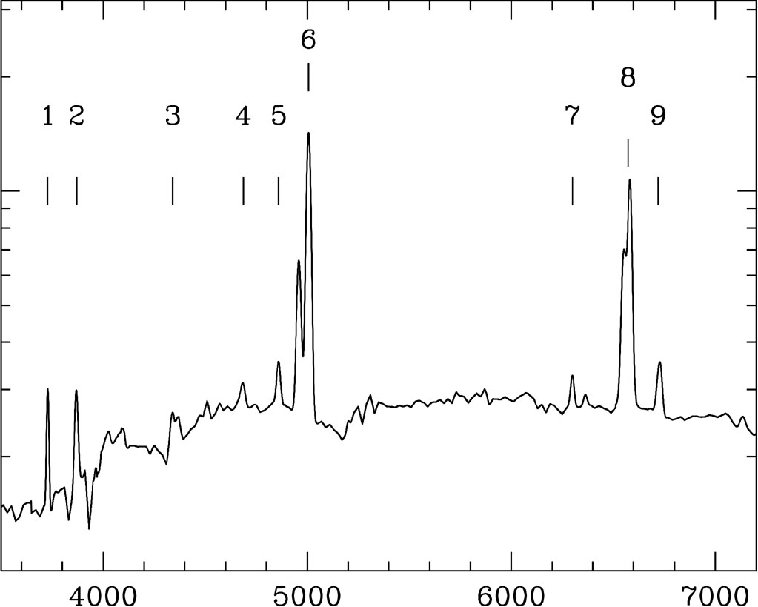

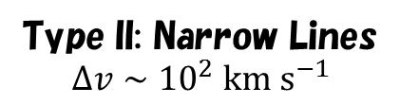








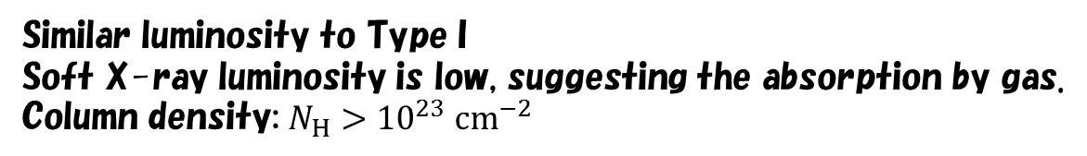
Seyfert Type II
NGC 1068
$$[O III]$$
$$[N II]$$
$$[Ne III]$$
$$H_{γ}$$
$$H_{β}$$
$$[O II]$$
$$He II$$
$$[O I]$$
$$[S II]$$
Type II: Narrow Lines
$$Δv∼{10}^{2} km s^{−1}$$
Similar luminosity to Type I
Soft X-ray luminosity is low, suggesting the absorption by gas.
Column density: $N_{H}>{10}^{23} cm^{−2}$

Slide 19
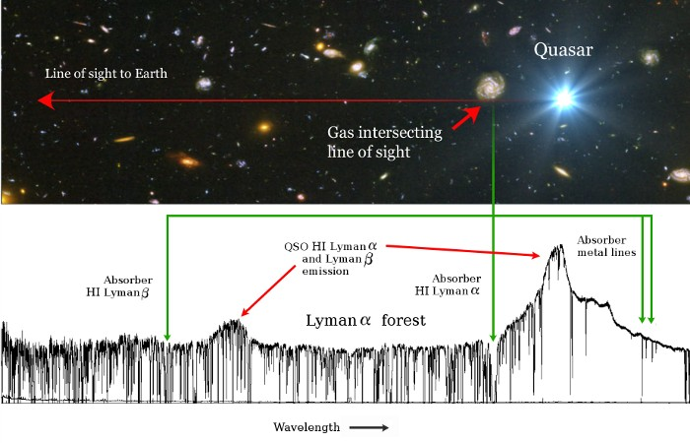
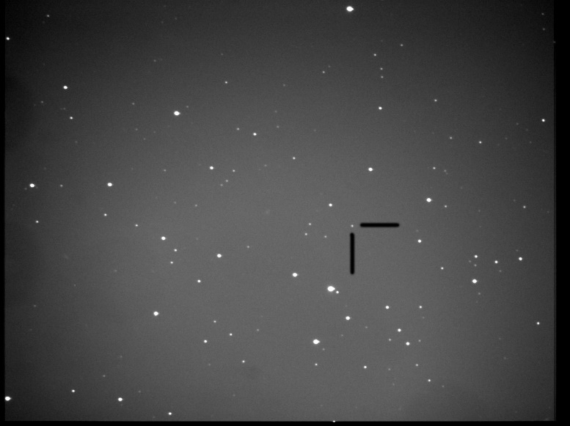
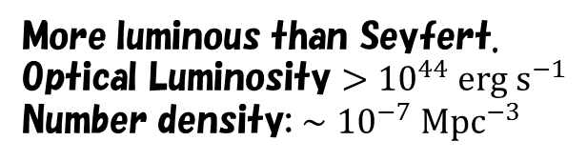
Quasar
More luminous than Seyfert.
Optical Luminosity $>{10}^{44} erg s^{−1}$
Number density: $∼{10}^{−7} Mpc^{−3}$
3C 48 (z=0.37)
Most of QSOs are distant.
Almost point sources.
Most of QSOs are type I.
Composite spectrum from 101 QSOs
Zheng+ 1997

Slide 20
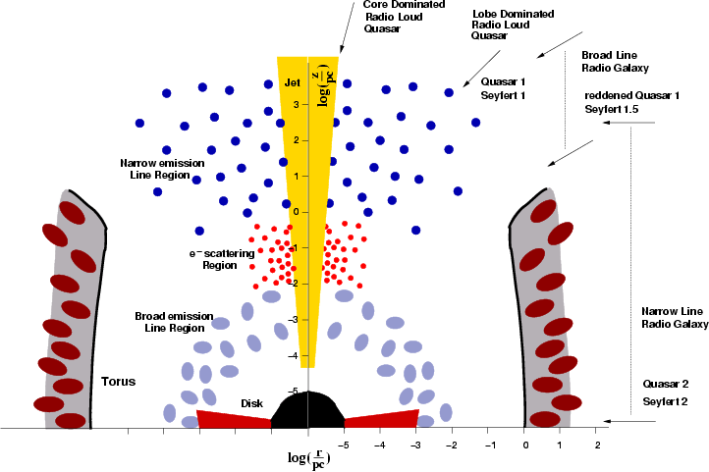
Unified Model
Type I
Type II
cannot see
broad lines
Line
Scattered
X-ray
Optical
Line
X-ray
Zier & Biermann 2002
Hot corona

Slide 21
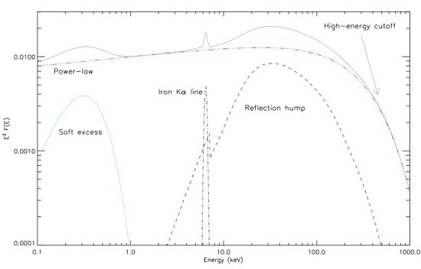


X-ray spectrum
Typical X-ray spectrum
Seyfert galaxy IC 4329A
$$O VII$$
$$Fe K$$
Ricci+ 2011
Brenneman+ 2014

Slide 22
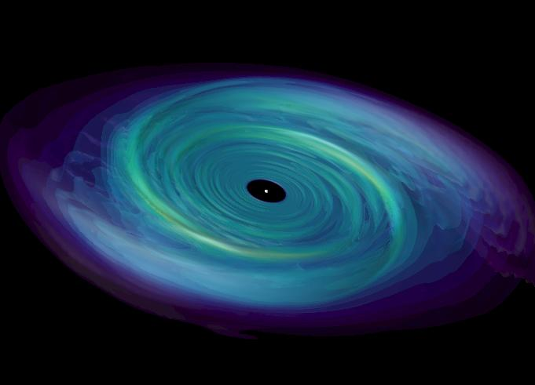

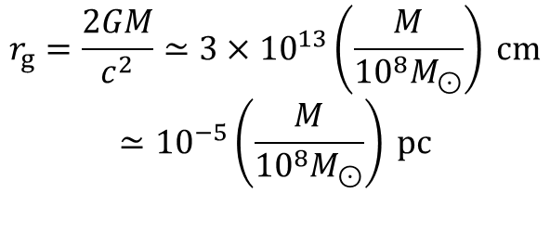
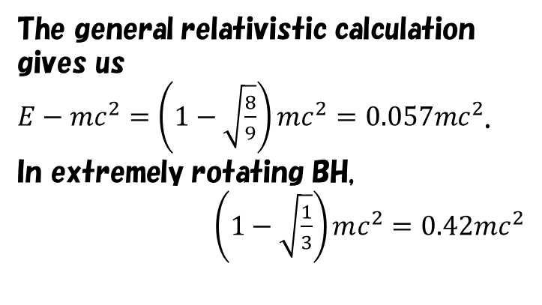
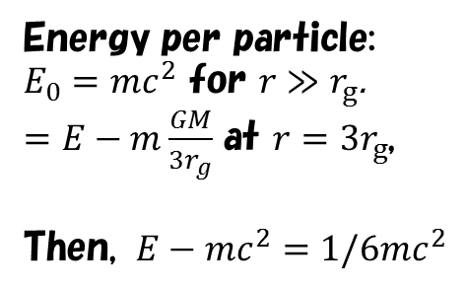

Black Hole and Accretion Disk
Schwarzschild radius:
$$r_{g}=\frac{2GM}{c^{2}}≃3×{10}^{13}\left(\frac{M}{{10}^{8}M_{⊙}}\right) cm$$
$$≃{10}^{−5}\left(\frac{M}{{10}^{8}M_{⊙}}\right) pc$$
Energy per particle:
$E_{0}=mc^{2}$ for $r≫r_{g}$.
$=E−m\frac{GM}{3r_{g}}$ at $r=3r_{g}$,
Then, $E−mc^{2}=1/6mc^{2}$
Inner most stable circular orbit$=3r_{g}$
(non-rotating BH)
The general relativistic calculation
gives us
$E−mc^{2}=\left(1−\sqrt{\frac{8}{9}}\right)mc^{2}=0.057mc^{2}$.
In extremely rotating BH,
$\left(1−\sqrt{\frac{1}{3}}\right)mc^{2}=0.42mc^{2}$
In extremely rotating BH, $0.5r_{g}$
(In the Sun, nuclear fusion $4p→He$ implies $ΔE=0.0068mc^{2}$)

Slide 23
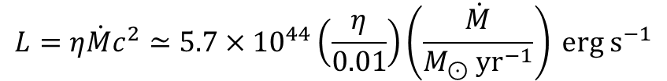

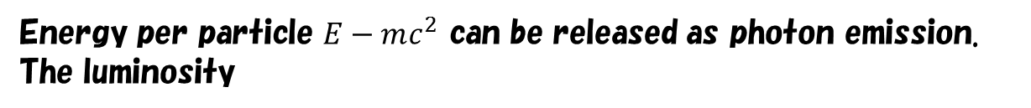
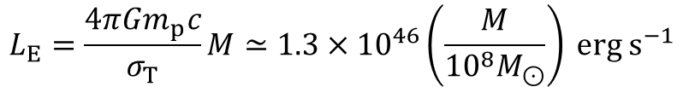


Eddington Luminosity
Energy per particle $E−mc^{2}$ can be released as photon emission.
The luminosity
$$L=η\dot{M}c^{2}≃5.7×{10}^{44}\left(\frac{η}{0.01}\right)\left(\frac{\dot{M}}{M_{⊙} yr^{−1}}\right) erg s^{−1}$$
However, photon emission prevents accretion of matter.
Radiative force per particle $\frac{σ_{T}L}{4πcr^{2}}$
Emission
Gravity per particle $\frac{GM}{r^{2}}m_{p}$
To accrete matter, gravity force should be larger than radiative force.
The maximum Luminosity, so-called Eddington luminosity
$$L_{E}=\frac{4πGm_{p}c}{σ_{T}}M≃1.3×{10}^{46}\left(\frac{M}{{{10}^{8}M}_{⊙}}\right) erg s^{−1}$$
Of course, $≫{10}^{8}L_{⊙}=3.9×{10}^{41} erg s^{−1}$

Slide 24
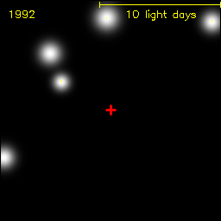

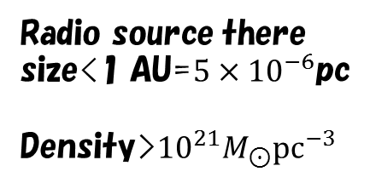

Kinematical Signature of BH
Center of our galaxy
0.13pc
$2.5×{10}^{6}M_{⊙}$ for $r<0.2$ pc
NGC 4258
Radio source there
size<1 AU=$5×{10}^{−6}$pc
Density>${10}^{21}M_{⊙}pc^{−3}$
$$4×{10}^{7}M_{⊙}$$

Slide 25


Mass Estimate
Reverberation
Distance to the broad line region $R_{BLR}$
Spectrum
Velocity dispersion $V^{2}$
Virialization
Kaspi+ 2000

Slide 26
AGN density evolution
Ueda+ 2014
Wall+ 2005

Slide 27




Luminosity Function & X-ray Background
Evolution of Luminosity function
X-ray background
$$23−24$$
$$<22$$
$$22−23$$
$$\log{N_{H}=24−26}$$
Ueda+ 2014
The X-ray sky is dominated by AGNs.

Slide 28
Blazar and
Radio Galaxy
Jet from AGN core

Slide 29
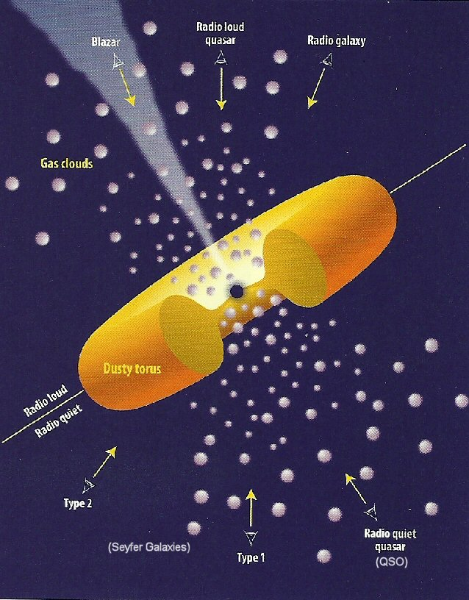

Jet Axis and Observer
Radio Loud $≃$ Accompanying Jet
Blazar: Jet seen by on-axis observers
Radio Galaxy: Jet seen by off-axis
observers

Slide 30
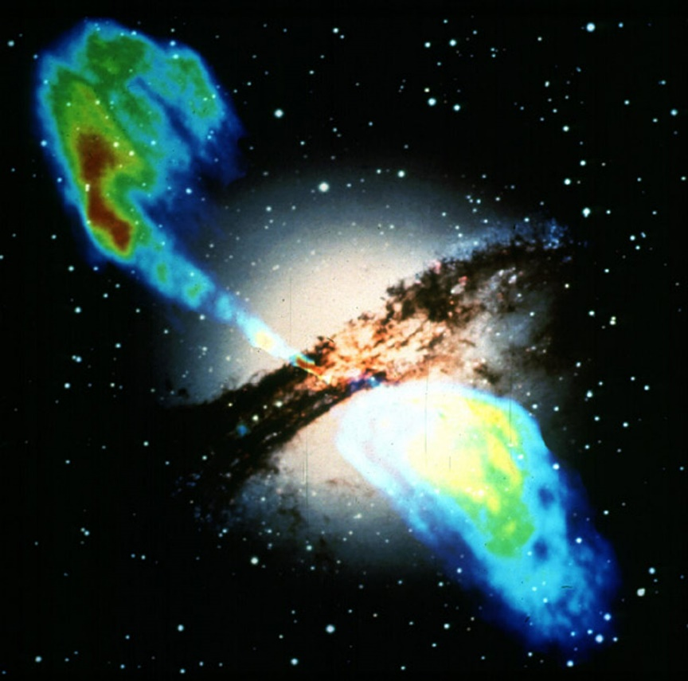
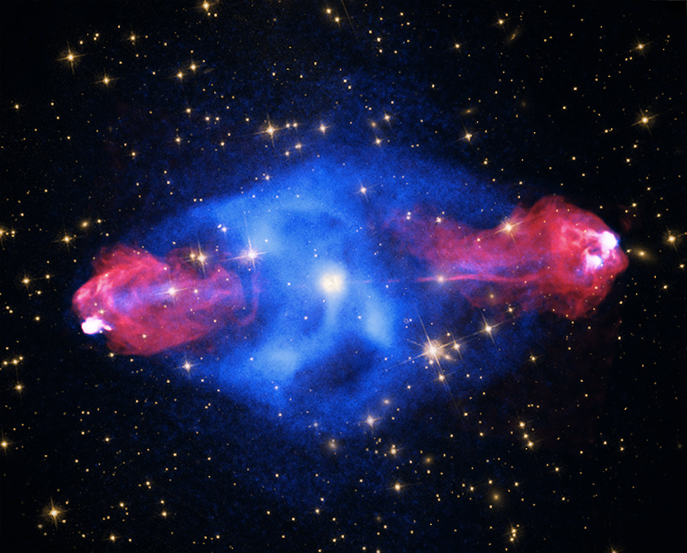
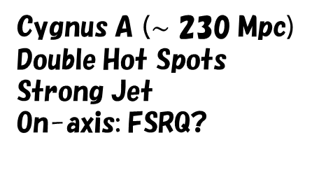



Radio Galaxy
FR I (Fanaroff and Riley Class I)
FR II
Centaurus A ($∼$ 4 Mpc)
Intensity decreases along the jet.
Weak Jet
On-axis: BL Lac?
Cygnus A ($∼$ 230 Mpc)
Double Hot Spots
Strong Jet
On-axis: FSRQ?
Number density: $∼{10}^{−6} Mpc^{−3}$
Number density: $∼{3×10}^{−8} Mpc^{−3}$

Slide 31
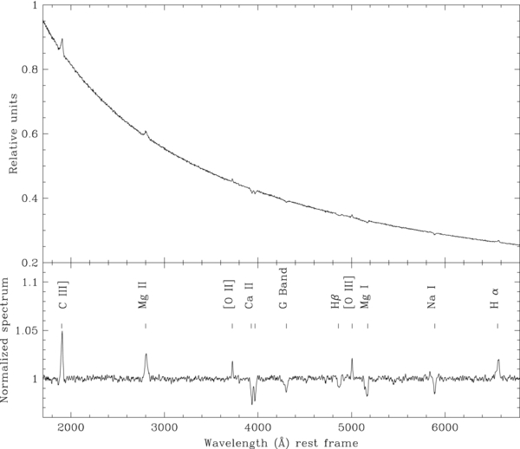

Blazar: BL Lac
Prototype: BL Lacertae (z=0.07)
Broadband spectrum
Mrk 421 (Abdo+ 2011)
Average spectrum
Emission is dominated by the jet.
Synchrotron peak is in X-ray.
TeV target.
Landoni+ 2013
Power-law spectrum.
Hard to find emission lines.
Number density: $∼3×{10}^{−7} Mpc^{−3}$

Slide 32

Blazar: Flat Spectrum Radio Quasar (FSRQ)
3C 279
Luminous than BL Lac.
Synchrotron peak is in optical.
Most of energies are released
in gamma-ray.
External photons from broad
line region or dust torus
contribute to the seed photons
for inverse Compton scattering.
Ackerman+ 2016
Number density: $∼{10}^{−9} Mpc^{−3}$

Slide 33
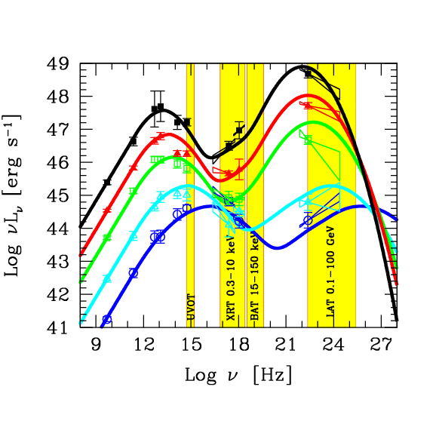
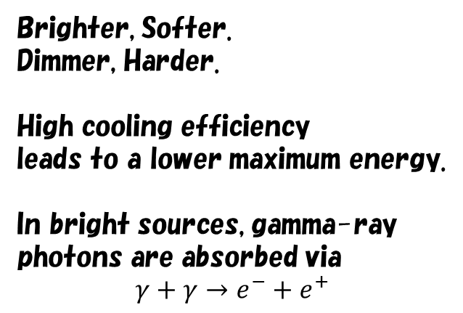
Blazar Sequence
Brighter, Softer.
Dimmer, Harder.
High cooling efficiency
leads to a lower maximum energy.
In bright sources, gamma-ray
photons are absorbed via
$$γ+γ→e^{−}+e^{+}$$
Donato+ 2001, Ghisellini 2015

Slide 34
Background Radiation
Average energy density of radiation in the Universe

Slide 35
Gamma-ray Background
Ajello+ 2015
Inoue & Tanaka 2016
The gamma-ray sky is dominated by blazars.

Slide 36
Constraint on DM signal
Possible gamma-ray signal
from pair annihilated dark matters.
This depends on the sub-halo
structure
Ajello+ 2015

Slide 37
Relativistic Jet
Most Enigmatic Phenomena in the Universe

Slide 38
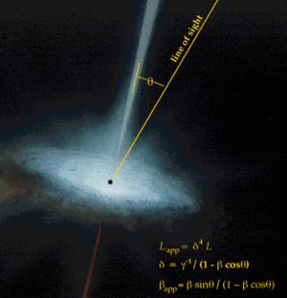
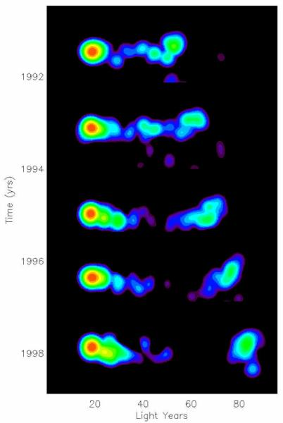









Superluminal Motion
Blazar 3C 279@z=0.536
22GHz by VLBA
$$β_{obs}$$
$$β=0.997, Γ≃13$$
$$θ\left[degree\right]$$
$$t_{arrival}=δt+\frac{D−vδtcosθ}{c}$$
$$vδt$$
$$vδtsinθ$$
$$θ$$
$$vδtcosθ$$
$$t_{arrival}=\frac{D}{c}$$
$$δt_{obs}=δt(1−βcosθ)$$
～7.5c
$$β_{obs}=\frac{βsinθ}{1−βcosθ}$$

Slide 39
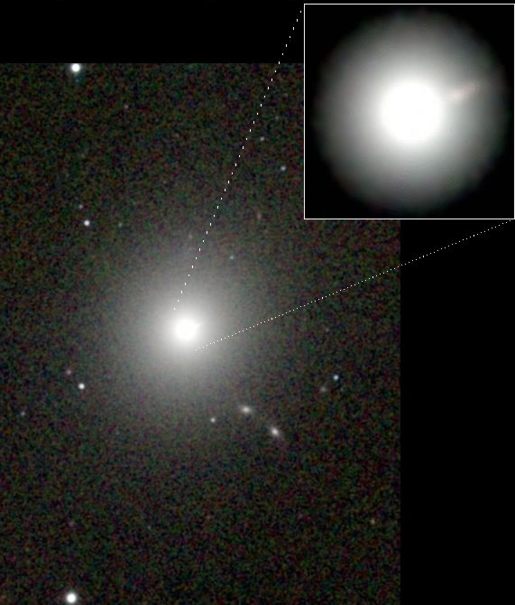
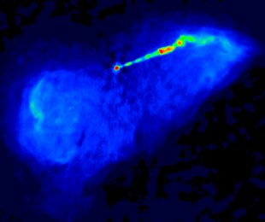

M87
FR I radio galaxy (elliptical)
Distance 16.7Mpc (Virgo cluster),
Black hole mass $∼7×{10}^{9}M_{⊙}$
Optical Image

Slide 40

Proper motion in M87
Asada+ 2014 (18 cm)
Viewing angle ${14}^{ο}$
Gradual acceleration?

Slide 41
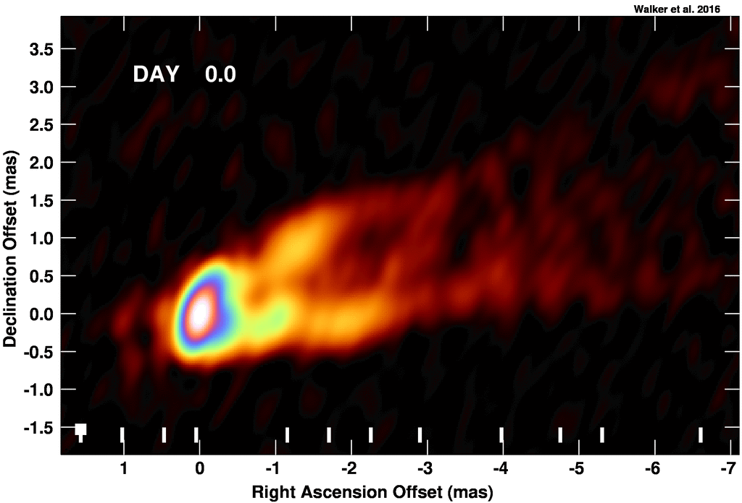
Spine-Sheath Structure?
Walker+ 2016
Hawley & Krolik 2006

Slide 42


Limb brightening
Beamed Photon
(Invisible)
Loosely Beamed
(visible)
High $Γ$
Low $Γ$
Asada+ 2016

Slide 43
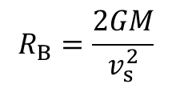

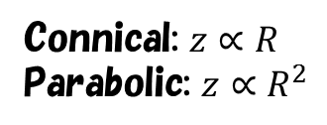





Collimation
Free expansion?
$$R$$
$$R$$
$$z∝R$$
confinement
by external gas?
$$z∝R^{1.7}$$
$$z$$
$$z$$
Connical: $z∝R$
Parabolic: $z∝R^{2}$
Asada+ 2012
Bondi radius: at which escape velocity=sound velocity.
$$R_{B}=\frac{2GM}{v_{s}^{2}}$$

Slide 44
Accretion Disk
Energy Source of Jet?

Slide 45

Physics in Accretion Disk
Gas rotates with nearly Keplerian motion.
  Inner gas faster
  Velocity Shear in radial direction.
Viscosity transports angular momentum.
  Magnetic Field acts as viscosity.
Gas gradually falls inward.
Gravitational energy converts to heat via viscosity.
Photon emission from hot gas.

Slide 46


Formulation
Continuity Equation (Mass conservation)
$$\frac{∂ρ}{∂t}+∇⋅(ρv)=0$$
Motion Equation (Momentum conservation)
$$ρ\frac{∂v}{∂t}+ρ\left(v⋅∇\right)v=−∇P−ρ∇Φ+μΔv+(ξ+μ/3)∇(∇⋅v)$$
Pressure
Gravity
Viscosity
Energy conservation
Gravity
$$\frac{∂}{∂t}\left(\frac{1}{2}ρv^{2}+ε\right)=−∇⋅\left[v\left(\frac{1}{2}ρv^{2}+ε+P\right)−v⋅τ\right]−ρv⋅∇Φ−Λ$$
Viscous heating
Radiative cooling
Viscosity Tensor
$$τ_{ij}=μ\left(\frac{∂v_{i}}{∂x_{j}}+\frac{∂v_{j}}{∂x_{i}}−\frac{2}{3}δ_{ij}∇⋅v\right)+ξδ_{ij}∇⋅v$$

Slide 47












Viscosity (Phenomenological)
Cylindrical Coordinate $(R,θ,z)$
$$q_{vis}≡τ_{ij}\frac{∂v_{i}}{∂x_{j}}=μ{\left(R\frac{dΩ}{dR}\right)}^{2}$$
$$\hat{R}$$
Kepler rotation $Ω=\sqrt{\frac{GM}{R^{3}}}$
$$R$$
$q_{vis}=\frac{9}{4}μΩ^{2}=\frac{9}{4}νρΩ^{2}$ ($ν≡μ/ρ$)
We define viscous torque as $T_{vis}=μR\frac{dΩ}{dR}$, then
$$μΔv=\frac{1}{R^{2}}\frac{∂R^{2}T_{vis}}{dR}$$
Alpha-viscosity model: $T_{vis}=−αP$
Non-dimensional parameter $α$
$$H$$
$$αH$$
Vortex exchanges the angular momentum.

Slide 48







Magnetorotational instability
Origin of viscosity (Balbus & Hawley 1991)
Simulation
Magnetic Field
tension
Typical wave length: $H\frac{v_{A}}{v_{s}}$
Effective viscosity
$$α∼0.01−0.1$$
Alfven velocity $v_{A}=\frac{B}{\sqrt{4πρ}}$
Typical growing timescale: $Ω^{−1}$
may grow as $δB^{2}∼P$

Slide 49





Continuity Equation
Steady and axially symmetric
$$\frac{∂ρv_{z}}{∂z}=−\frac{1}{R}\frac{∂Rρv_{R}}{dR}$$
Integrating over z. $\int{dz}$
$$\dot{M}=−2πRv_{R}Σ=const.$$
Note $v_{R}<0$
where the surface density $Σ=\int{ρdz}$
Just expressing that mass inflow rate is constant.

Slide 50







Momentum Equation ($R,θ$)
Steady and axially symmetric
$$Ω=\sqrt{\frac{GM}{R^{3}}}$$
$R$-component:
Kepler rotation, balance between centrifugal and gravitational forces.
$θ$-component:
$$\frac{∂}{∂R}\left(R^{3}ρv_{R}Ω\right)=\frac{∂}{∂R}\left(R^{3}νρ\frac{dΩ}{dR}\right)$$
Integrating over z with the continuity eq. and finally integrating over R.
$$νΣ=\frac{\dot{M}}{3π}\left(1−\sqrt{\frac{R_{in}}{R}}\right)$$
Disk
$$R$$
$$R_{in}$$

Slide 51






Momentum Equation ($z$)
Steady and axially symmetric
$z$-component:
Neglecting the ram pressure,
$$−\frac{∂P}{∂z}=ρ\frac{∂Φ}{∂z}$$
$$ρ\frac{∂Φ}{∂z}=ρ\frac{GM}{R^{2}}\frac{z}{\sqrt{R^{2}+z^{2}}}≃ρ\frac{GM}{R^{3}}z=ρΩ^{2}z$$
$$−\frac{∂P}{∂z}≃\frac{P}{H}$$
Finally, the sound speed is expressed with the disk height as
$$\frac{P}{ρ}≡v_{s}^{2}=Ω^{2}H^{2}$$
or
$$\frac{2PH}{Σ}≃Ω^{2}H^{2}$$

Slide 52





Energy Equation
Steady and axially symmetric
Integrating over z,
$$Q_{adv}=Q_{vis}−Q_{rad}$$
Advection of heat=Viscous Heating – Radiative Cooling
$$Q_{vis}≡\int{q_{vis}dz=\frac{9}{4}νΣΩ^{2}}$$
$$Q_{rad}≡\int{Λdz}$$
When the disk is optically thick, the thermal radiation is
expressed with the effective temperature as
$Q_{rad}=σ_{SB}T_{eff}^{4}$ where the Stefan–Boltzmann constant $σ_{SB}=\frac{π^{2}}{60ℏ^{3}c^{2}}$
$$Q_{adv}≡\int{\left(∇⋅\left[v\left(\frac{1}{2}ρv^{2}+ε+P\right)\right]+ρv⋅∇Φ\right)dz}$$
Very rough estimate:
$$Q_{adv}∼\frac{\dot{M}}{πR^{2}}\frac{PH}{Σ}$$

Slide 53













Summary
Continuity:
$$\dot{M}=−2πRv_{R}Σ$$
$$Ω=\sqrt{\frac{GM}{R^{3}}}$$
Parameters: $M, \dot{M}, R_{in}, α$
Variables: $Σ, Ω, P, v_{R}, H, ν$
$R$-component:
Equation of State
$$νΣ=\frac{\dot{M}}{3π}\left(1−\sqrt{\frac{R_{in}}{R}}\right)$$
$θ$-component:
$T_{eff}$, or $Q_{rad}$
depending on optical depth
and temperature.
$z$-component:
$$\frac{2PH}{Σ}≡v_{s}^{2}=Ω^{2}H^{2}$$
Energy (entropy):
$$Q_{adv}=Q_{vis}−Q_{rad}$$
$$Q_{adv}∼\frac{\dot{M}}{πR^{2}}\frac{PH}{Σ}$$
$$Q_{vis}=\frac{9}{4}νΣΩ^{2}$$
Alpha-viscosity model: $αPH=\frac{3}{2}νΣΩ$

Slide 54





Shakura-Sunyaev Standard Disk
The disk is optically thick and hot enough.
$$Q_{vis}−Q_{rad}≃0→$$
$$Q_{rad}=σ_{SB}T_{eff}^{4}=Q_{vis}=\frac{9}{4}νΣΩ^{2}$$
Effective temperature
$$T_{eff}={\left[\frac{3GM\dot{M}}{8πσ_{SB}R^{3}}\left(1−\sqrt{\frac{R_{in}}{R}}\right)\right]}^{1/4}$$
$$≃20{\left(\frac{M}{{10}^{8}M_{⊙}}\right)}^{−\frac{1}{2}}{\left(\frac{\dot{M}}{M_{⊙} yr^{−1}}\right)}^{\frac{1}{4}}{\left(\frac{R}{3r_{g}}\right)}^{−\frac{3}{4}}{\left(1−\sqrt{\frac{R_{in}}{R}}\right)}^{\frac{1}{4}} eV$$
not depends on $α$
Luminosity
$$L_{disk}=4π\int{RdRσ_{SB}T_{eff}^{4}}=\frac{GM\dot{M}}{2R_{in}}≃4.7×{10}^{45}\left(\frac{\dot{M}}{M_{⊙} yr^{−1}}\right){\left(\frac{R_{in}}{3r_{g}}\right)}^{−1}erg s^{−1}$$
$$=0.38{\left(\frac{M}{{10}^{8}M_{⊙}}\right)}^{−1}\left(\frac{\dot{M}}{M_{⊙} yr^{−1}}\right){\left(\frac{R_{in}}{3r_{g}}\right)}^{−1}L_{E}=0.083{\left(\frac{R_{in}}{3r_{g}}\right)}^{−1}\dot{M}c^{2}$$

Slide 55





Inner-most Stable Circular Orbit (ISCO)
Kerr parameter: $0≤a<1$
Effective Potential (Newtonian)
Effective Potential (GR)
Decreasing angular momentum of particle
$$r_{in}^{2}−3r_{g}r_{in}∓4ar_{g}\sqrt{\frac{r_{g}r_{in}}{2}}−\frac{3}{4}a^{2}r_{g}^{2}=0$$
$${a=0: r}_{in}=3r_{g}$$
$$a→1:{ r}_{in}=\frac{r_{g}}{2}$$

Slide 56



Advection Dominated Accretion Flow (ADAF)
$$Q_{adv}=Q_{vis}−Q_{rad}$$
Case 1: Too low density, optically thin, emissivity low
Bremsstrahlung
If we neglect the cooling,
$$T\left(3r_{g}\right)∼\frac{GMm_{p}}{3r_{g}}≃160MeV$$
Hot, dim disk
Case 2: Too high density, optically thick, photon escape time $≫$ advection time.
Super Eddington $\dot{M}c^{2}≫L_{E}$
Emission
Accretion
Bright soft disk
Radiation pressure domitates
Super massive black holes at very high z may have grown like this.

Slide 57


Jet from accretion disk?
The accretion disk has been considered as the engine of the jets.
Blandford & Payne (1982)
Simulation: Ohsuga & Mineshige (2011)
Magnetic and Radiative Forces produce
disk wind, whose velocity is typically
$0.1−0.3c$

Slide 58
Blandford-Znajek
Process
Energy Extraction from Black Hole

Slide 59




Rotating Black Hole
Angular momentum of black hole
This rotation energy can be
used as the jet energy?
The maximum value $a=1$
Mass of black hole
naked mass
Rotation energy
For $a=1$
$$\frac{ΔM}{M_{BH}}=\frac{\sqrt{2}−1}{\sqrt{2}}∼0.3$$

Slide 60






Flat Space Time
Spherical Coordinate: $x^{μ}=\left(x^{0},x^{1},x^{2},x^{3}\right)=(ct,r,θ,φ)$
$$g_{μν}=\left(\begin{matrix}1 & 0 & 0 & 0 \\ 0 & −1 & 0 & 0 \\ 0 & 0 & −r^{2} & 0 \\ 0 & 0 & 0 & −r^{2}\sin^{2}{θ}\end{matrix}\right)$$
Flat Space Time
Line element
$$ds^{2}=g_{μν}dx^{μ}dx^{ν}=g_{00}{\left(dx^{0}\right)}^{2}+g_{11}{\left(dx^{1}\right)}^{2}+g_{22}{\left(dx^{2}\right)}^{2}+g_{33}{\left(dx^{3}\right)}^{2}$$
$$=c^{2}dt^{2}−dr^{2}−r^{2}dθ^{2}−r^{2}\sin^{2}{θdφ^{2}}>0$$
Momentum of particle
$$p^{μ}=mc\frac{dx^{μ}}{ds}$$
$$p^{μ}p_{μ}=g_{μν}p^{μ}p^{ν}=m^{2}c^{2}$$
(Contravariant)
Action of particle $S→p_{μ}=−\frac{∂S}{∂x^{μ}}$
(Covariant 4-vector)
zero-component: $p_{0}=g_{0μ}p^{μ}=−\frac{∂S}{c∂t}=H$ Hamiltonian,
constant for test particle
$$p^{0}=mc\frac{cdt}{ds}=mc\frac{cdt}{cdt\sqrt{1−{\left(\frac{v}{c}\right)}^{2}}}=γmc, p_{0}=g_{00}p^{0}=γmc$$

Slide 61







Kerr Space Time
$$g_{03}$$
$$ds^{2}=g_{00}{\left(cdt\right)}^{2}−dl^{2}$$
$a→0:$ Schwarzschild BH. In this case,
$$p^{0}=mc\frac{cdt}{ds}=mc\frac{cdt}{cdt\sqrt{g_{00}−{\left(\frac{dl}{cdt}\right)}^{2}}}=\frac{mc}{\sqrt{g_{00}}\sqrt{1−{\left(\frac{v}{c}\right)}^{2}}}$$
$$v≡\frac{dl}{dτ}=\frac{dl}{\sqrt{g_{00}}dt}$$
Non-rela
zero-component: ${cp}_{0}≃cg_{00}p^{0}=mc^{2}\frac{\sqrt{g_{00}}}{\sqrt{1−{\left(\frac{v}{c}\right)}^{2}}}≃mc^{2}+\frac{1}{2}mv^{2}−\frac{GMm}{r}$
Energy conservation in Newton physics.
$$a≠0→cp_{0}=cg_{00}p^{0}+cg_{03}p^{3}$$
$g_{00}$ and $p^{3}$ can be negative, so the energy ${cp}_{0}$ can be negative.

Slide 62








Ergosphere
defined by $g_{00}=0$
Here, $g_{00}<0$,
the energy $cp_{0}$ can be negative.
$$ε_{2}<0$$
decay
defined by $g_{11}=∞$
Penrose process
$$ε$$
$ε_{1}=ε−ε_{2}>ε$ energy extraction!
The initial energy of particle outside the ergosphere $ε=cp_{0}>0$.
It penetrate into the ergosphere, keeping $ε$ constant.
It decays into two particles. The energy of one can be negative.
The negative energy particle falls into the BH: energy of BH decreases!
The escaped other particle has energy larger than the initial value.
This process seems ad hoc. But this shows that the ergosphere can be
the place where the BH energy releases.

Slide 63

FIDO
In the ergosphere, $g_{00}<0$. To keep $ds^{2}>0$, $dl^{2}$ should be finite.
So a particle cannot come to rest in the ergosphere ($|v|=\left|\frac{dl}{dτ}\right|>0$).
Fiducial observer (FIDO)：
Lapse function
Four velocity of FIDO
Contravariant
Covariant

Slide 64




Magnetic Energy Release
The frame-dragging effect in the ergosphere.
This will induce twisted magnetic fields.
The induced Poynting flux may propagate outward.
The thickness of the ergosphere
Volume of the ergosphere
Magnetic Energy
$$E_{B}=$$
Timescale
$$Δt=$$
Energy Release Rate: $\frac{E_{B}}{Δt}∼$

Slide 65

Maxwell’s Equations
Electromagnetic tensor and its dual tensor.
Antisymmetric Levi-Civita symbol
Determinant
Magnetic and Electric Fields projected to FIDO
Definition of Spatial Vector Calculation in the Kerr Space Time
$$γ≡−g_{11}g_{22}g_{33}=\frac{ΣA}{Δ}\sin^{2}{θ}$$
Maxwell’s equations in the Kerr Space Time
where
same form as the equations without gravity.

Slide 66




Ideal MHD
In flat space time, the Lorentz toransformations
$$E_{∥}^{′}=E_{∥}, E_{⊥}^{′}=Γ\left(E_{⊥}+\frac{v}{c}×B_{⊥}\right)$$
In the plasma rest frame, $E^{′}=0$
$$→E=−\frac{v}{c}×B$$
$$→c\frac{E×B}{B^{2}}=v_{⊥}$$
In the Kerr space time,
$$c\frac{D×B}{B^{2}}$$
provides the perpendicular velocity of matter
for FIDO.

Slide 67





Steady State and Force-Free
Energy conservation
Energy exchange with matter.
Here, we neglect.
Split Monopole
Energy density
Poynting Flux
$→B^{1}\sqrt{γ}$ is constant along B.
Ideal MHD, $E⊥B$. Here, we can write
$→Ω$ is constant along B.
$θ$-component of
$$→$$
is constant along B.

Slide 68



Boundary Condition
Near the horizon,
There, the matter may fall radially with a speed$≃c$.
In the comoving frame $D′=0$ in the ideal MHD.
So, for FIDO,
$$c\frac{D×B}{B^{2}}≃−c$$
Znajek condition
This leads to
near the horizon.
$$c\frac{D×B}{B^{2}}≃c$$
At $r≫r_{g}$, the matter velocity may be close to $c$. Then,
We obtain
Comparing the two equations,
: angular velocity of magnetic field.

Slide 69

Poynting Flux
If we express
Luminosity
Note $a≪1$
We have neglected matter.

Slide 70


GRMHD simulation
Mckinney 05
Funnel
Nakamura+ 2018
Disk(wind)
Stagnation surface
($u^{r}=0$)
Matter density continuously decreases.
To have a steady solution, particle injection
is needed.
The injection rate adjusts the magnetization parameter.
Magnetic energy dominates the jet.

Slide 71
Magnetic Jet Acceleration
Can a jet accelerate to relativistic speed?

Slide 72

Poynting Flux Dominated Jet
$$\frac{B^{2}}{8π}≫ρc^{2}$$
Cutting out a part of
spherical flow.
Conical jet
Assume spherically symmetric.
At a large distance, we can neglect $B_{∥}$, so that $B≃B_{⊥}$
Magnetization parameter:
At the foot of the jet,

Slide 73






Available Lorentz factor
Steady state + ideal MHD $E=−v/c×B$
$→rB∝1/v$, then $L_{B,iso}=v{\left(rB\right)}^{2}∝1/v$
As the jet accelerates, the magnetic luminosity decreases with radius.
Energy transfer from magnetic to kinetic.
But, when
,
$$L_{B,iso}≃L_{max}=c{\left(rB\right)}^{2}$$
because
$${L_{max}−L}_{B,iso}=\left(c−v\right){\left(rB\right)}^{2}≃\frac{L_{B,iso}}{σ}≃L_{K,iso}$$
No room to give energy to matter.
So $Γ_{max}=\sqrt{σ}$
Total luminosity:
Inefficient acceleration.
($Γ_{max}=σ_{0}$ is ideal)

Slide 74










Axially symmetric jet
The jet is confined by the disk wind. It seems parabolic, not conical.
Cylindrical Coordinate $(ct,R,φ,z)$
$$e_{z}$$
$$e_{φ}$$
$$e_{R}$$
$$z$$
$$R$$
$$φ$$
$$\frac{∂}{∂φ}→0$$
Then,
$$∇=\left(\frac{∂}{∂R},0,\frac{∂}{∂z}\right), ∇⋅A=\frac{1}{R}\frac{∂RA_{R}}{∂R}+\frac{∂A_{z}}{∂z}$$
$$∇×A=\left(−\frac{1}{R}\frac{∂RA_{φ}}{∂z},\frac{∂A_{R}}{∂z}−\frac{∂A_{z}}{∂R},\frac{1}{R}\frac{∂RA_{φ}}{∂R}\right)$$
$$ΔA=\frac{1}{R}\frac{∂}{∂R}\left(R\frac{∂A}{∂R}\right)+\frac{∂^{2}A}{∂z^{2}}$$

Slide 75



Vector Potential
Fields are defined by the vector potential.
Magnetic Flux
Poloidal component
This means
$Ψ$ is constant along B
$$E_{φ}∝v_{p}×B_{p}$$
So$v_{p}∥B_{p}$.
Introducing a value$Ω≡c\frac{dA^{0}}{dΨ}$, which is also constant along B,
we can rewrite
Ideal MHD condition provides an identical equation.

Slide 76

MHD equations
Continuity
is constant along B
Energy Conservation
is constant along B
Momentum Conservation
$φ$-component
is constant along B

Slide 77
Radial Evolution
Introducing the Alfven Mach number for poloidal velocity as
where the Alfven velocity
The evolutions along B are expressed as
where
are constant along B
Alfven radius
where
From the definition $Γ^{2}=1/(1−\frac{v_{p}^{2}}{c^{2}}−\frac{v_{φ}^{2}}{c^{2}})$, $B_{p}(x=\frac{R}{R_{L}})$ provides

Slide 78


Final Lorentz factor
At $R≫R_{L},$ namely $x≫1$, the Lorentz factor should be constant.
This implies
same as spherical expansion.
At $x≫1$, if
inefficient
if
efficient
In the acceleration phase,
and the Mach number grows faster than $x$.

Slide 79



Magnetic Line
Simulations show magnetic field
line $z∝R^{1.6}$.
The magnetic field is the tangent
of the field line.
If we express $z∝R^{b}$,
For $b>1$, $B_{z}≫B_{R}$ at a large $R$.

Slide 80


Acceleration feature
Momentum Conservation
Poloidal component:
where the current is written as
(Ampere equation)
Cold ($P=0$) and assume $z≫R$
$$∼$$
If $b>1$, the Mach number grows faster than $x∝R$.
Finally

Slide 81



Radio Observation of M87
Free expansion?
$$R$$
$$z∝R$$
$$b=1.7→Γ∝z^{\frac{b−1}{b}}=z^{0.4}$$
confinement
by external gas?
Viewing angle ${14}^{ο}$
$$z∝R^{1.7}$$
$$Γ∝z^{0.4}$$
$$z$$
Asada+ 2012
Asada+ 2014
Bondi radius: at which escape velocity=sound velocity.
$$R_{B}=\frac{2GM}{v_{s}^{2}}$$
Consistent?

Slide 82

Magnetization in M87
Kino+ 2015
implies
ISCO size
EHT 230GHz obs.
Synchrotron self-absorption
optical depth: $α_{SA}×size$

Slide 83
Magnetic energy dominance in M87
Frequency, optically-thick radius
for Synch. Self-abs., and flux provides
very sensitive function

Slide 84
Magnetic Reconnection
Direct energy release from magnetic field

Slide 85



Magnetic Reconnection
Non-ideal MHD

Slide 86

Petschek Reconnection
Fast reconnection.
Slow shock is essential.
Only around here, the resistivity is finite.

Slide 87




Wave speed in MHD
MHD equations
$$B_{0}$$
$$θ$$
$$k$$
Phase velocity
Alfven wave
Fast/Slow wave
$$V_{s}<V_{A}<V_{f}$$

Slide 88














Energy conversion
Fast wave
Magnetic pressure
Gas pressure
Magnetic $→$ Kinetic/Thermal
Dissipation at shock surface
Slow wave
Slow shock
$$θ$$
$$v_{A}\cos{θ}$$
$$B$$
$$v∼v_{A,up}\sin{θ}$$
$$θ$$
$$v_{A}\sin{θ}$$
$$B_{z,dw}=B_{z,up}$$
$$v_{s,up}\cos{θ}<v<∼v_{A,up}\cos{θ}$$
$$B_{⊥,dw}≪B_{⊥,up}$$
$$z$$

Slide 89











Gradual acceleration due to magnetic reconnection
In ideal MHD and steady outflow,
the induction eq.
Adopting
$$L=Γ\dot{M}c^{2}+c{\left(rB\right)}^{2}≃σ_{0}\dot{M}c^{2}$$
$$\frac{∂B}{∂t}=∇×\left(v×B\right)=0$$
Matter
Magnetic
Initial=const.
$$\frac{dΓ}{∂r}∼2\frac{σ_{0}}{ct_{dis}}$$
For spherically symmetric case,
In the laboratory frame,
$$\frac{∂vrB}{∂r}=0$$
$$∼c$$
$$∼c$$
In non-ideal MHD case,
the magnetic dissipation timescale $t_{dis}$
Scale $l_{B}$
All fluid elements move with $∼c$
So the scale $l_{B}$ is almost constant.
Lorentz contraction:
In the comoving frame, $l_{B}^{′}=Γl_{B}∝Γ$.
$v_{A}^{′}≃c$, so ${t′}_{dis}∼l_{B}^{′}$/$v_{A}^{′}$ $∝Γ$.
$$t_{dis}=Γ{t′}_{dis}∝Γ^{2}$$
$$\frac{∂vrB}{∂r}∼\frac{vrB}{vt_{dis}}$$
For $v≃c=const.$
$$\frac{∂}{∂r}{\left(rB\right)}^{2}∼−2\frac{{\left(rB\right)}^{2}}{ct_{dis}}$$
$$\frac{dΓ}{∂r}∝Γ^{−2}→Γ∝r^{1/3}$$
Close to the case of the parabolic ideal MHD jet.

Slide 90
Blazar Emission Spectrum
From radio to gamma-ray

Slide 91






nuFnu-Plot
Photon Number Flux
$$Φ\left(E\right):Photons eV^{−1} cm^{−2} s^{−1}$$
Photon index $Γ$ is defined as $Φ\left(E\right)∝E^{−Γ}$
Energy Flux
$$F\left(E\right)=EΦ\left(E\right):Photon Energy eV^{−1} cm^{−2} s^{−1}$$
$$F\left(E\right)∝E^{1−Γ}$$
Total energy Flux $\int_{E_{1}}^{E_{2}}{F\left(E\right)dE}∝E_{2}^{2−Γ}−E_{1}^{2−Γ}$
If $Γ>2$, low-energy photons dominate the total energy.
If $Γ<2$, high-energy photons dominate the total energy.
nuFnu-plot
$νF_{ν}=EF\left(E\right)=E^{2}Φ\left(E\right):erg cm^{−2} s^{−1}$ is convenient to see
which energy range dominate.

Slide 92
BL Lac
Broadband spectrum
Abdo+ 2011
Tagliaferri+ 2008
Mrk 421 (z=0.031)
1ES 1959+650
(z=0.047)
TeV gamma-rays: $γ>{10}^{6}$ for electrons, $γ>{10}^{3}$ for protons, $≫Γ$

Slide 93
Mrk 501
Abdo+ 2011
Acciari+ 2011
1997 Outburst
2009
z=0.034

Slide 94

Extremely Hard Blazar
Aharonian+ 2017
$$γ(TeV)+γ(IR)→e^{−}+e^{+}$$
z=0.186

Slide 95
1ES 0229+200
z=0.14
MAGIC data
Preliminary
Detection of valley?

Slide 96
PKS 2155-304
z=0.116
taken 2013
Madejski+ 2016

Slide 97

Gamma-ray Variability in PKS 2155-304
>200 GeV taken 2002
with H.E.S.S.
Shortest $∼200 s$
Aharonian+ 2007

Slide 98
FSRQ
3C 279 (z=0.536)
PKS1510-089 (z=0.36)
2008-2010
taken 2011
Hayashida+ 2012
Nalewajko+ 2012

Slide 99

3C 279 Flare in 2015
$∼{10}^{49}erg s^{−1}$ in isotropic equivalent.
Ackermann+ 2016

Slide 100
Particle Acceleration by Shock Wave
Standard model to produce high-energy particles

Slide 101


Direct Evidence of Shock Acceleration
Supernova Remnant SN1006
Acero+ 2010
a few thousands km/s

Slide 102

Power-law spectrum
Crab Pulsar wind nebula
3×10¹⁵eV
3×10¹⁸eV
Tanaka & Asano 2017
GeV=10⁹eV≒m_{p}c²

Slide 103


Fermi Acceleration
Collisionless Shock
Electromagnetic Field induced by
plasma turbulence.
This scatters charged particles.
Then, the upstream plasma is decelerated,
and heated.

Slide 104




Downstream Rest Frame
Upstream
Downstream
$$θ_{d}$$
$$v$$
$$E_{0}$$
Particle trajectory
Shock Front
In the upstream rest frame,
$$E^{′}=ΓE_{0}(1−β\cos{θ_{d}})$$

Slide 105



Scattering in Upstream
Upstream
Downstream
Particle trajectory
$$E^{′}=const.$$
$$v$$
$${θ′}_{u}$$
Shock Front
In the upstream rest frame,
$$E^{′}=ΓE_{0}(1−β\cos{θ_{d}})$$

Slide 106


Downstream Rest Frame Again
Upstream
Downstream
$$v$$
$$E$$
Particle trajectory
Shock Front
In the downstream rest frame,
$${E=ΓE}^{′}\left(1+β\cos{{θ′}_{u}}\right)$$
$=Γ^{2}E_{0}\left(1+β\cos{{θ′}_{u}}\right)$ $(1−β\cos{θ_{d}})$

Slide 107






Shock Jump Condition
Non-relativistic
Relativistic
Upstream
Downstream
Upstream
Downstream
$$n_{u}, T_{u}, v_{u}$$
$$n_{u}, T_{u},Γ_{u}$$
$$M=\frac{v_{u}}{v_{s}}≫1$$
Shock Front
Shock Front
Particle Number $nv$
Energy $nv\left(\frac{1}{2}v^{2}+\frac{5}{2}\frac{T}{m}\right)$
Momentum $nT+nmv^{2}$
Particle Number $nΓv$
Energy $vΓ^{2}\left(ε+nT\right)$
Momentum $nT+β^{2}Γ^{2}\left(ε+nT\right)$
Internal Energy
$ε≃nmc^{2}$ (cold) or $3nT$ (relativistic)

Slide 108





Shock Jump Condition
Non-relativistic
Relativistic
Upstream
Downstream
Upstream
Downstream
$$n_{u}, T_{u}, v_{u}$$
$$n_{u}, T_{u},Γ_{u}$$
$$\frac{v_{u}}{4}$$
$$\frac{c}{3}$$
Shock Front
Shock Front
Particle Number $n_{d}=4n_{u}$
Velocity $v_{d}=\frac{1}{4}v_{u}$
Temperature $T_{d}=\frac{3}{16}mv_{u}^{2}$
Particle Number $n_{d}=(4Γ+3)n_{u}$
Relative Lorentz factor $Γ≃Γ_{u}/\sqrt{2}$
Energy Density $(Γ−1)n_{d}{mc}^{2}$

Slide 109






Downstream Rest Frame
Non-relativistic
Relativistic
Upstream
Downstream
Upstream
Downstream
$$v$$
$$Γ$$
Particle trajectory
$$\frac{v}{3}$$
$$\frac{c}{3}$$
Shock Front
Shock Front
Relative Velocity
$$v=\frac{3}{4}v_{u}$$
Relative Lorentz factor
$$Γ≃\frac{Γ_{u}}{\sqrt{2}}$$

Slide 110






Downstream Rest Frame
Non-relativistic
Relativistic
Upstream
Downstream
Upstream
Downstream
$$v$$
$$Γ$$
Particle trajectory
$$\frac{v}{3}$$
$$\frac{c}{3}$$
$$\cos{θ_{d}}=0$$
Shock Front
Shock Front
$$\cos{θ_{d}}=−1/3$$
$$\overline{\cos{θ_{d}}}=−2/3$$
$$\overline{\cos{θ_{d}}}=−3/4$$
$$\cos{θ_{d}}=−1$$
$$\cos{θ_{d}}=−1$$
Isotropic Motion in the downstream

Slide 111









Upstream Rest Frame
Non-relativistic
Relativistic
Upstream
Downstream
Upstream
Downstream
$$v$$
$$Γ$$
Particle trajectory
$$\frac{4v}{3}$$
$$\sqrt{2}Γ$$
Shock Front
Shock Front
$$\cos{θ_{d}}=−1/3$$
$$\cos{{θ′}_{u}}=0$$
$$\overline{\cos{{θ′}_{u}}}+1∼Γ^{−2}$$
$$\overline{\cos{{θ′}_{u}}}=2/3$$
$$\cos{{θ′}_{u}}=−1+1/2Γ^{2}$$
$$\cos{{θ′}_{u}}=1$$
Anisotropic in the upstream.
Shock Front is fast.
Isotropic Motion even in the upstream

Slide 112







Energy Gain
$E=Γ^{2}E_{0}\left(1+β\cos{{θ′}_{u}}\right)$ $(1−β\cos{θ_{d}})$
$$ΔE=E−E_{0}$$
Non-relativistic
Relativistic
$$ξ≡\frac{\overline{ΔE}}{E}≃\frac{4v}{3c}$$
$$ξ≡\frac{\overline{ΔE}}{E}∼2$$
Assuming continuous density $n_{CR}$ around the shock front
Upstream
Downstream
Upstream
Downstream
$$v$$
$$Γ$$
$$\frac{v}{3}$$
$$\frac{c}{3}$$
Shock Front
Shock Front

Slide 113






Escape Probability
$E=Γ^{2}E_{0}\left(1+β\cos{{θ′}_{u}}\right)$ $(1−β\cos{θ_{d}})$
$$ΔE=E−E_{0}$$
Non-relativistic
Relativistic
$$ξ≡\frac{\overline{ΔE}}{E}≃\frac{4v}{3c}$$
$$ξ≡ \frac{\overline{ΔE}}{E}∼2$$
$$P_{esc}≃\frac{4v}{3c}$$
$$P_{esc}≃\frac{3}{4}$$
Probability repeating the process n times: ${\left(1−P_{esc}\right)}^{n}$
Energy after n processes: ${E=E}_{0}{\left(1+ξ\right)}^{n}$
Then, $n\left(E\right)∝E^{−1−\check{γ}}$, where $\check{γ}≡\frac{\log{{\left(1−P_{esc}\right)}^{−1}}}{\log{(1+ξ)}}$
$$\check{γ}≃1$$
$$\check{γ}∼1.3$$
Simulation

Slide 114


Simulations
Unmagnetized pair plasma
$$Γ=15$$
Sironi+ 2013

Slide 115
Relativistic Effects on Emission
Spectrum, luminosity and variability

Slide 116














Lorentz transformation
Emitter
$$ε=Γ(ε^{′}+β\cos{θ′)}$$
$$R$$
When photons are isotropic in this frame,
$$\overline{ε}=Γ\overline{ε^{′}}$$
Energy Density $U=Γ^{2}U′$
Size $R/Γ$
$$μ≡\cos{θ}$$
$$μ=\frac{μ^{′}+β}{1+βμ′}$$
Emitter rest frame
Photon energy $ε′$
$μ^{′}=0 \left(θ^{′}=\frac{π}{2}\right)$ corresponds to
$$θ′$$
$$μ=β→θ^{2}≃{1/Γ}^{2}$$
$$θ≃1/Γ$$
Size $R$
$$dt^{′}=\frac{dt}{Γ}$$
Beamed Emission

Slide 117













Luminosity
$$(c−v)Δt$$
Rest frame
$$vΔt$$
$$cΔt$$
$$t=0$$
$$t=Δt=ΓΔt′$$
$$Δt_{obs}=\frac{c−v}{c}Δt≃\frac{Δt}{2Γ^{2}}=\frac{Δt′}{2Γ}$$
$$E=ΓE′$$
$$θ≃1/Γ$$
Energy release $E′$ during $Δt′$
Luminosity
Beamed Emission
$$dΩ=dΩ^{′}/Γ^{2}$$
$$\frac{dL_{obs}}{dΩ}=\frac{E}{dΩΔt_{obs}}≃Γ^{4}\frac{dL′}{dΩ′}$$
$$\frac{dL′}{dΩ′}=\frac{E′}{4πΔt′}$$
Isotropic $→$

Slide 118





Variability: Curvature
$$R≃cΔt$$
Simultaneous emission
$$δt≃Δt_{obs}$$
$$1/Γ$$
So even if the shell
keeps emitting during
$R=0$ to $R$, the observed
timescale becomes$δt$.
Observer
Variability Time scale
If the shell width $W$ is thicker than $R/Γ^{2}$, the timescale becomes longer as $W/c$.

Slide 119








Implied size of emission region
PKS2155-304
The Schwarzschild radius
is $3×{10}^{14} cm$ for $M={10}^{9}M_{⊙}$.
How to produce such a thin
shell from a big black hole?
Conical Jet
$$θ_{j}≃1/Γ$$
$$R/Γ$$
Shortest $∼200 s$
$$R$$
$$R∼2Γ^{2}cδt≃{10}^{16}{\left(\frac{Γ}{30}\right)}^{2} cm$$
If the emission region is spherical
in the rest frame, $W^{′}∼R/Γ$,
$$W∼\frac{R}{Γ^{2}}∼c δt$$
seems OK.
But, the width of the emission region
should be thinner than
$cδt=6×{10}^{12}cm$.

Slide 120




Spectrum
$$ν′{F′}_{ν′}$$
$$νF_{ν}$$
$$Γ^{4}$$
$$Γ$$
$$ε′, ε$$

Slide 121







Off-axis
$$δ∼Γ$$
Doppler factor
$$δ≡\frac{1}{Γ(1−β\cos{θ})}$$
$$δ∼1/Γ$$
$$\frac{dL_{obs}}{dΩ}≃δ^{4}\frac{dL′}{dΩ′}$$
$$Δt_{obs}≃\frac{Δt′}{δ}$$

Slide 122
Leptonic Model
Synchrotron Self-Compton

Slide 123

Synchrotron

Slide 124





Emissivity
Energy release rate (dipole emission)
$$a_{⊥}=\frac{c^{2}}{R_{L}}→\frac{dE}{dt}=\frac{2e^{2}}{3c^{3}}γ^{4}{\left(\frac{eB}{γm}\right)}^{2}=\frac{2e^{4}B^{2}}{3m^{2}c^{3}}γ^{2}$$
Taking into account pitch angle, assuming isotropic velocity distribution,
$$\frac{dE}{dt}=\frac{4}{3}cσ_{T}U_{B}γ^{2}$$
Emissivity
$$\frac{dE}{dtdεdΩ}$$
$$\frac{1}{{4πε}_{typ}}\frac{dE}{dt}$$
$$ε_{typ}=ℏω_{typ}$$

Slide 125










Electron Energy Distribution
$$\frac{dN(ε)}{dt}=\frac{∂N(E)}{∂t}+\frac{∂}{∂E}\left(\frac{dE}{dt}N(E)\right)$$
$$E=γmc^{2}$$
Injection $∝E^{−p}$
Cooling (negative)$∝−E^{2}$
If the two terms balance, $N\left(E\right)∝E^{−(p+1)}$
Dynamical time scale $t_{dyn}=\frac{R}{c}$, Cooling time scale $t_{c}=\frac{E}{\dot{E}}=\frac{3mc^{2}}{4cσ_{T}U_{B}γ}$
Cooling break, where $t_{dyn}=t_{c}$
$$γ^{−p}$$
$$γ_{c}=\frac{3mc^{2}}{4cσ_{T}U_{B}t_{dyn}}$$
$$γ^{−(p+1)}$$
$$γ_{c}$$

Slide 126



Synchrotron spectrum from power-law electrons
$$L\left(ε\right)=\int{dEN(E)\frac{dE}{dtdε}}$$
$$L(ε)$$

Slide 127













Inverse Compton
electron
photon
Back to the laboratory frame
$$ε_{0}$$
$${ε∼γε^{′}∼γ^{2}ε}_{0}$$
$$E=γmc^{2}$$
$$ε_{0}$$
In the electron rest frame
$$\frac{dE}{dt}=\frac{4}{3}cσ_{T}U_{γ}γ^{2}$$
$$ε_{0}^{′}∼γε_{0}$$
Emissivity
$$\frac{dE}{dtdεdΩ}$$
Seed photon energy density.
The same form as synchrotron.
If $ε_{0}^{′}≪mc^{2}$, a scattering leads to
$$ε^{′}∼ε_{0}^{′}$$
$$\frac{1}{{4πε}_{typ}}\frac{dE}{dt}$$
$$ε_{0}^{′}$$
(If $ε_{0}^{′}>mc^{2}$, the emission efficiency decreases
and relation $ε_{typ}=γ^{2}ε_{0}$ breaks: Klein-Nishina effect)
$$ε_{typ}=γ^{2}ε_{0}$$

Slide 128

















Synchrotron Self Compton
Synchrotron emission.
$$νL_{ν}$$
$$νL_{ν}$$
$$L_{syn}$$
$$L_{syn}$$
$$ε^{\left(3−p\right)/2}$$
$$ε^{\left(2−p\right)/2}$$
$${\frac{U_{γ}}{U_{B}}L}_{syn}$$
$$ε^{\left(3−p\right)/2}$$
$$ε^{\left(2−p\right)/2}$$
$$ε_{typ}(γ_{min})$$
$$ε_{typ}(γ_{c})$$
$$ε_{typ}(γ_{max})$$
$$ε_{typ}(γ_{c})$$
$${γ_{c}^{2}ε}_{typ}(γ_{c})$$
Size $R→$ Photon escape time $R/c$
Synchrotron photon energy density
$${U_{γ}∼\frac{R}{c}L}_{syn}\frac{3}{4πR^{3}}∝R^{−2}$$
Small size$→$High efficiency

Slide 129








Parameter adjusting
$$Γ$$
$$L_{syn}∝B^{2}N\left(γ\right)γ^{2}Γ^{4}$$
$$∝{L_{syn}R}^{−2}N\left(γ\right)γ^{2}$$
SSA
$$γ+γ→e^{−}+e^{+}$$
$$γ^{2}$$
$$∝B^{2}Γγ^{2}$$
depends on $R$
$$γ+γ→e^{−}+e^{+}$$

Slide 130


Steady one zone model
Escape (escape time$=κR/c$)
Steady state
Inoue & Takahara 1996
(Mrk 421)
$$R$$
Electron Injection

Slide 131
Phenomenological model
Abdo+ 2011
Double broken power-law model with low energy cutoff.
Note: magnetic energy is subdominant.

Slide 132
External Compton (FSRQ)
Optical Luminosity vs. size of broad line region,
or dust torus.
Gandhi+ 2015

Slide 133

3C 279
Hayashida+ 2012

Slide 134
Two zone model; PKS 1510-089
Nalewajko+ 2012

Slide 135
3C 279 Flare

Slide 136

Steady 1D model
Asano+ 2014
Initial radius: $R_{0}=9.3×{10}^{16}$cm=0.03pc
Broken Power-law electrons are injected from $R=R_{0}$ to $2R_{0}$
Magnetic Field $B^{′}=B_{0}{\left(\frac{R}{R_{0}}\right)}^{−1}$ with $B_{0}=0.06 G$
Preliminary

Slide 137
Hadronic Model
Proton synchrotron and/or pion production

Slide 138




Proton acceleration
Shock acceleration: downstream rest frame
$$E=−\frac{v}{c}×B$$
$$v$$
Low-energy particle
High-energy particle
Down stream
Energy gain $∝\left|E\right|R_{L}∝B^{0}γ$
Acceleration time scale $∝R_{L}/c∝B^{−1}γm$
Given the particle energy,
acceleration time scales for electrons and protons are the same.

Slide 139




Emission from Protons
Proton synchrotron
$$ε_{typ}∝\frac{γ^{2}B}{m}∝\frac{E^{2}B}{m^{3}}$$
$$\frac{dE}{dt}∝\frac{B^{2}}{m^{2}}γ^{2}∝\frac{B^{2}}{m^{4}}E^{2}$$
$∼$20% of energy goes to pions.
If the target photons are X-ray,
$$γ⋅\left(1keV\right)>300 MeV$$
$$→E>3×{10}^{5}mc^{2}∼300TeV$$
Secondary photons: $0.2×\frac{300TeV}{2}$
$$∼30TeV$$
Photon energy in proton rest frame

Slide 140

Mrk 421
Mrk 421
Electron maximum energy,
where acc. time=cooling time.
Blue：muon synchro
Red：Proton synchro
Cooling time for $γ_{e,max}$=7.7s, while
$\frac{R_{L}}{c}≃4.5×{10}^{−5}$s.
If the acceleration time of protons for the same energy is also 7.7ｓ, the acceleration time for $γ_{p,max}$ is
$8×{10}^{8}$s, while $\frac{R}{c}≃1.3×{10}^{4}$s.
Fast cooling: Electron synchrotron becomes soft.
Low energy cutoff is required in Electron spectrum.
Magnetically dominated jet

Slide 141


Steady 1D model
Asano+ 2014
1ES 0229+200
Initial radius: $R_{0}=9.3×{10}^{16}$cm=0.03pc
Power-law electrons are injected from $R=R_{0}$ to $2R_{0}$
Power-law Protons are injected at $R=R_{0}$
Magnetic Field $B^{′}=B_{0}{\left(\frac{R}{R_{0}}\right)}^{−1}$ with $B_{0}=30 G$
For Electrons, $γ_{min}=2×{10}^{4}$, $γ_{max}={5×10}^{6}$, and index $p=2.0.$
For Protons, $γ_{min}=3.4$, $γ_{max}={3.4×10}^{10}$, and index $p=2.0.$
Magnetic Luminosity: $θ_{j}=\frac{1}{Γ}→5.8×{10}^{46} erg s^{−1}∼$5 times Eddington.
Preliminary

Slide 142
Implication from Spectral Modeling
Magnetization, jet acceleration, cosmic-ray
and neutrinos

Slide 143

Leptonic Model
This reproduces spectra well!
Low magnetization $\left(U_{B}≪U_{e}\right)$
is suggested.
seems unfavorable for the
magnetically driven jet launching,
and SSA obs. in M87.

Slide 144

How to accelerate jet?
The model for 3C 279 is consistent with
$Γ=15, R=0.02pc$ (distance of the emission region from the BH.)
The BH mass $3×{10}^{8}M_{⊙}$ implies $3r_{g}∼8.6×{10}^{−5}pc$.
The parabolic magnetic acceleration model,
$$Γ∼{\left(\frac{R}{3r_{g}}\right)}^{0.4}≃8.8<15$$
The magnetic acceleration is too slow.

Slide 145


Electron spectral index
For cooling break,
$$p_{2}−p_{1}=1$$
In some cases, a hard electron spectrum $(p<2)$ is required.
The spectral break seems inconsistent with the cooling break.

Slide 146


Maximum electron energy
Larmor radius for $γ_{max}$,
$$4×{10}^{12}cm≪R$$
Cooling timescale for $γ_{max}$,
$$5000 s>\frac{R_{L}}{c}∼100 s$$
Cooling timescale for $γ_{brk2}$,
$${10}^{6} s≫\frac{R_{L}}{c}∼0.6 s$$
In more optimistic model,
the maximum energy is determined by the size=Larmor radius.
But, the maximum energy is greatly
suppressed.
(Pulsar wind nebulae and supernova remnants seems consistent with the optimistic model.)

Slide 147

Hadronic Model
In the spectral modeling,
unnatural assumptions are needed.
Hard to say fitting results great…
High magnetization $\left(U_{B}≫U_{e}\right)$ is suggested.
The jet power tends to be huge.
In 1ES 0229+200,
Leptonic: $L_{jet}>{10}^{44}erg s^{−1}$
Hadronic: $L_{jet}>{6×10}^{46}erg s^{−1}$,
larger than Eddington Luminosity.
seems favorable for the
magnetically driven jet launching,
and SSA obs. in M87.

Slide 148







Shock dissipation in relativistic shock.
When the magnetic energy is much higher than the matter energy,
the Alfven speed is almost $c.$
So that the shock dissipation is not efficient.
$$σ=\frac{Magnetic Energy}{Matter Energy}≫1$$
The jump condition with the magnetic pressure gives the downstream speed as
$$Γ_{u}≫1$$
$$Γ_{d}∼\sqrt{σ}≫1$$
Insufficient deceleration
$→$ weak dissipation.
If $σ≪1, v_{d}=c/3$
The small Larmor radius in high B also implies difficulty for particle return
to the upstream. Shock acceleration may be not efficient.
Plasma skin depth $\frac{c}{\sqrt{\frac{4πne^{2}}{m}}}≫R_{L}$

Slide 149
Neutrinos from a blazar(?)
This may be consistent
with the hadronic model.

Slide 150
AGN-neutrinos correlation search
ICRC 2017
If most of gamma-rays from blazars is due to hadronic,
neutrino signals may be clustered around nearby bright blazars.
But, we do not find a clustering so far.

Slide 151

Ultra high-energy cosmic ray (UHECR)
The hadronic model supports the hypothesis that blazars are source of ultra high-energy cosmic rays.
Hillas diagram

Slide 152
AGN-UHECR correlation search
M82
If most of UHECRs are originated from blazars,
UHECR arrival signals may be clustered around nearby bright blazars.
Weak clustering around Cen A(very nearby!).

Slide 153
Alternative Models
Magnetic reconnection and turbulence

Slide 154


Two component jet
Spine & sheath
Tavecchio & Ghisellini 2008

Slide 155

Reconnection
Sironi & Spitkovsky 2014
A harder spectrum $p<2$ is possible.

Slide 156
Equipartition
Sironi+ 2015
The electron energy and magnetic energy are comparable.
Not favorable for the leptonic model.

Slide 157
Excitation of Turbulence
Rayleigh-Taylor
(Toma+ 2017)
Kelvin-Helmholtz
(Beckwith+ 2011)
Kink
(Bromberg & Tchekhovskoy)
2016

Slide 158

Turbulence
Reconfinement induced.
Star-jet interaction
Gourgouliatos & Komissarov 2018
Perucho+ 2017

Slide 159
Scattering by turbulence
Non-relativistic＋isotropic scattering
Energy diffusion coefficient
In general, the collision timescale$t_{coll}$ depends on energy.

Slide 160


Stochastic acceleration by turbulence
$$p_{y}$$
$$p+dp$$
$$p$$
$$p_{x}$$
$$p_{z}$$
Energy=const.
Outer: larger volume $→$ Higher acceleration
$$\frac{∂N_{e}(ε,t)}{∂t}=\frac{∂}{∂E}\left[D_{EE}\frac{∂N_{e}\left(E,t\right)}{∂E}\right]−\frac{∂}{∂E}\left[\left(\frac{2D_{EE}}{E}−\left\langle {\dot{E}}_{cool}\right\rangle \right)N_{e}\left(E,t\right)\right]+{\dot{N}}_{e,inj}(E,t)$$
Diffusion
Acceleration
Cooling
Injection

Slide 161
Mrk421+Hard Sphere
Asano & Hayashida 2018
$$Γ=15, B_{0}=0.16G, W^{′}=\frac{R_{0}}{Γ}={10}^{16}cm, ΔT_{inj}^{′}=\frac{W^{′}}{c}, K=3.7×{10}^{−6}s^{−1}, \dot{N}=9.8×{10}^{46}s^{−1}$$
See also Asano+ 2014
Kakuwa+ 2015
$t_{coll}∝E^{0}$, $D_{EE}{=KE}^{2}$
Hard, and curved spectrum.

Slide 162

End

