Slide 1
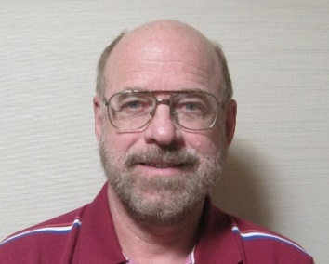
Heliospheric Remote Sensing Using IPS and Spacecraft Imagery
Bernard V. Jackson,
P. Paul Hick, Andy Buffington
Center for Astrophysics and Space Sciences,
University of California at San Diego, LaJolla, CA, USA
http://ips.ucsd.edu/ https://ashi.ucsd.edu/
Masayoshi

Slide 2
Introduction:
Highlights in the History of Interplanetary Scintillation (IPS) to View the Heliosphere
IPS and Thomson-Scattering Provides a Way Forward to Provide Global Heliospheric Modeling using Computer Assisted Tomography
The Use 3-D MHD Modeling Provides More Physics:
solar wind heating, heliospheric non-radial flow, shock processes
Recent Advances Using Solar Mass Ejection Imager (SMEI) and STEREO HI Instrumentation to Provide Higher-Resolution Tomography
5) Future Plans for a Heliospheric Imager
Notes:
My talk will proceed this way

Slide 3
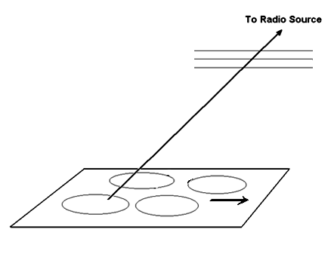
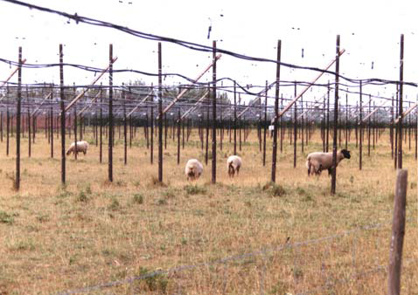
Interplanetary Scintillation (IPS) – What’s That?
IPS line-of-sight response
Cambridge England (Mullard) IPS array
Radio source time series

Slide 4
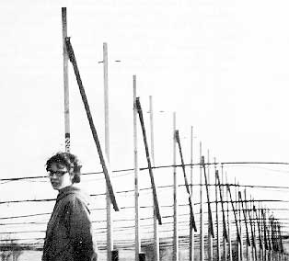
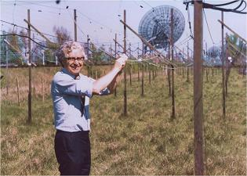
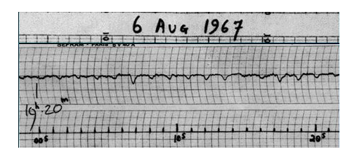
Interplanetary Scintillation (IPS) – What’s That?
“Scruff”
- LGMs
Student Joscelyn Bell
Anthony Hewish / Mullard IPS array
What’s This?

Slide 5
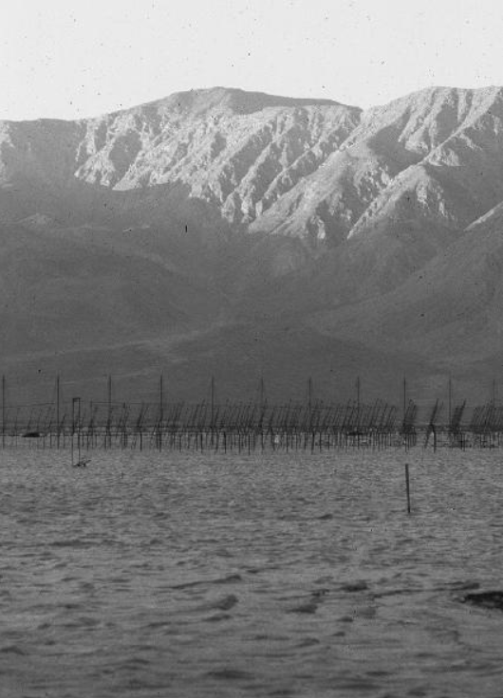
UCSD also had an IPS array system
(Clark Dry Lake antenna system - one of three
in the 1970’s
and early 1980’s)

Slide 6
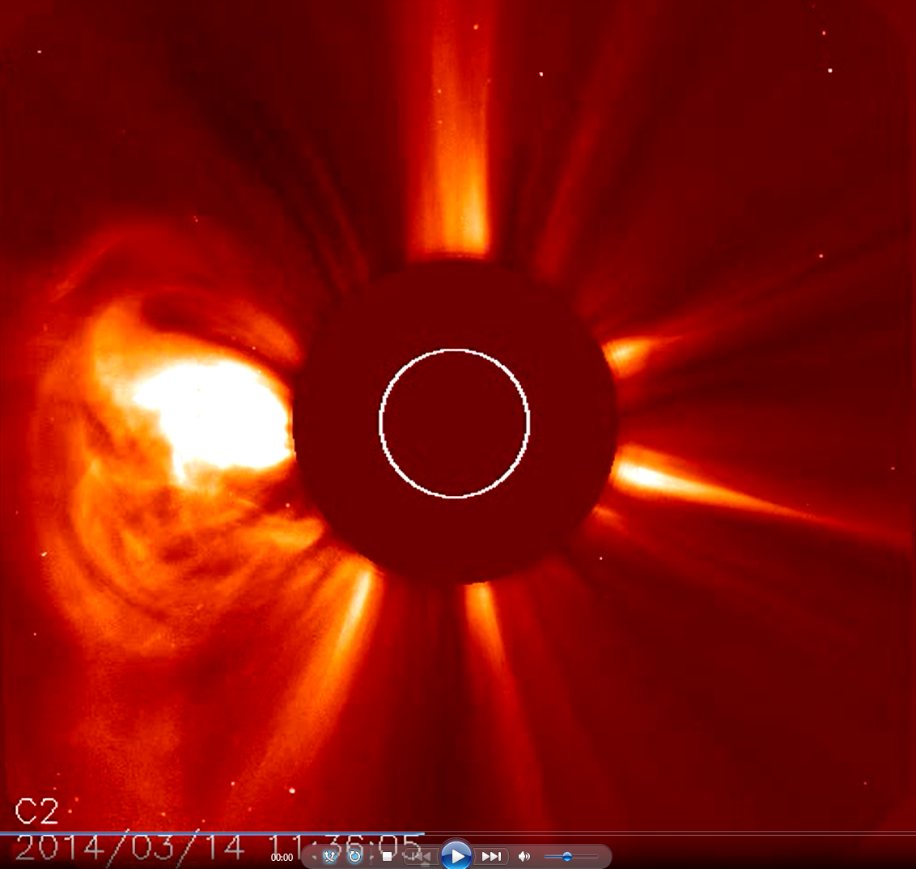
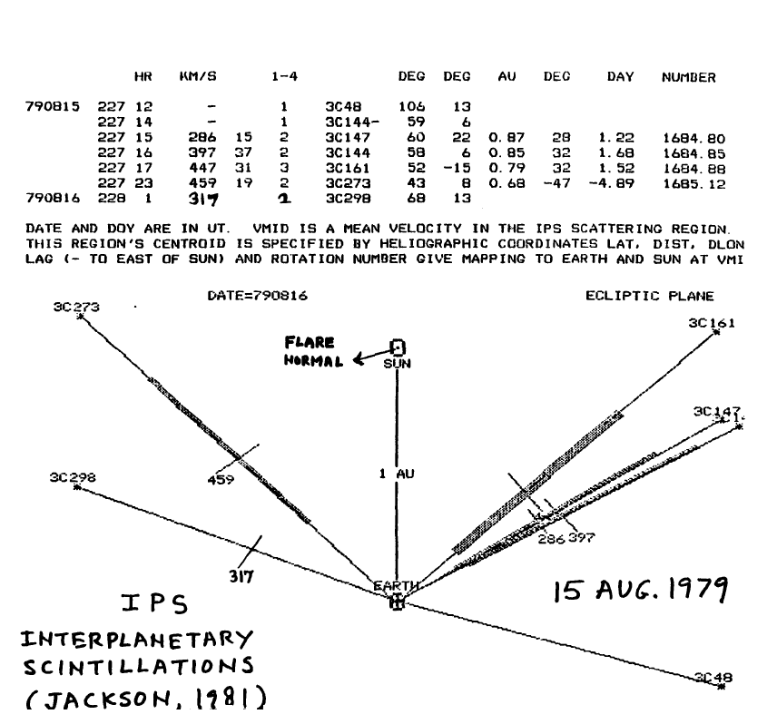
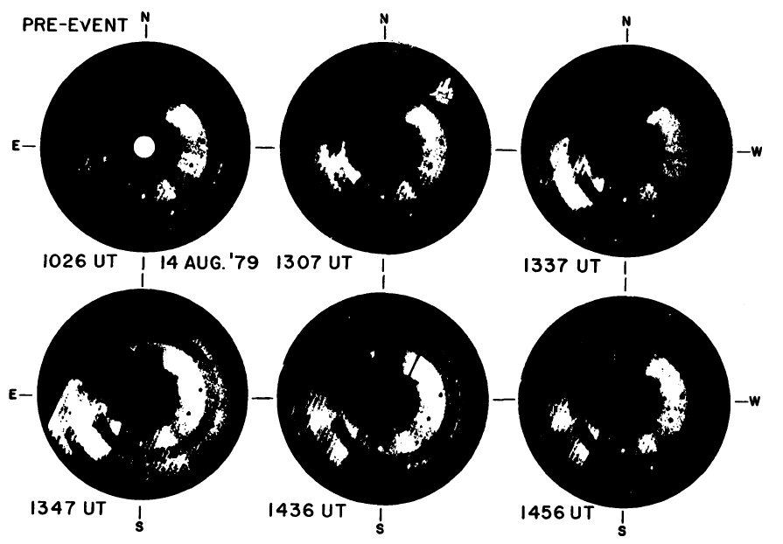
SOHO LASCO C2 CME (1995-present)
SOLWIND Coronagraph CME (1979/08/14)
CME!!
Interplanetary Scintillation (IPS)
14 March 2014 CME
P78-1 SOLWIND Coronagraph

Slide 7
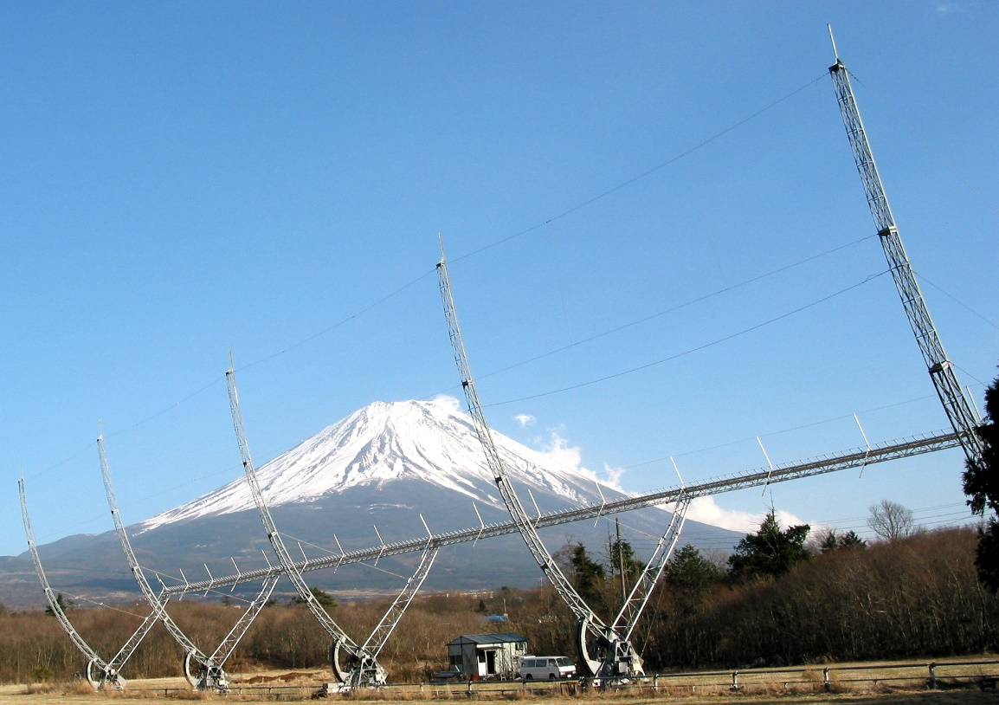
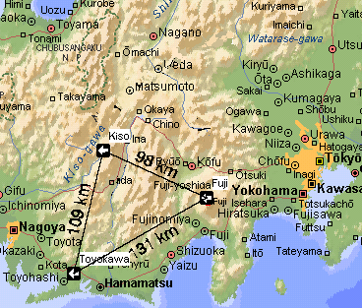
ISEE IPS Heliospheric Analysis
ISEE IPS array near Mt. Fuji
ISEE IPS array systems
Notes:
The STELab interplanetary scintillation 327 MHz remote-sensing cylindrical parabola near Mt. Fuji is shown. The array moves in declination to provide views of sources at different locations in the sky as they pass overhead. The other array of this type is at Kiso, to the north of Toyokawa. There is also an array at Toyokawa. All three arrays view the same scintillating source at the same time.

Slide 8
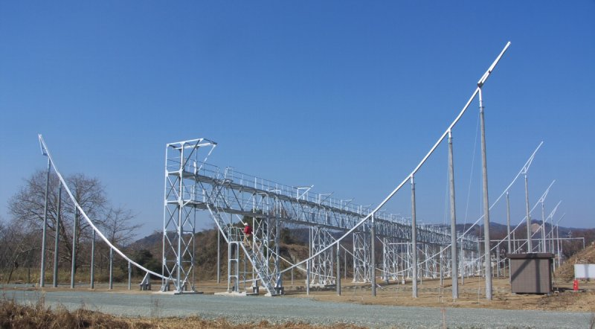
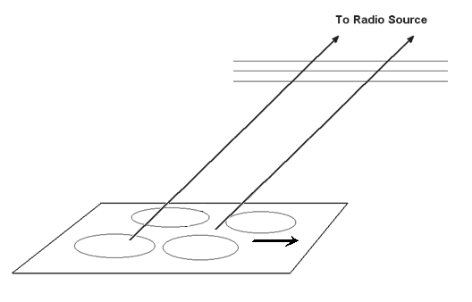
ISEE IPS Heliospheric Analysis
IPS line-of-sight response
ISEE IPS array systems
ISEE IPS array in Toyokawa (3,432 m² array now operates well – year-round operation began in 2011)
Notes:
Density inhomogenieties in the solar wind on the order of 150 km size from point radio sources produce an intensity pattern variation on the ground that travels away from the Sun with the solar wind speed. This pattern, measured and correlated between different radio sites in Japan allows a determination of the solar wind speed by translating this value to the line of sight perpendicular. The fuzz observed correlates from one radio site to another.

Slide 9
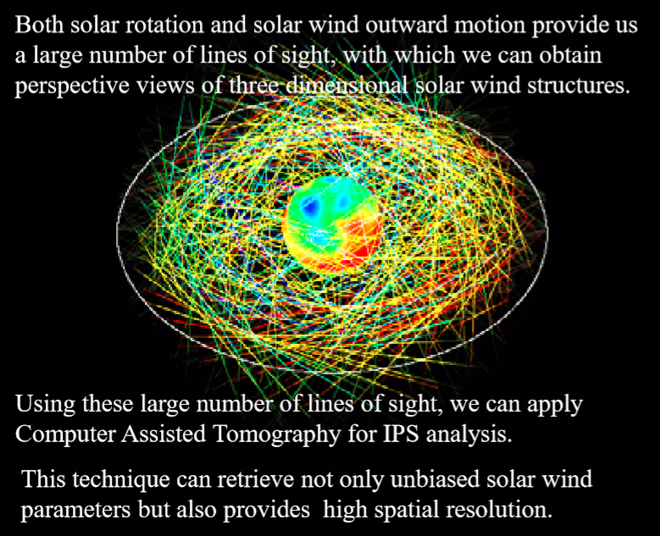
Corotating Tomography
(Programed 1995-1996)
Kojima, M., Tokumaru, M., Watanabe, H., Yokobe, A., Asai, K., Jackson, B.V., and Hick, P.L., 1998, ‘Heliospheric Tomography Using Interplanetary Scintillation Observations 2. Latitude and Heliocentric Distance Dependence of Solar Wind Structure at 0.1-1 AU’, J. Geophys. Res., 103, 1,981.
Jackson, B.V., Hick, P.L., Kojima, M., and Yokobe, A., 1998, ‘Heliospheric Tomography Using Interplanetary Scintillation Observations 1. Combined Nagoya and Cambridge data’,
J. Geophys. Res., 103, 12,049.
From Masayoshi Kojima (2013)

Slide 10
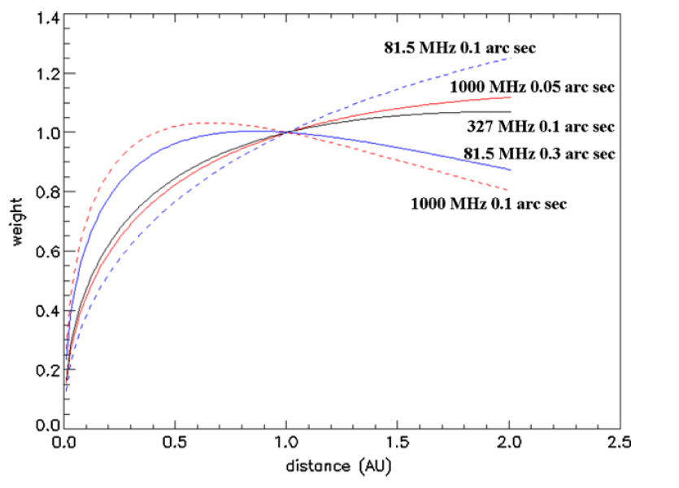
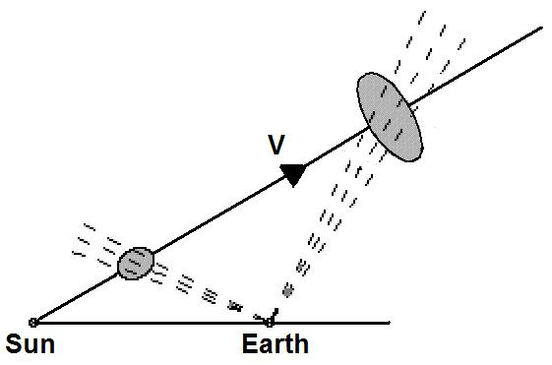
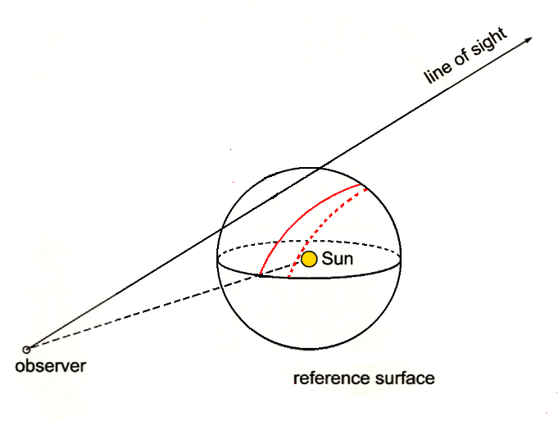
IPS line-of-sight response
Jackson, B.V., et al., 2008, Adv. in Geosciences, 21, 339-360.
Heliospheric C.A.T. analyses: example line-of-sight distribution for each sky location to form the source surface of the 3D reconstruction.
ISEE IPS
Sample outward motion over time
Notes:
This shows how the UCSD IPS time-dependent Computer Assisted Tomography (C.A.T.) analysis works. The 327 MHz IPS line of sight weighting provides a weight for each source observation on a spherical source surface below each line. As material moves outward from the Sun, it follows a very specific modeled path and expansion that is weighted differently at different times. The full mathematical treatment can be found in Jackson, B.V., et al., 2008, Adv. in Geosciences, 21, 339-360.

Slide 11
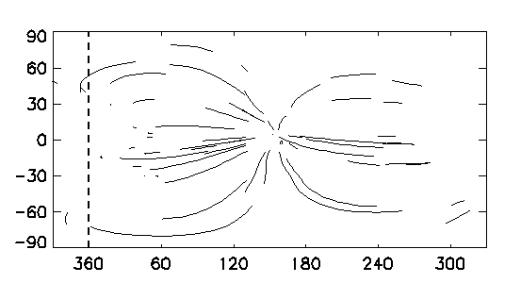
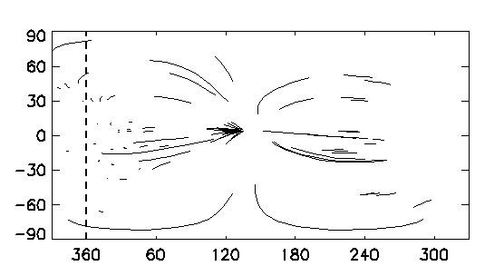
IPS line-of-sight response
Jackson, B.V., et al., 2008, Adv. in Geosciences, 21, 339-360.
Heliospheric C.A.T. analyses: example line-of-sight distribution for each sky location to form the source surface of the 3D reconstruction.
ISEE IPS
14 July 2000
13 July 2000
Notes:
This shows the line of sight traces on a Carrington map at the source surface (lower right). The line of sight weighting provides a weight for each source observation on the source surface. The full mathematical treatment can be found in Jackson, B.V., et al., 2008, Adv. in Geosciences, 21, 339-360.

Slide 12
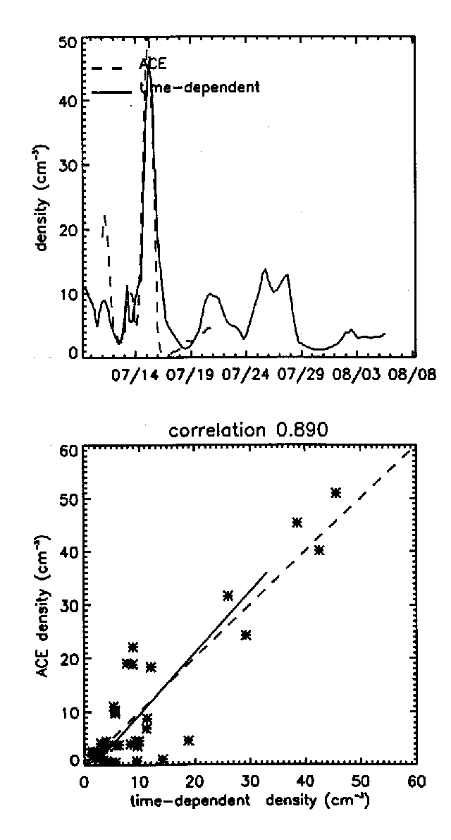
IPS C.A.T. analysis
Jackson, B.V., et al., 2002, Solar Wind 10, 31
Jackson, B.V., et al., 2008, Adv. in Geosciences 21, 339
“Bastille Day” event
14 July 2000
Density
Velocity

Slide 13
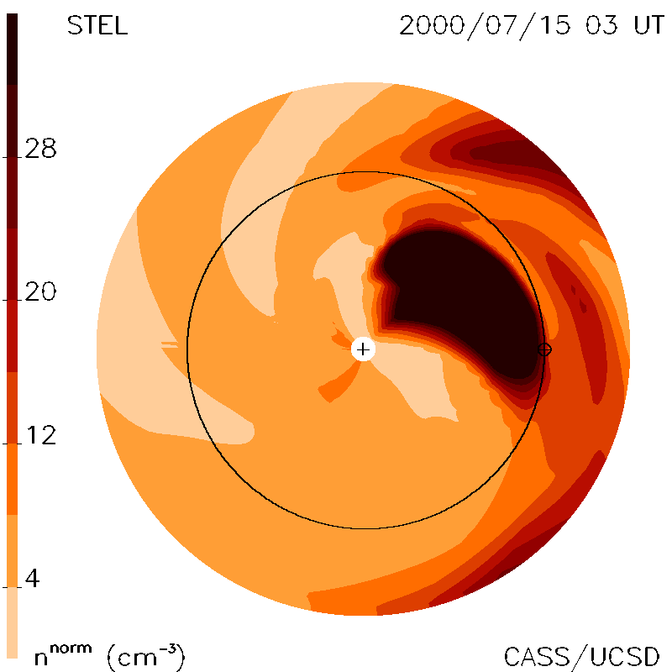
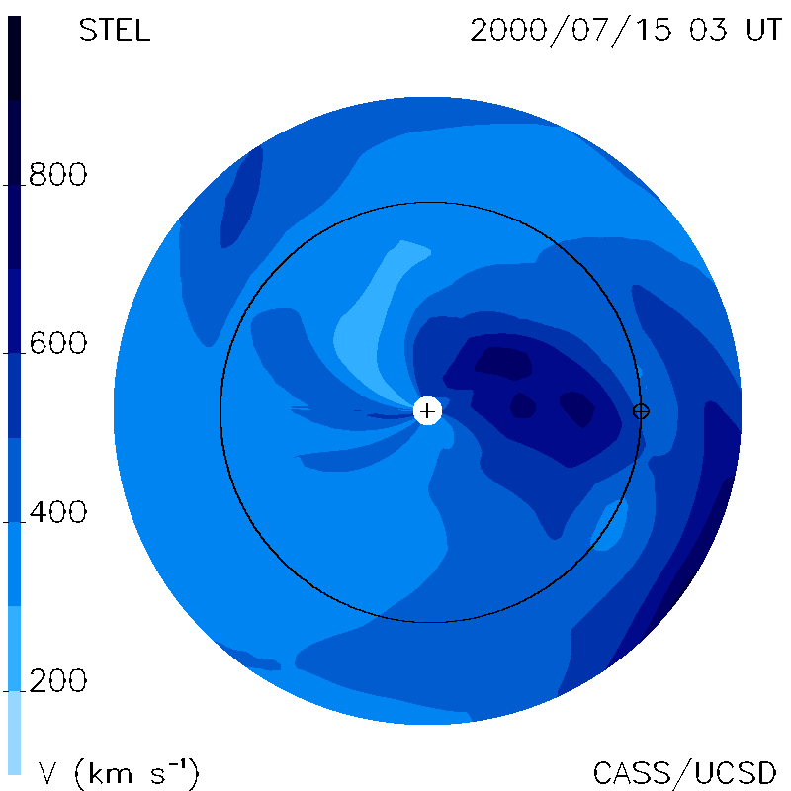
IPS C.A.T. analysis
Jackson, B.V., et al., 2002, Solar Wind 10, 31
Jackson, B.V., et al., 2008, Adv. in Geosciences 21, 339
“Bastille Day” event
14 July 2000
Density
IPS Density Ecliptic Cut
Velocity
IPS Velocity Ecliptic Cut

Slide 14
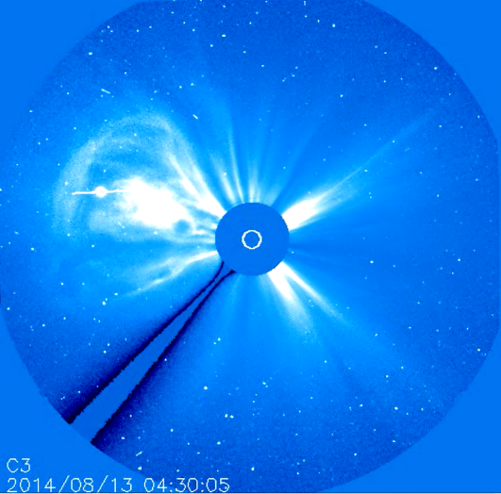
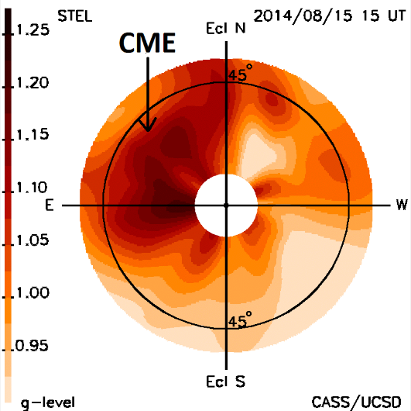
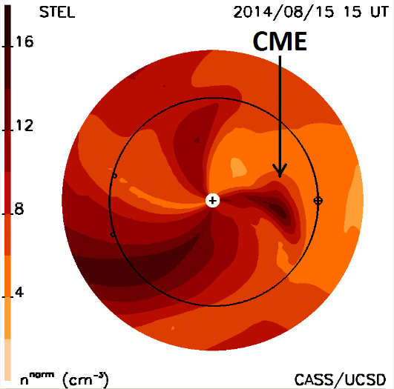
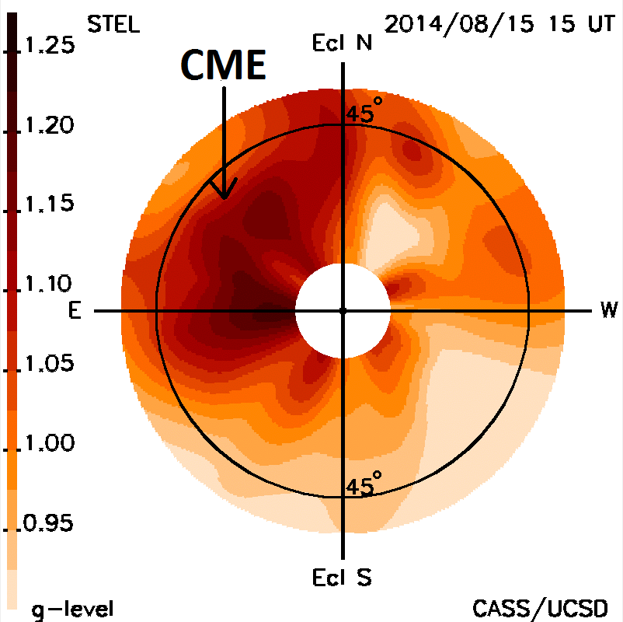
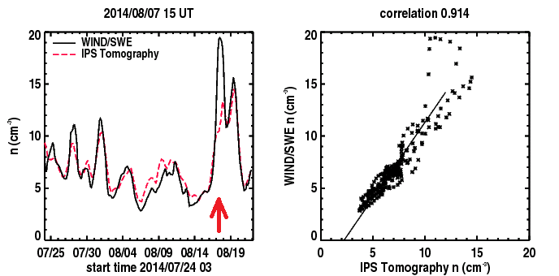
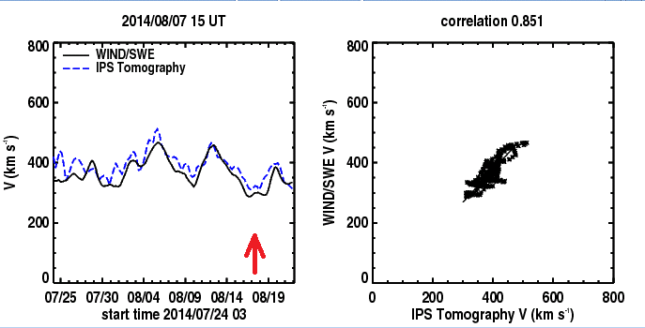
2014/08/12/ 21UT CME
CME LASCO C3 Coronagraph Image IPS g-level fisheye 2½ days later.
CME LASCO C3 Coronagraph IPS g-level fisheye Density Ecliptic Cut
CME LASCO C3 Coronagraph IPS g-level fisheye
UCSD Kinematic IPS Model
Time series showing CME density and velocity arrival.

Slide 15
Jackson, B.V., et al., 2011, Adv. in Geosciences, 30, 93-115; Jackson et al., 2013, Solar Phys., 258, 151-165
http://ips.ucsd.edu/ or http://ips.ucsd.edu/high_resolution_predictions/
UCSD Prediction Analyses
UCSD and other
IPS Web pages
Websites:
ISEE: http://stsw1.stelab.nagoya-u.ac.jp/index-e.html
USCD: https://ips.ucsd.edu/high_resolution_predictions
CCMC: https://iswa.ccmc.gsfc.nasa.gov/IswaSystemWebApp/
KSWC: http://www.spaceweather.go.kr/models/ips
GMU: http://spaceweather.gmu.edu/projects/enlil/
UK Met: soon to happen
Web analysis runs “automatically” using Linux on a P.C.
Notes:
UCSD has forecast background and CME solar wind conditions in real time at the Earth and throughout the heliosphere globally since the year 2000 with updates over this period at UCSD and at other locations around the world using a variety of different visualizations. Recently this has been used to drive the ENLIL 3-D MHD model, and to use ENLIL as a kernel in the tomographic result to provide comparative modeling results that can be accessed from this website (shown at top left on the website panel).

Slide 16
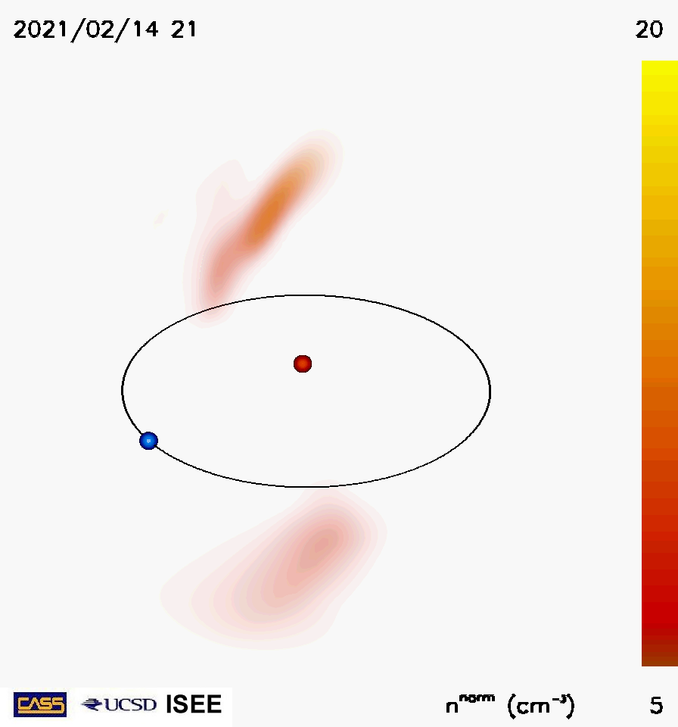
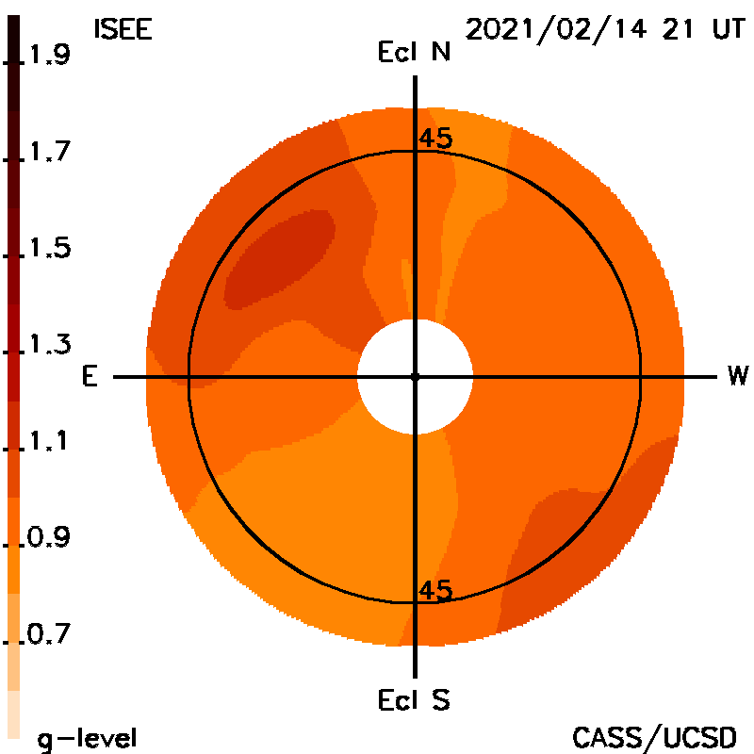
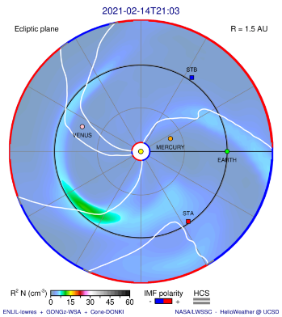
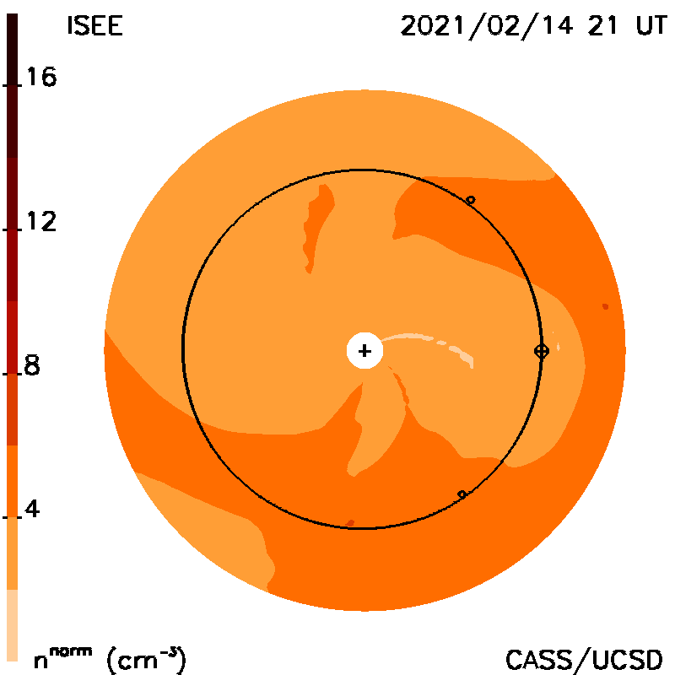
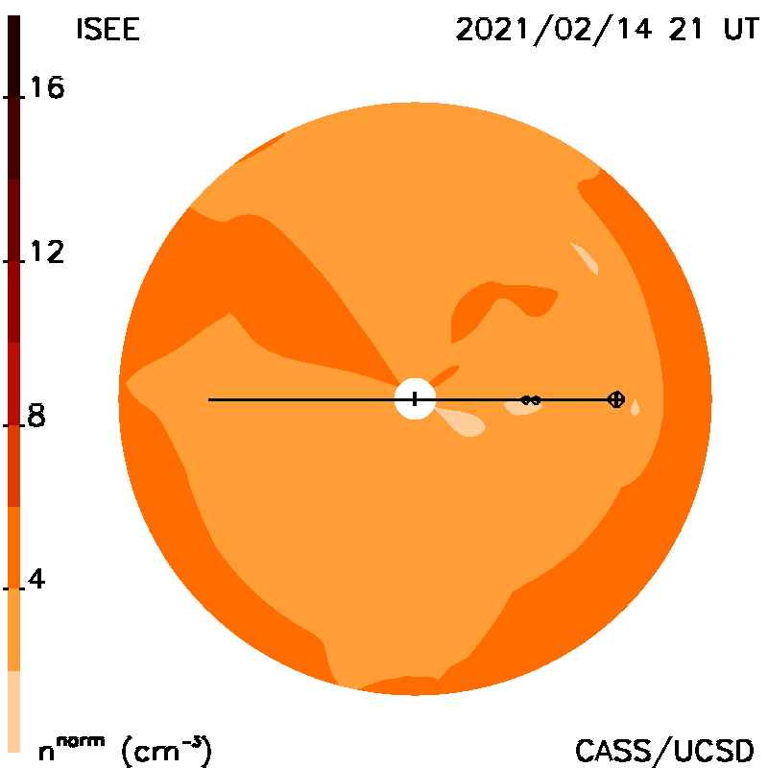
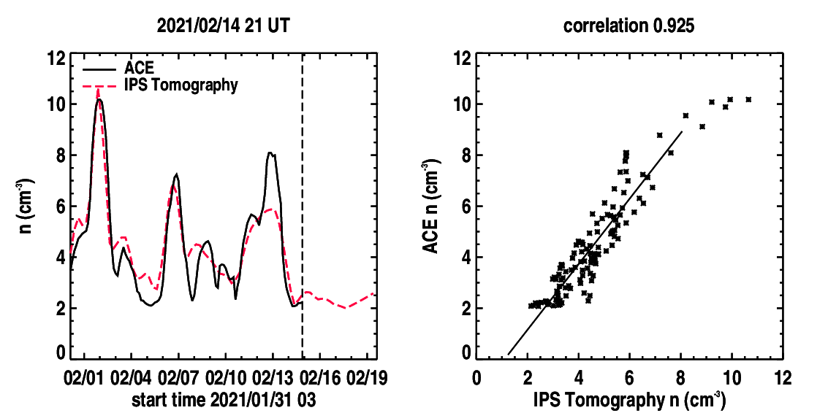
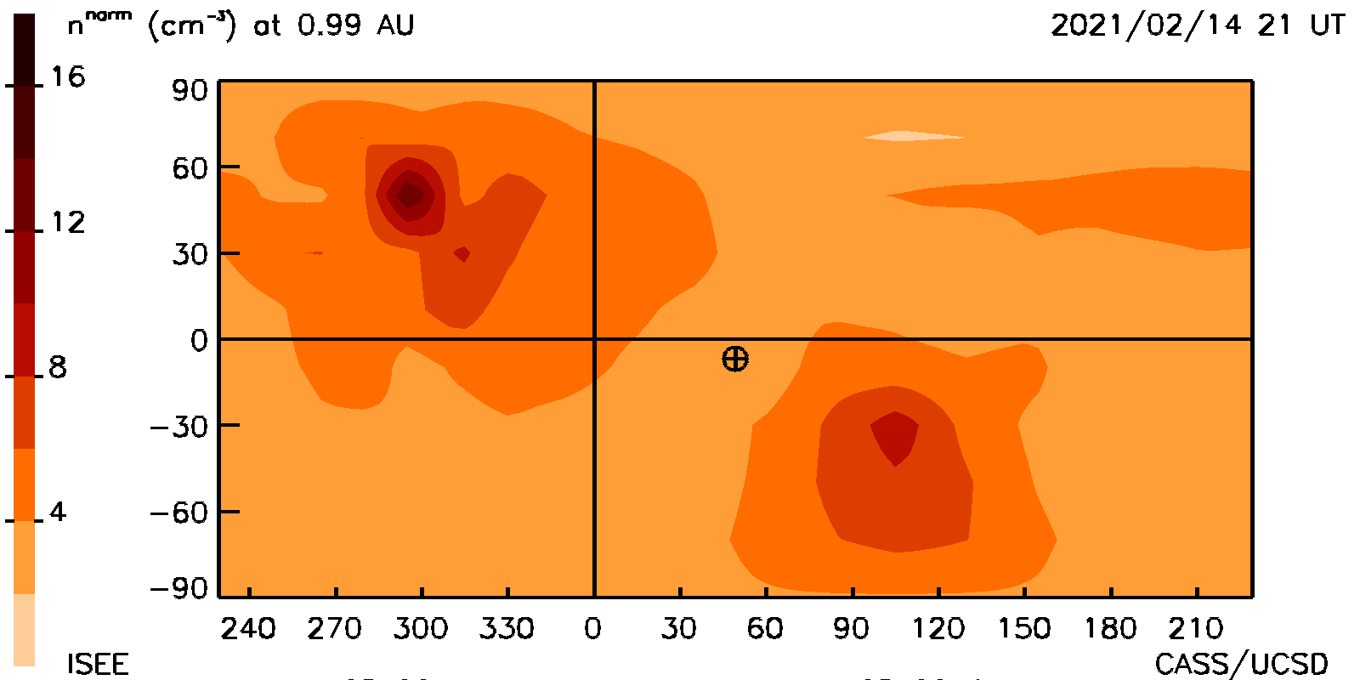
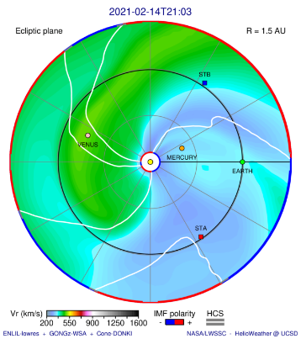
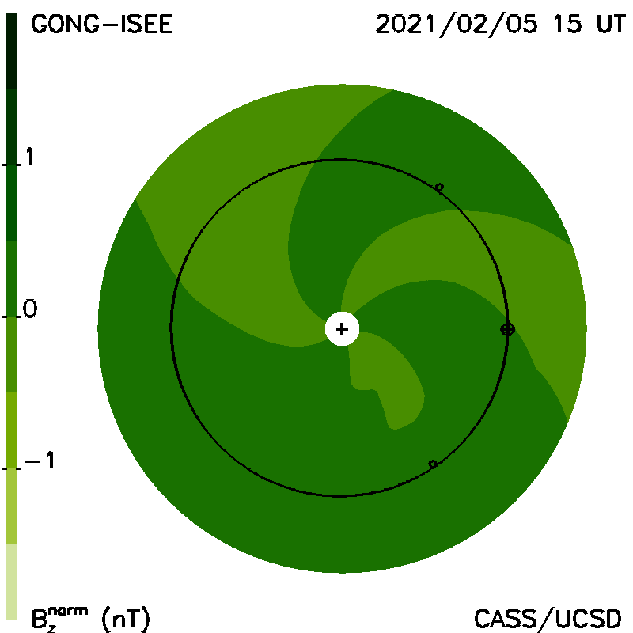
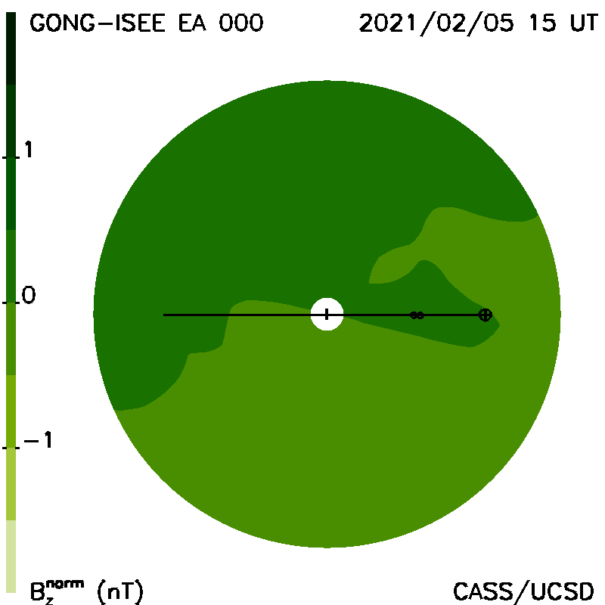
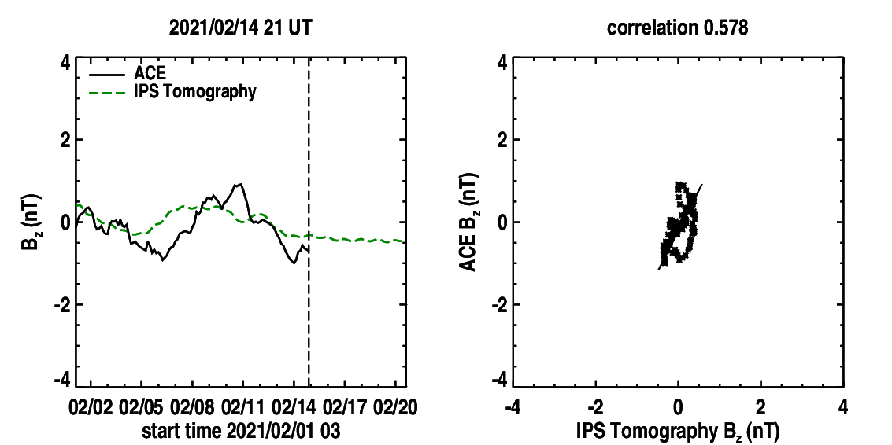
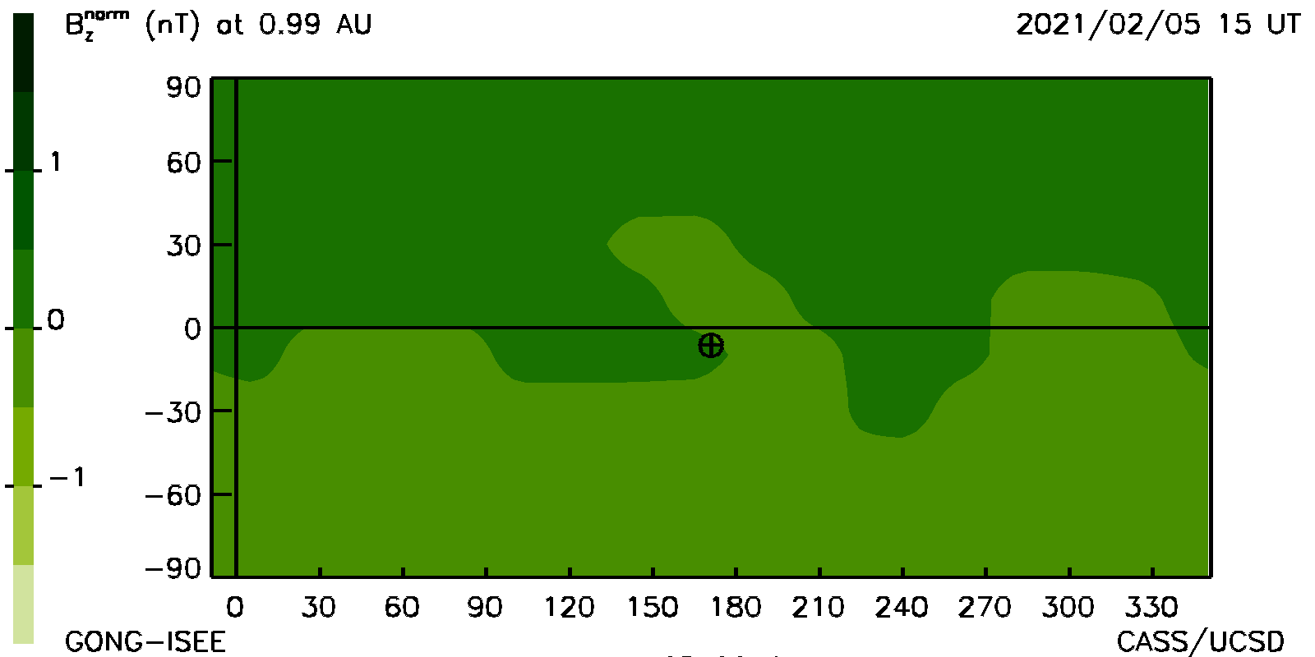
(http://ips.ucsd.edu/IPS-ENLIL_predictions)
UCSD IPS & IPS-Driven ENLIL Prediction
Yesterday’s 2021/02/14 21 UT Analysis from ISEE
Remote Density
Density Skymap
Density (n/cm³)
ENLIL Density
GSM Bz Magnetic Field (nT)
ENLIL Velocity
Web analysis runs automatically using Linux on a P.C.
Masayoshi
Notes:
Current 2021/01/18 09 UT UCSD Forecast at https;//ips.ucsd.edu/IPS-ENLIL_predictions

Slide 17
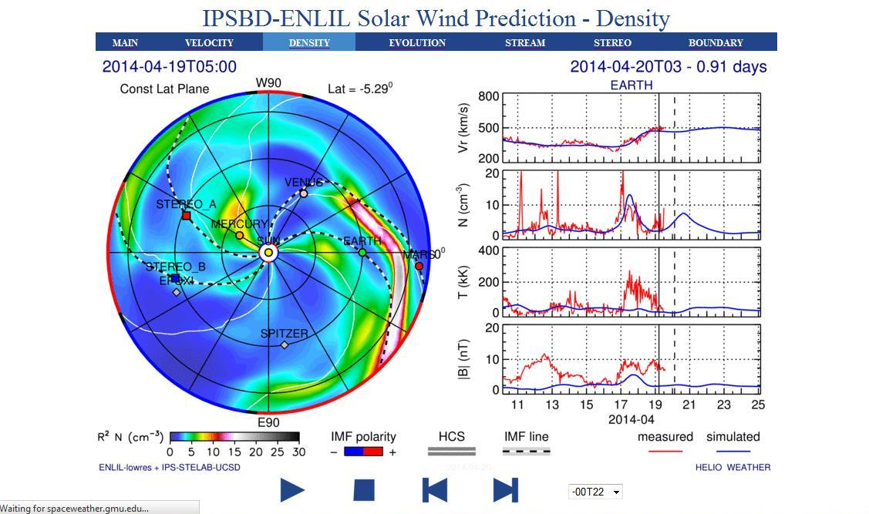
Kinematic Model Iterative Data Fit
UCSD IPS Data-Driven ENLIL Model (2014)
ENLIL 3D-MHD forward modeling from a 21.0 Rs 3-D time-dependent IPS
tomography boundary
Density ecliptic cut
http://spaceweather.gmu.edu/projects/enlil/latest/density.html

Slide 18
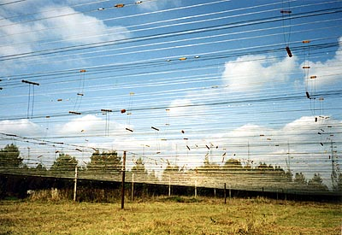
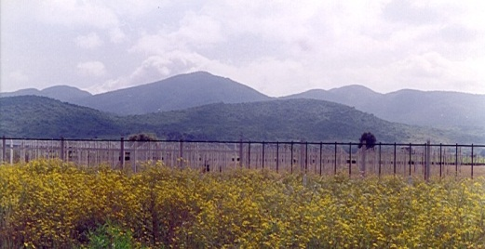
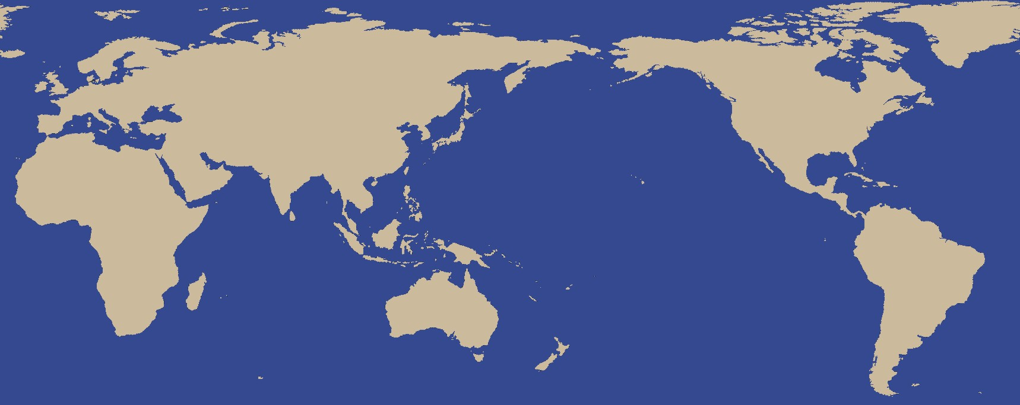
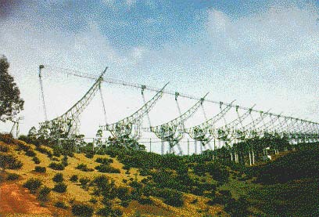
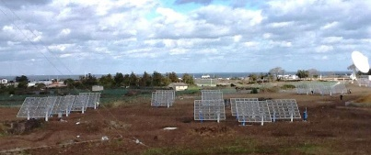
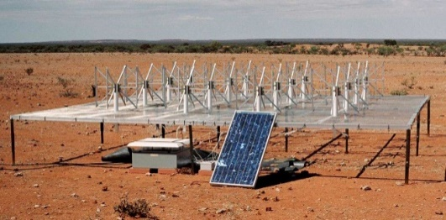
Worldwide IPS Stations (WIPSS) network
Pushchino103MHz
70,000㎡
STEL Multi-Station 327MHz
2000 ㎡×3, 3500 ㎡
MEXART
140MHz、10,000㎡
IPS
UK/EISCAT
LOFAR)
Russia
Korea
India
Japan
Mexico
MWA
80-300MHz
Ooty 327MHz、16,000㎡
US-Australia
Notes:
For studying transient phenomena especially fast-moving CMEs, continuous and high cadence observations are needed, and a world-wide network is essential to improve cadence of IPS observations to remove outages near the Sun. Shown here are the IPS stations where IPS observations have been performed. By exchanging IPS data among these stations, it is possible to provide continuous monitoring of the solar wind and fast-moving heliospheric structures from close to the Sun and outward.
18

Slide 19
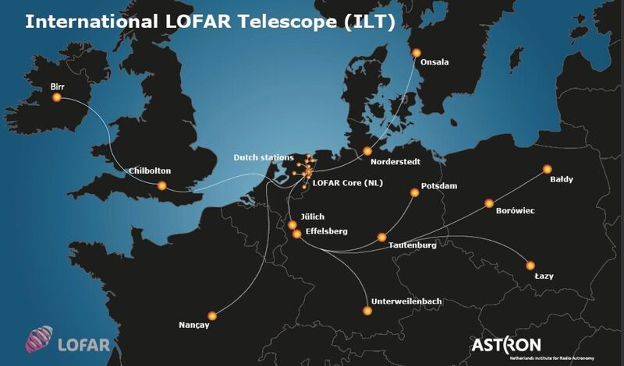
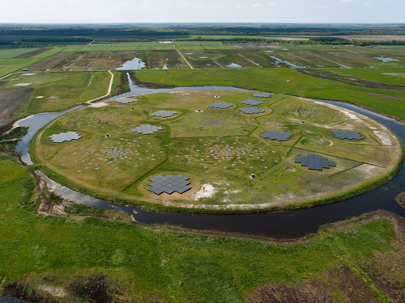
Campaign Mode
38 NL stations, 12 international stations
1 new station to come in Ireland (2017)
1 new station to come in Latvia (2019)
UK: 1
Frequency range: 10-240 MHz
High time- and frequency resolution
Multi-beam capabilities
WIPSS
Courtesy Richard Fallows, ASTRON, The Netherlands
Notes:
So far, the European Low Frequency (LOFAR) array has been one of the most successful participants in this Worldwide IPS Stations (WIPSS) Network that enables a combination of IPS radio sites used to fill in the longitudinal and temporal gaps in IPS observations, and the UCSD tomographic technique, enabling continuous coverage of velocity and density heliospheric proxies. Used only in “campaign mode” so far over approximately one-month intervals during Parker Solar Probe close solar passes, LOFAR has provided some of the best continuous predictions of the global heliosphere, and the efficacy of using combined IPS data sets.

Slide 20
ISEE and LOFAR Data Combined (PSP 2nd Pass)
g-level
density
Jackson et al., 2020, Frontiers in Astronomy and Space Sci., doi: 10.3389/fspas.2020.568429
LOFAR-ISEE density
LOFAR-ISEE velocity
Close Pass
Ʇ velocity
velocity
LOFAR data courtesy of LOFAR4SW consortium – R. Fallows, M.M. Bisi, B. Jackson, etc.
Notes:
The analyses, forecasts, and visualizations are helped significantly when more IPS stations can be combined. Shown are “Sun at center” fisheye plots of the scintillation strengths given as g-level and velocity perpendicular to the line of sight relative to the source values from both ISEE and LOFAR (often same sources at different times); Ecliptic cuts of densities and velocities of the global heliosphere at these different times are shown in the middle. At right are the combined ISEE and LOFAR time series data sets with ACE in-situ data for a one-month period at Earth, along with their Pearson’s R correlations.

Slide 21
ISEE and LOFAR Data Combined (PSP 2nd Pass)
Jackson et al., 2020, Frontiers in Astronomy and Space Sci., doi: 10.3389/fspas.2020.568429
LOFAR-ISEE density
LOFAR-ISEE velocity
PSP BepiColombo Stereo
Close Pass
Ecliptic cuts Meridional cuts
LOFAR data courtesy of LOFAR4SW consortium – R. Fallows, M.M. Bisi, B. Jackson, etc.
Notes:
This shows the period around the second Parker Solar Probe close pass on April 4, 2019, at 21 UT as before. Now, the meridional cuts at Earth are presented as well as the ecliptic cuts. This close solar pass is interesting in that at the end of the period, the PSP passes between the Sun and STEREO and the Sun and Earth providing a preview of the solar wind before it arrives at STEREO and Earth.

Slide 22
Non-Radial Transport - IPS-Driven ENLIL
The Iterative Process with the ENLIL 3-D MHD
New UCSD 64-core AMD machine
UHA MS-FLUKSS ENLIL
(Pogorelov) (Odstrcil)
Notes:
1) We have been successful in operating a near real-time iterated ENLIL model using the IPS time-dependent tomography throughout the period of the AFOSR contract. The ENLIL model provides non-radial heliospheric transport, and more “physics”. How this model works is shown in the flow diagram. We are able to provide a 3-iteration result beginning with the kinematic model outcome in a little over 6 hours with an old 16-node computer that has been a standard “workhorse”. 2) However, to experiment more with this system, and non-radial heliospheric flow we needed a new computer, and after many trials, we a have now purchased a new Linux (Dual 32 core processor) and colleague Dusan Odstrcil has just last week gotten this to run his ENLIL program on it.

Slide 23
IPS Iteratively Updated ENLIL Model Density
2017/09/4 & 10 CMEs, No Earth X8.2 09/10 12 UT CME
Iteration 0 (Kinematic-IPS)
Density
Velocity
CME ?
Iteration 3 (ENLIL-IPS)
Density
Velocity
CME ?
Notes:
From the old system run with an archival IPS data set in 2017 we show sample density and velocity fits for the same time period from the UCSD kinematic and the iterated ENLIL system. Both generally give comparable results.

Slide 24
Electron Thomson Scattering

Slide 25
Line-of-sight Response
Jackson, B.V., et al., 2008, Adv. in Geosciences 21, 339
Thomson scattering
Heliospheric C.A.T. analyses: example line-of-sight distribution for each sky location to form the source surface of the 3D reconstruction.
Solid line: brightness
Dashed line: Polarization Brightness (pB)
Notes:
The same is shown for daily observations from STELab IPS observations. <click> For the IPS, the “Nagoya” line of sight weighting provides a weight for each source observation on the source surface.

Slide 26
An “All Sky” Coronagraph
The Solar Mass Ejection Imager (SMEI)
Stray light suppression, precise photometry
The Coriolis spacecraft at Vandenberg AFB prior to flight (2002). The SMEI baffles are circled. The large NRL radiometer Windsat is on the top of the spacecraft.

Slide 27
The Solar Mass Ejection Imager (SMEI)
Titan II launch from Vandenberg AFB
6 January 2003.
Jackson, B.V., et al., 2004, Solar Phys., 225, 177
Launch 6 January 2003
Sun
C1
C2
C3
Sun
1 gigabyte/day; total ~4 terabytes
Simultaneous images from the three SMEI cameras.
(Operation stopped: September 28, 2011)
A joint US Air Force - NASA Project
Notes:
The best precedent for this is the Solar Mass Ejection Imager (SMEI), a predecessor to the STEREO heliospheric imagers, that was launched out of the Vandenberg Air Force Base in 2003 and was closed after over 8 years of successful operation in 2011. SMEI viewed nearly the whole sky in Thomson-scattered light in pieced-together strip images.

Slide 28
SMEI Webpages - http://smei.ucsd.edu
Notes:
A view of one pieced-together image is shown. Blank areas include a region within 18 degrees of the Sun, a location that was shuttered off that came too close to the Sun to provide viable data, and a location blanked by high energy particles and the aurora in the orbital auroral oval location.

Slide 29
Images from the 3-D reconstructions
26 May – 05 June 2003, (May 28 ‘Halo’ CME)

Slide 30
SMEI Webpages - http://smei.ucsd.edu
Notes:
UCSD maintains the only SMEI Web pages and has upgraded them at: http://smei.ucsd.edu. (click) The UCSD SMEI webpages, among other things, provide low-resolution 3-D tomographic analyses of the global heliosphere at 3-hour intervals over the whole of the SMEI 8-year lifetime.

Slide 31
Jackson, B.V., et al., 2008, J. Geophys Res., 113, A00A15, doi:10.1029/2008JA013224
27-28 May 2003 CME event period
Full SMEI data set, 6-hour cadence, 3º x 3º lat, long
SMEI proton density reconstruction for the 27-28 May 2003 halo CME sequence. Reconstructed and ACE L2 in-situ densities are compared over one Carrington rotation.

Slide 32
Jackson, B.V., et al., 2008, J. Geophys Res., 113, A00A15, doi:10.1029/2008JA013224
2003 May 27-28 CME events
CME mass
SMEI density 3D reconstruction of the 28 May 2003 halo CME as viewed from 15º above the ecliptic plane about 30º east of the Sun-Earth line.
SMEI density (remote observer view) of the 28 May 2003 halo CME

Slide 33
Current IPS New SMEI Analysis
Current Low Resolution IPS ~ 6-hour cadence New SMEI Analysis ~ 1 hour cadence
Kinematic Model Iteration 3 (ENLIL-IPS)
Earth environment comparable cadence values in 3-D latitude, longitude, and solar distance
Notes:
The forecasts include our UCSD standard Kinematic Model (that conserves mass and mass flux). We also have several other model versions displayed on these websites: one that is used to drive the ENLIL 3-D MHD model and another (shown in the middle panels that iterates using ENLIL as a kernel. However, to provide very high resolution, more data than supplied by current IPS is needed, and we have now shown the SMEI Thomson-scattering analysis, like as is planned for ASHI, can supply this with at least a one-hour cadence as shown in the right panels.

Slide 34
Thomson-Scattering Data Analyses
STEREO HI-A Tomography
AT EARTH
AT STEREO A
AT EARTH
Void
EARTH
Notes:
For ASHI we have recently resurrected the Solar Mass Ejection Imager (SMEI) Thomson-scattering analysis to use the STEREO HI data that is more nearly like that expected from ASHI than that from SMEI. This provides both SMEI and STEREO HI densities at previously unequaled temporal resolutions at the spacecraft with cadences of about one hour.
STEREO A reconstructions are shown here at the time of a large CME event passage in 2011 over a period of 6 days. From STEREO A alone the view of the heliosphere is incomplete but shows much interesting structure, that even at Earth can show both voids and density enhancements that are quite good (depending on which in-situ spacecraft data set you believe), and at lower resolution than at the spacecraft itself.; in this case the 3-D analysis highlights a different, somewhat later CME in 2011 (in the middle and right panels), and a cylindrical density void structure that was associated with enhanced magnetic field following the CME that passed to the north and east of Earth.

Slide 35
Thomson-Scattering Heliospheric Imager
https//ashi.ucsd.edu
Notes:
So, with ASHI, most of the hardware for the balloon flight test is now available, and currently being mechanically and thermally tested.

Slide 36
Thomson-Scattering Heliospheric Imager
https//ashi.ucsd.edu
ASHI balloon flight model
We now have a ride on a topside balloon flight – summer 2021!
Notes:
The ASHI group has recently been given a go-ahead by NASA and the Columbia Scientific Balloon Facility to ready ASHI for a balloon flight out of Texas or New Mexico in this coming summer. To view the whole sky without any bright features in the way, we must do this at night when no Moon is present, and from the balloon top. The major purpose of ASHI is the global 3-D reconstruction of the heliosphere in density from within about 2 degrees of the Sun outward to 180 degrees away from it. This allows the best tracking of structures outward from the Sun, the reconstruction of the region near the spacecraft, and an extension of the structure measured in-situ to nearby.

Slide 37
Thomson-Scattering Heliospheric Imager
Notes:
We have most of the hardware ready to fly on a topside balloon flight using a COTS camera. The trick in providing the small system mass, that is about one tenth that of SMEI, is the circular corral that prevents scattered light from the Sun and spacecraft appendages from entering the region near the lens (as described and ground tested in the right panels).

Slide 38
Night Sky Tests
ASHI
(All Sky Heliospheric Imager)
Instrument / Camera Tests
Notes:
Tests at night using the ASHI system have provided data that we can use, but just for processing techniques since the night sky even on the highest mountain tops, has been shown simply too bright to view the heliosphere.

Slide 39
Night Sky Tests
ASHI
(All Sky Heliospheric Imager)
Test Images
Notes:
Ground based tests calibrated against the stellar background provide a wonderful test of the system throughput to certify what we expect from the full-up system and how our direct plus small mirror system will operate in space.

Slide 40
We need help – lens, space qualified camera!
ASHI in GEO orbit
ASHI has a potential ride to GEO orbit in 2024 on an ESPA ring
similar to that of the US AF Eagle Spacecraft that is now operating.
Spacecraft ASHI
(10x SMEI throughput)
3 – 5 kg
ASHI
9U CubeSat ASHI
(With a Little Squeezing)
Notes:
Given a good camera, several versions of ASHI are possible, and we have potentially been scheduled for a ride to GEO orbit on an ESPA ring in ~2024 that is similar to that of the Air Force Eagle Spacecraft (if ASHI can be ready in time). With a little squeezing, (and probably not quite as close near-Sun viewing) a 9U CubeSat version of ASHI is also possible.

Slide 41
Conclusions:
Highlights in the History of Interplanetary Scintillation (IPS) to View the Heliosphere
IPS and Thomson-Scattering Provides a Way Forward to Provide Global Heliospheric Modeling using Computer Assisted Tomography
The Use 3-D MHD Modeling Provides More Physics:
solar wind heating, heliospheric non-radial flow, shock processes
Recent Advances Using Solar Mass Ejection Imager (SMEI) and STEREO HI Instrumentation to Provide Higher-Resolution Tomography
5) Future Plans for a Heliospheric Imager
Notes:
My talk will proceed this way

Slide 42
Magnetic Field Extrapolations

Slide 43
(Zhao, X. P. and Hoeksema, J. T., 1995, J. Geophys. Res., 100 (A1), 19.)
CSSS model
Dunn et al., 2005, Solar Physics 227: 339–353.
Source surface B_{r} field component sample
Inner region: the CSSS model calculates the magnetic field using photospheric measurements and a horizontal current model.
2. Middle region: the CSSS model opens the field lines. In the outer region.
3. Outer region: the UCSD tomography convects the magnetic field along velocity flow lines.
Notes:
Magnetic field predicted at UCSD using the CSSS model (Zhao & Hoeksema, 1995). The magnetic field at the source surface that is strictly perpendicular to that surface, is convected outward by the solar wind model values of velocity given in the UCSD tomography model.

Slide 44
RTN heliographic coordinates
Notes:
The Parker formulation of frozen in fields provides the amplitudes of the radial and tangential components of the solar wind in RTN coordinates. These fields give no component of field perpendicular to the heliographic equator. However the GSM field at Earth is not perpendicular to this plane.

Slide 45
In the meantime with magnetic fields something simple to try is to show the coupling between the field we can obtain and the GSM field
Magnetic Field
Russell - McPherron Effect
“Daily Implementation”
(Jackson, B.V., et al., 2019, Space Weather, 17, 639-652,doi:10.1029/2018SW002098)

Slide 46
RTN coordinates
GSM coordinates
(Russell, C. T., and McPherron, R. L., 1973, J. Geophys. Res., 78 (1), 92.)
Sun
Notes:
Viewed along the ecliptic plane, the Earth’s axis (and hence the pole of the Earth) is not perpendicular to the ecliptic plane and in summer and spring this geometric tilt maximizes away from the perpendicular, as does the Bz field component of the GSM field.

Slide 47
(Jackson, B.V., et al., 2019, Space Weather, 17, 639-652,doi:10.1029/2018SW002098)
GSM coordinates
RTN coordinates
(Russell, C. T., and McPherron, R. L., 1973, J. Geophys. Res., 78 (1), 92.)
Notes:
More precisely (since the heliographic equator is not exactly the same as the ecliptic), the Earth’s ecliptic and the heliographic equator with its spiral magnetic field look mor like this (depicted at the autumnal equinox). Here the RTN field component parallel to the GSM Bz component of Earth can have an effect that is maximum.

Slide 48
(Jackson, B.V., et al., 2019, Space Weather, 17, 639-652,doi:10.1029/2018SW002098)
UCSD Prediction Analyses
March 2017 Analyses from ISEE: Day -3
Bz (GSM)
Three Days In Future
From here
Web analysis runs automatically using Linux on a P.C.
Notes:
We provide a predicted value of the GSM field components using the CSSS modeling, and this is compared with 3-day smoothed GSM Bz value measured from ACE given by NOAA. This is projected into the future and compared in a Person’s R correlation 1) from the observations available on the plot were data exists up through the time shown, and 2) from observations one day into the future, that are determined for ~10 days once the observation are obtained. These are typical results and show about the same correlations. There is a dip toi a minimum in Bz that is predicted about 3 days into the future..

Slide 49
(Jackson, B.V., et al., 2019, Space Weather, 17, 639-652,doi:10.1029/2018SW002098)
UCSD Prediction Analyses
March 2017 Analyses from ISEE: Day -2
Bz (GSM)
Two Days In Future
From here
Web analysis runs automatically using Linux on a P.C.
Notes:
The same display as before is shown. The next day the dip to negative Bz is 2 days in the future.

Slide 50
(Jackson, B.V., et al., 2019, Space Weather, 17, 639-652,doi:10.1029/2018SW002098)
UCSD Prediction Analyses
March 2017 Analyses from ISEE: Day -1
Bz (GSM)
One Day In Future
From here
Web analysis runs automatically using Linux on a P.C.
Notes:
Now the dip is one day into the future.

Slide 51
(Jackson, B.V., et al., 2019, Space Weather, 17, 639-652,doi:10.1029/2018SW002098)
UCSD Prediction Analyses
March 2017 Analyses from ISEE: Day 0
Bz (GSM)
No Days In Future
Web analysis runs automatically using Linux on a P.C.
Notes:
Now the dip is present at the run time of the prediction..

Slide 52
(Jackson, B.V., et al., 2019, Space Weather, 17, 639-652,doi:10.1029/2018SW002098)
UCSD Prediction Analyses
March 2017 Analyses from ISEE: Day 0
NOAA Kp
Bz (GSM)
No Days In Future
Web analysis runs automatically using Linux on a P.C.
Notes:
And here is what has happened. The planetary Kp index that is present on the NOAA website is shown superimposed on the past display.

Slide 53
(Jackson, B.V., et al., 2019, Space Weather, 17, 639-652,doi:10.1029/2018SW002098)
IPS-Projected Bz Amplitude in GSM
Coordinates
(11 years of GONG data)
(Russell, C. T., and McPherron, R. L., 1973, J. Geophys. Res., 78 (1), 92.)
Notes:
That this field component is the Russell-McPherron effect is shown from 11 years of GONG data amplitudes of the Bz field predicted by UCSD. There is a maximum of this effect in the spring and fall of the year,

Slide 54
(Jackson, B.V., et al., 2019, Space Weather, 17, 639-652,doi:10.1029/2018SW002098)
Kp Skill Score Analysis Over Eleven Years
(Mozer, J. B., and Briggs, W. M., 2003, J. Geophys. Res., 108, 1262.
In a skill score comparison study similar to that of Mozer and Briggs, a contingency table (right) from the eleven years of data can be determined that gives the probability of our ability to predict a minor or greater geomagnetic storm (Kp ≥ 5) using this technique within a predicted window one day before and two days following a -Bz dip of at least 1.0 nT.
0.80 [Hit Rate = (n₁₁ + n₀₀)/n] {HR}
0.30 [Threat Score = n₁₁/(n₁₁ +n₀₁ +n₁₀)] {TS}
0.55 [Prob. Of Detection = n₁₁/(n₁₁ +n₀₁)] {POD}
(1.0 above is perfect, 0.0 the worst possible)
(The low TS is mostly from CMEs with the most n₁₀ hits present at solar maximum)
Contingency Table
(Even though no storm occurs with Kp ≥ 5, often Kp is enhanced)
0.40 [False Alarm Rate = n₀₁/(n₀₁ + n₁₁)] {FAR}
(0.0 is best possible, 1.0 the worst possible)
(CRs of Bz excursions < 0.25 nT are removed)
Notes:
Here a skill score analysis from 11-years of UCSD prediction data (see Jackson et al, 2019), is shown for the correspondence of the dips of Bz we have found, and the occurrence of minor and moderate geomagnetic storms via the criterion above. There is a hit rate per three-day interval of determining that a storm will occur of about 80%. The probably that this type storm will occur with dip present is better than 50%!

Slide 55
UCSD Prediction Example
(3-D MHD ENLIL Kernel)
Analysis last Friday
from ISEE at 15 UT
(http://ips.ucsd.edu/high_resolution_predictions)
IPS g-level
Density
Density (n/cm³)
Tangential Magnetic Field (nT)
Web analysis runs automatically using Linux on a P.C.
Masayoshi
Notes:
The converged 3-model that best fits the observations can provide many different views of the parameters fit at a given time. From left: Top line: Remotely sensed density, and velocity. Next line Density: ecliptic cut, meridional cut through the Earth longitude, Synoptic plot at the Earth’s distance, and time series (compared with ACE density up until the run time, Parson’s R correlation. Bottom line: same type displays for Tangential field in RTN as shown on the second line.

Slide 56
(Jackson, B.V., et al., 2019, Space Weather, 17, 639-652,doi:10.1029/2018SW002098)
GSM Bz UCSD September 27, 2019 prediction
NOAA Kp
Notes:
This example shown prior is a background solar wind effect. Since last September there have been very few geomagnetic storms, but three of those that have occurred are ones that were predicted by the UCSD technique, and this is one.

