Slide 1
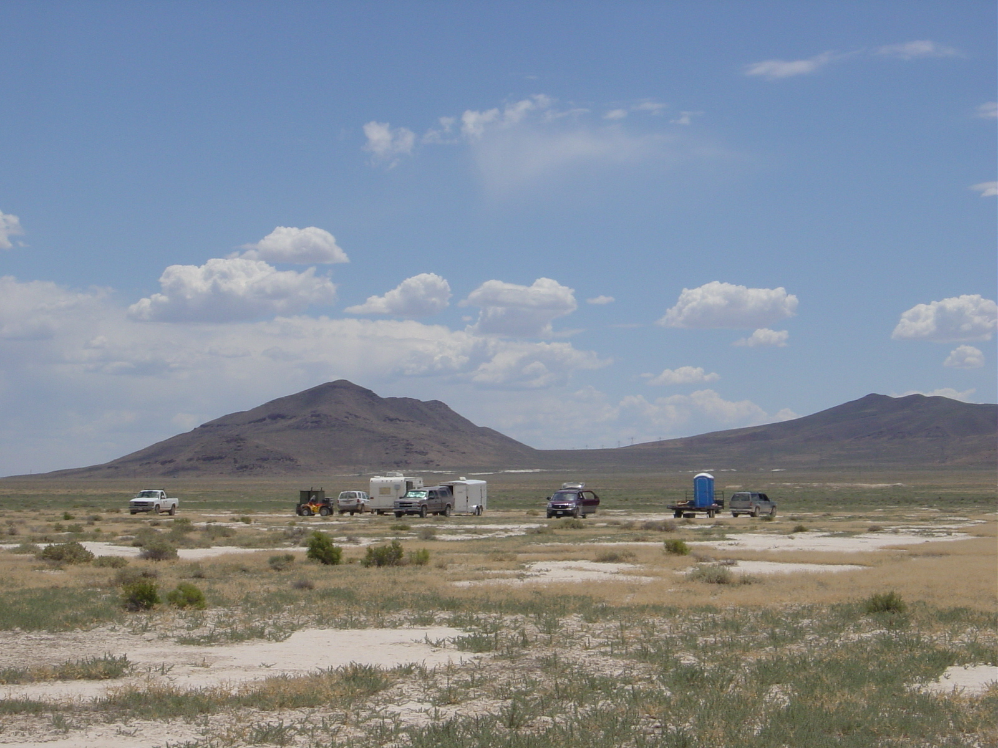
“Scientific Activities of ICRR”
--- Observation of Ultra-high Energy Cosmic Rays ---
The Status of Telescope Array
Oct. 19th, 2006 @ Kashiwa, Japan
M.Fukushima

Slide 2
Telescope Array (TA)
Originally planned as a large array of fluorescence telescopes
to identify the origin of super-GZK (E > 10²⁰eV) cosmic rays
(ICRR review in 2000).
HiRes monocular spectrum suggested existence of GZK cutoff
(27th ICRC @ Hamburg in 2001).
Physics? Method? Statistics?
Critical look at systematics of SD (AGASA) and FD (HiRes)
measurements became imperative.
Phase-1 TA financed in 2003 as SD / FD hybrid detector.

Slide 3
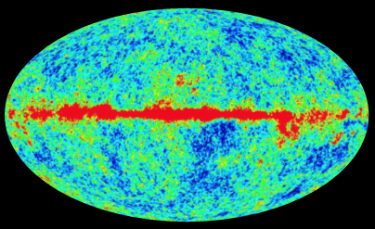
Mechanism of GZK Cutoff
ν
γ
p
π
＋
＋
ν
γ
＋
^{μ}
^{e}
E = 10 ²⁰ eV
n
p
E 0.8 x 10 ²⁰ eV
~
0.6 x 10⁻²⁷ cm²
2.725 K
411 ph / cm³
The super-GZK Cosmic Rays must call for a New Physics.

Slide 4
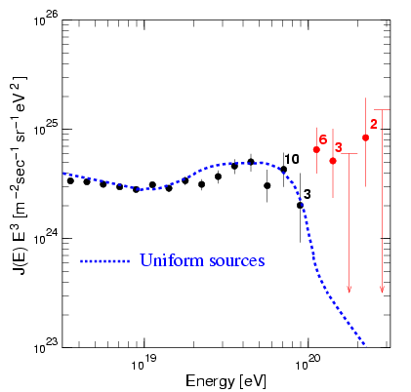
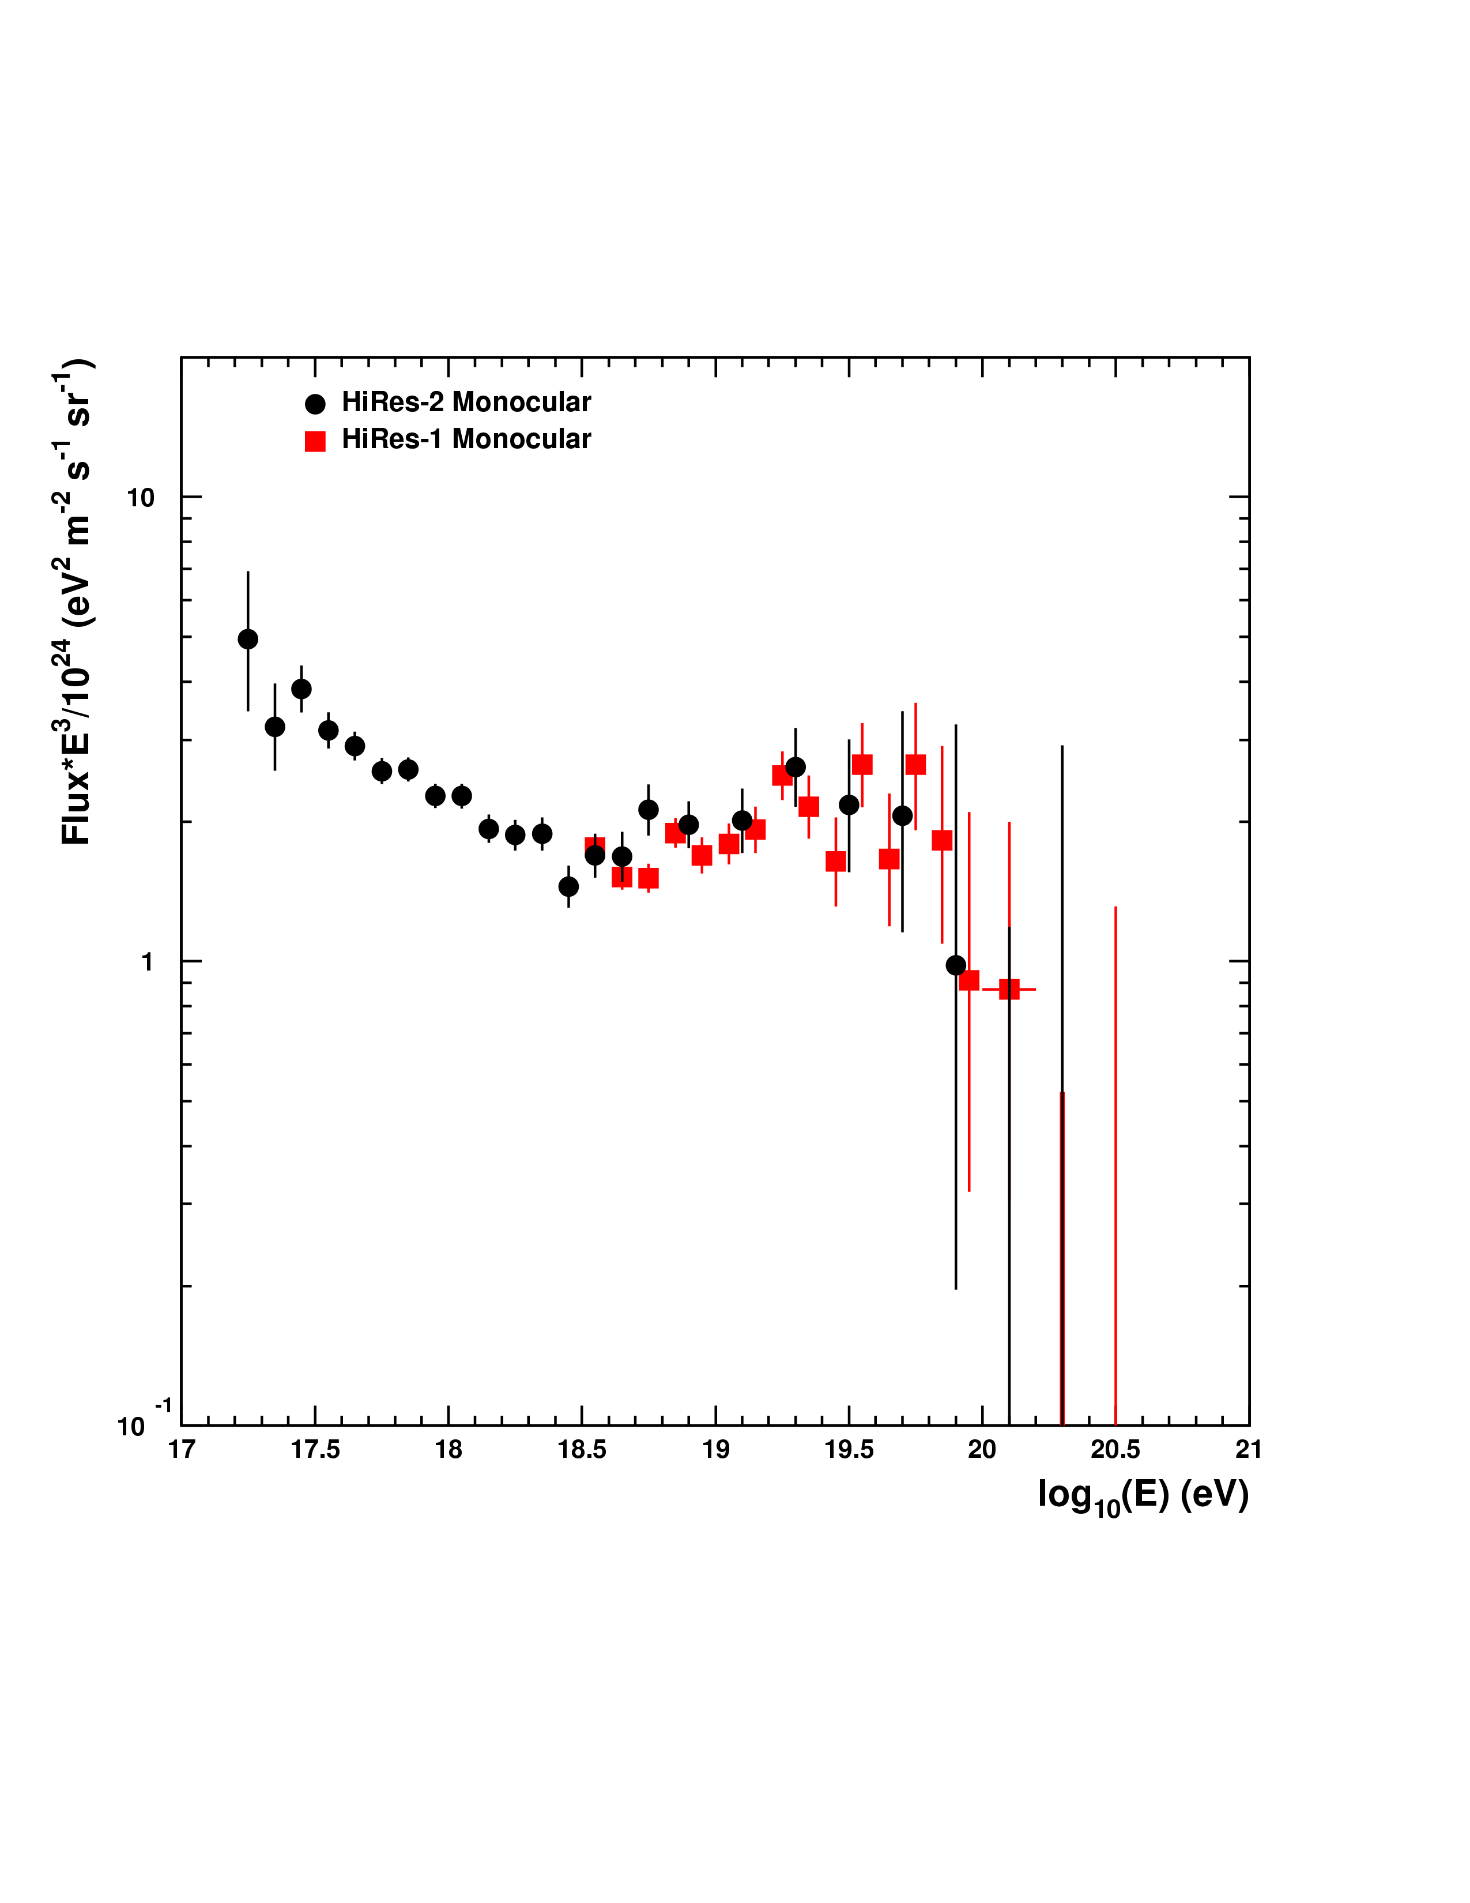
Energy Spectra by AGASA and HiRes (mono)
Ground Array (plastic scintillator)
Fluorescence Telescope
AGASA
HiRes

Slide 5
AGASA: stopped in Jan, 2004
Auger: 1st result in Aug. 2005
HiRes: stopped in Apr. 2006
TA: will start DAQ in April 2007
Auger-South: will be completed in 2007

Slide 6
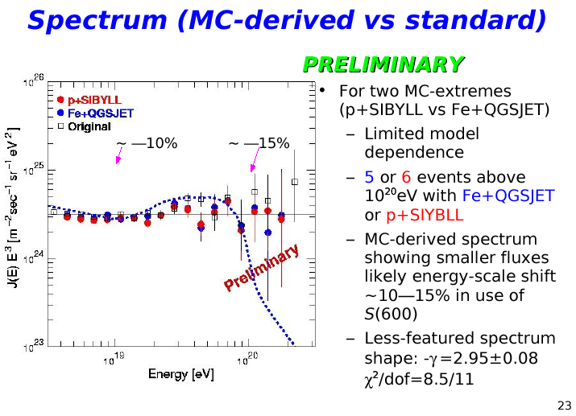
AGASA
SHINOZAKI
@WeiHai, 2006

Slide 7
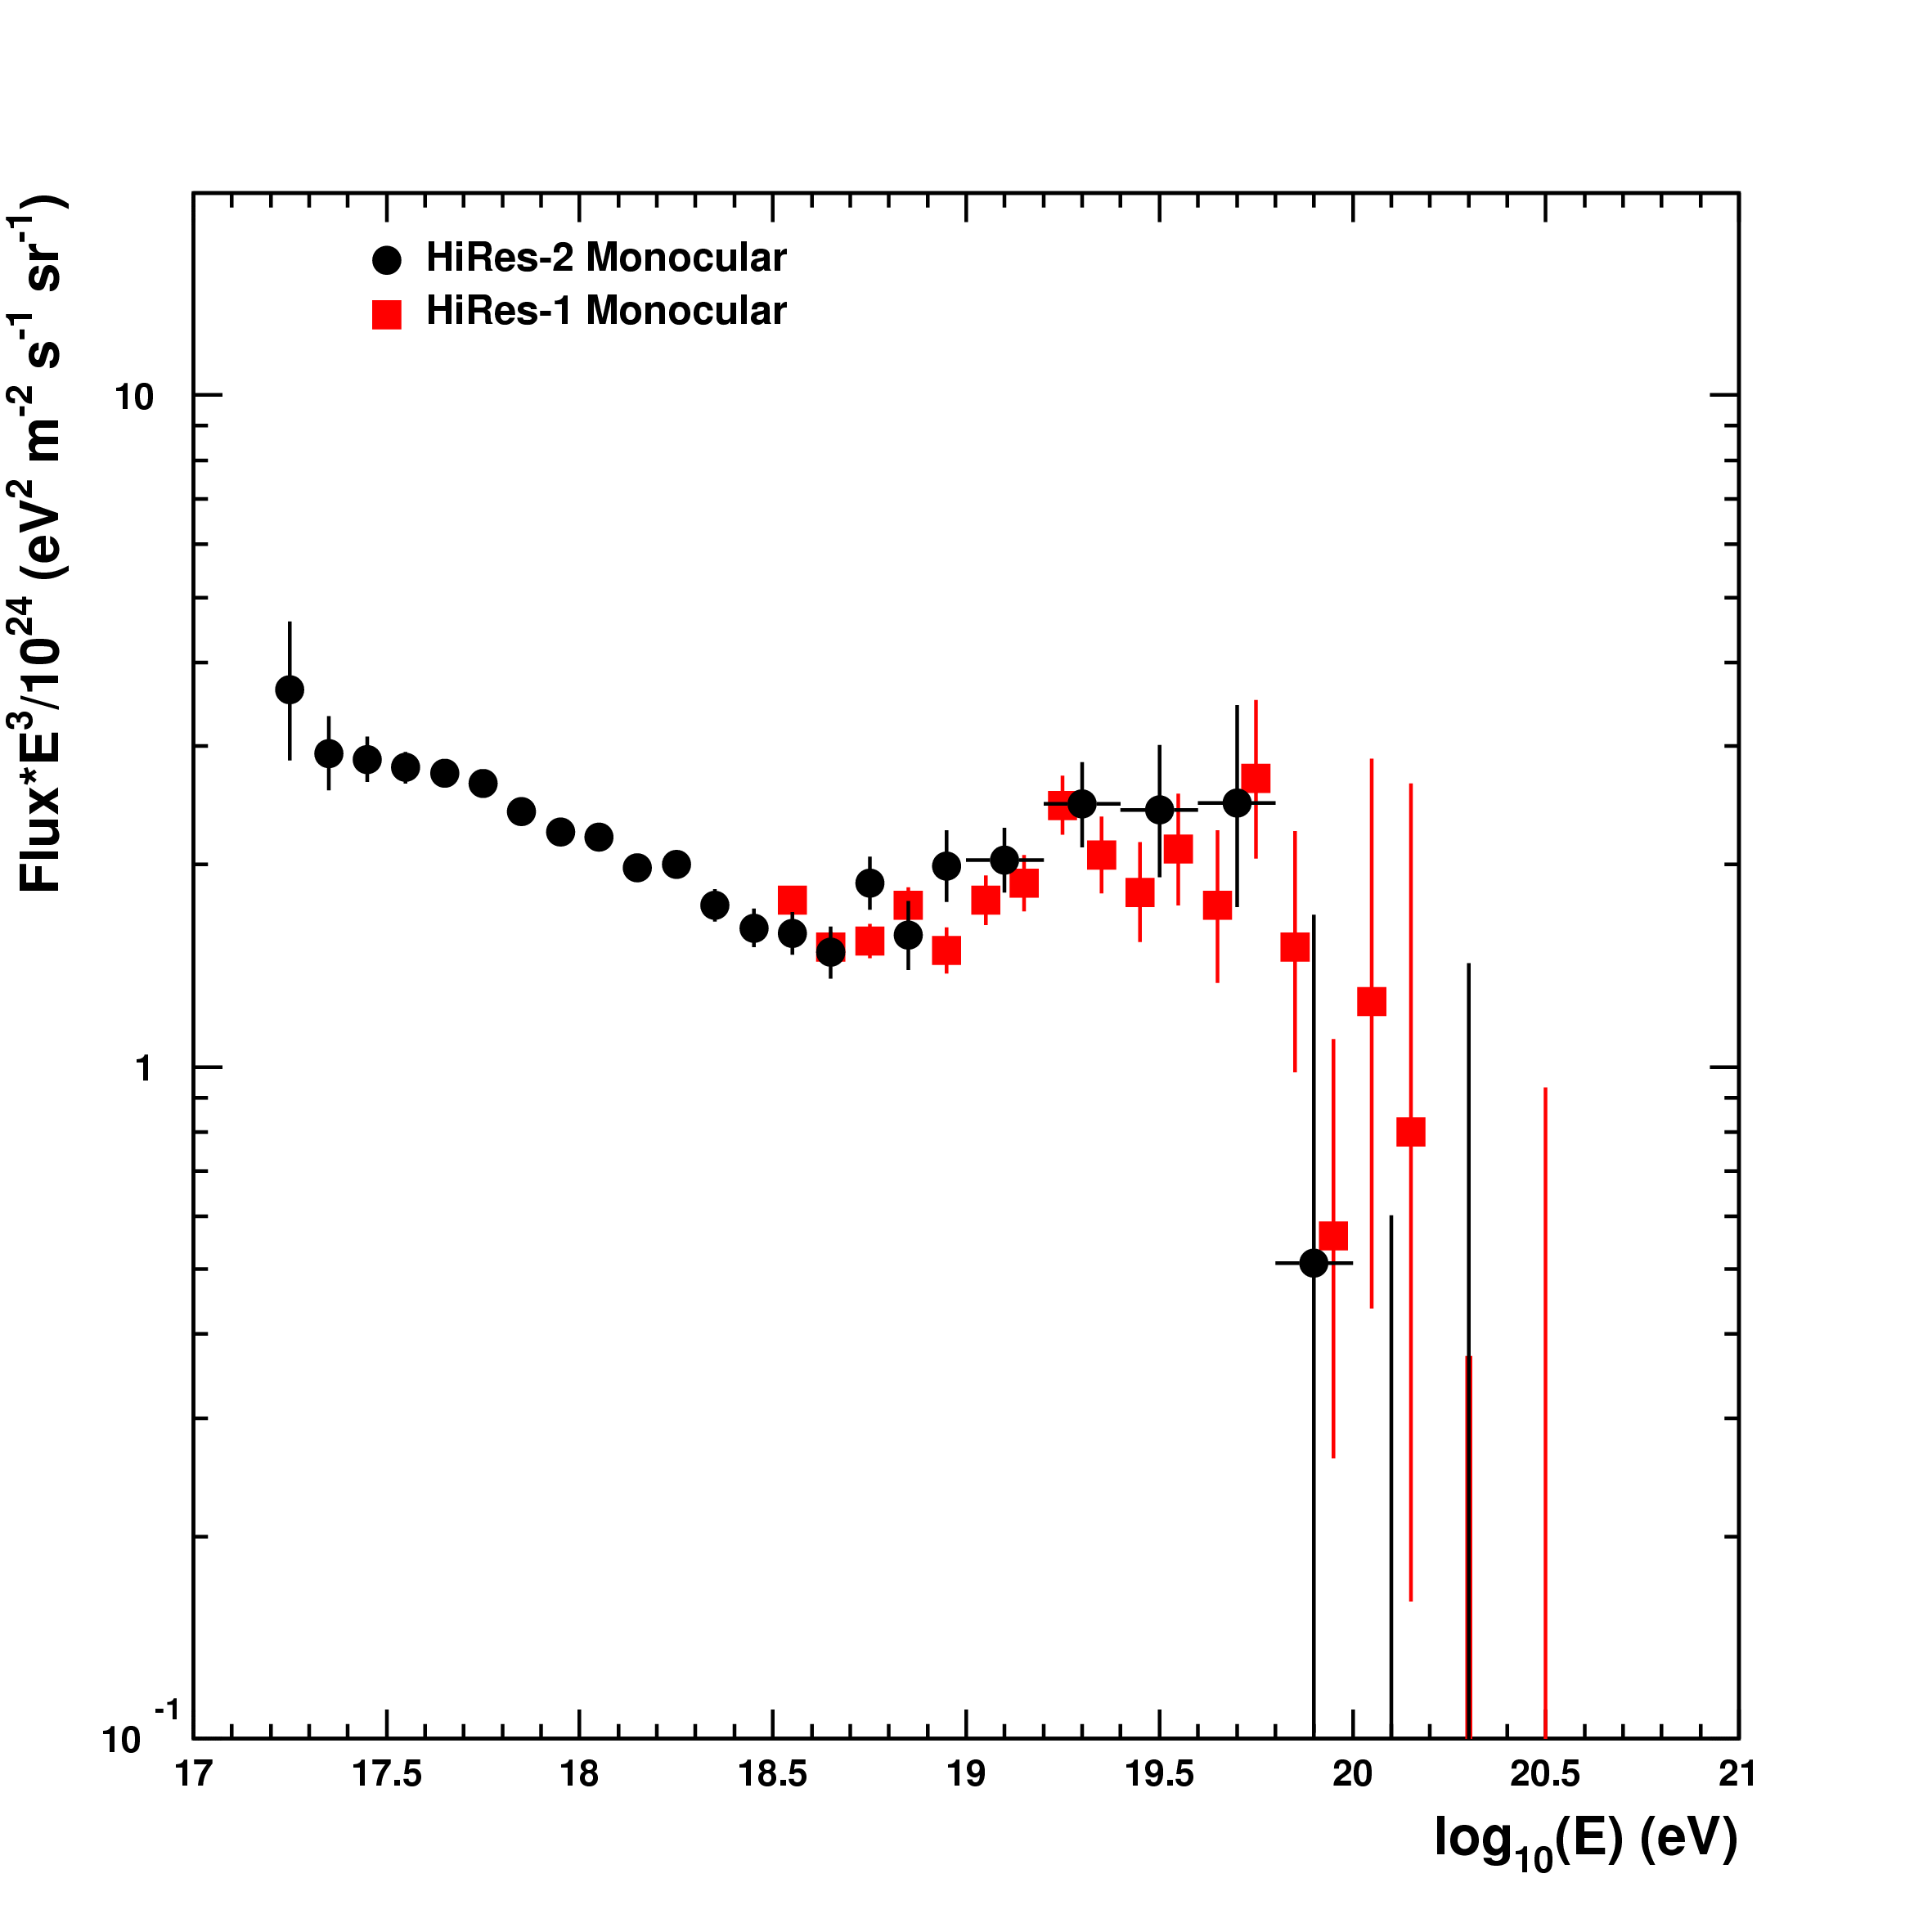
HiRes
Most recent Mono spectrum
(with cloud cuts)
New “fully efficient” stereo
Spectrum - no cloud cuts
Monocular Spectra
SOKOLSKY
@WeiHai, 2006

Slide 8
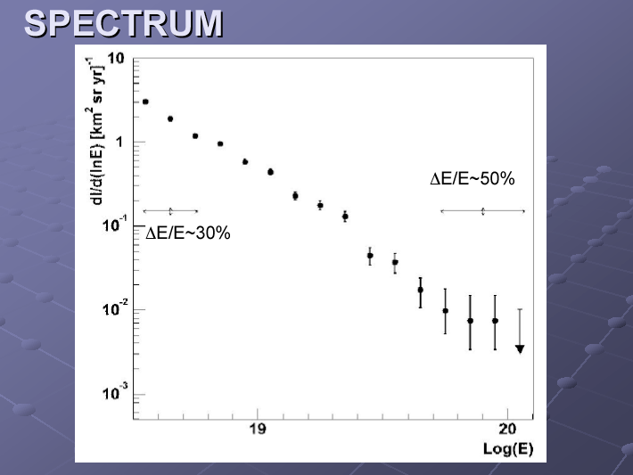
AUGER
ZAVRTANIK
@WeiHai, 2006

Slide 9
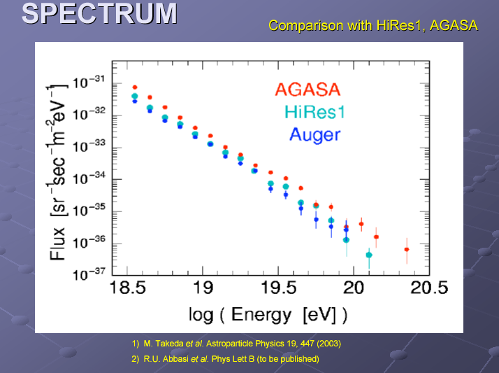
AUGER
ZAVRTANIK
@WeiHai, 2006

Slide 10
No conclusion reached on GZK.
Energy Scale is in question.
But it may not be the only cause
of Discrepancies.
Even after energy rescaling, # of events
with E > 10²⁰ eV differs among experiments.

Slide 11
AGASA: stopped in Jan, 2004
Auger: 1st result in Aug. 2005
HiRes: stopped in Apr. 2006
ph-1 TA: will start DAQ in April 2007
Auger-South: will be completed in 2007

Slide 12
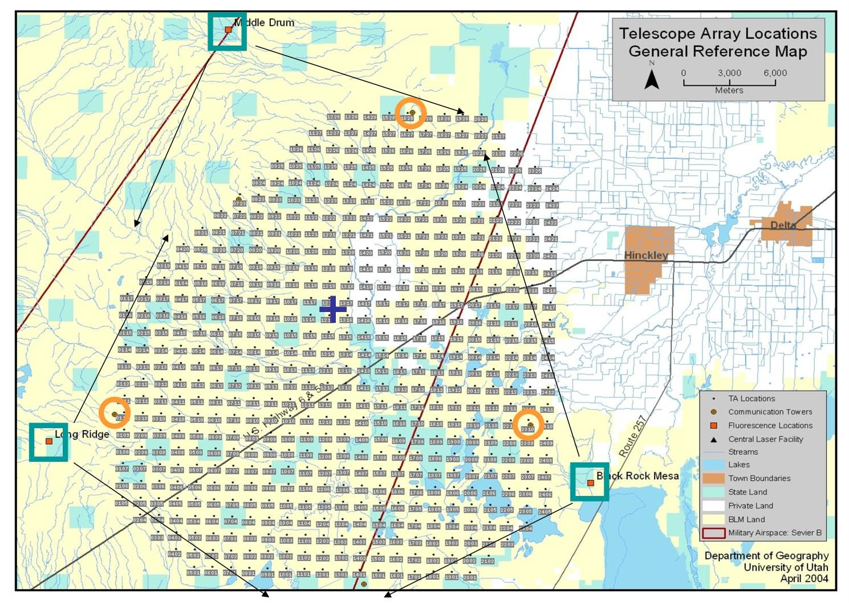
Millard County in Utah / USA
Phase-1 TA
576 Counters
AGASA x 9
Comm. Tower
CLF
TALE
3 x Fluorescence Stations
AGASA x 4
Low Energy Extension

Slide 13
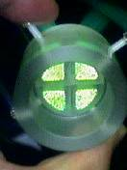
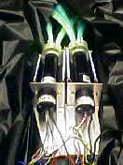
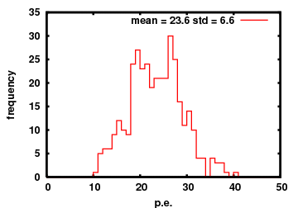
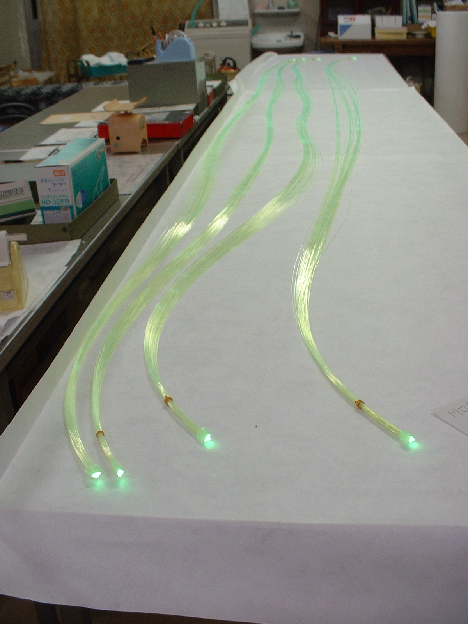
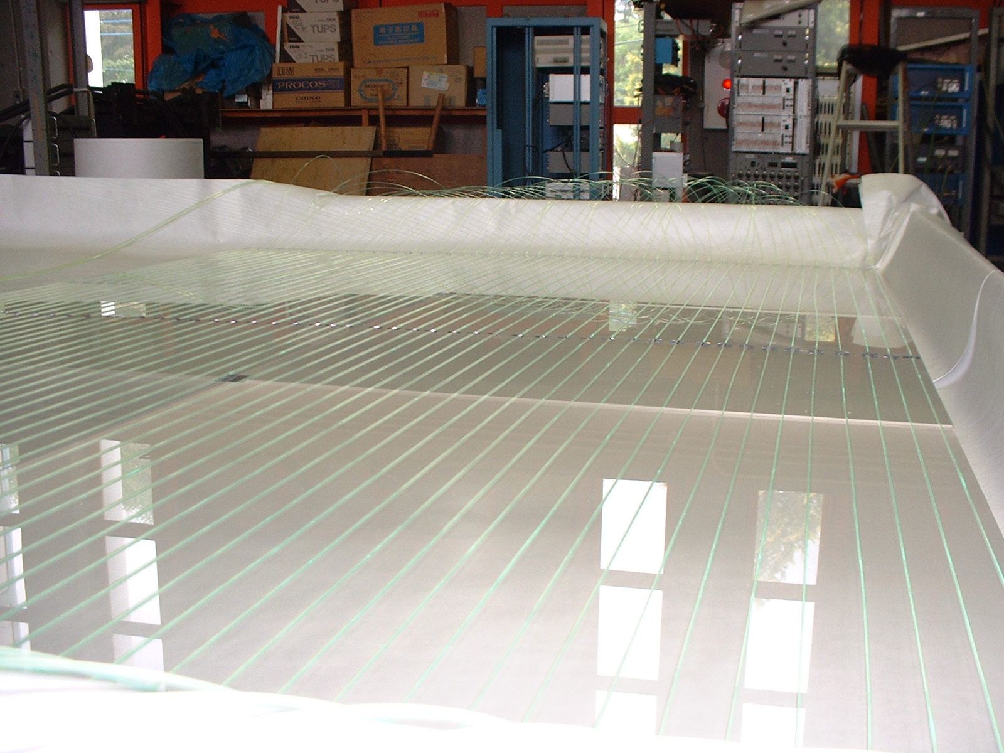
Plastic Scintillator
3 m², 12 mm t
WLSF readout, 2 layers overlaid
1 MIP photo-electron distribution
24 pe

Slide 14
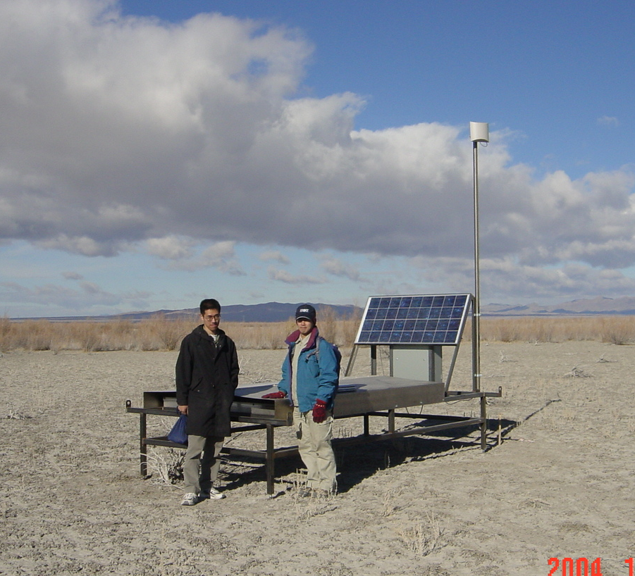
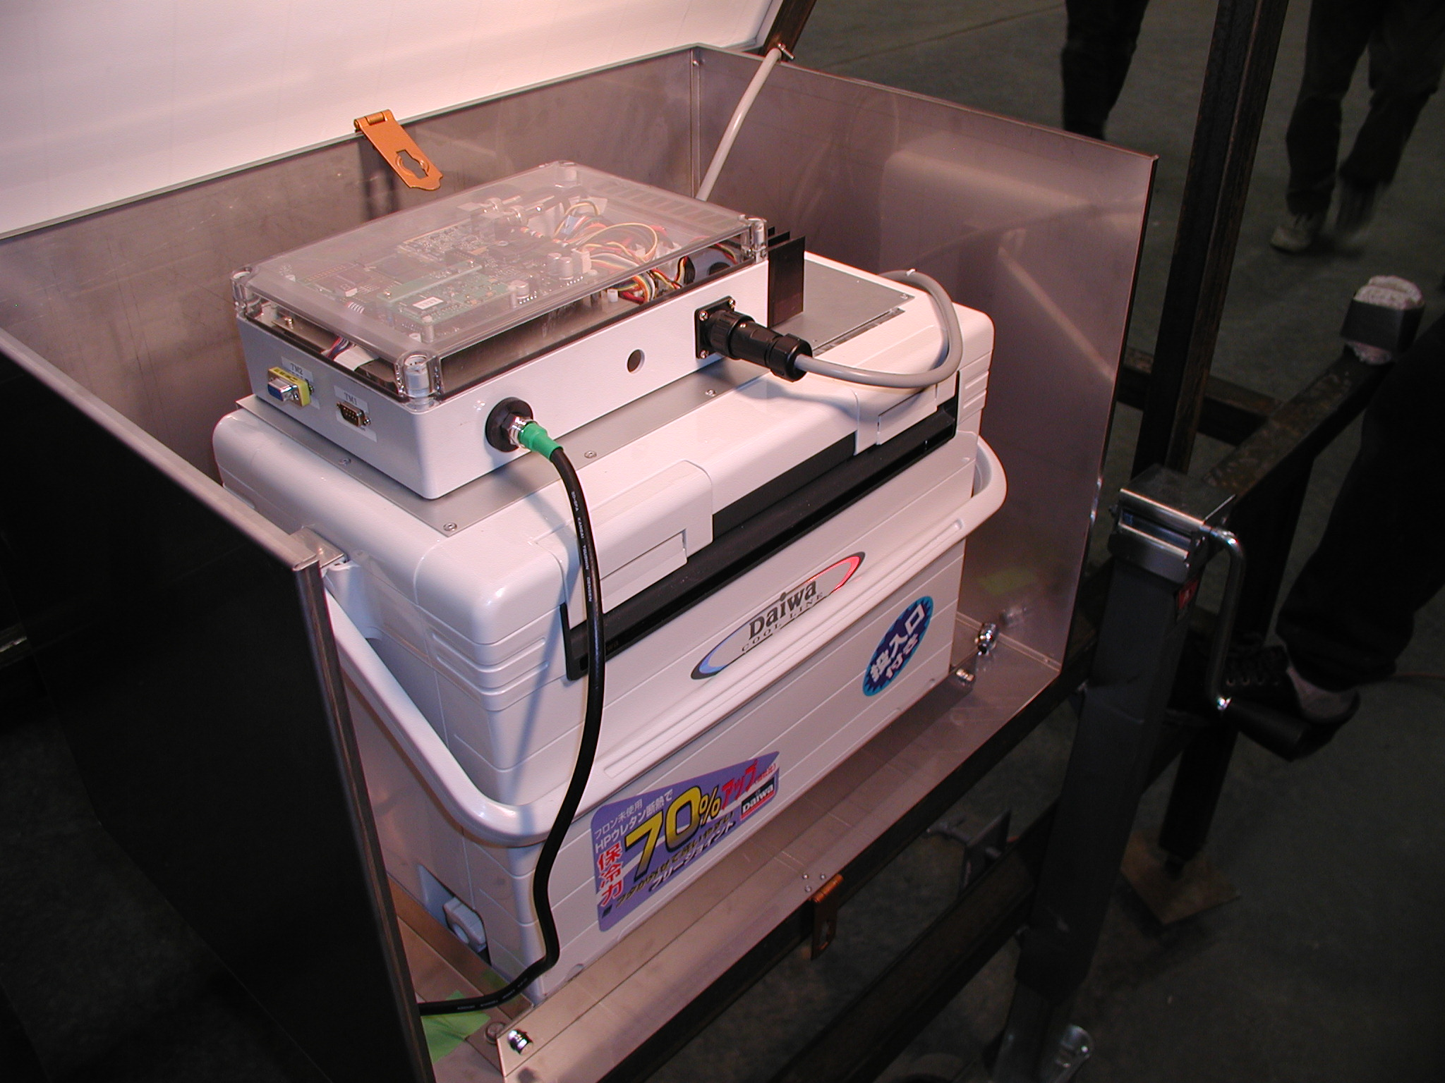
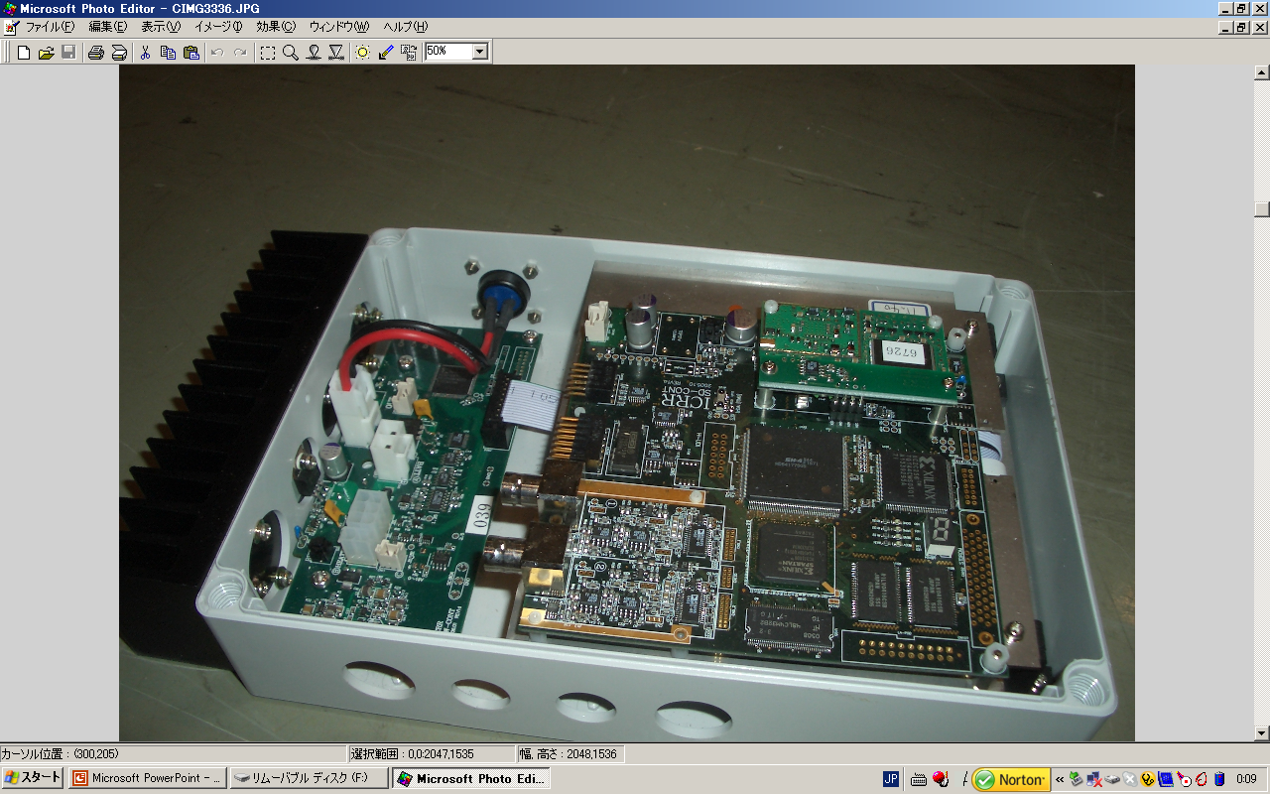
50 MHz, 12 bit FADC
GPS time stamp (~20ns)
Wireless LAN modem
Solar panel + charge controller
Battery
Slow control

Slide 15
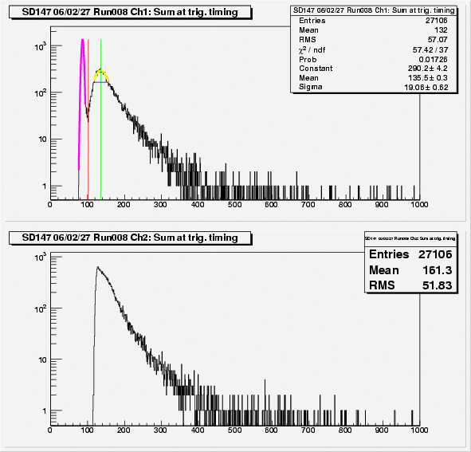
muon
spectrum
Spectrum and Rate for Cosmic Muon
trigger
Integrated over 12 time bins (240ns)
Wave form recorded
locally at each counter
Upper layer
628 Hz at 1/3μ
Timing sent to
comm. tower for
Coincidence Trigger
42 Hz at 3μ
~ 1000 Hz. Triggered by lower layer at 1/3μ level

Slide 16
Why Plastic Scintillator ?
Conserve AGASA energy scale and check
Sample electromagnetic shower (~90% of Eprimary)
>>> less dependent on
    primary composition
    hadronic interaction @EHE
Why Two Layers ?
trigger and calibration by muon
wider dynamic range (PMT Gain H/L)
linear upto 60 / 360 MIPs in 20 ns
S(600) for 3 x 10²⁰eV
may vary over GZK energy

Slide 17
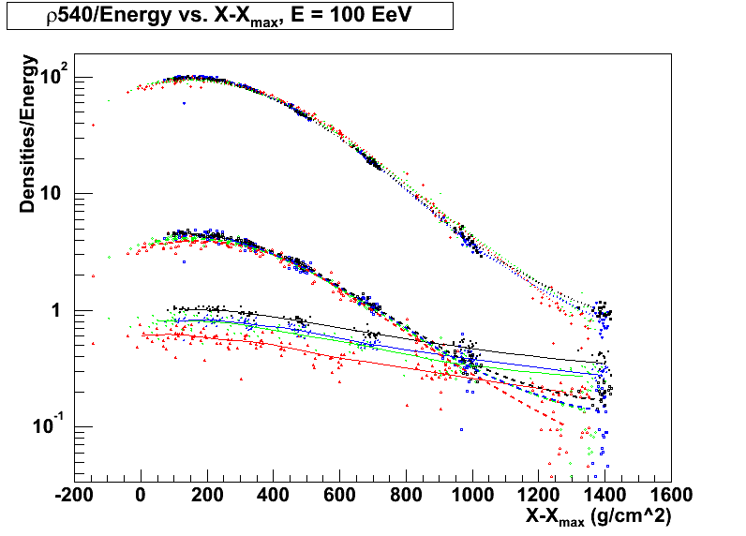
AUGER
Particle density at 540m from shower core vs X - Xmax
Iron/QGSJET
γ
0º
25º
Iron/SIBYLL
36º
Proton/QGSJET
45º
Proton/SIBYLL
e±
53º
ZENITH ANGLE
60º
66º
μ±
ARISAKA
GAP 2004-037

Slide 18
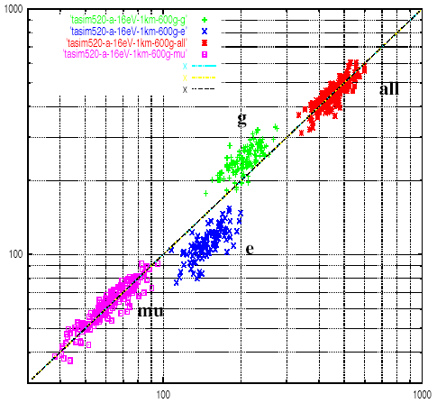
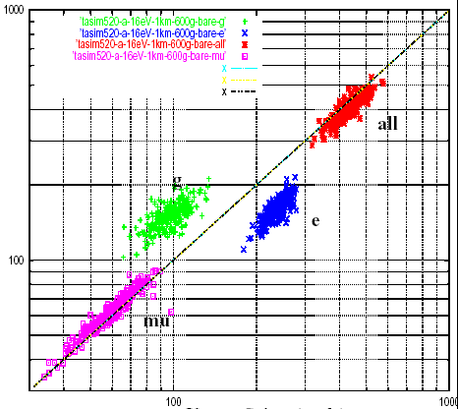
Expected Signals from e, γ, μ
by GEANT for 10¹⁶eV proton shower
@ 600 g/cm² and 1 km away from core
2.0 mm t Al
1.2 mm t Fe
1.0 mm t Fe
1.2 mm t Fe
10 mm t Scint.
# of particles in lower scintillator
# of particles in upper scintillator

Slide 19
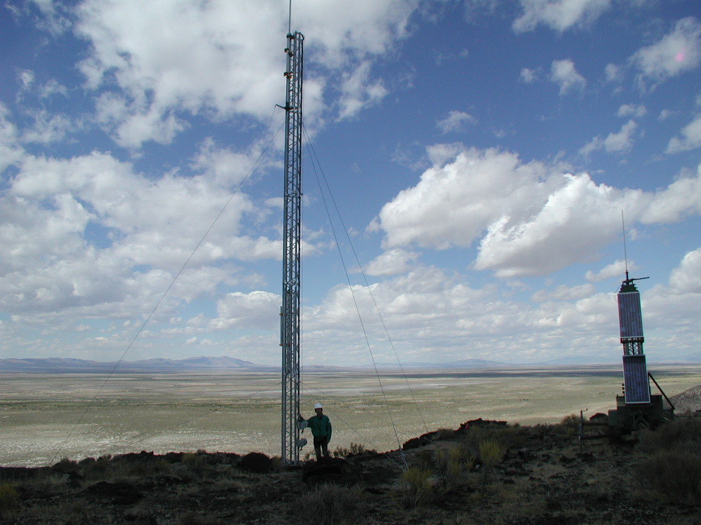
○ 80% of SDs & 3 towers on federal land.
○ Took 2.5 years for getting permission from BLM office.
Surveys of endangered animals and plants, cultural resources
and historical sites, and numerous other administrative works
done by U of Utah colleagues.
○ First comm. tower built on Sept.15th + 16th
○ First 50 counters will be deployed today (Sept 19).
○ 516 counters will be in the field by next February.
● 合計５１６台を、２００７年２月までに設置の予定

Slide 20
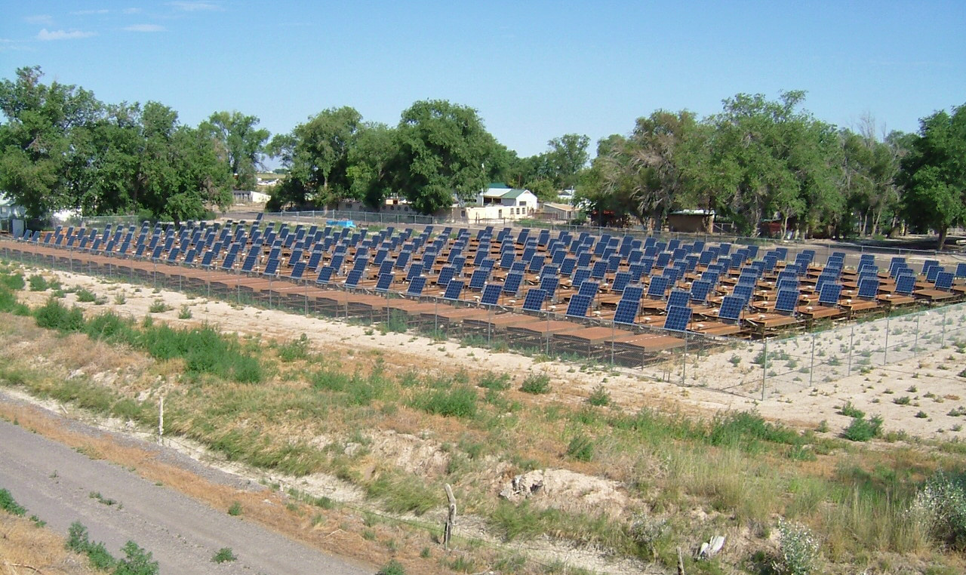
SDs waiting for Deployment near Delta Cosmic Ray Center

Slide 21
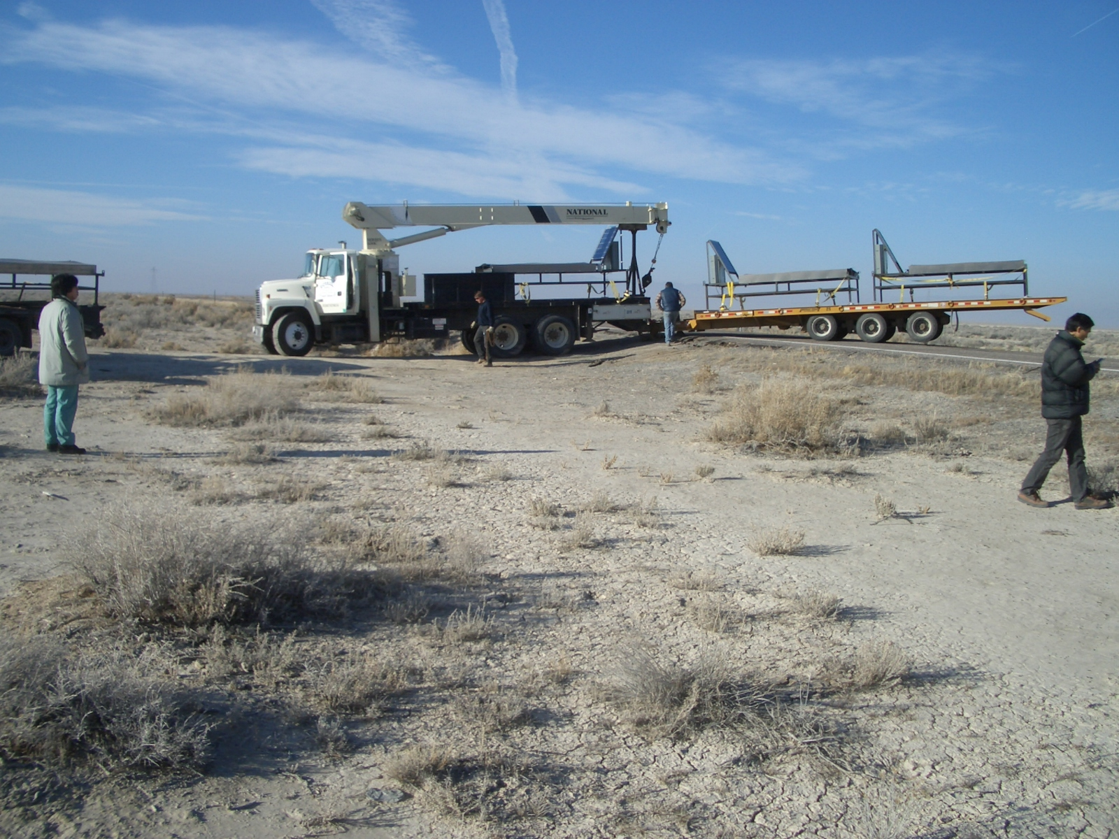
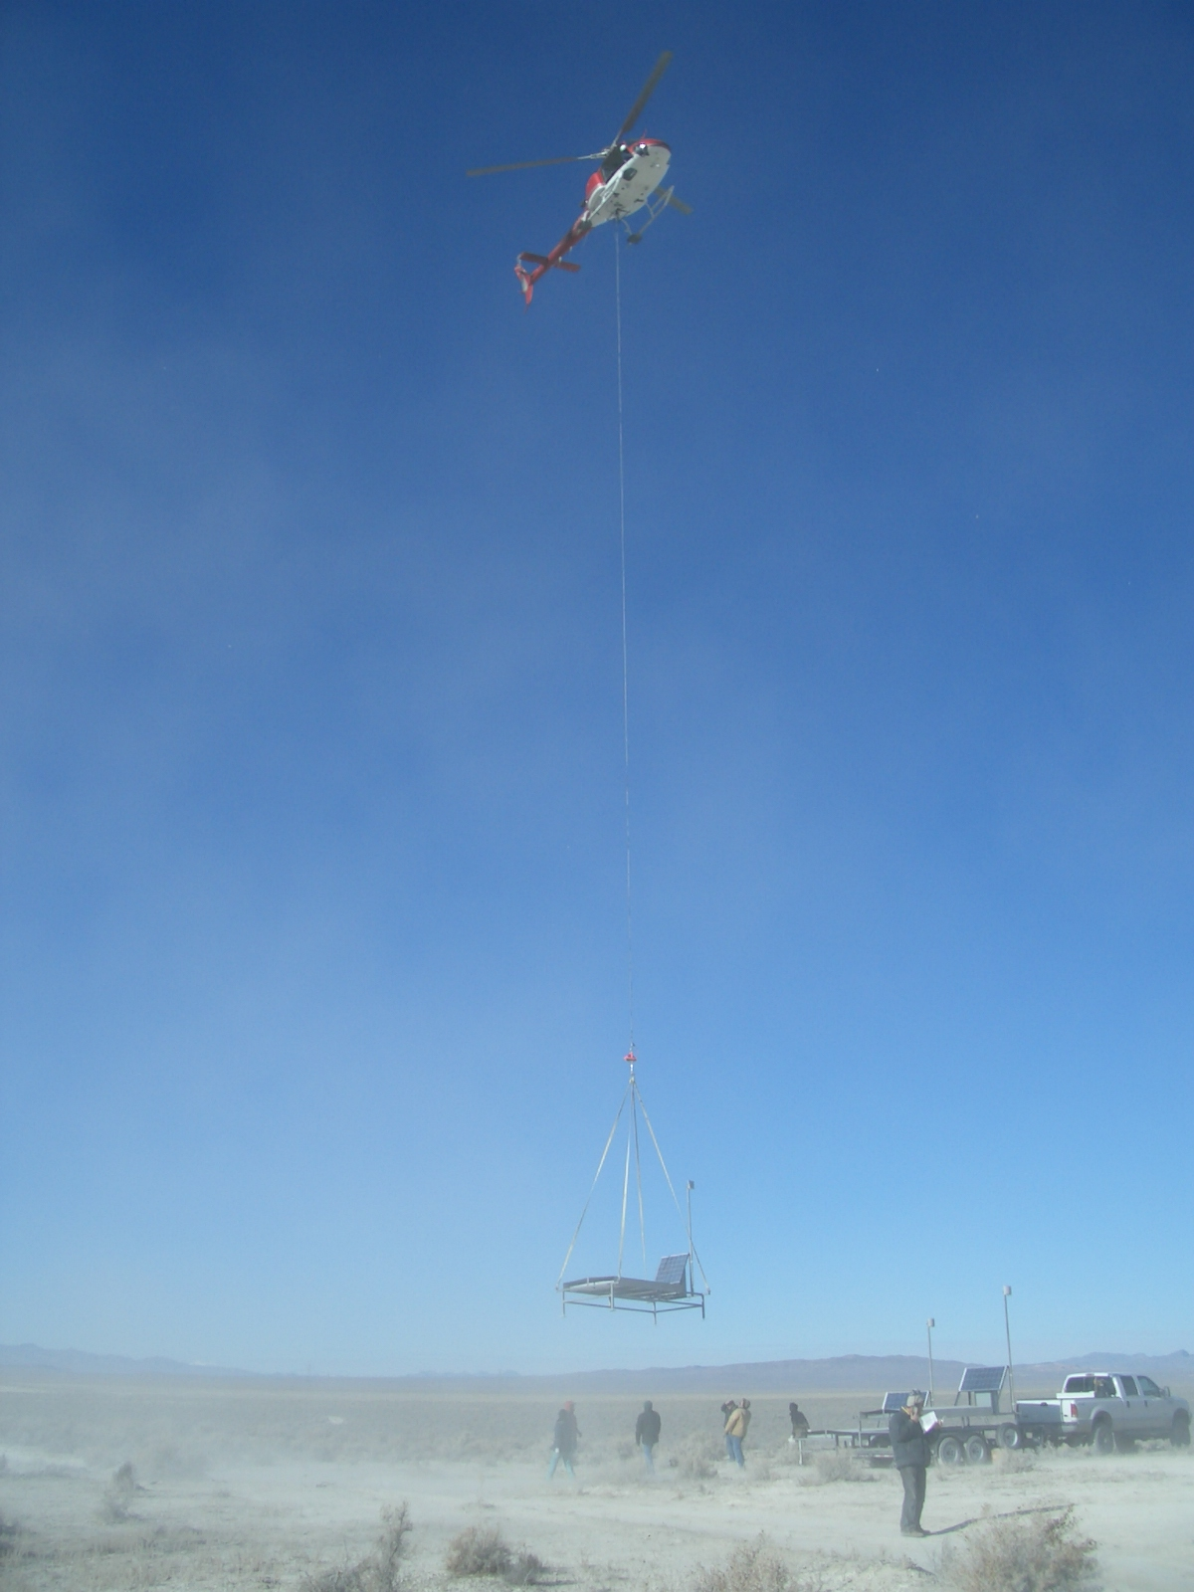
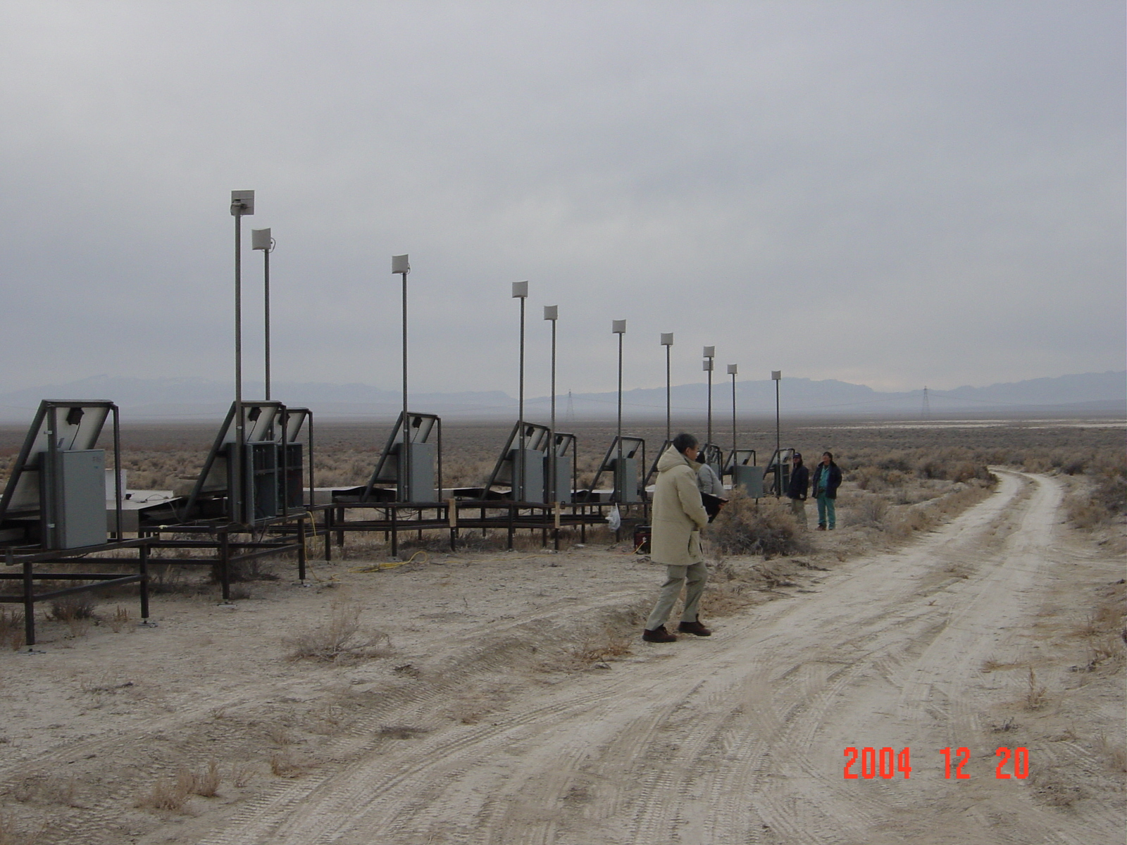
TEST DEPLOYMENT in Dec. 2004
From Delta to staging area (~30km)
18 SDs at the staging area
18 SDs deployed in 3 hours

Slide 22
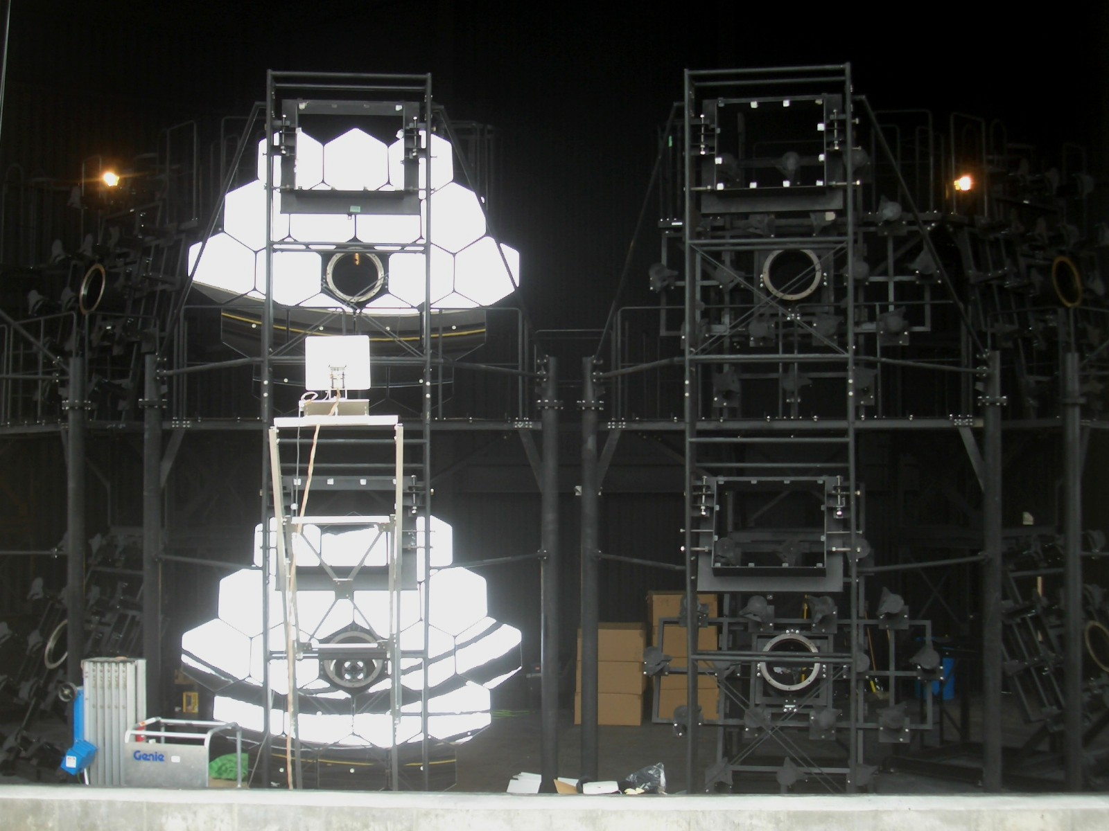
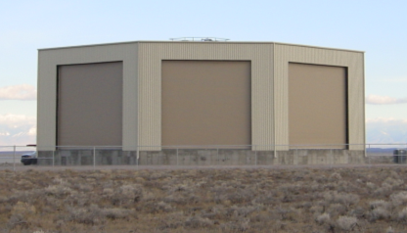
FLUORESCENCE ELESCOPE
Fixed telescope with spherical mirror
One telescope with 18⁰ x 15⁰ FoV
seen by mosaic PMT camera
6 x 2 telescopes / station
Field of View 3⁰-33⁰ for elevation
108⁰ for azimuth

Slide 23
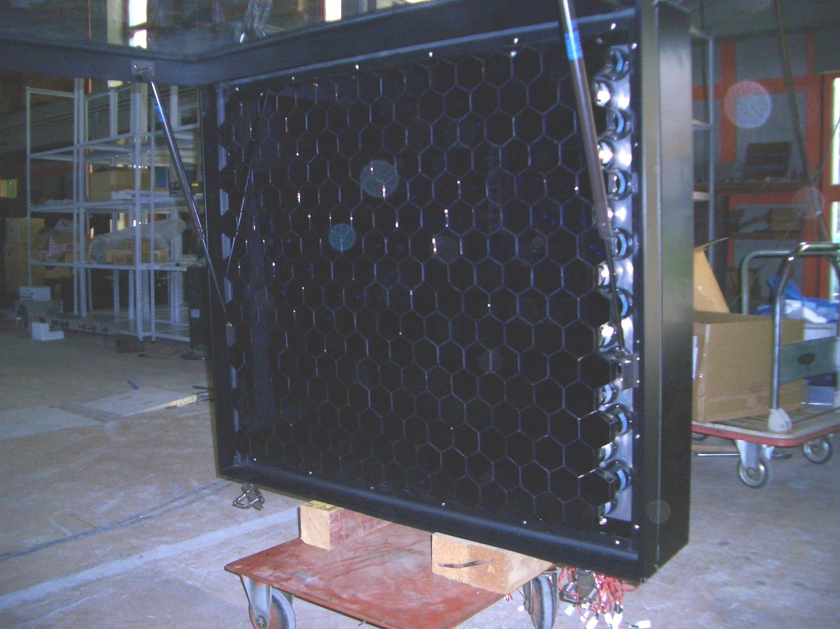
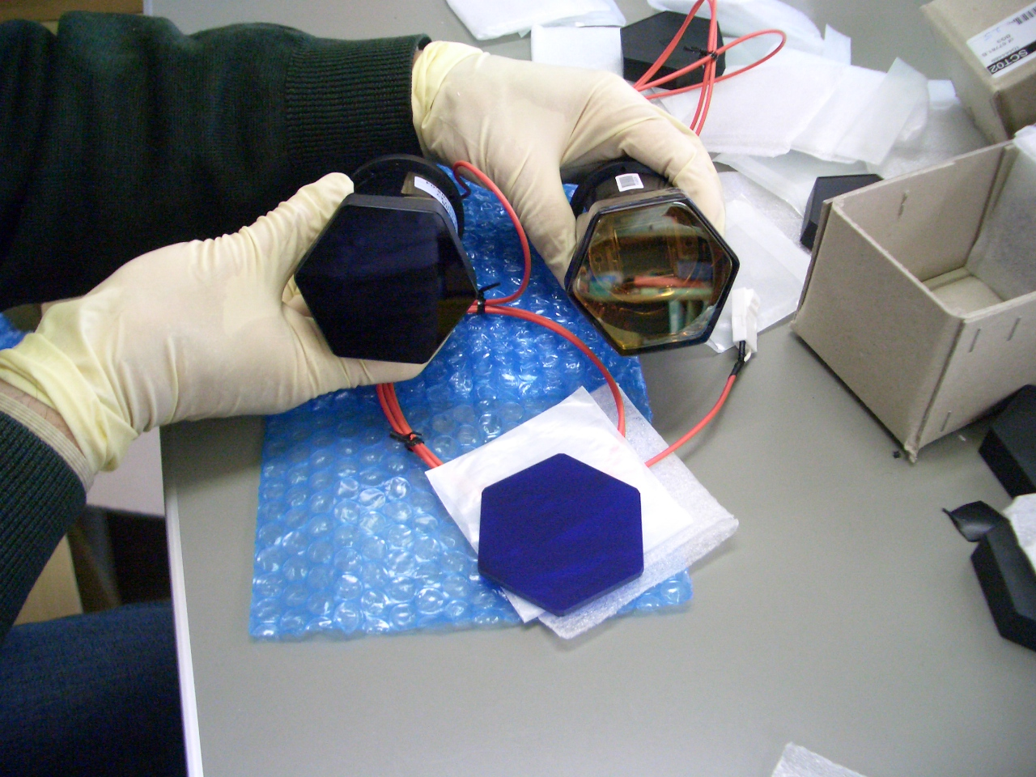
TELESCOPE CAMERA
16 x 16 PMT array
BG3 glass filter (UV transparent)
Pre-amplifier (x 50)
1. 3 PMTs: absolutely calibrated
by standard UV light source (self develop.)
& PMT gain monitored by YAP + ²⁴¹Am.
2. All 256 PMTs: relatively adjusted in situ
by diffused light ( Xenon flasher )
3. XY-mapping by UV-LED scanner

Slide 24
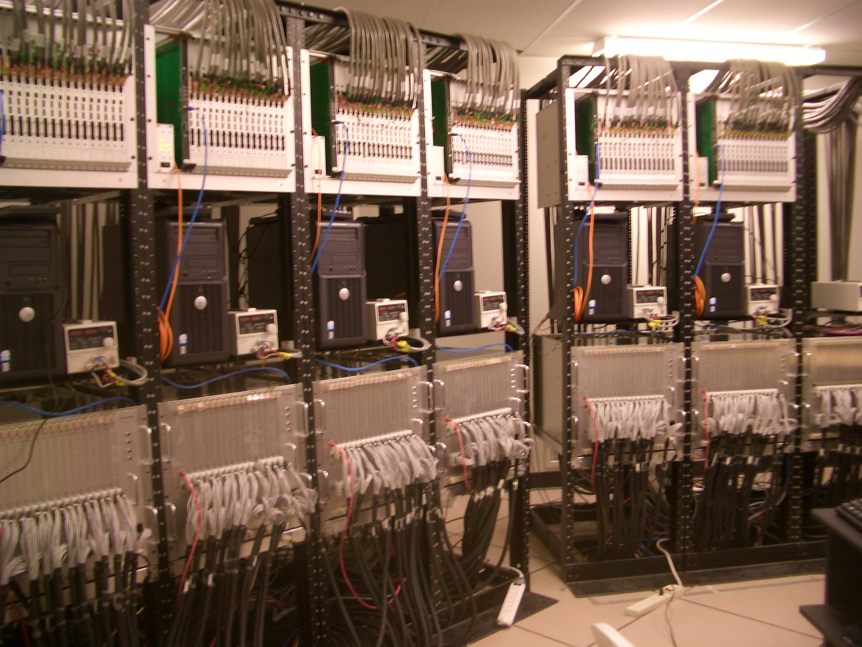
TELESCOPE ELECTRONICS
FADC
Track Trig.
PC
LV
HV PS
1 camera

Slide 25
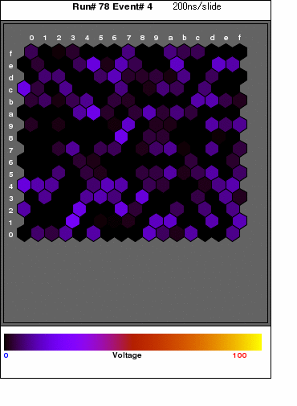
One of the first events of TA: 2005/07/12, 2:52 am, Utah.
200 ns / step.
top / bottom & left / right of camera view reversed.

Slide 26
Spherical Mirror (3.3m φ）, 1⁰ pixel PMT
Conserve HiRes optics (30% more light than HiRes)
Simple in Optics & Mechanics
“Sandwich” configuration for stereo meas..
    less than 20 km to the nearest FD station
    always tagged by the SD
-HV, DC coupled, 40MHz,12-bit sampling
No wave form distortion
Direct night sky BG measurement
“FD as a lidar”
~ms baseline update
5 contiguous PMTs for “track” trigger

Slide 27
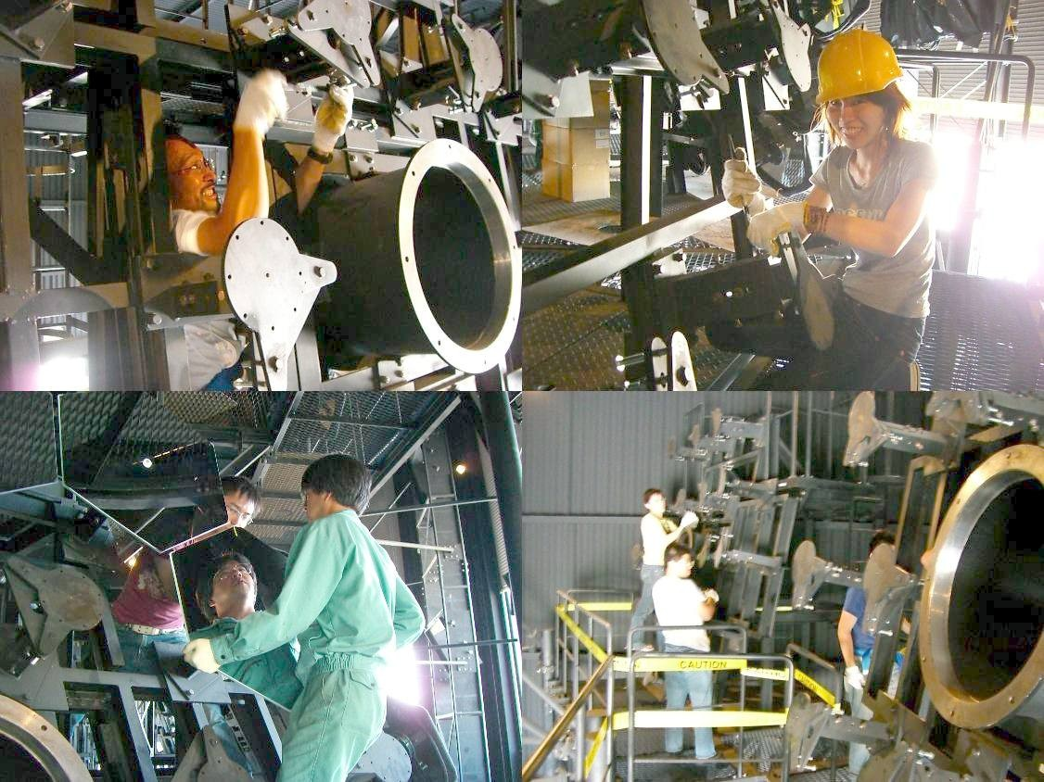
1st FD station: 8 / 12 telescopes completed
2nd station: to be ready by March, 2007
3rd station: transfer of HiRes. Ready by June, 2007.

Slide 28
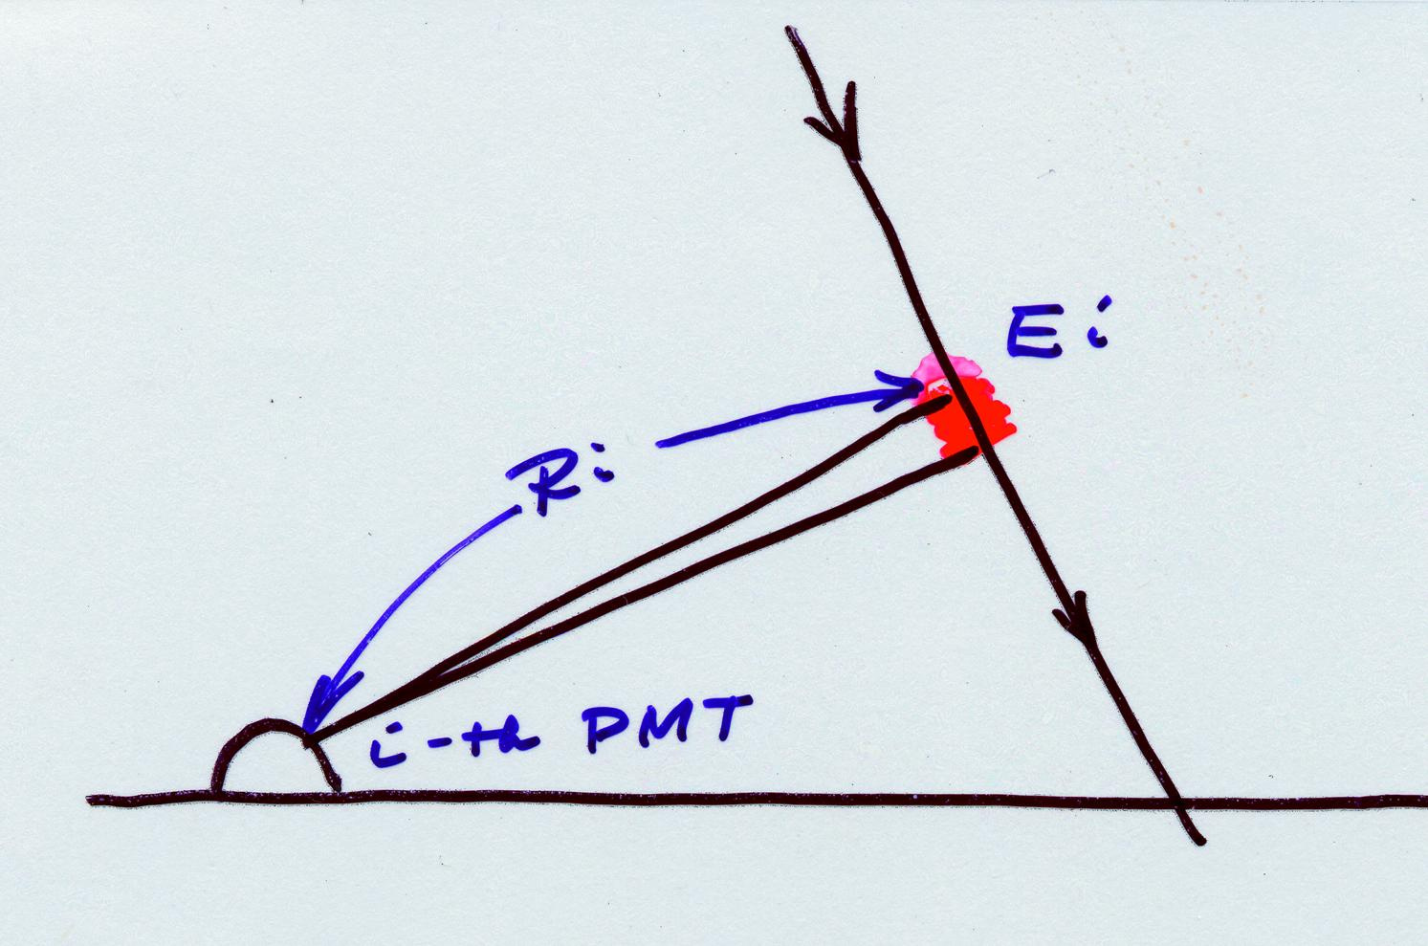
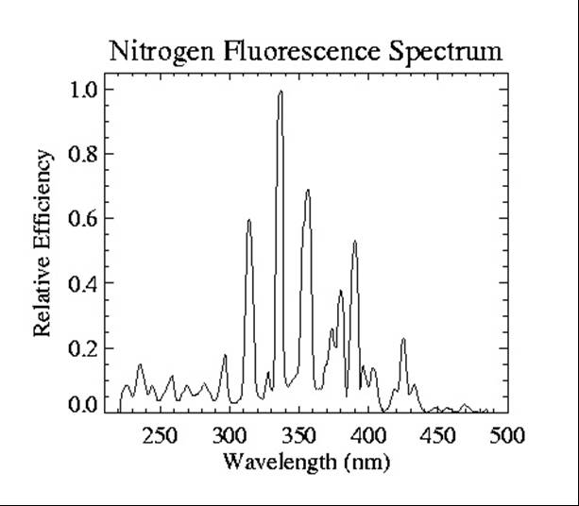
FD is a Total Absorption Calorimetry for absolute energy measurement
2. Atmospheric Corr.
1. Fluores. Eff.
loss of photons
ΔE # of photons
Air Fluorescence Spectrum
3. Telescope Calib.
# of ptotons ADC ch

Slide 29
Energy Deposit ＝
Fluorescence Efficiency
ｘ Rayleigh and Mie Scattering Loss
ｘ Obscuration （by camera and supporting structures）
ｘ Mirror Area and Reflectivity
ｘ Transparency of Camera Window （UV transp. lucite）
ｘ Transmittance of BG3 Filter （against Night Sky bg）
ｘ PMT Gap
ｘ PMT Quantum Efficiency
ｘ PMT (dinode) Collection Efficiency
ｘ PMT Gain
ｘ Preamplifier Gain
ｘ Cable Attenuation
ｘ Shaper/Amplifier Gain
ｘ FADC Conversion Gain
ｘ FADC Count
1.
2.
3.
4.
5.
6.
7.
8.
9.
10.
11.
12.
13.
14.
15.
Piece to Piece Calibration is needed.
We also have Xe flasher, YAP and LED
but….
Energy Deposit FADC count
Direct End to End Calibration is wanted.
５％? ｘ ＳＱＲＴ（１５） ～ ２０％ ???

Slide 30
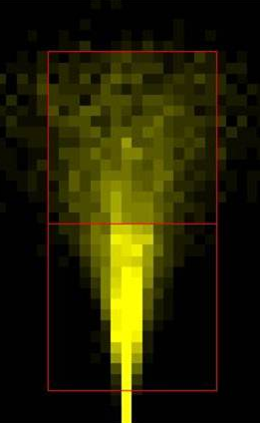
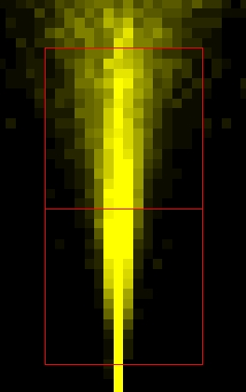
Inject Electron Linac Beam （10 - 40 MeV） into the Sky
Telescope FoV
PMT pixel
20 MeV
100 m away
40 MeV
100 m away
20 MeV / particle x 10⁹ ppp = 2 x 10¹⁶ eV total energy deposit.
Absolutely calibrated Light Source!!
From Energy deposit to ADC ch.

Slide 31
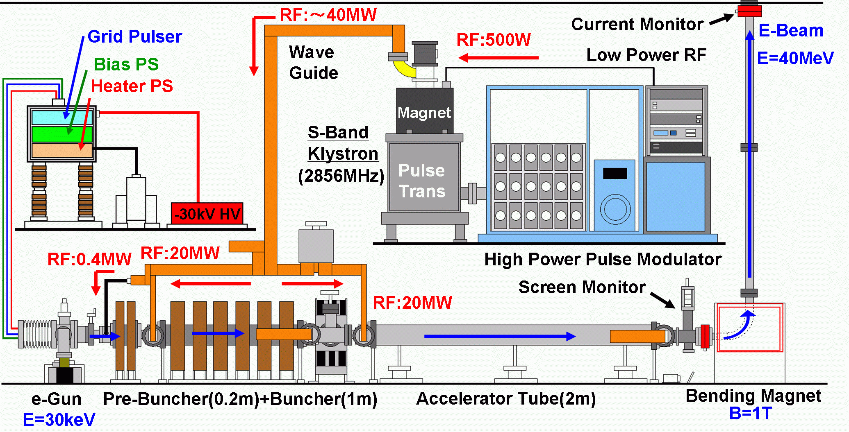
TA-Linac for calibration
Assembly of TA Linac proceeding using KEK B factory injector
components. Beam test at KEK in March, 2007.

Slide 32
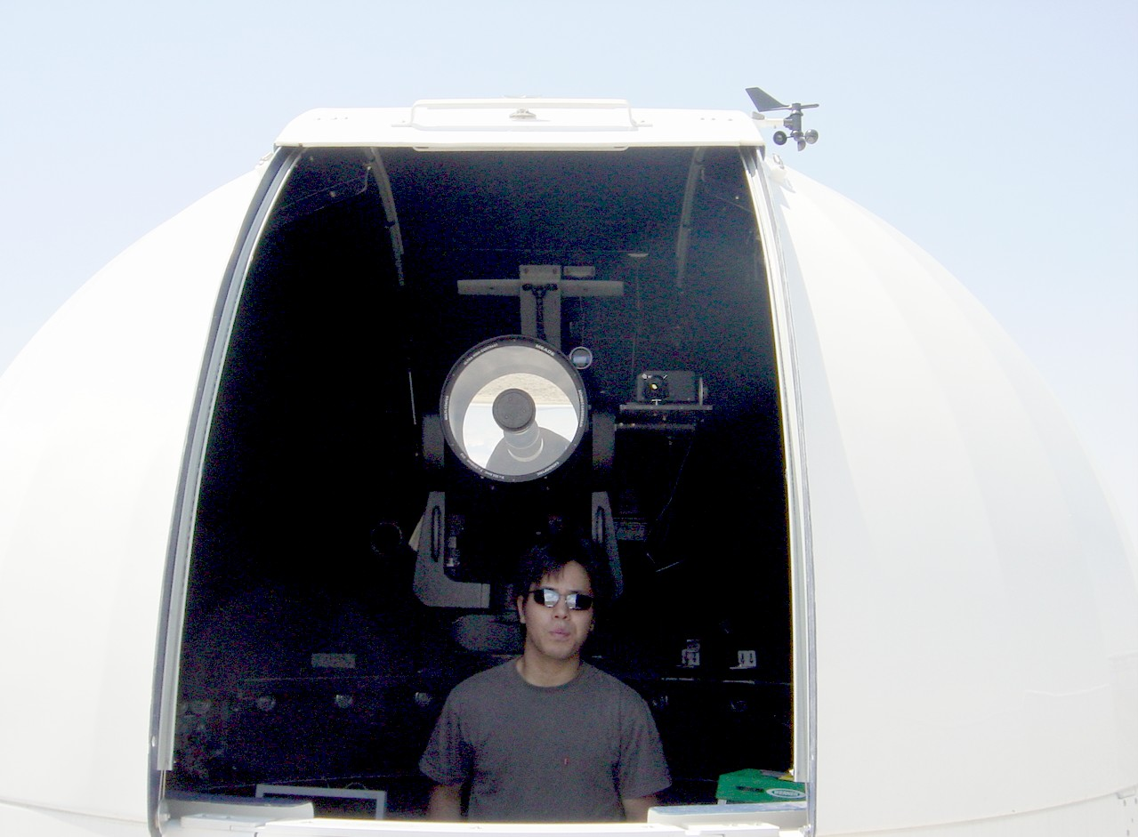
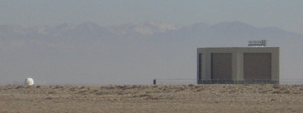
Lidar for Atomospheric Monitoring
YAG laser (355 nm, 5mJ)
MEADE telescope
on alto-azimuth mount.

Slide 33
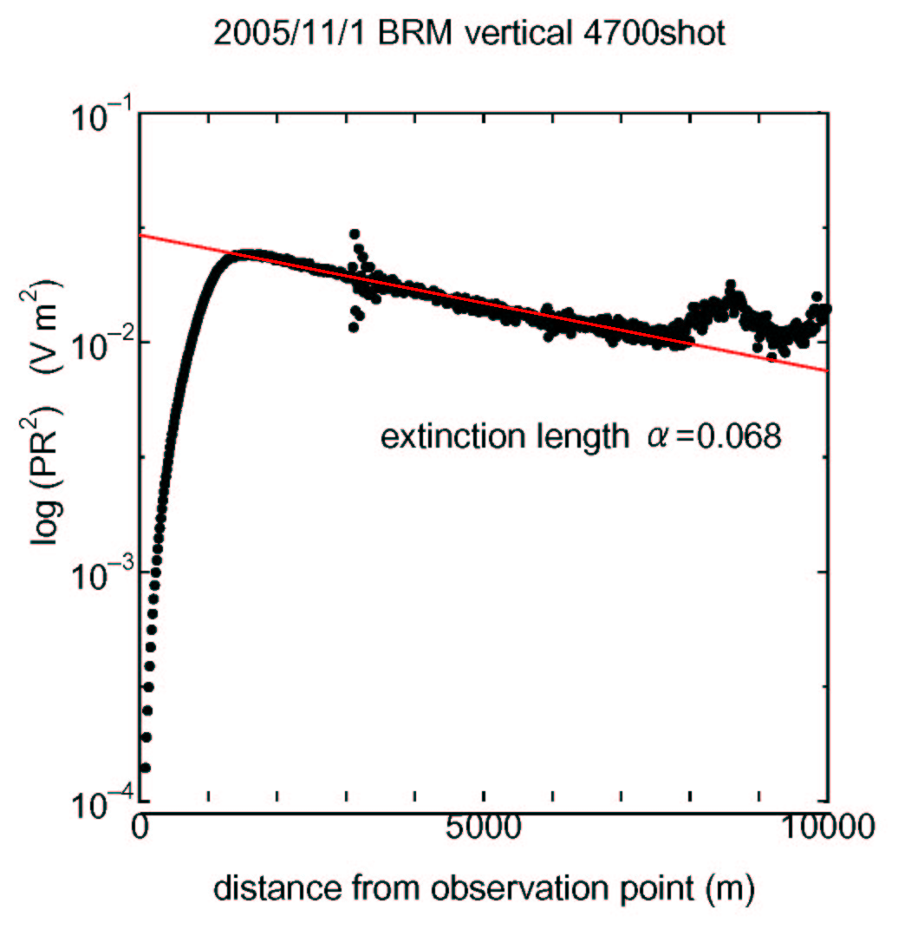
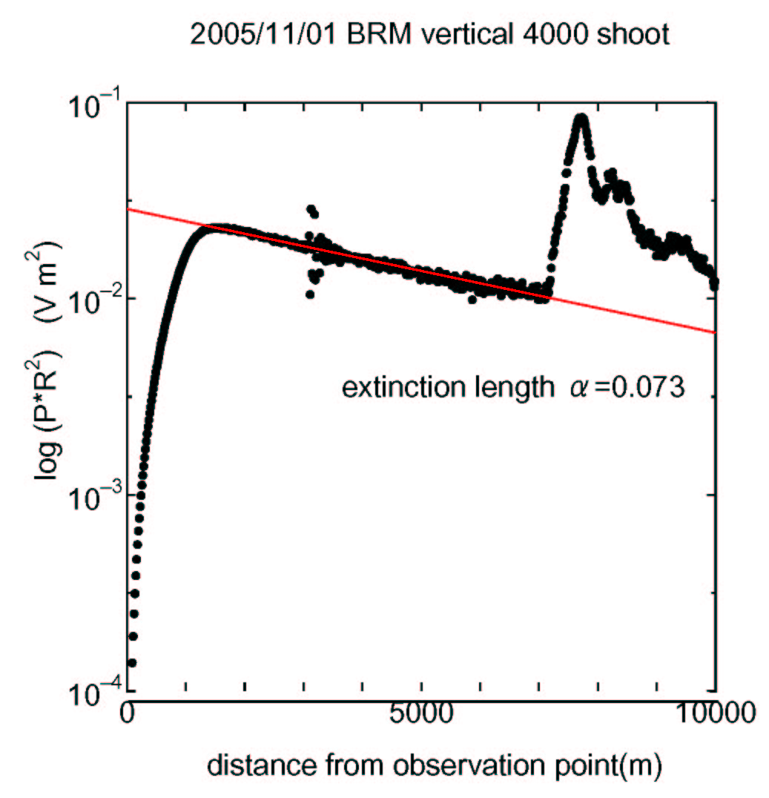
Lidar Observation at the BRM station
LOG (photons・R²)
Distance R (m)

Slide 34
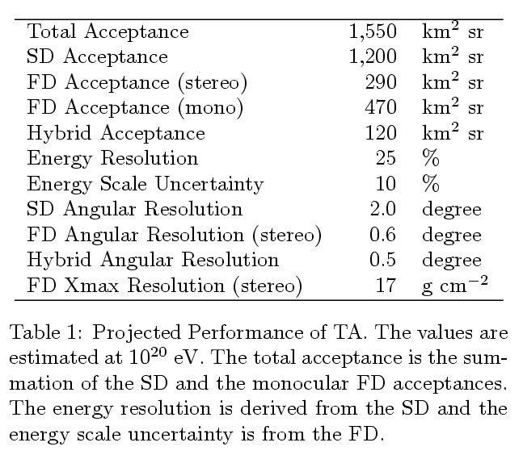
AGASA
140 km² sr
FD
25 %
or better
18 %
or better
2⁰
Performance of TA

Slide 35
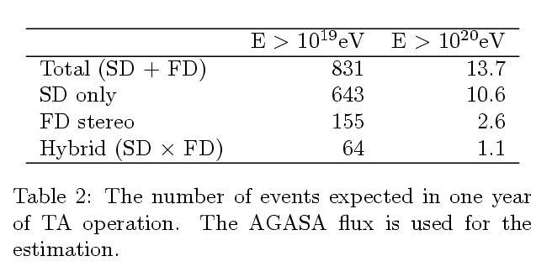
# of Events per Year
SPECTRUM
X -check
Calibration

Slide 36
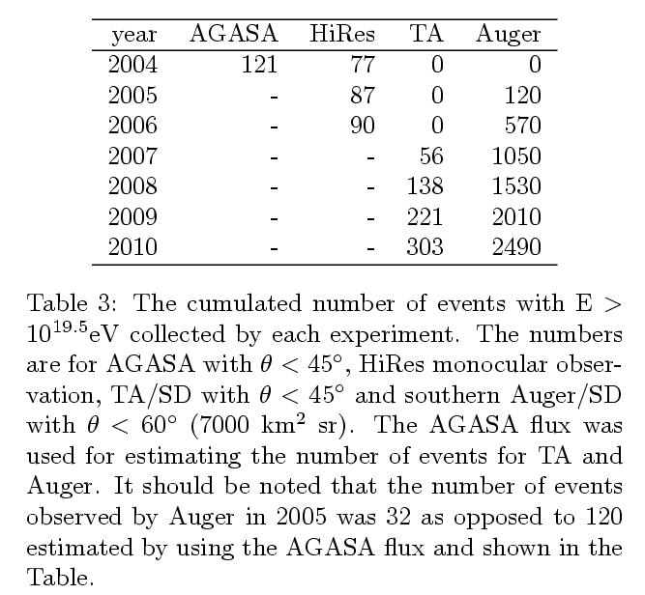
Cumulated # of Events

Slide 37
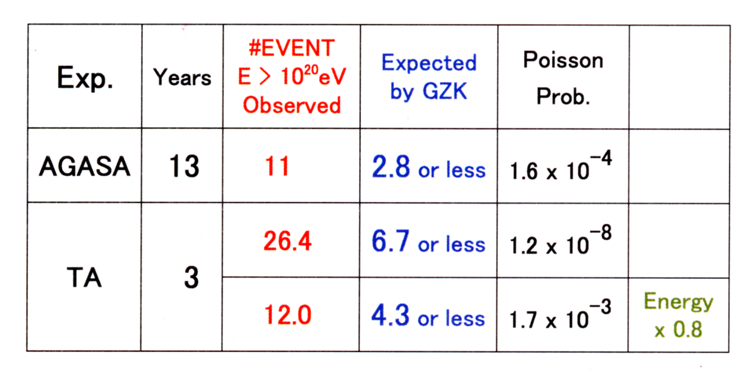
Log ( 流量 x E³)
Result of TA by spring 2010
AGASA flux
AGASA Energy x 1 or x 0.8
TA = SD (516 ctrs) + FD mono
Expected by
GZK cutoff
Log（エネルギー［eV］）

Slide 38
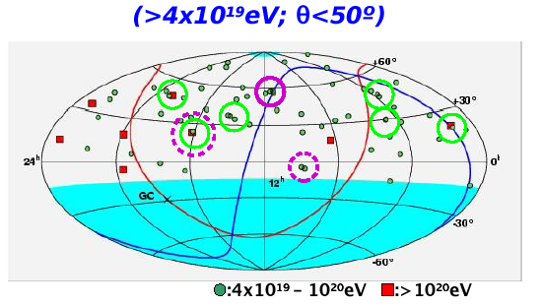
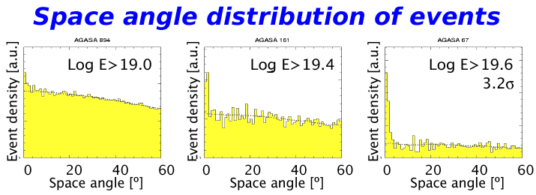
AGASA
SHINOZAKI
@WeiHai, 2006

Slide 39
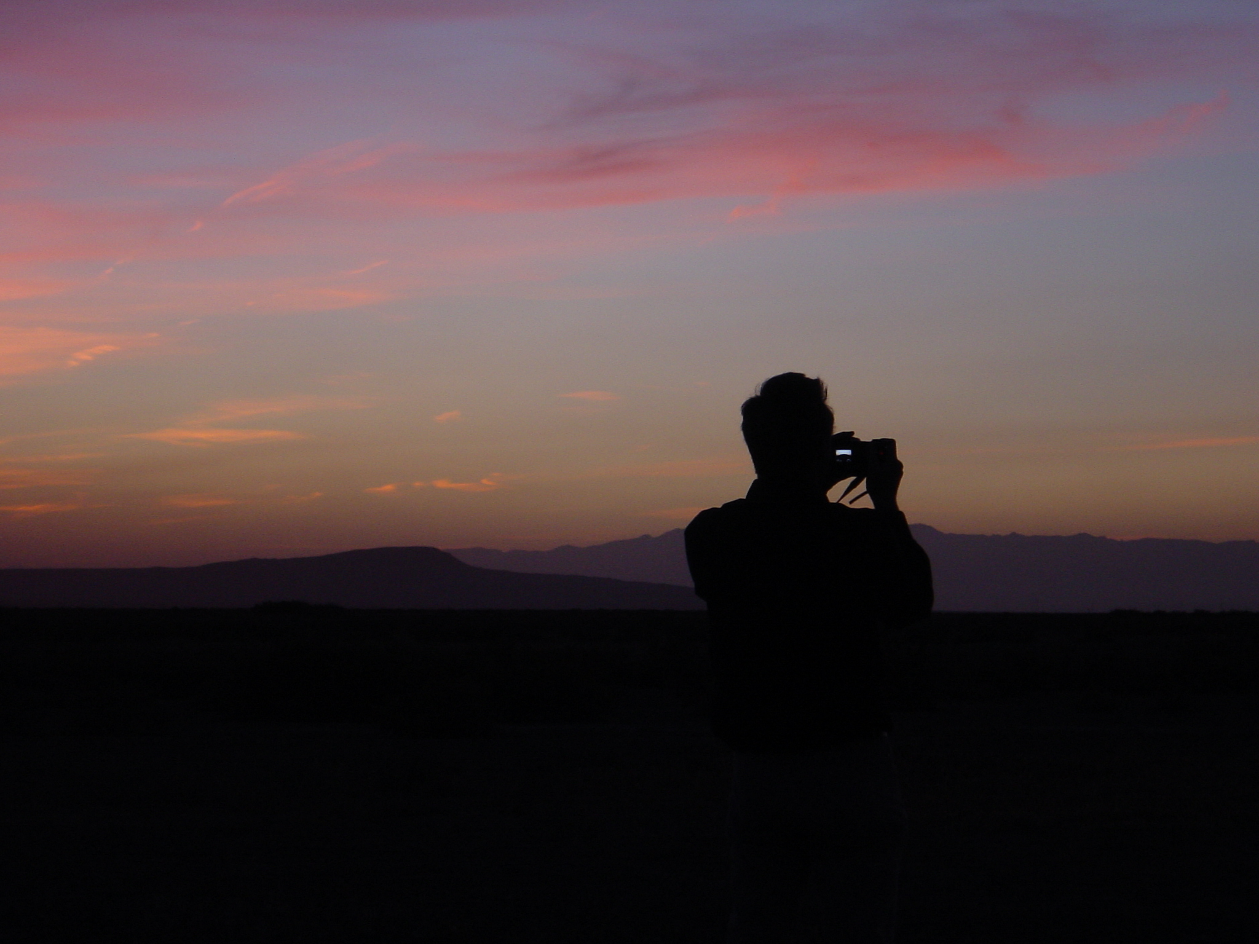
SUMMARY
Phase-1 TA approved in 2003: 10 x AGASA + FD
NSF budget approved in 2006: infra + FD + TALE
TALE: low energy extension of TA
Start data taking with 516 SDs & 3 FDs next spring.
516 SDs = 90% of proposal, 3rd FD by HiRes transfer
Confirm super-GZK and cluster in the North by 2010.
Understand SD systematics.
Establish stereo FD method and energy calibration.
Future: Integrated Giant Ground Detector (> 100 AGASA)

Slide 40
Telescope Array Collaboration
H.Kawai ª, T.Nunomura ª, N.Sakurai ª, S.Yoshida ª,
H.Yoshii ^{b}, K.Tanaka ^{c}, F.Cohen ^{d}, M.Fukushima ^{d}, N.Hayashida ^{d}, M.Ohnishi ^{d}, H.Ohoka ^{d},
S.Ozawa ^{d}, H.Sagawa ^{d}, T.Shibata ^{d}, H.Shimodaira ^{d}, M.Takeda ^{d}, A.Taketa ^{d}, M.Takita ^{d},
H.Tokuno ^{d}, R.Torii ^{d}, S.Udo ^{d}, H.Fujii ^{e}, T.Matsuda ^{e}, M.Tanaka ^{e}, H.Yamaoka ^{e}, K.Hibino ^{f},
T.Benno ^{g}, M.Chikawa ^{g}, T.Nakamura ^{h}, K.Kadota ^{j}, Y.Uchihori ^{k}, Y.Hayashi ^{l}, S.Kawakami ^{l},
K.Matsumoto ^{l}, Y.Matsumoto ^{l}, T.Matsuyama ^{l}, S.Ogio ^{l}, A.Ohshima ^{l}, T.Okuda ^{l},
D.R.Bergman ^{m}, G.Hughes ^{m}, S.Stratton ^{m}, G.B.Thomson ^{m}, N.Inoue ^{n}, Y.Wada ^{n},
K.Kasahara º, M.Fukuda ^{p}, T.Iguchi ^{p}, F.Kakimoto ^{p}, R.Minagawa ^{p}, Y.Tameda ^{p},
Y.Tsunesada ^{p}, J.W.Belz ^{qs}, J.A.J.Matthews ^{r}, T.Abu-Zayyad ^{s}, R.Cady ^{s}, Z.Cao ^{s},
C.C.H.Jui ^{s}, K.Martens ^{s}, J.N.Matthews ^{s}, J.D.Smith ^{s}, P.Sokolsky ^{s}, R.W.Springer ^{s},
S.B.Thomas ^{s}, L.R.Wiencke ^{s}, T.Doyle ^{t}, M.J.Taylor ^{t}, V.B.Wickwar ^{t}, T.D.Wilkerson ^{t},
K.Hashimoto ^{u}, K.Honda ^{u}, T.Ishii ^{u}, T.Kanbe ^{u},S.J.Baek ^{v}, J.E.Kim ^{v}, K.S.Kim ^{v}, S.Nam ^{v},
I.H.Park ^{v}, J.Yang ^{v}, B.G.Cheon ^{w}, Y.Unno ^{w}, Y.H.Yun ^{w}, I.S.Cho ^{x}, Y.J.Kwon ^{x}
(a) Chiba University (b) Ehime University (c) Hiroshima City University
(d) ICRR, University of Tokyo, (e) Institute of Particle and Nuclear Studies, KEK
(f) Kanagawa University (g) Kinki University (h) Kochi University (j) Musashi Institute of Technology
(k) National Institute of Radiological Sciences (l) Osaka City University (m) Rutgers University
(n) Saitama University (o) Shibaura Institute of Technology (p) Tokyo Institute of Technology
(q) University of Montana (r) University of New Mexico (s) University of Utah
(t) Utah State University (u) Yamanashi University (v) Ewha Womans University
(w) Chonnam University (x) Yonsei University
80 physicists
From Japan, USA and Korea

