Slide 1
Q&A on T2K
construction of beam line
near detectors
budget
collaboration (contribution from each)
T2KK

Slide 2
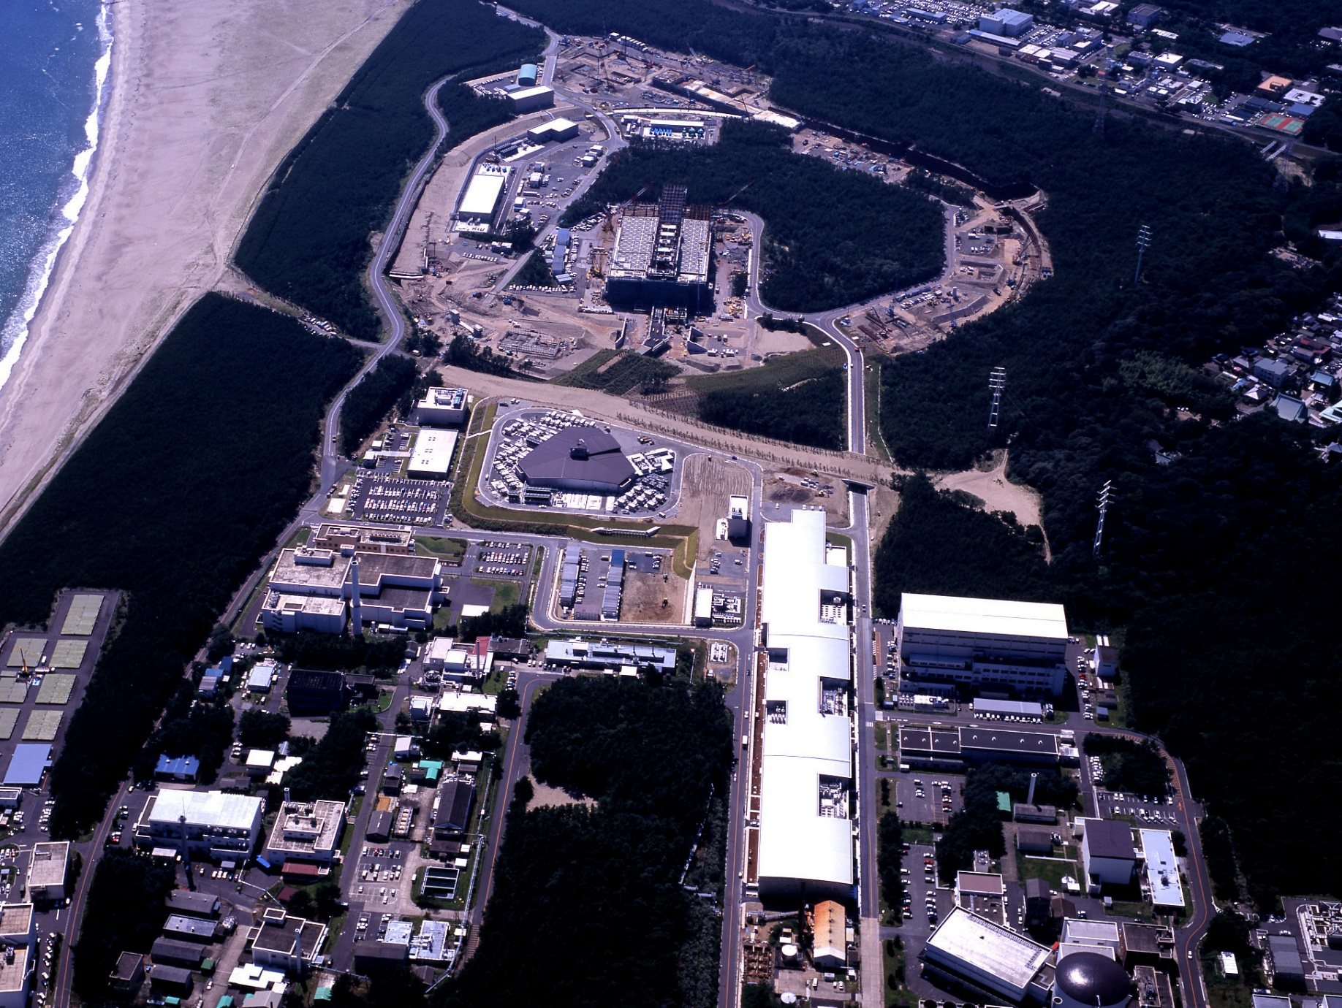
Bird’s-Eye View (Feb. 2006)
Hadron Experimental Hall
50 GeV MR
A round=1,600m
Materials & Life
Experimental Hall
3NBT
Neutrino
3GeV RCS
A round=350m
3-50BT
Linac
(330m)

Slide 5
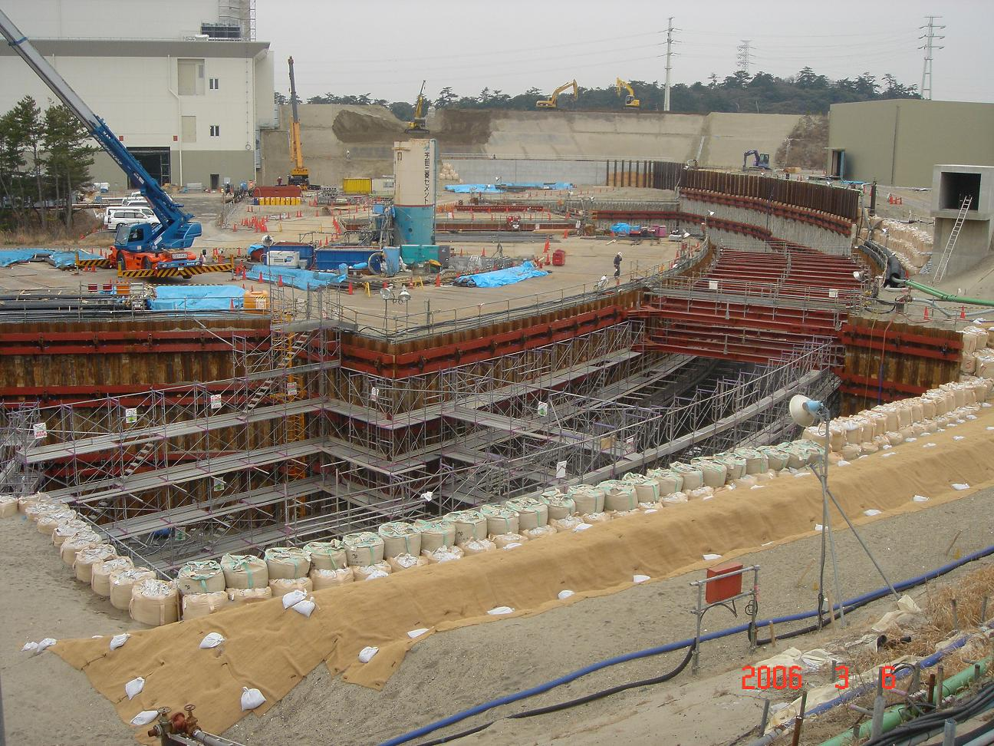
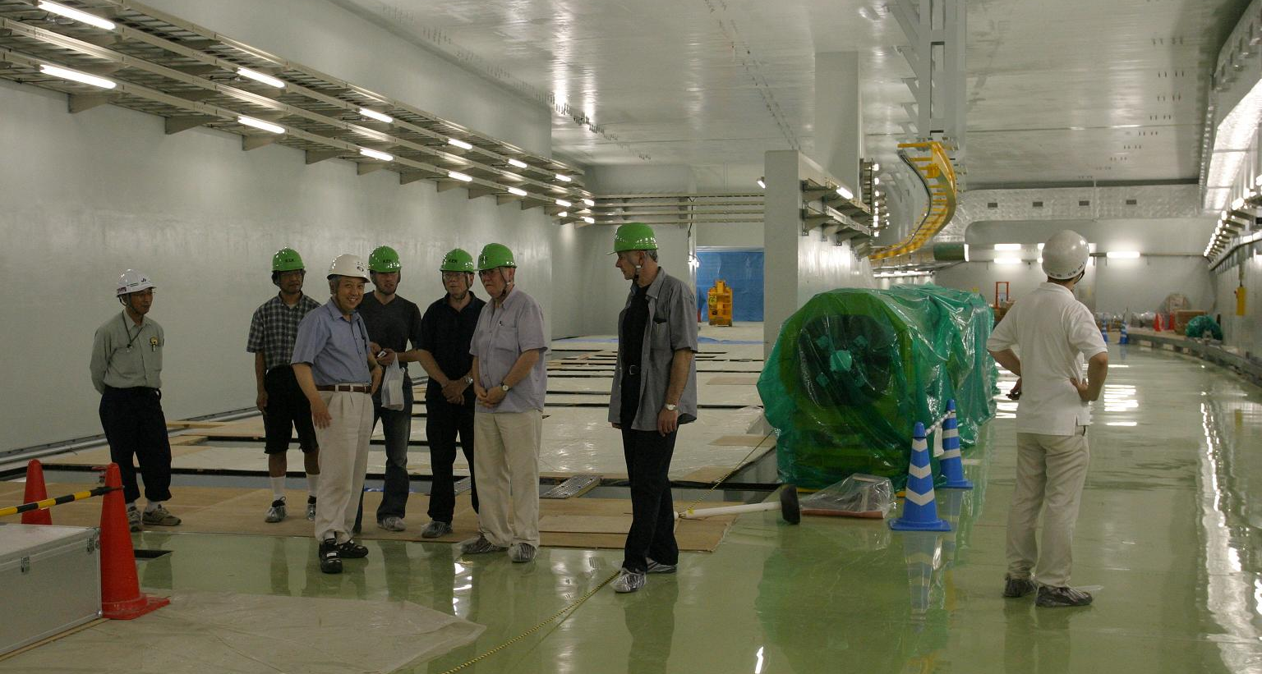
Primary Beam-line
Material Life
& Science
3NBT
DV
ARC
Preparation
Section
July, 2006
Preparation Section
50GeV
March, 2006

Slide 6
plan
3
h.n.+RFx2
2
400MeV
Linac
Beam Power (MW)
h.n.
RF mod
RF
commissioning
RCS power
1
0.5MW
0
2008
2009 2010 2011 2012
0.1MW >0.5MW >0.75MW

Slide 7
Neutrino Beam Line for T2K Experiment
Components
Primary proton beam line
  Normal conducting magnets
  Superconducting arc
  Proton beam monitors
Target/Horn system
Decay pipe
Beam dump
muon monitors
Near neutrino detector
Special Features
Superconducting combined function magnets
Off-axis beam
Target
Station
decay volume
280m
Beam dump/μ-pit
Near detector
To Super-Kamiokande

Slide 8
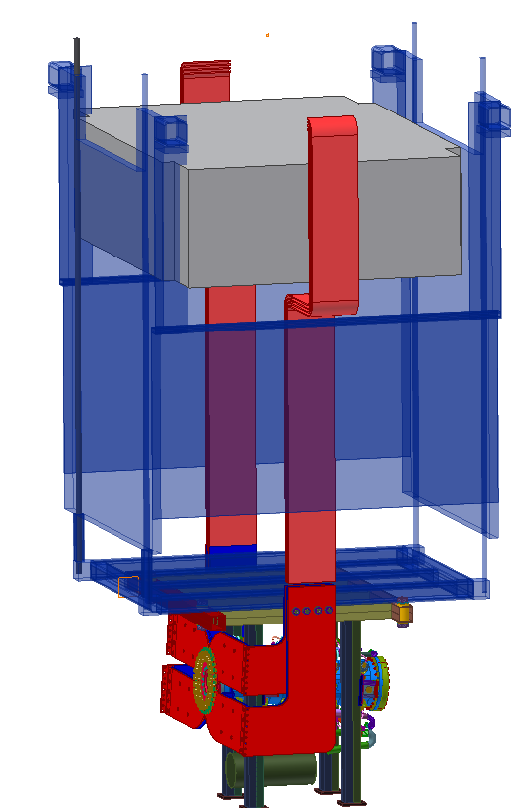
Horns
1st horn
  Successful operation at 320kA
  Long-term current operation test
2nd horn design / 3rd horn prototype in FY06
Support module
  Conceptual design done on
    Remote coupling of horns and water / He pipes.
    Kinematic alignment system
  R&D
    Remote coupling of strip-lines
    Water circulation system (7m pumping up)
    Support module itself
Produce everything in FY2007
concrete
Iron Block Shield inside
Remote coupling here

Slide 9
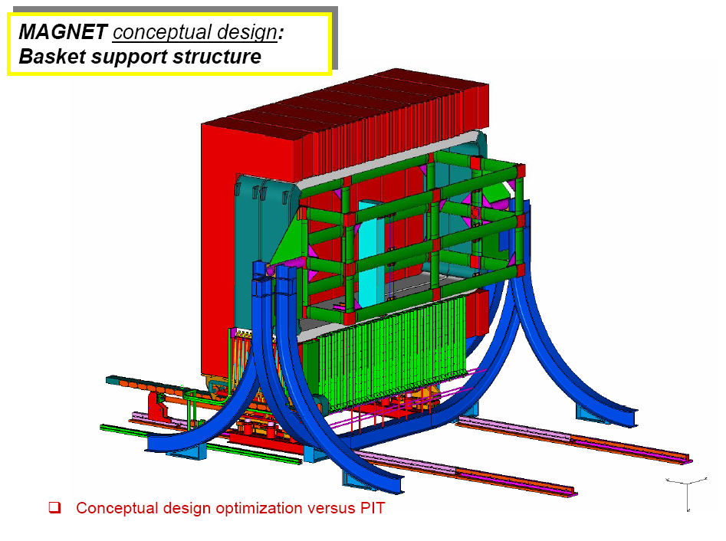
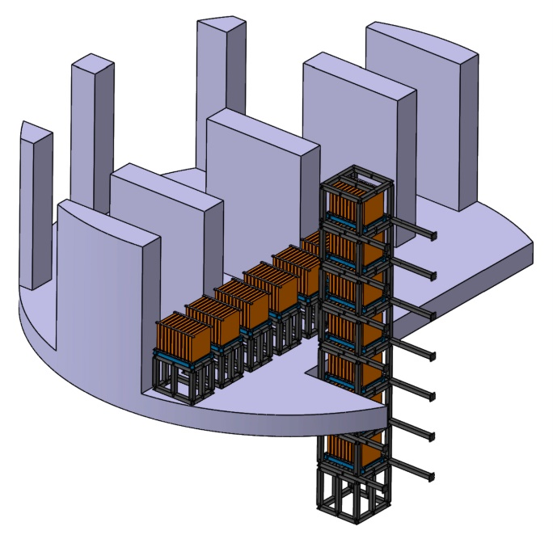
ND280 Neutrino Detector
(Experimental Hall with 3 floors)
Ground level
2.5deg beam center
28.5m
On-Axis Neutrino Monitor
Off-Axis
Neutrino Detector
Current design
37m

Slide 10
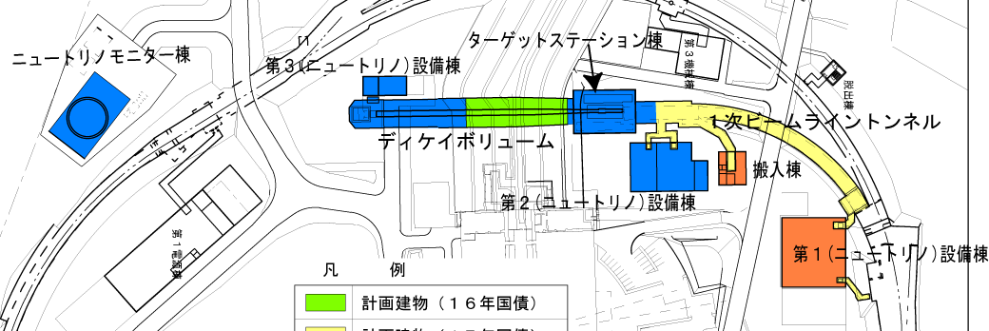
Schedule of ν beam line
Beam dump &
half of Decay vol.
const.: ’07~’08
Install: ’08
Target station
const.: ’06~’07
Install: ’08
Near detector
const.: ’07~’08
Install: ’08
Proton beam line
const.: ’05~’06
Install: ’08
2004.4-2006.3
half of Decay volume
const.: ’04~’05
Install: ’04
2005.4-2007.3
2006.4-2008.3
Buildings
Const.: ’07
2007.4-2009.3

Slide 11
Japanese funding situation
Beamline, detector hall civil (~80-oku\)
Equipments (~72-oku\)
Proton, muon, neutrino monitor (~ 4-oku\)
Foreign Contributions
~20M$
from
Canada, France, Italy, Korea, Poland,
Russia, Spain, Switzerland, UK, USA

Slide 12
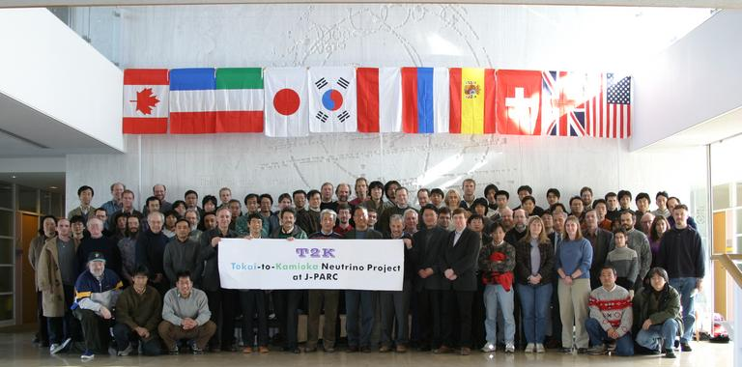
T2K Collaboration
11 Countries (number of members)
  Canada(24), France(8), Italy(11), Japan(46), Korea(9), Poland(1), Russia(8), Spain(12), Switzerland(3), UK(25), USA(42)
  58 Institutes, 189 Ph.D. members, still growing

Slide 13
Canada
  Damper system, OTR beam monitor, Remote handling, Actuator, Vacuum chamber, Fine-Grained-Detector (FGD), TPC
France
  SC quench detection system, TPC electronics, TPC
Italy
  UA1 magnet, Side-Muon-Ranger (SMRD), 2km ND
Korea
  Beam Monitor electronics, neutrino monitor,
Poland
  Neutrino MC
Russia
  Neutrino Monitor, Photo-sensor, SMRD,
Spain
  UA1 magnet, TPC, software
Switzerland
  UA1 magnet, TPC, neutrino monitor
UK
  Target, target remote handling, Dump, Beam window, UA1 magnet, Electromagnetic Calorimeter, Basket, Electronics, Photo-sensor
USA
  SC correction magnets, 2nd horn, CT beam monitor, beam monitor electronics, GPS system, pi-zero detector (P0D), SMRD, 2km ND, Super-K
(1)Accelerator (2) Beam Line, (3) Near Neutrino Detector, (4) Super-K

Slide 14
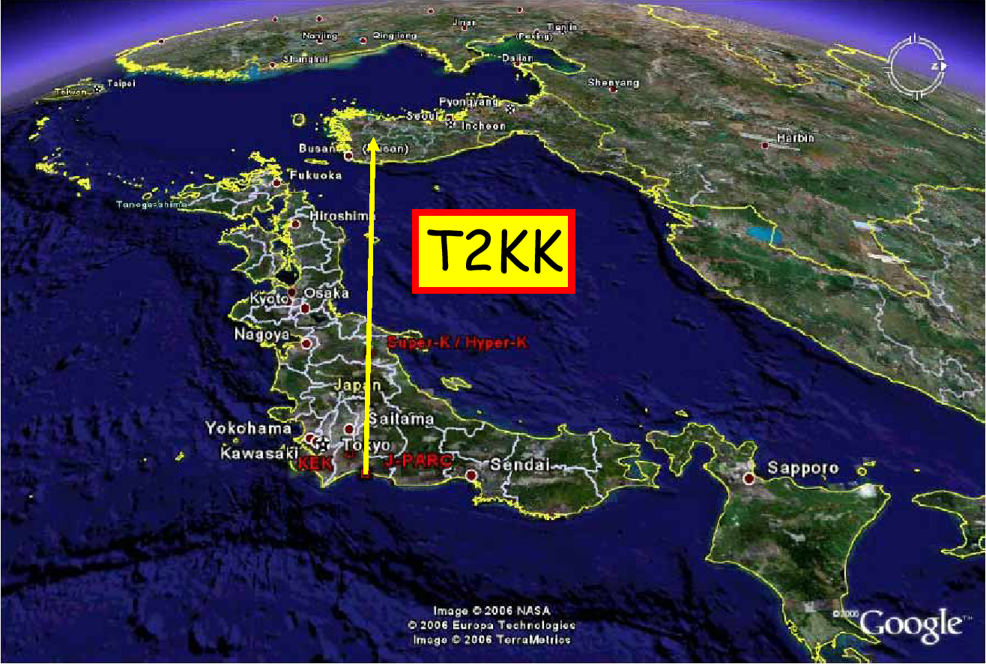
One of the future options of T2K
0.5Mton at Kamioka and 0.5Mton at Korea
Aim to
  resolve q13, d digeneracy
  Discriminate mass hierarchy
Studies and discussions have been done
  Hagiwara et al. Phy.Rev.B 637 (2006) 266
  Ishizuka et al., PRD 72 (2005) 033033
  2 International workshop on a Far Detector in Korea for the J-PARC Neutrino Beam

