Slide 1
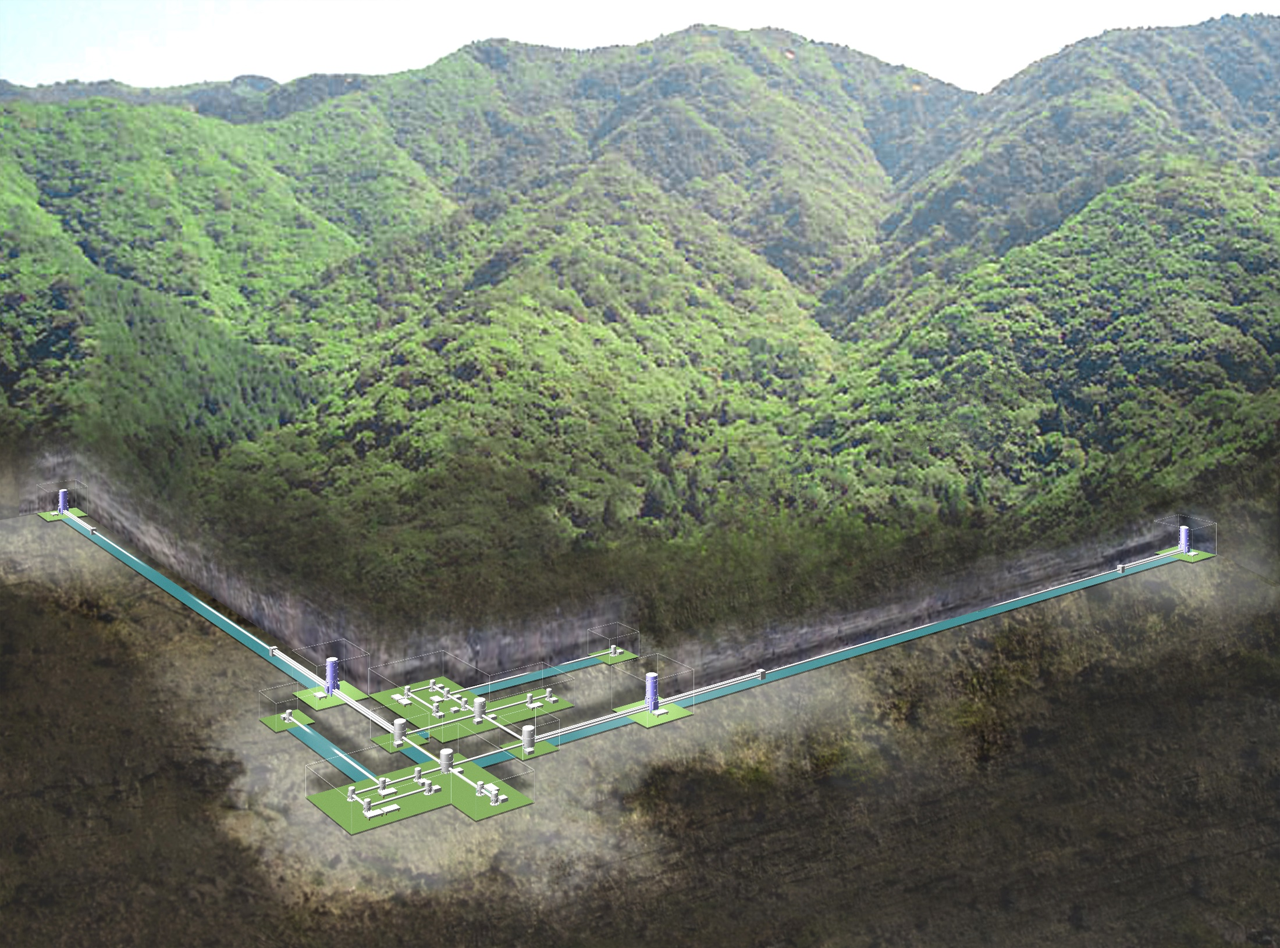
ICRR Review
@Kashiwa
19-20, October 2006
Gravitational wave group
Kazuaki Kuroda
LCGT/CLIO/TAMA Collaboration

Slide 2
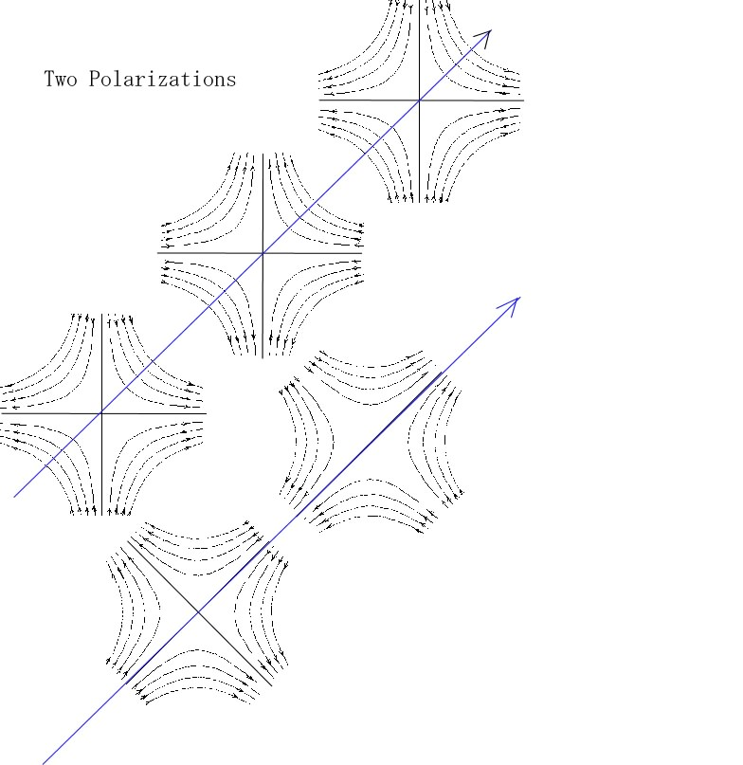
Gravitational wave (GW) is the propagation of spacetime distortion predicted by Einstein’s general relativity.
Hulse & Taylor proved its existence by the observation of PSR 1913+16.
It propagates as transverse wave with the speed of light
Theories of gravitation are tested by the detection of GW.
GW presents new eye to observe the Universe.

Slide 3
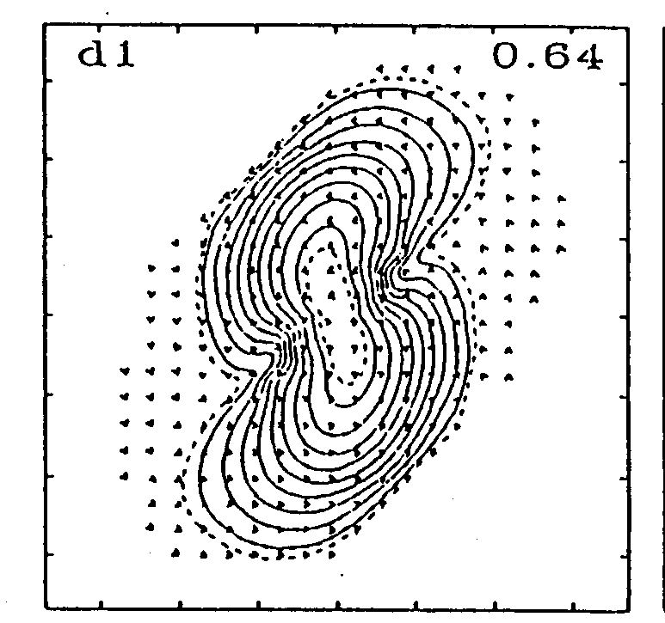
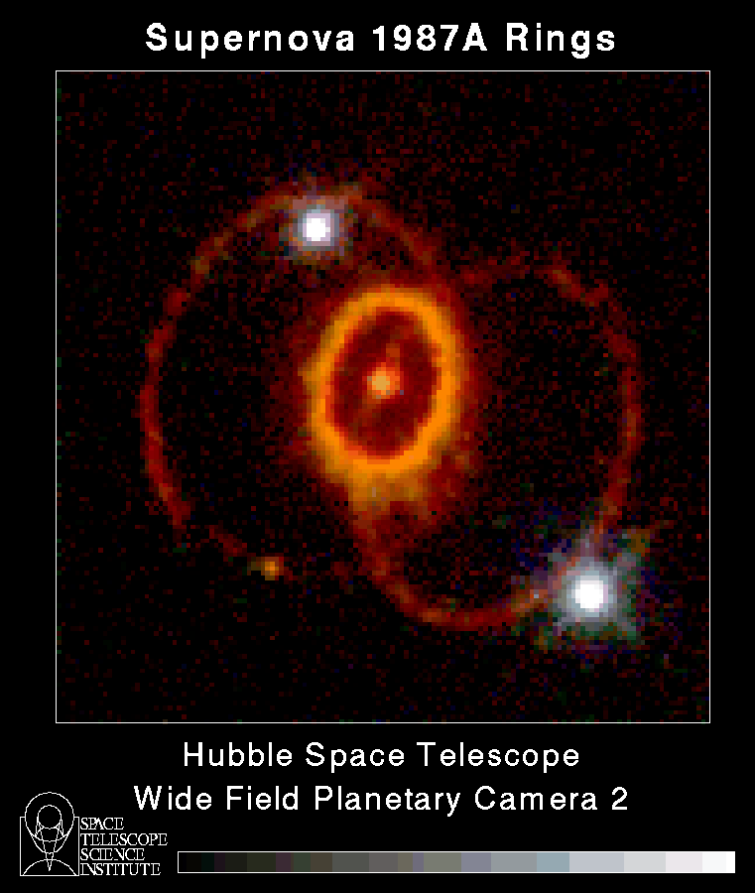
Possible sources of GW
Coalescence of neutron star binary
Super nova explosion
Coalescence of blackhole (BH) binary
Falling stars to BH
Spinning of a neutron star
Orbital motion of neutron star binary
Cosmic back ground radiation
Vibration of a cosmic string

Slide 4
Neutron star binaries detected in our Galaxy
PSR B1913+16
PSR B1534+21
PSR J1141-6545
PSR J0737-3039
PSR J1906+0746
Occurrence rate of coalescence is estimated by both the distribution and the life time of binaries, which gives about 10⁻⁵ per galaxy every year.

Slide 5
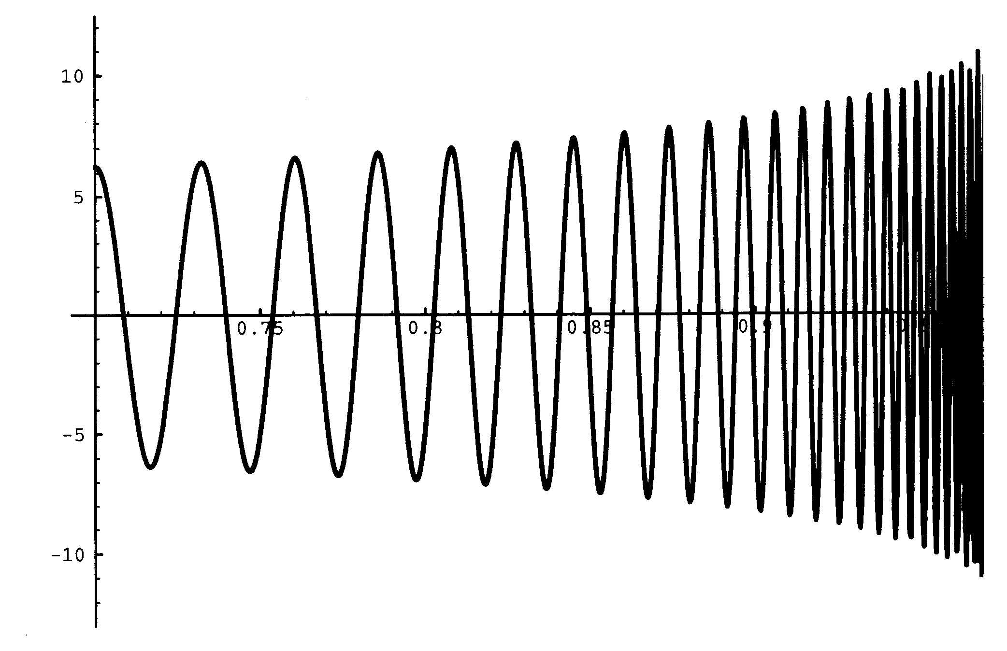
Chirping wave form produced
at the coalescence of binary neutron star
Amplitude
time

Slide 6
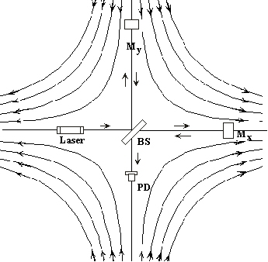
How to detect GW?
Suspended mass (Mx) and suspended beam splitter (BS) behave as two test masses.
Michelson interferometer measures the difference of displacements of two arms; Mx-BS and My-BS
Typical displacement triggered by an event of VIRGO cluster is 10⁻¹⁴ rad (10⁻¹⁸ m) for 1km arm length.
To enhance the sensitivity, optical paths are folded by many times. There are Delay-Line, Fabry-Perot and so on.

Slide 7
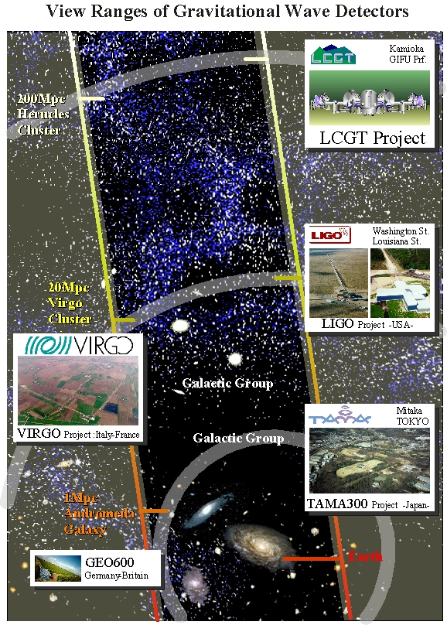
Existing observatories
There are LIGO (USA), VIRGO (French-Italian), GEO (Germany-England), TAMA (Japan).
The frequency is about 10⁻⁵ for one year for matured galaxy as ours. The detector covering the Virgo cluster （20Mpc) needs many years of observation.
For this reason, we need more sensitive detector to cover more remote galaxies. LCGT can observe events by neutron star binaries coalescing at 260Mpc at the maximum, rating from 1 to 28 for year on average.
1pc=3.3 ly

Slide 8
History of Interferometer in Japan
TENKO-100 1991-1994 ISAS
20m prototype 1991-1994 NAOJ
TAMA 1995-2001 NAOJ
LISM 2000-2002 Kamioka
CLIO 2003-2006 Kamioka
LCGT ……. Kamioka

Slide 9
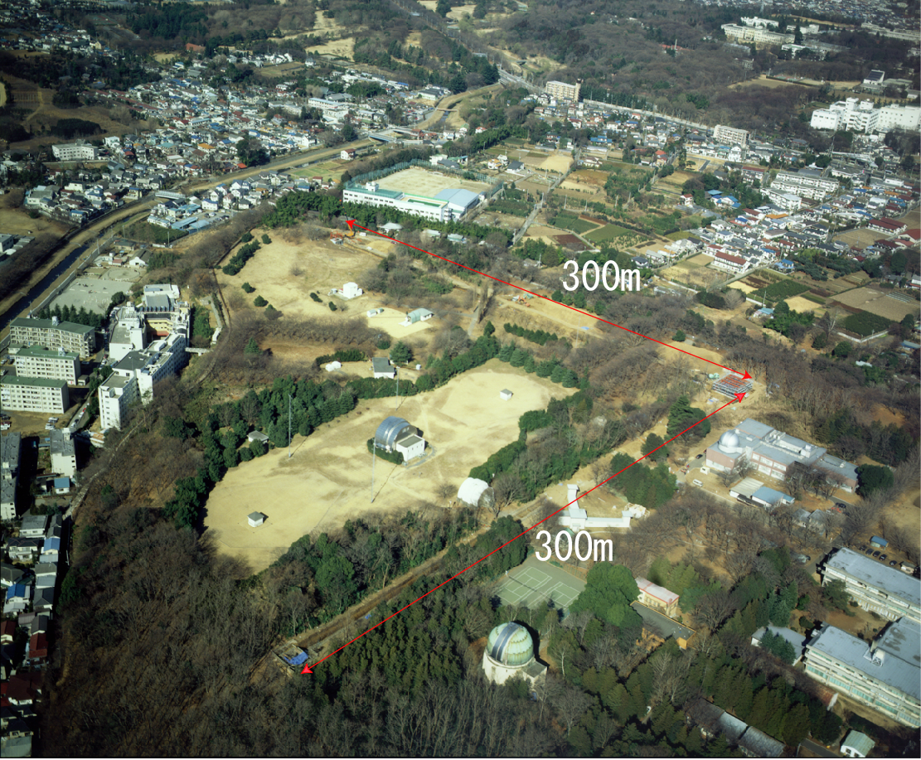
TAMA interferometer with baseline of 300m is placed
at Mitaka campus, NAOJ, in a suburb of Tokyo.

Slide 10
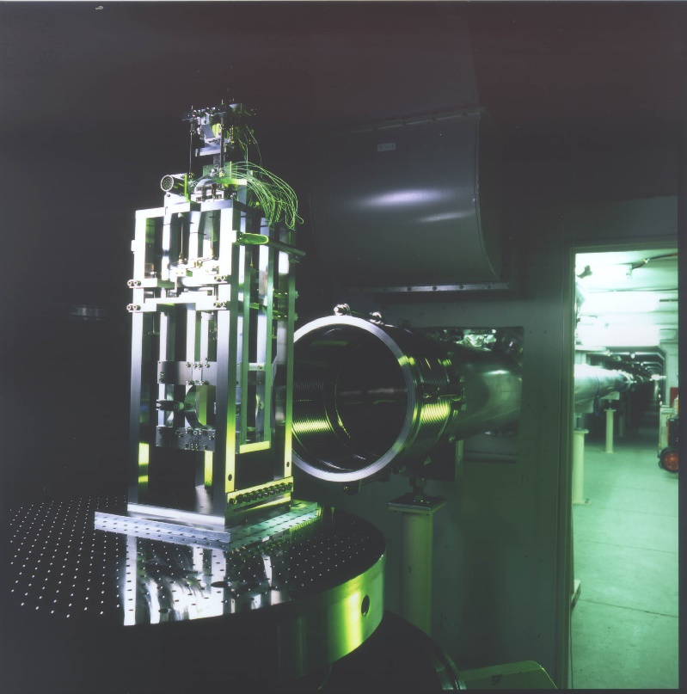
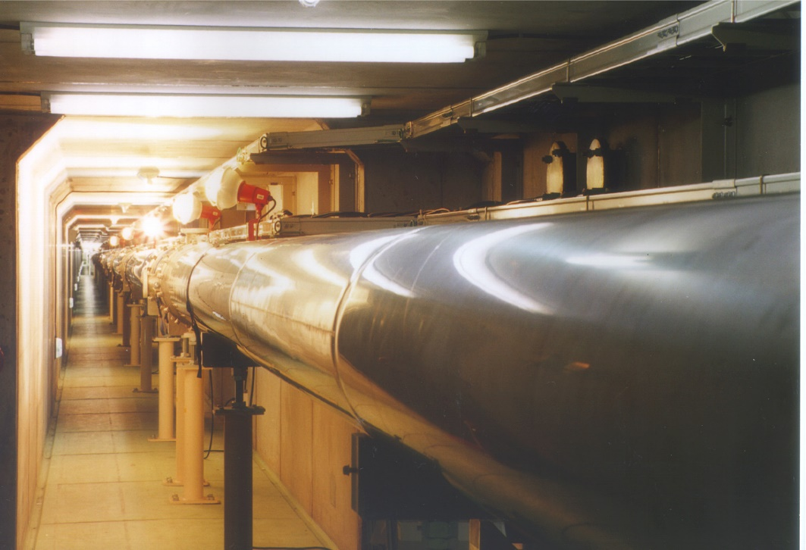
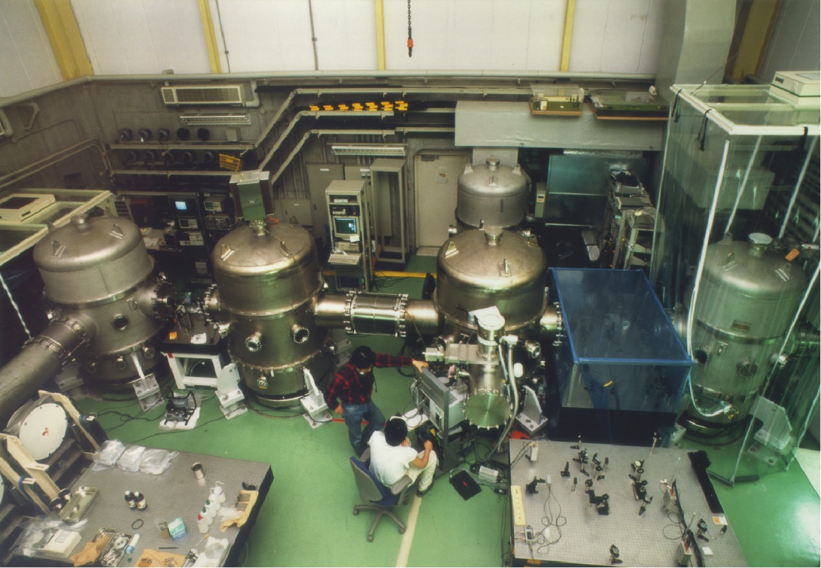
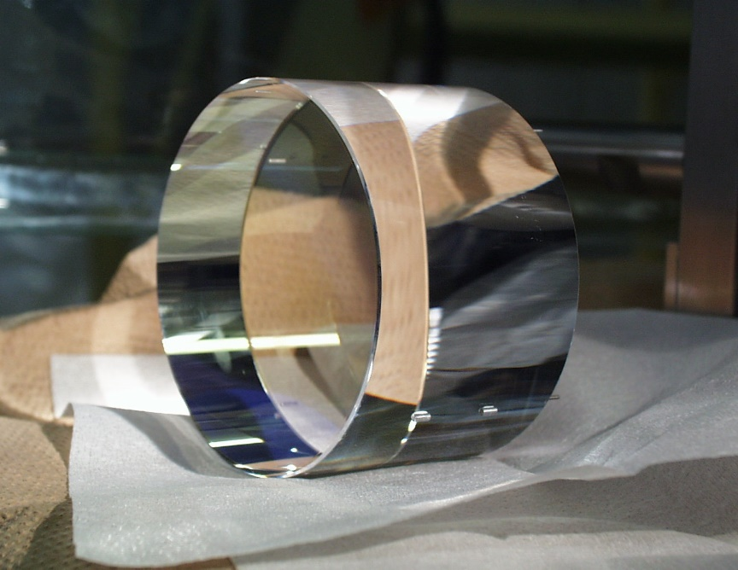
Technical achievements by TAMA
Mirror suspension
300m vacuum duct
Laser
FM2
MC
RM
BS
FM1
Fused silica mirror
Center room

Slide 11
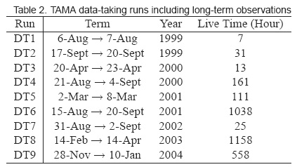
Observation by TAMA
Sensitivity improvement
Automatic operation
system for reliability
Continuous observation
more than 1000 hr with the
highest sensitivity.
Introduction of power recyl
LIGO overtook TAMA
Some parts of DT7-9 are overlapped with the science runs of LIGO (GEO)
and cooperative two papers have been published to limit the birth rates
of both coalescence and supernova in our Galaxy.

Slide 12
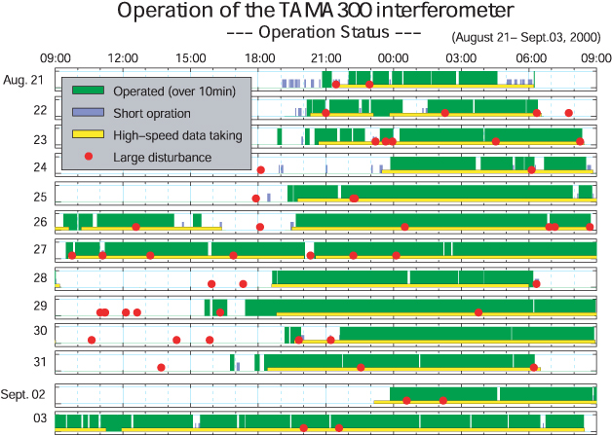
Large seismic disturbances tend to cause the loose lock. By this data we installed extra anti-vibration systems under the vacuum chambers and improved the suspension system.

Slide 13
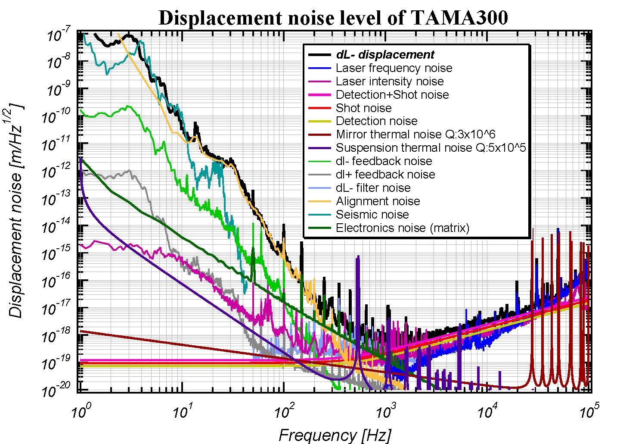
Current sensitivity of TAMA
---all noise sources are identified within an error of factor 2---

Slide 14
TAMA Achievement
Optical interferometer system (power recycling, Fabry-Perot Michelson, control system) was successfully completed.
2. Nine observation runs accumulated data exceeding 3000 hours. →Nine papers published
3. The sensitivity of TAMA in 2000 was the best in the world and achieved a stable long term operation for the first time.
Current status
１．Observation runs have not been done after DT9 ended in January, 2004.
２．Installation of a low frequency anti-vibration system (SAS) is ongoing.

Slide 15
LISM
We had been heavily bothered by seismic noise in
the operation of both a 20m prototype and TAMA.
LISM is the 20m prototype moved from Mitaka
campus of NAOJ to Kamioka mine. This prototype
confirmed the quietness of the underground and
guaranteed a stable operation of the interferometer.
The 20m prototype at Mitaka was a Fabry-Perot
Michelson interferometer but it was changed to
a locked Fabry-Perot one at Kamioka.

Slide 16
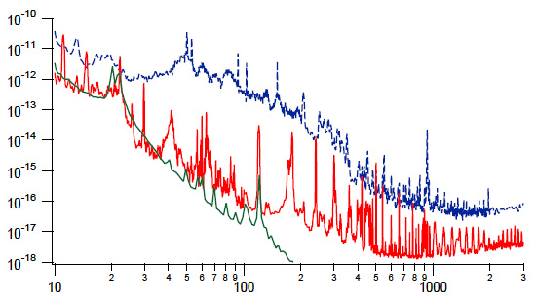
When the ２０ｍ interferometer was moved from Mitaka to Kamioka mine, the noise at 100Hz was decreased by ４ orders and the spectrum limit by the anti-vibration system was achieved at frequencies less than 100Hz.
Blue: at Mitaka
Red: underground Kamioka
Green: limit by isolation system
Displacement spectrum m/RHz
Hz

Slide 17
CLIO
CLIO is a 100 m locked Fabry-Perot interferometer with cryogenic mirrors
Construction was started in 2002 and finished early in 2006.
Commissioning is underway.
CLIO will demonstrate the effectiveness of cryogenic mirror.

Slide 18
Thermal noise
Amplitude of thermal noise ∝{TΦ}^{1/2}
  T: temperature, Φ: mechanical loss angle
Pendulum mode thermal noise
  amplitude ∝ {1/f}^{1/2} (f<f₀) f₀: pendulum resonance
  amplitude ∝ {1/f}^{5/2} (f>f₀)
Substrate and Coating thermal noise
(consisting of Brownian noise and thermo-elastic one)
  amplitude ∝ {TΦ_{eff} / r }^{1/2}Λ , r: beam radius, Λ:
Brownian noise changes ∝ {1/f}^{1/2}
thermo-elastic noise ∝ {1/f}

Slide 19
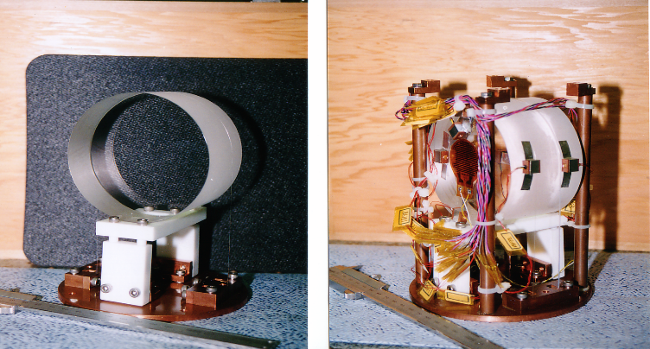
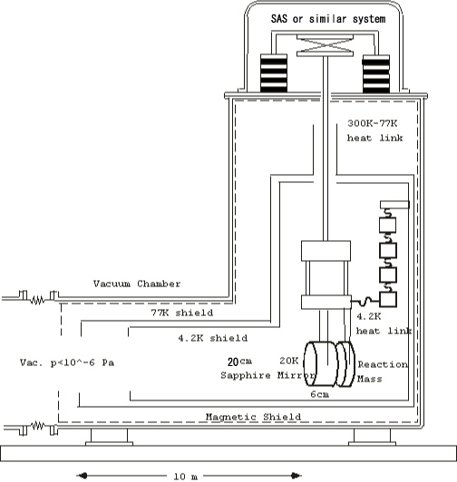
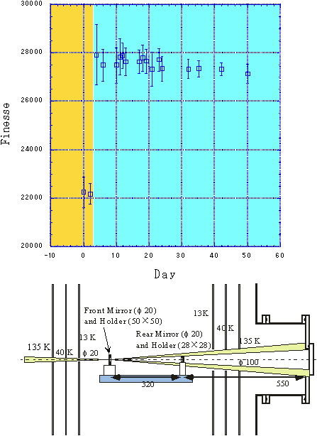
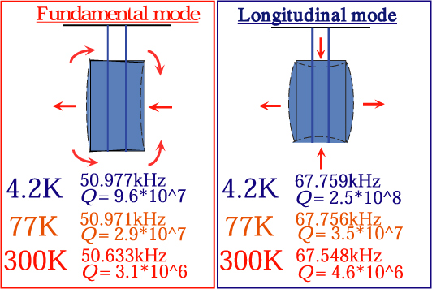
Cooling test
Cryogenic mirror was established
by several basic experiments.
Contamination test
Mechanical Q test
Original schematic diagram of cryo-mirror

Slide 20
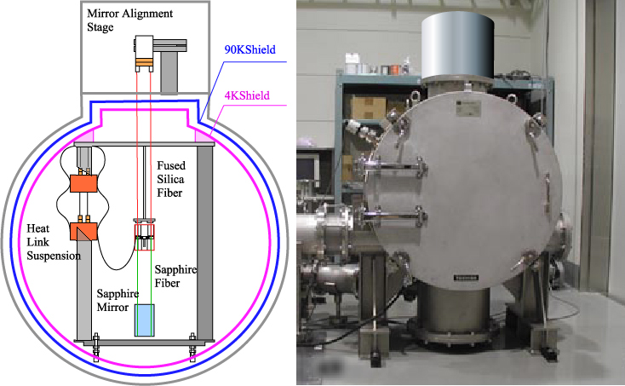
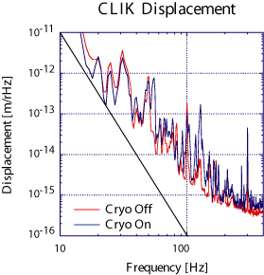
Suspension prototype was tested in Kashiwa campus in ICRR, in 2001.
Fabry-Perot cavity was locked at cryogenic temperature
and requirements on refrigerator were studied.
This result makes us to develop quieter refrigerator and softer heat link design.

Slide 21
Parameters of CLIO
Practical prototype of cryogenic interferometer
Baseline length: 100m
Interferometer: Locked FP
Laser source: 2W NPRO (1064nm)
Finesse: 7500
Main mirrors: 20K sapphire（TAMA size,Φ10cm）
Refrigerators: Pulse Tube type with flexible heat links

Slide 22
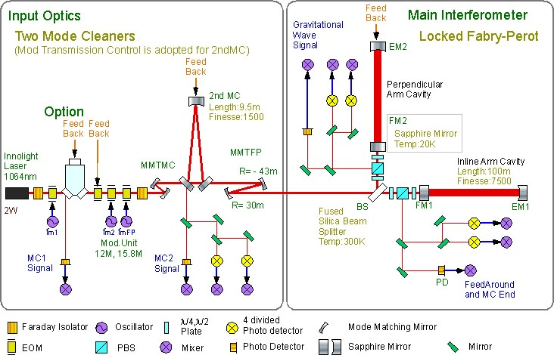
CLIO Optical design
Locked FP
(no recycling)

Slide 23
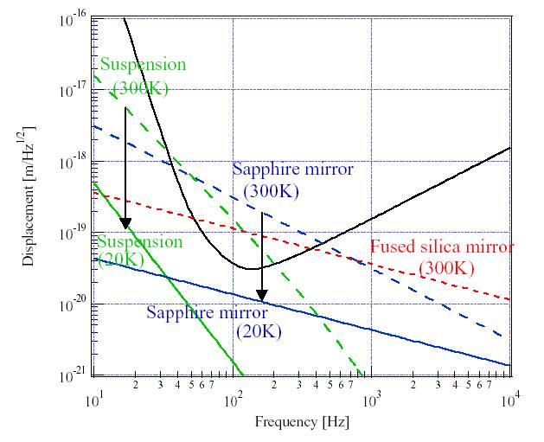
Expected reduction of thermal noise by CLIO (300K – 20K)
Mirror size
Φ10cm, t6cm

Slide 24
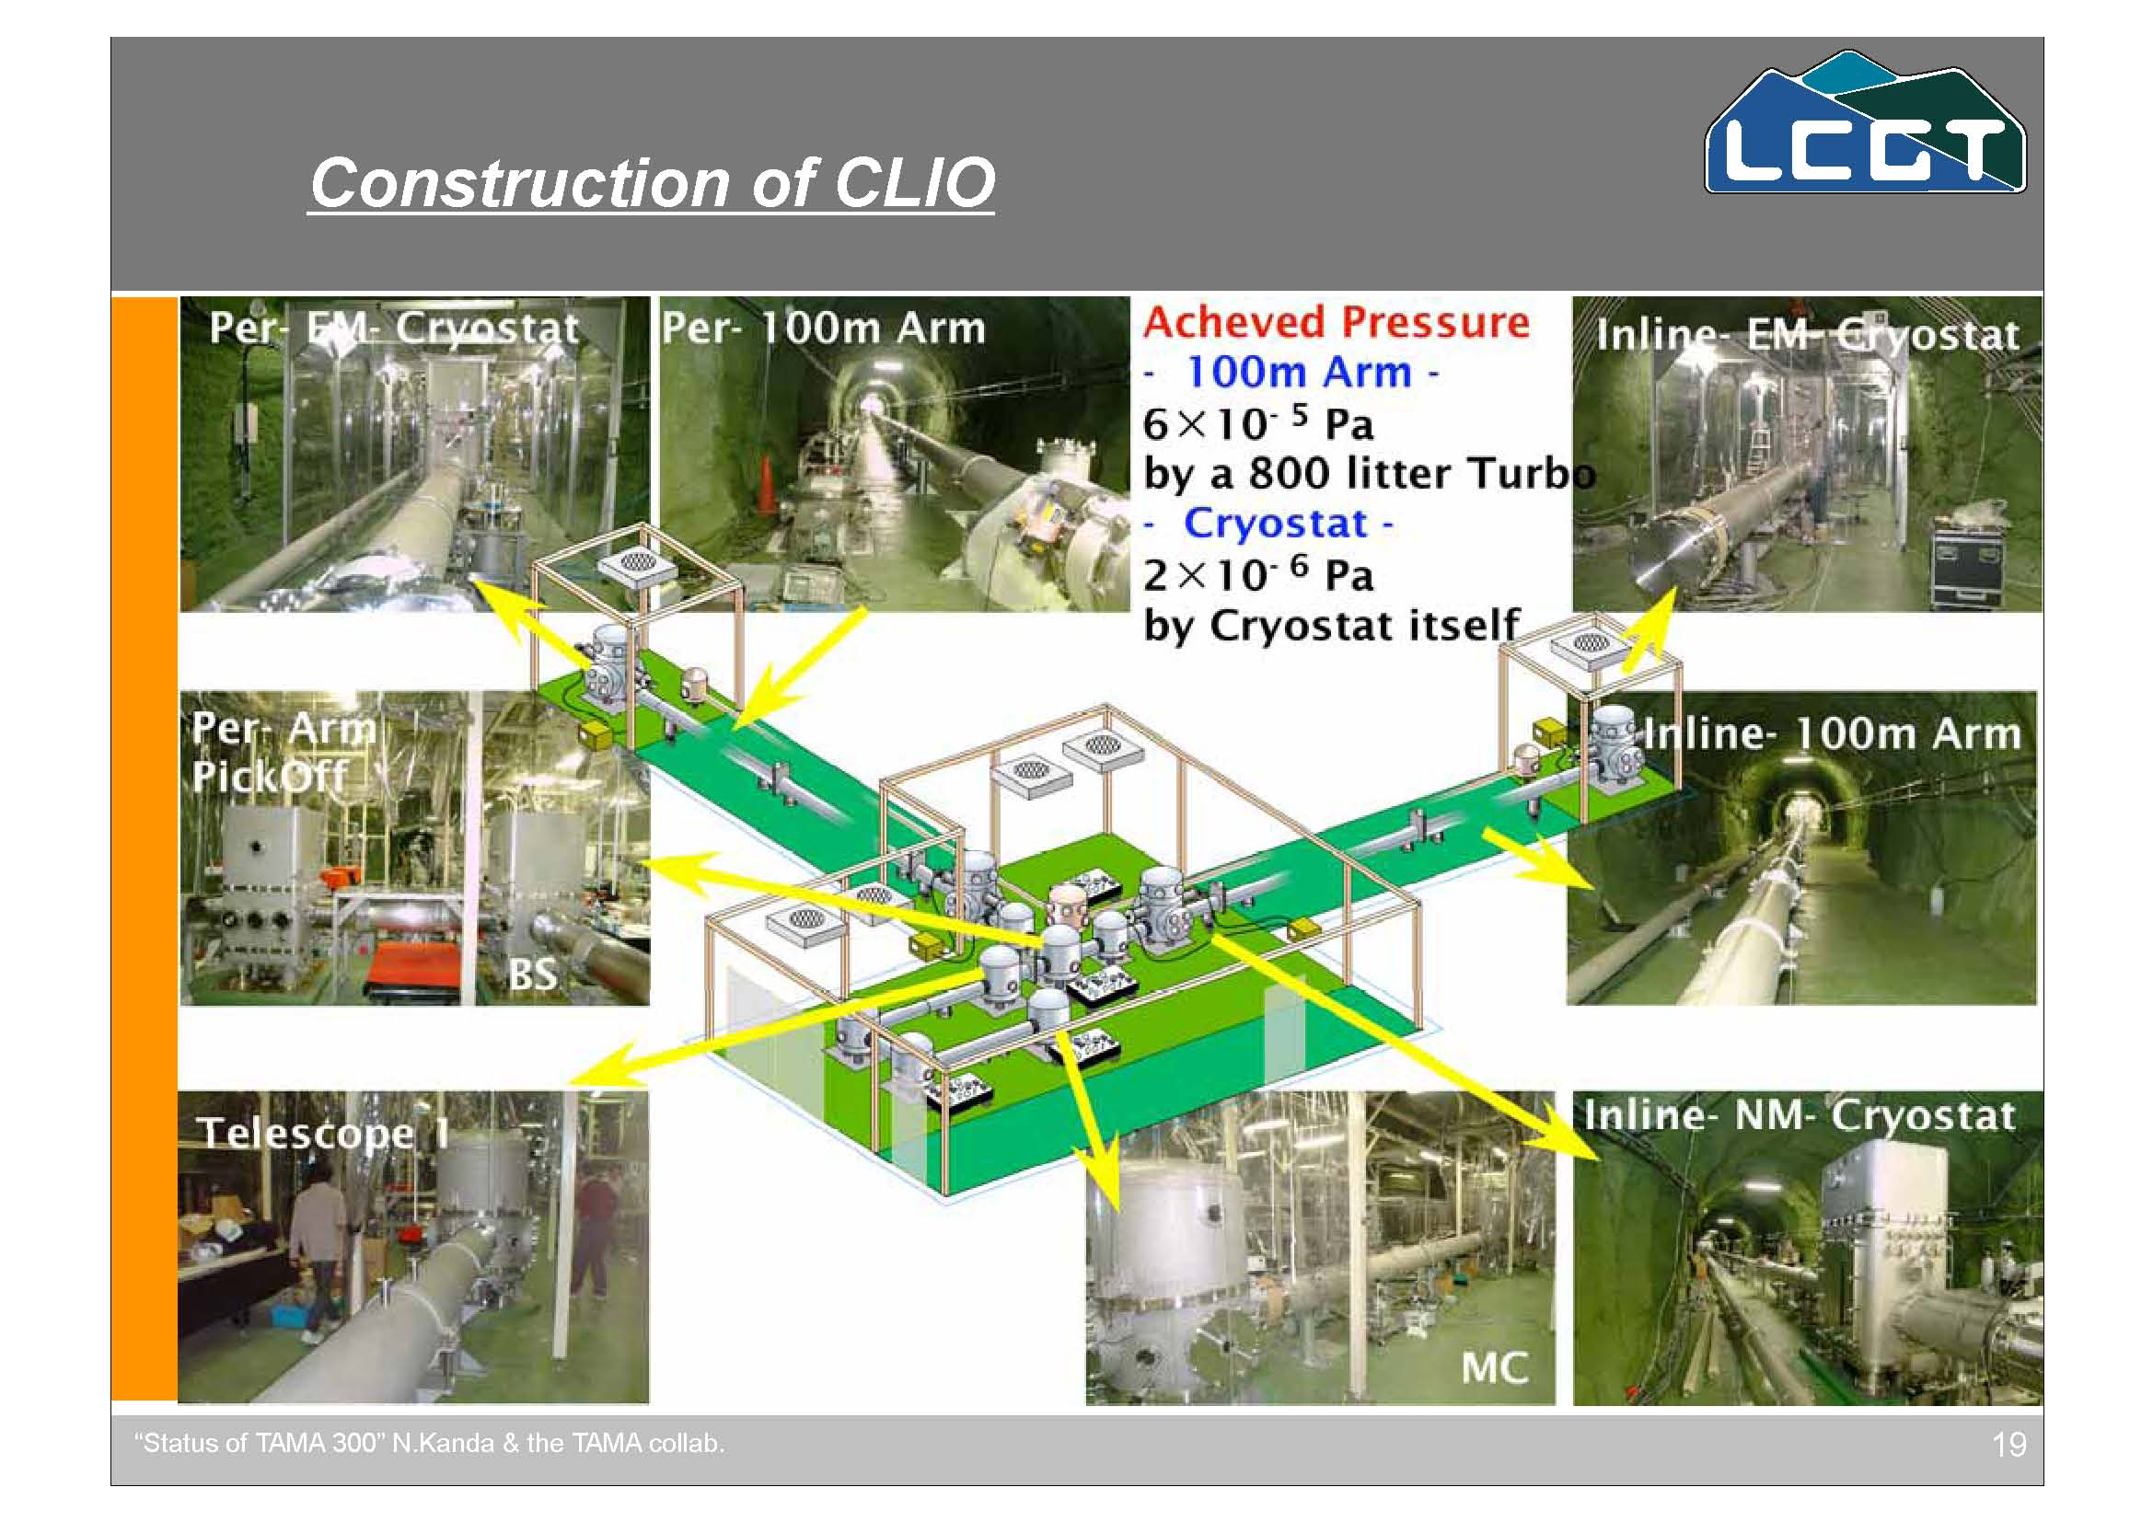

Slide 25
Quiet refrigerator was developed ( design in 2003)
F-6: Class. Quantum Grav. (Accepted), Pr-1: Proc. 28th ICRC (2003),
patent: Pa-3 Tomaru et al., 2003; Suzuki et al., 2003.
Switching box
Pulse tube ref.
1st & 2nd stages
Soft heat links
40K cold stage
4K cold head
To compressor

Slide 26
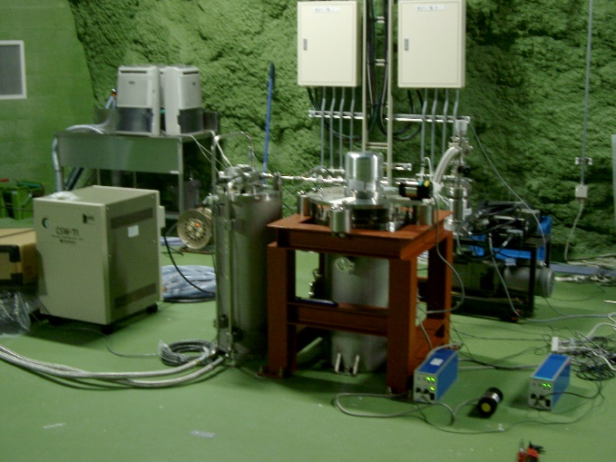
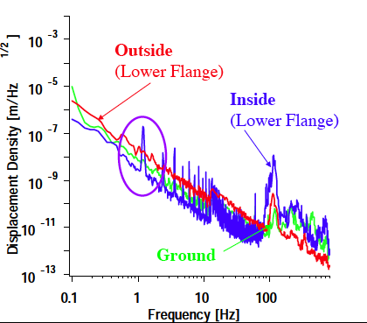
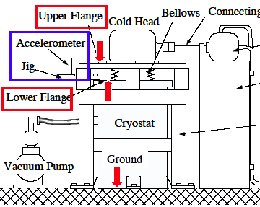
  Vibration test in the Kamioka mine
Compressor inside
Equivalent to the seismic noise has been achieved.

Slide 27
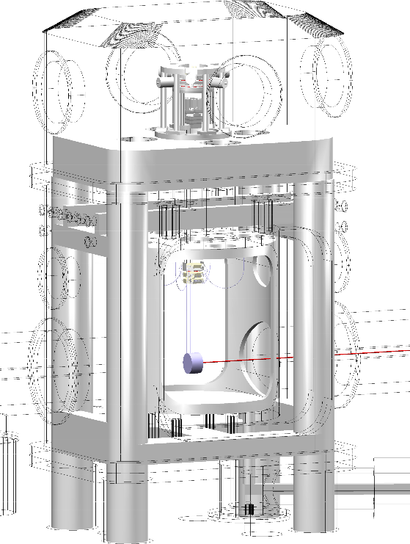
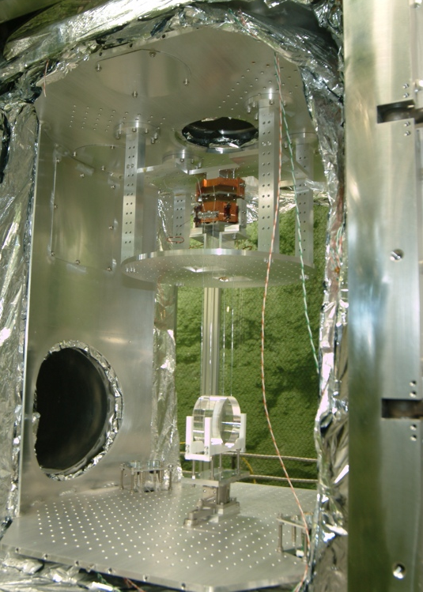
Internal view of mirror suspension

Slide 28
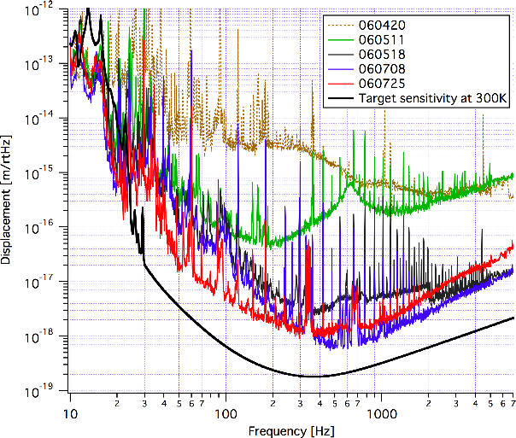
Sensitivity improvement of CLIO at 300K

Slide 29
Current status of CLIO
We have finished its hardware in this March and have succeeded to lock Fabry-Perot cavities at cryogenic temperature.
We are now in commissioning phase of the interferometer.
During this phase, we found out that the radiation shields extending to both sides introduced more heat than expected, which was quantitatively measured and radiation baffles were designed.

Slide 30
LCGT
LCGT is characterized by ‘cryogenics’,
‘underground’, and ‘3 km’.
Budget request for FY 2007 in vain.
LCGT collaboration requests to repeat the trial for FY 2008.
LCGT has a potential to be the final detector on the Earth.
Standard GW detector in the future international network to detect GW.

Slide 31
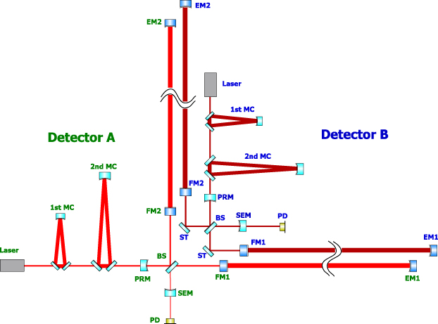
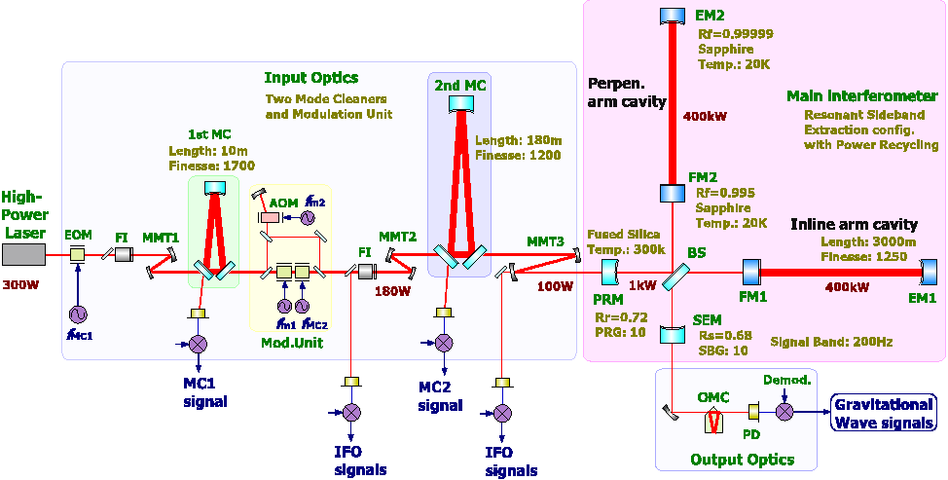
Optical design of LCGT
Two interferometers are arranged not to
interfere in the same vacuum system.
Optical design of the basic interferometer
150W

Slide 32
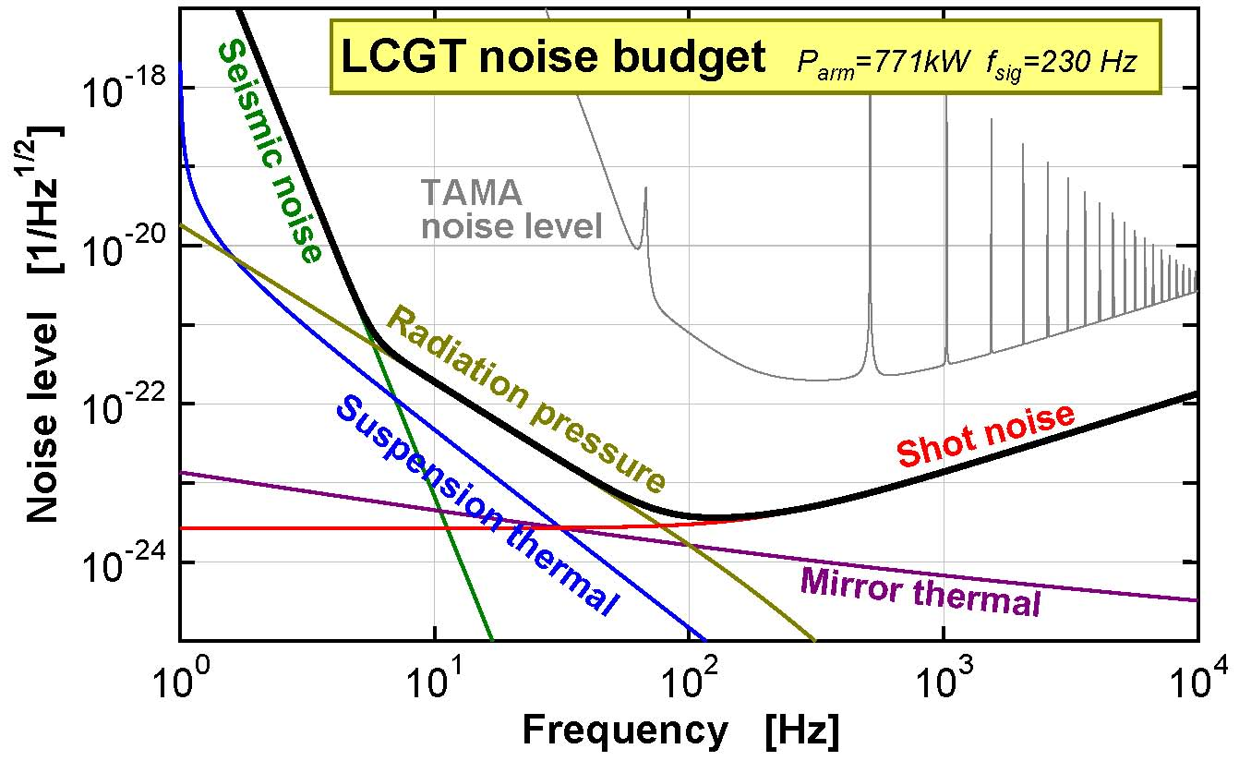
Sensitivity is limited only by quantum noises around
at observational frequency band.

Slide 33
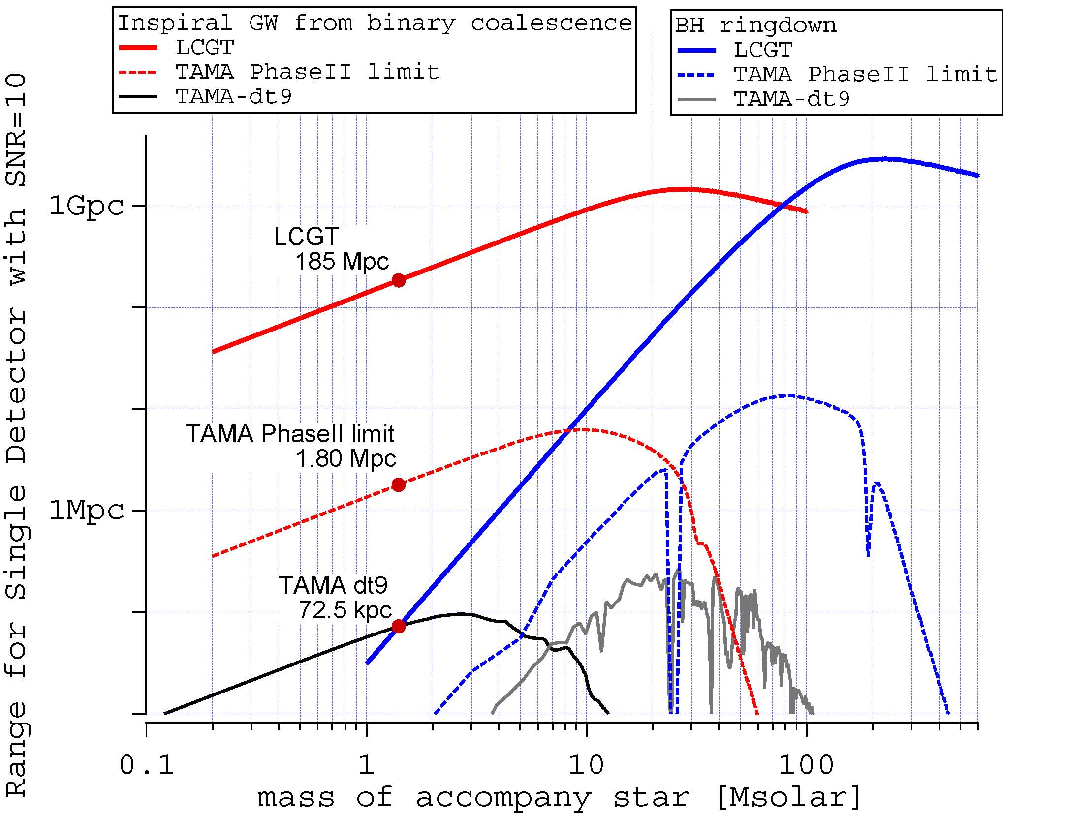
Single interferometer at its optimum

Slide 34
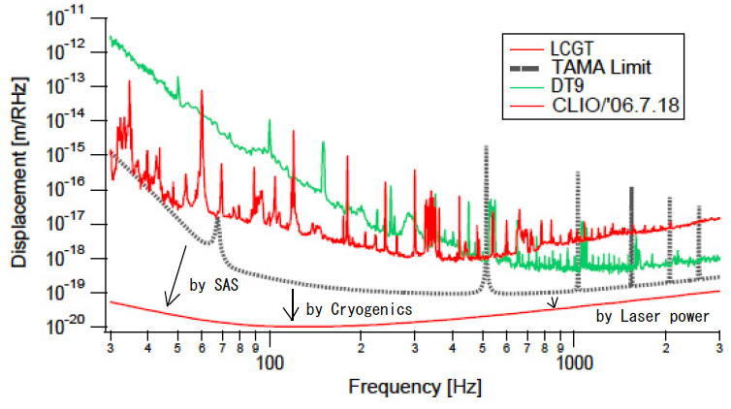
Displacement Sensitivities of interferometers

Slide 35
Technical foundation of LCGT is established by a prototype and intermediate size interferometers with challenging techniques
20m interferometer
  Kamioka mine 1999-2002
Cryogenic experiments
  KEK-ICRR 1997-2002
TAMA advancement
  NAO 1995-
RSE adoption
  NAO 1998-
SPI installation
  Phys. Dept. UT 1999-
SAS
  Phys. Dept. & NAO 1998-
    (CALTECH)
CLIO
LCGT

Slide 36
Sapphire cryogenic mirror produces valuable merits
No thermal lens effect
  due to high thermal conductivity and low thermal expansion rate (sapphire)
Avoidable optical spring parametric instabilities
  due to higher elastic wave speed (sapphire) and small beam size (cryogenic)
Free from large optical coating loss
  due to low temperature

Slide 37
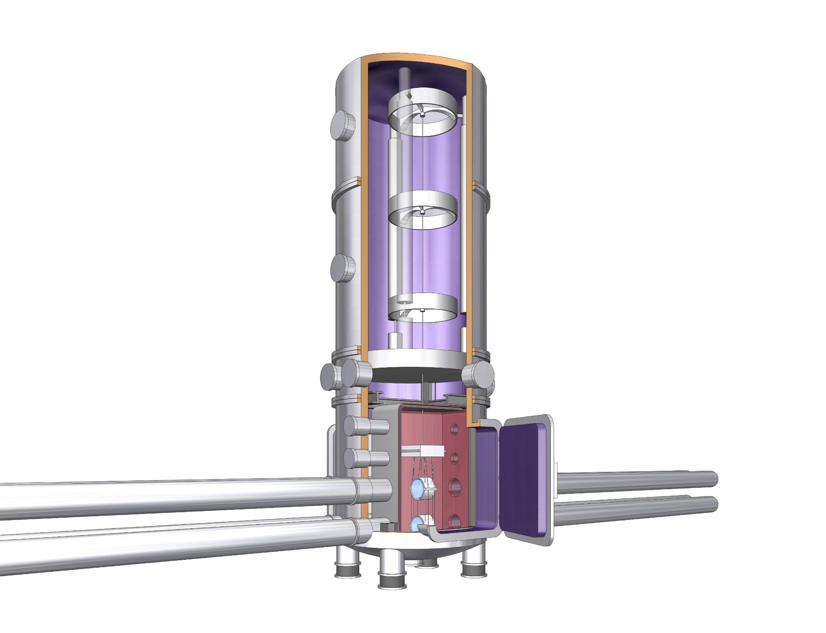
Suspension system
SAS: three stages with
inverted pendulum
Vacuum is common
Outer shield of cryostat
SPI sub-mirror
Heat links extend from here
to the inner shield
heat anchor.
Sapphire fiber
suspending mirror
Main mirror

Slide 38
Large heat production is avoided by RSE
Broad band RSE (Resonant Side band Extraction method) is applied.
Power recycling gain is set 11.
Finesse of the cavity is 1550, which means that observational band becomes to be lower than required.
RSE keeps the observation frequency band unchanged.

Slide 39
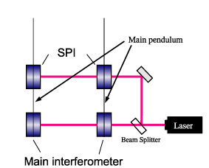
Refrigerator noise is avoided by SPI
Test mass of LCGT is connected to a cooling system by a heat link that possibly introduces mechanical noise. A suspension point interferometer (SPI) is introduced to maintain high attenuation of seismic and mechanical noise without degrading high heat conductivity.

Slide 40
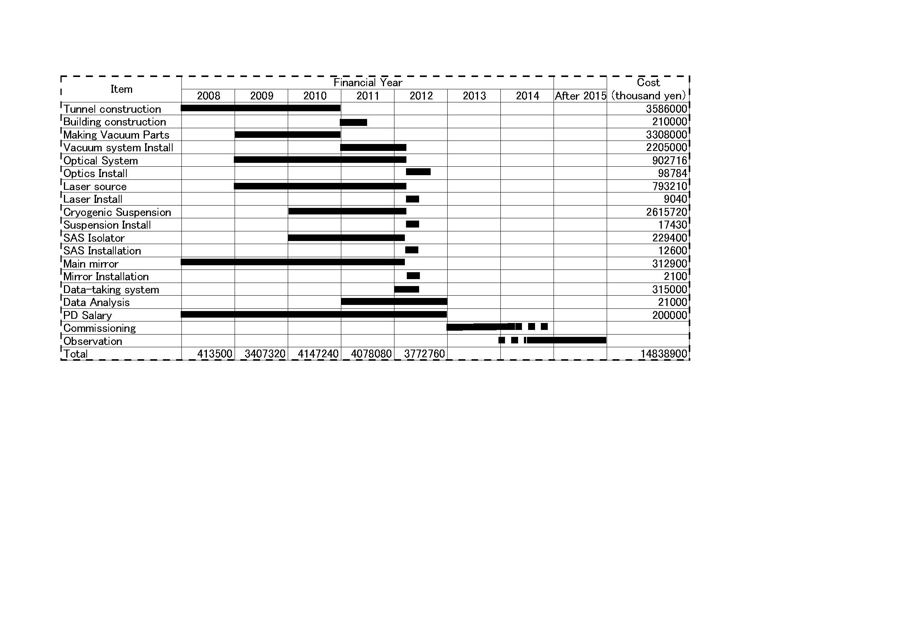
Schedule in the budget request for FY2008
110 JpnYen=1 US$
US$ 135M
It does not include
salaries & maintenances
of facilities.

Slide 41
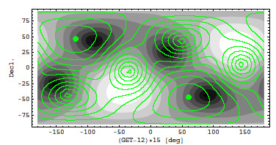
LCGT contributes the international observation by the coverage of
a complimentary sky to other detectors:
LCGT, grey scale, LIGO (Hanford), green contour curves.

Slide 42
Summary of LCGT
It is a 3km Fabry-Perot MI with a power recycling scheme and equipped with a broadband RSE. The laser power is 150W
Main mirrors made of sapphire are cooled at 20K. A SPI impedes the refrigerator- vibration.
Underground usage guarantees stable operation
Two independent interferometers are installed in the vacuum system.
The main target is detecting the coalescence of BNS, which can be detected 1.2-27.8 events per year at confidence level of 95% for mass 1.4Msun and S/N=10.
Possible standard interferometer in the future international network

Slide 43
International Collaboration
(as a dream)
GW observation on the Earth needs an international network consisting of detectors with similar sensitivity and reliable operation
Positioning LCGT as the standard interferometer on the Earth
Every observatory hopefully constructs LCGT in the future
An international organization is needed to help the hardware construction in each observatory
We will contribute to establish such organization by obtaining each governmental fund

Slide 44
Summary
We have acquired interferometer techniques (power recycling, Fabry-Perot Michelson, control system) by TAMA.
LISM confirmed underground significance.
CLIO proves the feasibility of cryogenic mirror, soon.
LCGT as the final and standard interferometer on the Earth reliably detects gravitational wave events.

