Slide 1
XMASS
19th October 2006
ICRR external review meeting,
S. Moriyama, ICRR
1. XMASS: physics targets
2. 3kg FV prototype detector
feasibility confirmation
3. 800kg liquid xenon detector
Search for dark matter

Slide 2
XMASS collaboration (2000-)
ICRR, Kamioka observatory:
Y. Suzuki, M. Nakahata, S.Moriyama, M. Shiozawa,
Y. Takeuchi, M. Miura,Y. Koshio, A.Takeda, K.Abe,
H.Sekiya, H.Ogawa, A.Minamino, T.Iida, K.Ueshima
ICRR, RCNN: T. Kajita, K. Kaneyuki
Saga Univ.: H. Ohsumi
Tokai Univ.: K. Nishijima, M.Sakurai, T.Maruyama
Gifu Univ.: S. Tasaka
Waseda Univ.: S. Suzuki, J. Kikuchi, T. Doke, A. Ohta, Y.Ebizuka, K.Deguchi
Yokohama Nat. Univ.: S. Nakamura, K. Uchida, M. Kikuchi, K. Tomita, Y. Ozaki, T. Nagase, T. Kamei, M. Shibasaki, S. Hagiawara
Miyagi Univ. of Edu.: Y. Fukuda, T. Sato
Nagoya Univ. : Y. Itow
Seoul National Univ.: Soo-Bong Kim
INR-Kiev, Ukraina: O. Ponkratenko,
UCI, USA: H. Sobel, M. Smy, M. Vagins, P.Cravens
Sejon University: Y.D.Kim, J.I.Lee, S.H.Moon
48 collaborators, 13 institutes

Slide 3
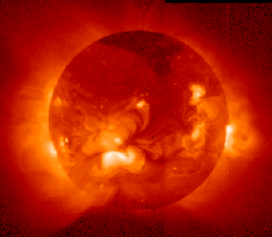
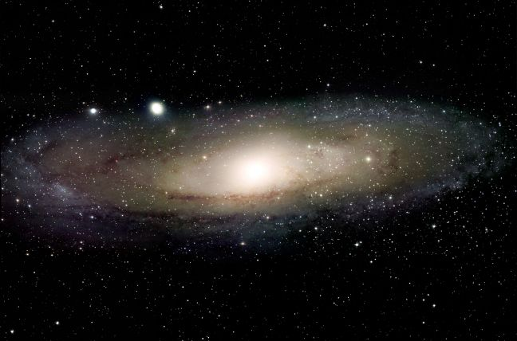
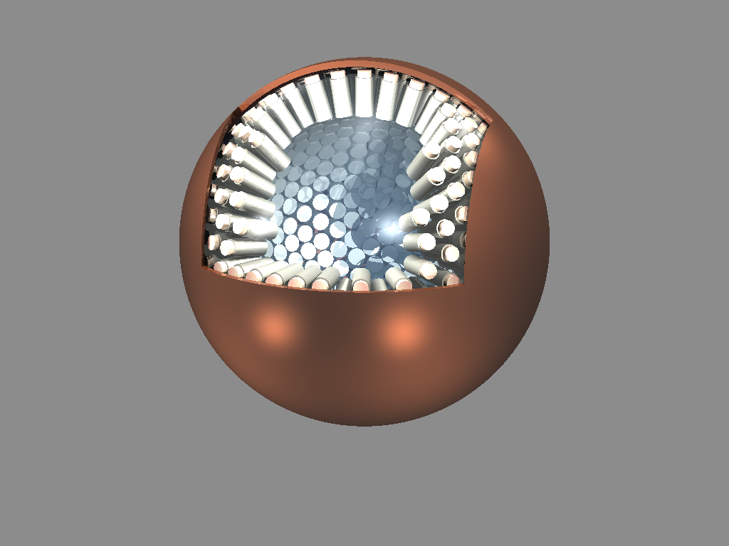
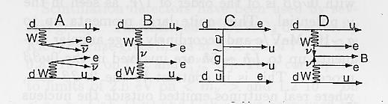
1. XMASS: physics targets
Goal: Multi purpose low-bg experiment with 10t LXe
Xenon MASSive detector for solar neutrino (pp/⁷Be)
Xenon neutrino MASS detector (ββ decay)
Xenon detector for Weakly Interacting MASSive Particles (DM search)
LXe scintillator
Solar neutrino
Dark matter
Double beta

Slide 4
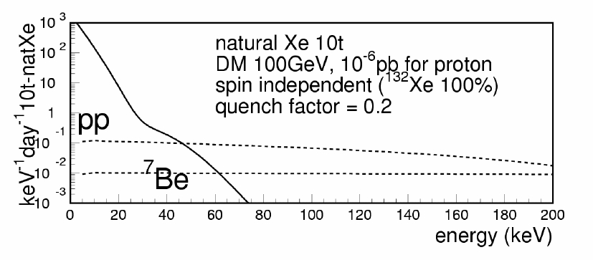
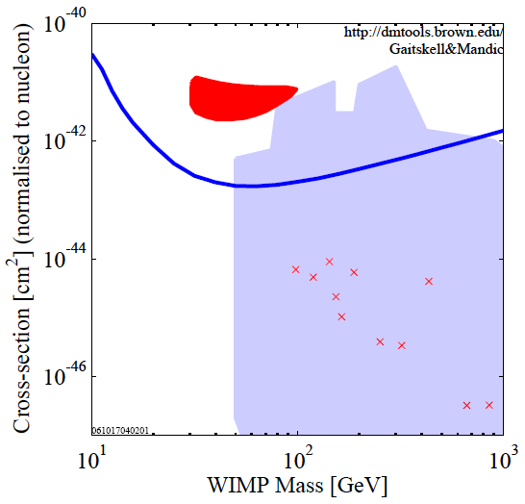
Ultimate sensitivity with 10t LXe:
Direct detection of Dark Matter
10⁻⁴
DAMA
10⁻⁶
CDMSII
Ellis et al. post-LEP benchmark
xsec. to nucleon [pb]
10⁻⁸
XMASS 10t
E_{th} = 5keV: 2000 events/day
10⁻¹⁰
（Eth = 20keV: 30 events/day）
10
10²
10³
Large photosensitive area
WIMP mass (GeV)
Max.-sensitivity, <10⁻¹⁰pb for spin independent xsec (5yr)

Slide 5
Why Liquid Xenon?
General properties:
Large scintillation yield (~42000photons/MeV ~NaI(Tl))
Scintillation wavelength (175nm, direct read out by PMTs)
Higher operation temperature (~165K, LNe~27K, LHe~4K)
Compact (ρ=2.9g, 10t detector ~ 1.5m cubic)
Not so expensive
Well-known EW xsec for solar ν, 136Xe ββ, large A (SI)
External gamma ray background:
Self shielding (large Z=54)
Internal background:
Purification (distillation, etc)
No long-life radio isotopes
Isotope separation is relatively easy
No ¹⁴C contamination (can measure low energy)
Circulation

Slide 6
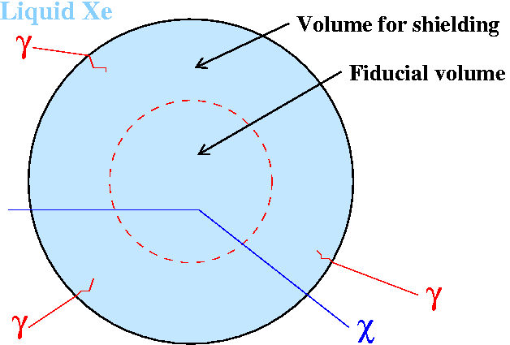
Key idea: self shielding effect for low energy signals
Single phase
liquid Xe
External γ ray from U/Th-chain
23ton all volume (d=240cm)
20cm wall cut
30cm wall cut (10ton FV)
Volume for shielding
Fiducial volume
BG normalized by mass
Large self-shield effect
PMTs
0
1MeV
2MeV
3MeV
Large Z makes detectors very compact
Large photon yield (42 photon/keV ~ NaI(Tl))
Liquid Xe is the most promising material.

Slide 7
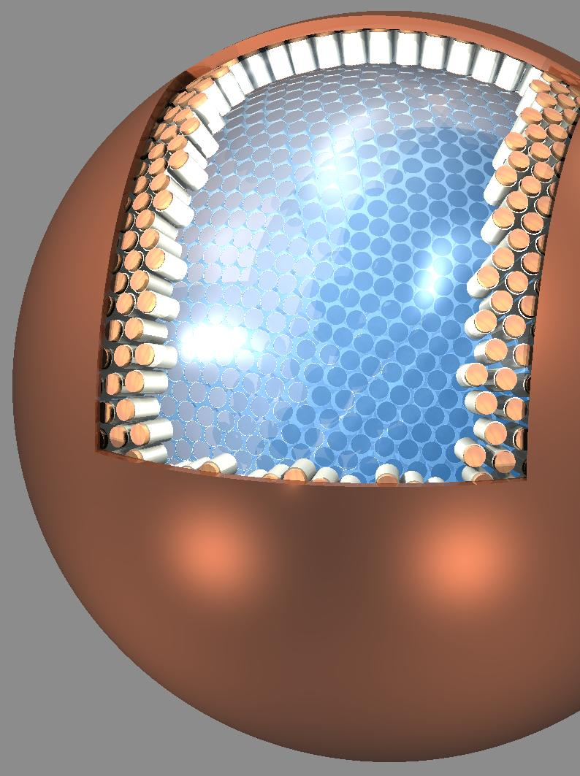
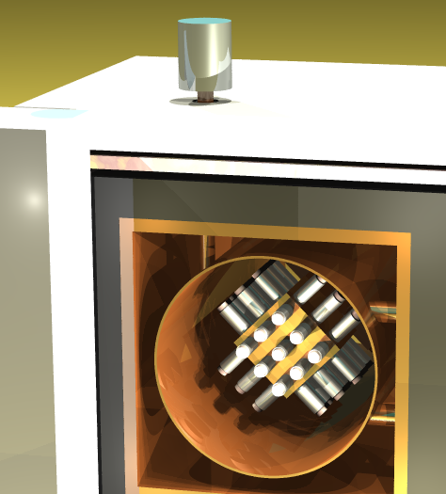
Strategy of the XMASS project
~1m
~2.5m
~30cm
800kg detector
(FV 100kg)
Dark matter search
~20 ton detector
(FV 10ton)
Solar neutrinos
Dark matter search
Prototype detector
(FV 3kg) R&D
Confirmation of feasibility of the ~1ton detector
Double beta decay option?
Feasibility confirmed

Slide 8
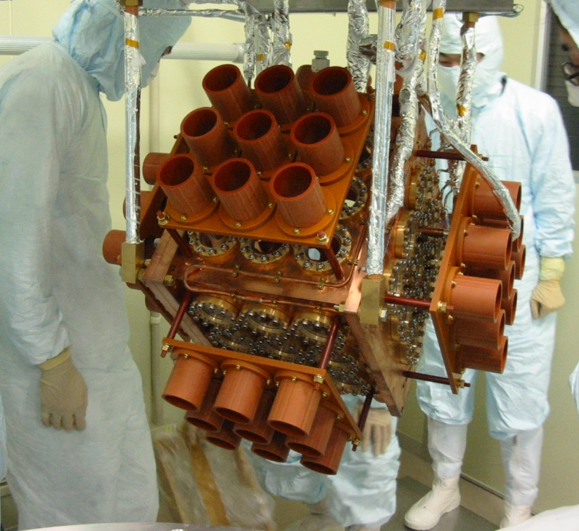
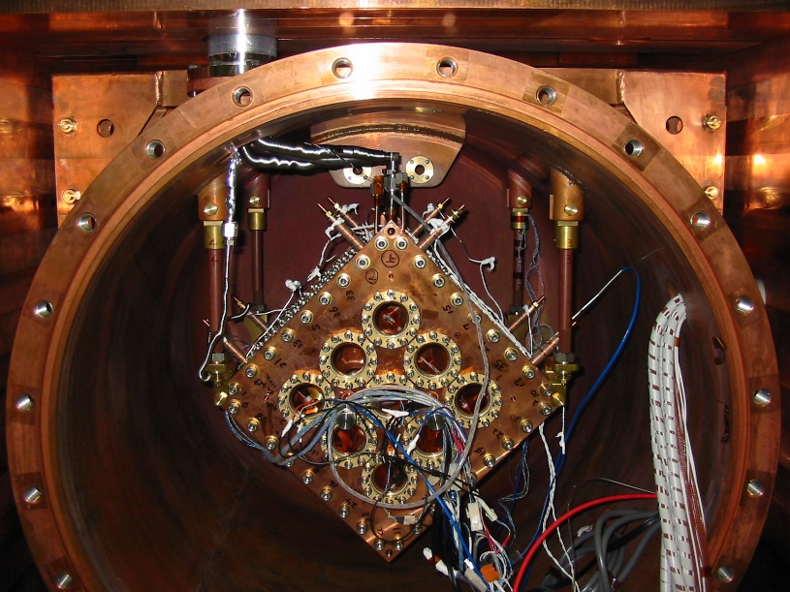
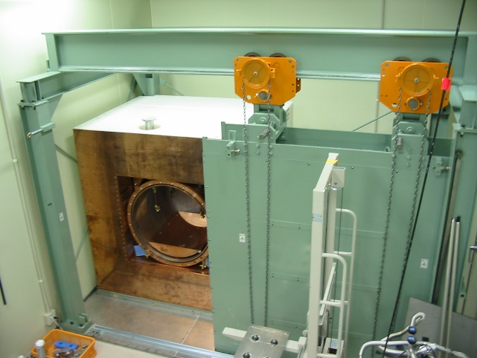
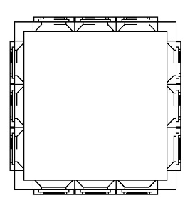
2. 3kg FV prototype detector
In the
Kamioka Mine
(near the Super-K)
OFHC cubic chamber
54 2-inch low BG PMTs
Hamamatsu
R8778
Liq. Xe
(31cm)³
γ ray/neutron shield
16% photo-
coverage
MgF₂ window
Demonstration of reconstruction,
self shielding effect, and low background properties.

Slide 9
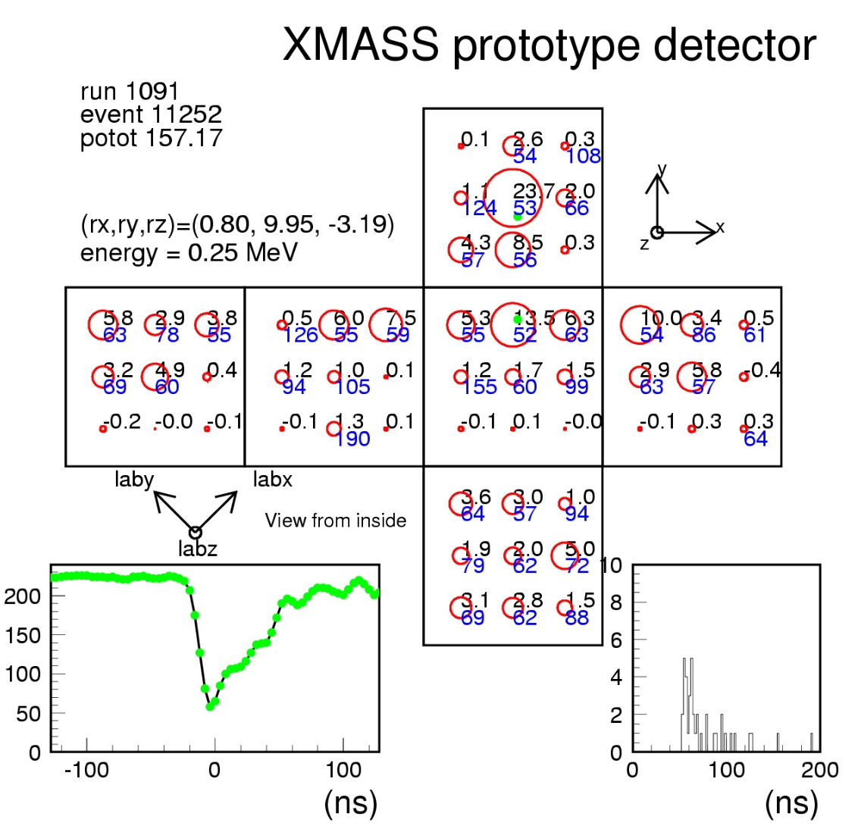
Vertex and energy reconstruction
Reconstruction is performed by
PMT charge pattern (not timing)
Calculate PMT acceptances from various
vertices by Monte Carlo.
Vtx.: compare acceptance map F(x,y,z,i)
Ene.: calc. from obs. p.e. & total accept.
Reconstructed
here
∑
exp(
−
μ
)
μ
n
Log(
L
)
=
Log(
)
PMT
n
!
QADC
L: likelihood
F(x,y,z,i)
μ
:
x total p.e.
Σ F(x,y,z,i)
n: observed number of
p.e
.
FADC
Hit timing
F(x,y,z,i): acceptance for i-th PMT (MC)
VUV photon characteristics:
L_{emit}=42ph/keV
τ_{abs}=100cm
τ_{scat}=30cm
=== Background event sample ===
QADC, FADC, and hit timing
information are available for analysis

Slide 10
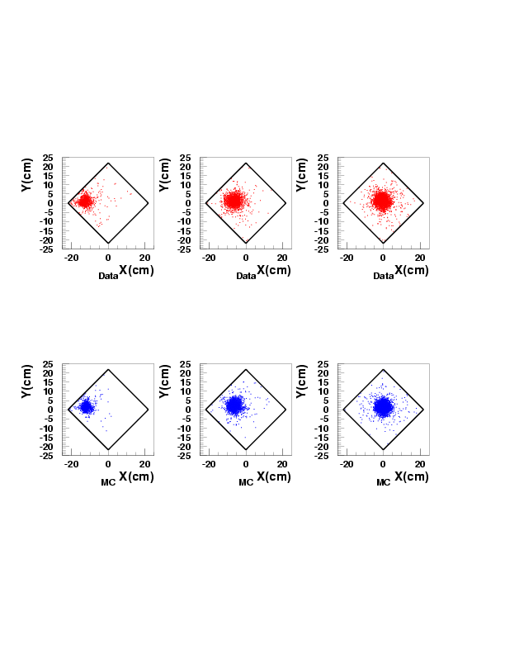
Source run
(γ ray injection from collimators) I
Collimator A
Collimator B
Collimator C
DATA
MC
Well reproduced.
+
+
+
A
B
C

Slide 11
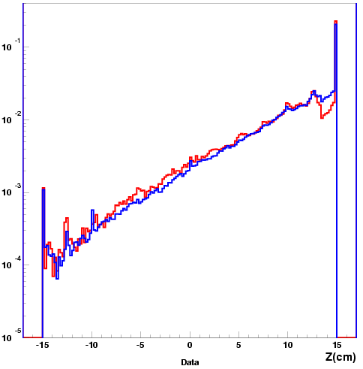
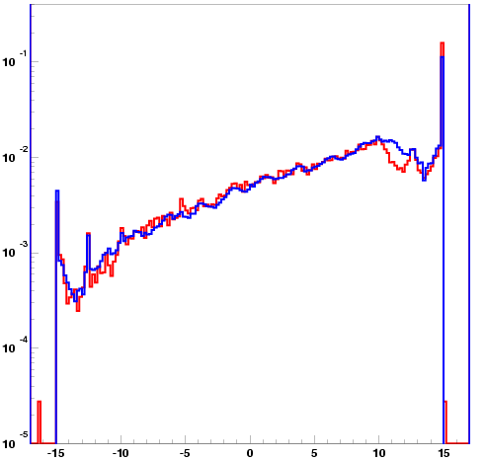
Source run
(γ ray injection from collimators) II
10⁻¹
¹³⁷Cs: 662keV
DATA
MC
10⁻¹
⁶⁰Co: 1.17&1.33MeV
DATA
MC
No energy
cut, only
saturation cut.
BG subtracted
ρ=2.884g/cc
Arbitrary Unit
10⁻²
10⁻²
~1/10
10⁻³
10⁻³
~1/200
10⁻⁴
10⁻⁴
PMT
Saturation
region
10⁻⁵
10⁻⁵
-15
Reconstructed Z
+15cm
-15
Reconstructed Z
+15cm
Self shield works as expected.
Photo electron yield ~ 0.8p.e./keV for all volume
Gamma rays
Z= -15
Z= +15

Slide 12
Background data
3.9days livetime
REAL DATA
MC simulation
1
All volume
1
All volume
20cm FV
20cm FV
10cm FV
(3kg)
10cm FV
(3kg)
Event rate (/kg/day/keV)
10⁻¹
10⁻¹
10⁻²
10⁻²/kg/day/keV
10⁻²
0
1000
2000
3000
0
1000
2000
3000
keV
keV
MC uses U/Th/K activity from PMTs, etc (meas. by HPGe).
Self shield effect can be clearly seen.
Very low background (10⁻² /kg/day/keV@50-300 keV)

Slide 13
Internal background activities
Goal to look for DM by 800kg detector
1x10⁻¹⁴ g/g
Current results
  ²³⁸U(Bi/Po): = (33+-7)x10⁻¹⁴ g/g
  ²³²Th(Bi/Po): < 23x10⁻¹⁴ g/g
  Kr: = 3.3±1.1ppt
x33
Factor ~30, but may decay out further
2x10⁻¹⁴ g/g
x12
Factor ~10 (under further study)
1 ppt
x3
Achieved by distillation
Very near to the target level of U, Th Radon and Kr contamination.

Slide 14
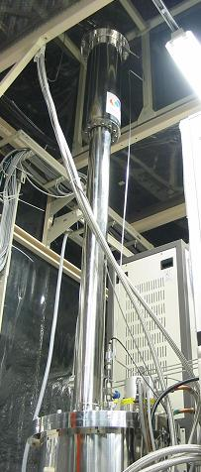
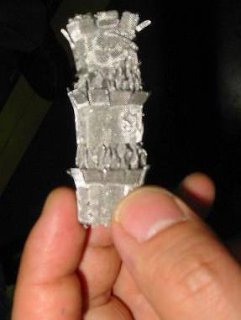
Distillation to reduce Kr (1/1000 by 1 pass)
Very effective to reduce internal impurities (⁸⁵Kr, etc.)
We have processed our Xe before the measurement.
 | Boiling point (@1 atm)
Xe | 165K
Kr | 120K
Original Xe:
~3 ppb Kr
Lower temp.
Off gas Xe:
330±100 ppb Kr
(measured)
~1%
~3m
Operation: 2 atm
Processing speed: 0.6 kg / hour
Design factor: 1/1000 Kr / 1 pass
13 stage of
2cmφ
Purified Xe:
=3.3±1.1ppt Kr (measured after
Kr-enrichment)
Higher temp.
~99%

Slide 15
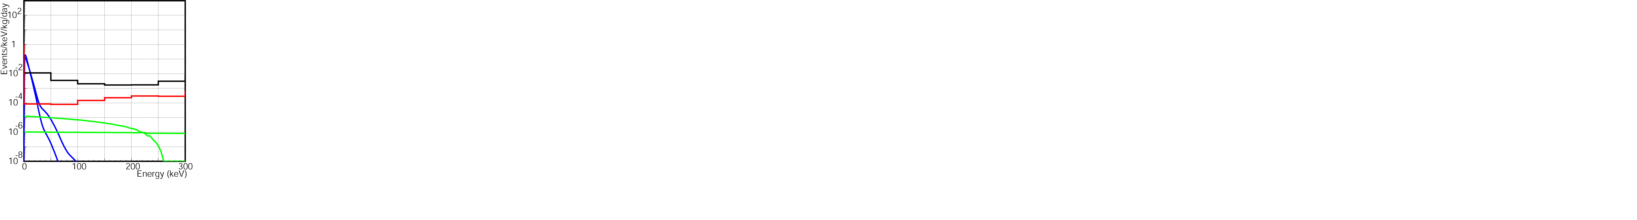
3. 800kg(100kg FV) detector for DM search
Improve Energy threshold ➔ immerse PMTs into LXe
Ext. γ BG: from PMT’s ➔ Self-shield effect demonstrated
Int. BG: Kr (distillation), Radon ➔ Almost achieved
“Full” photo-sensitive,“Spherical” geometry detector
γ ray BG from PMTs:
60cm, 346kg
40cm, 100kg
Achieved
pp & ⁷Be solar ν
80cm diameter
812-hex PMTs (1/10 Low BG)
70% photo-coverage ~5p.e./keVee
Expected dark matter signal
(assuming 10⁻⁴² cm², Q.F.=0.2 50,100GeV)

Slide 16
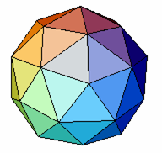
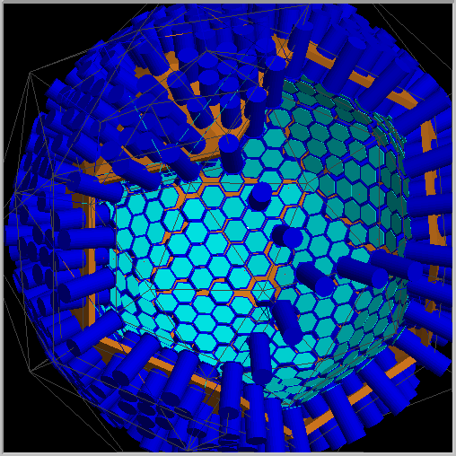
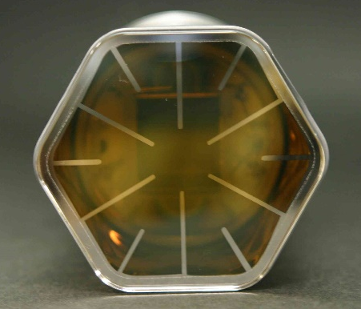
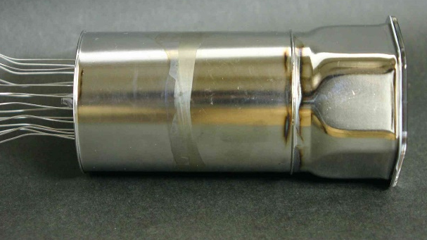
More detailed geometrical design
A tentative design (not final one)
12 pentagons / pentakisdodecahedron
Hexagonal PMT
~50mm diameter
Aiming for 1/10 lower BG than R8778
R8778: U 1.8±0.2x10⁻² Bq
Th 6.9±1.3x10⁻³ Bq
⁴⁰K 1.4±0.2x10⁻¹ Bq
This geometry has been coded in a Geant 4 based simulator

Slide 17
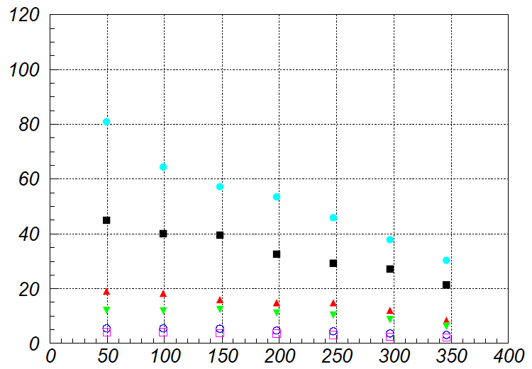
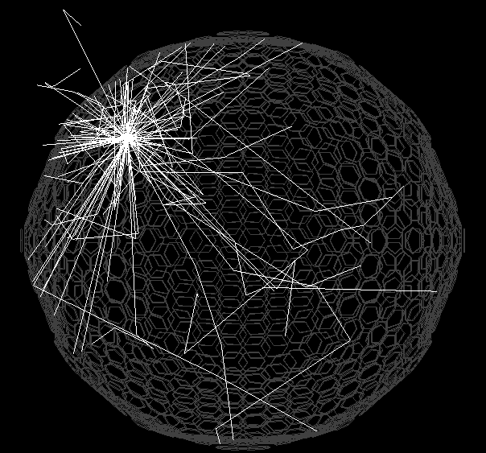
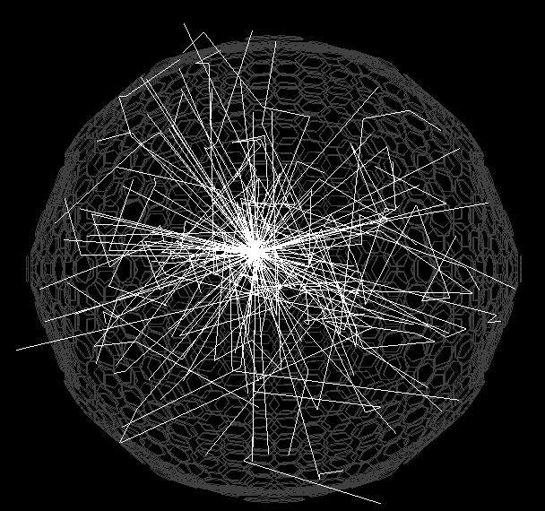
800kg reconstruction and BG study energy threshold: 5keV (~25p.e.)
12
10
Fiducial volume
8
5 keV
6
σ (reconstructed) [cm]
10 keV
4
50 keV
2
100 keV
10keV
R=5cm
10keV
R=35cm
1 MeV
500 keV
0
0
10
20
30
40
Distance from the center [cm]
Photon tracking: absorption,
scattering, and reflection
Extensive study to optimize the detector ongoing

Slide 18
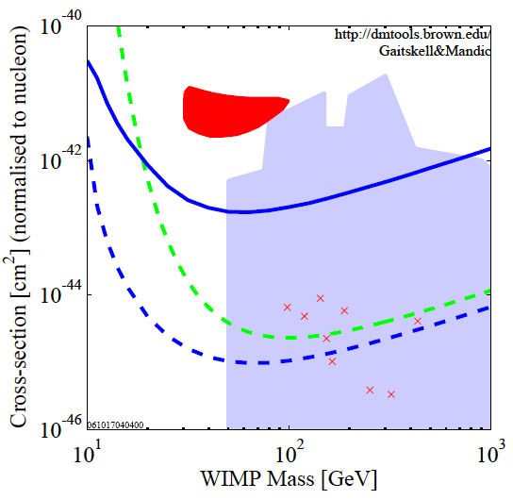
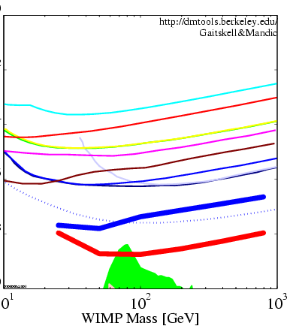
Expected sensitivity
XMASS FV 0.5ton year (100kg, 5yr)
3σ discovery
w/o any pulse shape information
10⁻⁴
10⁶
SI
SD
10⁴
Edelweiss Al2O3
10⁻⁶
CDMSII
Cross section to nucleon [pb]
10²
Tokyo LiF
Modane NaI
XENON100
CRESST
XMASS800kg
1
UKDMC NaI
10⁻⁸
WARP 140kg
NAIAD
10⁻²
SuperCDMS Phase A
XMASS800kg
10⁻¹⁰
J Ellis et al. benchmark
10⁻⁴
10
10²
10³
10
10²
10³
WIMP mass (GeV)
WIMP mass (GeV)
Plots except for XMASS:
http://dmtools.berkeley.edu
Gaitskell & Mandic
Large improvements ~10² expected.

Slide 19
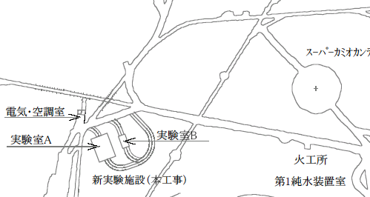
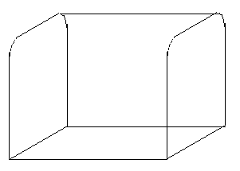

New experimental hall
New two halls will be excavated by the next summer.
One of them accommodates the xmass detector including a large water shield which protects it from gamma rays and neutrons.
250cm water
γ ~10⁻⁴
Fast neutron ~ 10⁻⁵
Super-K
New
hall 1
Hall 2
Water shield
8m
XMASS
detector
15m
9m
15m
21m

Slide 20
Summary
XMASS aims to detect
Low energy solar ν, 0νββ decay, and Dark Matter
Feasibility for 800kg liquid xenon detector was confirmed with the prototype detector.
Reconstruction, self shielding, and purification tech. have been demonstrated.
800kg detector is under designing.
10² improvement of sensitivity (~10⁻⁹pb) above existing experiments is expected.

