Slide 1
K2K and T2K
2006/10/19
For the 2006 External Review Panel
Masato Shiozawa
Kamioka Observatory

Slide 2
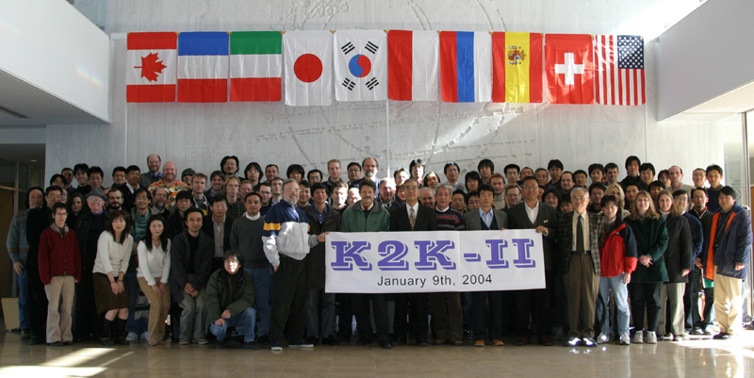
University of Barcelona, Boston University, Chonnam National University, Dongshin University, University of Geneva, Hiroshima University, ICRR, Inst. for Nuclear Research Moscow, KEK, Kobe University, Korea University, Kyoto University, Massachusetts Institute of Technology, Niigata University, Okayama University, University of Rome "La Sapienza“, Saclay (DSM-DAPNIA), Seoul National University, SUNY at Stony Brook, Tokyo University of Science, Tohoku University, University of California Irvine, University of Hawaii, University of Tokyo, University of Washington, University of Valencia, Warsaw University
35 institutes, 219 collaborators for latest K2K paper hep-ex/0606032

Slide 3
Publications (only refereed journal)
1) Measurement of Neutrino Oscillation by the K2K Experiment.
By K2K Collaboration
accepted for publication in Phys.Rev.D. [hep-ex/0606032]
2) Measurement of the quasi-elastic axial vector mass in neutrino-oxygen interactions.
By K2K Collaboration
Phys.Rev.D74:052002,2006. [hep-ex/0603034]
3) An Improved search for nu(mu) ---> nu(e) oscillation in a long-baseline accelerator experiment.
By K2K Collaboration
Phys.Rev.Lett.96:181801,2006. [hep-ex/0603004]
4) Search for coherent charged pion production in neutrino-carbon interactions.
By K2K Collaboration
Phys.Rev.Lett.95:252301,2005. [hep-ex/0506008]
5) Evidence for muon neutrino oscillation in an accelerator-based experiment.
By K2K Collaboration
Phys.Rev.Lett.94:081802,2005. [hep-ex/0411038]
6) Measurement of single pi0 production in neutral current neutrino interactions with water by a 1.3-GeV wide band muon neutrino beam.
By K2K Collaboration
Phys.Lett.B619:255-262,2005. [hep-ex/0408134]
7) The K2K SciBar detector.
By K. Nitta, et al.,
Nucl.Instrum.Meth.A535:147-151,2004. [hep-ex/0406023]
8) Search for electron neutrino appearance in a 250 km long baseline experiment.
By K2K Collaboration
Phys.Rev.Lett.93:051801,2004. [hep-ex/0402017]
9) Indications of neutrino oscillation in a 250 km long baseline experiment.
By K2K Collaboration
Phys.Rev.Lett.90:041801,2003. [hep-ex/0212007]
10) Near muon range detector for the K2K experiment: Construction and performance.
By K2K MRD GROUP
Nucl.Instrum.Meth.A482:244-253,2002, Erratum-ibid.A488:673,2002. [hep-ex/0107041]
11) Detection of accelerator produced neutrinos at a distance of 250-km.
By K2K Collaboration
Phys.Lett.B511:178-184,2001. [hep-ex/0103001]
12) Design, construction, and operation of SciFi tracking detector for K2K experiment.
By K2K Collaboration
Nucl.Instrum.Meth.A453:165-176,2000. [hep-ex/0004024]
oscillation 6
ν interactions 3
detector 3

Slide 4
K2K experiment overview
long baseline neutrino oscillation experiment using muon neutrino beam produced by 12GeV PS at KEK
Neutrino data have been accumulated successfully during Jan. 1999 to Nov. 2004 (completed).
νμ disappearance phenomena was confirmed by accelerator-based neutrino beam at the first time; νμ oscillation parameters (Δm² and sin²2θ) consistent with the atmospheric neutrino oscillation parameters.
No νe appearance signal was observed, sin²2θeμ<0.13 @ Δm²=2.8x10⁻³eV²

Slide 5
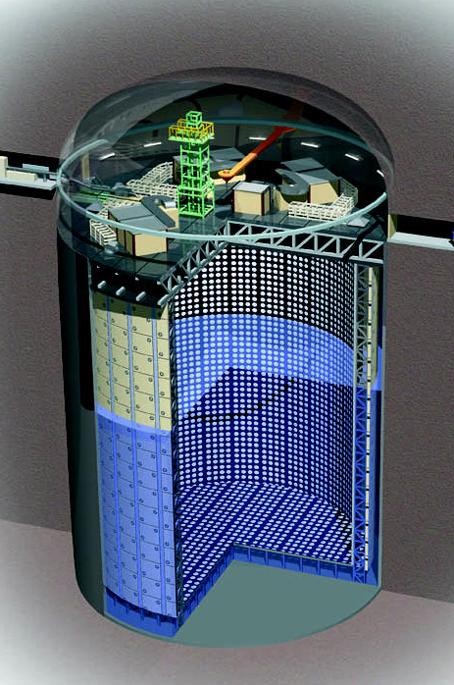
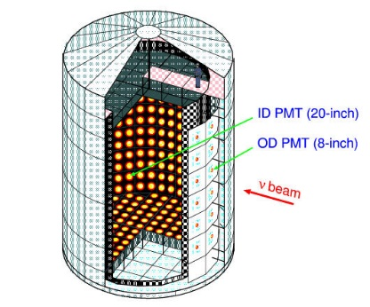
K2K experiment overview (cont.)
Super-K@250km
ICRR hosts two detectors.
  Super-K (the far detector) at 250km.
  1KT (1,000ton Water Cherenkov) at 300m.
took the responsibility for construction, calibration, data reduction, analyses
1KT@300m
ν

Slide 6
K2K neutrino beam (in KEK)
almost pure ν_{μ} beam (~98%)
Eν ~ 1.3 GeV
Aluminum target
ν_{μ} energy spectrum
@ front detector site
x10¹⁰
Front detector
Nν / cm² / 0.1GeV / 10²⁰ pot
200m decay tunnel
π⁺ → μ⁺ + ν_{μ}
p
E_{ν} (GeV)
12GeV PS

Slide 7
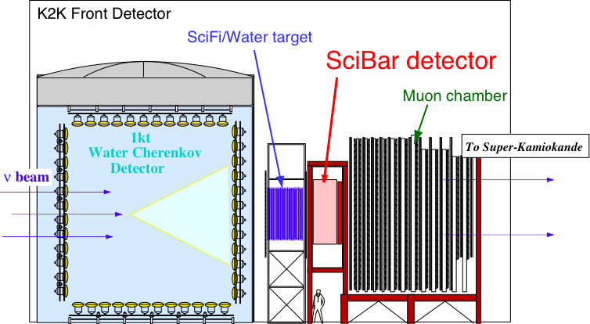
Near Detectors at 300m
1KT
SciFi
LG/SciBar
Lead Glass or
MRD
Muon Range Detector (MRD)
ν_{μ}
SK
1KT: water cherenkov detector
SciFi: scintillating fiber and water target
LG: Lead glass calorimeter (removed in 2002)
SciBar: full-active scintillator detector (installed in 2003)
MRD: muon ranger, iron absorbers and drift tubes

Slide 8
ND neutrino measurement
Absolute flux measurement
  1KT water Cherenkov data
Spectrum measurement
  1KT
    Fully contained 1 ring μ-like sample
  SciFi
    1track, 2track QE and 2track nonQE sample
  SciBar
    1track, 2track QE and 2-track nonQE sample

Slide 9
KT data
(and other near detectors)

Slide 10
Observed ν events in KT
KT
Y
Black: Data
Red : MC
Z
Z
ν
X
X
Fiducial volume
Very good agreement btw data and MC.
Y

Slide 11
Spectrum fit at near detector
p
Fully Contained single-ring μ ( CCQE:60%)
ν
μ
P_{μ}
cosθ_{μ}
(pμ, θμ) for 1ring μ-like sample (1KT), 1track, 2track QE
and 2track nonQE sample (SciFi, SciBar)
Φ(Eν), nonQE/QE ratio are obtained

Slide 12
Pμ distributions in each detector
Data
MC after fitting
CC QE
Best fit MC reproduces all data well.

Slide 13
μ directions at near detectors
1KT covers whole 4π direction.
Good agreement in angular distributions as well.

Slide 14
Super-K data
(and neutrino oscillation study)

Slide 15
Event selection @ SK
TOF (0.83m sec) cut using GPS
Selection criteria
|ΔT|<500μsec, no pre-activity
(Decay-e cut)
Total q within 300n sec
>200(K2K-I), 94(K2K-II) (~20MeV)
No OD activity (FC), Evis>30MeV,
Fiducial volume(Dwall>2m)
|ΔT|=-0.2 ~ +1.3μsec
# of events
578k
53k
115
112
112 on-timing fully contained events
in fiducial volume are observed.

Slide 16
SK event summary
 | SK events
FC | 112
1ring | 67
1ring μ | 58
1ring e | 9
multi ring | 45
Number
Spectrum
92.2×10¹⁸POT
112 FC events are observed
158.1 +9.2 / - 8.6 events are expected (no osc.).

Slide 17
ν_{μ} disappearance analysis
Number of FC events
Obs.
Expected.
112
158.1 (null osc.)
+9.2
- 8.6
Reconstructed Eν spectrum
1ring μ data
KS test probability for spectrum shape
null osc.
(Δm²,sin²2θ)
=(2.8x10⁻³,1.0)
Data-best fit (2.8x10⁻³,1.0)
Data-null osc.
37%
0.07%
Null oscillation probability
K2K
0.06% (3.4σ)
0.42% (2.9σ)
0.0015% (4.3σ)
Norm.
Shape
Shape+Norm.

Slide 18
ν_{μ} disappearance allowed region
Δlikelihood @ sin²2θ=1.0
Δlikelihood @ Δm²=2.8x10⁻³
Best fit : (Δm²,sin²2θ)
(2.55x10⁻³, 1.19) (all region)
(2.75x10⁻³, 1.0) (physical)
K2K confirmed neutrino oscillations discovered by atm ν.

Slide 19
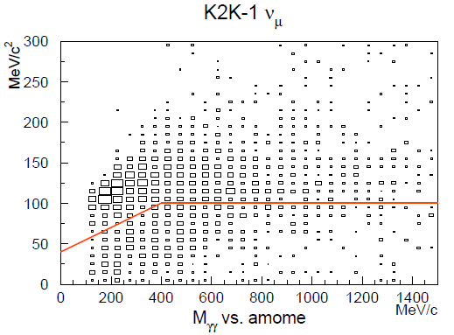
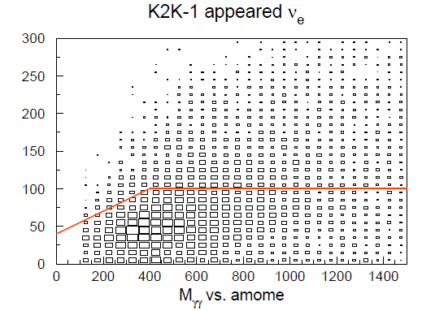
Event selection for ν_{e} appearance search
Pi0 cut
―K2K-1― | νμ MC | beam νe | Data
FCFV | 81.1 | 0.81 | 55
Single ring | 50.92 | 0.47 | 33
Tight e-like cut | 2.66 | 0.40 | 3
Evis > 100 MeV | 2.47 | 0.40 | 2
No decay-e | 1.90 | 0.35 | 1
Pi0 cut | 0.58 | 0.17 | 0
νμ BG
select
Invariant mass using additional 2nd ring (MeV/c2)
νe signal
―K2K-2― | νμ MC | beam νe | Data
FCFV | 77.4 | 0.86 | 57
Single ring | 49.41 | 0.52 | 34
Tight e-like cut | 3.21 | 0.44 | 5
Evis > 100 MeV | 2.93 | 0.44 | 5
No decay-e | 2.17 | 0.39 | 4
Pi0 cut | 0.74 | 0.21 | 1
select
1st ring momentum (MeV/c)
In total,
#expected BG = 1.70
#observed = 1

Slide 20
Exclude region for ν_{e} appearance search
limit
sensitivity
upper limit (90% CL)
sin²2θ_{μe}<0.13 @2.8x10⁻³ eV²
K2K
sin²θ13<~0.06@2.8x10⁻³eV²
(assuming sin²2θ23=1.0)
Consistent result
CHOOZ(reactor)
sin²θ13<~0.03@2.8x10⁻³eV²

Slide 21
Cross section measurements in KT

Slide 22
Measurement of single π⁰ production in neutral current neutrino interactions
π⁰ events
  single-event spill
  Fully-Contained
  number of rings = 2
  both e-like PID
  Mγγ : 85 ~ 215 MeV/c²
data
MC
non-π⁰ BG
Large NC fraction of 87%

Slide 23
Results
Phys.Lett.B619:255-262,2005.
stat. sys.
σ(NC1π⁰) / σ(ν_{μ}CC) = 0.064 ± 0.001 ± 0.007
at the K2K beam energy, <Eν>~1.3 GeV
cf. σ(NC1π⁰) / σ(ν_{μ}CC) = 0.065 from NEUT
cf. σ(ν_{μ}CC) ~ 1.1 x 10⁻³⁸ cm² / nucleon from NEUT
(K2K beam spectrum averaged)
<Eν> ~ 1.3 GeV

Slide 24
Study of atmospheric neutrino background for proton decay search
K2K neutrino energy well matches proton decay p→e⁺π⁰ BG
KT data statistics ~ 10Megatonyears (Super-K ~400years)
2- or 3-ring μπ⁰ events in KT
CC single pi0
CC single pi0
(Draft in preparation)

Slide 25
Summary of K2K
first detection of accelerator produced neutrinos at 250km distance.
νμ disappearance phenomena was confirmed by controlled neutrino beam, at known distance.
gives data for neutrino interaction studies.
There are still unknown mixing angle θ13. Precise determination of (sin²2θ23, Δm²) may help us to understand unknown underlying physics.
Next generation long baseline experiment, T2K

Slide 26
Future experiment, T2K

Slide 27
T2K experiment overview
commissioning of the JPARC neutrino beam-line is expected to be in 2009.
~50 times intense neutrino beam compared with K2K.
physics sensitivities are maximized by using quasi-monochromatic neutrino beam (beam pointing to off-axis angle)
aim to precisely measure νμ oscillation parameters (Δm² and sin²2θ) with the accuracy of ~1% level.
aim to discover nonzero θ13 down to sin²2θ13=~0.01 by νe appearance signal.

Slide 28
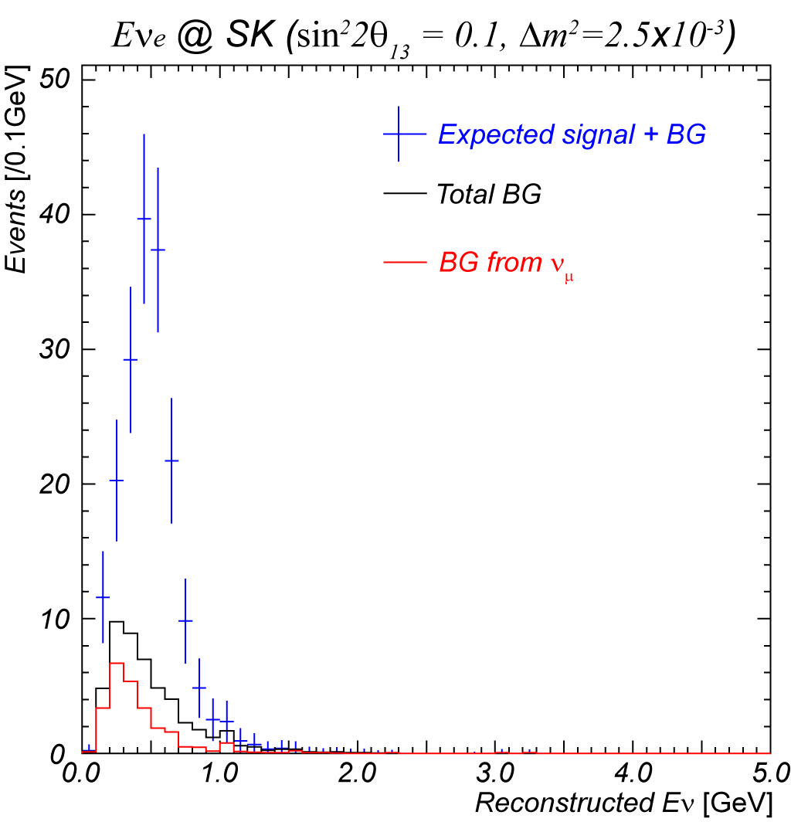
oscillation study:
νμ disappearance and ν_{e} appearance
Single-ring μ
Single-ring electron (w/ π⁰ cut)
Ratio of E_{ν}^{rec}
[with oscillation]
[no oscillation]
# of events
in 0.35~0.85 [GeV]
Signal … 103
Beam ν_{e} BG … 13
BG from ν_{μ} … 10
5x10²¹ POT
(sin²2θ₂₃,Δm²₂₃)
=(1.0, 2.7 x 10⁻³ eV²)
5x10²¹ POT
(sin²2θ₁₃,δ,Δm²₂₃)
=(0.1., 0, 2.5 x 10⁻³ eV²)
5×10²¹ POT MC

Slide 29
Super-K should be well prepared for T2K beam
ICRR hosts the far detector, Super-K at 300km.
All front-end electronics will be replaced by newly developed ones in 2008.
  The ASIC front-end chip development is ongoing
  ν observation with good stability and accuracy
Further detector calibration
  study ring-ID capability for π⁰ BG rejection in electron appearance
  improve absolute energy scale uncertainty < 1%
  light scattering and absorption in water, reflection on detector wall, TQ response of PMTs are also indispensable.
software upgrade
  improvements of reconstruction algorithms
  Cherenkov ring finding, vertex fitter, energy determination…

Slide 30
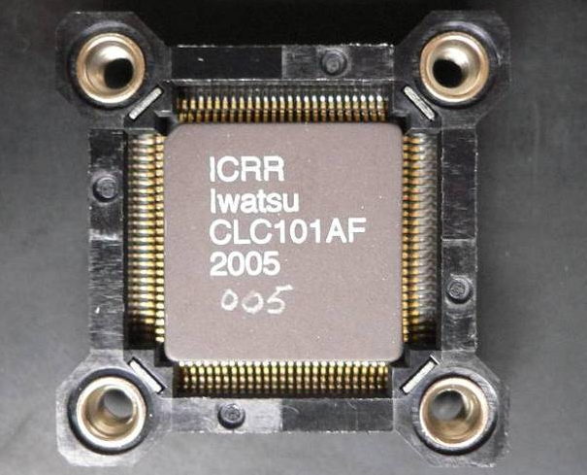

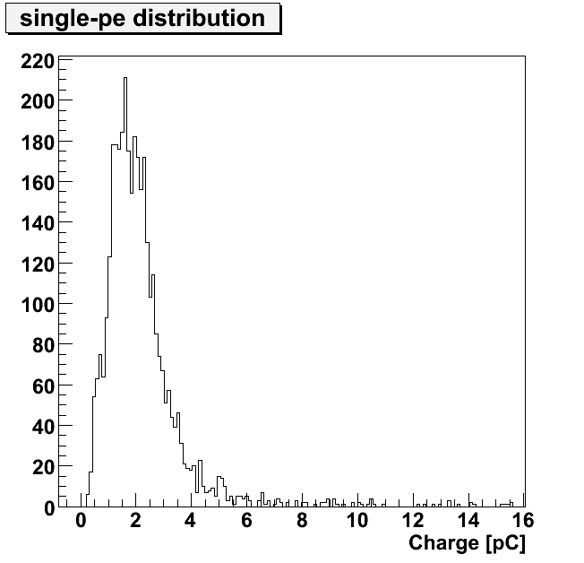
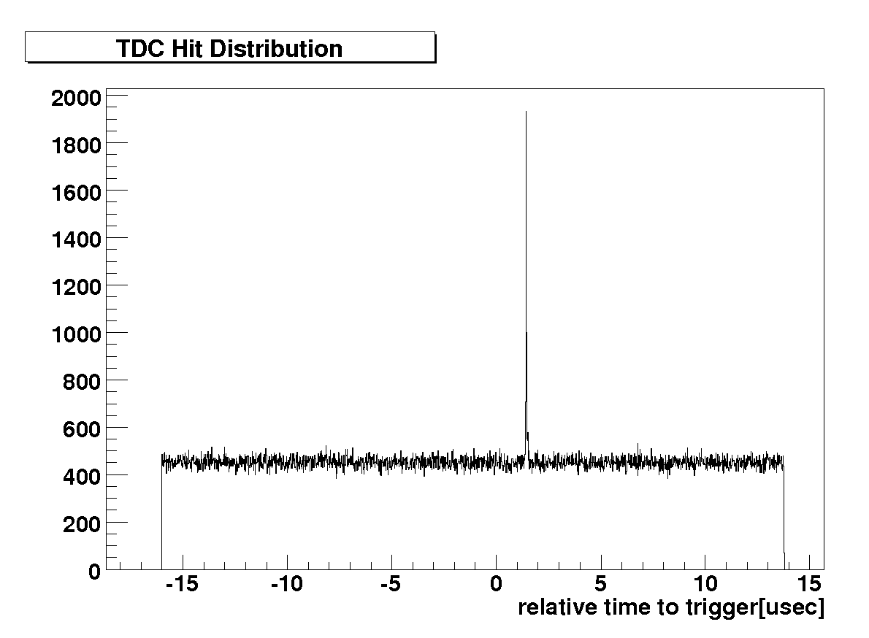
New front-end ASIC (QTC)
timing
3gain x 3ch
charge
Implement all delicate analog processes in one chip
→ aim to achieve noise free, accurate response of electronics
3 channel input
High-speed
  500nsec per one cycle
Build-in discriminator
Wider dynamic range
  ~ 1250 p.e. by 3 gain
  (c.f. ~250p.e. w/current FE)
Charge resolution
  0.1pC ~ 0.05p.e.
Timing resolution
  < 0.1nsec (RMS)
30usec
Lower Noise
  No noise hit @ - 0.5mV(~1/6 p.e.)
power dissipation
  < 200 mW/ch
Process
  0.35μm CMOS
1p.e. ~ 2pC
threshold : 1/3pC⬄-0.5mV

Slide 31
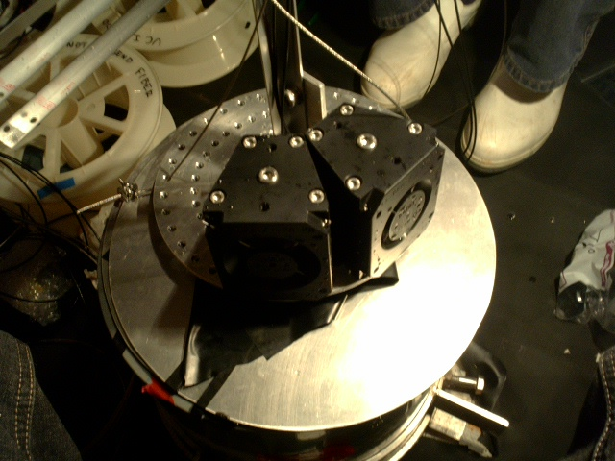
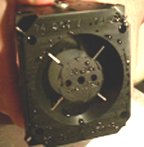
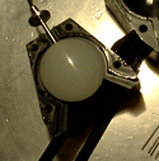
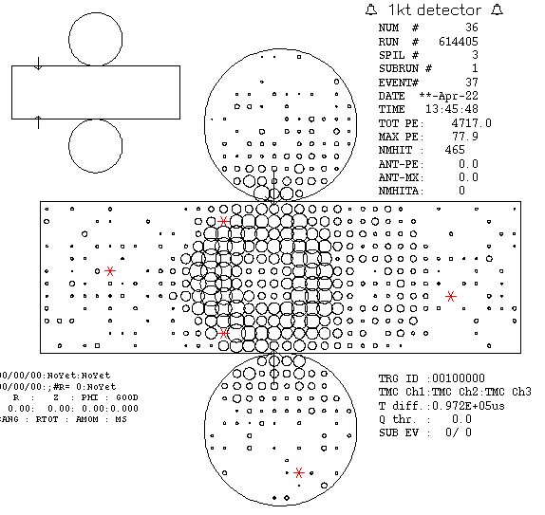
Cone light Generator (Prototype)
Θ₁₂
w
α
Corresponds to 500MeV/c π⁰ Θ₁₂=50°
Laser ball enclosed in delrin vessel.
Adjustable:
  cone angle (α), width (w) & opening angle (Θ₁₂)
To study π⁰ ring finding efficiency
Data taking successful at 1KT

Slide 32
Summary of T2K
ICRR will take the responsibility for the far detector (operation, calibration, data analyses)
aim to measure νμ oscillation parameter with ~1% accuracy.
aim to discover unknown θ13 down to sin²2θ13~0.01.
Thank you very much.

