Slide 1
High energy gamma-rays
and
Lorentz invariance violation
Gamma-ray team A – data analysis
Takahiro Sudo,Makoto Suganuma,
Kazushi Irikura,Naoya Tokiwa,
Shunsuke Sakurai
Supervisor: Daniel Mazin, Masaaki Hayashida

Slide 2
Introduction

Slide 3
What can we learn from γ-rays ?
Motivation: to see whether the special relativity holds at high energy scale.
Is there Quantum Gravitational effect, which modifies space-time structure and cause Lorentz invariance violation?

Slide 4
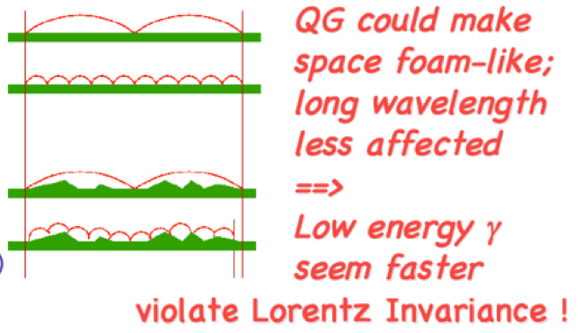
How we measured:
If QG makes space not flat, γ-rays of shorter wavelength are more affected, so higher energy γ-rays travel slower.
Then, the speed of light is not constant!
So the arrival times of γ-rays emitted simultaneously depend on their energies.

Slide 5


What we measured:
We measured arrival times of γ-rays of higher energies and lower energies.
We determined ΔE, got Δt from data, and calculated “quantum gravity energy scale”
We compared E_{QG} of n=1 and 2 with Planck Energy scale.

Slide 6
What we learn in this research:
The meaning of E_{QG} is the energy scale at which QG effects begin to appear.
So if E_{QG} is less than Planck energy scale,
it means QG effect is detected
The birth of a new physics!

Slide 7
Fermi Analysis

Slide 8
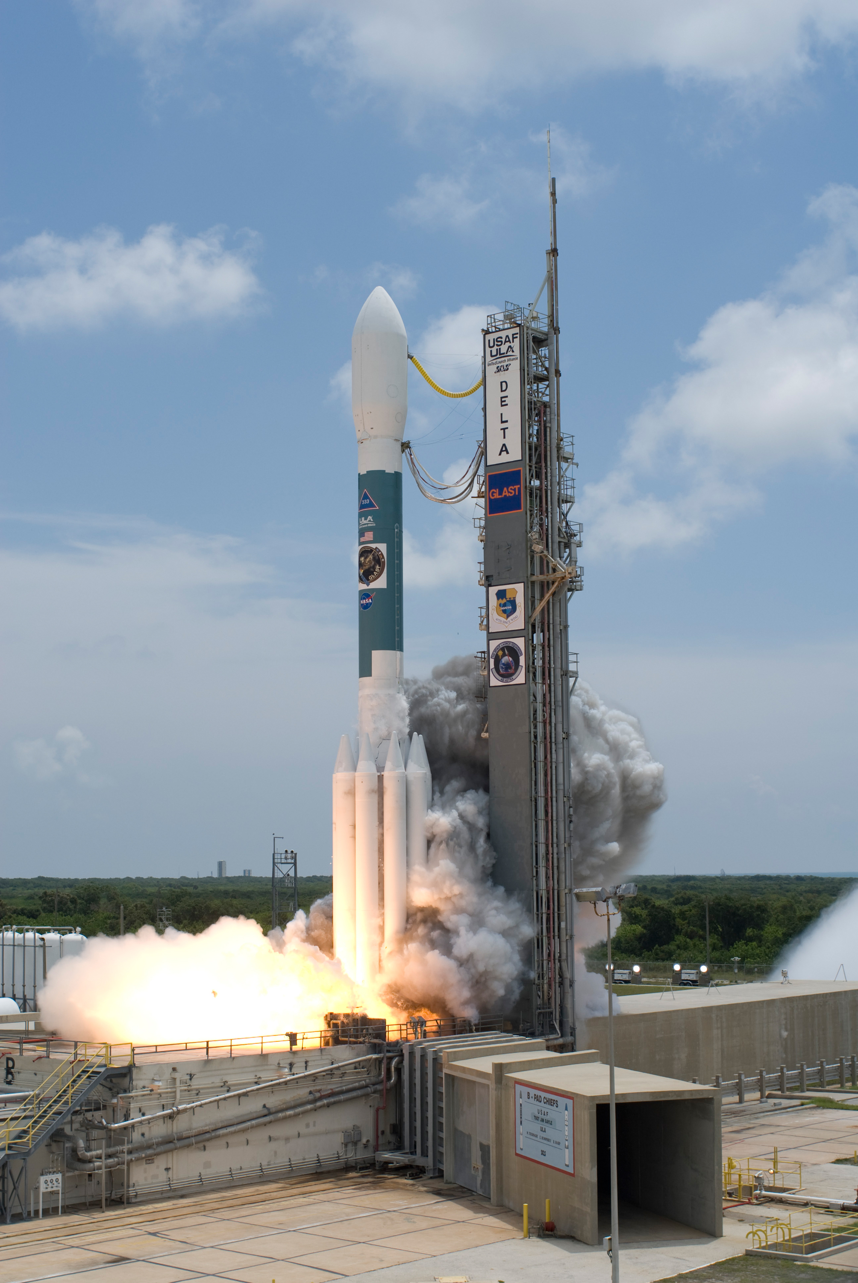
About Fermi
launched from Cape Canaveral 11 June 2008
The Fermi satellite is in orbit around the earth today.

Slide 9
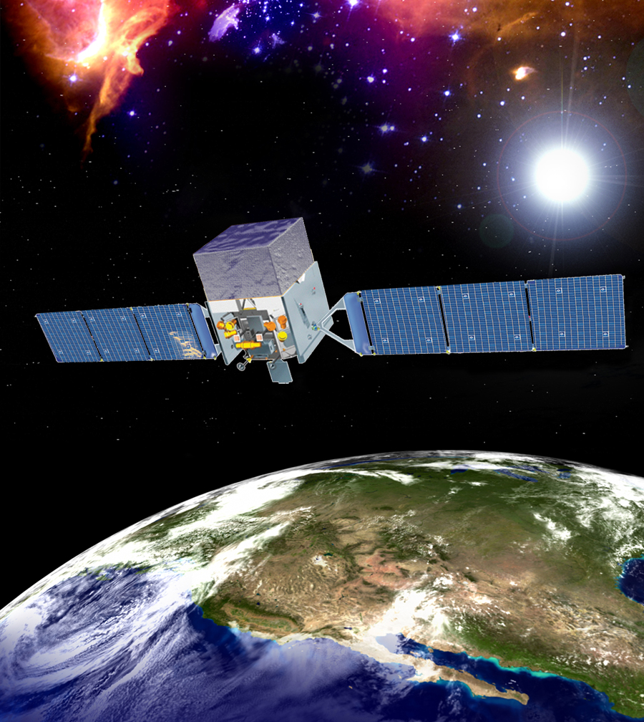
About Fermi
-Two Gamma-Ray detectors
LAT
(Large Area Telescope)
->High energy range
Detects Gamma-Rays of 20MeV-300GeV
GBM
(Gamma-Ray Burst Monitor)
->Low energy range
Detects Gamma-Rays of 8keV-40MeV
http://fermi.gsfc.nasa.gov

Slide 10
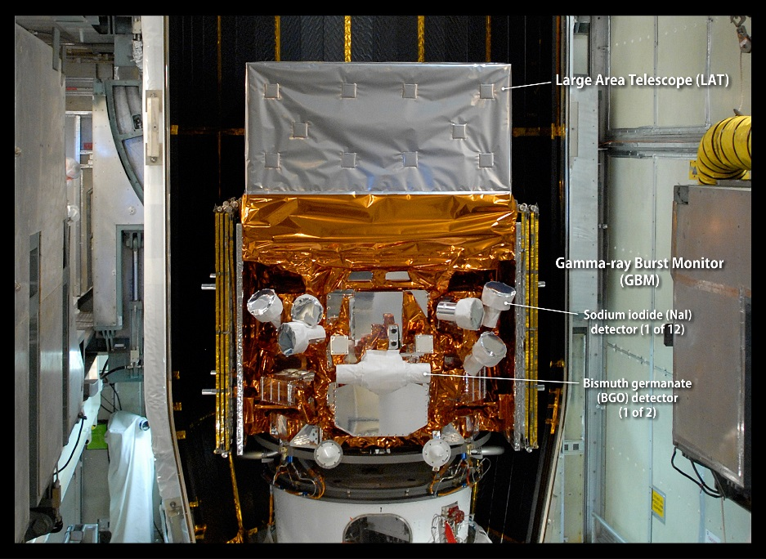
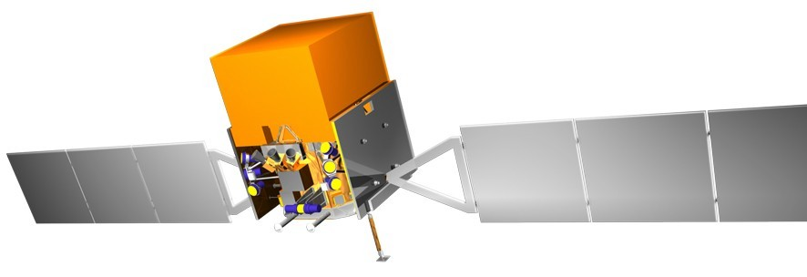
Instrument
Gamma-ray Burst Monitor(GBM)
・Detects Gamma-Rays of 8keV-40MeV
（Low energy range）
・Views entire unoccupied sky
Scintillator
GBM

Slide 11
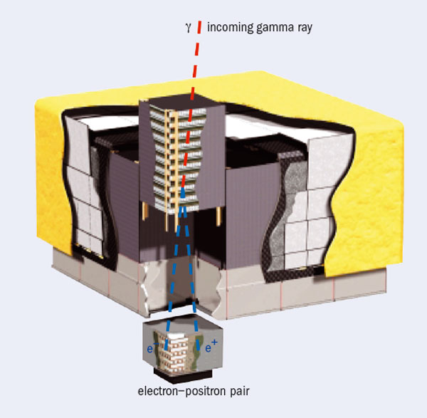
Instrument
Large Area Telescope(LAT)
Detects Gamma-Rays of 20MeV-300GeV
（High energy range）
Gamma-Ray converts in LAT to an electron and a positron.
->1. Direction of the photon
2. energy of the photon
3.arrival time of the photon
LAT

Slide 12
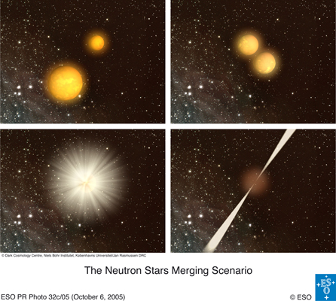
Target Object(GRB)
GRB080916C(z=4.35±0.15)
  Hyper nova (Long Burst≃a few 10 s)
  (119.847,-56.638)
GRB090510B(z=0.903±0.001)
  The Neutron star merging (Short Burst≃1s)
  (333.553,-26.5975)
Gamma-ray emission mechanism not well understood

Slide 13
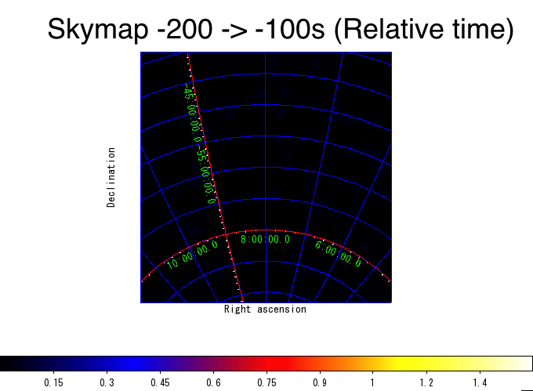
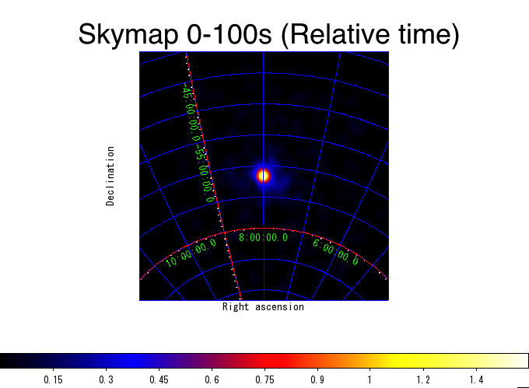
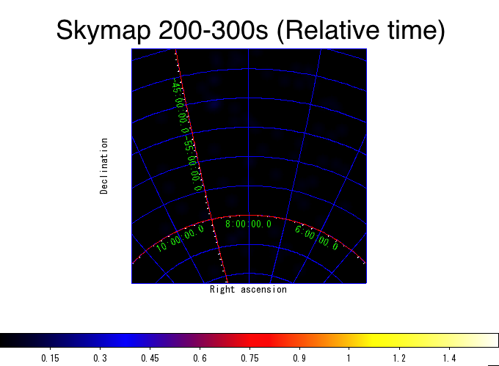
GRB080916C Skymap
“Relative time” = Relative time to the onboard event trigger time.

Slide 14
Method
Low energy range(GBM data)
  How to decide to arrival time (t_{low})
High energy range(LAT data)
  How to select photon
  (Check a direction of photon’s source)
  Decide to arrival time(t_{high})
dt = t_{high} - t_{low}

Slide 15
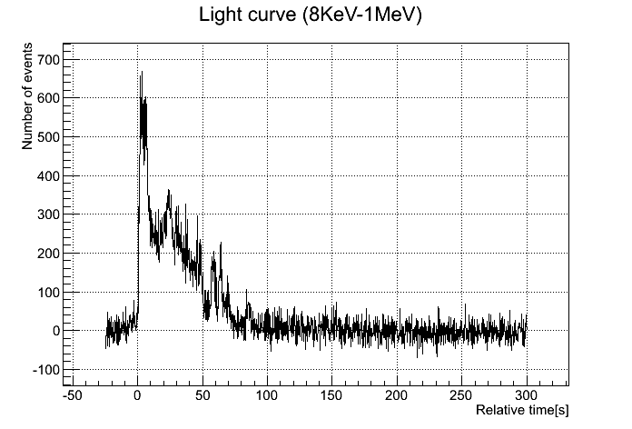
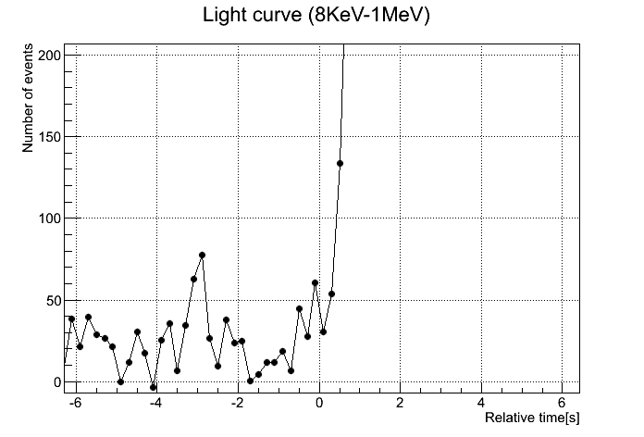
How to decide to arrival time(t_{low})
5σ
Probability that count of noise is more than 5σ ~ 0.000001
σ=21 count
Here is t_{low}

Slide 16
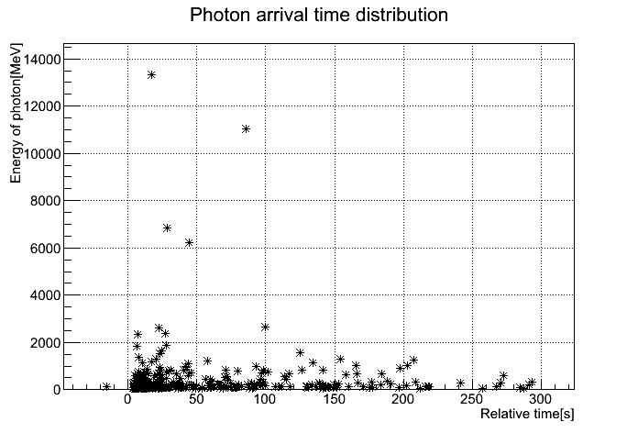
How to select highest energy photon
Use this photon
Here is t_{High}

Slide 17
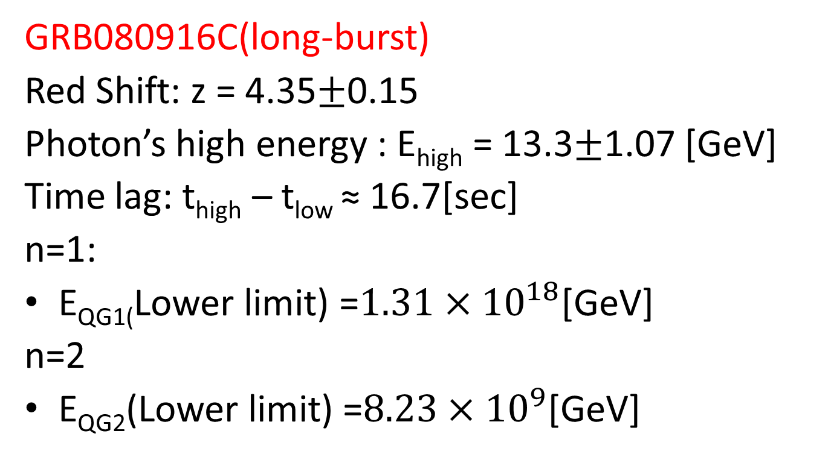
Result(Fermi)
GRB080916C(long-burst)
Red Shift: z = 4.35$±$0.15
Photon’s high energy : E_{high} = 13.3$±$1.07 [GeV]
Time lag: t_{high} – t_{low} ≈ 16.7[sec]
n=1:
E_{QG1(}Lower limit) =$1.31×{10}^{18}$[GeV]
n=2
E_{QG2}(Lower limit) =$8.23×{10}^{9}$[GeV]

Slide 18
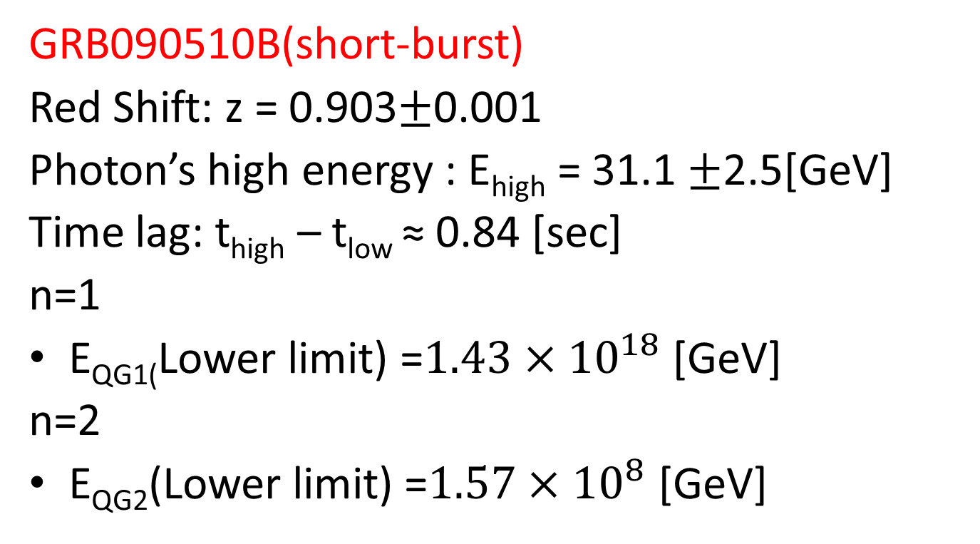
Result(Fermi)
GRB090510B(short-burst)
Red Shift: z = 0.903$±$0.001
Photon’s high energy : E_{high} = 31.1 $±$2.5[GeV]
Time lag: t_{high} – t_{low} ≈ 0.84 [sec]
n=1
E_{QG1(}Lower limit) =$1.43×{10}^{18}$ [GeV]
n=2
E_{QG2}(Lower limit) =$1.57×{10}^{8}$ [GeV]

Slide 19
MAGIC analysis
Gamma-rays from Blazars

Slide 20
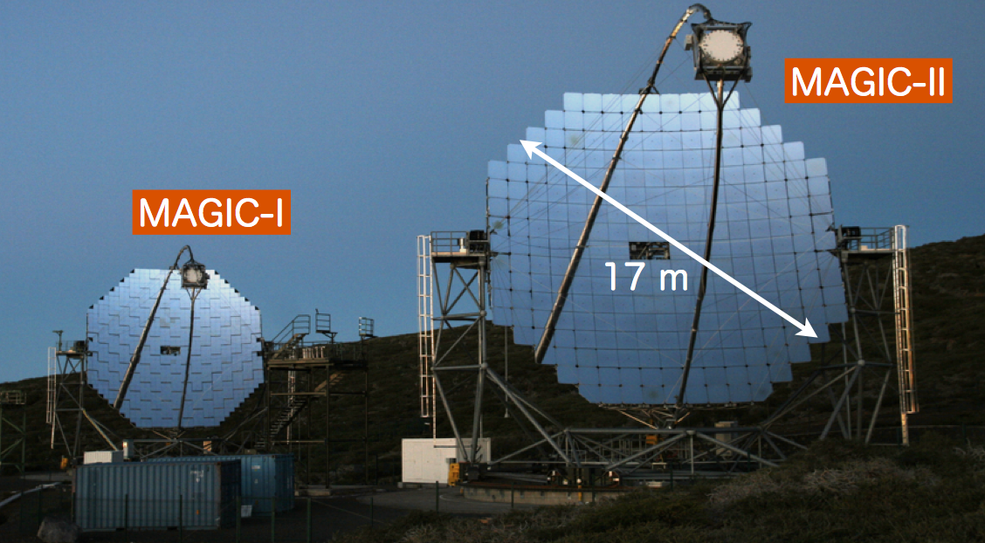
What’s MAGIC?
NAME:
Major Atmospheric Gamma-ray Imaging Cherenkov(=MAGIC) Telescope
SYSTEM:
Two 17 m diameter Imaging Atmospheric Cherenkov Telescope
ENERGY THRESHOLD:
50 GeV

Slide 21
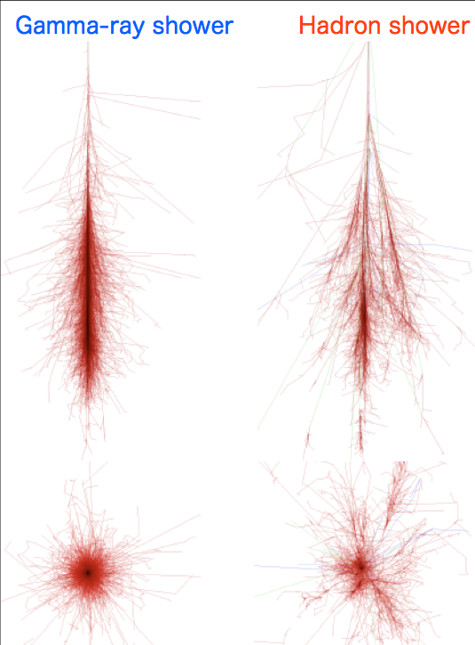
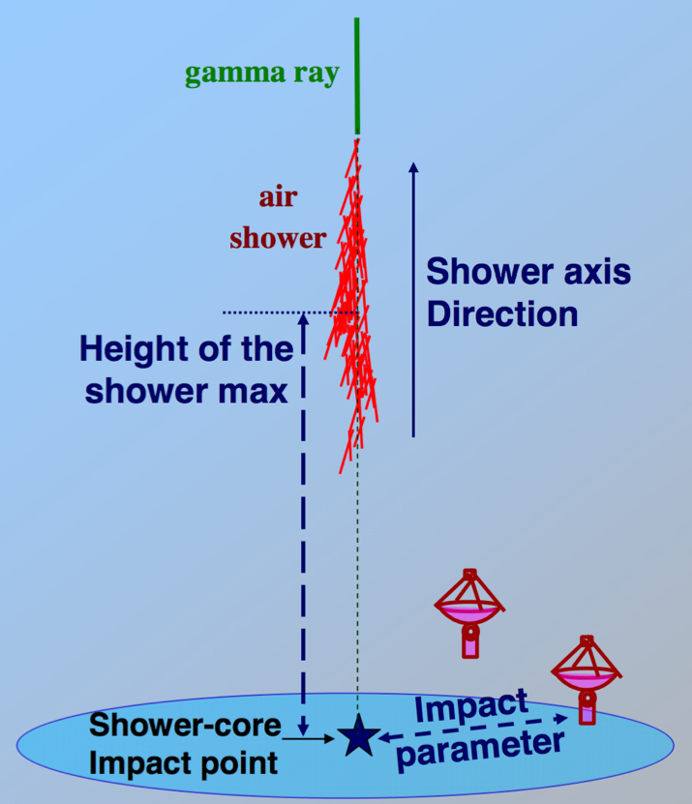
Atmospheric Cherenkov
Gamma-ray shower:
spreading narrow
Hadron shower:
spreading wide, background
Measuring Cherenkov Light:
both of showers make CL

Slide 22
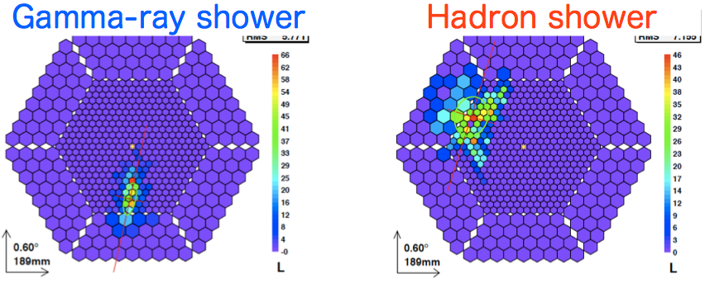
Difference of image
Gamma-ray shower:
an ELLIPSE image, main axis points toward to the arrival direction
Hadron shower:
captured as somehow RANDOM image, using to reduce background

Slide 23
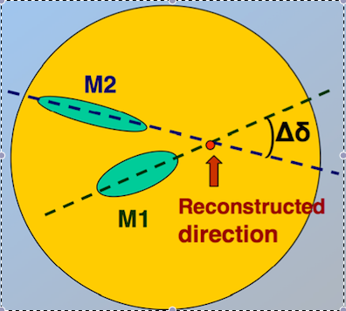
Stereo telescope
Ellipse image:
detectable direction
Stereo system:
compare MASIC1 with MASIC2 to detecting point

Slide 24
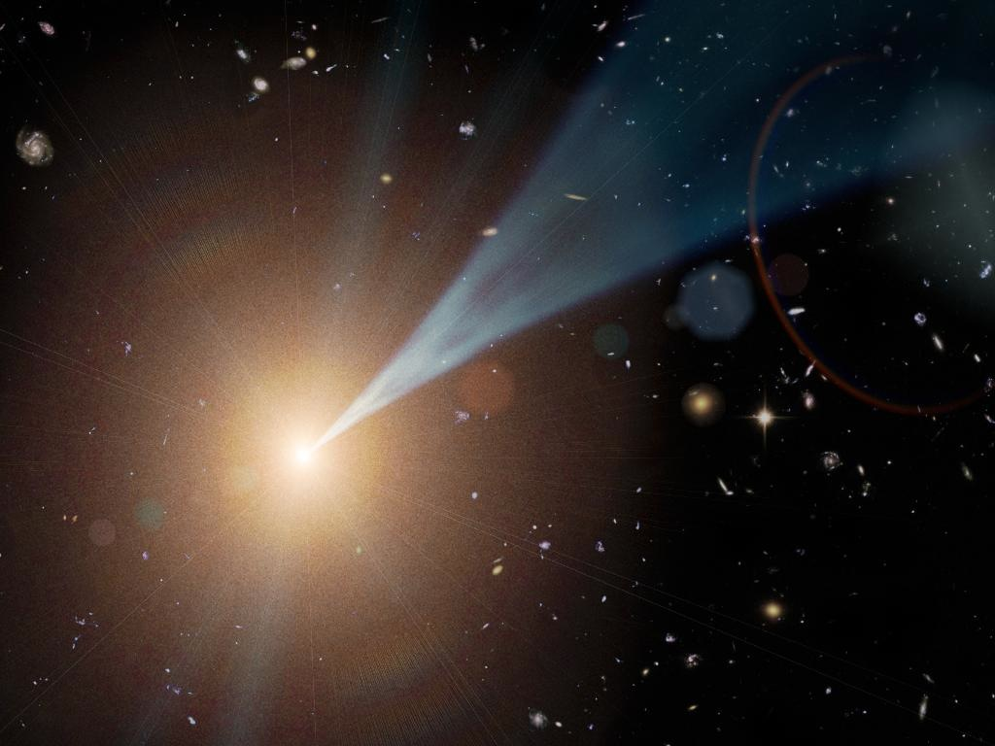
Targets
Mrk421:
An AGN, blazar, high peaked BL Lac, 11h04m27.3s +38d12m32s, z=0.030,
Data got 2013/04/13
S30218:
An AGN, blazar, high peaked BL Lac, 02h21m05.5s +35d56m14s, z=0.944,
Data got 2014/07/23-31

Slide 25
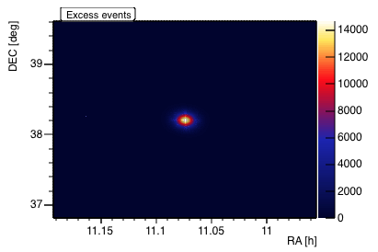
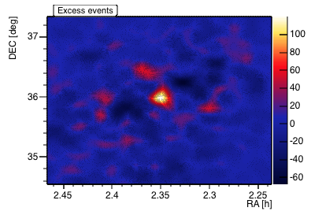
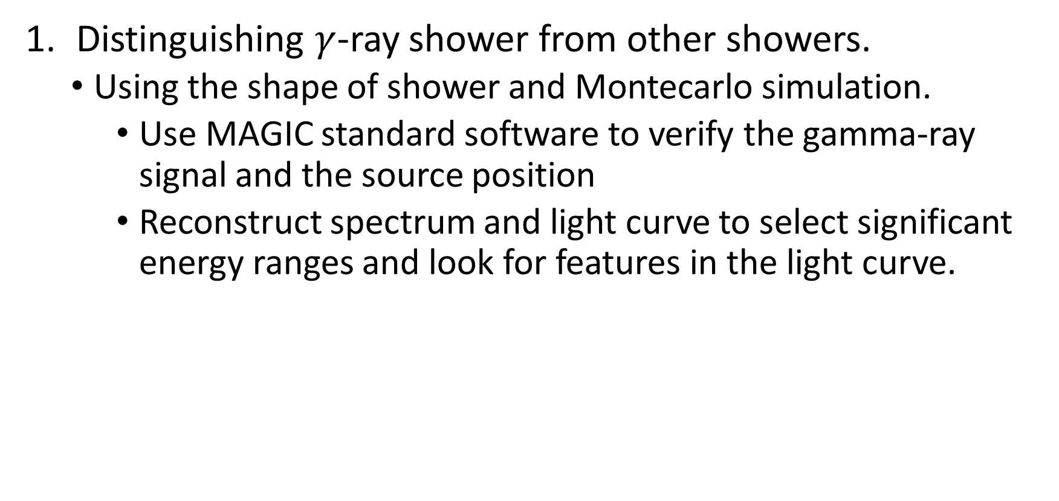
MAGIC Data analysis
Distinguishing $γ$-ray shower from other showers.
  Using the shape of shower and Montecarlo simulation.
    Use MAGIC standard software to verify the gamma-ray signal and the source position
    Reconstruct spectrum and light curve to select significant energy ranges and look for features in the light curve.
Mrk421
S30218
Notes:
Introduce myself
We analize the MAGIC data in this method.
First of all, we need to distinguish gamma-ray shower from others.,using the shape of detected shower and montecarlo simuration data.
Here is a skymap, and we are sure to detect the significant signal.

Slide 26
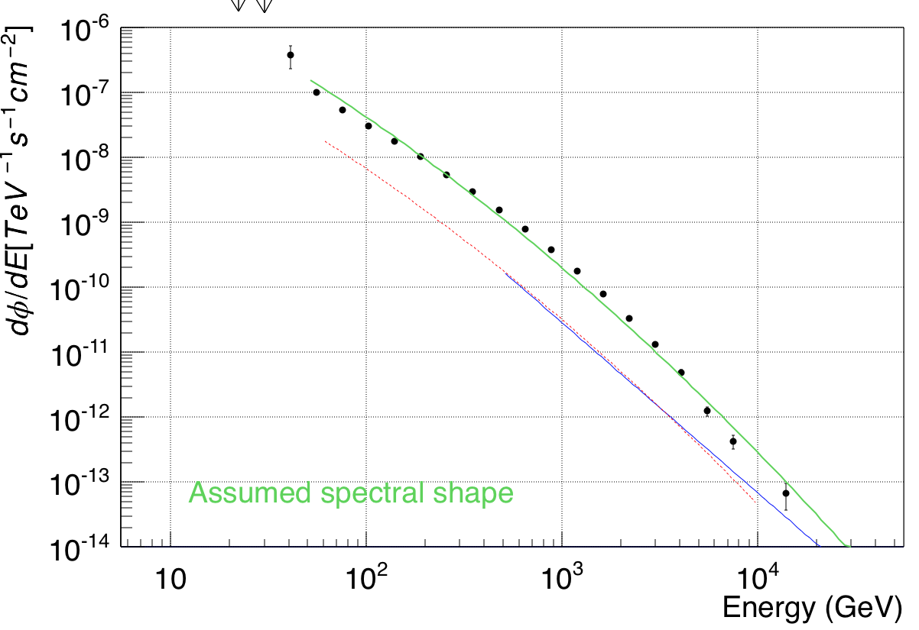
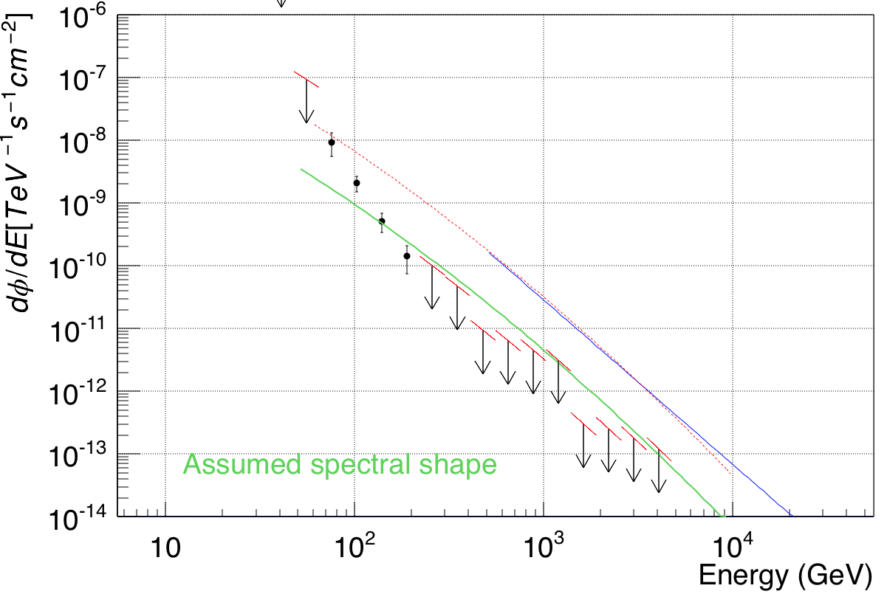

$dN_{exc}/dE$ plot.
Mrk421
S30218
We can use this energy range.
Notes:
Nexc is the number of significant events.
and then we get the dN_event/dE plot.
we choose energy range which can significantly detect the event.
It means we can use this range.

Slide 27
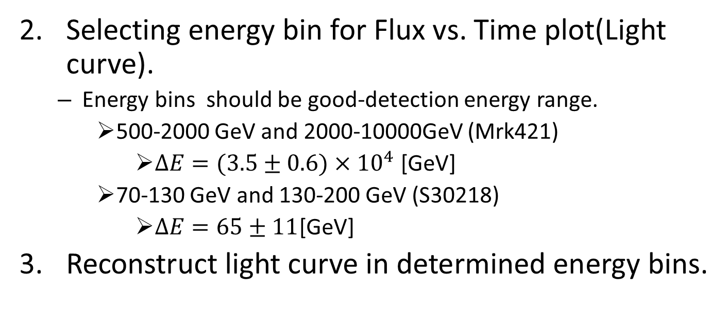
MAGIC Data analysis(2)
Selecting energy bin for Flux vs. Time plot(Light curve).
  Energy bins should be good-detection energy range.
    500-2000 GeV and 2000-10000GeV (Mrk421)
      $ΔE=(3.5±0.6)×{10}^{4}$[GeV]
    70-130 GeV and 130-200 GeV (S30218)
      $ΔE=65±11$[GeV]
Reconstruct light curve in determined energy bins.
Notes:
As we saw, Energy bins should be good-detection energy range. and we also calculate the difference of energy bins.
1. 500-2000 GeV and 2000-10000GeV (Mrk421)
dE$=(3.5±0.6)×{10}^{4}$[GeV]
2. 70-130 GeV and 130-200 GeV (S30218)
dE=65±12 [GeV]

Slide 28
MAGIC Data analysis (3)
Normalize the light curve to the mean flux in the corresponding energy bin
Fitting the Light curve.
  Using Gaussian and Linear function.
    We allow these functions only to slide (strictly same shape)
      If these bins have the same origin, light curve must be the same.
  Calculate the delay of time
    Simply we calculate the difference of Gaussian peak or point the linear function crosses the time-axis(:crossing point).
Notes:
we normalized Flux by mean value of Flux and tried to fit these Light curve.using gaussian and linear function as a fitting function.
!!!
The point is fitting function is only one freedom to slide along with Time-axis.
this is because we observed the same shower in two energy bins, so the shape of normalized Light curve must be the same.
!!!
then calculate the delay of time by using gaussian peak an crossing point between the linear function and time-axis

Slide 29
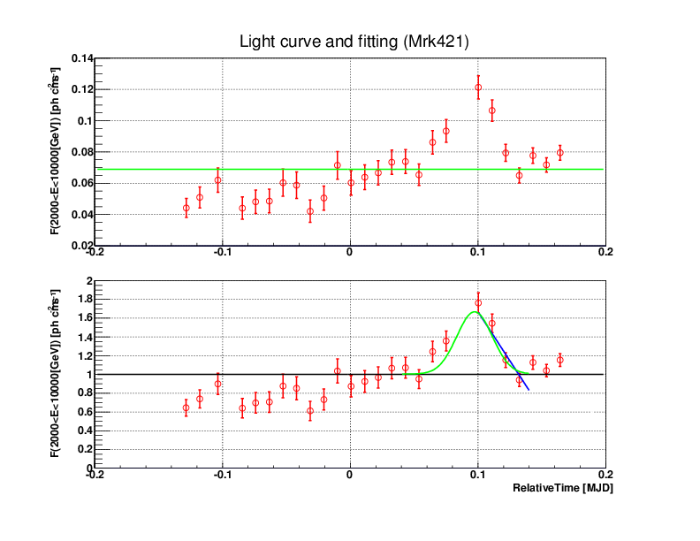
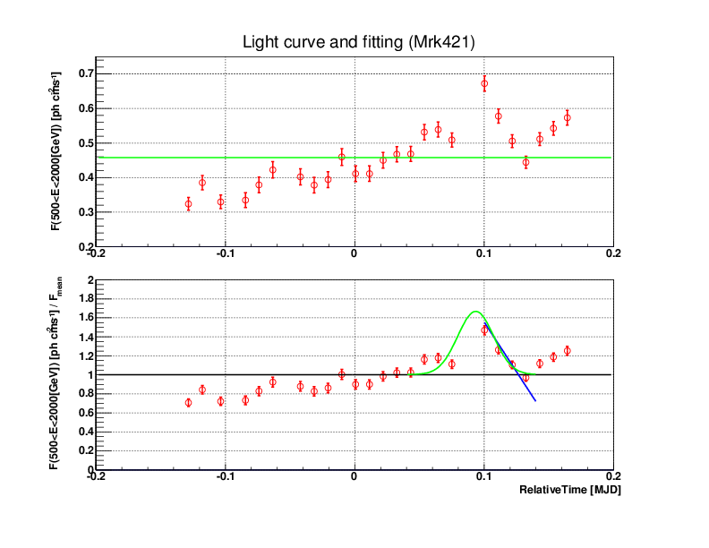
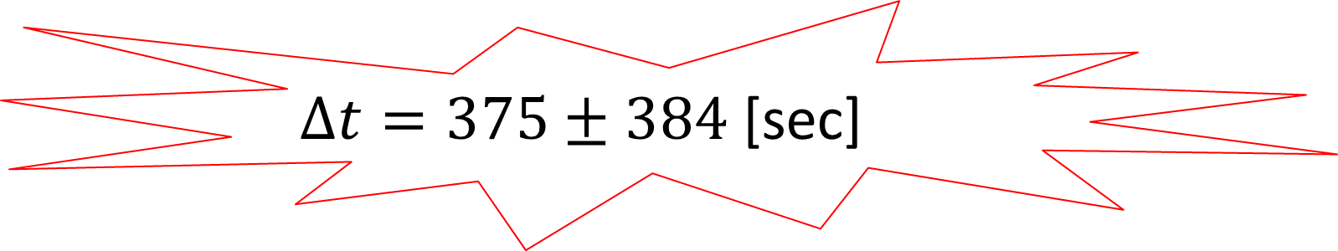
Result (Mrk421)
Actual Flux
Actual Flux
$Δt=375±384$ [sec]
Normalized Flux
Normalized Flux
Notes:
and I show the result of Mrk421.
Above graphs show Actual flux vs. time,and below graphs show normalized flux vs. time.
we use this value and this value to calculate delta t(animation pointing peak of gaussian.)
and we derived delta t.

Slide 30
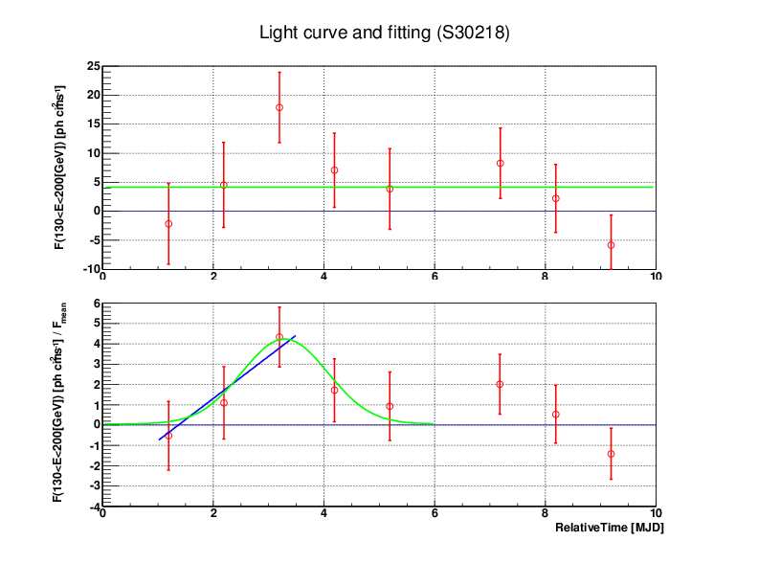
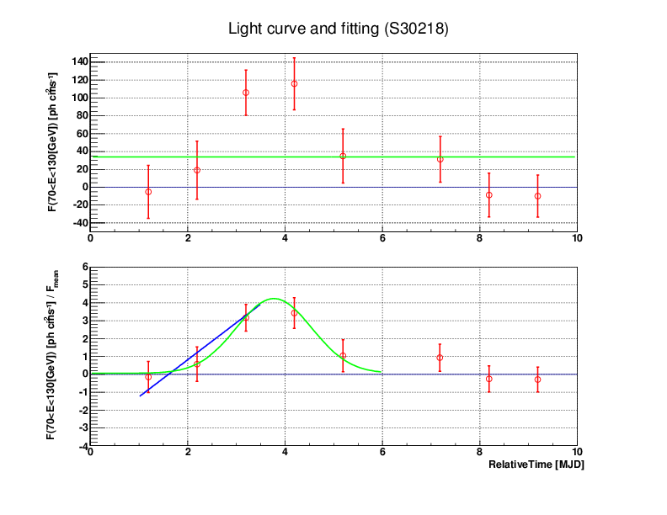
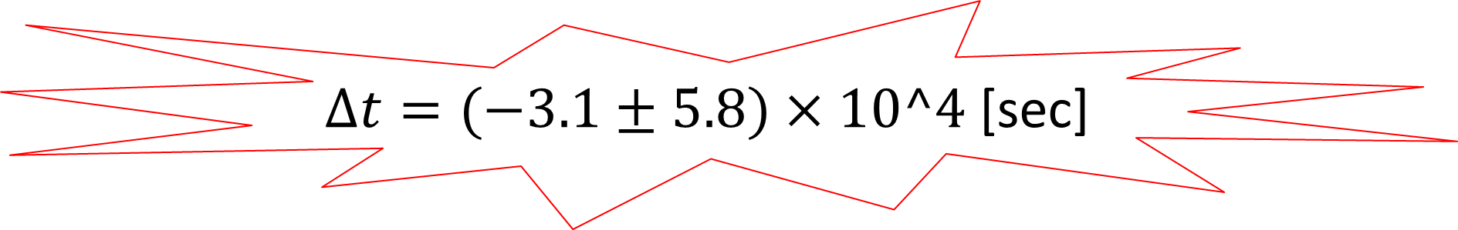
Result (S30218)
Actual Flux
Actual Flux
$Δt=(−3.1±5.8)×10^4$ [sec]
Normalized Flux
Normalized Flux
Notes:
and I show the result of S30218. as I showed the Mrk421.
we use this value and this value to calculate delta t(animation pointing crossing point.)
and we derived deltat.

Slide 31

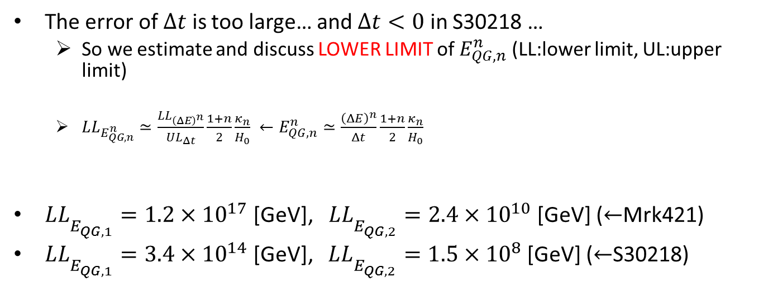
Result of calculation and Estimate of $E_{QG,n}^{n}$
The error of $Δt$ is too large… and $Δt<0$ in S30218 …
  So we estimate and discuss LOWER LIMIT of $E_{QG,n}^{n}$ (LL:lower limit, UL:upper limit)
  $LL_{E_{QG,n}^{n}}≃\frac{LL_{{\left(ΔE\right)}^{n}}}{UL_{Δt}}\frac{1+n}{2}\frac{κ_{n}}{H_{0}} ←E_{QG,n}^{n}≃\frac{{\left(ΔE\right)}^{n}}{Δt}\frac{1+n}{2}\frac{κ_{n}}{H_{0}}$
$LL_{E_{QG,1}^{}}=1.2×{10}^{17}$[GeV], $LL_{E_{QG,2}^{}}=2.4×{10}^{10}$[GeV] ($←$Mrk421)
$LL_{E_{QG,1}^{}}=3.4×{10}^{14}$[GeV], $LL_{E_{QG,2}^{}}=1.5×{10}^{8}$[GeV] ($←$S30218)
n=1
n=2
Notes:
as I showed, the error of dt is too big, and badly, in S30218, dt is smaller than 0!!!
so, we gave up discussing the mean value of E_QG, and we discussed Lower Limit of E_QG.
We can derive lower limit of E_QG from this formula.
and show the values we calculated.
in Mrk421 case,
lower limit of 1st order EQG = 1.2 times 10 to 17 GeV,
and
lower limit of 2st order EQG = 2.4 times 10 to 10 GeV,
in S30218 case,
lower limit of 1st order EQG = 3.4 times 10 to 14 GeV,
and
lower limit of 2st order EQG = 1.5 times 10 to 8 GeV,

Slide 32
Discussion

Slide 33
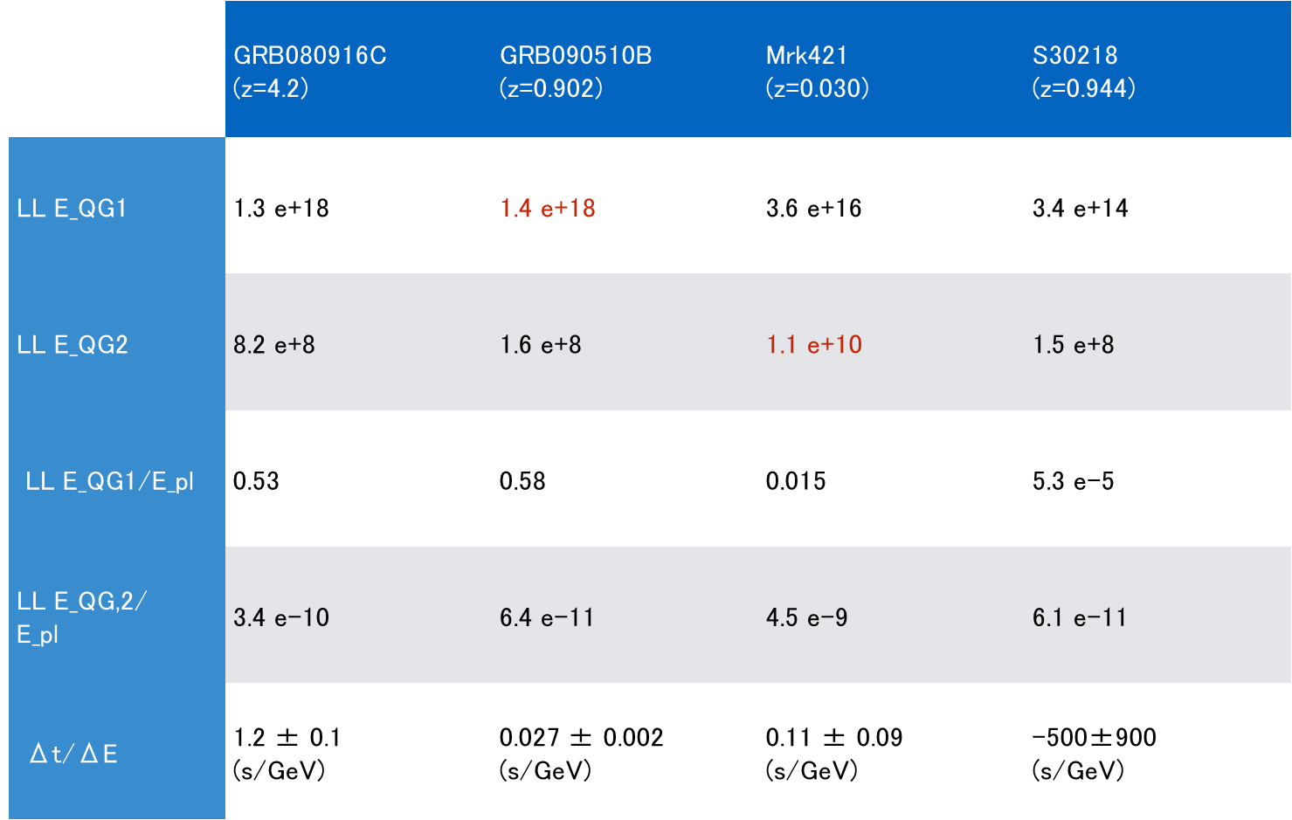
Combined Result
  LL E_QG = Lower Limit of E_QG E_pl = Planck Energy scale = 2.435 e+18 GeV

Slide 34
Discussion
In this research, we could not determine the value of E_QG.
We set lower limit for E_QG for n=1,2.
It’s possible quantum gravitational effect appears at energy scale higher than 1.4 e+18 GeV
We can almost reach Planck Energy scale
in gamma-ray astronomy!

Slide 35
Discussion
Fermi data is the best for linear term(n=1).
Fermi
MAGIC

Slide 36
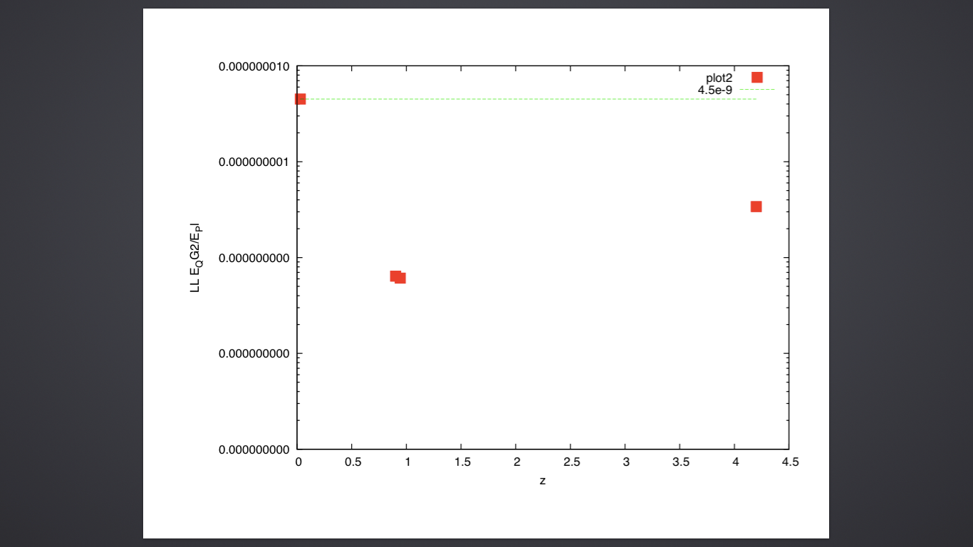
Discussion
MAGIC data is the best for quadratic term(n=2).
MAGIC

Slide 37
Summary
We analysed data from Fermi and MAGIC to calculate quantum gravitational energy scale.
We set lower limits for E_QG and E_QG for n=1 and 2.
Our limit for n=1 is close to Planck Energy Scale!!
Fermi is the best for linear term while MAGIC is the best for quadratic term.
We still have room for improvement especially for n=2.
    More data from CTA will help!!

Slide 38
Back up

Slide 39
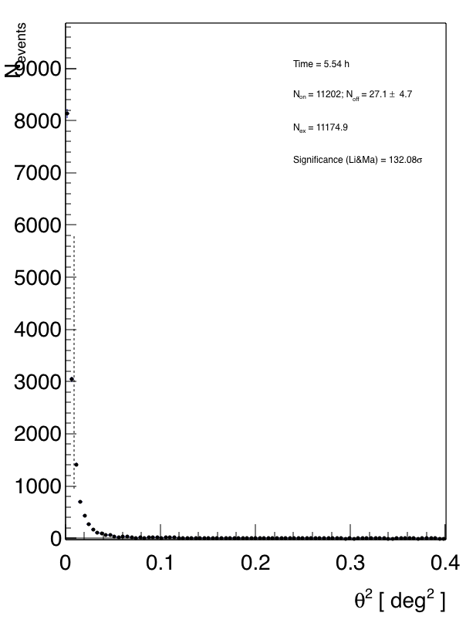
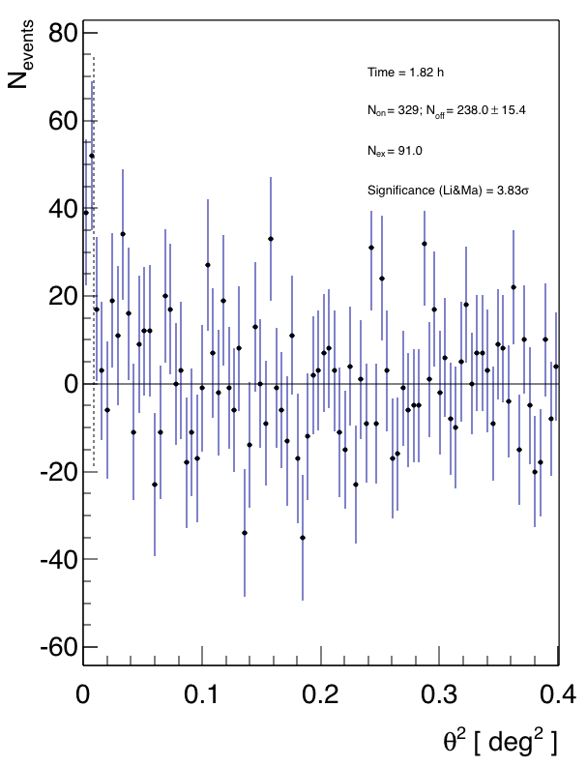
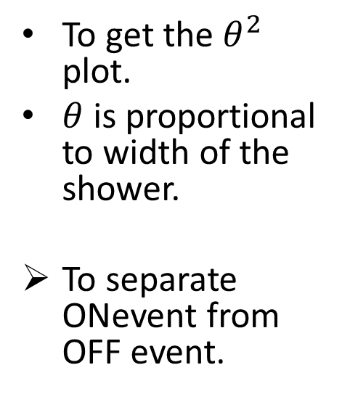
Odie
To get the $θ^{2}$ plot.
$θ$ is proportional to width of the shower.
To separate ONevent from OFF event.

Slide 40
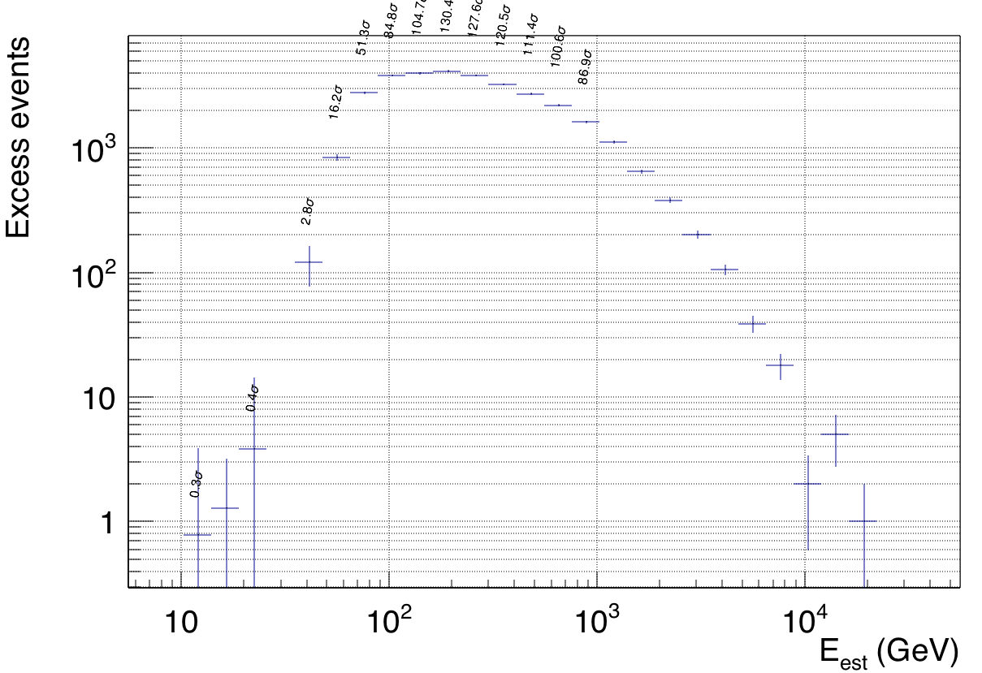
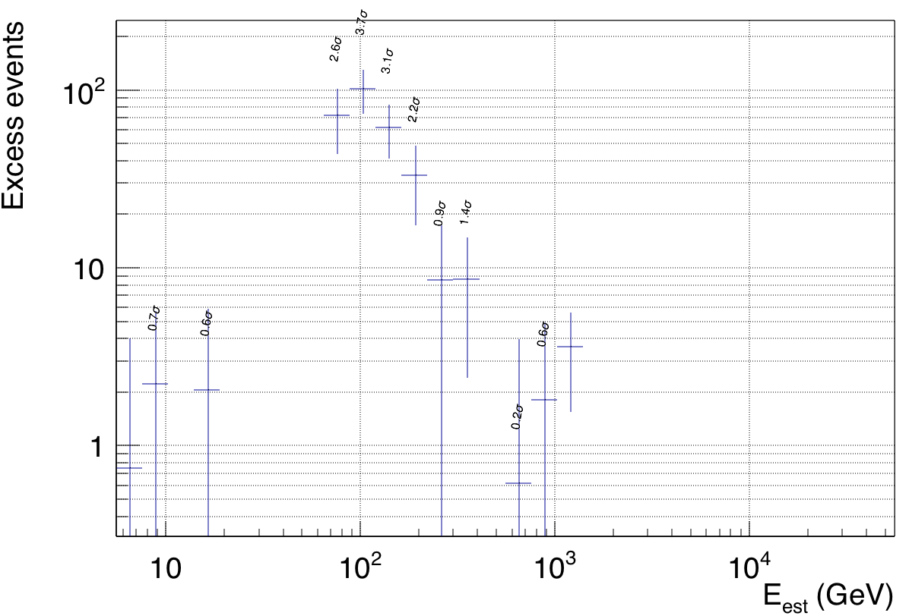
FLUTE(2)
To determine energy bins using $dσ_{N_{exc}}/dE$ plot.
And also to get light curve.(as I said in my presentation)

Slide 41
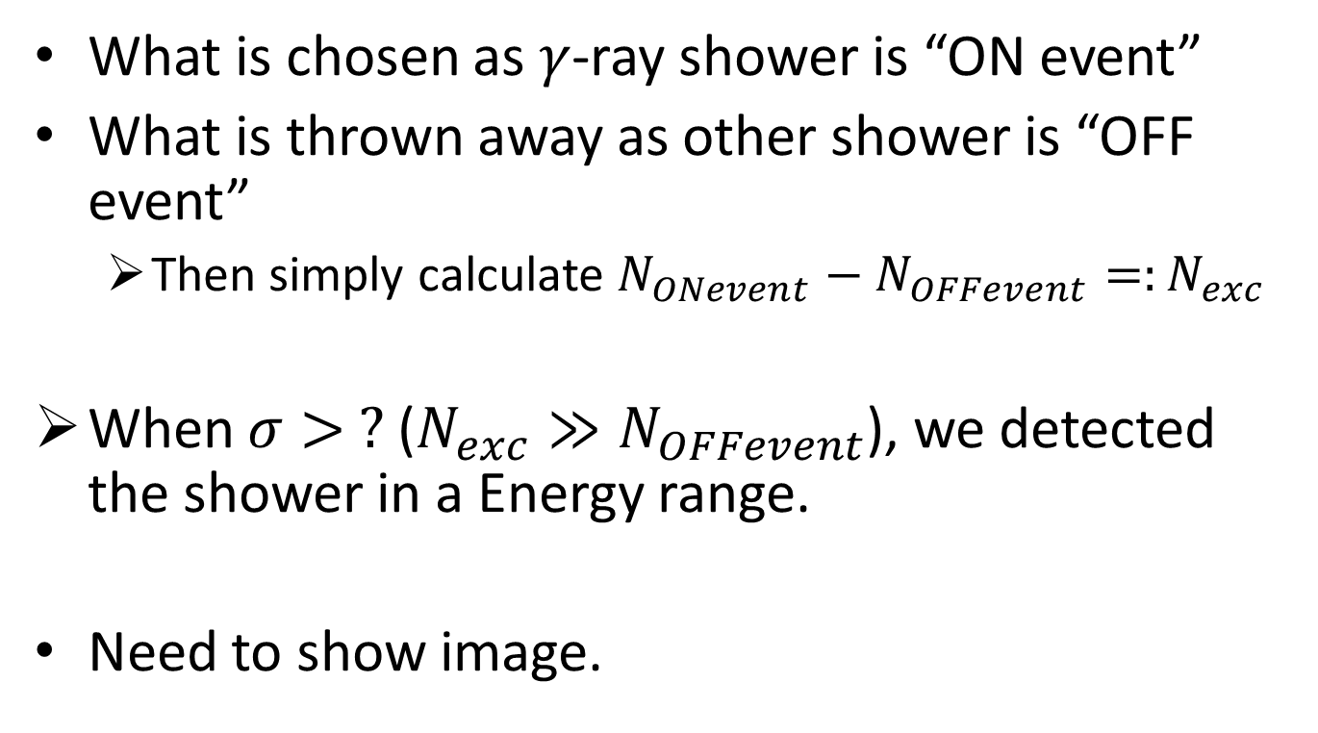
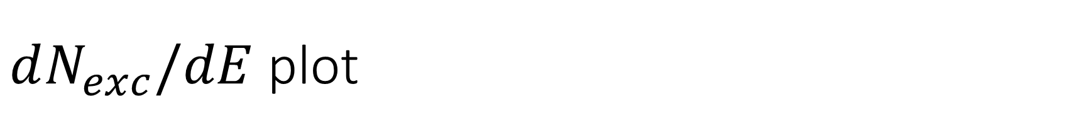
$dN_{exc}/dE$ plot
What is chosen as $γ$-ray shower is “ON event”
What is thrown away as other shower is “OFF event”
  Then simply calculate $N_{ONevent}−N_{OFFevent}=:N_{exc}$
When $σ> ?$($N_{exc}≫N_{OFFevent}$), we detected the shower in a Energy range.
Need to show image.

Slide 42
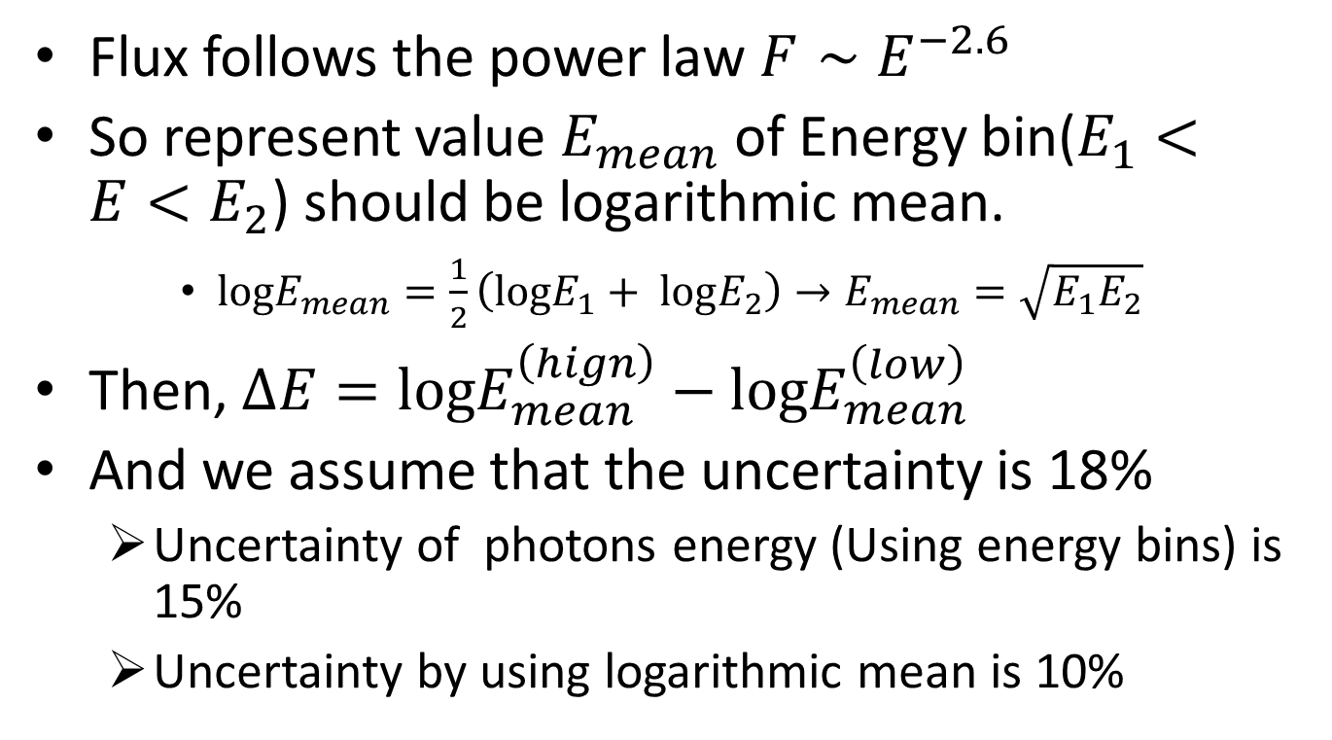

Uncertainty of $ΔE$
Flux follows the power law $F∼E^{−2.6}$
So represent value $E_{mean}$ of Energy bin($E_{1}<E<E_{2}$) should be logarithmic mean.
    ${logE}_{mean}=\frac{1}{2}\left(logE_{1}+ logE_{2}\right)→E_{mean}=\sqrt{E_{1}E_{2}}$
Then, $ΔE={logE}_{mean}^{\left(hign\right)}−{logE}_{mean}^{\left(low\right)}$
And we assume that the uncertainty is 18%
  Uncertainty of photons energy (Using energy bins) is 15%
  Uncertainty by using logarithmic mean is 10%

Slide 43
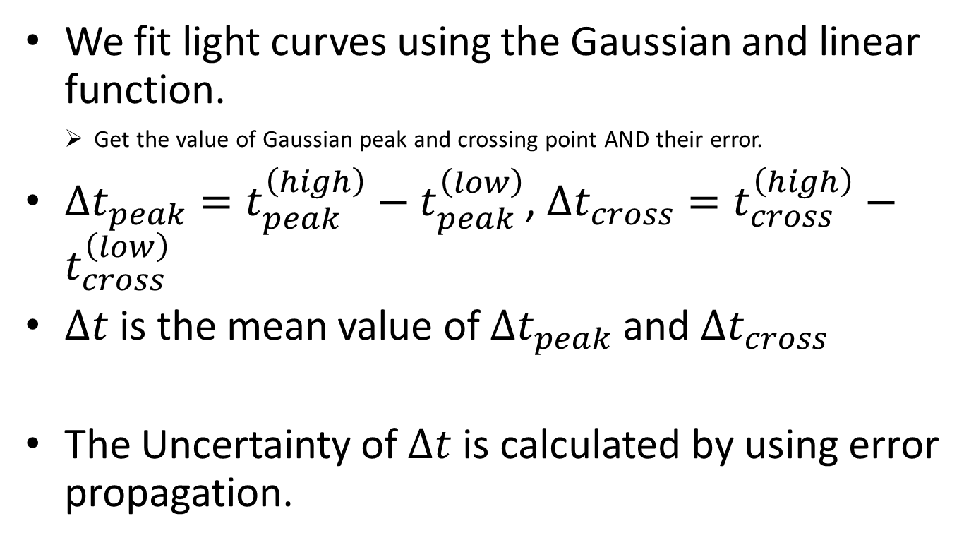

Uncertainty of $Δt$
We fit light curves using the Gaussian and linear function.
    Get the value of Gaussian peak and crossing point AND their error.
$Δt_{peak}=t_{peak}^{\left(high\right)}−t_{peak}^{\left(low\right)}$, $Δt_{cross}=t_{cross}^{\left(high\right)}−t_{cross}^{\left(low\right)}$
$Δt$ is the mean value of $Δt_{peak}$ and $Δt_{cross}$
The Uncertainty of $Δt$ is calculated by using error propagation.
Each value has each error.

Slide 44
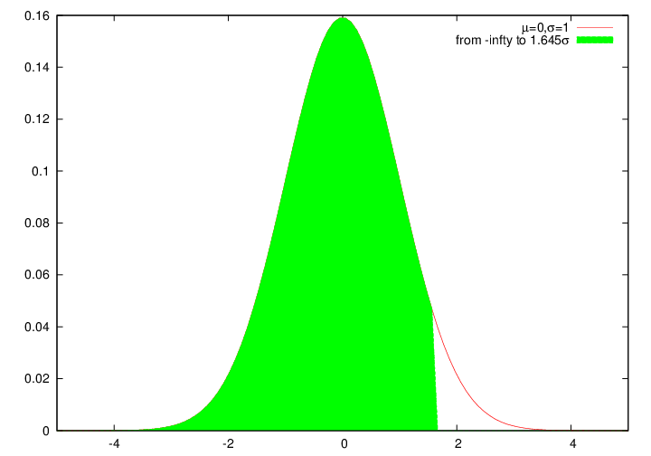
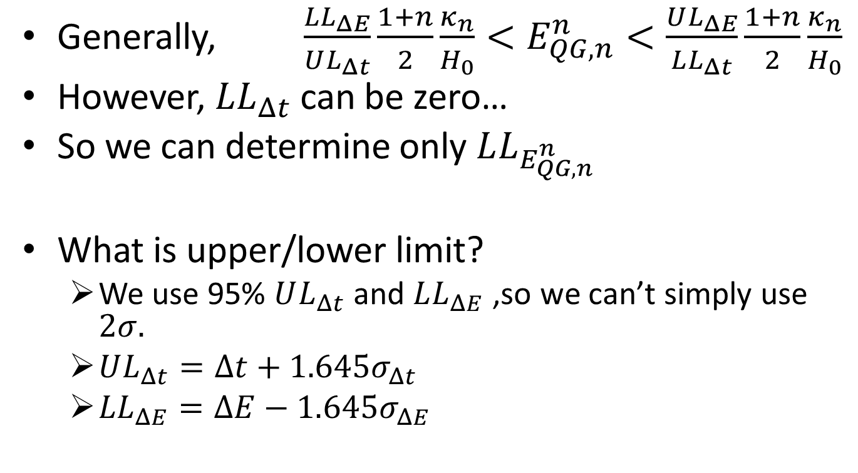
Determination of upper/lower limit
Generally, $\frac{LL_{ΔE}}{UL_{Δt}}\frac{1+n}{2}\frac{κ_{n}}{H_{0}}<E_{QG,n}^{n}<\frac{UL_{ΔE}}{LL_{Δt}}\frac{1+n}{2}\frac{κ_{n}}{H_{0}}$
However, $LL_{Δt}$ can be zero…
So we can determine only $LL_{E_{QG,n}^{n}}$
What is upper/lower limit?
  We use 95% $UL_{Δt}$ and $LL_{ΔE}$ ,so we can’t simply use $2σ.$
  $UL_{Δt}=Δt+{1.645σ}_{Δt}$
  ${LL}_{ΔE}=ΔE−{1.645σ}_{ΔE}$

Slide 45
$dN_{exc}/dE$ plot
What is chosen as -ray shower is “ON event”
What is thrown away as other shower is “OFF event”
  Then simply calculate
When (), we detected the shower in a Energy range.
Need to show image.

Slide 46
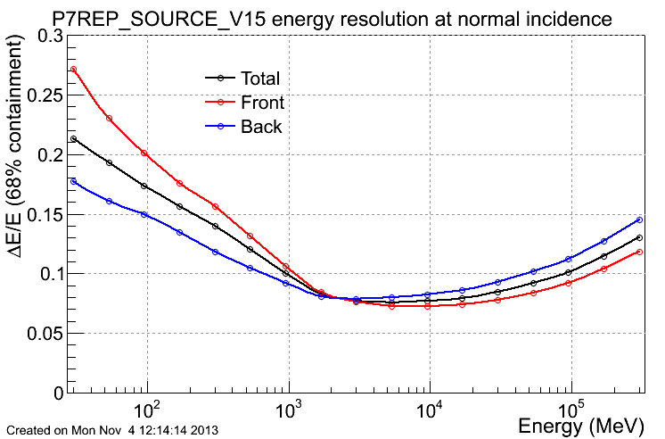
Error of Physics quantity
Arrival time
Photon’s energy
  dE/E = 0.08 in this energy range

Slide 47
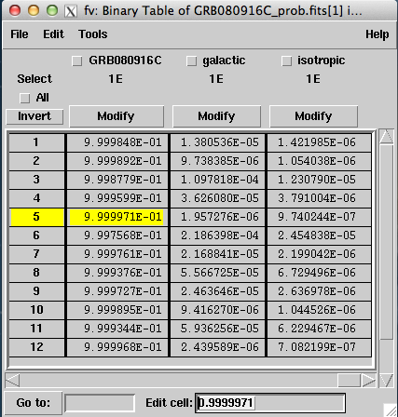
Where is photon’s truly source?
The probability of ratio that photon came from GRB source is 0.9999971
There are background sources like as galactic gamma-rays and isotropic gamma-rays

Slide 48
Check a direction of photon’s source(1)
A・B
= |A||B|(sinθ_{A}cosφ_{A}sinθ_{B}cosφ_{B}
+ sinθ_{A}sinφ_{A}sinθ_{B}sinφ_{B} + cosθ_{A}cosθ_{B})
=|A||B|cosθ
θ
A=(|A|sinθ_{A}cosφ_{A,} |A|sinθ_{A}sinφ_{A,} |A|cosθ_{A})
B=(|B|sinθ_{B}cosφ_{B,} |B|sinθ_{B}sinφ_{B,} |B|cosθ_{B})
Difference of degree is 0.1degree!

Slide 49
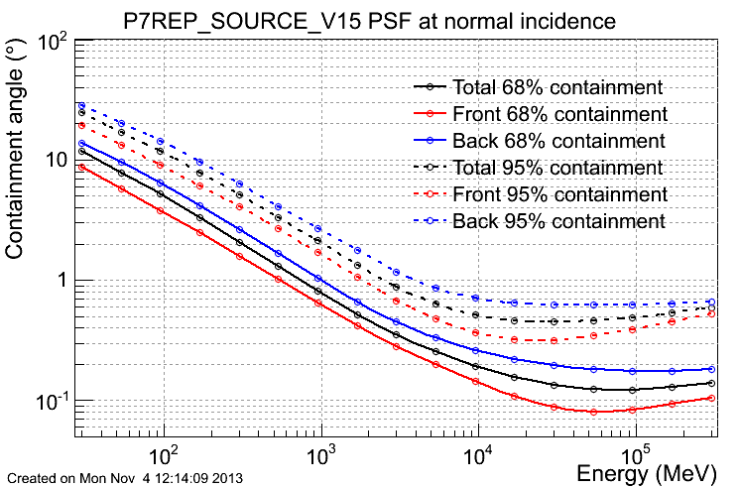
Check a direction of photon’s source(2)

Slide 50

What kappa

