Slide 1
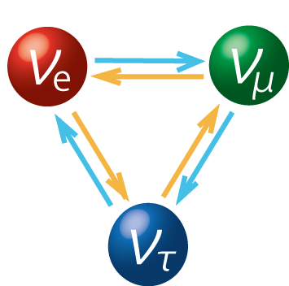
Neutrino Physics
Member
Eriko kusunoki
Kenji shu
Takeshi saito
Mesanori iwamoto
Mitsutaka nakao
NISHIMURA Group

Slide 2
CONTENTS
ν- Source
Theory of Neutrino Physics
Super Kamiokande (Super K)
Measuring Cosmic Rays
T2K Experiment
Analyzing T2K data
ν- Oscillation
ν- Detector

Slide 3
Theory of Neutrino Physics

Slide 4
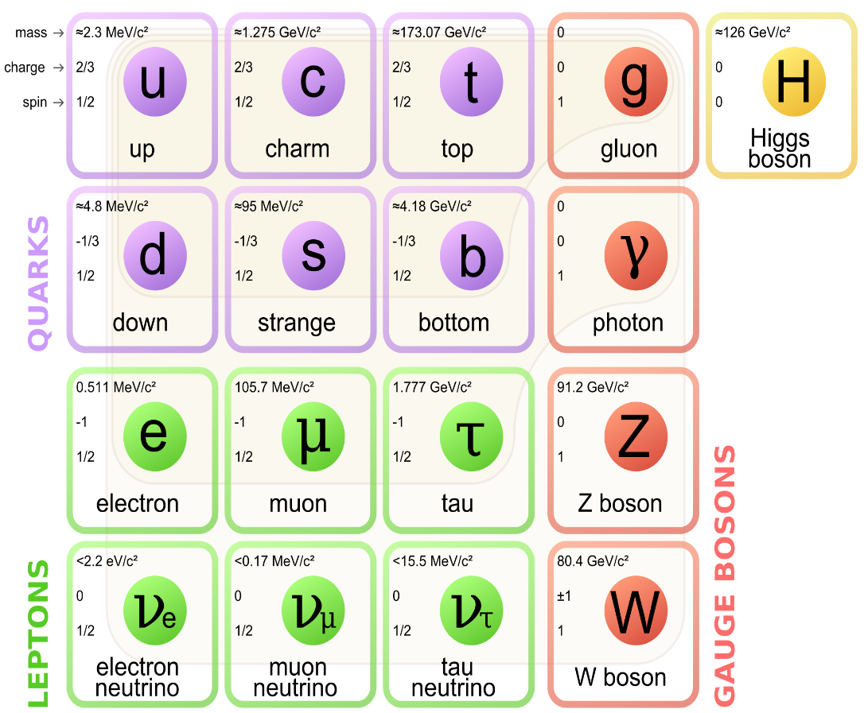
What is neutrino?
・Three Flavors
・Neutral (no charge)
・Only Weak Interaction
・Very Tiny Mass
very difficult for detecting…
Notes:
----- 会議メモ (14/03/08 12:02) -----
You all have heard about this many times.
I will briefly review the future of neutrinos.
They have three flavors. Here. electron type, muon type, and tauon type
Neutral. They have no charge.
Weak Interaction. Neutrinos rarely interact with other particles.
The mass is very small.
you all already know about this,
It is very difficult for us to detect neutrinos.
So, how can we detect neutrinos?

Slide 5
The interesting point is…
Neutrino Oscillation

Slide 6
Neutrino Oscillation(Two mixing case)
・The mass basis is different from the interaction basis.
flavour
Θ:mixing angle
mass
The probability to change νμ into ντ is…
✔
L : Length [km]
E : energy[GeV]
Δm² : mass square difference[eV²]
✔
✔
but nature is more complex…
Notes:
違いがしーた
変わるかくりつがP下

Slide 7
Neutrino Oscillation(Three mixing case)
✔
✔
❓
~45°
~34°
Atmospheric Neutrinos
νμ→ντ
Accelerator
νμ→νe
Solar Neutrinos
νe→νx
What we want to know is …
T2K
Mixing Parameter
Notes:
θが先
matrix

Slide 8
CP violation~What is δCP in PMNS matrix?~
This parameter leads to CP violation.
Leading Term
CP term
Notes:
大と小を強調
後半一気に他にもいろいろあります

Slide 9
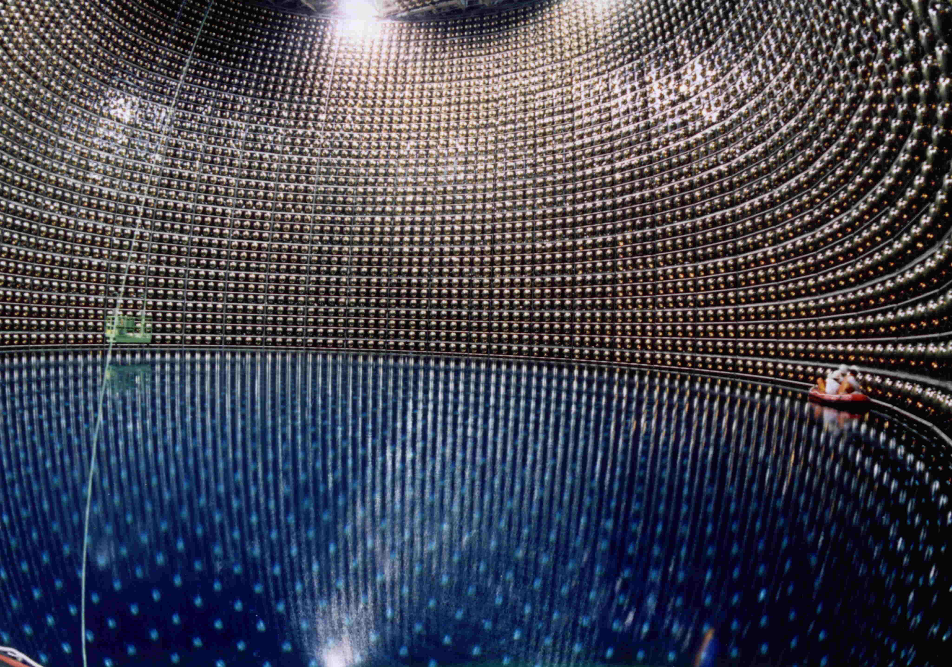
How can we detect neutrinos?
The answer is…
Super K

Slide 10
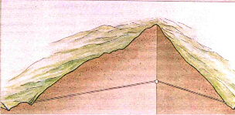
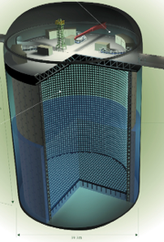
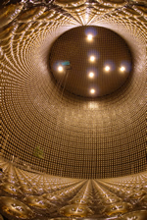
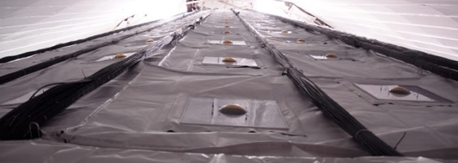
Super-Kamiokande
Kamioka
1km
Inner tank
11,129 PMTs (50cm)
detect neutrinos.
1km Underground
We can block muons that originate from cosmic ray.
41.4m
outer tank
1,885 PMTs (20cm)
distinguish neutrinos from muons coming from outside.
water
39.3m
50,000 t
Notes:
We can detect neutrino at superKamiokande. It is 1km under the ground. The reason is that We can block muons that originate from cosmic ray. Inner tank, there are about 11,000 PMTs, PMT stands for PhotoMultiplier-tube, these detect neutrinos. And outer tank there are about 2,000 smaller PMTs, these distinguish neutrinos from muons coming from outside.

Slide 11
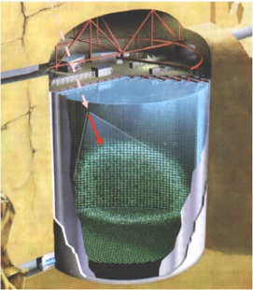
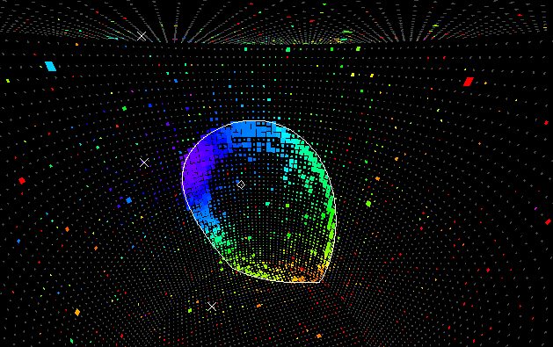



Neutrino detection @Super-Kamiokande
inverse beta decay
Neutrinos interact with particle in water.
n
p
O
→ SK detect Cherenkov light that is created when a charged particle travels faster than the speed of light in water.
H
$$W^{+}$$
$$e^{+}$$
$$\overline{ν_{e}}$$
Cherenkov light
Blue : weak light
neutrino
Vertex
Timing of detection
Vertex position
Finding Cherenkov ring
Neutrino traveling direction and energy
Event display
Red : strong light
Notes:
Then I explain how we detect neutrinos.
This Feynman diagram shows inverse beta decay. Neutrinos interact with particle in water.
→ SK detect Cherenkov light that is created when a charged particle travels faster than the speed of light in water.
Next look at this event display. Coloring means that red is stronger light and blue is weaker light.
First we measure timing of detection, then
Vertex position is found by light detected timing. After finding ring , we can find neutrino traveling direction and energy.

Slide 12
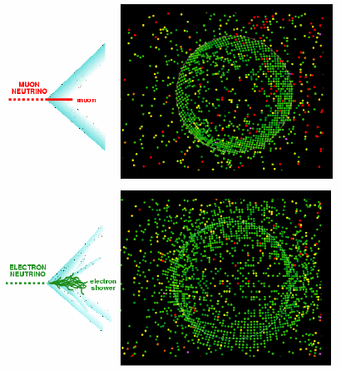

Neutrino experiments @Super-Kamiokande
Atmospheric neutrinos:E < PeV (so far)
SK discovered $ν_{μ}→ν_{τ}$ oscillations by measuring the neutrino energy and the angle.
Neutrinos have mass!
Solar neutrinos : E < 20 MeV
SK provided strong evidence for solar neutrino oscillations.

Slide 13
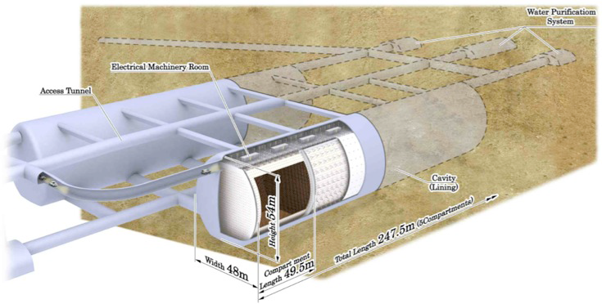
Neutrino detectors
Super-Kamiokande
Next: Hyper-Kamiokande
Improving performance
(Volume of tank) ×25
PMT (PhotoMultiplier-tube)
HPD (Hybrid-Photo‐Detector)
To measure the light energy, we use PMTs.
HK might uses HPDs instead of PMT.
Let’s use HPD !!!!
Metal dynode
Photon
ｅ
ｅ
ｅ
photoelectric effect
Avalanche diode
HPD accomplish superior performance in low cost !!
~8kV
~2kV
Notes:
To measure the light energy, we use PMTs at SK.
The signal multiplies process is that First, photon knock out free electrons through photoelectric effect. Then these electrons accelerated across a large voltage and knock out even more electrons.
In future HK might uses HPD instead of PMT for detector. HPD accomplish superior performance in low cost.
In our experiment, we used HPD for detector.

Slide 14
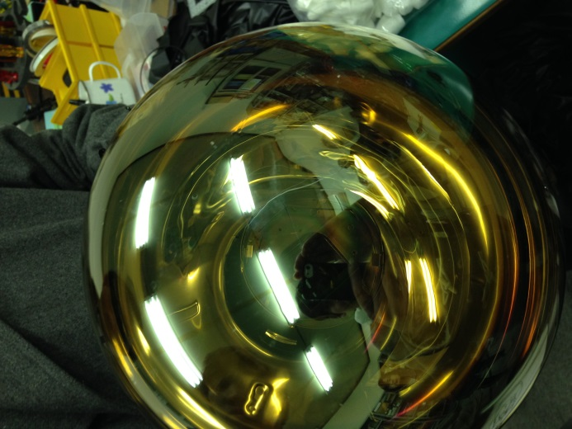
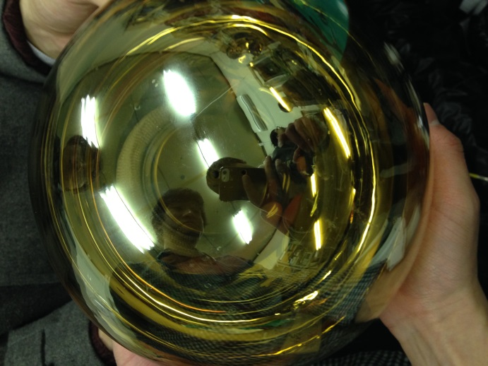
Testing PMTs and HPDs
These PMT are used in super-K
to measure the cosmic rays.
HPDs may be used in
Hyper-K .
We tested an HPD and a PMT
to measure the angular
Distribution of cosmic ray muons .
PMT
HPD

Slide 15
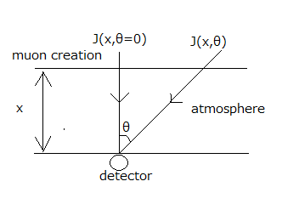

The Angular Distribution of Cosmic ray Muons
The flux is given by
J(x,θ) = J(x,0) ${(cosθ)}^{n}$ (n = $\frac{x}{λ})$
Where λ is mean free path
The purpose of this
experiment was
finding the value of n.

Slide 16
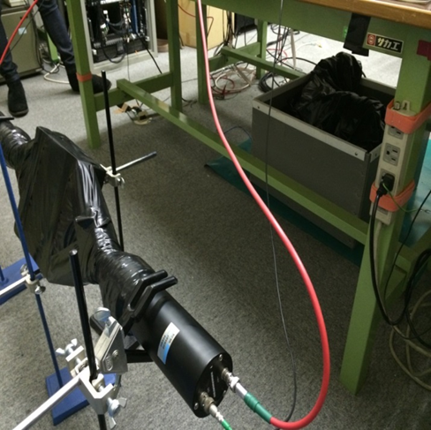
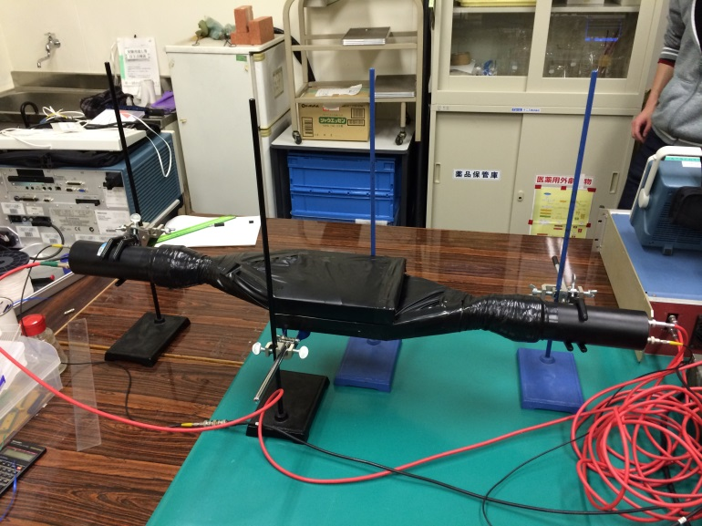
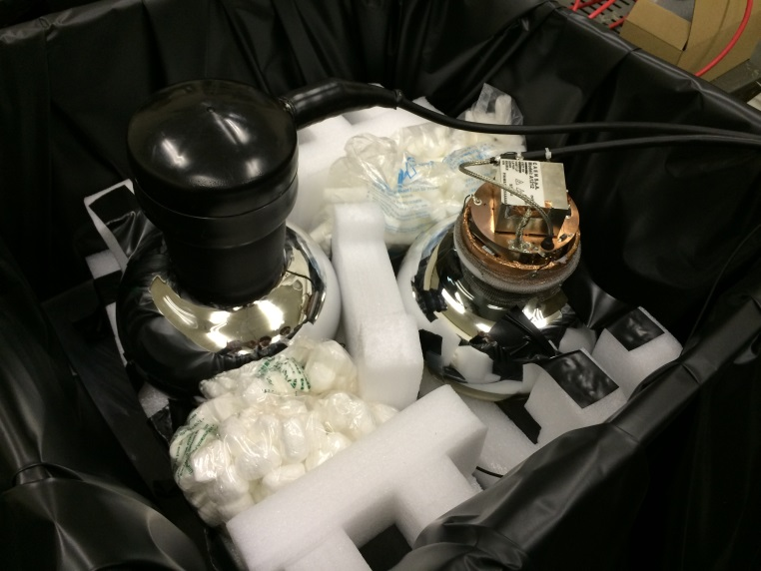
Set up
We used two sets of two
detectors to measure
the angular distribution.
μ
Scintillator(20cm×20cm)
Scintillator(50cm×50cm)
HPD
PMT
PMT
First detector
Second detector

Slide 17
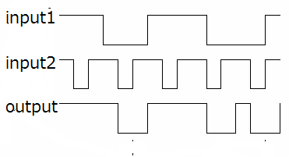
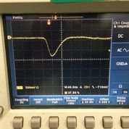
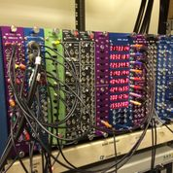
We made a coincident
circuit to count muons
which activated all
detectors.

Slide 18
Results
angle[degree] | measuring time[second] | count | flux[Hz/counter]
0 | 15502.80 | 1276 | 0.0823
30 | 23489.36 | 1015 | 0.0397
50 | 42961.68 | 1345 | 0.0241
70 | 50647.65 | 817 | 0.00901
We corrected flux by a solid angle

Slide 19
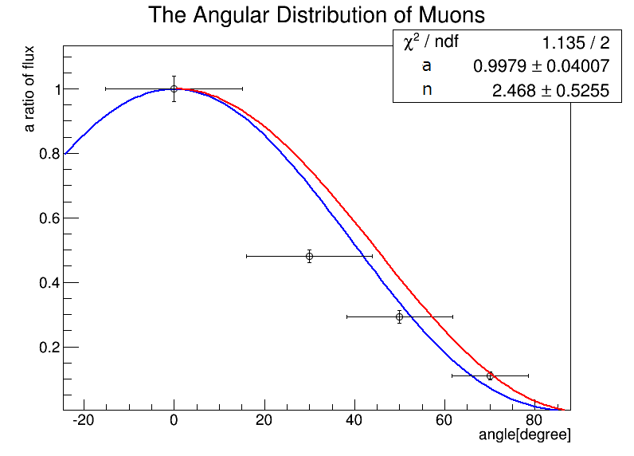

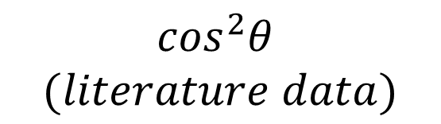
fitting
$$\cos^{2}θ$$
$$(literature data)$$
We fitted a×${(cosθ)}^{n}$ and determined
n = 2.47$±$0.53 .

Slide 20
T2K Experiment

Slide 21
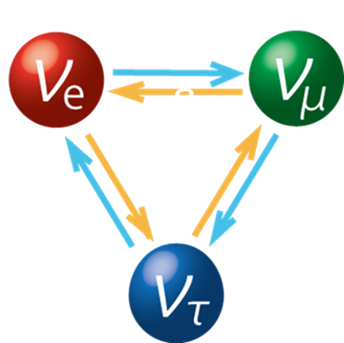
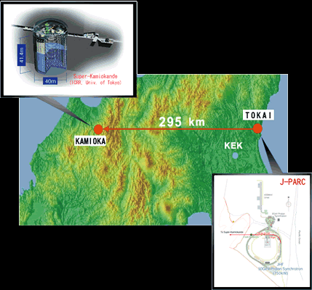



What is T2K?
Tokai(J-PARC) to Kamioka(SK)
Pure $v_{μ} beam$
SK can distinguish $v_{e}$ and $v_{μ}$
Observe $v_{e}$ appearing and $v_{μ}$ disappearing
$$v_{μ}$$
$v_{e}$?
http://t2k-experiment.org/ja/

Slide 22
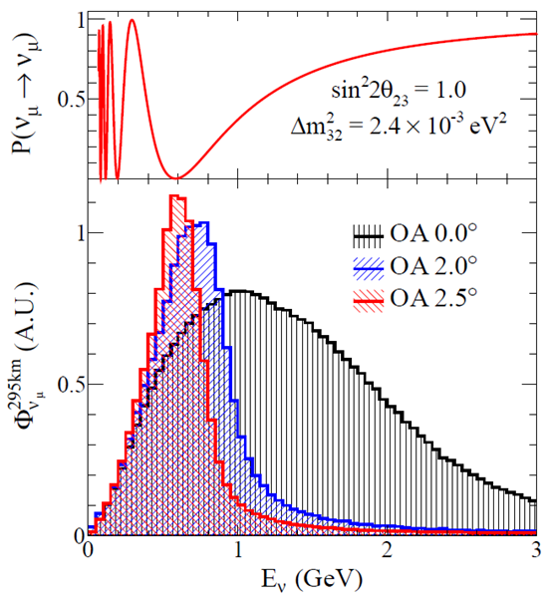


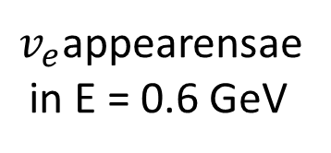

Devices to discovery
Distance
Off axis
$$ν_{μ}$$
(on axis)
。
$$π^{+}$$
2.5
$v_{e}$appearensae
in E = 0.6 GeV
$v_{μ}$disappearing in L =295 km
SK
L = 295 km
E ～ 0.6 GeV

Slide 23

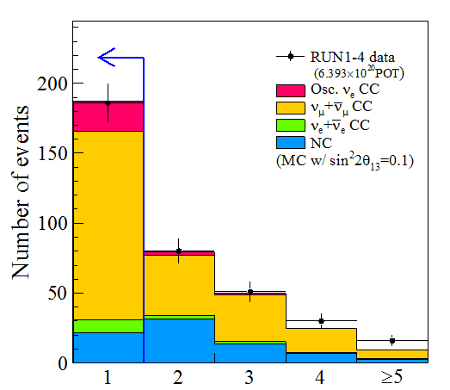
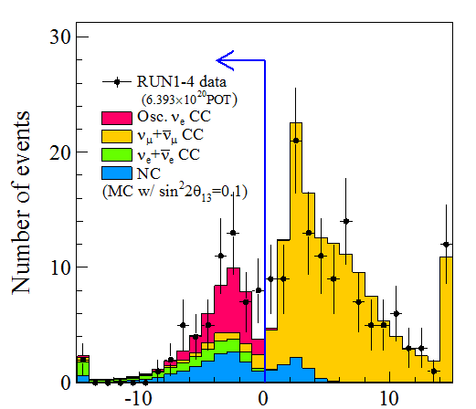



Enrichment signals
Selection one ring $μ_{e}$-like events
Reduce BG cuts using Monte Carlo calculations
377 events is first selected by timing
193
60
Number of rings
e -like evernts
cut NC,μ
cut collapse π,μ
cut $v_{e}$ in beam
cut $π^{0}$BG
57 44 39 28

Slide 24




events
$$ν_{e}$$
-like single ring events were found
Was happened?
$θ_{13} =$ ?
6.57 $× {10}^{20}$
Proton created in J-PARC :
expected BG : 4.92
So we calculate expectation and estimate $θ_{13}$

Slide 25






J-PARC beamline
$$v_{e}$$
$$e^{+}$$
target
$$v_{μ}$$
$$π^{+}$$
$$μ^{+}$$
on axis
p
μ dump
$$v_{μ}$$

Slide 26
Analyzing T2K data
Notes:
Now I want to talk about one of our task, analyzing actual T2K data. We used data acquired in T2K experiment to find mix angle theta13 and estimated error and confidence level of theta13 existence.
First, let’s talk about a method to determine theta13.

Slide 27


What we have
T2K result
$νe$number :
$$N_{obs}\left( νμ→νe\right)=28$$
Proton number :
$$Np=6.570×1020$$
Very new :
Physical Review Letters, 2014 Feb
Theory
$$P\left(νμ→νe\right)\left(θ13\right) ≃\sin^{2}{θ_{23}}\sin^{2}{2θ_{13}}\sin^{2}{1.27\frac{Δm_{31}^{2}L}{E}}+(CP, solar,matter term)$$

Slide 29

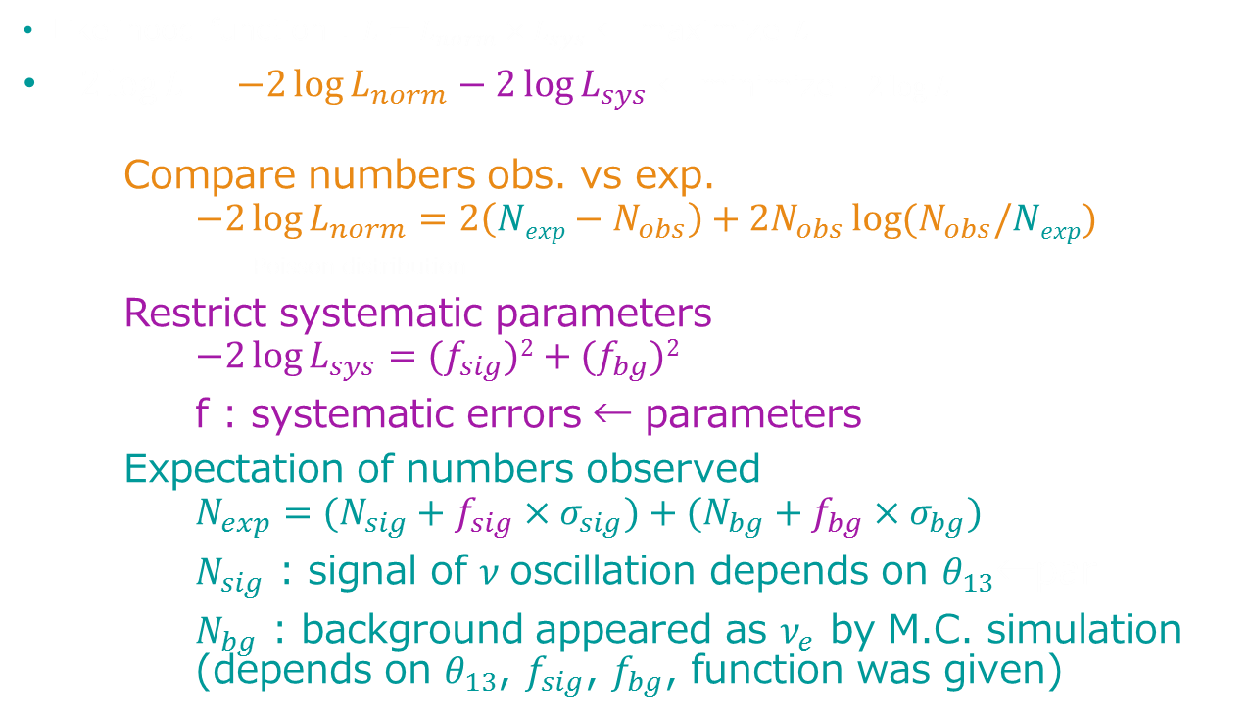
Maximum Likelihood Method to find $θ_{13}$
Likelihood function : $L=L_{norm}×L_{sys}$ ← maximize L
$−2\log{L}=−2\log{L_{norm}}−2\log{L_{sys}}$ ← minimize $−2\log{L}$
Compare numbers obs. vs exp.
$$−2\log{L_{norm}}=2\left(Nexp−N_{obs}\right)+2N_{obs}\log{(N_{obs}/Nexp)}$$
Poisson distribution
Restrict systematic parameters
$$−2\log{L_{sys}}={(f}_{sig})2+(f_{bg})2$$
f : systematic errors ← parameters
Expectation of numbers observed
$$N_{exp}=(N_{sig}+f_{sig}×σ_{sig})+(N_{bg}+f_{bg}×σ_{bg})$$
$N_{sig}$ : signal of $ν$ oscillation depends on $θ_{13}$←par
$N_{bg}$ : background appeared as $ν_{e}$ by M.C. simulation (depends on $θ_{13}$, $f_{sig}$, $f_{bg}$, function was given)
Notes:
As you know, we use statistical method, “most likelihood method”. Simply talking this means that we determine parameters by making a possibility for getting exact result acquired in an experiment to be maximum. This time, we have T2K data, electron-neutrino numbers 28 and incident muon-neutrino numbers known by .

Slide 30



Get $θ_{13}$

Slide 31




Get errors
Error(1 sigma)
$$−2\log{L}≃χ^{2}=\frac{{\left(x−μ\right)}^{2}}{σ^{2}}$$
→ $−2\log{L}=1⟺x=μ±σ$
get $θ_{13}$ at $−2\log{L}=1$
$$\sin^{2}{2θ_{13}}={0.137}_{−0.032}^{+0.037}$$
$$0.137$$
$$+0.037$$

Slide 32



Get confidence level for $θ_{13}≠0$
$−2\log{L}≃σ^{2}$
→ $P\left(θ_{13}\right)=$
$$1−\sqrt{−2\log{L}(θ_{13})}$$
get $−2\log{L}$ at $θ_{13}=0$
Significance : 6.9σ
$θ_{13}$ actually exists and non-zero!!!

Slide 33



Comparison with actual T2K
Actual T2K
Our verification
$\sin^{2}{2θ_{13}}={0.140}_{−0.037}^{+0.038}$
$θ_{13}≠0$ C.L. : $7.3σ$
$\sin^{2}{2θ_{13}}={0.137}_{−0.032}^{+0.037}$
$θ_{13}≠0$ C.L. : $6.9σ$
Same value, same error
T2K was correct!!!
(C.L. is better by using energy likelihood function)

Slide 34

In actual T2K experiment…
Likelihood function
$$L\left(N_{obs}, E_{obs}^{rec};θ,f\right)=L_{norm}\left(N_{obs};θ,f\right)×L_{shape}\left(E_{obs}^{rec};θ,f\right)×L_{syst}(f)$$
$$L_{norm}\left(N_{obs};θ,f\right)=\frac{e^{Nexp(θ,f)}{\left[Nexp\left(θ,f\right)\right]}^{Nobs}}{N_{obs}!}$$
$$L_{shape}\left(E_{obs}^{rec};θ,f\right)=\prod_{i=1}^{N_{obs}}{ρ(E_{obs,i}^{rec};E^{rec},θ,f)}$$
$$L_{syst}\left(f\right)=\frac{1}{{\left(2π\right)}^{k/2}\sqrt{|V|}} exp(−\frac{1}{2}∆f^{T}V^{−1}∆f)$$
$θ$ : oscillation parameter $f$ : systematic error parameter
f are more than 49!

Slide 35

Future experiment
T2K is just in beginning
Continue to get 10 times more data
Check the sensitivity ($N_{obs}, N_{exp}→×10$)
$\sin^{2}{2θ_{13}}={0.137}_{−0.032}^{+0.037}→{0.137}_{−0.015}^{+0.018}$ (We did)
→ twice more precise
Anti-Neutrino experiment by Hyper-K
$P\left(νμ→νe\right)−P(\overline{ν}μ→\overline{ν}e)$ can measure $δ_{CP}$

Slide 36
Summary
Experiment
Analyzing
Theory

