Slide 1
High Energy Gamma Ray Group
Observing Galactic Center & Dark Matter Search
MAGIC Team
Ryoma Murata (UT B3)
Hiroki Sukeno (UT B3)
Tomohiro Inada (Kobe Univ. B3)
Fermi Team
Yuta Sato (TUS B4)
Taketo Mimura (Waseda Univ. B3)
Masahiko Yamada (UT B3)
Notes:
Inada

Slide 2
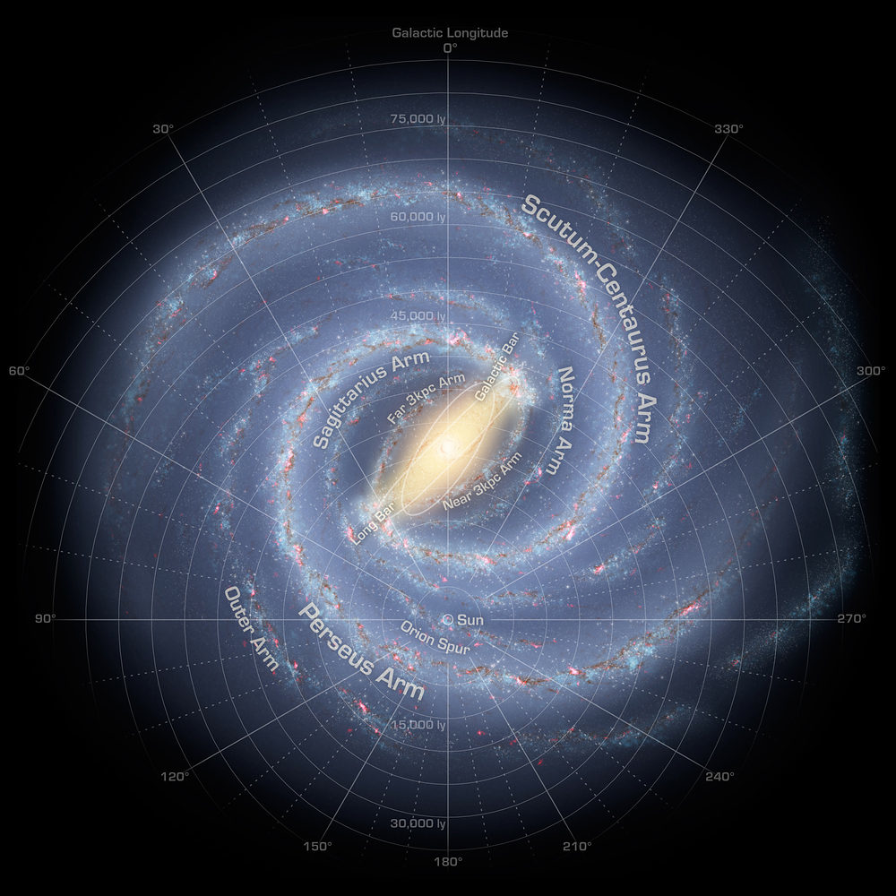
Introduction
a
Target: Galactic Center (Our Galaxy)
Objective: Activities of Galactic Center
  Gas blob(4M_{Earth}) is approaching the black hole-> Flare in the near future?
  Dark Matter Search at 133GeV
    cf. C. Weniger 2012
Data: MAGIC and Fermi analysis
Notes:
Inada

Slide 3
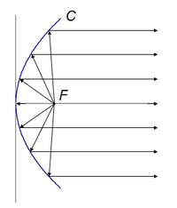
How to Measure (1): MAGIC
Image of Magic Telescope and Signals acquired
Notes:
Inada

Slide 4
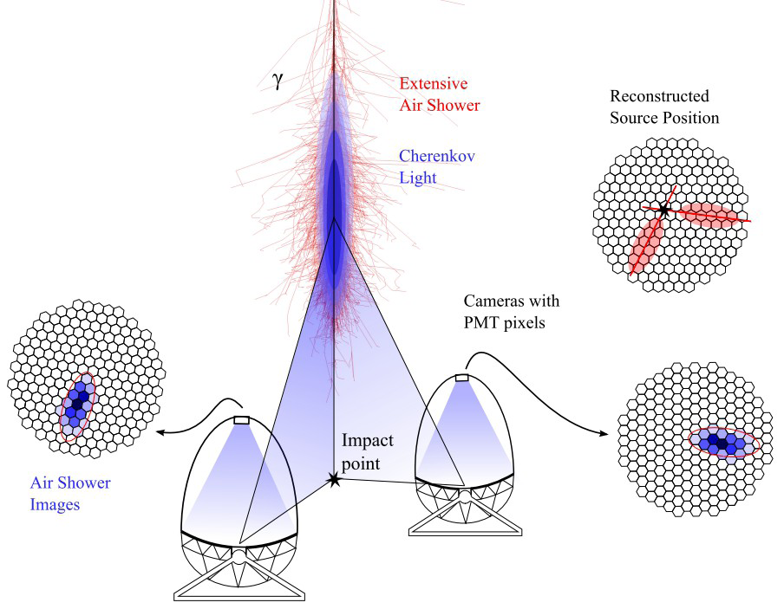
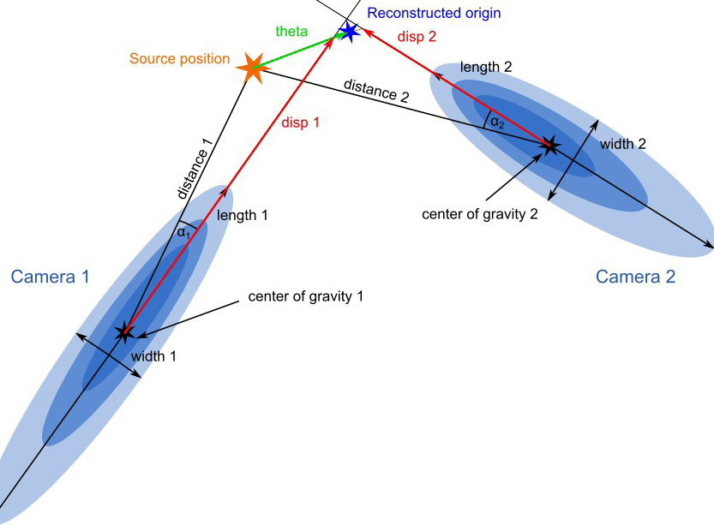
How to Measure (2) : MAGIC
Notes:
Inada

Slide 5
How to Measure (3) : MAGIC
Gamma rays vs. Hadron(Proton)
Hadronic components are 1000 times larger than Gamma rays
Low Energy Gamma rays -> difficult to distinguish with Hadron
Centered
Scattered
High Energy Gamma Rays
Hadron (Proton…)

Slide 6
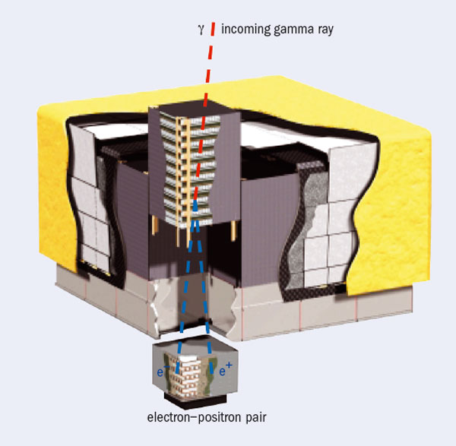
How to Measure: Fermi
Tracker
Analyzing direction
Calorimeter
Measuring energy
Notes:
Yuta sato

Slide 7
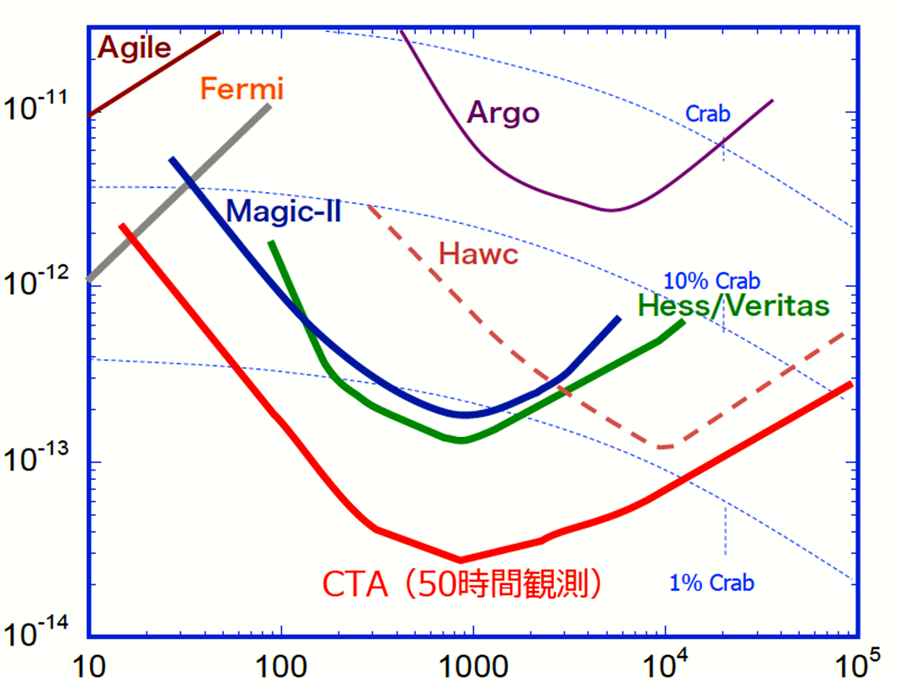
Difference between MAGIC and Fermi
Sensitivity of Fermi and MAGIC
EF(>E) (TeV/cm²s)
E(GeV)
Notes:
Sato
EF=energy* flux

Slide 8
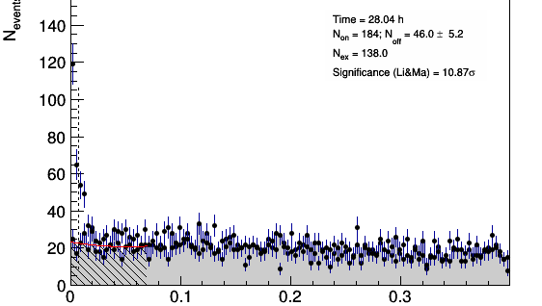
Theta Square Plot (High Energy) : MAGIC
θ [deg ]
2
2
Notes:
Sukeno

Slide 9
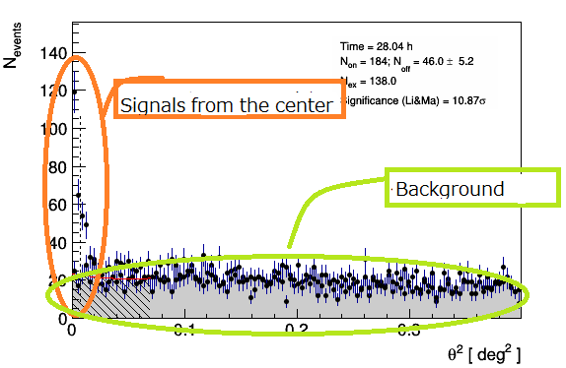
Theta Square Plot (High Energy) : MAGIC
Notes:
Sukeno

Slide 10
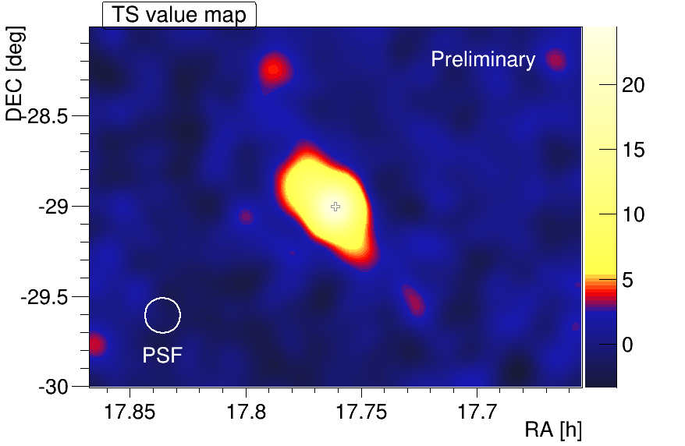
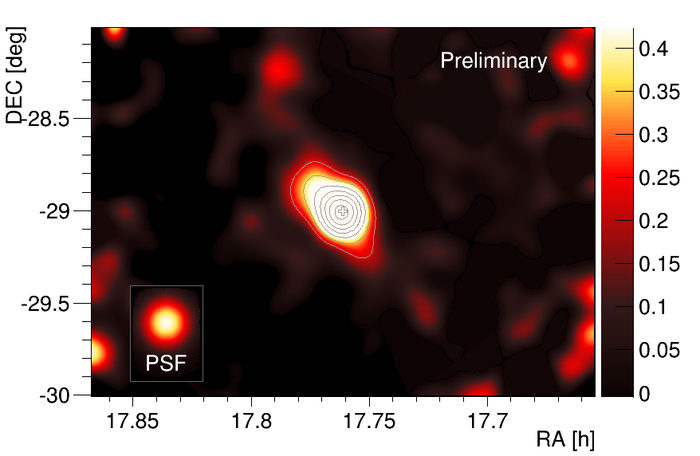
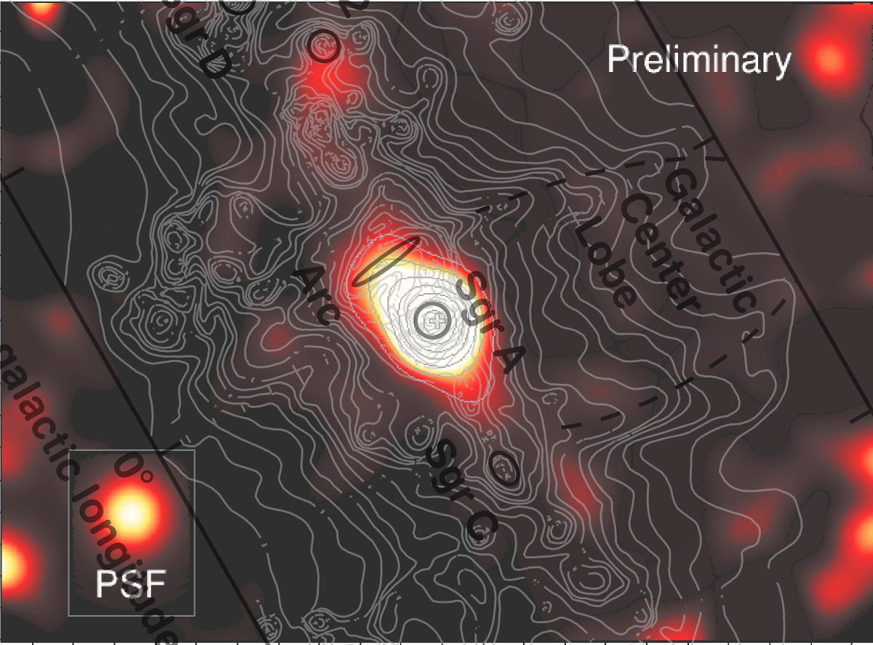
Skymap (E > 1 TeV) : MAGIC
Galactic Plane
Galactic Polar
Notes:
Sukeno

Slide 11
Skymap : Fermi
Galactic Plane
Galactic Polar
Notes:
Yuta sato

Slide 12
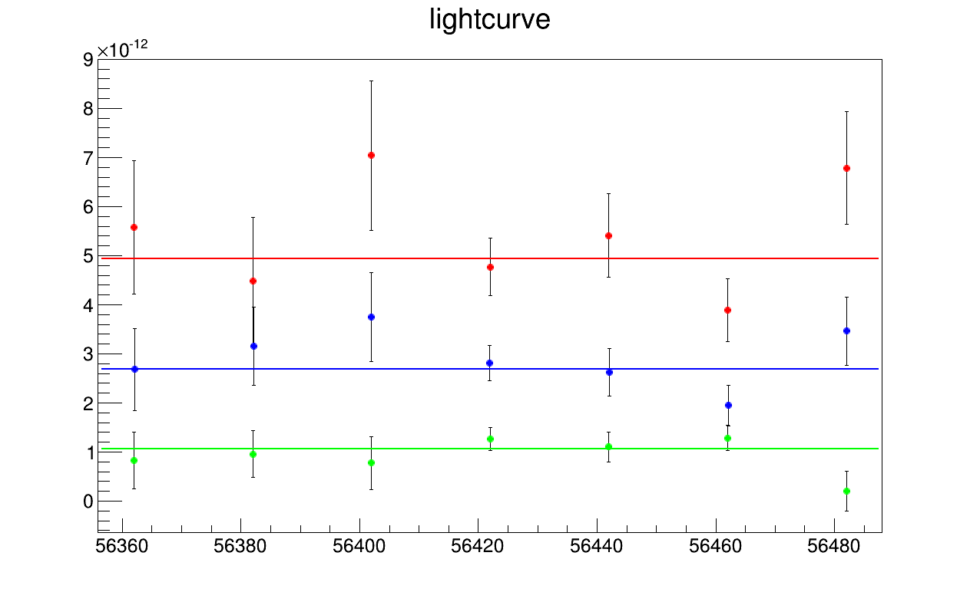
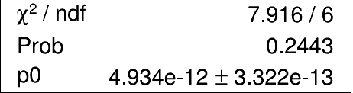
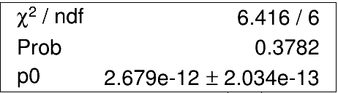
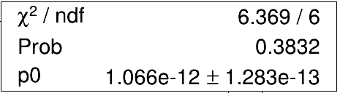
Light Curve : MAGIC
500GeV
1TeV
Integral Flux [cm-² s⁻¹]
2TeV
Consistent with constant
3/9/2013
7/7/2013
MJD(Date)
Notes:
Sukeno

Slide 13
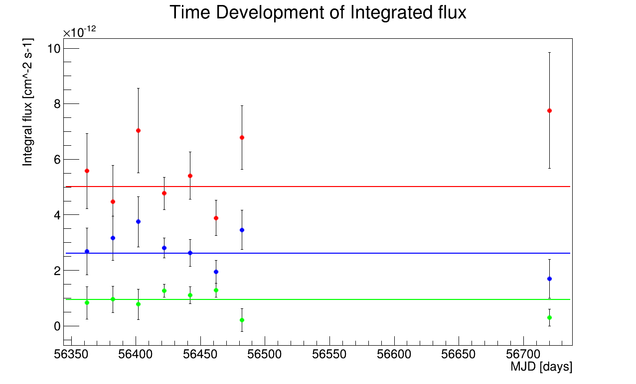
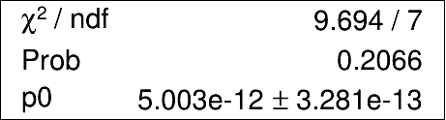
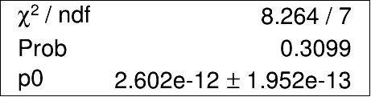
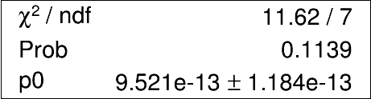
Light Curve : MAGIC
Light Curve combined with new plots
3/9/2013
3/7/2014

Slide 14
Light Curve : Fermi
By integrating dN/dE from 3 to 300 GeV
Integrated flux : 3-300 GeV [cm⁻² s⁻¹]
1/1/2013
8/2/2013
Notes:
Mimura Taketo

Slide 15
Latest Data from Fermi

Slide 16
Spectrum : Fermi
Seems good,
but bending slightly
dN/dE ~ E^{-3.00(6)}
reduced chi-squared: 1.60
(dof : 6)
Fermi cannot detect higher energy. Is this bending real?
Notes:
Mimura Taketo

Slide 17
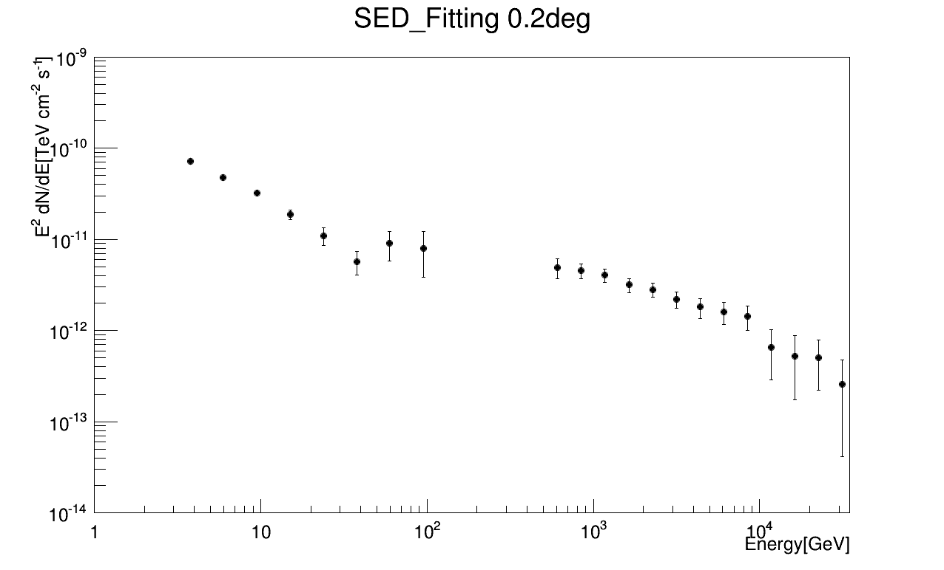
Spectrum: MAGIC & Fermi

Slide 18
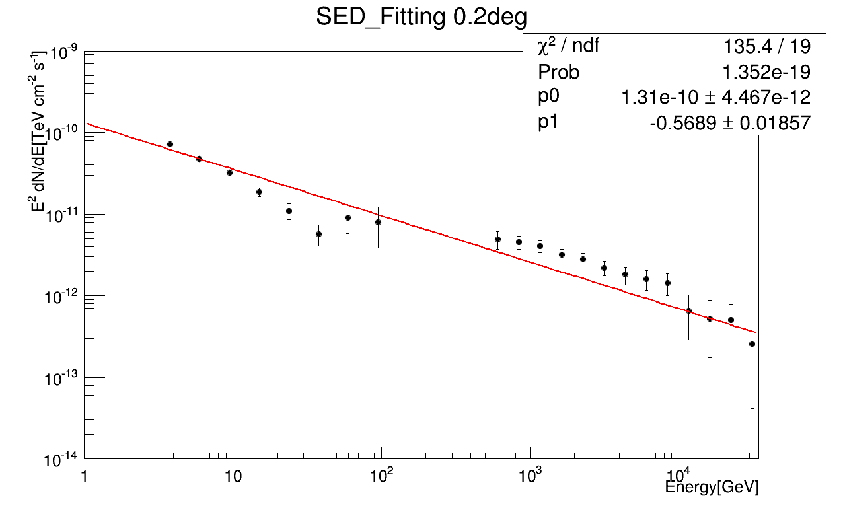
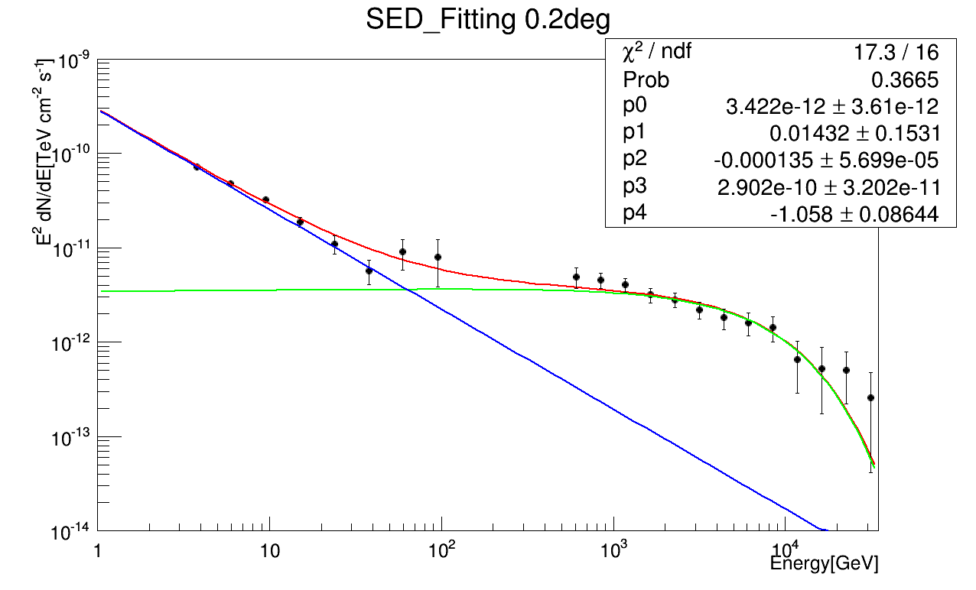
Spectrum Fitting : MAGIC & Fermi
MAGIC
Fermi
reduced chi-squared: 7.12
reduced chi-squared: 1.08
Single power law fitting is bad,
but chi-squared has improved significantly assuming two components
By F-test the significance of the two-component model exceeds 5σ
Notes:
Murata

Slide 19
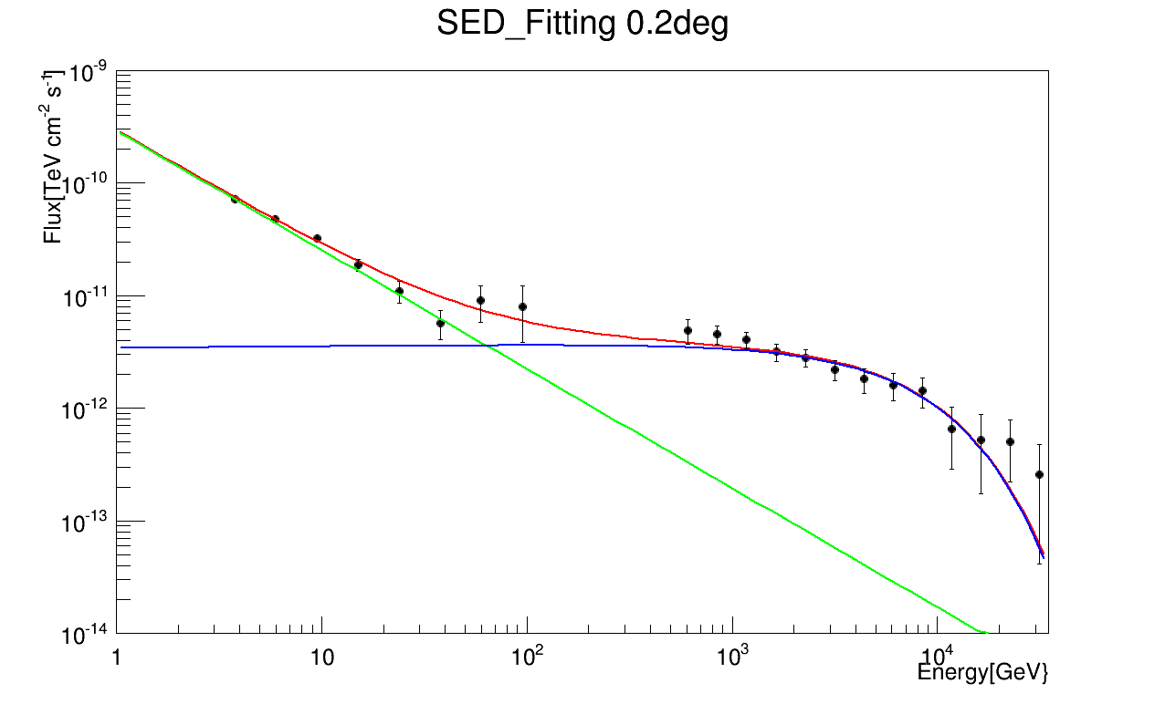
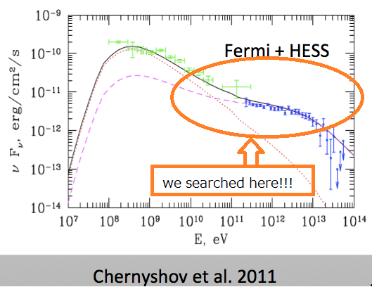
Spectrum Comparison
MAGIC & Fermi Spectrum
Other Known Result
Notes:
Murata

Slide 20
DM Search at 133GeV from Fermi
Counting ALL events within 3° from Galactic Center
Assuming Power Low background + Gaussian Peak
Peak width is 11% of Energy (red)
Free peak width (blue)
old data (43 months) & old+new data (56 months)
C. Weniger claimed that there existed a peak
at 133 GeV in old data
Local significance (130-140 GeV) from Li&Ma
Notes:
Yamada
Peak Width is from resolution of CsI

Slide 21
DM Search from Old Fermi Data
43 months
Peak at 135.5 ± 2.4 GeV
Local significance: 3.6σ
Notes:
Yamada

Slide 22
DM Search from Old + New Fermi Data
56 months
Peak at 136.5 ± 2.5 GeV
Local significance : 3.3σ
Consistent with 136.5 GeV Dark Matter, but the significance has decreased
Notes:
Yamada

Slide 23
Conclusion
We have found two components in the spectrum
  Related to X-ray super Flare 300 years ago?
Decrease in the significance of Dark Matter at 133GeV
Molecule blob Gamma ray
has not reached yet?
CTA is needed
for the future research
  Wider covering range
  More statistics
EF(>E) (TeV/cm²s)
E(GeV)
Notes:
Yamada

Slide 24
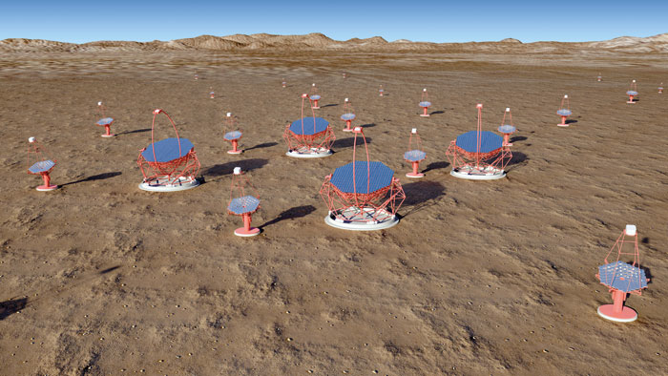
Conclusion
We have found two components in the spectrum
Decrease in the significance of Dark Matter at 133GeV
CTA is needed for the future research
Notes:
Yamada

Slide 25
Appendix A. Maximum Likelihood Method
Assuming Poisson Distribution
Estimate the total likelihood of the pattern
Maximize via parameters of the distribution
Or minimize log-likelihood

Slide 26
Appendix A. Model Fitting
For Fermi, we use Maximum Likelihood Method to determine a fitting model
Minimum Chi-squared Method is bad due to few stats
Result: Point-Like Source Model is better than Circle-Like Source Model (radius 0.4°) for G.C.
Ln (L_{good}/L_{bad} )=32
For MAGIC, we use < 0.2° (the best fit)
Notes:
Yamada Murata

Slide 27
Appendix B.
Minimum Chi-squared Method
Minimize chi-squared via parameters of f(x)
Chi-squared obeys chi-squared distribution χ²(dof) assuming the statistical error is Gaussian
Chi-squared / dof should be 1
  When more than 1, the fitting function is bad
  When less than 1, it is suspected to be a fabrication
dof=N-(# of fitting parameters)
  Because parameters are not independent of data
σ_{i}: expected statistical error

Slide 28
Appendix C. F-test
Compare two fittings (Which is better?)
F should obey F-distribution assuming the improvement of fitting is only from the increase in fitting parameters
  (null-hypothesis)
  Obeys F(Δdof,dof_{good})
When the possibility is lower than expected, improvement of fitting is NOT from the decrease in dof, BUT from “dark matter”.

Slide 29
Appendix C. F-distribution
F-distribution is defined by the quotient of two independent chi-squared distribution
F should obey F-distribution assuming the null-assumption
When F is in the tale of the distribution, the null assumption is dismissed (indication of dark matter)

Slide 30
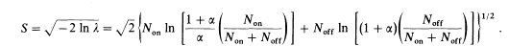
Appendix D. Li&Ma
Assuming Poisson Distribution
Compare whole count and background
Complicated formula from likelihood method
α is assumed to be 1/2
From Li & Ma 1983
Notes:
Alpha: background weight

Slide 31
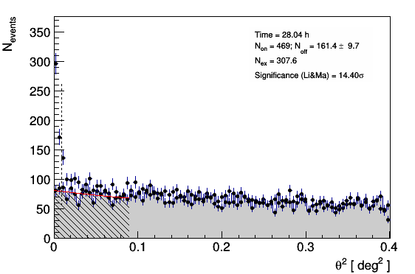
Theta Square Plot (Middle Energy) : MAGIC

Slide 32
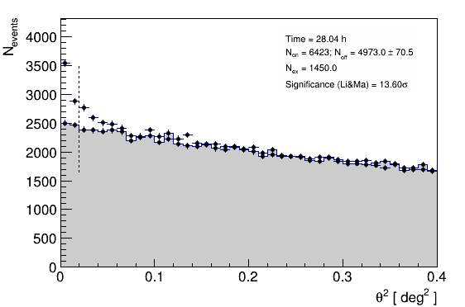
Theta Square Plot (Low Energy) : MAGIC

Slide 33
How to Measure: MAGIC
Calibration (auto) electronic signal ->photo electrons
Image Cleaning (auto)
Data Selection (auto)
Unite Data from Telescopes
Gamma/Hadron separation
etc…

Slide 34
How to Measure (2) : MAGIC
Clean up Signals
Parameterize (ellipse shape fitting)
  →automatically done
Data Selection eg.) Cloud, Moon, Cars…

Slide 35
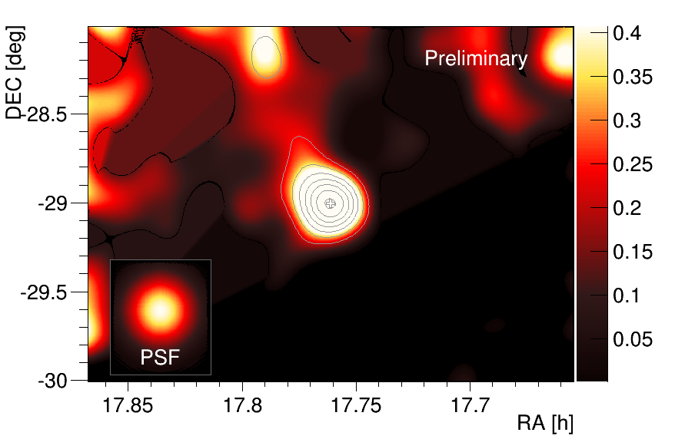
Skymap from MAGIC E>500GeV

Slide 36
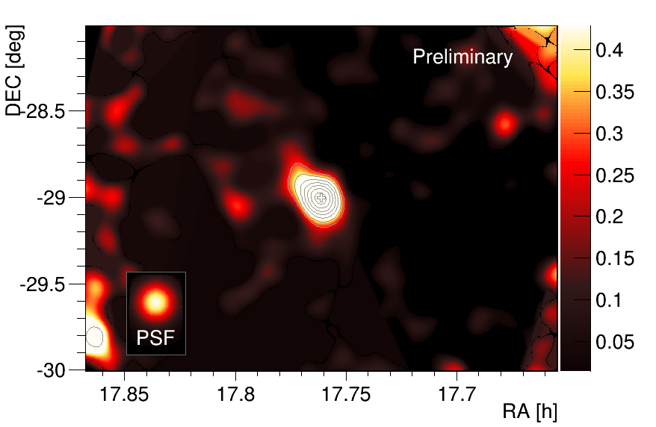
Skymap from MAGIC E>2TeV

Slide 37
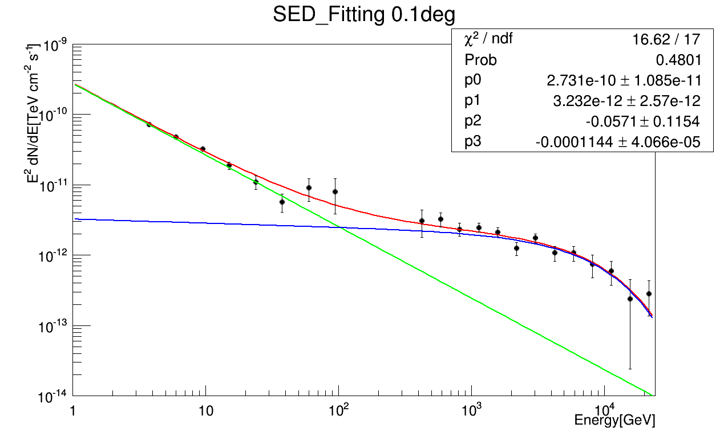
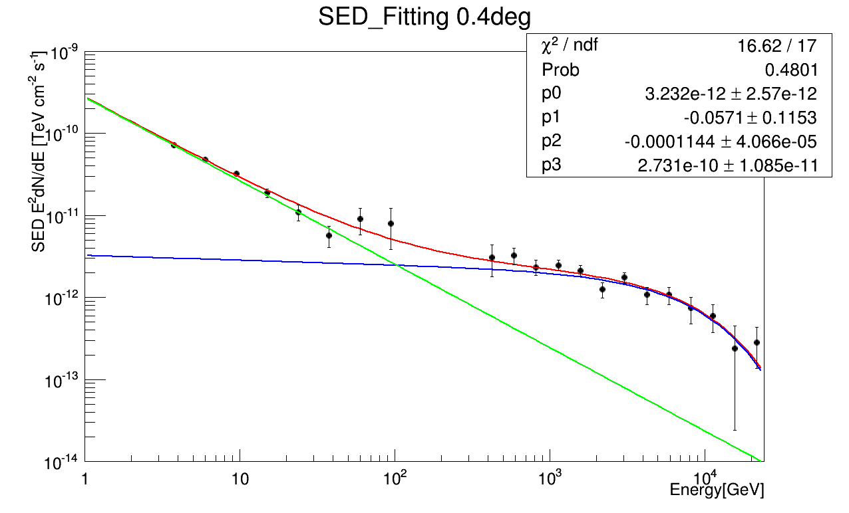
Spectrum Fitting :Fermi & MAGIC
￼

Slide 38
Hadronness-Energy distribution: MAGIC
Left: Monte-Carlo simulation for Gamma rays
Right: Background distribution
(Hadron >> Gamma → Background ≒ Hadron)
-> at higher Energy, separation goes well !!
Monte-Carlo simulation for Gamma rays
Background distribution

