Slide 1
Study of alpha backgrounds using flash ADC in the XMASS experiment
Feb. 22nd , 2013
ICRR, Suzuki-Lab.
M2 Osamu Takachio

Slide 2
Contents
Dark matter
XMASS experiment
DAQ system
Study of alpha backgrounds using flash ADC

Slide 3
Dark matter

Slide 4
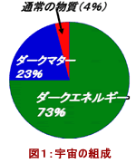
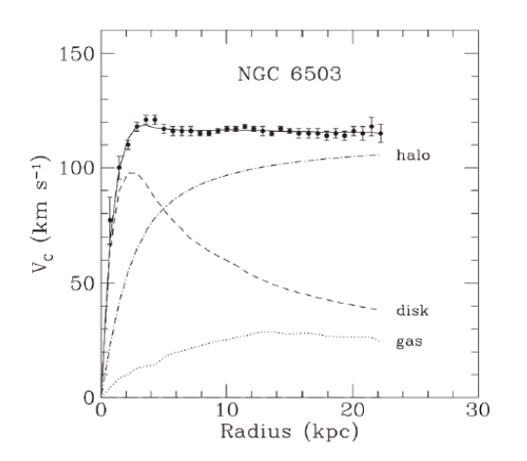
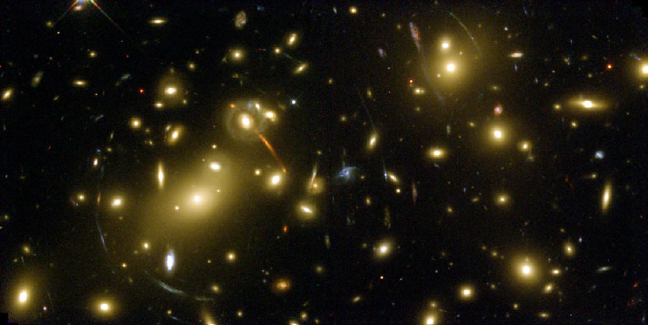
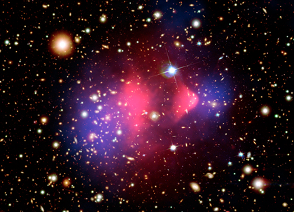
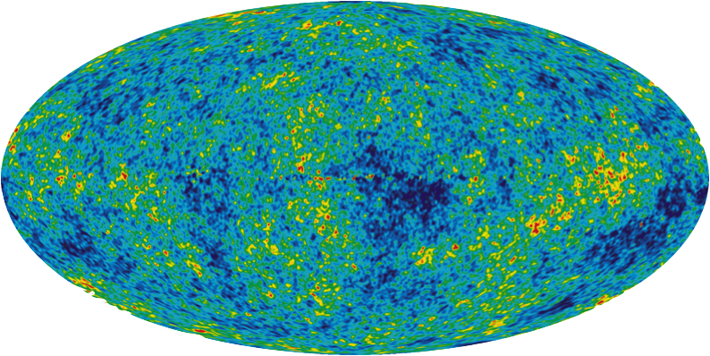
Dark matter
Ordinary matter (4%)
Dark matter
Observed value
Dark energy
Can be explained by dark mater
Can be explained by optical observation
Composition of the universe
Gravitational lens
Bullet Cluster
WMAP
Candidate of dark matter
WIMP (Weakly Interactive Massive Particle)
Super symmetry particle(超対称性粒子)
Notes:
暗黒物質は電磁波で観測できる通常のグッ質の5~6倍を占める未知の物質。

Slide 5
XMASS experiment

Slide 6
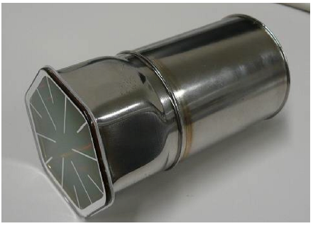
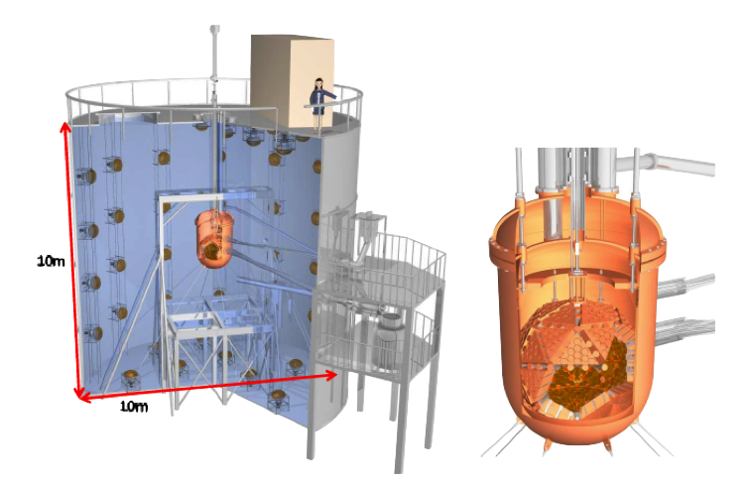
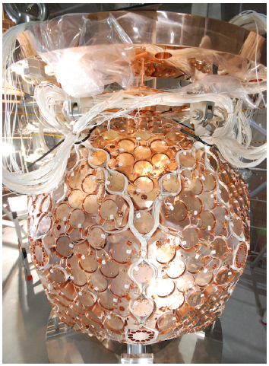
XMASS experiment is …
A versatile low background experiment using liquid xenon as a scintillator
Ongoing from October 2010 for the realization of direct detection of dark matter.
Was operated until May 2012, and searching of the dark matter and understanding of the detector was done.
Total mass 835kg
Effective mass100kg
Diameter 80cm (LXe)
PMT 10789-11
Water tank
OVC/IVC
PMT holder inserted 642 PMTs
Notes:
10m10mの水タンク内部にOVC、IVC。
IVCの中に液体Xeが入っている。
その中に642本のPMTが挿入された球形(実際には正12面体の各面をさらに5つの三角形で分割したペンタキスドデカヘドロンという構造)のPMTホルダーがある。

Slide 7
DAQ systems

Slide 8
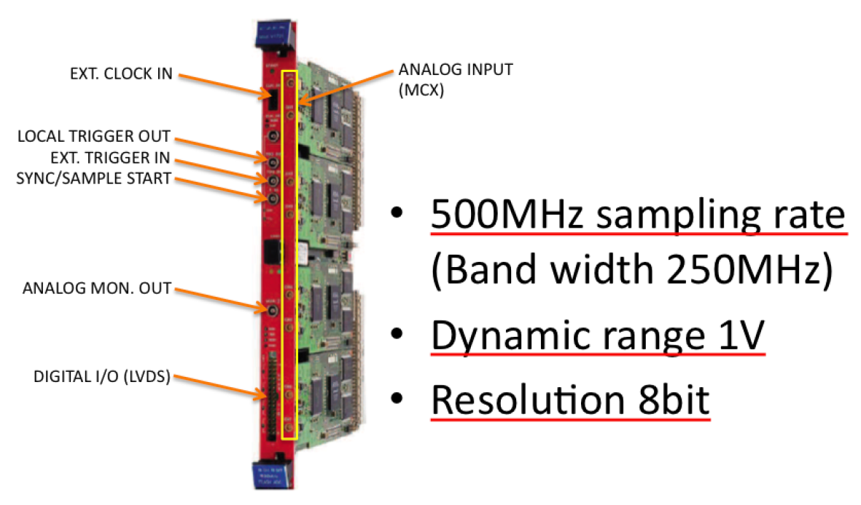
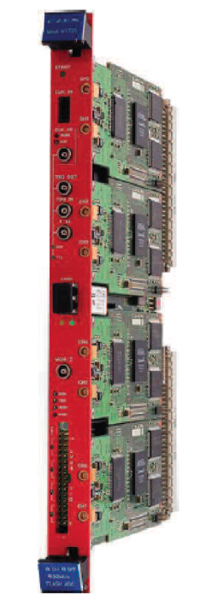
DAQ system
Trigger is generated from ATM HITSUM
• PMTSUM
Analog sum of the ~12 PMT signals input to 1 FADC channel (yellow).
FADC can take 642 all the PMT signals using 60 channels.
Notes:
PMT、ATM、FADCの簡単な説明。
トリガーの仕組みとPMTSUMについて詳しく。

Slide 9
Study of alpha backgrounds using flash ADC in the XMASS experiment

Slide 10
Motivation
Using waveform information available from FADC, we may be able to discriminate alpha events and gamma events.
We want to know how much alpha background exists in the detector.
With the information about alpha events (energy, position etc…), we want to identify and estimate the quantity of the cause of the background.
Then, we can move to the removal work of the causative substance from the detector, etc.

Slide 11
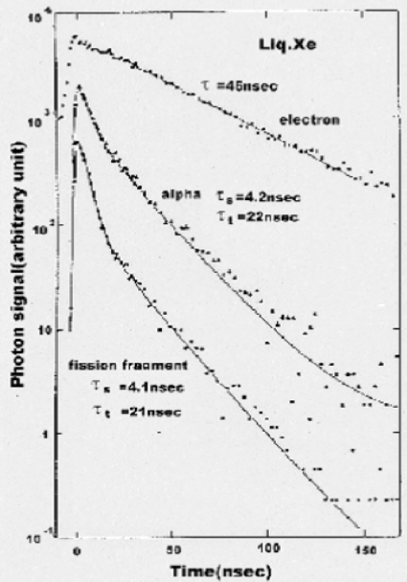
Waveform discrimination
In case of liquid xenon, the signals have different waveforms between nucleus recoil and electron recoil.
Waveform discrimination
Alphas OR gammas
For identification of background.
~MeV region
Dark matter OR gammas
For selection of dark matter signals.
~10keV region
Electron(Gamma)
τ = 45ns
Alpha
τ_{s} = 4.2ns
τ_{l} = 22ns
Electron(207Bi), α particles (210Po, 252Cf) was placed in a stainless-steel vessel(6.4cm in diameter) filled with liquid xenon.
Notes:
電子による電離イオン対の密度は低いため一部のイオン対はすぐに再結合できず、45nsという長い減衰時間を持つ。
一方、アルファ線や重イオンに対しては電離イオン対の密度が高いため再結合までの時間が短い。

Slide 12
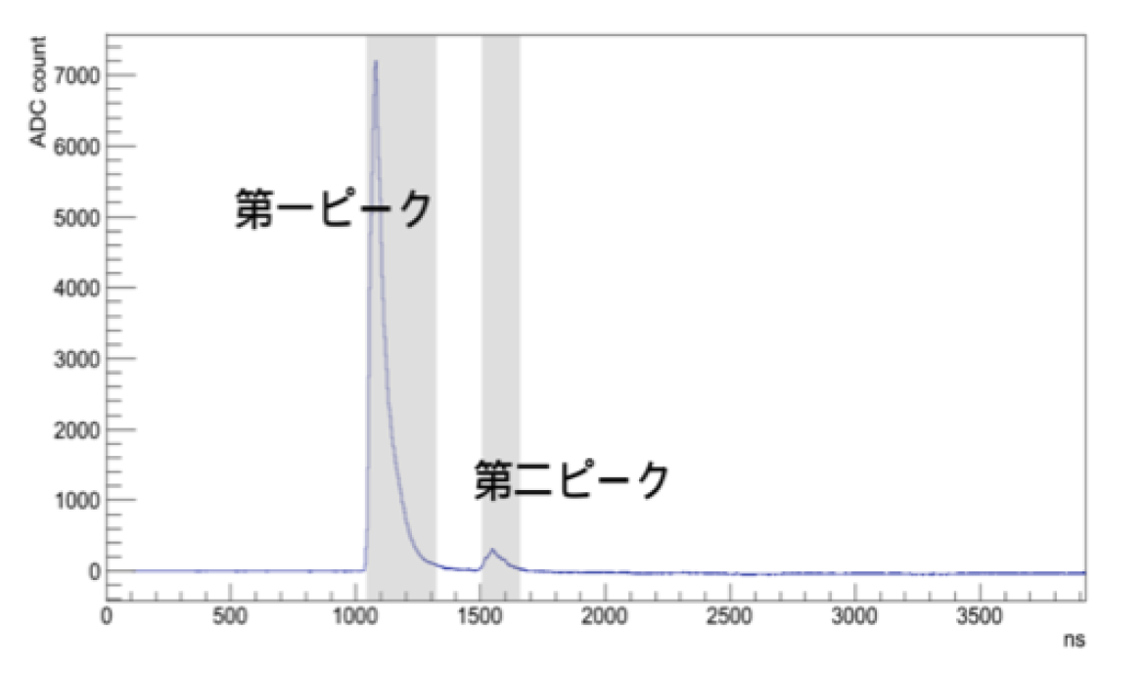
Peak search
Waveform Example
Get parameters of the peak
Area
Integrate between the starting point and ending point.
1count~22.4eV according to Co57 detector center calibration
Time constant (τ)
Fit exponential function
(peak+10ns to peak+150ns).
(First peak)
(Second peak)
Peak search method
Time window is 4us.
Baseline is the average of the first 100 samples.
Starting point is the crossing point of +20 ADC count.
Ending point is the crossing point of +10 ADC count.
Search next start point.
Notes:
幅を100nsの信号と仮定すると後述の変換係数を用いておよそ80pCの事象に対応する

Slide 13
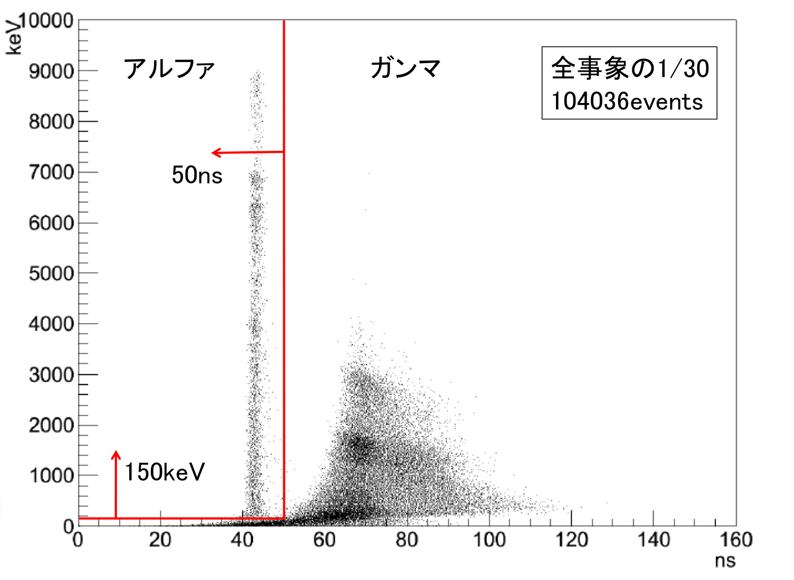
Time constant distribution
Co57 calibrated energy( )
1/30 of data from August 19th to September 3rd, 2011(13.7days)
The events over 150keV can be discriminated using 50ns criteria.
Alphas
Gammas
Time constant( )
Notes:
時定数の見積もりにはサチュレーションしたチャンネルを抜いた波形和にフィット。

Slide 14
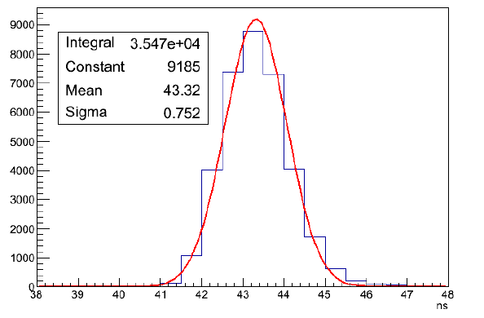
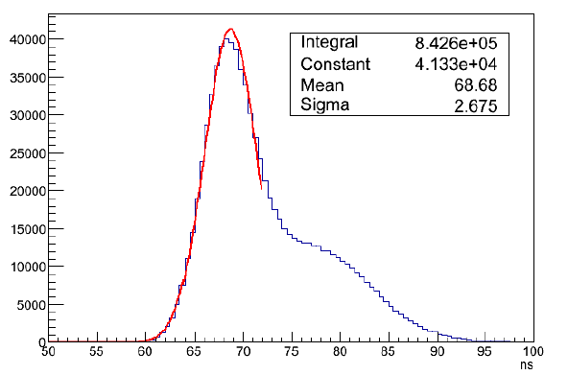
Estimation of the time constant
Project each plot to time constant axis to get mean value and sigma of alpha and gamma events.
Alphas
E>4MeV
35470events
Mean 43.3ns
Sigma 0.8ns
Gammas
1MeV<E<2MeV
842600events
Mean 68.7ns
Sigma 2.7ns
Alphas
τ_{α} = 43.3ns
σ = 0.8ns
Gammas
τ_{γ} = 68.7ns
σ = 2.7ns
The reason of bigger time constant than reference value (τ_{α} = 22ns, τ_{γ} = 45ns).
• PMT response and margin of the cable length(~5ns)
• frequency character of PMTSUM(~10ns) • discrepancy btw. Boards etc…
Notes:
ガンマの選択領域の理由
→PMTコバールのCo60からのガンマ線とわかってるから。
(聞かれたら…)
右側の肩はプリアンプのサチュレーションのため。

Slide 15
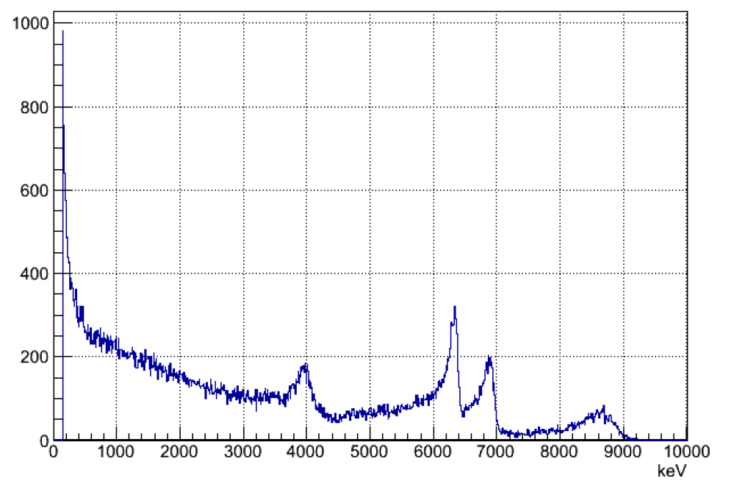
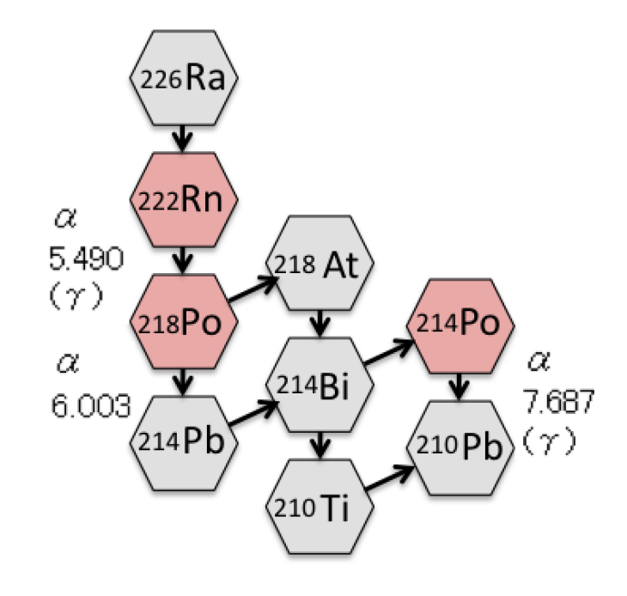
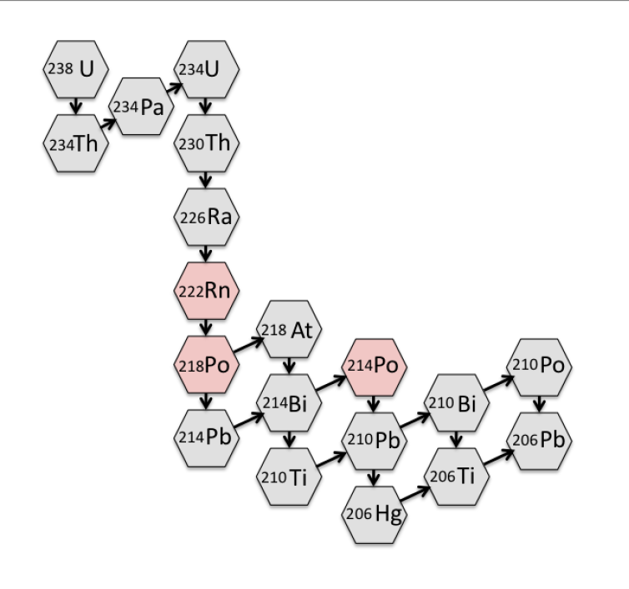
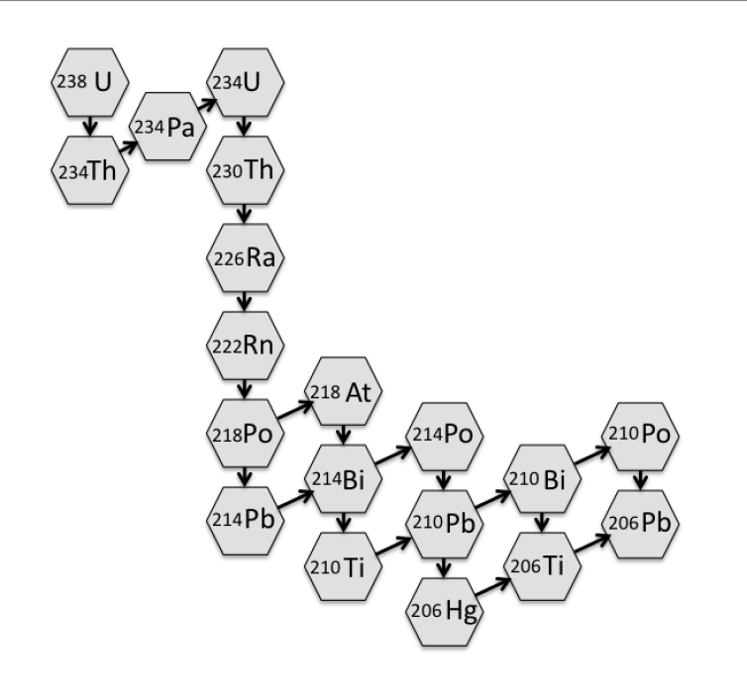
Energy spectrum of the alpha events
Alpha events
(105,051events)
(88.3mcps)
Uranium chain
(Secular equilibrium in the
liquid xenon in our detector)
Rn222
Po218
Po214
Notes:
Detector surface which attach to liquid xenon contaminate Ra226 and then blend into xenon.

Slide 16
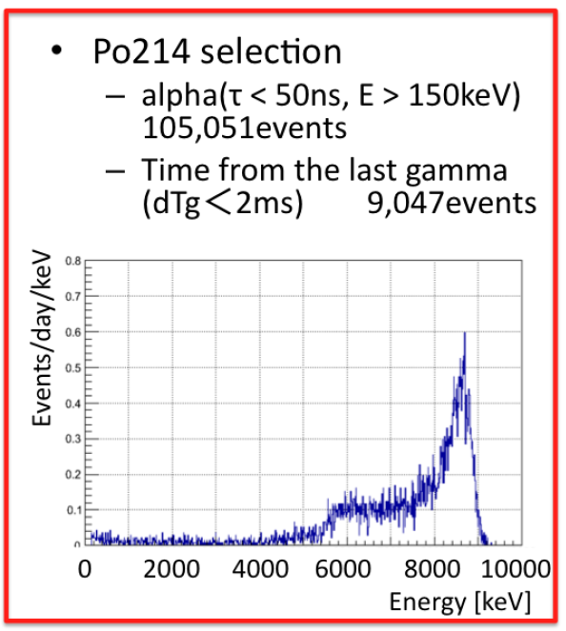
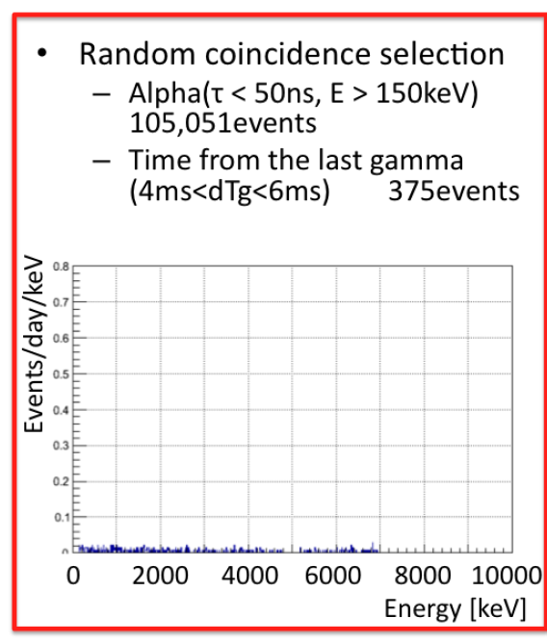
Selection of Po214 events
for estimation of the quantity
Decay rate of the pure Po214 is
RPo214 = 7.33 ± 0.01(stat.) × 10⁻³Bq

Slide 17
Comparison between data and MC
Rn222
Po218
Events/day/keV
Po214
Events/day/keV
Data (pure Po214) 7.33mBq
MC (Po214) 7.33mBq
Data (All alpha - Po214)
MC (Rn222+Po218) 7.33×2 mBq
Energy [keV]
Energy [keV]
Data and MC is similar spectrum.
Data and MC is similar spectrum.
MC is less than data.

Slide 18
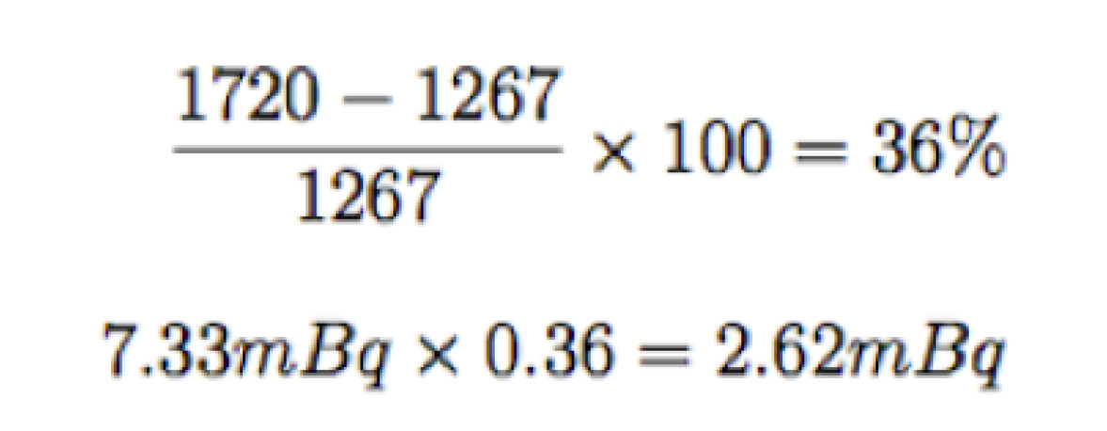
Re-evaluation of the amount of the uranium chain
Here I assume Rn222, Po218 and Po214 com into secular equilibrium, I treat the discrepancy as a systematic error.
Data 1720events/day(>4400keV)
MC 1267events/day(>4400keV)
Then each decay rate is,

Slide 19
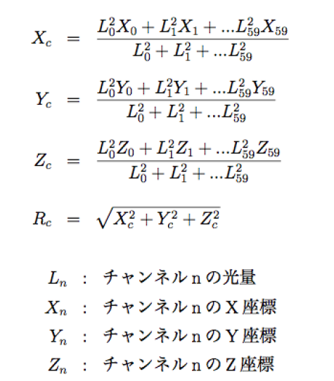
Light center is …
Equations
The way to identify the position of the events using 642 PMT’s light information.
Where ?
?
Light quantity of channel n
X-coordinate of channel n
Y-coordinate of channel n
?
Z-coordinate of channel n
XMASS detector

Slide 20
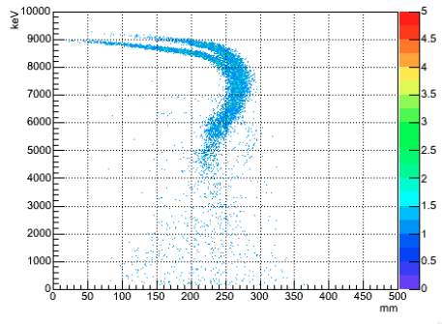
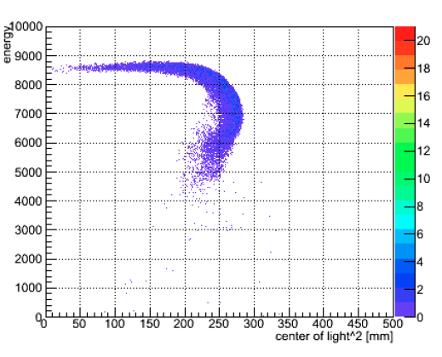
Light center distribution of Po214 events
Energy (keV)
data
XMASS detector
①
②
9047
events
③
③
②
Correspond to the surface of the detector
①
MC
Light center (mm)
This curve is due to PMT saturation.
23848
events
Here for next analysis,
We get a conversion factor for estimateion of the energy of the surface events.
7.7(MeV) ÷ (6.0 ± 0.5(MeV)) = 1.28 ± 0.11
(Po214)
(Data)
(Due to visual estimation of the energy, I set the error larger)
Notes:
サチュレーションの効果をわかりやすく説明。
赤丸の部分が検出器内側表面に対応するという結論にする。
※できれば確証となる資料をBack upスライドに用意しておきたい。

Slide 21
A peak observed at “4MeV”
→ To check the position of the events in the detector, I made the light center distribution of all alphas.
Newly found peak by this analysis!

Slide 22
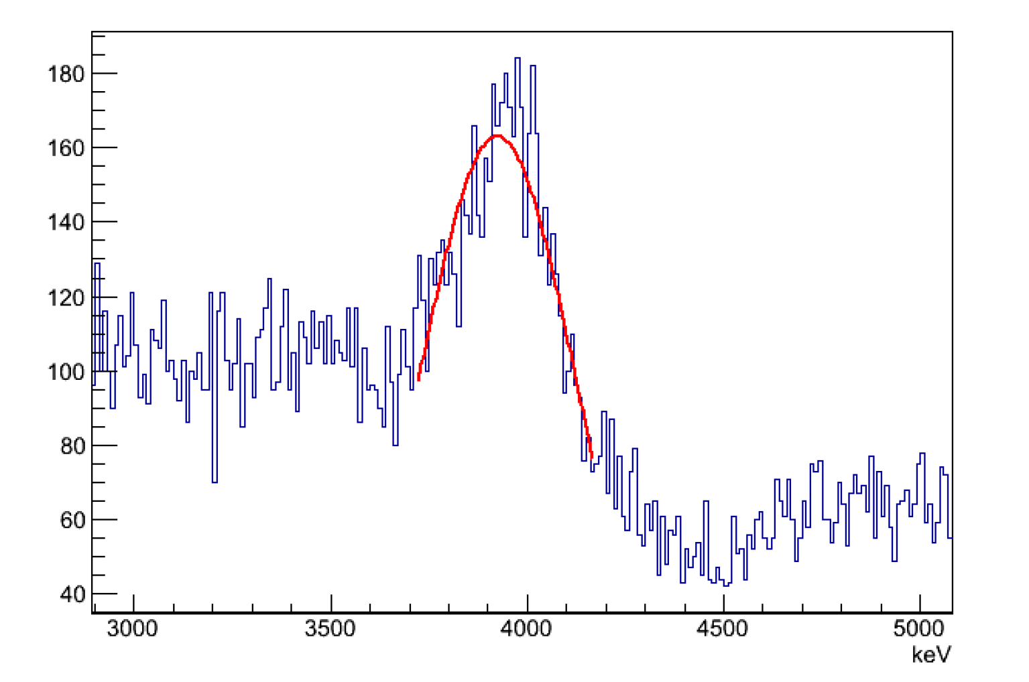
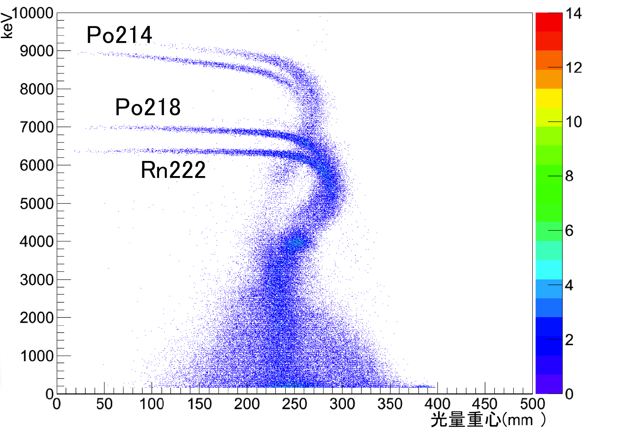
All alphas light center distribution and peak of the “4MeV”
data
Correspond to the surface of the detector
E_{Mean} = 3.92 ± 0.01(stat.)MeV
(3.92 ± 0.01)MeV × (1.28 ± 0.11)
= 5.02 ± 0.44MeV
(Scale factor)
• Alpha like
• Occur around the surface of the detector
• E = 5.02 ± 0.44 MeV
Pb210 of the uranium chain downstream may be contained within the surface of the detector!

Slide 23
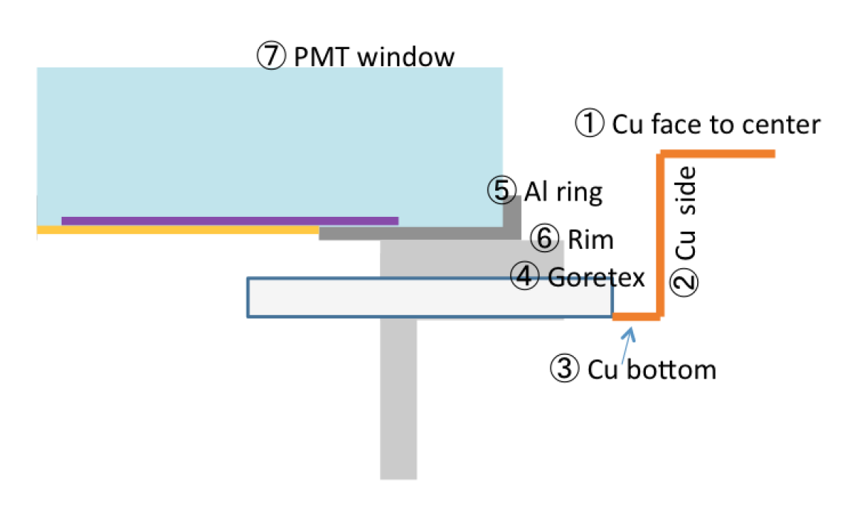
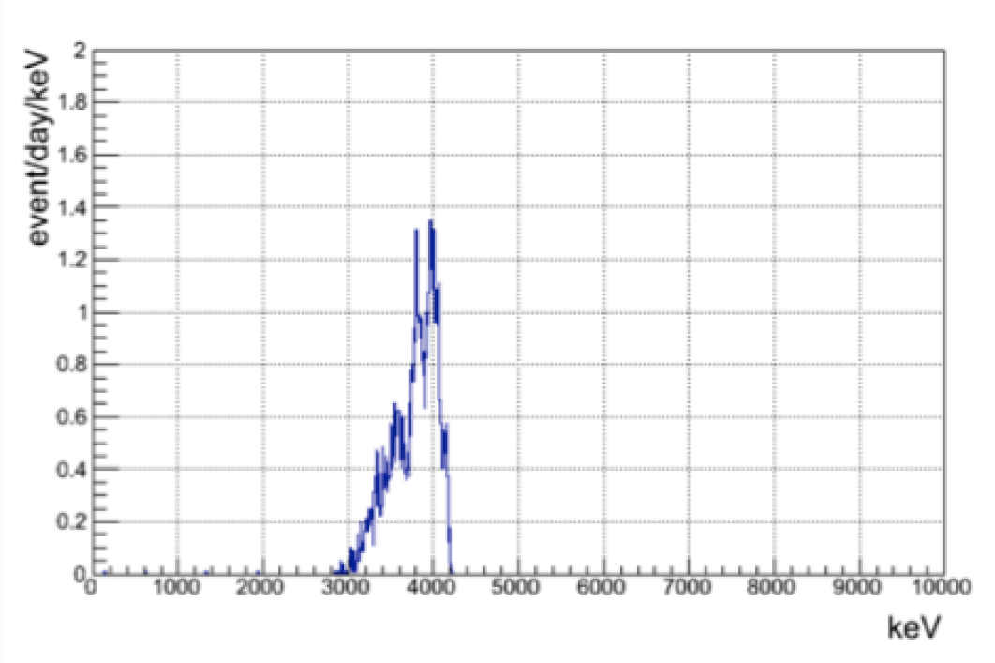
What is causing this alpha background??
Surface materials
① Cu (face to center) ?
② Cu (Side) ?
③ Cu (Bottom) ?
④ Goretex ?
⑤ PMT aluminum ?
⑥ PMT rim ?
⑦ PMT window ?
MC
This make “4MeV” peak
From this result,
I made alpha events using MC at,
Cu surface
Uranium in PMT aluminum
(1.8Bq fixed from other analysis)
？Bq
&
Goretex surface
(existence are suggested from the other analysis)

Slide 24
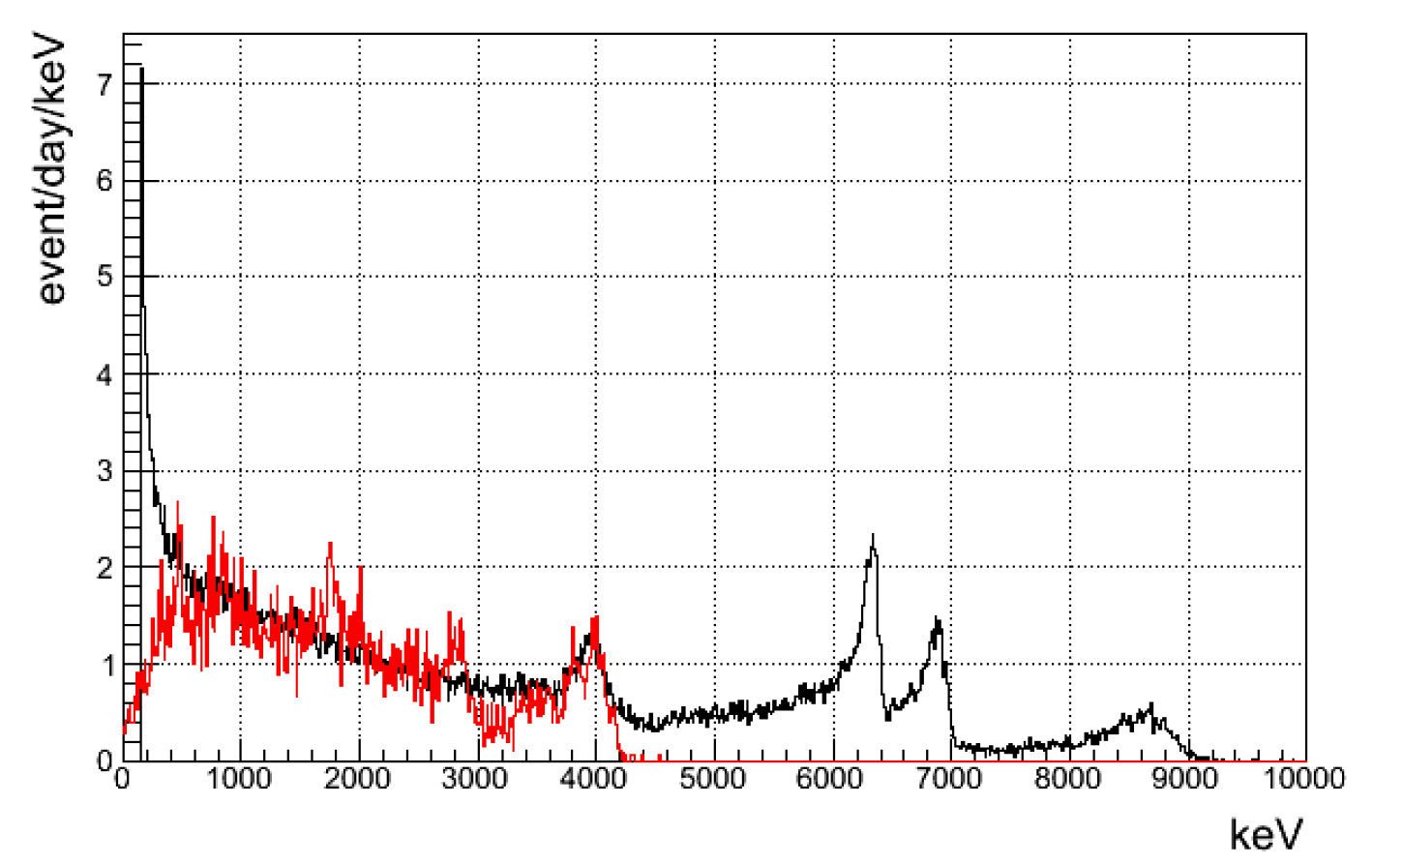
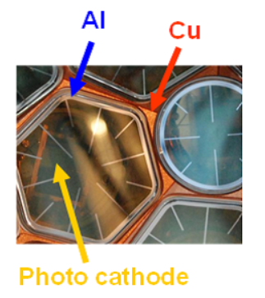
We are planning to implement electrostatic polishing on Cu to remove Rn daughters and quality control against Rn to prevent it being mixed into again.
DATA : All alpha spectrum
MC : Uranium alpha(1.8Bq) + Pb210 alpha(0.025Bq)
From the best fit between data and MC,
I got this value.
Cu surface Pb210
0.025±0.004Bq
Goretex surface Pb210

Slide 25
Summary
We can discriminate alpha like events and gamma like events using 50ns time constant criteria for over 150keV events.
There are about 88.3mcps alphas background in total.
Of them, as for the high energy part Rn222,Po218,Po214 in radon chain are dominant.
If we assume secular equilibrium, 7.33±0.01(stat.)±2.62(sys.)mBq
We can see a peak at 4MeV in the energy spectrum.
I succeed to identify the cause as Pb210 attached to the surface of the anoxic copper used as a PMT holder.
From comparison between data and MC, total amount of the surface Pb210 was estimated at 25±4mBq.
Now, we are already carrying out our refurbishment works.
Electrostatic polishing on Cu to remove Rn daughters
quality control against Rn.

