Slide 1
Measurement of Kr background in the XMASS experiment
ICRR
master’s course in physics
Keisuke Hieda

Slide 2
Contents
1.Introduction
2.Measurement of Kr in Xe
by GC and APIMS
3.85Kr event search using
Flash ADC data

Slide 3
1.Introduction

Slide 4
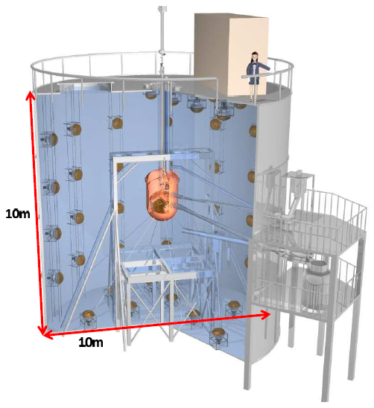
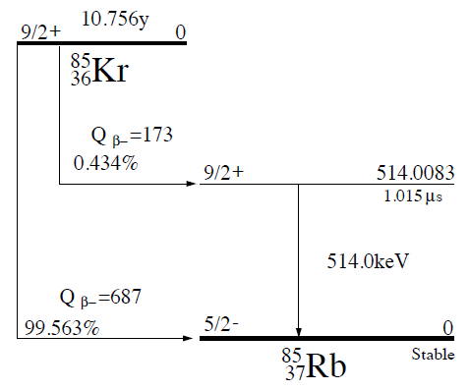
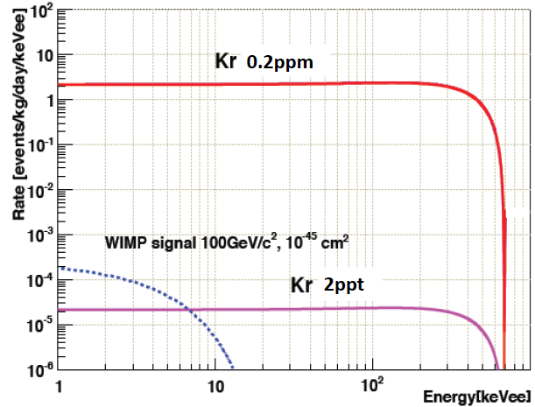
Introduction
・XMASS experiment started on 2010 for direct
dark matter search.
・The detector is installed in Kamioka mine and
filled with liquid Xe.
・Xe originally contains Kr and 85Kr beta decay is
serious background in XMASS experiment.
・Kr concentration in Xe should be below 2ppt to
detect dark matter (WIMP) signal.
Long life time

Slide 5
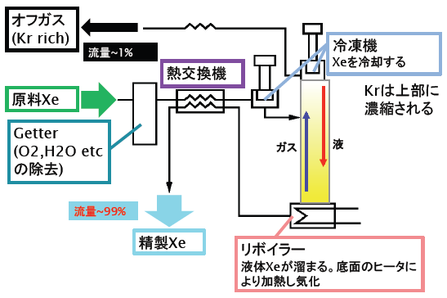
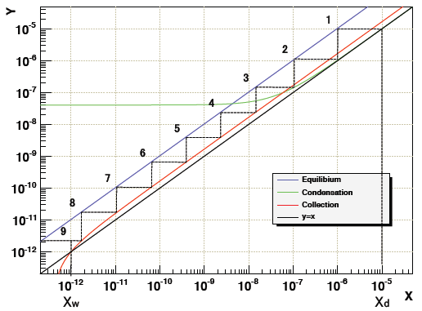
Introduction (Kr Removal)
・we removed Kr from Xe by distillation.
Xe boiling point | Kr boiling point
165[K] | 120[K]
・The structure and performance of XMASS distillation system
- Xe circulates in distillation tower and pure Xe is collected at
the bottom.
- We had to reduce Kr to 5-order smaller amount by distillation
because original Xe includes 0.3 ppm Kr.
Xd: Kr in off gas
Xw: Kr in pure Xe
Kr in gas Xe
distillation tower
Kr in liquid Xe

Slide 6
2.Measurement of Kr in Xe
by GC and APIMS

Slide 7
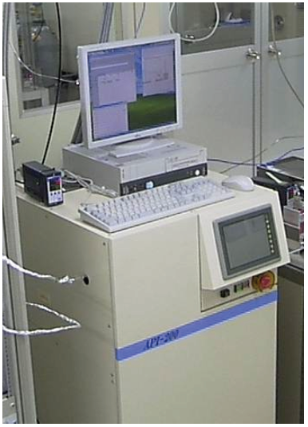
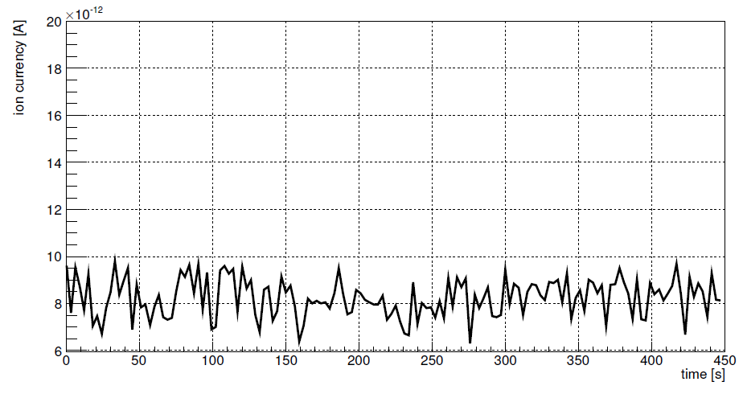
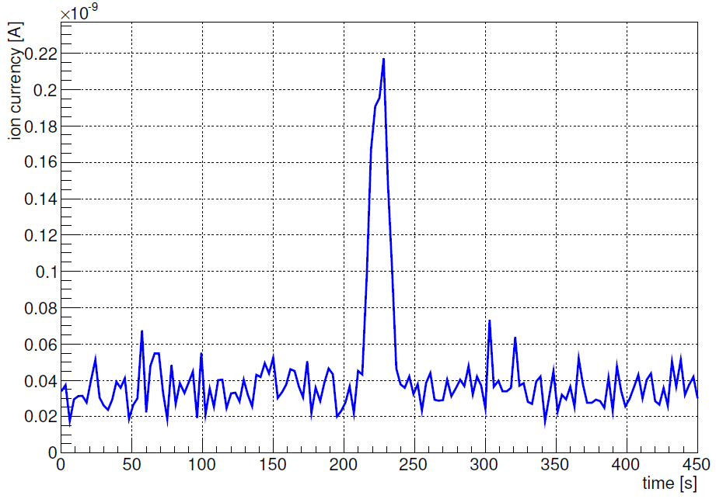
Atmospheric Pressure Ionization Mass Spectrometer
・APIMS is filled with Ar and sample is ionized
through interaction with Ar (Charge exchange
reaction) if ionization energy of sample is lower
than that of Ar.
${Ar}^{+}+X →Ar+X^{+}$
・This reaction frequently occurs in APIMS
because mean free path gets shorter in
atmospheric pressure.
measurement of
He gas including 200ppt Kr
measurement of pure He gas
Kr peak area is
proportional to
Kr concentration.

Slide 8
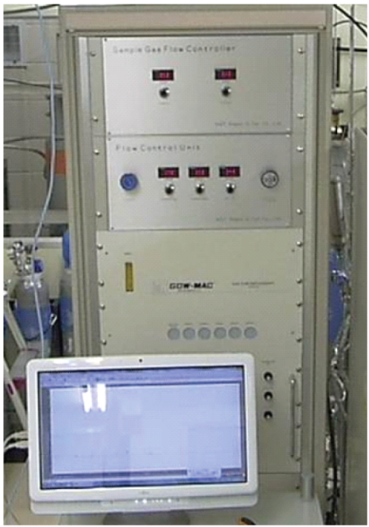
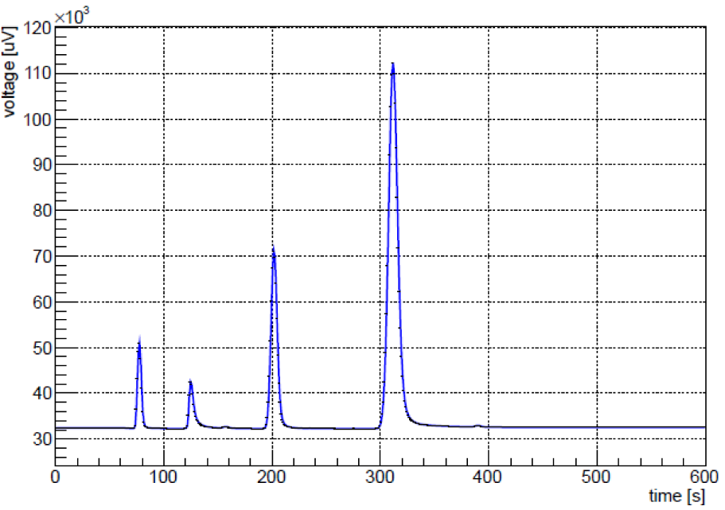
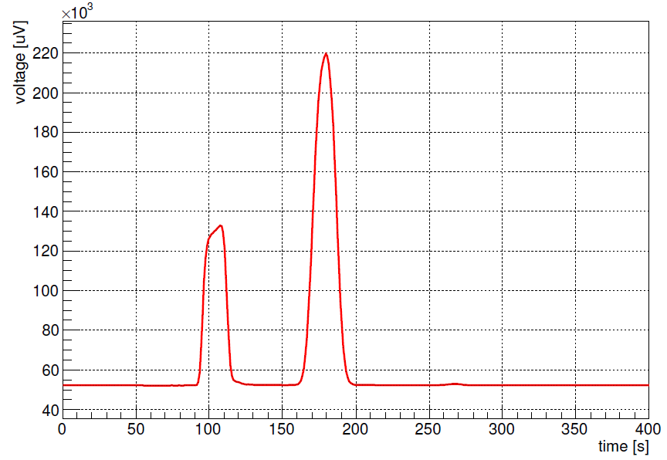
Gas Chromatography
・You can temporally separate components in Xe sample
by Gas Chromatography because the strength of
interaction with material in GC varies from component
to component in Xe sample.
impurity
Sensitivity (ppb)
CH4
Kr
Kr is observed between
150s and 210s.
CO2
N2+O2
H2
N2

Slide 9
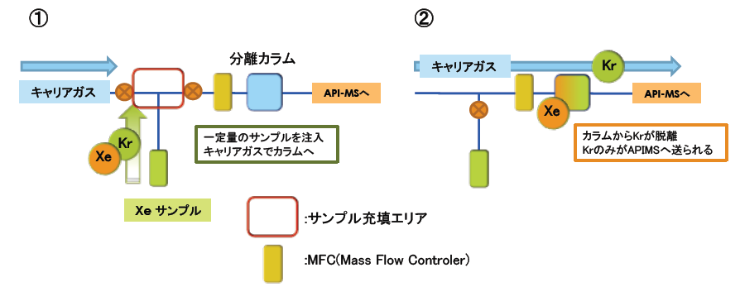
The method of Kr measurement
・Gas Chromatography
The sensitivity for Kr measurement is only 1ppb.
・APIMS
Ionization energy of Xe is lower than that of Kr so that
Kr is not ionized.
Combined measurement system of Gas Chromatography and
APIMS enables you to measure Kr with much higher sensitivity.
①Firstly Xe sample is introduced to Gas Chromatography and
Kr is separated from Xe.
②Only separated Kr is carried to APIMS and measured by APIMS.
Time region where
sample gas is carried
to APIMS
Kr

Slide 10
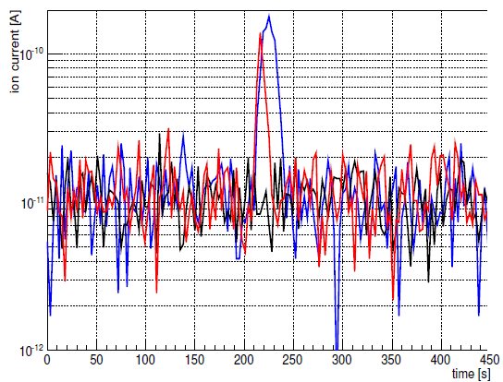
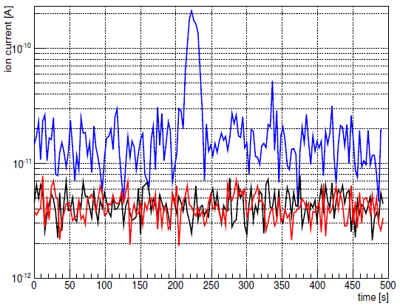
Measurement of Kr in Xe
1.pure He gas（background measurement）
2.Kr calibration gas measurement
3.Xe sample measurement
gas-phase Xe
APIMS
liquid-phase Xe
Kr peak is observed in Xe sample.
Kr peak is “not” observed in Xe
sample.

Slide 11
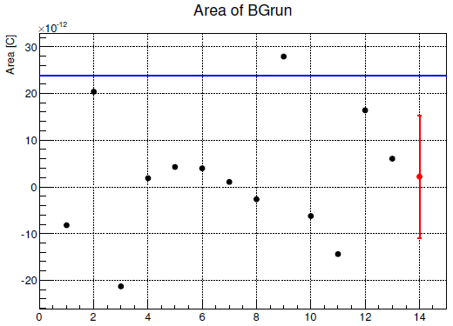
Calculation of Kr in Xe
・gas-phase Xe
$\left(Kr in Xe\right)$
$= \frac{Kr peak area in Xe sample}{Kr peak area in calibration gas}×(Kr in calibaration gas)$
・liquid-phase Xe
Xe sample measurement is comparable with background measurement.
Kr in Xe sample is below APIMS’s sensitivity for Kr.
The sensitivity depends on the background
level. So I measured background (pure He gas)
for many times and calculated the area.
Assuming that distribution of background
area follows normal distribution , I calculated
the upper limit of Kr in Xe at 90%C.L.
$\left(Kr in Xe\right)= \frac{background area@90\%C.L}{Kr peak area in calibration gas}$
$×(Kr in calibaration gas)$
90%C.L.
mean

Slide 12
Result
date | Sample point | Kr in calibration gas [ppb] | Kr in Xe [ppt]
2011/08/27 | liquid phase | 0.23±0.05 | < 2.3 (90%C.L.)
2011/09/02 | liquid phase | 0.23±0.05 | < 3.7 (90%C.L.)
2011/11/15 | gas phase | 0.16±0.05 | 77±22
2011/11/22 | gas phase | 0.16±0.05 | 55±16
2012/01/24 | liquid phase | 0.07±0.02 | < 1.2 (90%C.L.)
2012/01/26 | liquid phase | 0.07±0.02 | < 4.2 (90%C.L.)
・Kr in liquid-phase Xe is almost consistent with our goal (2ppt).
・Kr in gas-phase Xe is about one-order bigger than
Kr in liquid-phase Xe.
Temperature of XMASS detector is kept around Xe
boiling point ( about 170K) so that Kr easily evaporates
because Kr boiling point (120K) is lower than Xe boiling
point.

Slide 13
3.85Kr event search using
Flash ADC data

Slide 14
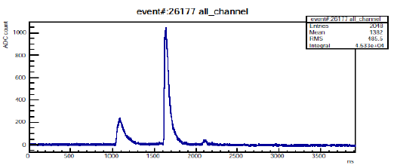
Flash ADC
・XMASS uses 642 PMTs. The sum of signal from 10 or 11 PMTs is
input into each Flash ADC channel. ( Flash ADC has 64 channels .)
・The figure below shows an example of FADC waveform.
Y-axis is ADC count obtained by transforming voltage into digital
signal. X-axis is time[ns].
8ch/board
・If you integrate this waveform , you can obtain event’s energy.
・The live time of FADC data for this analysis is 55.96 days.

Slide 15
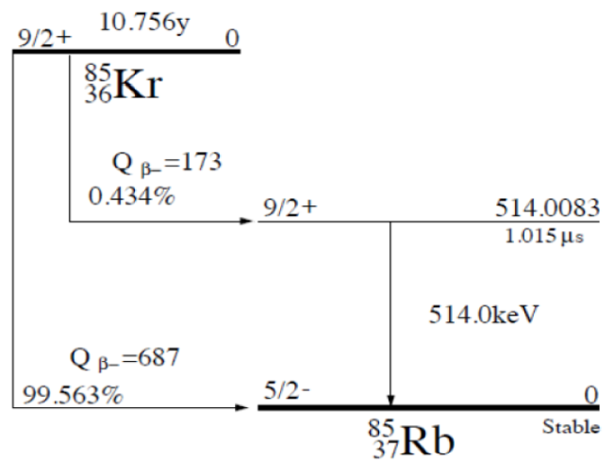
85Kr event search
・I tried to find β and γ coincidence event shown
in the right figure.
・Firstly I searched for FADC events which have
more than 2 peaks. And I named the first peak
“β-like peak” and the highest peak (except for
β-like peak) “γ-like peak”.
・Secondly I selected 85Kr event candidate based on
criteria shown below.
85Kr event candidate : 7.0±2.6(sta)±$\begin{matrix}5.8 \\ 5.1\end{matrix}$(Sys)
・The detail about α event cut was mentioned in takachio’s talk.
・Systematic error comes from uncertainty of energy reconstruction , α cut
criteria and so on.
β
life time
γ
cut criteria | efficiency
β-like peak energy < 260keV | 100%
α event cut | 95%
440keV < γ-like peak energy < 580keV | 76%
time difference between β-like peak and γ-like peak(dT) > 300ns | 75%
Total efficiency : 54%

Slide 16
background event
・If two independent events whose energies are comparable with
85Kr β and γ accidentally happen in short time , This event can be
background.
・I applied the following cut to all peaks in FADC dataset to estimate
the number of background events.
(background events)
=1.08[Hz]×0.17[Hz]×3700[ns]×86400[s/day]×55.96[day]
= 3.4event
・Considering statistic and systematic error in the same way as 85Kr
event candidate , I obtained the number below as background event.
criteria | event rate [Hz]
β-like peak energy < 260 kev && non-α event | 1.08
440keV<γ-like peak energy < 580 kev && non-α event | 0.17
FADC time window
background events : 3.4±1.8(sta)±$\begin{matrix}0.6 \\ 0.1\end{matrix}$(Sys)

Slide 17
Result
・I subtracted background event from 85Kr event candidate and
considered the remaining events as 85Kr events.
・I calculated the upper limit of Kr in Xe at 90%C.L.
(85Kr event candidate) – (background event)
= event
< 14.4event (90%C.L.) 26.6event (90%C.L.)
Efficiency:54%
XMASS uses 830kg Xe. Assuming that Kr in Xe is 2ppt , the number of
observed 85Kr event (for 55.96days) should be (2.8±0.9) events.
(Kr in Xe) < $\frac{26.6 evnt}{1.9 event}×$2ppt = 28.0ppt (90%C.L.)
・This result is consistent with the result of the other Kr measurement
・This upper limit is one-order higher than the other one , so I need
much more statistics and reduction of systematic error.

Slide 18
Conclusion & Summary
・XMASS experiment works on direct dark matter search using
liquid Xe.
・Xe originally includes Kr and 85Kr beta decay is serious background
in direct dark matter search.
・We removed Kr from Xe by distillation.
・I measured Kr in Xe with combined measurement system of GC and
APIMS and found Kr is reduced to about 2ppt as we expected.
・I searched for 85Kr decay based on β and γ coincidence event in
FADC data and showed the upper limit of Kr in Xe is
28.0 ppt (90%C.L.). This result is consistent with Kr measurement by
APIMS and GC.

