Slide 1
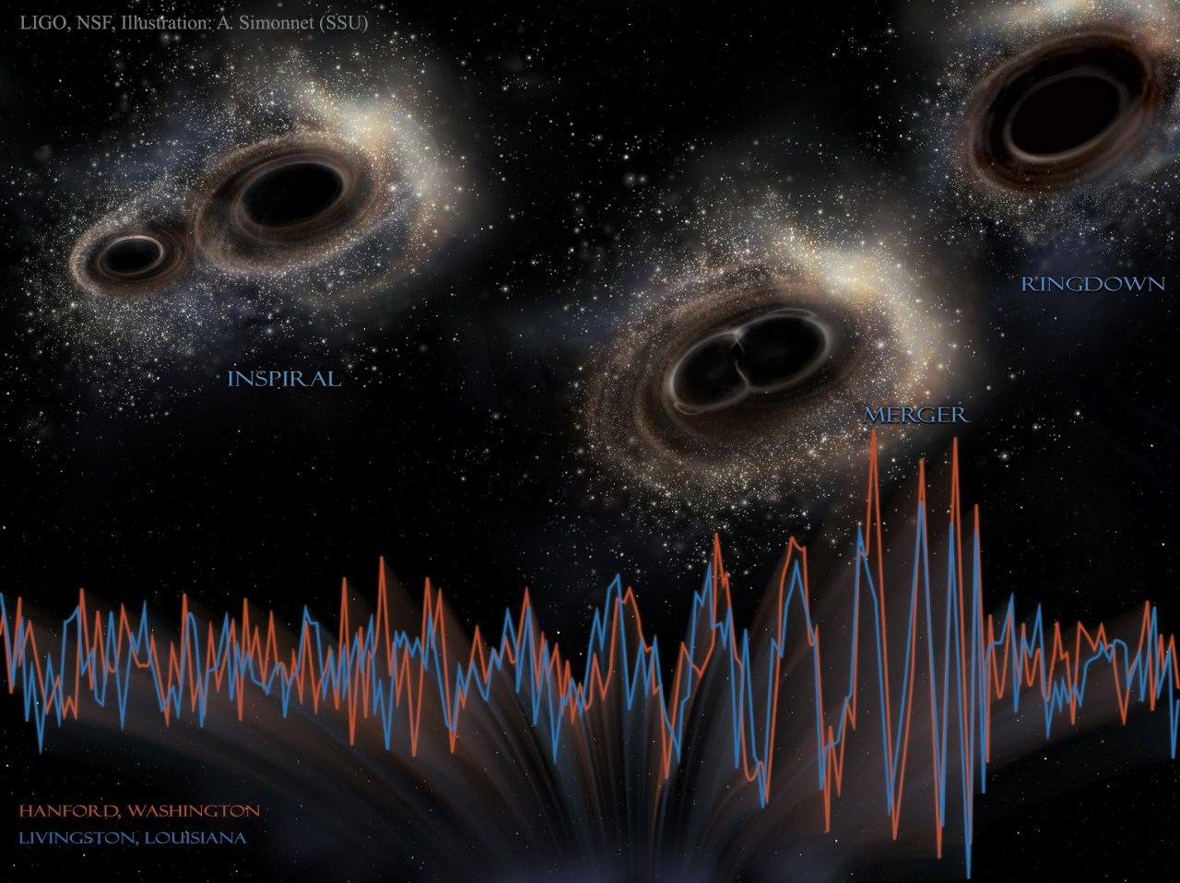
Remnants of first stars for gravitational wave sources
Tomoya Kinugawa
The University of Tokyo
collaborators: T. Nakamura, K. Inayoshi, K. Hotokezaka, D. Nakauchi
A. Miyamoto, N. Kanda, A. Tanikawa, T. Yoshida

Slide 2



Self introduction
Hometown: Yamanashi
Ph.D : Kyoto University TAP group.
ICRR (ICRR PostDoc. fellow)
→U. Tokyo Umeda lab.(JSPS SPDfellow)
→ICRR(Assistant Prof.)
My hobby: Kobudo, boardgame, etc
My work : GW from first star remnants, binary evolution

Slide 3
Introduction

Slide 4
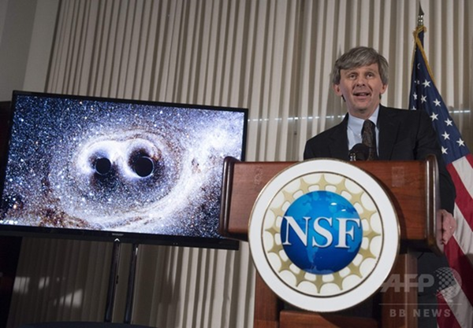
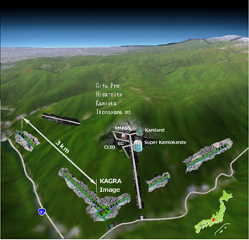
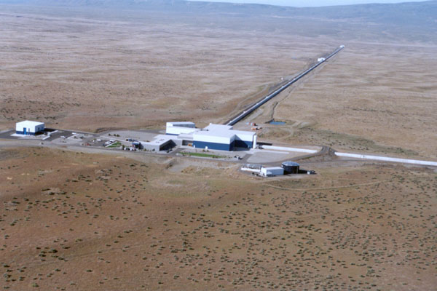
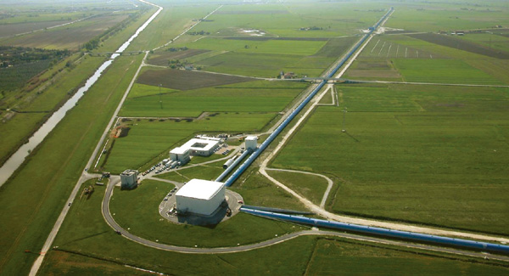
The beginning of Gravitational wave astronomy
Gravitational wave detectors
KAGRA Advanced LIGO Advanced VIRGO
©VIRGO
©KAGRA
©LIGO
Notes:
Nowadays, there are the gravitational wave detectors such as KAGRA adv. LIGO, VIRAGO.
KAGRA is the gravitational wave detector of Japan.
Adv. LIGO did observation run from last September to January.
They have detected the gravitational wave.
He said that “We have detected GW signal from Binary BH. We did it!”

Slide 5
Notes:
This is the signal of first gravitational wave.
aLIGO detected this signal on 14th September 2015.
Thus, the name of this signal is GW150914.

Slide 6
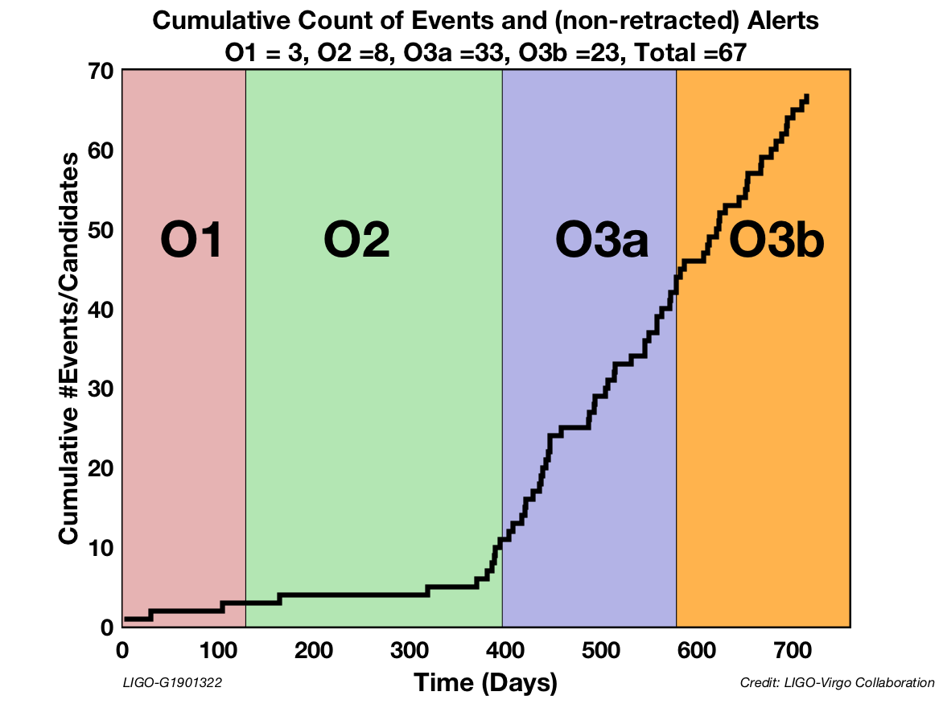
Until April 2020
From Dr. Ben Farr’s slide
Notes:
LIGO did three observating runs O1, O2, O3.
O3 separe te two reriod. The former period is O3a, later period is O3b
O3b suspended at 27th march.

Slide 7
Masses of GW events in O1+O2
GW events show that there are many massive BHs (≳30 Msun).
7/10 BBHs are massive BBHs in O1 and O2
On the other hand, the typical mass of BHs in X-ray binaries is ~10 Msun.
The origin of massive BBHs is mystery
The LIGO scientific collaboration 2018

Slide 8
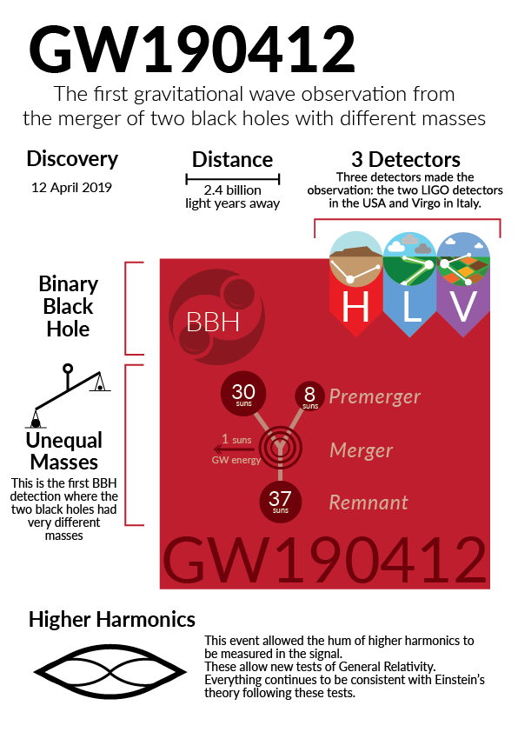
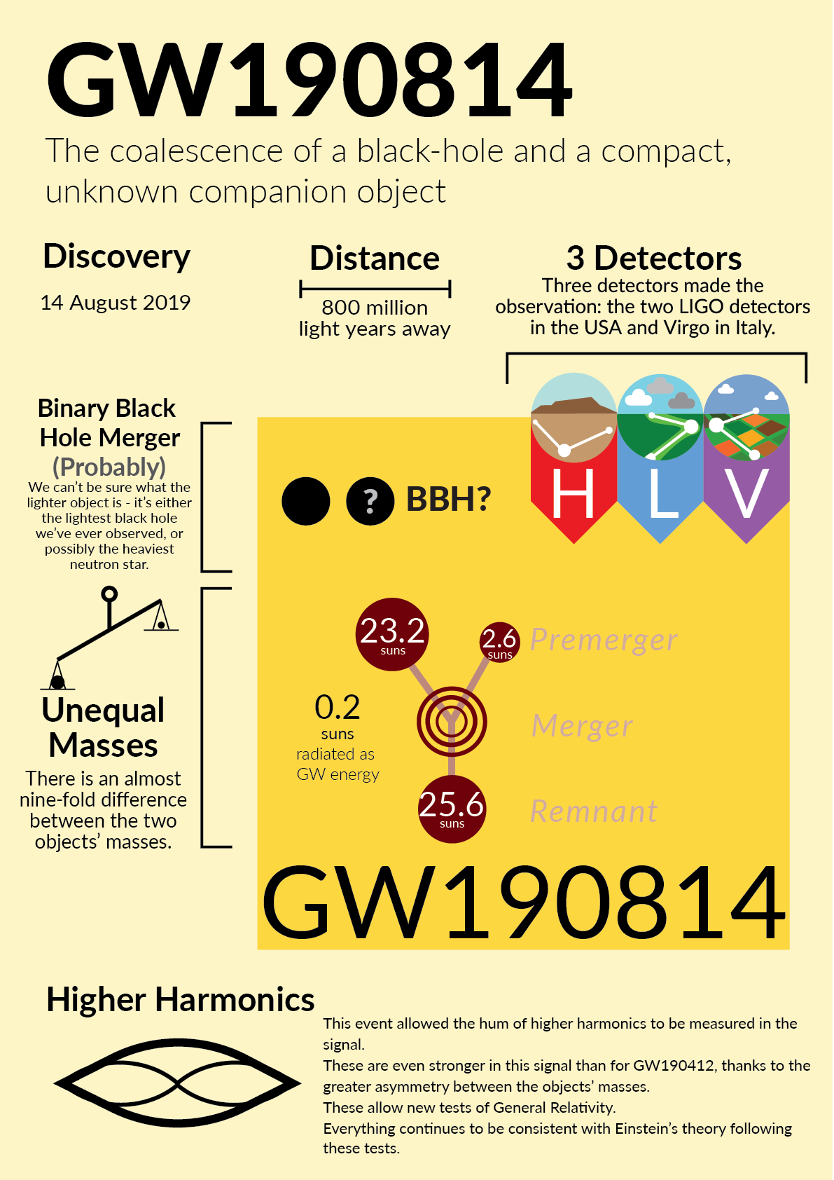
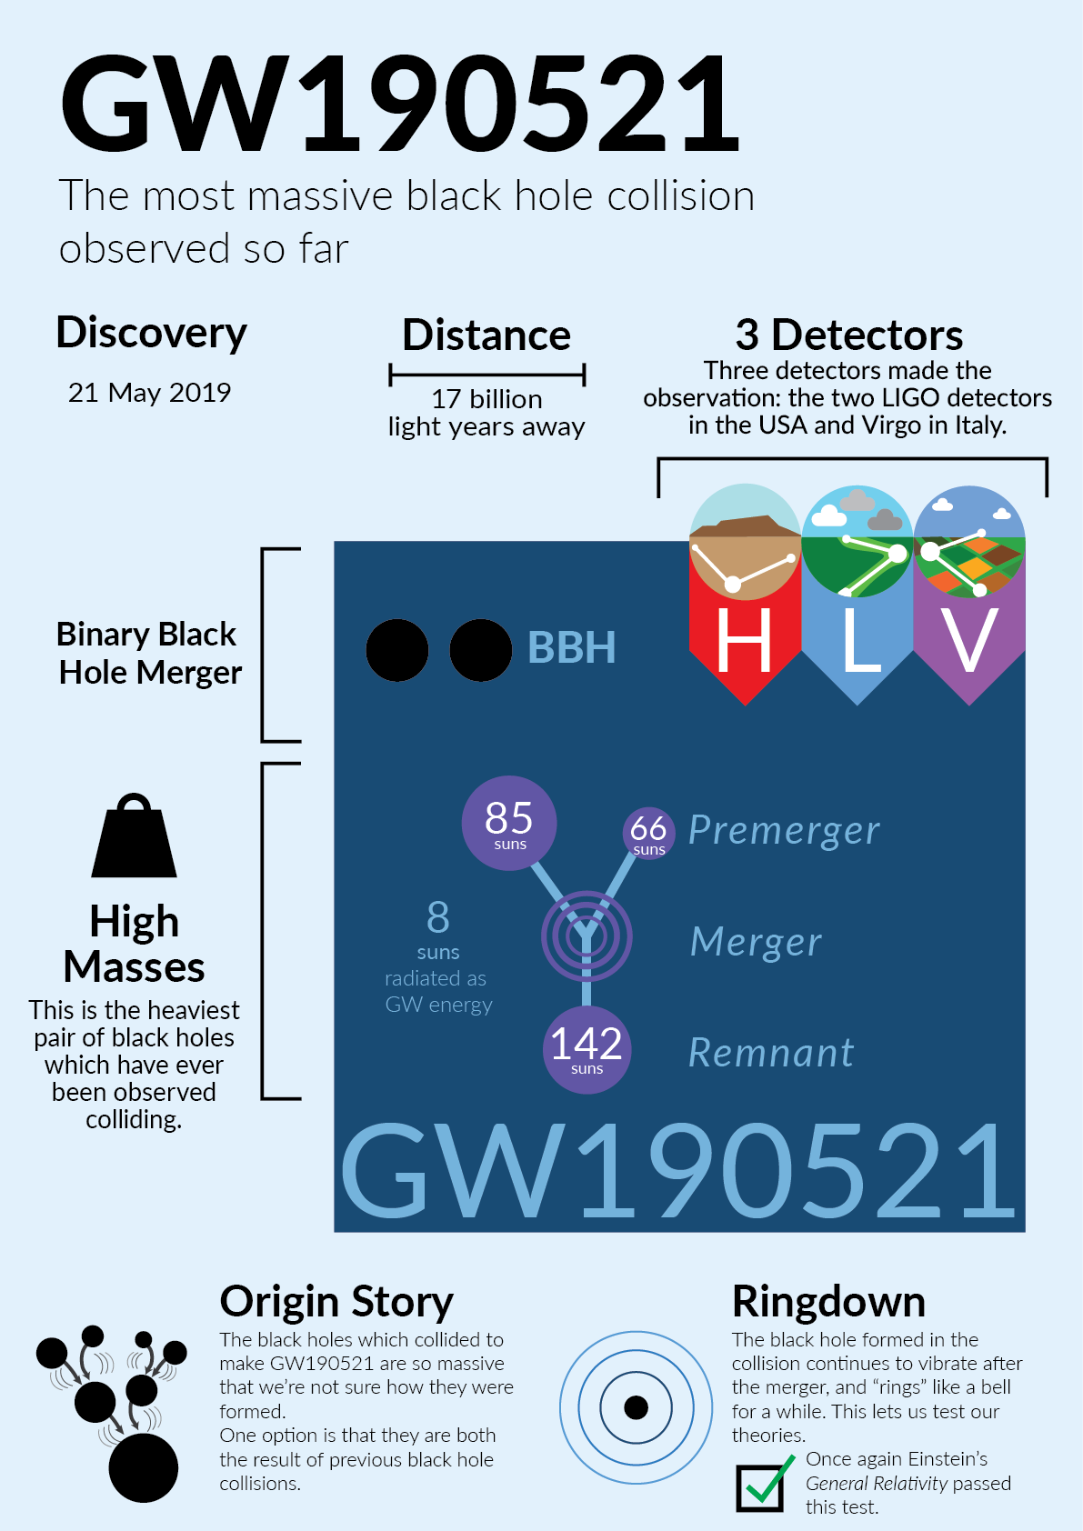
Extraordinary BH events in O3 run

Slide 9
Topics
Pop III stellar remnants as the origin of massive BH+BH (30Msun+30Msun)
1. Our prediction before GW150914
2. Recent studies of Pop III scenario
Formation pass of extraordinary BH event from Pop III (GW190521)

Slide 10
Masses of GW events in O1+O2
GW events show that there are many massive BHs (≳30 Msun).
7/10 BBHs are massive BBHs in O1 and O2
On the other hand, the typical mass of BHs in X-ray binaries is ~10 Msun.
The origin of massive BBHs is mystery
The LIGO scientific collaboration 2018

Slide 11
Origin of massive BBHs
7/10 GW BBHs in O1 and O2 are massive BBHs (30Msun+30Msun)
In order to explain the origin of such BBHs
Many theories exist such as
1)Pop II BBH
2)Pop III BBH
3)Primordial Binary BH (PBBH)
4)N body origin from Globular Cluster
…………………….
No metal field binaries
Notes:
In order to explain the origin of GW150914, many theories exist such as these brbrbrbr.
Especially, the Low metal field binary origin has been invoked

Slide 12
Pop III binary population synthesis
We simulate 10⁶ Pop III-binary evolutions and estimate how many binaries become compact binary which merges within Hubble time.
×84 models (Kinugawa et al.2014, 2016)
Initial stellar parameters are decided by Monte Carlo method with initial distribution functions
Initial parameter (M1,M2,a,e) distribution in our standard model
M1 : Flat (10 M<M<100 M)
q=M2/M1 : P(q)=const. (0<q<1)
a : P(a)∝1/a (a_{min}<a<10⁶R)
e : P(e)∝e (0<e<1)
de Souza SFR
The same distribution functions adopted for Pop I population synthesis

Slide 13
Total mass distribution of BBH which merge within the Hubble time
Typical total mass
M～60 M
(30 M +30 M)
TK et al. 2014,2016
IMF:Flat
(10M<M<140M)
We predicted !
Z=0 (Pop III)
Z=1/200 Zsun
e.g. Pop I, Pop II
(Z=0.02,0.001,0.0001)
IMF:Salpeter
(1Msun<M<140Msun)
Typical mass ～10 M
Z=1/20 Zsun
Z=Zsun
Total mass [Msun]
Notes:
This is the result of binary population synthesis.
We calculate the 10 to 6 binaries for each metallicity.
This figure is the total mass distribution of BH-BH which merge within the Hubble time per 10 to 6th binary.
Black line is the first star binary.
The typical total mass of Pop III BBH is 60 solarmass
It mean s that in the case of Pop III star the efficiency of massive BBH formation is very high.
We had shown this features at 2014, before GW150914
In this talk , I will talk about why Pop III become 30 Msun BBH and the event rate.

Slide 14
Wind mass loss & IMF
If the progenitor of BH is Pop I (=Solar metal stars)
Typical mass is small (IMF∝M^{-2.35}, 0.1Msun<M<100Msun)
Stars lose a lot of mass due to the strong stellar wind
The orbit become wide due to stellar wind mass loss
Belczynski et al. 2010
Notes:
Why we consider low metal.
If the progenitor of BBH is pop I,
They lose a lot of mass due to wind mass loss.
Due to strong wind, They cannot become 30 Msun BH.
Furthermore, orbit become wide due to wind mass loss

Slide 15
Wind mass loss & IMF
New
If the progenitor is low metal,
Pop II (Metal<0.1SolarMetal)
Typical mass is same as Pop I
But, week wind mass loss
Pop III (No metal)
Pop III stars are the first stars after the Big Bang.
Typical mass is more massive than Pop I, II
MpopIII~10-100Msun
No wind mass loss due to no metal.
Old
Minitial: 8Msun<M<150Msun
Single stellar evolution
with 2 stellar wind models.
(Belczynski et al.2010,
Abbot et al.2016)
Notes:
If the progenitor is low metal they possibly become massive BH.
In the case of Pop II, they typical mass is same as Pop I, but the wind mass loss weaker than that of Pop I.
So if Pop II star born as massive star, they possibly become massive BH.
Furthermore, Pop III stars which are the first stars after the big bang are born as massive star and no wind mass loss due to no metal.
Thus, Pop III star are easier to be massive compact object

Slide 16
Binary interaction changes progenitor mass
Mass transfer
Common envelope
Common envelope
Red Giants tend to become CE
Mass transfer
Close binary or merge
Notes:
What do determine the BBH mass?
It is not only wind massloss, but also binary interactions such as mass transfer and the common envelope phase.
Mass transfer is this.
The donor star become big and the matter of donor are captured by the gravitational force od receiver star.
So the mass are transffered from donor to receiver.
Common envelope is unstable mass transfer.
Primary star becomes giant and primary radius becomes large.
Secondary star plunges in primary envelope.
The friction occurs between secondary and primary envelope and transfers angular momentum and energy from orbit to envelope. Due to orbital energy transfer separation decreases and envelope expands and will be expelled.
Binary becomes close binary or merges during CE.

Slide 17
Z=1/20Z(=Pop II)
Z=Z(=Pop I)
All star evolve via a red giant
Almost all binaries evolve via a similar evolution pass (common envelope)
Notes:
On the other hand, in the case of Pop I and Pop II cases, all stars evolve via a red giant, so almost all binaries evolve via the similar evolution pass.

Slide 18
Why Pop III binaries become 30Msun BH-BH
M>50Msun red giant
➝Mass transfer is unstable
➝common envelope
➝1/3~1/2 of initial mass
(~25-30Msun)
M<50Msun blue giant
➝Mass transfer is stable
➝mass loss is not so effective
➝2/3~1 of initial mass (25-30Msun)
Large radius
Small radius
Marigo et al. 2001
Notes:
Why do Pop III binaries become 30 Msun Binary black holes?
This is HR diagram of Pop III.
The pop III whose mass is larger than 50 solarmass evolve as the red giant.
The mass transfer of red giant is generally unstable and it becomes the common envelope phase.
Thus, they lose the envelope and they become light.
Therefore, the BH mass become about 30 solar mass.
On the other hand, the Pop III whose mass is less than 50 solar mass evolve as a blue giant.
The mass transfer is stable and mass loss is not so effective.
Thus, they become about 30 solar mass BH.
So, Due to these two evolution path, the peak of BHBH mass is about 30 solar mass.
It does not depend on the IMF and binary parameters.
It only depends on the Pop III stellar evolution.

Slide 19
Total mass distribution of BBH which merge within the Hubble time
Z=0
This shape reflects the influence of Pop III stellar evolution
Z=1/200Zsun
These shapes have the influence of IMF
and the influence of stellar wind mass loss
Z=1/20Zsun
Z=Zsun
Total mass [Msun]
Notes:
Thus, the peak mass of Pop III reflects the influence of Pop III stellar evolution.
On the other hand, the shape of Pop II BH-BH mass distribution reflect the influence of IMF due to similar evolution pass.
Pop I has the influence of stellar wind due to strong wind.

Slide 20
Transition from Pop III to Pop II
Maximum radius of 30Msun (Tanikawa, Yoshida, TK et al. in prep.)

Slide 22
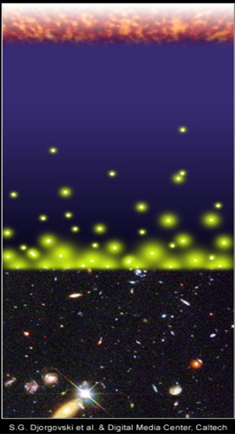
Pop III BBH remnants for gravitational wave
Big Bang
Pop III stars were born and died
at z~10 (~13.3Gyrs ago).
The typical merger time of compact binaries ~10⁸⁻¹⁰yr
dN/dt∝t⁻¹ (Kinugawa et al .214, Inayyoshi et al. 2017)
We might see Pop III BBH at the present day.
merger
merger
time
Djorgovski et al.&Degital Media Center
Notes:
Someone are wondering why we can see such old star which are born at the earlyuniverse.
Pop III stars were born and died at z~10.
However, the typical merger time of compact binaries due to gravitational radiation is too long.
Thus, We might see the gravitational wave from first stars.

Slide 23
Results in Kinugawa et al. 2014
The numbers of the compact binaries which merge within
Hubble time for 10⁶ binaries (Kinugawa et al. 2014,2016)
Our standard model
A lot of Pop III BH-BH binaries form and merge within Hubble time
Notes:
Next, I will show the detect rate of Pop III BH-BH.
In order to calculate that, first I show the fraction of merging BH-BH for Pop III.
We calculate the 10^6 Pop III binary.
The 10 % of Pop III binary become the BH-BH which merge within the Hubble time.

Slide 24
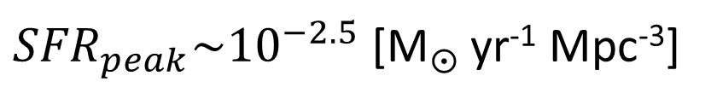
The star formation rate of Pop III
In order to calculate merger rate,
we need to know
・When were Pop III stars born?
・How many were Pop III stars born?
⇒Star formation rate
We adopt the Pop III SFR
by de Souza et al. 2011
Star formation rate [M yr⁻¹ Mpc⁻³]
${SFR}_{peak}\sim {10}^{−2.5}$ [M yr⁻¹ Mpc⁻³]
Redshift z
(de Souza et al. 2011)

Slide 25
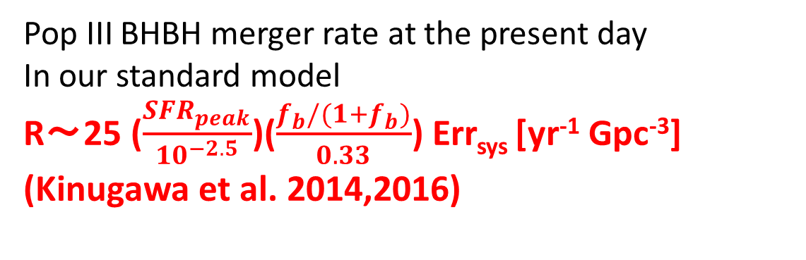
The Pop III BH-BH merger rate density
10⁻⁶
10⁻⁷
10⁻⁸
10⁻⁹
10⁻¹⁰
10⁻¹¹
10⁻¹²
10⁻¹³
10⁻¹⁴
IMF: Flat
Pop III BHBH merger rate at the present day
In our standard model
R～25 ($\frac{{SFR}_{peak}}{{10}^{−2.5}}$)($\frac{f_{b}/(1+f_{b})}{0.33}$) Err_{sys} [yr⁻¹ Gpc⁻³]
(Kinugawa et al. 2014,2016)
R(t) [yr⁻¹ Mpc⁻³]
Pop III star formation region
40 35 30 25 20 15 10 5 0
Redshift z

Slide 26
Detection range of KAGRA and Adv. LIGO
M_{BH}～30M SNR=8
Redshift z
SNR=8
For ringdown
Luminocity distance
～1.5 Gpc
Redshift z～0.28
SNR=8
For inspiral
Mass of one star [M]
©Kanda
Notes:
This figure is the detection range of KAGRA
The horizontal axis is the mass of one star.
The vertical axis is the red shift or luminosity distance of detection range.

Slide 27
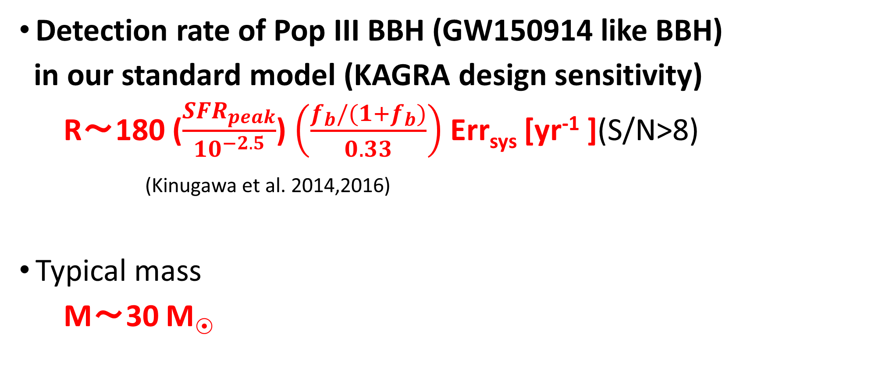
Detection rate of Pop III BH-BH
Detection rate of Pop III BBH (GW150914 like BBH)
in our standard model (KAGRA design sensitivity)
R～180 ($\frac{{SFR}_{peak}}{{10}^{−2.5}}$) $\left(\frac{f_{b}/(1+f_{b})}{0.33}\right)$ Err_{sys} [yr⁻¹ ](S/N>8)
(Kinugawa et al. 2014,2016)
Typical mass
M～30 M
Notes:
We also considered detection rate of Pop III BBH.
The detection rate of original design aLIGO is 180 per year.
This value depends on the SFR and the binary fraction of Pop III.
The typical mass of Pop III BBH is 30 solarmass, so we can see QNM of merged BBH
Therfore, we might detect the Pop III BBH by GW.
And we might check GR by Pop III BH QNM.
Furthermore, the mass distribution might distinguish Pop III from Pop I, Pop II.
If the chirp mass distribution can not distinguish Pop III due to small SFR or so, we can confirm Pop III BHBH by redshift dipendence.

Slide 28
Errsys (Example)
 | Errsys
Standard | (180 /yr)
Mass range: (10 M<M< 100 M or 140 M) | 1~3.4
IMF:Flat, M⁻¹, Salpeter | 0.42~1
IEF:f(e)∝e,const.,e^{-0.5} | 0.94~1
BH natal kick: σ_{V}=0,100,300 km/s | 0.2~1
CE:αλ=0.01,0.1,1,10 | 0.21~1
Mass transfer (mass loss fraction): β=0, 0.5, 1 | 0.67~1.3
The typical mass is not changed (~30 Msun).
Notes:
This table is the example of parameter dependence of Errsys.
We change the mass range, the initial distribution functions such as Initial mass function and initial eccentricity function.
And change the binary parameters such as SN natal kick velocity, common envelope parameters, and the parameter of the lose fraction of transferred stellar
Mass.
In our standard model choose red ones
At Each parameter range, Errsys change from 1 over several to a few.
In order to consider the lower boundary of Errsys,
We consider the worst model.
In the Worst model I choose the worst parameters in each parameter region, blue ones.
It is unlikely case
Errsys change from 0.046 to 4
On the other hand, the typical mass is not changed (~30 Msun)

Slide 29
Detection rate of Pop III BH-BH
Detection rate of Pop III BBH (GW150914 like BBH)
in our standard model (KAGRA design sensitivity)
R～180 ($\frac{{SFR}_{peak}}{{10}^{−2.5}}$) $\left(\frac{f_{b}/(1+f_{b})}{0.33}\right)$ Err_{sys} [yr⁻¹ ](S/N>8)
(Kinugawa et al. 2014,2016)
Typical mass
M～30 M
Notes:
We also considered detection rate of Pop III BBH.
The detection rate of original design aLIGO is 180 per year.
This value depends on the SFR and the binary fraction of Pop III.
The typical mass of Pop III BBH is 30 solarmass, so we can see QNM of merged BBH
Therfore, we might detect the Pop III BBH by GW.
And we might check GR by Pop III BH QNM.
Furthermore, the mass distribution might distinguish Pop III from Pop I, Pop II.
If the chirp mass distribution can not distinguish Pop III due to small SFR or so, we can confirm Pop III BHBH by redshift dipendence.

Slide 30

Pop III BBH?
ApJL Abbot. et al 2016
Notes:
30 Msun binary black holes have been already predicted by Pop III binary population synthesis.
Thus, LIGO paper said that “recently predicted BBH total masses agree astonishingly well with GW150914 and can have sufficiently long merger times to occur in the nearby universe (Kinugawa et al.2014)”

Slide 31
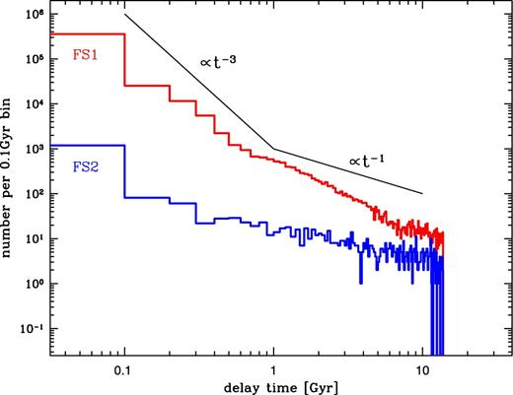
However....
After GW150914, there are 1 bad news and 1 objection for Pop III BBH scenario
1.Bad news
~1/3 decreasing expected Pop III SFR
Because of constraints by Planck τe
(Visbal et al.2015, Hartwig et al.2016, Inayoshi et al.2016)
2.Objection
Chris Belczynski tried to calculate
Pop III BBH merger rate.
In his calculation, almost all Pop III
BBHs merge at the early universe
Belczynski et al. 2017
Notes:
This is lower than previous measurements from WMAP(Komatsu et al.2011) and leaves less room for an early partial reionization

Slide 32
The Pop III BH-BH merger rate density
10⁻⁶
10⁻⁷
10⁻⁸
10⁻⁹
10⁻¹⁰
10⁻¹¹
10⁻¹²
10⁻¹³
10⁻¹⁴
IMF: Flat
Pop III BHBH merger rate at the present day
In our standard model
(Kinugawa et al. 2014,2016)
R～25 [yr⁻¹ Gpc⁻³]
(Kinugawa et al. 2014,2016)
SFR decreased factor 1/3
→～10 [ｙｒ⁻¹Gpc⁻³]
R(t) [yr⁻¹ Mpc⁻³]
BBH merger rate estimated by LIGO
R=9.7-101 [yr⁻¹ Gpc⁻³] (1811.12907)
Merger rate of massive BBH (~30Msun)
R～several [yr⁻¹ Gpc⁻³] (1811.12940)
Pop III star formation region
40 35 30 25 20 15 10 5 0
Redshift z

Slide 33
However....
After GW150914, there are 1 bad news and 1 objection for Pop III BBH scenario
1.Bad news
≲1/3 decreasing expected Pop III SFR
Because of constraints by Planck τe
(Visbal et al.2015, Hartwig et al.2016, Inayoshi et al.2016)
2.Objection
Chris Belczynski tried to calculate
Pop III BBH merger rate.
In his calculation, almost all Pop III
BBHs merge at the early universe
Belczynski et al. 2017

Slide 34
Difference between K14 and Belczynski’s Pop III calc.
Kinugawa 2014: use Pop III stellar evolution model (Marigo et al.2001)
Belczynski 2017: use modified Z=0.005Zsun model.
(HR and radius evolution is changed like Pop III, but MT stability is not changed)
red giant
blue giant
all giants treat as the red giant
→common envelope

Slide 35
Merger time distribution of Pop III BBH

Slide 36
However....
After GW150914, there are 1 bad news and 1 objection for Pop III BBH scenario
1.Bad news
≲1/3 decreasing expected Pop III SFR
Because of constraints by Planck τe
(Visbal et al.2015, Hartwig et al.2016, Inayoshi et al.2016)
2.Objection
Cryzs Belczynski tried to calculate
Pop III BBH merger rate.
In his calculation, almost all Pop III
BBHs merge at the early universe
Belczynski et al. 2017

Slide 37
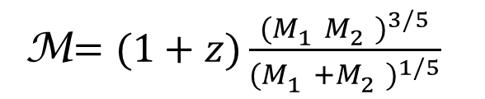
Mass distributions of observable BBHs (KAGRA)
Pop I/II(Zsun,1/10Zsun BBH (Dominik et al. 2012)
Pop III BBH
(Kinugawa et al. 2016)
M$=(1+z)\frac{{(M_{1}^{}M_{2}^{})}^{3/5}}{{(M_{1}^{}+M_{2}^{})}^{1/5}}$
The mass distribution might distinguish Pop III from Pop I, Pop II
→The evidence of Pop III
Even if Mass dist. cannot distinguish
→redshift dependence
(Miyamoto et al. 2017)
Notes:
This is miyamoto san’s result, the mass distribution can distinguish Pop III from Pop II.
but, recently, the maximum mass of Pop II is increasing by cris Belczynski’s work, and PopIII rate depend on the SFR of Pop III and there are uncertainty.
so Pop III peak possibly be buried under the Pop II BBHs.

Slide 38
Cumulative BBH merger rate
Log(events/yr)
Saturated at z≲3
Saturated at z≳10
Pop I and II BBH (≳5Msun)
(Belczynski et al. 2016)
(2 metallicity evolution models)
Pop III BBH (~30 Msun)
Redshift
Redshift
Notes:
These are the cumulative BBH merger rate of Pop III case and Pop I,II case.
The redshift dependence of Pop III is different from that of Pop I and II.
Thus, we can distinguish the Pop III BBH from Pop I and II
Of course, primordial Bh and the other progenitor have own redshift dependence.
We can check the progenitor of BH by the redshift dependence.

Slide 39
Merger time dependence of Pop III BBH spin
 | a1/M1<0.1 a2/M2<0.1 | a1/M1<0.1 a2/M2>0.9 | a1/M1>0.9 a2/M2<0.1 | a1/M1>0.9 a2/M2>0.9
Merger time <1Gyr | 25% | 36% | 0% | 23%
Merger time >10Gyr | 70% | 0.3% | 4% | 0%
If the origin of massive BBHs is Pop III,
high spin BBHs are easier to be detected at high redshift

Slide 40
Mass distributions of observable BBHs (KAGRA)
Pop I/II BBH (Dominik et al. 2012)
Pop III BBH (Kinugawa et al. 2016)
The mass distribution might distinguish Pop III from Pop I, Pop II
→The evidence of Pop III
Even if it cannot distinguish
→redshift dependence
(Miyamoto et al. 2017)
Notes:
This is miyamoto san’s result, the mass distribution can distinguish Pop III from Pop II.
but, recently, the maximum mass of Pop II is increasing by cris Belczynski’s work, and PopIII rate depend on the SFR of Pop III and there are uncertainty.
so Pop III peak possibly be buried under the Pop II BBHs.

Slide 41
Cumulative BBH merger rate
Log(events/yr)
Saturated at z≲3
Saturated at z≳10
Pop I and II BBH (≳5Msun)
(Belczynski et al. 2016)
(2 metallicity evolution models)
Pop III BBH (~30 Msun)
Redshift
Redshift
Notes:
These are the cumulative BBH merger rate of Pop III case and Pop I,II case.
The redshift dependence of Pop III is different from that of Pop I and II.
Thus, we can distinguish the Pop III BBH from Pop I and II
Of course, primordial Bh and the other progenitor have own redshift dependence.
We can check the progenitor of BH by the redshift dependence.

Slide 42
Merger time dependence of Pop III BBH spin distribution
 | a1/M1<0.1 a2/M2<0.1 | a1/M1<0.1 a2/M2>0.9 | a1/M1>0.9 a2/M2<0.1 | a1/M1>0.9 a2/M2>0.9
Merger time <1Gyr | 25% | 36% | 0% | 23%
Merger time >10Gyr | 70% | 0.3% | 4% | 0%
If the origin of massive BBHs is Pop III,
high spin BBHs are easier to be detected at high redshift

Slide 43
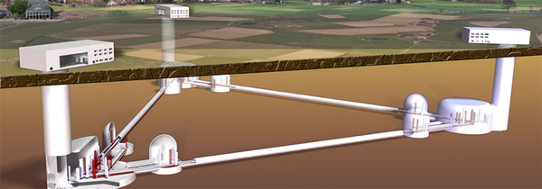
Future plan of GW observer :
ET, CE, B-DECIGO and DECIGO
Einstein telescope (ET): the next generation GW observatory of Europe
Cosmic explorer (CE) : the next generation GW observatory of US.
DECIGO: Japanese space gravitational wave observatory project
B-DECIGO: test version of DECIGO
ET, CE, B-DECIGO : z~10 (30 Msun BH-BH)
DECIGO can see Pop III BH-BHs
when Pop III stars were born (z~20)!
(Nakamura, Ando, Kinugawa et al. 2016)
Notes:
DECIGO is the Japanese space gravitational wave observatory project.
It has good sensitivity from 0.1 Hz to 10 Hz.
Pre-DECIGO is test version.
Pre-DECIGO might see such binary black holes up to redshift 30.
The expected detection rate is about 10 to fifth per yr.
The SFR of Pop III has the peak at z~10.
Thus, it can see pop III BHBH when they were born.
Furthermore, we check the redshift dependence of high mass BHBH mergers.

Slide 44
Detection rate for ET and aLIGO design sensitivity
aLIGO
ET
Chirp mass [Msun]

Slide 45
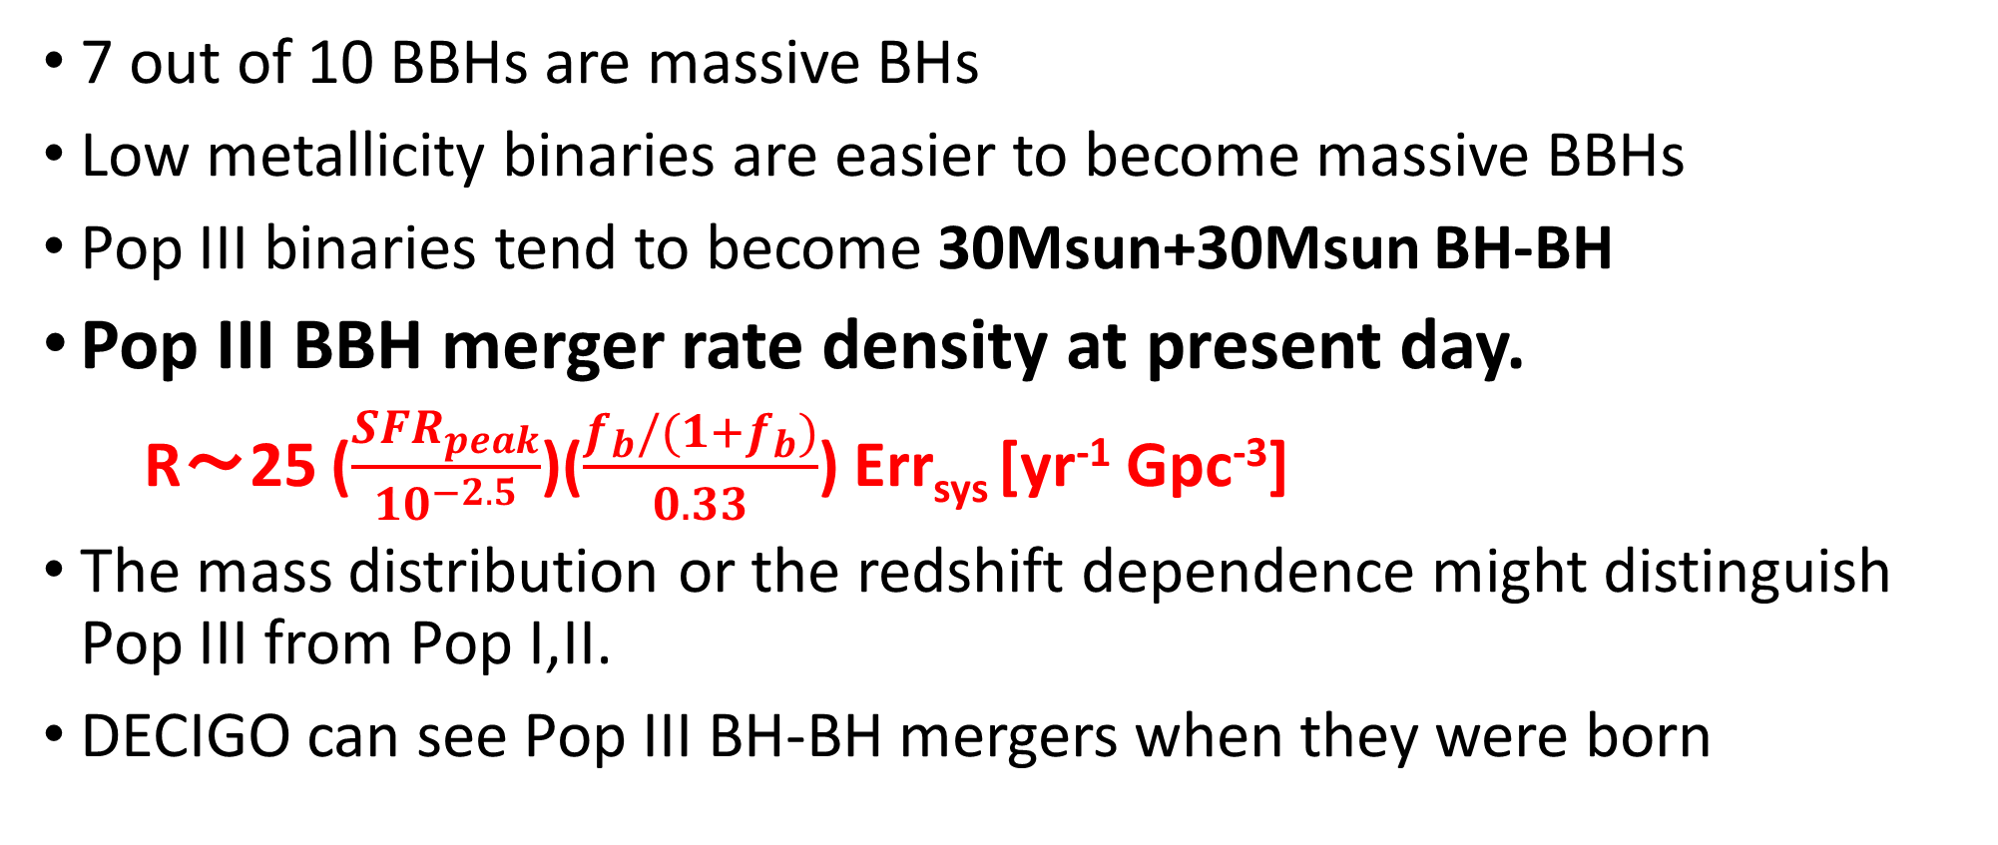
Pop III BBH
7 out of 10 BBHs are massive BHs
Low metallicity binaries are easier to become massive BBHs
Pop III binaries tend to become 30Msun+30Msun BH-BH
Pop III BBH merger rate density at present day.
R～25 ($\frac{{SFR}_{peak}}{{10}^{−2.5}}$)($\frac{f_{b}/(1+f_{b})}{0.33}$) Err_{sys} [yr⁻¹ Gpc⁻³]
The mass distribution or the redshift dependence might distinguish Pop III from Pop I,II.
DECIGO can see Pop III BH-BH mergers when they were born
Notes:
This is summary.

Slide 46
Outline
Pop III stellar remnants as the origin of massive BH+BH (30Msun+30Msun)
Formation pass of extraordinary BH event from Pop III (GW190521)

Slide 47
Formation of extraordinary event of O3
GW190521

Slide 48
Why GW190521 is extraordinary BH
Mass 85Msun+66Msun
PPISN
PISN

Slide 49
GW190521 Formation models
Hierarchical Black-Hole Mergers (e.g. Liu &Lai 2020)
Pop II without PPISN (Belczynski 2020)
Pop III (Farrell et al. 2020, Kinugawa et al.2020, Safarzadeh& Haiman 2020 )
Accretion onto BHs in dense molecular cloud (Rice et al.2020)
Primordial BH, Modified Gravitation Theory, Beyond standard theory.....

Slide 50
Calculation models
In the case of Pop III, it is still unknown how much envelope is elected by PPISN
No PPISN model
PPISN model
We calculate 10^6 Pop III binaries for each model.
IMF: flat 10Msun<M<150Msun
Mass ration: flat 0<q<1
Separation: logflat a_{min}<a<10⁶Rsun
Eccentricity: proportional to e 0<e<1

Slide 51
Pop III remnant mass for single star case

Slide 52
Why GW190521 is extraordinary BH
Mass 85Msun+66Msun
PPISN
PISN

Slide 53
Pop III remnant mass for single star case

Slide 54
Masses of merging BBHs
Primary mass of GW190521
Secondary mass of GW190521

Slide 55
Event rate
0.13 /yr/Gpc³ for PPISN model
0.66 /yr/Gpc³ for no PPISN model
Detection rate of GW190521 is 0.02--0.43 /yr/Gpc³

Slide 56
GW190521-like BBHs formation pass of PopIII
GW190521 mass is consistent with GW190521 for no PPISN, and PPISN models
Event rate 0.13-0.66 /yr/Gpc3 is consistent with observational event rate 0.02--0.43 /yr/Gpc3

Slide 57



summary
7 out of 10 BBHs are massive BHs (30Msun+30Msun) in O1+O2 results
Pop III binaries tend to become 30Msun+30Msun BH-BH
Pop III BBH merger rate density at present day.
R～25 ($\frac{{SFR}_{peak}}{{10}^{−2.5}}$)($\frac{f_{b}/(1+f_{b})}{0.33}$) Err_{sys} [yr⁻¹ Gpc⁻³]
The mass distribution or the redshift dependence might distinguish Pop III from Pop I,II.
Pop III also explain the extraordinary BBH in O3 result
Massive BBHs = the fossil of Pop III ?
Notes:
This is summary.

