Slide 1



Axion Dark Matter Search with Interferometric Gravitational Wave Detectors
Ippei Obata (ICRR, University of Tokyo)
arXiv:1903.02017,
Phys.Rev.Lett.121 (2018) 161301 [arXiv:1805.11753]
Collaborators：
Koji Nagano (ICRR)
Tomohiro Fujita (Kyoto University)
Yuta Michimura (University of Tokyo)
2019.5.9 ICRR Seminar

Slide 2
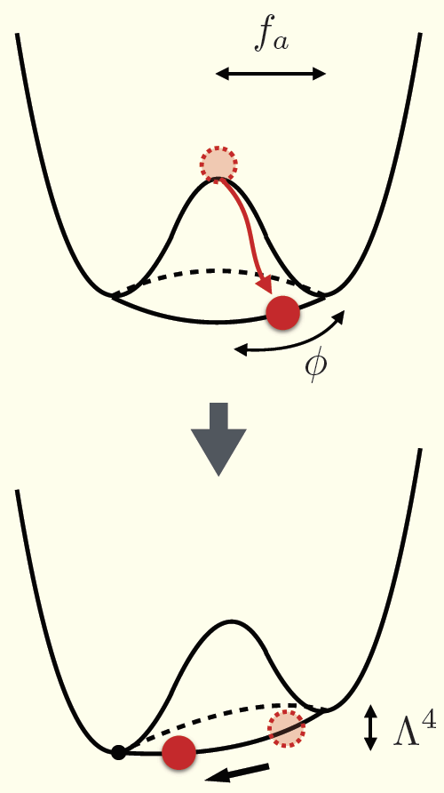
What is Axion?
QCD Axion
(Peccei & Quinn, 1977)
A pseudo NG boson of PQ mechanism in order to solve the strong CP problem in QCD physics
Axion-like particles (ALPs, string axion)
(Svrcek & Witten 2006)
A plentitude of axion-like particles provided by the compactifications of extra dimensions
A scalar field with small mass, tiny interactions
→ candidate for dark matter

Slide 3
Axion as Dark Matter (misalignment production)
(background evolution)
In early universe (m < H),
(frozen due to the Hubble friction)
In late universe (m > H),
(start to oscillate)
After oscillation begins, axion behaves as a pressureless matter fluid
(Pressure) < (Gravity)
→Dark Matter!

Slide 4
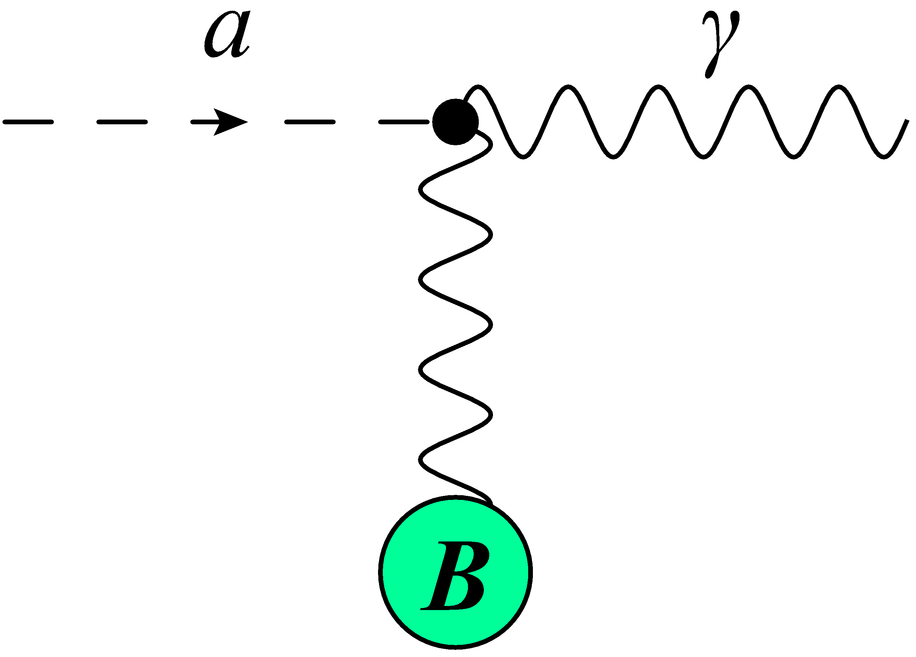
Search for Axion (DM) via Photon
Axion generically couples to photon via the topological term
Axion is converted into photon under the background magnetic field (“axion-photon conversion”)

Slide 5
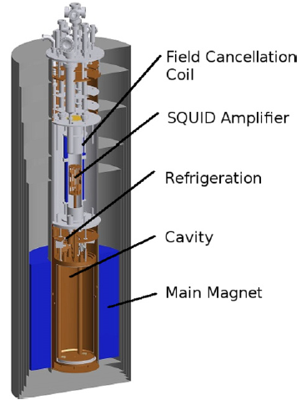
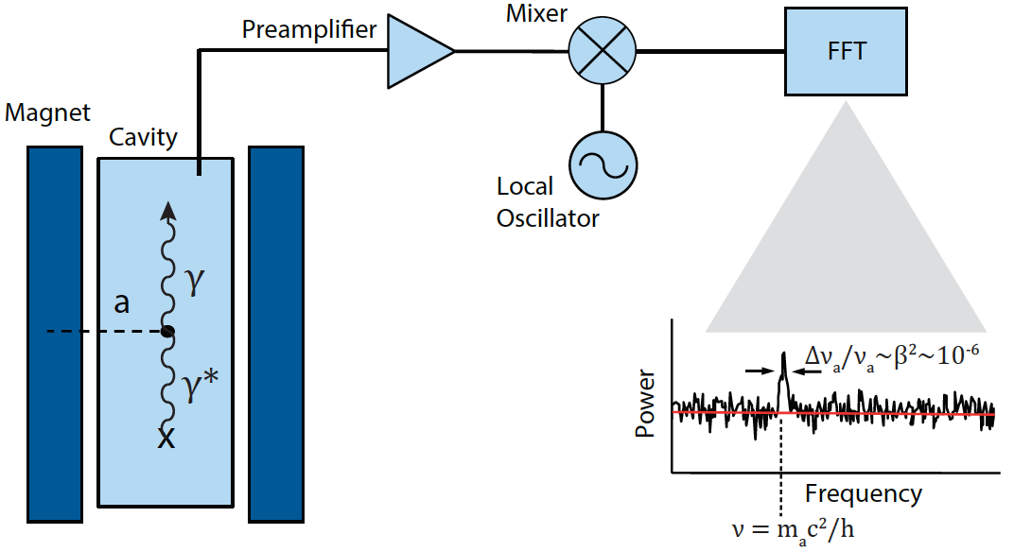
Axion-photon conversion Experiments (1)
Axion Haloscopes
ADMX (Axion Dark Matter eXperiment)
(Asztalos+ 2009, …)
ADMX 2014
ADMX Patras 2016
A microwave resonant cavity using a superconducting magnet B~8T.
It can probe the power signal of axionDM-photon conversion around μeV axion mass.

Slide 6
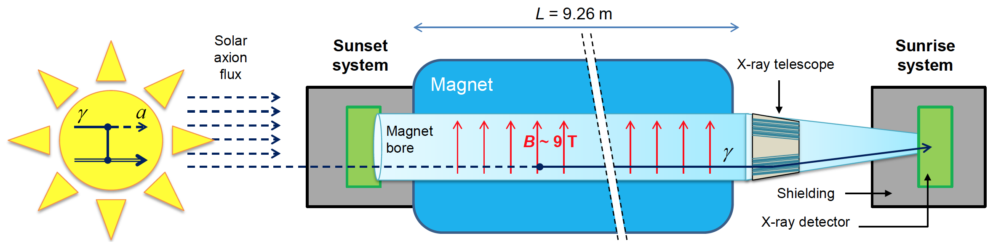
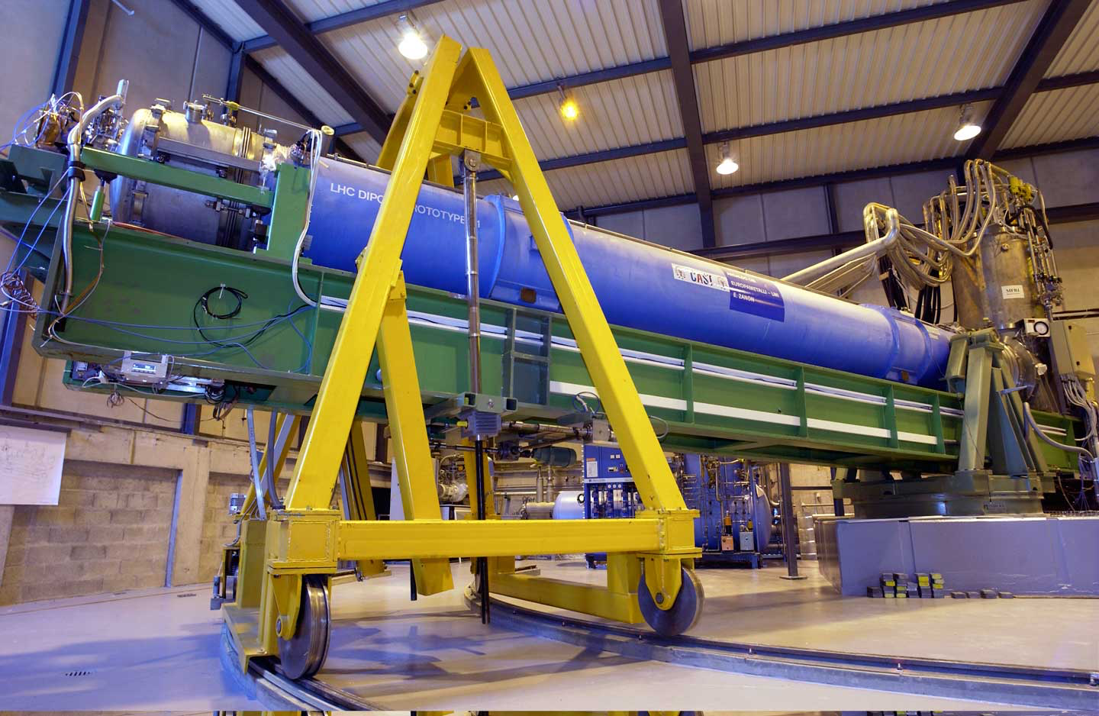
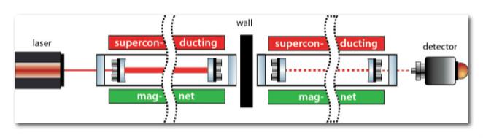
Axion-photon conversion Experiments (2)
Axion Helioscope
(Zioutas+ 2004,…)
CAST 2017
CAST (CERN Axion Solar Telescope)
IAXO (International Axion Observatory) : Next generation
Light-Shinning-through-a-Wall (LSW)
(Ehret+ 2009,…)
ALPS II
ALPS (Any Light Particle Search) @ DESY

Slide 7
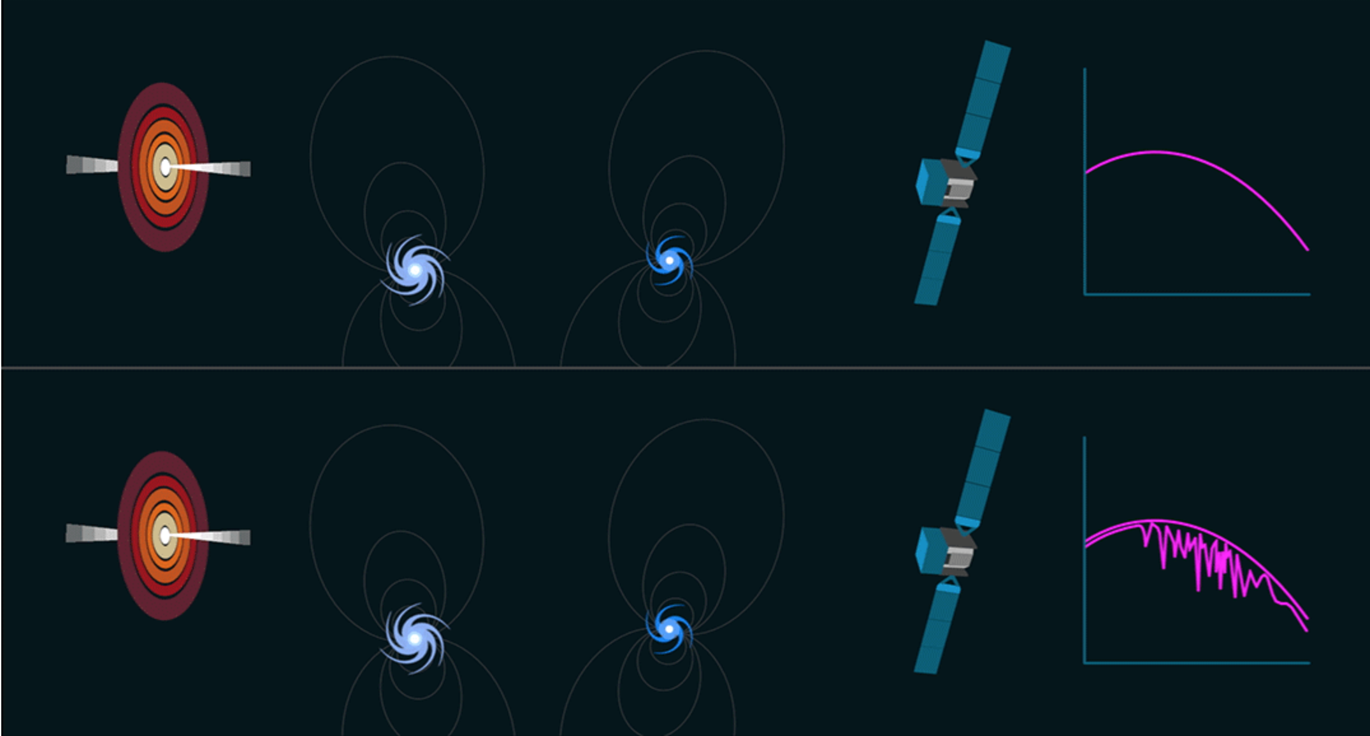
Axion-photon conversion Observations
→
nasa-fermi-mission
Axion-photon conversion will modify the spectrum of cosmic rays.
The prediction depends on the uncertainty of magnetic filed in the cluster background.

Slide 8
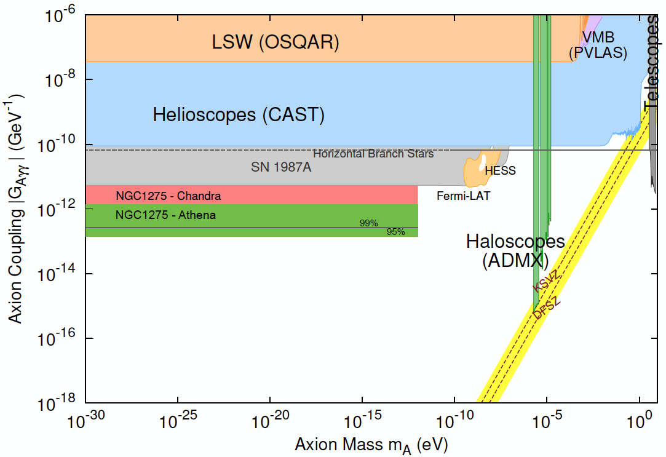
Overview of Target Spaces
(prospect)
Unknown Area
Conlon+ 2017

Slide 9
Axion DM – Photon Interaction
EOM for photon :
Axion DM :
Decomposing two circular polarized photons, we get the following dispersion relation

Slide 10
Axion DM – Photon Interaction
The phase velocity of each polarized photon is given by
Therefore, we get the difference of phase velocities between two modes
Is it possible to test this tiny phase difference?

Slide 11
Modulation of photon polarization
Propagating direction
Axion DM modulates
the linear-polarized light!
Photon
polarization
Its magnitude depends on the axion-photon coupling
Its frequency depends on the axion mass

Slide 12
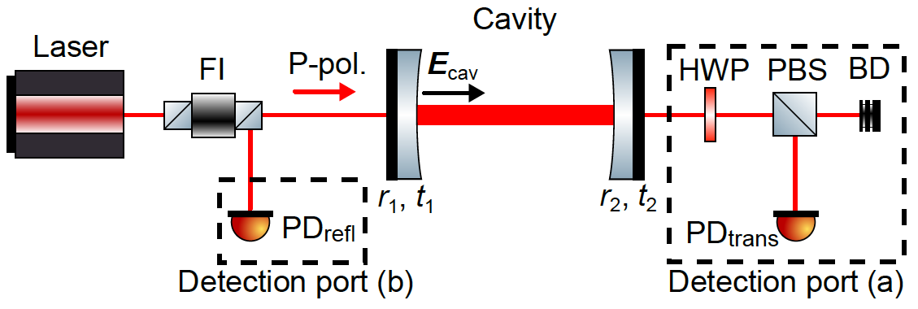
Experimental Setup
K.Nagano, T.Fujita, Y.Michimura, IO
1903.02017
FI: Faraday isolator
HWP: half wave plate
PBS: polarizing beam splitter
BD: beam dump
reflectivity and transmissivity of
cavity mirrors

Slide 13
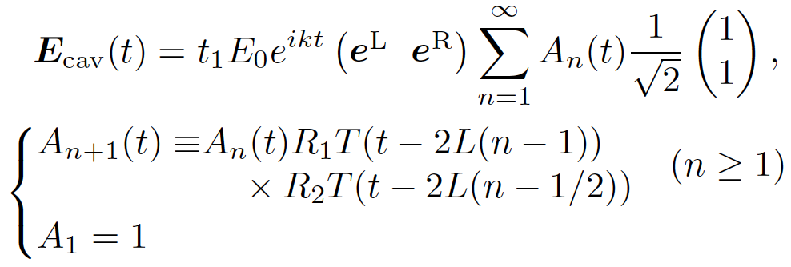
Experimental Setup
K.Nagano, T.Fujita, Y.Michimura, IO
1903.02017
Electric vector inside cavity:
(superposition of reflected beams)

Slide 14
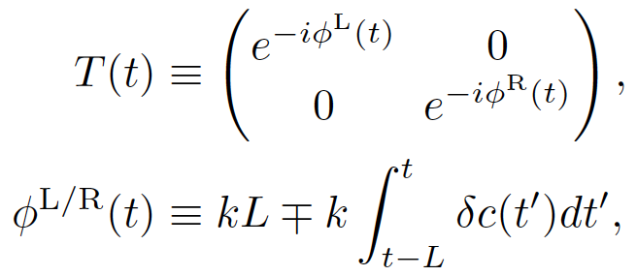
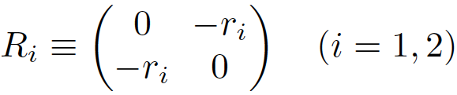
Experimental Setup
K.Nagano, T.Fujita, Y.Michimura, IO
1903.02017
Transfer matrix
Reflection matrix

Slide 15
Experimental Setup
K.Nagano, T.Fujita, Y.Michimura, IO
1903.02017
The signal is enhanced inside the cavity

Slide 16
Experimental Setup
K.Nagano, T.Fujita, Y.Michimura, IO
1903.02017
S-pol.
Available for the detector of large t_2

Slide 17
Experimental Setup
K.Nagano, T.Fujita, Y.Michimura, IO
1903.02017
S-pol.
Available for the detector of small t_2

Slide 18
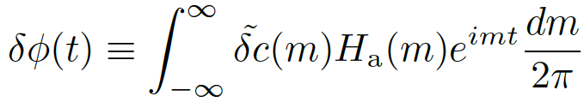
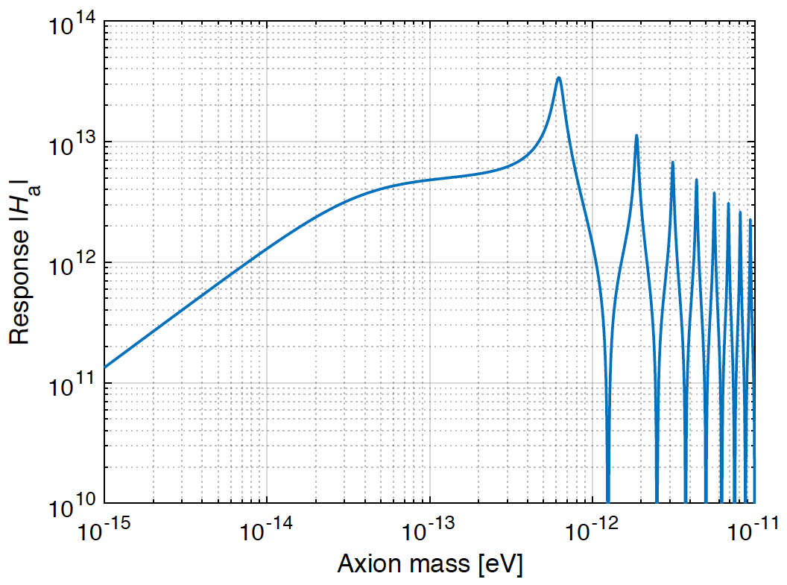
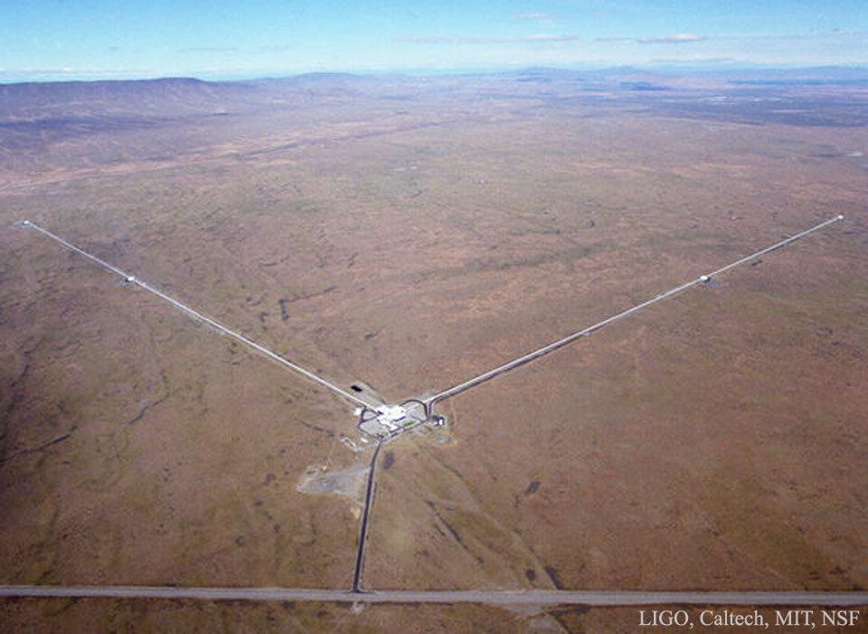
Response funcition
m L ~ 1 is best sensitivity
(proportional to 1/m)
→longer cavity length is better
→GW detectors!
LIGO

Slide 19
SN ratio
The sensitivity is determined by quantum shot noise
(coherent time of axion DM)

Slide 20
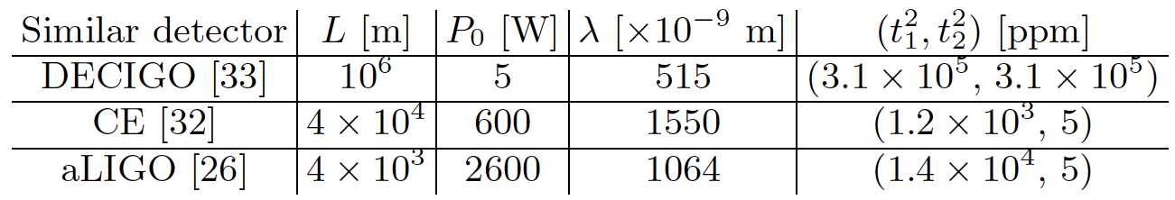
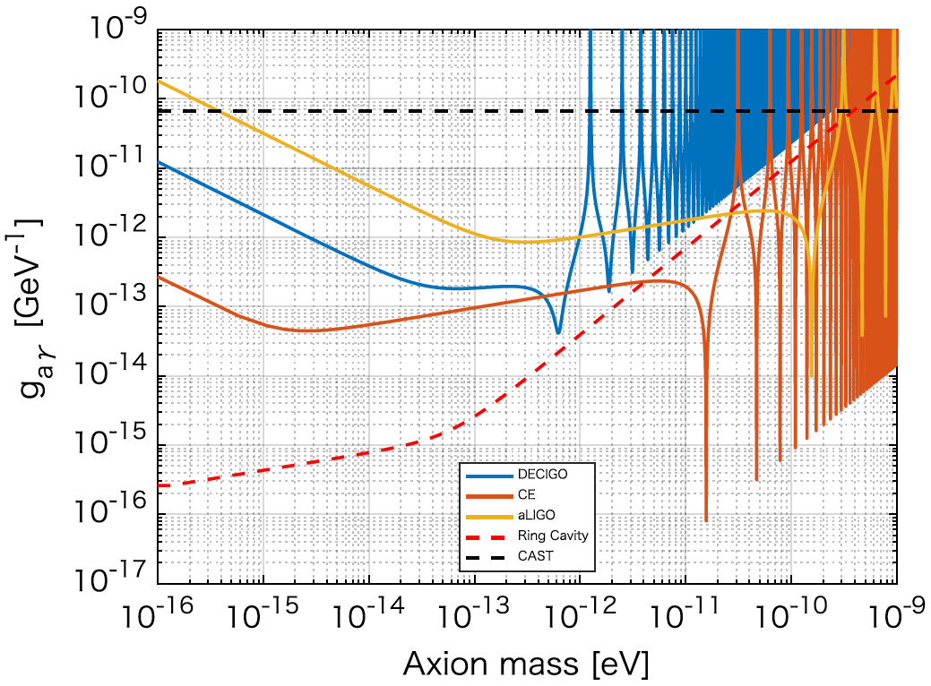
Sensitivity curves
←current limit
(CAST@CERN)
aLIGO
DECIGO
Cosmic Explorer

Slide 21
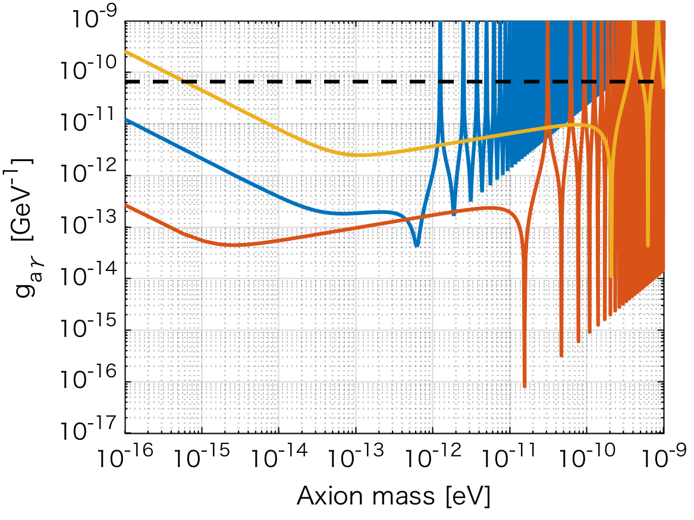
Sensitivity curves
KAGRA
←current limit
(CAST@CERN)
KAGRA
DECIGO
Cosmic Explorer

Slide 22
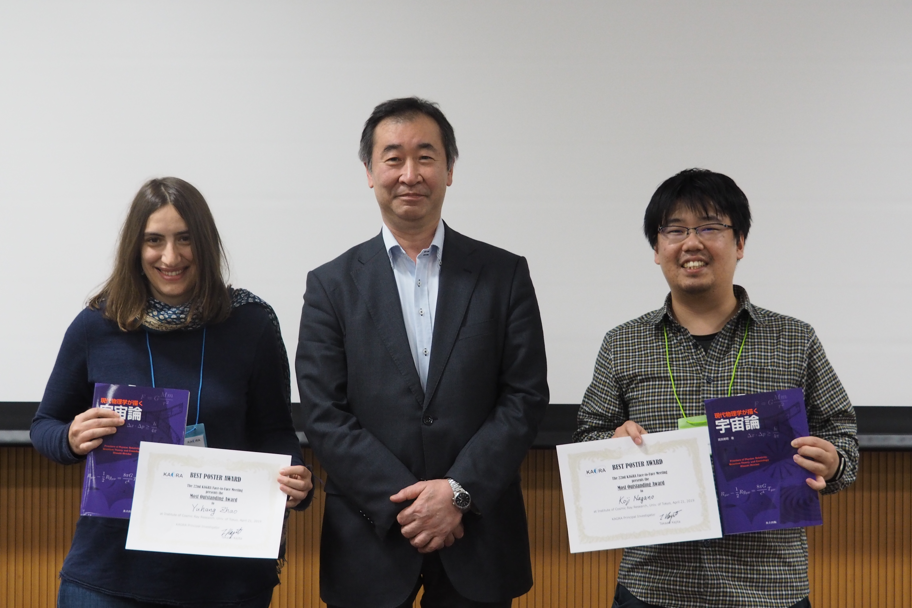

Slide 23
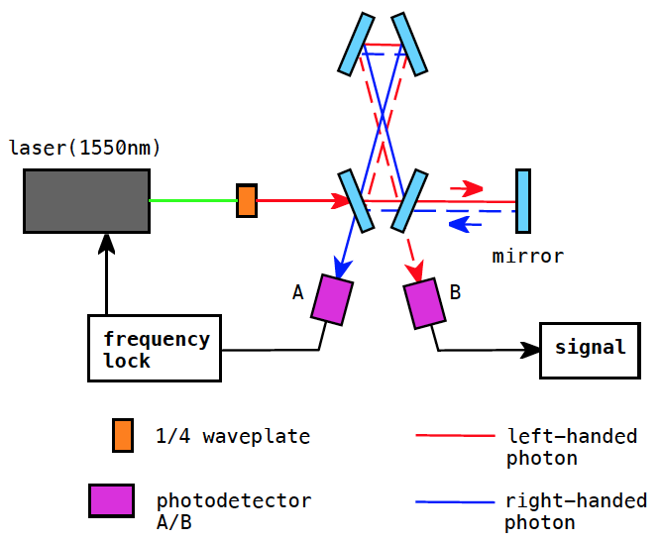
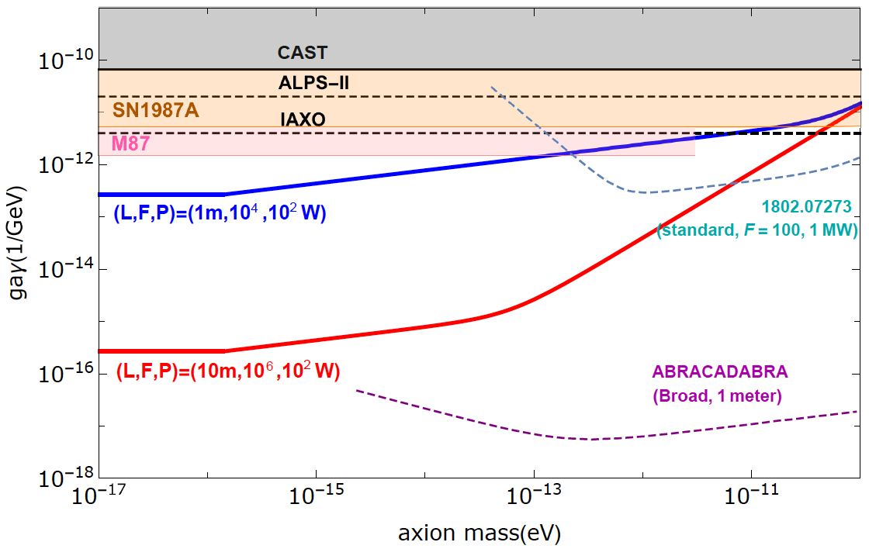
Bow-Tie Ring Cavity
IO+ Phys.Rev.Lett.121 (2018) 161301
The optical cavity which measures the difference of resonant frequencies between two circular-polarizations of the laser beams

Slide 24
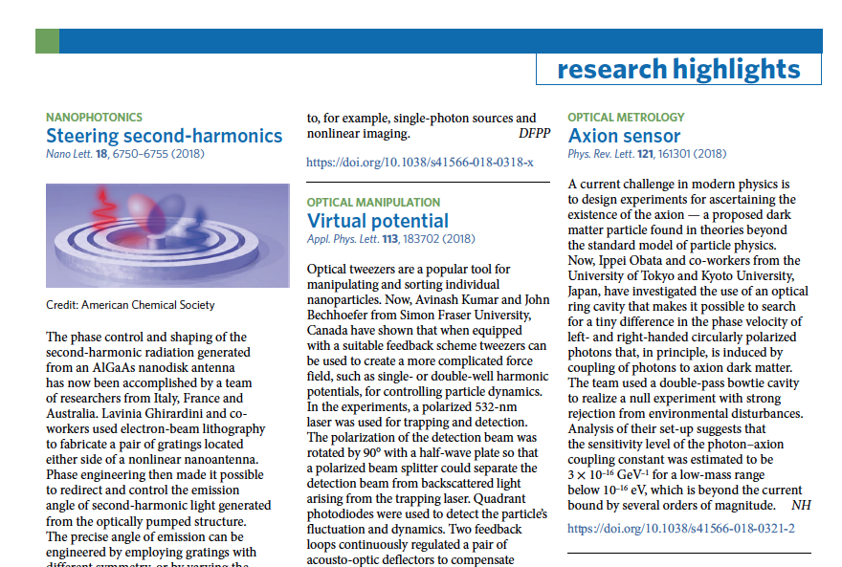

Slide 25
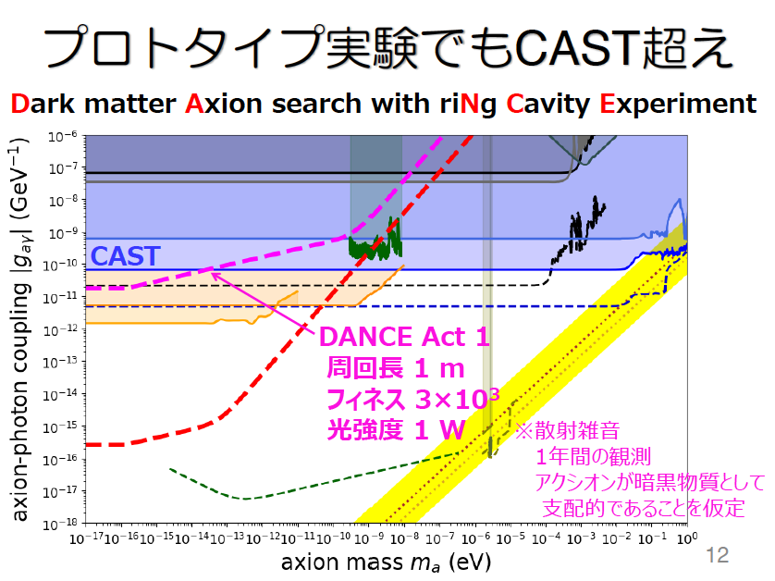
Michimura-san’s slide

Slide 26
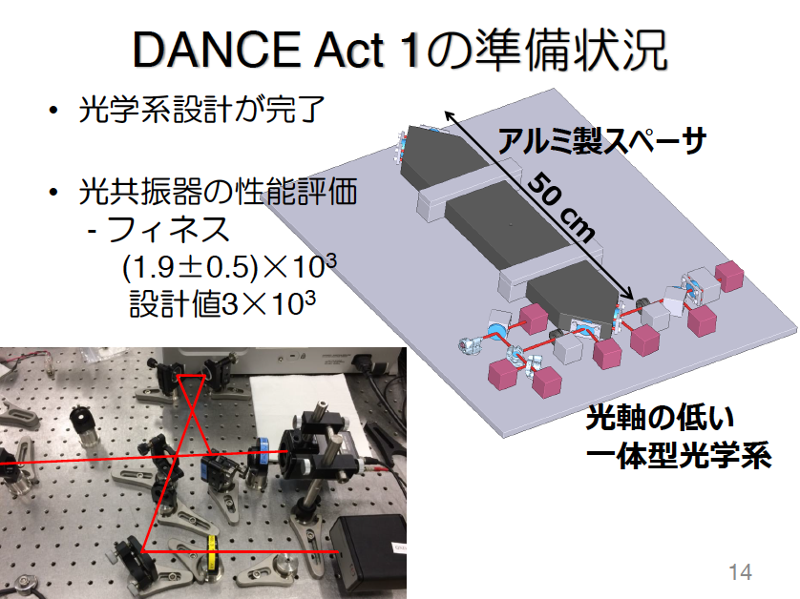
Michimura-san’s slide

Slide 27
Summary & Outlook
We suggest an experimental scheme to search for axion dark matter with the linear optical cavity used in gravitational wave detectors.
We found that these sensitivities can reach beyond the current limit with a wide range of axion mass and our new scheme can coexist with the observation run for gravitational waves.
Which detection port (a) or (b) can be constructed depends on the gravitational wave detectors.
We hope that our scheme is applied to KAGRA,DECIGO, ….

