Slide 1
Inside Nature
The Editorial Process Explained

Slide 2
Agenda table
1 | A Brief History of Nature
2 | Meet the Editors
3 | The Editorial Process
4 | Appeals, Transfers, and Author/Referee Services
5 | Writing for Impact

Slide 3
A Brief History of Nature
1.0

Slide 4
Nature was launched in 1869…
Nature’s Original Mission:
FIRST, to place before the general public the grand results of Scientific Work and Scientific Discovery; and to urge the claims of Science to a more general recognition in Education and in Daily Life; And, SECONDLY, to aid Scientific men themselves, by giving early information of all advances made in any branch of Natural knowledge throughout the world, and by affording them an opportunity of discussing the various Scientific questions which arise from time to time.

Slide 5
…and a lot has changed since then
Nature’s Revised Mission (2000):
First, to serve scientists through prompt publication of significant advances in any branch of science, and to provide a forum for the reporting and discussion of news and issues concerning science. Second, to ensure that the results of science are rapidly disseminated to the public throughout the world, in a fashion that conveys their significance for knowledge, culture and daily life.

Slide 6
Nature publishes:
This Week
Editorials
World View
Research Highlights
Seven Days
News in Focus
News
Features
Comment
Comment
Books & Arts
Correspondence
Research
News & Views
Reviews & Perspectives
Insights
Analysis
Articles
Letters
Brief Communications Arising
Careers

Slide 7
The size of the editorial operation
~100 editorial staff including Editor-in-Chief, 2 Chief Editors, 28 Associate & Senior Editors, editorial assistants and other staff (e.g. journalists)
Staff based in London, DC, San Francisco, San Diego, Munich, Berlin, Paris, Tokyo, Sydney, Delhi, Shanghai…
~120 editorial pages per week
>12,000 submissions per year; ~800 papers published

Slide 8
Meet the Editors
2.0

Slide 9
Nature Editors are…
Full-time professional editors able to focus 100% on the science
Passionate about science and the communication of science
All have a solid research background – we know what it is like!
Completely independent:
No external editorial board
Journals editorially independent from each other
In touch with the community:
Typically travel ~4-5 weeks/year – conferences and visit labs
Frequent meetings internally and with experts to explore and develop standards, policies, criteria

Slide 10
An Editor’s Responsibilities
Selection of primary research manuscripts for publication
Commissioning Review articles & Insights
Attending scientific meetings and visiting labs
Consulting and advising other sections of Nature on core subject areas
… and maybe some science writing

Slide 11
Nature Editors are…
…the interface between the journal and the global scientific community

Slide 12
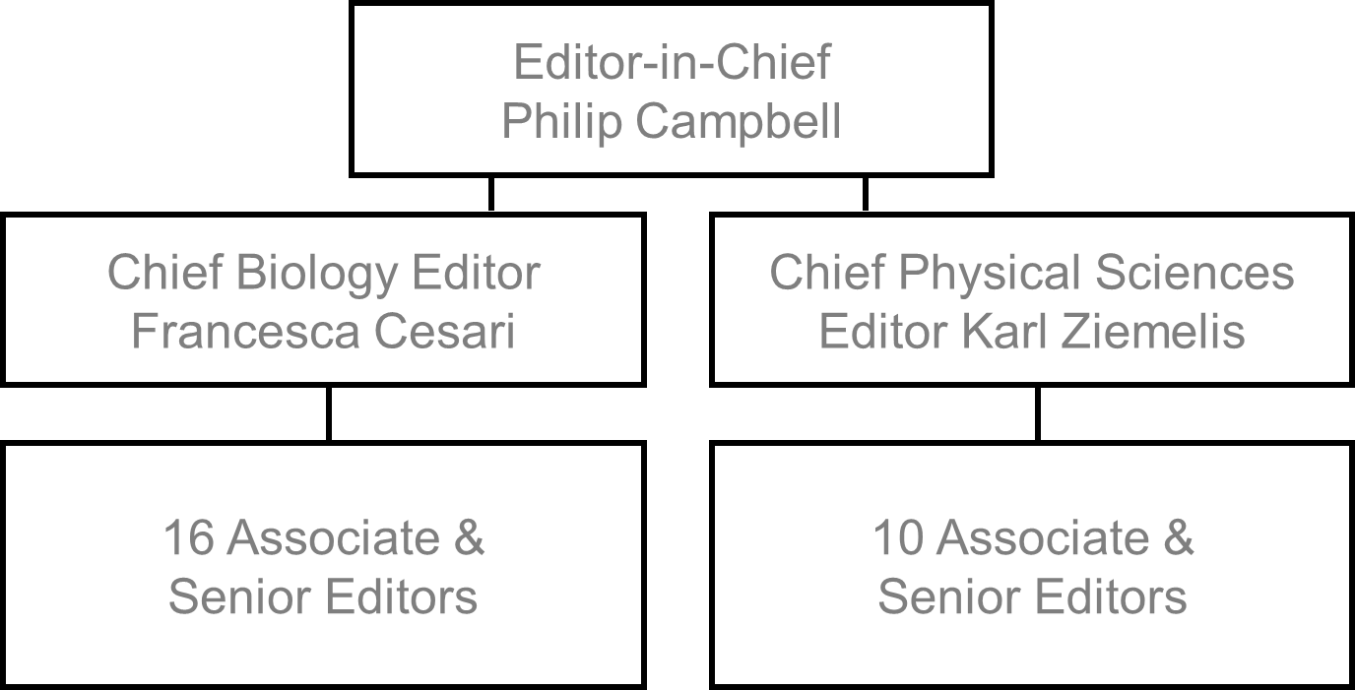
Nature’s Editorial Structure:
Editor-in-Chief
Magdalena Skipper
Chief Biology Editor
Francesca Cesari
Chief Physical Sciences Editor
Karl Ziemelis
17 Associate &
Senior Editors
11 Associate &
Senior Editors

Slide 13
The Physical Sciences Team
London
Rosamund Daw Gaia Donati Luke Fleet Claire Hansell Magdalena Helmer Bryden Le Bailly Juliane Mossinger John VanDecar Karl Ziemelis | Materials science, bioengineering Physics, mathematics Applied physics, engineering Materials chemistry, energy materials Physical and inorganic chemistry Organic chemistry, chemical biology Environmental science, biogeochemistry Geophysics Physics, geophysics
Berlin
Tobias Roedel | Condensed-matter/solid-state physics
Washington DC
Leslie Sage | Astronomy and astrophysics
San Francisco
Michael White | Climate science

Slide 14
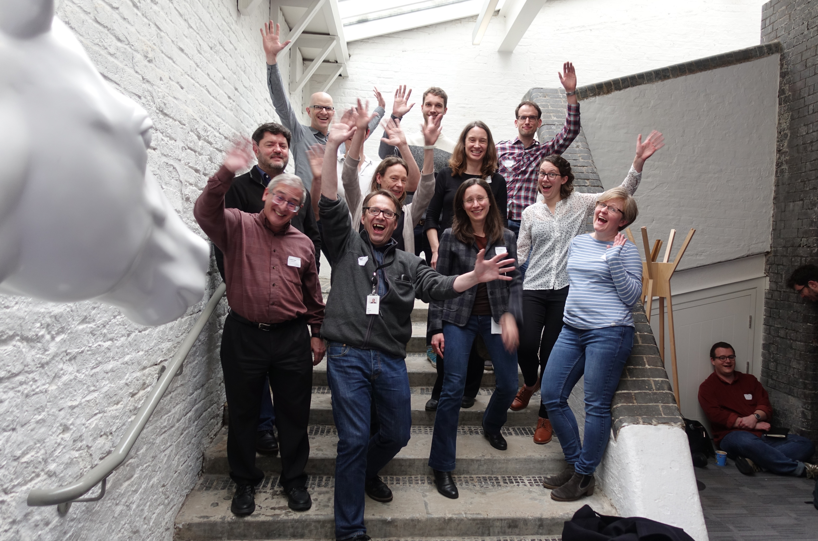

Slide 15
The Editorial Process
3.0

Slide 16
The Editorial Process?

Slide 17
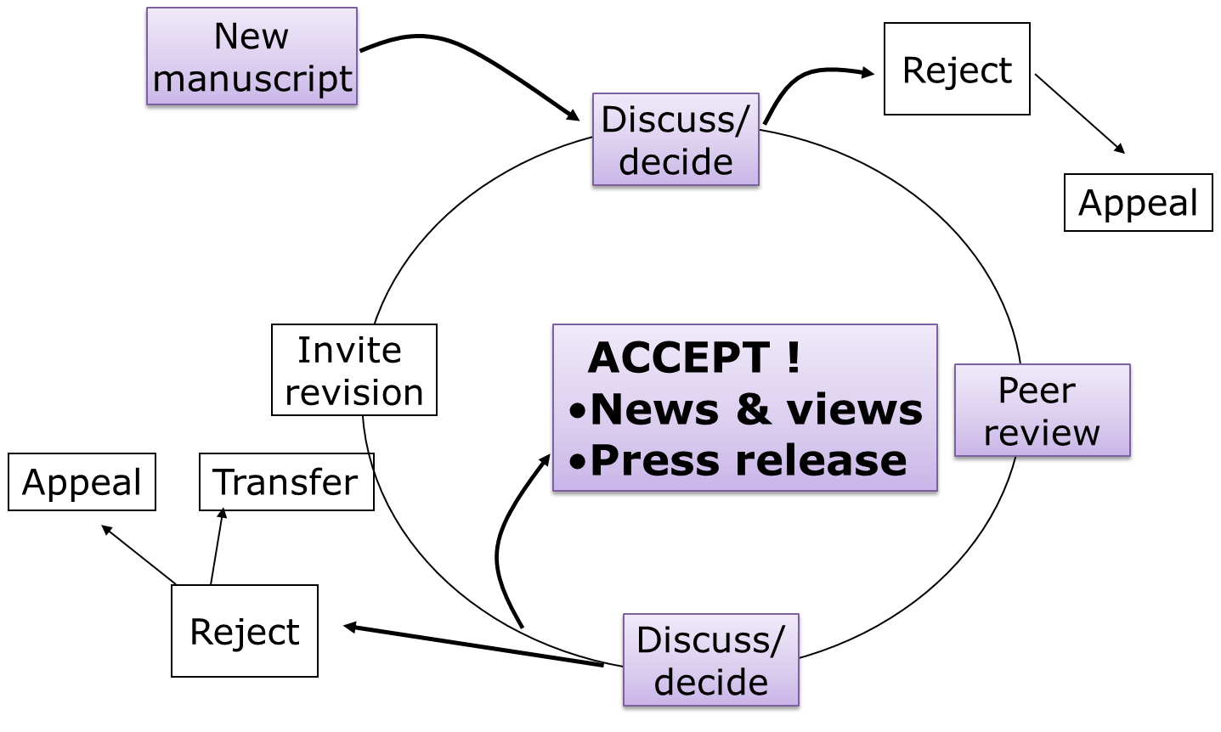
The Editorial Process!

Slide 18
Editorial Selection Criteria
The editors are looking for those papers that have the greatest scientific and/or societal significance. They are not making a technical judgement on the quality of the work. They are not basing their assessment on the quality of the writing.
Significant step towards a key disciplinary goal?
Clear impact in the field… and beyond?
Provides new and important directions for research?
Addressing a question that is broadly interesting for the journal's readership?
Novelty/elegance; the ‘cleverness’ factor?
The judgement about which papers are reporting results that are in principle suitable for publication in Nature is made by Nature's editors, not its referees.
Only ~20% of submitted papers are sent out for peer review

Slide 19
Style and Format
For the initial submission, papers may be submitted in any reasonable format and of reasonable length.
Detailed guidance on Nature style and format will be given later in the process, for those papers that are moving towards acceptance and publication.
Article versus Letter?
Most Nature papers are published in the shorter Letter category – the editorial criteria for Articles are much more stringent.
Article vs. Letter is ultimately an editorial decision. We may upgrade or downgrade a submission based on:
Significance of the study in the field
Potential breadth of impact
Completion
Ultimately papers are given the length they need (regardless of category)

Slide 20
Manuscripts are evaluated based on their content, not on the cover letter, looks, or proficiency in English…
…but be considerate of the editors’ and reviewers’ time

Slide 21
Peer Review
We use experts from around the world and continually add new reviewers to our databases
>19,000 reviewers used for the Nature journals in 2011
~2,500 reviewers refereed 3 or more manuscripts across the Nature journals in 2011
Usually 2 or 3 referees selected per paper on the basis of:
technical expertise
breadth of knowledge
Fairness
Timeliness
usefulness of reviews to editors and authors

Slide 22
Reviewer Assessment
Technical assessment:
General quality of the data
Controls
Standards in the field
Experimental support for conclusions
Subjective assessment:
Extent of (conceptual) advance
Likely impact on the field

Slide 23
Reviewer Anonymity and Double-Blind Review
Reviewer anonymity is assumed by default
Many referees would otherwise refuse to review
“Let scientists stay friends”
Prevents bland, timid reviews & favour-trading
…but reviewers can identify themselves if they wish (and many do)
Single-blind peer review is assumed by default, but:
Authors can opt for double-blind peer review at the initial submission stage
It is the authors’ responsibility to ensure that their submission is fully anonymized

Slide 24
Decisions after Review
Reject or Revise?
Peer review is not a ‘show of hands’
Reviewers sometimes disagree with each other, and for good reasons
Editors may overrule reviewers on subjective points…
Editors, not the reviewers, decide ultimately what is published in Nature

Slide 25
Appeals, Transfers, and Author/Referee Services
4.0

Slide 26
Can you challenge a decision?
Yes!
Nature editors carefully consider all appeals, and all appeals are seen by the handling editor and at least one other senior editor. But only a few appeals ultimately “succeed”.
What helps?
Compelling scientific arguments, not opinion
New data/information
Referees and/or editor made significant factual errors or missed important points that directly undermine the main reason for rejection
What doesn’t help?
Celebrity endorsement or invoking author’s status/reputation
Threats and abuse
Cosmetic changes or hype

Slide 27
Transferring Manuscripts
A manuscript declined by one of the Nature journals (at any stage) can be easily transferred, by the author, to another journal published by Springer Nature.
When the transfer takes place between Nature journals, the referee reports and reviewer identities are also transferred, to help deliberation at the receiving journal and to speed up the process.
Author decides whether to transfer or submit anew
Transfer saves author's time – no reformatting, rekeying or re-entering of author/manuscript metadata
Transfer of referees reports may expedite the decision process at the receiving journal
More efficient use of referees’ time

Slide 28
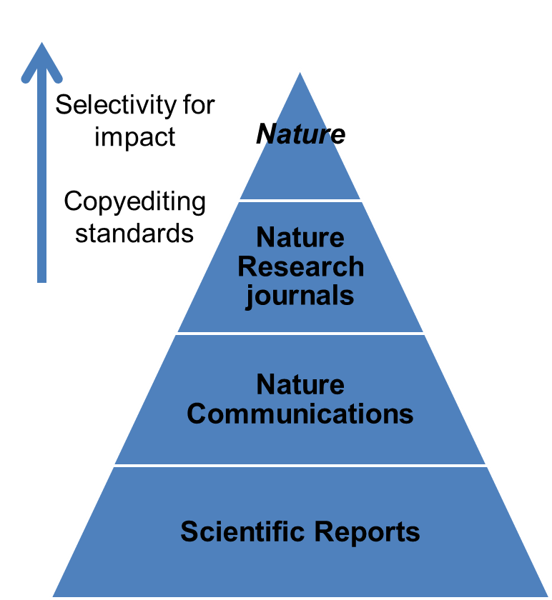
The Nature Heirarchy
Nature and the Nature Research journals offer the highest selectivity and editing added value
Nature Communication applies the same selectivity for validity and quality but slightly lower researcher impact and a reduced level of copyediting
Scientific Reports deliberately applies minimal standards of significance and long-term impact, operates with an external editorial team, and offers no copyediting

Slide 29
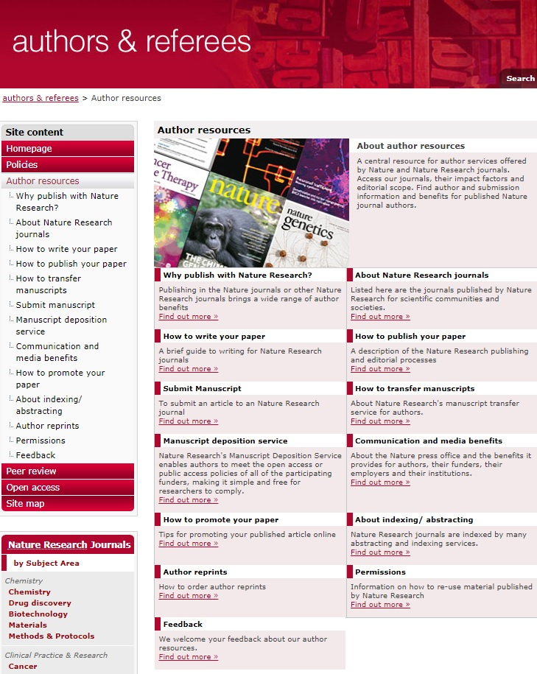
Authors and Referees Services
Authors & Referees Services department ensures that the interests of authors and referees are considered in every product & service within Springer Nature
We deposit papers into major repositories on behalf of authors, in agreement with self archiving policies of all funders
SharedIt link provided for distribution of published paper
Download and citations statistics; Referee accreditation

Slide 30
Writing for Impact
5.0

Slide 31
What makes a paper “great”? Great science!
Blockbuster science
The ‘big picture’ science that makes the headlines
Great science
Any worthwhile science undertaken with rigour and passion is ‘great’ science
Any great science (addressing questions big or small) can form the basis of a great paper…

Slide 32
Turning your great science into a GREAT paper
A GREAT paper should:
be the culmination/celebration of a project, big or small
be written with the same attention to detail – and passion – as the research underlying it
be read, used and (maybe) even enjoyed
A GREAT paper won’t:
be written and published solely for the purpose of bolstering a CV. Just because a paper can be written doesn’t necessarily mean that it should be written, at least at this point in time
be seen as a chore to write – if you do not feel any passion for the paper, it is most unlikely that others will too!

Slide 33
Know your audience
Hold their attention
Lay foundations

Slide 34
Know your audience #1
Who might be interested in the work?
Your immediate community (hopefully!)
Others in the same or closely-related disciplines (possibly)
The scientific community at large (rarely)
… and the general public (who knows?!?)
Context is key
Motivation: What was the question I was tackling, and why?
Result: What did I find, and how does this relate to the motivation?
Implication: Where do we go from here?

Slide 35
Know your audience #2
Have I assumed to much prior knowledge?
Even specialists can struggle to follow arguments in highly technical fields – help them!
Be succinct, but don’t be obtuse – and don’t write in ‘code’!
Explaining is not the same as ‘dumbing down’
Be realistic
Not every result will ‘cure cancer’ or ‘disprove Einstein’ – yet many results have the potential to motivate and inspire outside the immediate community
Don’t exaggerate – you want to attract expert readers, not put them off
Feel free to speculate – but clearly label it as such
Choose your journal with the target audience in mind

Slide 36
Everyone is busy
Authors, referees, editors and readers are all busy people – time is precious
To maximise the impact of your work, you first need to ensure that it gets read, which in turn requires an investment of time on the part of the reader
Focus on getting the key information across as efficiently and as usefully as possible

Slide 37
Be mindful of your readers’ time #1
A lesson from journalism
You are competing for readers’ time, so capture their attention from the outset. The best news items always start with the news.
Titles: Avoid open-ended titles and state the main finding of the work
Abstract: Don’t just summarize your findings – place them in context and mention the implications. A casual reader will be wondering whether it is worth their while reading on, so give them the information that they need to make an informed decision
Avoid exaggeration – remember your audience! (i.e. fellow academics)
Be mindful of terminology, acronyms and paradigm-shifts
The Nature-style summary paragraph:
http://www.nature.com/nature/authors/gta/2c_Summary_para.pdf

Slide 38
How to construct a Nature summary paragraph

Slide 39
Be mindful of your readers’ time #2
Organise your thoughts
Strip down to the elements essential to conveying the results – you are not writing a novel
Bullet-point your message and arguments, and build the paper around that
Do not pad the main paper out with superfluous information…
…but don’t leave out anything important or gloss over problematic issues
Signposting as you go
Guide the reader by starting each section with a brief statement of what is to follow (e.g. “We will now calculate the conditions under which XX leads to YY”)
A time-pressured reader should be able to quickly navigate through the paper, section-by-section, to follow the gist (if not the detail) of the argument
Title your figures and tables!

Slide 40
Think of the users
A paper is not simply the announcement of your own research achievements – it should be much more than something to be read once and filed away
A paper is very rarely the final word on the matter – it is a stepping stone on the way to future scientific achievements
A GREAT paper offers no barriers or obstruction to others building on the work - indeed, it should be a resource that actively facilitates replication and extension

Slide 41
Laying foundations for future work
Removing barriers
Science is messy: By all means be selective for the purposes of clarity, but be specific about any such selection – if an experiment is tricky to realise and/or has a high failure rate, this is valuable information for others attempting to build on the work
Don’t hide problems: do not leave out problematic information that appears to detract from the message of the paper – it should be part of that message
Clearly distinguish between information that is central to the paper’s claims, secondary to the claims (i.e. required only by fellow practitioners), and provided mainly for completion
Archive the full information behind a paper – even better and if the journal platform permits, include the source data in the paper itself
Be alert to changing community standards – and champion those standards!

Slide 42
Know your audience
Hold their attention
Lay foundations

Slide 43
Thank you
Feedback & questions always welcome
k.ziemelis@nature.com

