Slide 1
Fast waveform digitizing for the search of the μ⁺ → e⁺γ decay
Stefan Ritt :: Paul Scherrer Institute :: Switzerland
ICRR Seminar, University of Tokyo, Chiba, March 31st, 2017

Slide 2
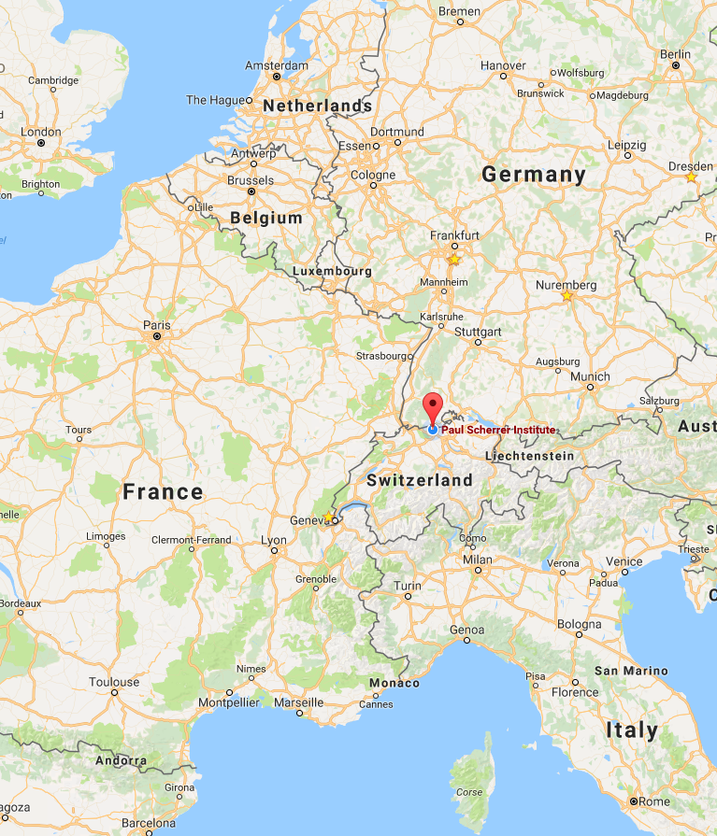
Fast waveform digitizing for the search of the μ⁺ → e⁺γ decay
Stefan Ritt :: Paul Scherrer Institute :: Switzerland
LHC
ICRR Seminar, University of Tokyo, Chiba, March 31st, 2017

Slide 3


Two talks in one
The “pure” science
The “dirty” technology behind
Search for New Physics via
charged lepton flavor violation
(cLFV)
Ultrafast
waveform
digitizing

Slide 4
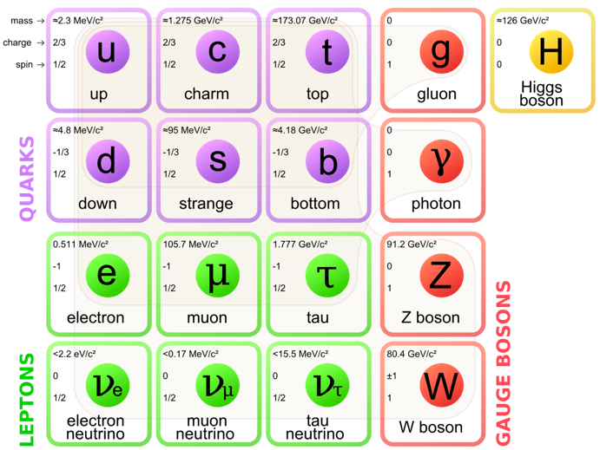
Motivation for cLFV searches
Standard Model (SM) of particle physics is very successful, but falls short on
  Dark matter
  Matter-antimatter asymmetry
  Gravity
  ...

Slide 5
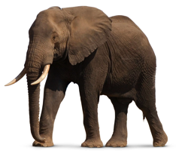

Searches for New Physics Beyond the SM
Energy Frontier – LHC/ILC
Real BSM
particles
“Direct” Searches Λ ~ 10 TeV
Intensity Frontier - cLFV
Virtual BSM
particles
“Indirect” Searches Λ > 1000 TeV

Slide 6
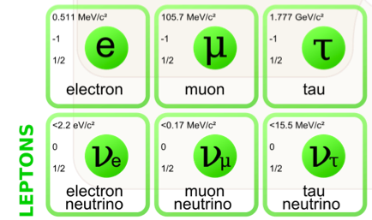
Quick introduction to cLFV
Lepton Flavor Violation
  observed in the neutral sector
  (neutrino oscillations)
  Not observed in the charged sector
  “accidental” symmetry!
✓
X
Neutral Sector
Charged Sector
ν_{e}
ν_{τ}
µ ➔ eɣ
µ ➔ eee
τ ➔ eɣ
…
ν_{µ}

Slide 7
cLFV in the SM
cLFV is possible in the SM through neutrino mixing,
but immeasurable small
γ
W⁻
μ⁻
ν_{μ}
ν_{e}
e⁻
“Beauty of cLFV”
γ
μ⁻
e⁻
⇒ A cLFV signal would be clear evidence for New Physics

Slide 8
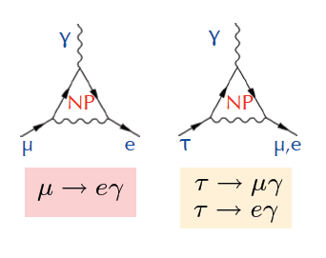
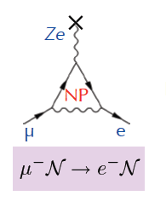
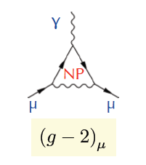
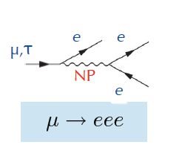
cLFV processes sensitive to New Physics (NP)
μ, τ “forbidden” decays
μ → e
conversion
Anomalous
magnetic
moment

Slide 9
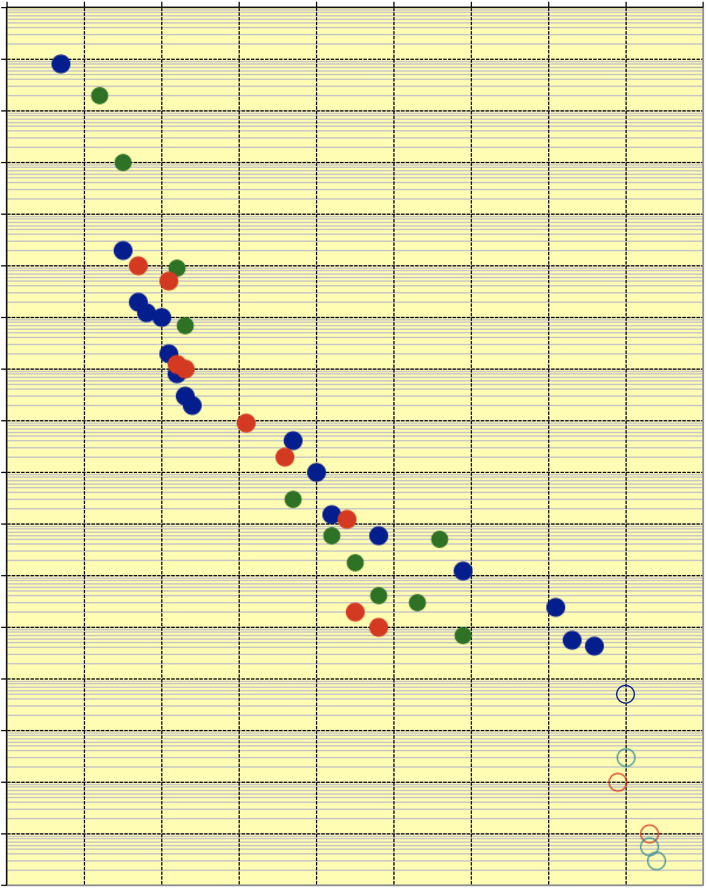
History of cLFV searches with muons
Started with
Pontecorvo & Hincks 1947
Currently all three limits held by PSI experiments
MEG II experiment aim for 10x improvement
COMET (JPARC) and Mu3e aim for > 100x improvement
1
10⁻¹
μ → e γ
μΑ → eA
10⁻²
μ → eee
10⁻³
10⁻⁴
10⁻⁵
10⁻⁶
10⁻⁷
10⁻⁸
10⁻⁹
10⁻¹⁰
10⁻¹¹
MEG
10⁻¹²
10⁻¹³
MEGII
10⁻¹⁴
SINDRUM
10⁻¹⁵
COMET
10⁻¹⁶
Mu2e
Mu3e
10⁻¹⁷
1940 1950 1960 1970 1980 1990 2000 2010 2020 2030

Slide 10
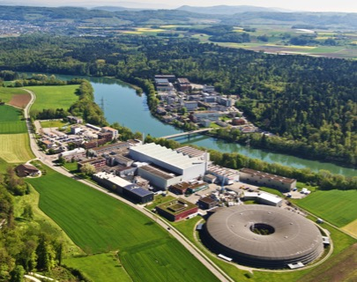
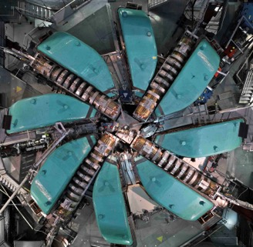
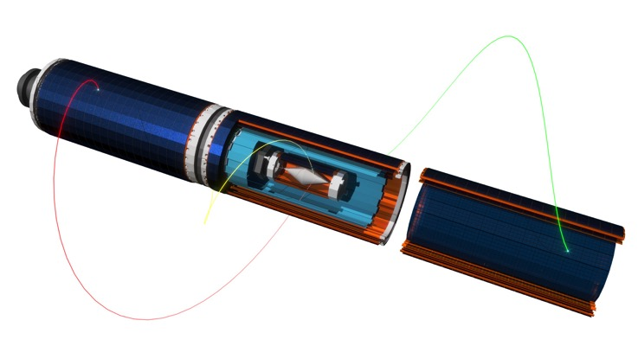
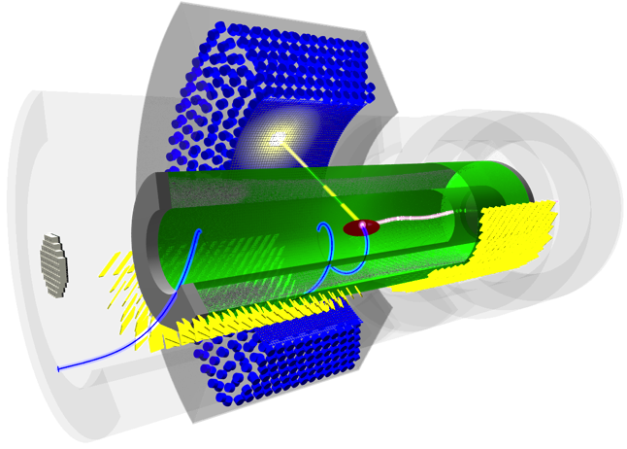
cLFV Experiments at PSI
High Intensity Proton
Accelerator facility:
590 MeV proton energy
2.4 mA proton current
1.4 MW power
MEG / MEG II
µ⁺→e⁺ɣ
Mu3e (Phase I+II)
µ⁺→e⁺e⁻e⁺
Sensitivity Goal
≈ 1 x10⁻¹⁶
Sensitivity Goal
≈ 4 x10⁻¹⁴

Slide 11
The MEG Experiment

Slide 12





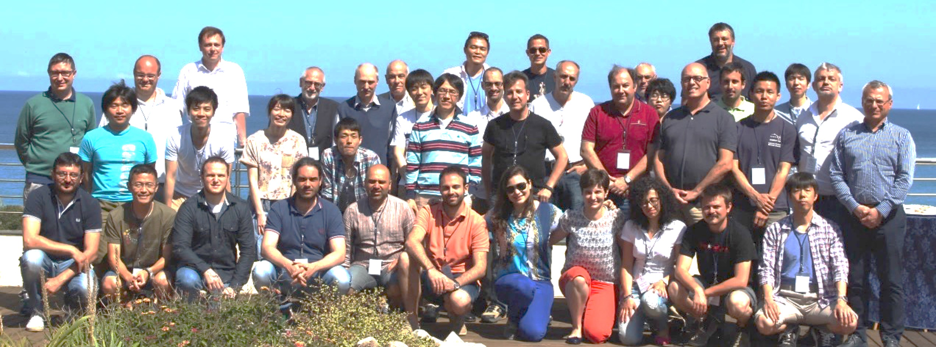
MEG Experiment at PSI
～70 researchers from 5 countries

Slide 13
Signal and Background μ→ e γ
Signal
Prompt Background
Accidental Background
52.8 MeV
< 52.8 MeV
γ
γ
γ
ν
ν
ν
μ
e
μ
μ
ν
180º
μ
e
ν
e
e
< 52.8 MeV
ν
52.8 MeV
< 52.8 MeV
μ→ e γ
θ_{γe} = 180º e and γ in time E_{e} = 52.8 MeV E_{γ} = 52.8 MeV

Slide 14
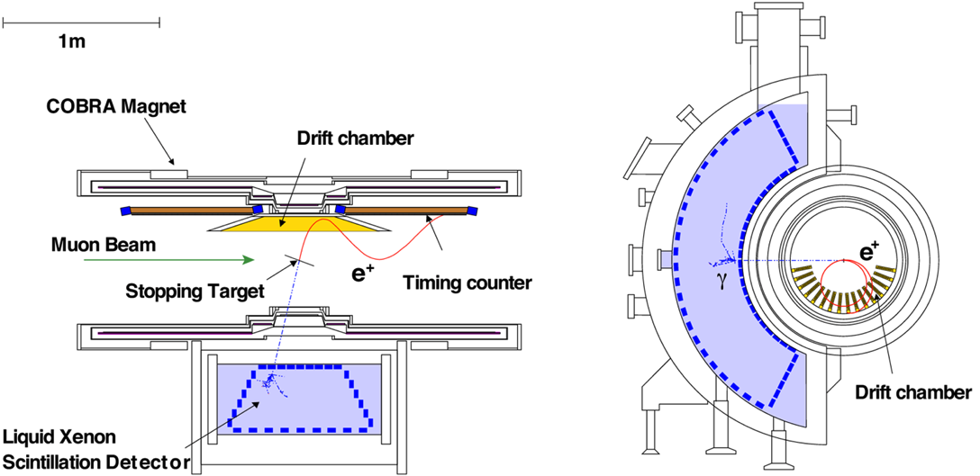
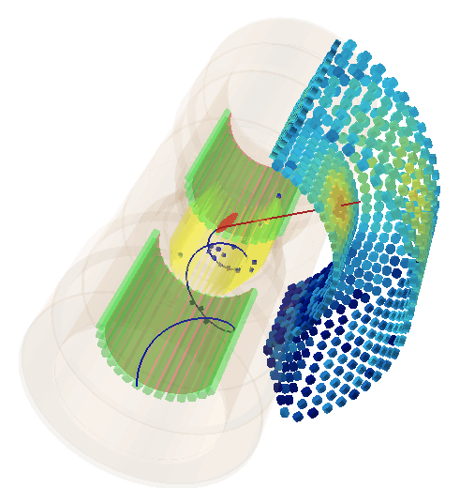
MEG Experiment Layout
COBRA Magnet
Gradient field s.c. 1.27 T magnet
sweeps out “high p_{T}” e⁺ quickly
Drift Chamber
Ultra-light material
Precise measurement
of e⁺ tracks
Muon Beam
Most intense DC
muon beam
up to 10⁸ μ/s
on target
μ⁺
Timing Counter
Resolution <100ps
in 1.4T B-field
γ
1m
Liquid Xenon Calorimeter
World’s largest LXe calorimeter
~900 l (2.7t) with 846 PMTs
immersed in Xenon
Lots of pioneering work
e⁺

Slide 15
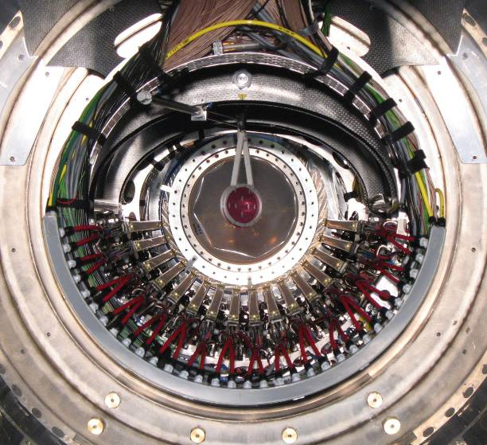
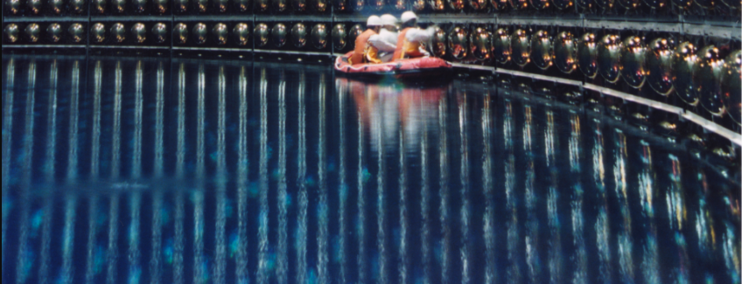
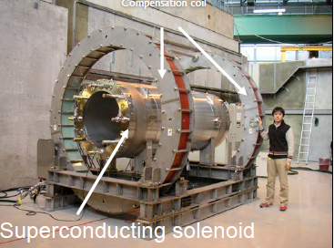
A few pictures
Stopping
Target
LXe calorimeter
assembly

Slide 16



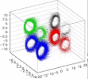

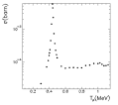

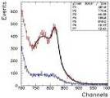

Calorimeter Calibrations
μ radiative decay
γ
Laser
LED
e
Lower beam intensity < 10⁷
to reduce pile-ups
A few days ~ 1 week to get enough statistics
μ
(rough) relative timing calib.
< 2~3 nsec
ν
ν
PMT Gain
Higher V with light att.
Can be repeated frequently
π⁰→ γγ
π⁻ + p → π⁰ + n
π⁰ → γγ (55MeV, 83MeV)
π⁻ + p → γ + n (129MeV)
10 days to scan all
volume precisely
LH₂ target
Laser
alpha
MEG Detector
Standard
Calibrations
e⁺
PMT QE & Att. L
Cold GXe LXe
γ
e⁻
Nickel γ Generator
Proton Acc
Li(p,γ)Be
LiF target at COBRA center
17.6MeV γ
~daily calib.
Can be used also for initial setup
9 MeV Nickel γ-line
off
on
K
Illuminate Xe from the back
Source (Cf) transferred by comp air → on/off
Bi
Tl
NaI
F
Li(p, γ1) at 14.6 MeV
3 cm
20 cm
Polyethylene
Li(p, γ0) at 17.6 MeV
0.25 cm Nickel plate
Absolute calibration, long term stability, continuous monitoring

Slide 17
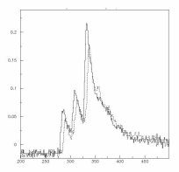
Requirements DAQ
Calorimeter Signals
Amplitude (charge) resolution 0.1% for liquid Xenon calorimeter
Time resolution < 100 ps
Pile-up rejection < 10 ns
0.511 MeV
< 52.8 MeV
~100ns
t
Waveform digitizing
> 1 GSPS
necessary !
100ns

Slide 18
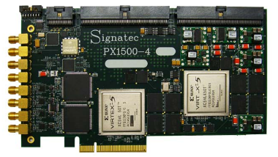
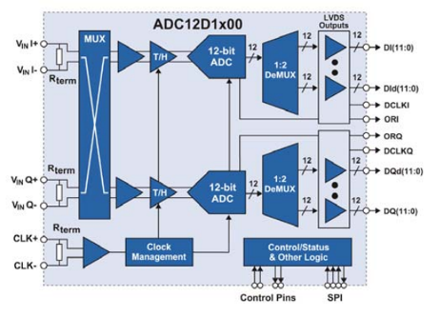
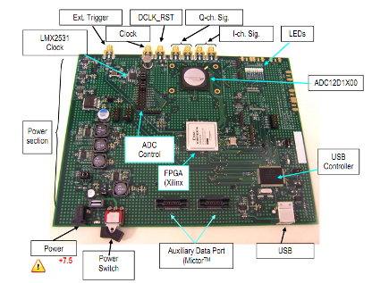
Flash ADC solutions
8 bits – 3 GS/s – 1.9 W → 24 Gbits/s
10 bits – 3 GS/s – 3.6 W → 30 Gbits/s
12 bits – 3.6 GS/s – 3.9 W → 43.2 Gbits/s
14 bits – 0.4 GS/s – 2.5 W → 5.6 Gbits/s
PX1500-4:
2 Channel
3 GS/s
8 bits
24x1.8 Gbits/s
1-20 k€ / channel
1.8 GHz!
ADC12D1X00RB:
1 Channel
1.8 GS/s
12 bits
Requires high-end FPGA
Complex board design
FPGA power

Slide 19
Switched Capacitor Array (SCA) Chips

Slide 20
Switched Capacitor Arrays
0.2-2 ns
10-100 mW
Inverter “Domino” ring chain
IN
Waveform
stored
Out
FADC
33 MHz
Clock
Shift Register
“Time stretcher” GHz → MHz

Slide 21
Time Stretch Ratio (TSR)
Typical values:
δt_{s} = 0.5 ns (2 GSPS)
δt_{d} = 30 ns (33 MHz)
→ TSR = 60
δt_{s}
IN
Clock
Out
Dead time =
Sampling Window ∙ TSR
(e.g. 100 ns ∙ 60 = 6 μs)
δt_{d}

Slide 22
Timing resolution estimation
voltage noise Δu
signal height U
timing uncertainty Δt
rise time t_{r}
number of samples on slope
Simplified estimation!

Slide 23
Achievable timing resolution
U | Δu | f_{s} | f_{3db} | Δt
100 mV | 1 mV | 2 GSPS | 300 MHz | ∼10 ps
1 V | 1 mV | 2 GSPS | 300 MHz | 1 ps
1V | 1 mV | 10 GSPS | 3 GHz | 0.1 ps
today:
optimized SNR:
next generation:
includes detector noise
in the frequency region of the rise time
D.A. Stricker-Shaver, S. Ritt, B.J. Pichler,
“Novel Calibration Method for Switched Capacitor Arrays Enables Time Measurements with Sub-Picosecond Resolution”,
IEEE Trans.Nucl.Sci. 61 (2014), 3607

Slide 24
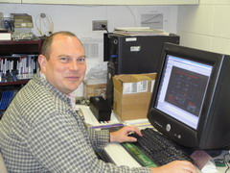
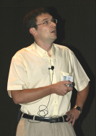

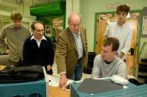





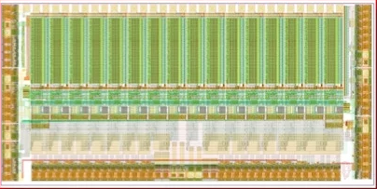
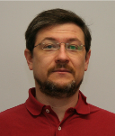

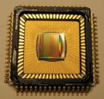
Switched Capacitor Arrays for Particle Physics
E. Delagnes
D. Breton
CEA Saclay
G. Varner, Univ. of Hawaii
H. Frisch et al., Univ. Chicago
STRAW3
LABRADOR3
TARGET
AFTER
SAM
SAMPIC
PSEC1 - PSEC4
0.13 μm IBM
Large Area Picosecond Photo-Detectors Project (LAPPD)
0.25 μm TSMC
Many chips for different projects
(Belle, Anita, IceCube …)
0.35 μm AMS, 0.18 μm IBM
T2K TPC, Antares, Hess2, CTA
www.phys.hawaii.edu/~idlab/
matacq.free.fr
psec.uchicago.edu
DRS1
DRS2
DRS3
DRS4
0.25 μm UMC
Universal chip for many applications
MEG experiment, MAGIC, Veritas,
TOF-PET
SR
R. Dinapoli
PSI, Switzerland
2002
2004
2007
2008
www.psi.ch/drs

Slide 25
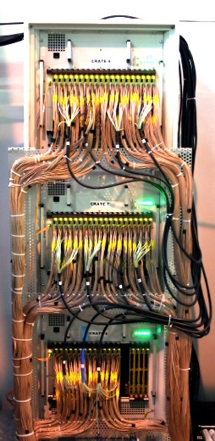
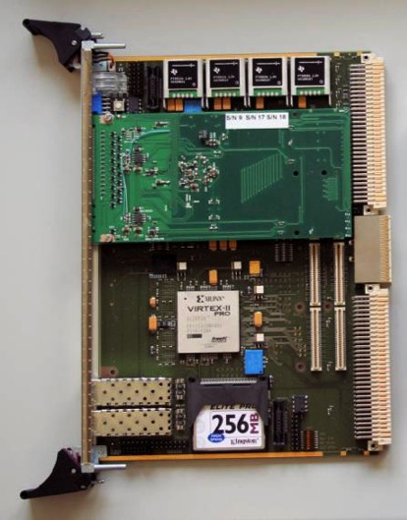
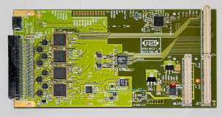
MEG Electronics 1999-2013
Separated
DAQ & Trigger & HV
VME based system
DRS4 piggy-back on general purpose FPGA board
Power
Trigger
Active
Splitter
Clock distribution
PMT
Trigger Bus
DRS4
DAQ
HV
DRS4
5 GSPS / 12 bit
3000 Channels DRS4
(0.8 GSPS / 1.6 GSPS)
1000 Channels Trigger (100 MSPS)
5 Racks

Slide 26
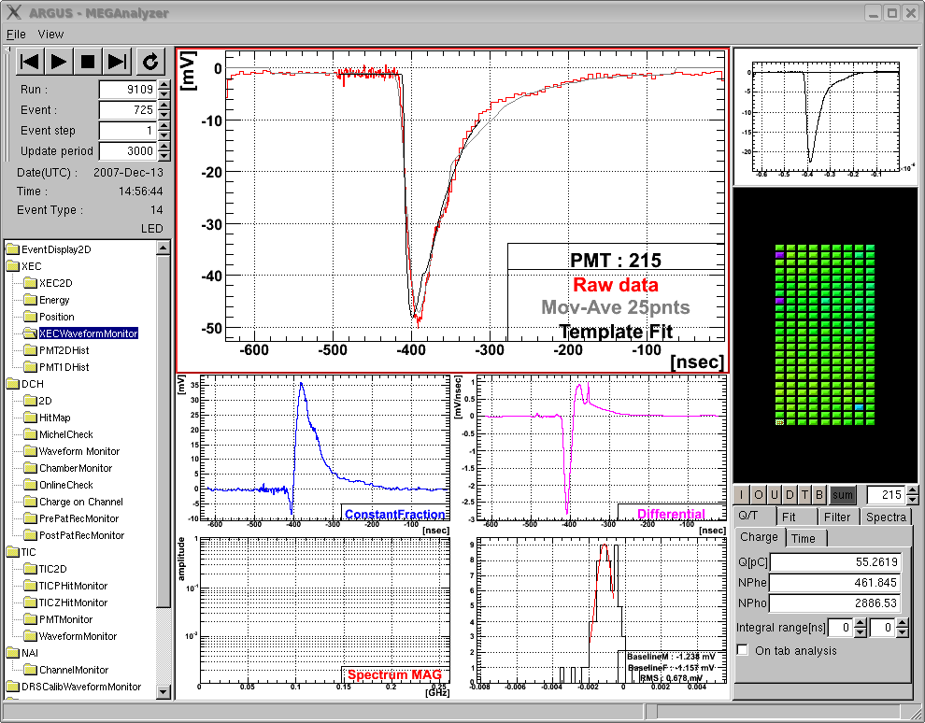
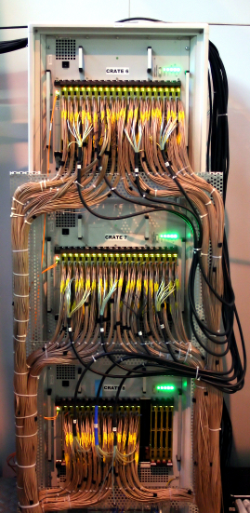
MEG on-line waveform display
“virtual oscilloscope”
γ
Σ848
PMTs
Liq. Xe
μ
template
fit
PMT
1.5m
Drawback: 400 TB data/year

Slide 27
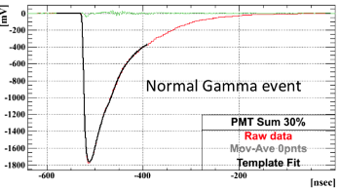
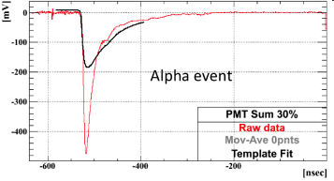
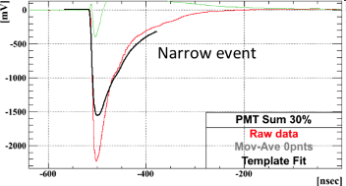
Pulse shape discrimination
γ
μ
γ
α
α
μ

Slide 28
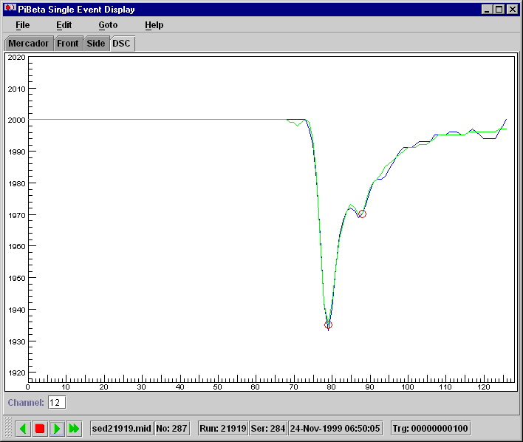
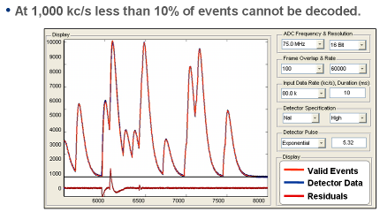
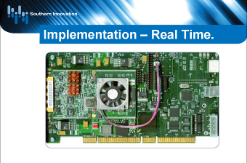
Template Fit
πβ Experiment
500 MHz sampling
Determine “standard” PMT pulse by
averaging over many events → “Template”
  Find hit in waveform
  Shift (“TDC”) and scale (“ADC”)
  template to hit
  Minimize c²
  Compare fit with waveform
  Repeat if above threshold
Store ADC & TDC values
14 bit
60 MHz
www.southerninnovation.com

Slide 29
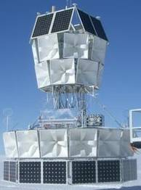
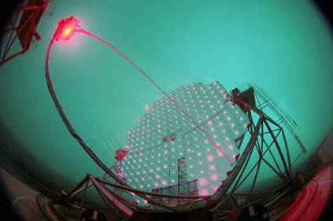
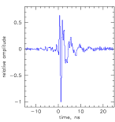
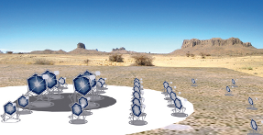
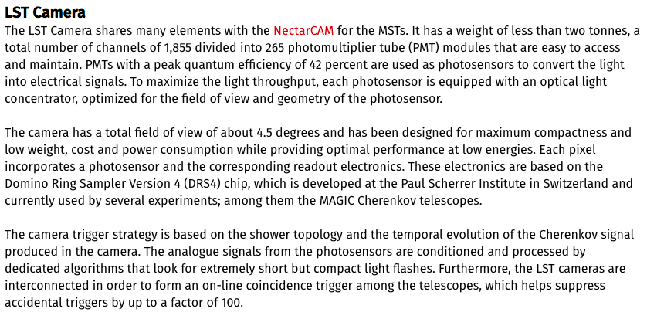
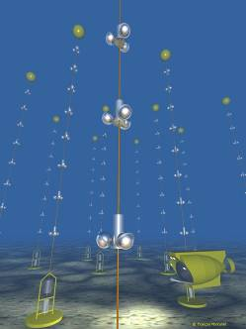
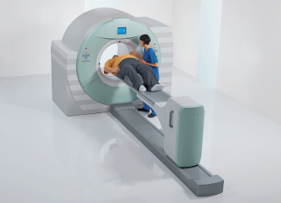

Other Applications
Gamma-ray astronomy
CTA
320 ps
Magic
Antares
(Mediterranean)
Antarctic Impulsive
Transient Antenna
(ANITA)
IceCube
(Antarctica)
ToF PET (Siemens)

Slide 30





Things you can buy
DRS4 chip (PSI)
32+2 channels
12 bit 5 GSPS
> 500 MHz analog BW
1024 sample points/chn.
110 μs dead time
MATACQ chip (CEA/IN2P3)
4 channels
14 bit 2 GSPS
300 MHz analog BW
2520 sample points/chn.
650 μs dead time
SAM Chip (CEA/IN2PD)
2 channels
12 bit 3.2 GSPS
300 MHz analog BW
256 sample points/chn.
On-board spectroscopy
DRS4 Evaluation Board
4 channels
12 bit 5 GSPS
750 MHz analog BW
1024 sample points/chn.
500 events/sec over USB 2.0

Slide 31
The MEG Result

Slide 32
Full MEG Dataset
NEW
double statistics
3 x 10¹⁴
5.7x10⁻¹³ (2013)
2 x 10¹⁴
Muons Stopped on Target
2.4x10⁻¹² (2011)
1 x 10¹⁴

Slide 33
MEG data analysis
3 years of heavy analysis work intentionally left blank...

Slide 34


Event distribution
52.8 MeV
γ
μ
180º
e
52.8 MeV
1, 1.64 and 2σ
contours on
signal PDF
No indication of signal excess
90% signal efficiency cut (74% for E_{γ}) for not displayed variables
Highest probability events differ in left and right plots.

Slide 35
Final MEG Result
Best fit to Data
N_{RMD} =625 ± 28
N_{acc} = 7739 ± 38
Signal PDF
(upper limit
magnified by 100)
Best fit: BR(μ→eγ) = -2.2 x 10⁻¹³, Upper Limit: BR(μ→eγ) ≦ 4.2 x 10⁻¹³

Slide 36

MEG Impact
L. Calibbi et al.
Eur. Phys. J. C74
(2014) 1-20
Antusch et al.
JHEP 0611 (2006) 090
MEG 2016
MEG 2016
Large parameter space for BSM models (SUSY) are already excluded by MEG

Slide 37


MEG: a “cover” experiment
Final MEG paper
Polarization Paper

Slide 38
The MEG II Experiment

Slide 39



MEG II
Increase beam intensity
3x10⁷ μ/s → 7x10⁷ μ/s
Improve detector resolutions to suppress increased background
PMT → SiPMT
(4000 channels, >1m²)
expected 2x better resolutions
Pixelated timing count
expected σ = 35 ps vs. 105 ps
New cylindrical drift chamber
efficiency 88% vs. 46%
hit resolution 120 μm
MEG I

Slide 40




A few recent pictures
Pixelated Timing Counter
Cylindrical Drift Chamber
Liquid Xenon Calorimeter

Slide 41
MEG vs. MEG II electronics
Power
MEG Experiment 1999-2013
Separated DAQ & Trigger
3000 Channels DRS4
(0.8 GSPS / 1.6 GSPS)
1000 Channels Trigger
(100 MSPS)
5 Racks
Trigger
Active
Splitter
Clock distribution
PMT
Trigger Bus
DRS4
DAQ
HV
DRS4
5 GSPS / 12 bit
MEG II Experiment 2015-
9000 Channels
Same rack space
  Avoid dead space between boards
  Combine DAQ & Trigger
  Integrate high voltage
Timing requirement
  O(10 ps) between any two channels
?
TDAQ
SiPM

Slide 42


Crate Options
Feature | VME | ATCA | ???
Transfer speed O(100 MB/s) | ✔ | ✔ | ✔
Dual-Star Topology with Gbit links | ✗ | ✔ | ✔
Shelf management | ✗ | ✔ | ✔
Fast trigger distribution | ✗ | ✗ | ✔
Low-jitter precision clock O(ps) | ✗ | ✗ | ✔
200 V SiPM biasing | ✗ | ✗ | ✔
< 2000 € per crate including power | ✗ | ✗ | ✔

Slide 43


Custom Design “WaveDAQ”
Standard 19” crate + custom backplane
Idea: Not only a solution for MEG II,
but more general “crate standard”
Take the best ideas on the market and combine them
  Single 24 V backplane power
  “Dual Star“ Serial gigabit links
  Serial bus (SPI) for configuration
  Hot-swap functionality
  Trigger / Busy signals in backplane
  Low skew (<5 ps) clock
  SiPM HV 200 V
  Shelf management
  with Ethernet interface
    Power
    Temperature
    Fans control
    Board management
    Firmware upload
Data Concentrator Board (DCB)
Trigger Concentrator Board (TCB)

Slide 44



Half Height Backplane
5.43 ps

Slide 45


WaveDREAM Board (WDB)
Spartan 6
5 GSPS
80 MSPS
Drs4 based REAdout Module

Slide 46



WaveDREAM2 HV
Microblaze @
Spartan
~ 20 $US / channel
+/- 1mV
Ripple < 10 μV

Slide 47
One-crate system Trigger & DAQ
Up to 256 Channels
Detector
Gbit Ethernet
220 V

Slide 48

MEG II System
Scaling up to 16k channels

Slide 49



WaveDAQ status
Successful beam test with stable operation
Noise level of
at 4 mV
@ gain 100 x
Multi-crate tests successful
Full 9000 channel system finished by end of 2017
Beam Test
4 Create Test
Trigger Test

Slide 50

Waveform display in browser with HTML5
http://midas.psi.ch/scope

Slide 51

Remote Data Visualization
Hardware
driver
Web-Server
Canvas
mongoose.h
mongoose.c
Internet
JavaScript
PC
Controller
FPGA with soft-core
AJAX
Browser with HTML5

Slide 52


Smartphone and Tablet

Slide 53

Outlook: DRS5
input
250 nm UMC → 110 nm UMC
Fast sampling stage: 10 GSPS with
analog bandwidth > 1.5 GHz
Secondary sampling stages:
  32 x N bins each, total 4096 bins
  Self-triggered
  Store segments for ~ms
  (global trigger)
  Simultaneous sampling and
  digitization (quasi dead-time free)
On-chip Wilkinson ADC with
fast serial link output
Successful test of 10 GSPS
sampling stage in 2015
Final chip not before 2019
Ideas partially implemented
in SAMPIC chip arXiv:1604.02385
shift register
. . . . . . . . . . . . . . . . . . . . . . . . . . . . . . . . .
fast sampling stage
secondary sampling stage

Slide 54



Conclusions
Final MEG result
BR(μ→eγ) ≦ 4.2 x 10⁻¹⁴ @ 90% C.L.
has been published in 2016
Technical developments took much
longer than anticipated (1999-2008)
If you design your tool in a more general way, it can be to the benefit of other groups

