Slide 1
初代星連星由来の連星ブラックホール重力波
衣川 智弥
東大宇宙線研
高エネルギー天体グループ
Notes:
Thank you for invitation today.
I’m Tomoya Kinugawa.
Last year, I was Ph.D student at Kyoto university. Now I’m PostDoc at ICRR.
Today, I will be talking about binary black hole remnant of first stars for gravitational wave sources.

Slide 2

自己紹介
出身地 山梨県
京大 天体核研究室➝宇宙線研
ポスドク1年目
研究テーマ 連星進化 初代星 重力波
趣味 酒 睡眠 居合 旅行
酒のみ友達募集中

Slide 3
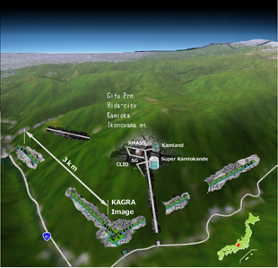
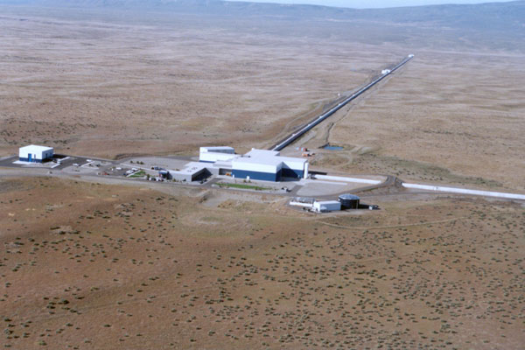
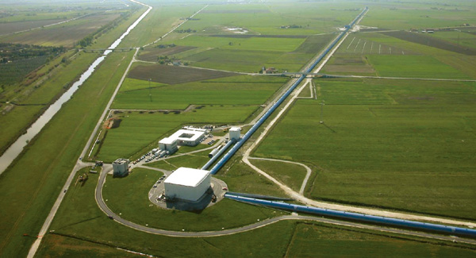
The beginning of Gravitational wave astronomy
Gravitational wave detectors
KAGRA Advanced LIGO Advanced VIRGO
©VIRGO
©KAGRA
©LIGO
Notes:
Nowadays, there are the gravitational wave detectors such as KAGRA adv. LIGO, VIRAGO.
KAGRA is the gravitational wave detector of Japan.
Adv. LIGO did observation run from last September to January.
They have detected the gravitational wave.

Slide 4
GW150914

Slide 5
GW150914
Notes:
The name of first gravitational wave event is GW one five o nine one four.
The luminosity distance is 400 Mega parsec.
Redshift is 0.09
Masses are 36 and 29 solarmass.
They are much heavier than the general BH candidate such as BH of X ray binary whose typical mass is 10 solarmass.

Slide 6
Pop III BH-BH?
ApJL Abbot. et al 2016
Notes:
Thus, GW150914 is different from conbentional BH candidates.
However, 30 Msun binary black holes have been already predicted by Pop III binary population synthesis.
Thus, LIGO paper said that “recently predicted BBH total masses agree astonishingly well with GW150914 and can have sufficiently long merger times to occur in the nearby universe (Kinugawa et al.2014)”
In this talk, I talk about Pop III binary population synthesis and why they become 30 solar mass binary black holes.

Slide 7
The main target of gravitational wave source
・Compact binary mergers
Binary neutron star (NS-NS)
Neutron star black hole binary (NS-BH)
Binary black hole (BH-BH)
©KAGRA
How many times can we detect compact binary mergers？
➝Estimated by the binary population synthesis
Notes:
First, I introduce the main target of GW source.
The main target of gravitational wave is the compact binary merger such as binary neutron star, neutron star black hole binary and binary black hole.
How many time can we detect compact binary mergers by gravitational wave detectors?
It is estimated by the binary population synthesis

Slide 8
How to calculate the event rate
NS-NS
We can get information from binary pulsar observations
・The empirical rate from pulsar observations (Kalogera et al. 2004,etc)
・Binary population synthesis(Belczynski et al. 2002, 2004, Dominik et al.2012,etc)
NS-BH,BH-BH
・Binary population synthesis
There were no observation until GW150914.
Thus, there is no other way except binary population synthesis
Notes:
In the case of NS-NS, there are two method to calculate detection rate.
There are binary pulsar observations.
Thus, we can estimate the empirical rate from binary pulsar observations.
The other method is a theoretical method, binary population synthesis.
Especially, in the case of NS-BH, BH-BH, there is no observation until GW150914.
Thus, there is no other way except the binary population synthesis.

Slide 9
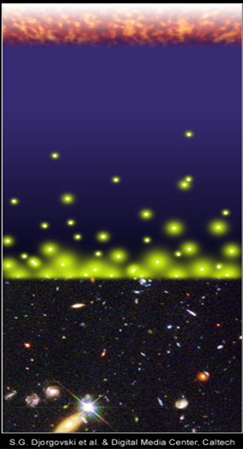
The binary population synthesis for gravitational event rate
Previous research: Pop I (Belczynski et al. 2002 etc)
Pop I stars are solar metal stars
The typical merger time of compact binaries ~10⁸⁻¹⁰yr
The accumulation of GWs from the early universe
We must consider binaries which born at the early universe.
Big Bang
merger
merger
time
Djorgovski et al.&Degital Media Center
Notes:
The previous research is Pop I binary population synthesis.
However, the typical merger time of compact binaries due to gravitational radiation is too long.
So, even though the binary born at the early universe, they can merge at the present day.
Thus, the accumulation of GW sources from the early universe is important.
We must consider binaries which born at the early universe.

Slide 10
Our target
Population III (Pop III) stars are the first stars after the Big Bang.
Big Bang
Pop III binaries
Pop III binaries
merger
merger
time
Djorgovski et al.&Degital Media Center
Notes:
Therefore, our target is Pop III binaries.
Population III stars are the first stars after the Big Bang.
There are no observation of Pop III stars, because they born and died at the early universe.
However, they maybe exist as the gravitational wave source.

Slide 11
Pop III star and Pop III binary
Population III (Pop III) stars are the first stars after the Bing Bang.
Binary fraction of Pop III stars ～1/2
(Stacy et al. 2013, Susa et al. 2014)
Merger timescale due to gravitational radiation may be so long that Pop III binaries merge at the present day.
Big Bang
Pop III binaries
merger
merger
time
Djorgovski et al.&Degital Media Center
Notes:
In recent simulations, the binary fraction is suggested as one half.
So, they possibly form the binary .
In general, The typical merger time is too long.
So, even though the binary born at the early universe, they can merge at the present day.
Therefore, we consider Pop III binaries as the gravitational wave source.

Slide 12
The differences between Pop III and Pop I
 | Pop I stars (Sun like stars)
Metallicity | ２％
Radius | Large
Typical Mass | 1 Msun
Wind mass loss | effective
Pop III stars
0
Small
10-100 Msun
Not effective
Pop III binaries are easier to be massive compact binary
Notes:
This table shows the differences between Pop III and Pop I.
Pop III is no metal star.
The radius is small, the typical mass is large, and wind mass loss is not effective.
Thus, Pop III binaries are easier to be massive compact binary.

Slide 13
Method
Notes:
Next, I talk about the calculation method.

Slide 14
How to calculate binaries?
1. Initial M1,M2,a,e determined
2. Stellar evolutions
NS-NS,NS-BH,
BH-BH
4. Calculate merger time
5. Repeat this calculation
Not compact binary
survive
Stop calculation
3. Binary interactions
M1,M2,a,e change
Merge or disrupt

Slide 15
Binary Interactions
Tidal friction
Mass transfer
Common envelope
Supernova effect
Gravitational radiation
Tidal friction
Mass transfer
Change
M1,M2,a, e
Common envelope
SN
Supernova effect
Gravitational Waves
We need to specify some parameters to calculate these effects.
We use the parameters adopted for Pop I population synthesis in Our standard model.
Notes:
In order to calculate pop III binary population synthesis, we consider the binary interactions.
These binary interactions change binary parameters such as primary mass, secondary mass, separation and eccentricity.
We need to specify some parameters to calculate these effects.
We use the parameters adopted for Pop I population synthesis in our standard model.

Slide 16
Pop III binary population synthesis
We simulate 10⁶ Pop III-binary evolutions and estimate how many binaries become compact binary which merges within Hubble time.
×84 models
Initial stellar parameters are decided by Monte Carlo method with initial distribution functions
Initial parameter (M1,M2,a,e) distribution in our standard model
M1 : Flat (10 M<M<100 M)
q=M2/M1 : P(q)=const. (0<q<1)
a : P(a)∝1/a (a_{min}<a<10⁶R)
e : P(e)∝e (0<e<1)
The same distribution functions adopted for Pop I population synthesis

Slide 17
Result

Slide 18
Results
The numbers of the compact binaries which merge within
Hubble time for 10⁶ binaries
Our standard model
A lot of Pop III BH-BH binaries form and merge within Hubble time
Close NS binaries do not form

Slide 19
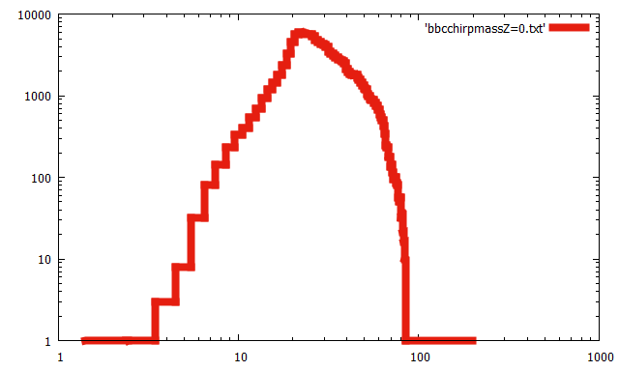
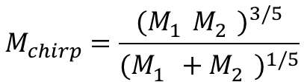
Pop III BH-BH chirp mass distribution
Typical mass
M～30 M
$$M_{chirp}=\frac{{(M_{1}^{}M_{2}^{})}^{3/5}}{{(M_{1}^{}+M_{2}^{})}^{1/5}}$$
Z=0 (Pop III)
Chirp mass [M]
Notes:
This figure describe the Pop III BH-BH chirp mass distribution.
The horizontal axis is the chirp mass.
The vertical axis is the number distribution in the total number 10 to the sixth.
In our result, the typical mass is about 30 solar mass.
Nothe that the chirp mass look like light than intlingic mass.
For example, 25+25 BHBH’s chirp mass is about 21 msun.
30+30 become 26Msun

Slide 20
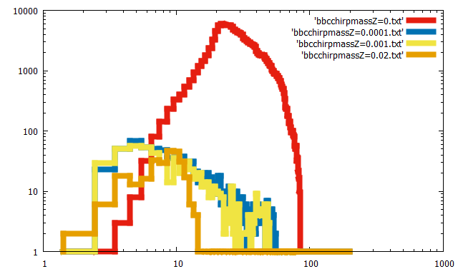
The difference of chirp mass distribution
Typical chirp mass
M～30 M
Z=0
Z=0.001
e.g. Pop I, Pop II
(Z=0.02,0.001,0.0001)
IMF:Salpeter
Typical mass ～10 M
Z=0.0001
Z=0.02
=Zsun
Chirp mass [M]
Notes:
In order to compare the other metallicity case such as Pop I and Pop II stars, we calculate the other metallicity case using our population synthesis code.
In the other metallicity case, the typical mass is about ten solar mass and the peak is several solar mass.
Therefore, the Pop III BH-BH chirp mass and the peak of the chirp mass distribution is more massive than those of the other metallicity.

Slide 21
Merged Pop III BH mass and spin distributions
GW150914
GW150914
Kinugawa, Nakano and Nakamura 2016

Slide 22
The star formation rate of Pop III
In order to calculate merger rate,
we need to know
・When were Pop III stars born?
・How many Pop III stars were born?
⇒Star formation rate

Slide 23
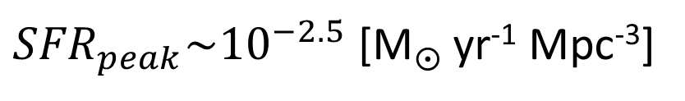
Pop III SFR (de Souza et al. 2011)
We adopt the Pop III SFR
by de Souza et al. 2011
Semi-analytical model
ΛCDM cosmological simulation
+
・radiation feedback
・metal pollution
・star formation
Star formation rate [M yr⁻¹ Mpc⁻³]
${SFR}_{peak}\sim {10}^{−2.5}$ [M yr⁻¹ Mpc⁻³]
Redshift z
(de Souza et al. 2011)

Slide 24
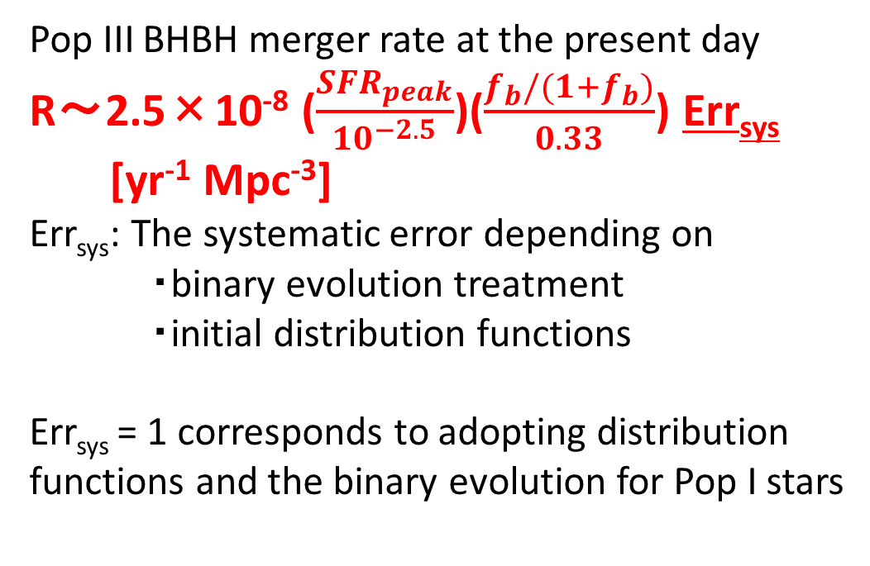
The Pop III BH-BH merger rate
10⁻⁶
10⁻⁷
10⁻⁸
10⁻⁹
10⁻¹⁰
10⁻¹¹
10⁻¹²
10⁻¹³
10⁻¹⁴
IMF: Flat
Pop III BHBH merger rate at the present day
R～2.5×10⁻⁸ ($\frac{{SFR}_{peak}}{{10}^{−2.5}}$)($\frac{f_{b}/(1+f_{b})}{0.33}$) Err_{sys}
[yr⁻¹ Mpc⁻³]
Err_{sys}: The systematic error depending on
・binary evolution treatment
・initial distribution functions
Err_{sys} = 1 corresponds to adopting distribution functions and the binary evolution for Pop I stars
R(t) [yr⁻¹ Mpc⁻³]
Pop III star formation region
40 35 30 25 20 15 10 5 0
Redshift z

Slide 25
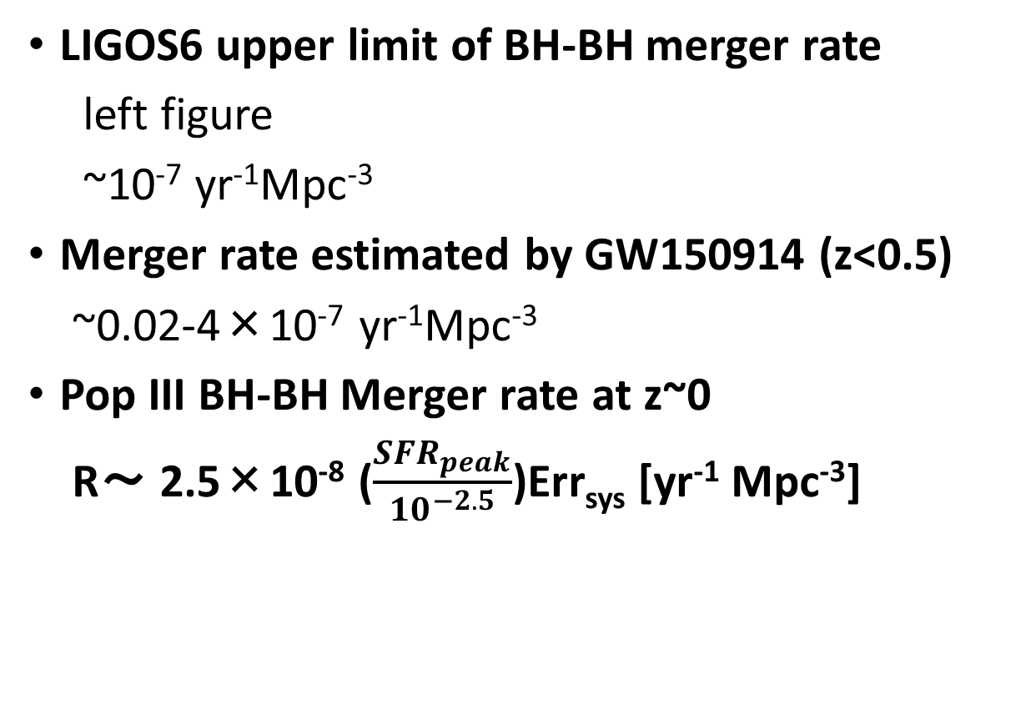
Consistency with LIGOS6 and Acv.LIGO
LIGOS6 upper limit of BH-BH merger rate
left figure
~10⁻⁷ yr⁻¹Mpc⁻³
Merger rate estimated by GW150914 (z<0.5)
~0.02-4×10⁻⁷ yr⁻¹Mpc⁻³
Pop III BH-BH Merger rate at z~0
R～ 2.5×10⁻⁸ ($\frac{{SFR}_{peak}}{{10}^{−2.5}}$)Err_{sys} [yr⁻¹ Mpc⁻³]
Our result is consistent with LIGO
Aasi, Abadie, Abbott et al. (2013)

Slide 26
Detection range of KAGRA and Adv. LIGO
M_{BH}～30M SNR=8
Redshift z
SNR=8
For QNM
Luminocity distance
～1.5 Gpc
Redshift z～0.28
SNR=8
For inspiral
Mass of one star [M]
©Kanda
Notes:
This figure is the detection range of KAGRA
The horizontal axis is the mass of one star.
The vertical axis is the red shift or luminosity distance of detection range.

Slide 27
Inspiral and QNM
merge
inspriral
QNM

Slide 28
Detection range of KAGRA and Adv. LIGO
M_{BH}～30M SNR=8
Redshift z
SNR=8
For QNM
Luminocity distance
～1.5 Gpc
Redshift z～0.28
SNR=8
For inspiral
Mass of one star [M]
©Kanda
Notes:
This figure is the detection range of KAGRA
The horizontal axis is the mass of one star.
The vertical axis is the red shift or luminosity distance of detection range.

Slide 29
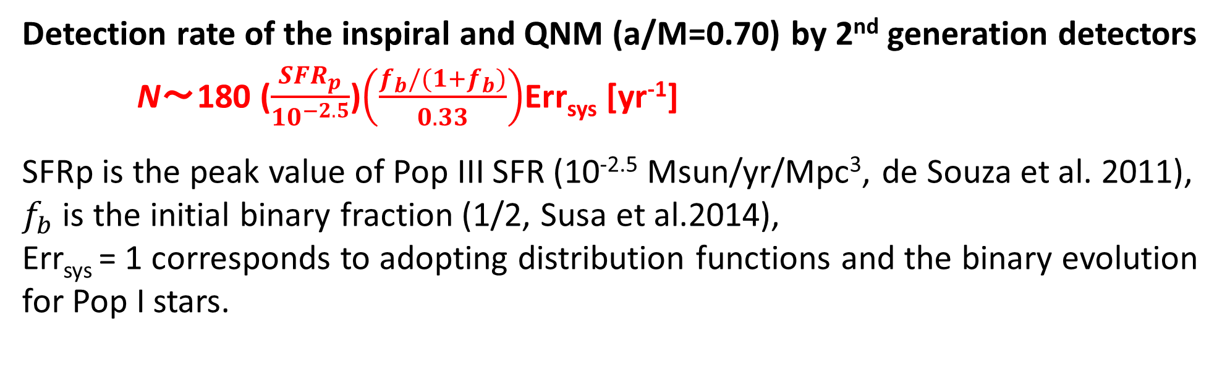
Detection rate
Detection rate of the inspiral and QNM (a/M=0.70) by 2nd generation detectors
N～180 ($\frac{{SFR}_{p}}{{10}^{−2.5}}$)$\left(\frac{f_{b}/(1+f_{b})}{0.33}\right)$Err_{sys} [yr⁻¹]
SFRp is the peak value of Pop III SFR (10^{-2.5} Msun/yr/Mpc³, de Souza et al. 2011),
$f_{b}$ is the initial binary fraction (1/2, Susa et al.2014),
Err_{sys} = 1 corresponds to adopting distribution functions and the binary evolution for Pop I stars.
To evaluate the robustness of the chirp mass distribution and the range of Err_{sys}, we examine the dependence of the results on the unknown parameters and the initial distribution functions.
Notes:
Using that detection range, we calculate the detection rate.

Slide 30
Errsys (Example)
 | Errsys
Standard | (180 /yr)
Mass range: (10M<M< 100 M or 140 M) | 1~3.4
IMF:Flat,M⁻¹,Salpeter | 0.42~1
IEF:f(e)∝e,const.,e^{-0.5} | 0.94~1
SN natal kick:V=0,100,300 km/s | 0.2~1
CE:αλ=0.01,0.1,1,10 | 0.21~1
Mass transfer (mass loss fraction): β=0, 0.5, 1 | 0.67~1.3
Worst | 0.046
On the other hand, the typical chirp mass is not changed (~30 Msun).
Notes:
This table is the example of parameter dependence of Errsys.
We change the mass range, the initial distribution functions such as Initial mass function and initial eccentricity function.
And change the binary parameters such as SN natal kick velocity, common envelope parameters, and the parameter of the lose fraction of transferred stellar
Mass.
In our standard model choose red ones
In order to consider the lower boundary of Errsys,
We consider the worst model.
In the Worst model I choose the worst parameters in each parameter region, blue ones.
It is unlikely case
Errsys change from 0.046 to 4
On the other hand, the typical mass is not changed (~30 Msun)

Slide 31
Why Pop III binaries become 30Msun BH-BH
M>50Msun red giant
➝Mass transfer is unstable
➝common envelope
➝1/3~1/2 of initial mass
(~25-30Msun)
M<50Msun blue giant
➝Mass transfer is stable
➝mass loss is not so effective
➝2/3~1 of initial mass (25-30Msun)
Notes:
Why do Pop III binaries become 30 Msun Binary black holes?
This is HR diagram of Pop III.
The pop III whose mass is larger than 50 solarmass evolve as the red giant.
The mass transfer of red giant is generally unstable and it becomes the common envelope phase.
Thus, they lose the envelope and they become light.
Therefore, the BH mass become about 30 solar mass.
On the other hand, the Pop III whose mass is less than 50 solar mass evolve as a blue giant.
The mass transfer is stable and mass loss is not so effective.
Thus, they become about 30 solar mass BH.
So, Due to these two evolution path, the peak of BHBH mass is about 30 solar mass.
It does not depend on the IMF and binary parameters.
It only depends on the Pop Iii stellar evolution.

Slide 32

Pop III BH-BH
Errsys=0.046~4
⇒Detection rate R～8.3-720 ($\frac{{SFR}_{peak}}{{10}^{−2.5}}$) $\left(\frac{f_{b}/(1+f_{b})}{0.33}\right)$ [yr⁻¹ ](S/N>8)
expected O1’s rate=above rate/3³/4～above rate/100
Chirp mass M～30 M
We might detect the Pop III BH-BH by GW
1. We might see BH QNM from Pop III BH-BH
➝ We might check GR by Pop III BH QNM
2. The chirp mass distribution might distinguish Pop III from Pop I, Pop II
➝The evidence of Pop III star
Notes:
If the chirp mass distribution can not distinguish Pop III, we can confirm Pop III BHBH future observation.

Slide 33
Other Pop III SFRs
SPH simulation
(Johnson et al. 2013)
SFRp~ 10⁻³-10⁻⁴ Msun/yr/Mpc³
Constraints by Planck
(e.g.Hartwig et al.2016, Inayoshi et al.2016)
optical depth of Thomson scattering
total Pop III density≲10⁴⁻⁵ Msun/Mpc³
by Visbal et al.2015

Slide 34
future plan of GW observer : pre-DECIGO and DECIGO
DECIGO: Japanese space gravitational wave observatory project
Pre-DECIGO: test version of DECIGO
Pre-DECIGO : z~10 (30 Msun BH-BH)
~10⁵ events/yr
DECIGO can see Pop III BH-BHs
when Pop III stars were born!
(Nakamura, Ando, TK et al. in prep)
These range are been checking now
This is preliminary result
Kawamura et al. 2011
Notes:
If we cannot distinguish Pop III from Pop I, Pop II, we consider the confirmation by the future gravitational wave observatory such as DECIGO.
DECIGO is the Japanese space gravitational wave observatory project.
It has good sensitivity from 0.1 Hz to 10 Hz.
Pre-DECIGO is test version.
Pre-DECIGO might see such binary black holes up to redshift 30.
The expected detection rate is about 10 to fifth per yr.
We estimated these range at DECIGO meeting two weeks ago.
These range is been checking now.
The SFR of Pop III has the peak at z~10.
Thus, it can see pop III BHBH when they were born.
Furthermore, we check the redshift dependence of high mass BHBH mergers.

Slide 35
Appendix

Slide 36
Quasi normal mode
fc is frequency of QNM
Q is the quality factor of QNM which relate to the attenuation of QNM

Slide 39
Why do Pop III stars have these properties?
Zero metal stars
-No line cooling and dust cooling at the star formation
-High temperature and high Jeans mass (M_{J}∝T^{3/2})
⇒More massive than Pop I stars (Pop I stars are solar like stars)
The typical mass is 10-100M
-Missing metal and dust i.e. missing powerful opacity source
-The stellar photosphere become small
⇒Smaller radius than Pop I stars
-Stellar wind is driven by radiation pressure on resonance lines of
heavier ions or dust grains
-However, Pop III stars do not have heavier ion and dust grain
⇒No wind mass loss
Notes:
Why do pop III stars nave these properties/
The reason is no metal.
Hosoku: the jeans mass is the critical mass to collapse.
we can say the cloud will collapse if its mass is bigger than the Jean's mass

Slide 40
Pop I and Pop II case (Dominik et al. 2015)
From 1/200 Zsun to 1.5 Zsun
BH-BH detection rate (Their standard model) ~300/yr
25% of above rate is >20 Msun BHBH
Thus, Detection rate of high mass BHBH ~80/yr

Slide 41
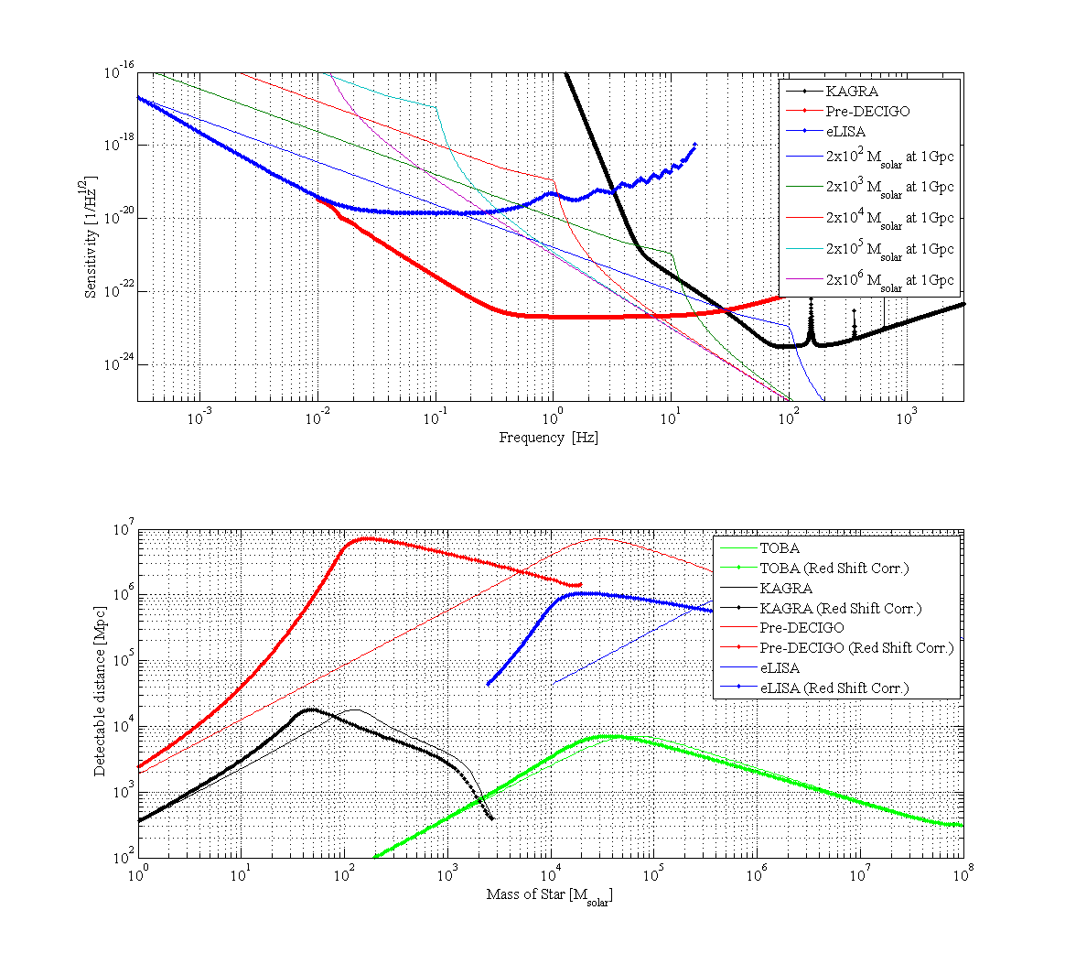

Slide 43
DECIGOの感度曲線
Pop III のSFRのピークはz~9
Red shift chirp mass=(1+z)Mc
Pop III BHBH (z~9) ⇒300 Msun (10Hz)
Kawamura et al. 2011

Slide 44
How to calculate the event rate
NS-NS
We can get information from binary pulsar observations
・The empirical rate from pulsar observations (Kalogera et al. 2004,etc)
・Binary population synthesis(Belczynski et al. 2002, 2004, Dominik et al.2012,etc)
NS-BH,BH-BH
・Binary population synthesis
There is no observation.
Thus, there is no other way except binary population synthesis
Notes:
How to calculate the event rate?
In the case of NS-NS, there are two method to calculate detection rate.
There are binary pulsar observations.
Thus, we can estimate the empirical rate from binary pulsar observations.
The other method is a theoretical method, binary population synthesis.
On the other hand, in the case of NS-BH, BH-BH, there is no observation.
Thus, there is no other way except the binary population synthesis.
In this talk, I focus on the binary population synthesis.

Slide 45
merger rate calculated by population synthesis
Pop I galactic merger rate [Myr⁻¹]
Dominik et al.(2012)
These merger rates are calculated by Population synthesis (PS).
There are wide differences between models.
I will talk about what is PS and what determine the merger rates.
Notes:
This table is the galactic merger rates of Pop I compact binaries calculated by the binary population synthesis.
Pop I is a solar metal stars.
However, there are some uncertainties and there are wide differences between models.
The merger rate change by a factor of several hundreds.
I will talk about what is population synthesis and what determine the merger rates.

Slide 46
Binary Interactions
Supernova effect
Common envelope
Stable mass transfer
Orbital evolution
(Tidal friction, Gravitational radiation)
In this talk, I will explain these two binary interactions.
Notes:
I introduce the binary interactions
Supernova effect, common envelope, Stable mass transfer, orbital evolution such as tidal friction, gravitational radiation.
These binary interactions change binary parameters such as primary mass, secondary mass, separation and eccentricity.
In this talk, I will explain these two binary interactions

Slide 47
Supernova(SN) effect
For example, we consider NS and NS progenitor binary.
NS
(1.4-2M)
NS progenitor
(8-25M)
When NS progenitor becomes supernova, NS progenitor suddenly loses mass and becomes NS.
Then, due to instant mass loss the binding energy of binary decreases and binary NS disrupts.
SN
Binary NS cannot survive!
disrupt
But in fact binary pulsars have been observed.
Why can binary NS survive?
This reason is common envelope.

Slide 48
Common envelope (CE)
CE is unstable mass transfer phase.
Primary star becomes giant and primary radius becomes large.
Secondary star plunges in primary envelope.
The friction occurs between secondary and primary envelope and transfers angular momentum and energy from orbit to envelope. Due to orbital energy transfer separation decreases and envelope expands and will be expelled.
Binary becomes close binary or merges during CE.
4
1
2
3
Secondary
Primary

Slide 49
Can NS binary survive via CE?
We consider NS and NS progenitor binary again.
NS(1.4-2M)
8-20M
no CE
CE
SN
If CE occurs, envelope was already expelled before SN.
Thus, mass ejection at SN becomes smaller than SN mass ejection via no CE.
Due to small mass ejection at SN the loss of binding energy becomes small.
Binary can survive !
Therefore, Common Envelope is important.
2-6M
disrupt
SN

Slide 50
The treatment of CE
We assume the fraction of the orbital energy is used to expel envelope.
We use simple energy formalism in order to calculate separation after CE a_{f}
For given Mcore1, Menv1 M2, initial separation a_{i}
a_{i}
a_{f}
Assuming efficiency of
mass ejection
Final separation a_{f}
The loss of orbital energy
the energy required to expel envelope
α: the efficiency of energy transfer from orbit to envelope
λ: the binding energy parameter
These common envelope parameters are uncertain.
・How much the orbital energy can be used to expel envelope?
・How much the internal energy of envelope is used to expel envelope?
Notes:
I explain the treatment of CE.
We assume the fraction of the orbital energy is used to expel envelope.
We use simple energy formalism in order to calculate separation after CE af.
The left hand side is the loss of the orbital energy and the right hand side is the energy required to expel envelope.
Alpha is the efficiency of energy transfer from orbit to envelope.
Lambda is the binding energy parameter.
For given primary core mass, primary envelope mass, initial separation ai and assuming alpha and lambda, we canget the separation after common envelope.
However, these common envelope parameters are uncertain.
How much the orbital energy can be used to expel envelope?
How much the internal energy of envelope is used to expel envelope?

Slide 51
The rate dependence on CE parameters
The loss of orbital energy
the energy required to expel envelope
Separation after CE a_{f} is dependent on CE parameters.
For simplicity, α=1.
If λ is large i.e, the energy required to expel envelope is small,
the loss of orbital energy during CE becomes small and a_{f} is large.
If a_{f} is large, binary tend not to merge during CE and can survive.
However, if a_{f} is too large, binary cannot merge within Hubble time due to GW.
・The number of merger during CE Merger rates
・Merger timescale t_{GW}∝a⁴ Merger rates
λ
a_{f}

Slide 52
The dependence on CE parameters
For example, we consider how Pop I NS-NS merger rate depend on CE parameters.
Pop I NSNS merger rate [Myr⁻¹ galaxy⁻¹] Dominik et al.2012
αλ
a_{f}
・The number of coalescence during CE Merger rates
・Merger timescale t_{GW}∝a⁴ Merger rates
Notes:
Let consider the dependence on the CE parameters.
This table is the pop I binary NS merger rate.
We assume alpha is unity, and change the lamda from 0.01 to 10.
First, due to the number of coalescence during CE is decrease the merger rate increase.
However lambda become larger than 1, the merger timescale become too long. Thus the merger rate decrease.
Therefore, these parameter change merger rate by a factor of hundred.
This is the big problem of the population synthesis and binary evolution study.

Slide 53
Binary population synthesis
Population synthesis is a method of numerical simulation to research the population of stars with a complex evolutions.
Population synthesis can predict properties and merger rates of unobserved sources such as NS-BH, BH-BH
The common envelope of the key process of population synthesis
However, Common envelope parameters are uncertain.
This uncertainty change event rate by a factor of several hundreds.
We should reveal this uncertainty via comparison between result of population synthesis and observations such as GW and other observations and improve binary evolution theory

Slide 54
Example: CE dependence
We calculate αλ=0.01, 0.1, 1, 10 cases N_{total}=10⁶
The number of merged Pop III BH-BH change by a factor of several.
On the other hand, Pop I merger rates changed by a factor of several hundreds.
What is the reason?

Slide 55
Pop III stars evolve as the blue giant.
Pop III stars evolve as the blue giant.
Thus, Pop III giants do not so expand and tend not to become the common envelope phase.
Therefore, Pop III binary evolution is not so dependent on the common envelope parameters.
log L
log Teff
Notes:
Hosoku:In the case of Pop III, there are no Hertzsprung gap phase in which the star expand to giant. The He burning phase start soon after the main sequence.
The reason is the high core temperature.
The Pop III star have no carvon, so they first occur the p-p chain. The power law of the temperature dependence of the pp chain energy release is lower than the CNO cycle.
Thus, the Pop III core have high temperature and they will start 3-alpha reaction early phase in the MS phase.

Slide 56
Why do Pop III stars have these properties?
Zero metal stars
-No line cooling and dust cooling at the star formation
-High temperature and high Jeans mass (M_{J}∝T^{3/2})
⇒More massive than Pop I stars (Pop I stars are solar like stars)
The typical mass is 10-100M
-Missing metal and dust i.e. missing powerful opacity source
-The stellar photosphere become small
⇒Smaller radius than Pop I stars
-Stellar wind is driven by radiation pressure on resonance lines of
heavier ions or dust grains
-However, Pop III stars do not have heavier ion and dust grain
⇒No wind mass loss
Notes:
Hosoku: the jeans mass is the critical mass to collapse.
we can say the cloud will collapse if its mass is bigger than the Jean's mass

Slide 59
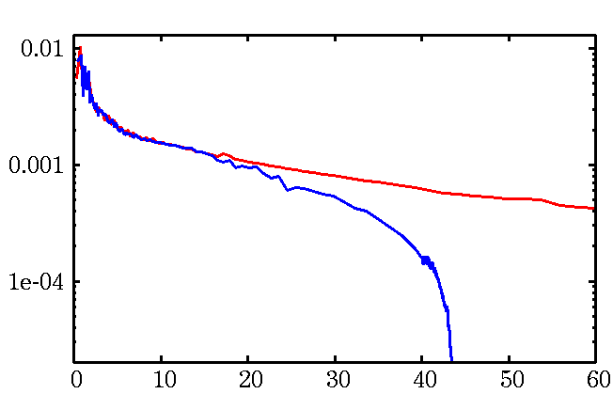
What is the expected Mass of Pop III stars ?
Without UV feedback
The typical mass about 10³ M
(Omukai & Palla 2003,etc.)
With UV feedback
The typical mass 10-100 M
(Hosokawa et al. 2011, 2012)
Without Feedback
With Feedback
Hosokawa et al. 2011
Pop III stars → 10-100 M compact binary

Slide 60
IMF
・Pop I
Salpeter
Pop III
Flat？
Log Flat？
Log N
Stacy & Bromm 2013
∝M^{-2.35}
0 2
Log M
Hirano et al.2014 Susa et al. 2014

Slide 61
IMF dependence

Slide 62
Uncertainties of Pop III binary population synthesis
Initial condition
IMF
mass ratio
separation
eccentricity
Binary interactions
Common envelope
Mass transfer
Supernova kick

Slide 63
eccentricity distributions
General eccentricity distribution (Heggie 1975)
P(e)∝e (Standard)
CygnusOB2 association（Kobulnicky et al. 2014）
P(e)=const.
Observations of O stars(M>15Msun) (Sana et al.2012)
P(e)∝e^{-0.5}

Slide 64
eccentricity dependence

Slide 65
Uncertainties of Pop III binary population synthesis
Initial condition
IMF
mass ratio
separation
eccentricity
Binary interactions
Common envelope
Mass transfer
Supernova kick

Slide 66

Mass transfer
β=0：conservative
1>β>0：non conservative
In Standard model, we use the fitting function
This is fitted for Pop I stars.
Thus, we check β=0,0.5,1 cases.
Secondary is MS or He-burning
(Hurley et al. 2002)
$$\dot{M_{2}}=\dot{−M_{1}}$$
Secondary is giant

Slide 67
Mass transfer dependence

Slide 68
Supernova kick
Pulsar kick ~200-500km/s
Pulsar observation suggest NSs have the natal kick at the SN.
BHXRBs have large distance from galactic plane.
Black hole natal kick? （Repetto,Davis&Sigurdsson2012）
⇒We check the kick dependence.
σ=0km/s (Standard)、σ=100km/s、σ=300km/s

Slide 69
SN kick dependence

Slide 70
Detection range of KAGRA and Adv. LIGO
M_{BH}～30M SNR=8
Redshift z
SNR=8
For QNM
Luminocity distance
～1.5 Gpc
Redshift z～0.28
SNR=8
For merge
Mass of one star [M]
©Kanda

Slide 71
重力波検出のノイズ
散射雑音・・・レーザー由来の雑音
熱振動・・・熱振動による雑音
地面振動・・・地面振動による雑音 10Hz以下で効いてくる

