Slide 1
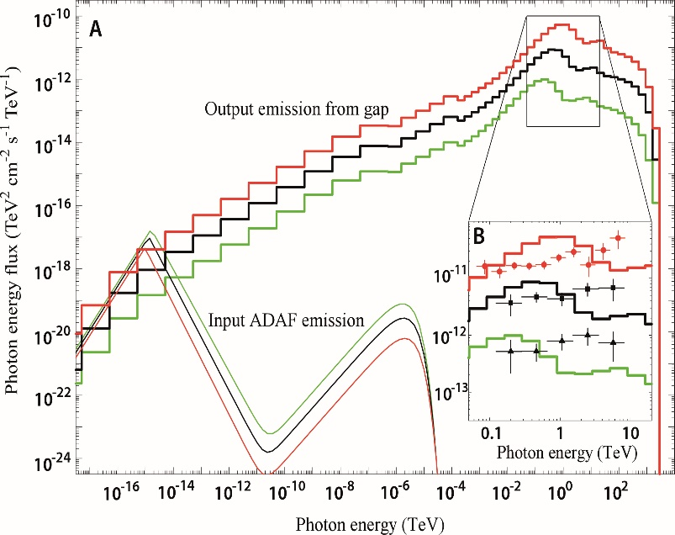
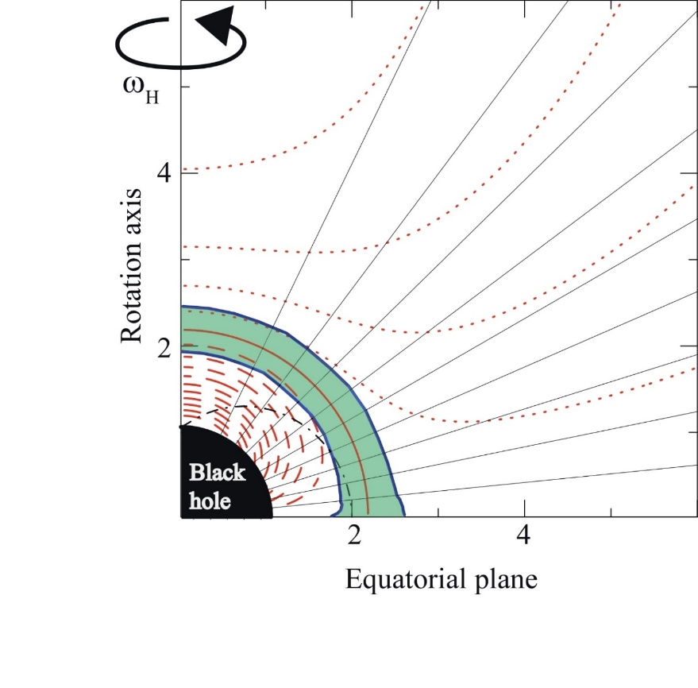
HE & VHE emissions from rapidly rotating black holes
Kouichi HIROTANI
ASIAA,Taiwan
ICRR
February 24, 2016
Notes:
My topic will deal with recent development in particle accelerator theories in black hole magnetospheres.

Slide 2
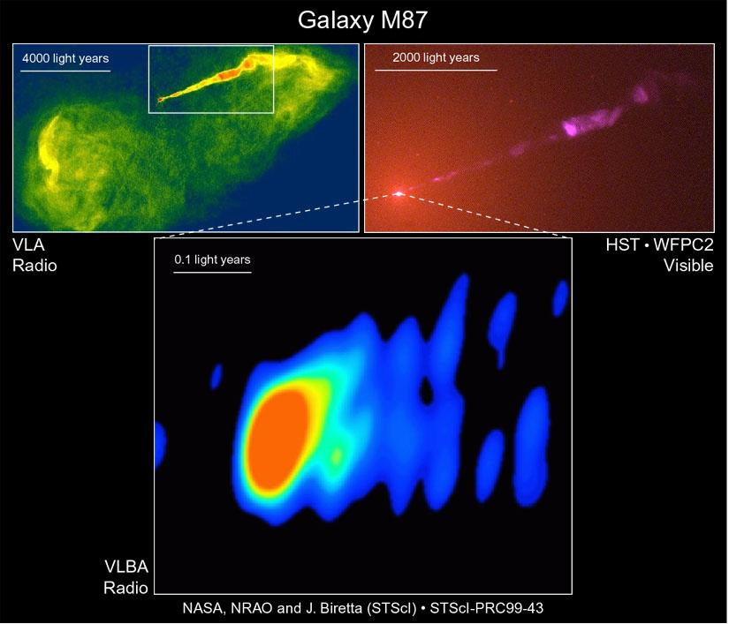
§ 1 Introduction
Radio emission from extra-galactic jets probably result from a relativistically moving plasma consisting of B & e±’s following power-law energy distribution.
(Blandford &Königl 1979, ApJ 232, 34)
NASA, NRAO & Biretta (STSci),
STSci-PROC99-43

Slide 3
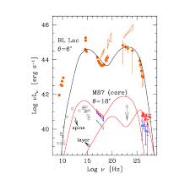
§ 1 Introduction
Radio emission from extra-galactic jets probably result from a relativistically moving plasma consisting of B & e±’s following power-law energy distribution.
(Blandford &Königl 1979, ApJ 232, 34)
Their non-thermal spectrum ranges from radio to γ-rays.
Fig.) Spectral energy distribution of M87 core and the BL Lac.
(Tavecchio + ’09, AIP
conf. proc. 1085, 431)

Slide 4
§ 1 Introduction
Radio emission from extra-galactic jets probably result from a relativistically moving plasma consisting of B & e±’s following power-law energy distribution.
(Blandford &Königl 1979, ApJ 232, 34)
Their non-thermal spectrum ranges from radio to γ-rays.
Possible emission processes are synchrotron and inverse-Compton scatterings (ICS) by the relativistic particles accelerated at shocks in the jets.
In this shock-in-jet model, the γ-rays can reach very high energies (VHE, ~TeV) via ICS off the highest energy e±’s.

Slide 5
§ 1 Introduction
Jets can be powered when the rotational energy of BHs are electromagnetically extracted.
(Blandford &Znajek 1977, MNRAS 179, 433)
Size of jet formation region > r_{g}=GM/c²=1.5×10¹³ M₈ cm.
VLBI has not yet provided the angular resolution on this scale. (e.g., @230GHz, M87 resolved at 11r_{g} scale)

Slide 6
§ 1 Introduction
Instead, the size can be indirectly inferred from temporal variability of emission.
If an initial perturbation takes place in the AGN-rest frame, the jet will also exhibit variations on the same time scale for a distant observer (i.e., us).
If such an emission varies within the horizon-light-crossing time scale, Δt_{BH}= r_{g}/c² = 8.3 M₈ min., it strongly suggest that the emitting region is smaller than the central BH.
→ Direct signals from the vicinity of the horizon.

Slide 7
§ 1 Intro.: Radio galaxy IC 310
First detection of the horizon-scale rapid variations:
MAGIC observed IC 310 (S0, z =0.0189) in Nov 2012.
M-σ rel.→ M=(1~7)×10⁸ M_{ʘ}, Δt_{BH} = 8~57 min.
An extraordinary
outburst was
detected above
300 GeV.
Aleksić et al.
(Science 346, 1080, 2014)

Slide 8
§ 1 Intro.: Radio galaxy IC 310
First detection of the horizon-scale rapid variations:
MAGIC observed IC 310 (S0, z =0.0189) in Nov 2012.
M-σ rel.→ M=(1~7)×10⁸ M_{ʘ}, Δt_{BH} = 8~57 min.
The flux attains
6×10⁻¹¹ cm⁻²s⁻¹,
4 times higher than
the previous high.
Aleksić et al.
(Science 346, 1080, 2014)

Slide 9
§ 1 Intro.: Radio galaxy IC 310
First detection of the horizon-scale rapid variations:
MAGIC observed IC 310 (S0, z =0.0189) in Nov 2012.
M-σ rel.→ M=(1~7)×10⁸ M_{ʘ}, Δt_{BH} = 8~57 min.
The flux attains
6×10⁻¹¹ cm⁻²s⁻¹,
4 times higher than
the previous high.
Conservative estimate
of shortest variability,
Δt_{obs}=4.8 min.
Aleksić et al.
(Science 346, 1080, 2014)

Slide 10
§ 1 Intro.: Radio galaxy IC 310
First detection of the horizon-scale rapid variations:
MAGIC observed IC 310 (S0, z =0.0189) in Nov 2012.
M-σ rel.→ M=(1~7)×10⁸ M_{ʘ}, Δt_{BH} = 8~57 min.
The flux attains
6×10⁻¹¹ cm⁻²s⁻¹,
4 times higher than
the previous high.
Conservative estimate
of shortest variability,
Δt_{obs}=4.8 min.
Conservative variability time scale ~ (.08~.6)Δ t _{BH}.
Thus, if initial perturbation originates in AGN-rest frame, the variability takes place at sub-horizon scale.
Aleksić et al. (Science 346, 1080, 2014)

Slide 11
§1 Subhorizon-scale variability
Aleksić et al. (Science 346, 1080, 2014)
In general, there are a few possible explanations of such a rapid variation (Δ t _{var} «Δ t _{BH} ):
  Mini-jet structures within the jet,
  (2) Jet-cloud interactions, where the clouds may originate from stellar winds,
  (3) Magnetospheric models, similar to pulsar HE emission models

Slide 12
§1 Subhorizon-scale variability
Aleksić et al. (Science 346, 1080, 2014)
In general, there are a few possible explanations of such a rapid variation (Δ t _{var} «Δ t _{BH} ):
  Mini-jet structures within the jet,
  (2) Jet-cloud interactions, where the clouds may originate from stellar winds,
  (3) Magnetospheric models, similar to pulsar HE emission models

Slide 13
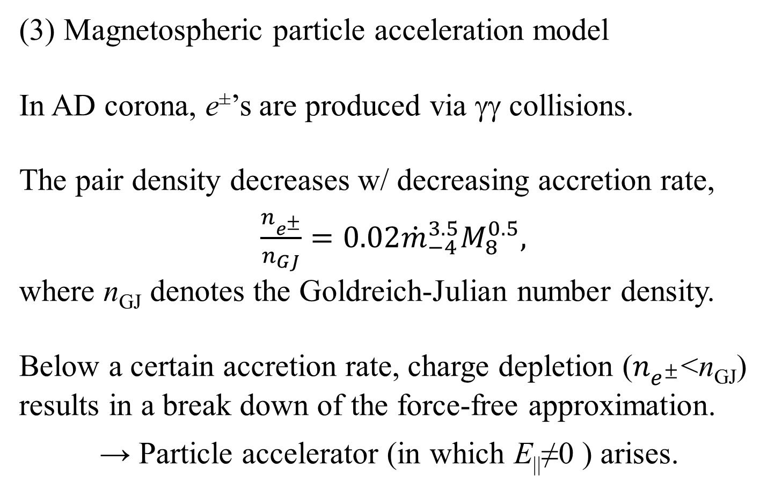
§1 Subhorizon-scale variability
Aleksić et al. (Science 346, 1080, 2014)
(3) Magnetospheric particle acceleration model
In AD corona, e±’s are produced via γγ collisions.
The pair density decreases w/ decreasing accretion rate,
$\frac{n_{e^{±}}}{n_{GJ}}=0.02{\dot{m}}_{−4}^{3.5}M_{8}^{0.5},$
where n_{GJ} denotes the Goldreich-Julian number density.
Below a certain accretion rate, charge depletion ($n_{e^{±}}$<n_{GJ}) results in a break down of the force-free approximation.
→ Particle accelerator (in which E||≠0 ) arises.

Slide 14
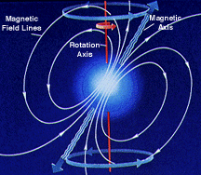
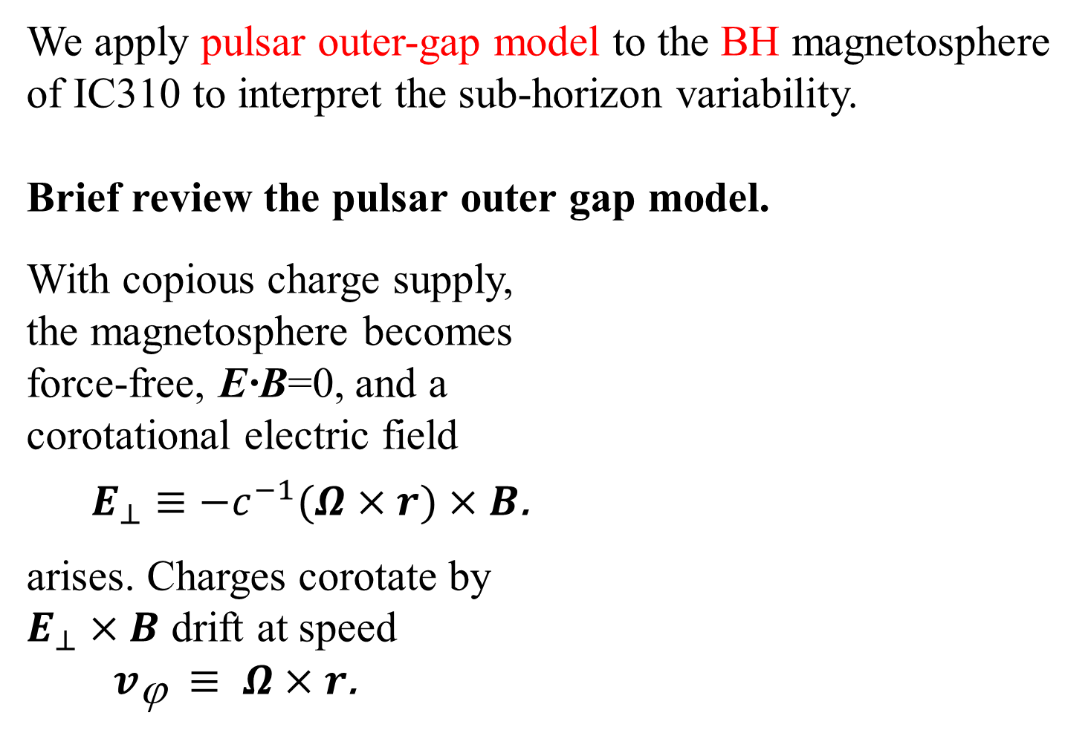
§2 Magnetospheric accelerator model
We apply pulsar outer-gap model to the BH magnetosphere of IC310 to interpret the sub-horizon variability.
Brief review the pulsar outer gap model.
With copious charge supply,
the magnetosphere becomes
force-free, E·B=0, and a
corotational electric field
$E_{⊥}$ $≡{−c}^{−1}(Ω×r)×$ $B$.
arises. Charges corotate by
$E_{⊥}×$ $B$ drift at speed
$v_{\text{j} }$ $≡ Ω×r$.

Slide 15
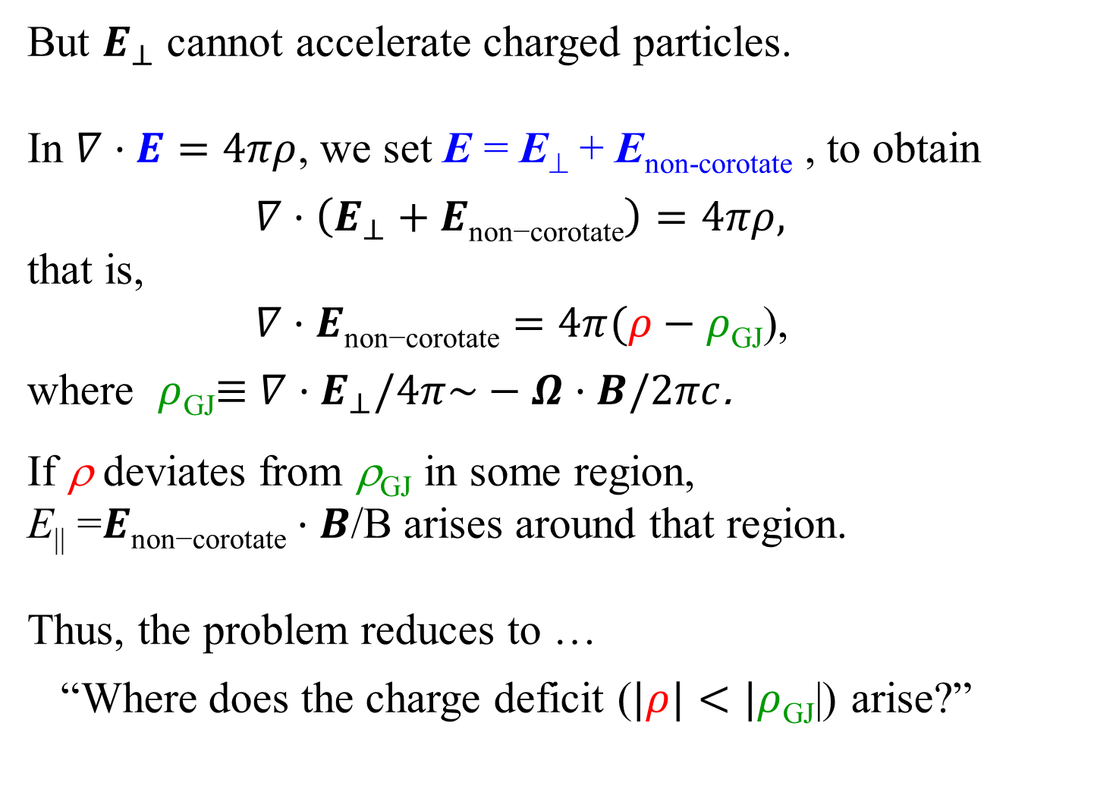
§2 Magnetospheric accelerator model
But $E_{⊥}$ cannot accelerate charged particles.
In $∇·E=4πρ$, we set E = E⊥ + E_{non-corotate} , to obtain
$∇·\left(E_{⊥}+E\text{non}\text{−}\text{corotate}\right)=4πρ,$
that is,
$∇·E\text{non}\text{−}\text{corotate}=4π(ρ−ρ$_{GJ}),
where $ρ$_{GJ}$≡$ $∇·E_{⊥}/4π\sim −$ $Ω$ $·B/2πc$.
If ρ deviates from ρ_{GJ} in some region,
E|| =$E\text{non}\text{−}\text{corotate}·B$/B arises around that region.
Thus, the problem reduces to …
“Where does the charge deficit ($|ρ|<|ρ$_{GJ}|) arise?”

Slide 16
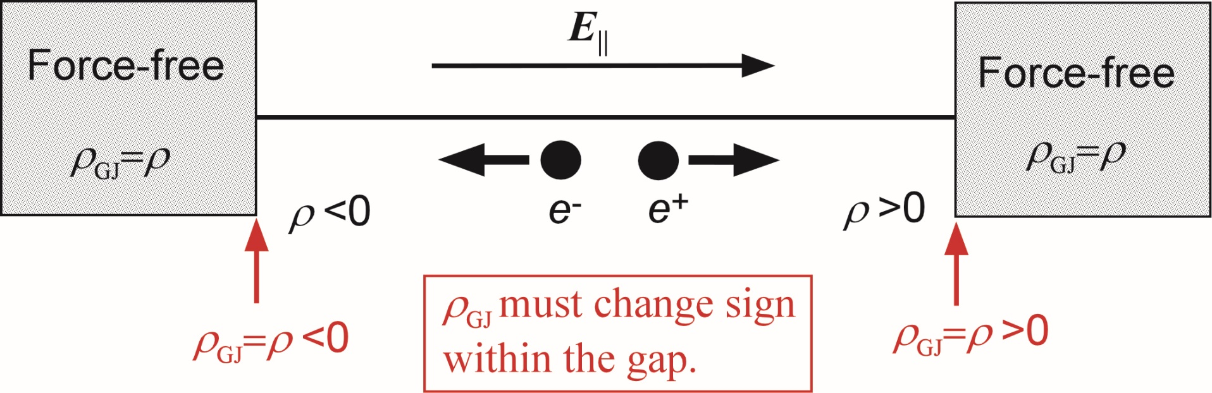
§2 Magnetospheric accelerator model
A charge deficit naturally appears across the null charge surface, where ρ_{GJ}=0.
If E|| appears in some region, the accelerator (or the gap) boundaries should connect to the force-free magnetosphere outside, i.e., ρ =ρ_{GJ}.

Slide 17
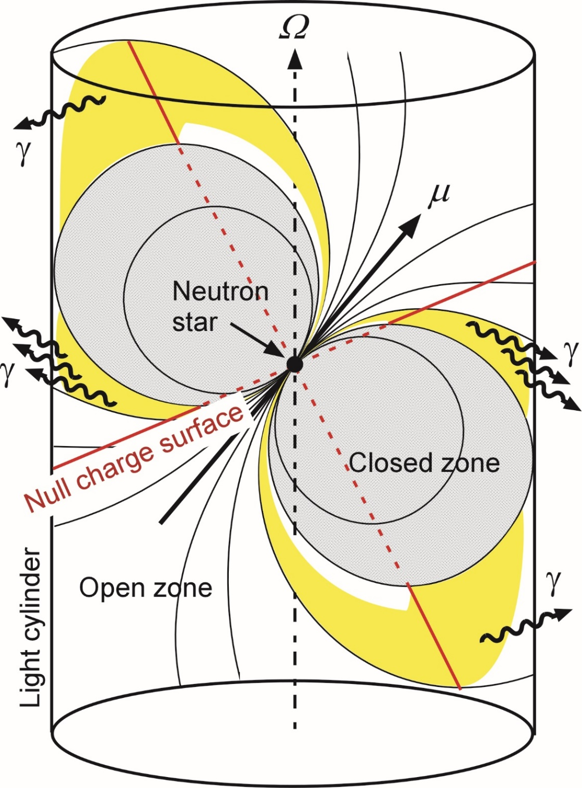
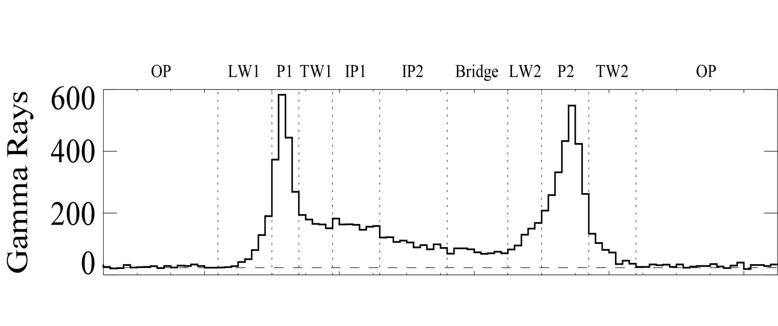
§2 Outer gap model
In a pulsar magnetosphere,
null surfaces (ρ_{GJ}=0) appear in the higher altitudes by global curvature of dipole B.
→ hollow cone emission
(ΔΩ > 1 ster)
Cheng + (1986, ApJ 300, 500)
Successfully explained wide-separated double peaks.
one NS rotation

Slide 18
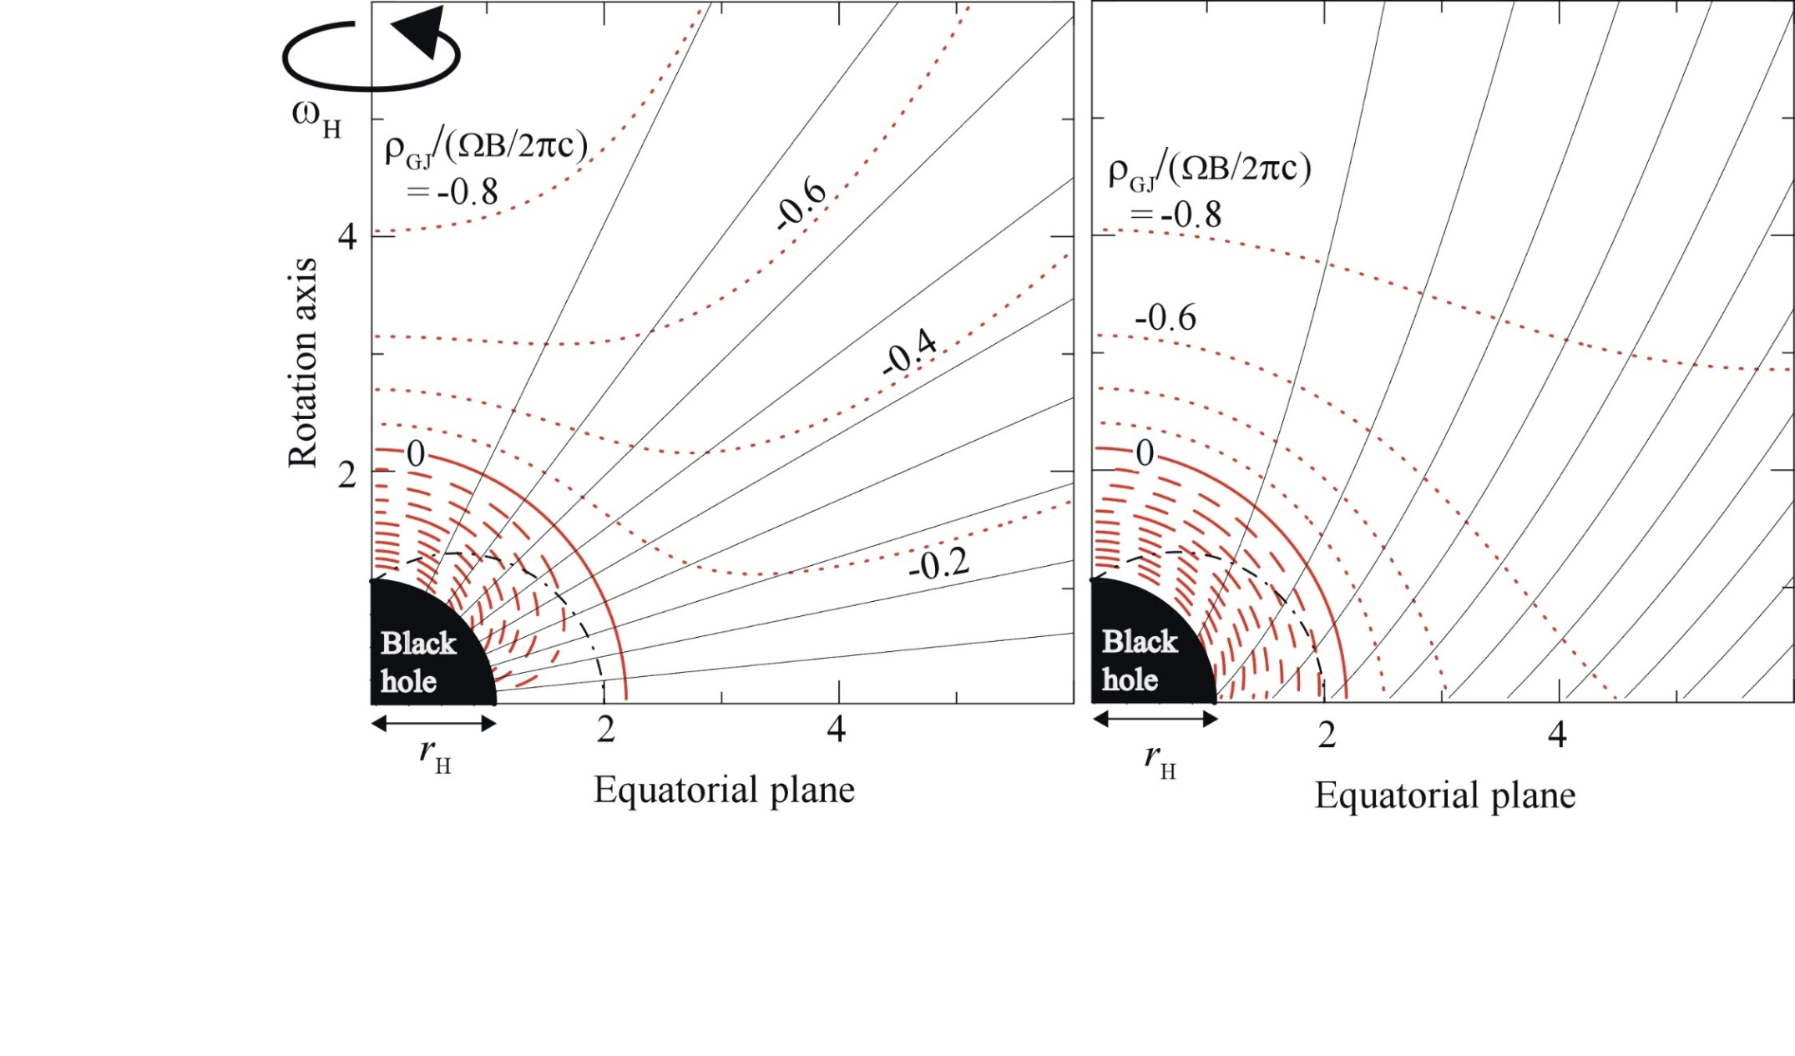
§3 BH gap model
In a black hole magnetosphere, null surface appears near the horizon due to space-time dragging.
Beskin, Istomin, Par’ev (Soviet Astron. 36, 642, ’92)
Ω=0.3ω_{H}
KH & Pu 2016,
ApJ 818, 50

Slide 19
§3 BH gap model
In a black hole magnetosphere, null surface appears near the horizon due to space-time dragging.
Beskin, Istomin, Par’ev (Soviet Astron. 36, 642, ’92)
The GR Goldreich-Julian charge density:
Ω: angular freq. of B
ω: angular freq. of frame dragging
α: redshift factor (lapse function)
Ψ: magnetic flux function
Ω=0.3ω_{H}

Slide 20
§3 BH gap model
Null surface is formed close to the Ω=ω surface.
Its position little depends on B_{p} if ∂Ω/ ∂Ψ≈0.
We thus adopt a radial B_{p}.
The GR Goldreich-Julian charge density:
Ω: angular freq. of B
ω: angular freq. of frame dragging
α: redshift factor (lapse function)
Ψ: magnetic flux function
Ω=0.3ω_{H}

Slide 21
§3 BH gap model
So far, we have seen that a BH gap appears around the null surface that is located near the horizon.
Within the gap, rotational energy of a BH can be partly dissipated into e±’s kinetic energy and radiation.
Thus, the maximum gap luminosity is limited by the energy extraction power from the rotating BH.
Let us analytically examine the flux of a BH gap emission as a function of the BH mass.

Slide 22
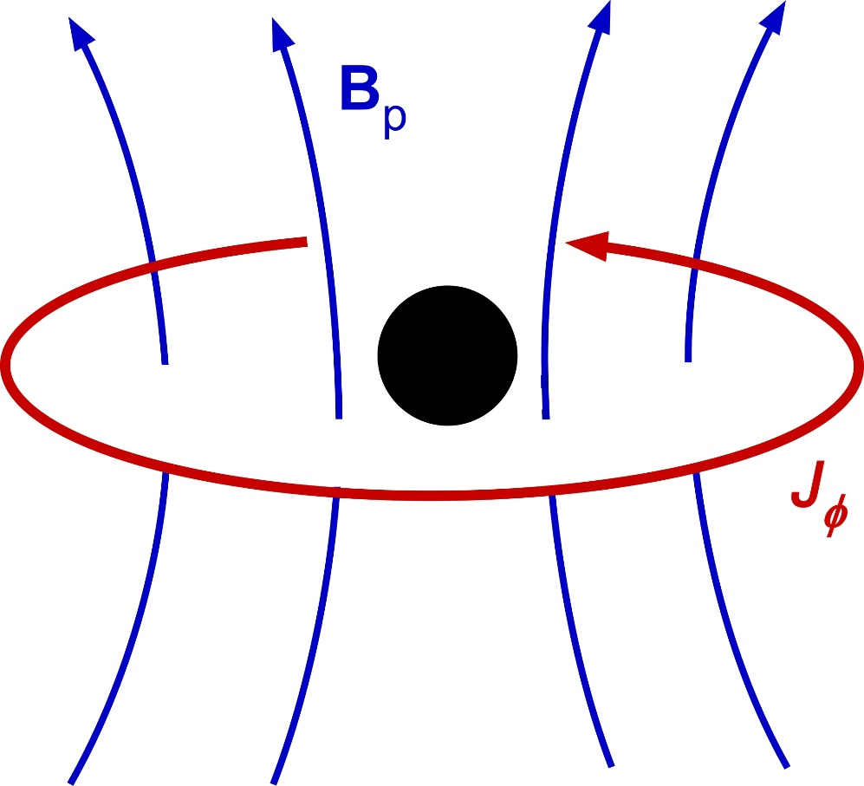
§3 BH gap model
Toroidal (azimuthal) electric current in accretion flow produces poloidal (meridional) magnetic field, B_{p}.
(poloidal)
BH
(toroidal)

Slide 23
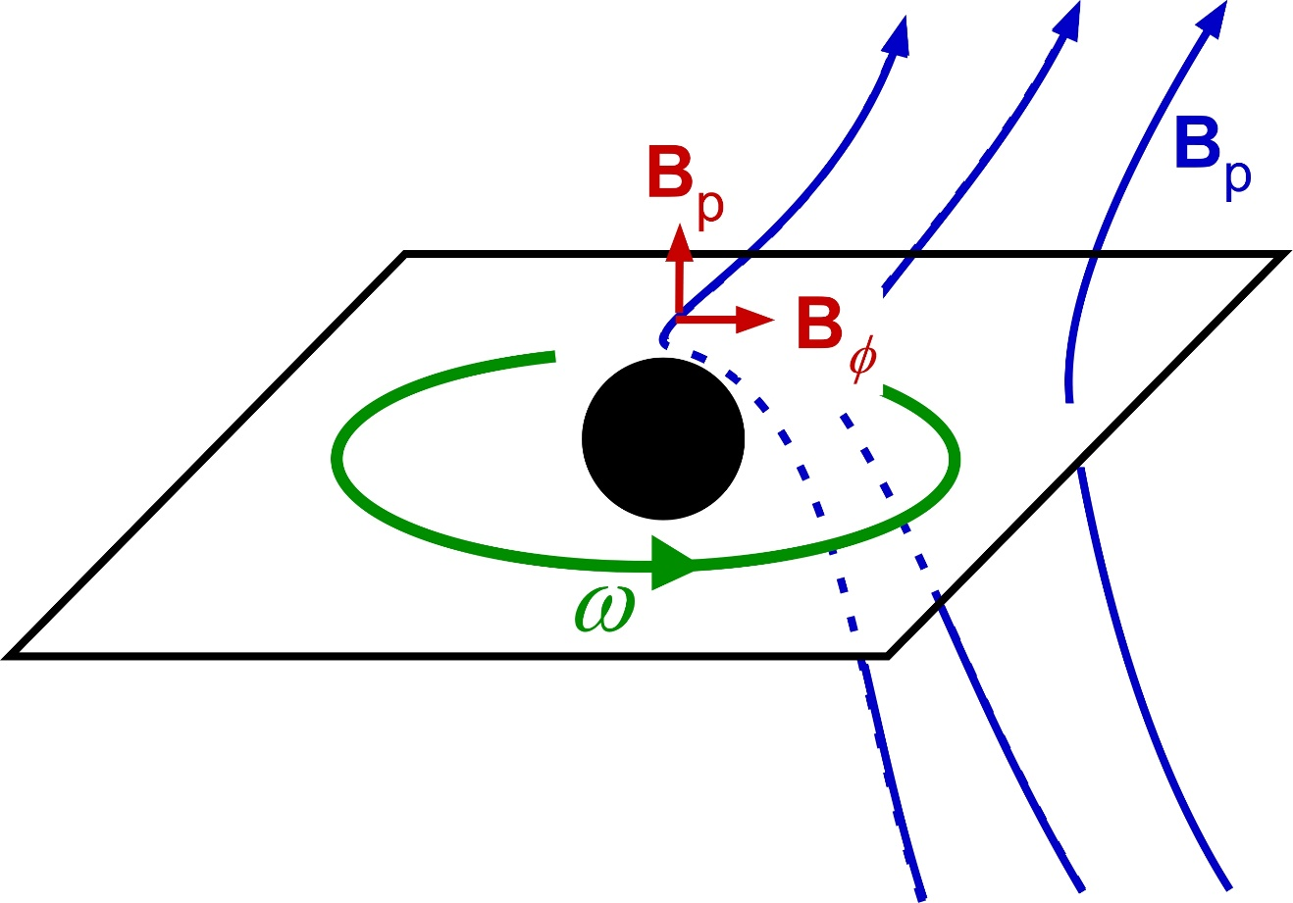
§3 BH gap model
Toroidal (azimuthal) electric current in accretion flow produces poloidal (meridional) magnetic field, B_{p}.
Due to frame dragging, B_{φ} is produced from B_{p}.
Frame dragging

Slide 24
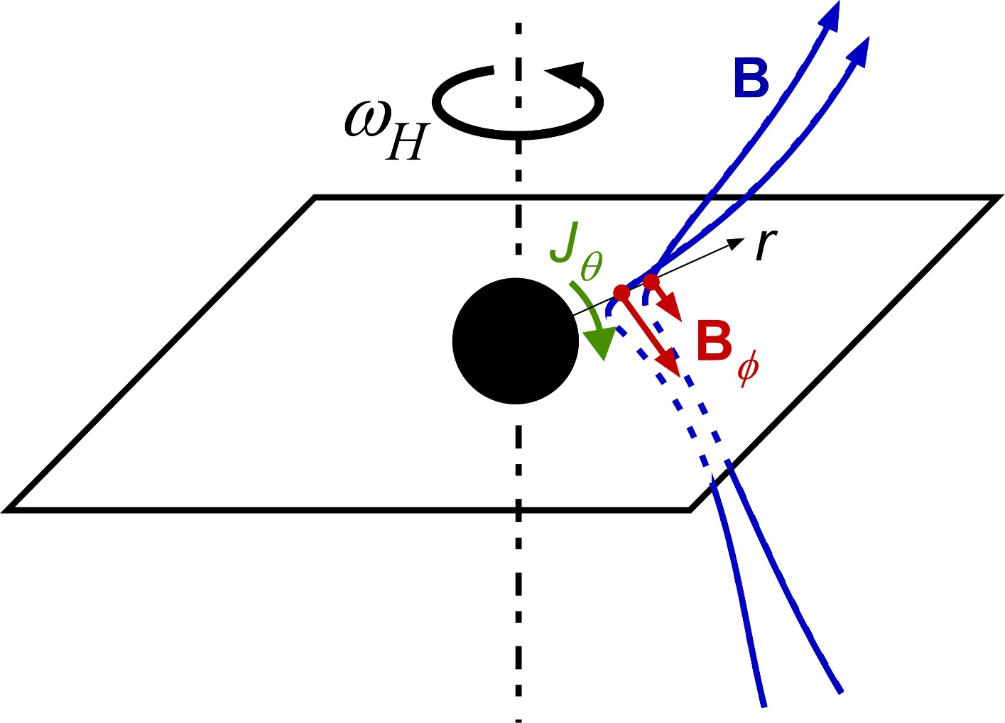
§3 BH gap model
Toroidal (azimuthal) electric current in accretion flow produces poloidal (meridional) magnetic field, B_{p}.
Due to frame dragging, B_{φ} is produced from B_{p}.
Decreasing frame dragging, , results in radial gradient of B_{φ} ,
a meridional return
near
the horizon.
and hence
current
BH

Slide 25
§3 BH gap model
Toroidal (azimuthal) electric current in accretion flow produces poloidal (meridional) magnetic field, B_{p}.
Due to frame dragging, B_{φ} is produced from B_{p}.
Decreasing frame dragging, , results in radial gradient of B_{φ} , and hence J_{θ} .
This J_{θ} causes counter torque, ,
on the horizon (depositing negative EM energy).
As a result, BH rotational energy is extracted electrodynamically at a rate (Blandford & Znajek 1977),

Slide 26
§3 BH gap model
EM power of the BH’s rotational energy extraction:
Assuming that magnetic buoyancy balances with plasmas’ in-falling motion, we obtain
Substitution of B≈B_{eq} into L_{BZ} gives

Slide 27
§3 BH gap model
EM power of the BH’s rotational energy extraction:
The BH gap uses only a part (say, κ <1) of L_{BZ}. We thus find the maximum flux of a BH gap,
where .
Next, we must constrain .
Notes:
The BH gap uses only a part of this spin-down power.

Slide 28
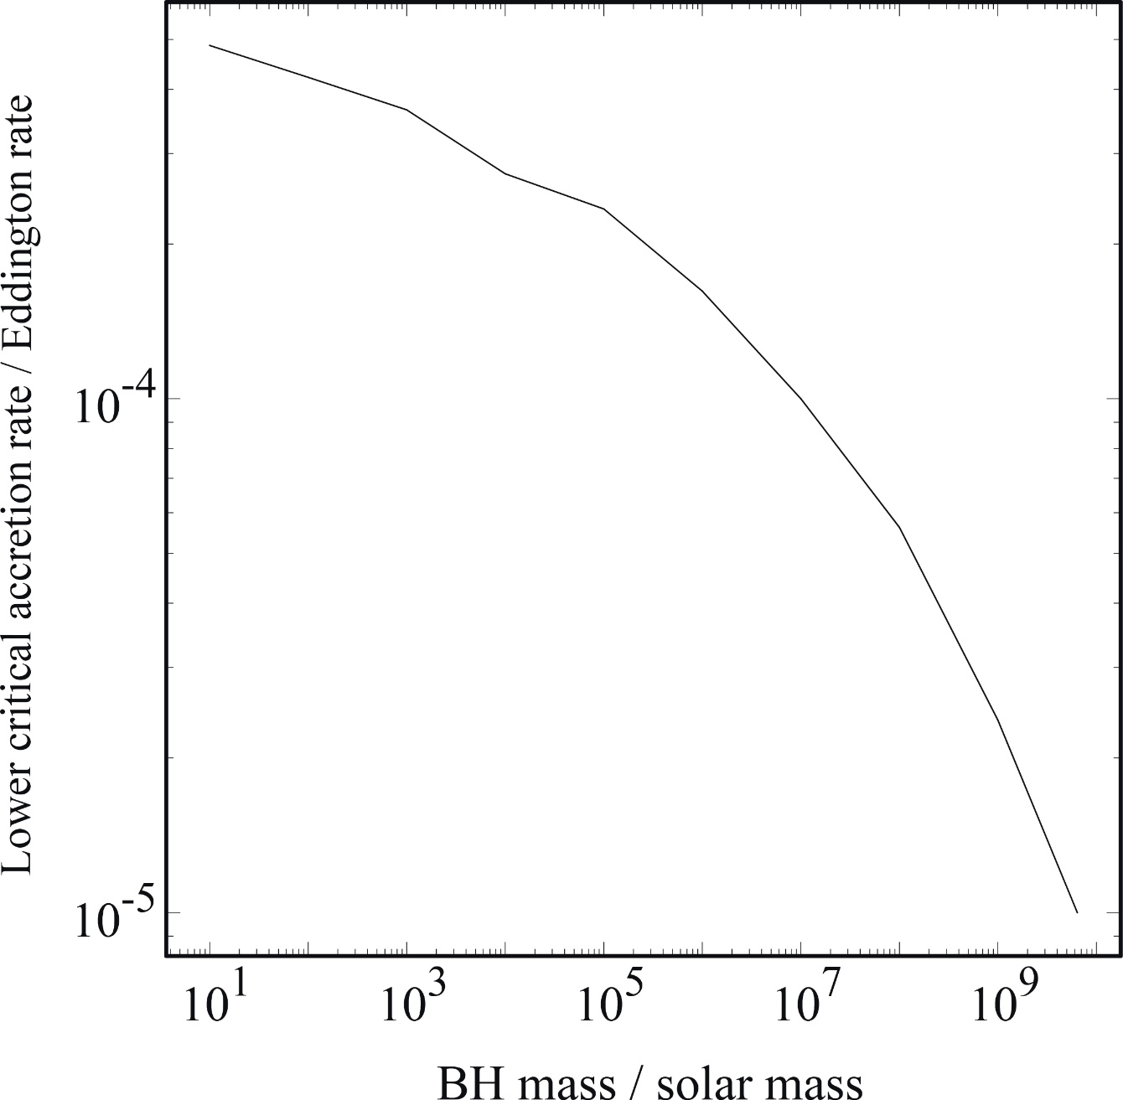
§3 BH gap model
When
,
gap luminosity maximizes at L_{gap}.
a=0.9M
There is a minimum accretion rate below which the gap ceases to exist.
This
is solved by the method to be described below.
KH, Pu, Nakamura 2016

Slide 29
§3 BH gap model
KH, Pu, Nakamura 2016, in prep.
Substituting into , we find
Stellar-mass BHs
Due to small potential drop in the gap and heavy absorption outside the gap, γ-ray peaks in <30GeV.
Thus, we must compile photons for years to observe with Fermi.
We here assume a duty cycle, ε ~ 0.01.

Slide 30
§3 BH gap model
KH, Pu, Nakamura 2016, in prep.
Substituting into , we find
Stellar-mass BHs
(II) Intermediate-mass BHs
ε: duty cycle
For IMBHs and SMBHs, γ-ray flux peaks in 30GeV-10TeV. Thus, we can time-resolve the flare w/ IACT and adopt ε =1.

Slide 31
§3 BH gap model
KH, Pu, Nakamura 2016, in prep.
Substituting into , we find
Stellar-mass BHs
(II) Intermediate-mass BHs
(III) Super-massive BHs
ε: duty cycle

Slide 32
§3 BH gap model
KH, Pu, Nakamura 2016, in prep.
Thus, stellar-mass and super-massive BHs are plausible.
Stellar-mass BHs
(II) Intermediate-mass BHs
(III) Super-massive BHs
ε: duty cycle
Notes:
From the VHE long-term light curve of M87, the duty cycle for VHE flares is ~ (4-28)% (Abramowski + ’12, ApJ 746, 151).

Slide 33
§3 BH gap model
KH, Pu, Nakamura 2016, in prep.
Thus, stellar-mass and super-massive BHs are plausible.
Today, we consider SMBHs and apply the BH gap model to IC310 (M~10^{8.5}M_{ʘ}), M87 (M~10^{9.8}M_{ʘ}).
Then briefly examine stellar-mass BHs.

Slide 34
§4 SMBH gap: the case of IC310
If we adopt B=B_{eq}~700G, we obtain L_{gap}~2×10⁻¹³ ergs s⁻¹.
However, the flare flux well exceeds 10⁻¹¹ ergs s⁻¹.
Notes:
As we have seen, the BH gap appears …

Slide 35
§4 SMBH gap: the case of IC310
If we adopt B=B_{eq}~700G, we obtain L_{gap}~2×10⁻¹³ ergs s⁻¹.
However, the flare flux well exceeds 10⁻¹¹ ergs s⁻¹.
We thus assume a=0.998M (extreme Kerr BH) and adopt
B=10⁴G, because plasma & B densities are significantly enhanced (~30 times than a=0.90M case, ~10² times than a=0 case; Hirose et al. 1992, ApJ 606, 1083), owing to the causality (i.e., to prevent the appearance of ‘naked singularity’; Bardeen 1970, Nature 226, 64).
If BH-gap emission is confirmed by observations, it may indicate that the central BH of IC310 is extremely rotating.
Notes:
As we have seen, the BH gap appears …

Slide 36

§4 SMBH gap: the case of IC310
In general, Gap appears around the null surface located near the horizon.
By solving the set of
Poisson eq. for Ψ and
e± & γ Boltzmann eqs.,
we can find its actual
distribution.
Fig. gap distribution for
Equi-ρ_{GJ} contours
Radial B_{p}
Ω=0.3ω_{H}
KH & Pu 2016,
ApJ 818, 50
Notes:
As we have seen, the BH gap appears …

Slide 37
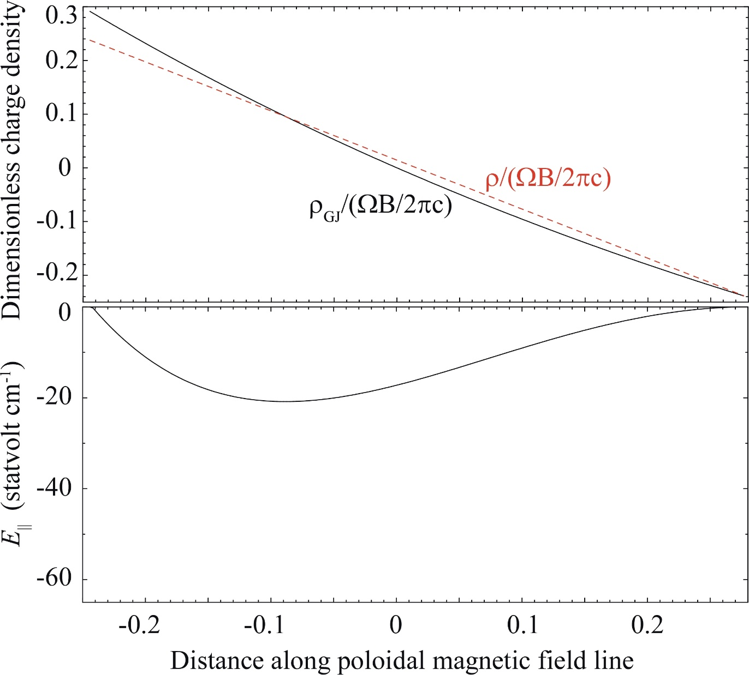
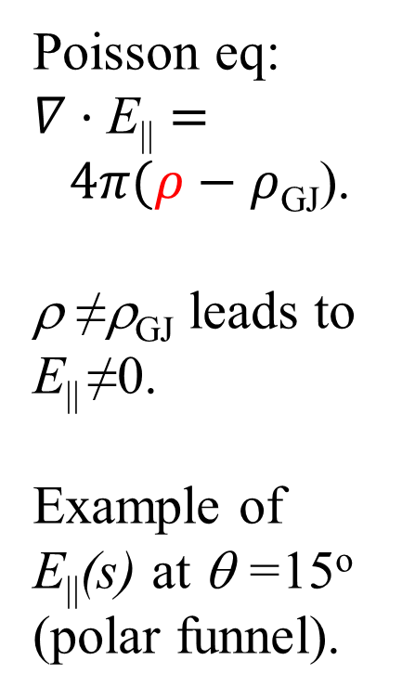
§4 SMBH gap: the case of IC310
Along B line, acceleration electric field E|| arises.
Poisson eq:
$∇·\text{E}\text{||}= 4π(ρ−ρ$_{GJ}).
ρ ≠ρ_{GJ} leads to E|| ≠0.
Example of
E||(s) at θ =15º (polar funnel).
E||(s)
B=10⁴ G (fixed, not equilibrium)
KH & Pu 2015, ApJ 818, 50

Slide 38
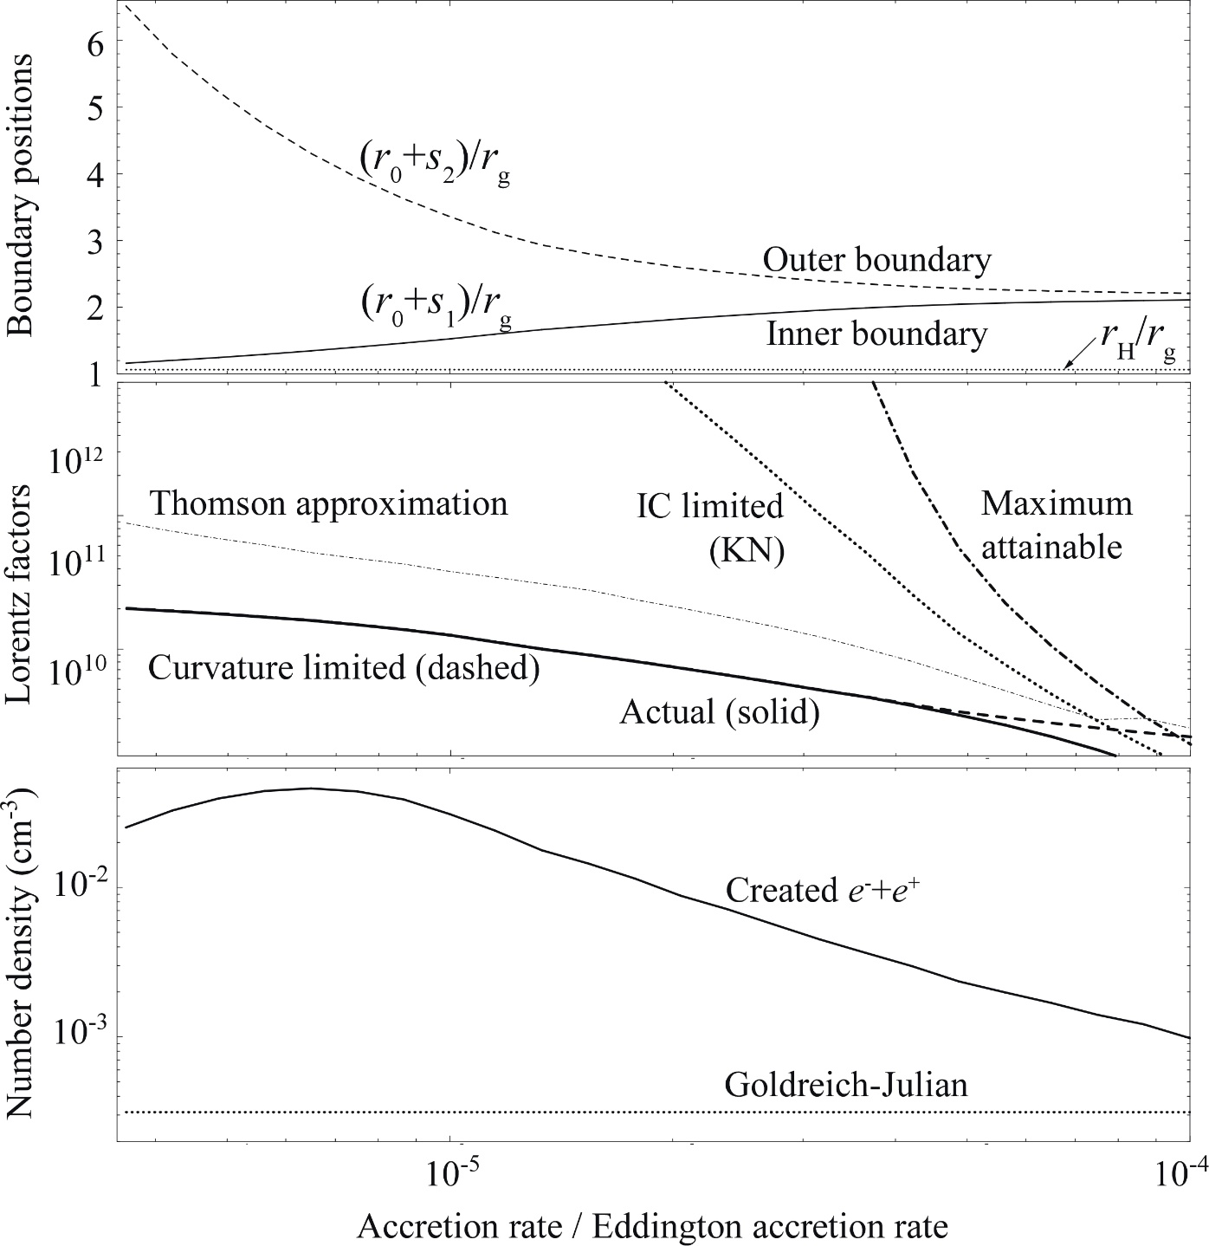
§4 SMBH gap: the case of IC310
Gap width w increases with decreasing
.
Since ,
gap becomes most luminous when the inner boundary almost touches down the horizon.
Gap width
w=s₂-s₁
Decreasing
B=10⁴ G (fixed)
KH & Pu 2015, ApJ 818, 50

Slide 39
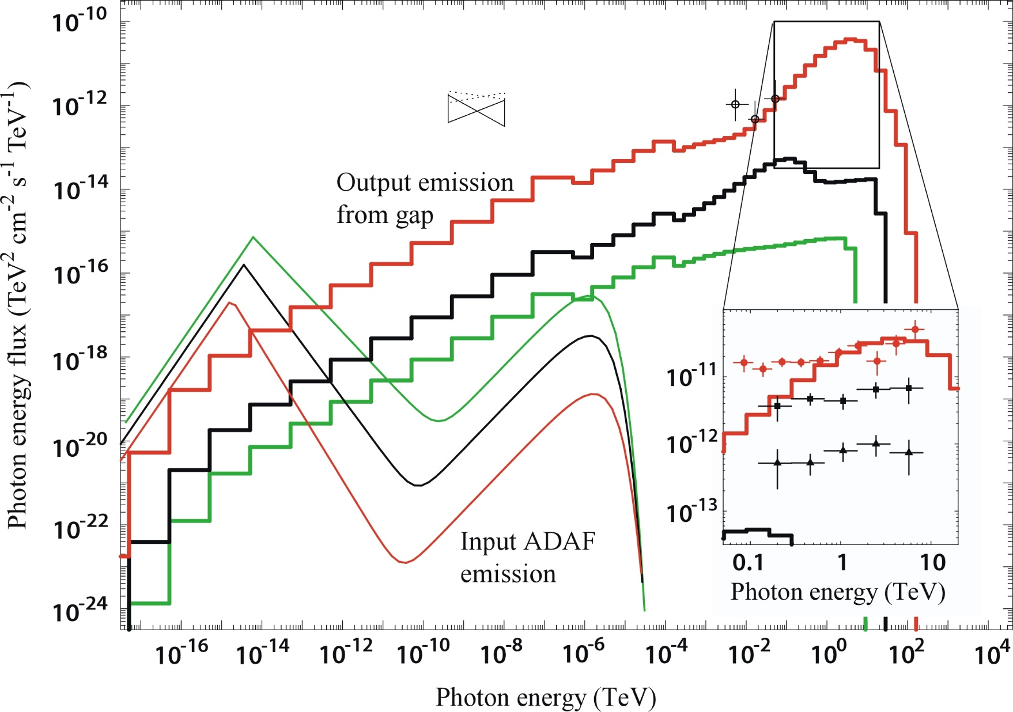
§4 SMBH gap: IC310
Large curvature radius, R_{c}=10 r.
KH & Pu 2015, ApJ 818, 50
B=10⁴ G
(fixed,
not equil.)
Notes:
In a time-averaged sense, in the polar funnel, the magnetic field lines threading the horizon are well-ordered and approximated by a split monopole. Thus, the magnetic field curvature radius may be large.

Slide 40
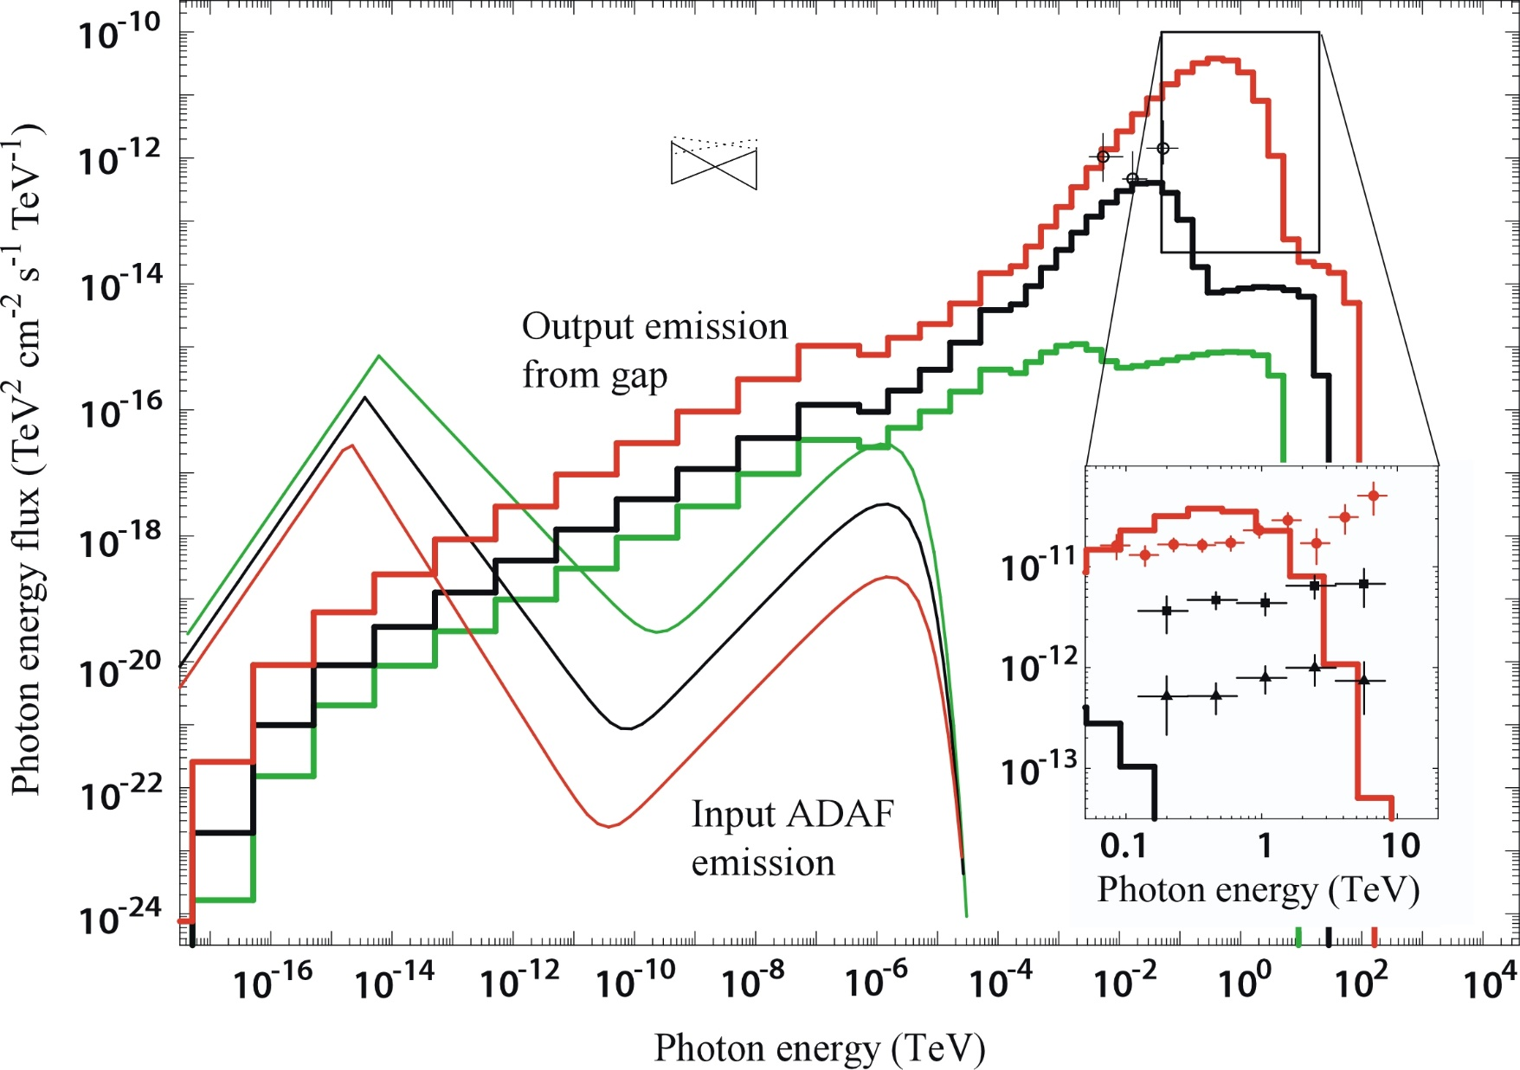
§4 SMBH gap: IC310
Small curvature radius, R_{c}=0.1r.
KH & Pu 2016, ApJ 818, 50
B=10⁴ G
(fixed,
not equil.)
Notes:
However, the instantaneous magnetic fields may be kinked and bent in the evacuated funnel due to strong waves.

Slide 41
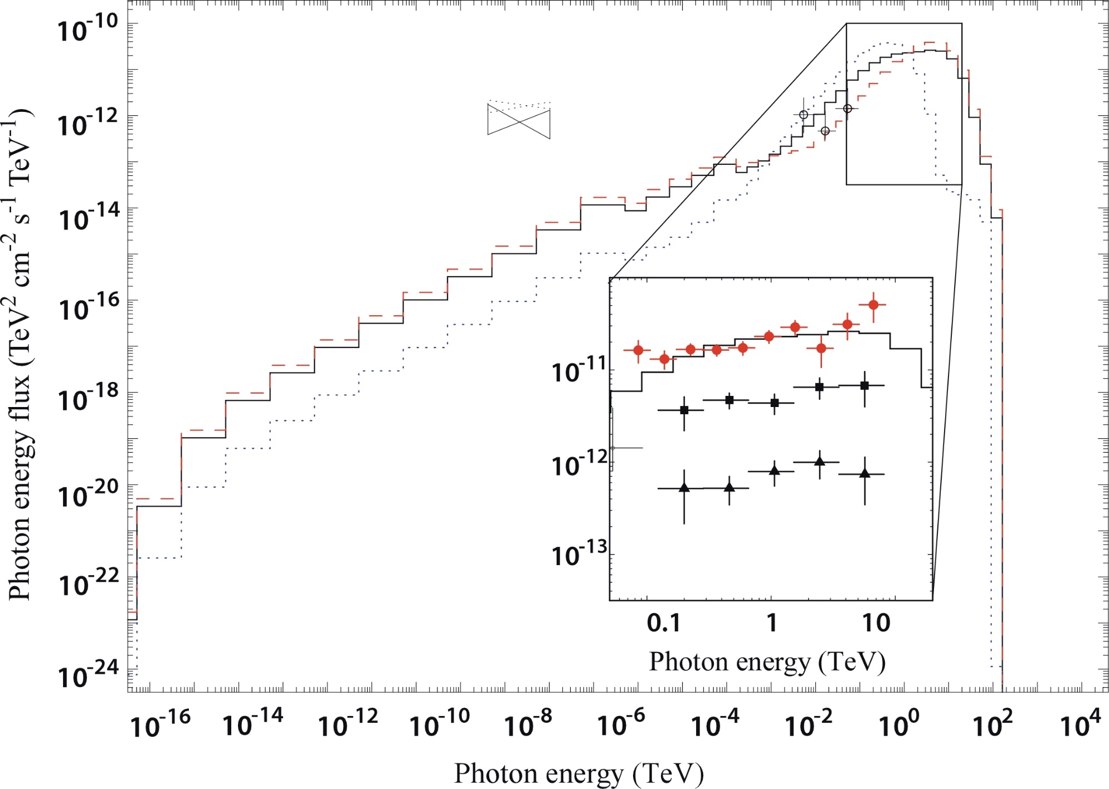
§4 SMBH gap: IC310
Superpose R_{c}=10 r (67%) & R_{c}=0.1 r (33%).
Power-law-like SED
is formed.
B=10⁴ G
(fixed,
not equil.)
KH & Pu 2016, ApJ 818, 50

Slide 42
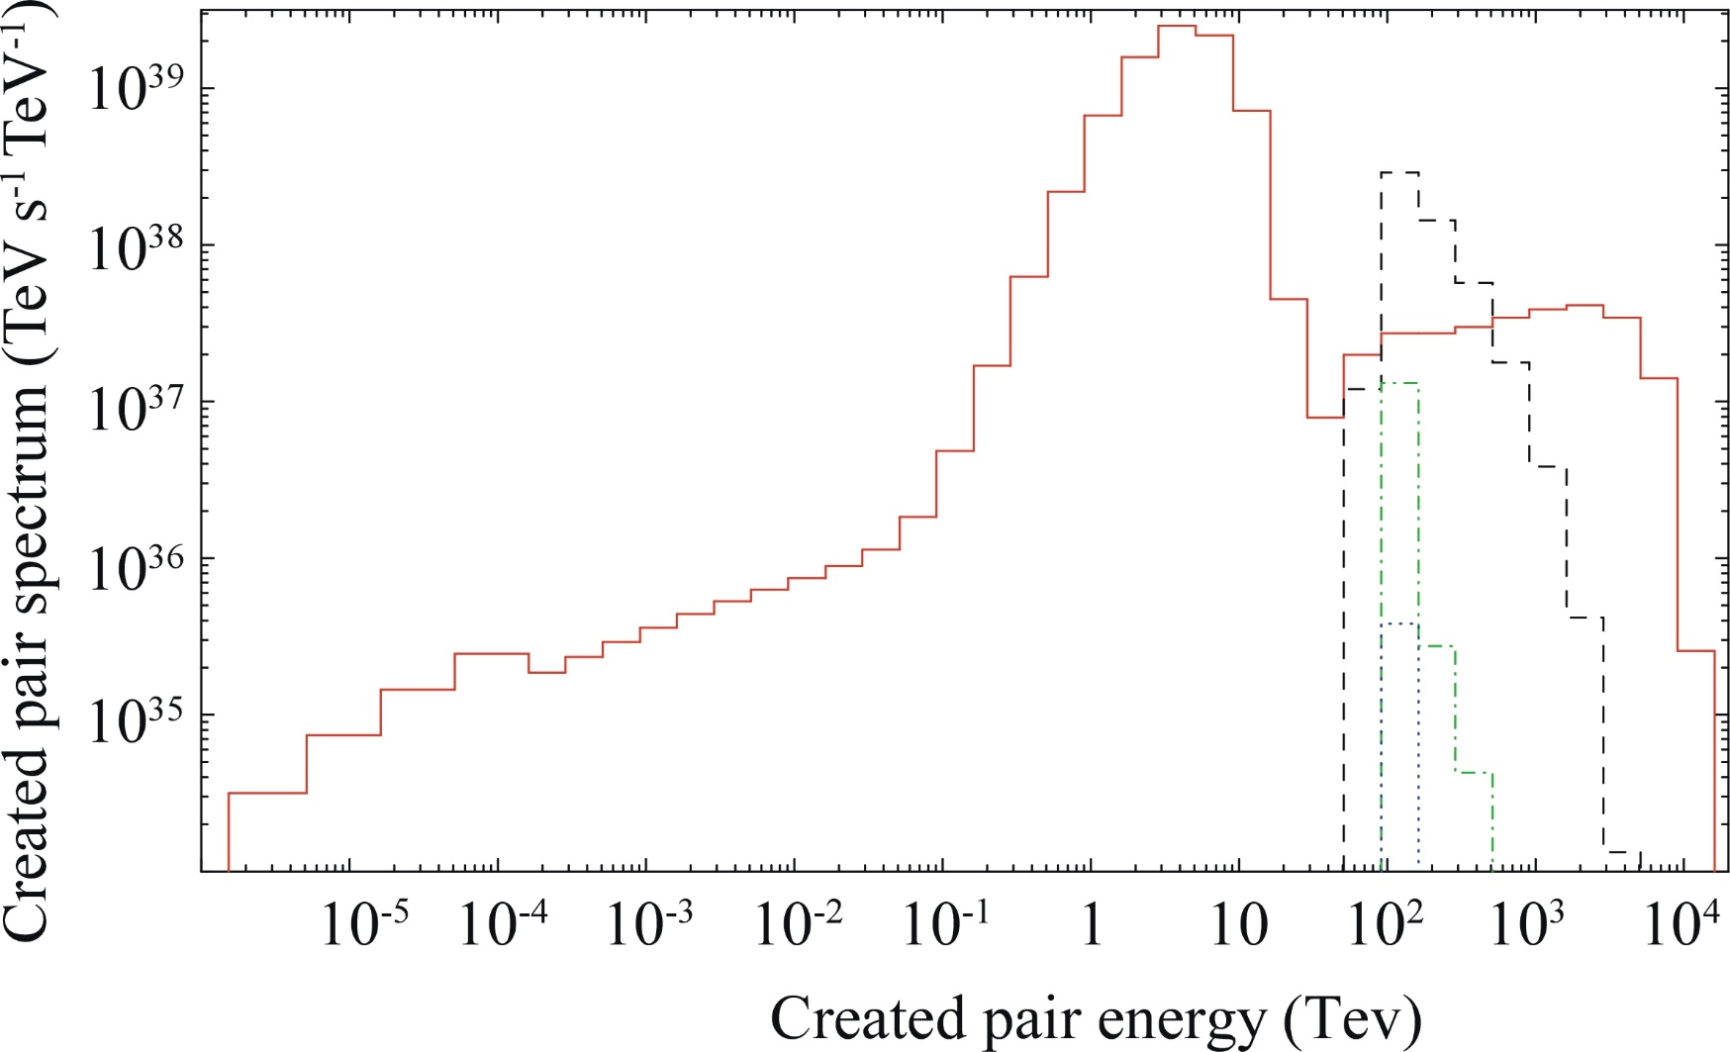
§4 SMBH gap: the case of IC310
Cascaded pair spectrum outside gap
→ Defines down-stream jet properties
Tertiary
Secondary
Quatenary
Quinary
KH & Pu 2016, ApJ 818, 50

Slide 43
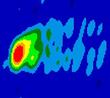
§5 SMBH gap: the case of M87
We next apply the same method to radio galaxy M87 (TeV J1230+1230, z=0.0044).
M~6.4×10⁹M_{ʘ} (Macchetto + ’97 ApJ 489, 579;
Gebhardt & Thomas ’09 ApJ 700, 1690)
M87
43 GHz
Junor + ’99 Nature 401, 891

Slide 44
§5 SMBH gap: the case of M87
We next apply the same method to radio galaxy M87 (TeV J1230+1230, z=0.0044).
M~6.4×10⁹M_{ʘ} (Macchetto + ’97 ApJ 489, 579;
Gebhardt & Thomas ’09 ApJ 700, 1690)
Light crossing time of the event horizon, 2GM/c³=18 hrs.
VHE variability timescale ~ days
→ Emission region < 5×10¹⁵δ cm
(Abramovski + ’12, ApJ 74, 151)
Viewing angle ~ 17º (Biretta + ’99; Cheung + ’07)
Weak beaming suggests emission from horizon scales.
We thus explore a BH-gap emission, assuming B=B_{eq}.

Slide 45
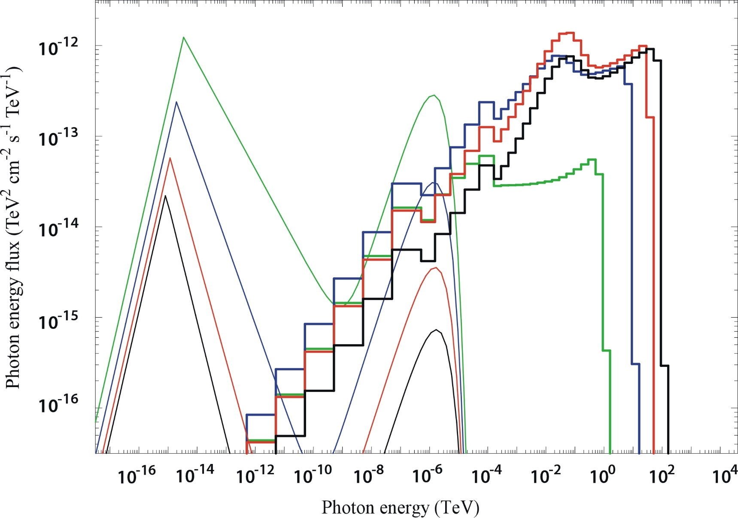
§5 SMBH gap: the case of M87
SED for different
1.3×10⁻⁵
1.0×10⁻⁴
3.2×10⁻⁵
1.3×10⁻⁵
KH, Pu, Nakamura 2016

Slide 46
§5 SMBH gap: the case of M87
SED for different
1.3×10⁻⁵
A few times smaller than the VHE flare
(MAGIC, VERITAS, 2012, ApJ 746, 151),
~(2-7)×10⁻¹¹ erg s⁻¹ cm⁻².

Slide 47
§5 SMBH gap: the case of M87
SED for different
1.3×10⁻⁵
In addition, this exceeds the observational
constraint, ~6×10⁻⁶ (SMA, Kuo + ’14).
Thus, examine if greater flux is obtained at smaller accretion rate by changing Ω_{F} and a.
KH, Pu, Nakamura 2016

Slide 48
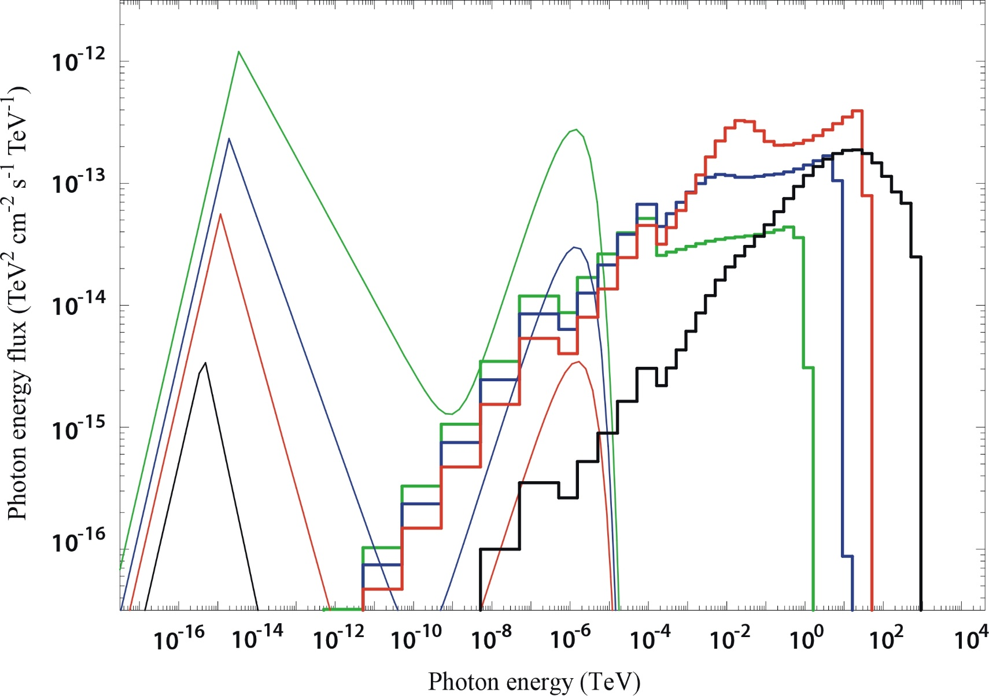
§5 SMBH gap: the case of M87
SED for different
1.0×10⁻⁴
3.2×10⁻⁵
2.4×10⁻⁶
KH, Pu, Nakamura 2016

Slide 49
§5 SMBH gap: the case of M87
SED for different
2.4×10⁻⁶
Gap solution exists at smaller
for slowly rotating magnetosphere Ω_{F}=0.15ω_{H}. However, the flux reduces to 30% of the 0.3ω_{H} case.
KH, Pu, Nakamura 2016

Slide 50
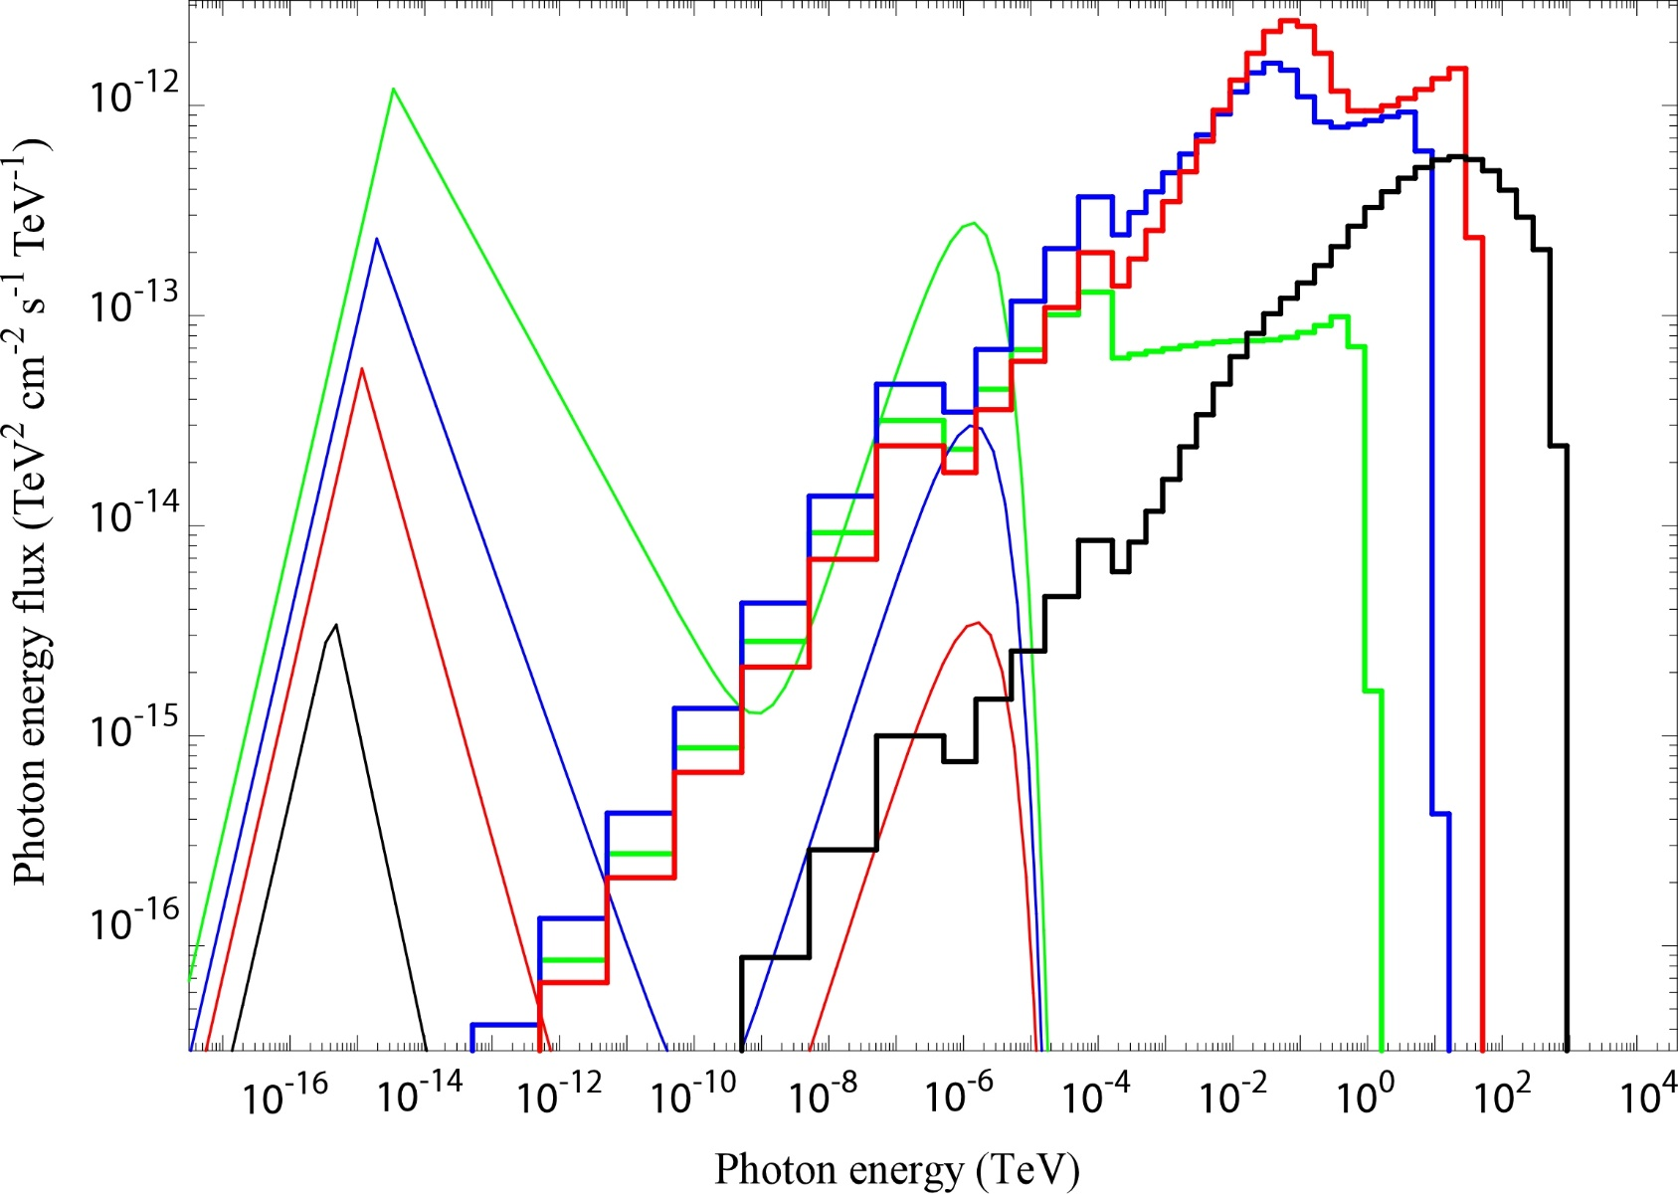
§5 SMBH gap: the case of M87
SED for different
1.0×10⁻⁴
3.2×10⁻⁵
2.4×10⁻⁶
KH, Pu, Nakamura 2016

Slide 51
§5 SMBH gap: the case of M87
SED for different
2.4×10⁻⁶
Gap solution exists at smaller also for rapidly rotating BH, a=0.99M. Flux increases from a=0.90M case, approaching the observed value,
~(2-7)×10⁻¹¹ erg s⁻¹ cm⁻².
KH, Pu, Nakamura 2016

Slide 52
§5 SMBH gap: the case of M87
SED for different
2.4×10⁻⁶
In any case,
Greater → quiescent
Smaller → flare
KH, Pu, Nakamura 2016

Slide 53
§5 SMBH gap: the case of M87
I.e., ADAF submm flux and BH-gap HE-VHE fluxes anti-correlate.
SED for different
2.4×10⁻⁶
In any case,
Greater → quiescent
Smaller → flare
KH, Pu, Nakamura 2016

Slide 54
§5 SMBH gap: the case of M87
SED for different
2.4×10⁻⁶
In addition,
Smaller VHE flux
→ lower cut-off energy
Consistent w/ VHE obs.
KH, Pu, Nakamura 2016

Slide 55
§5 SMBH gap: the case of M87
Predictions (irrespective of a/M, Ω_{F}/ω_{H}):
model submm & VHE fluxes
Shock-in-jet correlate.
BH gap anti-correlate.
Thus, simultaneous observations @ submm & VHE will discriminate the shock-in-jet vs. BH-gap models.
→ALMA & H.E.S.S./MAGIC/VERITAS
coordinated proposal
Previous coordinated observations were performed @ radio (1.7-43GHz), optical, X-ray (0.2-17keV), HE (0.1-100GeV), and VHE (0.1-10TeV) only. Thus, submm observations should be included next time.
Notes:
Shock-in-jet model: radio, X-ray, and VHE connections are particularly interest (Abramowski + ’12, ApJ 746, 151, sec 1).
VLBI allows for the highest angular resolution
X-rays show potential connection with VHE via SSC
Three episodes of VHE flares (2005, 2008, 2010)
2008: 43GHz VLBI (and Chandra X-ray flux) showed core flux increase within a few hundred Rs, suggesting direct vicinity of SMBH as the origin of VHE flare.

Slide 56
Summary
In low luminosity AGN, RIAF cannot provide enough MeV photons if . The resultant
e± pair density becomes sub-Goldreich-Julian.
This charge depletion leads to a gap formation around the null charge surface that is formed near the horizon by the frame dragging effect.
The rotational energy of the BH is partly dissipated in the gap as VHE emissions via ICS and curvature processes.
The VHE flare of IC 310 can be reproduced w/ the BH gap model @ for a=0.998M.
The same method is applicable to other low-luminosity AGNs, such as M87.
The VHE luminosity increases w/ decreasing . This anti-correlation can be checked by submm-10TeV observations.

Slide 57
Discussion
Pulsar vs. BH gap models
HE/VHE emission is dependent on B geometry in PSRs, but independent in BHs, because the null surface is formed by global B convex geometry in PSRs, but by the frame dragging in BHs.
Soft photons are provided by NS surface thermal X-rays in PSR magnetospheres, but by accretion flow in BH ones.
Accretion quenches gaps in PSRs, but activates in BHs (at very low accretion rate), because plasma accretes along open B field lines in a PSR magnetosphere, but cannot penetrate into the polar funnel in a BH magnetosphere.

Slide 58
Thank you.

Slide 59
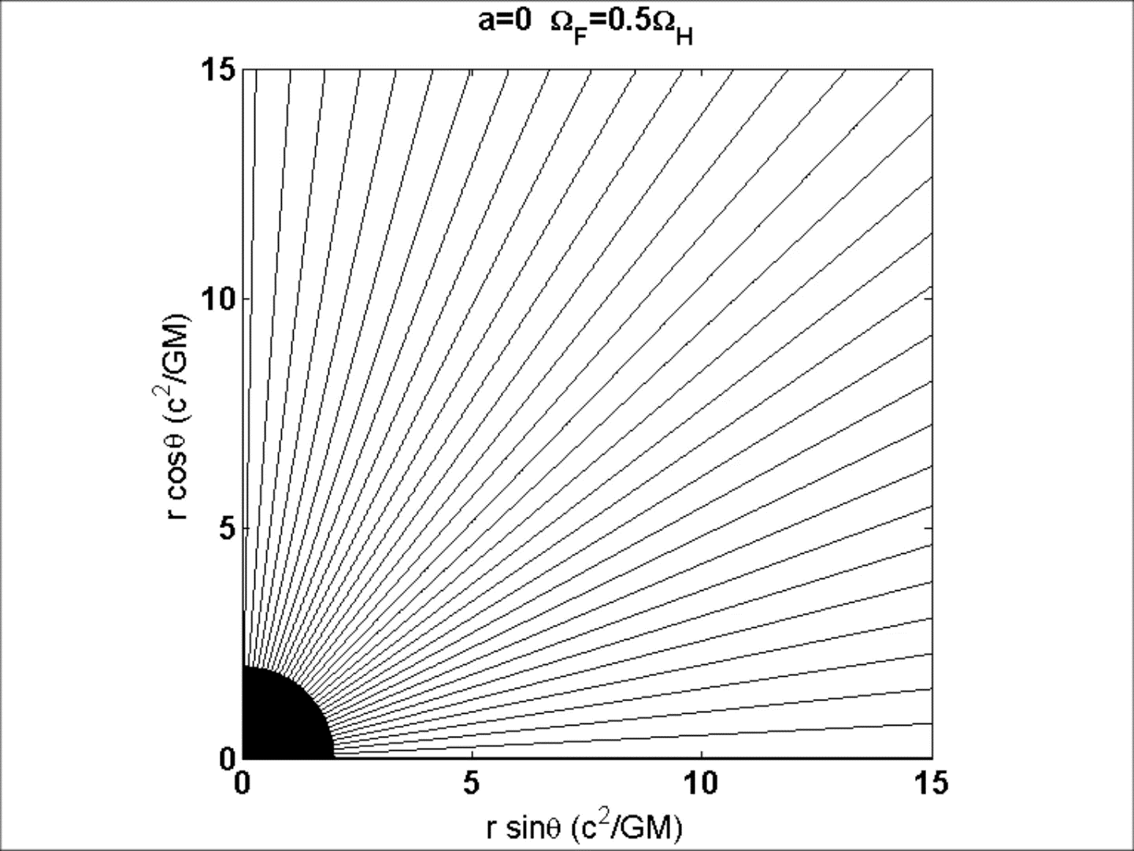
§3 BH gap model
Radial B_{p}
Equi-ρ_{GJ} contours
Pu, KH (2016)

Slide 60
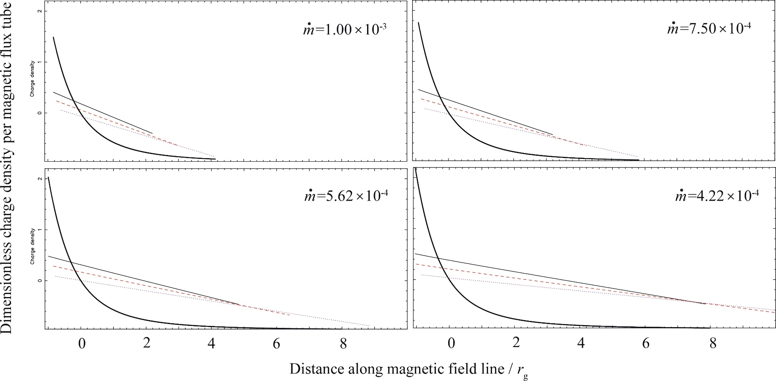
§3 The case of stellar-mass BHs
text
J_{in}=0.0
J_{in}=0.2
J_{in}=0.4
KH, Pu, Nakamura 2016

Slide 61
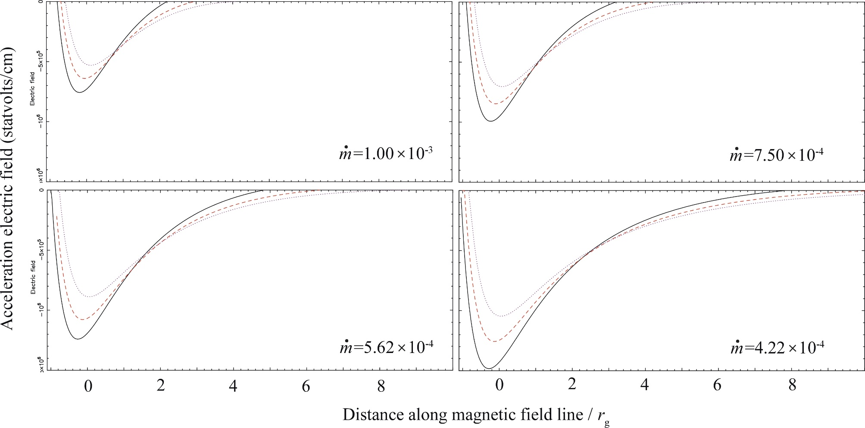
§3 The case of stellar-mass BHs
J_{in}=0.4
J_{in}=0.2
J_{in}=0.0
KH, Pu, Nakamura 2016

Slide 62
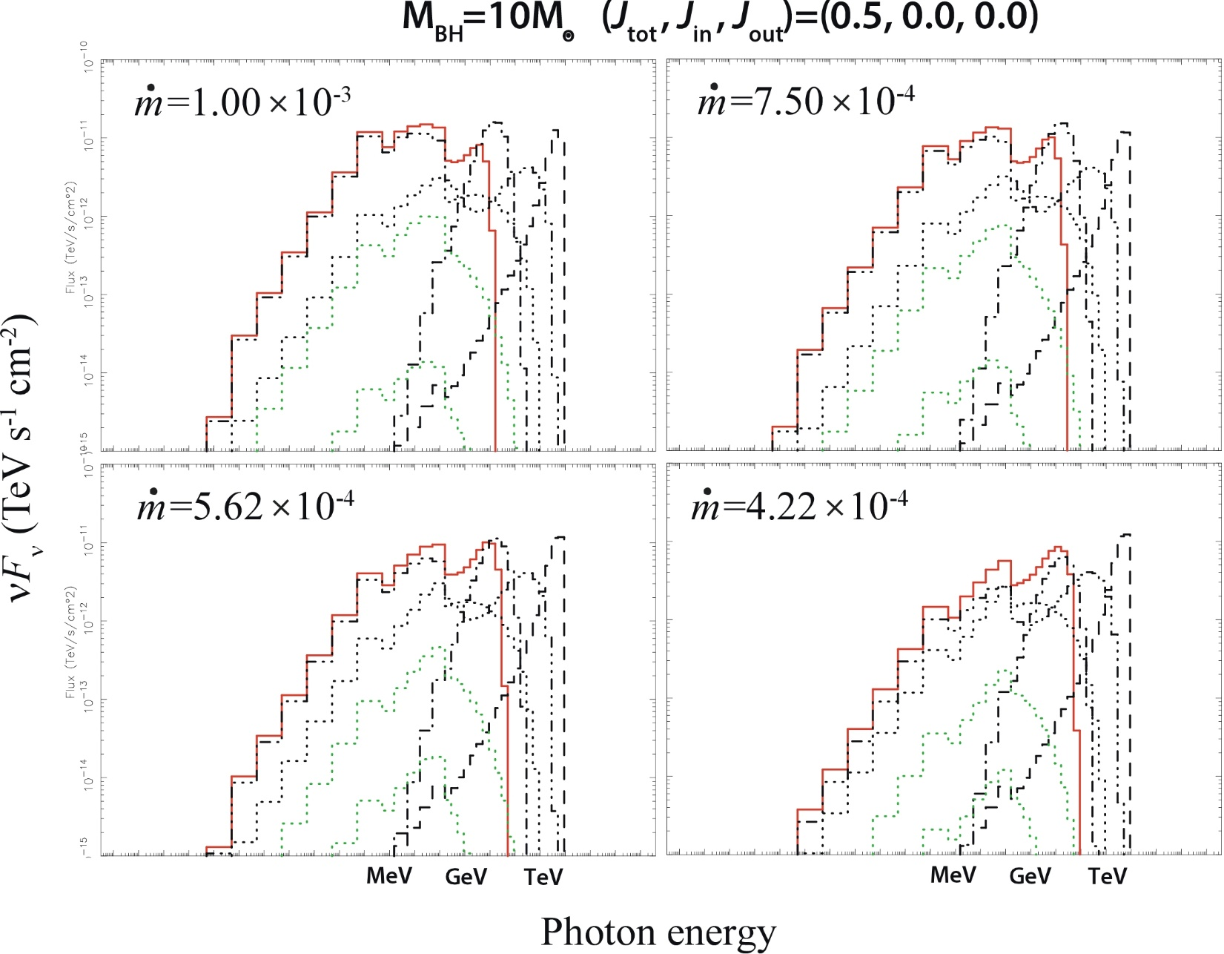
§3 The case of stellar-mass BHs
text
KH, Pu, Nakamura 2016

Slide 63
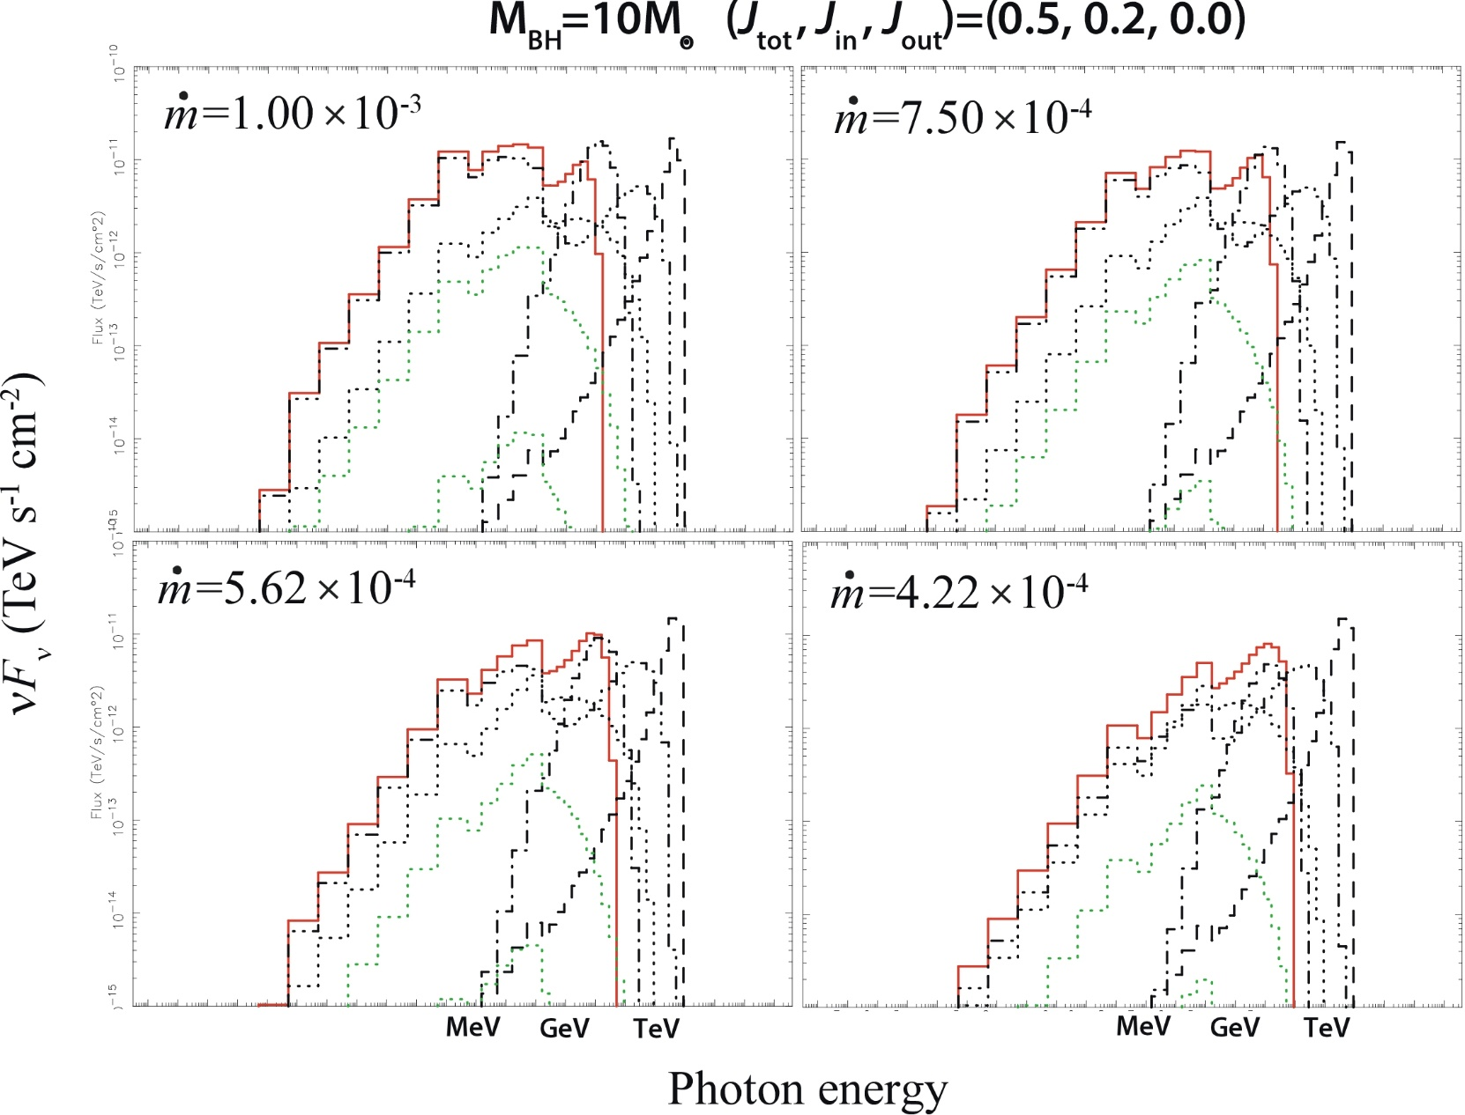
§3 The case of stellar-mass BHs
text
KH, Pu, Nakamura 2016

Slide 64
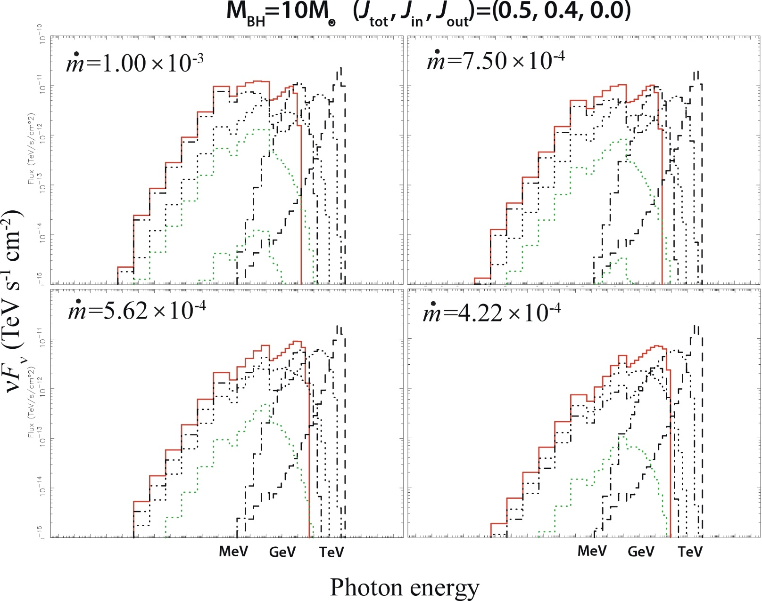
§3 The case of stellar-mass BHs
text
KH, Pu, Nakamura 2016

