Slide 1
Gravitational lensing of gravitational waves
In collaboration with
M. Hattori & T. Futamase (Tohoku Univ.).
Yousuke Itoh (RESCEU, U. of Tokyo)
seminar@ICRR, 2012 June 26
Affiliation：Tohoku U.(Prof. Futamase)→AEI, Potsdam→UWM → Tohoku U. → RESCEU
Research ： Post-Newton → LIGO Data Analysis → Cosmology → KAGRA
TexPoint fonts used in EMF.
Read the TexPoint manual before you delete this box.: AA

Slide 2
Contents
-1. Announcements.
0. Short Introduction
Young’s (cosmological) double slits experiment
Can we see interference pattern?
3. Gravitational lensing of gravitational waves
4. Real world

Slide 3
-1. Announcements
1st KAGRA Data Analysis School
@ RESCEU, 9/3(Mon.)-5(Wed.), 2012
  Introductory lectures by the Data analysis subgroup
  In Japanese (Sorry!)
  Travel support,
  Data analysis demonstration,
  Data analysis practice (octave?),
  Social gathering (Most important!)
2nd KAGRA Data Analysis School
@ NAOJ (Hopefully … )

Slide 4
Part 0:
Short Introduction

Slide 5
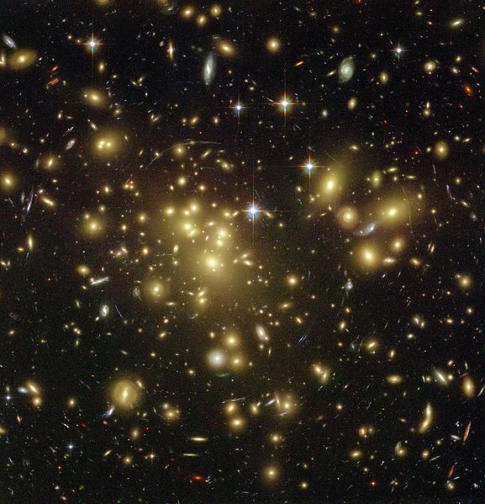

Just in case …
Gravitational lens?
http://spiff.rit.edu/classes/phys230/lectures/planets/Lens_Nav.swf
Chandra (pinkish) & Weak lensing (bluish, pseudo-) images of the bullet cluster
http://chandra.harvard.edu/photo/2006/1e0657/
HST image of Abell 1689

Slide 6
Introduction
GW suffers from GL effect by galaxies and clusters
GWs are coherent in many cases and we may be able to see interference pattern.
Takahashi & Nakamura ApJ 595 1039 (2003)
  GL of GWs
  1e6 ~ 1e9 M_{ʘ} Lens (for the obsolete LISA detector)
  Diffraction effect
  Lens mass & source position relative to optical axis.
Any other astrophysical information from GL of GW phenomena?

Slide 7
Part 1:
Young’s (cosmological) double slit experiment

Slide 8
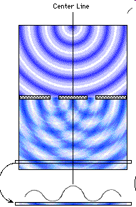
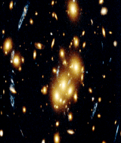
Motion in a spatial interference pattern
Transverse velocity
http://www.bottomlayer.com/bottom/reality/chap2.html

Slide 9
Part 2:
Can we see interference pattern?

Slide 10
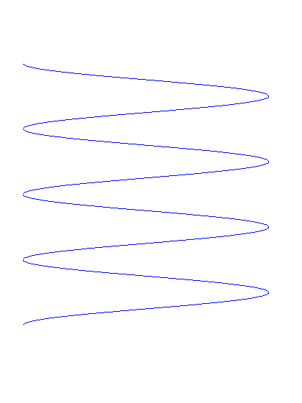

Probably no in Electro Magnetic Astronomy …
$$θ$$
Summation of incoherent emitters (bunch of electrons …)
interfere distractively
Can see interference only when …

Slide 11

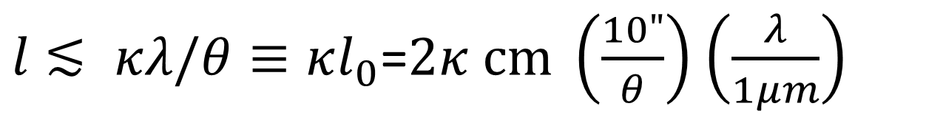

Probably no in Electro Magnetic Astronomy …
$$l$$
$$θ$$
$l$ $≲ κλ/θ≡κl_{0}$=$2κ cm \left(\frac{10"}{θ}\right)$ $\left(\frac{λ}{1μm}\right)$
We can see interference pattern only when the linear dimension of the source (galaxy) is less than ~ 2 cm.
Impossible!!

Slide 12
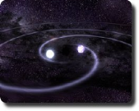
Probably yes in Gravitational Wave Astronomy …?
$$θ$$
Coherent emitter (single source if we are lucky (?) …)
Interfere constructively.
Can see interference if …

Slide 13

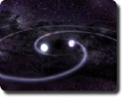

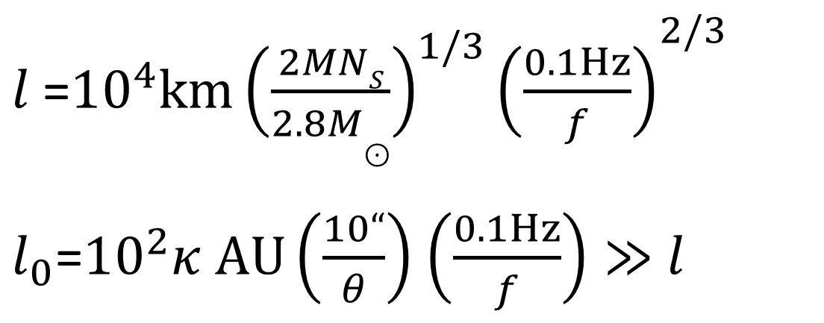
Probably yes in Gravitational Wave Astronomy …?
$$θ$$
$l$=${10}^{4}km{{\left(\frac{2MNS}{2.8M⊙}\right)}^{1/3}\left(\frac{0.1Hz}{f}\right)}^{2/3}$
$l_{0}$=${10}^{2}κ AU\left(\frac{10“}{θ}\right)$ $\left(\frac{0.1Hz}{f}\right)≫$ $l$

Slide 14
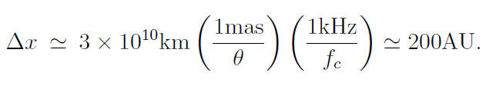


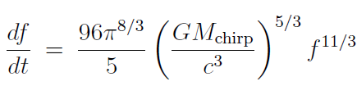

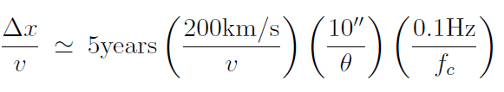
Cosmological Young’s experiment in GWA possible in reality?
Pulsars in globular clusters
  But diffraction obscures the interference pattern when
NS/NS binaries
  But freq. derivative & SNR complicates the issue.
&

Slide 15
No (ﾉω･､) in space, but …
Yes (♪ d(⌒o⌒)b♪) in a computer
Time delay
  Reach the observer separately in time
  Extract the interference pattern in a computer
SNR
  Integrate to get SNR
  Interference disappears
  Filtered output
Chirp
  Intrinsic frequency (time-)derivative

Slide 16
Part 3:
Gravitational lensing of gravitational waves

Slide 17

Lensed GW from inspiraling binary
No relative motion geometrical optics approximation (Takahashi & Nakamura 2003)
Dopper shift in mass and time due to relative motion
Гis dopper shift difference between the two images

Slide 18



If you like equations (copy from my paper).
Detector index
GL amplification
Half integer: saddle = ½ etc
Amplitude of the detector beam pattern function
Phase of the detector beam pattern function.
Doppler phase due to the DECIGO orbital motion.

Slide 19

Beam pattern function (II)
Shift due to the Doppler effect by the Detector motion

Slide 20
Beam pattern function (I)

Slide 21


Do you still like equations?
Image index
time variable
GL amplitude
GL amplitude

Slide 22
We would like to determine for the following parameters (in case of no relative motion.)
Chirp mass
Phase of coalescence
Time of coalescence
Luminosity distance to the source
Source direction
Binary orbital plane inclination
Lens image relative parity
Time delay
Relative magnification

Slide 23

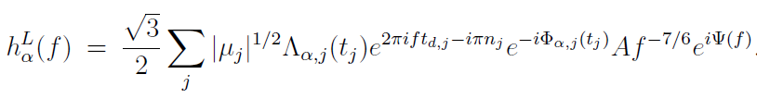
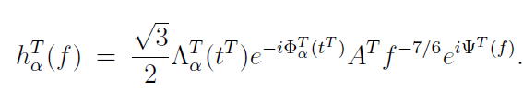
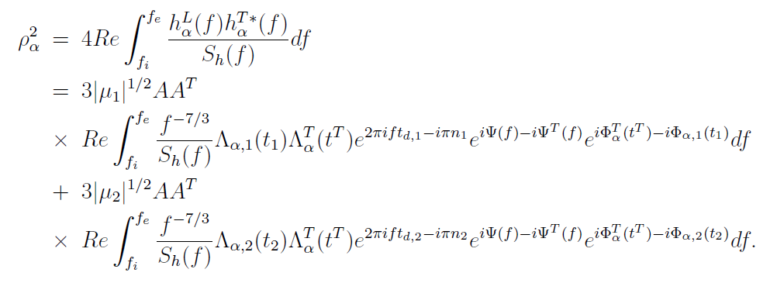
Geometrical Optics Approx. (GOA)
Lens
Template

Slide 24
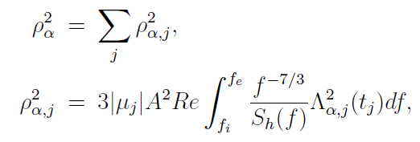
Geometrical Optics Approx. (GOA)
Lens
Template
We can separately detect the two images.

Slide 25
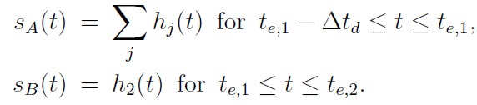


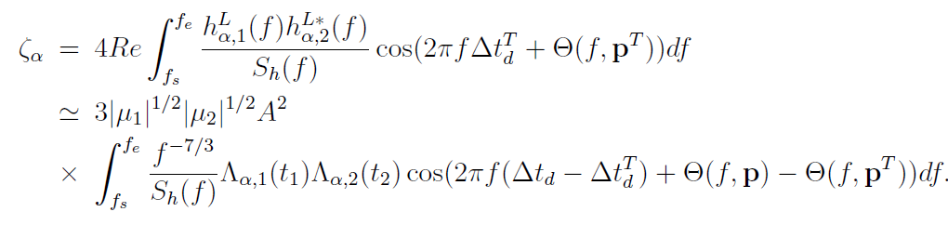
To extract interference in GOA (no noise).
Even without detector noise
In stead,

Slide 26
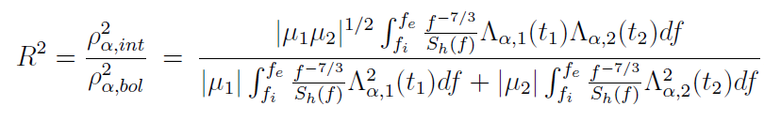
Differential SNR

Slide 27



Transverse velocity
When relative transverse velocity is not zero,
  Doppler shift to frequency, unobservable a priori.
  Doppler shift to the Masses and time variables
  Unobservable a priori.
  Time variation in the source direction
  Unobservable for astronomical sources.
  But relative Doppler factor is observable

Slide 28





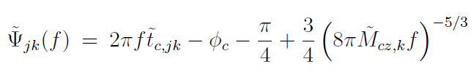
For those who like equations (if any)…
Dopper factor

Slide 29
SNR as a function of template mismatch in Г

Slide 30
Differential SNR w or w/o mismatch in Г

Slide 31
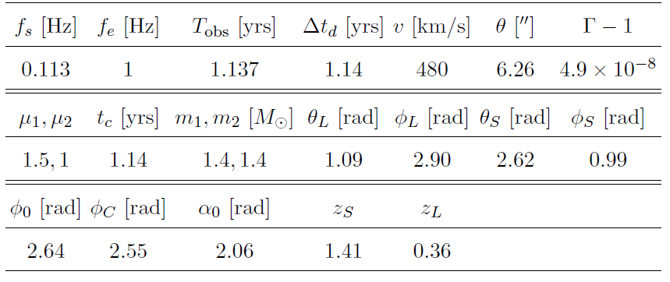
Example parameters (Q0957+561)

Slide 32

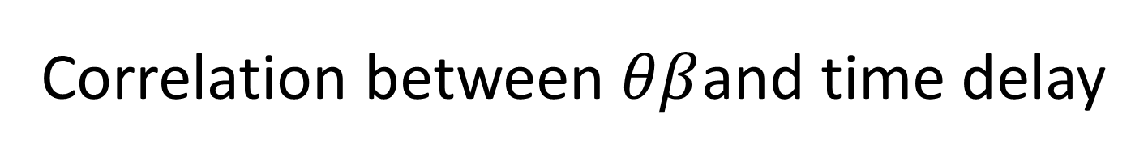
Correlation between $θβ$and time delay

Slide 33
Along the “ridge”

Slide 34
Part 4:
Real world

Slide 35
Noises
Parameters estimation noises
Detector noises

Slide 36
Effect of nuisance parameters estimation errors (td = 1.14 years)

Slide 37
Effect of nuisance parameters estimation errors to Г(td = 1.14 years)

Slide 38
Effect of nuisance parameters estimation errors to td (td = 1.14 years)

Slide 39
Effect of nuisance parameters estimation errors (td = 5.1 years)

Slide 40
Effect of nuisance parameters estimation errors to Г

Slide 41
Effect of nuisance parameters estimation errors to td

Slide 42
10 different nuisance parameters set, 1000 noise realizations each (td = 1.4 years)

Slide 43
10 different nuisance parameters,
1000 noise realizations each (td = 5.1 years)

Slide 44
If you think mass/tc should give Г
It is mathematically true but at lesser accuracy.

Slide 45
Summary (as of 10:10, June 26, 2012)
It is possible that gravitational wave can be gravitationally lensed in principle.
I could not come up with any natural source that shows observable spatial interference pattern.
On a computer, we can extract information contained in the interference term.
For this purpose, I propose a new statistic ζ.
With ζ, we can measure the transverse velocity of the sources which is hard to detect in a conventional EM GL in the DECIGO/BBO era.

