Slide 1
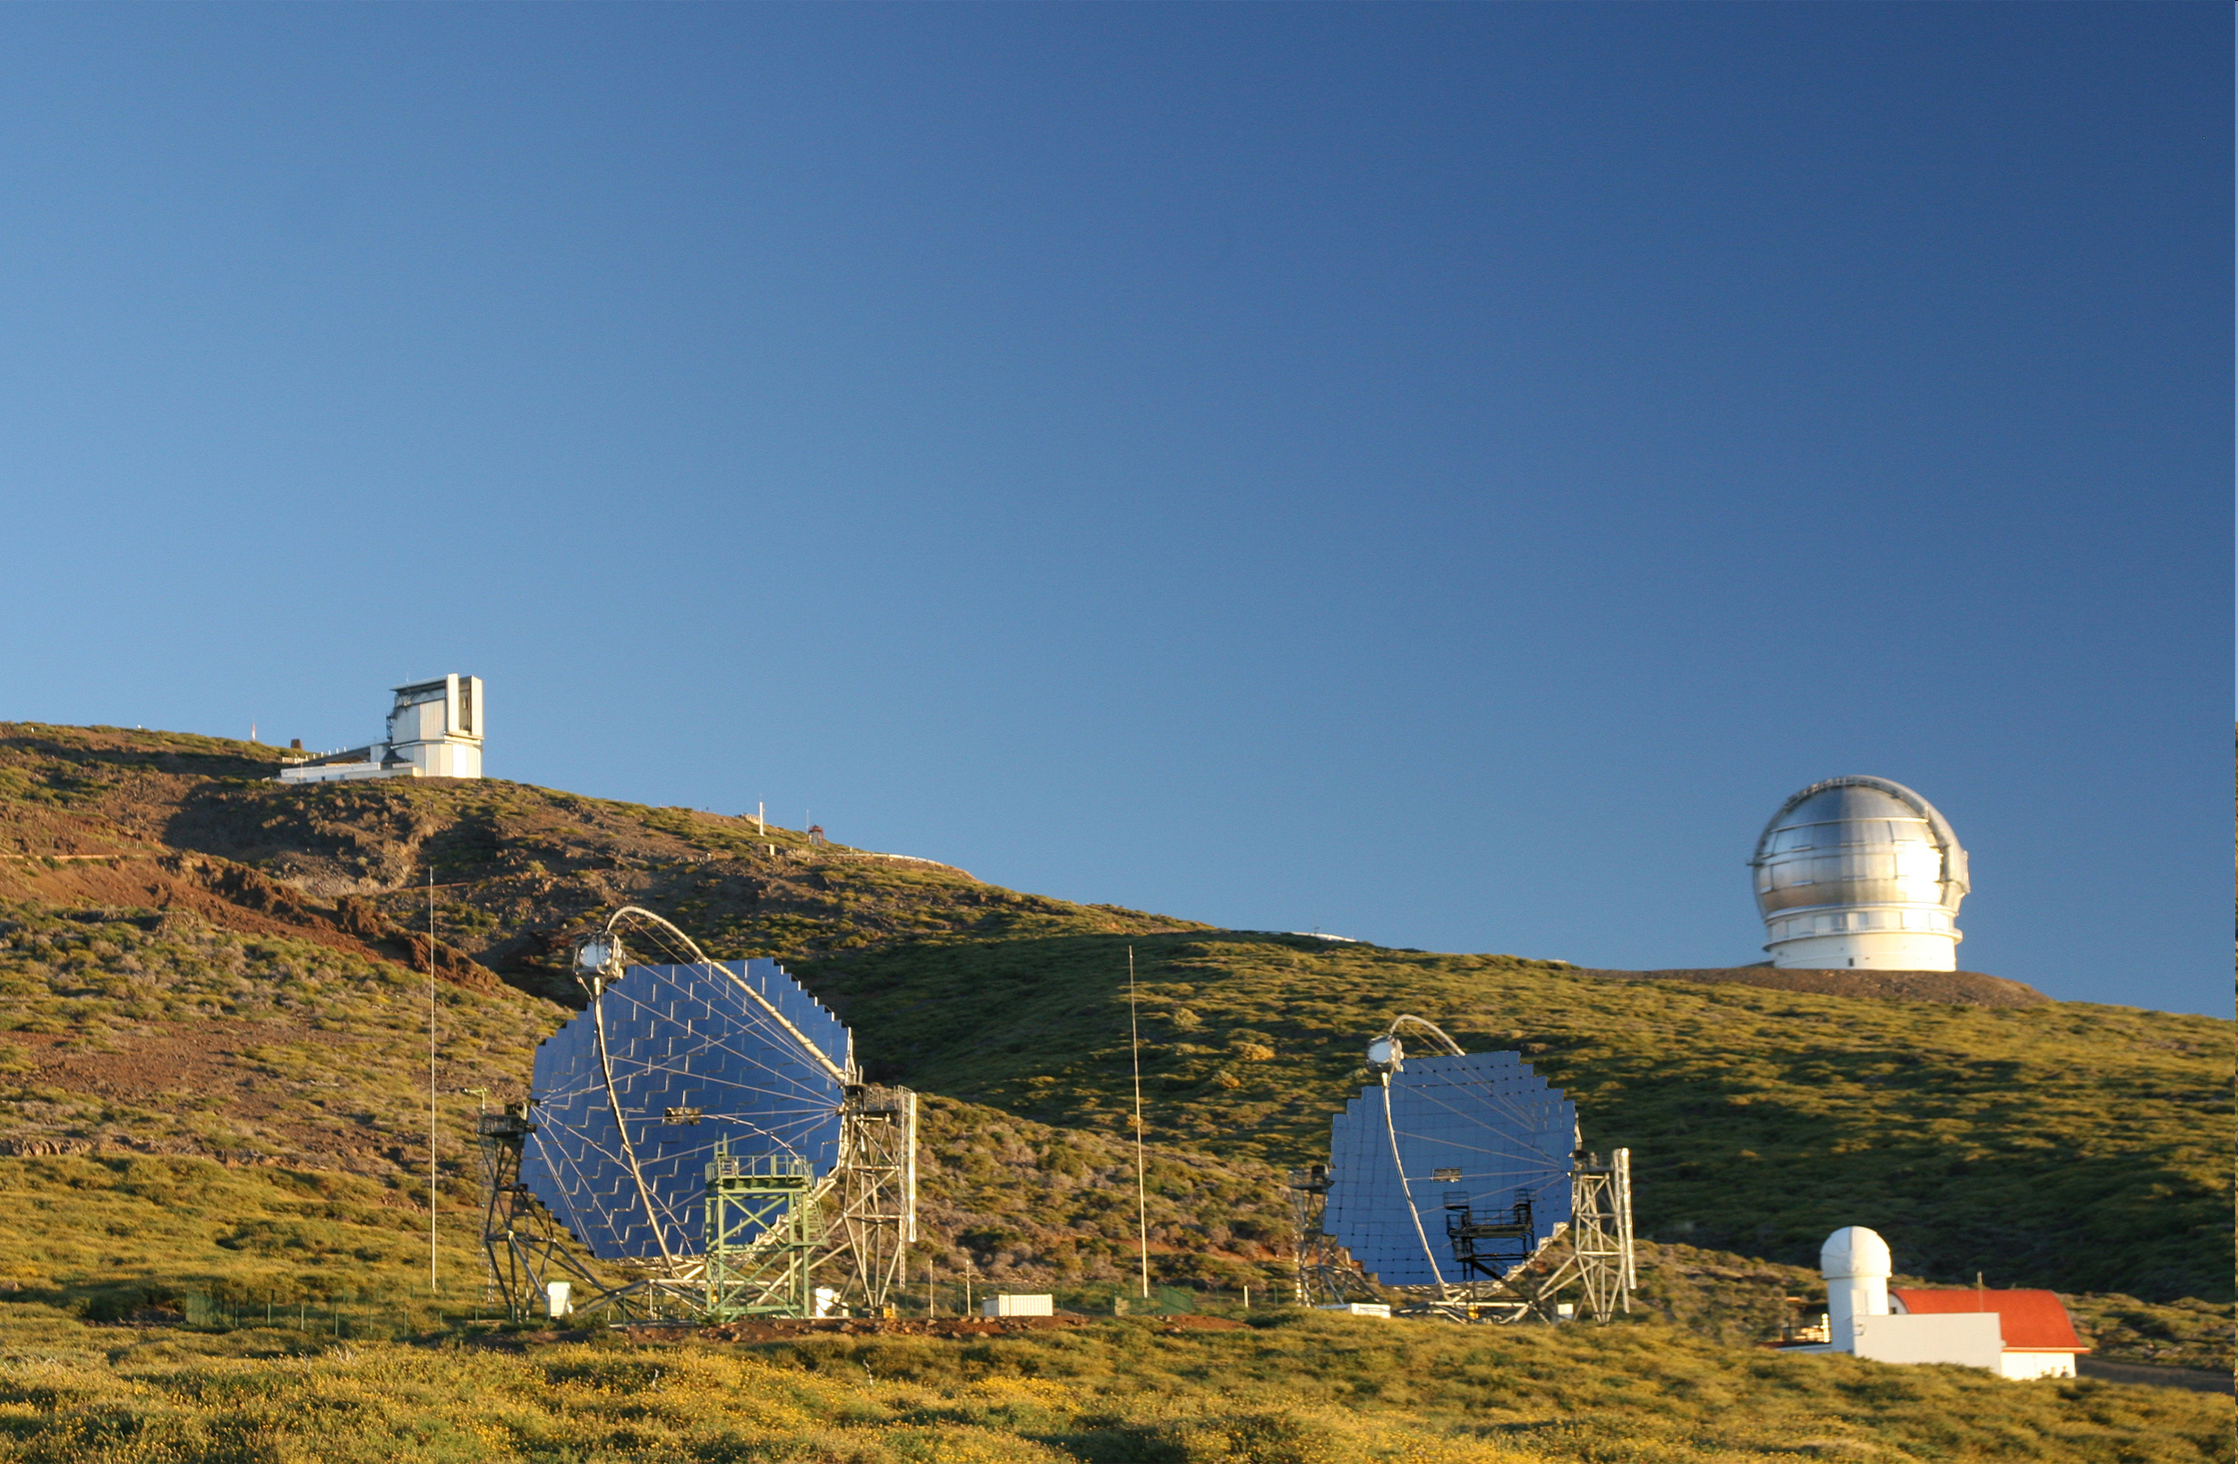
Gamma-ray astronomy and fundamental physics
Alessandro De Angelis
INFN-U.Udine/INAF/LIP-IST; guest professor at ICRR, U. Tokyo
Introduction: why gamma rays? How?
Some results related to fundamental physics
What’s next
May 2012

Slide 2
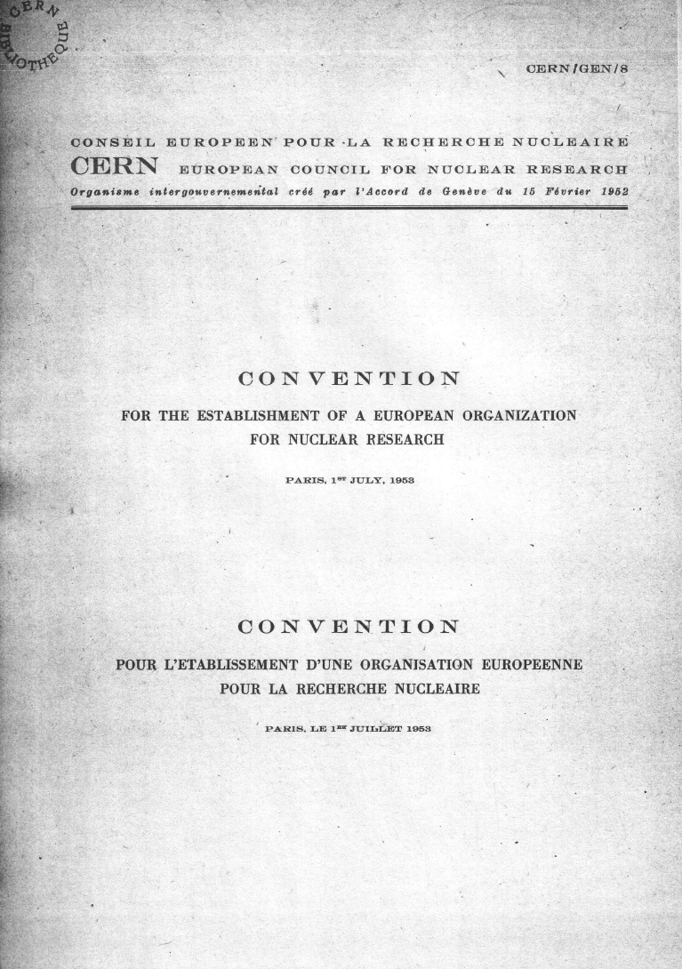
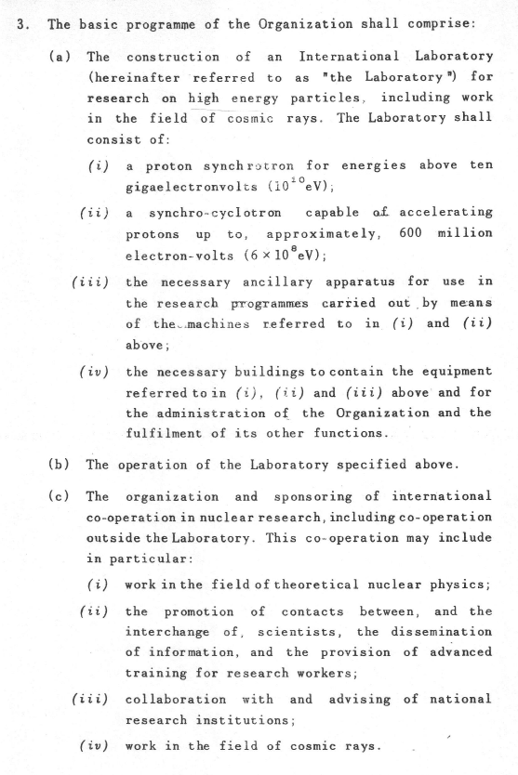
Research on cosmic rays is in CERN’s constitution
(…)

Slide 3
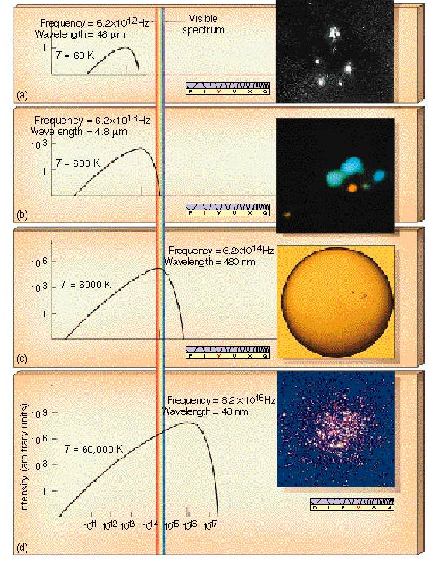
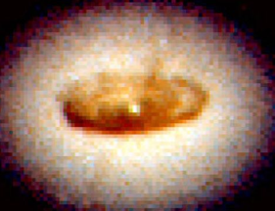
A Galactic gas cloud
called Rho Ophiuchi:
60 K
Dim star near the
center of the Orion Nebula:
600 K
Our star – the Sun:
6000 K
Thermal Radiation: Black Body Spectrum
Cluster of very bright stars, Omega Centauri,
as observed from the space:
60,000 K
But this is still ~1 keV, in the X-Ray band!
Accretion Disks can reach
temperatures >> 10⁵ K

Slide 4
High Energy γ rays: non-thermal Universe
Particles accelerated in extreme environments interact with medium
  Gas and dust; Radiation fields – Radio, IR, Optical, …;
  Intergalactic Magnetic Fields, …
Gamma rays traveling to us!
  HE: 30 MeV to 30 GeV
  VHE: 30 GeV to 30 TeV
No deflection from magnetic fields, gammas point ~ to the sources
  Magnetic field in the galaxy: ~ 1μG
  R (pc) = 0.01p (TeV) / B (μG)
  => for p of 300 PeV @ GC the directional information is lost
  Gamma rays can trace cosmic rays at energies ~10x
Large mean free path
  Regions otherwise opaque can be transparent to X/γ
Plus: “new” particles (e.g. Dark Matter)
Studying Gamma Rays allows us to see these aspects of the Universe

Slide 5
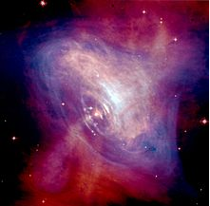
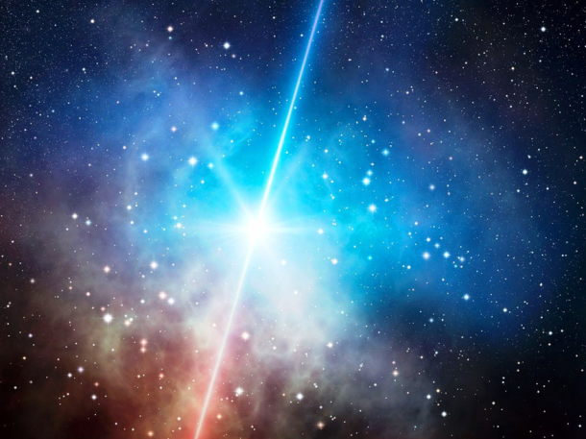
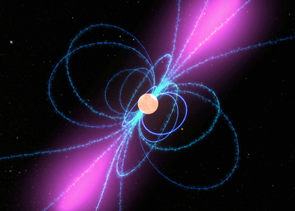
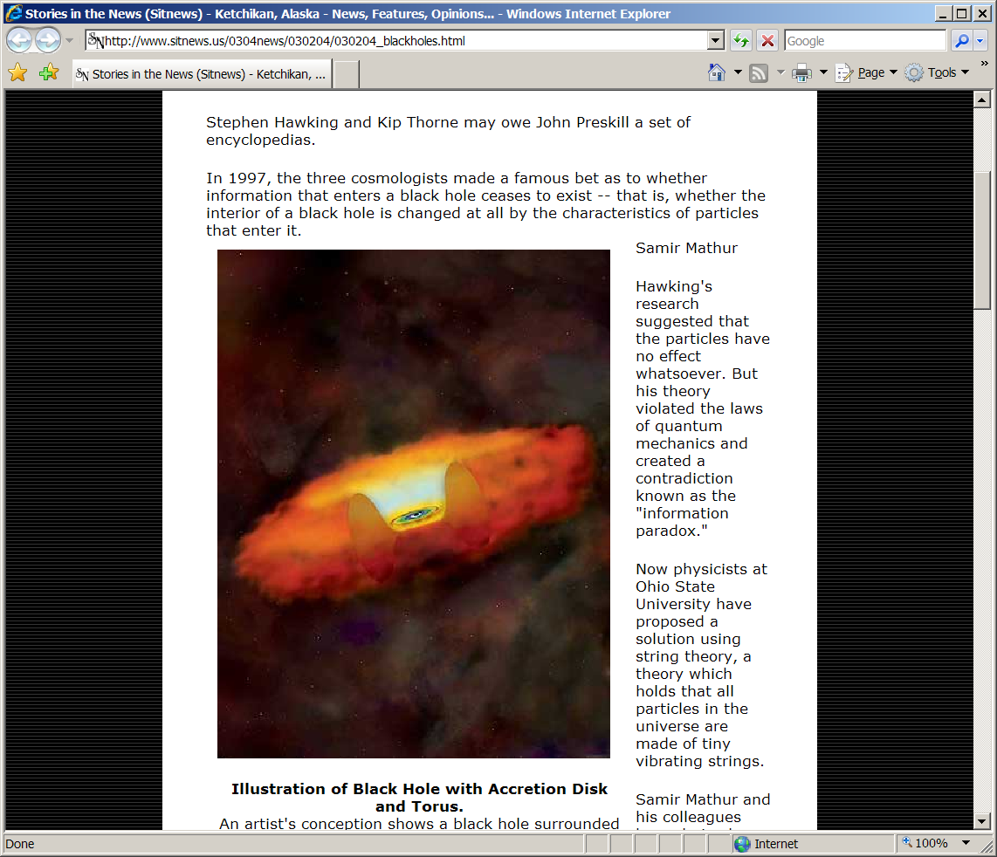
Examples of known extreme environments
GRB
SuperNova Remnants
Pulsars
Accretion Disk 3- 10 r_{s}
Black Hole Diameter = 2r_{s} ~ 4 AU
Active Galactic Nuclei
~ parsecs

Slide 6
Cosmic γ rays: different production mechanisms expected to be at work
e.m. processes
e⁻ (TeV)
Synchrotron
γ (eV-keV)
hadronic cascades
B
p⁺ (>>TeV)
γ (TeV)
Inverse Compton
π⁰
γγ (TeV)
γ (eV)
matter
π⁻
π⁺
IC
In the VHE region,
dN/dE ~ E^{-Γ} (Γ: spectral index)
To distinguish between had/leptonic origin
study Spectral Energy Distribution (SED):
(differential flux) . E²
E² dN/dE
π⁰decay
VHE
energy E

Slide 7
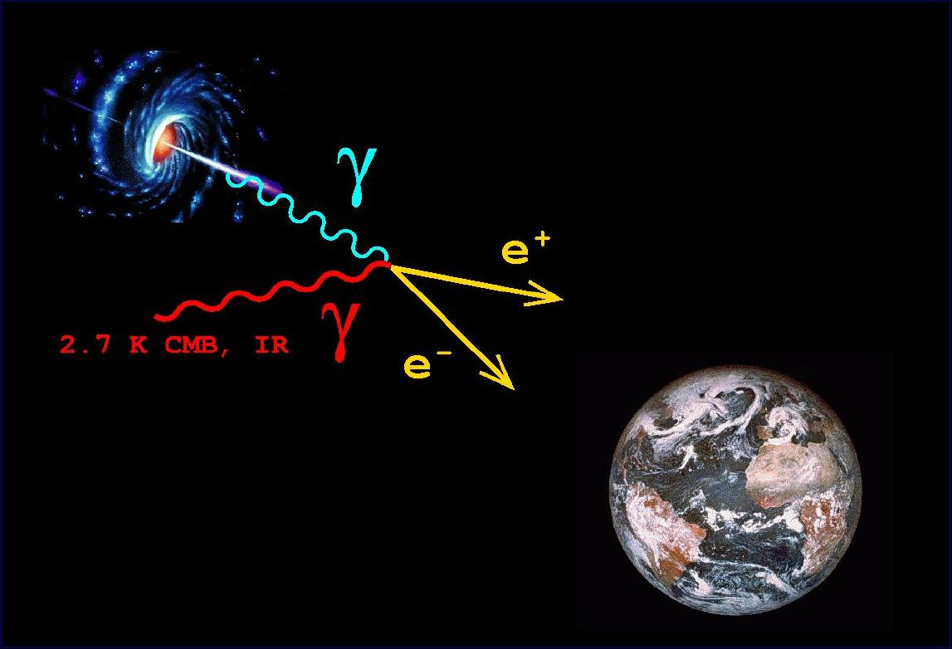
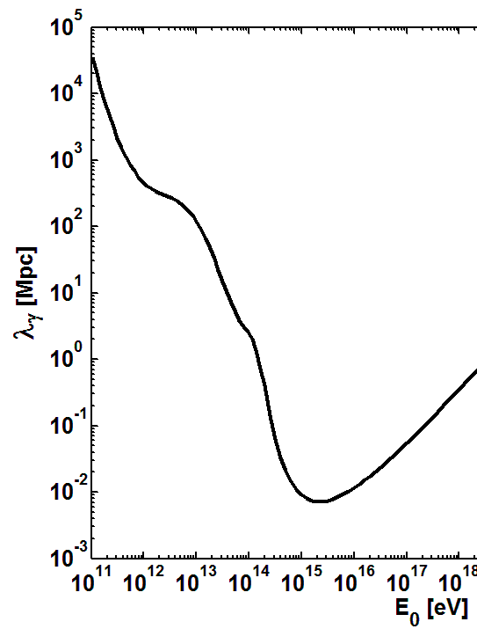
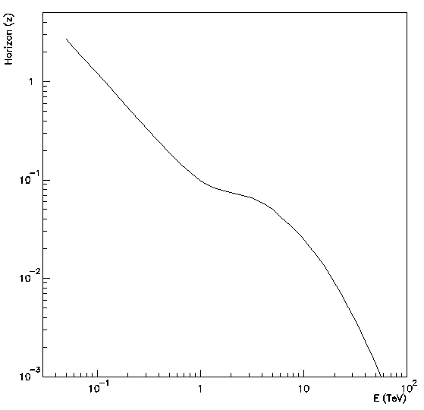


How do gamma rays reach us?
  τ(E,z) = 1 γ – ray horizon
Cen A
(3.5 Mpc)
> 1
region of opacity
Galactic Centre
(9 kpc)
redshift z
30 GeV
100 GeV
τ = 1
γ_{VHE}γ_{bck} → e⁺e⁻
σ(β) ~
De Angelis, Galanti, Roncadelli 2011
with Franceschini EBL modeling
Max for:
γ ray energy (TeV)

Slide 8
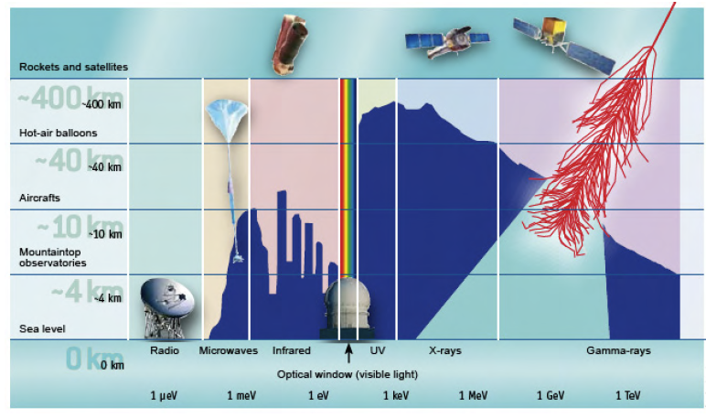
Gamma rays interact with the atmosphere
=> GeV (HE) detection requires satellites; TeV (VHE) can be done at ground

Slide 9
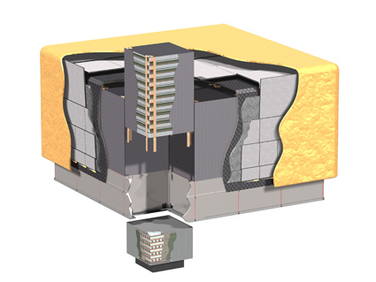
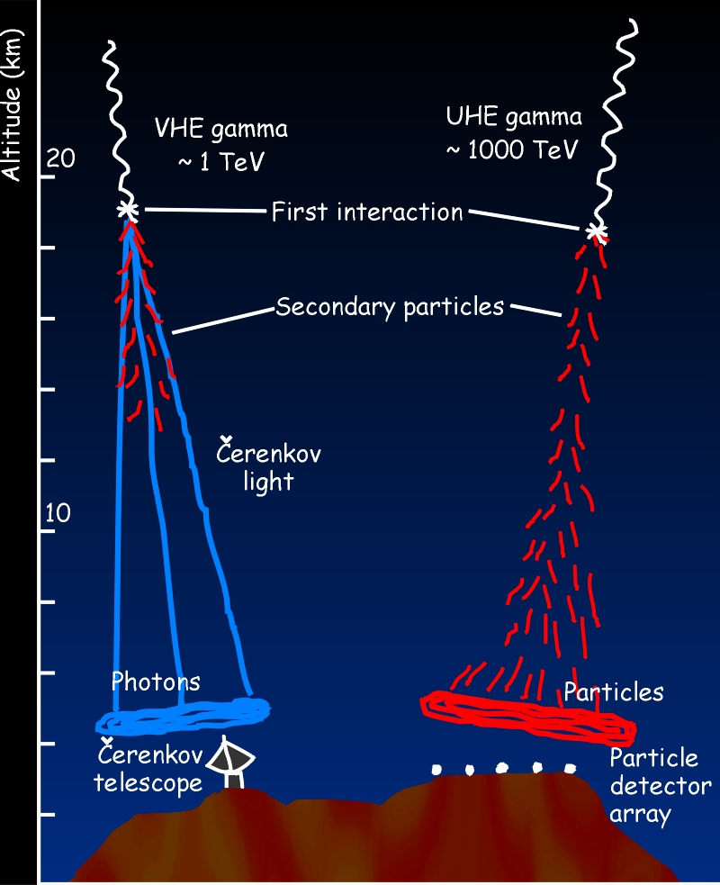
Detectors
Precision Si-strip Tracker (TKR)
18 XY tracking planes
Single-sided silicon strip detectors 228 μm pitch, 8.8 10⁵ channels
Measure the photon direction
γ
Satellites (AGILE, Fermi)
  Silicon tracker (+calorimeter)
Cherenkov telescopes
(HESS, MAGIC, VERITAS)
Extensive Air Shower det.
(ARGO): RPC, scintillators
HEP detectors!
e⁺
e⁻

Slide 10
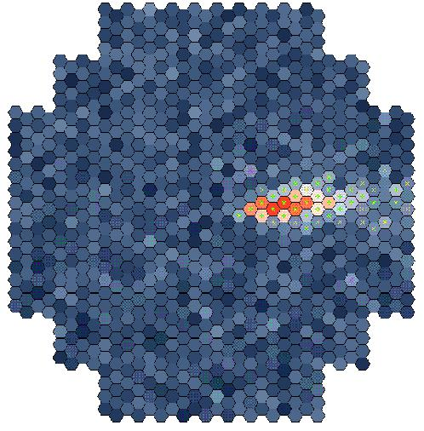
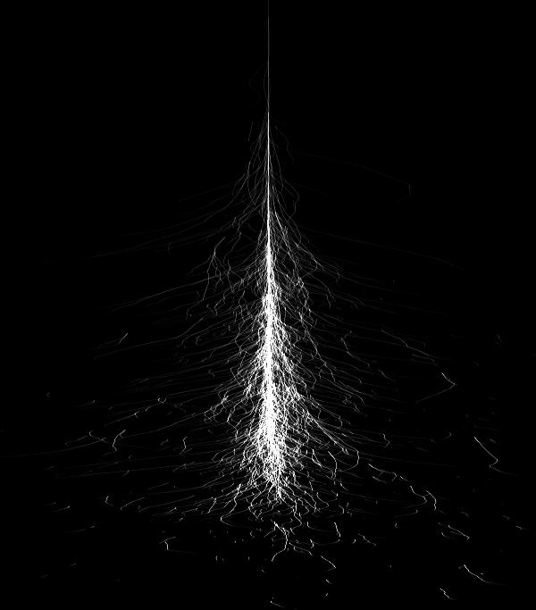
The Cherenkov technique
Incoming
γ-ray
  θ_{c} ~ 1º
  e Threshold @ sl: 21 MeV
Maximum of a 1 TeV shower
~ 8 Km asl
~ 200 photons/m² in the visible
Angular spread ~ 0.5º
~ 10 km
~ 1º
Cherenkov light
Image intensity
↓ Shower energy
Image orientation
↓ Shower direction
~ 120 m
Image shape
Primary particle
Notes:
Threshold @ sea level : 21 MeV for e, 44 GeV for μ
Maximum of a 1 TeV γ shower ~ 8 Km asl
200 photons/m² in the visible

Slide 11
Systems of Cherenkov telescopes
Better bkgd reduction
Better angular resolution
Better energy resolution

Slide 12

Signal duration: ~ 3ns

Slide 13
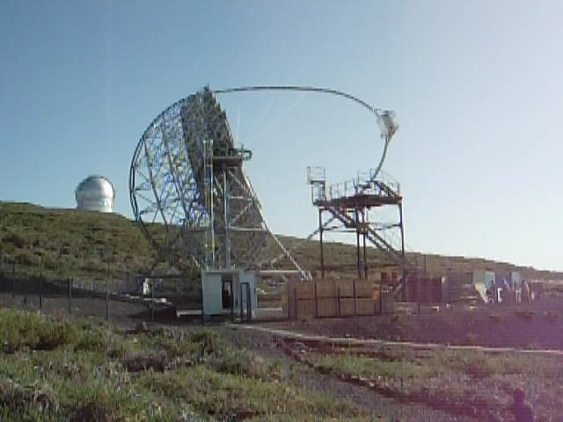
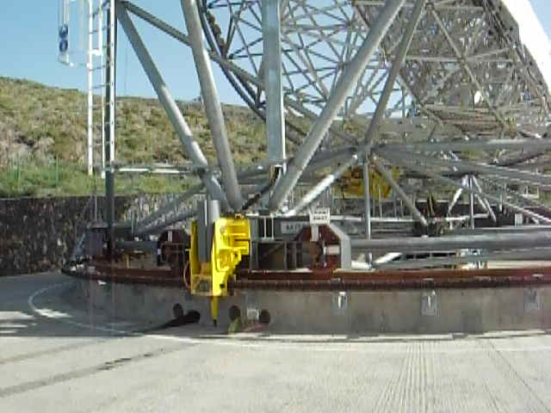
MAGIC at La Palma
the largest reflector in the world
(2 x 17 meters diameter telescopes)
An international collaboration of 160 scientists from institutes in Germany, Italy, Spain, Japan, Switzerland, Finland, Poland, Bulgaria, Croatia
Commissioned as a stereo system since May 2010
(was mono since 2004)

Slide 14
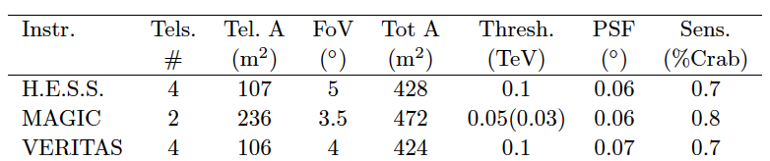
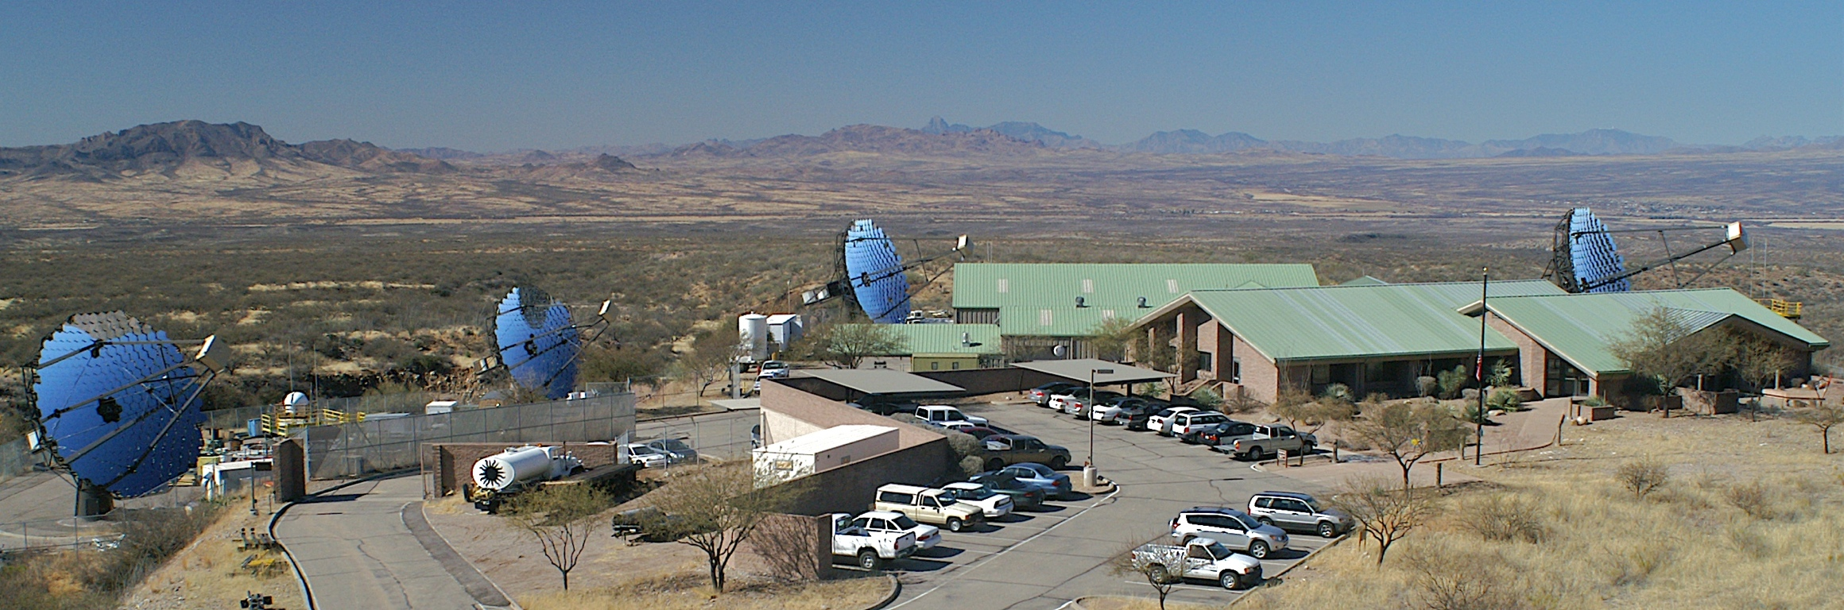
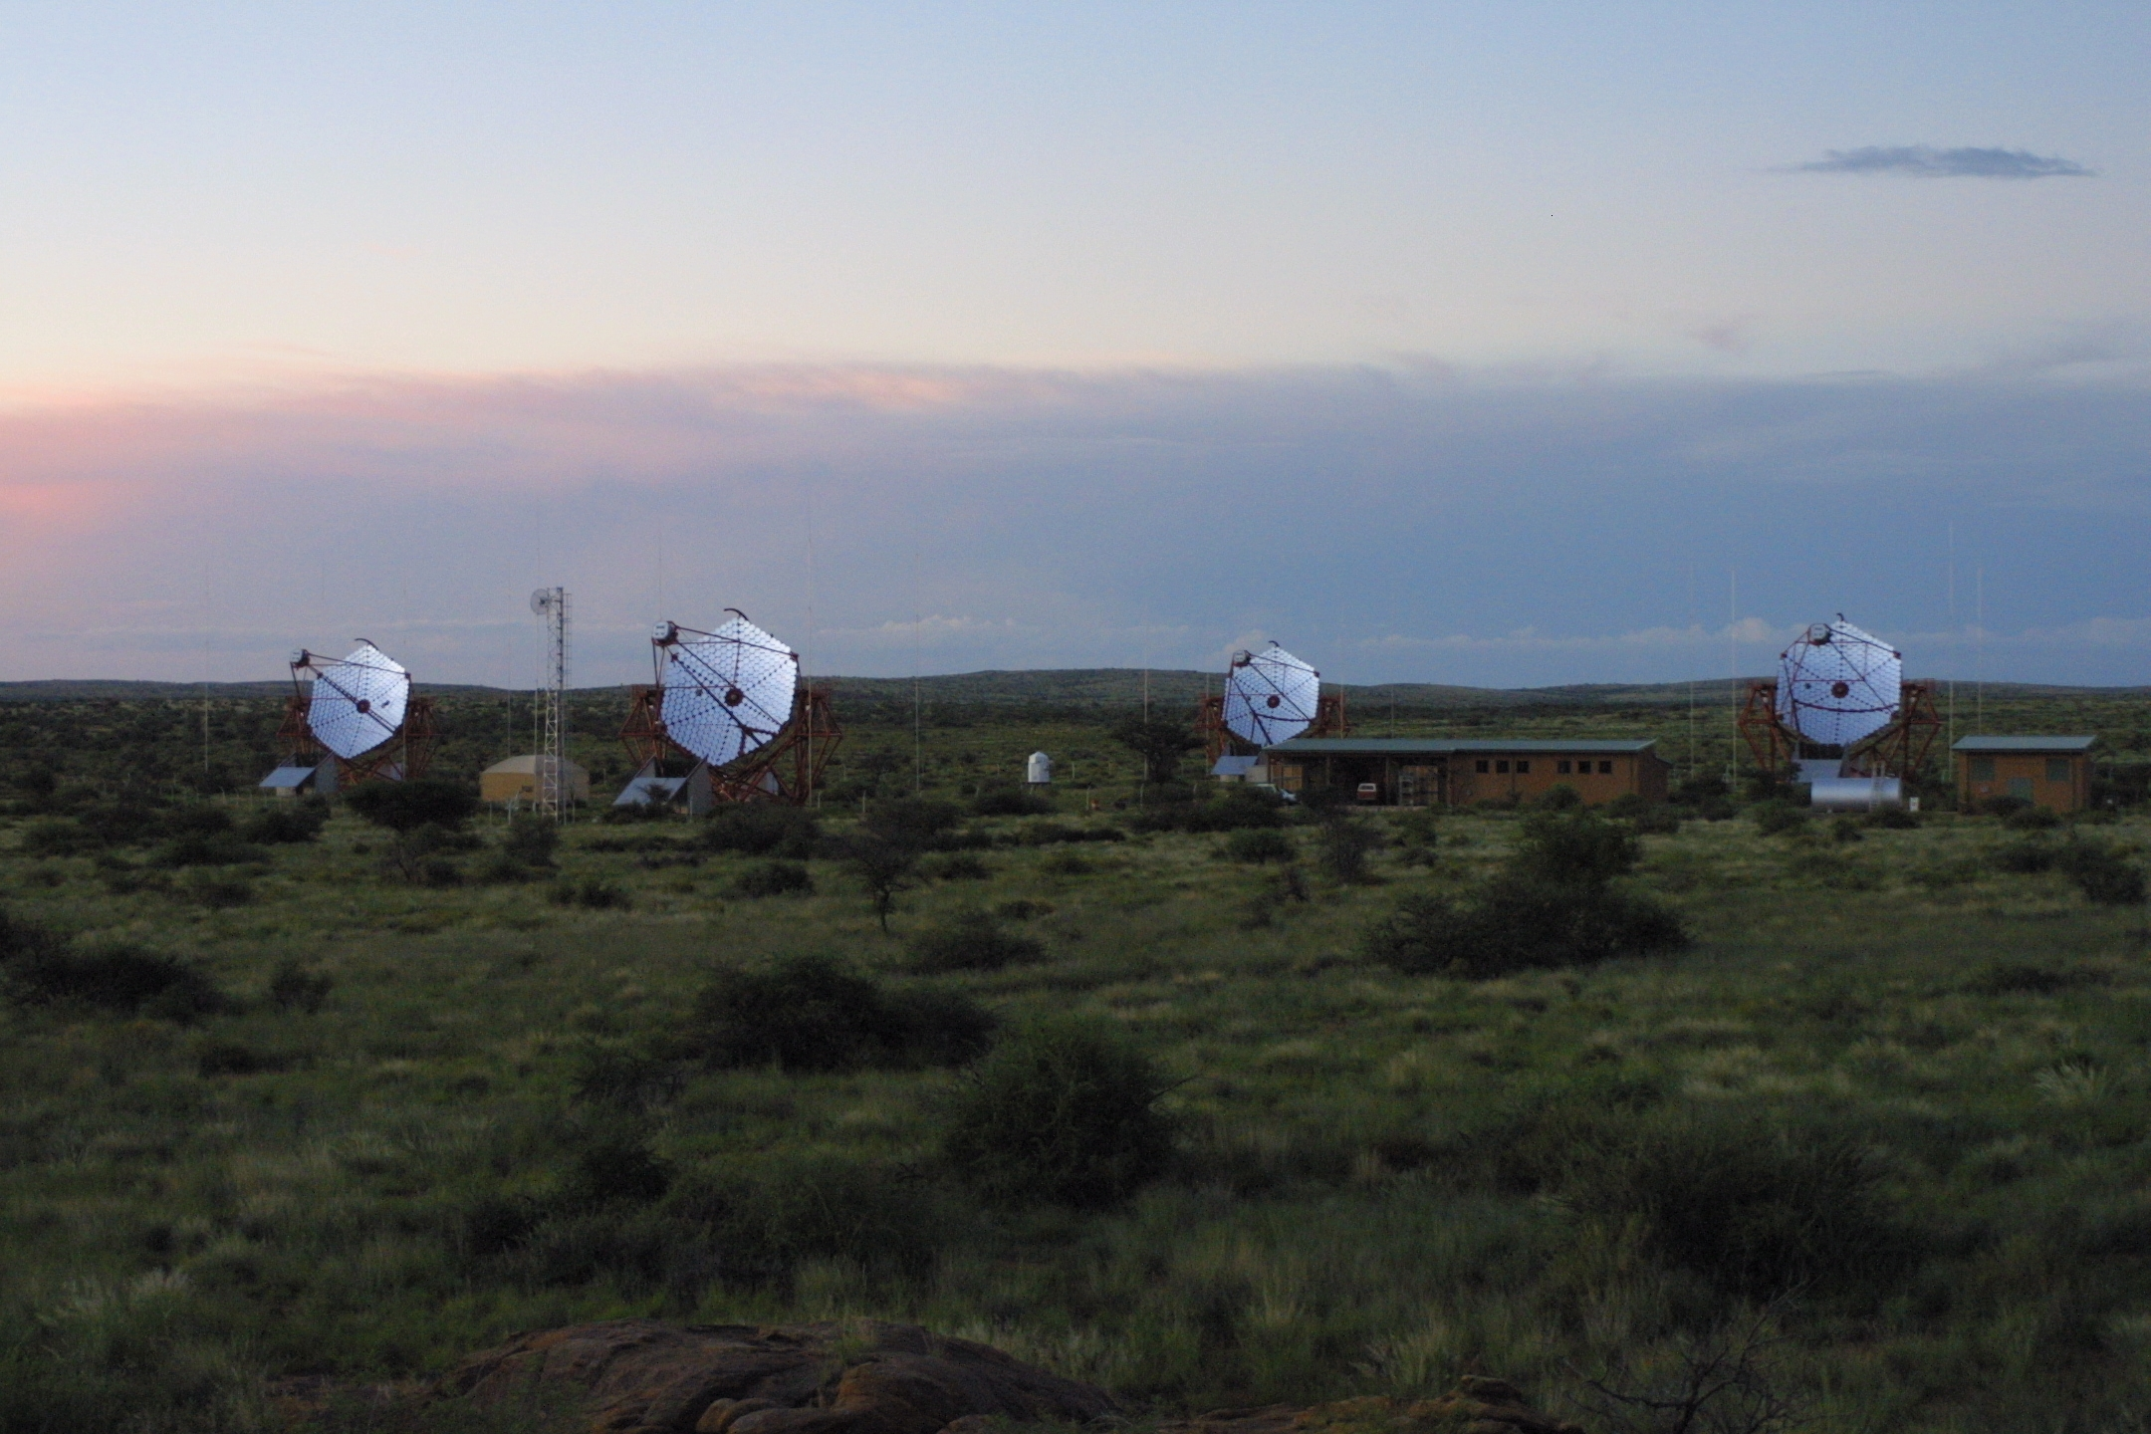
VERITAS: 4 telescopes (~12m) in Arizona operational since 2006
VERITAS: 4 telescopes (~12m) in Arizona operational since 2006
H.E.S.S.: 4 telescopes (~12m) in Namibia operational since 2003
Major upgrade expected ~end 2011:
Very large (28m) central telescope in construction

Slide 15
Agile
(A. De Angelis 2012)
Fermi
Argo
Crab
E*F(>E) [ TeV/cm²s]
Agile, Fermi, Argo, Hawk: 1 year
Magic, Hess, Veritas, CTA: 50h
Magic-II
10% Crab
Hess/Veritas
1% Crab
15

Slide 16
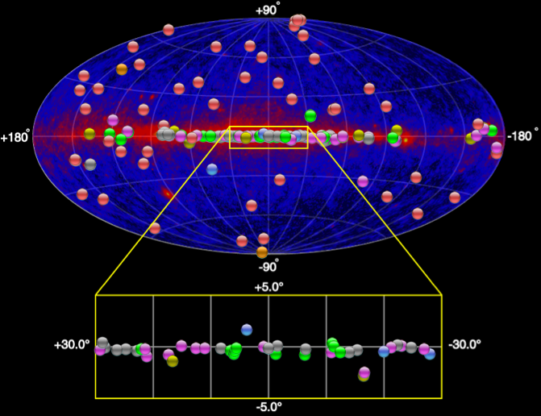
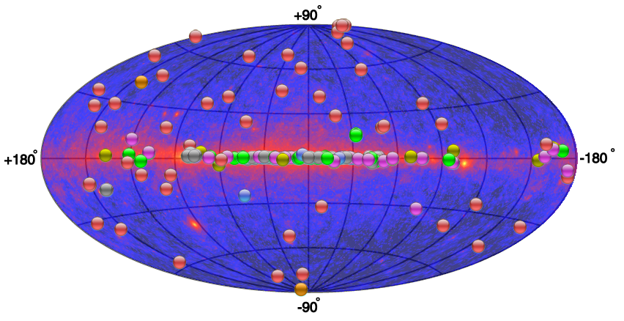
Highlight in γ-ray astrophysics (MAGIC,
HESS, VERITAS)
Thanks mostly to Cherenkov telescopes, imaging of VHE (> 130 GeV) galactic sources and discovery of many new galactic and extragalactic sources: ~ 150 (and >200 papers) in the last 7 years
  And also a better knowledge of the diffuse gammas and electrons
A comparable success in HE (the Fermi realm); a 10x increase in the number of sources
A new tool for cosmic-ray physics and fundamental physics

Slide 17
Main physics results and perspectives
(with emphasis on fundamental physics)
Cosmic Rays
Transparency of the Universe;
Tests of Lorentz Invariance;
Axion-Like Particles
Search for “WIMP” Dark Matter

Slide 18

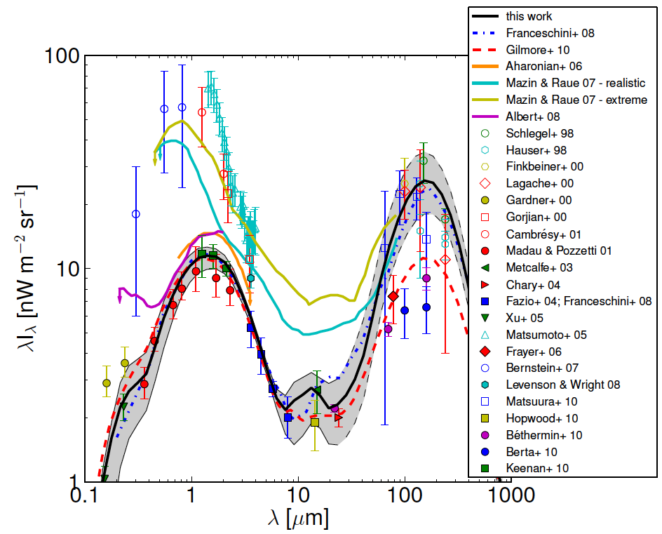
Propagation of γ-rays
e⁺
dominant process for absorption:
e⁻
x
γ_{VHE}γ_{bck} → e⁺e⁻
x
x
σ(β) ~
≈
Heitler 1960
maximal for:
    For gamma rays, relevant background component is optical/infrared (EBL)
    different models for EBL: minimum density given by cosmology/star formation
(Galanti et al. 2012)
Mean free path
Measurement of spectral features permits to constrain EBL models
(Dominguez et al. 2011)
Notes:
Subaru

Slide 19
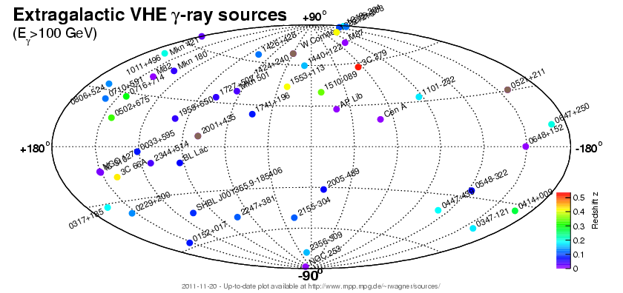
Extragalactic
Sources
~50 Sources
…
1ES 1011+496 z=0.21 MAGIC 2007
1ES 0414+009 z=0.29 HESS/Fermi 2009
S5 0716+71 z=0.31±0.08 MAGIC 2009
1ES 0502+675 z=0.34 VERITAS 2009
PKS 1510-089 z=0.36 HESS 2010
4C +21.43 z=0.43 MAGIC 2010
3C 66A z=0.44 VERITAS 2009
3C 279 z=0.54 MAGIC 2008

Slide 20
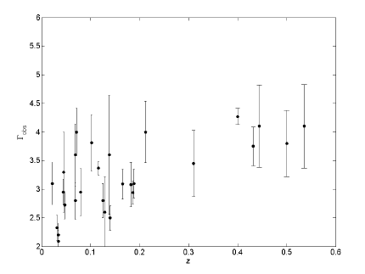
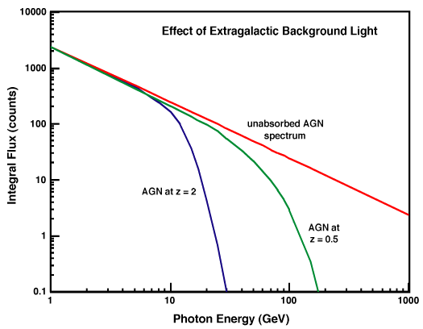
Are our AGN observations consistent with theory?
Selection bias?
New physics ?
Measured spectra affected by attenuation in the EBL:
observed spectral index
~ E⁻²
(DA, Galanti, Roncadelli; PRD 2011)
  redshift
redshift z
> 1
region of opacity
τ = 1
De Angelis, Galanti, Roncadelli 2011
with Franceschini EBL modeling
The most distant:
MAGIC 3C 279 (z=0.54)
γ ray energy (TeV)

Slide 21
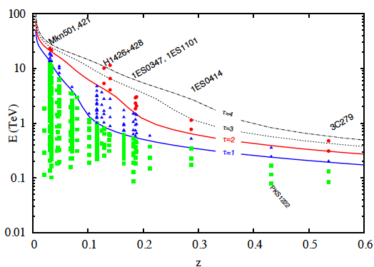
Attempts to quantify the problem overall
Analysis of AGN
  For each data point, a corresponding lower limit on the optical depth τ is calculated using a minimum EBL model
  Nonparametric test of consistency
  Disagreement with data: overall significance of 4.2 σ
  => Understand experimentally the outliers
(Horns , Meyer 2011)

Slide 22
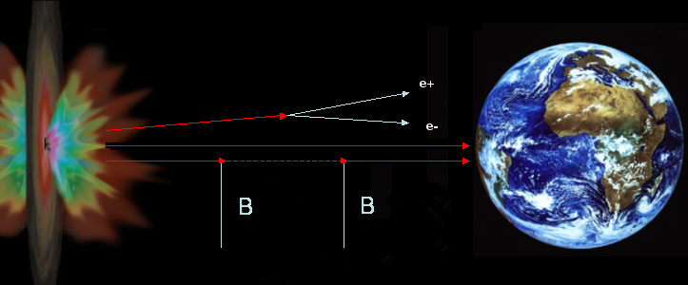
If there is a problem
Explanations from the standard ones
  very hard emission mechanisms with intrinsic slope < 1.5 (Stecker 2008)
  Very low EBL, plus observational bias, plus a couple of “wrong” outliers
to almost standard
  γ-ray fluxes enhanced by relatively nearby production by interactions of primary cosmic rays or ν from the same source
to possible evidence for new physics
    Oscillation to a light “axion”? (DA, Roncadelli & MAnsutti [DARMA], PRD2007, PLB2008)
    Axion emission (Simet+, PRD2008)
    A combination of the above (Sanchez Conde et al. PRD 2009)
observed spectral index
  redshift

Slide 23

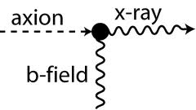
Axions
The “strong CP problem”: CP violating terms exist in the QCD Lagrangian, but CP appears to be conserved in strong interactions
Peccei and Quinn (1977) propose a solution: clean it up by an extra field in the Lagrangian
  Called the “axion” from the name of a cleaning product
  Pseudoscalar, neutral, stable on cosmological scales, feeble interaction, couples to the photon
    Can make light shine through a wall
  The minimal (standard) axion coupling g ∝ 1/m; however, one can have an “ALP” in which g = 1/M is free from m

Slide 24
The photon-axion mixing mechanism
γ
a
a
γ
a
γ
…
γ*
γ*
γ*
γ*
Propagation: Raffelt-Stodolsky 1987; Csaki-Kaloper-Terning 2002; DA Roncadelli MAnsutti 2007; Simet Hooper Serpico 2008
Magnetic field 1 nG < B < 1aG (AGN halos). Cells of ~ 1 Mpc
m_{a} < 0.02 eV (direct searches)
g < 10⁻¹⁰GeV⁻¹ from the non observation of γ-rays from the SN1987A, and direct searches

Slide 25
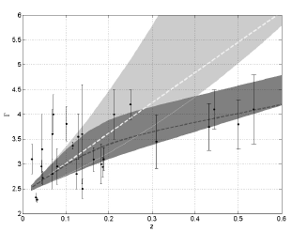
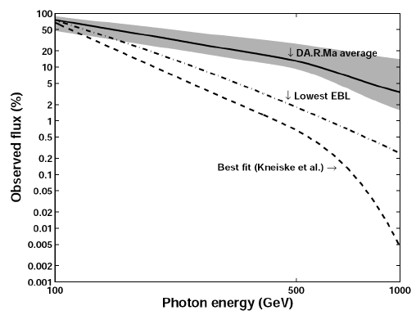
If B ~ 0.1 – 1 nG, observations can be explained
DARMA
3C279
Note: if conversion “a la
Simet-Hooper-Serpico”,
=> the effect could be directional
Could also be something else:
Whatever (light and almost sterile) particle feebly coupling to the photon
  Paraphoton
    Shadow photon
  New millicharged particles…

Slide 26
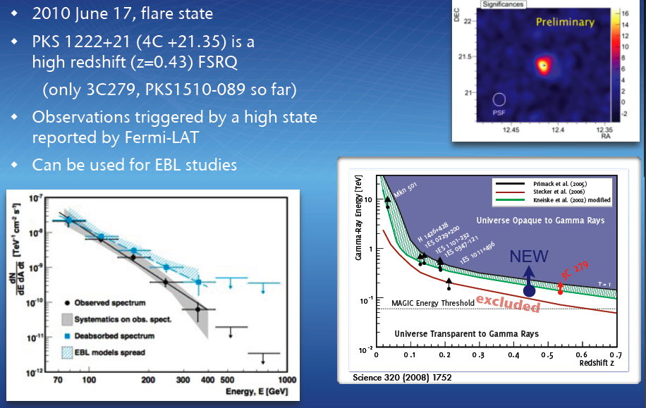
Recent confirmation: something not understood

Slide 27
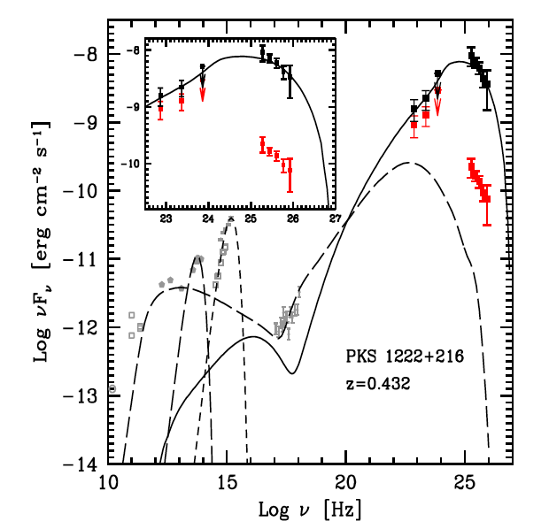
PKS1222: an alternative discussion of the problem
Tavecchio, Roncadelli, Galanti, Bonnoli 2012:
  the γ → a conversion occurs before most of the photons reach the BLR. Accordingly, ALPs traverse this region unimpeded and
  Outside, the re-conversion a → γ takes place either in the same magnetic field of the source or in that of the host galaxy
  Resulting parameters of the ALP needed to fit the data consistent with DARMA

Slide 28
Summarizing: if the expected photon yield at VHE is different from what we think, what might be wrong?
Emission models are more complicated than we think (but only for sources far away: nearby sources behave well)
VHE photons are generated on the way (interaction of cosmic rays, neutrinos and photons with intergalactic medium: Sigl, Essey, Kusenko, …)
Something is wrong in the γγ -> e+e- rate calculation
  Vacuum energy (new sterile particles coupling to the photons): DARMA, …
    For example an ALP: consistent values for m, g=(1/M) in a range not experimentally excluded (“Se non e’ vero e’ ben pensato”)
  γγ -> e+e- cross section
    QED calculations appears to be in a safe region; then it must be
    the boost (Lorentz transformations; relativity)

Slide 29
Is Lorentz invariance exact?
For longtime violating Lorentz invariance/Lorentz transformations/Einstein relativity was a heresy
  Is there an aether? (Dirac 1951)
  Many preprints, often unpublished (=refused) in the ’90s
    Gonzales-Mestres, ADA, Jacobson, …
Then the discussion was open
  Trans-GZK events? (AGASA collaboration 1997-8)
  LIV => high energy threshold phenomena: photon decay, vacuum Cherenkov, GZK cutoff (Coleman & Glashow 1997-8)
  GRB and photon dispersion (Amelino-Camelia et al. 1997)
  Framework for the violation (Colladay & Kostelecky 1998)
  LIV and gamma-ray horizon (Kifune 1999)
  …

Slide 30
LIV? New form of relativity?
Von Ignatowsky 1911: {relativity, omogeneity/isotropy, linearity, reciprocity} => Lorentz transformations with “some” invariant c (Galilei relativity is the limit c →∞)
CMB is the aether: give away isotropy?
QG motivation: give away linearity? (A new relativity with 2 invariants: “c” and E_{P})
In any case, let’s sketch an effective theory…
  Let’s take a purely phenomenological point of view and encode the general form of Lorentz invariance violation (LIV) as a perturbation of the Hamiltonian (Amelino-Camelia+)

Slide 31
A heuristic approach: modified dispersion relations
(perturbation of the Hamiltonian)
We expect the Planck mass to be the scale of the effect
=> effect of dispersion relations at cosmological distances can be important at energies well below Planck scale:

Slide 32
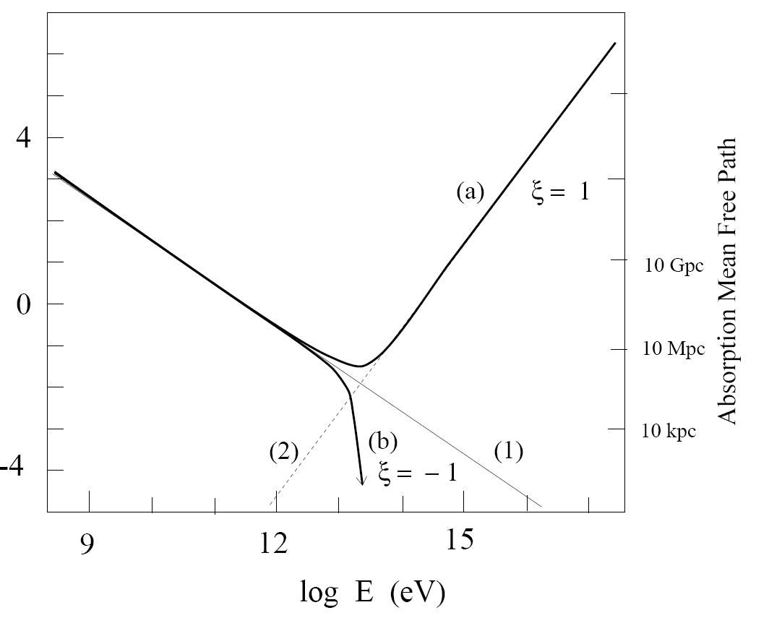
Other effects of LIV: modified thresholds (Coleman-Glashow); transparency (Kifune 99)
ξ < 0 :
  Increased transparency (threshold γγ -> ee moves forward)
ξ = -1
ξ = 1

Slide 33
c_{e} = c_{γ}(1+δ), 0 < abs(δ) << 1 Coleman & Glashow; Stecker and Glashow
If δ<0 => c_{e} < c_{γ} => decay γ -> e⁺e⁻ kinematically allowed for gamma with energies above
E_{max} = m_{e} sqrt(2/abs(δ))
- E_{γ} > 100 TeV => abs(δ) < 5 x 10⁻¹⁷
2. If δ>0 => c_{e} > c_{γ} => electrons become superluminal for energies larger than E_{max}/sqrt(2) => Vacuum Cherenkov Radiation.
- E_{e} > 2 TeV from cosmic electron radiation => abs(δ) < 2 x 10⁻¹⁴
Modification of γ γ -> e+e- threshold. Using Mkn 501 and Mkn 421 spectra observations up to E_{g} > 20 TeV
=> abs(δ) < 1.3 x 10⁻¹⁵
From MAGIC Mkn501 (taken as a LIV signal): |δ| ~ 2 10⁻¹⁵

Slide 34
Astrophysical constraints: time of flight
Effect of dispersion relations at cosmological distances can be important at energies well below Planck scale:

Slide 35
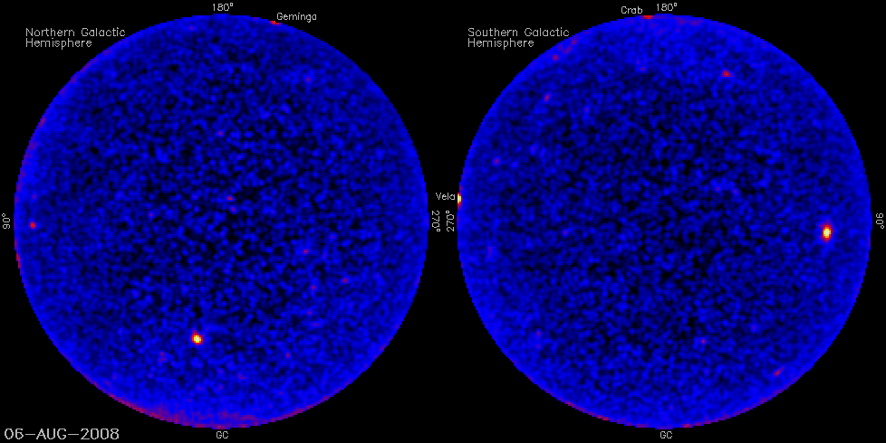
Variability

Slide 36
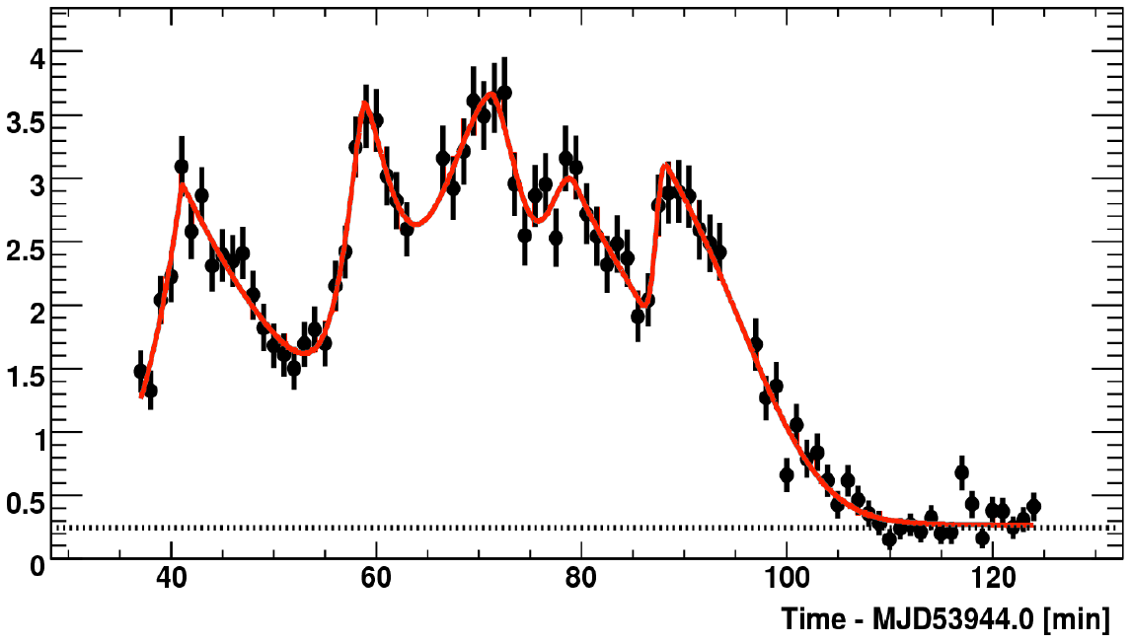
Rapid variability
astro-ph/0702008
arXiv:0708.2889
MAGIC, Mkn 501
Doubling time ~ 2 min
HESS PKS 2155
z = 0.116
July 2006
Peak flux ~15 x Crab
~50 x average
Doubling times
1-3 min
R_{BH}/c ~ 1...2.10⁴ s
H.E.S.S.
arXiV:0706.0797

Slide 37
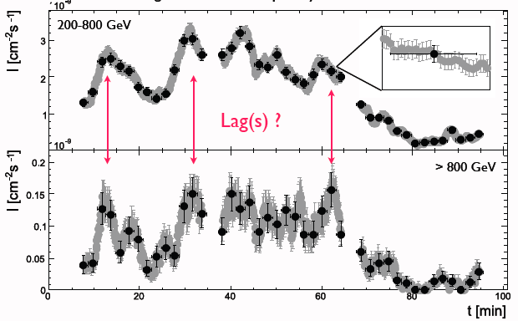
Tests of Lorentz violation: the name of the game
HESS, PKS 2155

Slide 38
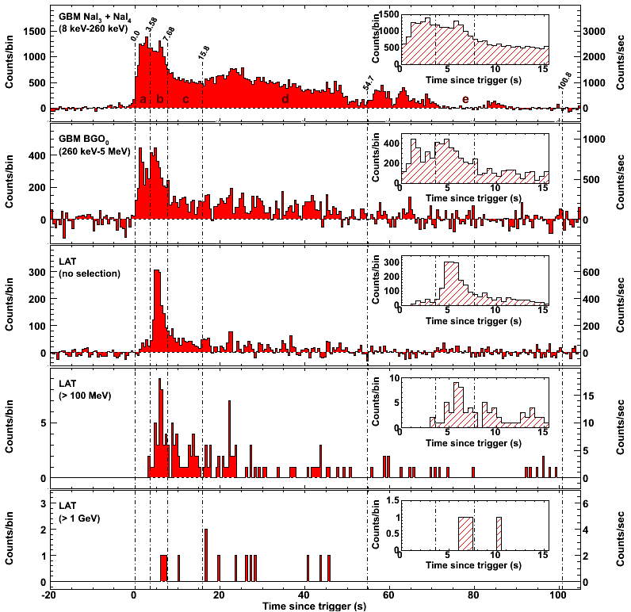
Quite some interest on Mkn 501 flare by MAGIC…
1st order
0.15-0.25 TeV
0.25-0.6 TeV
0.6-1.2 TeV
1.2-10 TeV
MAGIC Mkn 501, PLB08
(with J. Ellis et al.)
E_{s1} ~ 0.04 M_{P} (ξ ~ -25)
E_{s1} > 0.02 M_{P}
HESS PKS 2155, PRL08
E_{s1} > 0.06 M_{P}
GRB X-ray limits:
E_{s1} > 0.11 M_{P} (Fermi, but…)
< 5 MeV
4 min lag
> 1 GeV

Slide 39
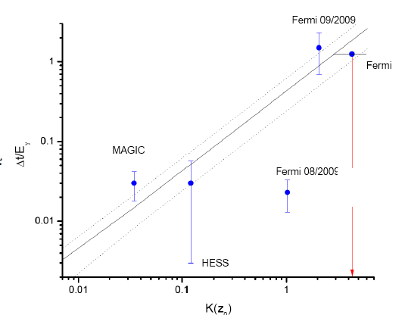
LIV in Fermi vs. MAGIC+HESS
GRB080916C at z~4.2 : 13.2 GeV photon detected by Fermi 16.5 s after GBM trigger. At 1st order
The MAGIC result for Mkn501 at z= 0.034 is Δt = (0.030 +- 0.012) s/GeV; for HESS at z~0.116, according to Ellis et al., Feb 09, Δt = (0.030 +- 0.027) s/GeV
Δt ~ (0.43 ± 0.19) K(z) s/GeV
Extrapolating, you get from Fermi (26 +- 11) s
(J. Ellis et al., Feb 2009)
SURPRISINGLY CONSISTENT:
DIFFERENT ENERGY RANGE
DIFFERENT DISTANCE
K(z)~z
ξ ~ -12

Slide 40
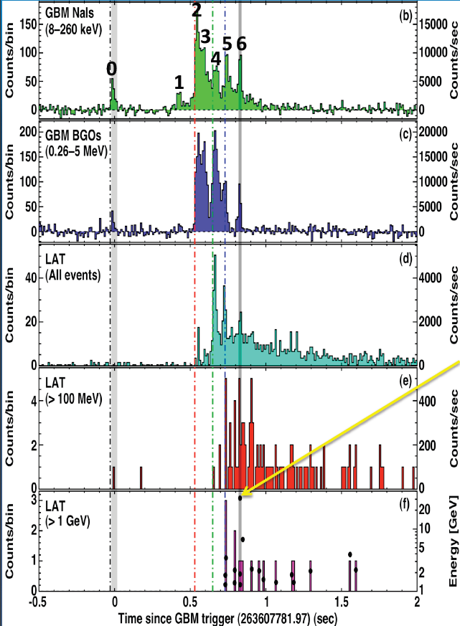
BUT: Fermi GRB 090510 GRB 090902
z = 0.903 ± 0.003
prompt spectrum detected, significant deviation from Band function at high E
High energy photon detected:
31 GeV at T_{o} + 0.83 s
[expected from Ellis & al. (12 ± 5) s]
tight constraint on Lorentz Invariance Violation:
  E_{s1} = M_{QG} > several M_{Planck}
z = 1.8 ± 0.4
one of the brightest GRBs
observed by LAT
after prompt phase, power-low emission persists in the LAT data as late as 1 ks post trigger:
highest E photon so far detected: 33.4 GeV, 82 s after GBM trigger
[expected from Ellis & al. (26 ± 13) s]
much weaker constraints on LIV E_{s}
=> Fermi rules, and 1st order violations appear unlikely

Slide 41
2nd order? Cherenkov rules!
E_{s2} > 6 10¹⁰ GeV (~10⁻⁹ M_{P}) (HESS, MAGIC)
A no-loss situation:
if propagation is standard, cosmology with AGN

Slide 42

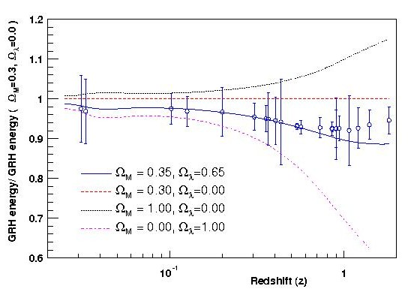
If propagation is standard, cosmology with AGN
GRH depends on the γ–ray path and there the Hubble constant and the cosmological densities enter => if EBL density and intrinsic spectra are known, the GRH might be used as a distance estimator
GRH behaves differently than other observables already used for cosmology measurements.
Blanch & Martinez 2004
PKS2005-489
PKS 2155-304
H1426+428
H2356-309
1ES1959+650
Mkn 180
1ES 2344+514
1ES1218+304
1ES1101-232
EBL constraints are paving the way for the use of AGN to fit Ω_{M} and Ω_{Λ} …
Mkn 421
Mkn 501
Simulated
measurements

Slide 43
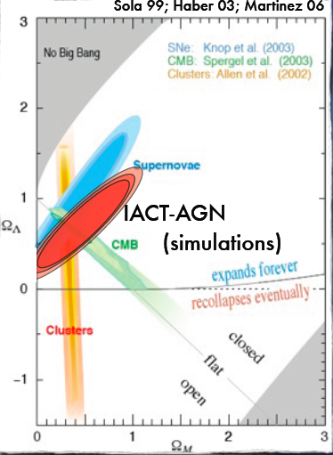
Determination of H₀, Ω_{M} , Ω_{L}
Using the foreseen precision on the GRH (distance at which τ(E,z)=1) measurements of 20 extrapolated AGN at z>0.2, cosmological parameters can be fitted.
=> The Δχ²=2.3 2-parameter contour might improve by a factor 2 the 2004’ Supernovae combined result !

Slide 44
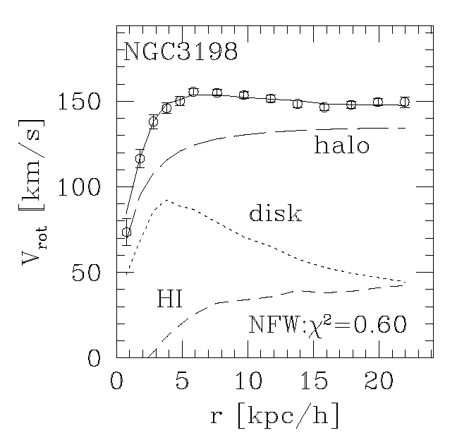
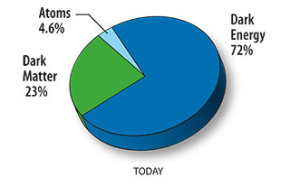

The Dark Matter Problem
Measure rotation curves for galaxies:
Begelman/Navarro
r
For large r, we expect:
we see: flat or rising rotation curves
Hypothesized solution: the visible galaxy is embedded in a much larger halo of Dark Matter (neutral; weakly interacting; mix of particles and antiparticles - in SUSY Majorana)
Famous
Bullet Cluster

Slide 45
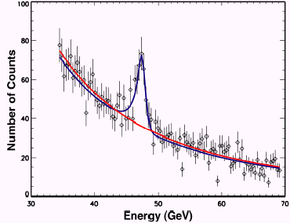
Which signatures for gamma detectors?
Self-annihilating WIMPs, if Majorana (as the neutralino in SUSY), can produce:
  Photon lines (γγ, γZ)
  Photon excess at E < m
  from hadronization
Excess of antimatter
(annihilation/decay)
Excess of electrons,
if unstable
from particle physics
Look to the closest point with M <<L
from astrophysics

Slide 46
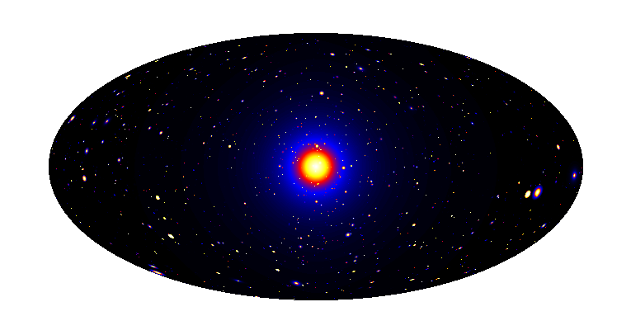
Many Places to Seek DM!
Galactic Center
Good statistics but source
confusion/diffuse background
Satellites
Low background and good source id,
but low statistics, astrophysical background
Milky Way Halo
Large statistics but diffuse background
All-sky map of simulated gamma ray signal from DM annihilation
(Pieri et al 2006)
Spectral Features
Lines, endpoint Bremsstrahlung,…
No astrophysical uncertainties, good source Id, but low sensitivity because of expected small BR
Extra-galactic
Large statistics, but astrophysics, galactic diffuse backgrounds

Slide 47
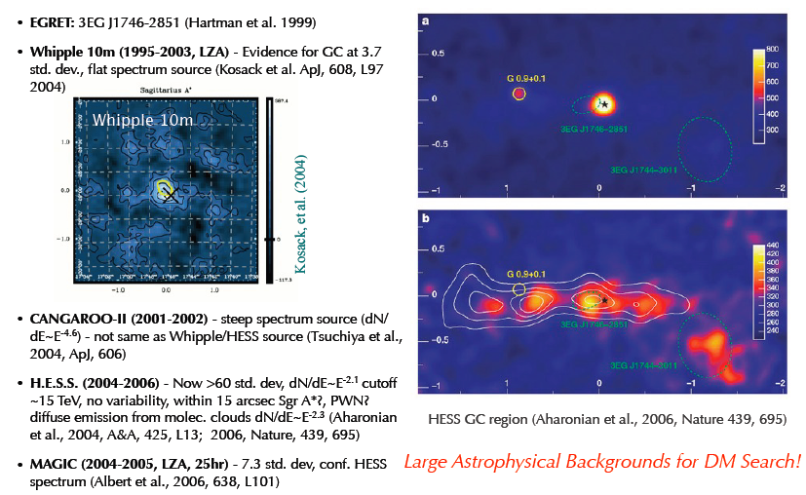
Results from GC
(Buckley 2011)

Slide 48
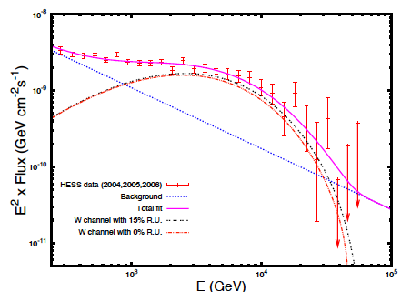

γ-ray detection from the GC
detection of γ-rays from GC by Cangaroo, Whipple, HESS, MAGIC
hard E^{-2.2} spectrum
fit to χ-annihilation continuum
spectrum leads to: M_{χ} > 14 TeV
  other interpretations possible (probable)
  Galactic Center: very crowded sky region, strong exp. evidence against cuspy profile
no real indication of DM…
The spectrum is featurless!!!
Chandra GC survey
NASA/UMass/D.Wang et al.
CANGAROO (80%)
H.E.S.S.
Whipple
(95%)
from W.Hofmann, Heidelberg 2004

Slide 49


One of the focuses: dwarf Spheroidals
BOOTES
Dwarf Spheriodal Galaxies (dSphs) are approx. “spherical” collections of stars orbiting the Milky Way, (?) held together by DM (?)
Large Optical Surveys (eg. SSDS, HST,…) has enabled astronomers to identify 20 or more such objects.
Mass–to-Light ratio (indicative of DM content) often > 100 and some > 1000!
Ideal locations to search indirect gamma rays signs from Annihilation or Decay of DM
FORNAX

Slide 50


dSph
Milky Way satellites Sagittarius, Draco, Segue1, Willman1, Perseus, …
  proximity (< 100 kpc)
  no central BH (which may change the DM cusp)
  large M/L ratio (low baryonic content)
  No signal for now…
Results dominated by Fermi observations of Segue1
in the Leo constellation at ~23 kpc from the Sun
luminosity is ~300x the Sun, M/L ~3400
small improvement by stacking
  Still a factor of >4 larger than a possible signal, even at low mass and in the most favorable assumptions
    Majorana WIMP, DM profiles
  What could improve it?
    A “boost” of ρ² given by an anomalous DM concentration in subhalos
    At 100 GeV, an improvement by a factor of 30 in sensitivity

Slide 51




Data-driven line searches (1)
Very recently, one paper claims a positive signal (a ~4σ photon excess at ~130 GeV from Fermi data)
  C. Weniger, arXiv:1204.2797
  Selection of the region
  b(i)ased on data
  Large overlapping with
  The Fermi “bubbles”

Slide 52

Data-driven line searches (2)
Confirmed by an independent analysis
  Tempel+, arXiv:1205.1045
  Not confirmed by a “blind” line search by the official Fermi team on May 14 (But warning: it’s a different thing)
Perspects from IACT: bad. Fermi: wait several years. LHC?

Slide 53

Cosmic rays: the ATIC anomaly
MAGIC ICRC 2011
all e⁺e⁻
Preliminary
No peaks;
a possible excess might have standard/astrophysical explanations

Slide 54



Cosmic rays: the PAMELA anomaly
Unexpected increase in e⁺/e⁻ ratio (PAMELA) confirmed by Fermi @ ICRC 2011:
e⁺/e⁺+e⁻
?
MAGIC
Moon shadow observation mode
developed for the MAGIC telescopes
[MAGIC ICRC 2011]
probe e+/e- ratio at 300-700 GeV
sensitivity (50h): 300-700GeV: ~4.4% Crab
measurement possible in few years

Slide 55
DM: interplay with accelerators
LHC may find candidates but cannot prove that they are the observed Dark Matter, nor localize it
Direct searches (nuclear recoil) may recognize local halo WIMPs but cannot prove the nature and composition of Dark Matter in the sky
LHC reach limited to some 200-600 GeV; IACT sensitivity starts at some ~200 GeV (should improve)

Slide 56




A wish list for the future
extend E range beyond 50 TeV
better angular resolution
larger FOV
Galactic sources & CR
AGN & gamma prop.
New particles, new phenomena
  dark matter and astroparticle physics
monitor many objects simult.
extend E range under 50 GeV
10x sources
better flux sensitivity
lower threshold

Slide 57

The CTA concept (a possible design)
2 arrays: north+south
→ all-sky coverage
core array
100 GeV-10 TeV
~ 23 ø ~12 m telescopes
low energy section
E_{thresh} ~ 10 GeV
4 ø ~ 23 m telescopes
high energy section
~35 ø = 6-7 m tel.
on 10 km² area

Slide 58

CTA operation modes
Monitoring
4 telescopes
Survey mode:
Full sky at current
sensitivity in ~1 year
Very deep field
Deep field
~1/3 of telescopes

Slide 59
Agile
(A. De Angelis 2012)
Fermi
Argo
Crab
E*F(>E) [ TeV/cm²s]
Agile, Fermi, Argo, Hawk: 1 year
Magic, Hess, Veritas, CTA: 50h
Magic-II
Hawc
10% Crab
Hess/Veritas
Far universe
Pulsars
Fundamental physics
Cosmic rays
at the knee
CTA
1% Crab
59

Slide 60
Relevance to high energy physics
Physics
  Energy: TeV energy scale (particle acceleration, elementary processes in the Universe)
  Evolution of the Universe
  Fundamental physics
    Search for cosmological Dark Matter
    Axion-like particles and new particles
    Probe Quantum gravity (space time structure of vacuum) – close to the Planck Scale
  Hadronic interactions (Gamma / Hadron separation)
  Synergy with neutrino detectors
Cutting edge technologies developed in HE physics
  High QE advanced photodetectors, HPDs, SiPMs
  Analogue signal transmission via optical fibers
  Readout system 2GHz ultra fast analogue ring sampler
  Ultra fast trigger system
  Large data flow, massive computing (GRID computing)

Slide 61
Summary
Clear interplay between VHE (γ) astrophysics and fundamental physics; this model of cooperation has worked well, and can work well in the future
  We are confident that this exchange between complementary worlds will be useful, as history of particle physics demonstrated
Cosmic Rays:
  SNR as galactic sources established
    Astronomy with charged CR is difficult
    Astronomy with neutrinos will be difficult
    VHE photons can be the pathfinder
Still no detection of DM
  The information from no detection is not as good as for accelerators
A few clouds might hide new physics
  Photon propagation
Rich fundamental science (and astronomy/astrophysics) from gamma rays
  HEA is exploring regions beyond the reach of accelerators
  A “simple” extension of present detectors is in progress: CTA

Slide 62

BACKUP

Slide 63
Origin of V(HE) Cosmic Rays
Supernovae may be source of particles up to >10¹⁵ eV
  Nuclei receive energy from the shock wave of the supernova explosion
The sources for ultrahigh cosmic rays are extragalactic: probably, AGN (and GRB?)
Galactic (~1000 nG) and extragalactic (~0.1 nG?) fields make it difficult to observe directly the sources of CR
  Gamma rays?

Slide 64

Remember: despite the opinion of the Fantastic 4, only ~1%-0.1% of the cosmic rays are gammas…
(In 1998, the Human Torch called his son “Cosmic Ray” in memory of that event)
Marvel 1961

Slide 65
Connection gamma/CR
Study of target-accelerator systems: pinpointing sources of cosmic rays up to the knee
  New “fresh” cosmic rays interacting with matter near the source OR…
pp -> nπ⁰ -> 2nγ
Secondary γ -rays have ~ 1/10 of the energy of the primary p
For a power-law proton distribution the γ -ray distribution is again a power law with the same spectral index
  This property should not be misinterpreted in the sense of a delta-function approximation: in general the γ -ray spectrum at energy Eγ does not trace the proton spectrum at energy Ep/f.
    any feature in the proton spectrum will reappear smoothed in the γ -ray spectrum (e.g., an exponential cutoff in the proton spectrum, exp(−Ep/E_{cut}), is transformed into a sub-exponential, exp[−(16Eγ /E_{cut})^{1/2}]

Slide 66



Sources of CR up to the knee
Cherenkov telescopes & gamma satellites
Evidence that SNR are sources of CR up to ~1000 TeV (almost the knee) came from morphology studies of RX J1713-3946 (H.E.S.S. 2004)
Striking evidence from the morphology of SNR IC443 (MAGIC + Fermi/Agile 2010)
Fermi,
Egret
Magic,
Veritas
IC443

Slide 67


Molecular clouds close to IC 443, W51
¹²CO emission line 2001 (cyan line)
contours of 20 cm VLA radio data from Condon et al. (1998) (green)
1720 MHz OH maser indication for a shock in a high matter density environment (black point)
X-ray contours from Rosat (purple) (Asaoka & Aschenbach 1994)
Gamma –ray contours from EGRET (Hartman et al. 1999) (black)
g-ray excess coincides with cloud
[Albert et al. ApJ 664L 87A 2007
W51: gamma rays come from a
molecular cloud separated from the pulsar
Notes:
67
1.—Sky map of -ray candidate events (background subtracted) in the
direction of MAGIC J0616+225 for an energy threshold of about 150 GeV
in galactic coordinates. Overlayed are 12CO emission contours (cyan) from
Dame et al. (2001), contours of 20 cm VLA radio data from Condon et al.
(1998) (green), X-ray contours from Rosat (Asaoka & Aschenbach 1994)
(purple) and -ray contours from EGRET (Hartman et al. 1999) (black). The
12CO contours are at 7 and 14 K km/s, integrated from -20 to 20 km/s in velocity,
the range that best defines the molecular cloud associated with IC 443.
The contours of the radio emission are at 5 mJy/beam, chosen for best showing
both the SNR IC 443. The X-ray contours are at 700 and 1200 counts /
6 · 10-7 sr. The EGRET contours represent a 68% and 95% statistical probability
that a single source lies within the given contour. The white star denotes
the position of the pulsar CXOU J061705.3+222127 (Olbert et al. 2001). The
black dot shows the position of the 1720 MHz OH maser (Claussen et al.
1997). The white circle shows the MAGIC PSF of = 0.1◦.
The maser
emission is an indication for a shock in a high matter density
environment. It is assumed to be due to collisionally excited
H2 molecules heated by the shock.

Slide 68
More on morphology

Slide 69
More on SED

Slide 70
Orphan flares?

Slide 71


Extragalactic sources: situation less clear (Auger?)
Joint HESS-MAGIC-VERITAS campaign on M87 (Science 2009)
The M87 radio-galaxy Jet
Colours: 0.2 - 6 keV (Chandra)
Contours: 8 GHz radio (VLA)
VHE
HST-1
Core
Knot A
Knot D
Chandra
X-ray
Al ~60 Mly
Shared monitoring HESS, MAGIC VERITAS
Confirmation of day-scale VHE variability
Correlation with the nucleus in X & Radio.
Evidence of central origin of the VHE emission (60 Rs to the BH)
nucleus
nucleus
Radio
Peak flux
jet

Slide 72



Cen A
Located at a distance of ~13 Mly, the best candidate as a CR emitter from Auger
Very faint VHE gamma-ray emitter (HESS 2009)

Slide 73

CR: clear synergy with neutrino detectors
Smoking gun would be a correlation of VHE CR (difficult: magnetic fields) or a neutrino signal
Many model uncertainties present in the gamma/p relation disappear when studying gamma/neutrino
(reflects the fact that pions decay into gamma rays and neutrinos that carry 1/2 and 1/4 of the energy of the parent. This assumes that the four leptons in the charged pion decay equally share the charged pion’s energy)
Very accurate input for
neutrino detectors

Slide 74

Complementarity to Fermi

Slide 75



Crab pulsar
Hubble
Chandra
Science 322, 2008
First detection of a pulsar above 25 GeV
with special “sum” trigger
> 100 GeV
+ T. Saito thesis 2010, VERITAS 2011, MAGIC2011:
Extension of spectrum to 400 GeV:
inconsistent with the exponential
+ cutoff extrapolation (>5σ)
Challenging result for pulsar models
T. Saito (MAGIC), PhD Thesis (2010)
VERITAS, Science 2011
MAGIC, ApJ 2011

Slide 76



CTA performance: angular resolution
Angular resolution improves as more telescopes used
in reconstrution
Angular resolution
closer to theoretical limit
HAWC
MILAGRO
Fermi
HESS
CTA
factor 3
improvement

Slide 77

CTA: Expectations for Galactic plane survey
HESS map of the Gal.plane, total exp ~500 hours

Slide 78

CTA schedule (optimistic)
2008 | 2009 | 2010 | 2011 | 2012 | 2013 | 2014 | 2015

