Slide 1
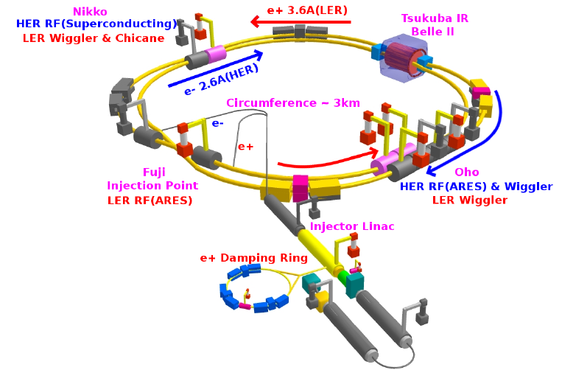
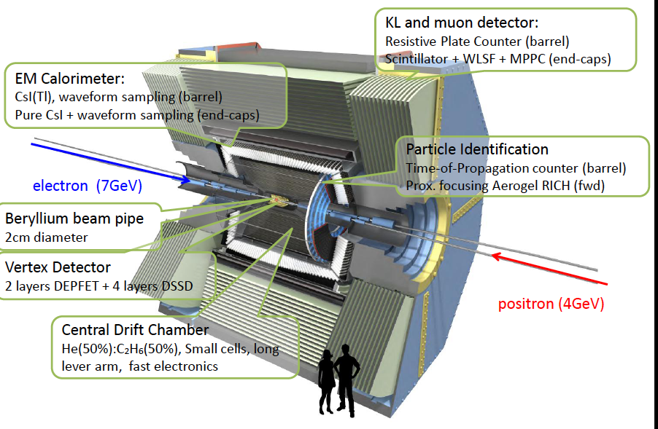
Status of SuperKEKB/Belle-II project
Hiroyuki Nakayama (KEK)
2011.07.13 ICRR seminar
KEKB and Belle: successful
Physics prospects for Super B factory
Status of SuperKEKB/Belle-II
Beam background estimation

Slide 2

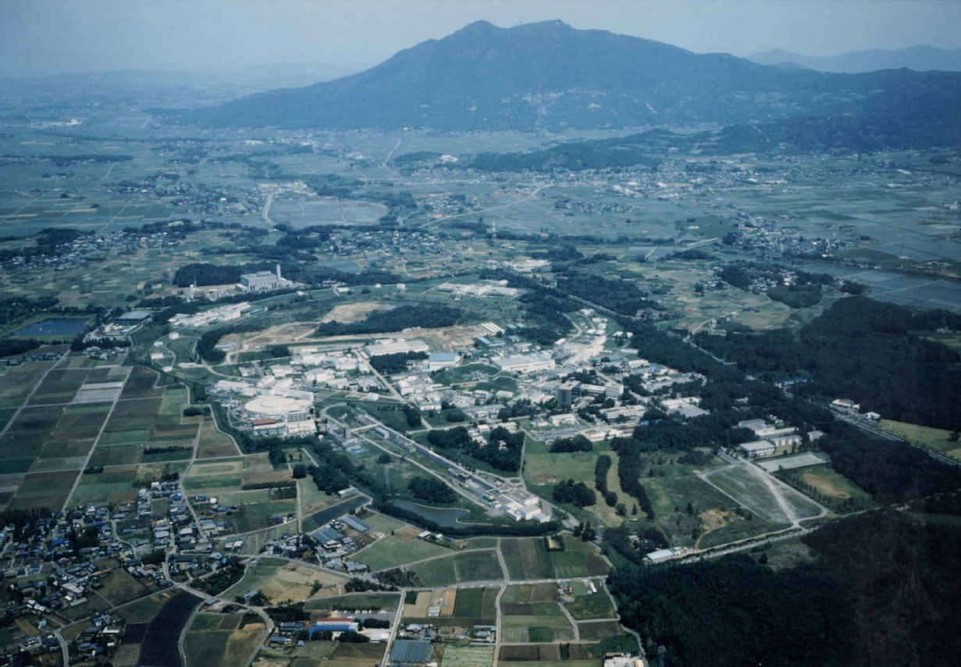
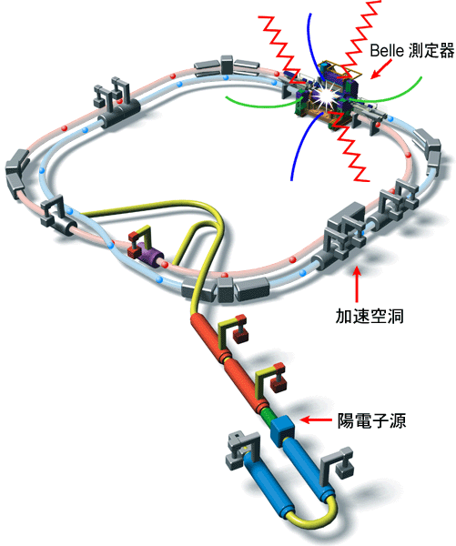
KEK and KEKB
Mt. Tsukuba
3.5 GeV e⁺ X 8.0 GeV e⁻
crossing angle = 11 mrad.
KEKB
Belle
~1 km in diameter
~3 km circumference

Slide 3
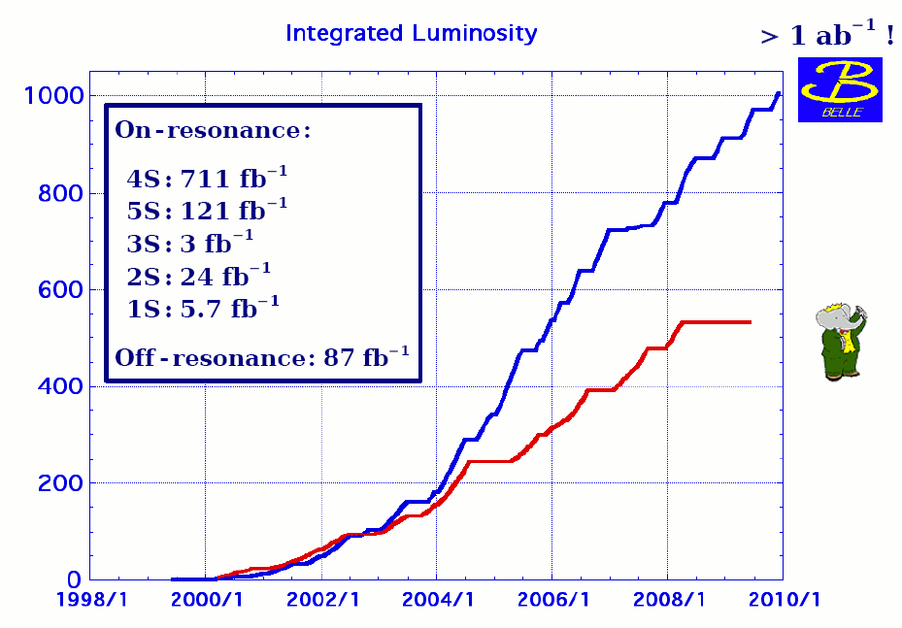
Belle/KEKB Integrated luminosity passed 1000 fb⁻¹ (➔have to switch to new units, 1 ab⁻¹)
Peak lumi record at KEKB: L=2.1 x 10³⁴/cm²/sec with crab cavities

Slide 4
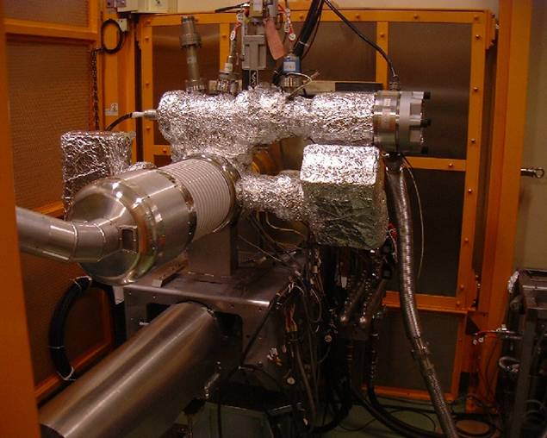
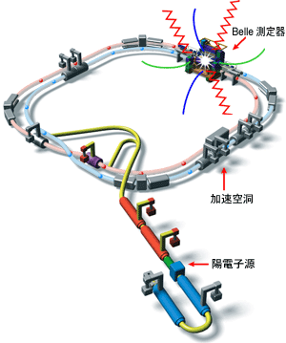
KEKB tunnel tour: Electron gun
Same principle as Cathode Ray Tube (Braun tube)

Slide 5
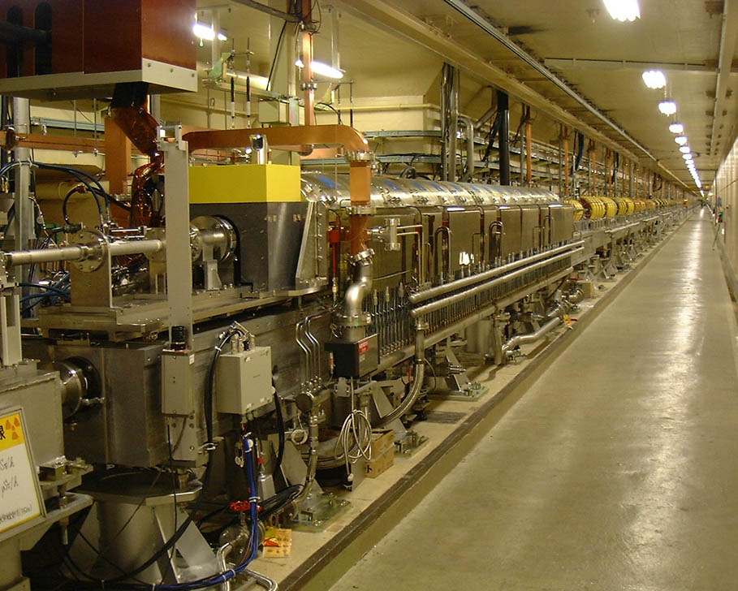
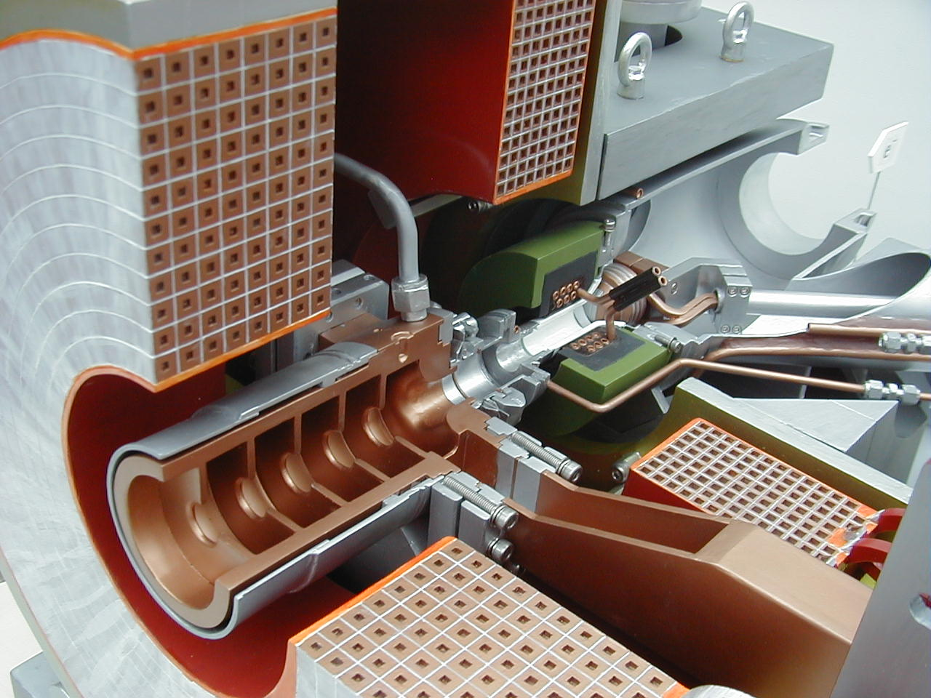
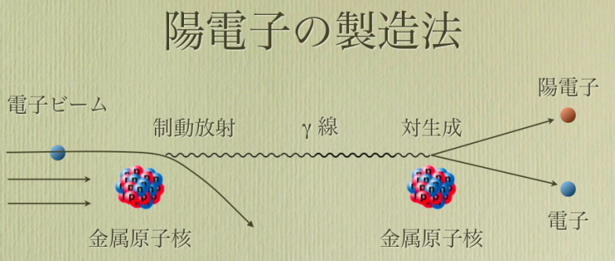
KEKB tunnel tour: Positron source
e-
e-
Tungsten
e+

Slide 6
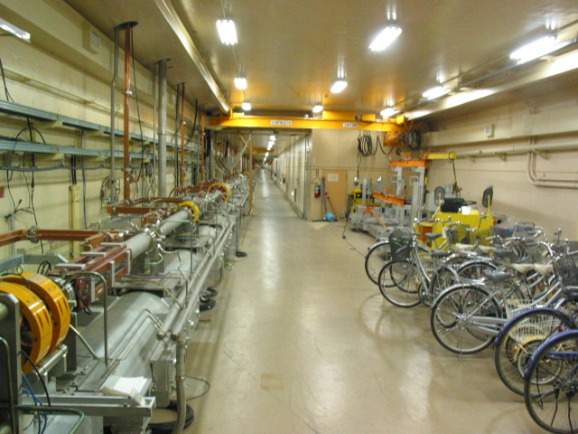
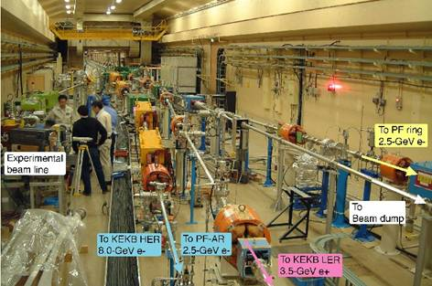
KEKB tunnel tour: LINAC（Injector）
500m linear tunnel
Branches at the end of LINAC

Slide 7
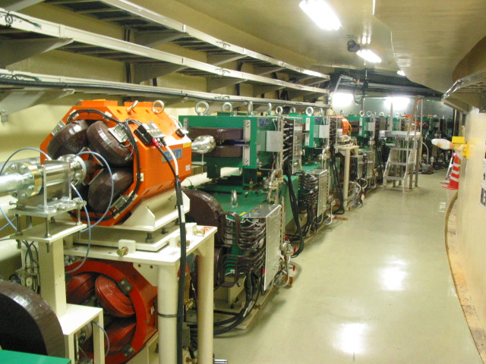
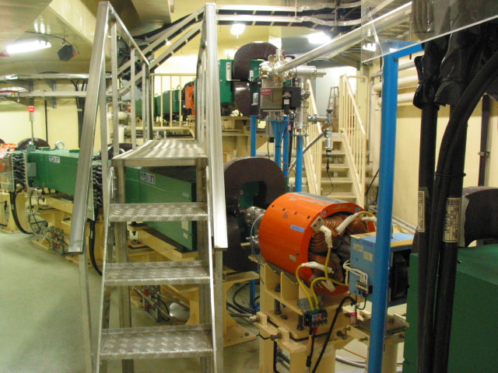
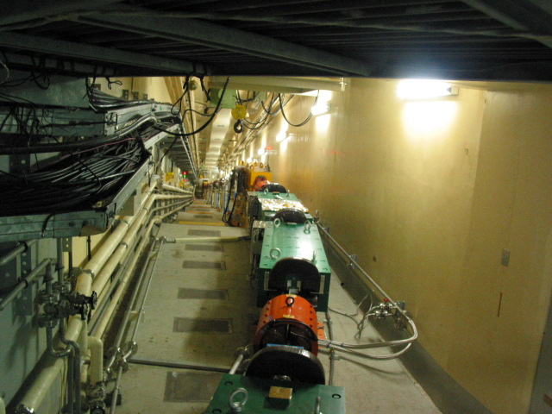
KEKB tunnel tour: Beam Transport Line
Two lines from LINAC, one on another
Goes to different direction
5m below ground g 11m

Slide 8
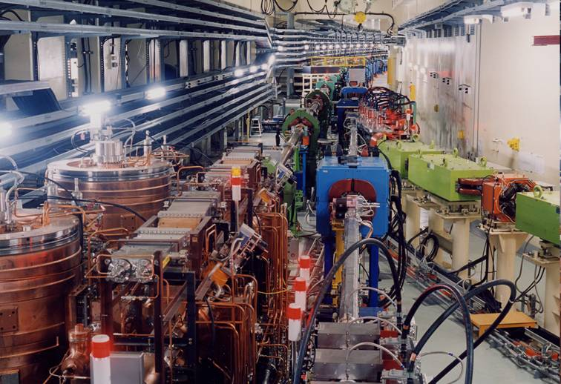
KEKB tunnel tour: Into the Main Ring
e⁻ from
LINAC
e⁺
e⁻

Slide 9
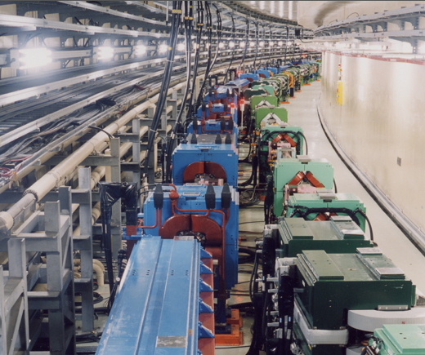
KEKB tunnel tour: Arc Section
e⁻
e⁺
Actually, this is a arc section after e⁻
reaches Belle

Slide 10
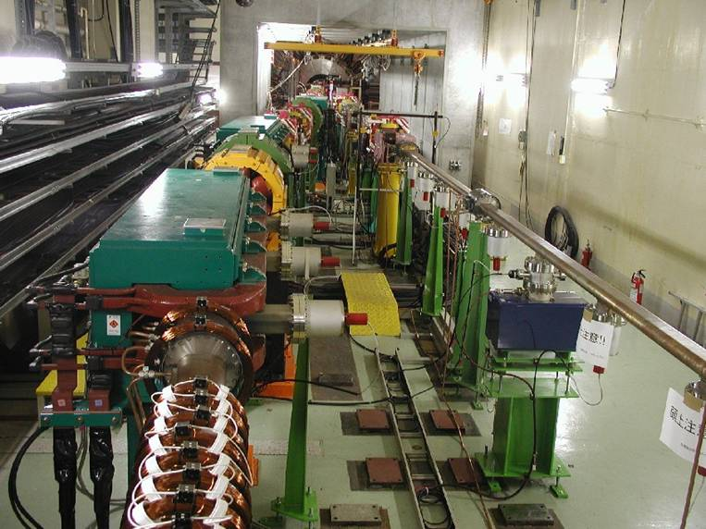
KEKB tunnel tour: Interaction Region
Belle Detector
e⁺
e⁻
Coils to remove electron cloud in LER

Slide 11
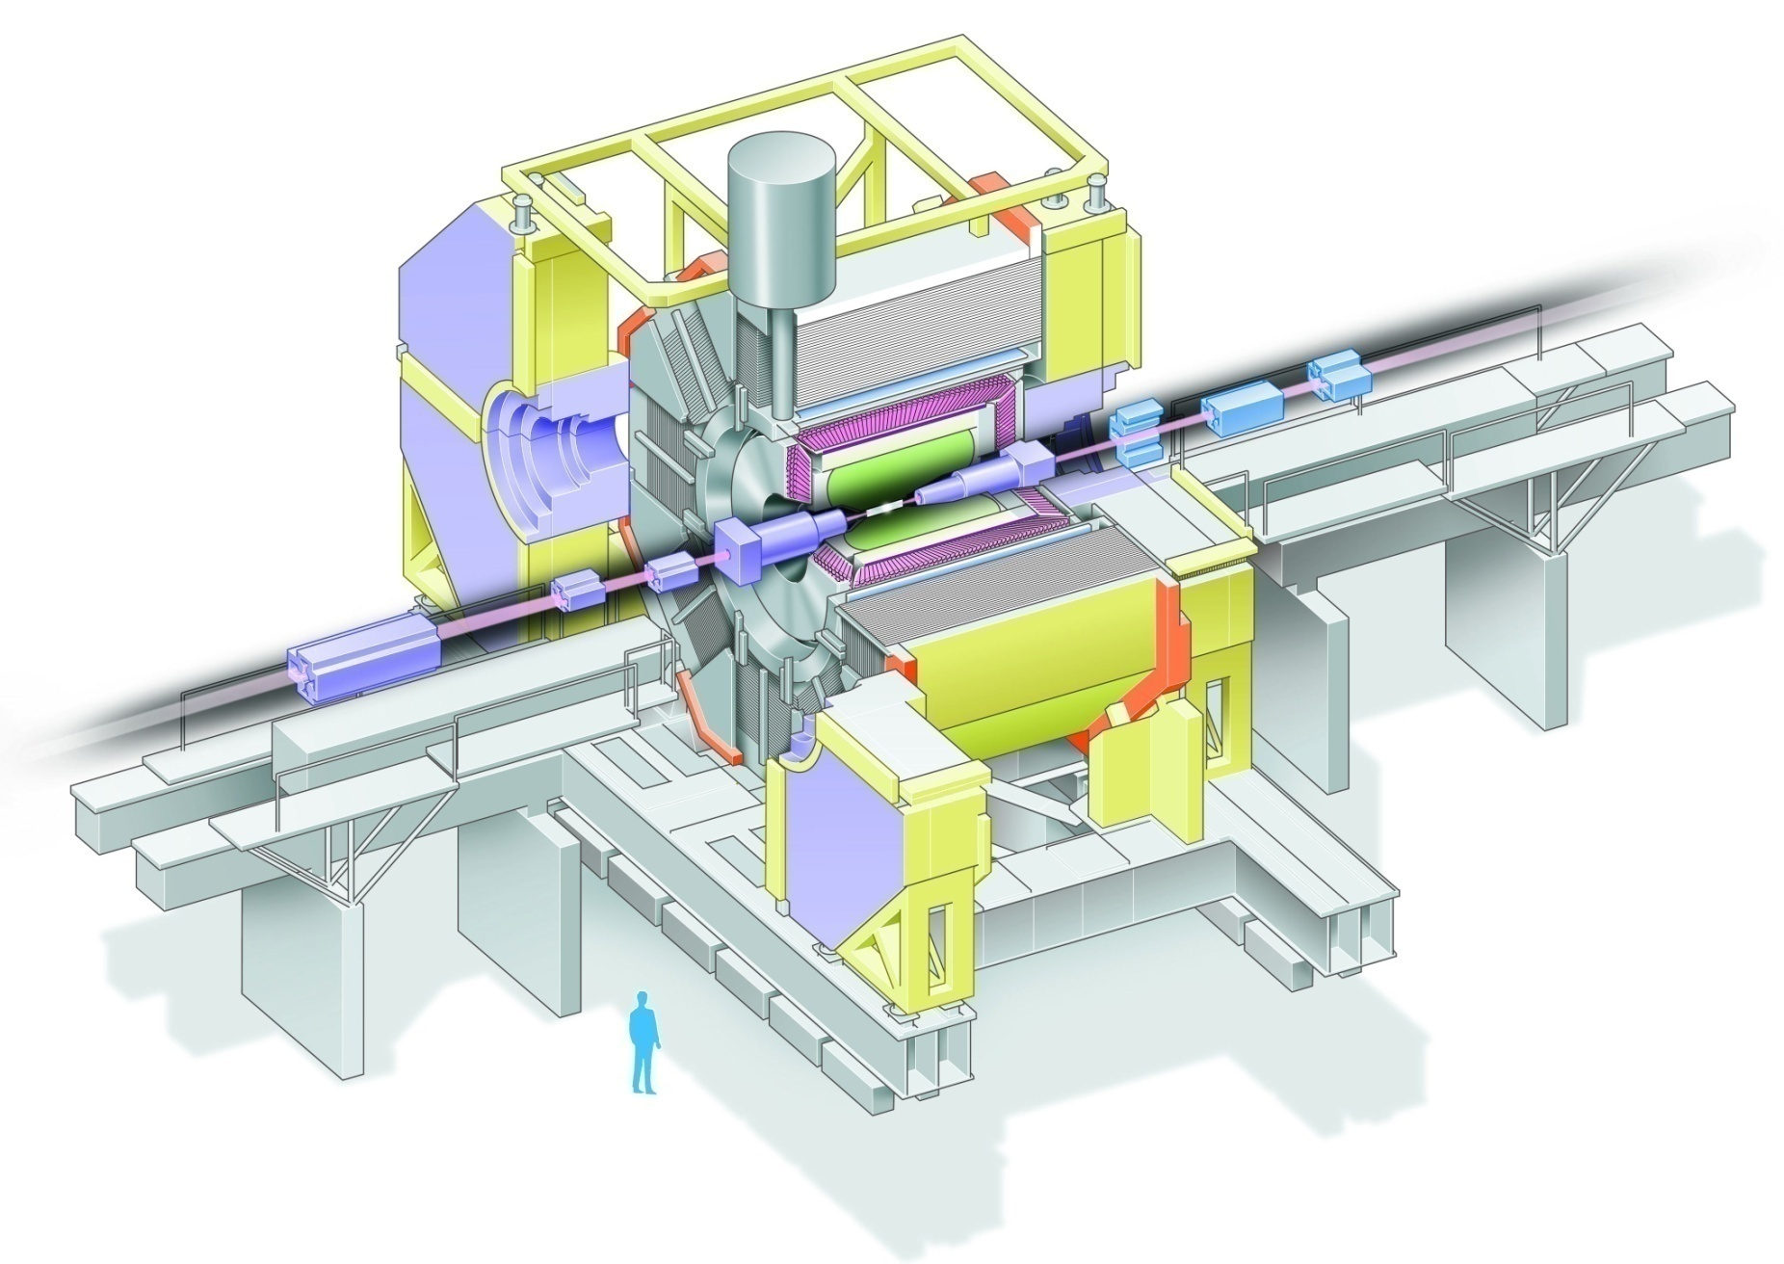
Belle Detector
Aerogel Cherenkov cnt.
n=1.015~1.030
SC solenoid
1.5T
3.5 GeV e⁺
CsI(Tl)
16X₀
TOF conter
8 GeV e⁻
Central Drift Chamber
small cell +He/C₂H₆
“Hermetic”
“Multi-layer”
Si vtx. det.
3/4 lyr. DSSD
μ / K_{L} detection
14/15 lyr. RPC+Fe

Slide 12
Important features of Belle detector
General features in HEP experiment:
measure trajectory and momentum of charged particle
measure energy of gamma
identify muon
…
+ Special features for B-physics
Measure the decay vertex position of B meson (asymmetric beam energy)
Particle identification (K/π)
…
μ⁺
J/Ψ
_
μ⁻
B⁰
ϒ(4S)
B₁
K_{S}
f_{CP}
electron
(8GeV)
positron
(3.5GeV)
ν_{μ}
π⁻
B₂
K⁺
B⁰
π⁻
μ⁺
Flavor tag
Δz ~ 200μm

Slide 13
Why Do We Need an Asymmetric Collider?
In order to measure time we must measure distance: t=L/v.
How far do B mesons travel after being produced by the Y(4S) (at rest)
at a symmetric e⁺e⁻ collider?
At a symmetric collider we have for the B mesons from Y(4S) decay:
p_{lab} =0.3 GeV, m_{B}=5.28 GeV
Average flight distance <L>= (βγ)cτ_{B}= (p/m)(468μm)=(0.3/5.28)(468μm)=(27μm)
This is too small to measure!!
τ_{B}=1.6x10⁻¹² sec
If the beams have unequal energies then the entire system is Lorentz Boosted:
βγ = p_{lab} /E_{cm}=(p_{high}-p_{low})/E_{cm}
SLAC: 9 GeV+3.1 GeV βγ = 0.55 <L>= 257μm
KEK: 8 GeV+3.5 GeV βγ = 0.42 <L>= 197μm
We can measure these decay distances !
Because of the boost and the small p_{lab} the time measurement is a z measurment.
z-axis
asymmetric
SLAC, KEK
symmetric
CESR

Slide 14
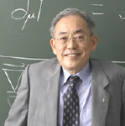
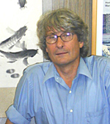
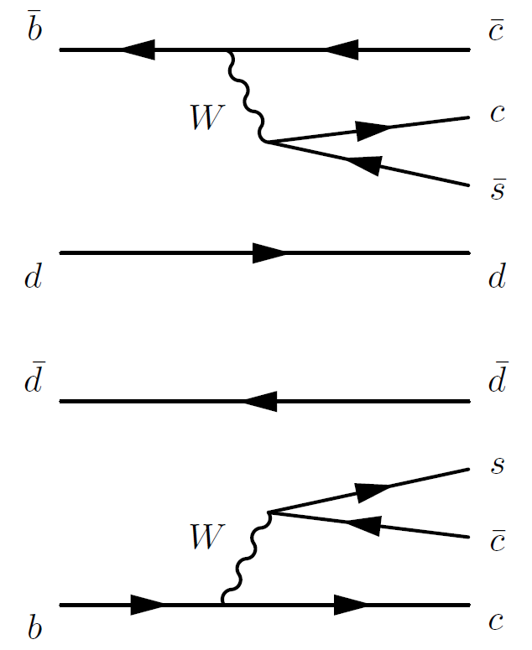
“Golden mode”: B→J/ψ K_{s}⁰
BgJ/ψK_{S} TCPV measurement is a good test of KM theory!
Advocated by Bigi, Carter, and Sanda (1980)

Slide 15
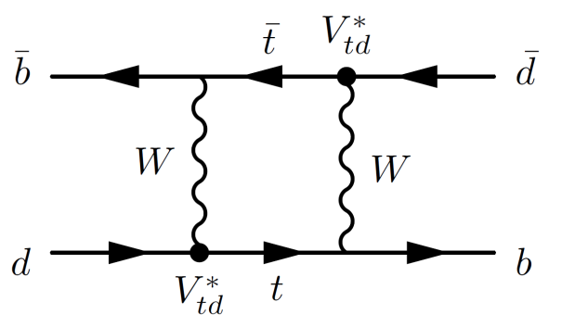
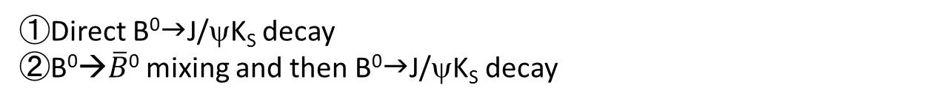

$B$⁰ →$\overline{B}$⁰ mixing
Im
①Direct B⁰gJ/ψK_{S} decay
②B⁰→$\overline{B}$⁰ mixing and then B⁰gJ/ψK_{S} decay
①
Re
②
φ₁

Slide 16
Time-dependent CP asymmetry
Asymmetry of CPV is:
Time-dependent CP asymmetry (TCP)
A_{CP} oscillates as function of time, A_{CP} amplitude∝sin2φ₁

Slide 17
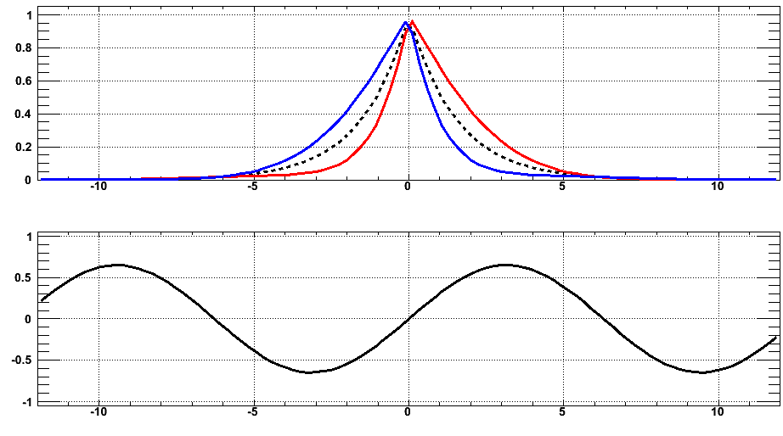
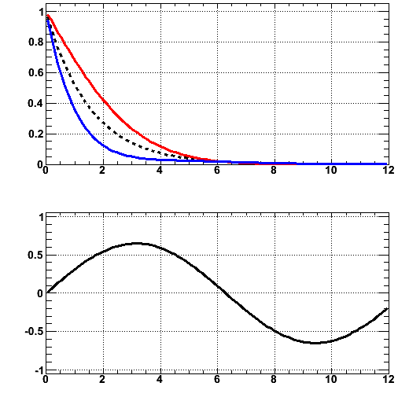
Δt = t_{J/ψKs} − t_{tag}
_
μ⁺
J/Ψ
B⁰
μ⁻
ϒ(4S)
B₁
K_{S}
electron
(8GeV)
positron
(3.5GeV)
f_{CP}
B₂
ν_{μ}
π⁻
B⁰
π⁻
K⁺
μ⁺
Flavor tag
_
B⁰gJ/ψK_{S}
B⁰gJ/ψK_{S}
in case t_{J/ψKs} < t_{tag}
in case t_{J/ψKs} > t_{tag}
red－blue
red＋blue
Decay Time difference Δt (ps)
崩壊時間 (ps)
sin2φ₁
Asymmetry Curve
Decay Time difference Δt (ps)

Slide 18
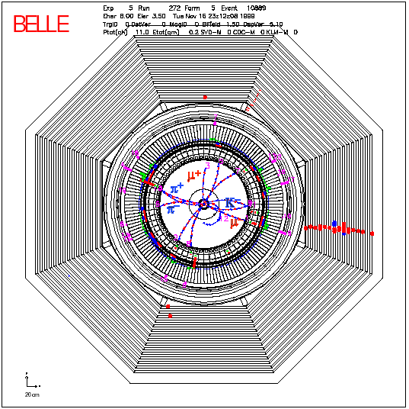
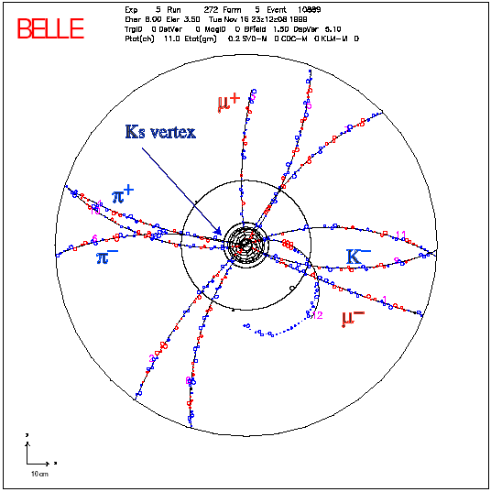
Event Display of B⁰→J/ψK_{S}
J/ψ◊μ⁺ μ⁻
K_{s} ◊ π⁺ π⁻

Slide 19
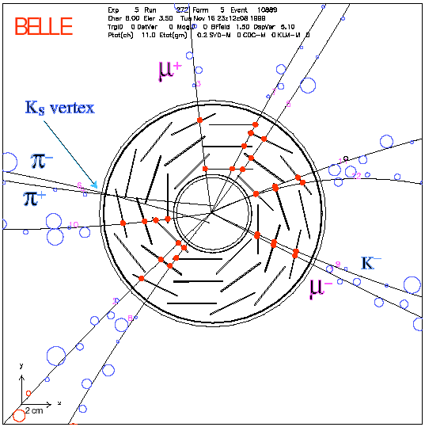
Event Display of B⁰→J/ψK_{S}

Slide 20
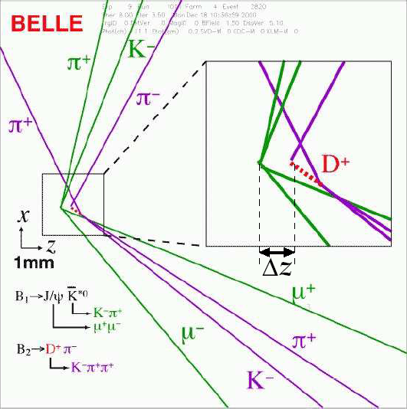
Event Display of B⁰→J/ψK₀^{(*)}
Boost

Slide 21
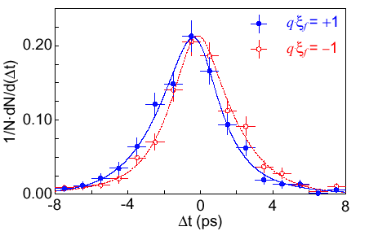
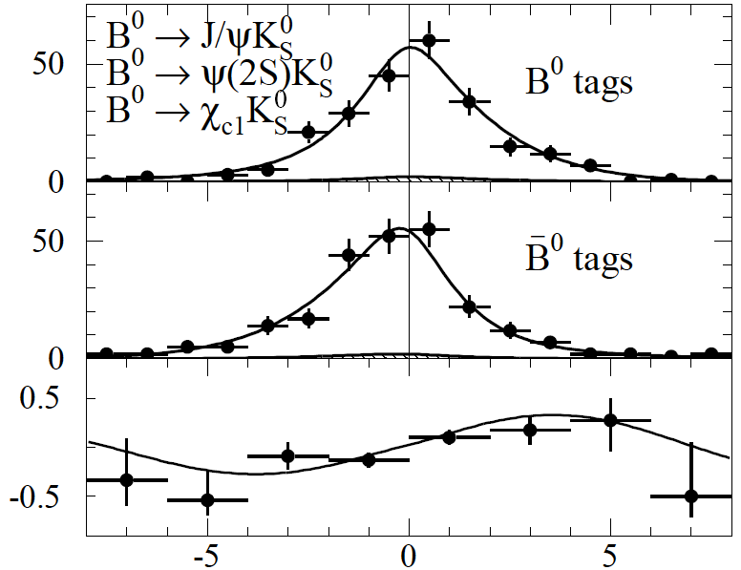

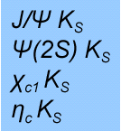

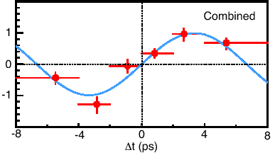

First Observation: CPV in B
_
1137
events
B⁰ tag
Summer
2001
B⁰ tag
Events
( )
J/ψ K*⁰
_
32M BB
Asymmetry
31M BB
Asymmetry
[PRL 87,091802(2001)]
[PRL 87,091801(2001)]
sin2φ₁= 0.99 ± 0.14± 0.06
0.59 ± 0.14 ± 0.05
~20% error

Slide 22
Latest measurement of sin2φ₁
Only ~5% error!!

Slide 23
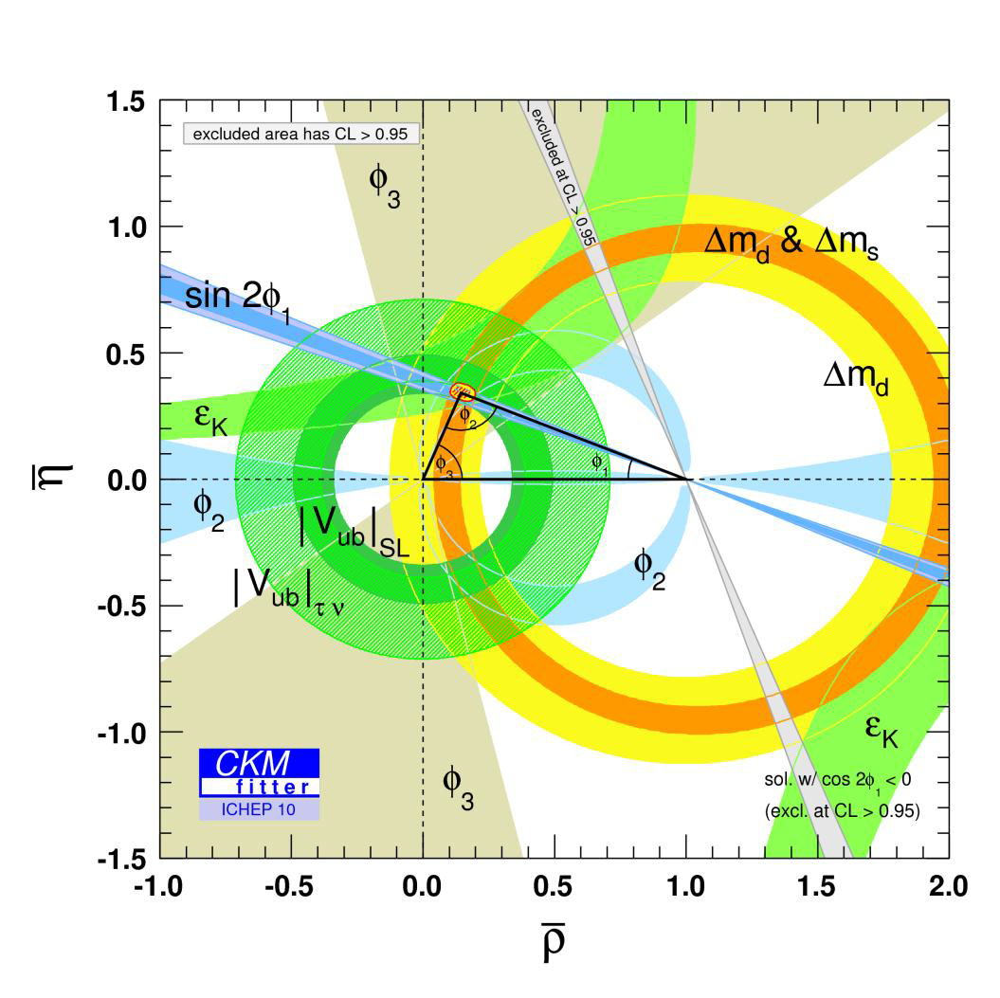
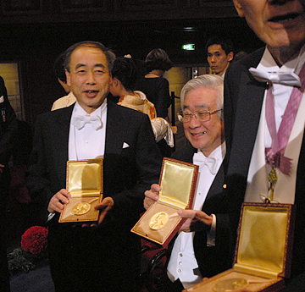
Physics results achieved by Belle
Belle have made a wide variety of achievements over ~10 year running period:
CKM triangle measurements
  Matrix elements, Unitary triangle angles
Direct CP violation:
  B→ K+ π−, B◊π+π−
New hadronic states:
  X, Y, Z mesons
Rare probes of new physics
  b→s γ, b→s l+l-
2008 physics Nobel prize

Slide 24
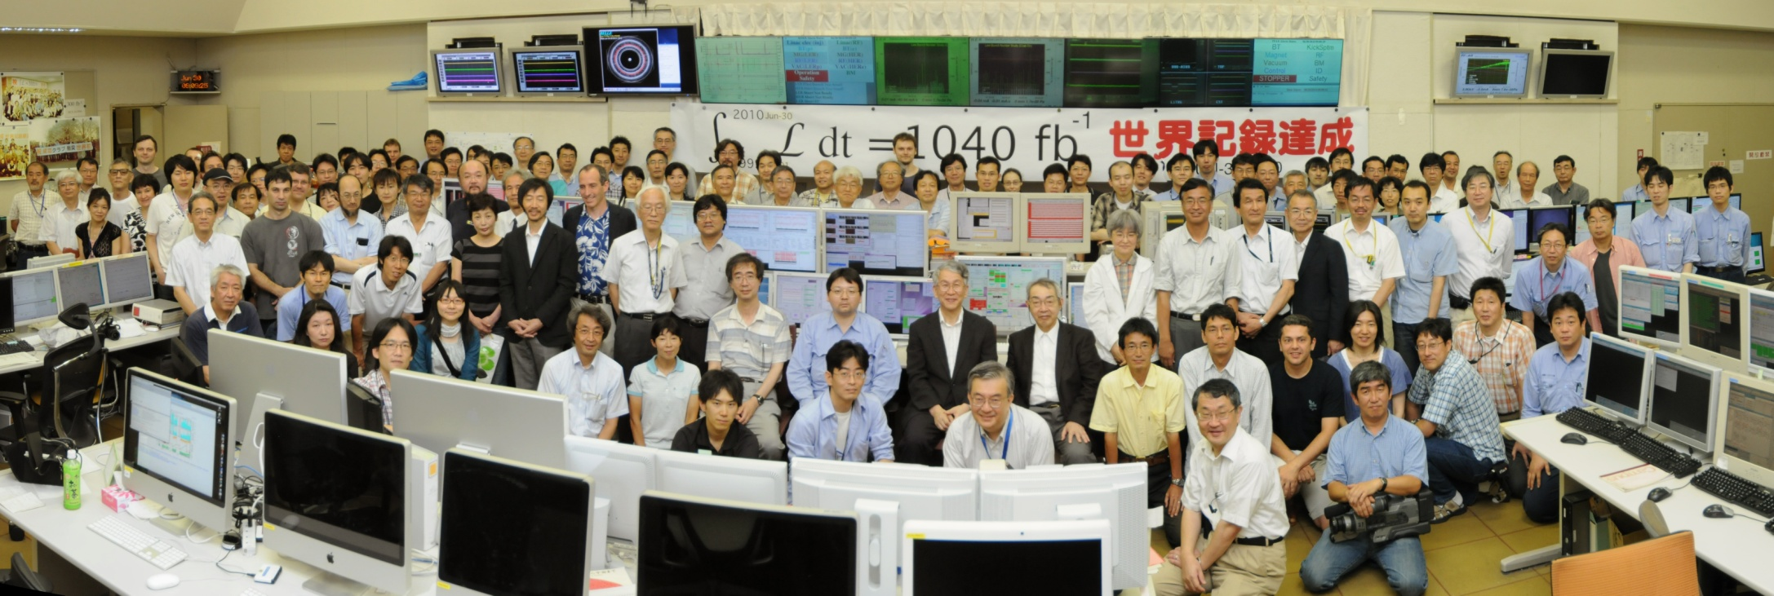
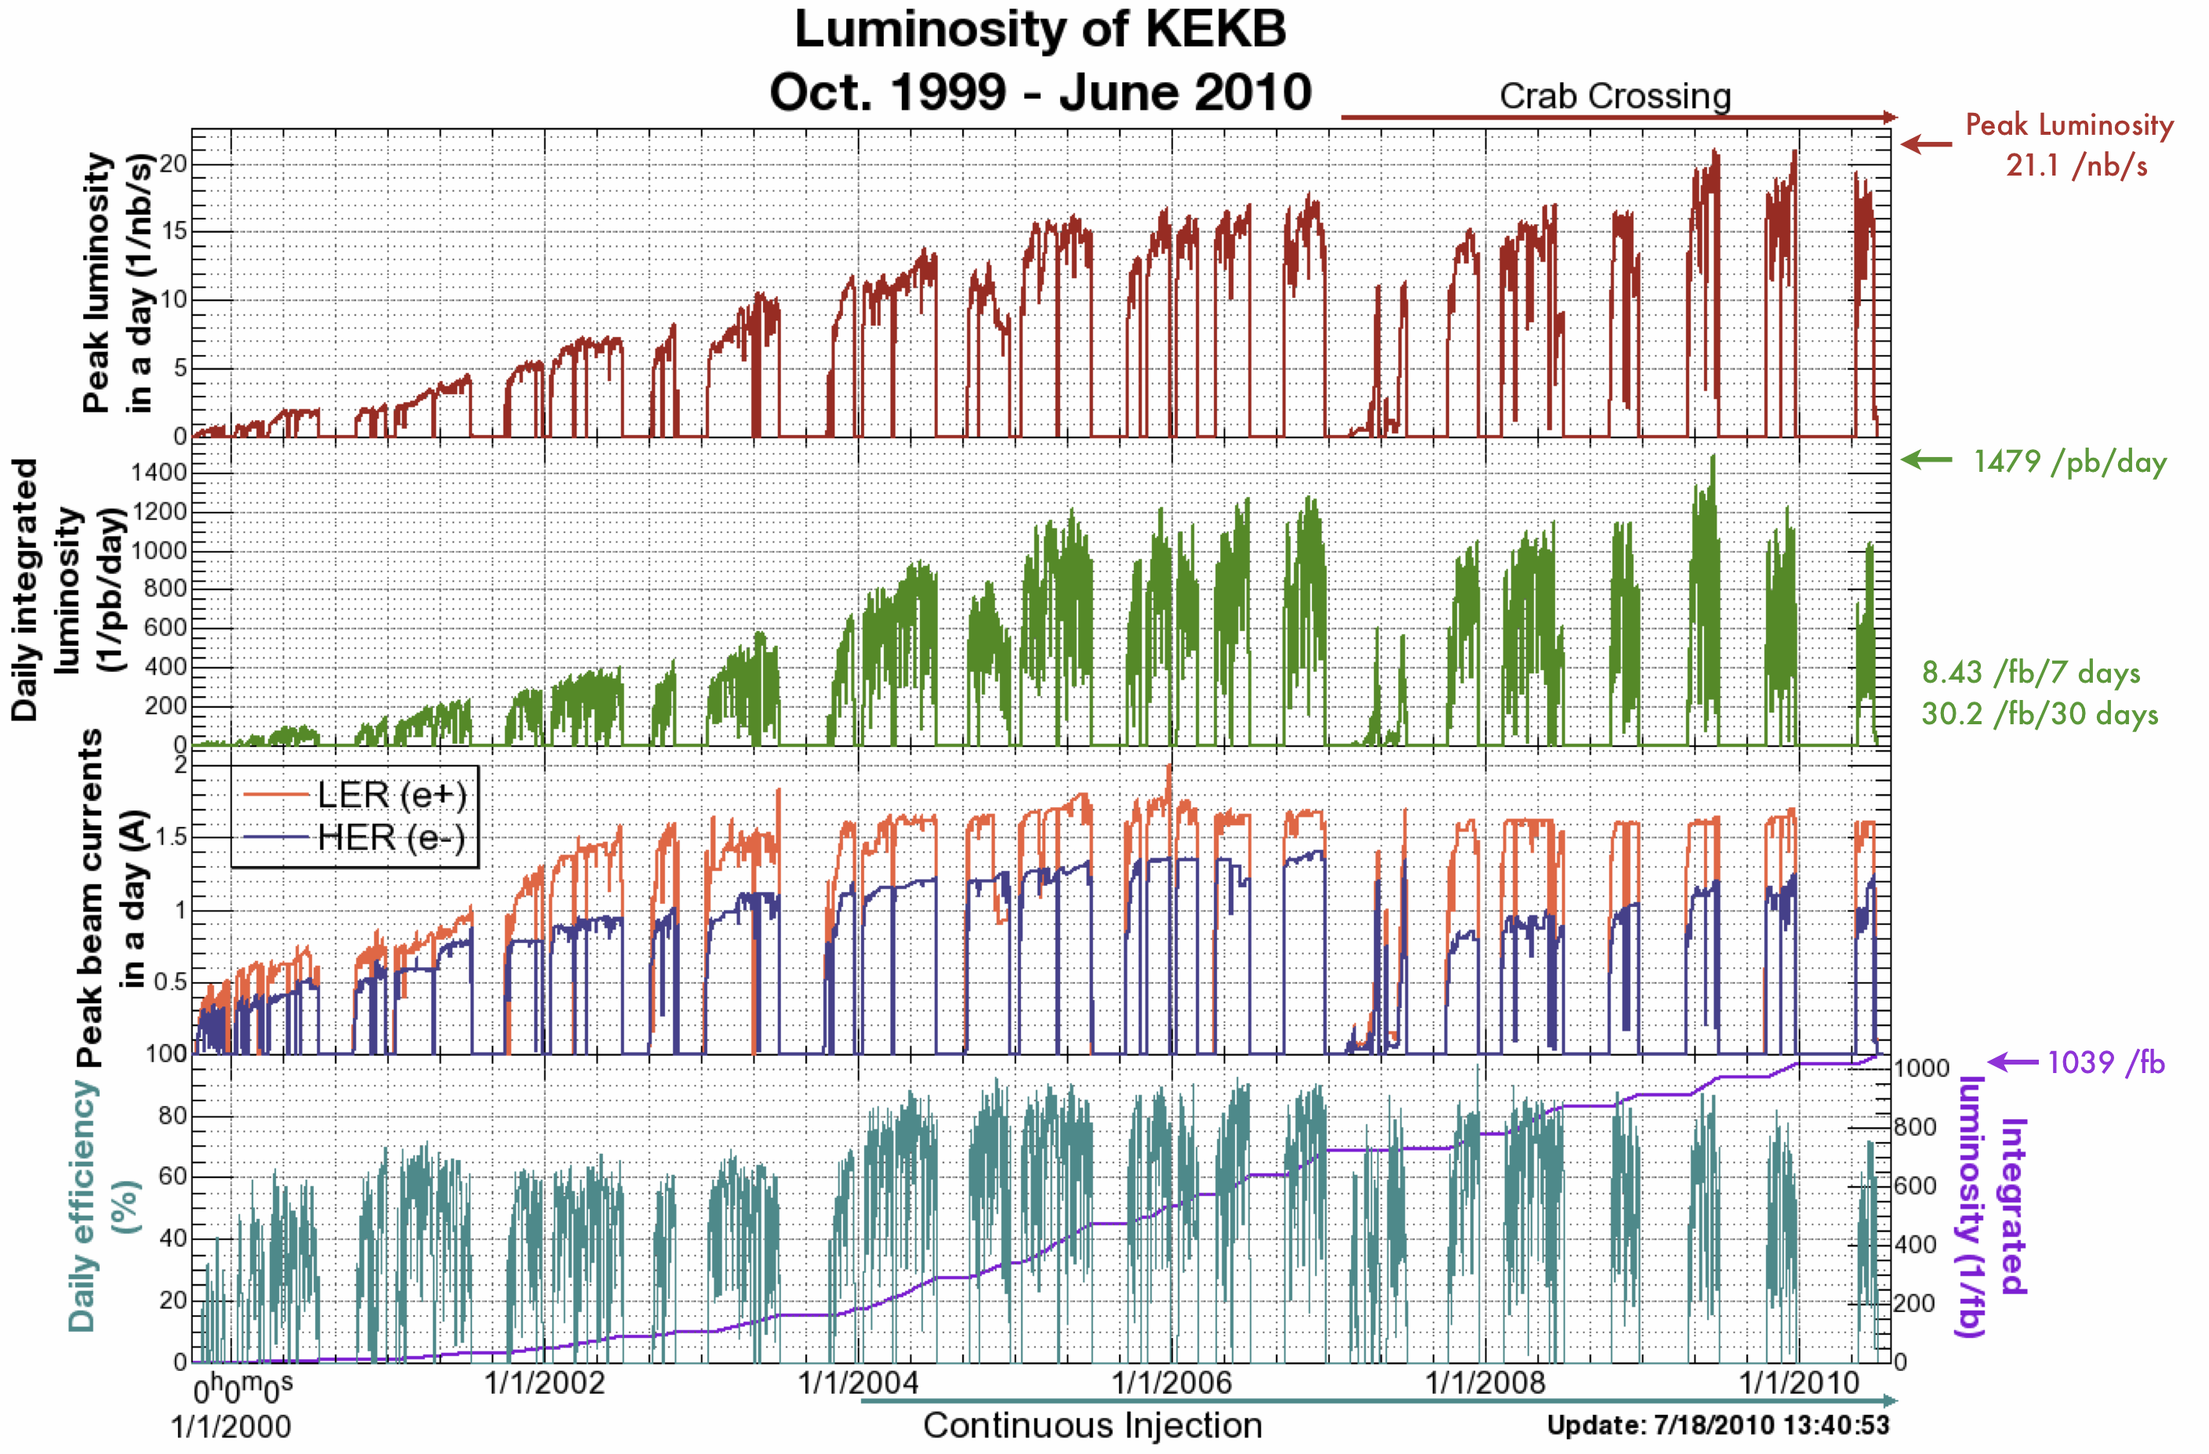
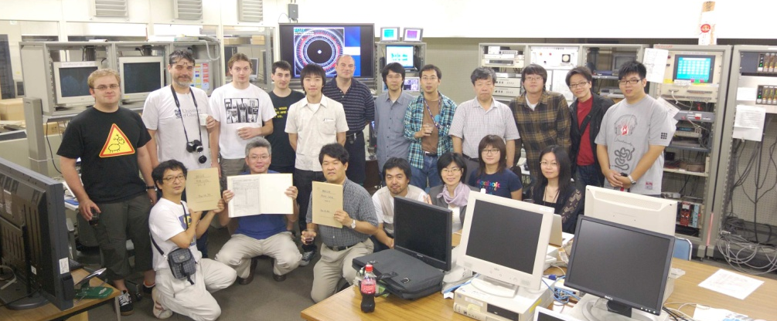
The last beam abort of KEKB on June 30, 2010
First physics run on June 2, 1999
Last physics run on June 30, 2010
L_{peak} = 2.1x10³⁴/cm²/s
L > 1ab⁻¹
Notes:
After 11 years of successful operation, KEKB was shut down for the upgrade last June.
Total accumulated luminosity was more than 1 ab^-1.
Achieved peak luminosity was twice the design value.

Slide 25
Happy end of a story,
but not the end of the B-factory.

Slide 26
Baryogenesis
Evidences that
SM is incomplete
Neutrino mass
Dark matter
Mass hierarchy
Grand unification
There must be New Physics @ TeV scale !!
Super-
symmetry ?
Extra-dimension ?
Composite
Higgs ?
But , or else ?
Flavor physics : key to identify the correct theory for NP
B physics
CPV, FCNC, …
LFV
tauonic decays

Slide 27
Energy Frontier and Luminosity Frontier
Direct Production by High Energy Coll.
Virtual Production via Quantum Eff.
~
q
p
p
b
s
~
~
χ
γ
g
~
~
~
q
χ
ν
_
q
q
l⁻
Tunnel effect
Energy Frontier
Luminosity Frontier
Even if no new particles are found in Energy Frontier experiment (which is not exciting), Luminosity Frontier experiment can search for new physics. With more accumulated data, sensitivity to higher energy scale is achieved.

Slide 28
Flavor Physics: sensitivity to each NP model
Popular SUSY models
 | mSUGRA | MSSM+ν_{R} |  | SU(5)+ν_{R} |  | U(2) FS
 |  | degenerate | non-degenerate | degenerate | non-degenerate
A_{CP}(sγ) |  |  |  |  |  | ✔
S(K*γ) |  |  |  | ✔ | ✔ | ✔
S(ργ) |  |  |  | ✔ | ✔ | ✔
S(φK_{S}) |  |  |  | ✔ | ✔ | ✔
S(B_{s}→J/ψ φ) |  |  |  | ✔ | ✔ | ✔
μ→eγ |  | ✔ |  | ✔ | ✔ | ?
τ→μγ |  | ✔ | ✔ | ✔ | ✔ | ?
τ→eγ |  |  | ✔ |  | ✔ | ?
…
Observables
…
✔: deviation from SM
Flavor Physics:
DNA identification of NP
[based on T.Goto et.al. PRD77, 095010(2008)]

Slide 29
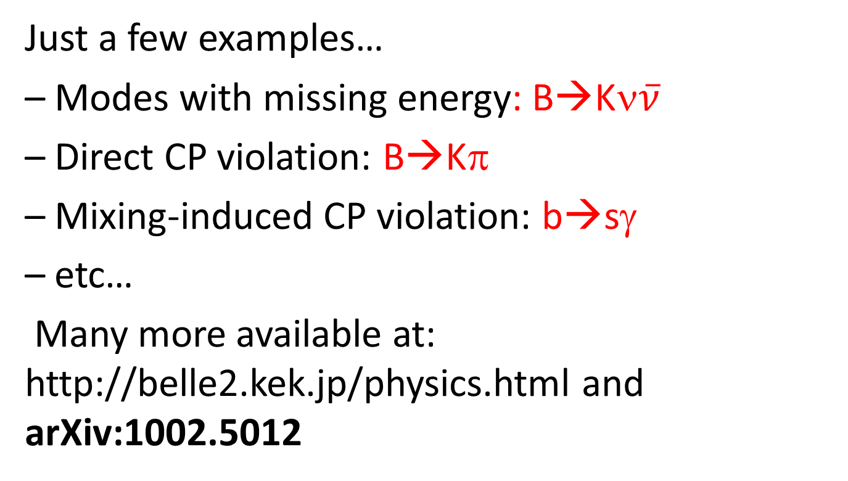
Physics topic @ Belle-II
Just a few examples…
– Modes with missing energy: B→Kν$\overline{ν}$
– Direct CP violation: B→Kπ
– Mixing-induced CP violation: b→sγ
– etc…
Many more available at: http://belle2.kek.jp/physics.html and arXiv:1002.5012

Slide 30
Features of Belle II detector@SuperKEKB
High momentum PID with low fake rates to observe and study b→s and b→d penguins
In contrast to LHCb, superb neutral detection capabilities.
e.g. B→K_{S}π⁰ γ (to detect right-handed currents), Direct CPV in B→K_{s}⁰π⁰
Capable of observing rare “missing energy modes” such as B→Kν𝜈 ̅ with B tags. Hermeticity is critical.

Slide 31
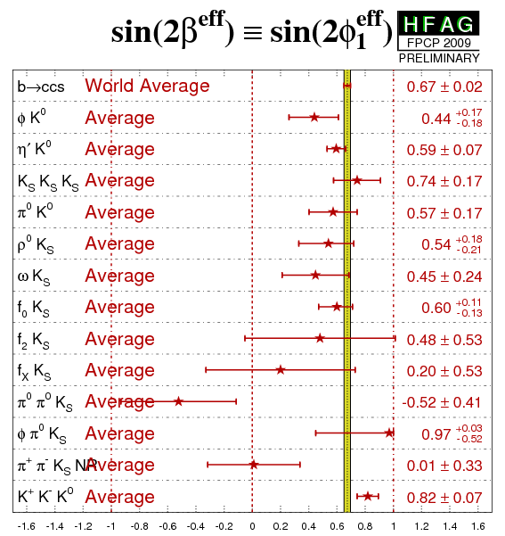
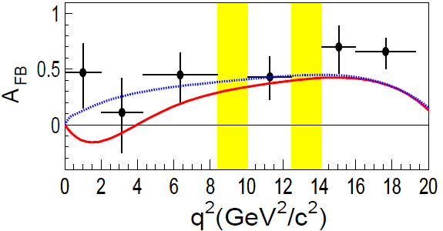
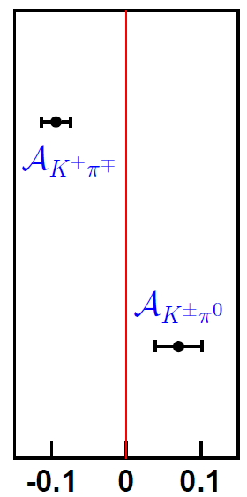
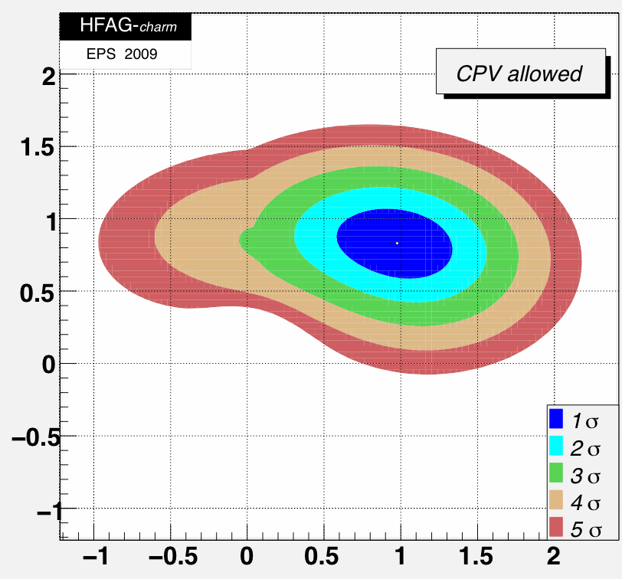
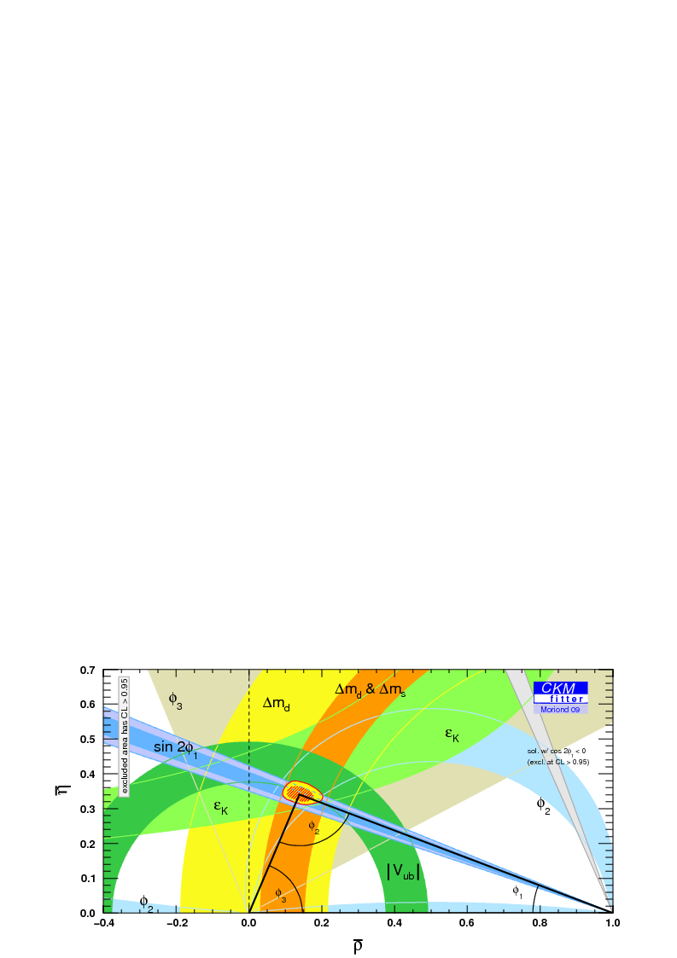
NP indication(?) seen with Belle-I
b→s遷移でCP非対称性に異常？
B→K*ℓ⁺ℓ⁻の前後方非対称性に異常？
B⁰ と B±でA_{CP}非対称性の大きさに差異
C₇=−C₇SM
SM
Belleでも新物理の信号が見え始めている？
ユニタリティー三角形に矛盾？
予想外に大きなD⁰-D⁰混合
f_{L}(B→VV) ≠ 1
Theoretical calculations
using V_{ub}, Δm_{d},ε_{K}
tree
penguin
…..
Direct
measurement

Slide 32
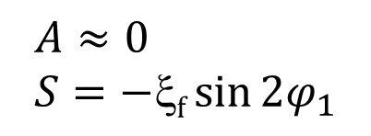
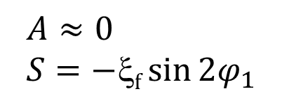
sin2φ₁ in b→sqq:
SM case
_
_
c
J/Ψ
b
$A≈0$
$$S=−\text{x}\text{f}\sin{2φ_{1}}$$
B⁰
w
c
_
d
s
K⁰
d
_
w
_
b
s
φ, η’...
B⁰
t
g
s
$A≈0$
$$S=−\text{x}\text{f}\sin{2φ_{1}}$$
_
d
s
K⁰
d

Slide 33
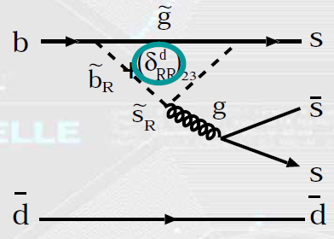
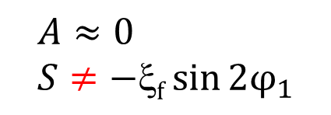
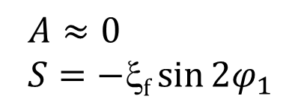
sin2φ₁ in b→sqq
NP case
_
_
c
$A≈0$
$$S=−\text{x}\text{f}\sin{2φ_{1}}$$
J/Ψ
b
B⁰
w
c
_
d
s
K⁰
d
_
w
_
b
s
φ, η’...
B⁰
t
g
s
_
＋
d
s
K⁰
d
$A≈0$
$$S≠−\text{x}\text{f}\sin{2φ_{1}}$$

Slide 34


Anomaly in 2003 and now
Blue line：fitted
Black dashed line：sin2φ₁
PRD 82, 073011 (2010) 657MBB
The discrepancy has become
less significant with more data,
but is still statistically limited.

Slide 35



A_{CP} in b→s transition @Belle-II
With 10-50 ab⁻¹ data, accuracy ~ O(0.01)
MC
J/ψK⁰
now
New Physics
φK⁰
0.2
Accuracy(ΔS)
50 ab⁻¹
0.1
S(φK⁰)=0.39 is assumed
0.05
0.2
0.02
ΔS(φK⁰)
0.1
0.5
1
10
50
Luminosity [ab⁻¹]
Can be used to distinguish several SUSY models.
SU(5)+ν_{R}
(non-degenerate)
U(2)FS
mSUGRA
−0.2
0
2
[TeV]

Slide 36
SuperKEKB

Slide 37

SuperKEKB Luminosity Target
SuperKEKB
8x10³⁵ cm⁻²s⁻¹
Collect ~50 ab-1 by 2020-2021.
2x10³⁴ cm⁻²s⁻¹
x40 !!
Notes:
As you can see in this trend plot, the target luminosity of SuperKEKB is about 2 order higher than the current B factories.
But how can it be achieved?

Slide 38

Accelerator upgrade
At SuperKEKB, we increase the luminosity based on
“Nano-Beam” scheme, which was originally proposed for SuperB by P. Raimondi.
  Vertical β function at IP: 5.9 → 0.27/0.30 mm (x20)
  Beam current: 1.7/1.4 → 3.6/2.6 A (x2)
→ L = 2x10³⁴ → 8x10³⁵ cm⁻²s⁻¹ (x40)
Luminosity Gain
Notes:
At SuperKEKB, we will increase the luminosity based on so-called “Nano-Beam” scheme, which was originally proposed by SuperB collaboration.
The concept is as follows:
The luminosity can be expressed by this formula, and what we’re going to do is to change these two parameters circled in red.
Beta sub y, which is the vertical beta function at interaction point, will be squeezed by factor 20. This results in the factor 20 increase of luminosity.
I, beam current will also be doubled.
In total, 40 times higher luminosity can be achieved.

Slide 39





Dilemma in Straightforward Upgrade
Hourglass Effect
Bunch length must be well shorter than the vertical beam size. Otherwise collisions in skirts deteriorate luminosity (make even worse).
Coherent SR
Bunch length must be long enough so that the SR won’t be coherent. CSR increases energy spread, beam size; and deteriorates luminosity.
λ$≪$σ_{z}
Incoherent SR
$$I∝{Ne}^{2}$$
λ$\sim$σ_{z}
Coherent SR
$$I∝{\left(Ne\right)}^{2}$$
Reaches a ceiling at L=2-6×10³⁵cm⁻²s⁻¹

Slide 40
Collision Scheme
KEKB head-on (crab crossing)
Nano-Beam SuperKEKB
5-6 mm
10-12 μm
100-150 μm
d
2 φ = 83mrad
6-7 mm
Half crossing angle: φ
overlap region = bunch length
overlap region << bunch length
Hourglass requirement
~ 6 mm
~ 300 μm
Vertical beta function at IP can be squeezed to ~300μm.
Need small horizontal beam size at IP.
→ low emittance, small horizontal beta function at IP.

Slide 41
Machine Design Parameters
parameters |  | KEKB |  | SuperKEKB |  | units
 |  | LER | HER | LER | HER
Beam energy | Eb | 3.5 | 8 | 4 | 7.007 | GeV
Half crossing angle | φ | 11 |  | 41.5 |  | mrad
# of Bunches | N | 1584 |  | 2500
Horizontal emittance | εx | 18 | 24 | 3.2 | 5.3 | nm
Emittance ratio | κ | 0.88 | 0.66 | 0.27 | 0.24 | %
Beta functions at IP | βx*/βy* | 1200/5.9 |  | 32/0.27 | 25/0.30 | mm
Beam currents | Ib | 1.64 | 1.19 | 3.6 | 2.6 | A
beam-beam param. | ξy | 0.129 | 0.090 | 0.0886 | 0.081
Bunch Length | σz | 6.0 | 6.0 | 6.0 | 5.0 | mm
Horizontal Beam Size | σx∗ | 150 | 150 | 10 | 11 | um
Vertical Beam Size | σy∗ | 0.94 |  | 0.048 | 0.062 | um
Luminosity | L | 2.1 x 10³⁴ |  | 8 x 10³⁵ |  | cm⁻²s⁻¹

Slide 42











What’s new at SuperKEKB
Belle II
e⁺ 4GeV 3.6 A
Colliding bunches
New IR
e⁻ 7GeV 2.6 A
New superconducting /permanent final focusing quads near the IP
New beam pipe
& bellows
SuperKEKB
Replace short dipoles with longer ones (LER)
Add / modify RF systems for higher beam current
Low emittance positrons to inject
Positron source
Redesign the lattices of HER & LER to squeeze the emittance
Damping ring
New positron target / capture section
TiN-coated beam pipe with antechambers
Low emittance gun
Low emittance electrons to inject
Target: L = 8x10³⁵/cm²/s

Slide 43
Major Items to Upgrade
Rebuild IR
Optics improvements:
  Tsukuba straight section
  Arcs
  Wiggler sections
Magnets
  Build or rearrange many magnets
  Survey and alignment
New LER beam pipes for electron-cloud suppression
Strengthen RF system
Improve speed and resolution of beam monitor and control system:
  Position: BPMs, digital Bunch-by-bunch feedback
  Size: (SRM, X-ray)
  Collision monitors: Large Angle Beamstrahlung Monitor (G. Bonvicini)
  Damping ring monitors
Upgrade the injector linac and beam transport system
Install a 1.1 GeV positron damping ring
Increase capacity of cooling system for the magnets and vacuum system
Design Concept of SuperKEKB
Re-use the KEKB tunnel.
Re-use KEKB components as much as possible.
  Preserve the present cells in HER.
  Replace dipole magnets in LER, re-using other main magnets in the LER arcs.

Slide 44




Removal of ring magnets
storage area.

Slide 45
Belle-II detector

Slide 46


Belle-I disassembly has finished
Beam Pipe and Vertex Detector extraction: on Nov. 10, 2010
Belle Detector Roll-out: Dec. 9, 2010
End-caps, CDC, B-ACC, TOF extraction: in Jan. 2011

Slide 47
Belle II Detector
KL and muon detector:
Resistive Plate Counter (barrel)
Scintillator + WLSF + MPPC (end-caps)
EM Calorimeter:
CsI(Tl), waveform sampling (barrel)
Pure CsI + waveform sampling (end-caps)
Particle Identification
Time-of-Propagation counter (barrel)
Prox. focusing Aerogel RICH (fwd)
electron (7GeV)
Beryllium beam pipe
2cm diameter
Vertex Detector
2 layers DEPFET + 4 layers DSSD
positron (4GeV)
Central Drift Chamber
He(50%):C2H6(50%), Small cells, long lever arm, fast electronics

Slide 48

Detector upgrade
48
Notes:
Now, moving on to the detector upgrade.
Lower half of this picture shows the former Belle detector, and the upper half the new Belle-II detector.
I will explain the upgrade of each sub-detector one by one.

Slide 49

Detector upgrade
Vertex detector: 4lyr. Si strip
→ 2lyr. pixel(DEPFET) +4lyr. Si strip
49
Notes:
As for the vertex detector, current 4 layers of Si strip detector will be replaced by
2 layers of pixel detector and 4 layers of Si strip detector.
The readout chips will also be replaced with the ones with shorter integration time.

Slide 50

Detector upgrade
Drift chamber for tracking:
Small cells, longer lever arms, faster readout
Vertex detector: 4lyr. Si strip
→ 2lyr. pixel(DEPFET) +4lyr. Si strip
Belle
Belle II
50
Notes:
Drift chamber for tracking will be upgraded with smaller cells to cope with higher BG rate.
The longer lever arm will enable better momentum resolution.
The readout system will be replaced with faster one, to reduce deadtime.

Slide 51


Detector upgrade
Drift chamber for tracking:
Small cells, longer lever arms, faster readout
Vertex detector: 4lyr. Si strip
→ 2lyr. pixel(DEPFET) +4lyr. Si strip
new PID system:
Cherenkov imaging, very fast readout
51
Notes:
Particle identification system will be replaced by a completely new one,
using the concept of Cherenkov imaging and very fast photon sensor.

Slide 52

Detector upgrade
Drift chamber for tracking:
Small cells, longer lever arms, faster readout
Vertex detector: 4lyr. Si strip
→ 2lyr. pixel(DEPFET) +4lyr. Si strip
Calorimeter:
New readout with
wave form sampling
new PID system:
Cherenkov imaging, very fast readout
52
Notes:
Calorimeter will be equipped with the new readout system, capable of wave form sampling which leads to the reduction of BG by factor of 7.

Slide 53

Detector upgrade
Drift chamber for tracking:
Small cells, longer lever arms, faster readout
Vertex detector: 4lyr. Si strip
→ 2lyr. pixel(DEPFET) +4lyr. Si strip
Calorimeter:
New readout with
wave form sampling
Endcap K_{L}/muon:
RPC →Scintillator +MPPC
new PID system:
Cherenkov imaging, very fast readout
53
Notes:
KL/muon detector will be renewed from RPC to Scintillator+MPPC, to cope with increasing neutron background.
These are the main detector upgrade features, and
I’d like to explain a little further about the vertex detector and PID in the following few slides.

Slide 54



Belle-II vertex detector
Si strip
5th lyr.
6th lyr.
3rd lyr.
4th lyr.
2nd lyr.
1st lyr.
Belle-II
Pixel: r=14/22mm
Si strip: r=38/80/115/140mm
pixel
Belle
4lyr. Si strip
→ 2lyr. pixel(DEPFET) + 4lyr. Si strip
Si strip: r=20/43.5/70/88mm
Pixel detector closer to IP
→Improved decay vertex resolution
Increased radial coverage
→ better K_{s} acceptance
σ[μm]
Belle
Belle II
20μm
10μm
54
pβsin(θ)^{5/2} [GeV/c]
Notes:
As I mentioned before, we add 2 layers of pixel detector closer to IP, which brings about much better decay vertex resolution.
Thanks to the increased radial coverage, we will also have better acceptance for Ks.

Slide 55


Belle-II Particle Identification System
Barrel PID: Time of Propagation Counter (TOP)
Endcap PID: Aerogel RICH (ARICH)
Focusing
mirror
200mm
MCP-PMT
Cherenkov photon
Quartz radiator
Aerogel radiator
Thin quartz bar with very flat surface
Precise timing measurement with MCP-PMT
n~1.05
Hamamatsu HAPD
+ new ASIC
Completely different from Belle PID:
better K/π separation
more tolerance for BG
less material
(better calorimeter resolution)
B⁺→ρ⁺γ analysis
Belle
Belle-II
Notes:
Particle identification system will be fully replaced.
For the Barrel part, we will use so-called TOP counter which consists of thin quartz bars and photo-sensors with very precise timing resolution.
For the endcap part, we will use Aerogel-RICH which consists of layers of aerogel radiaters with different indices and HAPD equipped with fast readout.
The upgraded PID system will have much better K/pi separation, as shown visibly in these two plots.
The new system will have more tolerance for BG,
It will be less material, which means better resolution of calorimeter placed just outside PID.

Slide 56
Interaction Region Design and Beam Background

Slide 57


Final focusing magnets
  θ =22mrad
IP
  θ =83mrad
IP
QC2LP
QC1LP
QC1RE
QC2RE
QC1RP
QC2LE
IRON
IRON
QC1LE
QC2RP
IRON
Larger crossing angle θ
Final Q for each ring→ more flexible optics design
No bend near IP→ less emittance, less background
Notes:
Although there are a number of features of the accelerator upgrade, here, let me pick up the design of final focusing magnet.
The crossing angle is changed to be much larger than that of KEKB, so that each rings can have their own final q magnet.
This will lead to flexible adjustment of orbit design.
The another benefit from independent final q magnet is that the bend by downstream Q magnet which existed at KEKB will disappear.
This will realize less emittance without dispersion coming the bend close to IP,
and also lead to less background such as SR at downstream magnet or over-bent spent electron from Radiative Bhabha event, which is expected to be the dominant BG of Italian SuperB.

Slide 58


Interaction region design
Belle
<Belle-II>
Smaller beam pipe radius
（r=15mm⇒10mm）
Wider beam crossing angle
（22mrad⇒83mrad）
Pipe crotch starts from closer to IP, complicated structure
New detector: PXD
（more cables&pipes）
Belle-II

Slide 59

PXD cables & pipes

Slide 60


IP beam pipe
Belle-II
Light material (Be) inside detector acceptance
Paraffin (C₁₀H₂₂)flow to remove heat from mirror current (~80W)
Gold plating (~10um)
on inner wall to stop SR
Much simpler Be shape (also much cheaper) since we allow Paraffin and vacuum to attach both side of welding
Paraffin flow
SUS
SUS
Be
SUS
Belle
Al
SUS
Be

Slide 61

Beam pipe mock up for cooling test
SUS mockup
We need to remove ~80W by paraffin flow.
<Items to check>
- Laminar or turbulence?
- Required Paraffin flow rate?
- Tolerable pressure drop inside beam pipe?
- Paraffin temperature rise?
- Pump, pipes, valves, etc…

Slide 62




Cooling test
Old version of mock up
6 RTDs
2.1 l/min.
150 kPa
Heat source (~75W) inside beam pipe
Chiller tank (20℃)
Flow monitor
Pressure monitor (in)
Beam pipe
(Gap=0.5mm)
Pressure monitor(out)
Bypass
23 kPa
pump

Slide 63





Beam background
At SuperKEKB with x40 larger Luminosity, beam background will also increase drastically.
  Touschek scattering
  Beam-gas scattering
  Synchrotron radiation
  Radiative Bhabha event: emitted γ
  Radiative Bhabha event: spent e+/e-
  2-photon process event: e+e-→e+e-e+e-
  Beam-beam scattering
  etc…
Beam-origin
Luminosity dependent
e⁺
e⁻
e⁻
Notes:
In this slide, I have listed up variety of possible beam background sources at SuperKEKB.
Among these background sources, so-called “Touschek scattering” will be the most difficult one to cope with, which I will explain in more detail in the following slides.

Slide 64

Background sources
~1. Scattered beam particles~
Touschek
Touschek scattering
  Intra-bunch scattering
  Rate∝(beam size)-1
    Vertical beam size: 0.94um→0.048/0.062um
    Increase drastically (x20) at SuperKEKB
  Rate∝(beam energy)-3
    Beam energy asymmetry is relaxed: 3.5/8.0GeV→4.0/7.5GeV
Beam-gas scattering
  Scattering by remaining gas, Rate ∝IxP
  Vacuum level at SuperKEKB will be similar to KEKB,
  so less dangerous compared to Touschek scattering
  Vacuum level in IR region could be worse than KEKB, but particles scattered in IR region will be lost far downstream IP and will not be dangerous for the detector
Brems
Coulomb

Slide 65

Touschek/Beam-gas background
Scattered e+
Shower
Shower
Scattered e-
Scattered e+/e- becomes off-trajectory and hit IR beam pipe.
They creates not only EM shower but also neutrons.

Slide 66




Countermeasure: Collimators
Horizontal collimator @ SuperKEKB
Collimators at arc sections
Belle-II
For SuperKEKB, collimators at
-200m~-20m from IP is effective
cf. collimator @KEKB
At SuperKEKB, beam is collimated from both side (inner/outer).
(cf. KEKB: from inner side only)
Beam
Mask Head
Notes:
One possible solution is the use of collimators to block off-momentum particles
before they reach any closer to IP.
Since more collimation is required, we plan to have horizontal collimation from both inner and outer sides.
One potential problem may be the fact that outer collimator will be hit by the SR photons, but we have already confirmed that we can handle the SR heat deposit.

Slide 67




Countermeasure: Heavy-metal shield
Heavy-metal shield to protect PXD/SVD from showers coming from upstream.
Belle-II IP design (Preliminary )
~1.5cm thick
(=few radiation length)
cf. Heavy-metal shield @ Belle
Notes:
Another countermeasure is to use heavy-metal shield to protect inner detectors, which was also used for current Belle.
“Heavy-metal” is specifically referring to Tungsten-alloy, with a very short radiation length and capacity to stop showers created by the Touschek scattered particles.

Slide 68

Loss position of
LER Touschek background
LER Touschek loss positions with all horizontal collimators closed
(0.9GHz e+@1.2m from IP)
LER
Notes:
According to the simulation, LER Touschek-scattered positrons are hitting the beam pipe around 1.2m upstream from IP,
Which is inside the belle-II detector and final focusing magnet.

Slide 69

LER Touschek full simulation
Generated vertex of all MC particles
LER Touschek only
Perfect collimation
Accumulated for 0.2us
LER

Slide 70

Simulated background hits on PXD
Occupancy=
Occupancy=
PXD occupancy from LER Touschek is less than PXD requirement (2%)
Notes:
We run full-detector simulation for this LER Touschek background and simulated occupancy on PXD is small enough.
We are now investigating the impact on outer detectors. SVD,CDC, etc…

Slide 71

b
Neutron flux from LER Touschek
0.9GHz e+
LER e+
0.9GHz e+= ~10¹¹/cm2/year neutrons at 1m away
2m
3m
γs in showers hit nuclei and generate 1~2 neutrons per e+ via ”Giant Dipole Resonance”.
e+ hitting point is INSIDE detector. Almost no space to put neutron shield.
0.9GHz e+ = few*10¹¹/cm2/year neutrons (1MeV equiv.):
→ comparable to our assumption for detector R&D
Notes:
As I mentioned before, neutrons generated in the shower is also important background.
Since neutron generated points are inside detector, there is almost no space to put neutron shield material such as polystyrene.
Neutron rate from LER Touschek is ~10^11 per cm2 per year, which is comparable to our assumption we have used for sub-detector R&D.
So, we can tolerate this neutron background level.
1.5* (0.9*10^9)[1/sec] * (1*10^7)[sec/year] / (4*100^2*3.14) [cm2] = (1.3 * 10^16)/ (13*10^4) = 10^11

Slide 72


Background sources
~2. Synchrotron radiation~
φ20mm→φ9mm collimation on incoming beam pipe
Most of SR photons are stopped by the collimation and direct hits on IP beam pipe is negligible
HOM can escape from outgoing beam pipe
To hide IP beam pipe from reflected SR, “ridge” structure on inner surface of collimation part.
Beam pipe design
e-
φ20mm
IP beam pipe (Be)
φ9mm
incoming/outgoing beam pipe (Ta)
e+
~2x10²/bunch (>5keV) photons
hit beam pipe here
→ PXD occp. <<1%
Ridge structure
Notes:
Moving on to the next, I would like to show our optimized beam-pipe design to stop SR background.
Incoming part of beam pipe is collimated from f20mm to f9mm, therefore most of SR photons coming from upstream can be stopped by this collimation and direct hits on IP beam pipe, made of Beryllium, are negligible.
We don’t have to worry about HOM trap, since the outgoing pipes are made straight and HOM can escape .
It is also worthwhile to note that “ridge” or “saw-tooth” structure is set on the inner surface of collimation part to avoid the reflected SR hitting the IP beam-pipe.
The expected SR background of the inner detector is much smaller than the minimal requirement, so we are satisfied with this clever design of beam-pipe.

Slide 73

“Ridge” structure
Al mockup

Slide 74
Background sources (cntd.)
~3. Luminosity dependent~
Radiative Bhabha
  Rate∝Luminosity (KEKBx40),
  EM shower from spent e+/e-:
  hit position is very far (~10m) from IP,
  Neutrons from emitted γ (hitting downstream magnet)
  Main BG for KLM. Need to increase neutron shields in the tunnel
2-photon process
  Generated e+e- pair might hit PXD
  Confirms to be OK, according to KoralW
  simulation and KEKB machine study
“0.2%(<<2%) occupancy on PXD”
Notes:
Touschek/beam-gas background is coming from each beam.
Next background source is coming from collision of two beams,
proportional to Luminosity.
After radiative Bhabha collision at IP, both spent beam particle and emitted gamma contribute to background.
2-photon process via this Feynman diagram is simulated to be small enough.
The simulation validity is confirmed by machine study at KEKB.

Slide 75
Radiative Bhabha
Emitted gamma hit magnet at ~10m downstream and creates neutrons
neutrons
IP
gamma
e+/e-
e+/e- lose energy by radiative Bhabha process and will be lost at ~10m downstream
Notes:
EM shower from spent e+/e- will be small enough, since loss position of spent e+/e- will be far enough from IP.
Emitted gamma will hit downstream magnet and create neutrons in the beam tunnel.

Slide 76

Radiative Bhabha @Belle (photon g neutrons)
End-cap KLM
Polyethylene shield (10cm) at KEKB
x40 at SuperKEKB!!

Slide 77




Polyethylene neutron shield at Belle
layer 9 before shield
layer 9 after shield
KLM efficiency recovered!

Slide 78

Additional neutron shield around radiative Bhabha photon dump
Radiative Bhabha rate is x40 higher than KEKB
HER first bend (BL0RE)
IP+7~11m
Photon dump
IP ~14m
n
n
n
gamma
n
n
n
n
Gamma hitting iron creates neutron via giant dipole resonance
Polyethylene shield (10cm) at KEKB
Additional neutron shield
around photon dump is necessary
Notes:
The neutron generation rate will be 40 times higher than KEKB.
We should increase the neutron shield around gamma dump, to protect our detectors.

Slide 79
Schedule, collaboration

Slide 80
Main Ring construction schedule
FY2010(H22) |  |  |  |  |  | FY2011(H23) |  |  |  |  |  | FY2012(H24) |  |  |  |  |  | FY2013(H25) |  |  |  |  |  | FY2014(H26)
Linac commissioning
DR commissioning
MR Tunnel
MR commissioning
Disassemble KEKB
Set shields
Remove shields
Floor
Beam Pipe
Survey & base plate
2014 Sep.
Fabrication
Baking & TiN coating
R&D
Installation, system check, cabling etc.
Magnet
Fabrication
Field measurement
Installation, cabling
QCS
alignment
R&D,design
Fabrication
Installation, alignment etc.
Field measurement
Monitor
R&D
Fabrication, installation
RF
Fabrication, rearrangement etc.
R&D,Prototype,test
Infrastructure
Design
Building Construction
Cooling system

Slide 81

Belle II Construction Schedule
2014 Sep.

Slide 82

Belle II Collaboration
15 countries/regions, ~60 institutes, ~400 collaborators

Slide 83

Belle II Japan
KEK 47
Nagoya Univ. 15
Nara Women's Univ. 10
Niigata Univ. 5
Osaka City Univ. 4
Toho Univ. 3
Tohoku Univ. 14
Tokyo Metropolitan Univ. 4
U-Tokyo 4
Nuclear Physics Consortium (NPC) 15

Slide 84

Summary
B-factory has achieved good test of KM theory.
Indication of NP(?) is already seen.
NP search is the main aim of Super B-factory.
SuperKEKB accelerator: x40 luminosity
Belle II detector: better performance and survives under x20 background environment
We have just start construction and start experiment in 2014.
参加してみようかなと思った人は是非ご一緒に
NP

Slide 85


Thank you !!

Slide 86
Backup: physics at Belle-II

Slide 87


Slide 88


Slide 89


Slide 90


Slide 91


Slide 92


Slide 93


Slide 94


Slide 95


Slide 96


Slide 97

Physics sensitivity at Belle-II
Belle-II TDR

Slide 98

Physics sensitivity at Belle-II

Slide 99
Backup: SuperKEKB

Slide 100
Luminosity
よく知られているルミノシティの式
バンチに含まれる
電子の数
バンチに含まれる
陽電子の数
バンチの衝突頻度
n_{b}: バンチ数
f₀ : 周回周波数
幾何学的ロス
衝突点での
水平方向のビームサイズ
衝突点での
垂直方向のビームサイズ
ルミノシティに限界があるとすれば、
話は単純ではない。
Notes:
教科書に載っている良く知られたルミノシティの式。
ルミノシティに限界があるとすれば、何によって限界が決まっているのかが重要となる。

Slide 101
ルミノシティには限界があって
ビーム・ビームで決まっている?
Lorentz
factor
ビーム・ビーム パラメータ
ビーム電流
衝突点でビームが互いに
及ぼし合う力の大きさ
古典電子半径
幾何学的な要因
による補正係数
0.8 ~ 1 (short bunch)
衝突点でのx方向と
y方向のビームサイズ
の比 0.5 ~ 1 % (flat beam)
衝突点での
y方向のβ関数
衝突点でのビームの絞り量「焦点深度」
ルミノシティーは、
ビーム電流とビーム・ビーム パラメータの積に比例し、β_{y}＊関数に反比例する。
Notes:
ルミノシティの限界はビームビーム相互作用によって決まっていると思われている。
ビームビーム相互作用は、衝突するビームが互いに及ぼし合う力。
ルミノシティはビーム・ビーム相互作用の大きさを示すパラメータの入った式で評価される。
ルミノシティは、電流とビーム・ビームパラメータの積に比例し、衝突点における垂直ベータ関数に反比例する。
垂直ベータ関数は、ビームの絞り具合、「レンズの焦点距離」に相当する。

