Slide 1


最高エネルギー宇宙線の
加速機構解明への挑戦
Jiro Shimoda & Tomoki Wada
高エネルギー現象で探る宇宙の多様性V,
ICRR, 2025, Oct, 20-21
←Sample of Magnetar Burst
SGR 1935+2154
・Trigger Mechanism？
・Particle acceleration？
Cf.) Wada & Shimoda 2024, Shimoda & Wada 2025
Mereghetti+20
X-ray
FRB

Slide 2
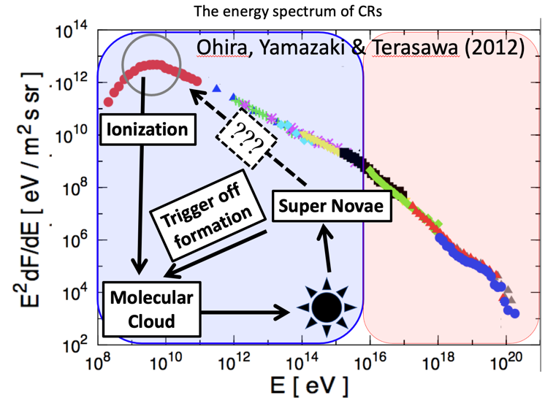
Cosmic Rays (GeV ~ 100 EeV)
Energy density:
~1 eV/cc
Comparable with the ISM energy densities.
Recent: Important role for the Galactic Evolution, Star formation, Planet formation, etc…
Important for understanding the Universe
Energy density:
~1 neV/cc
(May) NOT Important for the Universe
But, unique messengers for the highest-energy physics

Slide 3
Highest Energy Cosmic Rays (>100 EeV)
TA collaboration (2023)
2021 May 27th 10:35:56 (UTC)
Amaterasu (the highest-energy CRs)
Energy~200 EeV (2*10²⁰ eV)!
m.f.p. ~ 1-10 Mpc (by photon)
The Origin & Acceleration Mechanism BIG MYSTERY.

Slide 4
Highest Energy Cosmic Rays (>100 EeV)
TA collaboration (2023)
2021 May 27th 10:35:56 (UTC)
“Hillas diagram”
Ecr/qB ~ Object Size→Confine the CRs
Amaterasu (the highest-energy CRs)
Energy~200 EeV (2*10²⁰ eV)!
m.f.p. ~ 1-10 Mpc (by photon)
The Origin & Acceleration Mechanism BIG MYSTERY.

Slide 5
Highest Energy Cosmic Rays (>100 EeV)
TA collaboration (2023)
2021 May 27th 10:35:56 (UTC)
Amaterasu (the highest-energy CRs)
Energy~200 EeV (2*10²⁰ eV)!
m.f.p. ~ 1-10 Mpc (by photon)
The Origin & Acceleration Mechanism BIG MYSTERY.
GRB221009A→Brightest Of All Time (BOAT GRB)
でニュートリノnon-detection（IceCube+23）
GRBは厳しい？？？

Slide 6
Highest Energy Cosmic Rays (>100 EeV)
TA collaboration (2023)
2021 May 27th 10:35:56 (UTC)
Angelis+13
Amaterasu (the highest-energy CRs)
10 EeV
200 EeV
Energy~200 EeV (2*10²⁰ eV)!
m.f.p. ~ 1-10 Mpc (by photon)
The Origin & Acceleration Mechanism BIG MYSTERY.
The m.f.p. of proton & gamma-ray

Slide 7
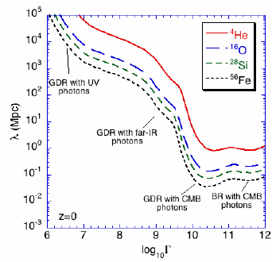
Highest Energy Cosmic Rays (>100 EeV)
TA collaboration (2023)
2021 May 27th 10:35:56 (UTC)
Allard+08
Amaterasu (the highest-energy CRs)
200 EeV
Energy~200 EeV (2*10²⁰ eV)!
m.f.p. ~ 1-10 Mpc (by photon)
The Origin & Acceleration Mechanism BIG MYSTERY.
The m.f.p. of others

Slide 8
Highest Energy Cosmic Rays (>100 EeV)
TA collaboration (2023)
2021 May 27th 10:35:56 (UTC)
Amaterasu (the highest-energy CRs)
Energy~200 EeV (2*10²⁰ eV)!
m.f.p. ~ 1-10 Mpc (by photon)
The Origin & Acceleration Mechanism BIG MYSTERY.

Slide 9
Highest Energy Cosmic Rays (>100 EeV)
TA collaboration (2023)
2021 May 27th 10:35:56 (UTC)
Source Candidates of Amaterasu
Amaterasu (the highest-energy CRs)
Unger & Farrar (2024) state
*no candidate* among powerful radio galaxies.
They support the Transients Scenario.

Slide 10
Highest Energy Cosmic Rays (>100 EeV)
TA collaboration (2023)
2021 May 27th 10:35:56 (UTC)
Source Candidates of Amaterasu
Amaterasu (the highest-energy CRs)
Unger & Farrar (2024) state
*no candidate* among powerful radio galaxies.
They support the Transients Scenario.

Slide 11
Highest Energy Cosmic Rays (>100 EeV)
TA collaboration (2023)
2021 May 27th 10:35:56 (UTC)
Source Candidates of Amaterasu
Amaterasu (the highest-energy CRs)
Unger & Farrar (2024) state
*no candidate* among powerful radio galaxies.
They support the Transients Scenario.

Slide 12
Observations of ~100 EeV Cosmic Rays
TA Collaboration 2024
Arrival direction
→ Looks no hot spot (No hints)
Composition
→ Heavy elements are likely
TA実験『<10 Mpcで鉄だけ加速して！』
→＊鉄だけ＊を加速する環境って・・・？

Slide 13
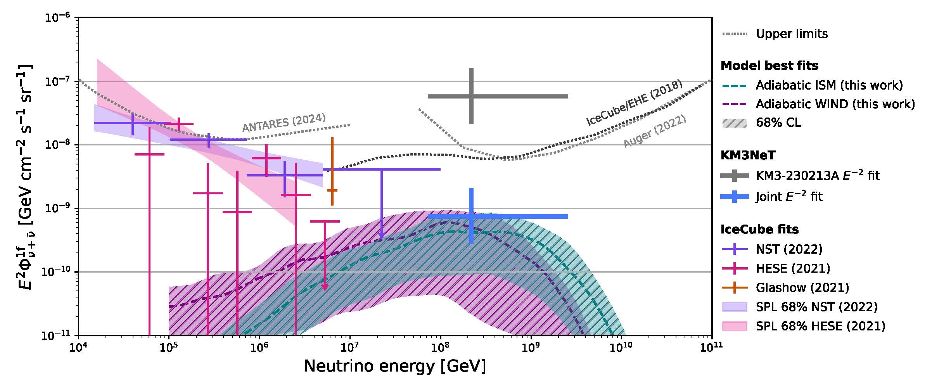
Recent News: KM3NeT ~100 PeV Neutrino
arXiv:2509.14895
*Strange* source(s)？
そんなとこに点打たれても．．．
IceCube Joint fitでflux下がったけど，正しい？

Slide 14
Recent News: KM3NeT ~100 PeV Neutrino
arXiv:2509.14895
*Strange* source(s)？
そんなとこに点打たれても．．．
IceCube Joint fitでflux下がったけど，正しい？

Slide 15
Neutron Stars (Magnetars) as a candidate of source
“Hillas diagram”
Ecr/qB ~ Object Size→Confine the CRs
Neutron Stars w/ B ~ 10¹⁵ G are one of the candidates.
How accelerates *nuclei* in a Neutron Star Transient Event is the main problem.
(see, also Arons 04, Kotera 11, Asano+06)
＊中性子星の周りには「電子・陽電子」はたくさん居ます．*核子*は謎です．
＊銀河系内で30個くらい確認されてます．
＊あまりに手掛かりが無いので，素朴なアイデアから考えていきたい．

Slide 16
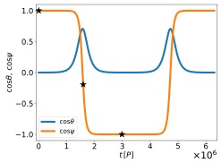
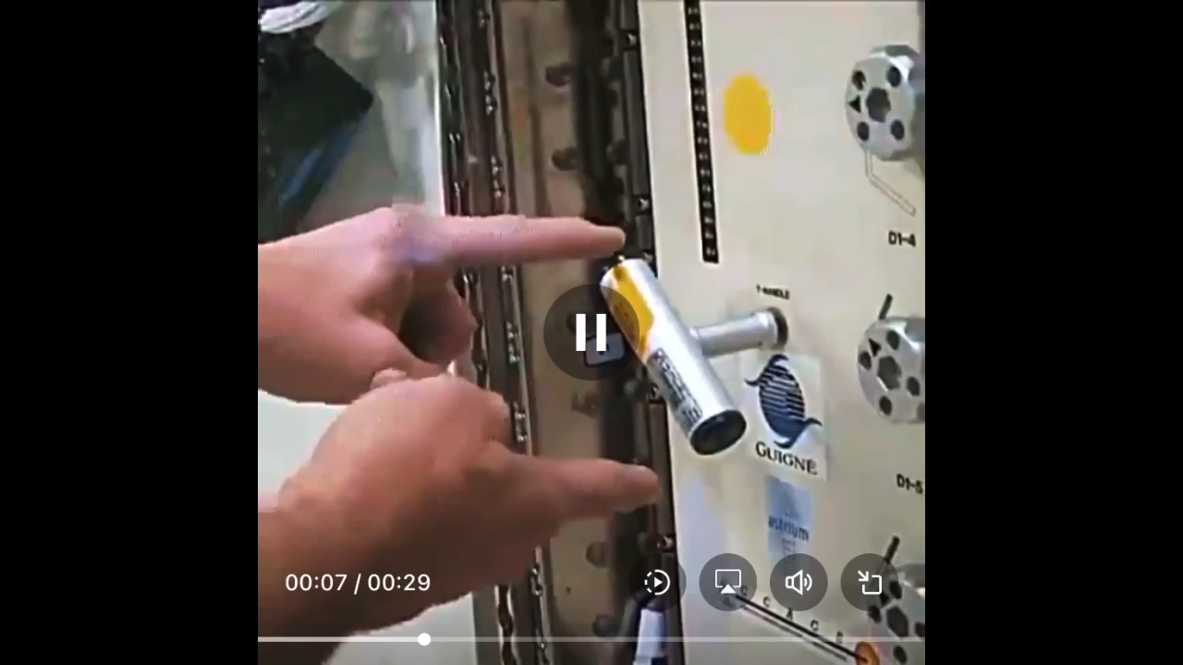
New Scenario for *Trigger* Mechanism of NS-transients
↓from Twitter
Known as the Dzhanibekov effect as a solution of the Euler equation.
なんか面白そうな動画→
見つけた．
和田くんに聞いてみよ．

Slide 17
New Scenario for *Trigger* Mechanism of NS-transients
↓from Twitter
Known as the Dzhanibekov effect as a solution of the Euler equation.
ランダウの力学に書いてありますねえ（京都弁）．
計算↑しました（１日で）

Slide 18
New Scenario for *Trigger* Mechanism of NS-transients
Known as the Dzhanibekov effect as a solution of the Euler equation.
↓from Twitter
＊剛体を構成する質量要素が角運動量保存とエネルギー保存を満たしながら運動する時の「軌道」の一種．
角速度ベクトルΩ ≠ 角運動量ベクトルJ がポイント．

Slide 19
Neutron Stars (Magnetars) as a candidate of source
“Hillas diagram”
Ecr/qB ~ Object Size→Confine the CRs
Neutron Stars w/ B ~ 10¹⁵ G are one of the candidates.
How accelerates *nuclei* in a Neutron Star Transient Event is the main problem.
(see, also Arons 04, Kotera 11, Asano+06)
＊中性子星の周りには「電子・陽電子」はたくさん居ます．*核子*は謎です．
＊銀河系内で30個くらい確認されてます．

Slide 20
New Scenario for *Trigger* Mechanism of NS-transients
↓from Twitter
Known as the Dzhanibekov effect as a solution of the Euler equation.
この星，割れんの？

Slide 21
New Scenario for *Trigger* Mechanism of NS-transients
↓from Twitter
Known as the Dzhanibekov effect as a solution of the Euler equation.
調べてみました（数日で）．
割れますねえ（京都弁）．

Slide 22
New Scenario for *Trigger* Mechanism of NS-transients
Euler force Direction & Strength
from X-axis
The sudden motion of the spin axis induces the sudden rise of the Euler force (F_{Eul} =r * dΩ/dt).
→ Breaking the force balance among the Lorentz force and elastic force (Wada & Shimoda 24).
μ and σ give the *stiffness* of the rigid body (Ogata & Ichimaru 90, Chamel & Haensel 08, Kojima+21).
The shear of force with a length scale of x > l ~ 10³ cm is large enough to induce the plastic flow.
→ We expect appearing “Cracks” at the NS outer crust.

Slide 23
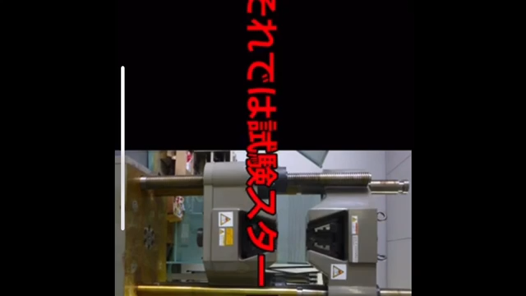
Euler vs. Elastic
福島県ハイテクプラザの
youtube投稿動画より
Kinetic Energy of
Euler force
vs.
Elastic energy
For Japanese students
ブリタニカ国際大百科事典より
・Plastic Flow（塑性流動）
一定限度をこえる応力を受けた物質に生じる不可逆的変形。
Parametrized by σ_{c}

Slide 24
What happens in the NS under the Dzhanibekov effect?
←0.1τ_{f}→
The waiting time for “flip”
Euler force appears
*Work* by Euler force
Elastic Potential Energy (*stiffness* of the crust material)
H = -ρ(dr/dρ)

Slide 25
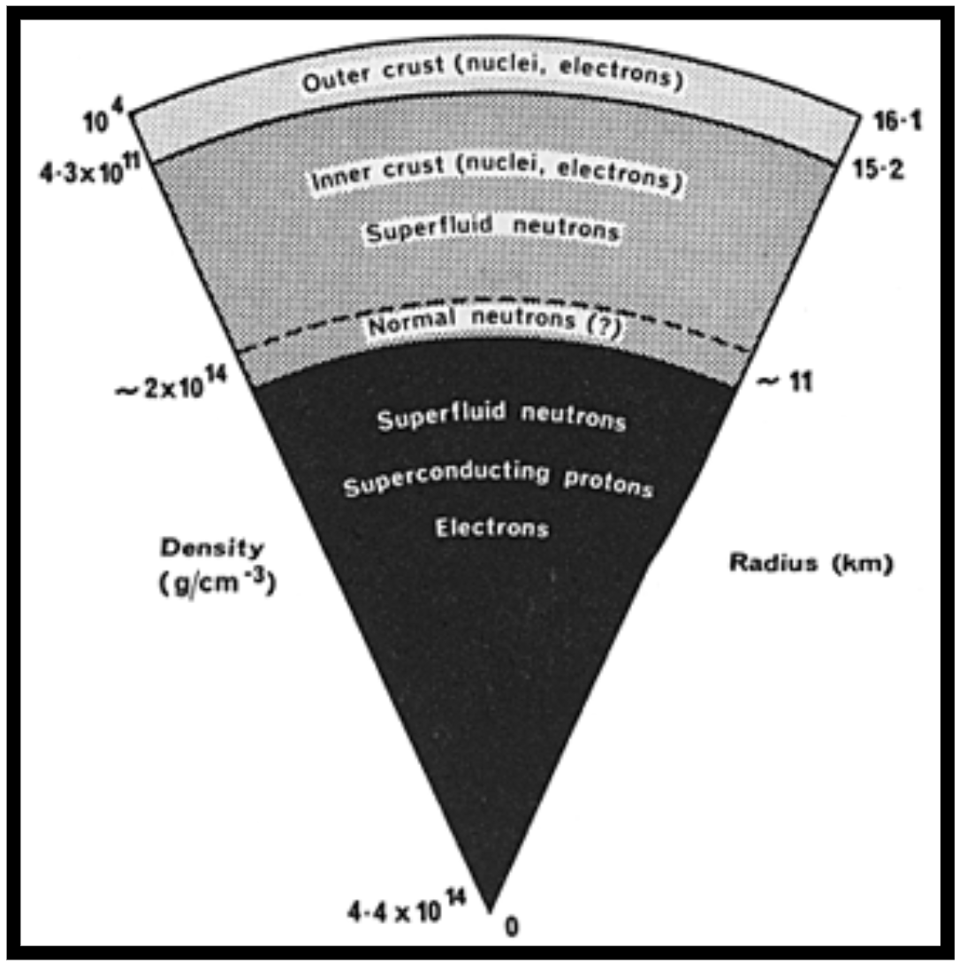
What happens in the NS under the Dzhanibekov effect?
Euler vs. Stiffness
The crust will be significantly affected within Δτ_{f} ~ 10⁻³ τ_{f} ~ 3 months δ₋₉⁻¹
Cracks reaches at H ~ 63 cm
Euler force can deform the NS surface at
ρ < 1.0e6 g/cc (r < 60 cm)
(Outer crust)

Slide 26
At a Moment of Phenomenon
Cracked at H ~ 63 cm
The degenerate, relativistic electrons can escape from the cracks against the gravity.
Cold ions (⁵⁶Fe) are not relativistic (cannot escape by themselves). Their escape following the electron streaming delays due to the Coulomb collisions.
is supposed (=plasma freq. energy).

Slide 27
At a Moment of Phenomenon (Shimoda&Wada 2025)
Very strong Electric field is induced.

Slide 28
At a Moment of Phenomenon (Shimoda&Wada 2025)
Injection of Cold ions
→ kinetic energy of T_{inj} ~ ηT_{i}
(η~5 is supposed)
→ n_{inj} ~ n_{i}exp(-η)
Effective Energy Loss Process
→ Nuclear spallation reactions
→ σ_{A}~πa_{A}² , a_{A}~4.59e-13 cm (A/56)^{1/3}
Estimated Maximum Energy of accelerated ions
Ions can be accelerated up to ~ ZeV=10²¹ eV scale within a time of ~ 1ps.

Slide 29
At a Moment of Phenomenon (Shimoda&Wada 2025)
Injection of Cold ions
→ kinetic energy of T_{inj} ~ ηT_{i}
(η~5 is supposed)
→ n_{inj} ~ n_{i}exp(-η)
Effective Energy Loss Process
→ Nuclear spallation reactions
→ σ_{A}~πa_{A}² , a_{A}~4.59e-13 cm (A/56)^{1/3}
Estimated Maximum Energy of accelerated ions
Instant ZeV-ion-acceleration in Upset Magnetar Origin Bursts
→ IZUMO Bursts

Slide 30
Discussion
Proper prediction of the IZUMO Bursts:
*neutrinos* w/energy of E_{ν}~ 0.05 ZeV/A ~ 100 PeV (10¹⁷ eV).
*neutrons* w/ energy of E_{n}< ZeV/A ~ 20 EeV (10¹⁹ eV).
β-decay time of neutron τ_{β}~ (10 min.)*γ_{n} < 4x10⁵ yr (E_{n}/20 EeV)
→ cτ_{β} < 120 kpc(E_{n}/20 EeV)
Ultrahigh-Energy CR *neutron* events @ the Earth can show time & position coincidences with NS-transient events from nearby galaxies.
Neutrons do not *feel* the B-field unlike from the usual CR nuclei (idea provided by Prof. Takashi Sako @ ICRR TA group)

Slide 31

Discussion2: Possibly Associated Phenomena
岩石（石英とか）を潰したり曲げたりしたら光る
Mereghetti+20
X-ray
FRB
ガムテひっぺがしたりしたら光る（摩擦発光）
Magnetarで見られる突発現象
→中性子星の地震（星振）やリコネクションとかが起源？多くのシナリオで採用されている．
クラストの破壊が伴うと期待される.
（案外脆い→Wada&Shimoda24）
クラストの破壊に伴う固有のシグナルとかを予言したい．
（X線は一応やった→Shimoda&Wada 25）

Slide 32
Kluger et al. 1998の計算例
Mean field → Exact (non-local, N-body like system)
New source→ Asymptotically Expanded S_vac (paper unit)
Old source → Phenomenological S_vac ~ (1+2Nk)E exp(-πλ)δ(p)

Slide 33
よりモダンなEdwards et al. 2025の計算例（ディラック方程式ベース）
補助変数を導入して解いている模様
（まだフォローしてない）

Slide 34
NS-transients observed by photons
H=110 m
H=7 m
H=63 cm
Cracked at H ~ 63 cm→ Develop
Electrons can occupy the Landau levels when
ρ > 1.0e8 g/cc (r = 4 m).
Fermi energy
~6 MeV 1st Landau Level
Fireball may be formed

Slide 35

NS-transients observed by photons
H=110 m
H=7 m
H=63 cm
deexcitations
Electron-Positron
Creation
Annihilation
~~~~~~>
B-field
<~~~~~~
~~~~~~>
~ MeV photons
Electrons can occupy the Landau levels when
ρ > 1.0e8 g/cc (r = 4 m).
Fermi energy
~6 MeV 1st Landau Level
Fireball may be formed

Slide 36
NS-transients observed by photons
H=110 m
H=7 m
H=63 cm
Out bursting Fireball
Mereghetti+20
X-ray
Our scenario can explain the SGR 1935+2154 bursting events
(Luminosity & ~100 keV Photons)
*FRB is still under debate.
FRB

Slide 37
Other Properties of SGR1935+2154 (Future works)
FRB associated burst
Glitch (~10 h)
Mereghetti+20
SGR 1935+2154 exhibits FRB-associated bursting activity at X-ray band (up to ~ 100 keV), called the burst-G.
Looks like an exceptional case → unusual mechanism?
The glitch activity, which can be interpreted by the change of Ω. → Does the Dzhanibekov effect reproduce it?
Hu+24

Slide 38
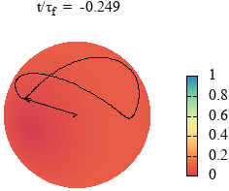
Summary
>100 EeV nuclei
20 EeV neutron
Instant ZeV-ion-acceleration in Upset Magnetar Origin Bursts
→ IZUMO Bursts
The *cracked* Area is ~ πl² ~ 3.0e8 cm² .
ΔΩang~πl²/(4πR*²)~1.0e-6, H ~ 100 m/R*~1.0e-2 (R*/10 km)⁻¹
For the Earth…
ΔA_{Earth}~4πR_{Earth}²ΔΩang~510 km² (出雲市~624 km²)
H_{Earth} ~ R_{Earth} (H/R*) ~ 63.71 km
出雲市（~ 624 km²）が吹き飛んで深さ~60 kmの穴を作るくらい。
(Not So Drastic)
~~~~~~>
100 PeV neutrino
100 keV photon

Slide 39
Amaterasu & SGR 1935+2154
SGR 1935+2154
(RA, Dec)=(293.750, +21.911) deg
( l, b)=(57, 0.8) deg
2021 May 16th 20:15:08 (GMT)
2021 May 27th 10:35:56 (UTC)
TA collaboration (2023)
Energy~200 EeV!
m.f.p ~ 1-10 Mpc (by photon)
Estimated Arrival directions for E > 100 EeV
(Fujii 2023)

Slide 40
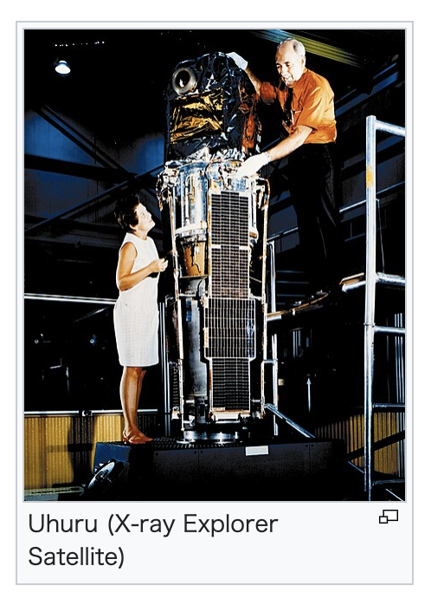
The case of Her X-1
e.g., Shakura+98, Kolsenikov+20, Heyl+23
Heyl+23
Wikipediaより
世界初とされるX線天文衛星Uhuruが1972年にHer X-1での35日周期の変動を報告したとされる．
ShakuraグループはPrecessionシナリオ推しの模様．

