Slide 1
GRB残光
浅野勝晃

Slide 2
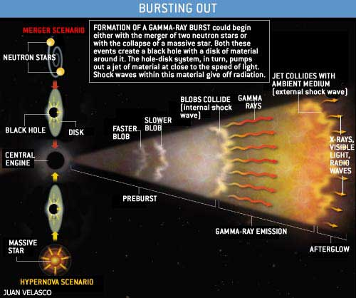
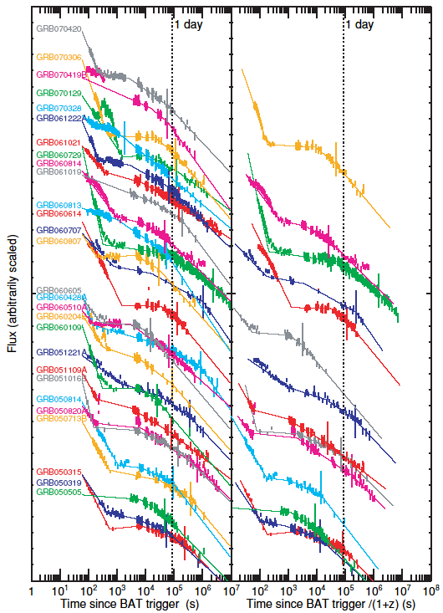
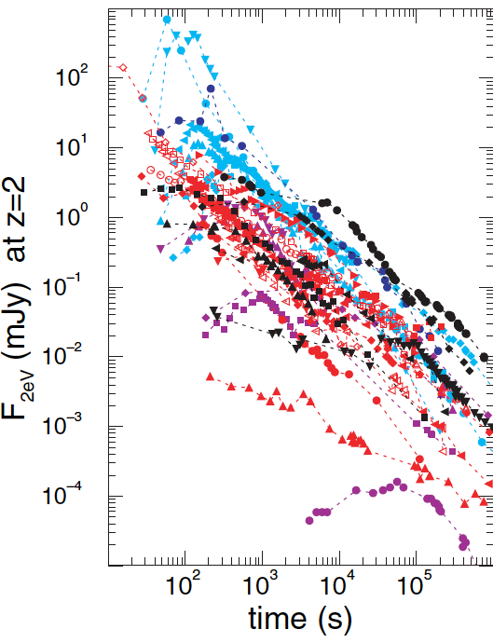
ガンマ線バースト
残光：主に電波、可視、X線
X線
可視
Racusin et al. 2009
Panaitescu & Vestrand 2008
即時放射（数十秒）：等方換算で10⁵¹-10⁵⁴erg、主に10keV-MeV
明るいものからはGeVの放射も検出されている。

Slide 3
ガンマ線残光
GRB 080916C
Fermi望遠鏡では、GeV以上での光子統計量は
スカスカ
Fermi team 09

Slide 4

Gamma-ray afterglow
Emission efficiency is common??
$$L_{LAT}∝t^{−1.2}$$
Nava+ 2014

Slide 5
34 GRB samples
Fermi-LAT 2’nd GRB catalog (1906.11403)
Occulted by the earth. E_{iso} may be underestimated.

Slide 6

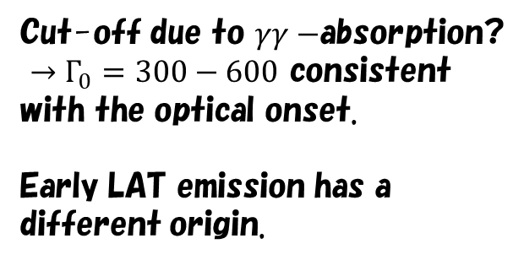
GRB 170405A
Arimoto, KA+ submitted
$$T_{90}∼80s$$
Preliminary
Cut-off due to $γγ−$absorption?
$→Γ_{0}=300−600$ consistent with the optical onset.
Early LAT emission has a different origin.

Slide 7
Gamma-ray closure relation
Tak, KA+ 2019
GRB 080916C
GRB 130427A
ISM rather wind.

Slide 8







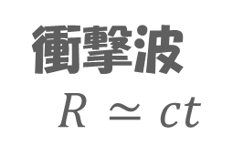


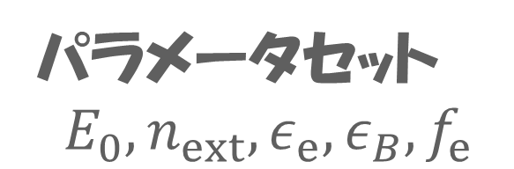


残光の標準モデル
ローレンツ因子 $Γ(R)$ と $n_{ext}(R)$
から磁場$B(R)$と加速電子の注入率を推定。
注入時のエネルギー分布
$$n(γ)$$
$$n_{0}$$
$$E^{−p}$$
$$Γ$$
爆発エネルギー
$$E_{0}$$
$$E^{−p−1}$$
$$γ$$
$$γ_{m}$$
$$γ_{c}$$
星$周密度$
$$n_{ext}$$
パラメータ$セット$
$$E_{0}, n_{ext}, ε_{e}, ε_{B}, f_{e}$$
衝撃波
$$R≃ct$$

Slide 9













単調な物理量の進化
ISM: $n_{ext}=const.$
Wind: $n_{ext}∝R^{−2}$
$$Γ=Γ_{0}{\left(\frac{R_{0}}{R}\right)}^{3/2}$$
$$Γ=Γ_{0}{\left(\frac{R_{0}}{R}\right)}^{1/2}$$
$$ε_{m/c}∝ΓB′γ_{m/c}^{2}$$
$$γ_{m}=γ_{0}{\left(\frac{R_{0}}{R}\right)}^{3/2}$$
$$γ_{m}=γ_{0}{\left(\frac{R_{0}}{R}\right)}^{1/2}$$
$$B=B_{0}{\left(\frac{R_{0}}{R}\right)}^{3/2}$$
$$B=B_{0}{\left(\frac{R_{0}}{R}\right)}^{3/2}$$
$$n_{nth}=n_{0}{\left(\frac{R_{0}}{R}\right)}^{3/2}$$
$$n_{nth}=n_{0}{\left(\frac{R_{0}}{R}\right)}^{5/2}$$
$$V=\frac{πR^{3}}{3Γ}$$
$$V=\frac{πR^{3}}{Γ}$$

Slide 10
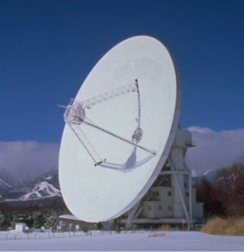
光速に近い運動をする光源
ほぼ光速度で運動する放射体
R
サイズがΓ²倍に

Slide 11














単調な物理量の進化
ISM: $n_{ext}=const.$
Wind: $n_{ext}∝R^{−2}$
$$R∝t_{obs}^{1/4}$$
$$R∝t_{obs}^{1/2}$$
$$Γ∝t_{obs}^{−3/8}$$
$$Γ∝t_{obs}^{−1/4}$$
$$ε_{m/c}∝ΓB′γ_{m/c}^{2}$$
$$ε_{m}∝t_{obs}^{−3/2}$$
$$ε_{m}∝t_{obs}^{−3/2}$$
$$ε_{c}∝t_{obs}^{−1/2}$$
$$ε_{c}∝t_{obs}^{1/2}$$
$$F_{max}∝t_{obs}^{0}$$
$$F_{max}∝t_{obs}^{−1/2}$$
$$F_{m−c}∝t_{obs}^{3(1−p)/4}$$
$$F_{m−c}∝t_{obs}^{−(3p−1)/4}$$
$$F_{>c}∝t_{obs}^{−(3p−2)/4}$$
$$F_{>c}∝t_{obs}^{−(3p−2)/4}$$

Slide 12
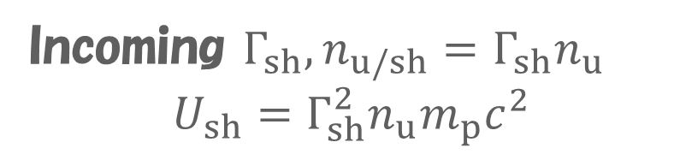
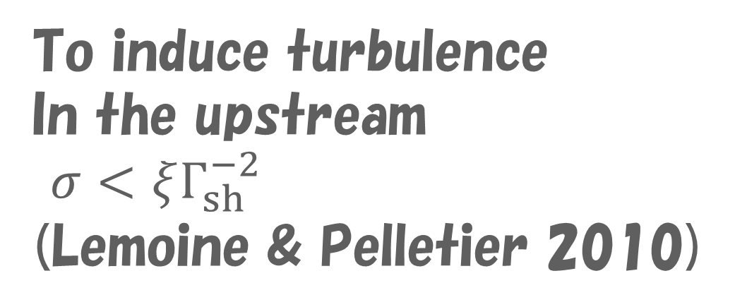
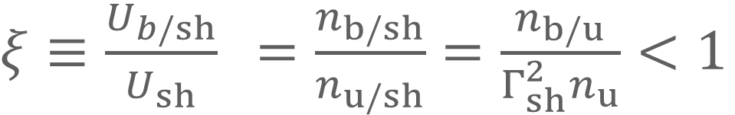
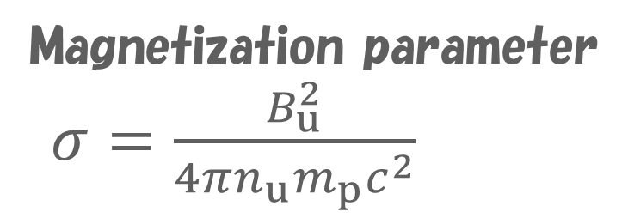
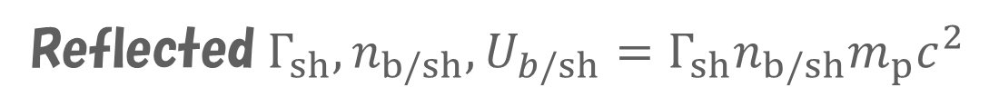
Particle acceleration in relativistic shock
Reflected particles
To induce turbulence
In the upstream
$σ<ξΓ_{sh}^{−2}$
(Lemoine & Pelletier 2010)
Shock rest frame
Reflected$Γ_{sh},n_{b/sh},U_{b/sh}=Γ_{sh}n_{b/sh}m_{p}c^{2}$
Precursor Scale
Incoming $Γ_{sh}, n_{u/sh}=Γ_{sh}n_{u}$
$$U_{sh}=Γ_{sh}^{2}n_{u}m_{p}c^{2}$$
$ξ≡\frac{U_{b/sh}}{U_{sh}}$ $=\frac{n_{b/sh}}{n_{u/sh}}=\frac{n_{b/u}}{Γ_{sh}^{2}n_{u}}<1$
Magnetization parameter
$σ=\frac{B_{u}^{2}}{4πn_{u}m_{p}c^{2}}$

Slide 13
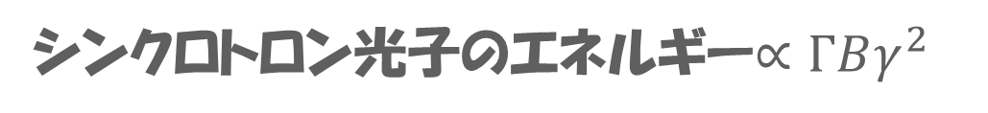

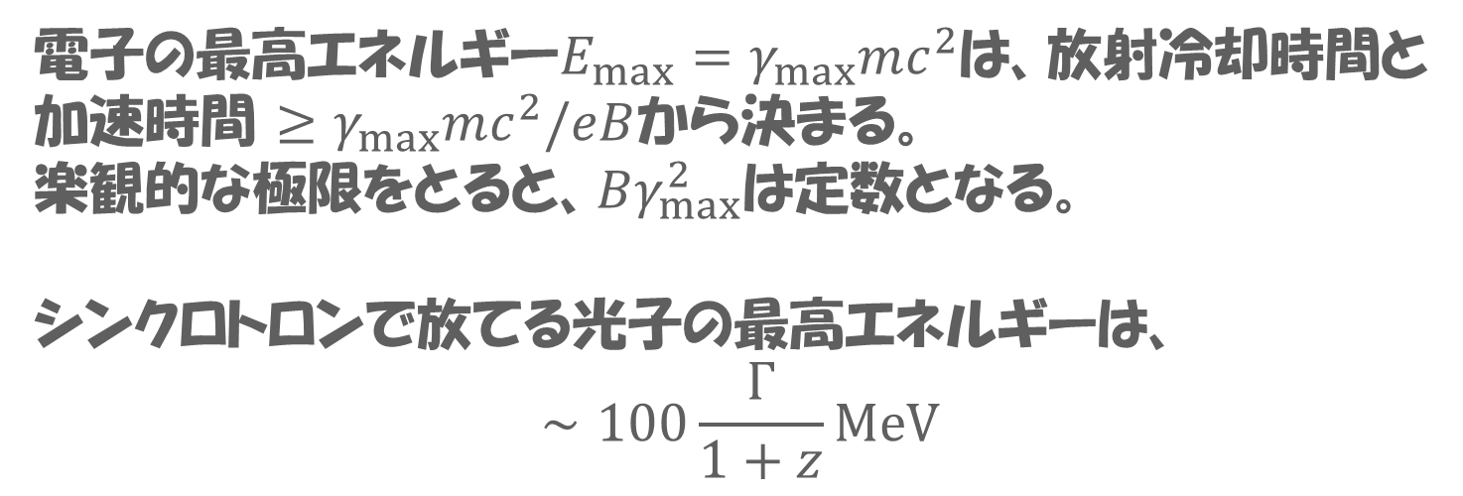
シンクロトロン放射の最高エネルギー
GRB 130427の場合。
比較的遅い時間帯にも数十GeVの光子が到達している。
シンクロトロンでは無理？
シンクロトロン光子のエネルギー$∝ΓBγ^{2}$
電子の最高エネルギー$E_{max}=γ_{max}mc^{2}$は、放射冷却時間と
加速時間 $≥γ_{max}mc^{2}/eB$から決まる。
楽観的な極限をとると、$Bγ_{max}^{2}$は定数となる。
シンクロトロンで放てる光子の最高エネルギーは、
$$∼100\frac{Γ}{1+z}MeV$$
観測時間$t_{obs}≃\frac{(1+z)R}{4cΓ^{2}}$が後になると、
ローレンツ因子$Γ$が小さくなり、最高エネルギーも
下がるはず。
Ackermann+ 14

Slide 14
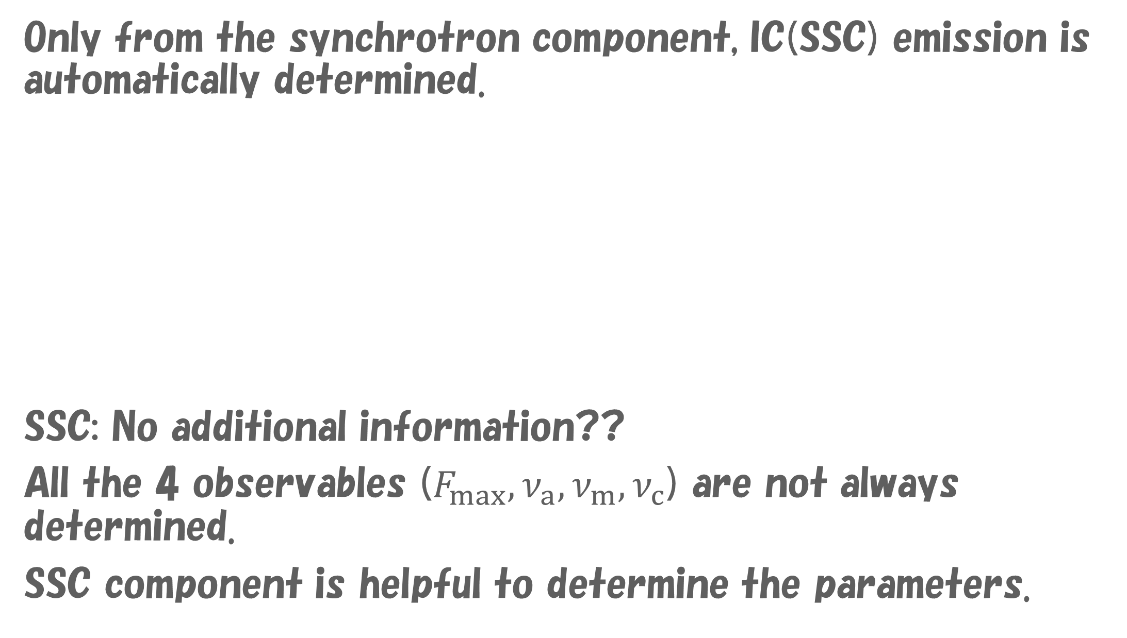
Inverse Compton
Only from the synchrotron component, IC(SSC) emission is automatically determined.
SSC: No additional information??
All the 4 observables ($F_{max}, ν_{a}, ν_{m}, ν_{c}$) are not always determined.
SSC component is helpful to determine the parameters.

Slide 15
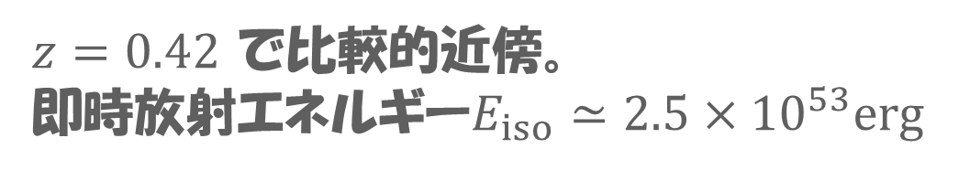
GRB 190114C
$z=0.42$ で比較的近傍。
即時放射エネルギー$E_{iso}≃2.5×{10}^{53}erg$
地上大気チェレンコフ望遠鏡による初の検出。
MAGIC：直径17m2台のステレオ観測。～7度/秒で旋回可能。
低いエネルギー閾値（＞50GeV）。
発生約60秒後から観測開始に成功。計1000発ほどの光子を検出。
Fermiなどによる即時放射の光度曲線。

Slide 16
多波長光度曲線とスペクトルの進化
残光放射と解釈できる。
EBLによる吸収は補正済み。

Slide 17
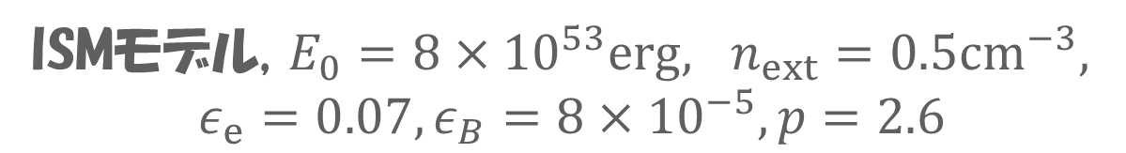
シンクロトロン放射ではない
シンクロトロン＋SSCによるスペクトルのModeling
赤線がシンクロトロンで出せる最高エネルギー
MAGIC “Discovery paper”
Nature 575, 455 (2019)
ISMモデル, $E_{0}=8×{10}^{53}erg, n_{ext}=0.5cm^{−3},$
$$ε_{e}=0.07, ε_{B}=8×{10}^{−5}, p=2.6$$

Slide 18
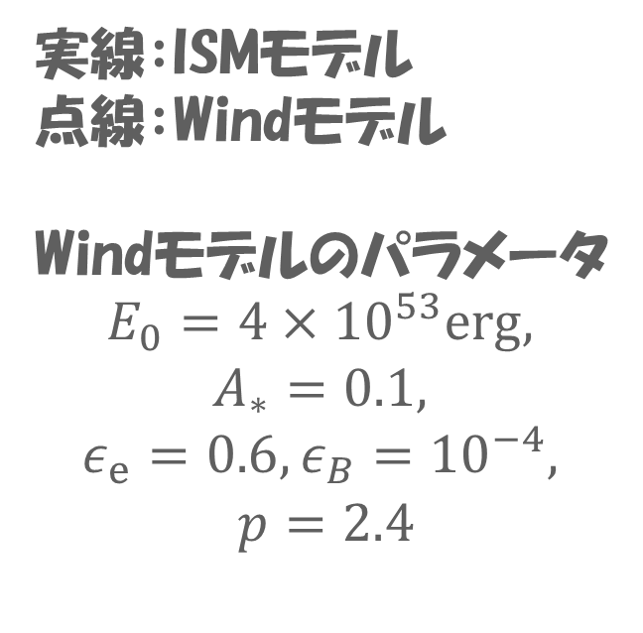
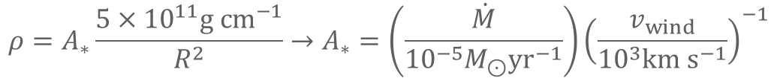
光度曲線
実線：ISMモデル
点線：Windモデル
Windモデルのパラメータ
$$E_{0}=4×{10}^{53}erg,$$
$$A_{∗}=0.1,$$
$$ε_{e}=0.6, ε_{B}={10}^{−4},$$
$$p=2.4$$
ISM：可視は合わない。
Wind：TeVが合わない。
後期は電波も合わせるのは
難しい。
（Kangas & Fruchter 2019）
GeVもt=10⁴sのFluxは、
逆コンプトン放射と考えられる。
$$ρ=A_{∗}\frac{5×{10}^{11}g cm^{−1}}{R^{2}}→A_{∗}=\left(\frac{\dot{M}}{{10}^{−5}M_{⊙}yr^{−1}}\right){\left(\frac{v_{wind}}{{10}^{3}km s^{−1}}\right)}^{−1}$$

Slide 19
Fermi Paper

Slide 20
Radio Lightcurves
Kangas & Fruchter 2019 arXiv:1911.01938
Radio data is inconsistent with the standard afterglow model.
We do not need to fit the long-period lightcurves
with a single set of parameters.
We focus on first 1000s.

Slide 21
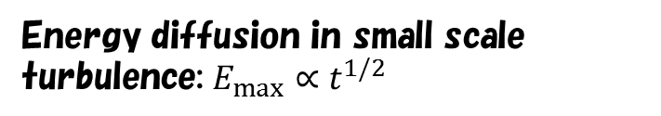

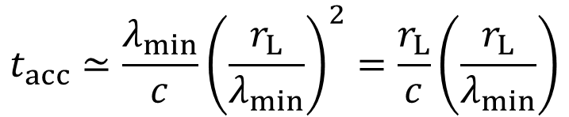
Can we extract further information/physics?
Maximum Energy of Electrons
Energy diffusion in small scale turbulence: $E_{max}∝t^{1/2}$
Sironi+ 2013
$$t_{acc}≃\frac{λ_{min}}{c}{\left(\frac{r_{L}}{λ_{min}}\right)}^{2}=\frac{r_{L}}{c}\left(\frac{r_{L}}{λ_{min}}\right)$$
$${λ_{min}≃\frac{c}{ω_{pp}}≪r_{L} for E}_{max}$$
If we believe PIC simulations, $t_{acc}≫\frac{r_{L}}{c}$

Slide 22
1D time-dependent calculation
Fukushima, KA+ 2017
Non-thermal electrons:
Mass:
Energy (Lorentz factor):
Density and Volume:
$$Γ∝t^{−2}$$
$$not t^{−3}$$
Magnetic Field:
Dashed: radiative
$$ε_{e}=0.9, ε_{B}=0.05$$
$$E_{0}={10}^{52}erg, Γ_{0}=100, n_{ISM}=1cm^{−3}, p=2.2,$$
$$ε_{e}=ε_{B}=0.1$$

Slide 23
1D time-dependent calculation
Electron energy distribution
Taking into account the theta-dependence on observables.
$$t_{obs}=(1+z)\left[\left(t−\frac{R−R_{0}}{c}\cos{θ}\right)+\frac{R_{0}}{c}(1−\cos{θ})\right]$$

Slide 24
Photon spectrum for an observer

Slide 25
GRB 130427A
$$E_{iso}=8.5×{10}^{53}erg$$
Switching Synchrotron→SSC above GeV

Slide 26
GRB 130427A
B
C

Slide 27
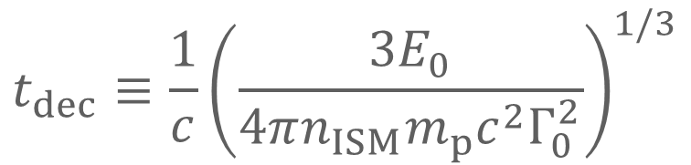
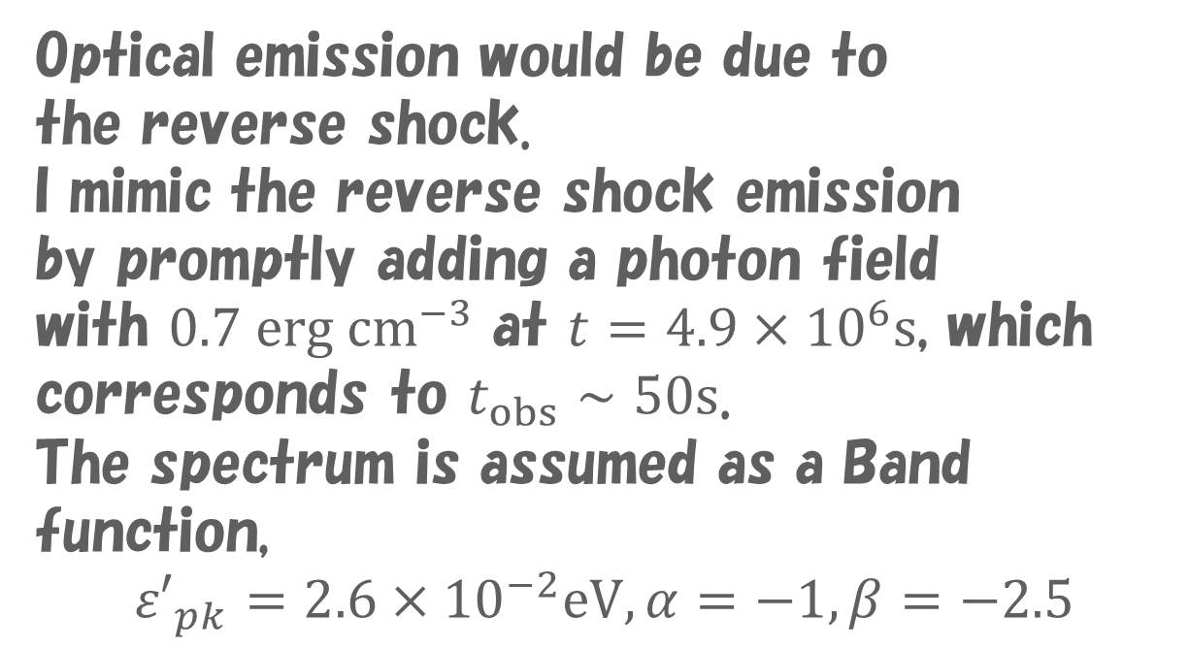
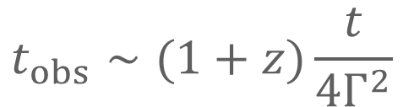
GRB 190114C ISM Model
$$E_{0}={10}^{54}erg, Γ_{0}=600, n_{ISM}=1cm^{−3}, f_{e}=0.3, ε_{e}=0.06, ε_{B}=9×{10}^{−4}, p=2.3$$
Evolutions of Lorentz factor and magnetic field
Number fraction of non-thermal electrons
$$t_{obs}∼(1+z)\frac{t}{4Γ^{2}}$$
Optical emission would be due to
the reverse shock.
I mimic the reverse shock emission
by promptly adding a photon field
with $0.7 erg cm^{−3}$ at $t=4.9×{10}^{6}s$, which corresponds to $t_{obs}∼50s$.
The spectrum is assumed as a Band function,
$${ε′}_{pk}=2.6×{10}^{−2}eV, α=−1,β=−2.5$$
$$t_{dec}≡\frac{1}{c}{\left(\frac{3E_{0}}{4πn_{ISM}m_{p}c^{2}Γ_{0}^{2}}\right)}^{1/3}$$
Time in the engine rest frame

Slide 28
Light curves and Spectra
Maximum energy of electrons is determined by balance $t_{c}=t_{acc}=η\frac{γm_{e}c^{2}}{eB}$
Preliminary
Rev.Sh. Emission is not so important
as seed photons for IC.
Even for $η=100$,
the spectrum seems OK in GeV range

Slide 29

Wind Model
$$n_{wind}=A_{∗}\frac{5×{10}^{11}g cm^{−1}}{{m_{p}R}^{2}}$$
$$E_{0}={10}^{54}erg, Γ_{0}=300, A_{∗}=0.1, f_{e}=0.3, ε_{e}=0.08, ε_{B}=1.2×{10}^{−3}, p=2.35$$
Evolutions of Lorentz factor and magnetic field
Number fraction of non-thermal electrons
$$t_{obs}∼(1+z)\frac{t}{4Γ^{2}}$$
Optical emission would be due to
the reverse shock.
I mimic the reverse shock emission
by promptly adding a photon field
with $1.7 erg cm^{−3}$ at $t=2.6×{10}^{6}s$, which corresponds to $t_{obs}∼50s$.
The spectrum is assumed as a Band function,
$${ε′}_{pk}=2.1×{10}^{−2}eV, α=−1,β=−2.5$$
$$t_{dec}≡\frac{1}{c}\frac{E_{0}}{4πA_{∗}(5×{10}^{11})g cm^{−1}c^{2}Γ_{0}^{2}}$$
Time in the engine rest frame

Slide 30
Light curves and Spectra
Maximum energy of electrons is determined by balance $t_{c}=t_{acc}=η\frac{γm_{e}c^{2}}{eB}$
Preliminary
Rev.Sh. Emission is not so important
as seed photons for IC.
Even for $η=100$,
the spectrum seems OK in GeV range

Slide 31




Can we extract further information/physics?
Number Fraction of Accelerated Electrons
We determined only parameters for
accelerated electrons
Eichler & Waxman 2005
$$γ_{m}=γ_{0}{\left(\frac{R_{0}}{R}\right)}^{1/2}$$
$$n_{nth}=n_{0}{\left(\frac{R_{0}}{R}\right)}^{5/2}$$
If $\frac{E_{0}}{n_{ext}}$ is the same, the evolution of
$$Γ=Γ_{0}{\left(\frac{R_{0}}{R}\right)}^{1/2}$$
is also the same.
$$B=B_{0}{\left(\frac{R_{0}}{R}\right)}^{3/2}$$
Irrespective of $n_{ext}$ we can assume the same
By adjusting the parameter $f_{e}$, number fraction,
the amount of accelerated electrons $n_{0}{\left(\frac{R_{0}}{R}\right)}^{5/2}$ can be kept.

Slide 32
Constraint on f_{e}?
As long as $\frac{E_{0}}{n_{ISM}}$ or $\frac{E_{0}}{A_{∗}}$ is the same, the evolution of $Γ$ is the same too.
The magnetic field $B$ (not $ε_{B}$) and
the density of the non-thermal electrons ($n_{e}$ or $U_{e}$) are already constrained by the observation.
The parameters obtained by $f_{e}=1$ are transformed by $f_{e}<1$ as
$E_{0}→\frac{E_{0}}{f_{e}}, n_{ISM}→\frac{n_{ISM}}{f_{e}}, ε_{e/B}→f_{e}ε_{e/B}$
Let us consider thermal synchrotron.
The density of the thermal electrons $n_{th}=\frac{1−f_{e}}{f_{e}}n_{e}$
Absorption coefficient for synchrotron self-absorption
$$α_{ν}=\frac{c^{2}}{8πν^{2}T}\int{N\left(E\right)P\left(ν,E\right)dE}=\frac{j_{ν}c^{2}}{2ν^{2}T}$$
Given the evolution of $Γ$ and CSM density,
the energy density and temperature for the thermal electrons are determined as
$$U_{th}=Γ\left(1+ε_{th}\frac{m_{p}}{m_{e}}\right)n_{th}m_{e}c^{2}=3Tn_{th}$$
The effect of heating by protons:
$$ε_{th}$$

Slide 33
Thermal Synchrotron
$$F_{obs,ν}={F′}_{ν′}\frac{Γ}{1+z}, {F′}_{ν′}=π{\left(\frac{R}{D}\right)}^{2}S_{ν′}^{′}\left(1−\exp\left(−τ_{ν^{′}}\right)\right)$$
$$S_{ν′}^{′}=\frac{2ν^{′2}T}{c^{2}}\left(1−\exp\left(−τ_{ν^{′}}\right)\right)$$
$$D=\frac{D_{L}}{1+z}$$
$D_{L}$: Luminosity distance
$Δ=\frac{R}{12Γ}$ for ISM
$Δ=\frac{R}{4Γ}$ for wind
$$ν^{′}=ν\frac{1+z}{Γ}, τ_{ν′}=α_{ν′}Δ$$
Adopting evolutions of $Γ$ and $B$ obtained numerically,
I calculate the thermal synchrotron for optimistic cases such as $f_{e}=0.01$

Slide 34
ISM thermal optical-radio emission
Thin dotted: $f_{e}=0.01, ε_{th}=0$, Thin solid: $f_{e}=0.01, ε_{th}=0.0006$
Preliminary
Thick Black: Reverse shock model shown in page 2.

Slide 35
Wind thermal optical-radio emission
Thin dotted: $f_{e}=0.01, ε_{th}=0$, Thin solid: $f_{e}=0.02, ε_{th}=0.001$
Preliminary
Thick Black: Reverse shock model shown in page 4.

Slide 36
まとめ
地上チェレンコフ望遠鏡による初のGRB検出。
多波長光度曲線の振舞いから、MAGICが検出したガンマ線は残光起源と解釈できる。
シンクロトロンでは説明がつかず、SSCと考えるのが妥当。SSCでモデリングした結果も、他のGRBと比べ、極端なパラメータを要求しない。
ISMかWindかは決着がつかなかった。長時間の光度曲線を説明するには単純なモデルでは難しい。微視的パラメータの進化や、ジェット構造の効果など。
電子の最高エネルギー、熱的電子の割合など、新たな情報がもたらされる可能性がある。

