Slide 1
Gravitational waves from binary black hole remnants of first stars
Tomoya Kinugawa
(ICRR, University of Tokyo)

Slide 2

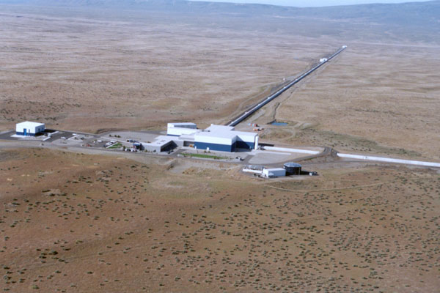
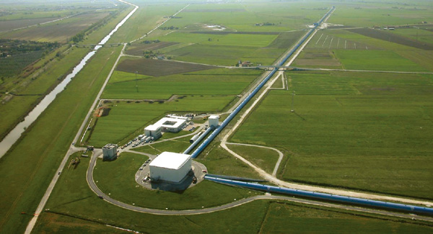
The beginning of Gravitational wave astronomy
Gravitational wave detectors
KAGRA Advanced LIGO Advanced VIRGO
©VIRGO
©KAGRA
©LIGO
Notes:
Nowadays, there are the gravitational wave detectors such as KAGRA adv. LIGO, VIRAGO.
KAGRA is the gravitational wave detector of Japan.
Adv. LIGO did observation run from last September to January.
They have detected the gravitational wave.

Slide 3
GW150914
Notes:
This is the signal of first gravitational wave.
aLIGO detected this signal on 14th September 2015.
Thus, the name of this signal is GW150914.

Slide 4
GW150914
Notes:
This is the LIGO’s paper.
They say,
The luminosity distance is 400 Mega parsec.
Redshift is 0.09
Masses are 36 and 29 solarmass.
They are much heavier than the general BH candidate such as BH of X ray binary whose typical mass is 10 solarmass.

Slide 5
GW150914
Low metal field binaries
©Nakamura
Notes:
The black holes of GW150914 is different from conventional black holes in x-ray binaries.
In ordr to explain the origin of GW150914, many theories exist such as these brbrbrbr.
Especially, the Low metal field binary is widely accepted theory

Slide 6
Why field binaries?
There are many massive close binaries
Example
Milky way young open clusters
71 O stars fbinary=69+/-9% (P<3200days) Sana et al. 2012
30 Doradus (Tarantula Nebula)
362 O stars fbinary=51+/-4%(P<3200days) Sana et al. 2013
Notes:
Why do we consider field binaries?
Because there are many massive binaries and the binary fraction of massive stars are high.

Slide 7
Why low metal?
If the progenitor of BH is Pop I (=Solar metal stars)
Belczynski et al. 2010
Notes:
Why we consider low metal.
If the progenitor of BBH is pop I,
They lose a lot of mass due to wind mass loss.
This figure is the result of single star evolution with two stellar wind models.
The horizontal axis is the ZAMS mass of Pop I.
The vertical axis is the compact object mass of each mass.
Due to strong wind, They cannot become 30 Msun BH.

Slide 8
Why low metal?
New
If the progenitor is low metal,
Pop II (Z<0.1Zsun)
Typical mass is same as Pop I
But, week wind mass loss
Pop III (No metal)
Typical mass is more massive than Pop I, II
MpopIII~10-100Msun
No wind mass loss due to no metal.
Old
Minitial: 8Msun<M<150Msun
Single stellar evolution
with 2 stellar wind models.
(Belczynski et al.2010,Abbot et al.2016)
Notes:
If the progenitor is low metal they possibly become massive BH.
In the case of Pop II, they typical mass is same as Pop I, but the wind mass loss weaker than that of Pop I.
This figure the metallicity dependence of single BHmass.
The horizontal axis is metallicity normalized by solar metal.
The vertical axis is BH maxim mass.
So if Pop II star born as massive star, they possibly become massive BH.
On the other hand, Pop III star are born as massive star and no wind mass loss due to no metal.
Thus, Pop III star are easier to be massive compact object

Slide 9
Total mass distribution of BH-BH which merge within the Hubble time
Typical total mass
M～60 M
(30 M +30 M)
Kinugawa et al.
2014, 2016
Z=0
Z=1/200 Zsun
e.g. Pop I, Pop II
(Z=0.02,0.001,0.0001)
IMF:Salpeter
(1Msun<M<140Msun)
Typical mass ～10 M
Z=1/20 Zsun
Z=Zsun
Total mass [Msun]
Notes:
This figure is the total mass distribution of BH-BH which merge within the Hubble time.

Slide 10
What do determine the BH-BH mass?
Steller wind mass loss
Binary interactions
(Mass transfer, Common envelope)
Common envelope
Mass transfer
Close binary or merge
Notes:
What do determine the BBH mass?
It is not only wind massloss, but also binary interactions such as mass transfer and the common envelope phase.
Mass transfer is this.
The donnor star become big and the matter of donnor are captured by the gravitational force od receiver star.
So the mass are transfferd from donnor to receiver.
Primary star becomes giant and primary radius becomes large.
Secondary star plunges in primary envelope.
The friction occurs between secondary and primary envelope and transfers angular momentum and energy from orbit to envelope. Due to orbital energy transfer separation decreases and envelope expands and will be expelled.
Binary becomes close binary or merges during CE.

Slide 11
Why Pop III binaries become 30Msun BH-BH
M>50Msun red giant
➝Mass transfer is unstable
➝common envelope
➝1/3~1/2 of initial mass
(~25-30Msun)
M<50Msun blue giant
➝Mass transfer is stable
➝mass loss is not so effective
➝2/3~1 of initial mass (25-30Msun)
Notes:
Why do Pop III binaries become 30 Msun Binary black holes?
This is HR diagram of Pop III.
The pop III whose mass is larger than 50 solarmass evolve as the red giant.
The mass transfer of red giant is generally unstable and it becomes the common envelope phase.
Thus, they lose the envelope and they become light.
Therefore, the BH mass become about 30 solar mass.
On the other hand, the Pop III whose mass is less than 50 solar mass evolve as a blue giant.
The mass transfer is stable and mass loss is not so effective.
Thus, they become about 30 solar mass BH.
So, Due to these two evolution path, the peak of BHBH mass is about 30 solar mass.
It does not depend on the IMF and binary parameters.
It only depends on the Pop Iii stellar evolution.

Slide 12
Z=Zsun(=0.02)
Z=1/20Zsun(=0.001)
All star evolve via a red giant
Almost all binaries evolve via similar evolution pass

Slide 13
Total mass distribution of BH-BH which merge within the Hubble time
Z=0
This shape reflects the influence of Pop III stellar evolution
Z=1/200Zsun
These shapes have the influence of IMF
and the influence of stellar wind mass loss
Z=1/20Zsun
Z=Zsun
Total mass [Msun]
Notes:
Thus, the peak mass of Pop III has the influence of Pop III stellar evolution.
On the other hand, the shape of Pop II BH-BH mass distribution has the influence of IMF
Because all binary evolve same evolution and wind mass loss is weak.
Pop I has the influence of stellar wind due to strong wind.

Slide 14
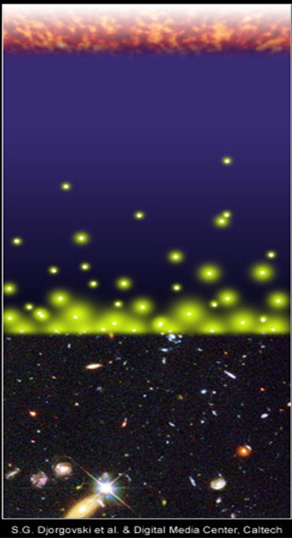
Pop III BH-BH remnants for gravitational wave
Pop III stars were born and died at z~10
The typical merger time of compact binaries ~10⁸⁻¹⁰yr
The accumulation of GW sources from the early universe
We might see binaries which born at the early universe.
Big Bang
merger
merger
time
Djorgovski et al.&Degital Media Center
Notes:
Someone are wondering why we can see such star which are born at the earlyuniverse.
Pop III stars were born and died at z~10.
So, unfortunately we cannot see the supernovae of first star
However, the typical merger time of compact binaries due to gravitational radiation is too long.
So, even though the binary born at the early universe, they can merge at the present day.
Thus, the accumulation of GW sources from the early universe is important.
We must consider binaries which were born at the early universe.
And We might see the gravitational wave from first stars.

Slide 15
Pop III BH-BH?
ApJL Abbot. et al 2016
Notes:
30 Msun binary black holes have been already predicted by Pop III binary population synthesis.
Thus, LIGO paper said that “recently predicted BBH total masses agree astonishingly well with GW150914 and can have sufficiently long merger times to occur in the nearby universe (Kinugawa et al.2014)”
In this talk, I talk about Pop III binary population synthesis and the detection rate of Pop III compact binaries

Slide 16
How to calculate Pop III binaries?
1. Initial M1,M2,a,e determined
2. Stellar evolutions
Compact binary
4. Calculate merger time
Not compact binary
5. Repeat this calculation
survive
3. Binary interactions
M1,M2,a,e change
Stop calculation
Merge or disrupt
1. Initial stellar parameters are decided by Monte Carlo method with initial distribution functions
(primary mass: M1, secondary mass: M2, separation: a, orbital eccentricity: e)
2. We calculate evolution of stars
3. If star fulfills the condition of binary interactions (BIs), we calculate BIs and change M1, M2, a, e .
・If binary merges or disrupts due to BIs before binary becomes compact binary, we stop calculation.
・If binary survives from BIs, we calculate stellar evolutions again.
4.If binary becomes compact binary (NS-NS, NS-BH, BH-BH), we calculate when binary merge due to GW.
5.We repeat these calculations and take the statistics of compact binary mergers.

Slide 17
Binary Interactions
Tidal friction
Mass transfer
Common envelope
Supernova effect
Gravitational radiation
Tidal friction
Mass transfer
Change
M1,M2,a, e
Common envelope
SN
Supernova effect
Gravitational Waves
We need to specify some parameters to calculate these effects.
We use the parameters adopted for Pop I population synthesis in Our standard model.
Notes:
In order to calculate pop III binary population synthesis, we consider the binary interactions.
These binary interactions change binary parameters such as primary mass, secondary mass, separation and eccentricity.
We need to specify some parameters to calculate these effects.
We use the parameters adopted for Pop I population synthesis in our standard model.

Slide 18
Pop III binary population synthesis
We simulate 10⁶ Pop III-binary evolutions and estimate how many binaries become compact binary which merges within Hubble time.
×84 models (Kinugawa et al.2016)
Initial stellar parameters are decided by Monte Carlo method with initial distribution functions
Initial parameter (M1,M2,a,e) distribution in our standard model
M1 : Flat (10 M<M<100 M)
q=M2/M1 : P(q)=const. (0<q<1)
a : P(a)∝1/a (a_{min}<a<10⁶R)
e : P(e)∝e (0<e<1)
The same distribution functions adopted for Pop I population synthesis

Slide 19
Results
The numbers of the compact binaries which merge within
Hubble time for 10⁶ binaries
Our standard model
A lot of Pop III BH-BH binaries form and merge within Hubble time
Close NS binaries do not form

Slide 20
Total mass distribution of BH-BH which merge within the Hubble time
Typical total mass
M～60 M
(30 M +30 M)
Kinugawa et al.
2014, 2016
Z=0
Z=1/200 Zsun
e.g. Pop I, Pop II
(Z=0.02,0.001,0.0001)
IMF:Salpeter
(1Msun<M<140Msun)
Typical mass ～10 M
Z=1/20 Zsun
Z=Zsun
Total mass [Msun]
Notes:
This figure is the total mass distribution of BH-BH which merge within the Hubble time.

Slide 21
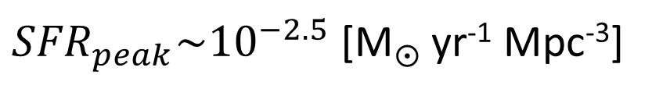
The star formation rate of Pop III
In order to calculate merger rate,
we need to know
・When were Pop III stars born?
・How many Pop III stars were born?
⇒Star formation rate
We adopt the Pop III SFR
by de Souza et al. 2011
Star formation rate [M yr⁻¹ Mpc⁻³]
${SFR}_{peak}\sim {10}^{−2.5}$ [M yr⁻¹ Mpc⁻³]
Redshift z
(de Souza et al. 2011)

Slide 22
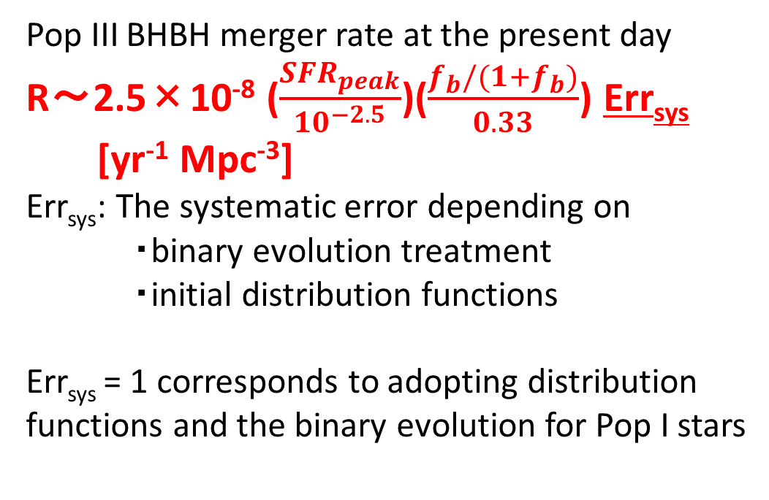
The Pop III BH-BH merger rate
10⁻⁶
10⁻⁷
10⁻⁸
10⁻⁹
10⁻¹⁰
10⁻¹¹
10⁻¹²
10⁻¹³
10⁻¹⁴
IMF: Flat
Pop III BHBH merger rate at the present day
R～2.5×10⁻⁸ ($\frac{{SFR}_{peak}}{{10}^{−2.5}}$)($\frac{f_{b}/(1+f_{b})}{0.33}$) Err_{sys}
[yr⁻¹ Mpc⁻³]
Err_{sys}: The systematic error depending on
・binary evolution treatment
・initial distribution functions
Err_{sys} = 1 corresponds to adopting distribution functions and the binary evolution for Pop I stars
R(t) [yr⁻¹ Mpc⁻³]
Pop III star formation region
40 35 30 25 20 15 10 5 0
Redshift z

Slide 23
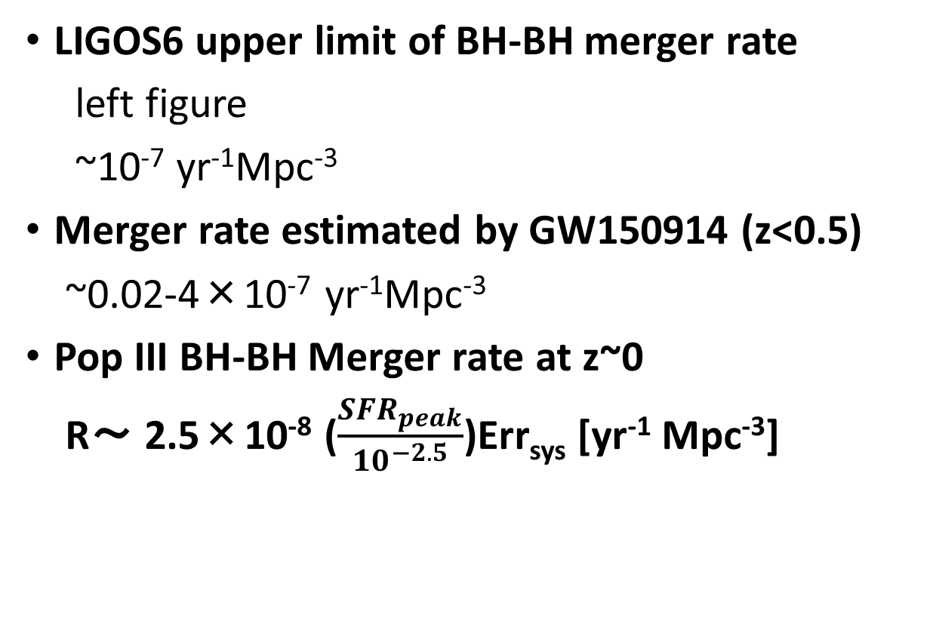
Consistency with LIGOS6 and Adv.LIGO
LIGOS6 upper limit of BH-BH merger rate
left figure
~10⁻⁷ yr⁻¹Mpc⁻³
Merger rate estimated by GW150914 (z<0.5)
~0.02-4×10⁻⁷ yr⁻¹Mpc⁻³
Pop III BH-BH Merger rate at z~0
R～ 2.5×10⁻⁸ ($\frac{{SFR}_{peak}}{{10}^{−2.5}}$)Err_{sys} [yr⁻¹ Mpc⁻³]
Our result is consistent with LIGO
Aasi, Abadie, Abbott et al. (2013)

Slide 24
Detection range of KAGRA and Adv. LIGO
M_{BH}～30M SNR=8
Redshift z
SNR=8
For QNM
Luminocity distance
～1.5 Gpc
Redshift z～0.28
SNR=8
For inspiral
Mass of one star [M]
©Kanda
Notes:
This figure is the detection range of KAGRA
The horizontal axis is the mass of one star.
The vertical axis is the red shift or luminosity distance of detection range.

Slide 25
Inspiral and QNM
merge
inspriral
QNM
Notes:
The inspiral means the gravitational wave from binary inspiral.
On the other hand, the QNM means the gravitational wave from the merged black hole quasi normal mopde.

Slide 26
Detection range of KAGRA and Adv. LIGO
M_{BH}～30M SNR=8
Redshift z
SNR=8
For QNM
Luminocity distance
～1.5 Gpc
Redshift z～0.28
SNR=8
For inspiral
Mass of one star [M]
©Kanda
Notes:
This figure is the detection range of KAGRA
The horizontal axis is the mass of one star.
The vertical axis is the red shift or luminosity distance of detection range.

Slide 27
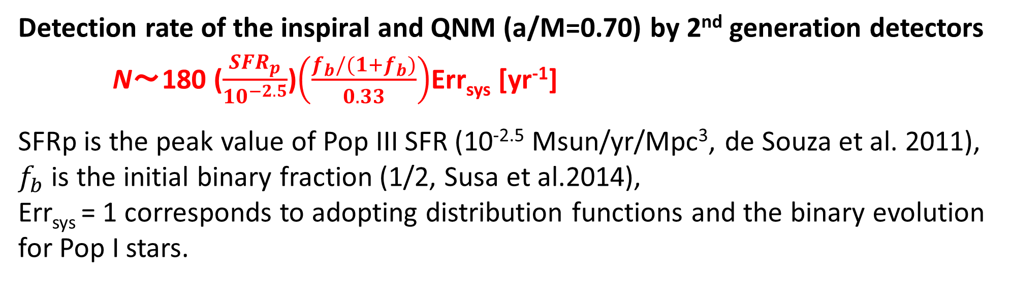
Detection rate
Detection rate of the inspiral and QNM (a/M=0.70) by 2nd generation detectors
N～180 ($\frac{{SFR}_{p}}{{10}^{−2.5}}$)$\left(\frac{f_{b}/(1+f_{b})}{0.33}\right)$Err_{sys} [yr⁻¹]
SFRp is the peak value of Pop III SFR (10^{-2.5} Msun/yr/Mpc³, de Souza et al. 2011),
$f_{b}$ is the initial binary fraction (1/2, Susa et al.2014),
Err_{sys} = 1 corresponds to adopting distribution functions and the binary evolution for Pop I stars.
To evaluate the robustness of the mass distribution and the range of Err_{sys}, we examine the dependence of the results on the unknown parameters and the initial distribution functions.
Notes:
Using that detection range, we calculate the detection rate.

Slide 28
Errsys (Example)
 | Errsys
Standard | (180 /yr)
Mass range: (10 M<M< 100 M or 140 M) | 1~3.4
IMF:Flat, M⁻¹, Salpeter | 0.42~1
IEF:f(e)∝e,const.,e^{-0.5} | 0.94~1
BH natal kick: V=0,100,300 km/s | 0.2~1
CE:αλ=0.01,0.1,1,10 | 0.21~1
Mass transfer (mass loss fraction): β=0, 0.5, 1 | 0.67~1.3
Worst | 0.046
On the other hand, the typical mass is not changed (~30 Msun).
Notes:
This table is the example of parameter dependence of Errsys.
We change the mass range, the initial distribution functions such as Initial mass function and initial eccentricity function.
And change the binary parameters such as SN natal kick velocity, common envelope parameters, and the parameter of the lose fraction of transferred stellar
Mass.
In our standard model choose red ones
At Each parameter range, Errsys change from 1 over several to a few.
In order to consider the lower boundary of Errsys,
We consider the worst model.
In the Worst model I choose the worst parameters in each parameter region, blue ones.
It is unlikely case
Errsys change from 0.046 to 4
On the other hand, the typical mass is not changed (~30 Msun)

Slide 29
Why Pop III binaries become 30Msun BH-BH
M>50Msun red giant
➝Mass transfer is unstable
➝common envelope
➝1/3~1/2 of initial mass
(~25-30Msun)
M<50Msun blue giant
➝Mass transfer is stable
➝mass loss is not so effective
➝2/3~1 of initial mass (25-30Msun)
Notes:
The reason is already said.
It is Pop III stellar evolution.
Why do Pop III binaries become 30 Msun Binary black holes?
This is HR diagram of Pop III.
The pop III whose mass is larger than 50 solarmass evolve as the red giant.
The mass transfer of red giant is generally unstable and it becomes the common envelope phase.
Thus, they lose the envelope and they become light.
Therefore, the BH mass become about 30 solar mass.
On the other hand, the Pop III whose mass is less than 50 solar mass evolve as a blue giant.
The mass transfer is stable and mass loss is not so effective.
Thus, they become about 30 solar mass BH.
So, Due to these two evolution path, the peak of BHBH mass is about 30 solar mass.
It does not depend on the IMF and binary parameters.
It only depends on the Pop Iii stellar evolution.

Slide 30

Pop III BH-BH
Errsys=0.046~4
⇒Detection rate R～8.3-720 ($\frac{{SFR}_{peak}}{{10}^{−2.5}}$) $\left(\frac{f_{b}/(1+f_{b})}{0.33}\right)$ [yr⁻¹ ](S/N>8)
Typical mass M～30 M
We might detect the Pop III BH-BH by GW
1. We might see BH QNM from Pop III BH-BH
➝ We might check GR by Pop III BH QNM
2. The mass distribution might distinguish Pop III from Pop I, Pop II
➝The evidence of Pop III star
Notes:
If the chirp mass distribution can not distinguish Pop III, we can confirm Pop III BHBH future observation.

Slide 31
future plan of GW observer : pre-DECIGO and DECIGO
DECIGO: Japanese space gravitational wave observatory project
Pre-DECIGO: test version of DECIGO
Pre-DECIGO : z~10 (30 Msun BH-BH)
~10⁵ events/yr
DECIGO can see Pop III BH-BHs
when Pop III stars were born!
(Nakamura, Ando, TK et al. in prep)
This is preliminary result
©Nakamura
Notes:
If we cannot distinguish Pop III from Pop I, Pop II, we consider the confirmation by the future gravitational wave observatory such as DECIGO.
DECIGO is the Japanese space gravitational wave observatory project.
It has good sensitivity from 0.1 Hz to 10 Hz.
Pre-DECIGO is test version.
Pre-DECIGO might see such binary black holes up to redshift 30.
The expected detection rate is about 10 to fifth per yr.
The SFR of Pop III has the peak at z~10.
Thus, it can see pop III BHBH when they were born.
Furthermore, we check the redshift dependence of high mass BHBH mergers.

Slide 32
Cumulative BH-BH merger rate
Log(events/yr)
Saturated at z≲5
Saturated at z~10
Pop I and II BH-BH
(2 metallicity evolution models)
Pop III BH-BH
Redshift
Redshift

Slide 33
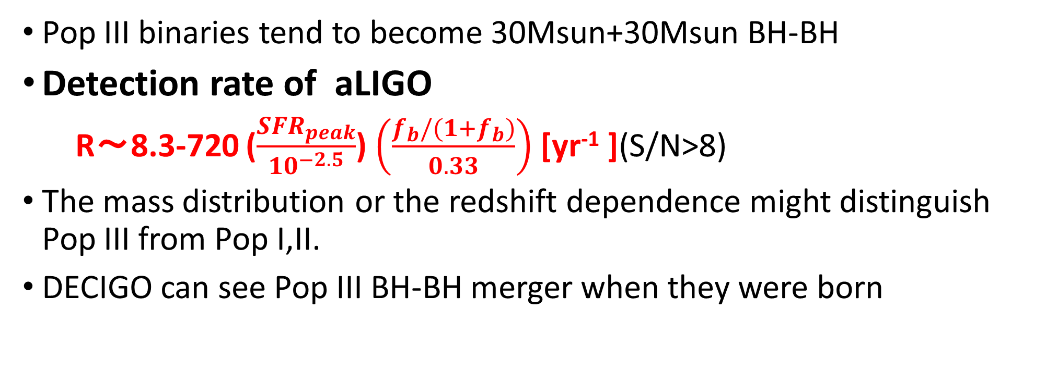
Conclusion
Pop III binaries tend to become 30Msun+30Msun BH-BH
Detection rate of aLIGO
R～8.3-720 ($\frac{{SFR}_{peak}}{{10}^{−2.5}}$) $\left(\frac{f_{b}/(1+f_{b})}{0.33}\right)$ [yr⁻¹ ](S/N>8)
The mass distribution or the redshift dependence might distinguish Pop III from Pop I,II.
DECIGO can see Pop III BH-BH merger when they were born

Slide 34
Appendix

Slide 35
Why NS-NS disrupt
For example, we consider NS and NS progenitor binary.
NS
(1.4-2M)
NS progenitor
(8-25M)
In the case of Pop III NS progenitor, wind mass loss and the mass loss due to binary interaction is not effective.
SN
When NS progenitor becomes supernova, NS progenitor suddenly loses mass and becomes NS.
Then, due to instant mass loss the binding energy of binary decreases and binary NS disrupts.
disrupt
Binary NS cannot survive!

Slide 36
Other Pop III SFRs
SPH simulation
(Johnson et al. 2013)
SFRp~ 10⁻³-10⁻⁴ Msun/yr/Mpc³
Constraints by Planck
(e.g.Hartwig et al.2016, Inayoshi et al.2016)
optical depth of Thomson scattering
total Pop III density≲10⁴⁻⁵ Msun/Mpc³
by Visbal et al.2015

Slide 37
Pop I and Pop II case (Dominik et al. 2015)
From 1/200 Zsun to 1.5 Zsun
BH-BH detection rate (Their standard model) ~300/yr
25% of above rate is >20 Msun BHBH
Thus, Detection rate of high mass BHBH ~80/yr

Slide 38
The differences between Pop III and Pop I
 | Pop I stars (Sun like stars)
Metallicity | ２％
Radius | Large
Typical Mass | 1 Msun
Wind mass loss | effective
Pop III stars
0
Small
10-100 Msun
Not effective
Pop III binaries are easier to be massive compact binary
Notes:
This table shows the differences between Pop III and Pop I.
Pop III is no metal star.
The radius is small, the typical mass is large, and wind mass loss is not effective.
Thus, Pop III binaries are easier to be massive compact binary.

Slide 39
The main target of gravitational wave source
・Compact binary mergers
Binary neutron star (NS-NS)
Neutron star black hole binary (NS-BH)
Binary black hole (BH-BH)
©KAGRA
How many times can we detect compact binary mergers？
➝Estimated by the binary population synthesis
Notes:
First, I introduce the main target of GW source.
The main target of gravitational wave is the compact binary merger such as binary neutron star, neutron star black hole binary and binary black hole.
How many time can we detect compact binary mergers by gravitational wave detectors?
It is estimated by the binary population synthesis

Slide 40
Quasi normal mode
fc is frequency of QNM
Q is the quality factor of QNM which relate to the attenuation of QNM

Slide 43
How to calculate the event rate
NS-NS
We can get information from binary pulsar observations
・The empirical rate from pulsar observations (Kalogera et al. 2004,etc)
・Binary population synthesis(Belczynski et al. 2002, 2004, Dominik et al.2012,etc)
NS-BH,BH-BH
・Binary population synthesis
There were no observation until GW150914.
Thus, there is no other way except binary population synthesis
Notes:
In the case of NS-NS, there are two method to calculate detection rate.
There are binary pulsar observations.
Thus, we can estimate the empirical rate from binary pulsar observations.
The other method is a theoretical method, binary population synthesis.
Especially, in the case of NS-BH, BH-BH, there is no observation until GW150914.
Thus, there is no other way except the binary population synthesis.

Slide 44
Why do Pop III stars have these properties?
Zero metal stars
-No line cooling and dust cooling at the star formation
-High temperature and high Jeans mass (M_{J}∝T^{3/2})
⇒More massive than Pop I stars (Pop I stars are solar like stars)
The typical mass is 10-100M
-Missing metal and dust i.e. missing powerful opacity source
-The stellar photosphere become small
⇒Smaller radius than Pop I stars
-Stellar wind is driven by radiation pressure on resonance lines of
heavier ions or dust grains
-However, Pop III stars do not have heavier ion and dust grain
⇒No wind mass loss
Notes:
Why do pop III stars nave these properties/
The reason is no metal.
Hosoku: the jeans mass is the critical mass to collapse.
we can say the cloud will collapse if its mass is bigger than the Jean's mass

Slide 45
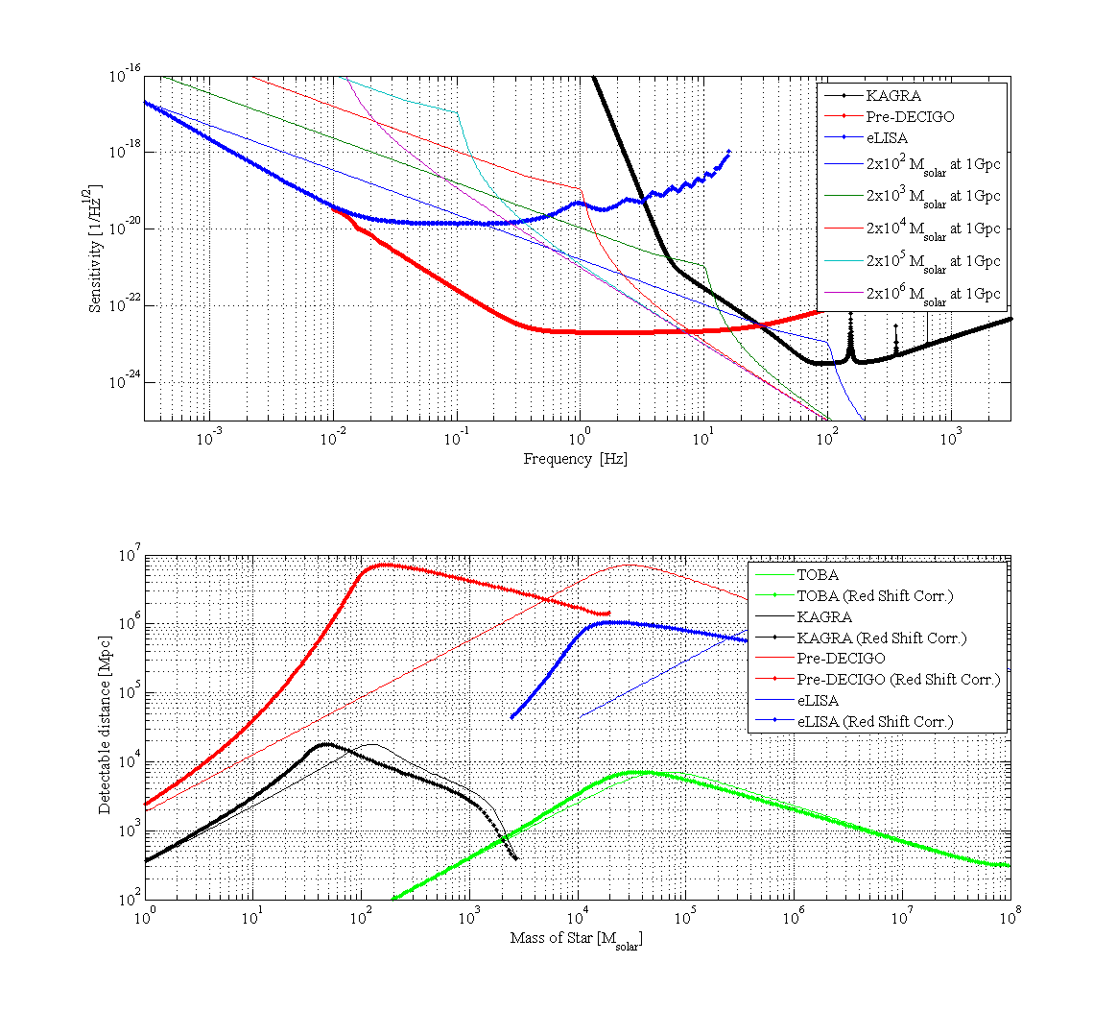

Slide 47
DECIGOの感度曲線
Pop III のSFRのピークはz~9
Red shift chirp mass=(1+z)Mc
Pop III BHBH (z~9) ⇒300 Msun (10Hz)
Kawamura et al. 2011

Slide 48
How to calculate the event rate
NS-NS
We can get information from binary pulsar observations
・The empirical rate from pulsar observations (Kalogera et al. 2004,etc)
・Binary population synthesis(Belczynski et al. 2002, 2004, Dominik et al.2012,etc)
NS-BH,BH-BH
・Binary population synthesis
There is no observation.
Thus, there is no other way except binary population synthesis
Notes:
How to calculate the event rate?
In the case of NS-NS, there are two method to calculate detection rate.
There are binary pulsar observations.
Thus, we can estimate the empirical rate from binary pulsar observations.
The other method is a theoretical method, binary population synthesis.
On the other hand, in the case of NS-BH, BH-BH, there is no observation.
Thus, there is no other way except the binary population synthesis.
In this talk, I focus on the binary population synthesis.

Slide 49
merger rate calculated by population synthesis
Pop I galactic merger rate [Myr⁻¹]
Dominik et al.(2012)
These merger rates are calculated by Population synthesis (PS).
There are wide differences between models.
I will talk about what is PS and what determine the merger rates.
Notes:
This table is the galactic merger rates of Pop I compact binaries calculated by the binary population synthesis.
Pop I is a solar metal stars.
However, there are some uncertainties and there are wide differences between models.
The merger rate change by a factor of several hundreds.
I will talk about what is population synthesis and what determine the merger rates.

Slide 50
Binary Interactions
Supernova effect
Common envelope
Stable mass transfer
Orbital evolution
(Tidal friction, Gravitational radiation)
In this talk, I will explain these two binary interactions.
Notes:
I introduce the binary interactions
Supernova effect, common envelope, Stable mass transfer, orbital evolution such as tidal friction, gravitational radiation.
These binary interactions change binary parameters such as primary mass, secondary mass, separation and eccentricity.
In this talk, I will explain these two binary interactions

Slide 51
Supernova(SN) effect
For example, we consider NS and NS progenitor binary.
NS
(1.4-2M)
NS progenitor
(8-25M)
When NS progenitor becomes supernova, NS progenitor suddenly loses mass and becomes NS.
Then, due to instant mass loss the binding energy of binary decreases and binary NS disrupts.
SN
Binary NS cannot survive!
disrupt
But in fact binary pulsars have been observed.
Why can binary NS survive?
This reason is common envelope.

Slide 52
Common envelope (CE)
CE is unstable mass transfer phase.
Primary star becomes giant and primary radius becomes large.
Secondary star plunges in primary envelope.
The friction occurs between secondary and primary envelope and transfers angular momentum and energy from orbit to envelope. Due to orbital energy transfer separation decreases and envelope expands and will be expelled.
Binary becomes close binary or merges during CE.
4
1
2
3
Secondary
Primary

Slide 53
Can NS binary survive via CE?
We consider NS and NS progenitor binary again.
NS(1.4-2M)
8-20M
no CE
CE
SN
If CE occurs, envelope was already expelled before SN.
Thus, mass ejection at SN becomes smaller than SN mass ejection via no CE.
Due to small mass ejection at SN the loss of binding energy becomes small.
Binary can survive !
Therefore, Common Envelope is important.
2-6M
disrupt
SN

Slide 54
The treatment of CE
We assume the fraction of the orbital energy is used to expel envelope.
We use simple energy formalism in order to calculate separation after CE a_{f}
For given Mcore1, Menv1 M2, initial separation a_{i}
a_{i}
a_{f}
Assuming efficiency of
mass ejection
Final separation a_{f}
The loss of orbital energy
the energy required to expel envelope
α: the efficiency of energy transfer from orbit to envelope
λ: the binding energy parameter
These common envelope parameters are uncertain.
・How much the orbital energy can be used to expel envelope?
・How much the internal energy of envelope is used to expel envelope?
Notes:
I explain the treatment of CE.
We assume the fraction of the orbital energy is used to expel envelope.
We use simple energy formalism in order to calculate separation after CE af.
The left hand side is the loss of the orbital energy and the right hand side is the energy required to expel envelope.
Alpha is the efficiency of energy transfer from orbit to envelope.
Lambda is the binding energy parameter.
For given primary core mass, primary envelope mass, initial separation ai and assuming alpha and lambda, we canget the separation after common envelope.
However, these common envelope parameters are uncertain.
How much the orbital energy can be used to expel envelope?
How much the internal energy of envelope is used to expel envelope?

Slide 55
The rate dependence on CE parameters
The loss of orbital energy
the energy required to expel envelope
Separation after CE a_{f} is dependent on CE parameters.
For simplicity, α=1.
If λ is large i.e, the energy required to expel envelope is small,
the loss of orbital energy during CE becomes small and a_{f} is large.
If a_{f} is large, binary tend not to merge during CE and can survive.
However, if a_{f} is too large, binary cannot merge within Hubble time due to GW.
・The number of merger during CE Merger rates
・Merger timescale t_{GW}∝a⁴ Merger rates
λ
a_{f}

Slide 56
The dependence on CE parameters
For example, we consider how Pop I NS-NS merger rate depend on CE parameters.
Pop I NSNS merger rate [Myr⁻¹ galaxy⁻¹] Dominik et al.2012
αλ
a_{f}
・The number of coalescence during CE Merger rates
・Merger timescale t_{GW}∝a⁴ Merger rates
Notes:
Let consider the dependence on the CE parameters.
This table is the pop I binary NS merger rate.
We assume alpha is unity, and change the lamda from 0.01 to 10.
First, due to the number of coalescence during CE is decrease the merger rate increase.
However lambda become larger than 1, the merger timescale become too long. Thus the merger rate decrease.
Therefore, these parameter change merger rate by a factor of hundred.
This is the big problem of the population synthesis and binary evolution study.

Slide 57
Binary population synthesis
Population synthesis is a method of numerical simulation to research the population of stars with a complex evolutions.
Population synthesis can predict properties and merger rates of unobserved sources such as NS-BH, BH-BH
The common envelope of the key process of population synthesis
However, Common envelope parameters are uncertain.
This uncertainty change event rate by a factor of several hundreds.
We should reveal this uncertainty via comparison between result of population synthesis and observations such as GW and other observations and improve binary evolution theory

Slide 58
Example: CE dependence
We calculate αλ=0.01, 0.1, 1, 10 cases N_{total}=10⁶
The number of merged Pop III BH-BH change by a factor of several.
On the other hand, Pop I merger rates changed by a factor of several hundreds.
What is the reason?

Slide 59
Why do Pop III stars have these properties?
Zero metal stars
-No line cooling and dust cooling at the star formation
-High temperature and high Jeans mass (M_{J}∝T^{3/2})
⇒More massive than Pop I stars (Pop I stars are solar like stars)
The typical mass is 10-100M
-Missing metal and dust i.e. missing powerful opacity source
-The stellar photosphere become small
⇒Smaller radius than Pop I stars
-Stellar wind is driven by radiation pressure on resonance lines of
heavier ions or dust grains
-However, Pop III stars do not have heavier ion and dust grain
⇒No wind mass loss
Notes:
Hosoku: the jeans mass is the critical mass to collapse.
we can say the cloud will collapse if its mass is bigger than the Jean's mass

Slide 62
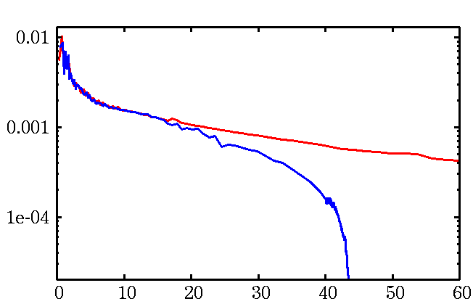
What is the expected Mass of Pop III stars ?
Without UV feedback
The typical mass about 10³ M
(Omukai & Palla 2003,etc.)
With UV feedback
The typical mass 10-100 M
(Hosokawa et al. 2011, 2012)
Without Feedback
With Feedback
Hosokawa et al. 2011
Pop III stars → 10-100 M compact binary

Slide 63
IMF
・Pop I
Salpeter
Pop III
Flat？
Log Flat？
Log N
Stacy & Bromm 2013
∝M^{-2.35}
0 2
Log M
Hirano et al.2014 Susa et al. 2014

Slide 64
IMF dependence

Slide 65
Uncertainties of Pop III binary population synthesis
Initial condition
IMF
mass ratio
separation
eccentricity
Binary interactions
Common envelope
Mass transfer
Supernova kick

Slide 66
eccentricity distributions
General eccentricity distribution (Heggie 1975)
P(e)∝e (Standard)
CygnusOB2 association（Kobulnicky et al. 2014）
P(e)=const.
Observations of O stars(M>15Msun) (Sana et al.2012)
P(e)∝e^{-0.5}

Slide 67
eccentricity dependence

Slide 68
Uncertainties of Pop III binary population synthesis
Initial condition
IMF
mass ratio
separation
eccentricity
Binary interactions
Common envelope
Mass transfer
Supernova kick

Slide 69

Mass transfer
β=0：conservative
1>β>0：non conservative
In Standard model, we use the fitting function
This is fitted for Pop I stars.
Thus, we check β=0,0.5,1 cases.
Secondary is MS or He-burning
(Hurley et al. 2002)
$$\dot{M_{2}}=\dot{−M_{1}}$$
Secondary is giant

Slide 70
Mass transfer dependence

Slide 71
Supernova kick
Pulsar kick ~200-500km/s
Pulsar observation suggest NSs have the natal kick at the SN.
BHXRBs have large distance from galactic plane.
Black hole natal kick? （Repetto,Davis&Sigurdsson2012）
⇒We check the kick dependence.
σ=0km/s (Standard)、σ=100km/s、σ=300km/s

Slide 72
SN kick dependence

