Slide 1
初代星起源連星ブラックホール
からの重力波
衣川 智弥
東大宇宙線研究所

Slide 2
GW150914
Notes:
This is the LIGO’s paper.
They say,
The luminosity distance is 400 Mega parsec.
Redshift is 0.09
Masses are 36 and 29 solarmass.
They are much heavier than the general BH candidate such as BH of X ray binary whose typical mass is 10 solarmass.

Slide 3
GW150914
36太陽質量+29太陽質量の連星ブラックホール（BBH)
一方、従来X線連星で観測されてきたBH候補天体は～10太陽質量
➝今まで観測されたBHより2-3倍重い
このBBHの起源を説明するために様々な説が提唱されている
・低金属量星(種族Ⅱ星)起源
・初代星（種族Ⅲ星）起源
・星団起源
・原始BH起源
・・・・・・・
連星として生まれてきた低金属な星起源

Slide 4

連星として生まれる星
・恒星のうち連星である者の割合は多い
Example
Milky way young open clusters
71 O stars fbinary=69+/-9% (P<3200days) Sana et al. 2012
30 Doradus (Tarantula Nebula)
362 O stars fbinary=51+/-4%(P<3200days) Sana et al. 2013
©star wars
Notes:
Why do we consider field binaries?
Because there are many massive binaries and the binary fraction of massive stars are high.

Slide 5
金属量
・宇宙の最初の元素はビッグバン元素合成によるもの
（C、Oといった重元素はない）
・その後、超新星で重元素がどんどん宇宙に放出されていく
つまり、金属量が少ないほど宇宙初期にできた星
・初代星(種族Ⅲ) 金属量0
・低金属量星(種族Ⅱ) 太陽の10%以下の金属量
・種族Ｉ 太陽と同程度の金属量

Slide 6
なぜ低金属量星を考えるのか?
もし、BHが種族Ｉ (=Solar metal stars)だったら？
➝重くても恒星風で質量を失いすぎる
そもそも質量分布がM^{-2.35}なうえ、軽い星（～太陽質量）が多い
Belczynski et al. 2010
Notes:
Why we consider low metal.
If the progenitor of BBH is pop I,
They lose a lot of mass due to wind mass loss.
This figure is the result of single star evolution with two stellar wind models.
The horizontal axis is the ZAMS mass of Pop I.
The vertical axis is the compact object mass of each mass.
Due to strong wind, They cannot become 30 Msun BH.

Slide 7
低金属量星の場合
New
種族Ⅱ (Z<0.1Zsun)
典型的な質量は種族Ｉと同等
しかし、低金属な分、恒星風が弱い
➝質量失いにくい
初代星 (No metal)
典型的な質量が種族Ｉ,ＩＩに比べ重い
MpopIII~10-100Msun
恒星風が効かない
Old
Minitial: 8Msun<M<150Msun
Single stellar evolution
with 2 stellar wind models.
(Belczynski et al.2010,Abbot et al.2016)
Notes:
If the progenitor is low metal they possibly become massive BH.
In the case of Pop II, they typical mass is same as Pop I, but the wind mass loss weaker than that of Pop I.
This figure the metallicity dependence of single BHmass.
The horizontal axis is metallicity normalized by solar metal.
The vertical axis is BH maxim mass.
So if Pop II star born as massive star, they possibly become massive BH.
On the other hand, Pop III star are born as massive star and no wind mass loss due to no metal.
Thus, Pop III star are easier to be massive compact object

Slide 8
金属量による（単独）星の違い
 | 種族Ｉ | 種族ＩＩ （低金属量星） | 種族ＩＩＩ （初代星）
金属量 | 太陽と同等 | 太陽の10%以下 | 0
質量 | ～１太陽質量 | ～１太陽質量 | ~10-100太陽質量
恒星風による質量損失 | 効く | 効きづらい | 全く効かない

Slide 9
Total mass distribution of BBH which merge within the Hubble time
Typical total mass
M～60 M
(30 M +30 M)
Kinugawa et al.
2014, 2016
Z=0
Z=1/200 Zsun
e.g. Pop I, Pop II
(Z=0.02,0.001,0.0001)
IMF:Salpeter
(1Msun<M<140Msun)
Typical mass ～10 M
Z=1/20 Zsun
Z=Zsun
Total mass [Msun]
Notes:
This figure is the total mass distribution of BH-BH which merge within the Hubble time.

Slide 10
なにがＢＢＨの質量分布を決めるのか?
単独星の進化（生まれたときの質量、恒星風による質量損失）
連星相互作用
(Mass transfer, Common envelope)
Common envelope
Mass transfer
Close binary or merge
Notes:
What do determine the BBH mass?
It is not only wind massloss, but also binary interactions such as mass transfer and the common envelope phase.
Mass transfer is this.
The donnor star become big and the matter of donnor are captured by the gravitational force od receiver star.
So the mass are transfferd from donnor to receiver.
Primary star becomes giant and primary radius becomes large.
Secondary star plunges in primary envelope.
The friction occurs between secondary and primary envelope and transfers angular momentum and energy from orbit to envelope. Due to orbital energy transfer separation decreases and envelope expands and will be expelled.
Binary becomes close binary or merges during CE.

Slide 11
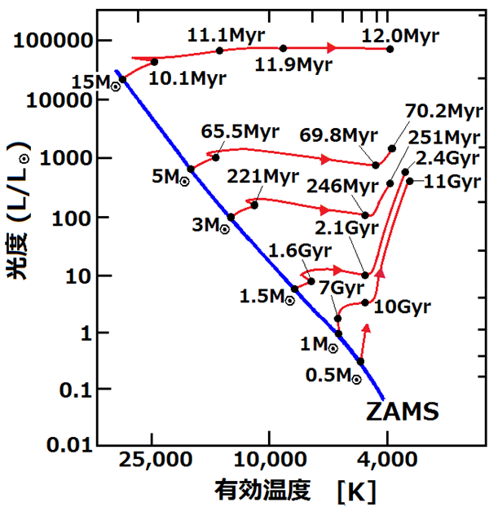
星の進化（HR図）
赤色巨星
Common envelope
になりやすい
主系列星
（水素燃焼の星）
小
大
半径
©http://astroexercise.wiki.fc2.com/wiki/

Slide 12
なぜ初代星が 30MsunのBBHになるのか？
M>50Msun 赤色巨星
➝Mass transfer 不安定
➝common envelope
➝1/3~1/2 of initial mass
(~25-30Msun)
M<50Msun 青色巨星
➝Mass transfer 安定
➝mass loss が効きづらい
➝2/3~1 of initial mass (25-30Msun)
Notes:
Why do Pop III binaries become 30 Msun Binary black holes?
This is HR diagram of Pop III.
The pop III whose mass is larger than 50 solarmass evolve as the red giant.
The mass transfer of red giant is generally unstable and it becomes the common envelope phase.
Thus, they lose the envelope and they become light.
Therefore, the BH mass become about 30 solar mass.
On the other hand, the Pop III whose mass is less than 50 solar mass evolve as a blue giant.
The mass transfer is stable and mass loss is not so effective.
Thus, they become about 30 solar mass BH.
So, Due to these two evolution path, the peak of BHBH mass is about 30 solar mass.
It does not depend on the IMF and binary parameters.
It only depends on the Pop Iii stellar evolution.

Slide 13
Z=Zsun
Z=1/20Zsun
種族Ｉ，ＩＩではどの星も赤色巨星を経由して進化
➝連星進化の経路も質量によって変わらない

Slide 14
Total mass distribution of BH-BH which merge within the Hubble time
Z=0
初代星起源BBHの質量分布は星の進化を反映
Z=1/200Zsun
種族ＩＩは初期質量分布を反映
種族Ｉは恒星風のせいで重いものができない
Z=1/20Zsun
Z=Zsun
Total mass [Msun]
Notes:
Thus, the peak mass of Pop III has the influence of Pop III stellar evolution.
On the other hand, the shape of Pop II BH-BH mass distribution has the influence of IMF
Because all binary evolve same evolution and wind mass loss is weak.
Pop I has the influence of stellar wind due to strong wind.

Slide 15
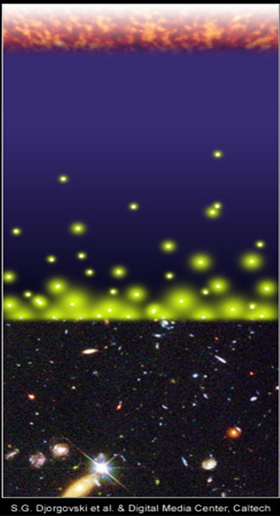
初代星起源のＢＢＨ
初代星が生まれる時期 z~10
重力波で合体するまでの時間~10⁸⁻¹⁰yr
重力波源の累積を考慮する必要がある
宇宙初期にできた星で現在合体するものが見られるかもしれない
Big Bang
merger
merger
time
Djorgovski et al.&Degital Media Center
Notes:
Someone are wondering why we can see such star which are born at the earlyuniverse.
Pop III stars were born and died at z~10.
So, unfortunately we cannot see the supernovae of first star
However, the typical merger time of compact binaries due to gravitational radiation is too long.
So, even though the binary born at the early universe, they can merge at the present day.
Thus, the accumulation of GW sources from the early universe is important.
We must consider binaries which were born at the early universe.
And We might see the gravitational wave from first stars.

Slide 16
Pop III BBH?
ApJL Abbot. et al 2016
Notes:
30 Msun binary black holes have been already predicted by Pop III binary population synthesis.
Thus, LIGO paper said that “recently predicted BBH total masses agree astonishingly well with GW150914 and can have sufficiently long merger times to occur in the nearby universe (Kinugawa et al.2014)”
In this talk, I talk about Pop III binary population synthesis and the detection rate of Pop III compact binaries

Slide 17
連星進化の理論計算
1.初期値(M1,M2,a,e)
決定
2. 単独星の進化
NS-NS,NS-BH,
BH-BH
4. 合体時間の
計算
それ以外
3. 連星相互作用
M1,M2,a,e change
計算停止
連星合体、解体
上記の連星計算をモンテカルロシミュレーションすることで連星の合体確率を計算する

Slide 18
連星相互作用
Tidal friction
Common envelope
Mass transfer
Supernova effect
Gravitational radiation
Tidal friction
Common envelope
Change
M1,M2,a, e
Mass transfer
SN
Supernova effect
Gravitational Waves
連星進化のパラメータは種族I連星と同様の値を仮定

Slide 19
初代星連星進化計算
10⁶個の初代星連星について進化計算
初代星の進化はMarigo et al. (2001)を使用
初期分布関数(Standard model)
M1 : P(M1)=const. (10 M<M<100 M)
q=M2/M1 : P(q)=const. (10/M₁<q<1)
a : P(a)∝1/a (a_{min}<a<10⁶R)
e : P(e)∝e (0<e<1)

Slide 20
計算結果(Standard model)
10⁶連星中の宇宙年齢以内に合体するコンパクト連星数
10⁶個中一割が連星ブラックホールとして合体

Slide 21
Total mass distribution of BH-BH which merge within the Hubble time
Typical total mass
M～60 M
(30 M +30 M)
Kinugawa et al.
2014, 2016
Z=0
Z=1/200 Zsun
e.g. Pop I, Pop II
(Z=0.02,0.001,0.0001)
IMF:Salpeter
(1Msun<M<140Msun)
Typical mass ～10 M
Z=1/20 Zsun
Z=Zsun
Total mass [Msun]
Notes:
This figure is the total mass distribution of BH-BH which merge within the Hubble time.

Slide 22
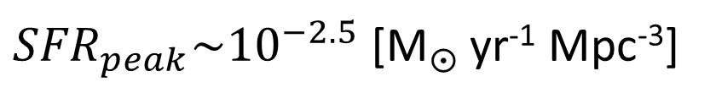
The star formation rate of Pop III
合体率を計算するために
・いつ初代星が生まれたのか?
・どのくらいの数が生まれたのか?
⇒初代星の星形成率が必要
初代星の星形成率として
右のものを使用
de Souza et al. 2011
Star formation rate [M yr⁻¹ Mpc⁻³]
${SFR}_{peak}\sim {10}^{−2.5}$ [M yr⁻¹ Mpc⁻³]
Redshift z
(de Souza et al. 2011)

Slide 23
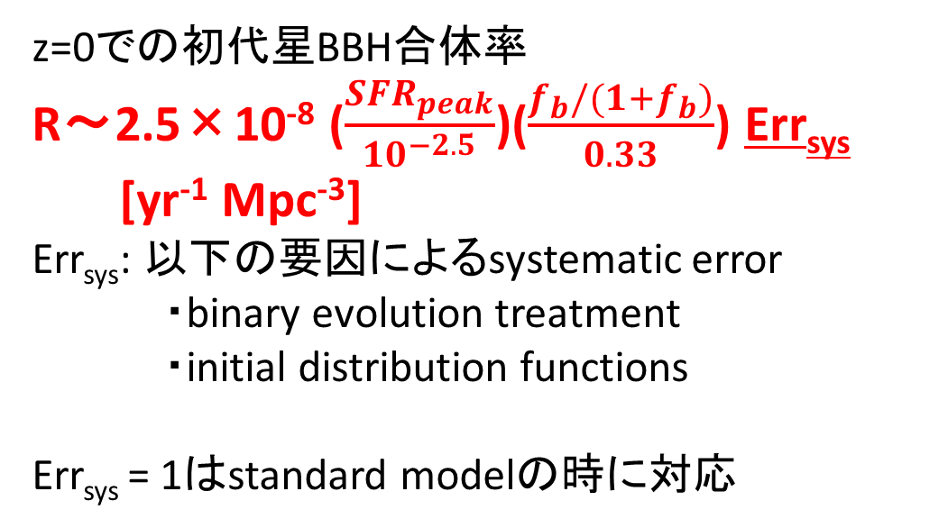
初代星BBHの合体率
10⁻⁶
10⁻⁷
10⁻⁸
10⁻⁹
10⁻¹⁰
10⁻¹¹
10⁻¹²
10⁻¹³
10⁻¹⁴
IMF: Flat
z=0での初代星BBH合体率
R～2.5×10⁻⁸ ($\frac{{SFR}_{peak}}{{10}^{−2.5}}$)($\frac{f_{b}/(1+f_{b})}{0.33}$) Err_{sys}
[yr⁻¹ Mpc⁻³]
Err_{sys}: 以下の要因によるsystematic error
・binary evolution treatment
・initial distribution functions
Err_{sys} = 1はstandard modelの時に対応
R(t) [yr⁻¹ Mpc⁻³]
初代星星形成領域
40 35 30 25 20 15 10 5 0
Redshift z

Slide 24
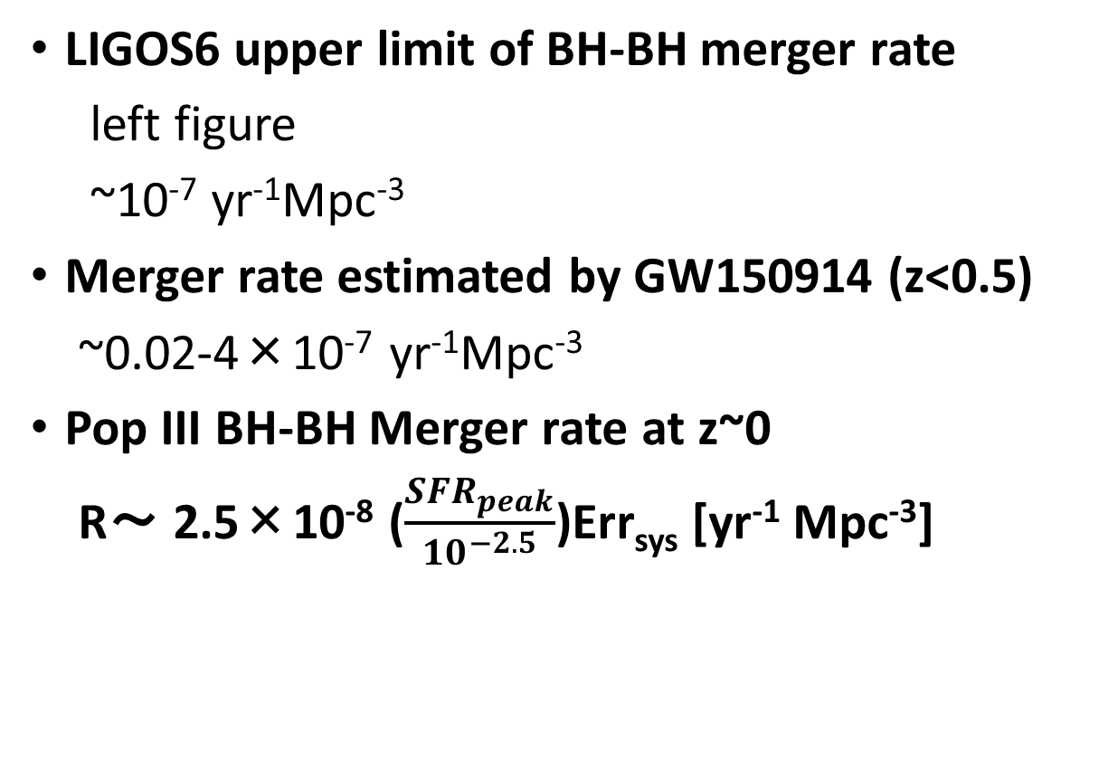
Consistency with LIGOS6 and Adv.LIGO
LIGOS6 upper limit of BH-BH merger rate
left figure
~10⁻⁷ yr⁻¹Mpc⁻³
Merger rate estimated by GW150914 (z<0.5)
~0.02-4×10⁻⁷ yr⁻¹Mpc⁻³
Pop III BH-BH Merger rate at z~0
R～ 2.5×10⁻⁸ ($\frac{{SFR}_{peak}}{{10}^{−2.5}}$)Err_{sys} [yr⁻¹ Mpc⁻³]
Our result is consistent with LIGO
Aasi, Abadie, Abbott et al. (2013)

Slide 25
Detection range of KAGRA and Adv. LIGO
M_{BH}～30M SNR=8
Redshift z
SNR=8
For QNM
Luminocity distance
～1.5 Gpc
Redshift z～0.28
SNR=8
For inspiral
Mass of one star [M]
©Kanda
Notes:
This figure is the detection range of KAGRA
The horizontal axis is the mass of one star.
The vertical axis is the red shift or luminosity distance of detection range.

Slide 26
Inspiral and QNM
merge
inspriral
QNM
Notes:
The inspiral means the gravitational wave from binary inspiral.
On the other hand, the QNM means the gravitational wave from the merged black hole quasi normal mopde.

Slide 27
Detection range of KAGRA and Adv. LIGO
M_{BH}～30M SNR=8
Redshift z
SNR=8
For QNM
Luminocity distance
～1.5 Gpc
Redshift z～0.28
SNR=8
For inspiral
Mass of one star [M]
©Kanda
Notes:
This figure is the detection range of KAGRA
The horizontal axis is the mass of one star.
The vertical axis is the red shift or luminosity distance of detection range.

Slide 28
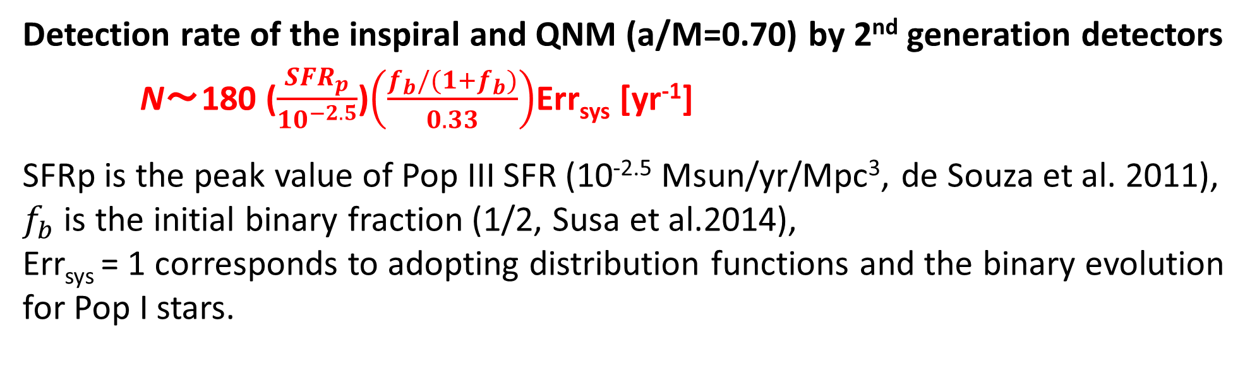
初代星BBHの観測レート
Detection rate of the inspiral and QNM (a/M=0.70) by 2nd generation detectors
N～180 ($\frac{{SFR}_{p}}{{10}^{−2.5}}$)$\left(\frac{f_{b}/(1+f_{b})}{0.33}\right)$Err_{sys} [yr⁻¹]
SFRp is the peak value of Pop III SFR (10^{-2.5} Msun/yr/Mpc³, de Souza et al. 2011),
$f_{b}$ is the initial binary fraction (1/2, Susa et al.2014),
Err_{sys} = 1 corresponds to adopting distribution functions and the binary evolution for Pop I stars.
To evaluate the robustness of the mass distribution and the range of Err_{sys}, we examine the dependence of the results on the unknown parameters and the initial distribution functions.
Notes:
Using that detection range, we calculate the detection rate.

Slide 29
Errsys (Example)
 | Errsys
Standard | (180 /yr)
Mass range: (10 M<M< 100 M or 140 M) | 1~3.4
IMF:Flat, M⁻¹, Salpeter | 0.42~1
IEF:f(e)∝e,const.,e^{-0.5} | 0.94~1
BH natal kick: V=0,100,300 km/s | 0.2~1
CE:αλ=0.01,0.1,1,10 | 0.21~1
Mass transfer (mass loss fraction): β=0, 0.5, 1 | 0.67~1.3
Worst | 0.046
一方で 初代星BBHの典型的な質量は変わらない (~30 Msun).
Notes:
This table is the example of parameter dependence of Errsys.
We change the mass range, the initial distribution functions such as Initial mass function and initial eccentricity function.
And change the binary parameters such as SN natal kick velocity, common envelope parameters, and the parameter of the lose fraction of transferred stellar
Mass.
In our standard model choose red ones
At Each parameter range, Errsys change from 1 over several to a few.
In order to consider the lower boundary of Errsys,
We consider the worst model.
In the Worst model I choose the worst parameters in each parameter region, blue ones.
It is unlikely case
Errsys change from 0.046 to 4
On the other hand, the typical mass is not changed (~30 Msun)

Slide 30
なぜ初代星が 30MsunのBBHになるのか？
M>50Msun 赤色巨星
➝Mass transfer 不安定
➝common envelope
➝1/3~1/2 of initial mass
(~25-30Msun)
M<50Msun 青色巨星
➝Mass transfer 安定
➝mass loss が効きづらい
➝2/3~1 of initial mass (25-30Msun)
Notes:
Why do Pop III binaries become 30 Msun Binary black holes?
This is HR diagram of Pop III.
The pop III whose mass is larger than 50 solarmass evolve as the red giant.
The mass transfer of red giant is generally unstable and it becomes the common envelope phase.
Thus, they lose the envelope and they become light.
Therefore, the BH mass become about 30 solar mass.
On the other hand, the Pop III whose mass is less than 50 solar mass evolve as a blue giant.
The mass transfer is stable and mass loss is not so effective.
Thus, they become about 30 solar mass BH.
So, Due to these two evolution path, the peak of BHBH mass is about 30 solar mass.
It does not depend on the IMF and binary parameters.
It only depends on the Pop Iii stellar evolution.

Slide 31

初代星 BBH
Errsys=0.046~4
⇒観測レート R～8.3-720 ($\frac{{SFR}_{peak}}{{10}^{−2.5}}$) $\left(\frac{f_{b}/(1+f_{b})}{0.33}\right)$ [yr⁻¹ ](S/N>8)
質量 M～30 M
初代星起源のBBHが重力波で見える（見えた?）かもしれない
1. 初代星起源のBBHではQNMも見えるかもしれない
➝ 初代星起源BHからのQNMでGRの検証ができるかもしれない
2. BBHの質量分布から初代星起源を種族I,IIと区別できるかもしれない
➝初代星の検証
Notes:
If the chirp mass distribution can not distinguish Pop III, we can confirm Pop III BHBH future observation.

Slide 32
future plan of GW observer :
B-DECIGO and DECIGO
DECIGO: Japanese space gravitational wave observatory project
B-DECIGO: test version of DECIGO
B-DECIGO : z~10 (30 Msun BH-BH)
~10⁵ events/yr
DECIGO can see Pop III BH-BHs
when Pop III stars were born!
(Nakamura, Ando, TK et al. 2016)
©Nakamura
Notes:
If we cannot distinguish Pop III from Pop I, Pop II, we consider the confirmation by the future gravitational wave observatory such as DECIGO.
DECIGO is the Japanese space gravitational wave observatory project.
It has good sensitivity from 0.1 Hz to 10 Hz.
Pre-DECIGO is test version.
Pre-DECIGO might see such binary black holes up to redshift 30.
The expected detection rate is about 10 to fifth per yr.
The SFR of Pop III has the peak at z~10.
Thus, it can see pop III BHBH when they were born.
Furthermore, we check the redshift dependence of high mass BHBH mergers.

Slide 33
Cumulative BBH merger rate
aLIGO
~10²-10³/yr
Pre-DECIGO
~10⁵/yr
Log(events/yr)
Saturated at z≲5
Saturated at z~10
Pop I and II BH-BH
(2 metallicity evolution models)
Pop III BH-BH
Redshift
Redshift

Slide 34
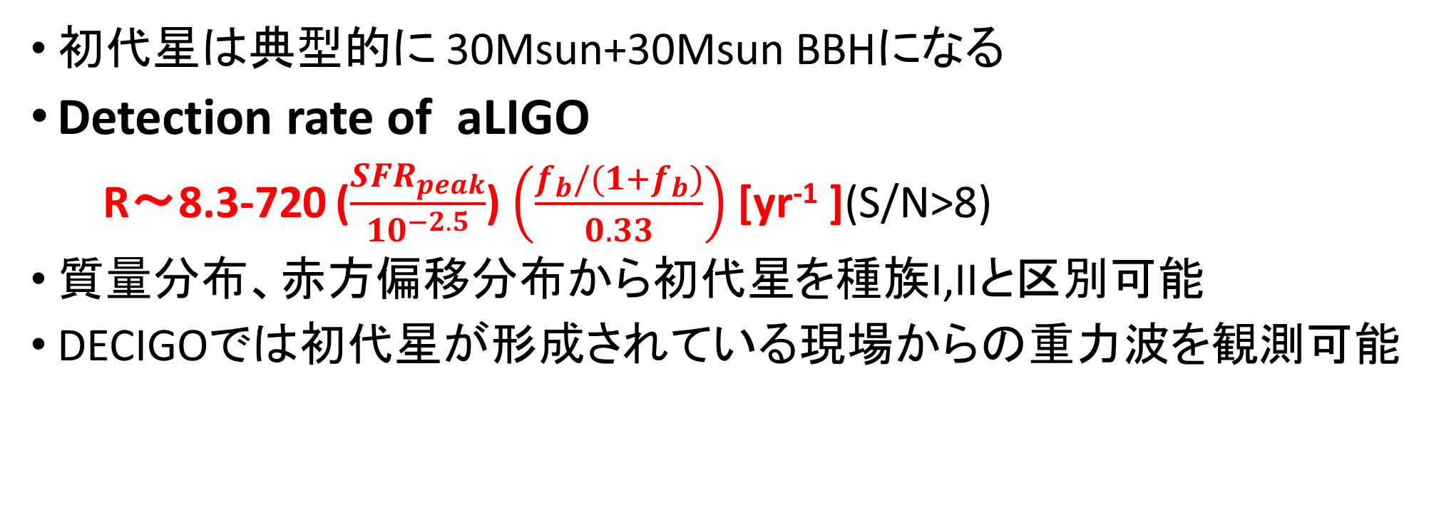
Conclusion
初代星は典型的に 30Msun+30Msun BBHになる
Detection rate of aLIGO
R～8.3-720 ($\frac{{SFR}_{peak}}{{10}^{−2.5}}$) $\left(\frac{f_{b}/(1+f_{b})}{0.33}\right)$ [yr⁻¹ ](S/N>8)
質量分布、赤方偏移分布から初代星を種族I,IIと区別可能
DECIGOでは初代星が形成されている現場からの重力波を観測可能

Slide 35
Appendix

Slide 36
Why NS-NS disrupt
For example, we consider NS and NS progenitor binary.
NS
(1.4-2M)
NS progenitor
(8-25M)
In the case of Pop III NS progenitor, wind mass loss and the mass loss due to binary interaction is not effective.
SN
When NS progenitor becomes supernova, NS progenitor suddenly loses mass and becomes NS.
Then, due to instant mass loss the binding energy of binary decreases and binary NS disrupts.
disrupt
Binary NS cannot survive!

Slide 37
Can NS binary survive via CE?
We consider NS and NS progenitor binary again.
NS(1.4-2M)
8-20M
no CE
CE
SN
If CE occurs, envelope was already expelled before SN.
Thus, mass ejection at SN becomes smaller than SN mass ejection via no CE.
Due to small mass ejection at SN the loss of binding energy becomes small.
Binary can survive !
Therefore, Common Envelope is important.
2-6M
disrupt
SN

Slide 38
Other Pop III SFRs
SPH simulation
(Johnson et al. 2013)
SFRp~ 10⁻³-10⁻⁴ Msun/yr/Mpc³
Constraints by Planck
(e.g.Hartwig et al.2016, Inayoshi et al.2016)
optical depth of Thomson scattering
total Pop III density≲10⁴⁻⁵ Msun/Mpc³
by Visbal et al.2015

Slide 39
Pop I and Pop II case (Dominik et al. 2015)
From 1/200 Zsun to 1.5 Zsun
BH-BH detection rate (Their standard model) ~300/yr
25% of above rate is >20 Msun BHBH
Thus, Detection rate of high mass BHBH ~80/yr

Slide 40
The differences between Pop III and Pop I
 | Pop I stars (Sun like stars)
Metallicity | ２％
Radius | Large
Typical Mass | 1 Msun
Wind mass loss | effective
Pop III stars
0
Small
10-100 Msun
Not effective
Pop III binaries are easier to be massive compact binary
Notes:
This table shows the differences between Pop III and Pop I.
Pop III is no metal star.
The radius is small, the typical mass is large, and wind mass loss is not effective.
Thus, Pop III binaries are easier to be massive compact binary.

Slide 41

The main target of gravitational wave source
・Compact binary mergers
Binary neutron star (NS-NS)
Neutron star black hole binary (NS-BH)
Binary black hole (BH-BH)
©KAGRA
How many times can we detect compact binary mergers？
➝Estimated by the binary population synthesis
Notes:
First, I introduce the main target of GW source.
The main target of gravitational wave is the compact binary merger such as binary neutron star, neutron star black hole binary and binary black hole.
How many time can we detect compact binary mergers by gravitational wave detectors?
It is estimated by the binary population synthesis

Slide 42
Quasi normal mode
fc is frequency of QNM
Q is the quality factor of QNM which relate to the attenuation of QNM

Slide 45
How to calculate the event rate
NS-NS
We can get information from binary pulsar observations
・The empirical rate from pulsar observations (Kalogera et al. 2004,etc)
・Binary population synthesis(Belczynski et al. 2002, 2004, Dominik et al.2012,etc)
NS-BH,BH-BH
・Binary population synthesis
There were no observation until GW150914.
Thus, there is no other way except binary population synthesis
Notes:
In the case of NS-NS, there are two method to calculate detection rate.
There are binary pulsar observations.
Thus, we can estimate the empirical rate from binary pulsar observations.
The other method is a theoretical method, binary population synthesis.
Especially, in the case of NS-BH, BH-BH, there is no observation until GW150914.
Thus, there is no other way except the binary population synthesis.

Slide 46
Why do Pop III stars have these properties?
Zero metal stars
-No line cooling and dust cooling at the star formation
-High temperature and high Jeans mass (M_{J}∝T^{3/2})
⇒More massive than Pop I stars (Pop I stars are solar like stars)
The typical mass is 10-100M
-Missing metal and dust i.e. missing powerful opacity source
-The stellar photosphere become small
⇒Smaller radius than Pop I stars
-Stellar wind is driven by radiation pressure on resonance lines of
heavier ions or dust grains
-However, Pop III stars do not have heavier ion and dust grain
⇒No wind mass loss
Notes:
Why do pop III stars nave these properties/
The reason is no metal.
Hosoku: the jeans mass is the critical mass to collapse.
we can say the cloud will collapse if its mass is bigger than the Jean's mass

Slide 47
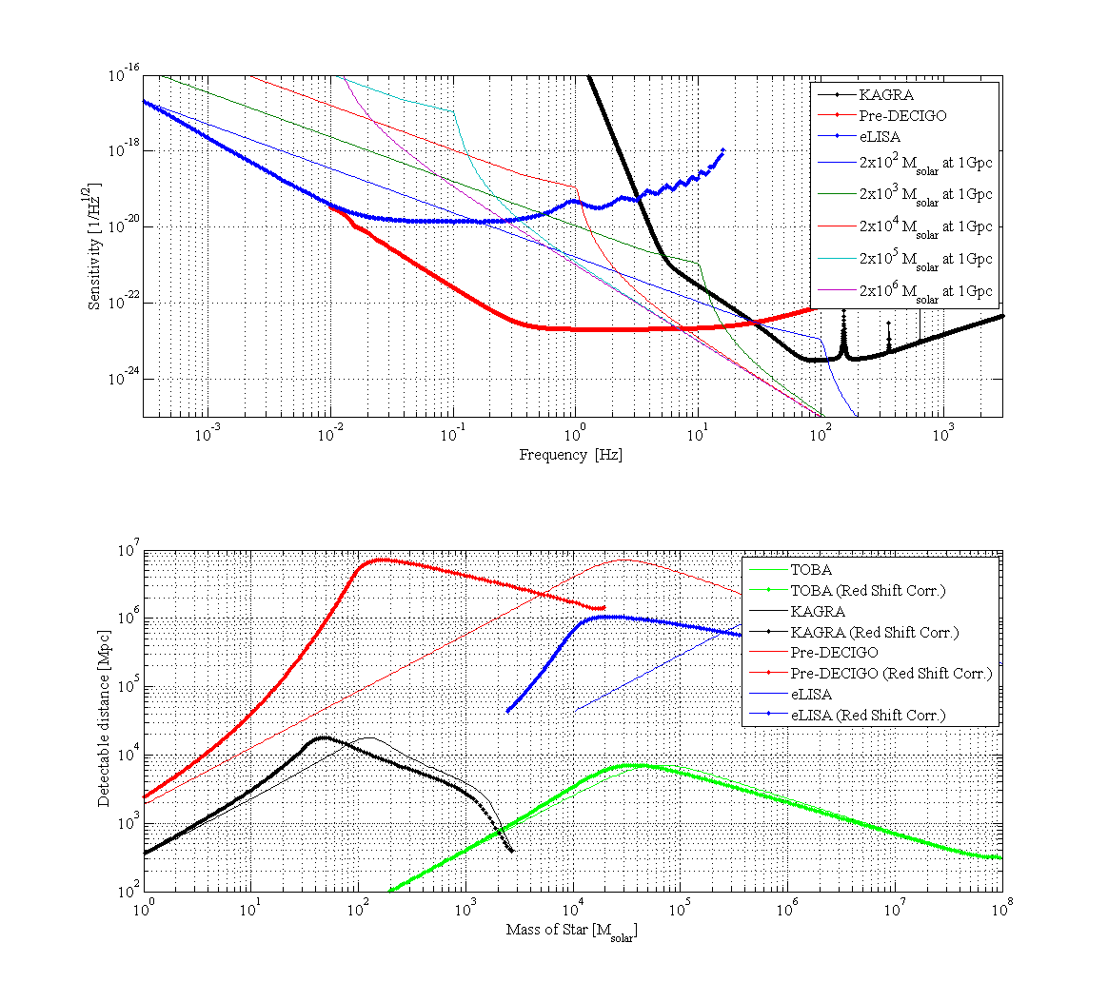

Slide 49
merger rate calculated by population synthesis
Pop I galactic merger rate [Myr⁻¹]
Dominik et al.(2012)
These merger rates are calculated by Population synthesis (PS).
There are wide differences between models.
I will talk about what is PS and what determine the merger rates.
Notes:
This table is the galactic merger rates of Pop I compact binaries calculated by the binary population synthesis.
Pop I is a solar metal stars.
However, there are some uncertainties and there are wide differences between models.
The merger rate change by a factor of several hundreds.
I will talk about what is population synthesis and what determine the merger rates.

Slide 50
DECIGOの感度曲線
Pop III のSFRのピークはz~9
Red shift chirp mass=(1+z)Mc
Pop III BHBH (z~9) ⇒300 Msun (10Hz)
Kawamura et al. 2011

Slide 51
How to calculate the event rate
NS-NS
We can get information from binary pulsar observations
・The empirical rate from pulsar observations (Kalogera et al. 2004,etc)
・Binary population synthesis(Belczynski et al. 2002, 2004, Dominik et al.2012,etc)
NS-BH,BH-BH
・Binary population synthesis
There is no observation.
Thus, there is no other way except binary population synthesis
Notes:
How to calculate the event rate?
In the case of NS-NS, there are two method to calculate detection rate.
There are binary pulsar observations.
Thus, we can estimate the empirical rate from binary pulsar observations.
The other method is a theoretical method, binary population synthesis.
On the other hand, in the case of NS-BH, BH-BH, there is no observation.
Thus, there is no other way except the binary population synthesis.
In this talk, I focus on the binary population synthesis.

Slide 52
Binary Interactions
Supernova effect
Common envelope
Stable mass transfer
Orbital evolution
(Tidal friction, Gravitational radiation)
In this talk, I will explain these two binary interactions.
Notes:
I introduce the binary interactions
Supernova effect, common envelope, Stable mass transfer, orbital evolution such as tidal friction, gravitational radiation.
These binary interactions change binary parameters such as primary mass, secondary mass, separation and eccentricity.
In this talk, I will explain these two binary interactions

Slide 53
Supernova(SN) effect
For example, we consider NS and NS progenitor binary.
NS
(1.4-2M)
NS progenitor
(8-25M)
When NS progenitor becomes supernova, NS progenitor suddenly loses mass and becomes NS.
Then, due to instant mass loss the binding energy of binary decreases and binary NS disrupts.
SN
Binary NS cannot survive!
disrupt
But in fact binary pulsars have been observed.
Why can binary NS survive?
This reason is common envelope.

Slide 54
Can NS binary survive via CE?
We consider NS and NS progenitor binary again.
NS(1.4-2M)
8-20M
no CE
CE
SN
If CE occurs, envelope was already expelled before SN.
Thus, mass ejection at SN becomes smaller than SN mass ejection via no CE.
Due to small mass ejection at SN the loss of binding energy becomes small.
Binary can survive !
Therefore, Common Envelope is important.
2-6M
disrupt
SN

Slide 55
Common envelope (CE)
CE is unstable mass transfer phase.
Primary star becomes giant and primary radius becomes large.
Secondary star plunges in primary envelope.
The friction occurs between secondary and primary envelope and transfers angular momentum and energy from orbit to envelope. Due to orbital energy transfer separation decreases and envelope expands and will be expelled.
Binary becomes close binary or merges during CE.
4
1
2
3
Secondary
Primary

Slide 56
The treatment of CE
We assume the fraction of the orbital energy is used to expel envelope.
We use simple energy formalism in order to calculate separation after CE a_{f}
For given Mcore1, Menv1 M2, initial separation a_{i}
a_{i}
a_{f}
Assuming efficiency of
mass ejection
Final separation a_{f}
The loss of orbital energy
the energy required to expel envelope
α: the efficiency of energy transfer from orbit to envelope
λ: the binding energy parameter
These common envelope parameters are uncertain.
・How much the orbital energy can be used to expel envelope?
・How much the internal energy of envelope is used to expel envelope?
Notes:
I explain the treatment of CE.
We assume the fraction of the orbital energy is used to expel envelope.
We use simple energy formalism in order to calculate separation after CE af.
The left hand side is the loss of the orbital energy and the right hand side is the energy required to expel envelope.
Alpha is the efficiency of energy transfer from orbit to envelope.
Lambda is the binding energy parameter.
For given primary core mass, primary envelope mass, initial separation ai and assuming alpha and lambda, we canget the separation after common envelope.
However, these common envelope parameters are uncertain.
How much the orbital energy can be used to expel envelope?
How much the internal energy of envelope is used to expel envelope?

Slide 57
The rate dependence on CE parameters
The loss of orbital energy
the energy required to expel envelope
Separation after CE a_{f} is dependent on CE parameters.
For simplicity, α=1.
If λ is large i.e, the energy required to expel envelope is small,
the loss of orbital energy during CE becomes small and a_{f} is large.
If a_{f} is large, binary tend not to merge during CE and can survive.
However, if a_{f} is too large, binary cannot merge within Hubble time due to GW.
・The number of merger during CE Merger rates
・Merger timescale t_{GW}∝a⁴ Merger rates
λ
a_{f}

Slide 58
The dependence on CE parameters
For example, we consider how Pop I NS-NS merger rate depend on CE parameters.
Pop I NSNS merger rate [Myr⁻¹ galaxy⁻¹] Dominik et al.2012
αλ
a_{f}
・The number of coalescence during CE Merger rates
・Merger timescale t_{GW}∝a⁴ Merger rates
Notes:
Let consider the dependence on the CE parameters.
This table is the pop I binary NS merger rate.
We assume alpha is unity, and change the lamda from 0.01 to 10.
First, due to the number of coalescence during CE is decrease the merger rate increase.
However lambda become larger than 1, the merger timescale become too long. Thus the merger rate decrease.
Therefore, these parameter change merger rate by a factor of hundred.
This is the big problem of the population synthesis and binary evolution study.

Slide 59
Binary population synthesis
Population synthesis is a method of numerical simulation to research the population of stars with a complex evolutions.
Population synthesis can predict properties and merger rates of unobserved sources such as NS-BH, BH-BH
The common envelope of the key process of population synthesis
However, Common envelope parameters are uncertain.
This uncertainty change event rate by a factor of several hundreds.
We should reveal this uncertainty via comparison between result of population synthesis and observations such as GW and other observations and improve binary evolution theory

Slide 60
Example: CE dependence
We calculate αλ=0.01, 0.1, 1, 10 cases N_{total}=10⁶
The number of merged Pop III BH-BH change by a factor of several.
On the other hand, Pop I merger rates changed by a factor of several hundreds.
What is the reason?

Slide 61
Why do Pop III stars have these properties?
Zero metal stars
-No line cooling and dust cooling at the star formation
-High temperature and high Jeans mass (M_{J}∝T^{3/2})
⇒More massive than Pop I stars (Pop I stars are solar like stars)
The typical mass is 10-100M
-Missing metal and dust i.e. missing powerful opacity source
-The stellar photosphere become small
⇒Smaller radius than Pop I stars
-Stellar wind is driven by radiation pressure on resonance lines of
heavier ions or dust grains
-However, Pop III stars do not have heavier ion and dust grain
⇒No wind mass loss
Notes:
Hosoku: the jeans mass is the critical mass to collapse.
we can say the cloud will collapse if its mass is bigger than the Jean's mass

Slide 64
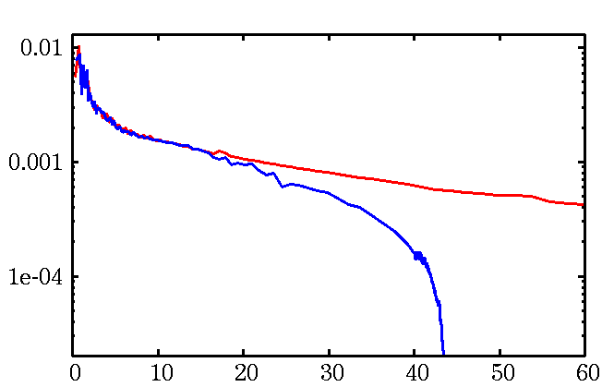
What is the expected Mass of Pop III stars ?
Without UV feedback
The typical mass about 10³ M
(Omukai & Palla 2003,etc.)
With UV feedback
The typical mass 10-100 M
(Hosokawa et al. 2011, 2012)
Without Feedback
With Feedback
Hosokawa et al. 2011
Pop III stars → 10-100 M compact binary

Slide 65
IMF
・Pop I
Salpeter
Pop III
Flat？
Log Flat？
Log N
Stacy & Bromm 2013
∝M^{-2.35}
0 2
Log M
Hirano et al.2014 Susa et al. 2014

Slide 66
IMF dependence

Slide 67
Uncertainties of Pop III binary population synthesis
Initial condition
IMF
mass ratio
separation
eccentricity
Binary interactions
Common envelope
Mass transfer
Supernova kick

Slide 68
eccentricity distributions
General eccentricity distribution (Heggie 1975)
P(e)∝e (Standard)
CygnusOB2 association（Kobulnicky et al. 2014）
P(e)=const.
Observations of O stars(M>15Msun) (Sana et al.2012)
P(e)∝e^{-0.5}

Slide 69
eccentricity dependence

Slide 70
Uncertainties of Pop III binary population synthesis
Initial condition
IMF
mass ratio
separation
eccentricity
Binary interactions
Common envelope
Mass transfer
Supernova kick

Slide 71

Mass transfer
β=0：conservative
1>β>0：non conservative
In Standard model, we use the fitting function
This is fitted for Pop I stars.
Thus, we check β=0,0.5,1 cases.
Secondary is MS or He-burning
(Hurley et al. 2002)
$$\dot{M_{2}}=\dot{−M_{1}}$$
Secondary is giant

Slide 72
Mass transfer dependence

Slide 73
Supernova kick
Pulsar kick ~200-500km/s
Pulsar observation suggest NSs have the natal kick at the SN.
BHXRBs have large distance from galactic plane.
Black hole natal kick? （Repetto,Davis&Sigurdsson2012）
⇒We check the kick dependence.
σ=0km/s (Standard)、σ=100km/s、σ=300km/s

Slide 74
SN kick dependence

