Slide 1
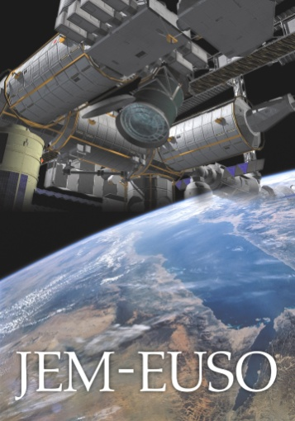













JEM-EUSO mission: Doing Astronomy by looking down to the Earth
戎崎俊一
理研基幹研
Deputy PI of the JEM-EUSO collaboration
CRCタウンミーティング2012年6月30日東京工業大学

Slide 2
Contents
宇宙からのエアシャワー観測のアイデア歴史
何が違うのか：見下ろすのと見上げるのと
JEM-EUSOミッション概要
パスファインダーミッション
ミッション状況とまとめ

Slide 3
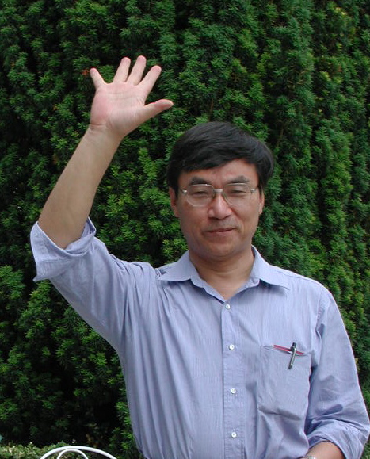
3人の巨人
John Linsley, Livio Scarsi, and 高橋義幸

Slide 4
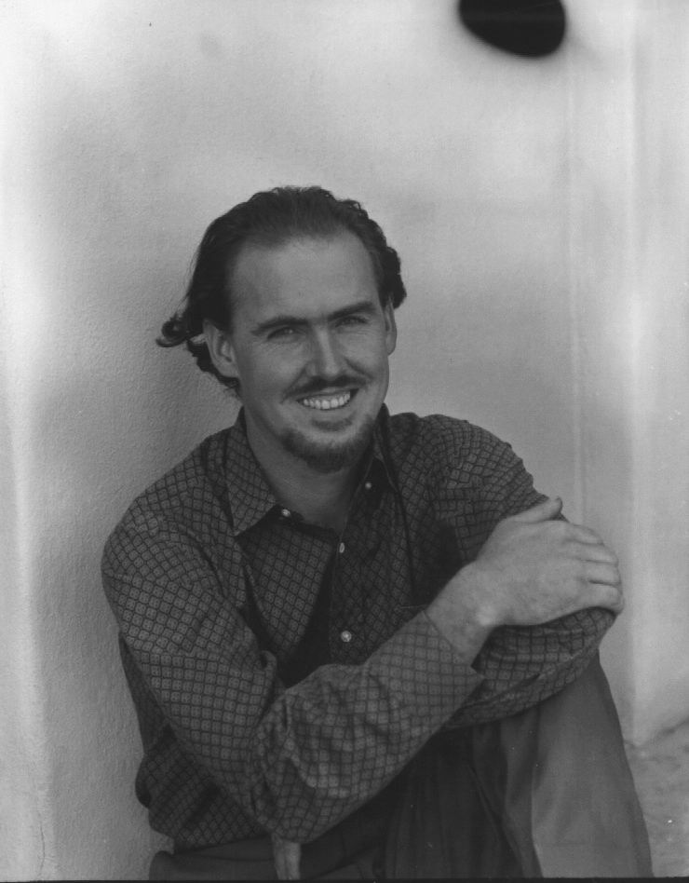
1979, John Linsleyのアイデア
SOCRAS: Satellite Observatory of Cosmic Ray Showers
John Linsley in 1979 in the Field Committee Report of NASA “Call for Projects and Ideas in High Energy Astrophysics for the 1980s”
The concept to observe, by means of Space Based devices looking at Nadir during the night, the fluorescence light produced by an EAS proceeding in the atmosphere
In Early 1990s John had moved to Palermo to work on the PLASTEX experiment with his old friend Livio Scarsi, and Osvaldo Catalano

Slide 5
高橋義幸 1995
フレネルレンズ
  視野を±30度まで拡大
観測領域 100,000 km²

Slide 6
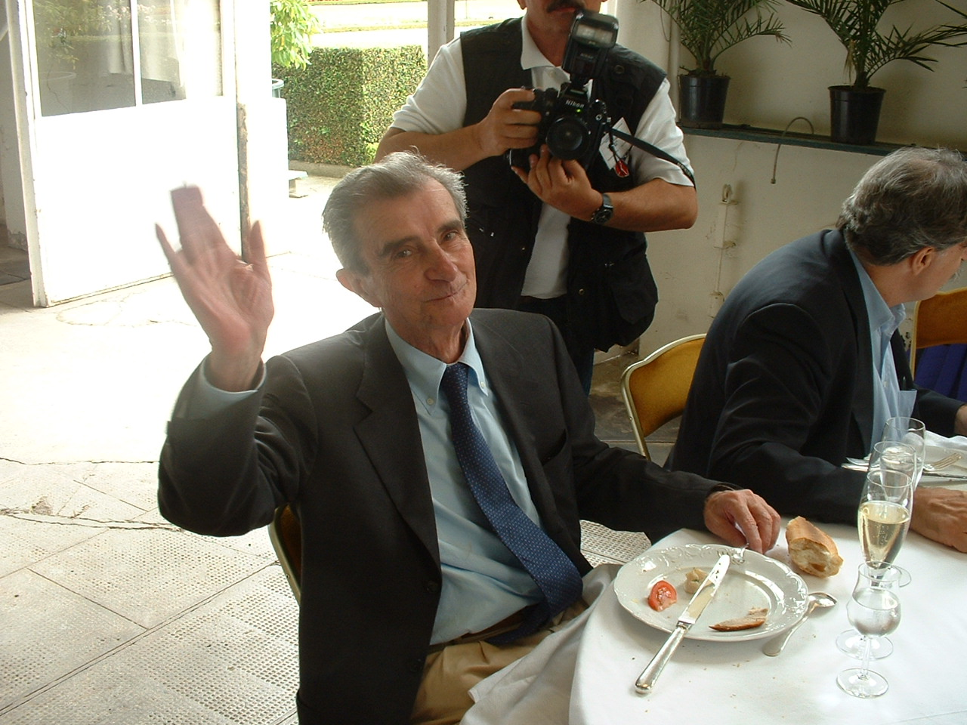
Livio Scarsi, EUSO PI
First 10²⁰ eV event (1963 Phys.Rev. with J. Linsley), PI (Beppo-SAX and EUSO)

Slide 7

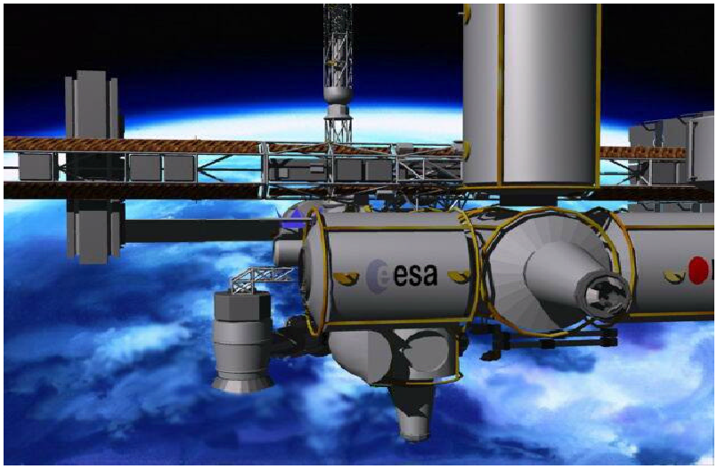
2000-2004 EUSO on Columbus (ISS)
The EUSO submitted to ESA in Oct. 1999 (as F2-F3 missions) was re-oriented to a payload for the ISS
Vincent Van Gogh, “The starry night”
Extreme Universe Space Observatory
2000-2001 Preliminary Accomodation study by D/MSM and D/SCI
ESA Phase A studies March 2002-2003

Slide 8
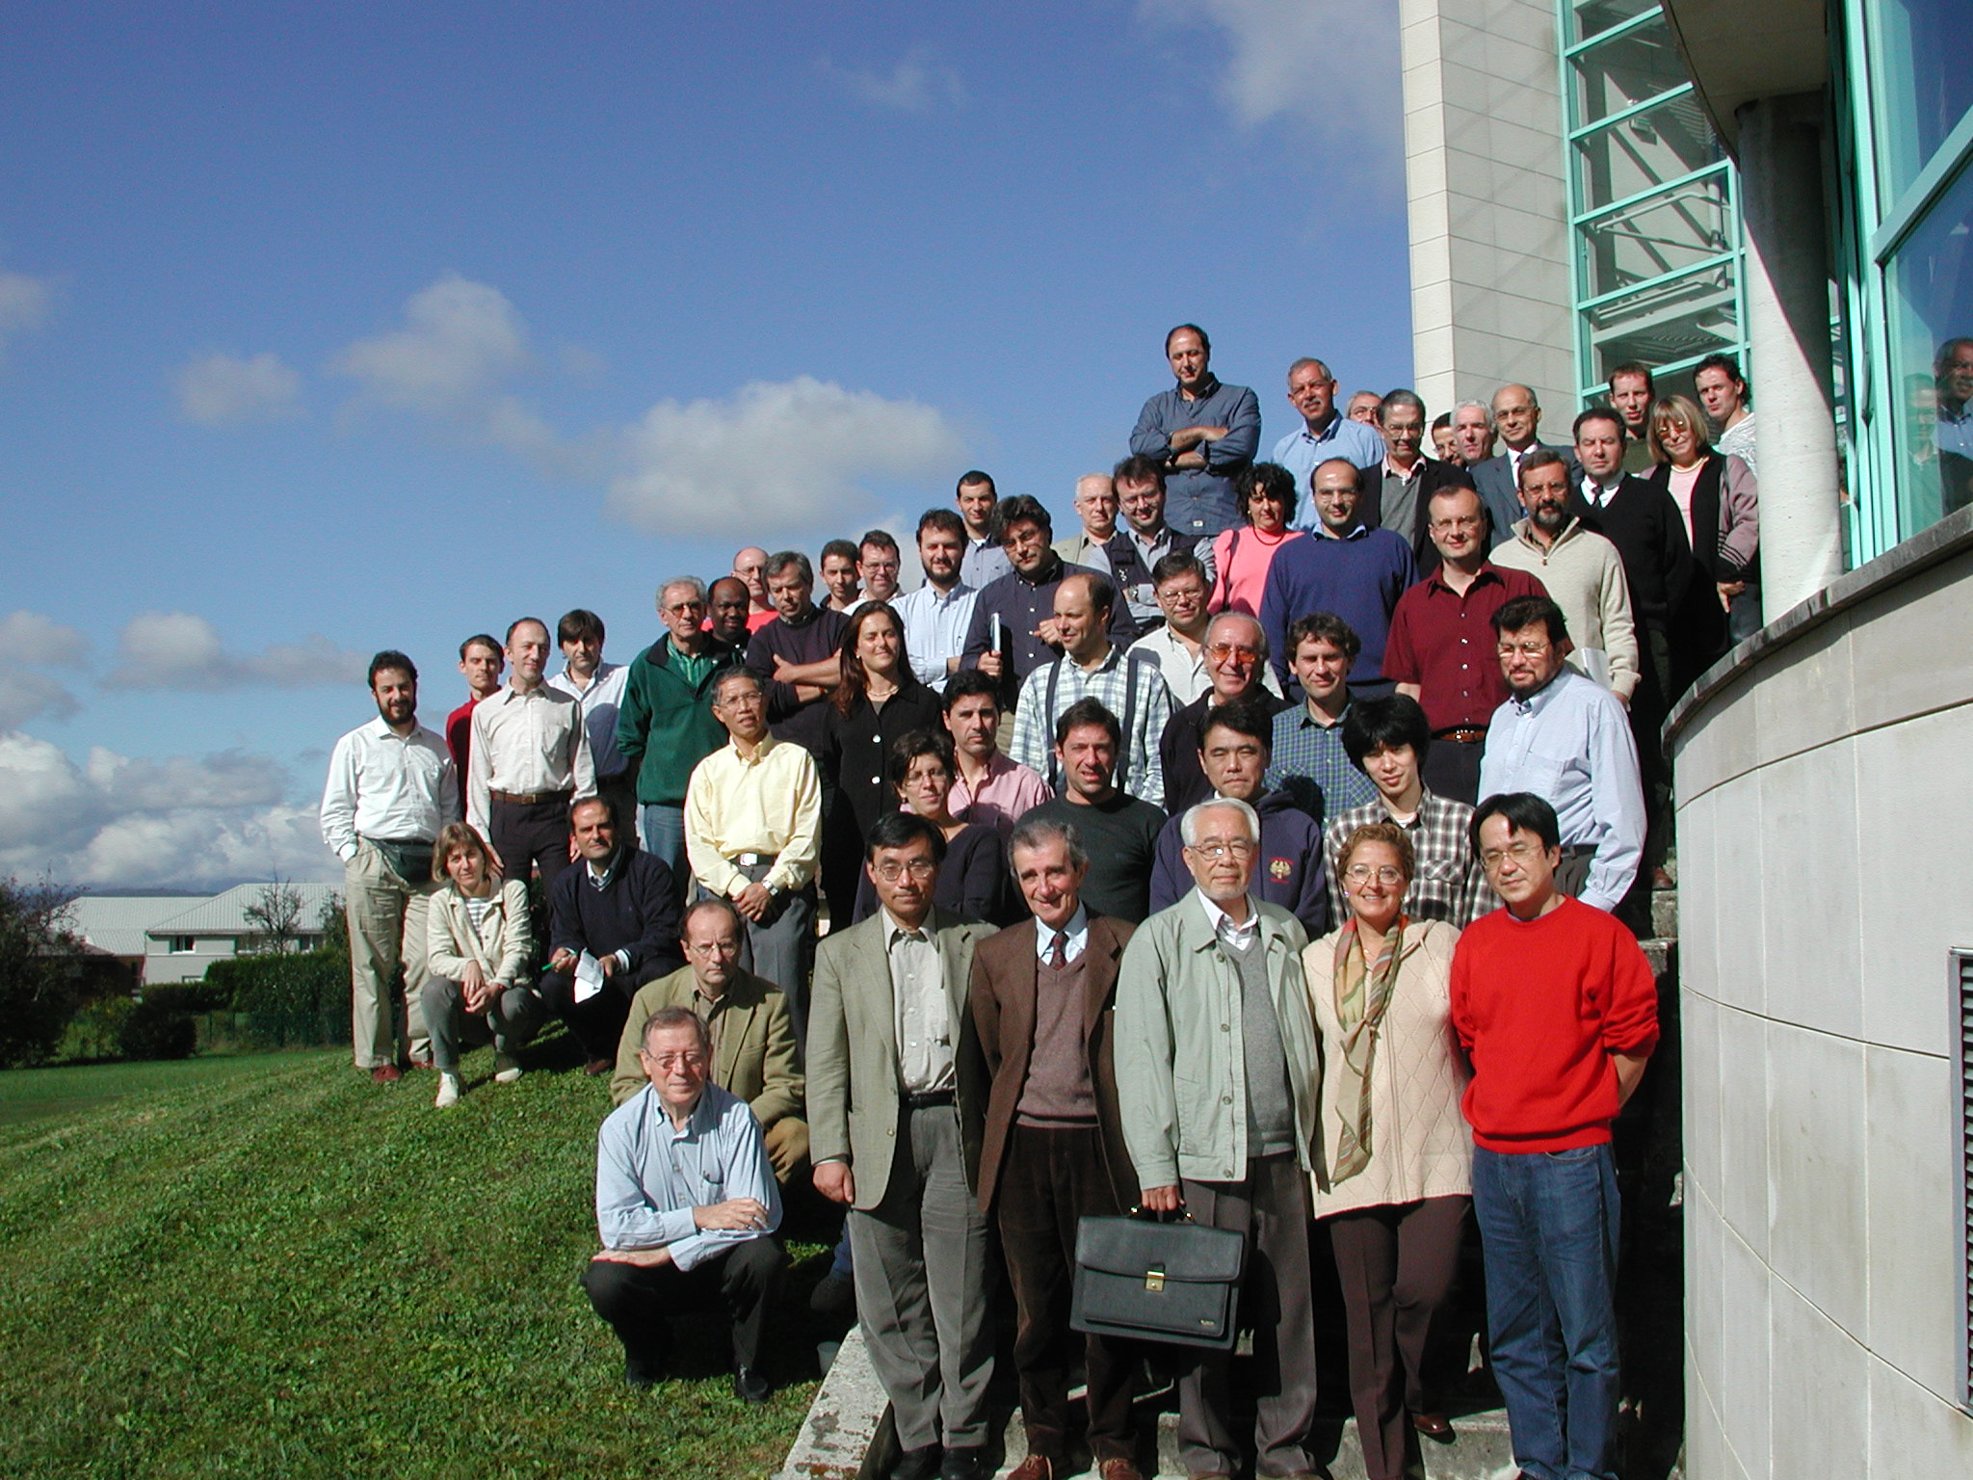
EUSO General Meeting, Annecy October 2001
Notes:
The capacity of leadership

Slide 9
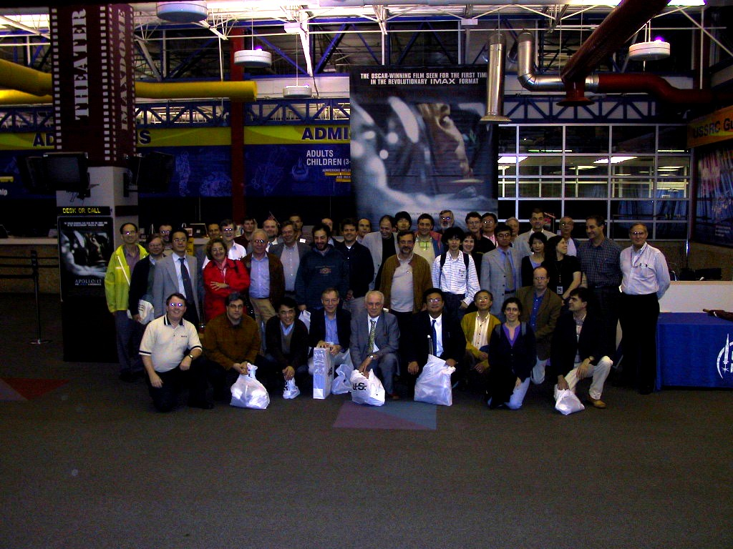
EUSO General Meeting, Huntsville, May, 2002

Slide 10
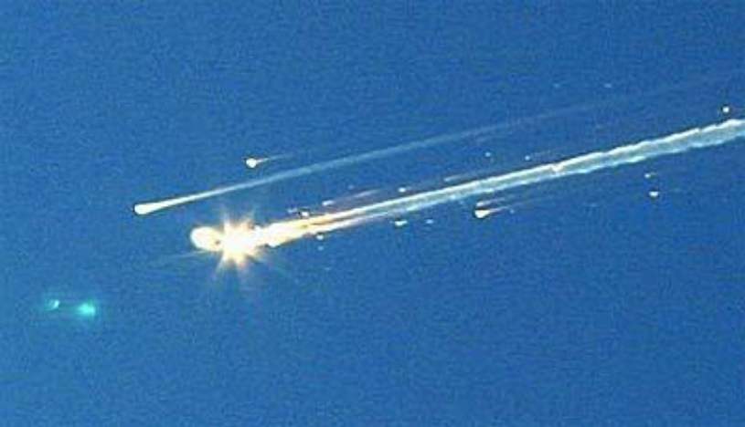
Space Shuttle Columbia Disaster
1st of February 2003

Slide 11
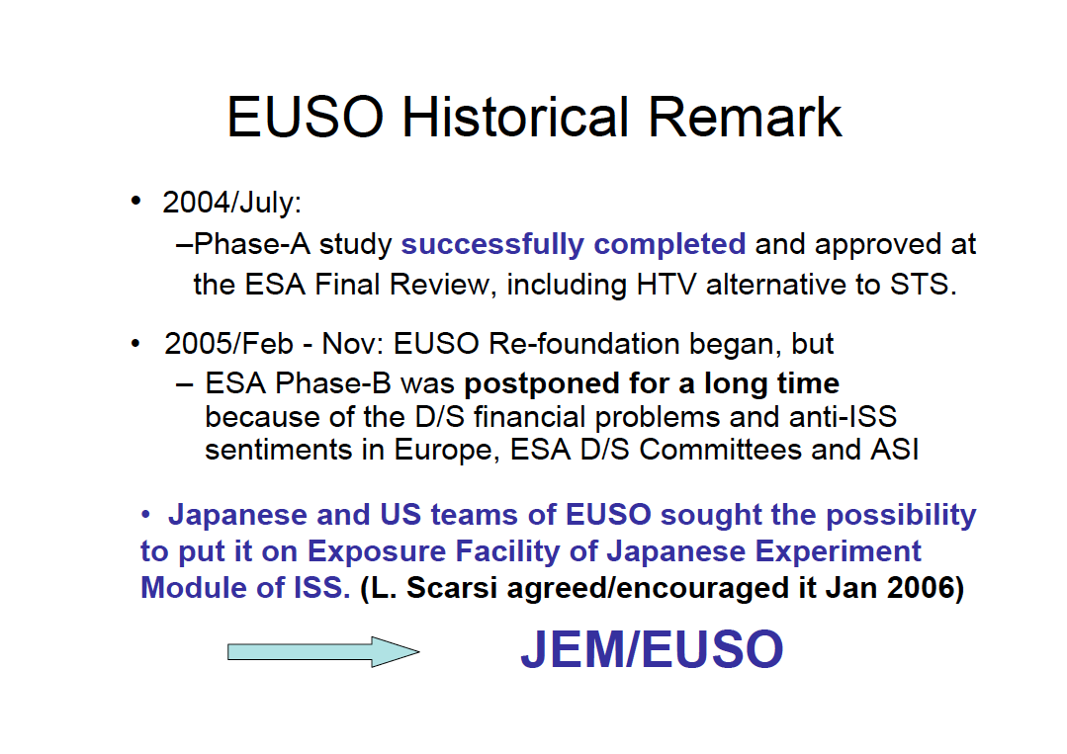
The new dream started at the EUSO Re-foundation meeting in Nov. 2005, in ESTEC
*Y. Takahashi’s presentation 2006

Slide 12
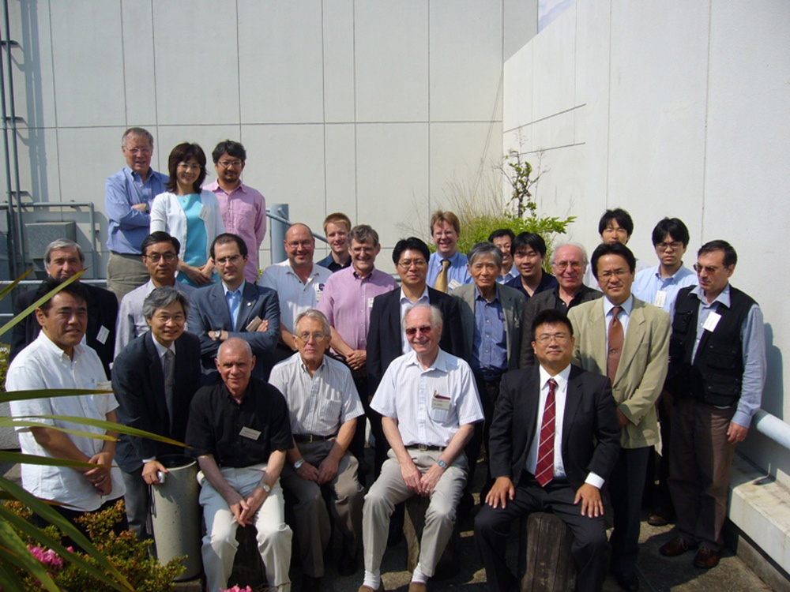
JEM-EUSO Kick-off meeting,
June 6-8 2007

Slide 13
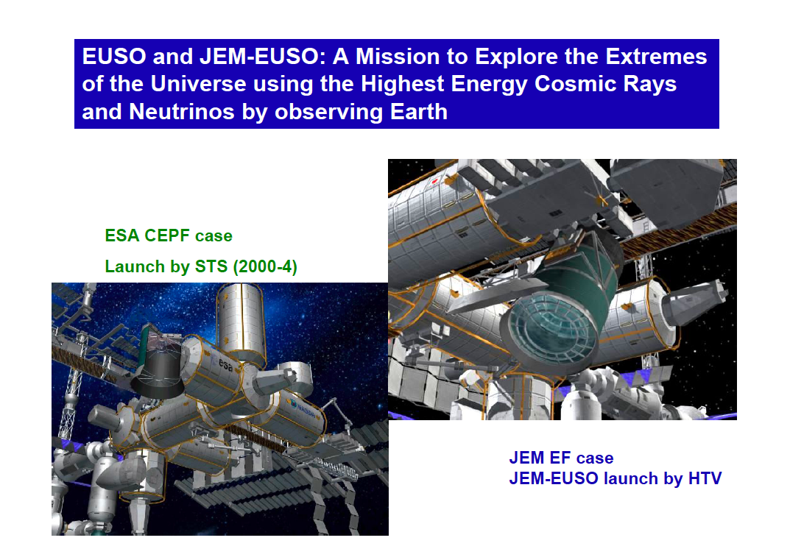
*Y. Takahashi’s presentation 2006

Slide 14
Contents
宇宙からのエアシャワー観測のアイデア歴史
何が違うのか：見下ろすのと見上げるのと
科学目的
装置
性能
パスファインダーミッション
ミッション状況とまとめ

Slide 15
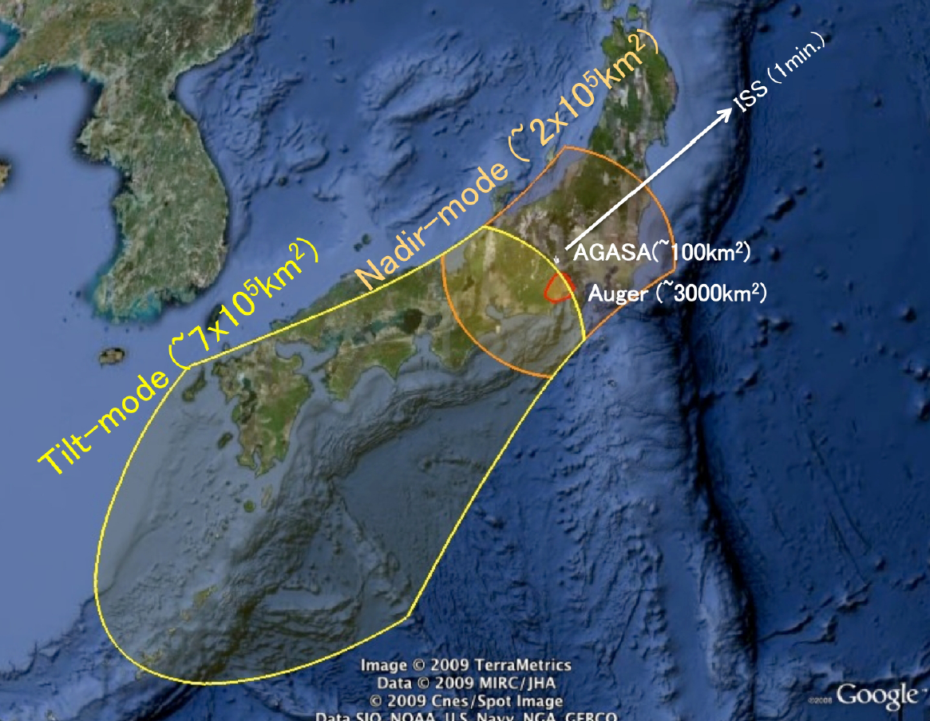
the huge exposure area
3000 Gton – for HE neutrinos

Slide 16
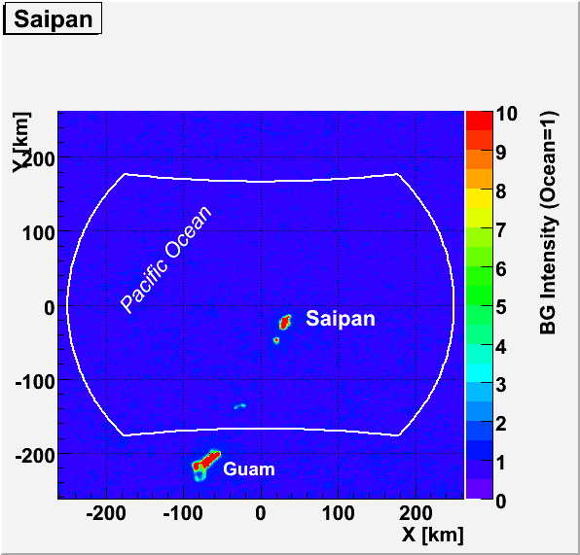
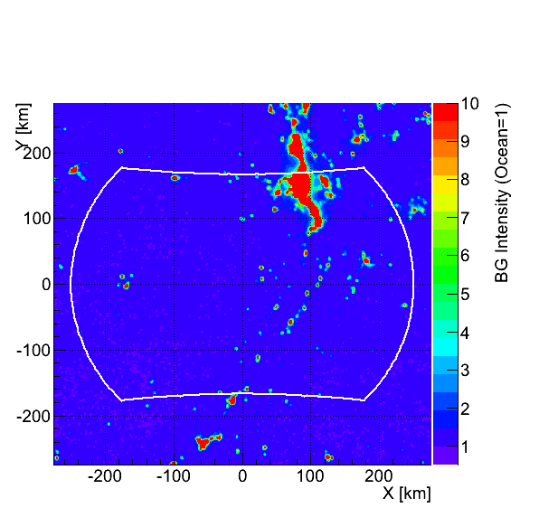
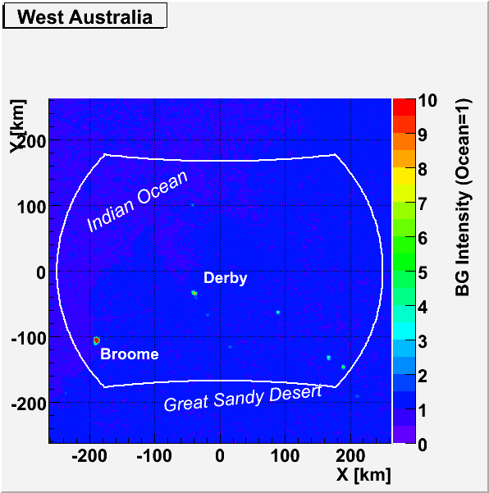
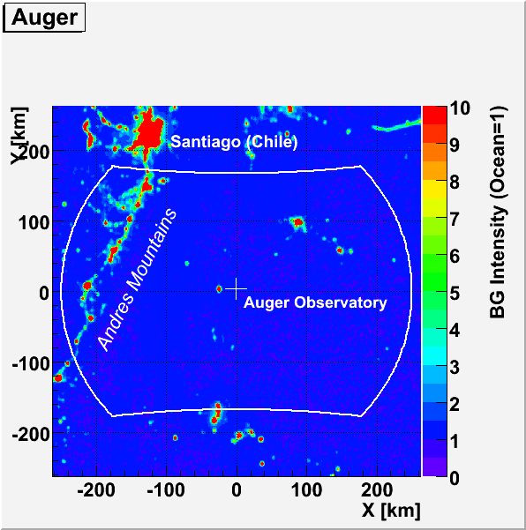
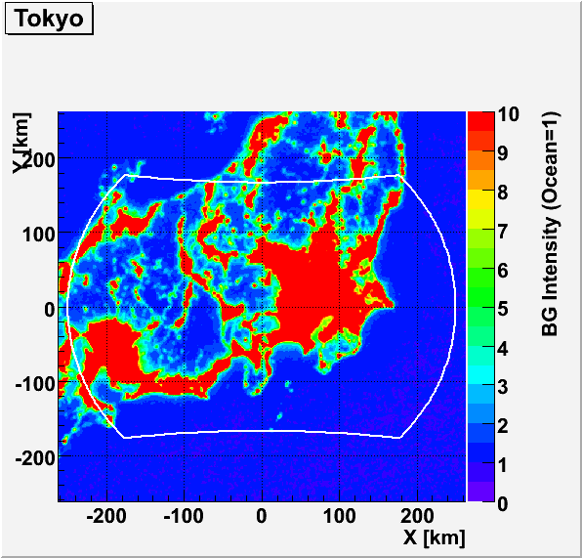
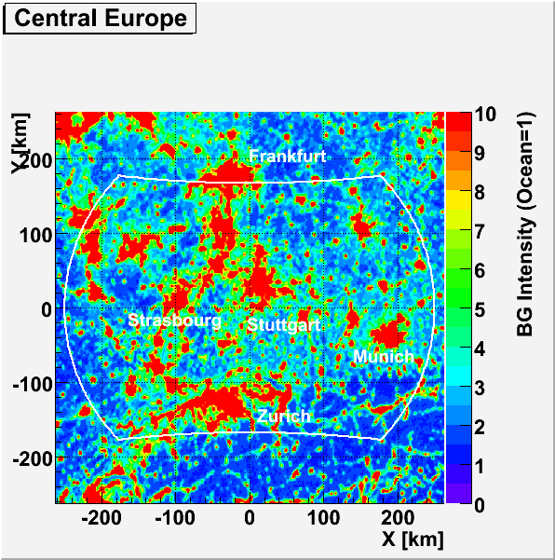
Saipan (mid-Pacific)‏
Utah
Western Australia
(ocean & desert) ‏
■
■
■
Auger site (Pampa)‏
Central Japan
Central Europe
Only 10% of the time
■
■
■
FoV of 1 PDM (27km x 27 km) ■
BG Ocean = 1 = 500 ph/m²/ns/sr
In the city impact we assumed that 1 PDM is blind if 1 km x 1km area sees I > I_{o}

Slide 17
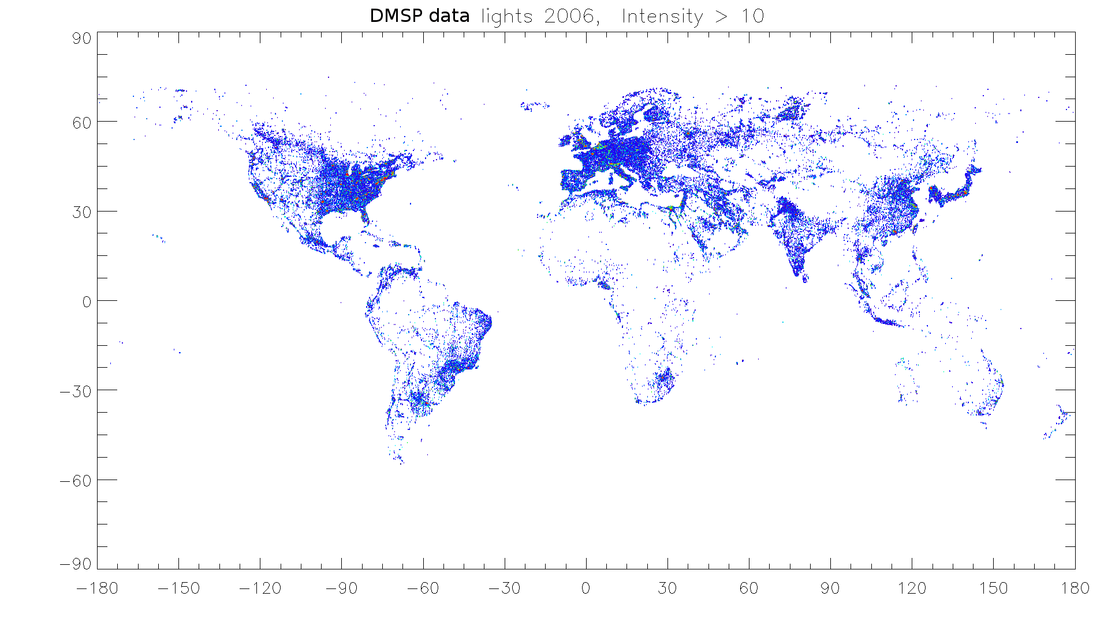
City lights – selection from DMSP data
Intensity > 2000 ph/m²/ns/sr (9% of FoV)
51°N
TA
Auger
51°S
P. Bobik, JEM-EUSO simulation meeting, Kosice, 2011

Slide 18
シャワーまでの距離が幾何学で決まっているステレオ観測は必要ない
Not shown to scale
(schematic illustration)‏
H>>h
D≒H
H>400km
h=10-20 km
Typical FOV of ground-based telescope

Slide 19
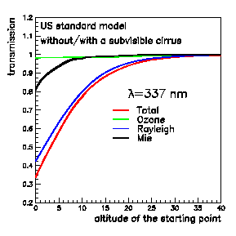
上半分の大気は下半分より透明
下半分
  ダストが多い
  雲が多い
  レイリー散乱が強い
Transmission
Altitude of the starting point

Slide 20
雲の被覆率
Clear sky ~ 29%
Green band ~ 60%
Cloud top
F.Garino et al., ID398
 | <3 km | 3-7 km | 7-10 km | >10 km
OD>2 | 17.2 | 5.2 | 6.4 | 6.1
OD:1-2 | 5.9 | 2.9 | 3.5 | 3.1
OD:0.1-1 | 6.4 | 2.4 | 3.7 | 6.8
OD<0.1 | 29.2 | <0.1 | <0.1 | 1.2
Optical Depth
Occurence of clouds (in %) between 50° N and 50° S on TOVS database. The matrix Optical depth vs. Cloud-top altitude is shown.
Confirmed by ISCCP,CACOLO & MERIS database
RELATIVE OCCURENCE OF CLOUDS BETWEEN 50° N & 50° S (TOVS DATA)
OPTICAL DEPTH | CLOUD-TOP ALTITUDE
 | <3 km | 3-7 km | 7-10 km | >10 km
>2 | 17.2 | 5.2 | 6.4 | 6.1
1-2 | 5.9 | 2.9 | 3.5 | 3.1
0.1-1 | 6.4 | 2.4 | 3.7 | 6.8
<0.1 | 29.2 | <0.1 | <0.1 | 1.2
Relative occurrence (%) of clouds between 50° N and 50° S latitudes on TOVS database in the matrix of cloud-top altitude vs optical depth. Daytime and ocean data are used for the better accuracy of the measurement GREEN → reconstruction possible for every Zenith Angle (ZA) YELLOW → reconstruction possible only for limited range of ZA RED → reconstruction severely affected by cloud presence
Notes:
Do not look at the graphics: it can be improved. Do you have the original table from Lupe?
Which is the key conclusion here? See next slide…
20

Slide 21
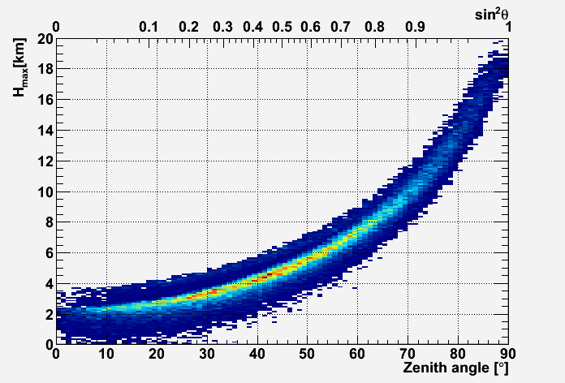
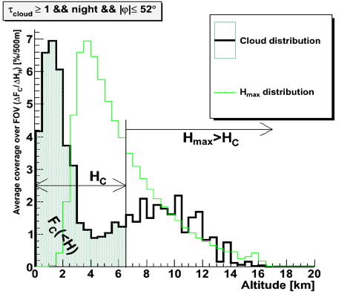
Cloud impact for shower maximum observability
Large ZA EAS has limited cloud impact

Slide 22
雲の被覆率
Clear sky ~ 29%
Green band ~ 60%
Cloud top
F.Garino et al., ID398
 | <3 km | 3-7 km | 7-10 km | >10 km
OD>2 | 17.2 | 5.2 | 6.4 | 6.1
OD:1-2 | 5.9 | 2.9 | 3.5 | 3.1
OD:0.1-1 | 6.4 | 2.4 | 3.7 | 6.8
OD<0.1 | 29.2 | <0.1 | <0.1 | 1.2
Optical Depth
Occurence of clouds (in %) between 50° N and 50° S on TOVS database. The matrix Optical depth vs. Cloud-top altitude is shown.
Confirmed by ISCCP,CACOLO & MERIS database
RELATIVE OCCURENCE OF CLOUDS BETWEEN 50° N & 50° S (TOVS DATA)
OPTICAL DEPTH | CLOUD-TOP ALTITUDE
 | <3 km | 3-7 km | 7-10 km | >10 km
>2 | 17.2 | 5.2 | 6.4 | 6.1
1-2 | 5.9 | 2.9 | 3.5 | 3.1
0.1-1 | 6.4 | 2.4 | 3.7 | 6.8
<0.1 | 29.2 | <0.1 | <0.1 | 1.2
Relative occurrence (%) of clouds between 50° N and 50° S latitudes on TOVS database in the matrix of cloud-top altitude vs optical depth. Daytime and ocean data are used for the better accuracy of the measurement GREEN → reconstruction possible for every Zenith Angle (ZA) YELLOW → reconstruction possible only for limited range of ZA RED → reconstruction severely affected by cloud presence
Notes:
Do not look at the graphics: it can be improved. Do you have the original table from Lupe?
Which is the key conclusion here? See next slide…
22

Slide 23
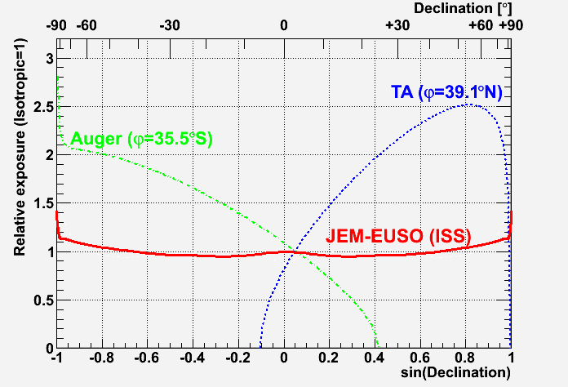
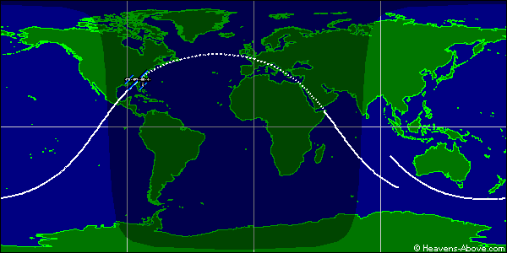
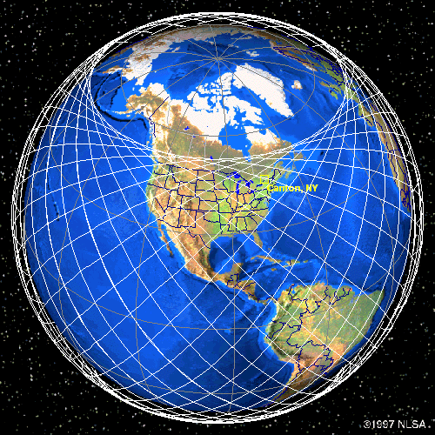
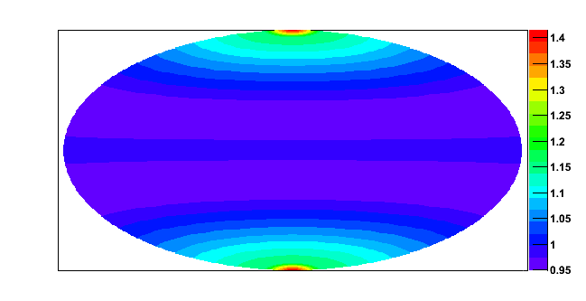
ほぼ一様な露出（南北天球）
Inclination: 51.6°
Height: ~400km
Space based Instrument can observe the arrival direction of EECR very uniformly owing to the nature of the ISS orbit.
http://www.nlsa.com/
全球をカバー

Slide 24
Contents
宇宙からのエアシャワー観測のアイデア歴史
何が違うのか：見下ろすのと見上げるのと
JEM-EUSOミッション概要
パスファインダーミッション
ミッション状況とまとめ

Slide 25

JEM EUSOコラボレーション
日本、米国、韓国、メキシコ、ロシア
ヨーロッパ：ブルガリア、フランス、ドイツ、イタリア、ポーランド、スロバキア、スペイン、スイス
77 機関、 250人以上の研究者
理研:：取りまとめ機関
Notes:
Presentation of the JEM-EUSO collaboration. Leading role of RIKEN
Many research institutions with a tradition in Space science.
Covergence of Astrophysicists with Particle Physicists, and atmosphere scientists.

Slide 26
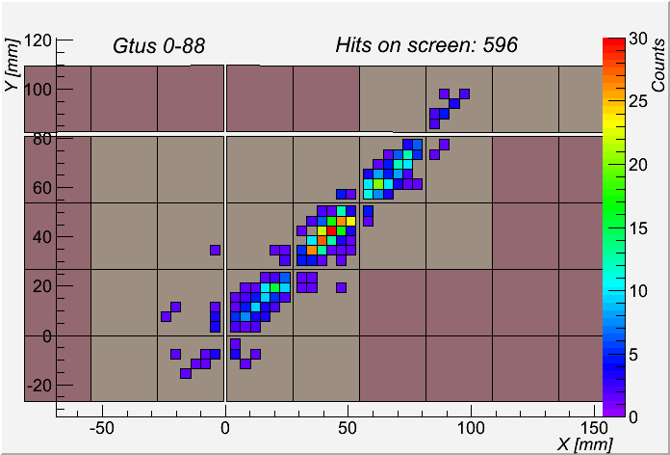
a) 蛍光光
b) 散乱チェレンコフ光
p, 10²⁰eV, 60 deg
c) 地上散乱チェンレンコフ光
GTU time units
高速のシグナル
Simulation of the light profile observed at the entrance pupil (above) and of the observed shower image (using the ESAF code)
Notes:
I might skeep this slide

Slide 27
基本科学目的
荷電粒子天文学の確立
  高統計到来方向解析による線源の同定
  個々の線源のエネルギースペクトル測定
  GZK構造の高統計測定
E>5.×10¹⁹eVにおける物理と天文学

Slide 28
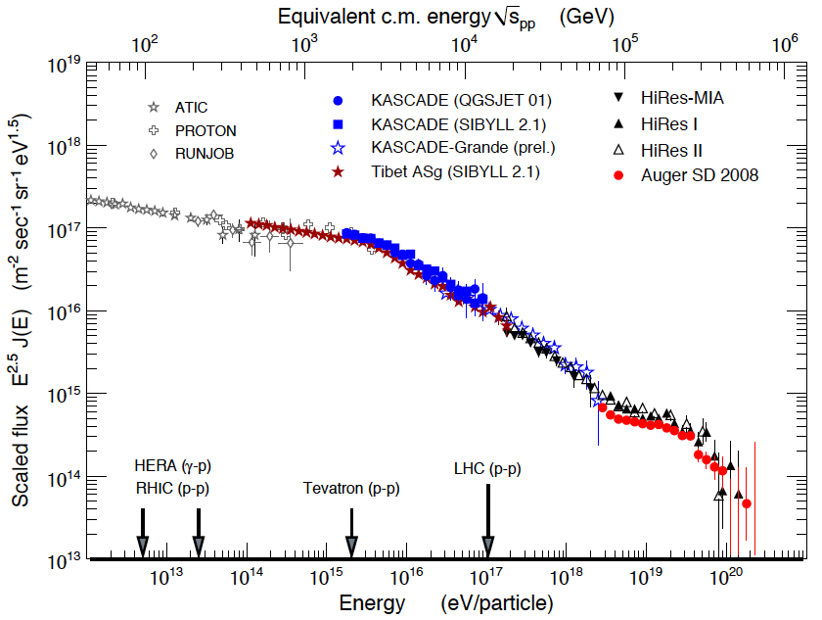
JEM-EUSO EE target region
OVERLAP
JEM-EUSO SCIENCE
1st Knee
2nd Knee
HE flux suppression (GZK?)
Ankle
ICRC 2011 : Beijing : JEM-EUSO Gustavo Medina-Tanco – ICN-UNAM

Slide 29
UHECR status in just one word
Previous to Auger / HiRes :
G. Medina Tanco - ICN/UNAM

Slide 30
UHECR status in just one word
Previous to Auger / HiRes :
Key Auger / HiRes result:
1000
G. Medina Tanco - ICN/UNAM

Slide 31
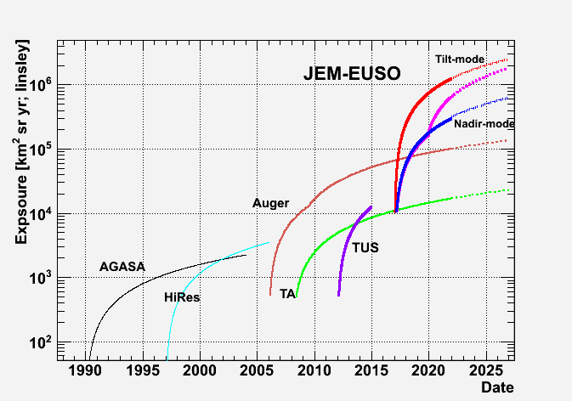
JEM-EUSO uniquenes
Large exposure + Full-sky coverage
10⁶ km² sr yr
G. Medina Tanco - ICN/UNAM

Slide 32
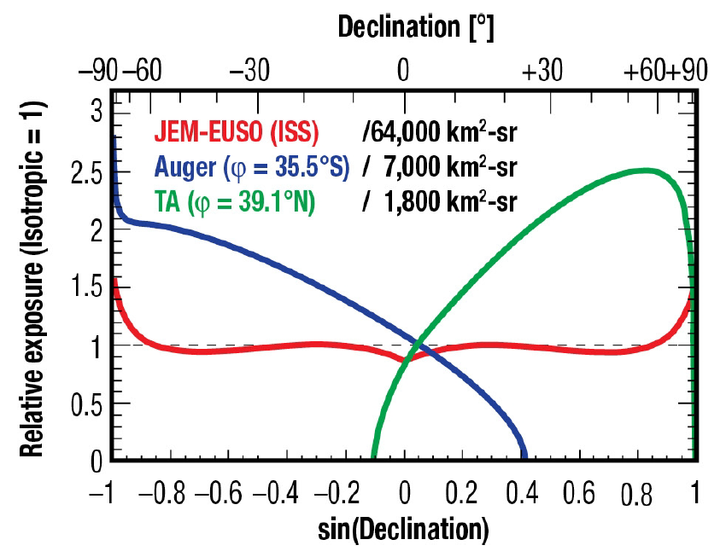
一様で大きな露出

Slide 33
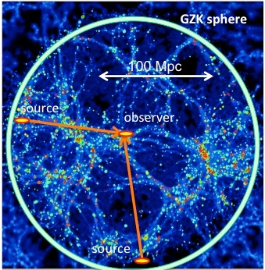
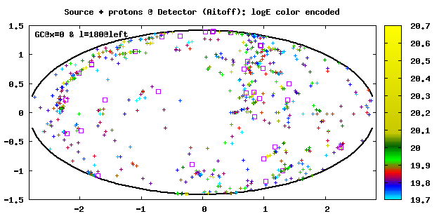
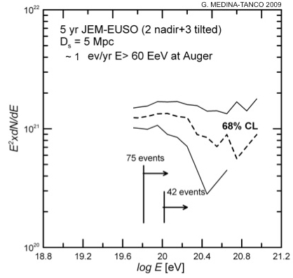
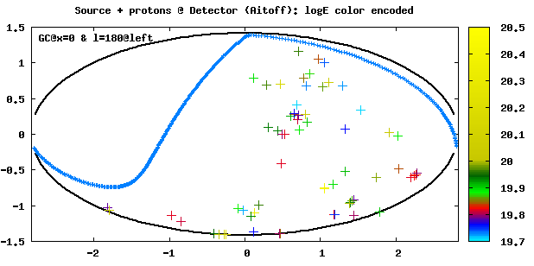
JEM-EUSO science potential
Single source astronomy
(1) PSF identification, (2) individual spectra, (3) multiplet statistical analysis,
(4) catalogue cross-correlation, (5) multiwavelength study, (6) GMF determination
log E
Same as previous with Auger present exposure

Slide 34
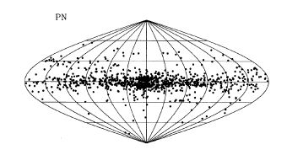
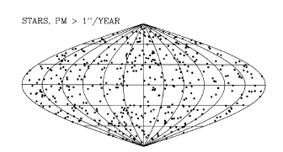
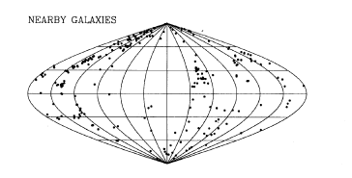
Distribution of Astronomical Objects
stars
X-ray Burst
Planetary Nebulae
GRB
?
Globular Clusters
Radio Sources
Nearby Galaxies

Slide 35
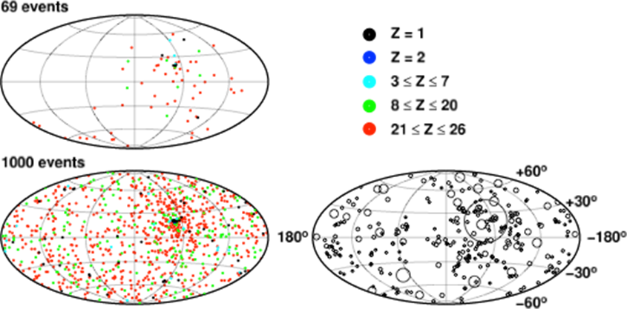
Arrival Distribution of Heavy Nuclei
A pessimistic case rather than a conservative case
Pure Fe composition initially (astrophysically unrealistic, but most pessimistic)
Almost upper limit values of GMF and IGMF

Slide 36
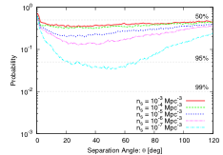
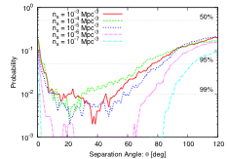
Arrival Distribution of Heavy Nuclei
A pessimistic case rather than a conservative case
Pure Fe composition initially (astrophysically unrealistic, but most pessimistic)
Almost upper limit values of GMF and IGMF
69 events Auger aperture
1000 events, Uniform aperture
Anisotropy will appear with > 99%.
Anisotropy from the nearest source is expected by JEM-EUSO.

Slide 37
試験的探求研究
新メッセンジャー
  超高エネルギーニュートリノの検出
    X₀ and X_{max}
  超高エネルギーガンマ線の検出
    X_{max} の変化LPM effect
磁場magnetic fields
  銀河磁場と局所宇宙の磁場構造に制限
高い発見能力と新しい物理への制限

Slide 38
ニュートリノ と陽子: X_{max}
Supanitsky & Medina-Tanco 2011
Distribution of X_{max} for protons and neutrinos for E=10²⁰ eV and θ=85° (First Peak of the shower profile)

Slide 39
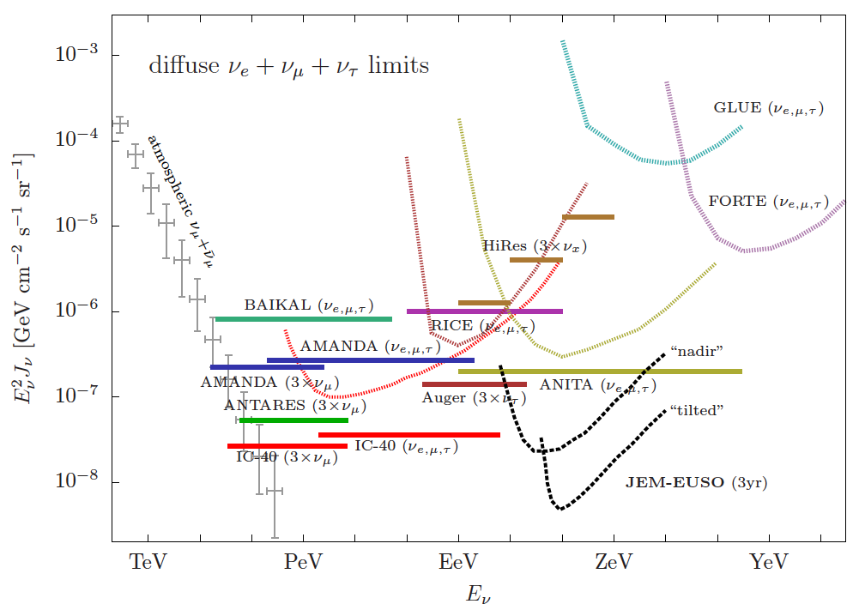
Upper limits on neutrino flux
G. Medina Tanco - ICN/UNAM

Slide 40
Key observation and instrument requirements
Observation area (Nadir) | ≥1.3×10⁵ (H_{orbit}/400[km])² km²
Arrival direction determination accuracy | ≤ 2.5° (at E=10²⁰ [eV] and 60° zenith angle)
Energy determination accuracy | ≤ 30% (E=10²⁰ [eV] and 60° zenith angle)
X_{max} determination accuracy | ≤ 120 [g/cm²] (E=10²⁰ [eV] and 60°zenith angle)
Energy threshold | ≤ 5.5×10¹⁹ [eV]
Duty cycle | ≥ 17%
Lifetime | > 3 years (goal: > 5 years)
Notes:
How is defined here the Observation duty cycle
How is defined the Instrument duty cycle?

Slide 41
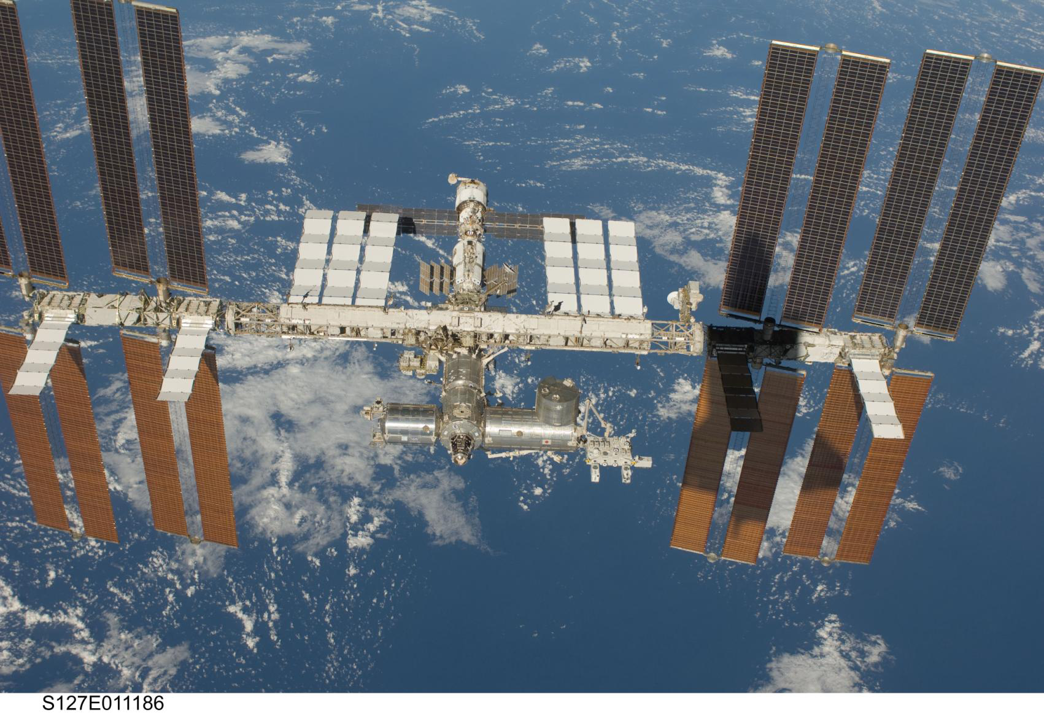
Japanese Experiment Module
“Kibo” July 2009
きぼう
51.6°

Slide 42
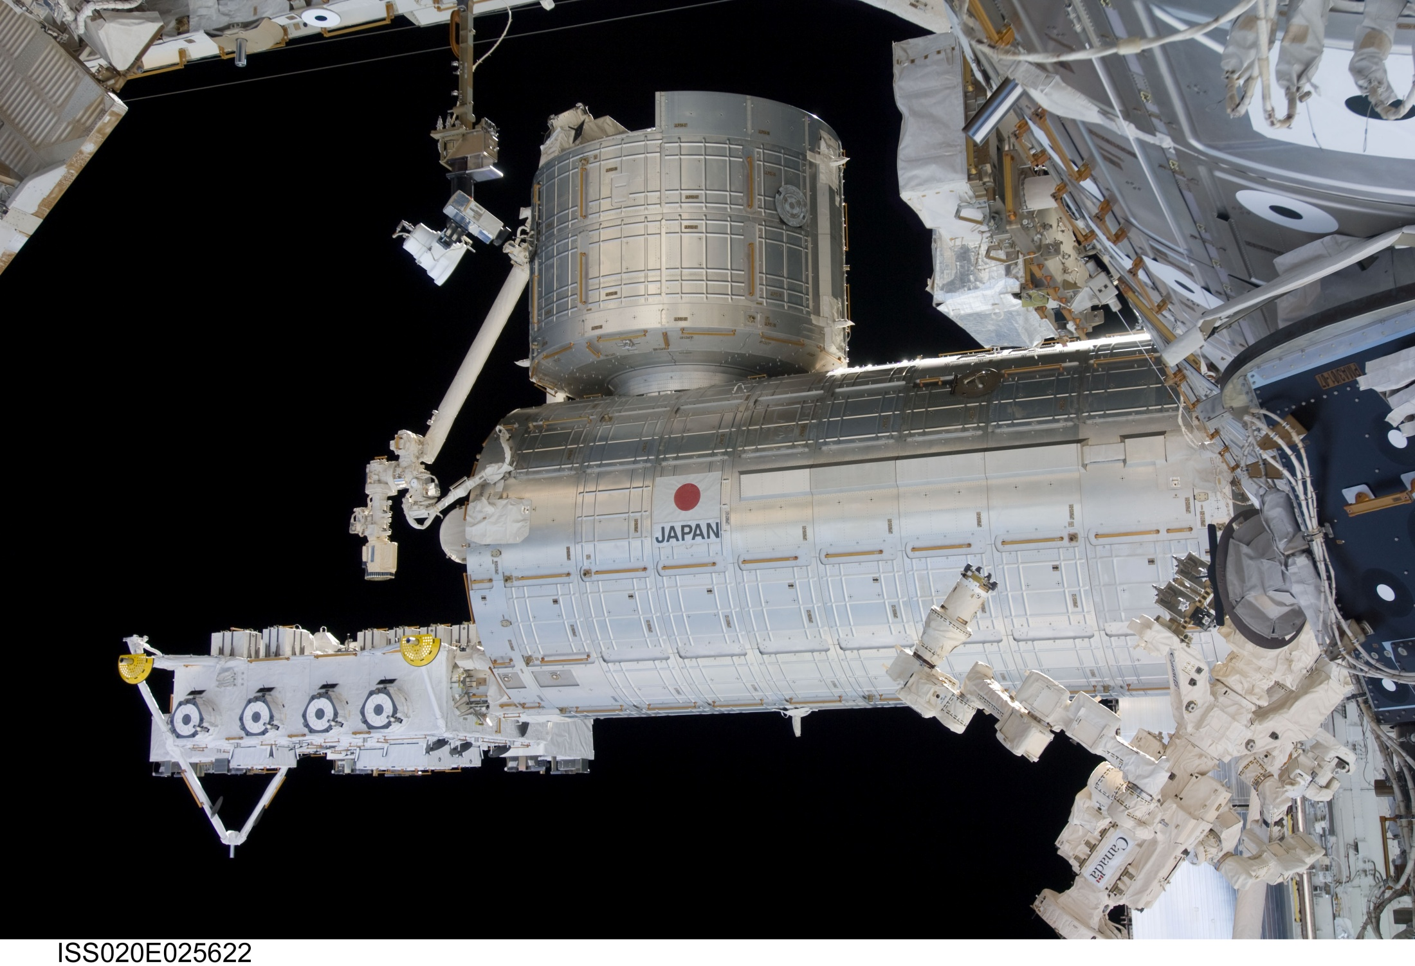
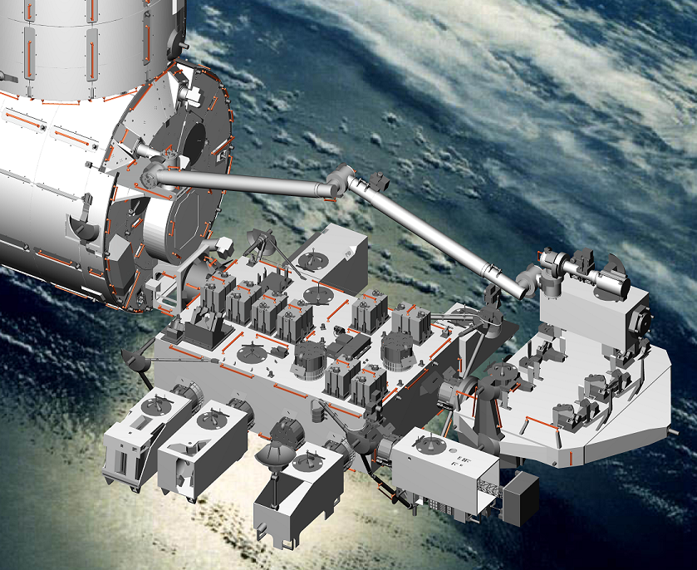
Robotic Arm
Candidate positions for JEM-EUSO
Standard Payload: mass 500 kg, envelope:1.85m×1.0m×0.8m

Slide 43
All mission aspects have been successfully studied by JAXA and RIKEN: open issue of ISS resources.
Parameter | Value
Launch date | JFY 2016
Mission Lifetime | 3+2 years
Rocket | H2B
Transport Vehicle | HTV
Accommodation on JEM | EF#2
Mass | 1938 kg
Power | 926 W (op.) 352 W (non op.)
Data rate | 285 kbps (+ on board storage)
Orbit | 400 km
Inclination of the Orbit | 51.6°
Operation Temperature | -10° to 50°

Slide 44
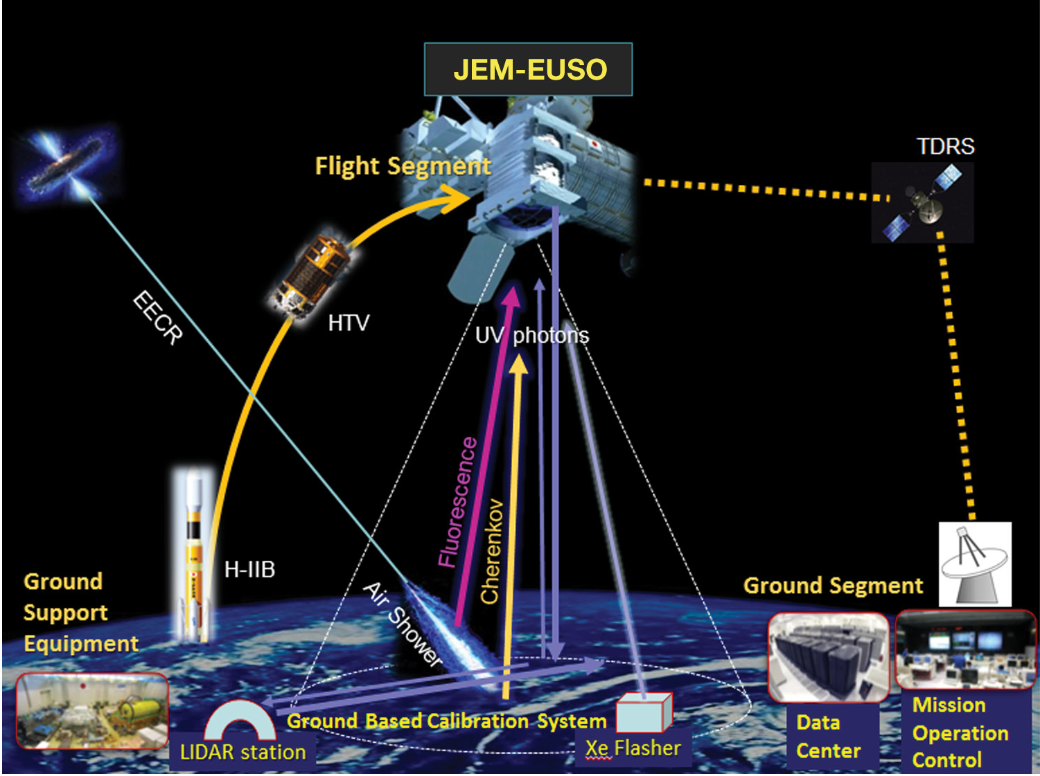





Slide 45
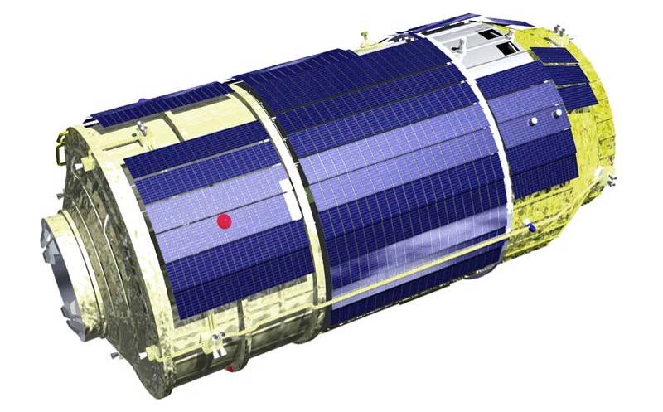
Science Instrument on HTV
Side view
H2B Transfer Vehicle (HTV)
3.7m
JEM-EUSO Telescope will be deployed after it is attached at the ISS
HTV was successfully launched on September 2009

Slide 46
AMS: Poster MD Rodriguez-Frias
Science Instrument: deployed
Focal Surface
Detector and
Electronics
Deployment
Mechanism
Focal Surface
Rear Lens
Middle Lens
Atmospheric Monitoring
System: IR-Cam + Lidar
Optics
Fresnel
lenses
Front Lens
Precision optics cancels chromatic aberration.
Materials: PMMA+CYTOP
Pallet

Slide 47
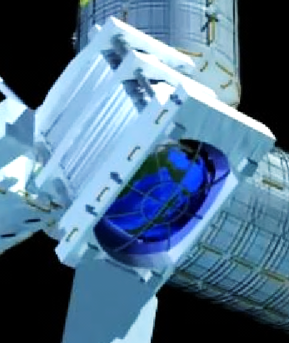







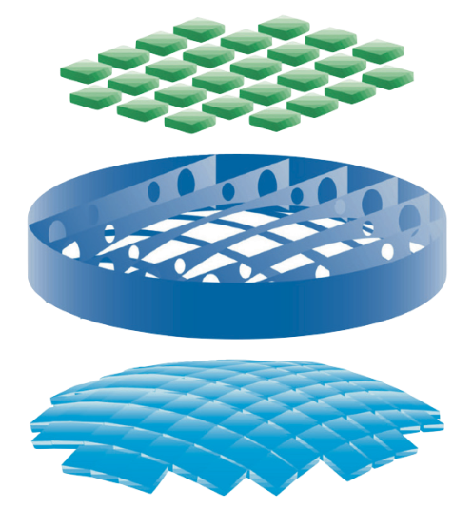
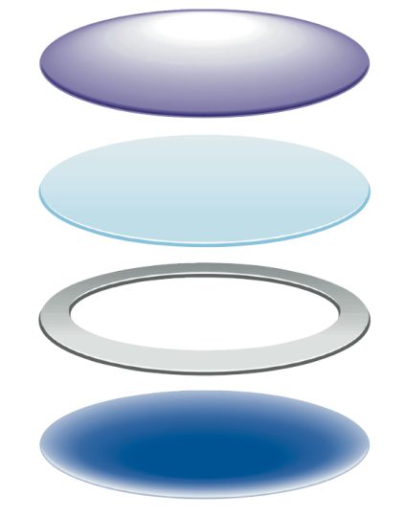


国際協力
DAQ Electronics
Optics
Rear Fresnel Lens
Precision Fresnel lens
Support Structure
Iris
Front Fresnel lens
Telescope Structure
Focal Surface Detector
On-board Calibration
BUS System : JAXA
Housekeeping
Ground Based Calibration
Atmospheric Monitoring
Ground Support Equipment
Simulation : Worldwide

Slide 48
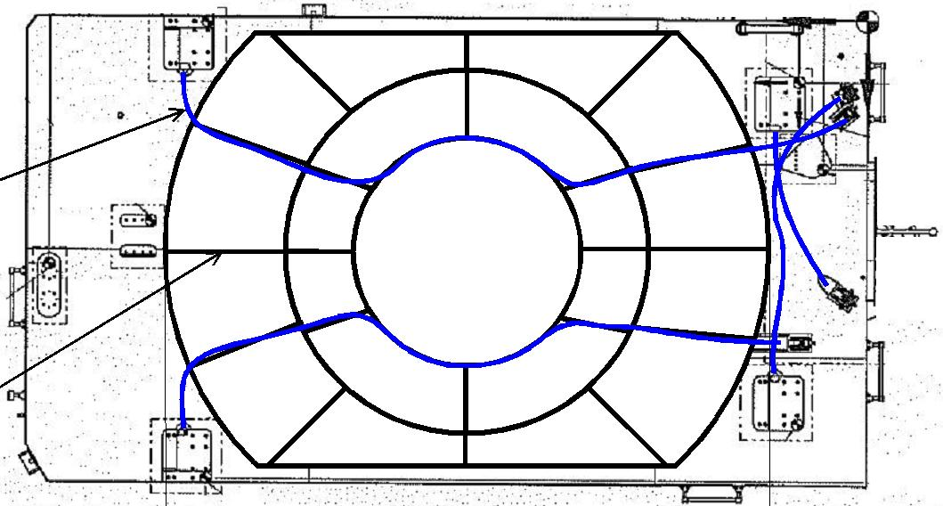


光学系のプロトタイプ
large diameter Fresnel lenses manufactured in Japan and tested in the US at the University of Alabama (Huntsville) and at MSFC (NASA)
1.5 m
2.65 m
Spot size is 2.5 mm!
Tested performances meet already the requirements (or are close to it)

Slide 49
Elementary Cell
(2x2 PMTs = 256 pixels)
MAPMT
(8x8 pixels)
Photo-Detector Module
(3x3 ECs = 2,304 pixels)
Focal Surface detector
137 PDMs = 0.3M Pixels

Slide 50
Why JEM-EUSO? Large exposure + Full sky coverage
1 MLinsley
Notes:
High energy 50% full efficiency: please explain

Slide 51
Comparison with current observatories
Observatory | Aperture km² sr | Status | Start | Lifetime | Duty cycle | Annual Exposure km² sr yr | Relative to Auger
Auger | 7,000 | Operations | 2006 | 4 (16) | 1 | 7000 | 1
TA | 1,200 | Operations | 2008 | 2 (14) | 1 | 1,200 | 0.2
TUS | 30,000 | Developed | 2012 | 5 | 0.14 | 4,200 | 0.6
JEM-EUSO (E≈10²⁰ eV) | 430,000 | Design | 2017 | 5 | 0.14 | 60,000 | 9
JEM-EUSO (highest energies) Tilted mode 35° | 1,500,000 | Design | 2017 | 5 | 0.14 | 200,000 | 28
Notes:
All numbers must be updated and changed!
Number of events must be given!

Slide 52


Estimation of event statistics
Observational time 19% & cloud-impact 70%
Incident spectrum assumed to Auger ICRC2011
Recovery model (Medina Tanco) also tested
Auger with recovery
Auger + 20%
Auger without recovery
If actual spectrum were Auger without recovery

Slide 53



Expected number of events in 1 year data taking
Full FoV
& all θ
R<150 km
& θ > 60°
JEM-EUSO
● Auger
● TA
R<60 km
& θ > 60°

Slide 54

Expected number of events 5 years (>E)‏
JEM-EUSO with recovery
JEM-EUSO without recovery

Slide 55
Contents
宇宙からのエアシャワー観測のアイデア歴史
何が違うのか：見下ろすのと見上げるのと
JEM-EUSOミッション概要
パスファインダーミッション
ミッション状況とまとめ

Slide 56
パスファインダーミッション
TUS (Lomonosov satellite: Russia)
EUSO-BALLOON (France)
TA-EUSO (日本)
MicroUVT (日本)

Slide 57
TUS
ロシアの衛星 “Lomonosov”
  2012内に打ち上げ予定
Skobeltsyn Institute of Nuclear Physics, Moscow State University, Russia
科学的、技術的パスファインダー
    宇宙からシャワーを見る
    UV背景光の観測
    PMT とエレクトロニクス
    UFFO (Ultra Fast Flash Observatory)
      韓国のガンマ線バーストミッション

Slide 58

Lomonosov Satellite
UFFO

Slide 59

TA-EUSO
2012年の12月までに
Telescope Array (TA) サイトにおける検出器テスト
TA-EUSO 望遠鏡はBlack Rock Mesaの蛍光望遠鏡の前に置く
  Electron Light Source at 100m
  Most nearby SD is at ~3.5 km
  Central Laser Facility ~21km

Slide 60


Slide 61

 | JEM-EUSO | TA-EUSO
Diameter(m) | 2.5 | 1.2(effective diameter 1m)
FOV/Pix(deg) | 0.08 | 0.17
FOV/PDM(deg) | 3.84 | ±4
Effective Area (km^2) | 28,191 | 3.94
S/sqrt(N) | 1
Target energy (eV) | >3.00E+19 | >1.00E+18
Number of PDM | 137 | 1
Event Rate(/h) | 0.56 | 0.1

Slide 62


Lenses
Electronics block
PDM detector
Size (mm)

Slide 63


TA FD
(Fluorescence detector)
TA-EUSO location
ELS: Electron Light Source
Lenses
TA site, UTAH, Black Mesa
Electronics block
PDM detector block
PDM detector
LASER Team
Size (mm)

Slide 64


JEM-EUSO Balloon
  気球から下を見る
    UV望遠鏡 (PDM EM + 3 lenses system)
  光学テスト
  背景光テスト
  40kmの高さから空気シャワーを見る
  フランス宇宙機関（CNES）
  Phase B進行が決定
  2013年の打ち上げを目指す
  数回のフライト

Slide 65



JEM-与圧部利用ミッション公募
MICRO-UVT

Slide 66

マイクロUVTの視野
UV背景光のMAP

Slide 67
Contents
宇宙からのエアシャワー観測のアイデア歴史
何が違うのか：見下ろすのと見上げるのと
JEM-EUSOミッション概要
パスファインダーミッション
ミッション状況とまとめ

Slide 68
Programmatics (1)
ヨーロッパ宇宙機関（ESA）: 2010年からELIPSプログラムの一部として研究。ESAは宇宙機関における調整役
ロシア宇宙機関（ROSCOSMOS）
  Tsniimash (Roscosmos ISS研究機関) Prof. Panasyuk （Russian PI）がJEM-EUSOについてSTEC委員会で報告、了承を得る
  モスクワ州立大学にて国際JEM-EUSO会合（2012年5月）
  Tsniimash研究所、ISS担当副所長からROSCOSMOS副理事長に手紙：JEM-EUSOへ参加とISS資源についての国際調整の依頼
  望遠鏡構造（含む伸展機構）を担当することで基本合意：MOU交換

Slide 69

ROSCOSMOS
有人プログラム所長への手紙

Slide 70

Programmatics (2)
米国宇宙機関（NASA）: SALMON AO (2011)は採択されなかった。2012年3月に新PIのAngela Olinto（シカゴ大）のもとARPA/ROSESに新提案：米国の宇宙ステーション資源の提供への道を開く。 その他のFunding Agencyへの提案を企画中
日本宇宙機関（JAXA）: 2015年ごろの有望ミッションとして推薦。米国およびロシアでの動きを歓迎
他の国： EUSO Balloonや
TA-EUSOへの参加。
JEM-EUSOへの予算の準備を進める

Slide 71

US team のAPRA提案書の一部

Slide 72


New Organization
  PI: Piergiorgio Picozza
  Deputy PI: Toshikazu Ebisuzaki
  Global Coordinator
  Andrea Santangelo

Slide 73











The Wizard Program
MASS-89, 91, TS-93, CAPRICE 94-97-98
NINA-1
PAMELA
NINA-2
GLAST
AGILE
AGILE /
GLAST after 2006
M 89
M 91
TS 93
C 94
C 97
C 98
PAMELA
•
•
•
•
•
•
…1989 · 1990 · 1991 · 1992 · 1993 · 1994 · 1995 · 1996 · 1997 · 1998 · 1999 · 2000 · 2001 · 2002 · 2003 · 2004 · 2005 · 2006 · 2007..
SILEYE-1
NINA-1
NINA-2
Alteino-SILEYE-3
SILEYE-2
ALTEA-SILEYE-4
SILEYE-1
SILEYE-2
ALTEINO: SILEYE-3
LAZIO SIRAD
ALTEA

Slide 74
まとめ
挑戦１：新しい観測手法
  宇宙から空気シャワーを見る最初のミッション
挑戦２：荷電粒子天文学
  極限エネルギー宇宙線の線源を同定
  個々のスペクトルを図る
  露出の飛躍的な増加
    10²⁰eVでPAOの9倍、最高エネルギーで27倍
  一様な露出
挑戦３：物理の基本原理
  ローレンツ不変性、新物理への制限
挑戦４：国際協同
  3つの大陸にまたがった広範な国際協力
  国際宇宙ステーション

Slide 75
これは始まりに過ぎない

Slide 76
S-EUSO
Photon Corrector Mirror: 8 m
FoV: > 50°
Pixel Size: 0.02°
Assembly and Tune-up in orbit (ISS)
  Space Factory Concept
  Make a Free-Flyer

Slide 77




Price tag $700M
Out of Strategic Planning
2002-2003
Optics option 15° FOV
Limited by Schmidt

Slide 78

Vertical assembly

Slide 79

Vertical assembly
& testing mode

Slide 80

Free-flyer kit mounted

Slide 81

Y. Takahashi 1999
Great observatory made &
deployed from the renewed ISS
heading for its own orbit

Slide 82

Released from ISS
in perfect condition

Slide 83

Huge Pacific Ocean will be our Detector
White circle → HORIZON from S-EUSO (900km)

Slide 84
Four Space-Based Missions
 | Optics Aperture [m²] | FOV | Pixel side | Orbit altitude [km²] | Geom. aperture [km² sr] | Annual exposure [linsley yr⁻¹]
TUS (2012—) | 1.8 | 9°x9° | 0.6° | 500 | 2.0x10⁴ | 2,700
JEM-EUSO (2017—) | 4.5 | 60°φx48° (40°φ) | 0.07° | 400 | 4.0x10⁵ (5.5x10⁴) | 60,000 (7000)
S-EUSO (2025—) | 38 | 50°φ | 0.04° | ~900 | 2.0x10⁶ | 300,000

Slide 85

Old Multi-OWL1996

Slide 86
Multi-units and/or multi-fleet
2 x 3 makes 6 times

Slide 87
予備

Slide 88

Individual source identification
HALO BORDER
G. Medina-Tanco, 2009
source
Inter-Galactic MF
Galactic MF
SOLAR CIRCLE
G. Medina Tanco - ICN/UNAM

Slide 89


Protons: E>55 EeV - 300ev from ULX + 500ev (bckgr) from IRAS
log E
True source direction
High energy
Low energy
G. Medina Tanco - ICN/UNAM

Slide 90

JEM-EUSO @ 5 yr
800 events: 70% bckgr from IRAS LSS + 30% from ULX PSrc
G. Medina Tanco - ICN/UNAM

Slide 91

JEM-EUSO @ 5 yr
800 events: 70% bckgr from IRAS LSS + 30% from ULX PSrc
G. Medina Tanco - ICN/UNAM

Slide 92

JEM-EUSO @ 5 yr
800 events: 70% bckgr from IRAS LSS + 30% from ULX PSrc
G. Medina Tanco - ICN/UNAM

Slide 93

JEM-EUSO @ 5 yr compared to Auger
800 events: 70% bckgr from IRAS LSS + 30% from ULX PSrc
Same as previous with Auger present exposure
G. Medina Tanco - ICN/UNAM

Slide 94

Fe: 500ev from ULX & no background events
log E

Slide 95

GMF assesment through PSF global patterns
Medina-Tanco & Teshima (2003)
Individual PSFs do not need to be visible – 2D correlation function in (l,b) is enough to recover the structure.
G. Medina Tanco - ICN/UNAM

Slide 96










OK
OK
BAD
OK
Signal attenuated
96
L.Saez et al., ID1034
Notes:
Qua sono elencate le situazioni elencate precendeentemente.
96

Slide 97


Scientific Objectives 3
Exploratory Objectives: Atmospheric science
  Nightglow
  Transient luminous events
  Space-atmosphere interactions and climate change
Exploratory Objectives: Meteors and meteoroids
A fast UV monitoring of the atmosphere

Slide 98
The UV Telescope Parameters
Parameter | Value
Field of View | ±30°
Monitored Area | >1.3×10⁵km²
Telescope aperture | ≥2.5 m
Operational wavelength | 300-400 nm
Resolution in angle | 0.075°
Focal Plane Area | 4.5 m²
Pixel Size | <3 mm
Number of Pixels | ≈3×10⁵
Pixel size on ground | ≈560 m
Time Resolution | 2.5 μs
Dead Time | <3%
Detection Efficiency | ≥20%
+
+
+ Optics Throughput

Slide 99


Upper limits on the photon-abundance – simple approach
Adapted fromAuger Collaboration, Astroparticle Phys. 31 (2009) 399–406
JEM-EUSO
COSMOGENIC PHOTONS
For a sample of size N, a rejection level α, and the ad hoc assumption that there are no γ events in the sample

Slide 100

Photon discrimination
ISS samples all possible relative configurations of the geomagnetic field vs. EAS direction.
JEM-EUSO is ideally suited to exploit interplay between LPM & photon splitting
γ
G. Medina Tanco - ICN/UNAM

Slide 101


Neutrinos from space
proton / nuclei
neutrino
G. Medina Tanco - ICN/UNAM

Slide 102
Neutrino discrimination: down-going neutrinos
Supanitsky & Medina-Tanco, 2011
Distribution of the first peak of the profiles for proton and neutrinos of E = 10²⁰ eV and θ= 85º.
G. Medina Tanco - ICN/UNAM

Slide 103

Inclined down-going discrimination
Supanitsky & Medina-Tanco, Astropart. Phys. 2011
G. Medina Tanco - ICN/UNAM

Slide 104
LIV for HE electrons and photons
The same argument of Glashow & Coleman can be applied to the decay of photons into e±-pairs
If δ ≠ 0
is kinematically allowed for all photons
with:
Thus even a trivial (but still restrictive) limit on δ comes from the mere eventual observation of HE photons by JEM-EUSO at ~ 10²⁰ eV:
G. Medina Tanco - ICN/UNAM

Slide 105

LI space symmetry violations
The possibility exists that there is an asymmetry in space, which could be the manifestation of vector fields in space.
A stringent test of relativity could be made from high multiplicity sources at known distances. If the GZK steepening functions consistently deviate at some directions in the sky external fields, like vector fields, might be emerging which are not unidirectionally Lorentz Invariant. On the other hand, the proof of non-vector fields would verify Lorentz Invariance at EHE.
The possibility remains that there is an asymmetry in space, which could be the manifestation of vector fields in space.
Gustavo Medina-Tanco – ICN-UNAM

Slide 106


UHECR spectra at different region of the sky
n_{ev}
θ
n_{LIV}
C.L.: 68% & 95%
ICRC2011 exposure
& trigger efficiency
G. Medina Tanco - ICN/UNAM

Slide 107

Micrometeoritos
Unknown velocity
Known projection
Atmosphere
Ground

Slide 108



Micrometeoritos: search for and characterization of small debris
Perseids + background
Orionids + background

Slide 109


太陽系周辺の物質分布
Welsh and Shelton 2009

