Slide 1
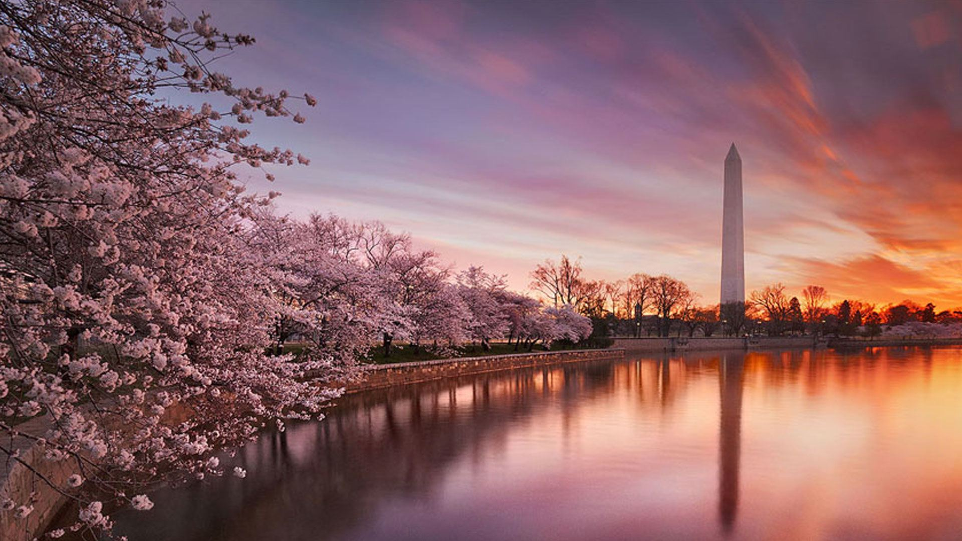
Studying Inhomogeneous Reionization at z>7 using Lyman Alpha Surveys
James E. Rhoads
NASA Goddard Space Flight Center
Based on work with multiple collaborations– the LAGER team, the DAWN Survey team, the WFIRST Cosmic Dawn team, the FIGS team–
and other collaborators

Slide 2
Why study reionization?
The first time that bound objects (stars, galaxies, black holes) had a significant impact on the universe around them.
The topology of reionization can give clues about the ionizing sources.

Slide 3
Desired Properties of Reionization Tests
Local
Disclaimer: your figure of merit may vary
Gunn-Peterson
21 cm mapping
Available
central
Lyman alpha
21cm wide angle
CMB polari-zation
GRB afterglow spectra

Slide 4
Reionization History Constraints
Neutral fraction vs. Redshift from Planck XLVII paper.
Blue bands give the 1σ and 2σ error regions inferred from CMB data.
Red points are published neutral fraction measurements; black points are limits (both upper and lower).
Upper bounds here include current LyA constraints.

Slide 5
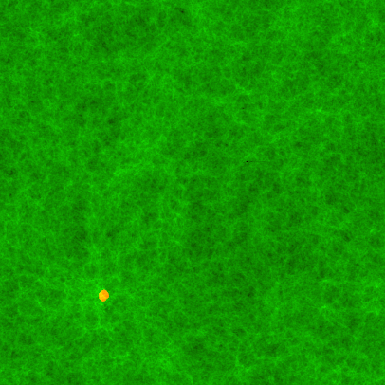
Simulation Results - from work of Iliev, Mellema, Shapiro, and collaborators
Movie of density field and HII regions
Green: neutral
Red: Ionized
Note: clustering & overlap.
From z=20 to 10 (WMAP3 parameters).
35/h Mpc

Slide 6
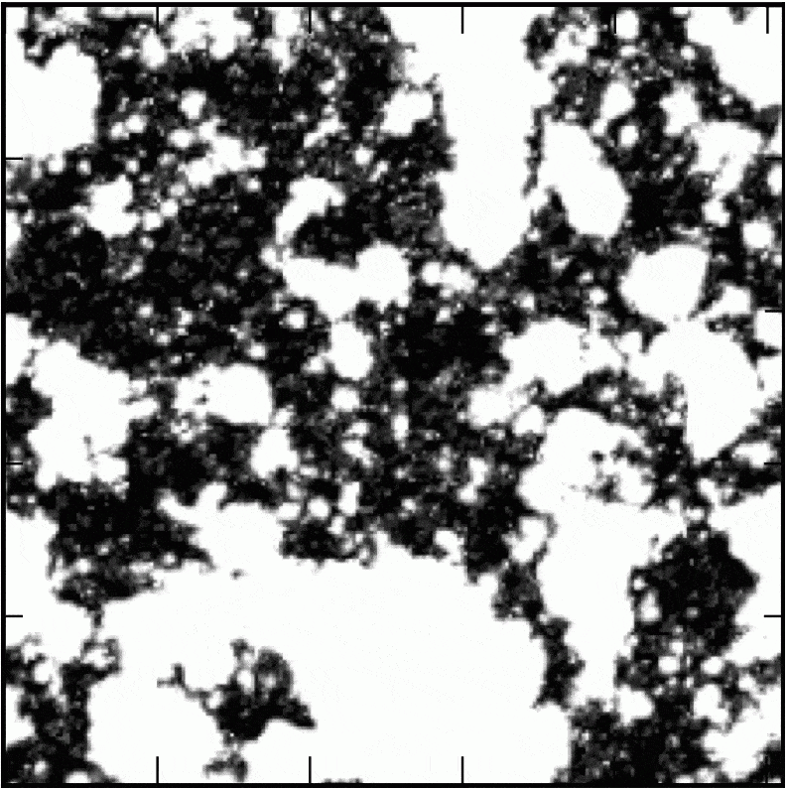
Inhomogeneous Reionization and Lyman α Galaxies
Neutral and ionized regions / observed Lyα galaxies.
Figures from Jensen et al 2012.
Ionized bubbles modulate visibility of Lyα.
This is used to infer properties of the bubbles.
Clustering test references: Furlanetto et al 2005, McQuinn et al 2007; Jensen et al 2012, 2014.
Notes:
WFIRST can map Lyα galaxies over a field this size.
(163 cMpc, ~ 1 deg.)

Slide 7
Reionization History Constraints
WFIRST
DAWN
LAGER

Slide 8
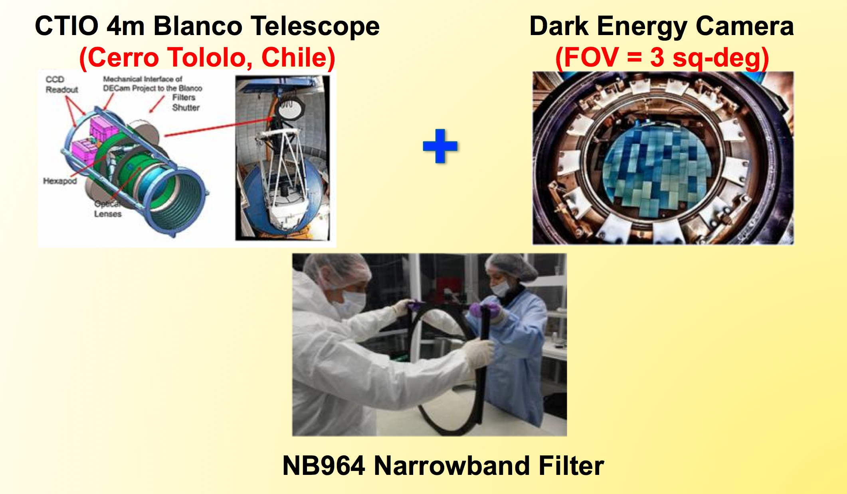
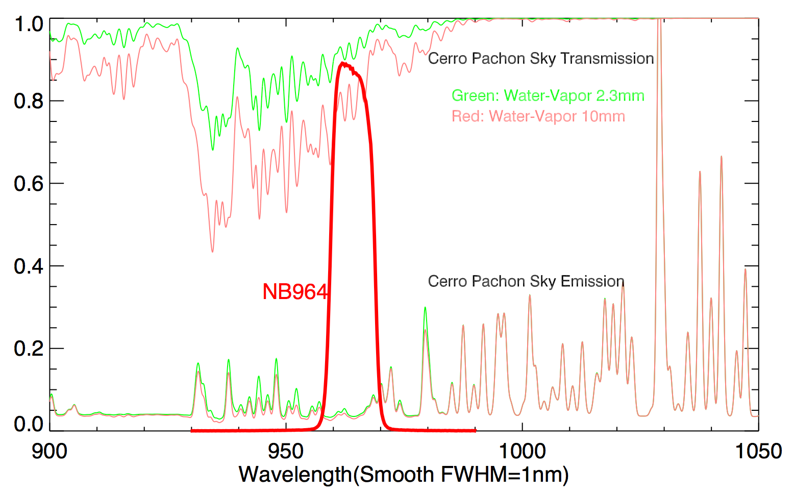
The LAGER Survey
Lyman
Alpha
Galaxies in the Epoch of Reionization
Sangeeta Malhotra, Junxian Wang, Zhenya Zheng, Polo Infante;
James Rhoads, Alistair Walker, Weida Hu, XianZhong Zheng, Linhua Jiang, Chunyan Jiang, Alicia Gonzalez, Xu Kong, Pascale Hibon, Gaspar Galaz, Felipe Barrientos, Huan Yang

Slide 9
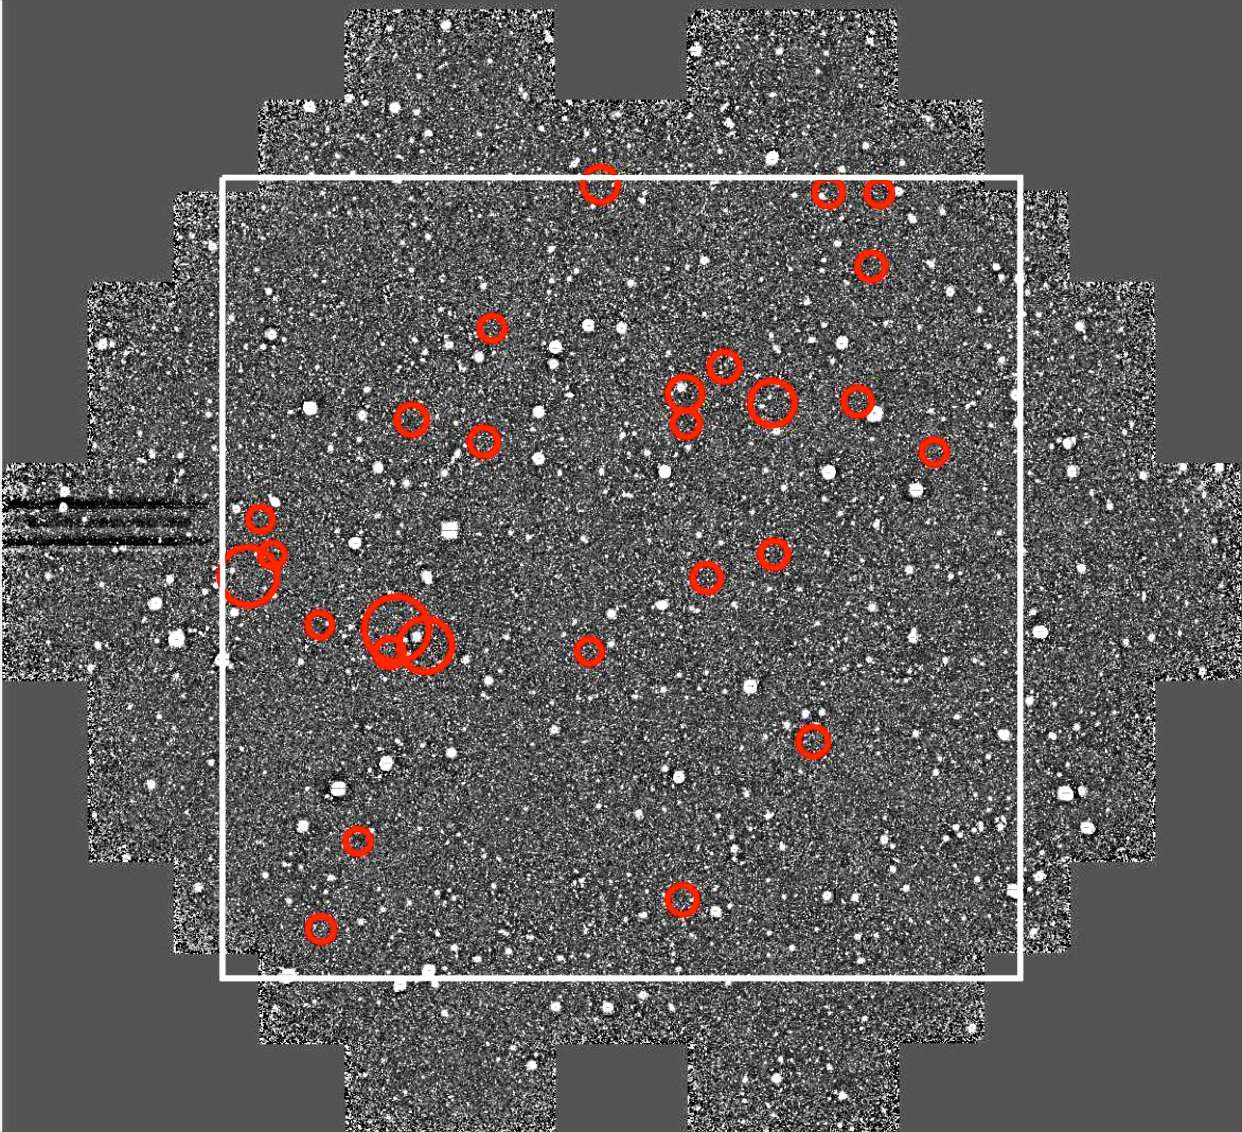
LAGER - first deep field
Circles mark candidate z~7 LAEs
Already more candidates than all prior z>=6.9 narrowband searches combined.
Zhenya Zheng’s talk
  Zheng et al 2017, ApJ 842, L22
Weida Hu’s poster
  Hu et al 2017, ApJ 845, L16

Slide 10
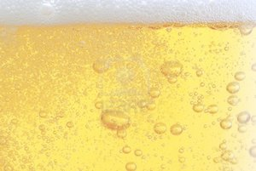
Bubbles in LAGER

Slide 11
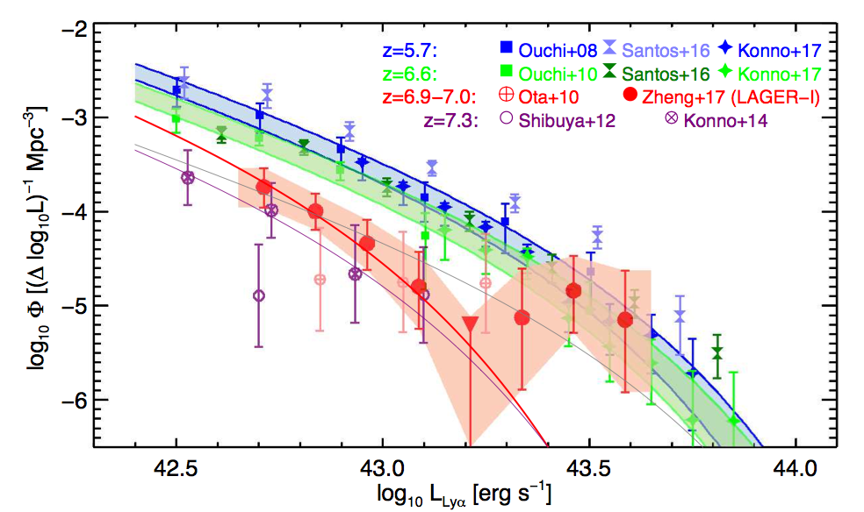
Bubbles in LAGER
The ionizing photon production from these brightest LAGER sources appears sufficient to produce a local ionized bubble – Malhotra et al 2018

Slide 12
Mimimum Volume of Ionized Gas
Following Malhotra & Rhoads 2006:
Each Lyα galaxy observed with IGM transmission T >~ 0.5 implies an ionized region.
The union of those ionized bubbles implies volume ionized & neutral fractions.
Applications to redshift 6.5 in MR06, to be updated in Rhoads + Malhotra 2018 in prep
At z=7, in LAGER:
20% of the volume, in projection, lies within 1.2 pMpc of a LAGER object in COSMOS

Slide 13
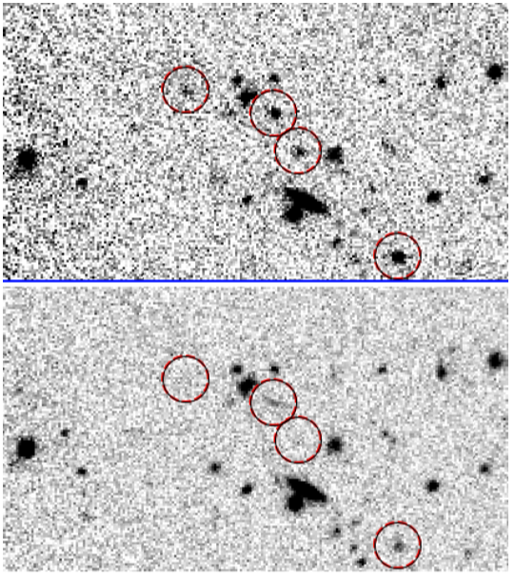
DAWN: The Deep And Wide Narrowband Survey
DAWN is an NOAO survey program using the 4m Mayall telescope at Kitt Peak + NEWFIRM camera (28’ FoV) + 1.06 micron narrowband filter (35Å FWHM). [Rhoads et al 2018 in prep]
Five fields, 3 at full depth (9e-18 erg/cm2/s); total area 1 square degree.
Sensitive to Lyα at z=7.7 [Tilvi et al 2018 in prep], Hα at z=0.62 [Coughlin et al 2018 in press], [OIII] at z=1.45, etc.
Top right: The DAWN survey filter
Middle right: NB image; lower right: J band image.
Notes:
Windows for z>7 Lyman-α Searches

Slide 14
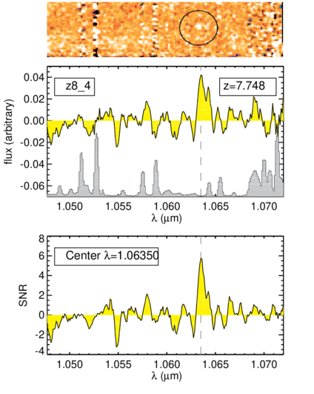
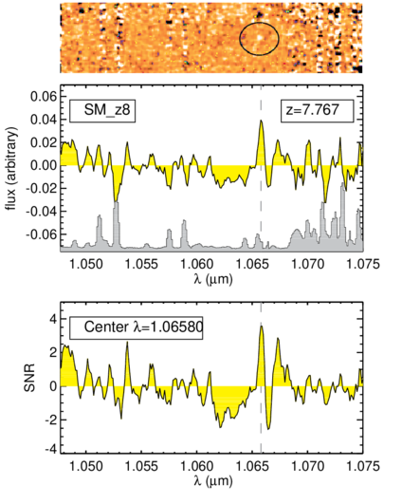
DAWN Survey z=7.7 LAEs
Tilvi et al 2018 in preparation

Slide 15
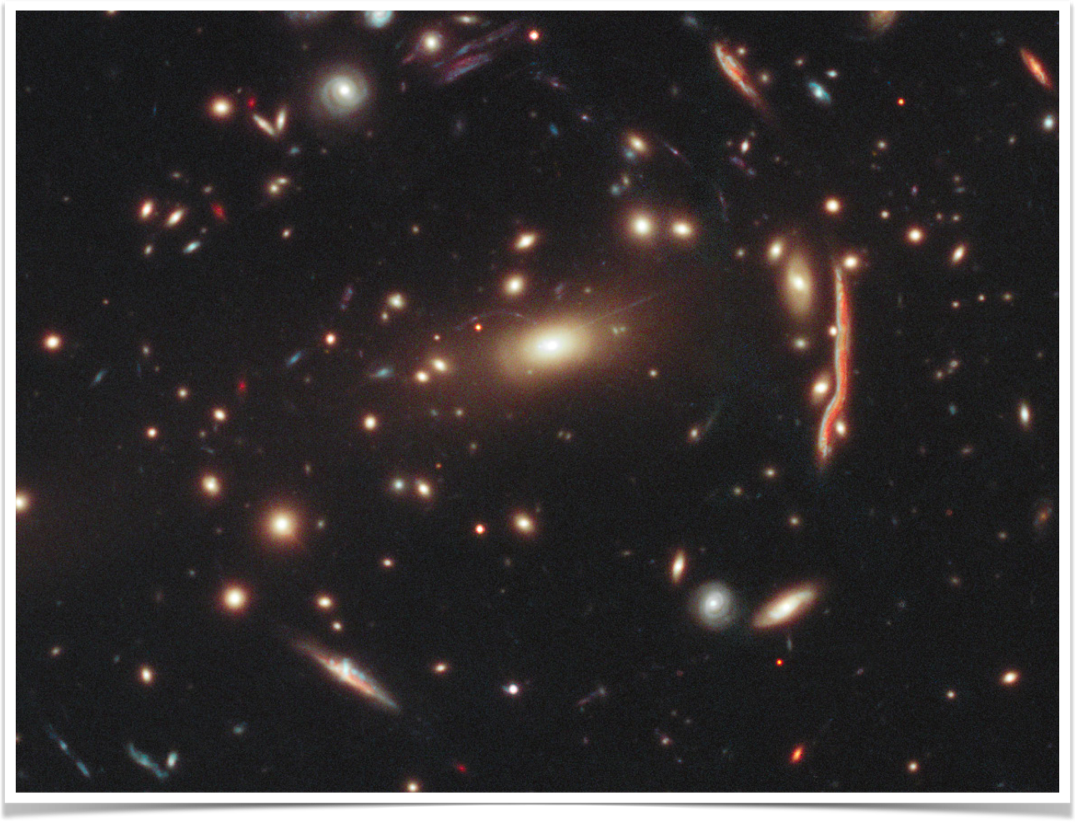
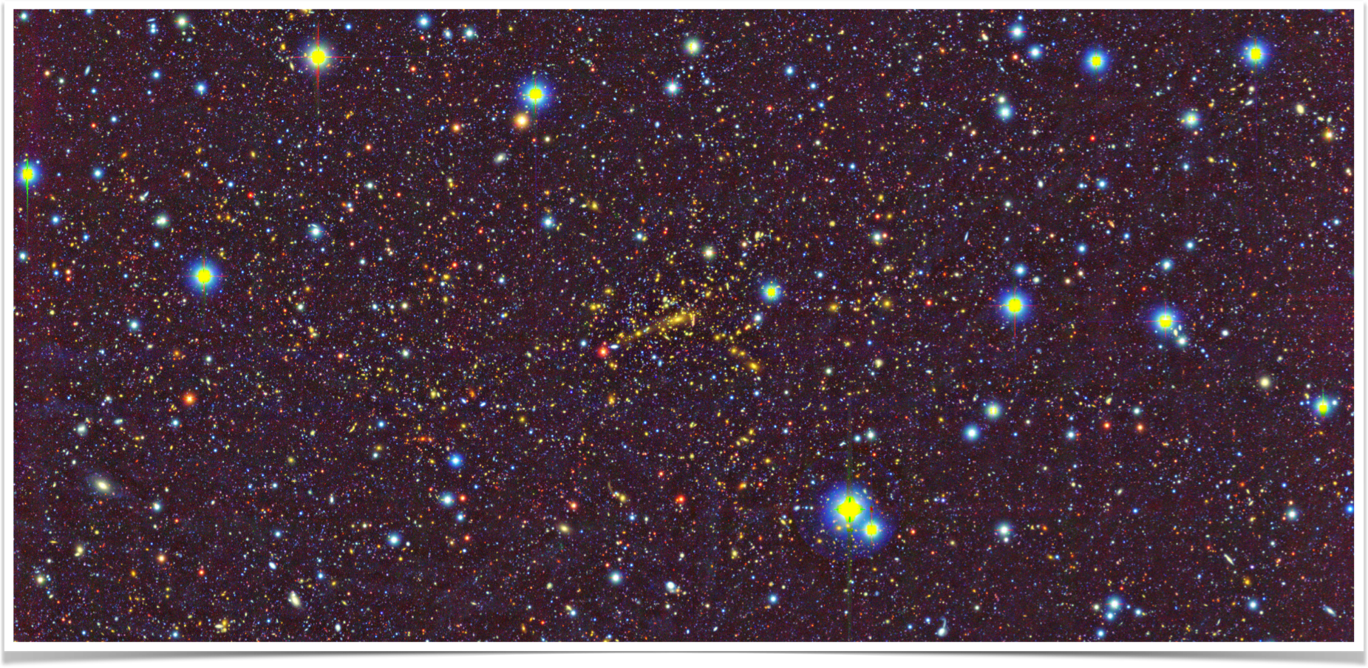
How wide is “W”?
WFIRST
Postman
HST
MACS
J1206.2
-0847
0.79 deg
15

Slide 16
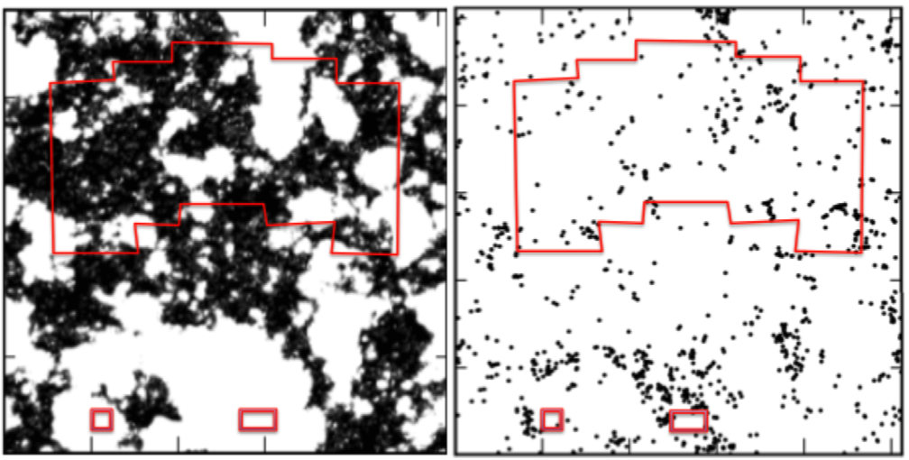
Prospects for LAEs with WFIRST
Fields of view: WFC3-IR (bottom left), JWST NIRCam (bottom right), WFIRST (top)

Slide 17
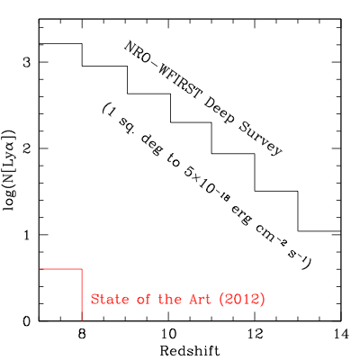
Studying Cosmic Dawn with WFIRST
James E. Rhoads, Sangeeta Malhotra,
Xiaohui Fan, Steven Finkelstein,
Rolf Jansen, Hannes Jensen,
Garrelt Mellema, Casey Papovich,
Vithal S. Tilvi, Rogier Windhorst,
Isak Wold, Erik Zackrisson.
D
A
W
F
I
R
S
T
N

Slide 18
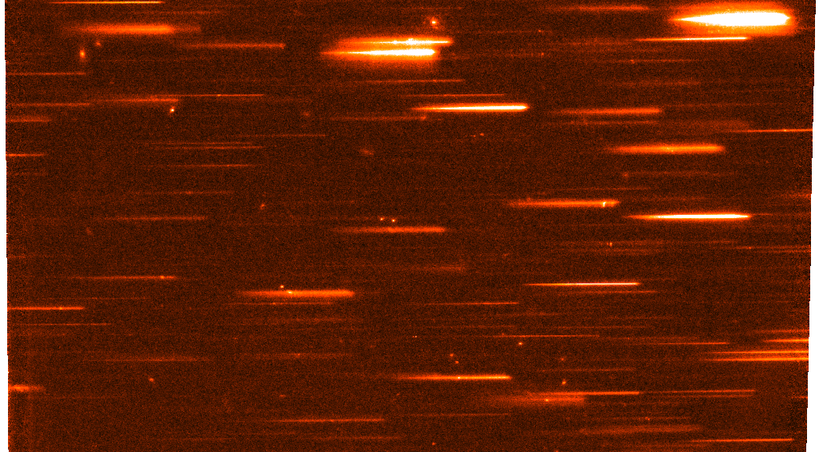
Deep Slitless Spectroscopy from Space
HST slitless spectroscopy: Deep programs, looking for Lyman break and Lyman alpha galaxies in the epoch of reionization:
GRAPES: HUDF, G800 10 orbits x 4 PAs
PEARS: G800, 8 fields to 5 x 4 PAs
FIGS: G102, 4 fields 8x5PAs [Nor Pirzkal’s talk]
GLASS
Shallower, wider surveys emphasizing galaxy physics:
3dHST: G141, c. 2 orbit depth
WISPS
WFIRST can do such surveys ~ 100 times more efficiently.

Slide 19
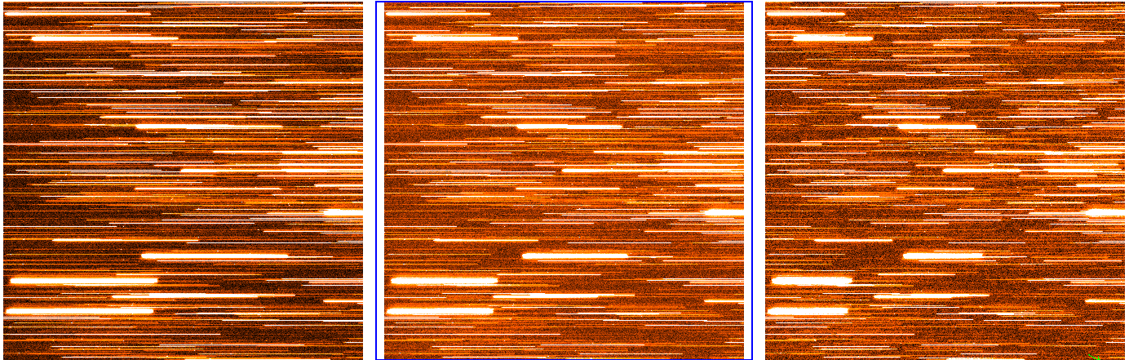
Simulated WFIRST grism observations (Tilvi)- crowding is a significant consideration, but can be solved using observations at multiple roll angles.
Notes:
Tilvi’s grism simulations- samples for 10.8, 15, 20 A/pixel
Left hand panel is like the planned grism. This is for 120 ksec, which is comparable to a cosmic dawn deep field.

Slide 20
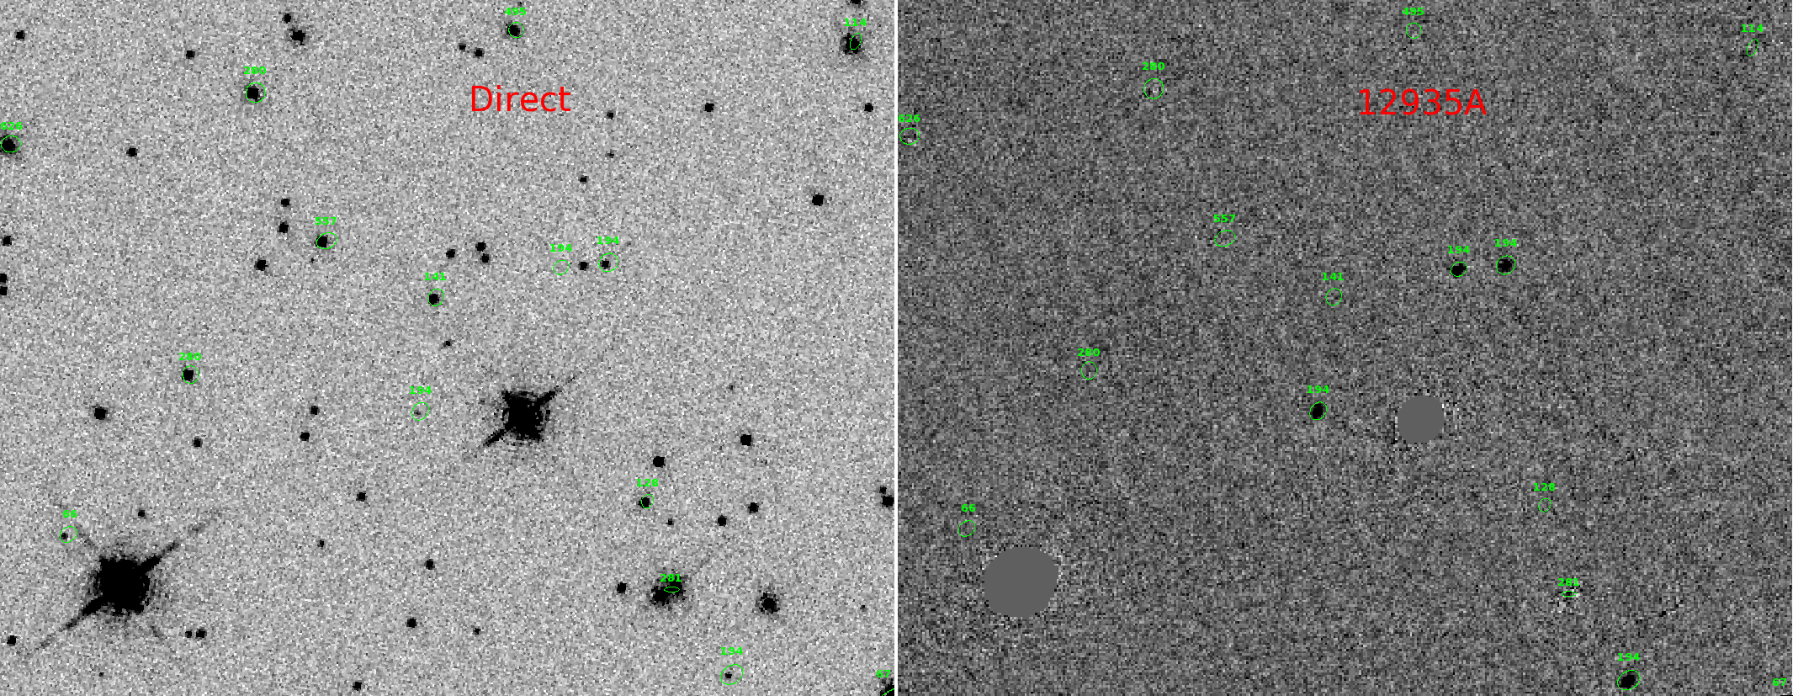
WFIRST Grism Simulation Results
Reconstruction of data cubes from grism data-- Work led by Isak Wold
Left: Simulated input direct image.
Right: Simulated WFIRST continuum subtracted data cube slice.

Slide 21
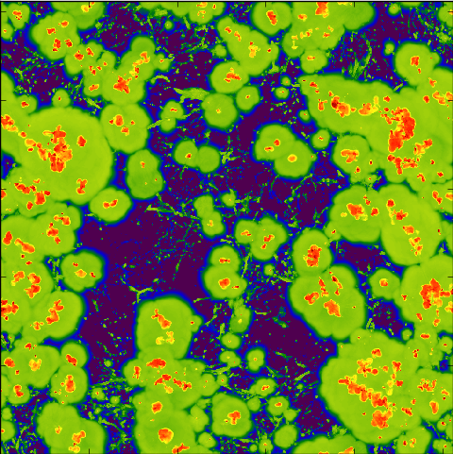
Cross-correlating the 21 cm signal with Lyα-emitters in the epoch of reionization
WFIRST Cosmic Dawn SIT member Erik Zackrisson is leading this effort
Lyα more easily transmitted from
ionized bubbles in the intergalactic
medium → Anti-correlation
expected between 21 cm and
Lyα-emitters in the partially
reionized Universe
Measuring this anti-correlation
will confirm that the redshifted
21 cm signal seen by SKA is real
(i.e. not due to foregrounds) and
provides strong constraints on
cosmic reionization scenarios
Lyα-emitters
21 cm from
neutral
hydrogen
Image Credit: D. Reynolds

Slide 22
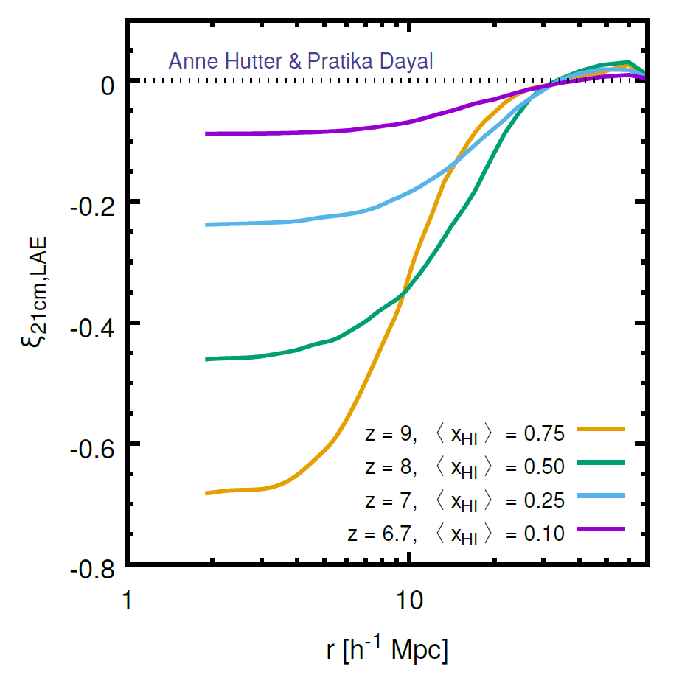
Comparing Lyman Alpha and 21cm with WFIRST and SKA
Team member Erik Zackrisson leading this topic for WFIRST Cosmic Dawn SIT
WFIRST HLS deep field
grism observations over 5 deg² down to 5×10⁻¹⁸ erg s⁻¹ cm⁻² →
4000 LAEs at z = 7
1500 LAEs at z = 8
300 LAEs at z = 9
No significant correlation
If IGM mostly ionized at z ≈ 7 →
Much stronger 21 cm – Lyα
cross-correlation ξ signal at
z = 8-9 (WFIRST)
than at z ≈ 7 (e.g. Subaru HSC)
Anti-correlation

Slide 23
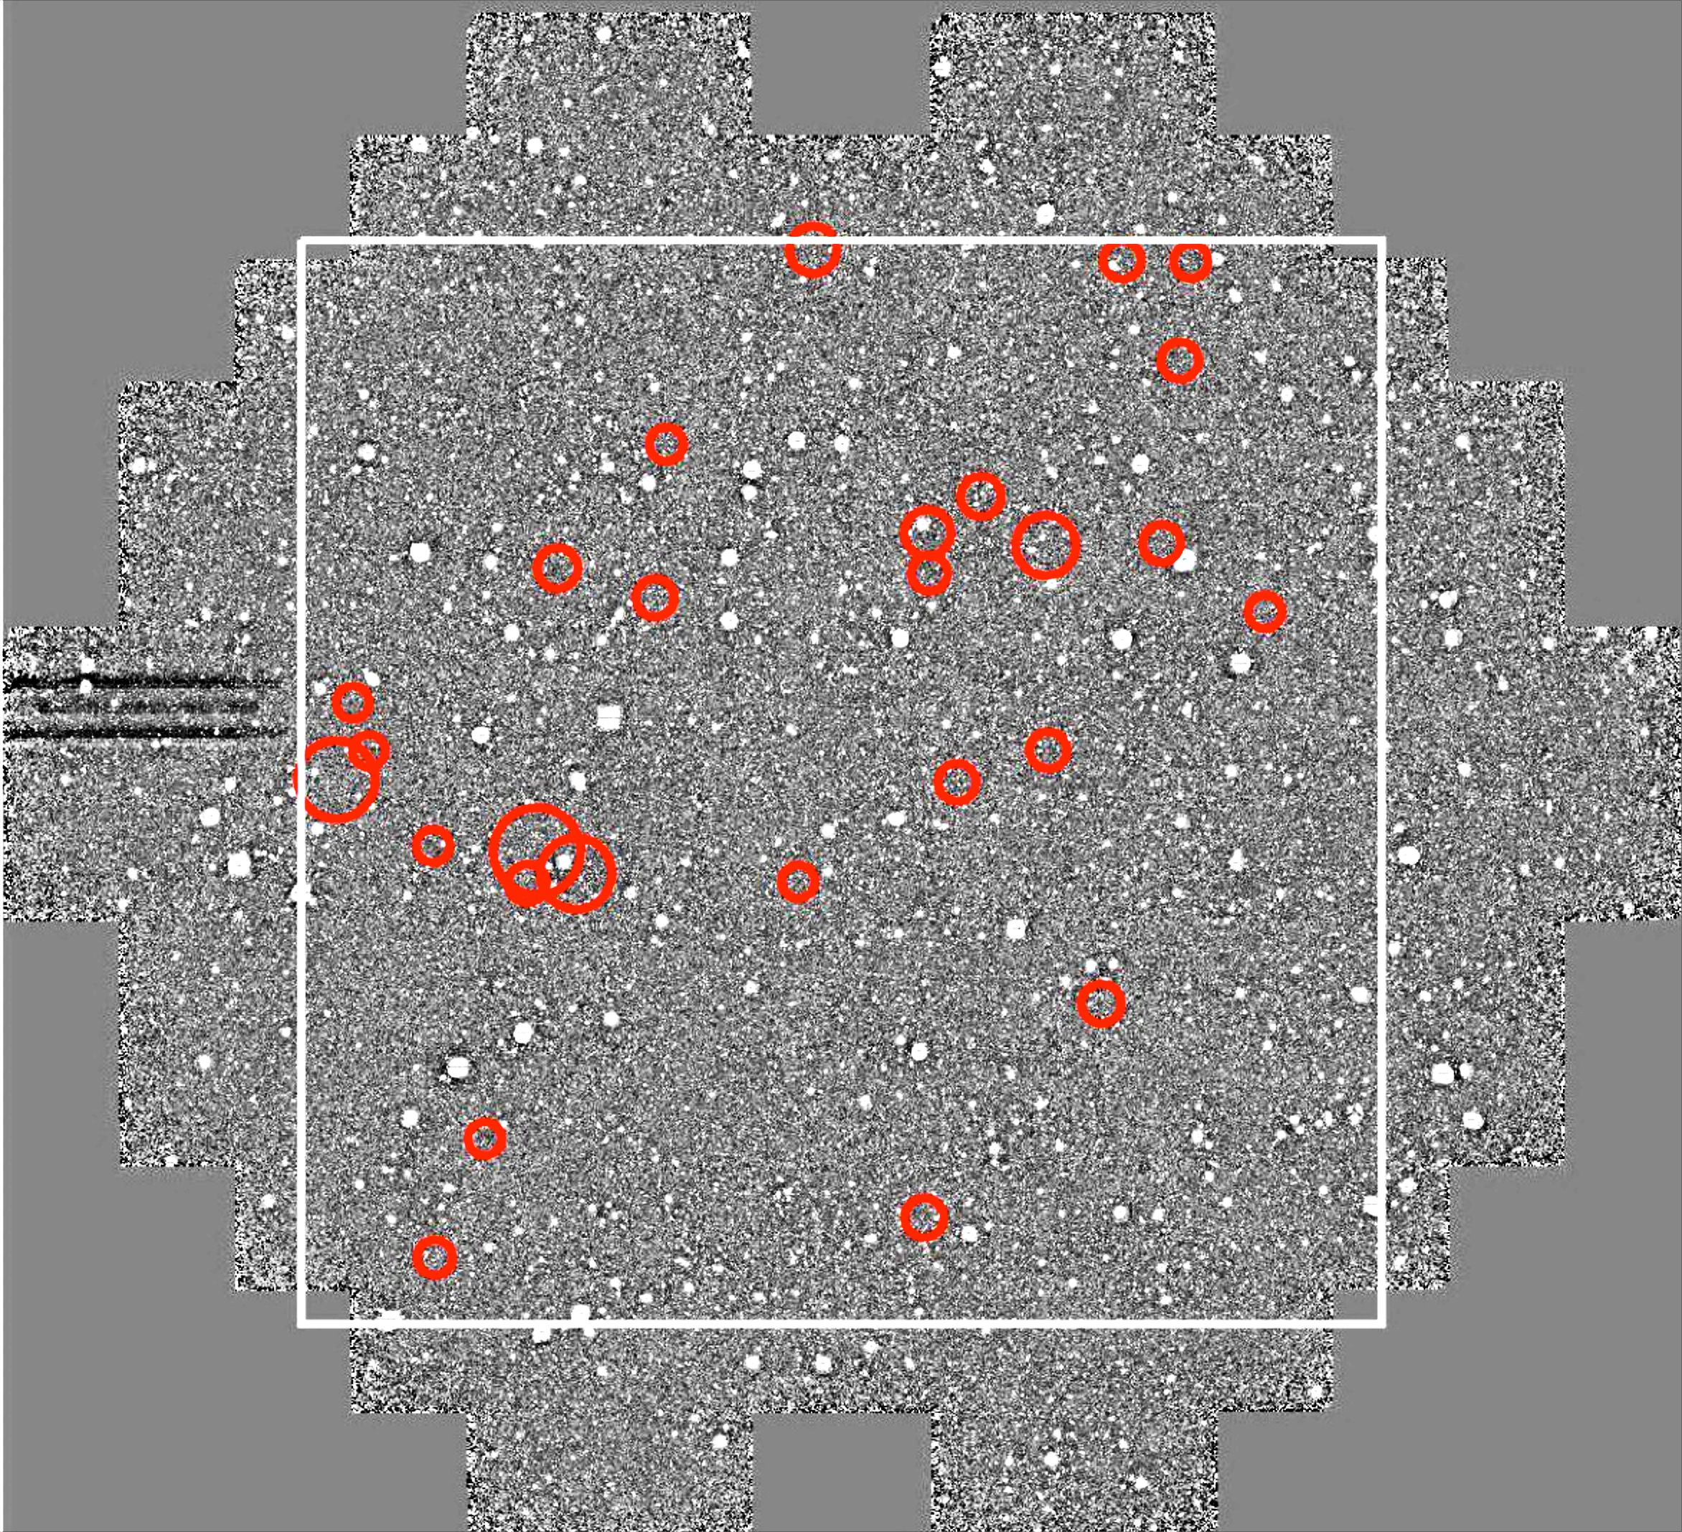
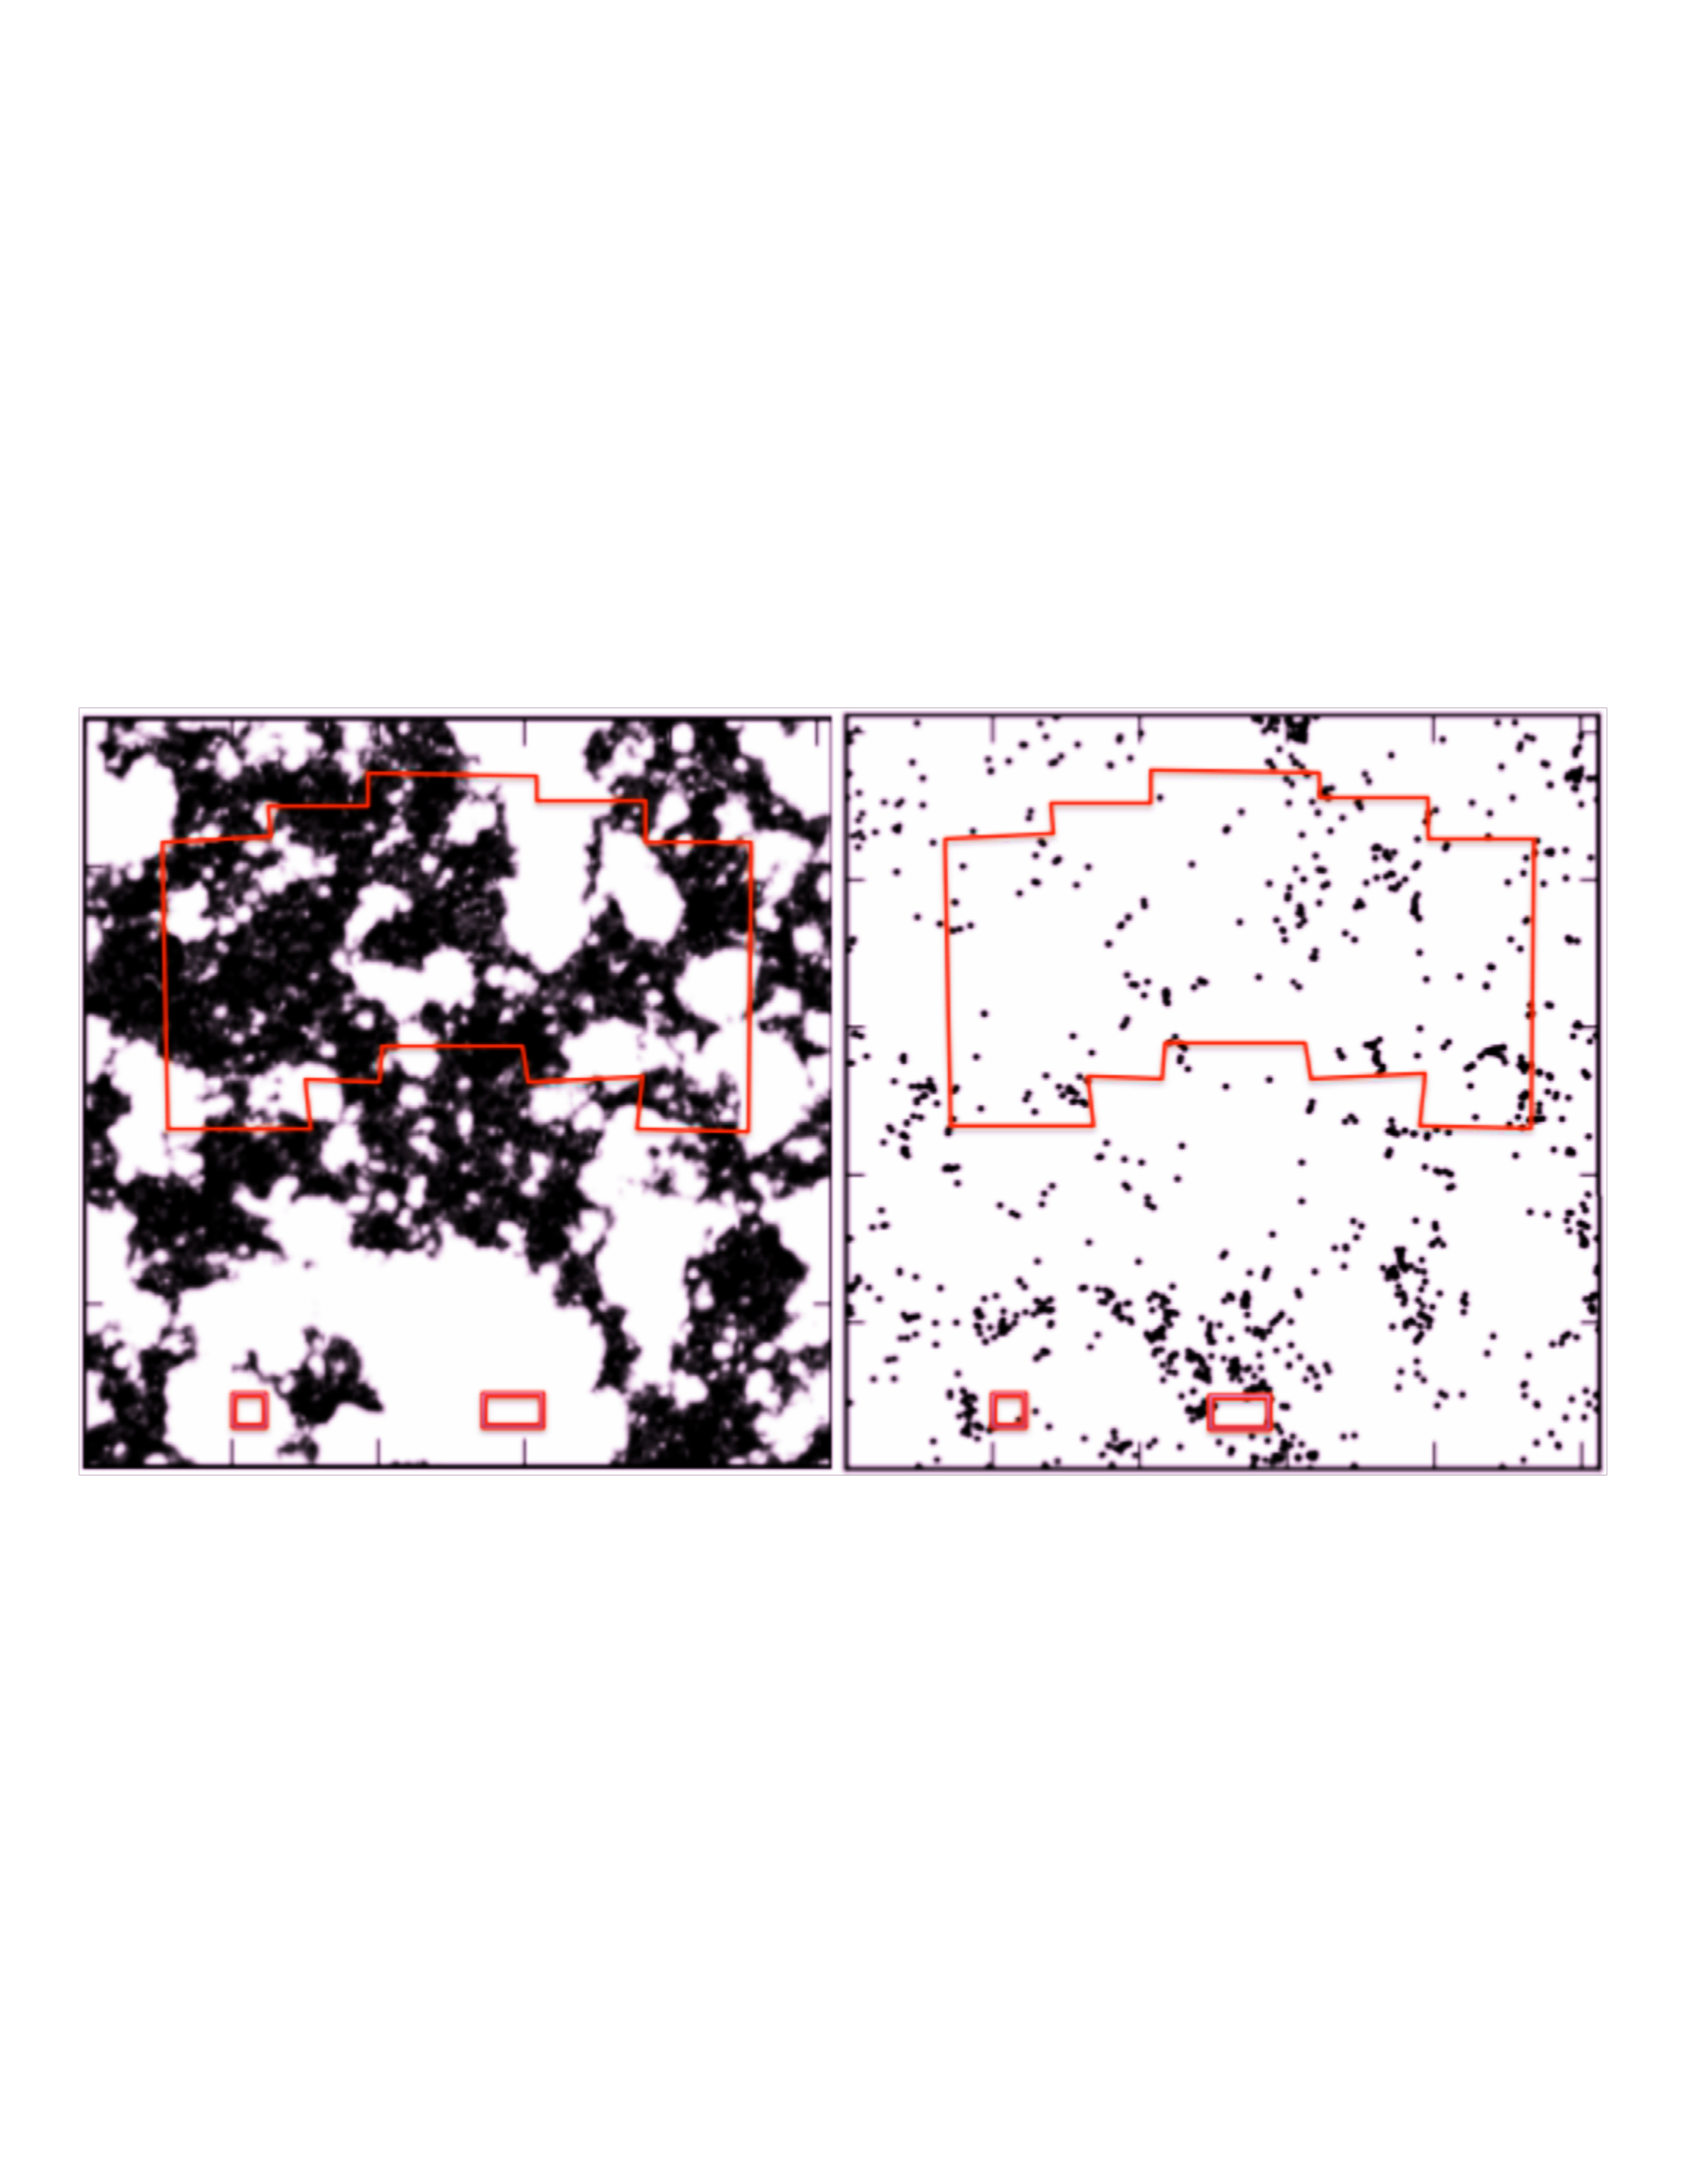
Summary and Conclusions
Wide-field Lyman Alpha Surveys are a powerful tool to test inhomogeneous reionization.
For now, we can do these searches with DECam, HSC, NEWFIRM, ...
We have spectroscopically confirmed LAEs at z=7.0 in LAGER, and z=7.7 in DAWN.
These samples provide some of the first direct evidence for ionized bubbles in the IGM.
WFIRST will enable similar searches at a wider range of redshifts, 7 < z < 14.

