Slide 1

Constraints on cosmic reionization from Lyα studies: current state of affairs and outlook for JWST
TOMMASO TREU (UCLA)
CHARLOTTE MASON (UCLA)

Slide 2
Outline
Introduction.
  Reionization
  The power of gravitational telescopes
The Grism Lens Amplified survey from Space (GLASS)
  Status Update
  Lya at the epoch of reionization
Inferences about reioinization from Lya emitters
The GLASS-JWST-ERS program

Slide 3
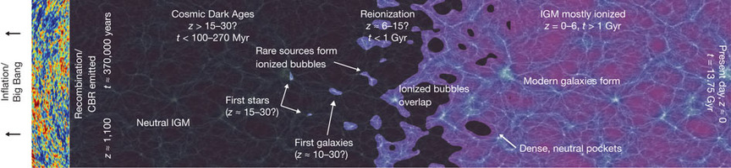


Cosmic reionization
Whodunit?
galaxies
quasars

Slide 4
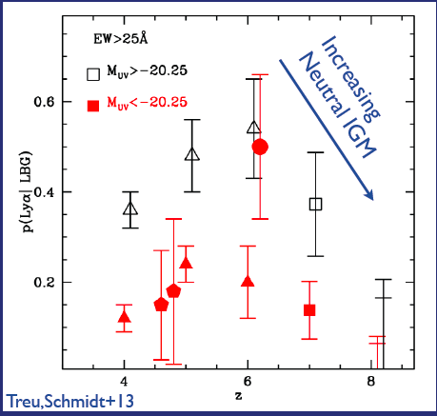
Is decline in lya a smoking gun of reionization?
What about bright objects with strong lya emission? (Roberts-Borsani+,Stark+..)
See also Schenker+,Pentericci+,Ono_

Slide 5
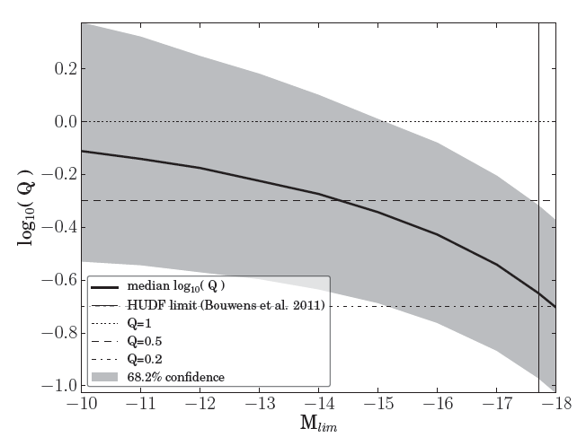
Faint galaxies are needed for reionization
Requires magnification with HST
Schmidt et al 2014

Slide 7
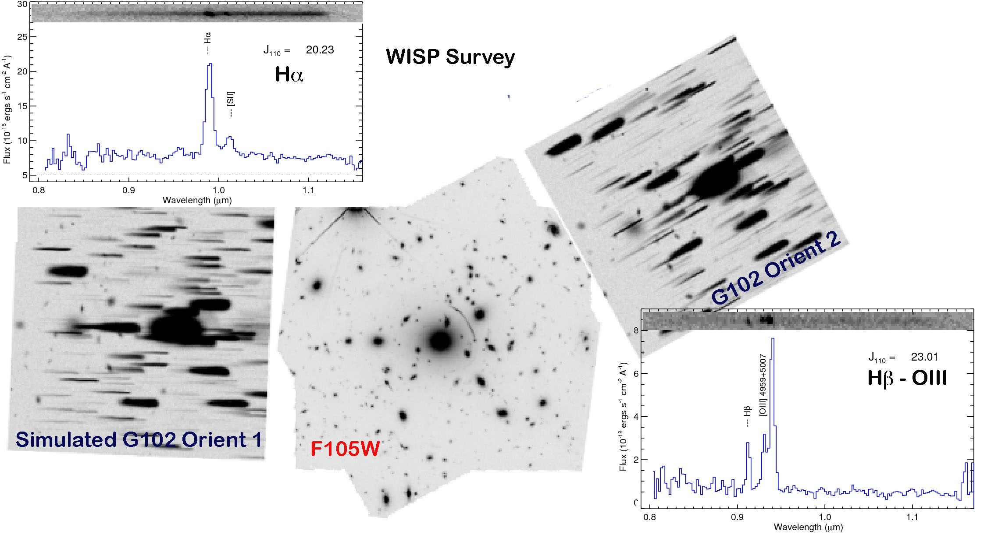
The tool: HST grisms

Slide 8
Strengths
Spectrum of everything in the field of view
High sensitivity and angular resolution owing to lensing magnification
Excellent photometric redshift owing to HFF/CLASH photometry
Uninterrupted wavelength coverage, potentially able to detect weaker and redder nebular lines
Many l.o.s reduce cosmic variance and lya patchiness effects (c.f. Robertson et al. 2014)

Slide 9
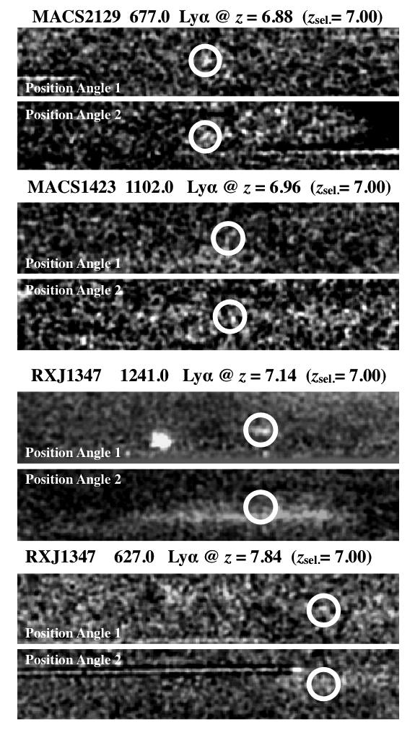
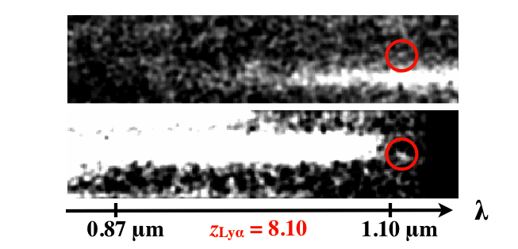
Lya at z~7 and above
Schmidt et al. 2016
Schmidt+ 2014
Also, confirmed lya in multiply imaged sources at z=6.1 and 6.4 (Boone+13, Balestra+13, Vanzella+14)

Slide 10
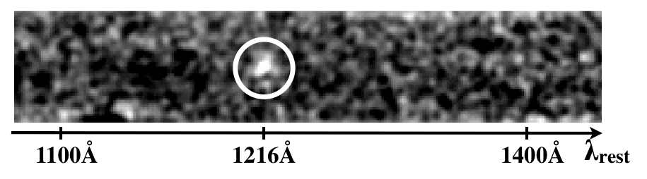
First measurement of spatial extension of (stacked) lya at z>7
Schmidt+ 2014
Schmidt et al. (2016); six clusters

Slide 11
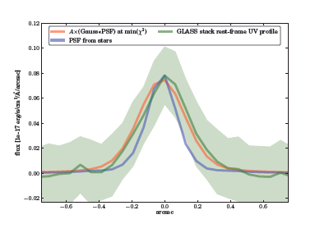
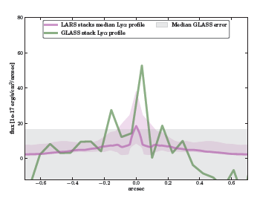
Spatial extension of (stacked) lya at z>7
Schmidt+ 2014
Schmidt et al. (2016); six clusters

Slide 12
Ground Based Follow-up

Slide 13
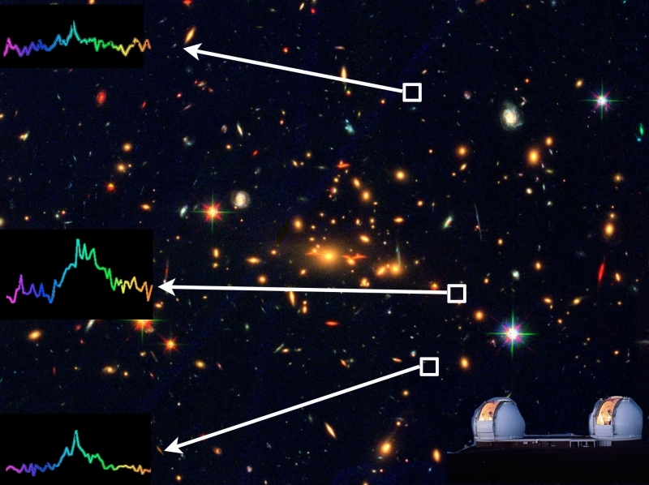
A faint multiply-imaged lya emitter at z~7
Huang et al. 2016b
Schmidt+ 2014

Slide 14
A faint multiply-imaged lya emitter at z~7
Huang et al. (2016)
Schmidt+ 2014
Huang et al. 2016b

Slide 15
A faint multiply-imaged lya emitter at z~7
Huang et al. (2016)
Magnification=3-11
M_{UV}=-18.6
M*~10⁷ Msun
Schmidt+ 2014
Huang et al. 2016b

Slide 16
A ultra-faint lya emitter at z=7.64
Huang et al. (2016)
Hoag et al. 2017
Magnification=3-11
M_{UV}=-19.6
M*~3x10⁸ Msun
Schmidt+ 2014

Slide 17
Ongoing Follow-up
Keck/MOSFIRE+DEIMOS (PI: Bradac & Trenti)
  9 clusters visible from Keck, up to 8-10 hrs integration per target
  Several detections at z<8
VLT/KMOS (PI: Fontana)
  6 Clusters visible from VLT, up to 15 hrs integration per target
  Observations completed, analysis in progress (Mason et al.)
JWST-ERS (PI: Treu)
  After launch..

Slide 18
Inferences about Reionization

Slide 19
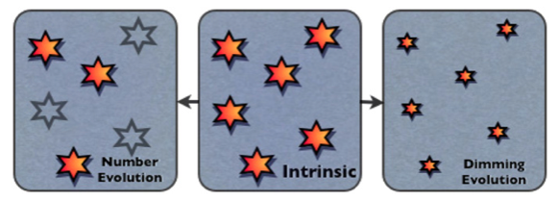
Toy models. What’s the spatial distribution of lya optical depth?
Bayesian inference from observations
(Treu et al. 2012, 2013)
Tilvi et al. 2014

Slide 20
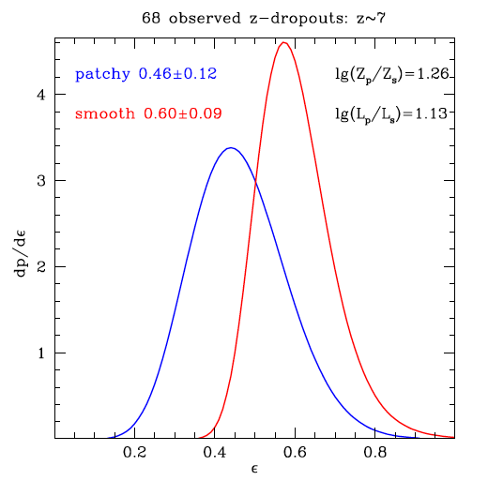
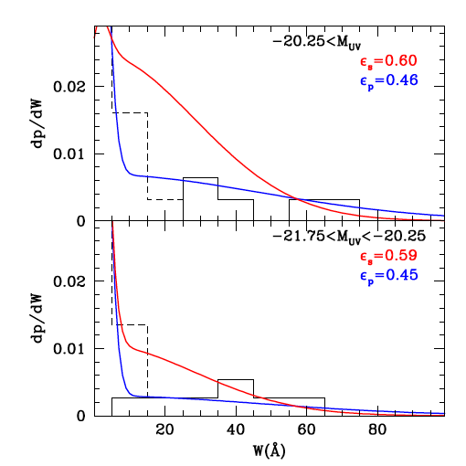
Patchy!
Pentericci et al. 2014 (models by TT); See also Tilvi et al. 2014

Slide 21
A multi-scale approach
CGM
ISM
ISM
Mesinger+15

Slide 22
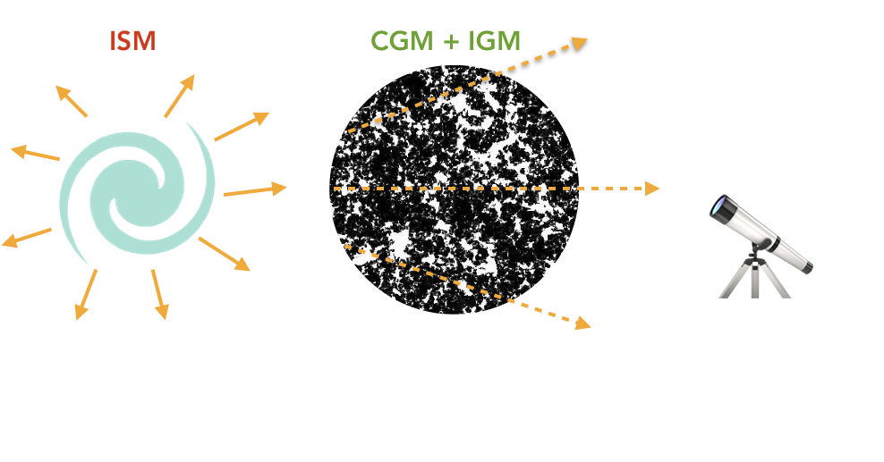
Forward model
Mason, TT,+18a

Slide 23
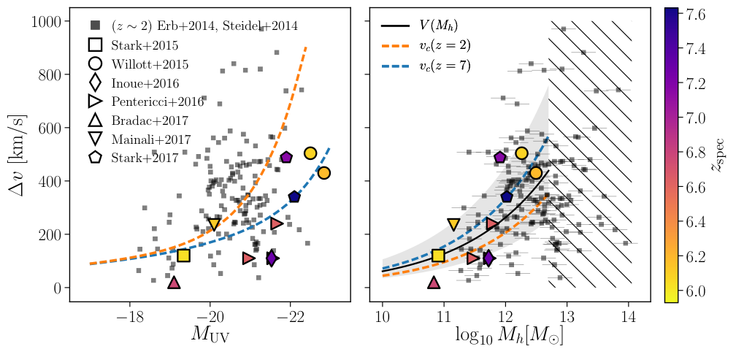
Effective Dv model
Mason, TT+18a

Slide 24
Bayesian Inference
Much tighter constraints than those based on fractions, because we are using the full information content!
Mason,TT+18a

Slide 25
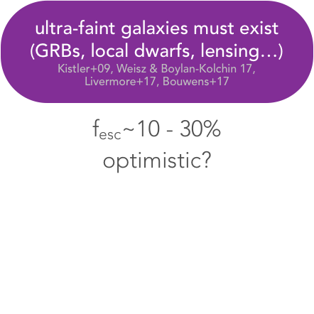
In context
detectable galaxies (MUV < -17) + ultra-faint galaxies (MUV < -12)
f_{esc} = 0.1 - 0.3C = 1 – 6
log ξ_{ion} ~ 25.2
Mason,TT+18a

Slide 26
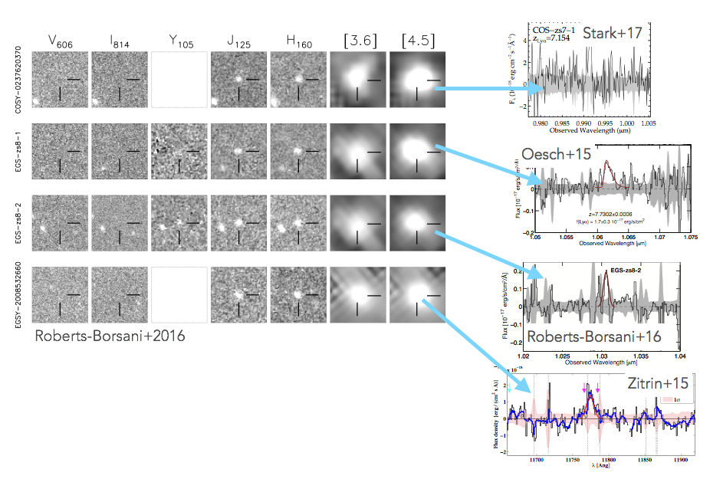
What about z>7.5 detections?
Mason,TT+18b

Slide 27
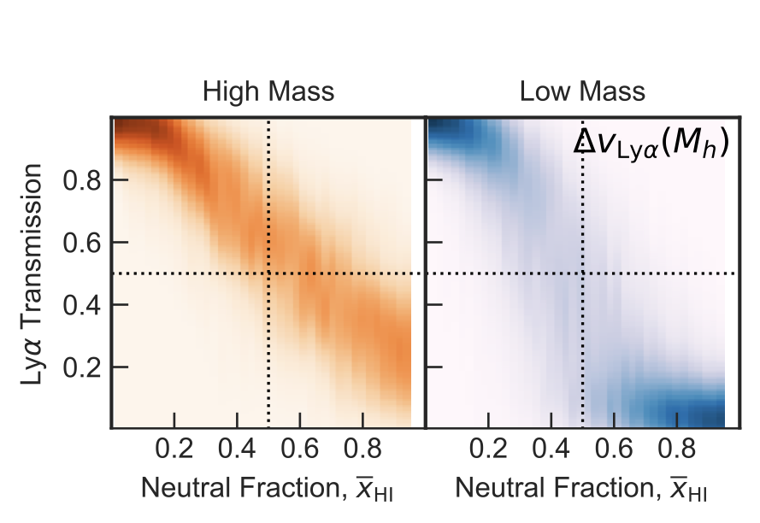
A physical explanation
UV bright galaxies live in overdensities, always further from neutral patches, and have higher intrinsic Dv
Mason,TT+18b

Slide 28
But also selection effects
Intrinsic EW must be high too!
Mason,TT+18b

Slide 29
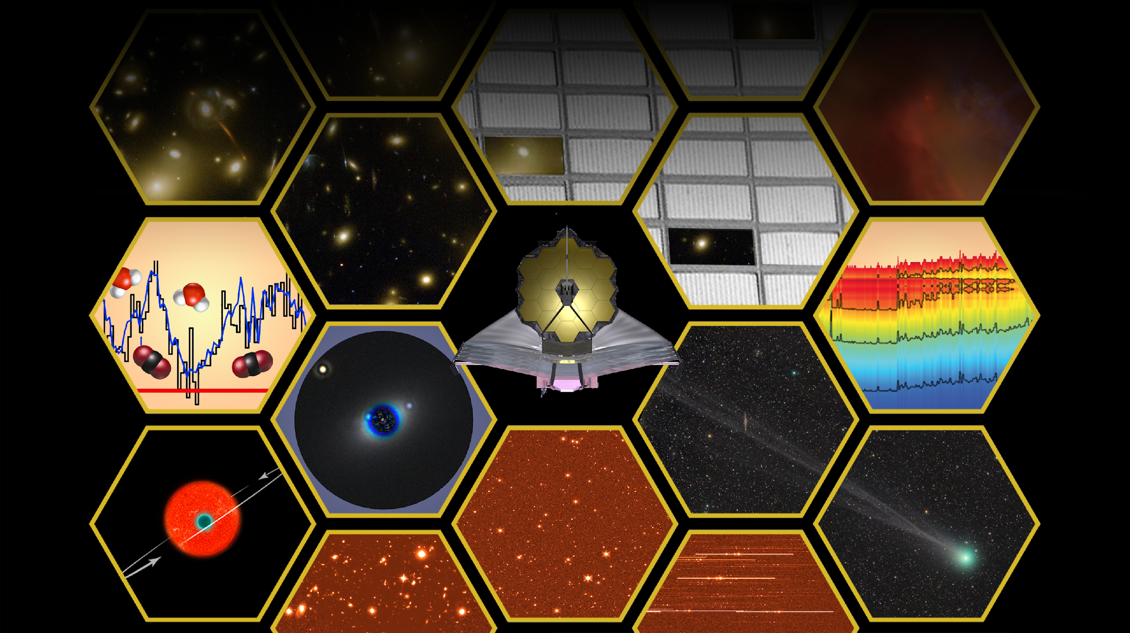
Through the looking GLASS: a JWST exploration of galaxy formation and evolution from cosmic dawn to present day

Slide 30
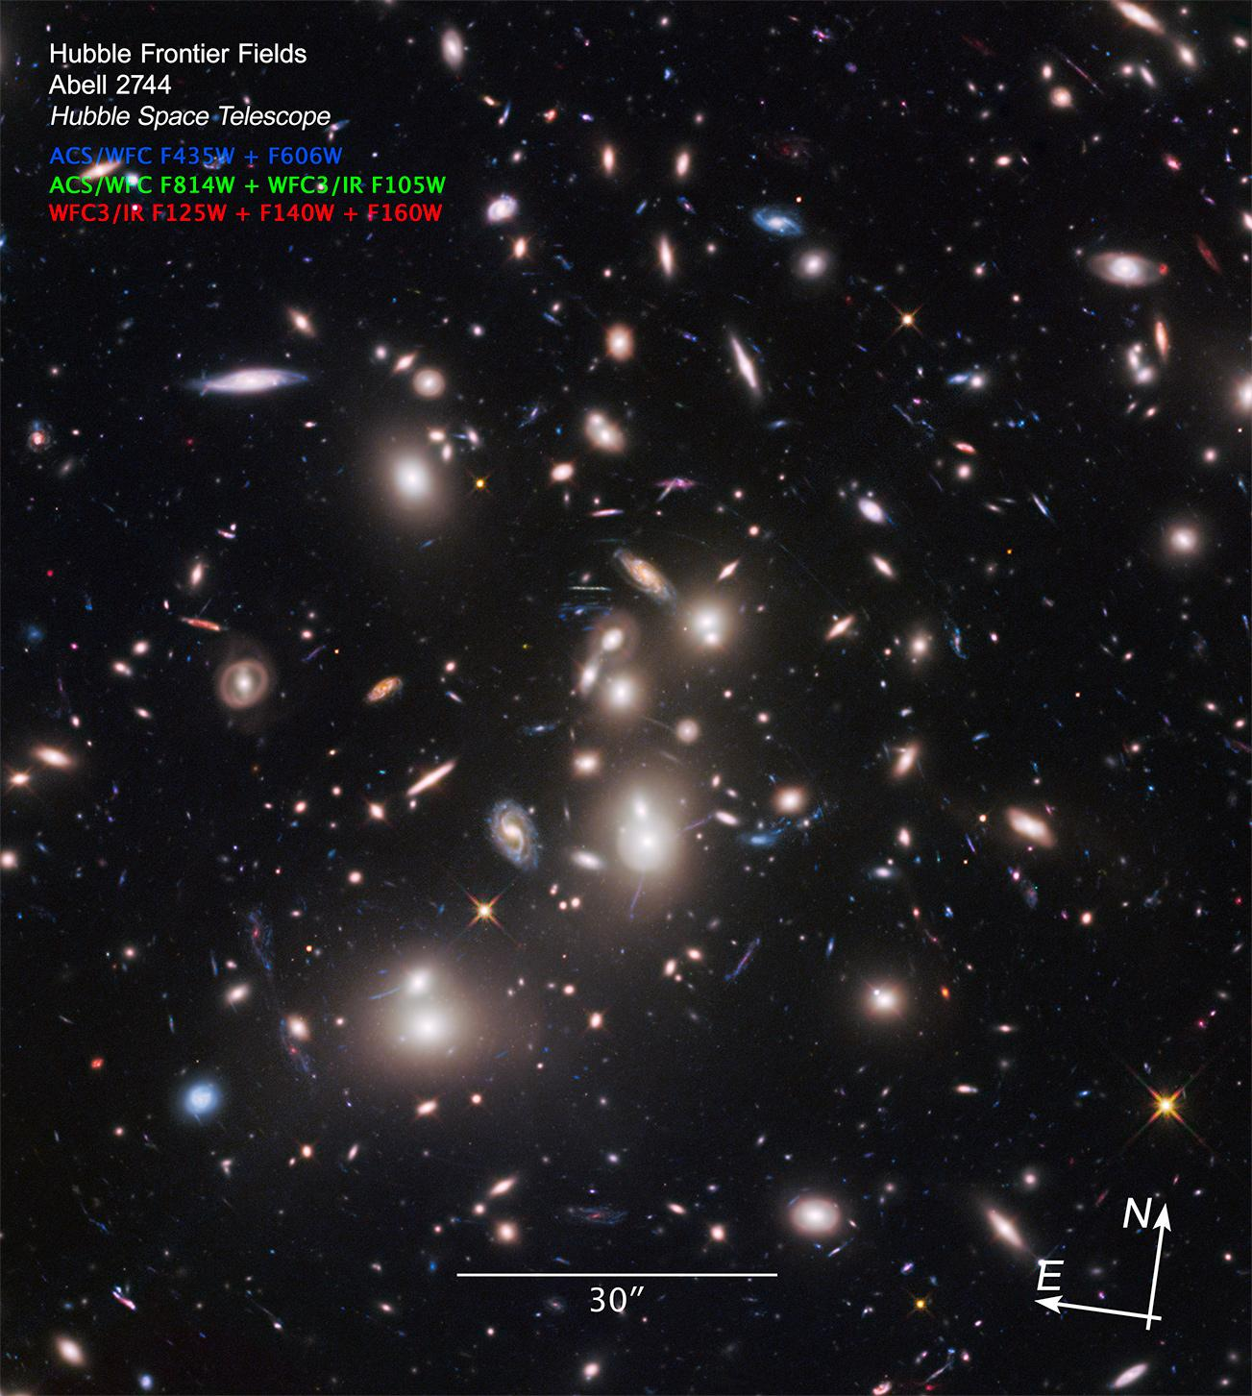
Primary Target and Observing Modes
NIRISS Wide Field Slitless Spectroscopy R~150 (F115, F150W, F200W): 35ks
Parallel NIRCAM imaging (F090W, F115W, F150W, F277W, F200W, F356W, F444W) 30ks; mAB~29
NIRSPEC MOS R~2700 (F100LP, F170LP, F290LP): 52ks
Parallel NIRCAM imaging (F090W, F115W, F150W, F277W, F200W, F356W, F444W) 50ks; mAB~29.4

Slide 31
Team
L.Abramson
M.Bradac
G.Brammer
A.Fontana
A.Henry
A.Hoag
K.Huang
C.Mason
T.Morishita
L.Pentericci
X.Wang
M.Bagley
I.Balestra
G.Bartosch
S.Bernard
R.Gavazzi
C.Grillo
K.Glazebrook
T.Jones
P.Kelly
D.Lange-Vagle
M.Malkan
D.Marchesini
A.Mercurio
B.Poggianti
P.Rosati
C.Scarlata
K.B.Schmidt
H.Shipley
M.Trenti
E.Vanzella
B.Vulcani

Slide 32
Key Science Drivers
What sources ionized the universe and when?
How do baryons cycle though galaxies?

Slide 33
Science Enabling Products
Stage I. Working version of:
  Object-based multi-instrument exploration tool
  RA/DEC based NIRISS forced-extraction tool
  Spectroscopic templates of z>5 sources
  Spectral quantities/catalogs
  NIRCAM-parallel catalogs of z>7 galaxies
Stage II:
  Quantitative comparison of NIRISS and NIRSPEC spectra
  Updated and improved versions of Stage I products

Slide 34
Summary
Something very interesting is happening at z>8:
  The IGM is becoming neutral (see Planck’s optical depth)
  And/or galaxies are changing rapidly
Lensing magnification allows us to probe the low luminosity regime
Preliminary results from GLASS show several confirmed lya emitters at z~7 but a dearth of strong emitters at z~8.
  This is in contrast with recent results for very bright objects
Follow-up is ongoing to confirm candidates and determine purity and completeness and quantify statistics
Based on our models, the data are consistent with a scenario where the universe is becoming neutral between z~8 and 7. Faint galaxies have not had time to carve out transparent bubbles around them by z~7.
JWST-ERS will provide new insights (e.g. Dv, spatial offset, etc)

Slide 35
Credits
K.Schmidt (AIP)
L.Abramson (UCLA)
S.Bernard (Melbourne)
M.Bradac (UCD)
G.Brammer (STScI)
M.Dijkstra (UoO)
A.Dressler (OCIW)
A.Fontana (Roma)
R.Gavazzi (IAP)
L.Guaita (Roma)
A.Henry (NASA)
A.Hoag (UCD)
K.Huang (UCD)
T.Jones (IfA)
P.Kelly (UCB)
M.Malkan (UCLA)
T.Morishita (UCLA)
C.Mason (UCLA)
L.Pentericci (Roma)
B.Poggianti (Padova)
M.Stiavelli (STScI)
M.Trenti (Melbourne)
A.vdLinden (Stanford/Dark)
B.Vulcani (Melbourne)
X.Wang (UCLA)
TEAM: glass.astro.ucla.edu;
DATA: https://archive.stsci.edu/prepds/glass/

Slide 36
The end

