Slide 1
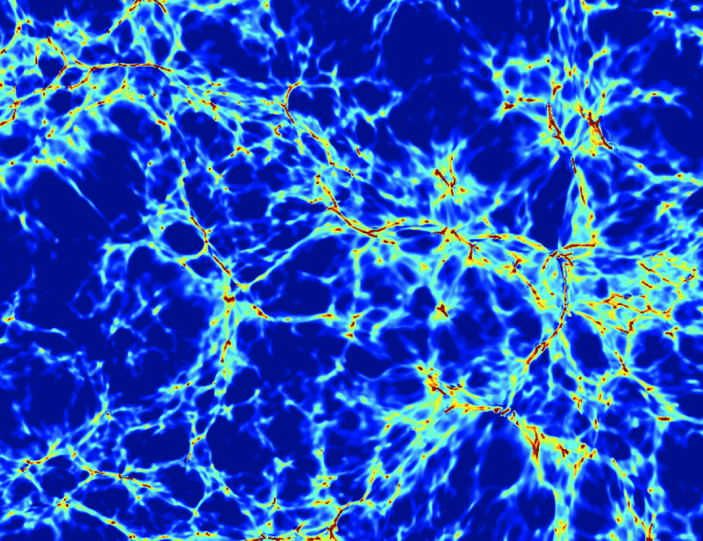

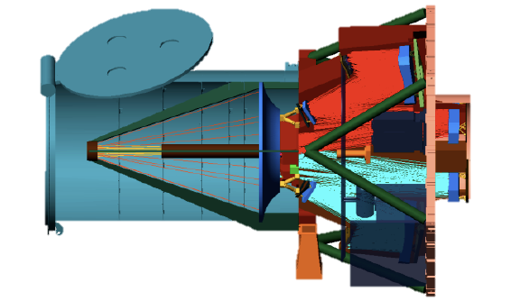
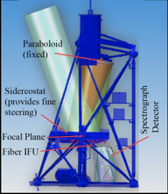
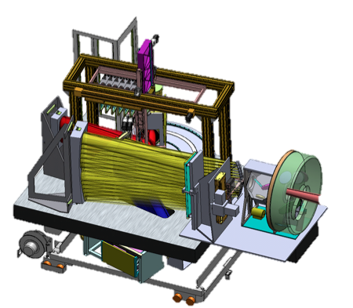
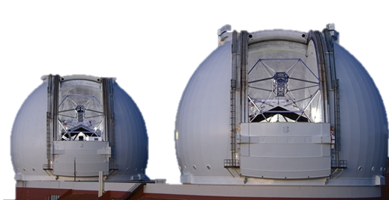
Imaging the IGM/CGM/CQM
Goals/Program/Techniques
FIREBALL-2
PCWI Proto-Galactic Disks
KCWI Overview
KCWI: PGDs → Multi-Filament Inflows
Keck Cosmic Reionization Mapper (KCRM)
XCWI
Christopher Martin
California Institute of Technology
For PCWI, KCWI, FIREBALL,ISTOS Team
Sakura CLAW
Tokyo
26-30 March 2018

Slide 2
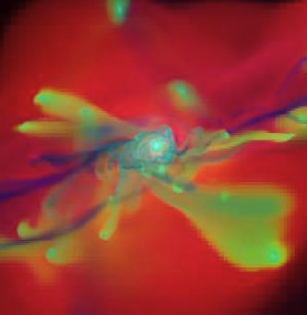
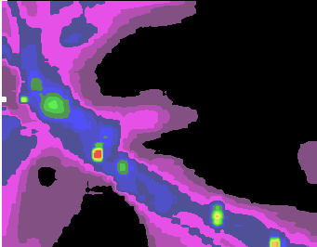
1. IGM Project: I. Goals
Imaging & Mapping the Hidden Cosmic Web of Baryons
Decode Lyα Emission &
UV Line Diagnostics
B. Discover/Map CGM Baryons,
Co-evolution with Galaxies
Inflows
Angular Momentum
Outflows
Agertz+09
C. Discover & Map IGM Baryons,
Correlate with Cosmic Web & Galaxies
D. Cosmological Applications of
CGM/IGM Emission Mapping

Slide 3
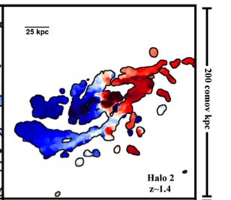
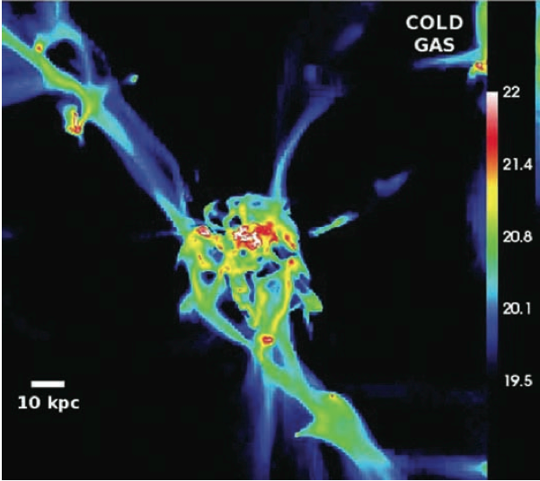
B. CGM Inflows: How does gas get into galaxies?
Cold Filament Accretion → Large Angular Momentum → Giant Rotating Disks/Rings of Gas
Velocity Profile
Cold Gas Profile
Stewart+2013
Pichon+11; Ceverino+10, Danovich+12,14

Slide 4
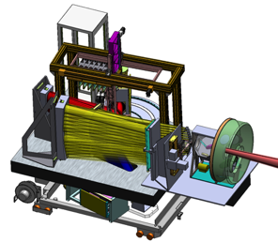
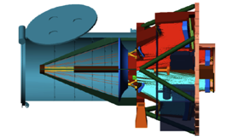
1. IGM Project: II. Program
Imaging & Mapping the Hidden Cosmic Web of Baryons
FIREBALL
Balloon
2050-2250Å
0.7<z_{Lyα}<0.85
ISTOS
Explorer
1250-2800Å
0.05<z_{Lyα}<1.2
KCWI
Keck
3500-10,500Å
2.0<z_{Lyα}<7.2
Time since Big Bang
Redshift
12
0.1
10
0.3
7
0.7
5.7
1
3
2
2
3
1.5
4
0.9
6
0.75
8
Billion yrs
ISTOS...
F
KCWI-B
KCWI-R
Cosmic Epoch
WHIM Grows, SF dies
Star Formation Epoch
SF Grows
Reionization
Wavelength (μm)
0.13
0.2
0.3
0.5
0.7
1.0
1.2

Slide 5
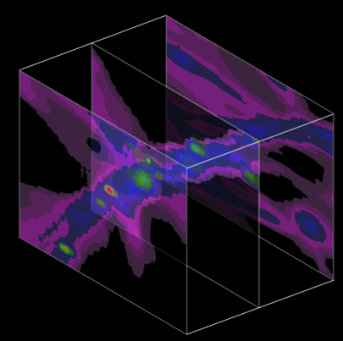
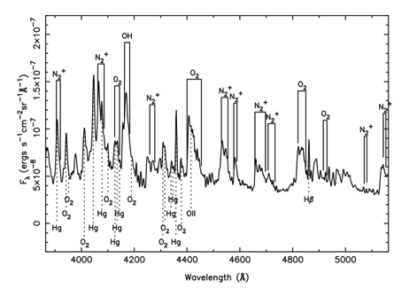
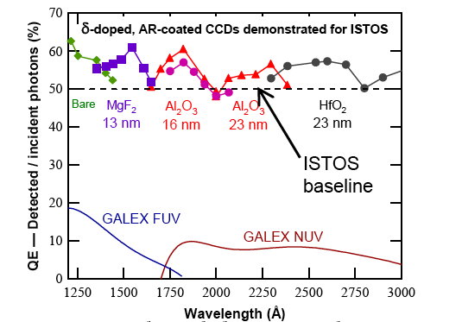
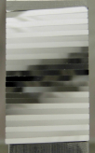
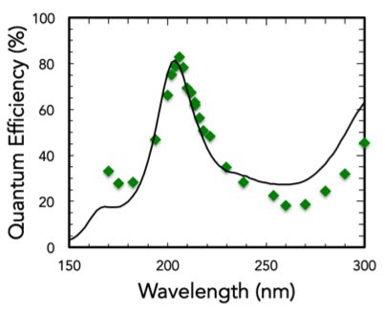
1. IGM Project: III. Methods
Imaging & Mapping the Hidden Cosmic Web of Baryons
A. Imaging/Multiplexed
UV Emission Line Spectroscopy
B. Precision
Sky Subtraction
C. High Efficiency,
Low Noise, Photon-Counting
Detectors

Slide 6
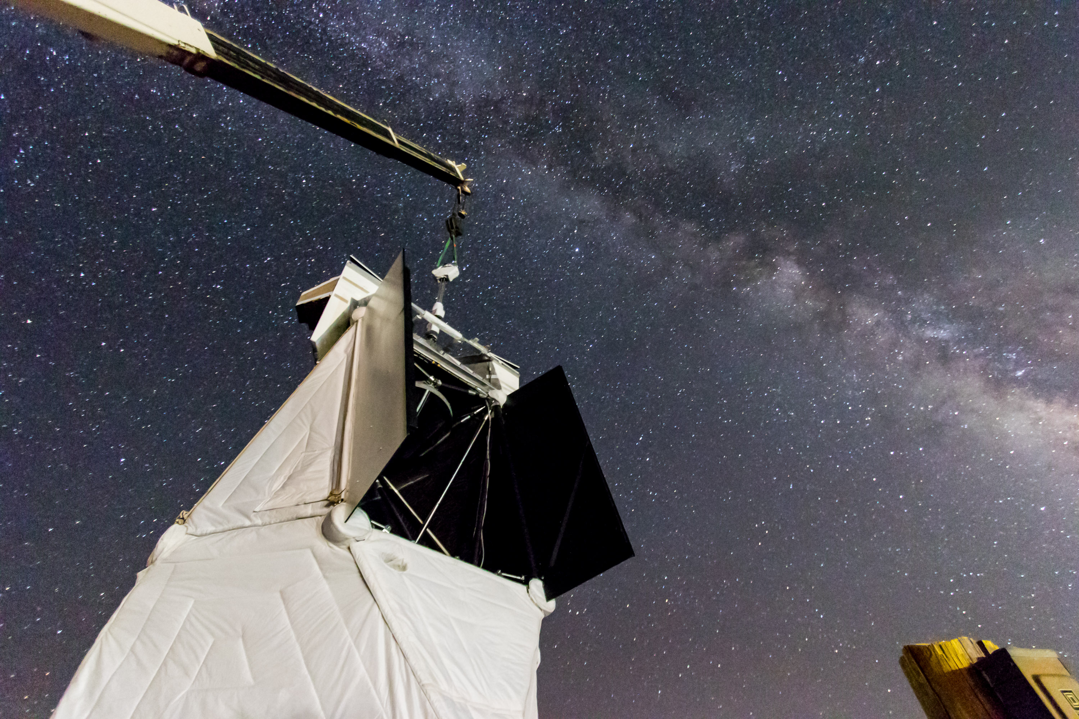
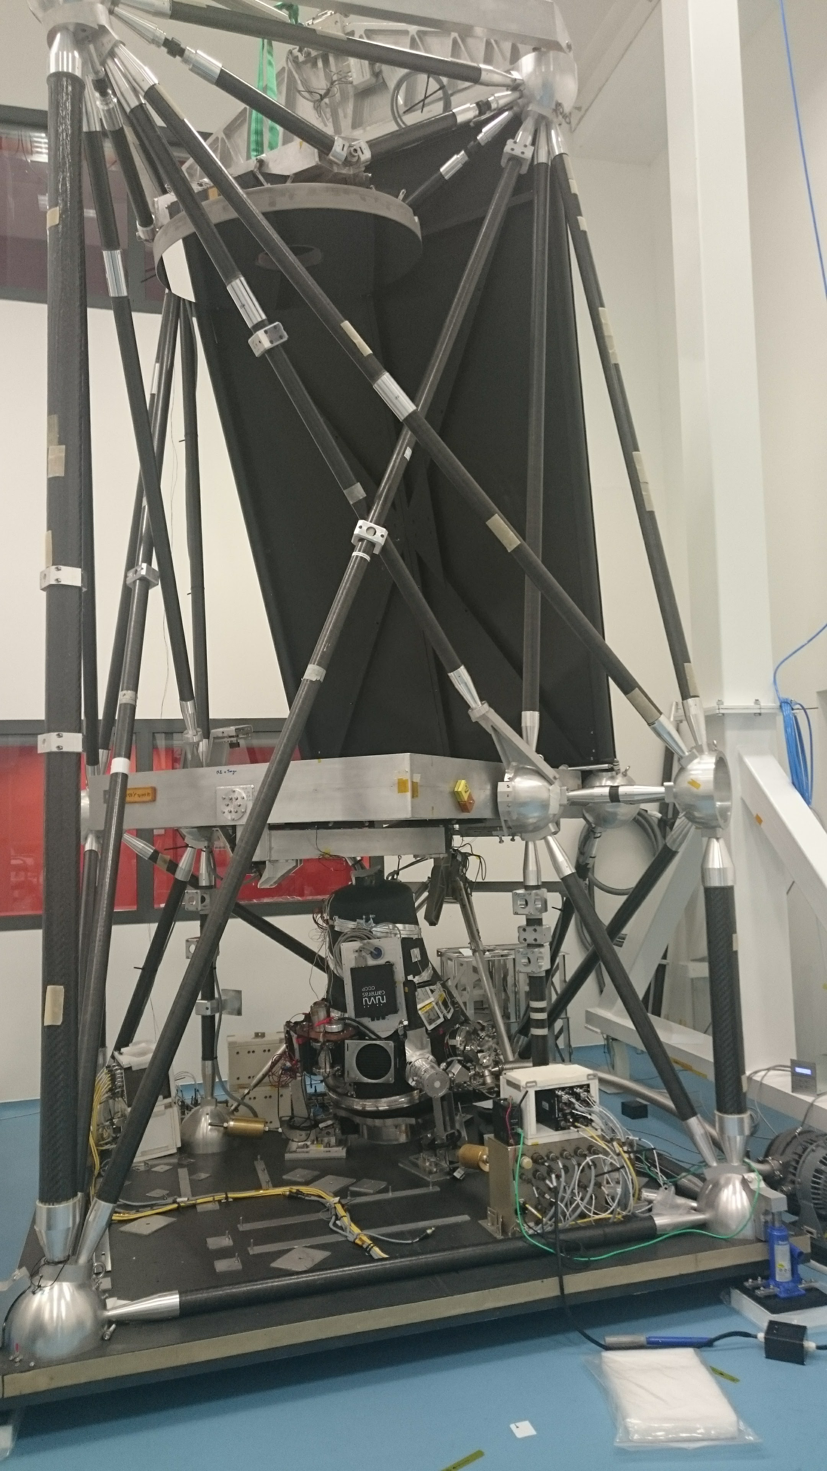






2. FIREBALL-2
Science:
1st wide-field, multi-object UV imaging spectroscopy
1st emission constraints on z=0.7 LAE, CGM. CQM
Technology:
1st High Efficiency UV Photon-counting detector
Low red-leak demonstration of EMCCD
High-efficiency/low-scatter anamorphic UV grating
Wide-field imaging UV spectrometer
Precision 4-axis pointing system for balloon gondola
Training:
FB-1/FB-2: 9 GRAs, of which 5 are women
FB-2: 3 Post-doctoral scholars, all women
Science/Technology Pathfinder for for MIDEX, UV probes, LUVOIR
6

Slide 7




FIREBALL-2
Faint Intergalactic Redshifted Emission Balloon
Probing Galaxy and CGM Lyα Emission with Multi-Object Spectroscopy
Goals
Discover & map Circum-galactic medium to explore IGM-galaxy co-evolution
Pathfind UV integral field spectroscopy
Pathfind next generation high performance UV detectors
Caltech
Christopher Martin- PI
Erika Hamden
Nicole Lingner
Gillian Kyne
Patrick Morrissey
Matt Matuszewski
Donal O’Sullivan
Marty Crabill+
JPL
Shouleh Nikzad
April Jewell
Tim Goodsall
Todd Jones
John Hennessey
Alex Carver
Michael Hoenk
Sam Chang+
LAM/CNES
Bruno Milliard
Robert Grange
Samuel Quiret
Didier Vibert
Didier Ferrand
Marc Jacquet
Frederi Mirc+
Columbia
David Schiminovich
Lauren Corlies
Jose Zorilla
Julia Gross
Nicole Melso
Michele Limon
Sam Gordon
Hwei Ru Ong+

Slide 8
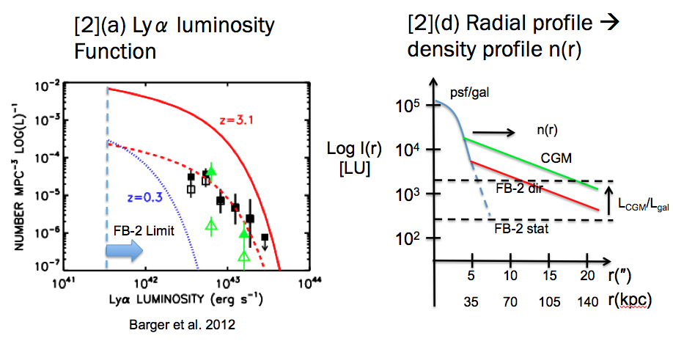
FIREBALL-2: Galaxy/CGM Lyα Photometry
Lyα Luminosity Function and Radial Profile→ separate Galaxy/Wind/CGM Emission

Slide 9
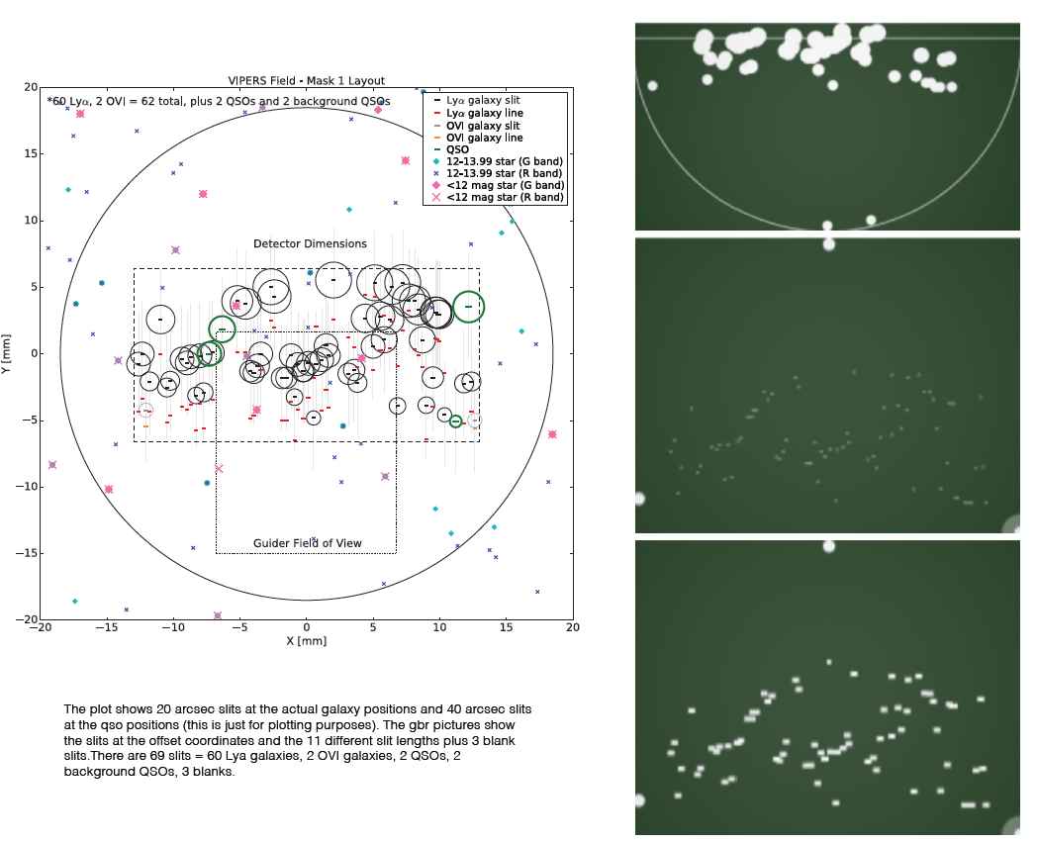
Targeted at Galaxy Concentration at z~0.7
Multi Object Mask

Slide 10
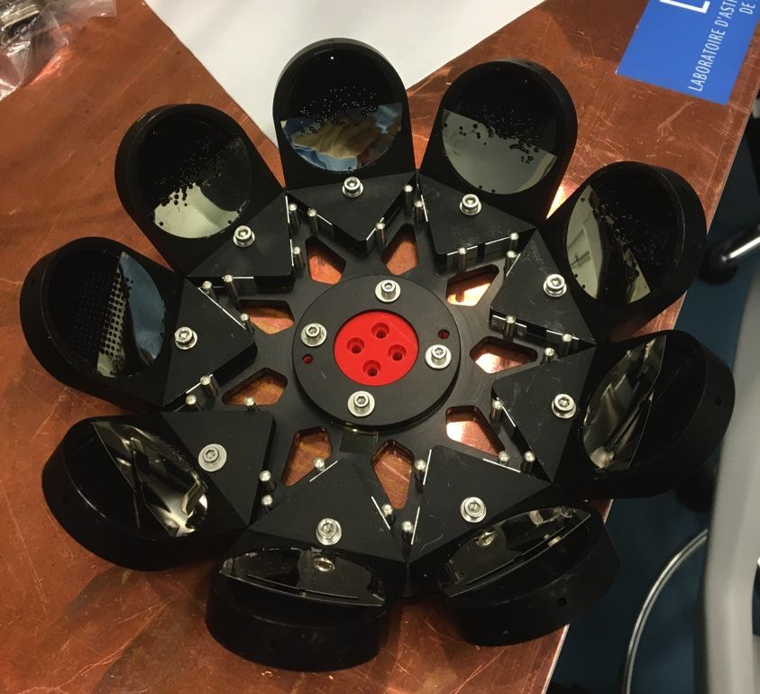
Laser Cut Multiobject
Mask Carousel loaded

Slide 11
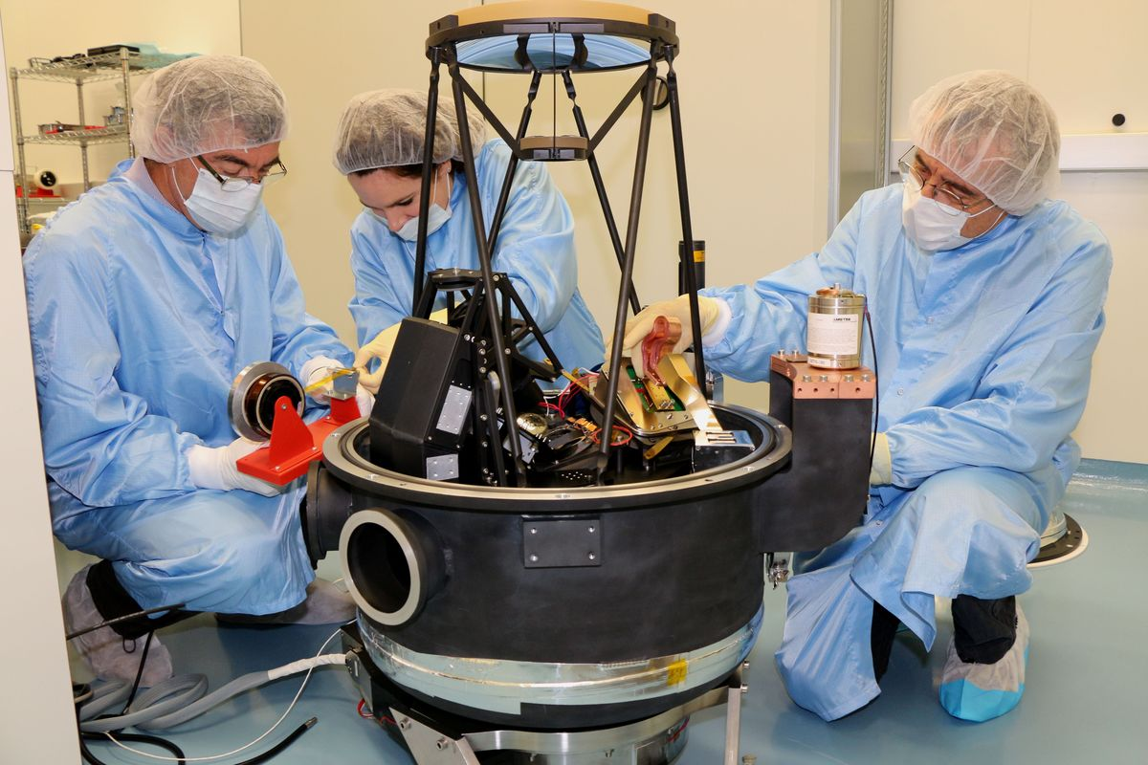
Spectrograph/Detector/Cryosystem
Robert G.
Bruno M.
Gillian K.
Focal
Corrector
MGS
Detector
Cold strap
Getter
Cryo-cooler

Slide 12
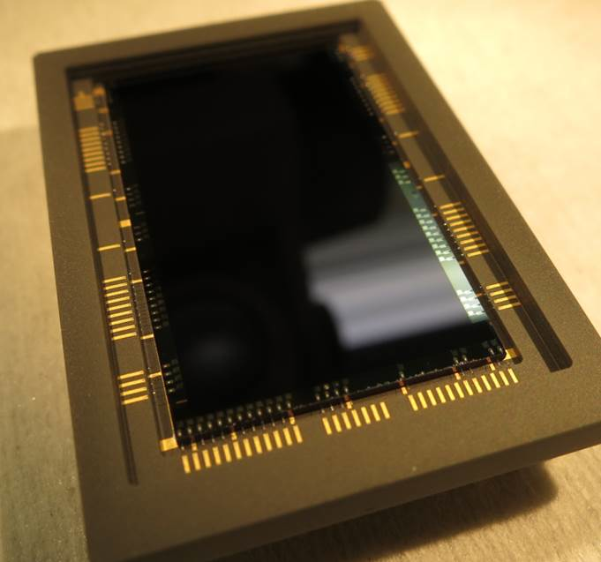
Science Detector
Flight device 13 QE
Reprocess Batch #1
MBE 2014.12.15
Three layer AR coating
QE testing at JPL.

Slide 13
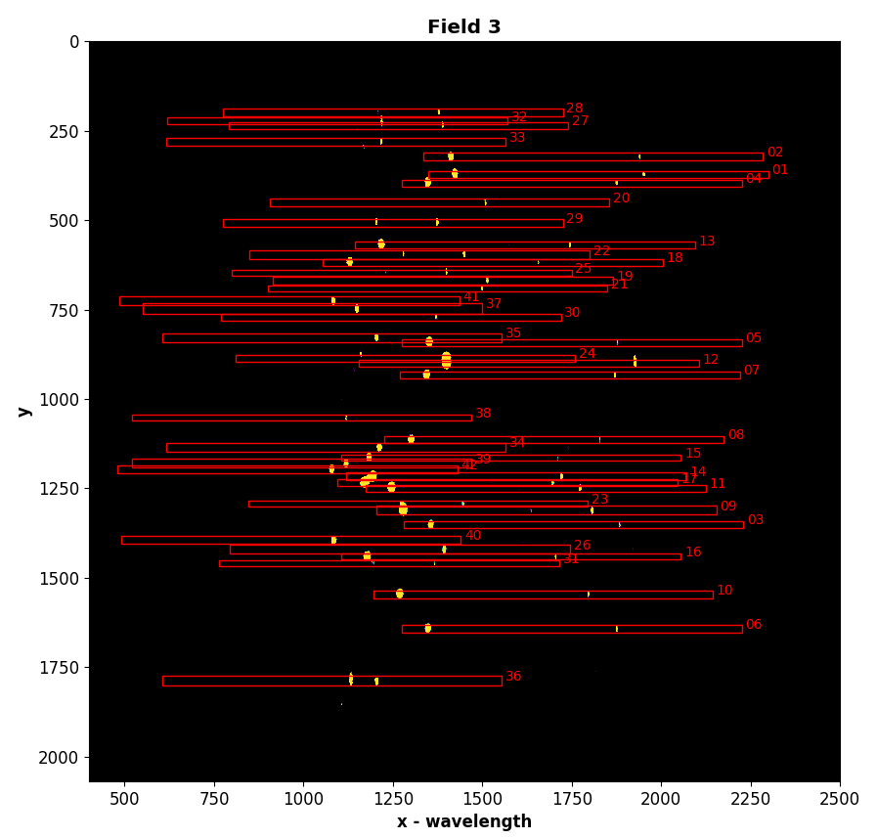
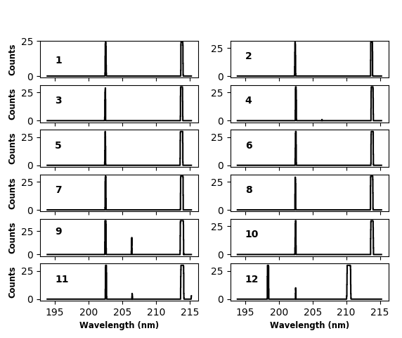
System Performance
Photon-counting image of calibration arc in Field 3 multi-slit mask
Individual slitlet spectral extraction
Before
After

Slide 14
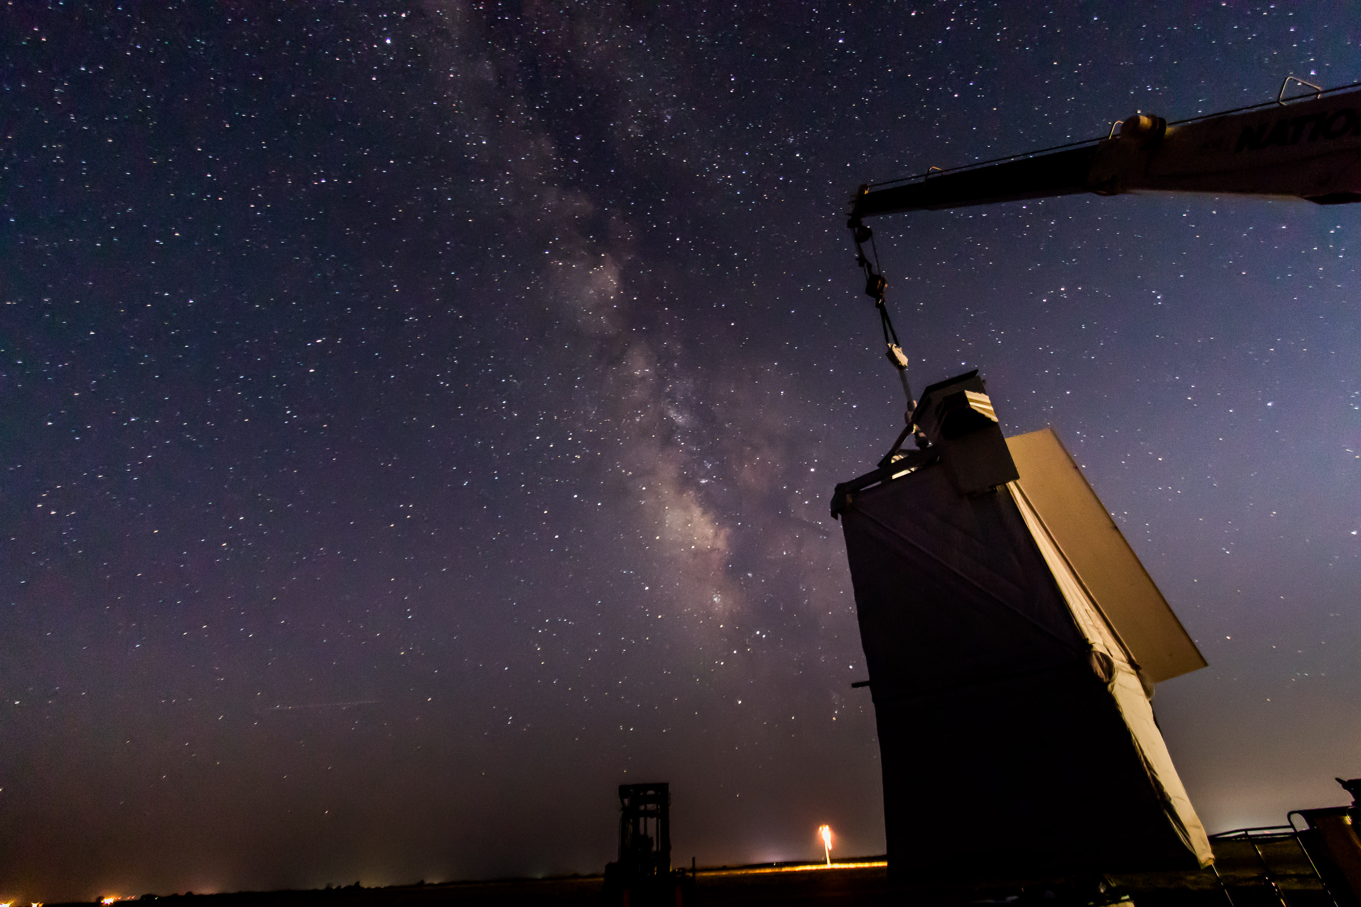
FIREBALL-2 Ready to Fly
UV optics measured efficiency 17%
High efficiency photon-counting detector (>50%)
Improved guidance algorithms validated in several sky tests
End-to-end test observing spectrum of artifical UV source while guiding 4-axis on artificial stars hanging on flight-chain simulator
Successful pre-flight integration campaign at Ft. Sumner
Successful compatibility test
FIREBALL-2 is READY FOR FLIGHT [Sept 2018]
SPIE 24 May 2006
IGM

Slide 15
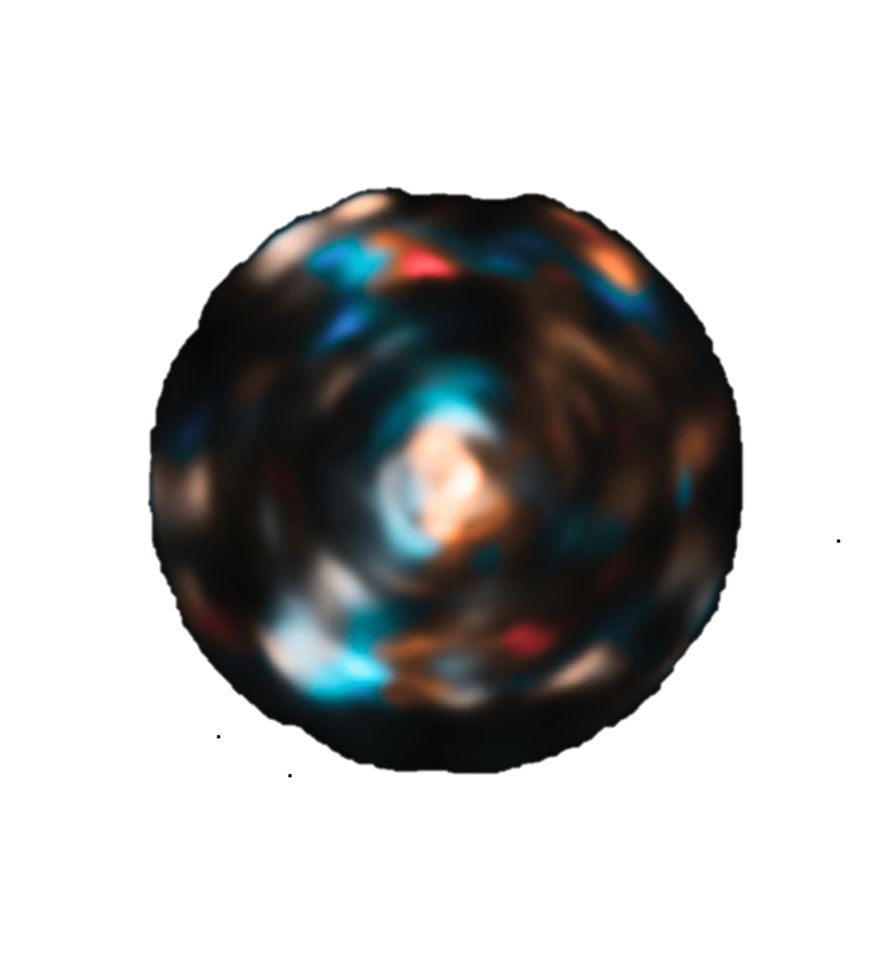
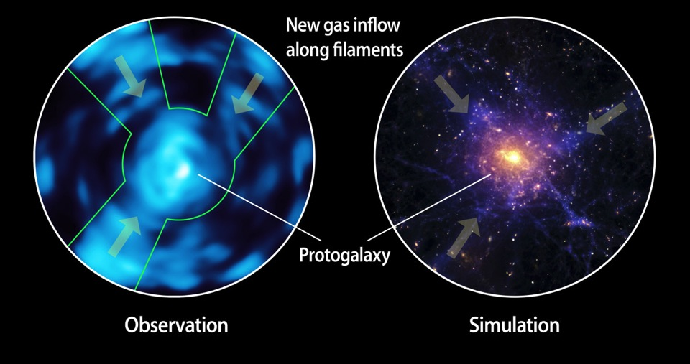
3. PCWI:
Kinematically Linked Filaments (LAB2)
L(Fil)
L(Blob)
Intensity
Velocity
Caltech Press Release April 28 – Results from Palomar Cosmic Web Imager
Martin et al. 2014b

Slide 16
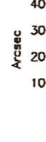
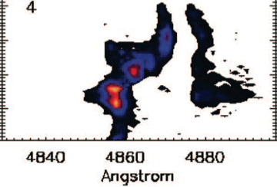
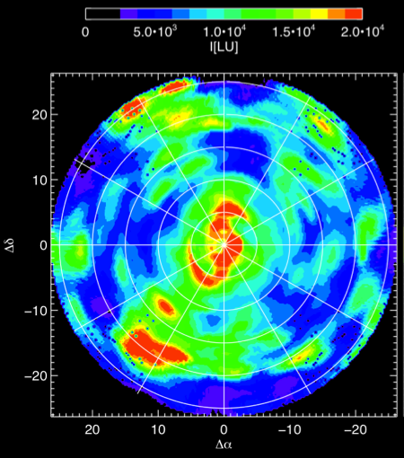
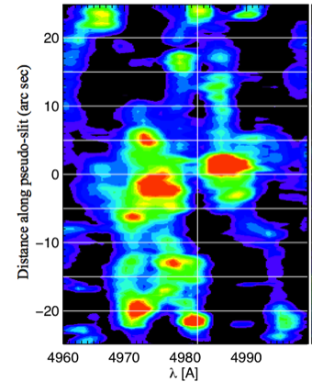
3. CGM Emission & Kinematics z~3 Lyman α blob
Cantalupo 06 Sim
Gas inflowing
& increasing density & turbulence
Emission
4669Å
Martin+2014b, PCWI IGM Paper I.
Spectral Image

Slide 17
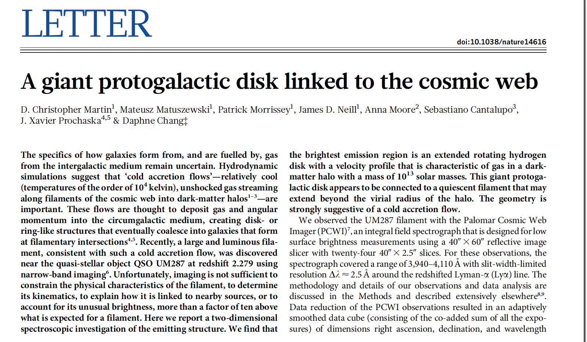
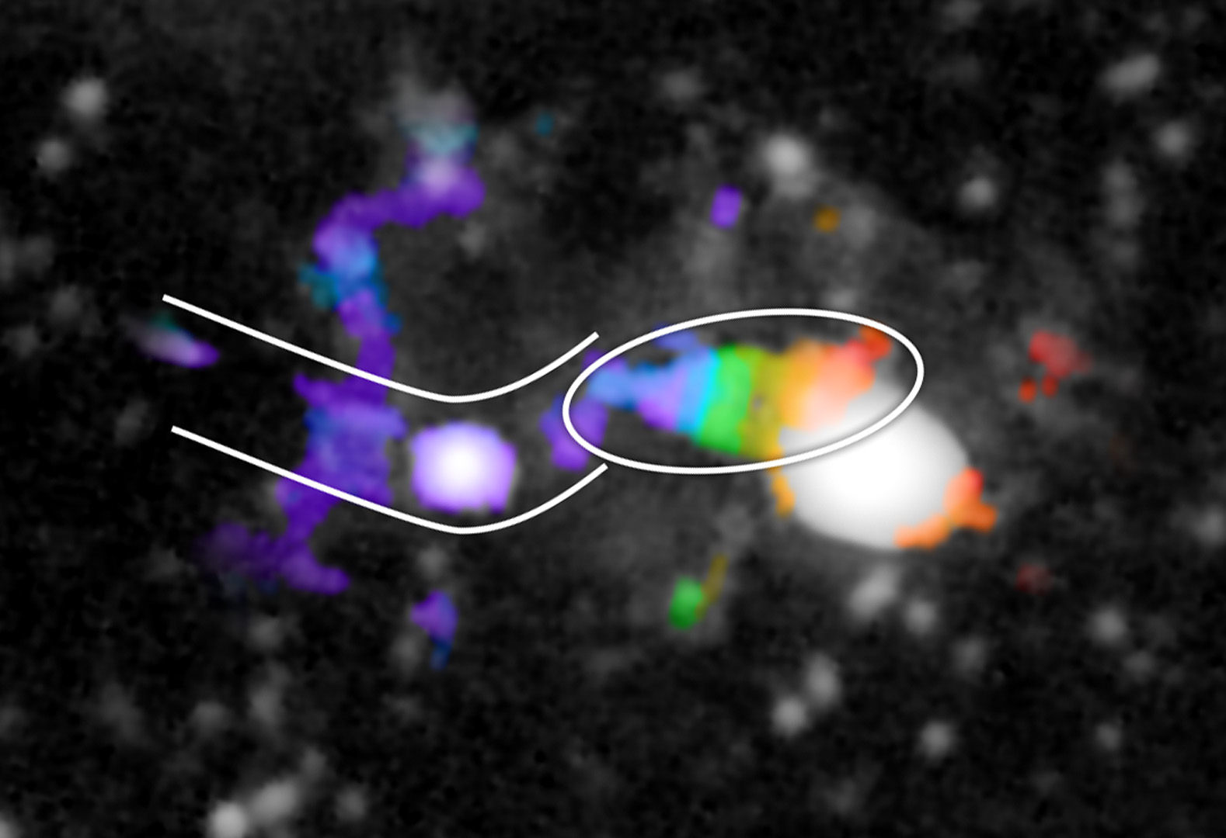
\
3. PCWI:
Discovery of Lyα Proto-Galactic Disks (PGDs)
Martin+15

Slide 18
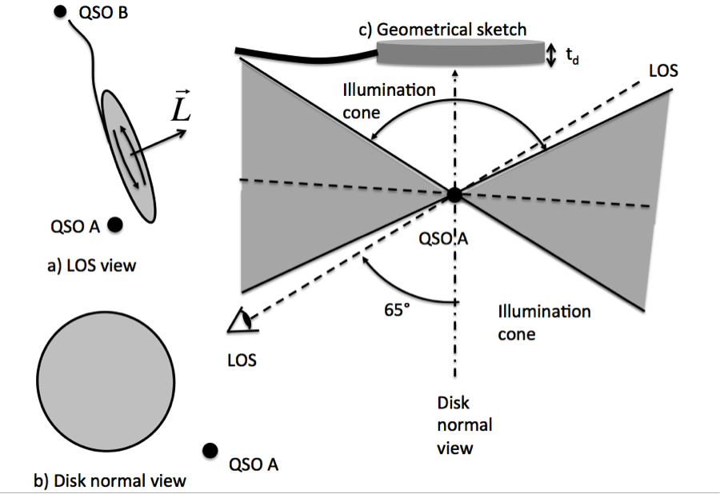
Protogalactic Disk: Model

Slide 19
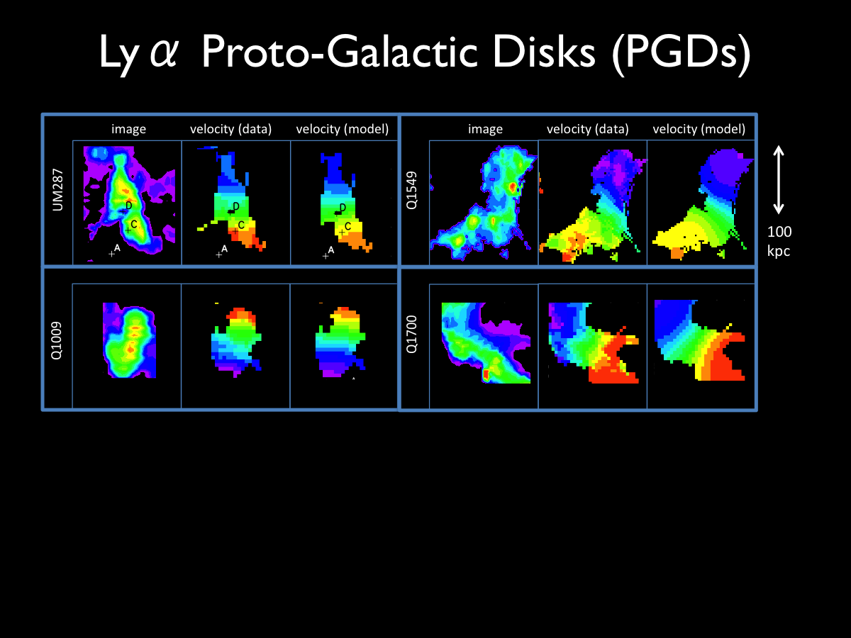
3. PCWI:
Discovery of Lyα Proto-Galactic Disks (PGDs)
Disk | z | R_{max} [kpc] | Log M_{h} | c | λ_{b} | T_{orb} [Gyr] | T_{vir} [Gyr] | σ_{v} [km/s] | #Fila-ments
UM287 | 2.28 | 65 | 13.0 | 3.2 | 0.14 | 0.9 | 2.8 | 53 | 1+
Q1549 | 2.84 | 110 | 12.6 | 3.1 | 0.30 | 2.0 | 1.6 | 44 | 2+
Q1009 | 2.65 | 45 | 12.7 | 1.7 | 0.24 | 0.8 | 2.4 | 54 | 1
Q1700 | 2.74 | 65 | 12.3 | 1.1 | 0.39 | 2.1 | 1.5 | 52 | 2?

Slide 20
PCWI Pilot Survey
Donal O’Sullivan, Matt Matuszewski, Prachi Parahar, CM CM

Slide 21
Protogalactic Disk Candidates
Mean shear <L> vs. Area & Axis Ratio

Slide 22
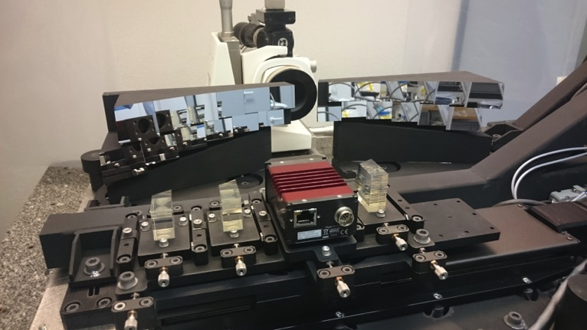
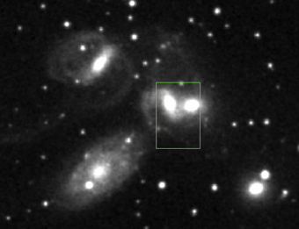
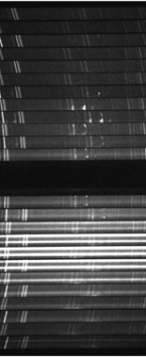
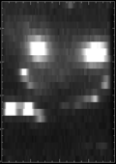
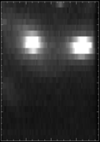
4. KCWI: Flexible & Powerful 2D Spectroscopy
3 selectable image slicers!
DSS Stephan’s Quintet
24 Slitlet spectra
λ
Strengths
Blue coverage (3500-6000Å)
Red coverage (5600-10500Å)
Precision Sky Subtraction
Flexible observing modes
High Resolution (R~20,000)
Hβ
Continuum
Slicer | Field of View | Spatial Resolution | Spectral Resolution
Small | 20” x 8” | 0.6” x 0.35” | 0.23 Å (R 20,000)
Medium | 20” x 16” | 0.6” x 0.7” | 0.45 Å (R 10,000)
Large | 20” x 32” | 0.6” x 1.4” | 0.90 Å (R 5,000)

Slide 23

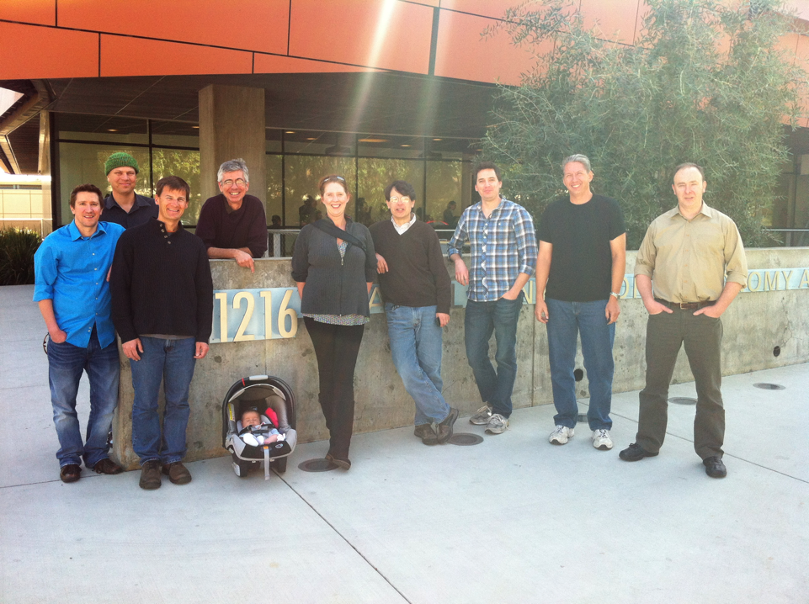
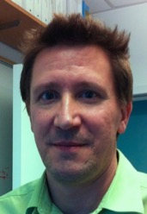



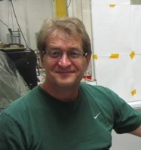
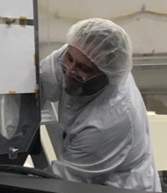
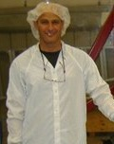
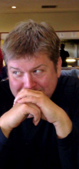
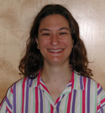


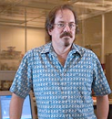
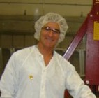
Keck Cosmic Web Imager
Team
Randy
Bartos
Patrick
Morrissey
Jason
Fucik
Bob
Weber
Steve Kaye
Jason Weiss
CM
Anna
Moore
Don
Neill
Steve
Kaye
Alex Delacroix
Marty Crabill
Ray Zarzaca
Kirk
Seaman
Daphne
Prachi Parihar
Donal O’Sullivan
Hector
Rodreguez
Connie
Rockosi
Drew
Phillips
Harland
Epps
Shawn
Callahan
Sean Adkins
Matt Matuszewski

Slide 24

KCWI Broad Bandpass

Slide 25

KCWI-B 1st Light: M3 Core
Abundances, Stellar Pops, Kinematics, IMBH
20”
2 x 10 minutes exposures with BH2 and Small Slicer →
Highest Spatial and Spectral Resolution

Slide 26






Jupiter – Exoplanet Analog
-12.6 km/s
+12.6 km/s
Medium slicer
BM grating at:
  3900Å
  4500Å
  5100Å
R ≈ 5000 (1Å)
~1 s exposures
(twilight)
North Equatorial Belt (NEB)
Equatorial zone (EqZ)
South Equatorial Belt (SEB)
KCWI IFU mosaic (3x2)
Rotation
KCWI Focal plane camera mosaic
I.dePater + KCWI team +
Notes:
Tiling

Slide 27
Guitar Nebula
Analyzing Physics of Pulsar Wind Nebulae – 30 km/s slices
KCWI Data
KCRM: Hα, [NII], [SII]
Kulkarni, Kyne+

Slide 28


M51
M51 High Velocity Shock Feedback
Explaining Star Formation Feedback
KCWI – High Velocity [OIII] Emission
Traces shocks from stellar feedback
KCWI-traced high velocity gas shocks (red) are produced by supernova from massive stars (blue) and disrupt gas to shut down star formation.
GALEX – UV
Spitzer – Infrared
SFA
GALEX – UV – Tracing OB stars
Spitzer – Infrared – Tracing gas/dust
SFR
DUST DISRUPTED
BY MASSIVE STARS
M*
TIME
2.5 KPC
M51 – Whirlpool Galaxy
STAR FORMATION
(DUST OBSCURED)
KCRM: Hα, [NII], [SII]
Hamden, Darvish, Martin+2018

Slide 29





Dark Matter Project: Ultra Diffuse Galaxies
Stellar Pops, Abundances, Kinematics, Dark Matter
Van Dokkum
Martin
Matuszewski
Abraham+17
KCWI
R band
Medium Slicer
BM grating
KCWI Intensity Scale -- electrons (1000 = 24.8 mag/arcsec²)
KCRM: CaT, CaH2, TiO, NaI, KI, FeH (Wing-Ford)

Slide 30

Quadruple Lensed Quasar
Young Galaxy Maps, IGM Maps
20’’
8’’
Small slicer
BL Grating
R ≈ 5000 (1Å)
3500 to 5500 Å
600s (twilight)
K.Rubin + KCWI team +

Slide 31
5. KCWI CQM Observations
Starting Fall 2017
Kinematic/Disk/Rotating Structure Properties
  Are they really disks!!?? (vs. discrete blobs, superpositions, outflows, etc…)
  Radial/Inspiral flow?
  Circular velocity
  Size, Dark Matter Halo mass, baryonic mass
  Morphology, Clumpiness, Radiative transfer
  Metal lines
Filament properties
  Number, length, size, mass/length, dominant filament,
Halo and Environmental Properties
  Halo mass, concentration, radius
Black Hole/AGN vs. Halo Properties
  Halo mass vs. AGN luminosity [BH mass]

Slide 32
QSO 1002
PCWI 1 hr
KCWI 1 hr
KCRM: Lyα CGM/CQM 4<z<7

Slide 33



Q1002
KCWI Channel Maps Show Rotating Structures
15”
540<v<675 km/s
675<v<810 km/s
810<v<945 km/s
945<v<1080 km/s
1080<v<1215 km/s
1215<v<1380 km/s

Slide 34
Q1002
2 Disks
One Centered on
QSO
KCWI Data
Intensity (data)
Intensity (model)
Velocity (data)
Velocity (model)
ROTATION
ONLY
Xi²~100
Disk (model)
Radial (model)

Slide 35
Q1002
Evidence for Radial
Inflow?
KCWI Data
Intensity (data)
Intensity (model)
Velocity (data)
Velocity (model)
ROTATION+
LINEAR ZONAL
RADIAL
Xi²~50
Disk (model)
Radial (model)

Slide 36
Cold Flow Inspiral
Surface Density/Flow
Azimuthal Velocity
Radial Velocity
Dekel 2016

Slide 37

Multi-Filament Inflow (MFI)
How Forming Galaxies Get Raw Food

Slide 38


Multi-Filament Inflow (MFI): Model 3c(i)
Azimuthal Flow (Faceon)
As Observed

Slide 39

Multi-Filament Inflow (MFI): Model 3c(i)
INFLOW
Radial Flow: Simulation
Radial Flow: MFI Model
OUTFLOW

Slide 40

Multi-Filament Inflow (MFI): Model 3c(i)
Radial Flow: As Observed
Radial Flow: MFI Model

Slide 41



UM287/Slug
Radial Flow Direction = Direction of Extended Filament
N(H)
v(model)
Radial Mass Flux
Radial velocity

Slide 42







KCWI CQM Imaging
HS1549 – Multi-Filament Inflow Model
Data
Model 1
Model 3b(ii)
Model 4
AIC
821
504
432
N(H) [Faceon]
dM/dt
v(radial)

Slide 43






KCWI Multi Filament Inflow Protogalaxies
>4 discovered to date
QSO1009
QSO0221
DISK
DATA
MFI
DISK
DATA
MFI
UM287
QSO1549
DISK
DATA
MFI
DISK
DATA
MFI

Slide 44

6. KCWI Red Channel
Keck Cosmic Reionization Mapper (KCRM)
Now Fully Funded
in Preliminary Design
Commissioning 2020

Slide 45


Reionization Epoch
Observations vs. Models
Topology
1-Q_{HII}=0.74
1-Q_{HII}=0.53
1-Q_{HII}=0.18
Robertson+13
Furlanetto & Mesinger 07

Slide 46

Reionization Epoch
KCRM Observables
Galaxy Halo (Residual HI)
Galaxy Ionization
Front Emission
QSO Ionization Front Emission
Local
QSO
Ionization
Front
Lensed Versions of
All of These!
10 cMpc
SF Galaxy
d
High δ gas Lyα Fluorescence
d
Lyα Emitter Luminosity
Lyα Emitter Line Profile (Bubble radius)
Lyα Emitter Redshift compared to Hα z
SF Galaxy
SF Galaxy
Background
QSO
Gunn-Peterson Gaps
Local
QSO
Background QSO Lyα forest
Lyα Emitter Clustering

Slide 47



7. XCWI eXplorer Cosmic Web Imager
Revealing the Cosmic Cycle of Baryons
Imaging Spectroscopy and Narrow-band Imaging in the Far and Near UV
Lyα 0.01<z<1.3
Caltech, JPL (Nikzad), LAM (Milliard), U. Arizona (Hamden), Columbia+ (Schiminovich)++
Instrument
1 meter telescope, Integral Field Spectrograph (1200-2600Å), Photon-counting UV CCD
Science Goals
Decode the star formation laws at low and high redshift
Decode Lyman α emission at low and high redshift
Discover & map Circum-galactic medium to explore IGM-galaxy co-evolution
Explore the extended, low surface brightness UV Universe

Slide 48

Summary
We are beginning to image the CGM
FIREBALL-2 will map Lyα and CGM at z~0.7 and test new technology for space missions
PCWI results confirmed and deepened by KCWI
KCWI is working as expected and delivering superb data
Multi-Filament Inflow Models provide an excellent fit to KCWI observations of 4 Proto-Galactic Inspirals
KCRM (KCWI red channel to z[Lyα]~8) is fully funded and under development
XCWI will perform low surface brightneds imaging spectroscopy over 1200Å<l<2800Å and map low redshift CGM and IGM
Thanks: FIREBALL=2 team (Milliard, Schiminovich, Hamden,+), CWI team, KCWI team (Morrissey, Matuszewski, Rizzi,+), KCRM and XCWI teams. Thanks to CLAW orginizers

Slide 49
本日は、ご清聴
ありがとうございました

