Slide 1
The First HETDEX Data-Mining: Searching for Lyα Escape from z ~ 2 Star Forming Galaxies
(a progress report)
Robin Ciardullo, Will Bowman,
Caryl Gronwall and the HETDEX Team

Slide 2
High-z Galaxies
Galaxies at z > 2 are classified by the method of selection:
  Lyman-break galaxies (LBGs)
  Sub-mm Galaxies (SMGs)
  Extremely Red Galaxies (EROs)
  Optical Emission-Line Galaxies (oELGs)
  (and NAGs – none of the above galaxies)
  BzK, BX/BM, and UGR galaxies
  Distant Red Galaxies (DRGs)
  IRAC Extremely Red Galaxies (IEROs)
  Lyα Emitting Galaxies (LAEs)
The task: make sense of this High-z Galaxy zoo

Slide 3
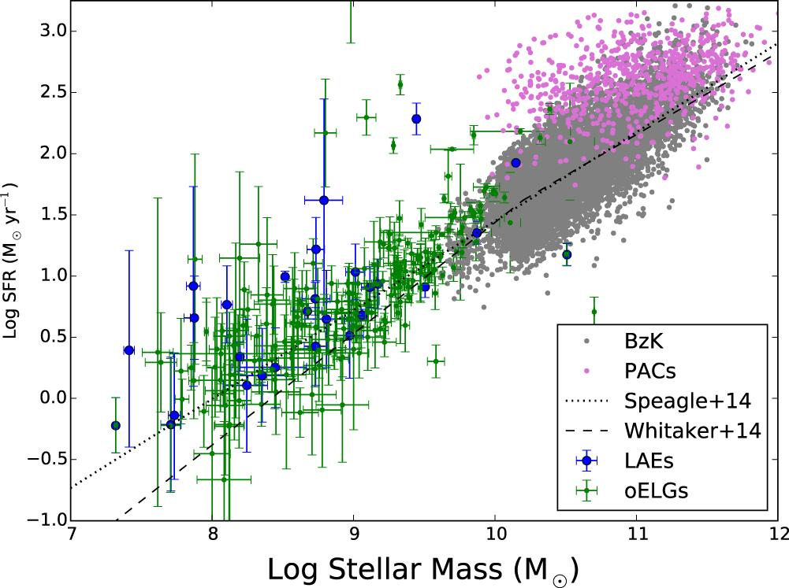
Galaxy Selection at High-z
Continuum-selection and sub-mm techniques generally pick out high mass galaxies, while methods which identify objects via emission-lines (either LAEs or oELGs) tend to find lower-mass objects.
Hagen et al. 2016
The lessens learned from one class may not carry over to another. We must carefully bootstrap our way from type to type.
Since LAEs and oELGs appear to be stellar-mass matched objects, we begin there.

Slide 4
Step 1: LAEs versus oELGs
LAEs
How do the properties of LAEs related to those of oELGS?
What makes an LAE an LAE?
oELGs

Slide 5
Step 1: LAEs versus oELGs
How do the properties of LAEs related to those of oELGS?
What makes an LAE an LAE?
oELGs
LAEs

Slide 6
Step 2: LAEs/oELGs versus LBGs, etc.
All z~2 galaxies
How do the properties of LAEs and oELGs related to those of LBGs, BzKs, etc.
How do low-mass galaxies differ from high-mass galaxies?
oELGs
LAEs

Slide 7
Step 2: LAEs/oELGs versus LBGs, etc.
All z~2 galaxies
How do the properties of LAEs and oELGs related to those of LBGs, BzKs, etc.
How do low-mass galaxies differ from high-mass galaxies?
oELGs
LAEs

Slide 8
Step 2: LAEs/oELGs versus LBGs, etc.
All z~2 galaxies
Properties of interest:
  Size
  Morphology (elongation, Sérsic)
  Stellar Mass
  Star formation rate
  Dust (stellar attenuation)
  Clustering, bias
  Metallicity
oELGs
LAEs

Slide 9
The Surveys
To compare LAEs with oELGs, we are using two large surveys:
  3D-HST (2-orbit HST exposures with the WFC G141 grism, covering 1.08 μm < λ < 1.68 μm at R ~ 130)
  HETDEX science verification (18.3 min IFU exposures with the Hobby-Eberly Telescope, covering 3500 Å < λ < 5500 Å at R ~ 750)
  Both surveys focus on well-observed regions of space, such as COSMOS, GOODS-N, and AEGIS.

Slide 10
The oELG sample
The 3D-HST sample:
  Extension of work by Greg Zeimann et al. (2014)
  m_{H} < 26 with strongest line (typically [O III] λ5007) brighter than ~ 5 × 10⁻¹⁷ ergs/cm²/s
  Restricted to redshift range 1.90 < z < 2.35, where multiple emission lines yield unambiguous redshifts
  Detectable lines include [O II] λ3727, [Ne III] λ3869, Hδ, Hγ, Hβ, and [O III] λλ4959,5007
  Skelton et al. (2014) provides matched-aperture photometry from 0.3 μm < λ < 8 μm (rest-frame Lyα to ~ 3 μm)

Slide 11
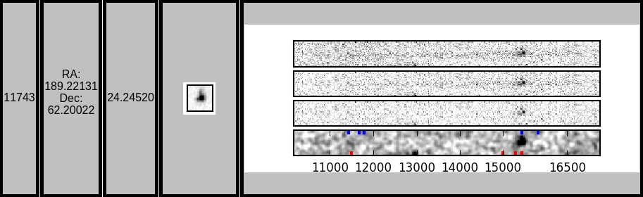
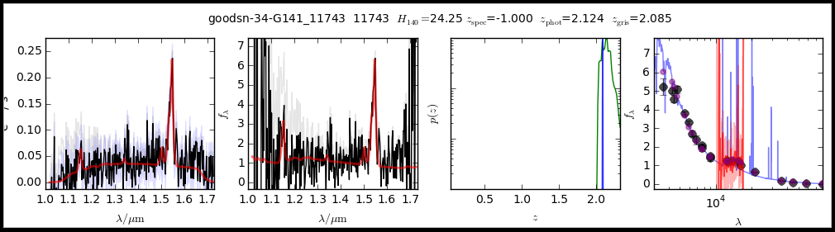
Example 3D-HST Object
reduced
contamination
continuum
smoothed
0.3
1.0
2.0
5.0
z_{phot}
λ (μm)

Slide 12
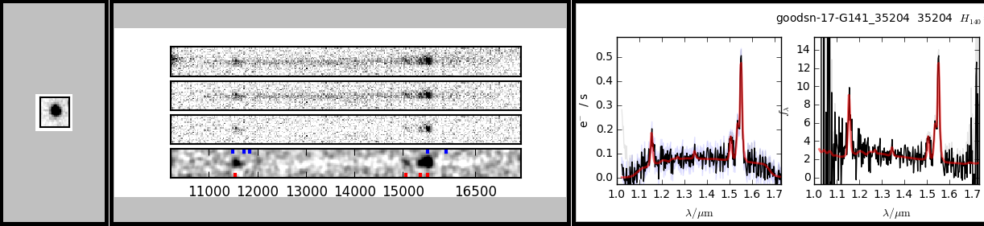
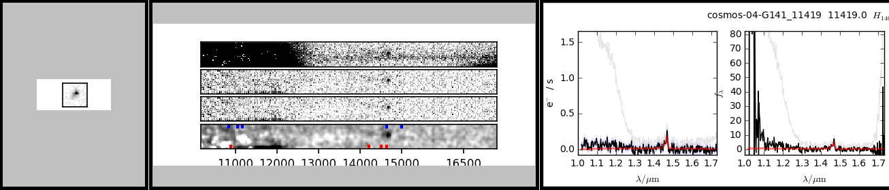
Example 3D-HST Objects

Slide 13
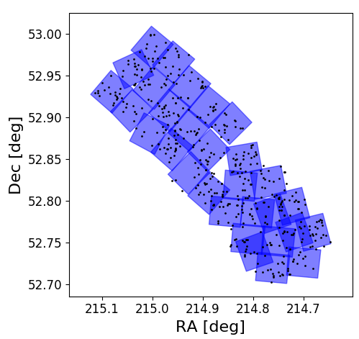
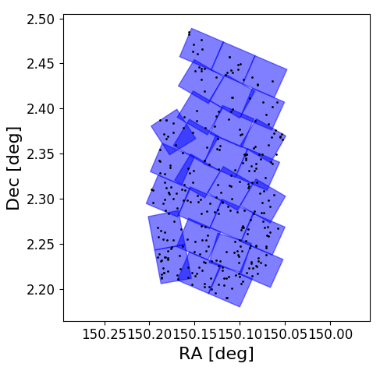
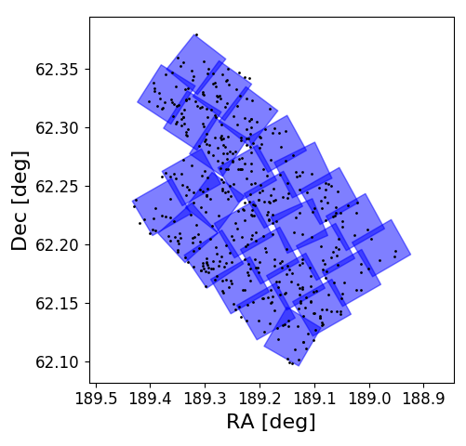
AEGIS
COSMOS
GOODS-N
The 3D-HST northern survey regions; the dots show the locations of 1.90 < z < 2.35 oELGs
 | AEGIS | COSMOS | GOODS-N | Total
z ~ 2 oELGs | 494 | 297 | 491 | 1282

Slide 14
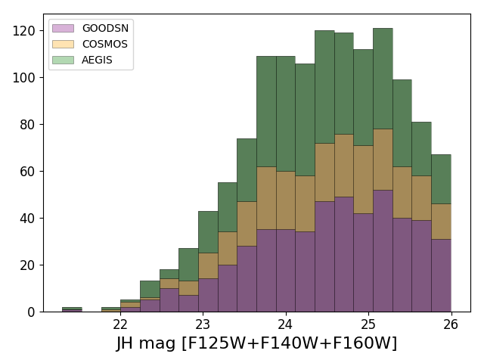
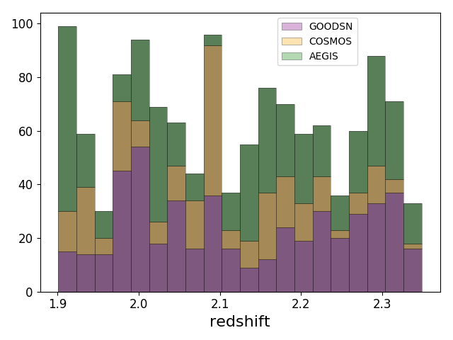
The oELG sample – Continuum Magnitude and Redshift Distributions

Slide 15
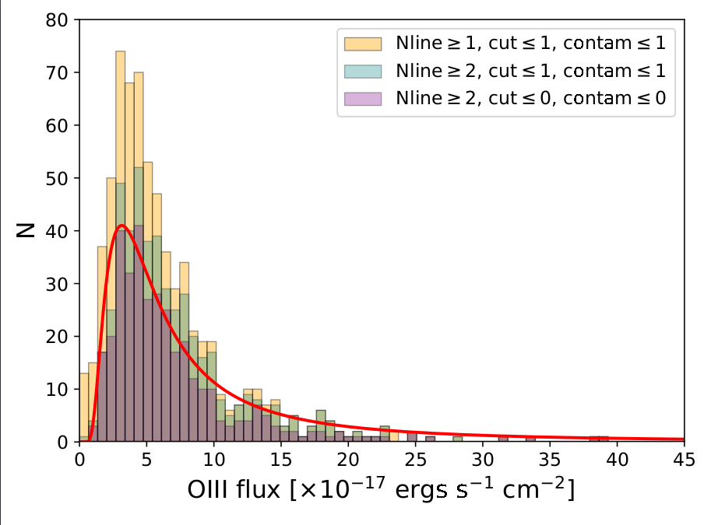
The oELG sample: [O III] λ5007 Flux Distribution
FIELD | 50% Completeness Limit (× 10⁻¹⁷ ergs/cm²/s)
AEGIS | 4.7
COSMOS | 5.9
GOODS-N | 4.6

Slide 16
The Star-Forming Galaxy Main Sequence
Our new sample of 3D-HST oELGs is > 5 times that studied by Hagen et al. (2016), and thus extends over a wider range of stellar mass (including the range of continuum-selected galaxies).

Slide 17
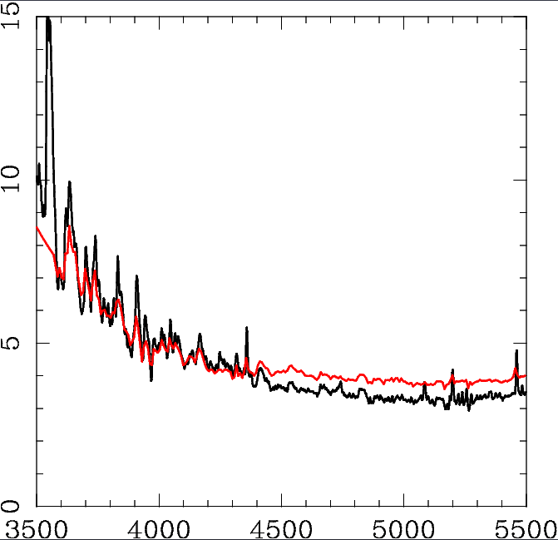
VIRUS Observations
HETDEX science verification is surveying GOODS-N, COSMOS, and AEGIS for LAEs between 1.90 < z < 3.5
R ~ 800 IFU spectroscopy between 3500 Å < λ < 5500 Å
448 1.5″ fibers per IFU
2 spectrographs per IFU; 2 CCDs per spectrograph
Started with 16 IFUs; now at 32
6.1 × 3 minute exposures per field
Flux limit ~ 6 × 10⁻¹⁷ ergs/cm²/s in our 3D-HST range 1.90 < z < 2.35
black: spec
red: measured
Flux (10⁻¹⁷ ergs/cm²/s)

Slide 18
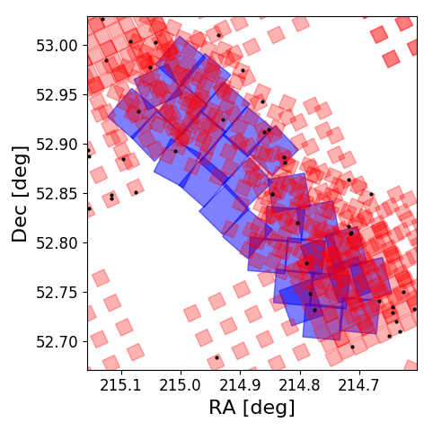
HETDEX Science Verification Frames
Most comprehensive observations to date are in AEGIS.
94 AEGIS pointings completed (mostly with ~ 16 IFUs per pointing)
COSMOS and GOODS-N survey on-going

Slide 19
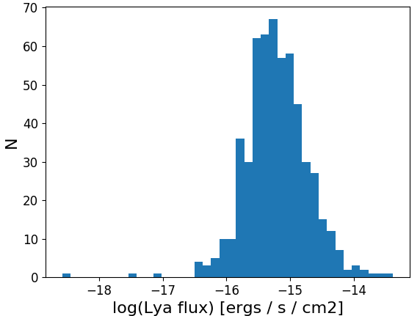
HETDEX Science Verification Frames
Most comprehensive observations to date are in AEGIS.
94 AEGIS pointings completed (mostly with ~ 16 IFUs per pointing)
COSMOS and GOODS-N survey on-going
First (incomplete) LAE catalog of AEGIS in hand
HETDEX flux limit

Slide 20
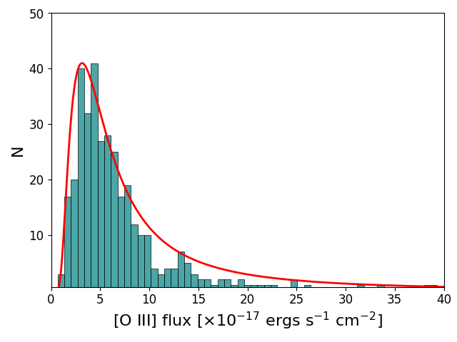
Note on the Depth of the Two Samples
The [O III] λ5007 completeness limit is ~ 5 × 10⁻¹⁷ ergs/cm²/s

Slide 21
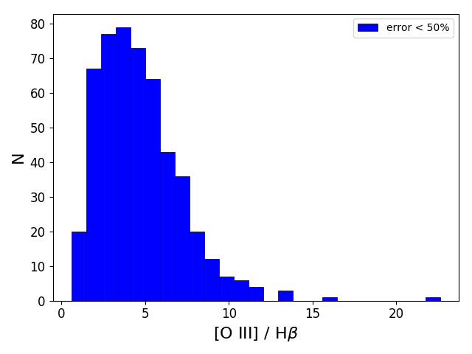
Note on the Depth of the Two Samples
The [O III] λ5007 completeness limit is ~ 5 × 10⁻¹⁷ ergs/cm²/s.
The observed ratio of [O III] λ5007 to Hβ is ~ 6.
The Case B Lyα/Hβ ratio is ~ 25
If the escape fraction is 100%, then Lyα for the faintest 3D-HST sources should be ~ 2 × 10⁻¹⁶ ergs/cm²/s, or ~ 3.3 times brighter than the HETDEX limit.

Slide 22
Note on the Depth of the Two Samples
At the [O III] λ5007 limit, galaxies with Lyα escape fractions below ~ 33% will be undetectable.
Brighter [O III] sources can probe to lower escape fractions
*This argument assumes [O III] is not attenuated by dust; we actually probe deeper than this.
**A few HETDEX science verifi-cation fields have deeper data.

Slide 23
Lyα escape fraction: the Case B Lyα / Hβ ratio
The hydrogen recombination rate that produces an n=2 electron is
The hydrogen recombination rate that produces an n=2 electron via a 4 ➝ 2 transition is
75% of the recombinations will land in the n=2 p-orbital and produce a Lyα photon. So the ratio of Lyα to Hβ is therefore

Slide 24
Looking for Lyα in 3D-HST Galaxies
Currently, ~ 750 out of the 1282 oELGs in our sample have been observed by HETDEX
The 3D-HST grism redshifts have a precision of Δz ~ 0.005, or ~6 Å. We therefore search a ± 6 σ (~ 72 Å) region around the wavelength implied by [O III] λ5007 for redshifted Lyα.
At this limit, we are (currently) susceptible to false detections (i.e., noise spikes and artifacts masquerading as Lyα). So we also search regions outside of the detection window.

Slide 25
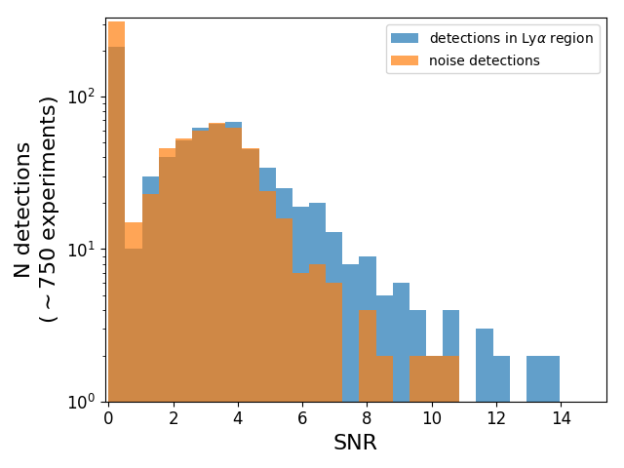
Real versus False Detections
HETDEX detections with S/N ≲ 5 are likely false.
Only ~ 50 detections likely to be real
Real detections

Slide 26
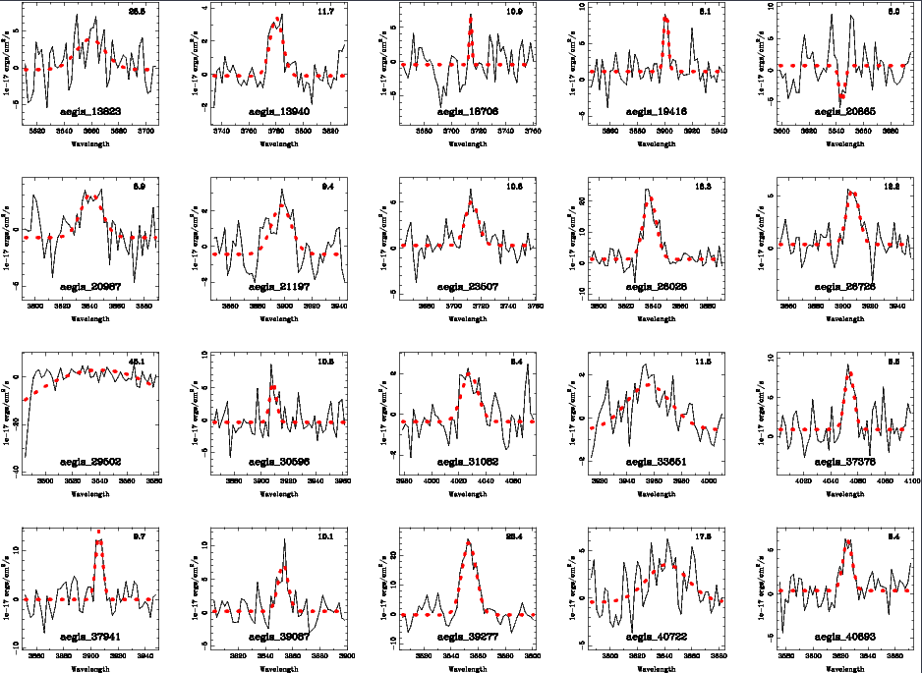
Thus far, only ~ 50 oELGs have “secure” detections in Lyα.

Slide 27
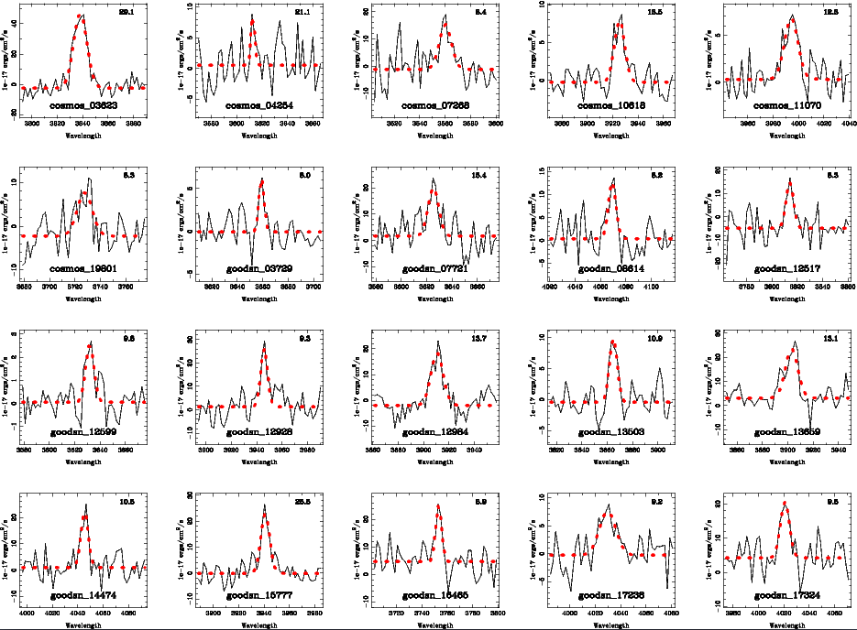
Thus far, only ~ 50 oELGs have “secure” detections in Lyα.

Slide 28
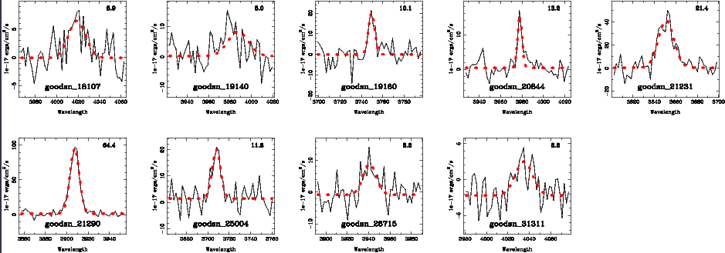
Thus far, only ~ 50 oELGs have “secure” detections in Lyα.

Slide 29
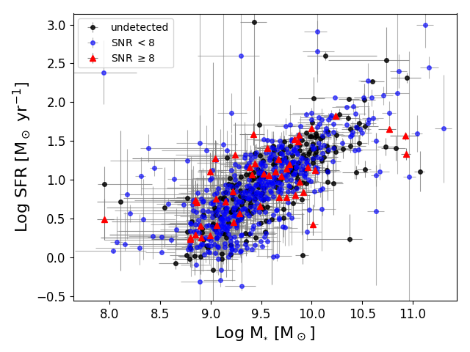
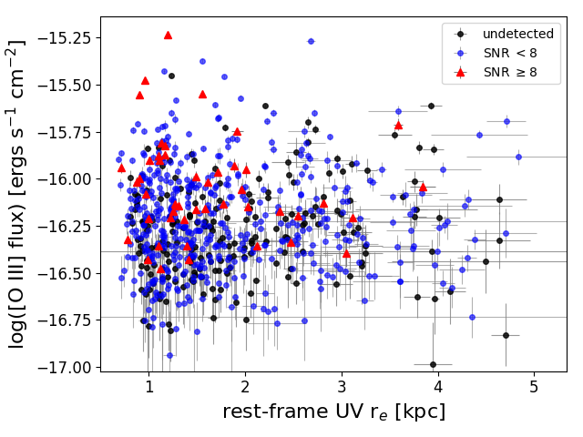
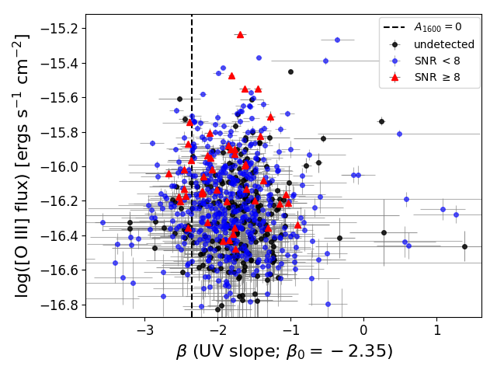
Results
Somewhat surprisingly, Lyα detections are not restricted to the brightest [O III] sources (i.e., those which probe faintest). There is marginal evidence (~95% confidence) that Lyα escapes more easily from small galaxies.

Slide 30
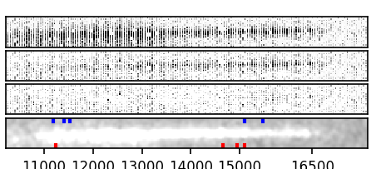
Recovering LAEs in 3D-HST
In AEGIS, only ~ 15 to 20 HETDEX LAEs lie in the 3D-HST footprint (5 cases of ambiguous counterparts)
Some fainter than the m_{H} ~ 26 limit
Some lie on contaminated regions

Slide 31
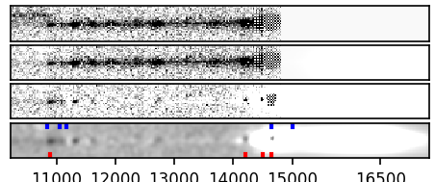
Recovering LAEs in 3D-HST
In AEGIS, only ~ 15 to 20 HETDEX LAEs lie in the 3D-HST footprint (5 cases of ambiguous counterparts)
Some fainter than the m_{H} ~ 26 limit
Some lie on contaminated regions
⟵ A “nice” detection

Slide 32
Recovering LAEs in 3D-HST
In AEGIS, only ~ 15 to 20 HETDEX LAEs lie in the 3D-HST footprint (5 cases of ambiguous counterparts)
Some fainter than the m_{H} ~ 26 limit
Some lie on contaminated regions
More expected as HETDEX detections reach their limit and catalogs in the COSMOS and GOODS-N fields are produced.

Slide 33
Summary
3D-HST/HETDEX data mining has begun, even with non-optimized HETDEX software.
The percentage of 1.90 < z < 2.35 oELGs that emit Lyα at levels brighter than the HETDEX limit (~ 6 × 10⁻¹⁷ ergs/cm²/s) is small (~ 5%). If Lyα is leaking out from these galaxies, it is doing so at a very low level (a couple of percent)
So far, the only marginal correlation we see between Lyα emission oELG property is with galaxy size. But our ability to explore this topic is changing rapidly!

