Slide 1




Mechanical energy production by starbursts and Predicting Lyman alpha output
Matthew Hayes & Axel Runnholm (Stockholm University) and LARS team
SnowSakura Cosmic Lyman Alpha Workshop, Tokyo 2018

Slide 2
Objectives of my talk
To demonstrate that:
Green Pea galaxies may have injected more mechanical energy than is obvious
We can predict the Lyman alpha luminosity of a galaxy reasonably well (after many years of saying we can’t – sorry about that)

Slide 3
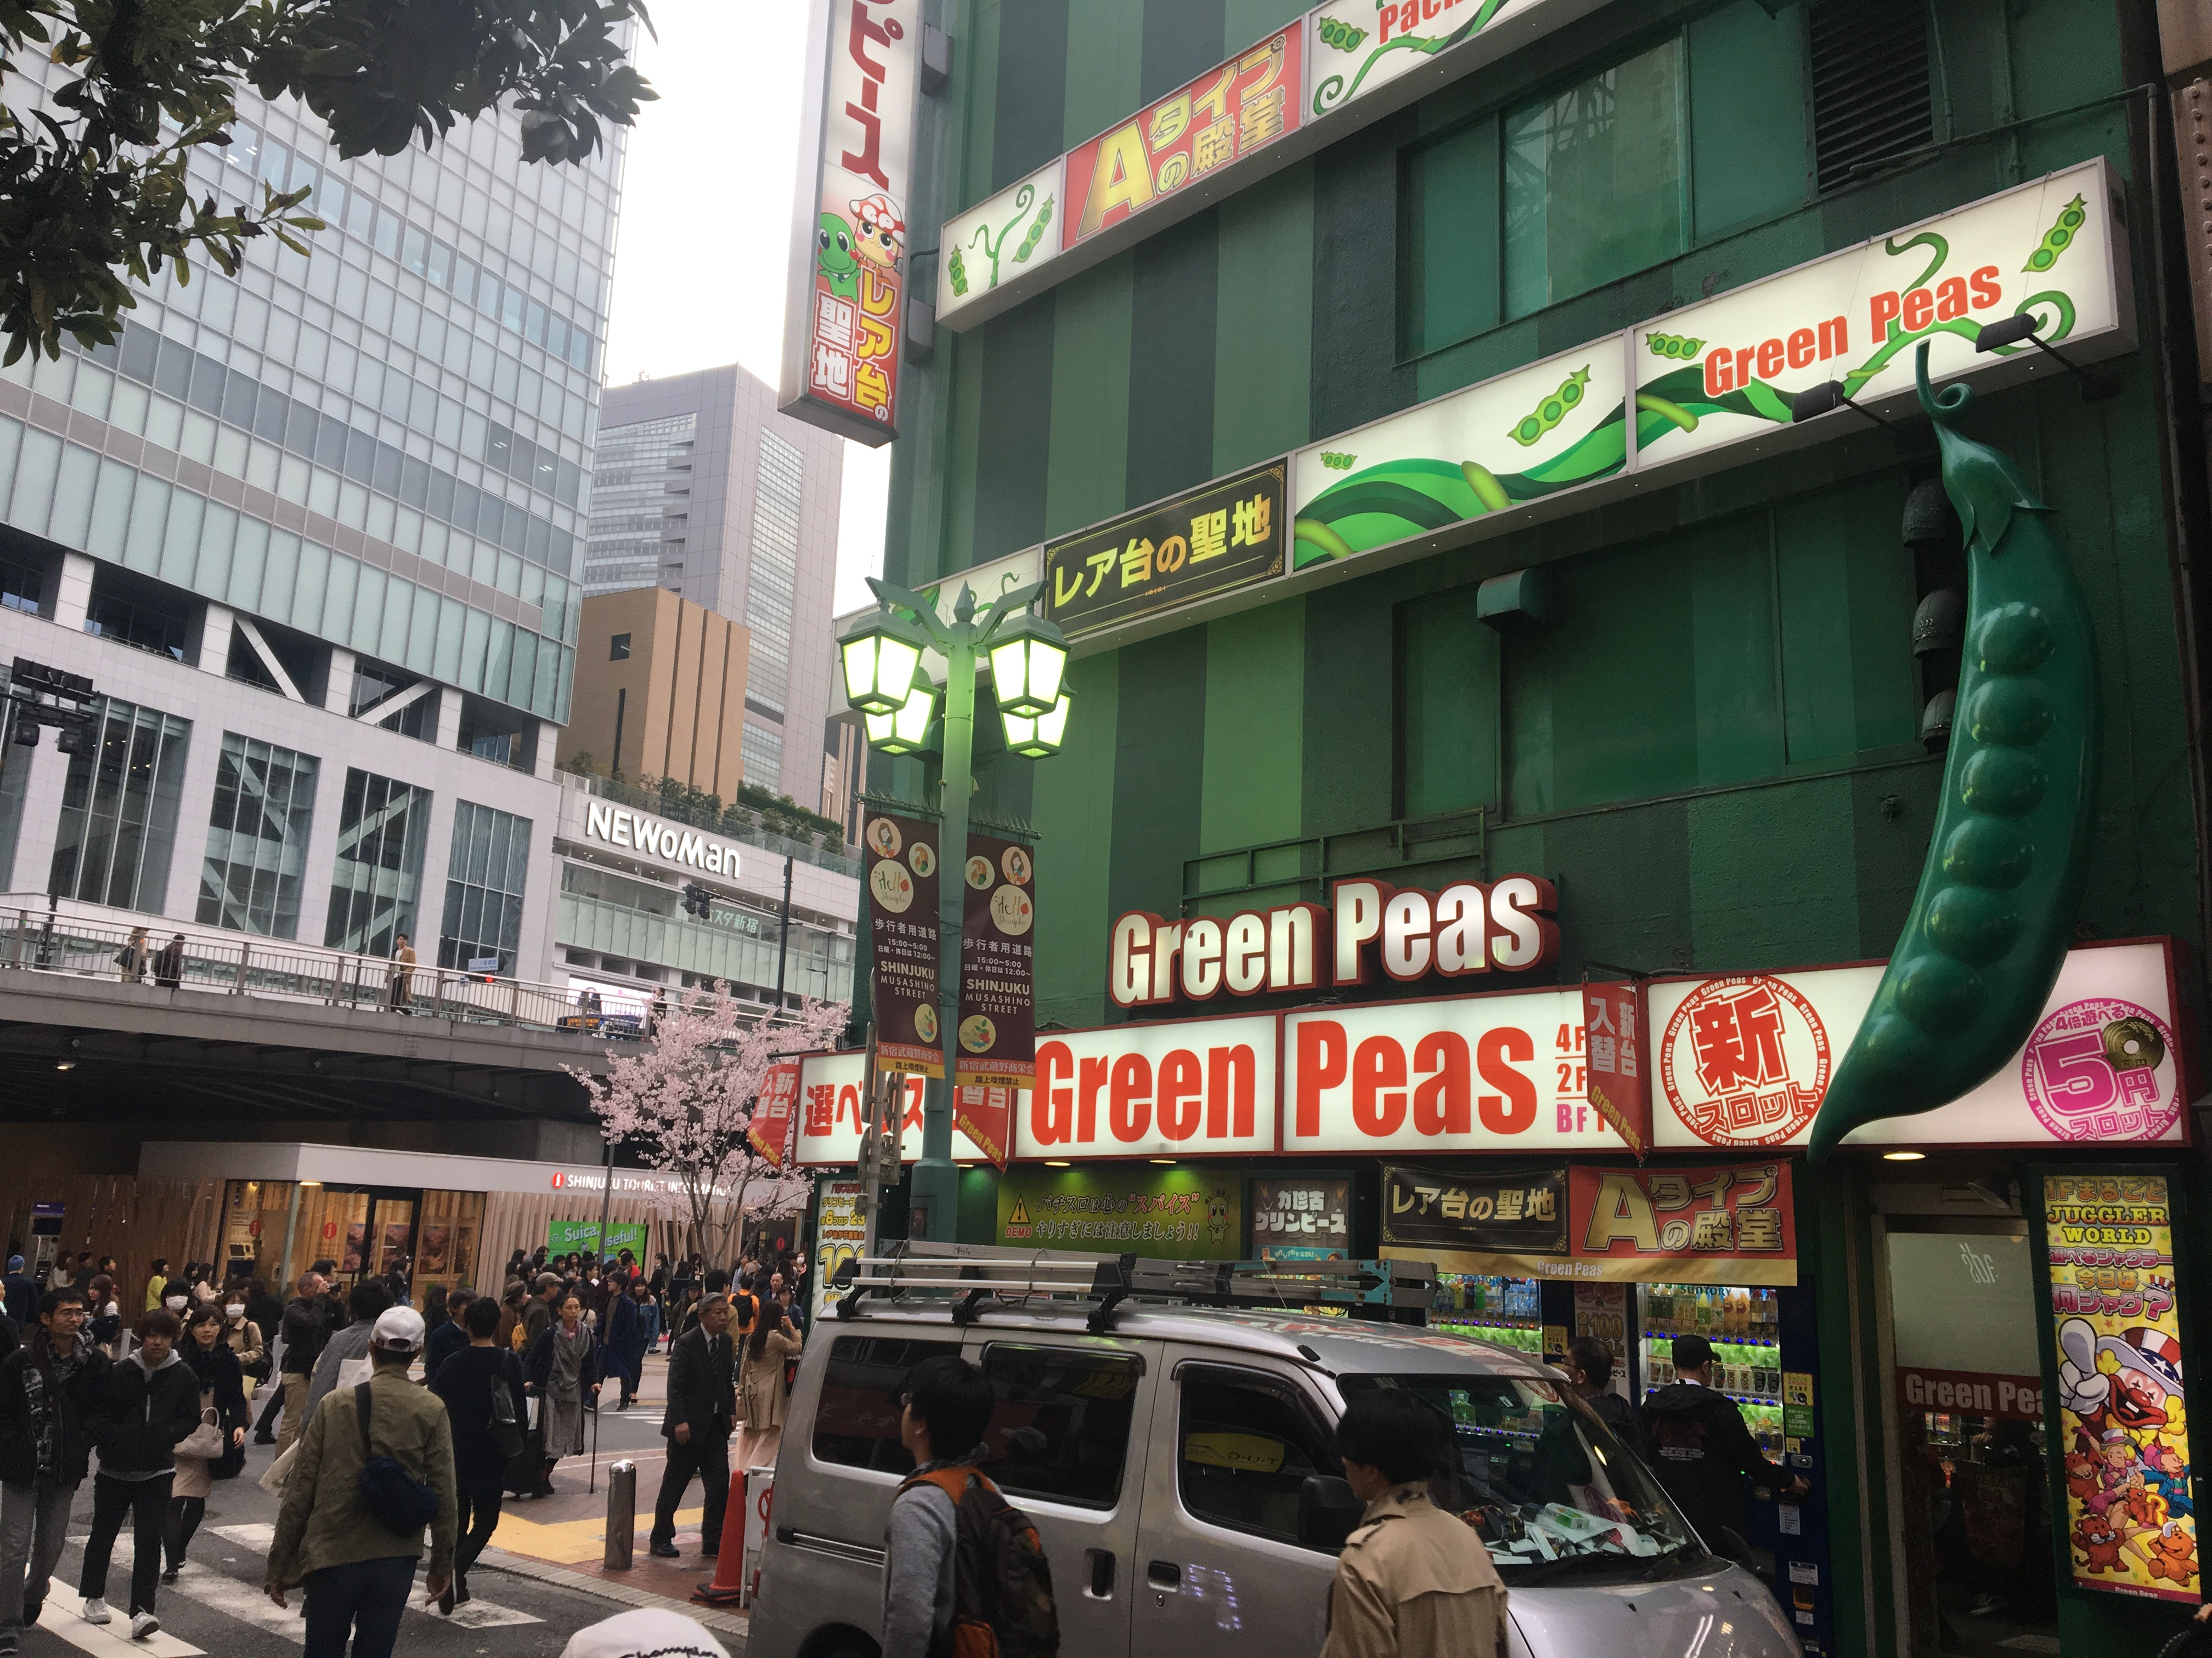
Part I – Green Peas
Observed growing wild near Shinjuku Station

Slide 4
Part I – Green Peas
Observed growing wild near Shinjuku Station

Slide 5
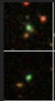
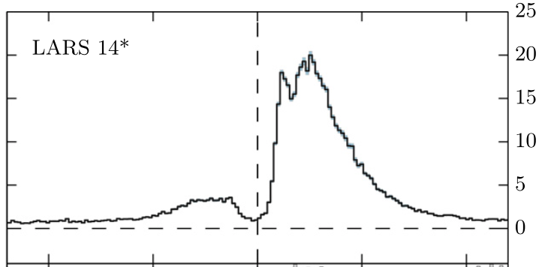
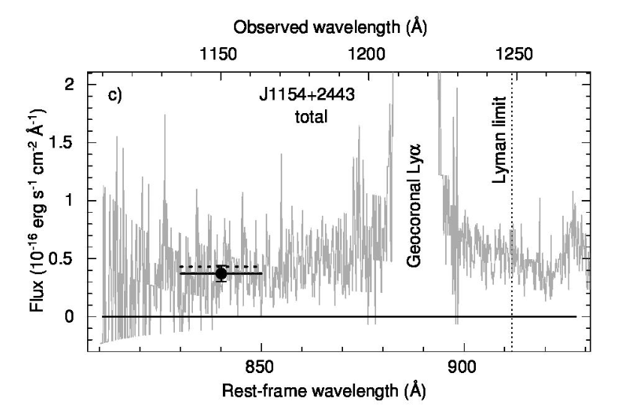
Observed to be:
Compact, highly star-forming, very strong line-emitting, Lya-emitting, LyC-emitting galaxies. ’Analogs’?
Undermetallic and YOUNG. Possibly pre-supernova (Jaskot+_

Slide 6
The ‘puzzle’: How can they be LCEs if they are so young?
Leitherer 1999,2014
SSP models: Q decreases rapidly with t: 100x less by 7 Myr.
Most energy comes from SNe: must wait >~4-5 Myr, then thermalize. (longer if there is a massive progenitor problem)
Log Q (photon/sec)
Log Emech (erg)
Log age (Myr)

Slide 7
Runnholm MSc thesis: How much energy have starbursts injected into their ISM?
(Actually wanted to examine wind energetics, not Lya)
Need precise age
  Not a job for conventional broadband SED modeling [SFH/age precision too course]
  Partly a job for emission line / photoionzation models
  This is a job for stellar spectral modeling

Slide 8
Evolution of stellar features
1 to 16 Myr
1 to 16 Myr
P Cyg wind lines { O VI, N V, C IV } at <7 Myr. ~O stars
Photospheric lines { C III 1175, C III+Si III ~1300Å }. 10 -30Myr. ~B stars

Slide 9
Goal and Sample
GOAL
To estimate what range of recent star-formation histories are permitted for local starbursts
Convert this to recent mechanical energy injection
SAMPLE & OBSERVATIONAL DATA
All HST COS-observed galaxies covering >=2 P Cyg/wind lines
(helps to remove a degeneracy between metals and age)
Matched with SDSS optical spectroscopy
(Note R~20,000 for COS and ~2000 for Sloan)
→ Green Peas (Henry+), LBG analogs (Heckman+)
A biased sample of 34 objects

Slide 10
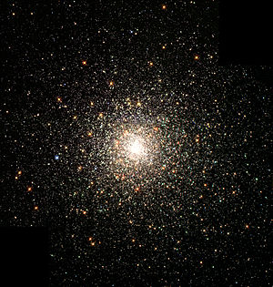
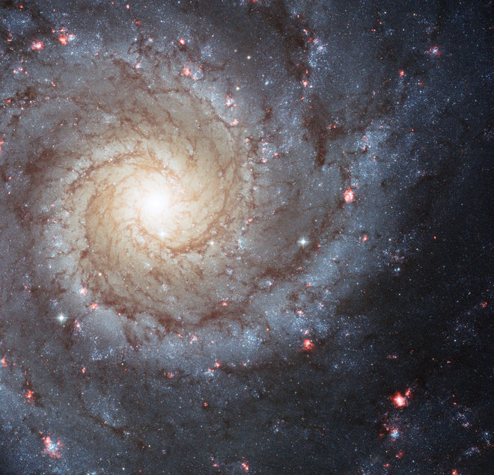
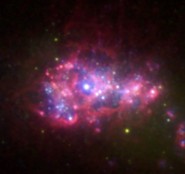
Methods
SPECTRAL MODELS & FITTING
High-res (0.3 Å) UV and optical Starburst99: GE tracks, Z=0.001 to solar
Convolved to different R in UV and optical +fit v_{disp}
Calzetti dust
MCMC posterior sampling
STAR FORMATION HISTORY
Simple stellar population (’burst’)
Constant star-formation rate
Multiple bursts (N=2, but code does >N)
t_{dyn} ~ t_{ff} ~ 10-25 Myr
star formation is very clustered
age, mass, v_{disp}, reddening
    Ionizing photos for H, He, He+ , SN rate and wind energy

Slide 11
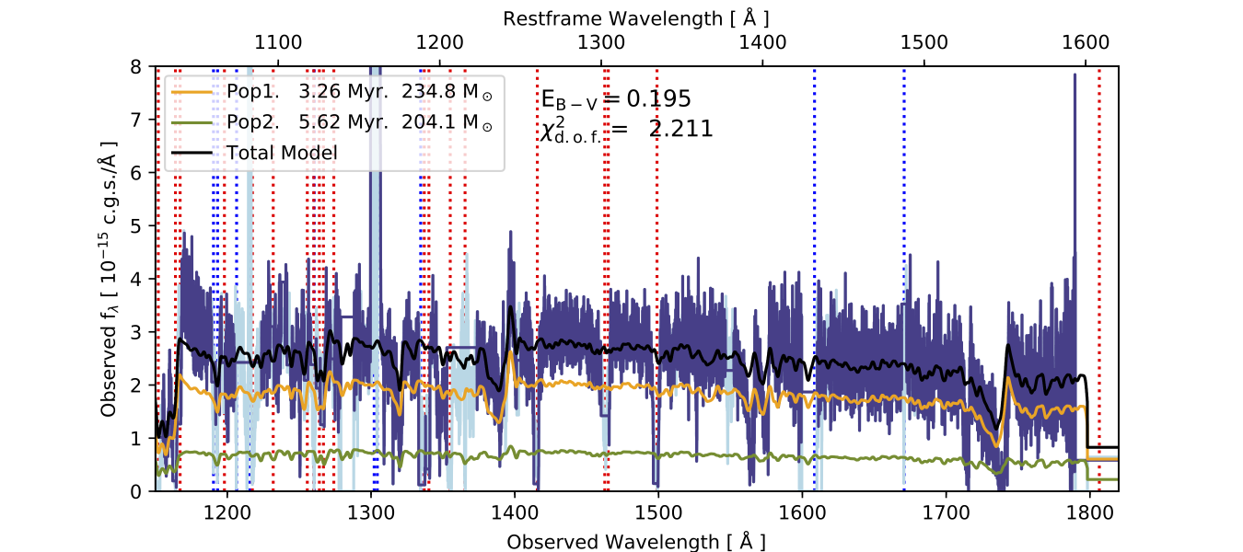
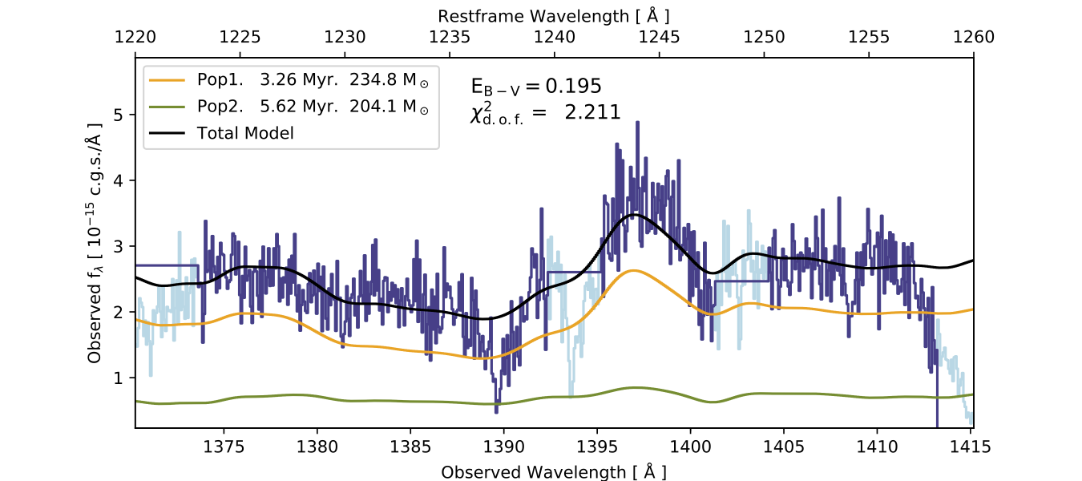
An example fit
3.3 Myr, 234 Msun E_{B-V} = 1.95
11 Myr, 204 Msun Chi2 =1.8
Excellent fits to the opt/UV continuum shape
Wind and photospheric lines well reproduced

Slide 12
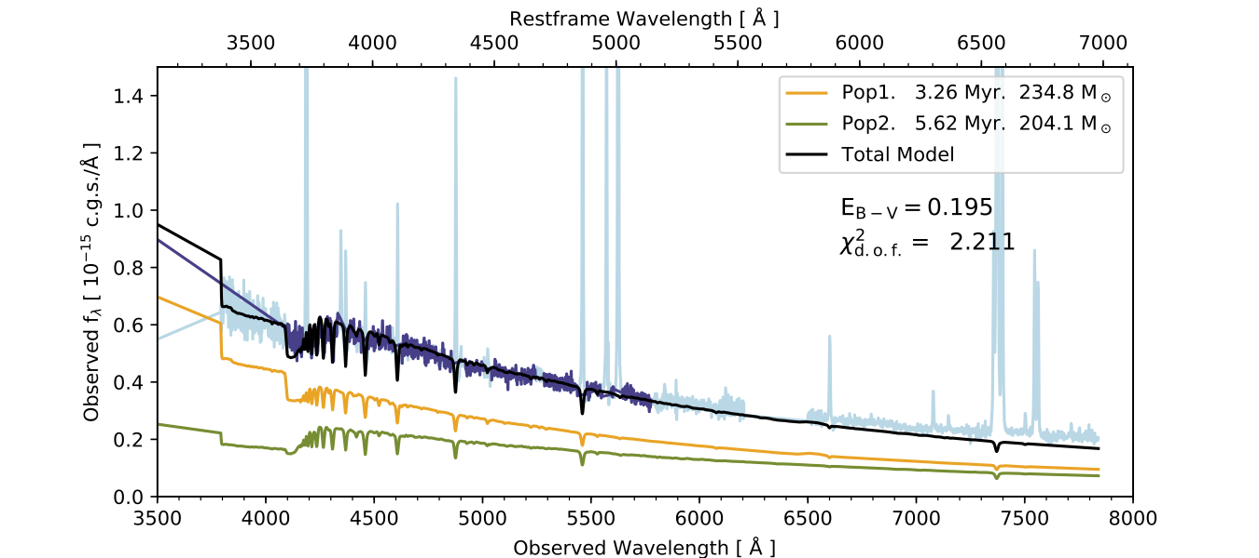
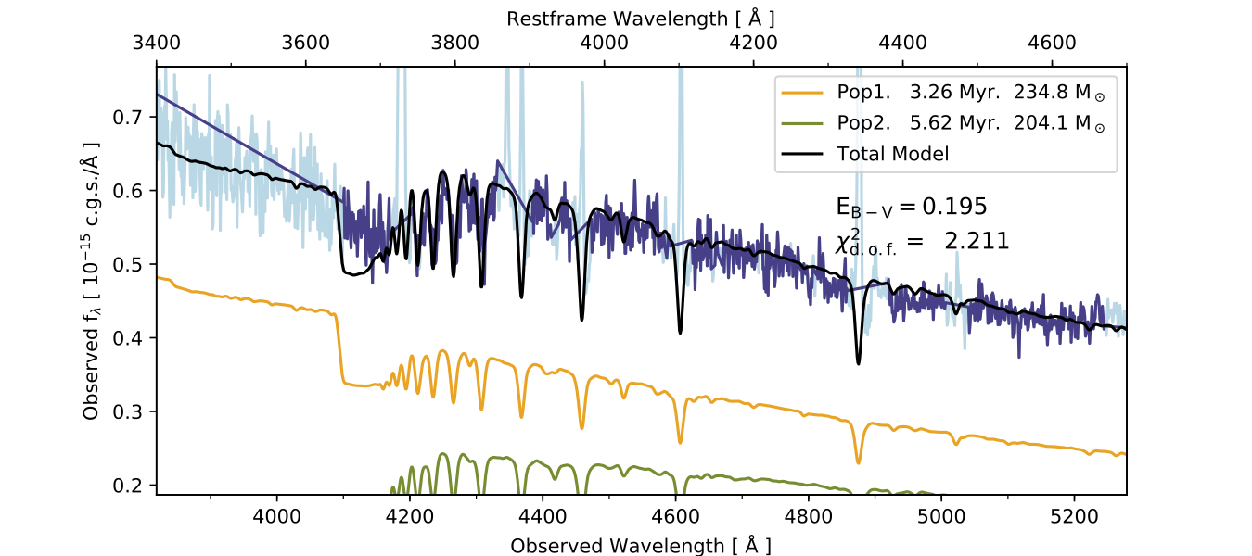
An example fit
3.3 Myr, 234 Msun E_{B-V} = 1.95
11 Myr, 204 Msun Chi2 =1.8
Excellent fits to the opt/UV continuum shape
Wind and photospheric lines well reproduced
Balmer absorption good!

Slide 13
Is two populations motivated?
Median chi-squared per d.o.f. is reduced by 26%

Slide 14
Is two populations motivated?
Pear = 0.75
Prob = 7e-7
Pear = 0.82
Prob = 1e-7
E(B-V) from the continuum agrees with Ha/Hb.
Improves with two populations (but was pretty good anyway)

Slide 15
Q(HI) Photon budgets
1 population and Ha (uncorrected for dust): bad correlation (P=0.2)
Pear = 0.24
Prob = 0.19

Slide 16
Q(HI) Photon budgets
1 population and Ha (uncorrected for dust): bad correlation (P=0.2)
Simple (Ha/Hb) dust correction to Ha helps (but not much). P=0.14
Pear = 0.24
Prob = 0.19
Pear = 0.27
Prob = 0.14

Slide 17
Q(HI) Photon budgets
1 population and Ha (uncorrected for dust): bad correlation (P=0.2)
Simple (Ha/Hb) dust correction to Ha helps (but not much). P=0.14
2 populations gets the answer right. P~10⁻⁴
➔ gets the O stars right
Pear = 0.24
Prob = 0.19
Pear = 0.38
Prob = 0.03
Pear = 0.27
Prob = 0.14
Pear = 0.62
Prob = 1.4e-4

Slide 18
A hidden population of stars

Slide 19
A hidden population of stars
Multiple population fitting:
- Increases the age by a factor of 3
- Increases the mechanical energy input by 4-10 x
I don’t think they are pre-SN → hence Lya and LyC radiators

Slide 20
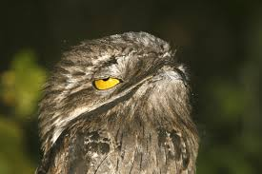
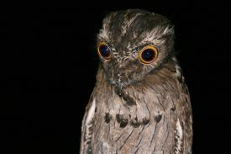
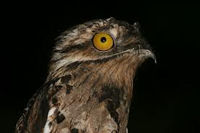
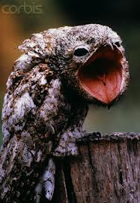


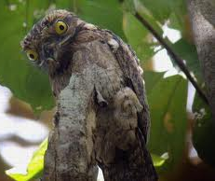
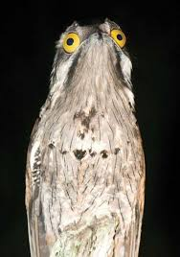

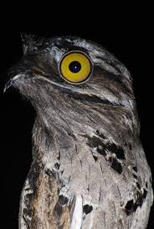

Slide 21
Predicting the Lya output of galaxies
’Lyman alpha is a complex, multiparametric problem with a large variety of results’
– J.M. Mas-Hesse, Madrid, Sometime in 2003
’In order to see Lya you need a handful of things to be true’
– D. Stark, Tokyo, 28 March 2018
The challenge:
To predict L_{Lya}^{Out} [ = L_{Lya}^{Int} * fesc(Lya) ] from a galaxy

Slide 22
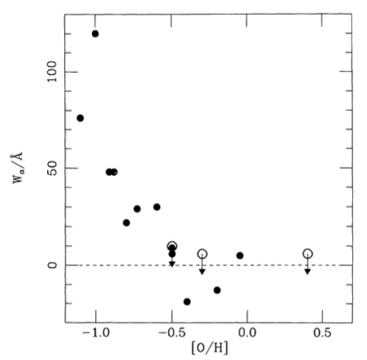
Predicting the Lya output of galaxies
Charlot & Fall 1993

Slide 23
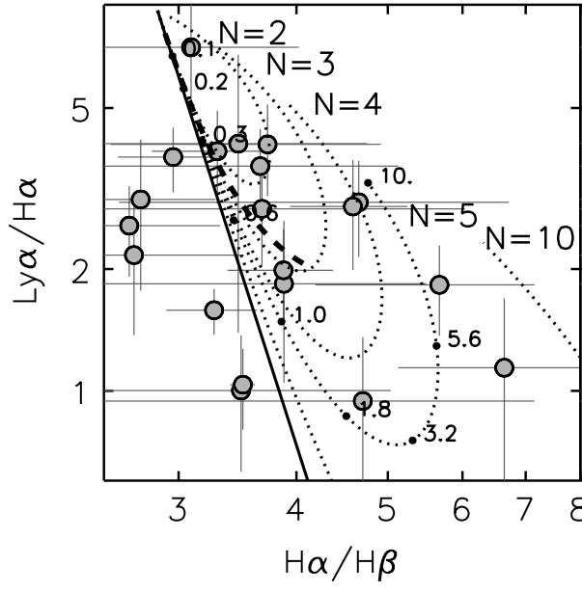
Predicting the Lya output of galaxies
Charlot & Fall 1993
Scarlata+2009

Slide 24
Predicting the Lya output of galaxies
Charlot & Fall 1993
Scarlata+2009
MH+2014

Slide 25
Predicting the Lya output of galaxies
Expanded from MH 2015
Charlot & Fall 1993
Scarlata+2009
MH+2014

Slide 26
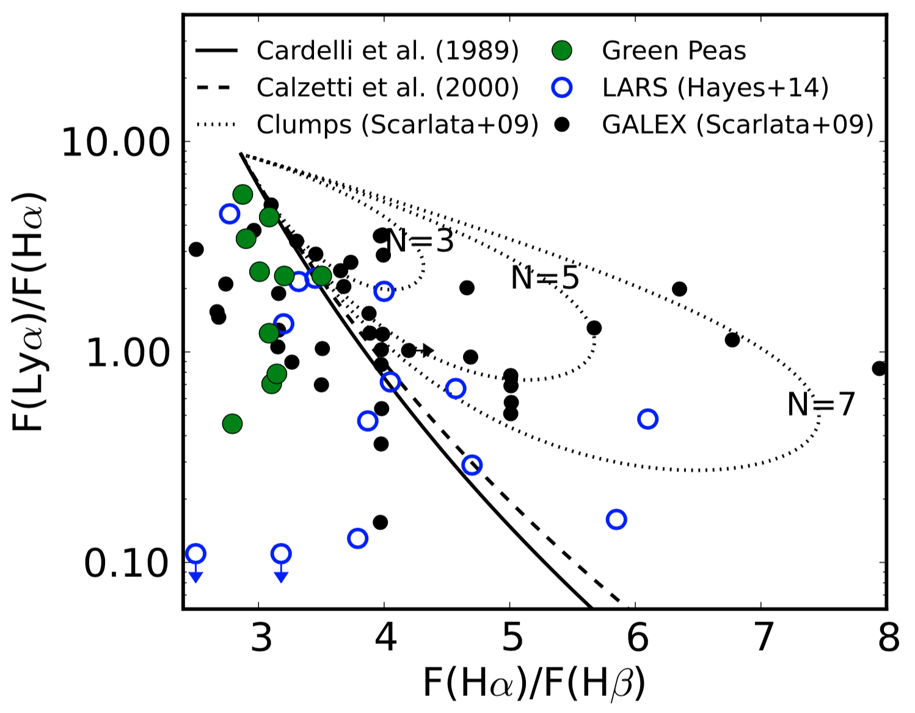
Predicting the Lya output of galaxies
Expanded from MH 2015
Charlot & Fall 1993
Scarlata+2009
MH+2014
Henry et al 2015

Slide 27
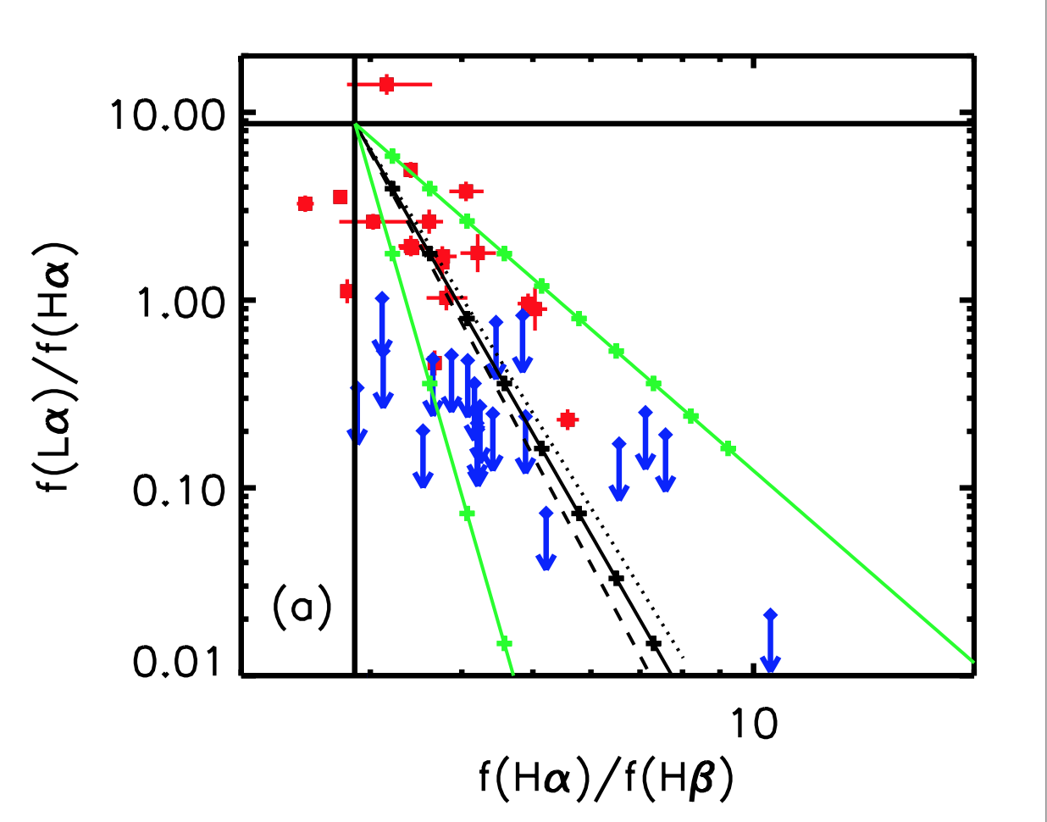
Predicting the Lya output of galaxies
Expanded from MH 2015
Charlot & Fall 1993
Scarlata+2009
Cowie+2011
MH+2014
Henry et al 2015

Slide 28
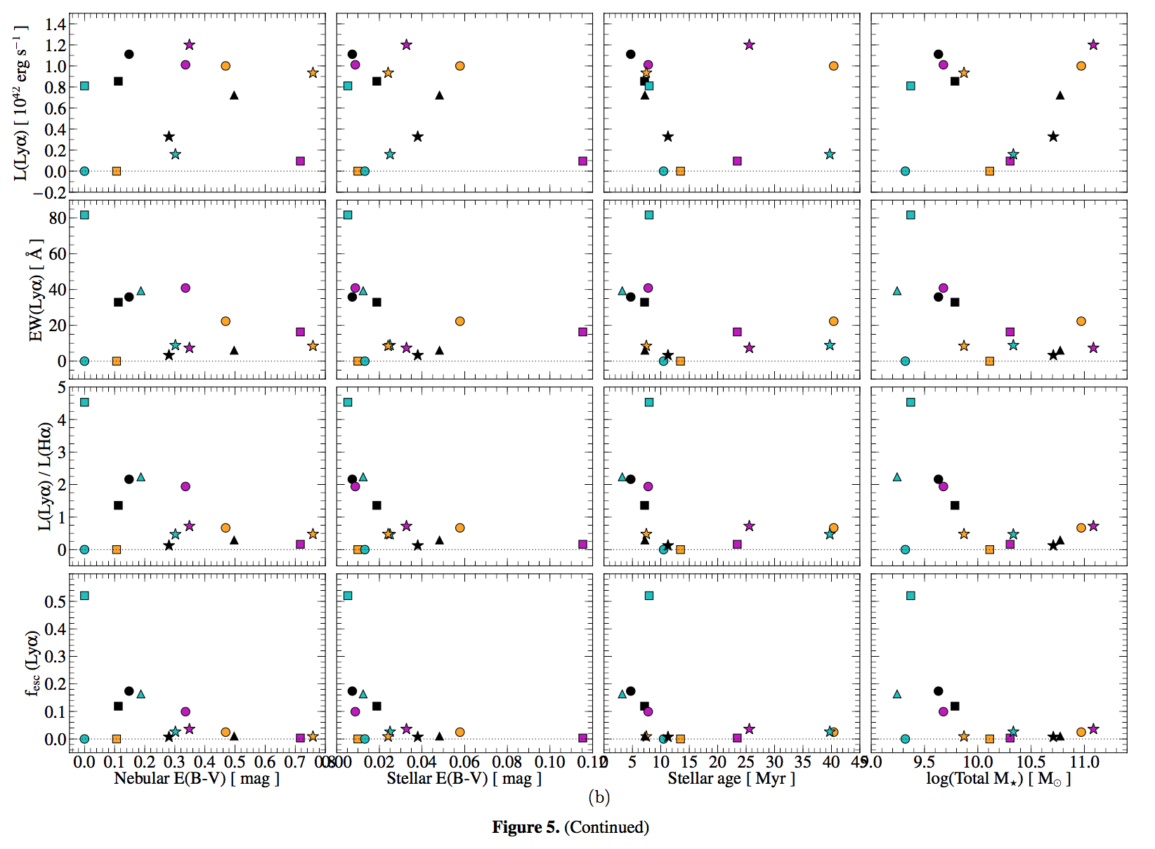
Predicting the Lya output of galaxies
MH+2014
Expanded from MH 2015
Charlot & Fall 1993
Scarlata+2009
Cowie+2011
MH+2014
Henry et al 2015

Slide 29
Predicting the Lya output of galaxies
MH+2014
Expanded from MH 2015
Charlot & Fall 1993
Scarlata+2009
Cowie+2011
MH+2014
Henry et al 2015

Slide 30

Putting it all together
Lyman alpha emitting galaxies are/have:
lower stellar mass
younger
more compact
higher Ha EW
bluer
less dusty
lower metallicity
more strongly ionizing
lower in HI mass
faster outflows
lower HI covering fractions
lower HI column densities
larger halos
more turbulent velocity fields
than non Lya emitting galaxies
Saas Fee 2015

Slide 31
Putting it all together
Lyman alpha emitting galaxies are/have:
lower stellar mass
younger
more compact
higher Ha EW
bluer
less dusty
lower metallicity
more strongly ionizing
lower in HI mass
faster outflows
lower HI covering fractions
lower HI column densities
larger halos
more turbulent velocity fields
than non Lya emitting galaxies
Mass-metallicity relation
Evolution related
Scattering related
Dust related
Feedback related

Slide 32
Putting it all together
Lyman alpha emitting galaxies are/have:
lower stellar mass
younger
more compact
higher Ha EW
bluer
less dusty
lower metallicity
more strongly ionizing
lower in HI mass
faster outflows
lower HI covering fractions
lower HI column densities
larger halos
more turbulent velocity fields
than non Lya emitting galaxies
Mass-metallicity relation
Evolution related
Scattering related
Dust related
Feedback related

Slide 33
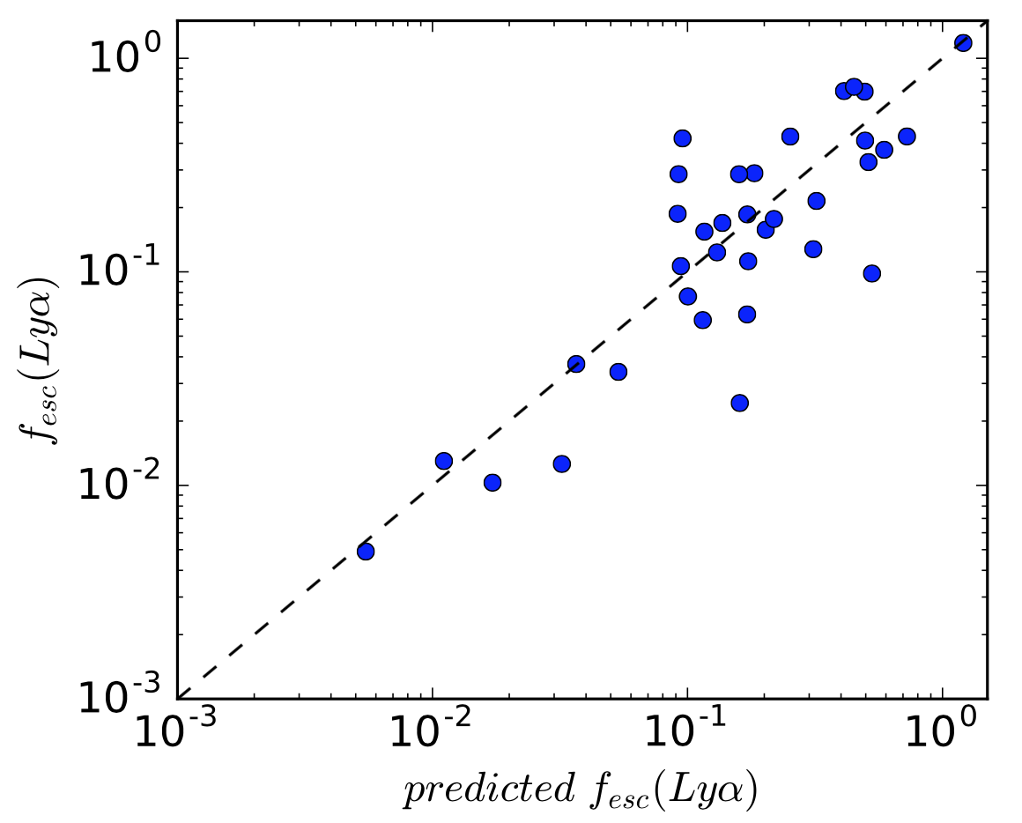
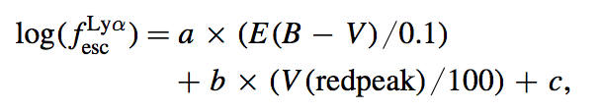
Predicting the Lya output of galaxies
Yang et al 2017: a very nice way of predicting Lya escape fraction as a product of E(B-V) and V(redpeak)
BUT – is using a Lya observable to predict Lya
Yang+2017

Slide 34
Putting it all together
Lyman alpha emitting galaxies are/have:
lower stellar mass
younger
more compact
higher Ha EW
bluer
less dusty
lower metallicity
more strongly ionizing
lower in HI mass
faster outflows
lower HI covering fractions
lower HI column densities
larger halos
more turbulent velocity fields
than non Lya emitting galaxies
Mass-metallicity relation
Evolution related
Scattering related
Dust related
Feedback related
Wouldn’t it be awesome if somebody had assembled all this in a homogeneously selected sample of galaxies?

Slide 35

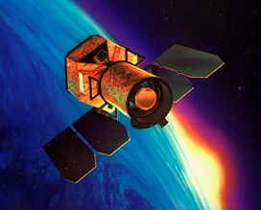
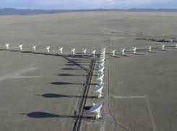
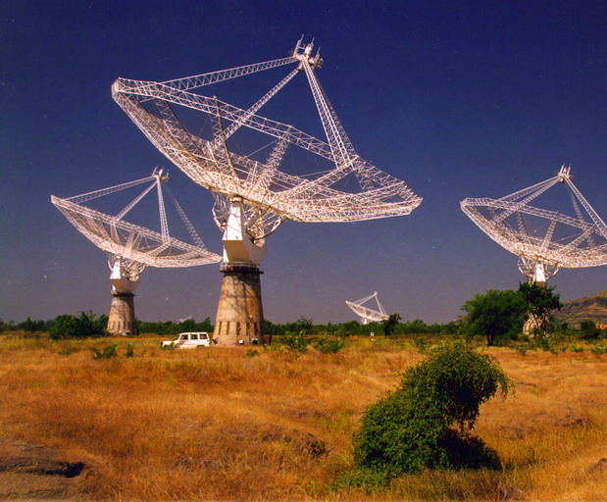
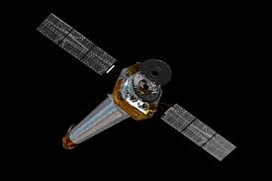
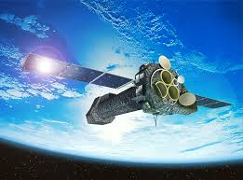
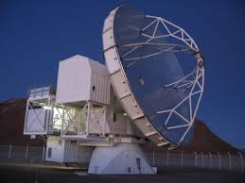
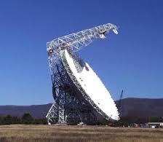
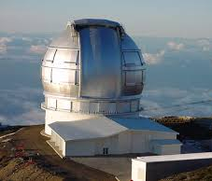
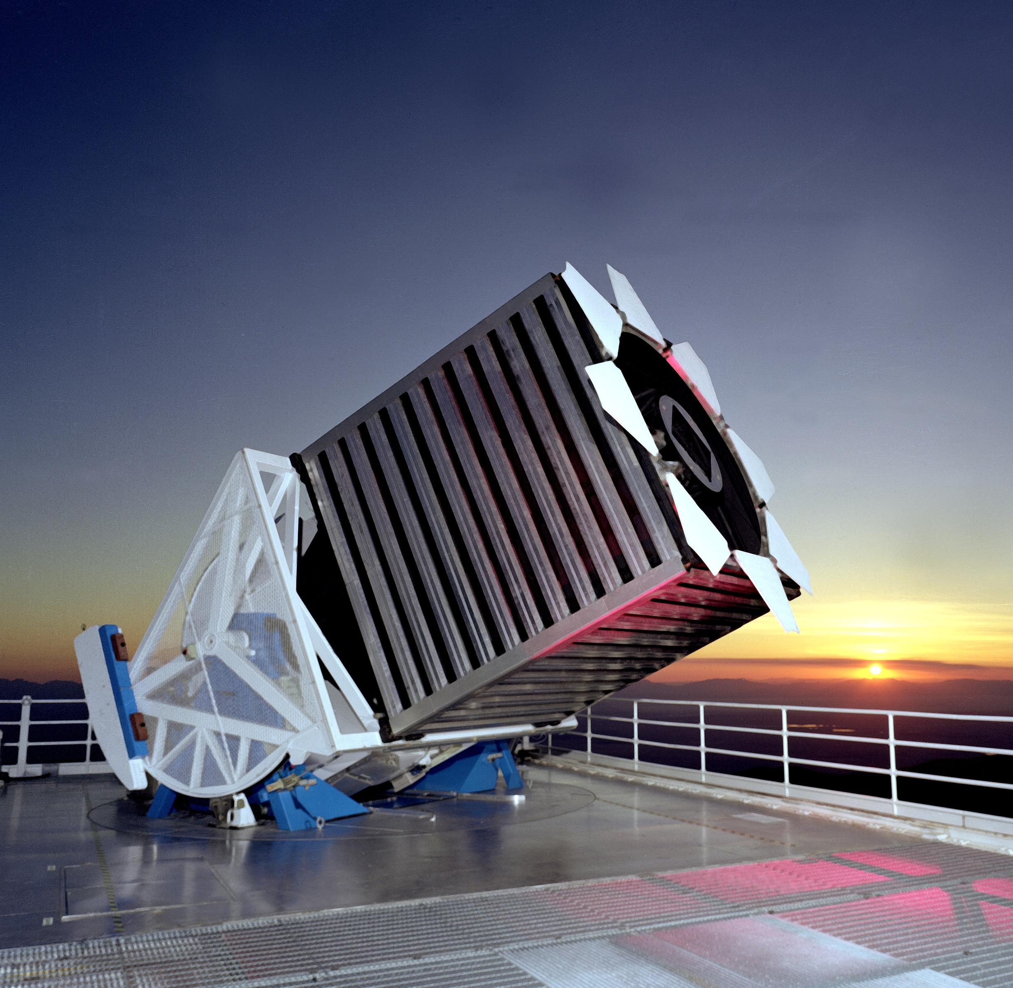
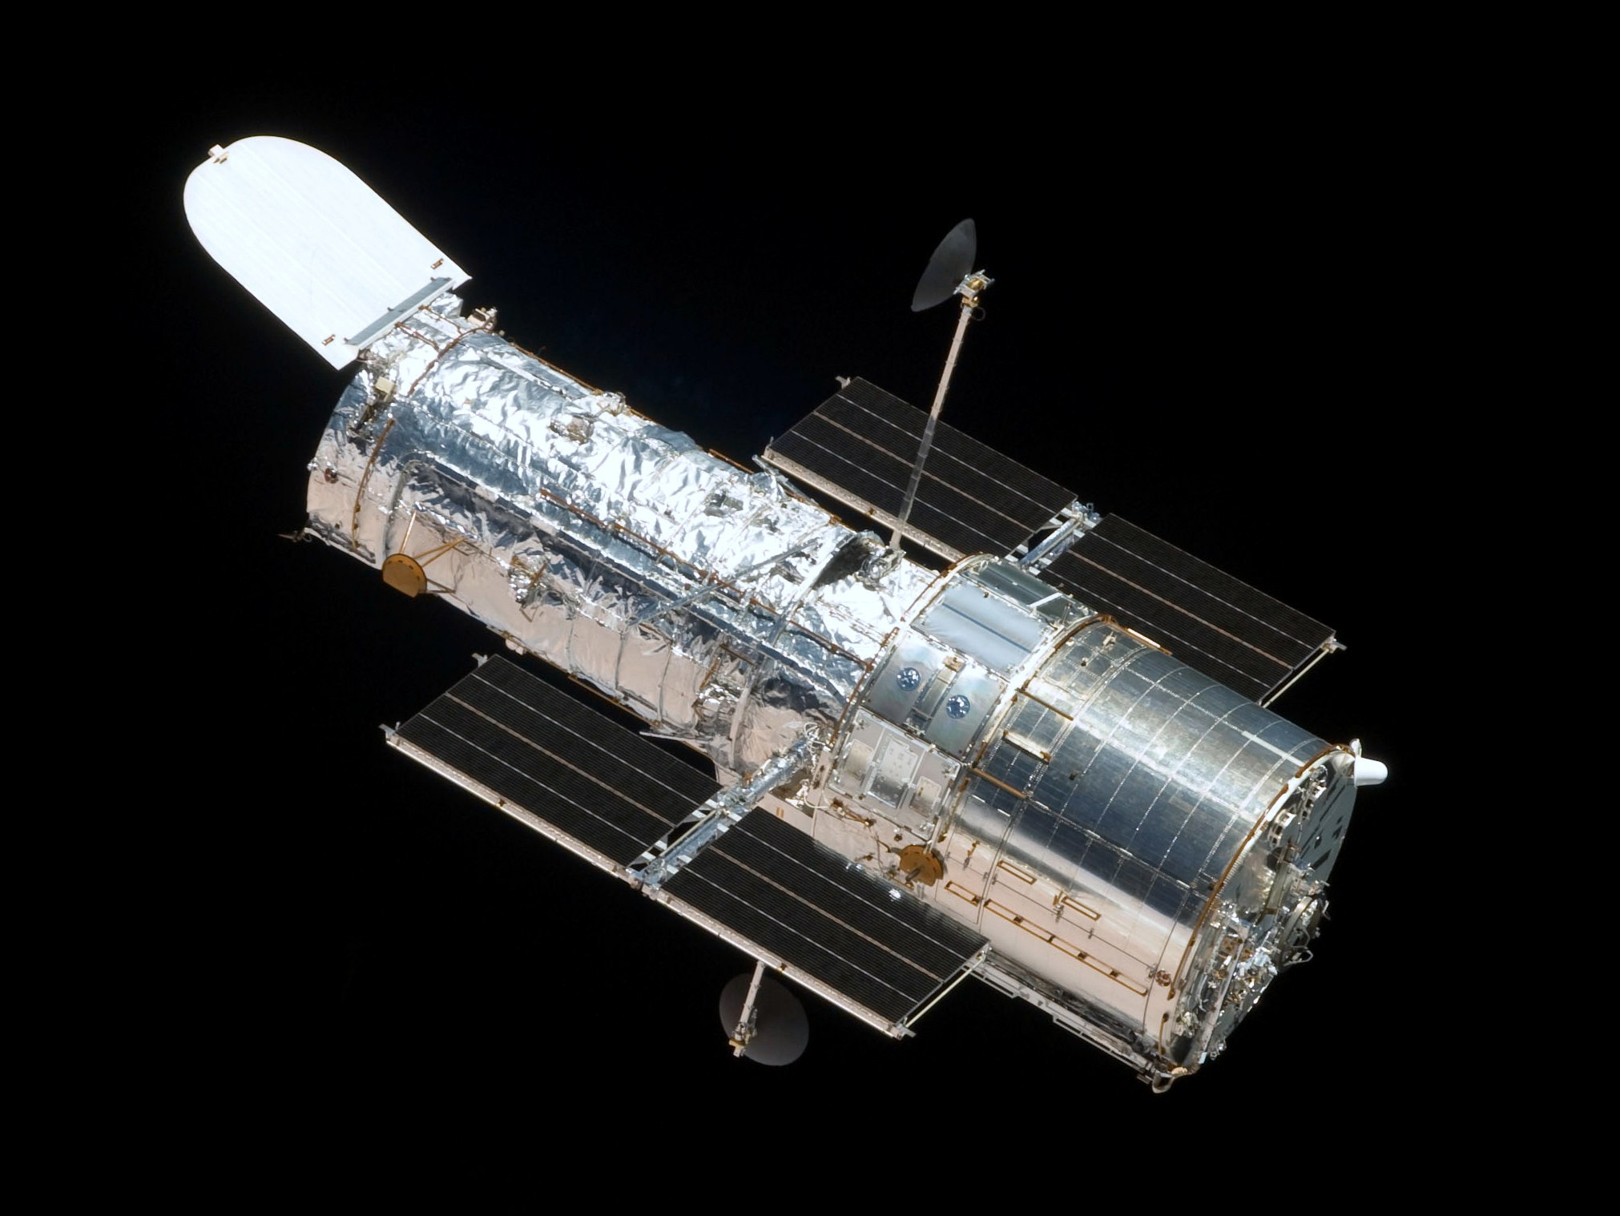
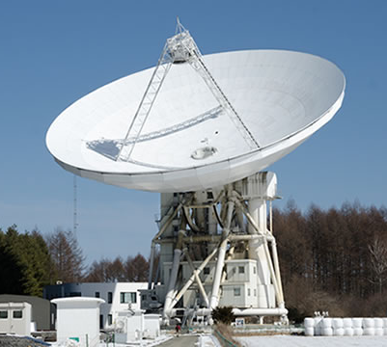
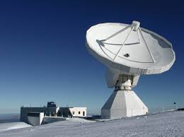
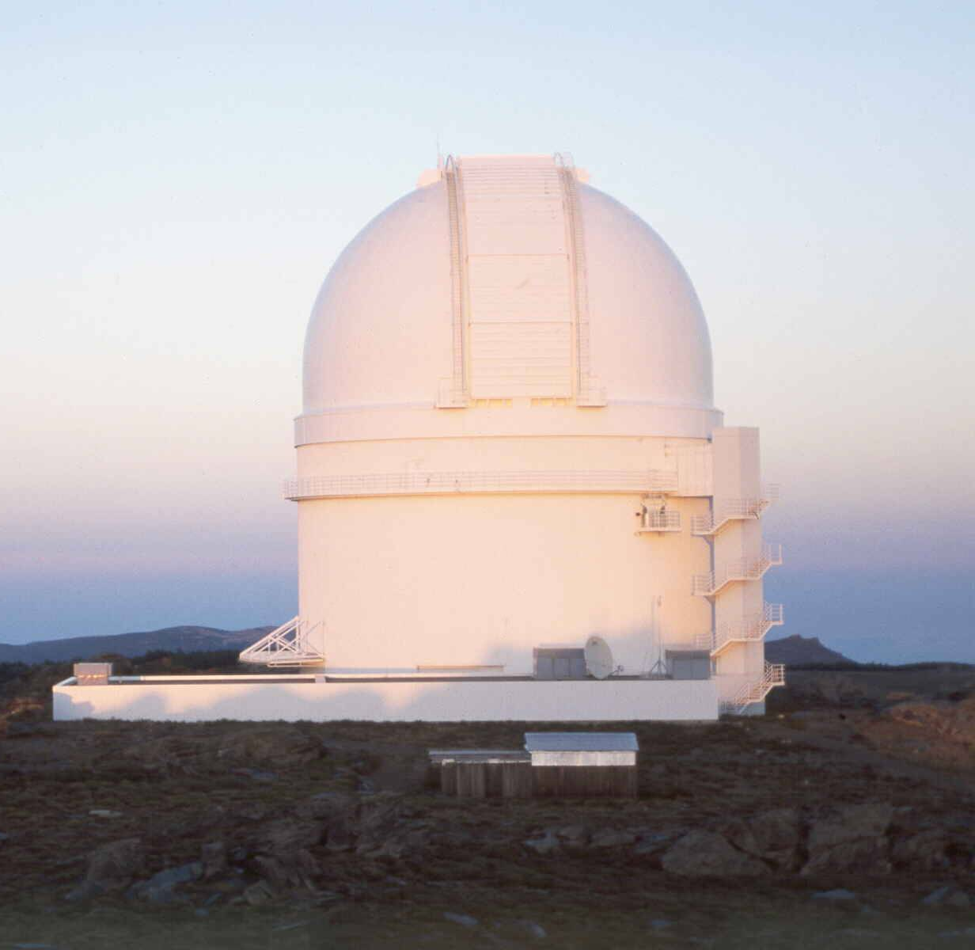
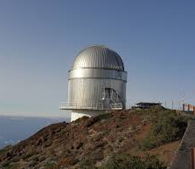

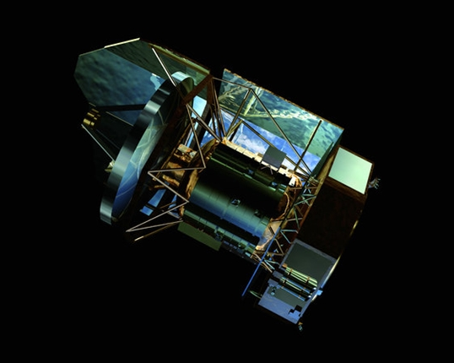
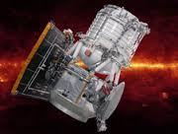
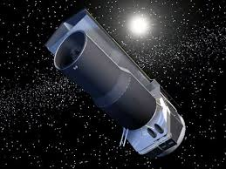
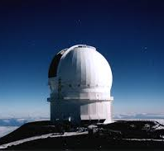
Predicting the Lya output of galaxies
Chandra
XMM-Newton
VLA
GMRT
GALEX
APEX
GBT
Sloan
HST
GTC
NRO
IRAM
CAHA 3.5
NOT
A team of ~30 expert, hardworking observers and theorists from 8 countries
SOFIA
CFHT
Herschel
WISE
Spitzer

Slide 36
Predicting the Lya output of galaxies
Assembled the full LARS hypertable of quantities (measured by Runnholm, Melinder, Rivera-Thorsen, Herenz, Bridge, MH)
Explored PCA, LDA, PCT, CCR, ETC...
Went to statistical consultants in the math dept: ”Why don’t you try performed multivariate linear regression backwards selection?”
Homogenized data
Performed multivariate linear regression of L_{Lya} vs {ALL}
Compute R² for all quantities, and execut backwards selection.
Physical Quantities
SFR
V_{max}
N_{HI}
Q
M_{stell}
E(B-V)
O/H
r_{UV}
M_{HI}
Observable Quantities
UV continuum
Ha
Hb
OIII
OII
Rest U
Rest B
Rest I
S_{21cm}
Notes:
Homogenizied: logged and subtracted the exponent, to give values close to 1, without whitening the data (does not becomeas subjected to the sample / more generalizable)
is the percentage of the variane that is captured by the paramter.

Slide 37
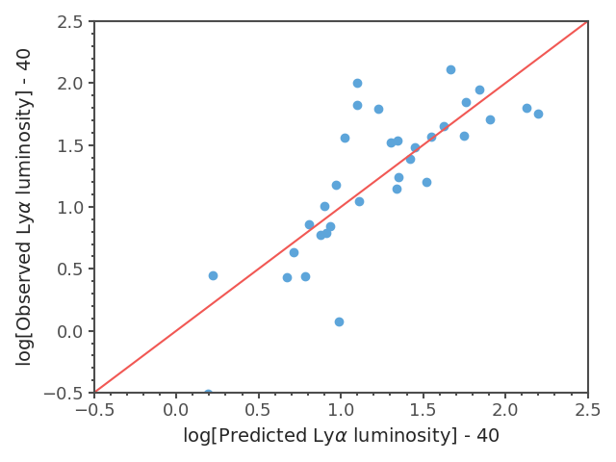
Predicting the Lya output of galaxies
Physical Quantities
SFR
V_{max}
N_{HI}
Q
M_{stell}
E(B-V)
O/H
r_{UV}
M_{HI}

Slide 38

Predicting the Lya output of galaxies
Physical Quantities
SFR
V_{max}
N_{HI}
Q
M_{stell}
E(B-V)
O/H
r_{UV}

Slide 39

Predicting the Lya output of galaxies
Physical Quantities
SFR
V_{max}
N_{HI}
Q
M_{stell}
E(B-V)
O/H

Slide 40

Predicting the Lya output of galaxies
Physical Quantities
SFR
V_{max}
N_{HI}
Q
M_{stell}

Slide 41

Predicting the Lya output of galaxies
Physical Quantities
SFR
V_{max}
N_{HI}
Q

Slide 42
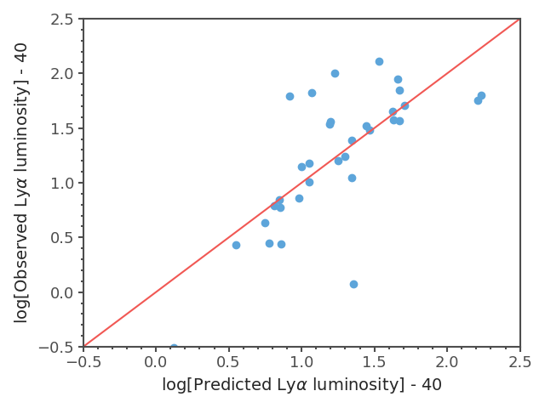
Predicting the Lya output of galaxies
Physical Quantities
SFR
V_{max}
N_{HI}

Slide 43
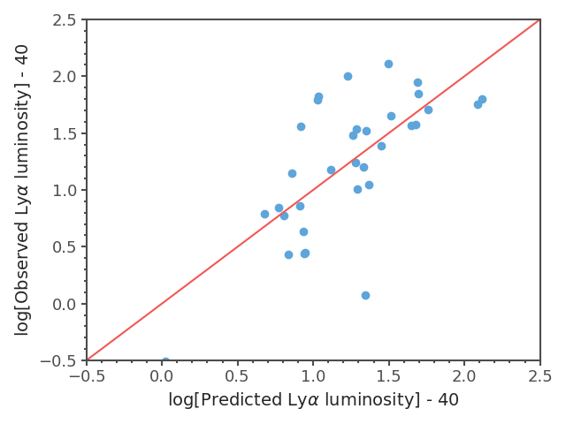
Predicting the Lya output of galaxies
Physical Quantities
SFR
V_{max}

Slide 44

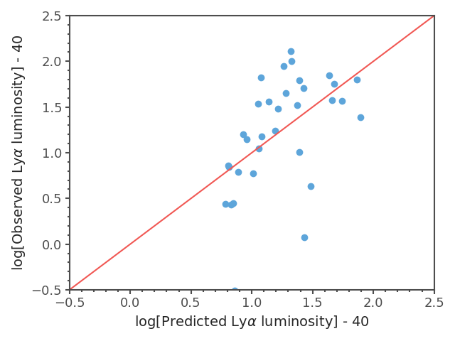
Predicting the Lya output of galaxies
Physical Quantities
SFR

Slide 45
Future
More independent quantities
  Vshear/Vmax of ionized and atomic gas), turbulence.
  Morphological quantities
  Stellar properties [e.g. 1st half of talk]
  …s
More independent quantities
  dv_{red} to avoid damping wing?
  Asymmetry / skew
  Comment/suggestions welcome!
Pure observable input
Observable Quantities
UV continuum
Ha
Hb
OIII
OII
Rest U
Rest B
Rest I
S_{21cm}
Notes:
Homogenizied: logged and subtracted the exponent, to give values close to 1, without whitening the data (does not becomeas subjected to the sample / more generalizable)
is the percentage of the variane that is captured by the paramter.

Slide 46
Conclusions
Optical+UV fitting of stellar populations works very well when multiple populations are included.
Mass-weighted recent SFH increases in age ~3x
→ number of SN and mechanical energy increases 4-10x
Multi-parametric linear models can well predict the Lya output of galaxies.
Predicting Lya output of LARS galaxies works better than we thought. [also big help from new data reduction efforts]
We know in what order to start obtaining data to predict Lya: SFR, V_{out}, NHI,
Observable Quantities
UV continuum
Ha
Hb
OIII
OII
Rest U
Rest B
Rest I
S_{21cm}
Notes:
Homogenizied: logged and subtracted the exponent, to give values close to 1, without whitening the data (does not becomeas subjected to the sample / more generalizable)
is the percentage of the variane that is captured by the paramter.

