Slide 1


Results and plans from LHCf
Hiroaki MENJO
(KMI, Nagoya University, Japan)
On behalf of the LHCf collaboration
Mini-workshop ”UHECR and hadron interaction in the LHC era”
@ ICRR, 12 Oct. 2011

Slide 2
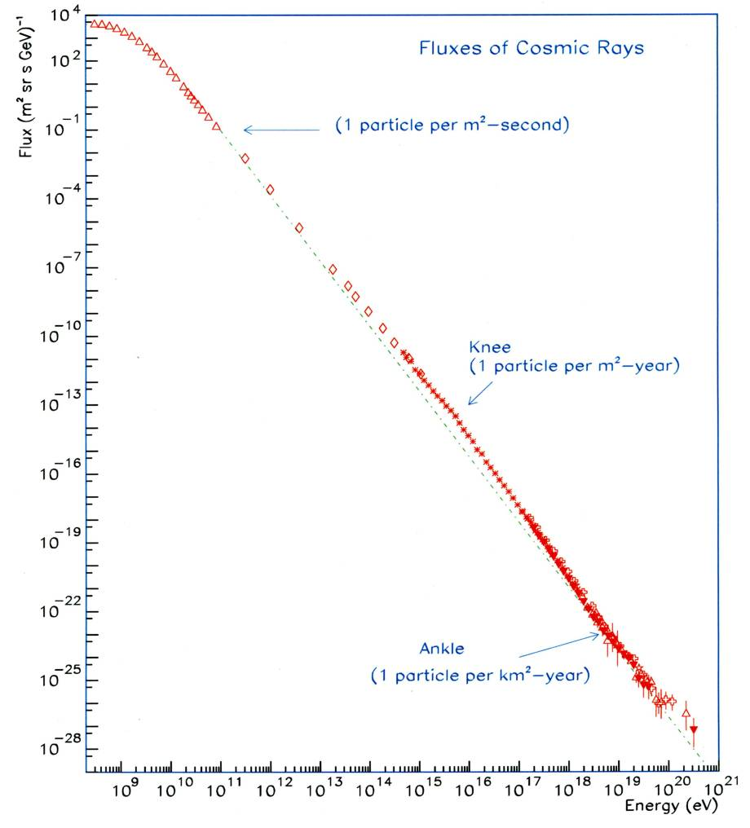
Contents
Large Hadron Collider
Introduction
The LHCf experiment
-An LHC forward experiment-
Forward photon
energy spectrum
at √s = 7eV p-p collisions
Future plans
Summary
-The most powerful accelerator on the earth-
Ultra High Energy Cosmic Rays
What is the most powerful accelerator
in the Universe ?
-
SppS
Tevatron
LHC

Slide 3






The LHCf collaboration
The LHCf collaboration
K.Fukatsu, T.Iso, Y.Itow, K.Kawade, T.Mase, K.Masuda, Y.Matsubara, G.Mitsuka, Y.Muraki, T.Sako, K.Suzuki, K.Taki Solar-Terrestrial Environment Laboratory, Nagoya Univ.
H.Menjo Kobayashi-Maskawa Institute, Nagoya Univ.
K.Yoshida Shibaura Institute of Technology
K.Kasahara, T.Suzuki, S.Torii Waseda Univ.
Y.Shimizu JAXA
T.Tamura Kanagawa University
M.Haguenauer Ecole Polytechnique, France
W.C.Turner LBNL, Berkeley, USA
O.Adriani, L.Bonechi, M.Bongi, R.D’Alessandro, M.Grandi,
P.Papini, S.Ricciarini, G.Castellini
INFN, Univ. di Firenze, Italy
K.Noda, A.Tricomi INFN, Univ. di Catania, Italy
J.Velasco, A.Faus IFIC, Centro Mixto CSIC-UVEG, Spain
A-L.Perrot CERN, Switzerland

Slide 4
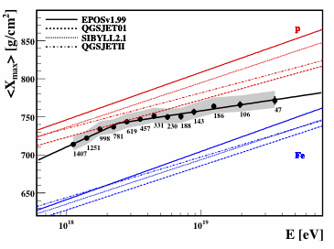
Introduction
HECRs
Extensive air shower observation
longitudinal distribution
lateral distribution
Arrival direction
Air shower development
Astrophysical parameters
Spectrum
Composition
Source distribution
X_{max} distribution measured by AUGER
PROTON
X_{max}
the depth of air shower maximum.
An indicator of CR composition
IRON
Uncertainty of hadron interaction models
>
10¹⁸
10¹⁹
Error of <X_{max}> measurement
Auger Coll. ICRC2011

Slide 5

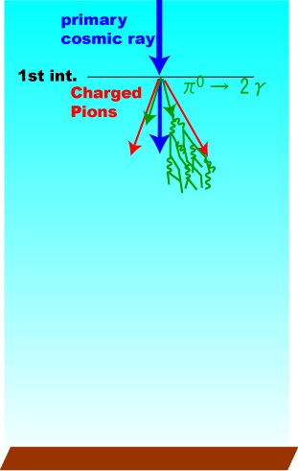
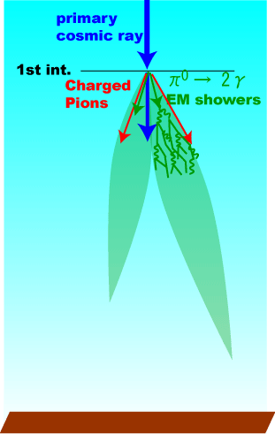
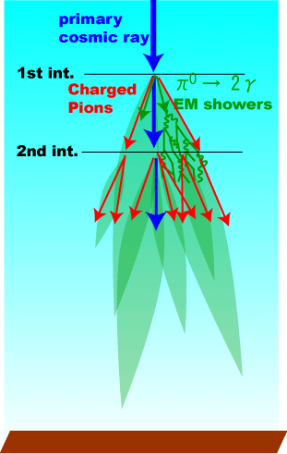
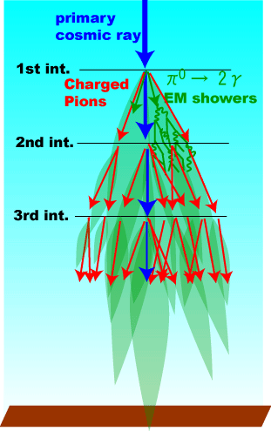
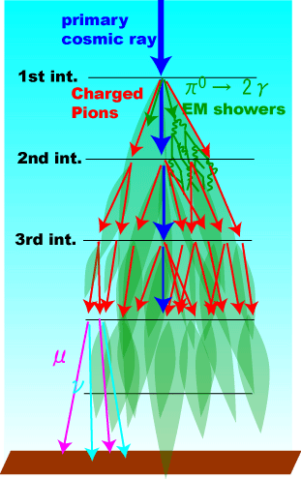

Air Shower
90% of shower particles are
electromagnetic components.
Feature of First interaction
between CR and air is effective
to whole air shower shape.
Key parameters
for air shower development
Total cross section
Multiplicity
Inelasticity/Secondary spectra

Slide 6
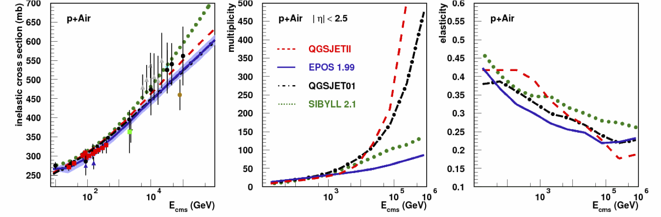
Key parameters
Total cross section
Multiplicity
Inelasticity/Secondary spectra
Predictions by hadron interaction models
which are used in air shower simulation
Big discrepancy in the high energy region !!!

Slide 7
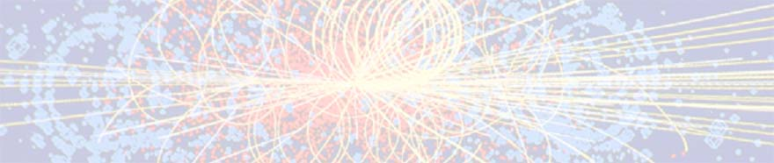
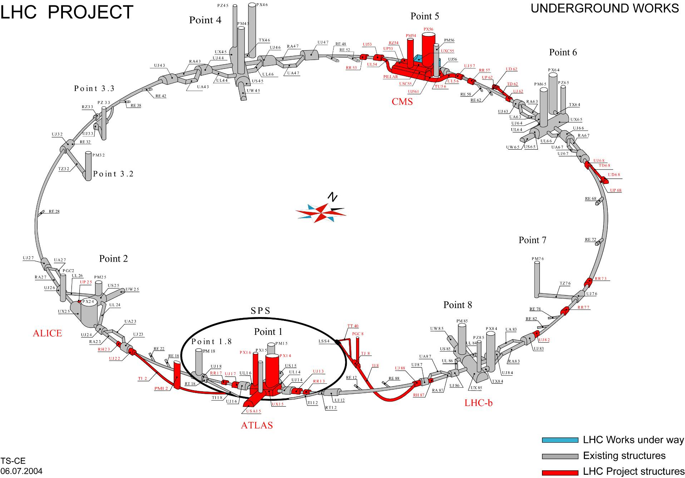
The Large Hadron Collider (LHC)
pp 7TeV+7TeV ➔ E_{lab} = 10¹⁷eV
pp 3.5TeV+3.5TeV ➔ E_{lab} = 2.6x10¹⁶eV
pp 450GeV+450GeV ➔ E_{lab} = 2x10¹⁴eV
2014-
Key parameters
for air shower developments
CMS/TOTEM
Total cross section
↔ TOTEM, ATLAS, CMS
Multiplicity
↔ Central detectors
Inelasticity/Secondary spectra
↔ Forward calorimeters
LHCf, ZDCs
ALICE
LHCb
ATLAS/LHCf
Notes:
So the calibration of the hadron interaction models at high energy is indispensable.
The dominant contribution to the energy flux is very forward region. So knowledge of the energy distribution of particles emitted in the very forward region in hadron interaction is very important. However so far only UA7 experiment has obtained data in the energy range exceeding 10 to14th eV.
Now the largest and highest energy accelerator “LHC” is under construction at CERN.
At the LHC interaction point, 7TeV-7TeV proton will collide. It correspond to 10to17th eV in the laboratory system.
It is 3 orders more than that of the UA7 experiment and near the range of ultra high energy cosmic rays

Slide 8
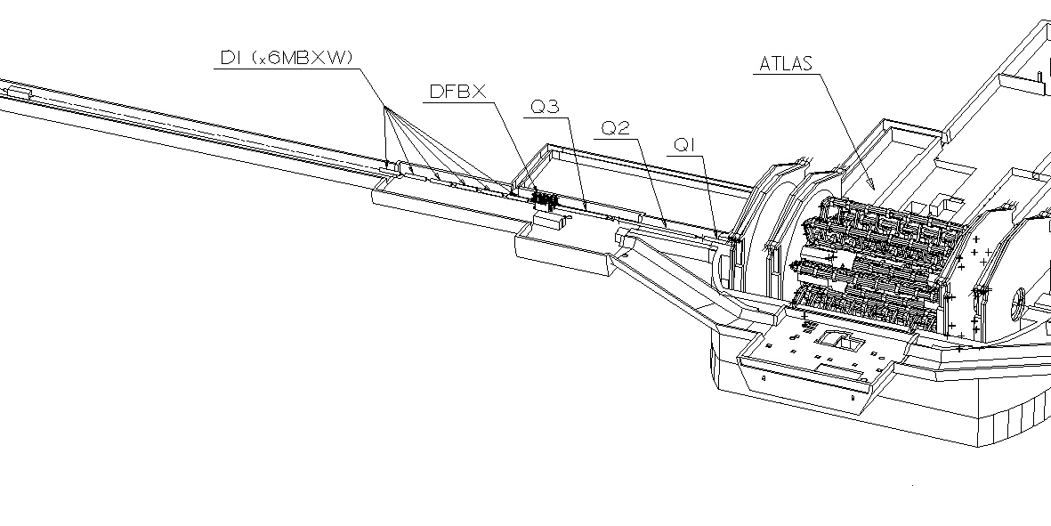
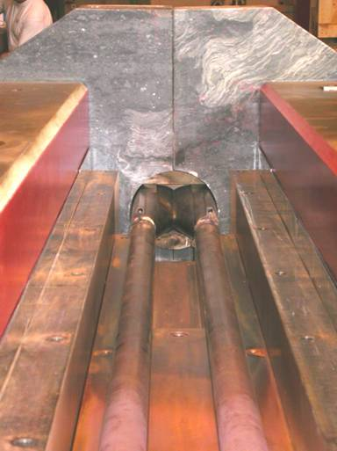
The LHCf experiment
LHCf Detector(Arm#1)
ATLAS
140m
Two independent detectors at either side of IP1 ( Arm#1, Arm#2 )
Beam pipe
Protons
Charged particles (+)
Neutral particles
Charged particles (-)
TAN -Neutral Particle Absorber-
transition from one common beam pipe to two pipes
Slot : 100mm(w) x 607mm(H) x 1000mm(T)
96mm

Slide 9
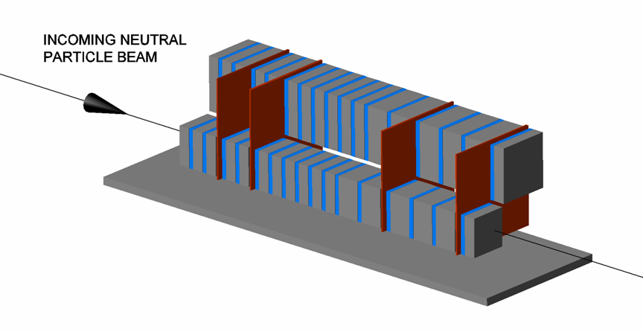
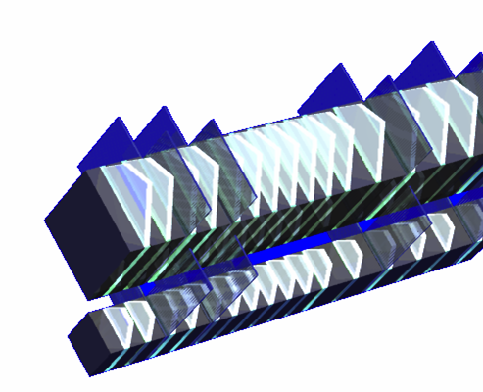
The LHCf Detectors
Sampling and Positioning Calorimeters
W (44 r.l , 1.7λ_{I} ) and Scintillator x 16 Layers
4 positioning layers
XY-SciFi(Arm1) and XY-Silicon strip(Arm#2)
Each detector has two calorimeter towers,
which allow to reconstruct π⁰
Expected Performance
Energy resolution (> 100GeV)
< 5% for photons
30% for neutrons
Position resolution
< 200μm (Arm#1)
40μm (Arm#2)
Arm2
32mm
25mm
Front Counter
thin scintillators with 80x80mm²
To monitor beam condition.
For background rejection of
beam-residual gas collisions
by coincidence analysis
40mm
Arm1
20mm
Notes:
The Arm#1 and Arm#2 , each detector has two sampling and imaging calorimeters.
The each calorimeter are made of 44 r.l. tungsten layer and 16 scintillator layers and 4 position sensitive layers.
The position sensitive layers of Arm#1 are made of XY pair of scintillating fiber bundles.
The position sensitive layers of Arm#2 are made of XY silicon strip detectors.
Two independent calorimeters allow to reconstruct neutral pion from pair photons.
The energy resolution is less than 5% for photons with more than 100GeV and about 30 % for neutrons.
The position resolution of Scintillating fibers in Arm1 is less than 200 um.
And position resolution of silicon detectors in Arm2 is about 40um.

Slide 10
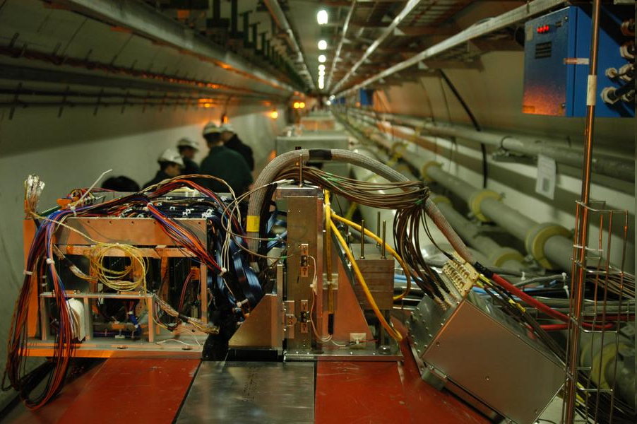
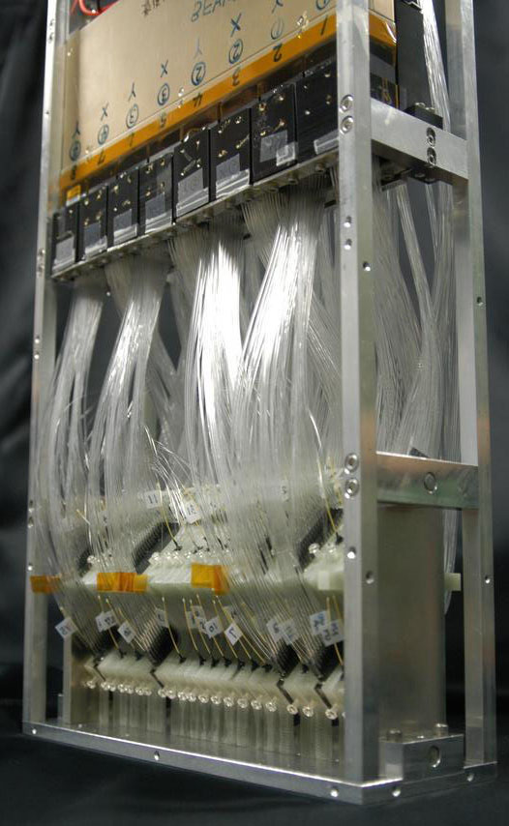
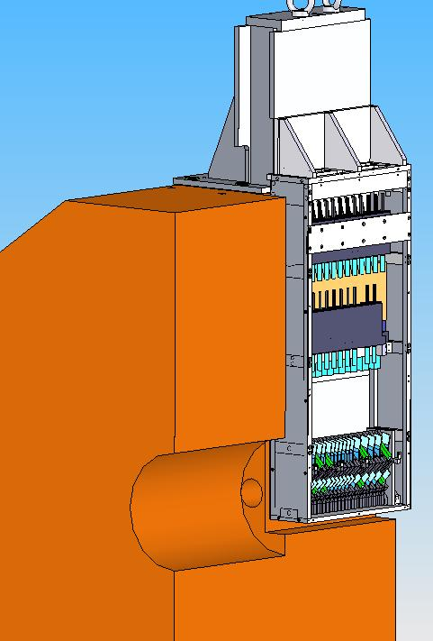
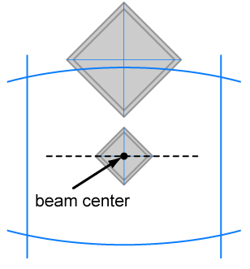
Photos
ATLAS
620mm
η
Shadow of beam pipes
between IP and TAN
280mm
90mm
8.7
∞
Pseudo-rapidity range.
η > 8.7 @ zero crossing angle
η > 8.4 @ 140urad
neutral beam axis

Slide 11
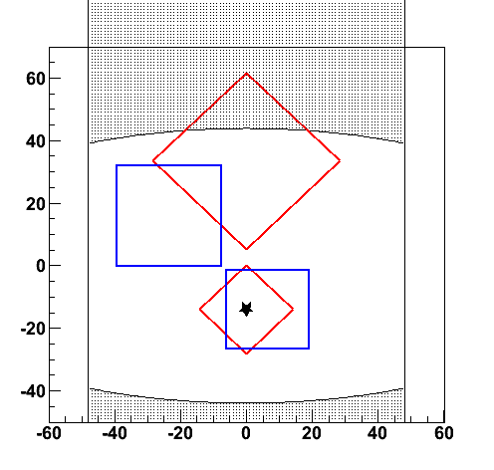
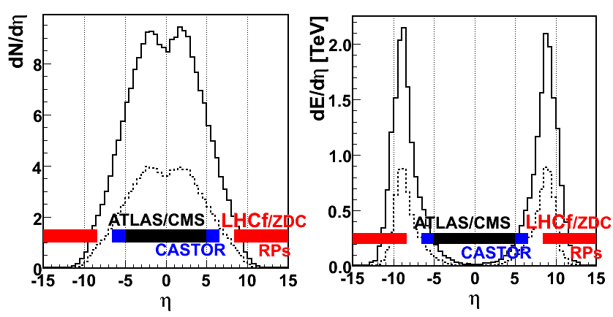
LHCf can measure
Front view of calorimeters
@ 100μrad crossing angle
η
Energy spectra and
Transverse momentum distbution of
beam pipe shadow
8.5
Gamma-rays (E>100GeV,dE/E<5%)
Neutral Hadrons (E>a few 100 GeV, dE/E~30%)
π⁰ (E>600GeV, dE/E<3%)
at pseudo-rapidity range >8.4
∞
Multiplicity@14TeV
Energy Flux @14TeV
Low multiplicity !!
High energy flux !!
simulated by DPMJET3
Notes:
Next, I present what we can measure.
We can measure energy spectra and transverse momentum distribution of gamma-ray with more than 100GeV
and neutral hadrons it’s mainly neutrons with more than a few hundreds GeV, and neutral pions with more than 700GeV
at rapidity range from 8.4 to infinity.
because we don’t have own central detectors and LHCf trigger is completely independent on ATLAS trigger,
so LHCf can measure only inclusive spectra . However we are recording ATLAS event ID number event by event,
so it is possible to identify coincidence events with ATLAS event and to analyze with ATALS in future.

Slide 12
Operation in 2009-2010
At 450GeV+450GeV
06 Dec. –15 Dec. in 2009
27.7 hours for physics, 2.6 hours for commissioning
~2,800 and ~3,700 shower events in Arm1 and Arm2
02 May – 27 May in 2010
~15 hours for physics
~44,000 and ~63,000 shower events in Arm1 and Arm2
At 3.5TeV+3.5TeV
30 Mar. – 19 July in 2010
~ 150 hours for physics with several setup
With zero crossing angle and with 100μrad crossing angle.
~2x10⁸ and ~2x10⁸ shower events in Arm1 and Arm2
Operation at √s = 900GeV and 7TeV has been completed successfully.
The detectors has been removed from the LHC tunnels at July 2010, and will be upgraded for the future operations.

Slide 13
Forward photon spectrum at √s = 7TeV p-p collisions
“ Measurement of zero degree single photon energy spectra
for √s = 7 TeV proton-proton collisions at LHC “
O. Adriani, et al., PLB, Vol.703-2, p.128-134 (09/2011)

Slide 14
Analysis for the photon spectra
DATA
  15 May 2010 17:45-21:23, at Low Luminosity 6x10²⁸cm⁻²s⁻¹
  0.68 nb-1 for Arm1, 0.53nb-1 for Arm2
MC
  DPMJET3.0４, QGSJETII03, SYBILL2.1, EPOS1.99
  PYTHIA 8.145 with the default parameters.
  10⁷ inelastic p-p collisions by each model.
Analysis Procedure
  Energy Reconstruction from total energy deposition
  in a tower with some corrections, shower leakage out etc.
  Particle Identification
  by shape of longitudinal shower development.
  Cut multi-particle events.
  Two Pseudo-rapidity selections, η>10.94 and 8.81<η<8.9.
  Combine spectra between the two detectors.

Slide 15
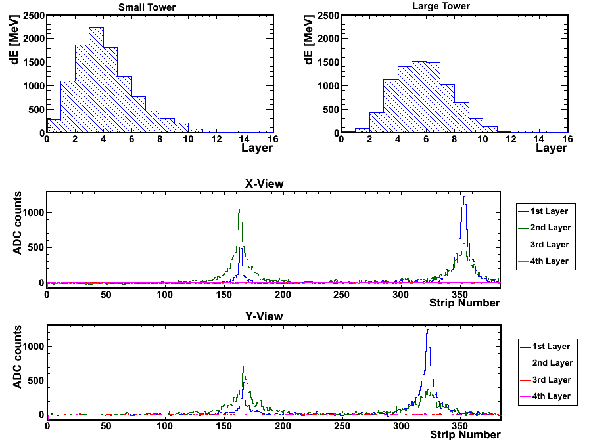
Event sample
Longitudinal development measured by scintillator layers
25mm Tower
32mm Tower
Total Energy deposit
➔Energy
Shape
➔PID
➔600GeV
photon
➔420GeV
photon
Lateral distribution measured by silicon detectors
X-view
Hit position,
Multi-hit search.
Y-view
π⁰ mass reconstruction from two photon.
Systematic studies

Slide 16
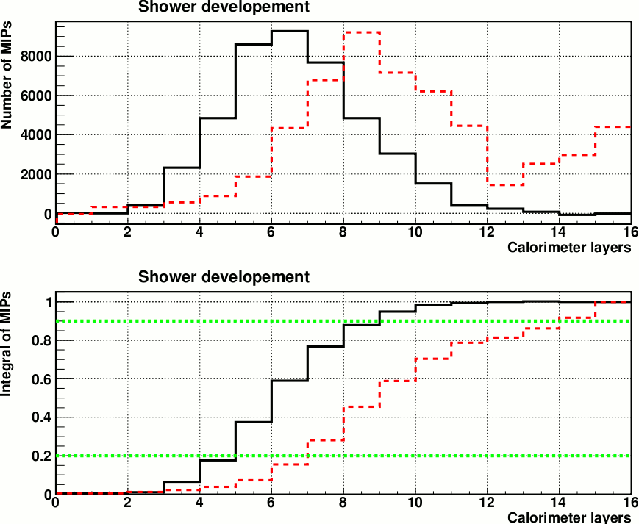
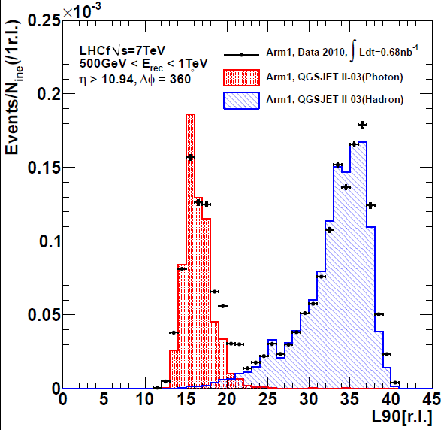
Particle Identification
Event selection and correction
  Select events <L_{90%} threshold and multiply P/ε
  ε (photon detection efficiency) and P (photon purity)
  By normalizing MC template L_{90%} to data,
  ε and P for certain L_{90%} threshold are determined.
Calorimeter Depth
Elemag: 44r.l.
Hadronic: 1.7λ
L_{90%} Distribution
dE
Photon
Hadron
Calorimeter layers
Integral of dE
Calorimeter layers

Slide 17
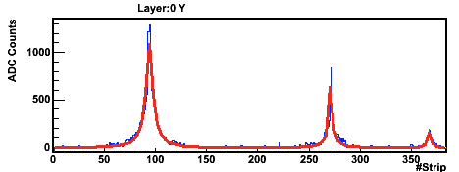
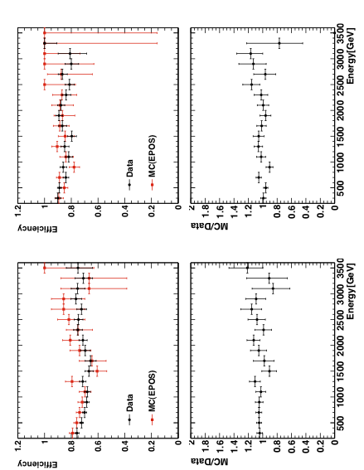
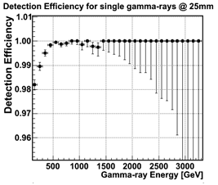
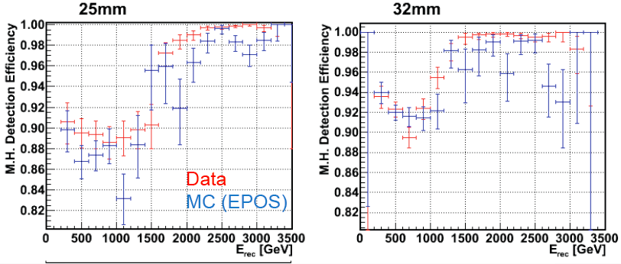
Multi-hit identification
Event cut of multi-peak events,
  Identify multi-peaks in one tower by position sensitive layers.
  Select only the single peak events for spectra.
An example of multi peak event
Double hit detection efficiency
Small tower
Large tower
Arm1
Single hit detection efficiency
Arm2

Slide 18
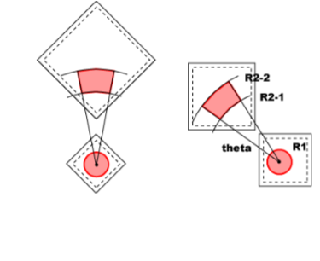
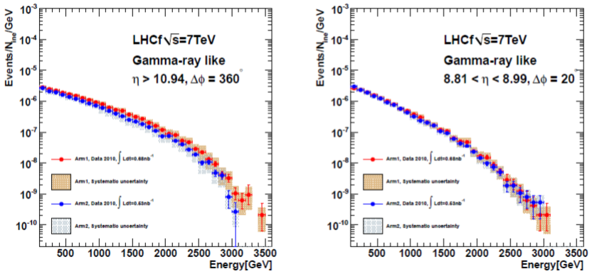
Comparison between the two detector
Pseudo-rapidity selection, η>10.94 and 8.81<η<8.9
Normalized by number of inelastic collisions with assumption as inelastic cross section of 71.5mb
( <->73.5±0.6^{stat.} ^{sys.} mb by TOTEM )
Spectra in the two detectors are
consistent within errors.
➔ Combined between spectra of Arm1 and Arm2
by weighted average according to errors
+1.8
-1.3
Arm1 detector
Arm2 detector

Slide 19
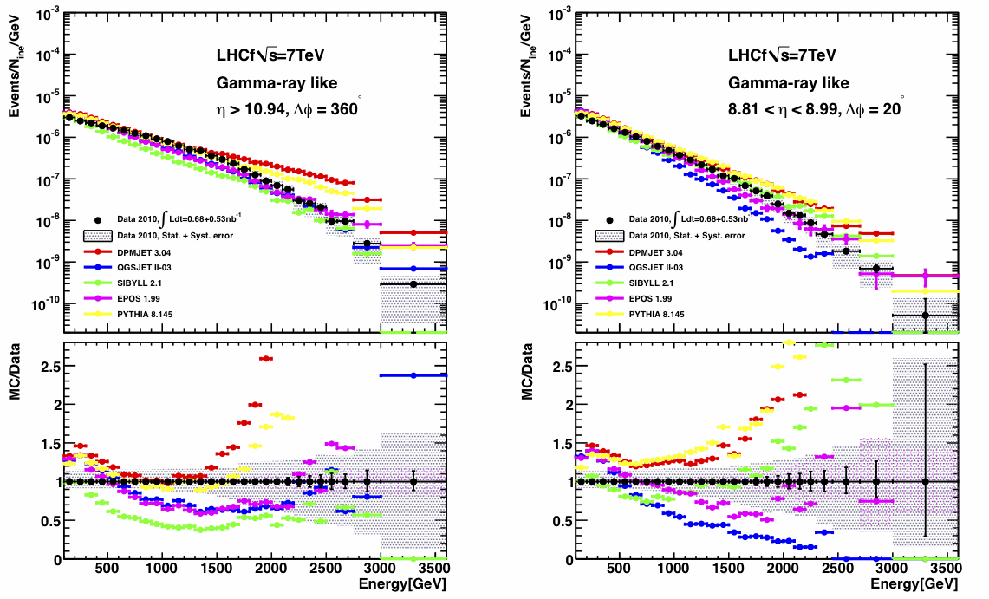
Comparison between MC’s
DPMJET 3.04 QGSJETII-03 SIBYLL 2.1 EPOS 1.99 PYTHIA 8.145
Gray hatch : Systematic Errors
Blue hatch: Statistics errors of MC

Slide 20
Comparison between MC’s
DPMJET 3.04 QGSJETII-03 SIBYLL 2.1 EPOS 1.99 PYTHIA 8.145
Gray hatch : Systematic Errors
Blue hatch: Statistics errors of MC
No model are not able to reproduce the LHCf results perfectly

Slide 21
Next Plans
Ongoing analysis
  Energy spectrum of photons
  in the wider pseudo-rapidity range.
  P_{T} distribution
  Hadron spectra
  π⁰ spectra
  Photon and Hadron energy spectra at 900GeV.
Future operations
  p-p collisions at the LHC designed energy,
  √s = 14TeV in 2014.
  Planning operations in 2012 and 2013.
    p-Pb collisions at LHC
    Operations at RHIC

Slide 22
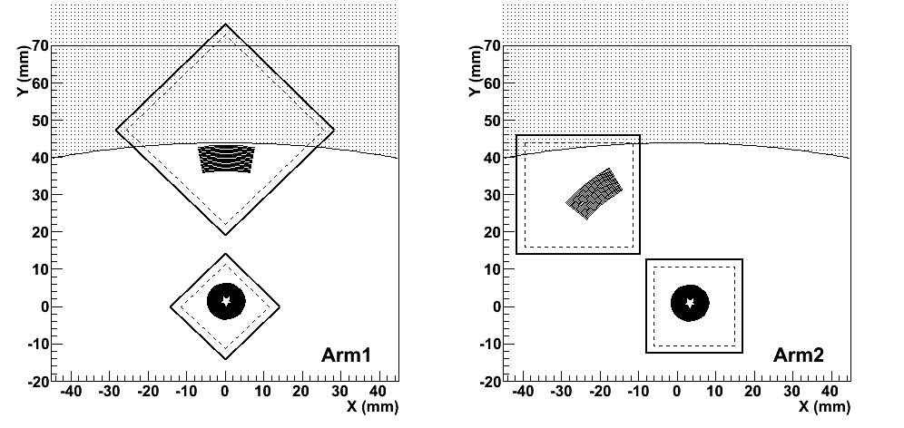
Pseudo-Rapidity coverage
In the paper, we selected the limited pseudo-rapidity ranges.
  η>10.94 and 8.81<η<8.9
The coverage will be improved
to the full acceptance of the detector.
  η>8.7 @ zero beam crossing angle.
  η>8.5 @ 100urad beam crossing angle.
Selected area
of analysis in the paper.

Slide 23
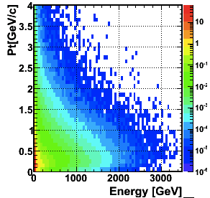

P_{T} acceptance for ϒ and n
pp 7TeV, EPOS
P_{T} acceptance
at zero beam crossing angle
P_{T} < 0.2GeV/c @450GeV
P_{T} < 0.5GeV/c @1TeV
P_{T} < 1.0GeV/c @2TeV
P_{T} < 2.5GeV/c @5TeV
P_{T}=Eθ
I.P

Slide 24
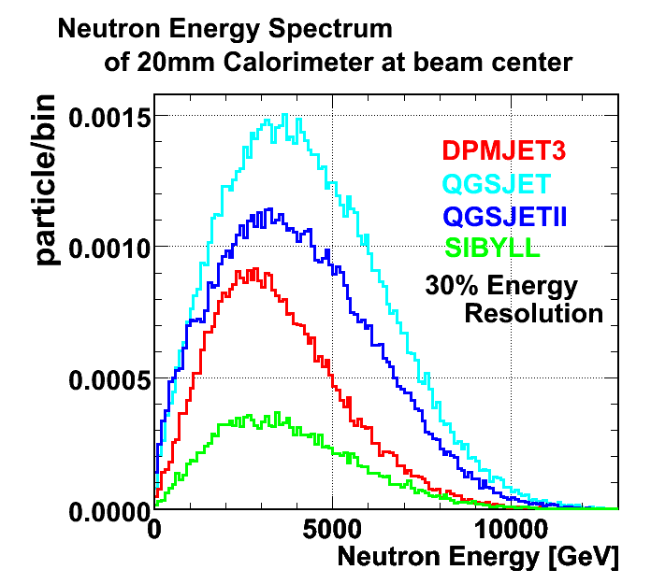
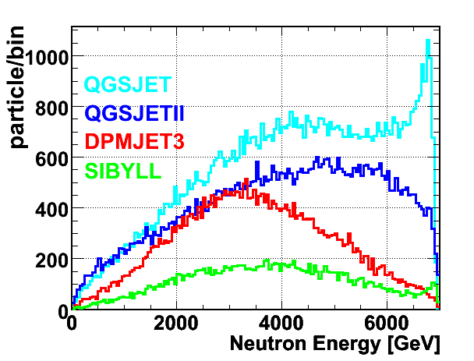
Neutron measurement
Huge model dependency of spectra in the forward region.
Energy resolution for hadrons ~ 30%.
Model predictions of 20mm cal. @ 14TeV p-p
w/o energy resolution
w/ 30% resolution

Slide 25
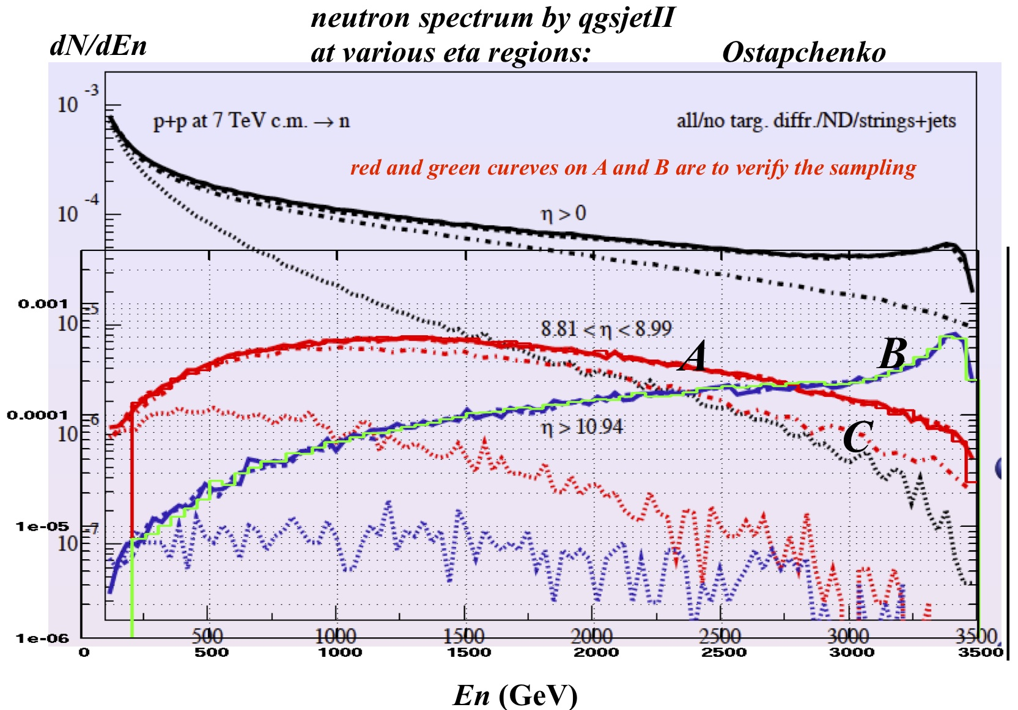
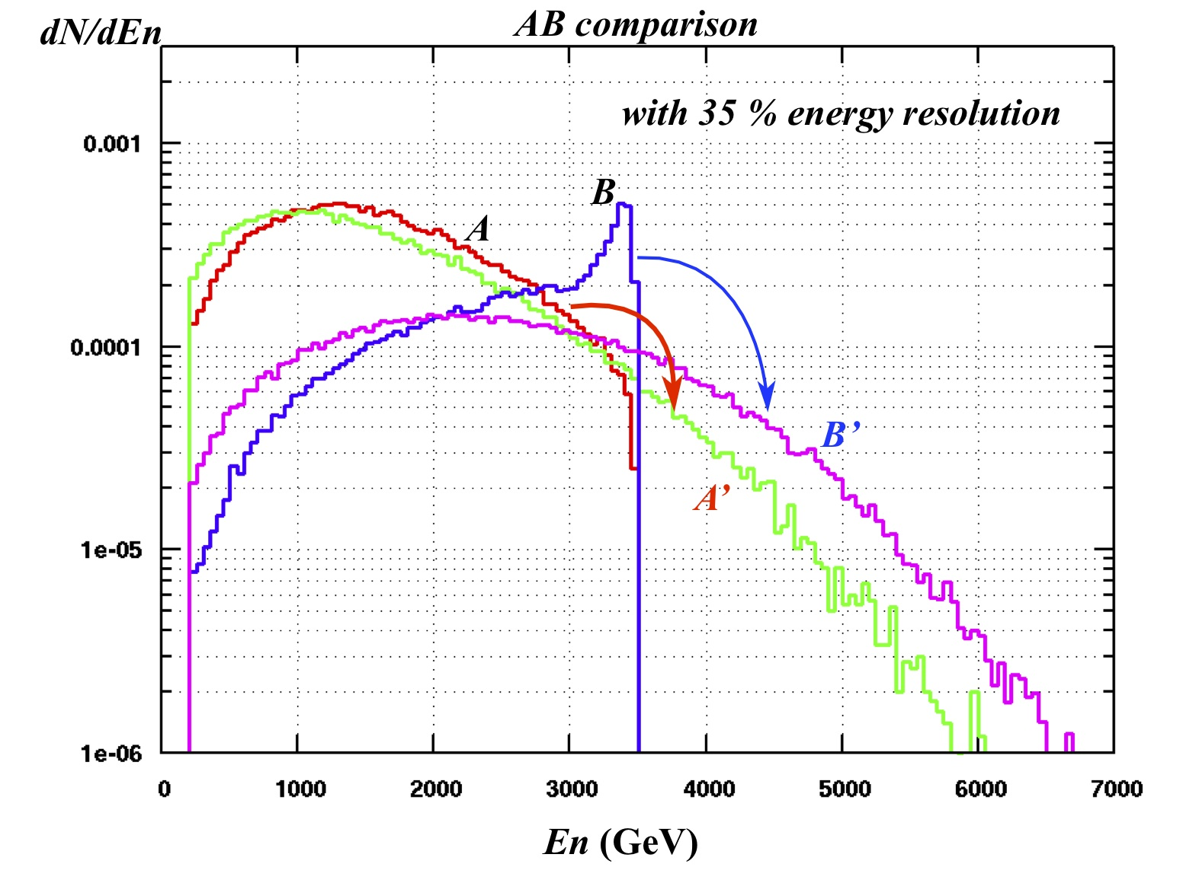
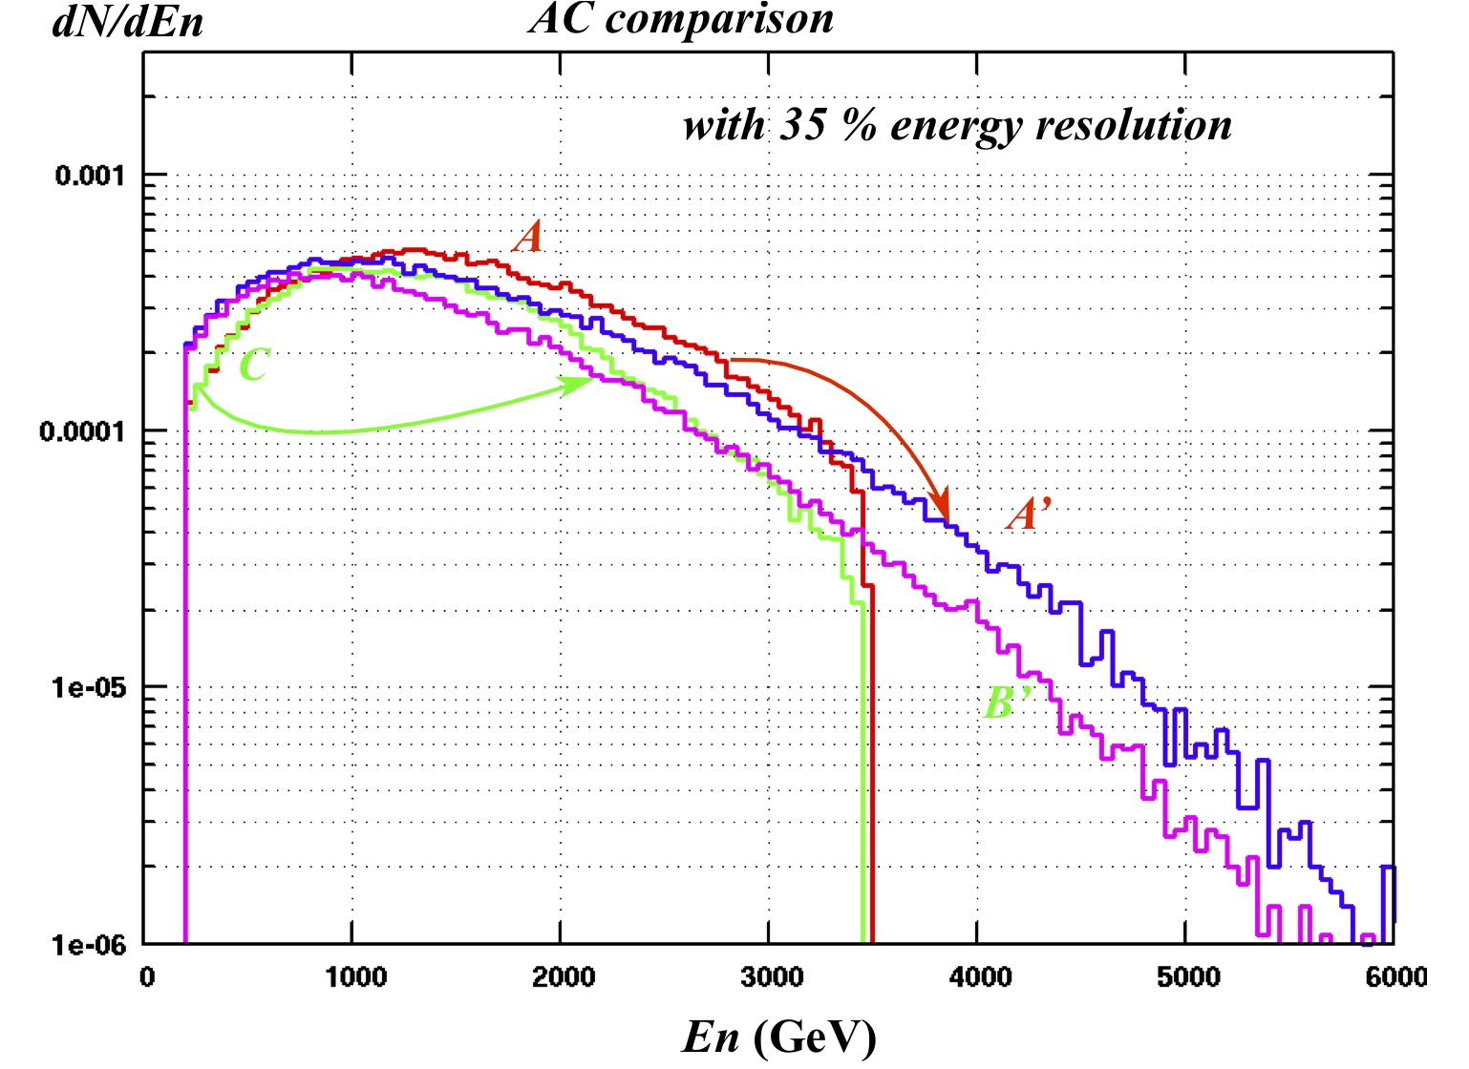
Neutron measurement
@ 7TeV p-p

Slide 26
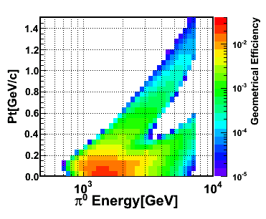
Pi0 measurement
Geometrical acceptance
at one detector position.
Type 1
γ₁(E₁)
R
140m
θ
γ₂(E₂)
I.P.1
Type 2
Two photon on one calorimeter.
Improve the efficiency for high energy pi0’s
I.P.1

Slide 27
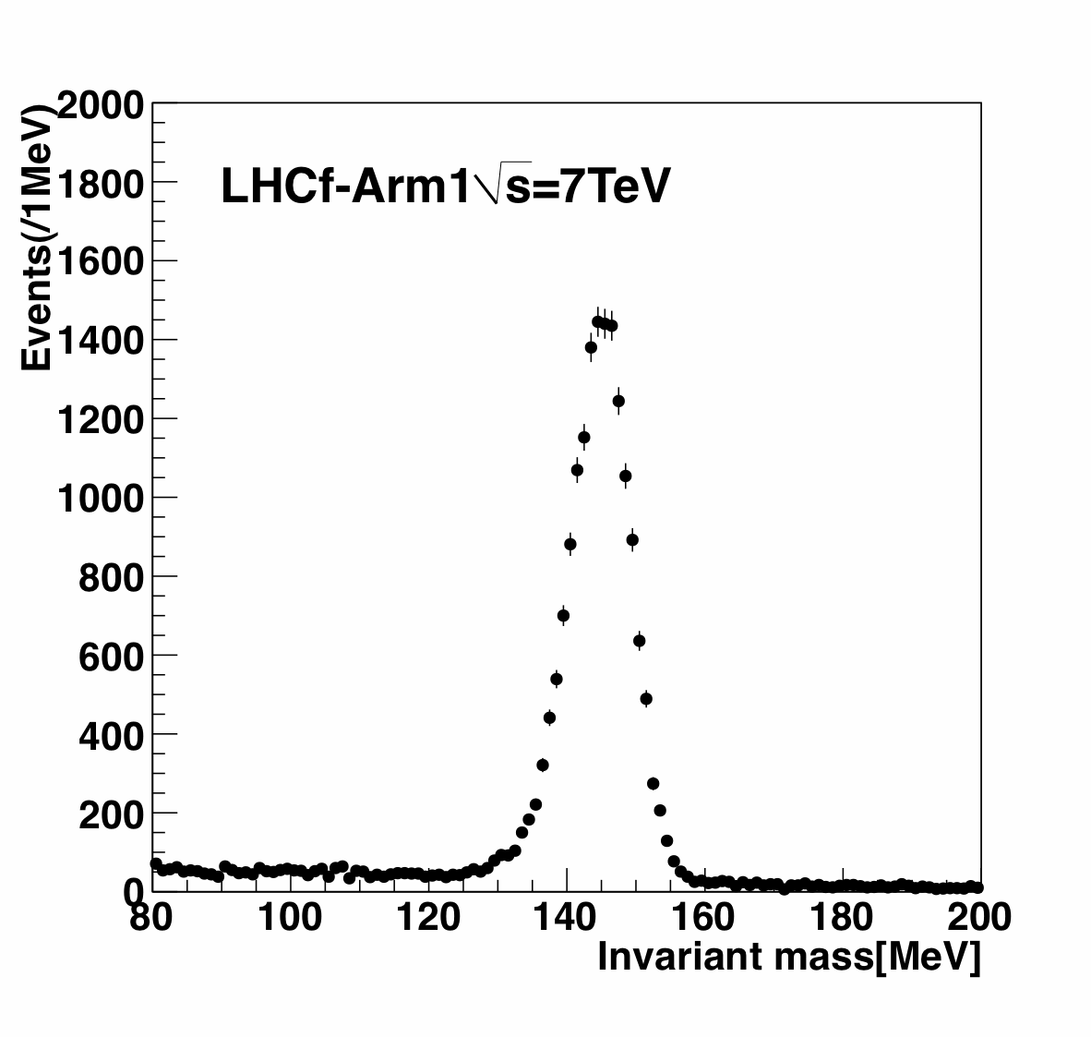
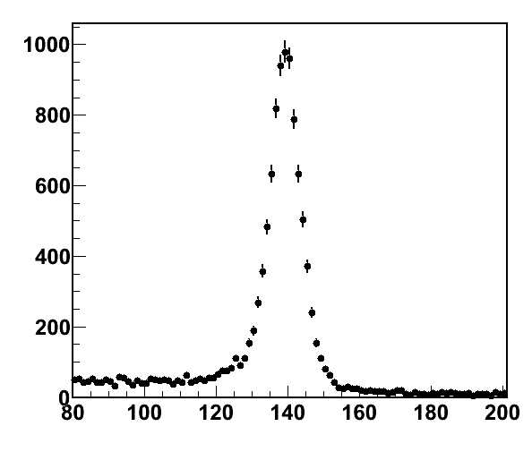
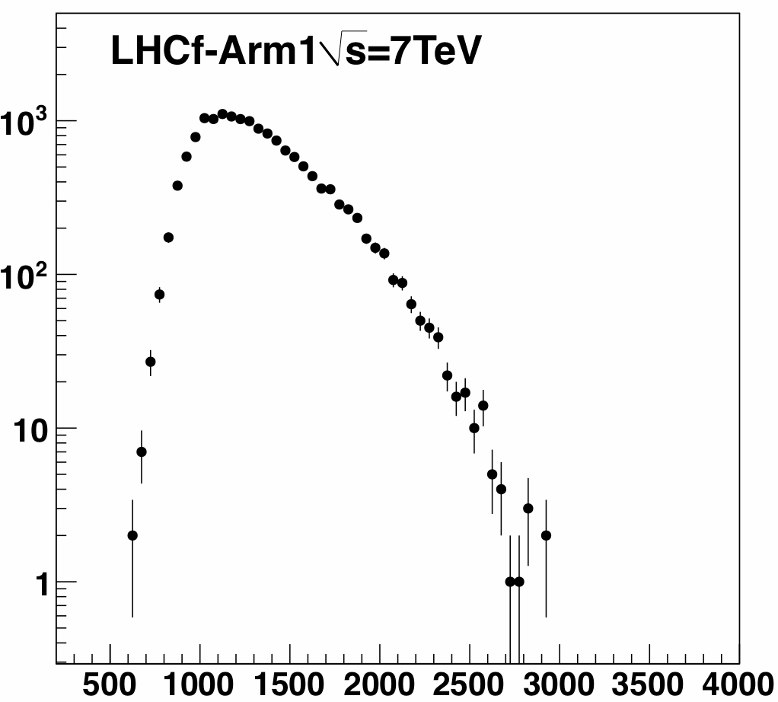
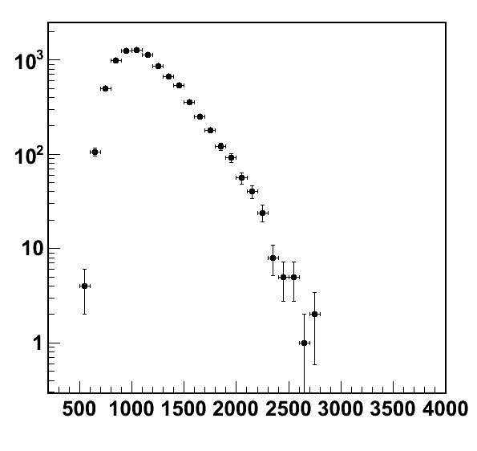
Pi0 analysis @ 7TeV pp is ongoing
Arm1
Arm2
Event /MeV
Event /MeV
Reconstructed mass [MeV]
Reconstructed mass [MeV]
Arm1
Arm2
Event /GeV
preliminary
Event /GeV
preliminary
Reconstructed energy [GeV]
Reconstructed energy [GeV]

Slide 28
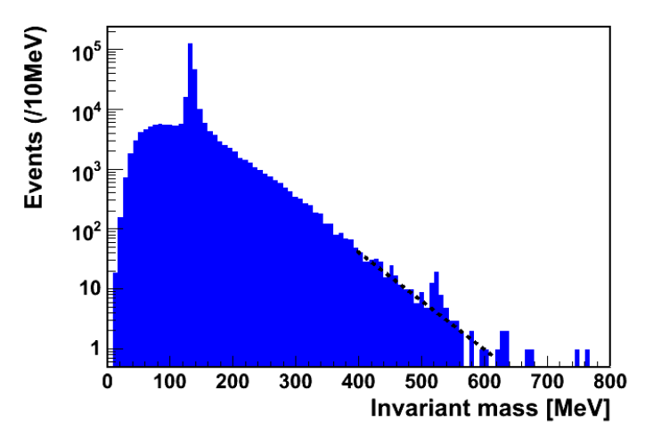
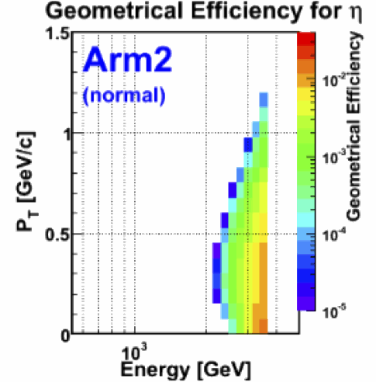


Other particles
η (➔γγ)
K⁰_{s} (➔π⁰π⁰➔4γ)
Λ (➔π⁰n)
Data measured by Arm2
(all data at 7TeV p-p with zero crossing angle)
E_{η}>2TeV
Pi0 events
Eta Candidate

Slide 29
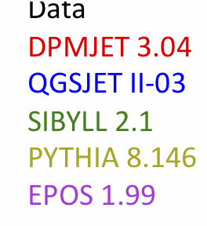
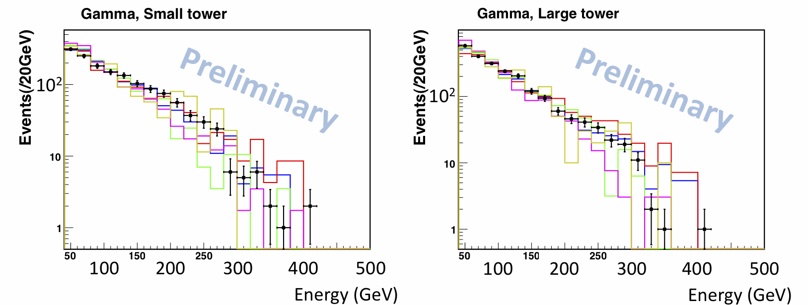
900GeV p-p analysis
Beam energy of 450GeV
  No efficiency for pi0
  ~ energy @ beam test SPS
The detector response
for hadrons is well known.
Preliminary results from Arm1 analysis
No correction of PID efficiency and purity
Normalized by number of entries

Slide 30
Future Operations
p-p collisions at the LHC designed energy,
√s = 14TeV in 2014.
Planning operations in 2012 and 2013.
  p-Pb collisions at LHC
    This is planed in Dec.2012 (final decision will be in Feb. 2012)
  Operations at RHIC
    We are contacting with RHIC people.
    p-p collisions at √s = 500GeV
    Ion collisions

Slide 31
Summary
LHCf is one LHC experiment dedicated for cosmic ray physics. The aim is to calibrate the hadron interaction models which are used in air shower simulations.
LHCf measured photon forward energy spectra in the pseudo-rapidity ranges, η>10.94 and 8.81<η<8.9
at √s = 7TeV proton-proton collisions.
We compared the spectra with several interaction models
  None of the models perfectly agree with data
  Large discrepancy especially in the high energy with all models.
Analysis is ongoing. Results at √s = 7TeV p-p collisions, energy spectra of photon, hadron, PT distributions and etc., will be provided soon and many results from future operations, p-p at 14TeV, p-A also.

Slide 32
Backup slides

Slide 33
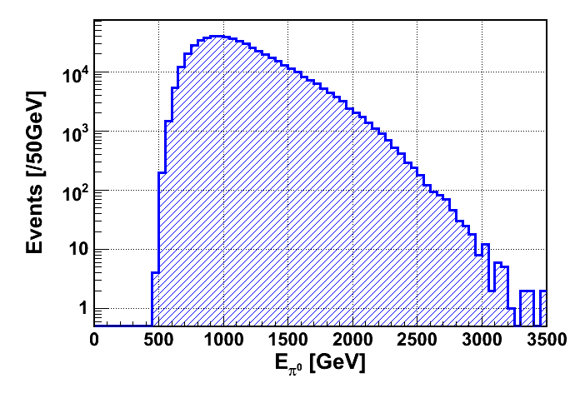
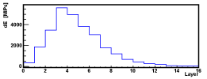
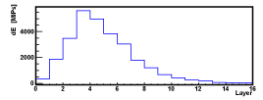

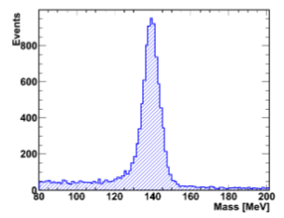
π⁰ reconstruction
An example of π⁰ events
measured energy spectrum @ Arm2
25mm
32mm
preliminary
Silicon strip-X view
γ₁(E₁)
Reconstructed mass @ Arm2
R
140m
θ
γ₂(E₂)
I.P.1
Pi0’s are a main source of electromagnetic secondaries in high energy collisions.
The mass peak is very useful to confirm the detector performances and to estimate the systematic error of energy scale.

Slide 34

Summary of systematic errors

Slide 35
P_{T} distribution for photons
pp 7TeV, EPOS

Slide 36



Front Counter
Fixed scintillation counter
L=CxR_{FC} ; conversion coefficient calibrated during VdM scans

Slide 37

pi0

