Slide 1
天体素粒子物理学特論II
Advanced Astroparticle Physics II
Katsuaki Asano
Takashi Sako
Masami Ｏｕｃｈｉ
(Institute for Cosmic Ray Research)

Slide 2
Introduction of Astroparticle Physics
Frontiers of the high-energy astrophysics, cosmic-ray observations, and observational cosmology.
In a narrow sense, Astroparticle Physics = Physics concerning Cosmic-rays, Gamma-rays, Neutrinos, and Unknown particles in space.
Such particles are produced in high-energy astronomical phenomena or from dark matters.
The origins of such particles are discussed in the cosmological context.
In a broad sense, this includes topics of inflation, baryogenesis, dark energy, and modified gravity.

Slide 3
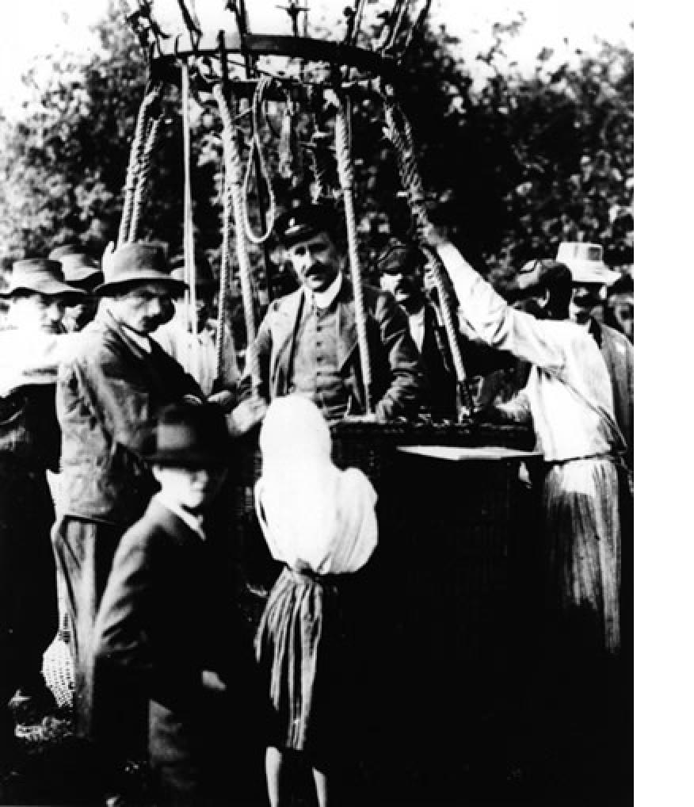
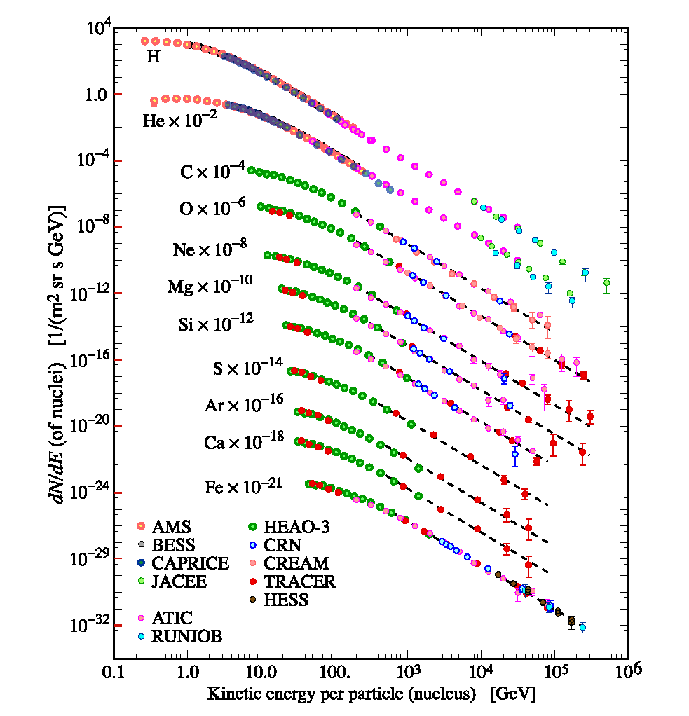

Start of Astroparticle Physics
Cosmic-rays: Relativistic nuclei
and leptons coming from space.
1911-1913 Victor Hess confirmed cosmic-rays.
Nobel Prize in 1936
$$E=γmc^{2}, m_{p}c^{2}=0.94GeV$$

Slide 4
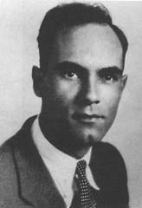
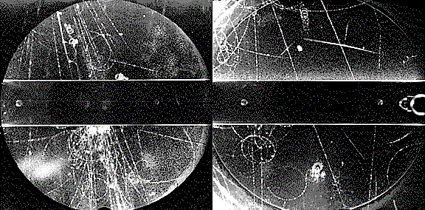
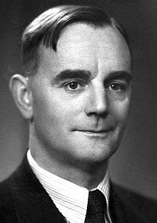
Particle Physics developed by cosmic-ray observation
1932 Carl Anderson found
Positrons in cosmic-rays.
1937 He found muons too.
1947 George Rochester and Clifford Butler found Kaons in cosmic-rays.
1936 Nobel Prize
1947 Cecil Powell found
Pions in cosmic-rays.
Kaons include strange quarks.
Later, Kaons lead to the discovery of CP violation.
Since then, the experimental particle physics had shifted to accelerators or reactors.
1950 Nobel Prize

Slide 5
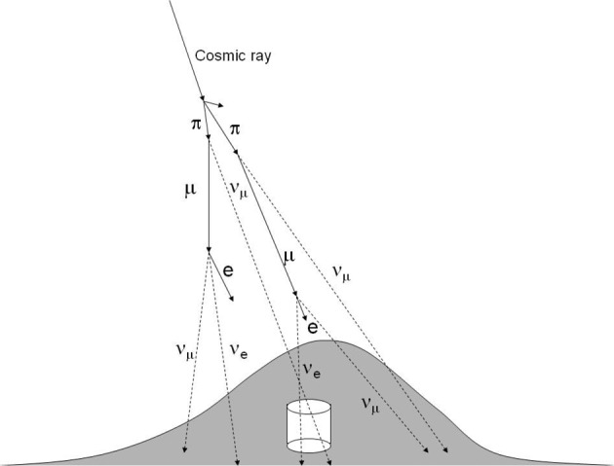
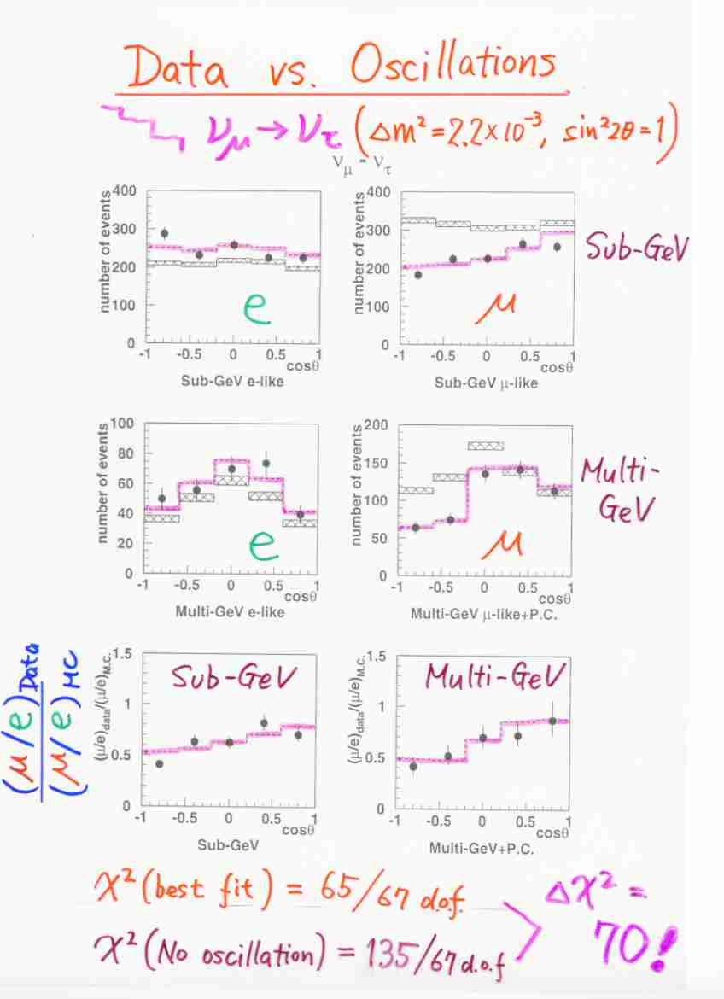
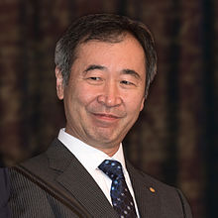
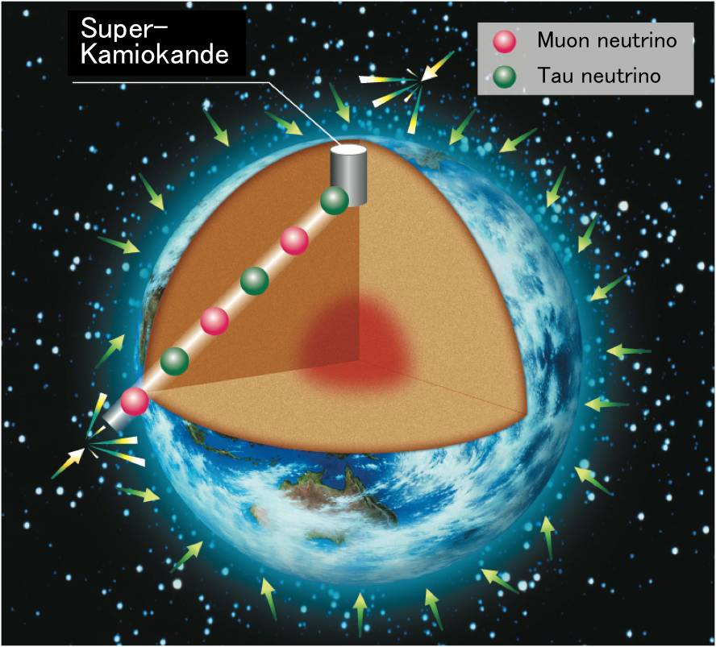
Breakthrough in Astroparticle Physics
Atmospheric Neutrinos
Discovery of Neutrino Oscillation (1998)
Neutrinos are massive!
⇒impact on particle physics
Nobel prize 2015

Slide 6
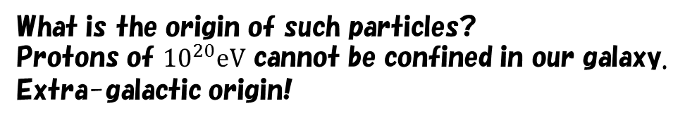
Ultra High-Energy Cosmic-Rays
What is the origin of such particles?
Protons of ${10}^{20}eV$ cannot be confined in our galaxy.
Extra-galactic origin!

Slide 7
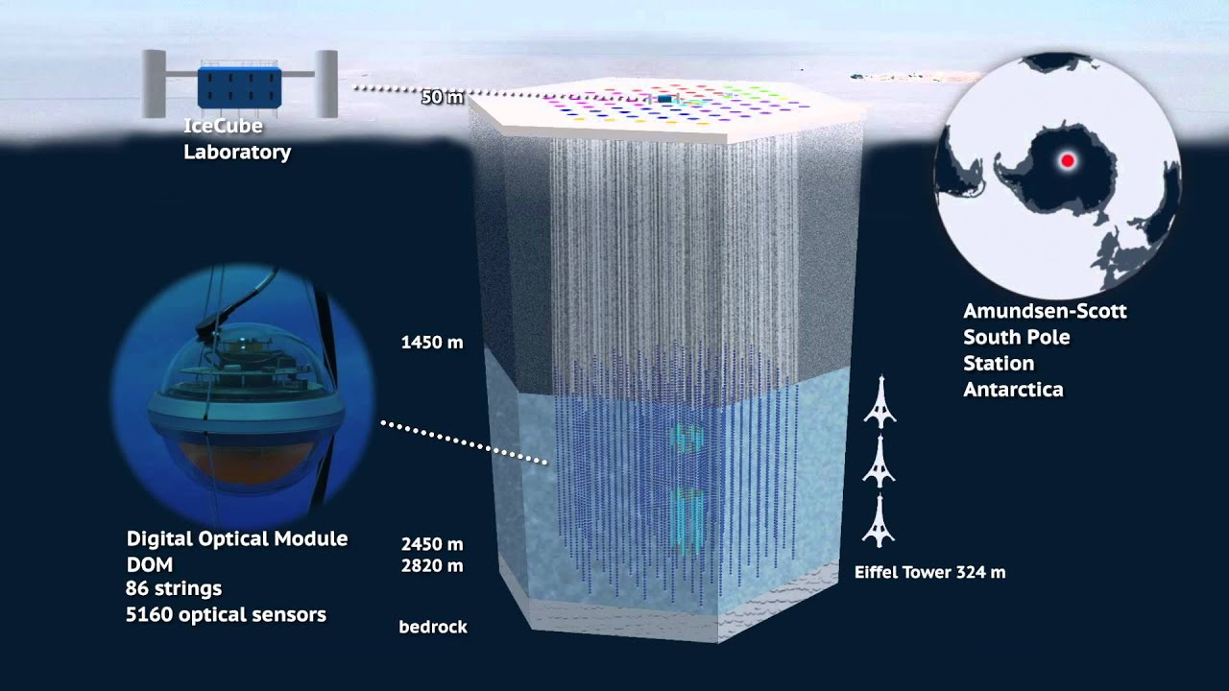
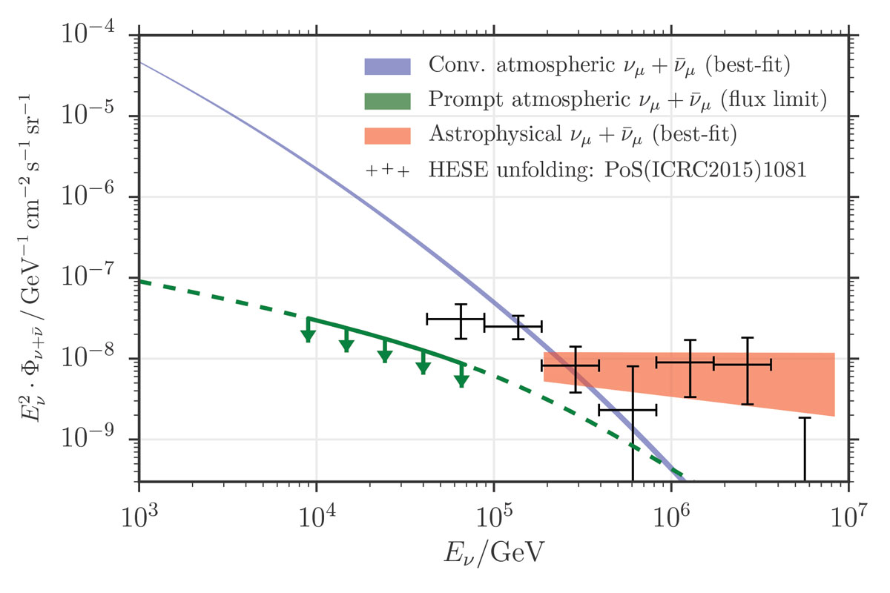
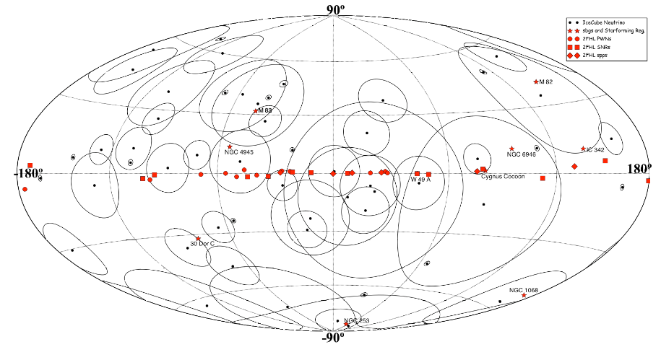

Neutrinos
Neutrinos of ${10}^{14}−{10}^{15}eV$
What is the origin of such neutrinos?
IceCube
Neutrino Detector in the Antarctic
Extra-galactic origin!

Slide 8
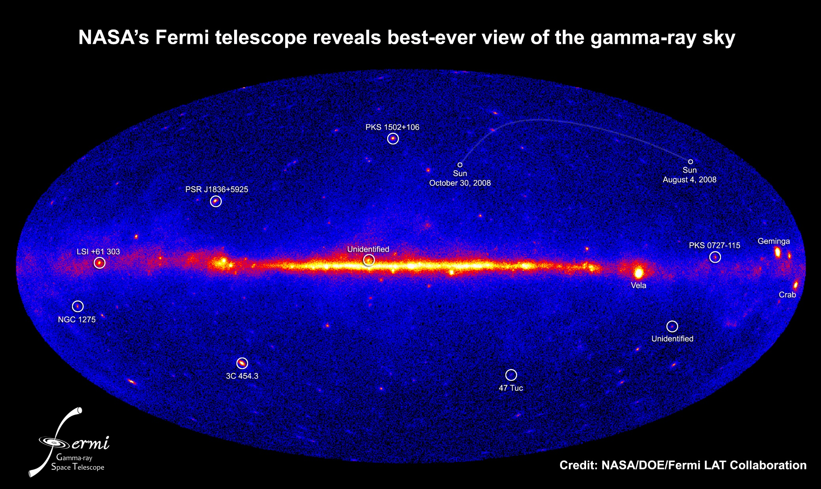
Gamma-Rays
Galactic Plane (Cosmic-ray origin), Pulsars, Supernova Remnants, Blazars…

Slide 9
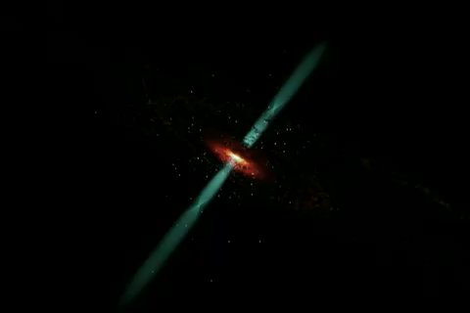
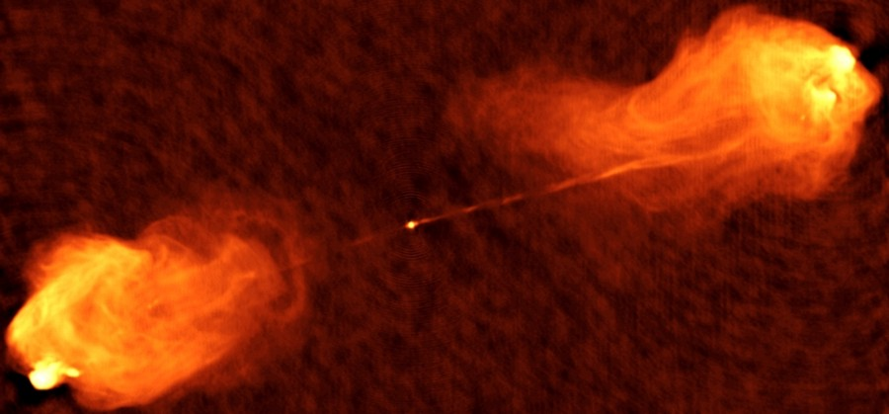
Blazars
On-axis view of
Relativistic Jet from a super massive black hole at the center of a galaxy.
Origin of high-energy paerticles.
Cygnus A
Radio image
Edge-on view of a blazar

Slide 10
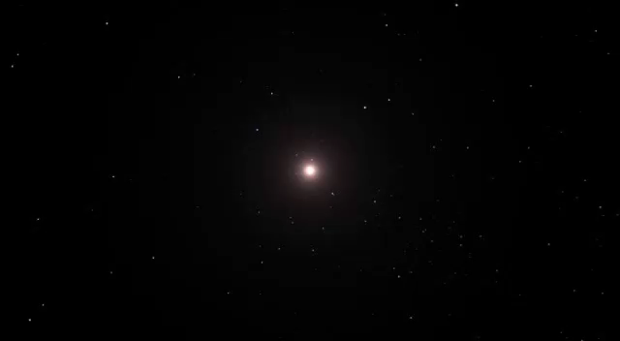
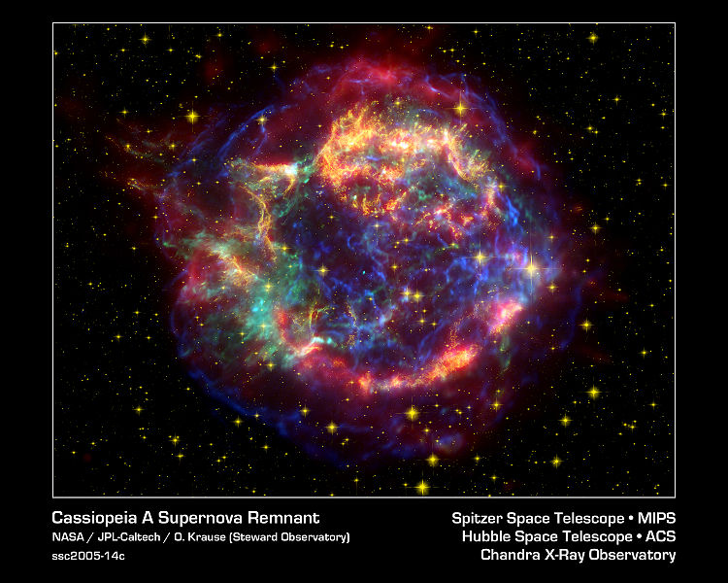
Other high-energy objects
Cassiopeia A exploded 1667
Supernova and its remnant
Main source of cosmic-rays(?)
～2.3pc

Slide 11
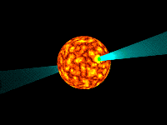

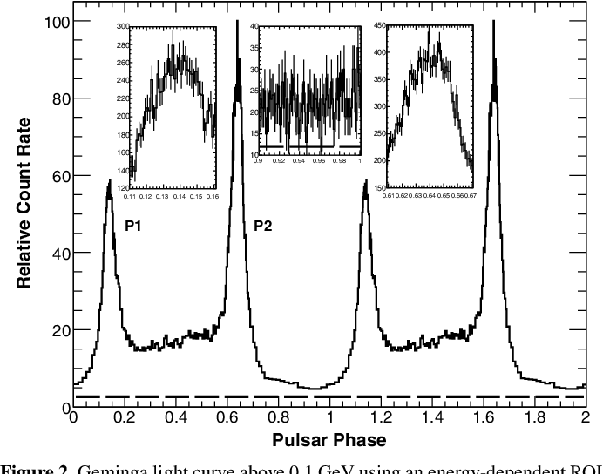
Other high-energy objects
Pulsar
Strongly magnetized (typically 10¹²G) neutron star, Spinning with a period of 1ms-1s. The radius is about 10km, and the density is～10¹⁵g/cm³. Periodic Pulse in radio, optical, X-ray and gamma-ray band.
Pulsar wind nebula
X-ray image of the Crab pulsar wind nebula.
Outflow of electron-positron plasma with a Lorentz factor Γ=10⁶.
Geminga Gamma-ray

Slide 12
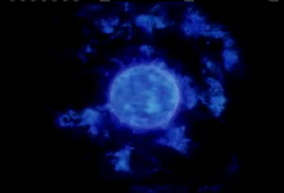
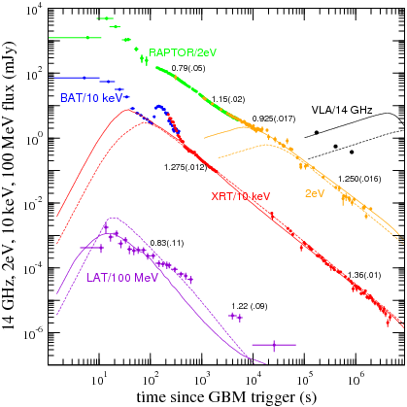
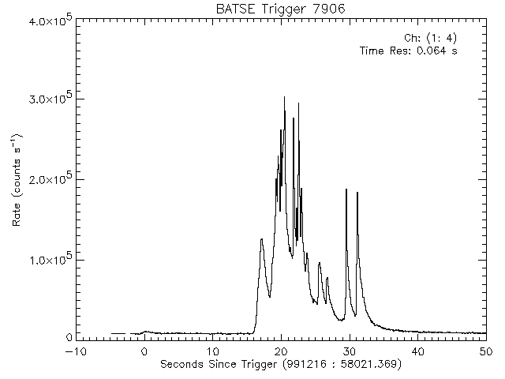
Other high-energy objects
Gamma-Ray Burst
Afterglow
Most energetic explosion in the Universe.
Relativistic Jet (Γ>100) from a black hole at the death of a massive star.
Prompt Emission (typically 0.1-1MeV)

Slide 13
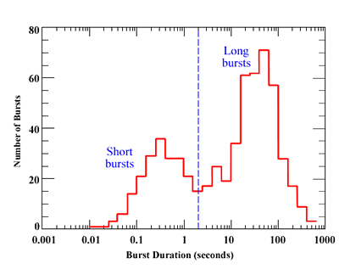
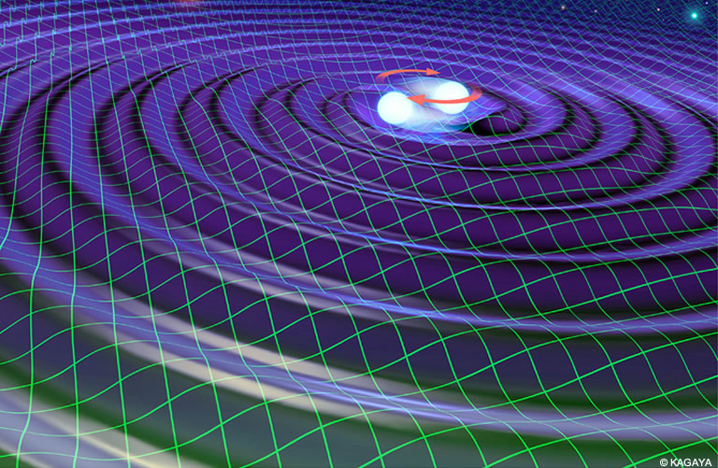
Other high-energy objects
Short Gamma-Ray Burst
GW170817
Detection of gravitational wave signal from a merger of binary neutron stars.
Accompanying a short gamma-ray burst, but very weak burst.
Jet from a merger of binary neutron stars?

Slide 14
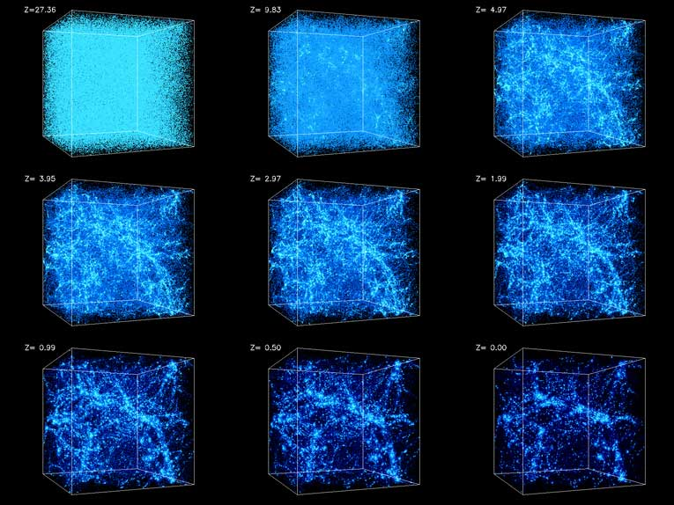

Cosmological History of Celestial Bodies
AGN (Active Supermassive BH) density
Star formation rate (SFR) estimated from UV/IR observations
Simulation:
Structure formation
$$z≡\frac{Δν}{ν}$$
Generation rate of high-energy objects ∝ SFR
Observed high-energy neutrinos were mainly produced at z～2?

Slide 15

Extragalactic Background Light (EBL)
Gamma-ray absorption due to $γ+γ→e^{−}+e^{+}$
$$E_{tgt}∼\frac{{\left(m_{e}c^{2}\right)}^{2}}{E}$$
Target photons are EBL
relate to star formation history.

Slide 16
Extragalactic Background Light (EBL)

Slide 17
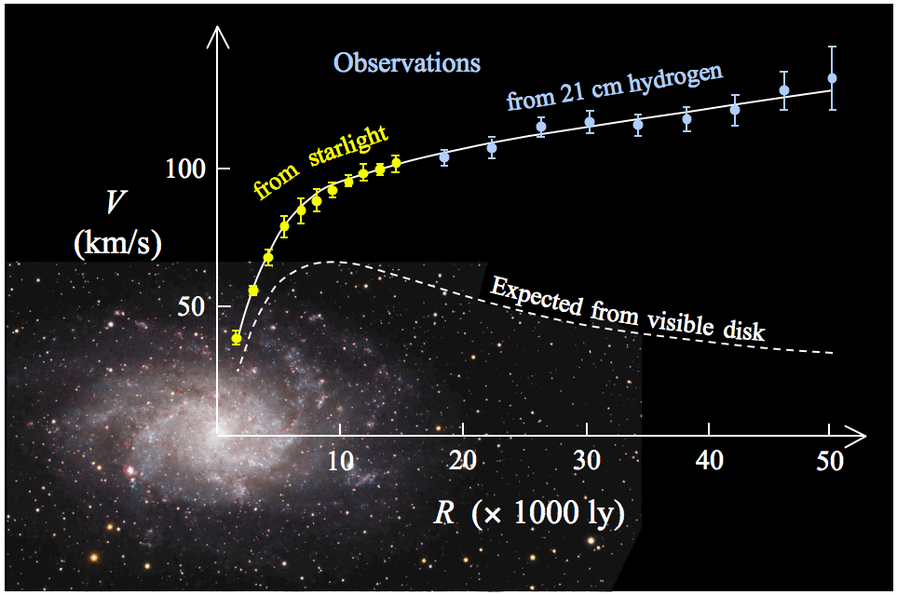
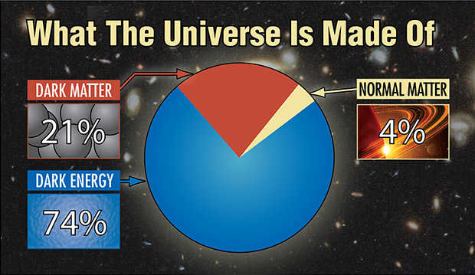
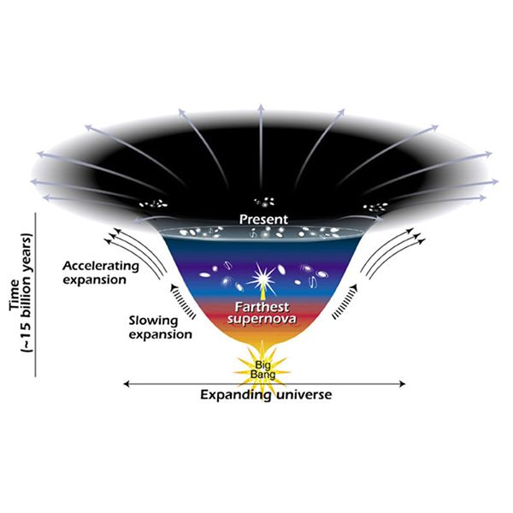
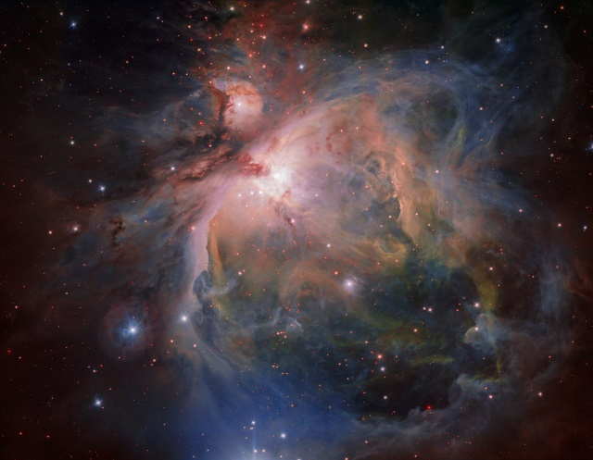
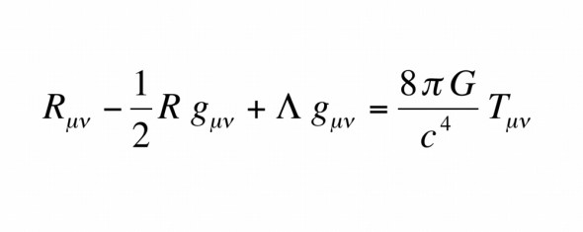
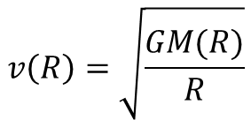
Particles in the Universe
$$v\left(R\right)=\sqrt{\frac{GM(R)}{R}}$$
Einstein equation
Gases and Stars

Slide 18
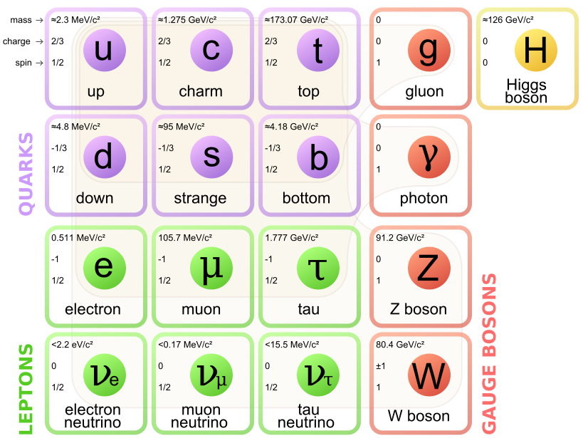
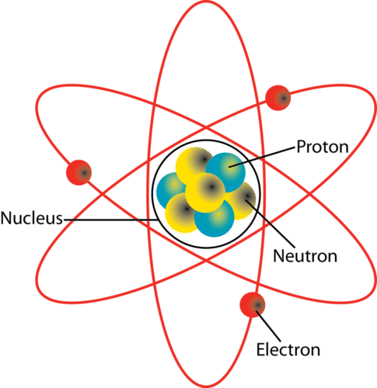
Dark Matter/Energy suggests particles beyond Standard Model
+Photon
+Neutrino

Slide 19
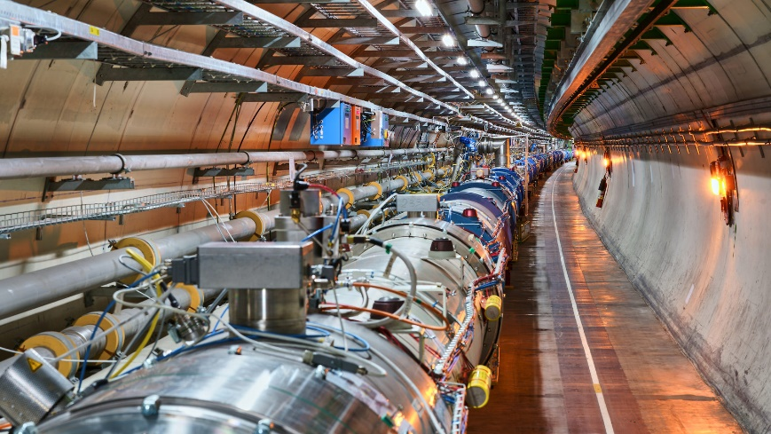
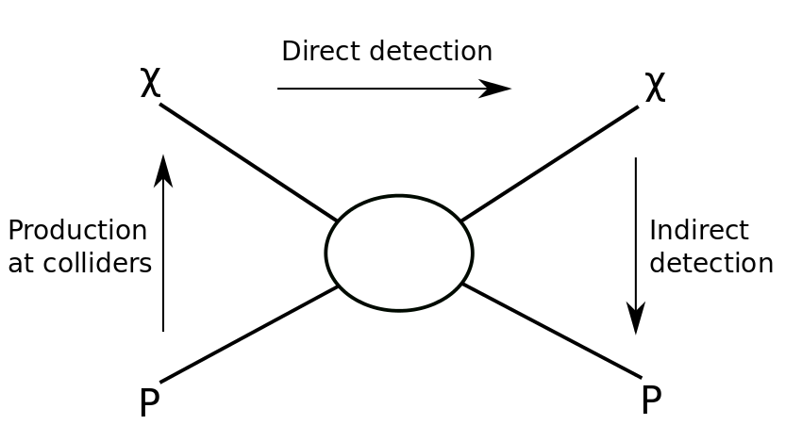
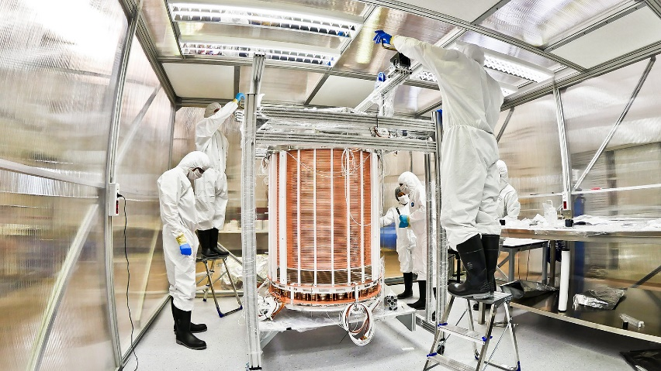


Candidate of dark matter particles
Lightest Supersymmetric Particle:
  Neutralino (Photino, Neutral Wino (Zino), Higgsino)
  Gravitino
Sterile Neutrino
Axion
Others (primordial black hole, modified gravity…)
LHC
How to detect?
$$p+p→χ+Others$$
XENON1T
$$χ+Xe→χ+Xe+γ$$

Slide 20
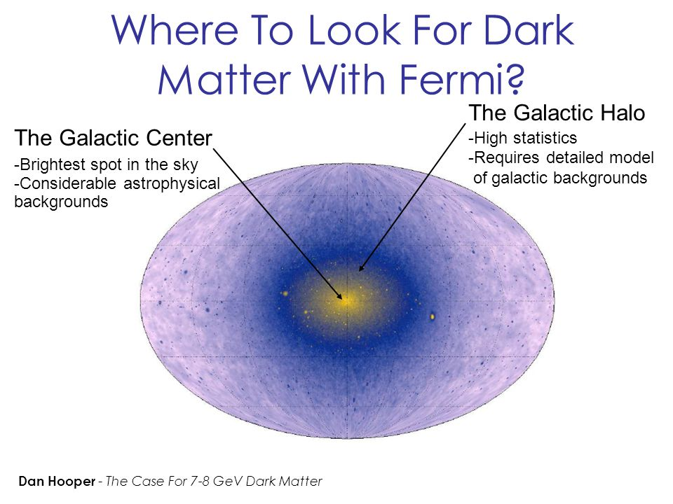
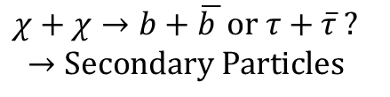
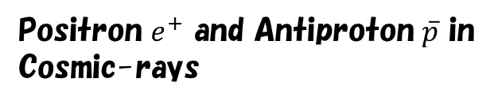
Indirect Search for dark matter
$$χ+χ→b+\overline{b }or τ+\overline{τ} ?$$
$$→Secondary Particles$$
Positron $e^{+}$ and Antiproton $\overline{p}$ in
Cosmic-rays
Secondary particles from dark matter?
Searching for secondary gamma-rays

Slide 21
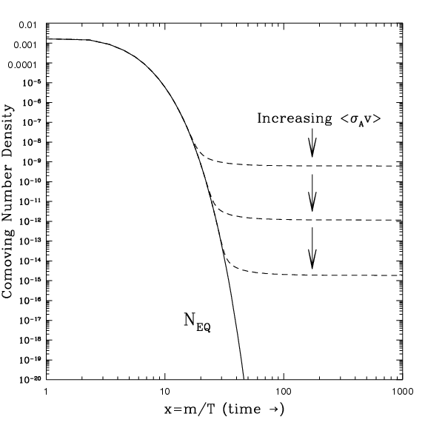
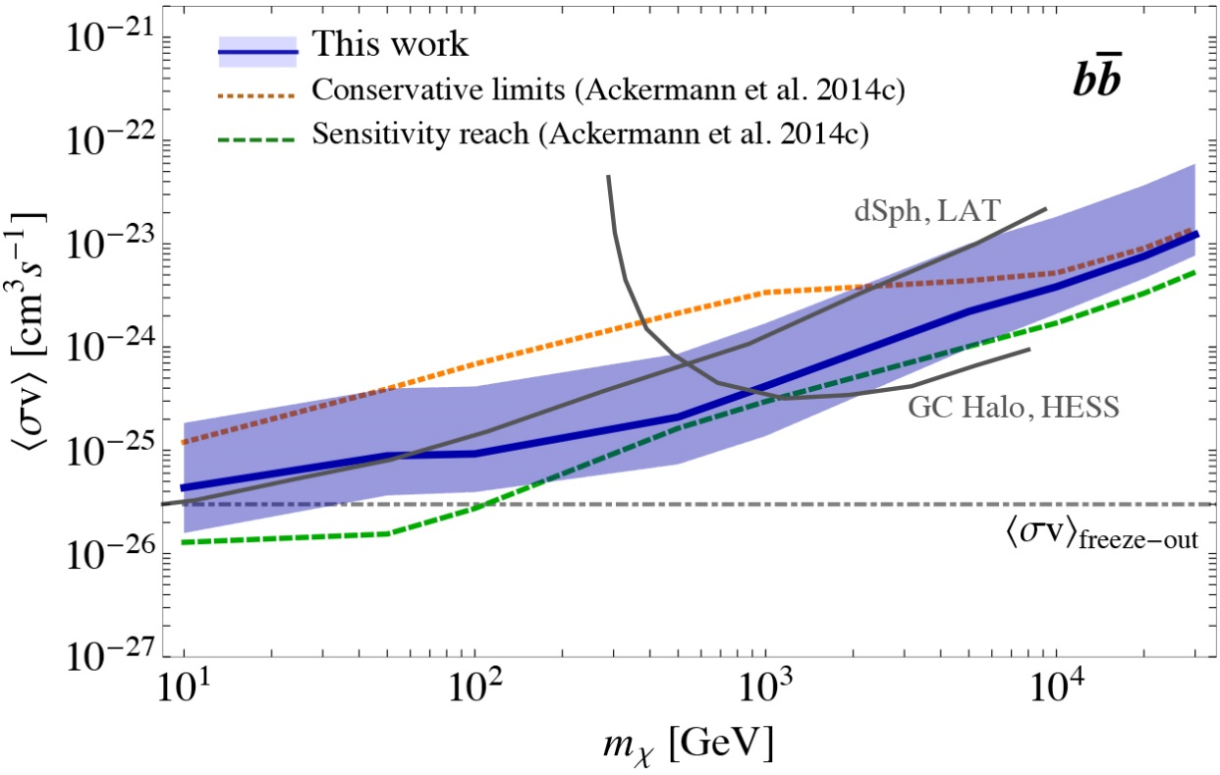
Thermal relic dark matter
In the very early universe, the dark matter density is determined by the thermal equilibrium. As the temperature drops, the thermal equilibrium is violated (freeze-out).
The amount of the dark matter suggests, the cross section is
$$σv∼3×{10}^{−26}cm^{3} s^{−1}$$

Slide 22
Accretion Disk and
Relativistic Jet

Slide 23
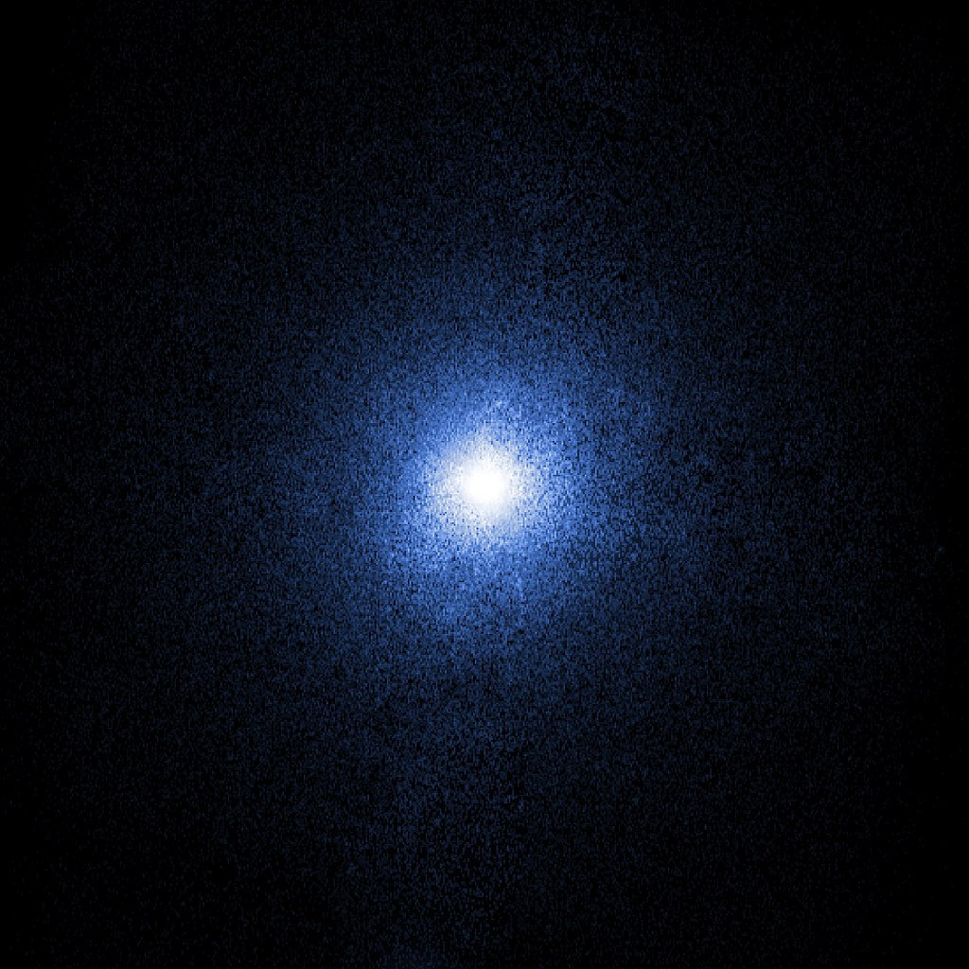
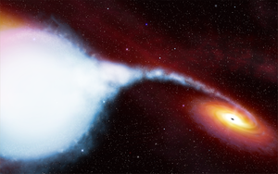

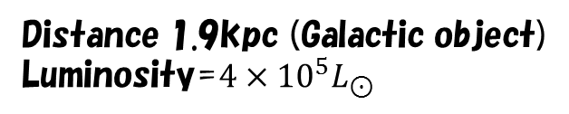
X-ray binary
Cygnus X-1
Black hole and accretion disk
Black hole mass $∼15M_{⊙}$
Distance 1.9kpc (Galactic object)
Luminosity=$4×{10}^{5}L_{⊙}$

Slide 24
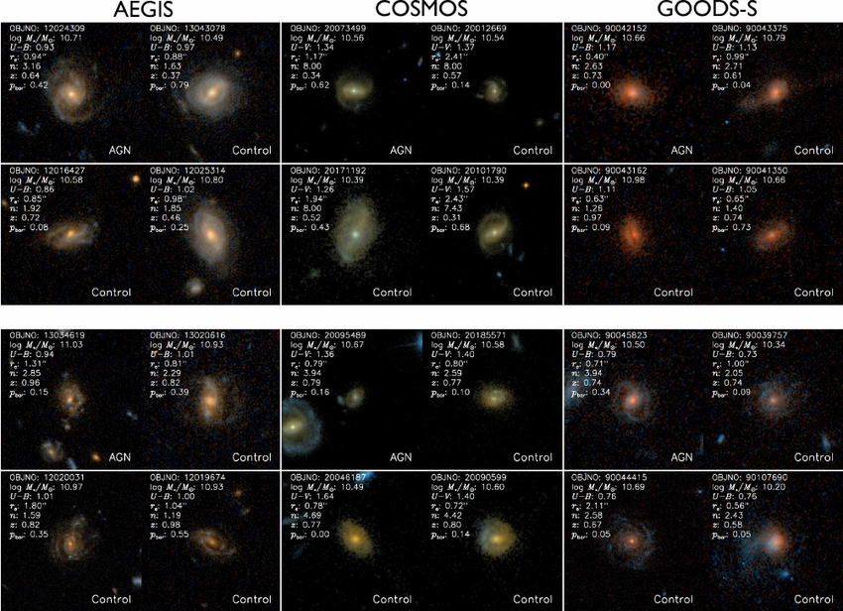
Active Galactic Nuclei
Very bright core = emission from the supermassive black holes.

Slide 25
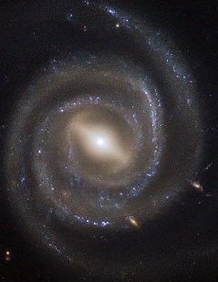
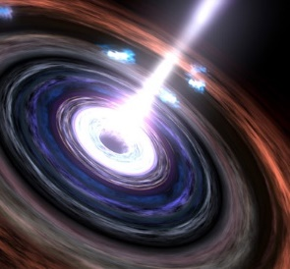
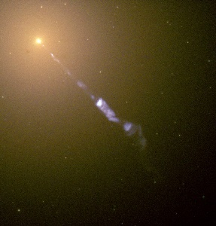
Active Galactic Nuclei
Active Galactic Nuclei (AGN)
Seyfert Galaxy
Quasar
Jet from BH
Blazar
Radio Galaxy

Slide 26
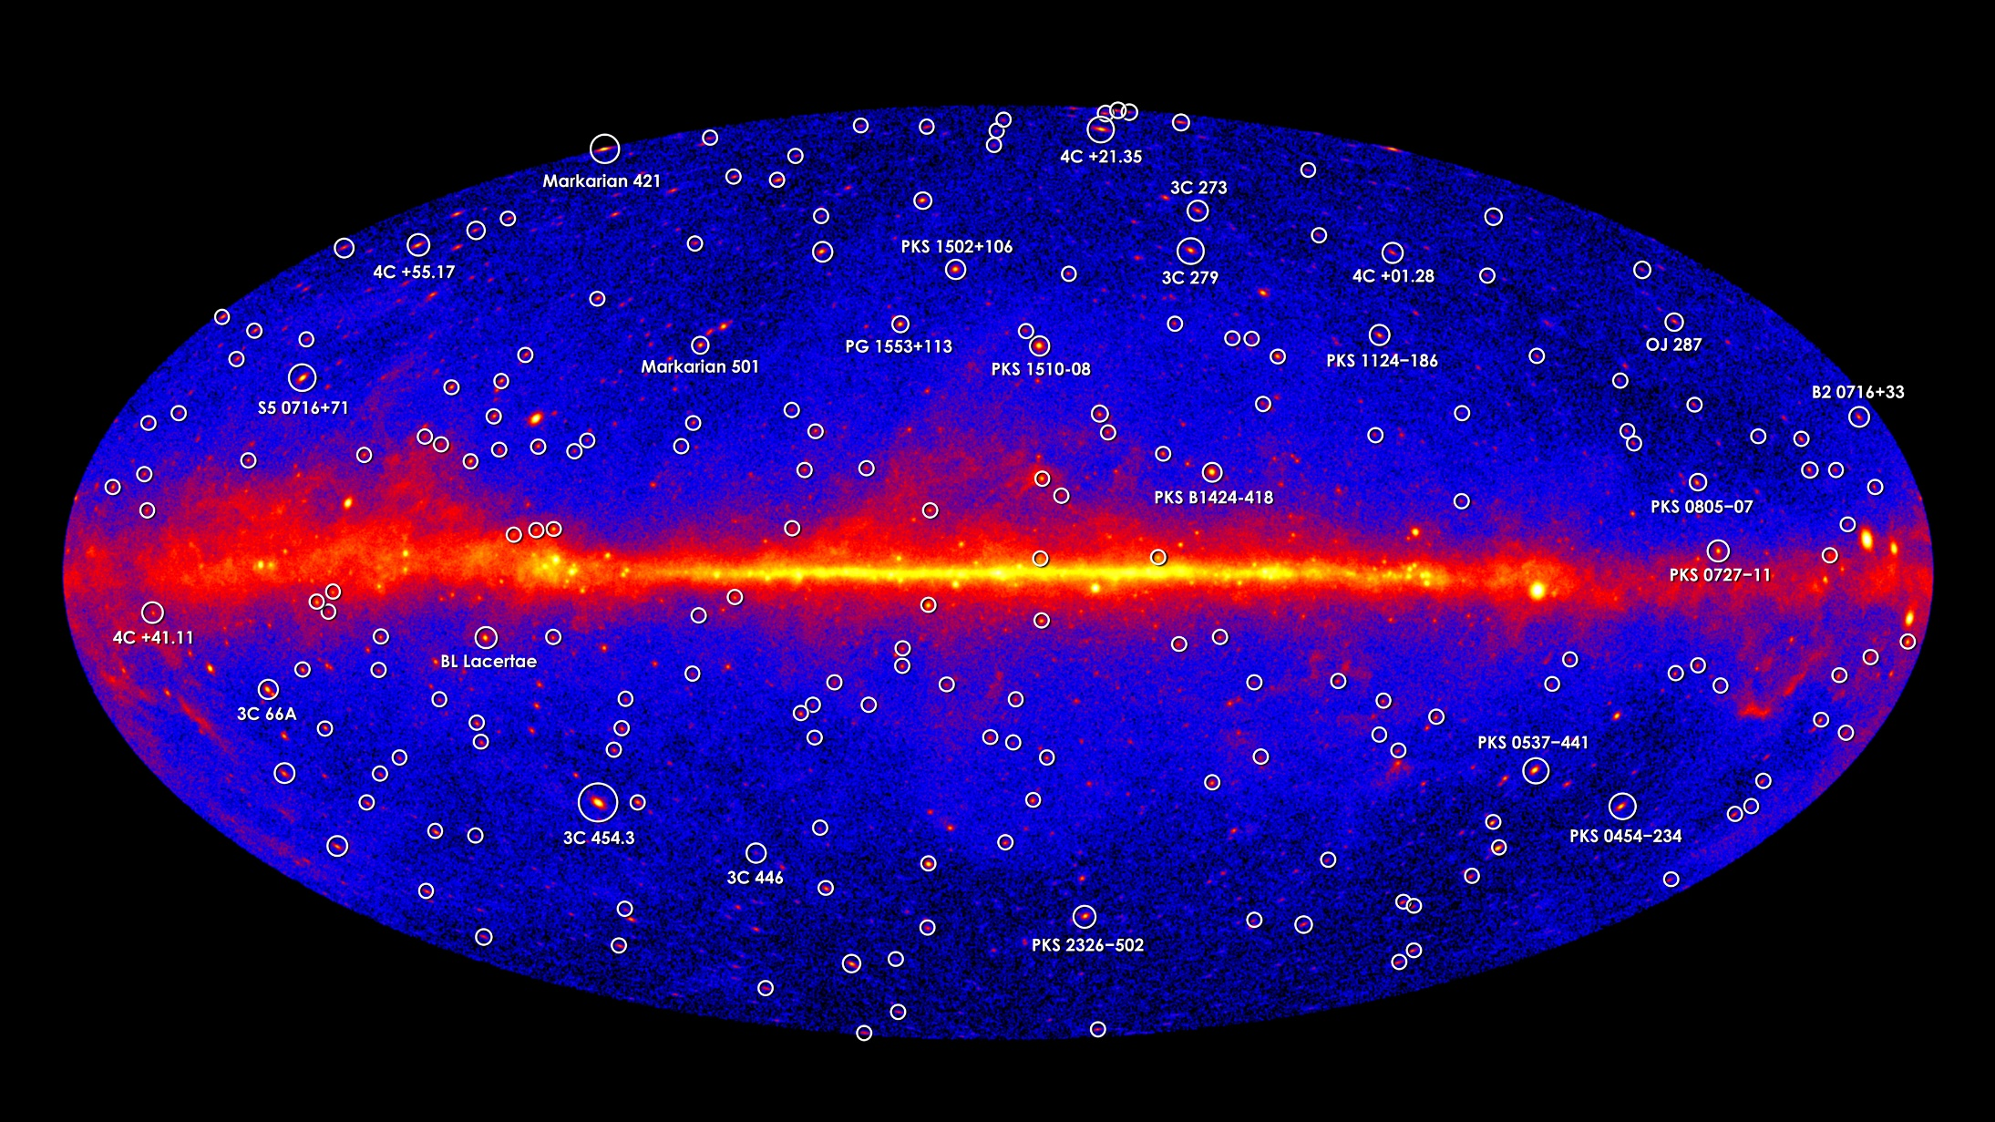
Gamma-ray Sky
Most of Extra Galactic Sources are Blazars

Slide 27




M87
FR I radio galaxy (elliptical)
Distance 16.7Mpc (Virgo cluster),
Black hole mass $∼7×{10}^{9}M_{⊙}$
Optical Image

Slide 28



Superluminal Motion
Blazar 3C 279@z=0.536
22GHz by VLBA
$$β_{obs}$$
$$β=0.997, Γ≃13$$
$$θ\left[degree\right]$$
$$t_{arrival}=δt+\frac{D−vδtcosθ}{c}$$
$$vδt$$
$$vδtsinθ$$
$$θ$$
$$vδtcosθ$$
$$t_{arrival}=\frac{D}{c}$$
$$δt_{obs}=δt(1−βcosθ)$$
～7.5c
$$β_{obs}=\frac{βsinθ}{1−βcosθ}$$

Slide 29

Black hole and jet
Blazar: Relativistic Jet from Super Massive Black Hole.
Lorentz Factor
$$Γ≡\frac{1}{\sqrt{1−{\left(\frac{v}{c}\right)}^{2}}}>10$$
Black Hole Mass
$$M={10}^{6}−{10}^{9}M_{⊙}$$
Jet Power
$$L_{j}>{10}^{10}−{10}^{13}L_{⊙}$$
Non-thermal Emission:

Slide 30

Gamma-ray bursts

Slide 31



Gamma-ray burst
$E_{γ}\sim {10}^{−3}−{10}^{0}M_{⊙}c^{2}$ in $Δt∼0.1−100s$
Huge number of gamma-ray with $ε>m_{e}c^{2}=511keV$.
Why can they escape without
$γ+γ→e^{−}+e^{+}$?
Relativistic Motion!
In the rest frame, the photon energy is in the X-ray band.

Slide 32



Black Hole
Concentration of mass in a compact region
induce a strongly deformed space-time.
The parameters are two.
Schwarzschild radius:
$$r_{g}=\frac{2GM_{BH}}{c^{2}}≃3\left(\frac{M_{BH}}{M_{⊙}}\right) km$$
Kerr parameter: $−1<a<1$
Angular momentum of black hole

Slide 33










Inner-most Stable Circular Orbit (ISCO)
Effective Potential (Newtonian)
Effective Potential (GR)
$$U_{eff}$$
$$U_{eff}$$
Decreasing angular momentum of particle
$$r$$
$$r$$
$$r_{in}^{2}−3r_{g}r_{in}∓4ar_{g}\sqrt{\frac{r_{g}r_{in}}{2}}−\frac{3}{4}a^{2}r_{g}^{2}=0$$
$$L=m\sqrt{GMr}$$
$${a=0: r}_{in}=3r_{g}$$
$$a→1:{ r}_{in}=\frac{r_{g}}{2}$$
Too small $L→$ No circular oribit.

Slide 34





Black Hole and Accretion Disk
Energy per particle:
$E_{0}=mc^{2}$ for $r≫r_{g}$.
$=E_{K}−m\frac{GM}{3r_{g}}$ at $r=3r_{g}$,
Then, $E_{K}−mc^{2}=1/6mc^{2}$
Inner most stable circular orbit$=3r_{g}$
(non-rotating BH)
The general relativistic calculation
gives us
$E_{K}−mc^{2}=\left(1−\sqrt{\frac{8}{9}}\right)mc^{2}=0.057mc^{2}$.
In extremely rotating BH,
$\left(1−\sqrt{\frac{1}{3}}\right)mc^{2}=0.42mc^{2}$
In extremely rotating BH, $0.5r_{g}$
5-40% of the rest mass energy can be converted into photons.
Very efficient energy conversion!
(In the Sun, nuclear fusion $4p→He$ implies $ΔE=0.0068mc^{2}$)

Slide 35

Physics in Accretion Disk
Gas rotates with nearly Keplerian motion.
  Inner gas faster
  Velocity Shear in radial direction.
Viscosity transports angular momentum.
  Magnetic Field acts as viscosity.
Gas gradually falls inward.
Gravitational energy converts to heat via viscosity.
Photon emission from hot gas.

Slide 36
Formulation
Continuity Equation (Mass conservation)
$$\frac{∂ρ}{∂t}+∇⋅(ρv)=0$$
Motion Equation (Momentum conservation)
$$ρ\frac{∂v}{∂t}+ρ\left(v⋅∇\right)v=−∇P−ρ∇Φ+μΔv+(ξ+μ/3)∇(∇⋅v)$$
Pressure
Gravity
Viscosity
Energy conservation
Gravity
$$\frac{∂}{∂t}\left(\frac{1}{2}ρv^{2}+ε\right)=−∇⋅\left[v\left(\frac{1}{2}ρv^{2}+ε+P\right)−v⋅τ\right]−ρv⋅∇Φ−Λ$$
Viscous heating
Radiative cooling
Viscosity Tensor
$$τ_{ij}=μ\left(\frac{∂v_{i}}{∂x_{j}}+\frac{∂v_{j}}{∂x_{i}}−\frac{2}{3}δ_{ij}∇⋅v\right)+ξδ_{ij}∇⋅v$$

Slide 37


Viscosity (Phenomenological)
Cylindrical Coordinate $(R,θ,z)$
$$q_{vis}≡τ_{ij}\frac{∂v_{i}}{∂x_{j}}=μ{\left(R\frac{dΩ}{dR}\right)}^{2}$$
$$\hat{R}$$
Kepler rotation $Ω=\sqrt{\frac{GM}{R^{3}}}$
$$R$$
$q_{vis}=\frac{9}{4}μΩ^{2}=\frac{9}{4}νρΩ^{2}$ ($ν≡μ/ρ$)
We define viscous torque as $T_{vis}=μR\frac{dΩ}{dR}$, then
$$μΔv=\frac{1}{R^{2}}\frac{∂R^{2}T_{vis}}{dR}$$
Alpha-viscosity model: $T_{vis}=−αP$
Non-dimensional parameter $α$
$$H$$
$$αH$$
Vortex exchanges the angular momentum.

Slide 38


Magnetorotational instability
Origin of viscosity (Balbus & Hawley 1991)
Simulation
Magnetic Field
tension
Typical wave length: $H\frac{v_{A}}{v_{s}}$
Effective viscosity
$$α∼0.01−0.1$$
Alfven velocity $v_{A}=\frac{B}{\sqrt{4πρ}}$
Typical growing timescale: ${τ=Ω}^{−1} (δB∝e^{−t/τ})$
may grow as $δB^{2}∼P$

Slide 39
Continuity Equation
Steady and axially symmetric
$$\frac{∂ρv_{z}}{∂z}=−\frac{1}{R}\frac{∂Rρv_{R}}{dR}$$
Integrating over z. $\int{dz}$
$$\dot{M}=−2πRv_{R}Σ=const.$$
Note $v_{R}<0$
where the surface density $Σ=\int{ρdz}$
Just expressing that mass inflow rate is constant.

Slide 40
Momentum Equation ($R,θ$)
Steady and axially symmetric
$$Ω=\sqrt{\frac{GM}{R^{3}}}$$
$R$-component:
Kepler rotation, balance between centrifugal and gravitational forces.
$θ$-component:
$$\frac{∂}{∂R}\left(R^{3}ρv_{R}Ω\right)=\frac{∂}{∂R}\left(R^{3}νρ\frac{dΩ}{dR}\right)$$
Integrating over z with the continuity eq. and finally integrating over R.
$$νΣ=\frac{\dot{M}}{3π}\left(1−\sqrt{\frac{R_{in}}{R}}\right)$$
Disk
$$R$$
$$R_{in}$$

Slide 41


Momentum Equation ($z$)
Steady and axially symmetric
$z$-component:
Neglecting the ram pressure,
$$−\frac{∂P}{∂z}=ρ\frac{∂Φ}{∂z}$$
Balance between the pressure and gravity.
$$ρ\frac{∂Φ}{∂z}=ρ\frac{GM}{R^{2}}\frac{z}{\sqrt{R^{2}+z^{2}}}≃ρ\frac{GM}{R^{3}}z=ρΩ^{2}z$$
$$−\frac{∂P}{∂z}≃\frac{P}{H}$$
Finally, the sound speed is expressed with the disk height as
$$\frac{P}{ρ}≡v_{s}^{2}=Ω^{2}H^{2}$$
or
$$\frac{2PH}{Σ}≃Ω^{2}H^{2}$$

Slide 42
Energy Equation
Steady and axially symmetric
Integrating over z,
$$Q_{adv}=Q_{vis}−Q_{rad}$$
Advection of heat=Viscous Heating – Radiative Cooling
$$Q_{vis}≡\int{q_{vis}dz=\frac{9}{4}νΣΩ^{2}}$$
$$Q_{rad}≡\int{Λdz}$$
When the disk is optically thick, the thermal radiation is
expressed with the effective temperature as
$Q_{rad}=σ_{SB}T_{eff}^{4}$ where the Stefan–Boltzmann constant $σ_{SB}=\frac{π^{2}}{60ℏ^{3}c^{2}}$
$$Q_{adv}≡\int{\left(∇⋅\left[v\left(\frac{1}{2}ρv^{2}+ε+P\right)\right]+ρv⋅∇Φ\right)dz}$$
Very rough estimate:
$$Q_{adv}∼\frac{\dot{M}}{πR^{2}}\frac{PH}{Σ}$$

Slide 43
Summary
Continuity:
$$\dot{M}=−2πRv_{R}Σ$$
$$Ω=\sqrt{\frac{GM}{R^{3}}}$$
Parameters: $M, \dot{M}, R_{in}, α$
Variables: $Σ, Ω, P, v_{R}, H, ν$
$R$-component:
Equation of State
$$νΣ=\frac{\dot{M}}{3π}\left(1−\sqrt{\frac{R_{in}}{R}}\right)$$
$θ$-component:
$T_{eff}$, or $Q_{rad}$
depending on optical depth
and temperature.
$z$-component:
$$\frac{2PH}{Σ}≡v_{s}^{2}=Ω^{2}H^{2}$$
Energy (entropy):
$$Q_{adv}=Q_{vis}−Q_{rad}$$
$$Q_{adv}∼\frac{\dot{M}}{πR^{2}}\frac{PH}{Σ}$$
$$Q_{vis}=\frac{9}{4}νΣΩ^{2}$$
Alpha-viscosity model: $αPH=\frac{3}{2}νΣΩ$

Slide 44

Shakura-Sunyaev Standard Disk
The disk is optically thick and hot enough.
$$Q_{vis}−Q_{rad}≃0→$$
$$Q_{rad}=σ_{SB}T_{eff}^{4}=Q_{vis}=\frac{9}{4}νΣΩ^{2}$$
Effective temperature
$$T_{eff}={\left[\frac{3GM\dot{M}}{8πσ_{SB}R^{3}}\left(1−\sqrt{\frac{R_{in}}{R}}\right)\right]}^{1/4}$$
$$≃20{\left(\frac{M}{{10}^{8}M_{⊙}}\right)}^{−\frac{1}{2}}{\left(\frac{\dot{M}}{M_{⊙} yr^{−1}}\right)}^{\frac{1}{4}}{\left(\frac{R}{3r_{g}}\right)}^{−\frac{3}{4}}{\left(1−\sqrt{\frac{R_{in}}{R}}\right)}^{\frac{1}{4}} eV$$
not depends on $α$
Total disk luminosity
$$L_{disk}=4π\int{RdRσ_{SB}T_{eff}^{4}}=\frac{GM\dot{M}}{2R_{in}}≃4.7×{10}^{45}\left(\frac{\dot{M}}{M_{⊙} yr^{−1}}\right){\left(\frac{R_{in}}{3r_{g}}\right)}^{−1}erg s^{−1}$$
$$=0.083{\left(\frac{R_{in}}{3r_{g}}\right)}^{−1}\dot{M}c^{2}$$

Slide 45

Jet from accretion disk?
The accretion disk has been considered as the engine of the jets.
Blandford & Payne (1982)
Simulation: Ohsuga & Mineshige (2011)
Magnetic and Radiative Forces produce
disk wind, whose velocity is typically
$0.1−0.3c$

Slide 46


Fireball model
Applicable especially for gamma-ray burst.
Viscous heating or neutrino pair annihilation:
$$ν+\overline{ν}→e^{−}+e^{+}$$
will deposit energy along the axis.
Photon+electron/positron energy density >> rest mass energy
=Radiation dominated plasma (fireball)
Radiation+small amount of baryon

Slide 47


Fireball = Fluid
When the initial temperature $≥m_{e}c^{2}$, huge amount of electron/positron are produced.
Photons are scattered by those particles (Thomson scattering).
Optical depth
Photons are confined in the plasma: One-fluid approximation.
$P=\frac{e}{3}, e:$ Radiation energy density, $ρ:$ baryon rest mass energy density.
Spherically symmetric relativistic fluid equations:
Mass cons.
Momentum cons.
Entropy cons.

Slide 48
Steady solution
When $Γ≃U≫1$, we obtain
When $e≫ρ$, we obtain
Efficient jet acceleration.

Slide 49

Rotation energy of black hole
defined by $g_{00}=0$
Here, $g_{00}<0$,
the energy $cp_{0}$ can be negative.
$$ε_{2}<0$$
decay
defined by $g_{11}=∞$
Penrose process
$$ε$$
$ε_{1}=ε−ε_{2}>ε$ energy extraction!
The initial energy of particle outside the ergosphere $ε=cp_{0}>0$.
It penetrate into the ergosphere, keeping $ε$ constant.
It decays into two particles. The energy of one can be negative.
The negative energy particle falls into the BH: energy of BH decreases!
The escaped other particle has energy larger than the initial value.
This process seems ad hoc. But this shows that the ergosphere can be
the place where the BH energy releases.

Slide 50

Magnetic Energy Release
The frame-dragging effect in the ergosphere.
This will induce twisted magnetic fields.
The induced Poynting flux may propagate outward.
The thickness of the ergosphere
Volume of the ergosphere
Magnetic Energy
$$E_{B}=$$
Timescale
$$Δt=$$
Energy Release Rate: $\frac{E_{B}}{Δt}∼$

Slide 51





Ideal MHD
Ohm’s law: $E=ηj$, $η$: resistivity
In astronomical plasma, $η=0$ is a good approximation.
So, in the fluid rest frame, $E=0$ (electrostatic shielding).
The Lorentz transformation of the electric field:
${E′}_{∥}=E_{∥}, E_{⊥}^{′}=Γ\left(E_{⊥}+\frac{v}{c}×B_{⊥}\right)$
Since $E^{′}=0,$ the ideal MHD condition is
$E=−v/c×B$
The current is provided by the Maxwell eq.
Force per unit volume on fluid is
$$ρ_{e}E+\frac{1}{c}j×B=ρ_{e}E−∇\frac{B^{2}}{8π}+\frac{1}{4π}\left(B⋅∇\right)B$$
where
$$∇⋅E=4πρ_{e}$$
Magnetic pressure + tension
Energy density of EM field: $\frac{E^{2}+B^{2}}{8π}$
Energy flux carried by EM field (Poynting flux): $\frac{c}{4π}E×B$

Slide 52



Frozen-in
ideal MHD $E=−v/c×B$
$$\frac{∂B}{∂t}=∇×(v×B)$$
$$\frac{DΨ}{Dt}=0$$

Slide 53
Poynting Flux Dominated Jet
$$\frac{B^{2}}{8π}≫ρc^{2}$$
Cutting out a part of
spherical flow.
Conical jet
Assume spherically symmetric.
At a large distance, we can neglect $B_{∥}$, so that $B≃B_{⊥}$
Magnetization parameter:
At the foot of the jet,

Slide 54



Available Lorentz factor
Steady state + ideal MHD $E=−v/c×B$
$→rB∝1/v$, then $L_{B,iso}=v{\left(rB\right)}^{2}∝1/v$
As the jet accelerates, the magnetic luminosity decreases with radius.
Energy transfer from magnetic to kinetic.
But, when
,
the effective sound speed (Alfven speed) is
comparable to the jet speed. The acceleration stops.
$$v_{A}=\frac{Bc}{\sqrt{4πρc^{2}+B^{2}}}$$
So $Γ_{max}=\sqrt{σ}$
Total luminosity:
Inefficient acceleration.
($Γ_{max}=σ_{0}$ is ideal)

Slide 55
Axially symmetric jet
The jet is confined by the disk wind. It seems parabolic, not conical.
Cylindrical Coordinate $(ct,R,φ,z)$
$$e_{z}$$
$$e_{φ}$$
$$e_{R}$$
$$z$$
$$R$$
$$φ$$
$$\frac{∂}{∂φ}→0$$
Then,
$$∇=\left(\frac{∂}{∂R},0,\frac{∂}{∂z}\right), ∇⋅A=\frac{1}{R}\frac{∂RA_{R}}{∂R}+\frac{∂A_{z}}{∂z}$$
$$∇×A=\left(−\frac{1}{R}\frac{∂RA_{φ}}{∂z},\frac{∂A_{R}}{∂z}−\frac{∂A_{z}}{∂R},\frac{1}{R}\frac{∂RA_{φ}}{∂R}\right)$$
$$ΔA=\frac{1}{R}\frac{∂}{∂R}\left(R\frac{∂A}{∂R}\right)+\frac{∂^{2}A}{∂z^{2}}$$

Slide 56

MHD equations
Continuity
is constant along B
Energy Conservation
is constant along B
Momentum Conservation
$φ$-component
is constant along B
Below we skip the detailed calculation...

Slide 57
Magnetic Line
Simulations show magnetic field
line $z∝R^{1.6}$.
The magnetic field is the tangent
of the field line.
If we express $z∝R^{b}$,
For $b>1$, $B_{z}≫B_{R}$ at a large $R$.
Finally

Slide 58
Radio Observation of M87
Free expansion?
$$R$$
$$z∝R$$
$$b=1.7→Γ∝z^{\frac{b−1}{b}}=z^{0.4}$$
confinement
by external gas?
Viewing angle ${14}^{ο}$
$$z∝R^{1.7}$$
$$Γ∝z^{0.4}$$
$$z$$
Asada+ 2012
Asada+ 2014
Bondi radius: at which escape velocity=sound velocity.
$$R_{B}=\frac{2GM}{v_{s}^{2}}$$
Consistent?

Slide 59

Caveats
Blazar spectra suggest the magnetic field in the jet is very low!
Some blazars show a fast acceleration ($Γ≫1$ at $z∼10−100r_{g}$ ), which contradict the slow magnetic acceleration.
How to generate the required ordered magnetic field?

Slide 60
Particle Acceleration

Slide 61
Cosmic Rays (Charged Particles)
Electron+Positron

Slide 62
Gamma-Rays
Emission from high energy particles

Slide 63
Emission from blazars
3C 279 (Hayashida+ 2015)
Mrk 421(Acciari+ 2011)

Slide 64




Multi-Wavelength Observation
Mrk 421 (Abdo+ 2011)

Slide 65

Supernova Remnant (SNR)
Supernova Remnant SN1006
Spectrum

Slide 66
Shock wave
Interstellar medium (ISM)
（plasma, ～1cm⁻³, T～1eV）
Rest frame
Kinetic Energy in explosion
～10⁵¹erg
ISM swept up in front of the ejecta
Ejecta
(～1-8000 km/s)
Shock front： Boundary between the swept-up gas
moving outward and the ISM at rest.
This propagates faster than the sound speed.

Slide 67
Shock Jump Condition
Downstream
Upstream (ISM)
Given n₁、T₁、v₁, how much are n₂、T₂、v₂?
Number：
Momentum：
Energy：
Shock front rest frame
A gas with a velocity v₁ decelerates at the
shock front. The kinetic energy is dissipated
to the heat energy.
⇒ Density and pressure increase
： proton mass
：heat capacity ratio
for a monatomic gas, 5/3

Slide 68
Shock Jump Condition
Sound speed in upstream
Mach number
（v₁ is the speed of the shock front
in the ISM rest frame.）

Slide 69
Propagation of a shock wave
Point source explosion
Number flux cons. gives
Shock front velocity v
Shell velocity in the ISM frame
Shell energy density
ISM（mass densityρ）
Homogeneous shell approximation
（Thickness Δ）
Energy cons.
Shell density
Volume
Mass conservation

Slide 70
Propagation of a shock wave
Assuming

Slide 71


Fermi Acceleration
Collisionless Shock
Electromagnetic Field induced by
plasma turbulence.
This scatters charged particles.
Then, the upstream plasma is decelerated,
and heated.

Slide 72








Downstream Rest Frame
Upstream
Downstream
$$θ_{d}$$
$$v$$
$$E_{0}$$
ISM
Particle trajectory
$$\frac{v}{3}$$
$$\cos{θ_{d}}=0$$
Shock Front
In the upstream rest frame,
$$\overline{\cos{θ_{d}}}=−2/3$$
$$E^{′}=ΓE_{0}(1−β\cos{θ_{d}})$$
$$\cos{θ_{d}}=−1$$

Slide 73








Scattering in Upstream
Upstream
Downstream
Particle trajectory
ISM
$$E^{′}=const.$$
$$v$$
$${θ′}_{u}$$
$$\frac{4v}{3}$$
Shock Front
$$\cos{{θ′}_{u}}=0$$
In the upstream rest frame,
$$\overline{\cos{{θ′}_{u}}}=2/3$$
$$E^{′}=ΓE_{0}(1−β\cos{θ_{d}})$$
$$\cos{{θ′}_{u}}=1$$

Slide 74


Downstream Rest Frame Again
Upstream
Downstream
$$v$$
$$E$$
ISM
Particle trajectory
$$\frac{v}{3}$$
Shock Front
In the downstream rest frame,
$${E=ΓE}^{′}\left(1+β\cos{{θ′}_{u}}\right)$$
$=Γ^{2}E_{0}\left(1+β\cos{{θ′}_{u}}\right)$ $(1−β\cos{θ_{d}})$

Slide 75







Energy Gain
$E=Γ^{2}E_{0}\left(1+β\cos{{θ′}_{u}}\right)$ $(1−β\cos{θ_{d}})$
$$ΔE=E−E_{0}$$
$$ξ≡\frac{\overline{ΔE}}{E}≃\frac{4v}{3c}$$
Assuming continuous density $n_{CR}$ around the shock front
$$\frac{dN_{CR}}{dtdS}=\int{\frac{dn_{CR}}{dΩ}v_{∥}dΩ}$$
$$=2π\int_{−\frac{v}{3c}}^{1}{\frac{n_{CR}}{4π}\left(ccosθ+\frac{v}{3}\right)}d\left(cosθ\right)$$
$$=\frac{n_{CR}}{2c}\int_{−\frac{v}{3}}^{c}{\left(ccosθ+\frac{v}{3}\right)}d\left(ccosθ\right)$$
$$=\frac{n_{CR}}{4c}{\left(c+\frac{v}{3}\right)}^{2}$$
Upstream
Downstream
$$f_{u→d}=\frac{{\left(c+\frac{v}{3}\right)}^{2}}{4c}n_{CR}$$
$$v$$
$$f_{d→u}=\frac{{\left(c−\frac{v}{3}\right)}^{2}}{4c}n_{CR}$$
$$\frac{v}{3}$$
Shock Front

Slide 76



Escape Probability
$$\frac{f_{d→u}}{f_{u→d}}=1−P_{esc}$$
$$P_{esc}≃\frac{4v}{3c}$$
Probability repeating the process n times: ${\left(1−P_{esc}\right)}^{n}$
Energy after n processes: ${E_{n}=E}_{0}{\left(1+ξ\right)}^{n}$
$$→n=\frac{\log{\frac{E_{n}}{E_{0}}}}{\log{(1+ξ)}}$$
$$N\left(>E_{n}\right)∝\sum_{m=n}^{∞}{{\left(1−P_{esc}\right)}^{m}}$$
The first term:${\left(1−P_{esc}\right)}^{n}$, the geometric ratio: $\left(1−P_{esc}\right)$,
then $N\left(>E_{n}\right)=\frac{{\left(1−P_{esc}\right)}^{n}}{P_{esc}}$.
$$\log{N\left(>E_{n}\right)=−log{P_{esc}}+\frac{\log{\frac{E_{n}}{E_{0}}}}{\log{(1+ξ)}}}\log\left(1−P_{esc}\right)$$
$$\log\left(N\left(>E_{n}\right)P_{esc}\right)=−\frac{\log{\frac{1}{\left(1−P_{esc}\right)}}}{\log{(1+ξ)}}\log{\frac{E_{n}}{E_{0}}}$$

Slide 77


Spectral index
$$\check{γ}≡\frac{\log{\frac{1}{\left(1−P_{esc}\right)}}}{\log\left(1+ξ\right)}→\log\left(N\left(>E_{n}\right)P_{esc}\right)=−\log{{\left(\frac{E_{n}}{E_{0}}\right)}^{\check{γ}}}$$
$$N\left(>E_{n}\right)∝\frac{1}{P_{esc}}{\left(\frac{E_{n}}{E_{0}}\right)}^{−\check{γ}}$$
$$ξ≃\frac{4v}{3c}≪1,P_{esc}=\frac{4v}{3c}≪1→\check{γ}≃\frac{P_{esc}}{ξ}=1$$
$$n\left(E\right)=\frac{dN\left(>E\right)}{dE}∝E^{−1−\check{γ}}=E^{−2}$$

Slide 78


Simulations
Unmagnetized pair plasma
$$Γ=15$$
Sironi+ 2013

Slide 79

Simulations (Non-relativistic)
$$v_{sh}=0.1c$$
$$K_{ep}={10}^{−3}−{10}^{−2}$$
Park, Caprioli, & Spitkovsky 2015

Slide 80
Propagation of Cosmic-Rays

Slide 81






Particle-wave interaction
Width of the disk: $W=300−500pc$
Traveling time: $\frac{W}{c}∼1000yr$?
No!
Larmor radius
Turbulence scale: $l$
$$r_{L}=\frac{E}{eB}$$
Magnetic Line
Particle trajectory
l≪ r_{L} …small fluctuation is negligible
l≫ r_{L} …travel along the field
l～ r_{L} …scattering
CR Boron is secondary particles.
High Boron production efficiency
$$∝n_{ISM}σct$$
= long residual time: ${∼10}^{7}yr$

Slide 82












Diffusion
Brownian motion
Diffusion coefficient: $\overline{x^{2}}=\overline{y^{2}}=\overline{z^{2}}=2Dt$
$$\overline{l^{2}}=N\left\langle Δl^{2}\right\rangle =2{Nl}_{m}^{2}$$
$$\overline{x^{2}}=\frac{\overline{l^{2}}}{3}=\frac{2{Nl}_{m}^{2}}{3}$$
$$N=\frac{vt}{l_{m}}→D=\frac{{vl}_{m}}{3}≃\frac{{cl}_{m}}{3}$$
Turbulence spectrum
$$\frac{dδB^{2}}{dk}$$
$$k^{−q}$$
Mean free path: $l_{m}$
$$P\left(Δl\right)∝\exp{(−\frac{Δl}{l_{m}})}$$
$$k=1/λ$$
$$r_{L}=\frac{E}{eB}$$
$$k=1/r_{L}$$
$${δB}_{eff}^{2}=k\frac{dδB^{2}}{dk}∝k^{1−q}∝r_{L}^{q−1}∝E^{q−1}$$
One-scattering
Quasi-linear analysis gives
$$\left\langle Δl\right\rangle =l_{m}, \left\langle Δl^{2}\right\rangle =2l_{m}^{2}$$
$$l_{m}\sim \frac{B^{2}}{δB_{eff}^{2}}r_{L}$$
So that $D∝l_{m}∝E^{2−q}$

Slide 83











Kolmogorov turbulence
Energy injection at $k=k_{0}$
$$\frac{dδB^{2}}{dk}$$
$$k^{−q}$$
$$k=\frac{1}{λ} \left[\frac{1}{L}\right]$$
$$D∝E^{2−q}∝E^{1/3}$$
$$k_{0}$$
Cascade to smaller scale
Disk thickness $H$
Escape time
$$t_{esc}∼\frac{H^{2}}{D}∼E^{−1/3}$$
Energy injection rate per unit mass
$$Ψ \left[\frac{L^{2}}{T^{3}}\right]$$
$$\frac{1}{ρ}\frac{dδB^{2}}{dk}\left[\frac{L^{3}}{T^{2}}\right]=Ck^{α}Ψ^{β}$$
Dimensional analysis gives
$α=−\frac{5}{3}, β=\frac{2}{3}$

Slide 84










Cosmic-Ray Spectrum
We obtain
$$n(E)∝E^{−(s+1/3)}$$
$$E^{−2.7}$$
s+1/3=2.7
$$E^{−3.1}$$
Knee
B/C-ratio is consistent with $t_{esc}∝E^{−1/3}$
$$E^{−2.7}$$
Diffusion equation
$\frac{∂f}{∂t}+D∆f=0→{\dot{n}}_{inj}+\frac{n}{t_{esc}}=0→$ $n\sim t_{esc}{\dot{n}}_{inj}$
$$t_{esc}∝E^{−1/3}$$
Cosmic-ray spectrum at injection
C₁₂+p ⇒ B₁₁+2p (90mb)
$${\dot{n}}_{inj}∝E^{−s}$$
$$s=2.4≠2.0$$

Slide 85












Cosmic-Ray Electron
$$E^{−3.1}$$
$${\dot{n}}_{inj}∝E^{−s}$$
$$R_{d}\sim \sqrt{Dt_{cool}}$$
CR density
$${∝R}_{d}^{−3}$$
Electrons lose energy via photon emission.
${\dot{n}}_{inj,eff}+\frac{n}{t_{cool}}=0→$ $n\sim t_{cool}{\dot{n}}_{inj,eff}$
$${\dot{n}}_{inj,eff}∝{\dot{n}}_{inj}R_{d}^{−1}∝E^{−(s+(1/3−1)/2)}$$
$$t_{cool}∝E^{−1}$$
$$R_{d}$$
Number of Sources
$${∝R}_{d}^{2}$$
$$n(E)∝E^{−(s+(1/3+1)/2)}$$

Slide 86


Knee
The knee energy (${10}^{15.5}eV$) corresponds to the maximum energy
available in supernova remnants?
The timescale of round trip～residual time in the upstream,
$t_{ret}≃\frac{4D}{cv_{1}}=\frac{4l_{m}}{3v_{1}}=η\frac{4r_{L}}{3v_{1}} (η≥1)$
Then the acceleration timescale
$$t_{acc}≃\frac{E}{ΔE}t_{ret}=\frac{20ηEc}{3eBv_{1}^{2}}$$
The size of the remnant should satisfy $R>v_{1}t_{acc}$.
Finally we obtain $E_{max}=\frac{3eBv_{1}R}{20ηc}=1.4×{10}^{13}\left(\frac{B}{μG}\right)\left(\frac{v_{1}}{3000km/s}\right)\left(\frac{R}{10pc}\right)eV$

Slide 87

Ultra High-Energy Cosmic-Rays
The size $R$ of the accelerator should be larger than the Larmor radius.
$E_{max}=eBR$
Hillas diagram

Slide 88
Radiation

Slide 89





Relativistic Beaming
K
K’
$$θ′$$
Lorentz transformation of angle $μ=\cos{θ}$
Photons emitted isotropically in the frame K’
$$−1≤μ^{′}≤1$$
In the frame K, $1−\frac{1}{γ^{2}}<μ<1, θ<1/γ$
$$γ$$
Photons are collimated.
Opening angle $1/γ$

Slide 90



Synchrotron Emission
Relativistic Electrons in a magnetic field emit photons
Accelerating charge emits photons with a rate
Dipole approximation
$$ω_{B}=\frac{eB}{γmc}$$
$$a_{⊥}=ωv_{⊥}$$
$$→\frac{dE}{dt}=\frac{2e^{4}}{3m^{2}c^{5}}B^{2}v_{⊥}^{2}γ^{2}$$

Slide 91


Typical photon energy
$$E_{typ}=ℏω_{c}=1.7\left(\frac{B}{1G}\right){\left(\frac{γ}{{10}^{4}}\right)}^{2}eV$$

Slide 92

Power-law energy distribution

Slide 93







Inverse Compton Scattering
Electron
In the electron rest frame
$$γ$$
$$ε_{0}^{′}=γε_{0}$$
Scattering
$${ε^{′}≃ε}_{0}^{′}$$
Thomson scattering
cross section $σ_{T}=\frac{8πe^{4}}{3m^{2}c^{4}}$
Photon energy $ε_{0}$
Typical photon energy
$$ε≃γε^{′}≃γ^{2}ε_{0}$$
$$\frac{dN}{dt}≃{{cσ}_{T}n}_{ph}, \frac{dE}{dt}≃γ^{2}ε_{0}\frac{dN}{dt}≃{{cσ}_{T}ε_{0}n}_{ph}γ^{2}={{cσ}_{T}U}_{ph}γ^{2}$$
A detailed calculation gives
$$\frac{{\dot{E}}_{syn}}{{\dot{E}}_{IC}}=\frac{U_{B}}{U_{ph}}$$

Slide 94





Doppler Factor
$$Γ$$
Opening angle $1/Γ$
$$θ$$
Plasma emitting photons
In the plasma rest frame, photons are isotropically emitted.
The energy release rate: $\frac{dE^{′}}{dt^{′}}$
Doppler Factor: $δ≡\frac{1}{Γ(1−β\cos{θ})}$ For $θ<\frac{1}{Γ}, δ∼Γ$, while $δ∼1/Γ$ for $|cos{θ|≪1}$
$$dt_{obs}=δ^{−1}dt^{′}, dE_{obs}=δdE^{′}, dΩ_{obs}=δ^{−2}dΩ^{′}$$
Distance: $D$
$$F_{obs}=\frac{dE_{obs}}{dt_{obs}dS_{obs}}=\frac{dE_{obs}}{dt_{obs}D^{2}dΩ_{obs}}=δ^{4}\frac{dE′}{D^{2}dt^{′}dΩ′}=\frac{δ^{4}}{4πD^{2}}\frac{dE′}{dt^{′}}$$

Slide 95
Synchrotron Self-Compton Emission
Blazar Mrk421
Synchrotron
Inverse Compton

Slide 96

Electron-positron pair creation
Gamma-ray burst spectrum
Only when

Slide 97



Hadronic Emission
Proton-Proton Collision
Gamma-ray
Neutrino
(m_{π}=135MeV)
Supernova remnant W44

Slide 98


Photopion Production
Roughly 20% of energy goes to pion. Two photons 10%+10%.
Neutrino Energy${∼E}_{π}(1−\frac{m_{μ}}{m_{π}})$
¼ of pion energy=5% of proton’s.
Each 1/3 of muon energy
=5% of proton’s.
Photon energy in the proton rest frame.
Inelasticity
Blazar TXS 0506+056
Neutrino?

Slide 99


GZK cut-off
Greisen-Zatsepin-Kuzmin limit
Ultra High-energy protons interact with cosmic microwave background.
Producing pions, they lose their energy. Energy loss timescale:
Only propagate $∼100Mpc$

Slide 100
Pulsar

Slide 101



Pulsar
Red: radio, Blue: gamma
Neutron star is the dense core left after a supernova explosion.
Radius: $∼10km$, Mass: $1.4−2.2M_{⊙}$
Magnetic Field: typically ${10}^{12}−{10}^{14}G$

Slide 102


Pulsar wind nebula
Pulsars release their rotation energy as a wind of electron-positron plasma.
Crab spectrum
X-ray image of G21.5-0.9
Black: pulsar
Blue: nebula

Slide 103




















Dipole Magnetic Field
$$Ω$$
Ideal MHD condition + Spin:
$E=−\frac{v}{c}×B=−\frac{1}{c}\left(Ω×r\right)×B$
Gauss’s law: $∇⋅E=4πρ_{e}$
Charge density: $ρ_{e}=−\frac{1}{2πc}\left(Ω⋅B\right)$
Surface charge: $ρ_{e}=−\frac{ΩB_{p}}{4πc}\left(3\cos^{2}{θ−1}\right)$
$$Ω$$
Star radius: $R$
$$−$$
$$−$$
$$−$$
If outside is vacuum, an electric field is formed.
Charged particles are pulled out.
$$−$$
$$−$$
$$B_{r}=\frac{B_{p}R^{3}\cos{θ}}{r^{3}}$$
$$B_{θ}=\frac{B_{p}R^{3}\sin{θ}}{{2r}^{3}}$$
$$\cos{θ=\frac{1}{\sqrt{3}}}$$
$$+$$
$$+$$
$$+$$
$$B_{φ}=0$$
$$+$$
Potential Difference
$$φ=\frac{B_{p}R^{2}Ω}{2c}\sin^{2}{θ}$$

Slide 104




Pulsar Magnetosphere
The magnetosphere is fulfilled by plasma.
If we adopt ideal MHD for steady axially symmetric system,
If the magnetic field is strong enough, that is
not deformed by the plasma. Then, the dipole field is maintained $(B_{φ}=0)$.
This leads to rigid rotation: $v_{φ}=RΩ$.
But, at $R∼R_{LC}$, $v_{φ}∼c$ so that the inertia of the plasma cannot be negligible. Then, the field is deformed, and open field lines appear.
As we already derived, the charge density is
$$ρ_{GJ}=−\frac{1}{2πc}\left(Ω⋅B\right)$$
so-called Goldreich-Julian density.
$$\sin{θ_{pc}=\sqrt{\frac{R}{R_{LC}}}}$$
$$=\frac{c}{Ω}$$

Slide 105




Parallel Electric Field
The particle density is not necessarily high enough to satisfy the GJ-density.
$$ρ_{GJ}=−\frac{1}{2πc}\left(Ω⋅B\right)$$
A parallel Field appears
$$∇⋅E_{∥}=4π(ρ_{e}−ρ_{GJ})$$
The potential difference:
$Δφ=φ\left(θ_{pc}\right)−φ(\text{0)=}\frac{B_{p}Ω^{2}R^{3}}{2c^{2}}$
If an electron is accelerated by this field.
$γm_{e}c^{2}=eΔφ=6.6×{10}^{12}\left(\frac{B_{p}}{{10}^{12}G}\right){\left(\frac{P}{1s}\right)}^{−2}{\left(\frac{R}{10km}\right)}^{3}eV$

Slide 106




Curvature Radiation
Similar to the synchrotron.
Photons
$$E_{typ}≃ℏω_{c}γ^{3}=\frac{ℏc}{R_{c}}γ^{3}≃2{\left(\frac{R_{c}}{{10}^{7}cm}\right)}^{−1}{\left(\frac{γ}{{10}^{6}}\right)}^{3}MeV$$
Energy release rate
$$\frac{dE}{dt}=\frac{2e^{2}}{3c^{3}}γ^{4}a_{⊥}^{2}$$
Curvature radius $R_{c}$
$$a_{⊥}=\frac{c^{2}}{R_{c}}→\frac{dE}{dt}=\frac{2e^{2}c}{3R_{c}^{2}}γ^{4}$$
Electrons moving along the magnetic field.

Slide 107



Pair-creation
Magnetic pair creation
Pair creation with X-rays
$$γ+γ→e^{−}+e^{+}$$
$$γ+B→e^{−}+e^{+}+B$$

Slide 108
Pulsar spectrum
Harding & Kalapotharakos 2015
Crab

Slide 109






Radio Emission
Coherent curvature radiation (?)
Particle Number $N$
Luminosity: $L=N\frac{2e^{2}c}{3R_{c}^{2}}γ^{4}$
$$λ_{typ}≃{{2πR}_{c}γ}^{−3}≃60\left(\frac{R_{c}}{{10}^{7}cm}\right){\left(\frac{γ}{100}\right)}^{−3}cm$$
Bunching
Different Component
$$λ$$
$$L_{coh}=\frac{2{(Ne)}^{2}c}{3R_{c}^{2}}γ^{4}=NL$$

Slide 110









Pulsar Wind
Magnetic energy dominant.
$$c$$
$$R_{LC}$$
$$\frac{dE}{dtdS}=\frac{B^{2}}{4π}c$$
At $r=\frac{R_{LC}}{\sin{θ}}$
$$B_{r}=\frac{B_{p}R^{3}Ω^{3}cos{θ}\sin^{3}{θ}}{c^{3}}$$
$$B_{θ}=\frac{B_{p}R^{3}Ω^{3}\sin^{4}{θ}}{{2c}^{3}}$$
$$B^{2}=\frac{B_{p}^{2}R^{6}Ω^{6}}{c^{6}}\sin^{6}{θ}\left(1{−\frac{3}{4}}\sin^{2}{θ}\right)$$
$$\frac{dE}{dt}=2πR_{LC}\int{dz\frac{B^{2}}{4π}c }$$
$$=2πR_{LC}^{2}\int_{0}^{π}{dθ\frac{c}{4π}}\frac{B_{p}^{2}R^{6}Ω^{6}}{c^{6}}\sin^{4}{θ}\left(1{−\frac{3}{4}}\sin^{2}{θ}\right)$$
$$=\frac{9πB_{p}^{2}R^{6}Ω^{4}}{128c^{3}}≃0.22\frac{B_{p}^{2}R^{6}Ω^{4}}{c^{3}}$$
$$z=\frac{R_{LC}}{\tan{θ}}$$

Slide 111





Spin-down
Spin-down of rigid sphere
$$\frac{dE}{dt}=\frac{d}{dt}\left(\frac{1}{2}IΩ^{2}\right)$$
Moment of inertia:
$$I=\int{ρr^{2}\sin^{2}{θ}dV=\frac{2}{5}MR^{2}}$$
$$=1.1×{10}^{45}{\left(\frac{R}{10km }\right)}^{2}\left(\frac{M}{1.4M_{⊙}}\right)g cm^{2}$$
$$Ω=2π/P$$
$$\frac{dE}{dt}=IΩ \dot{Ω}=−4π^{2}IP^{−3}\dot{P}$$
$$→B_{p}≃1.8×{10}^{12}{\left(\frac{R}{10km }\right)}^{−3}{\left(\frac{I}{{10}^{45}g cm^{2}}\right)}^{1/2}\sqrt{P}\sqrt{\frac{\dot{P}}{{10}^{−15}}}G$$

Slide 112






Current
$$j∥B$$
$$j∥B$$
Force on fluid:
$$∝j×B$$
The current should be closed.
Pulsar spin-down ⇒ Accelerate Plasma
$σ≫1$ at the light cylinder.

Slide 113






Pulsar wind nebula (PWN)
Contact Discontinuity
Termination shock
Wind
?
$$σ≫1,$$
$$Γ∼100$$
$$σ≪1,$$
$$Γ∼{10}^{3}−{10}^{5}$$
PWN
SNR
$$v≪1,$$
$$E_{ave}≫mc^{2}$$
Crab
$$B∼140μG$$
Synchrotron + Inverse Compton

Slide 114
Binary
Neutron Star

Slide 115

Binary Neutron Star
Orbital decay of PSR B1913+16
Orbital period 7.75 hour
Hulse–Taylor binary

Slide 116






Einstein Equation
$$μ, ν=0,1,2,3$$
$$ds^{2}=g_{μν}dx^{μ}dx^{ν}=g_{00}c^{2}dt^{2}+g_{11}dx^{2}+…$$
Einstein equation
First order of $h_{μν}$
$$\frac{1}{2}\left(Δ−\frac{1}{c^{2}}\frac{∂^{2}}{∂t^{2}}\right)ψ_{ν}^{μ}=\frac{8πG}{c^{4}}T_{ν}^{μ}$$
$$R_{μν}=R_{μν}(g_{μν})$$
$$g_{μν}=g_{μν}^{(0)}+h_{μν}$$
In vacuum
Background
Perturbation
$$\left(Δ−\frac{1}{c^{2}}\frac{∂^{2}}{∂t^{2}}\right)h_{ν}^{μ}=0$$
Wave equation
$$ψ_{ν}^{μ}≡h_{ν}^{μ}−\frac{1}{2}δ_{ν}^{μ}h$$

Slide 117







Gravitational Wave
The gauge freedom saves the components.
If a wave propagates along the x-axis,
$$G_{μν}≡R_{μν}−\frac{1}{2}g_{μν}R$$
$$h_{μν}=\left(\begin{matrix}0 & 0 & 0 & 0 \\ 0 & 0 & 0 & 0 \\ 0 & 0 & h_{+} & h_{×} \\ 0 & 0 & h_{×} & −h_{+}\end{matrix}\right)$$
$$t_{μν}=−\frac{c^{4}}{8πG}\left\langle G_{μν}^{(2)}\right\rangle$$
averaging over a significantly large scale.
Energy Flux
Second order of $h_{μν}$
$$\frac{dE}{dtdS}=ct^{01}$$
$$=\frac{c^{3}}{16πG}\left({\dot{h}}_{+}^{2}+{\dot{h}}_{×}^{2}\right)$$
transposition
That can be interpreted as
the energy momentum tensor for the GW.

Slide 118










GW Emission
From
$$\frac{1}{2}\left(Δ−\frac{1}{c^{2}}\frac{∂^{2}}{∂t^{2}}\right)ψ_{ν}^{μ}=\frac{8πG}{c^{4}}T_{ν}^{μ}$$
Ref. Electromagnetic Field
$$\left(Δ−\frac{1}{c^{2}}\frac{∂^{2}}{∂t^{2}}\right)A^{μ}=−\frac{4π}{c}j^{μ}$$
$$→A^{μ}=\frac{1}{c}\int{\frac{j_{(t−D/c)}^{μ}}{D}}dV$$
$$ψ_{ν}^{μ}=−\frac{1}{4π}\frac{16πG}{c^{4}}\int{\frac{T_{ν(t−D/c)}^{μ}}{D}}dV$$
With the conservation law $T_{ν,μ}^{μ}=0$,
$$\frac{1}{2c^{2}}\frac{∂^{2}}{∂t^{2}}\int{T_{00}x^{i}x^{j}dV}=\int{T_{ij}dV}$$
$$i,j=1,2,3$$
$$ψ_{ij}=−\frac{2G}{c^{4}D}{\ddot{I}}_{ij}$$
$$I_{ij}=\int{ρx^{i}x^{j}dV}$$
quadrupole moment
where
$$\frac{dE}{dtdS}=ct^{01}$$
with $dS=D^{2}dΩ$
$$\frac{dE}{dtdΩ}=\frac{G}{8πc^{5}}\left(δ^{ik}δ^{jl}−δ^{lj}n^{k}n^{i}−δ^{ik}n^{l}n^{j}+\frac{1}{2}n^{i}n^{j}n^{k}n^{l}\right)\left\langle {\overset{⃛}{J}}_{ij}{\overset{⃛}{J}}_{kl}\right\rangle$$
where
$$J_{ij}=I_{ij}−\frac{1}{3}δ_{ij}I_{k}^{k}$$

Slide 119










Summary
Gravitational Wave
Electromagnetic Wave
$$\frac{∂}{∂x^{ν}}\left(\frac{∂A^{ν}}{∂x^{μ}}−\frac{∂A^{μ}}{∂x^{ν}}\right)=−\frac{4π}{c}j^{μ}$$
$$h_{μν}=\left(\begin{matrix}0 & 0 & 0 & 0 \\ 0 & 0 & 0 & 0 \\ 0 & 0 & h_{+} & h_{×} \\ 0 & 0 & h_{×} & −h_{+}\end{matrix}\right)$$
$$A^{μ}=(φ,{ A}_{x}, 0, 0)$$
$$ψ_{ν}^{μ}=−\frac{1}{4π}\frac{16πG}{c^{4}}\int{\frac{T_{ν(t−D/c)}^{μ}}{D}}dV$$
$$A^{μ}=\frac{1}{c}\int{\frac{j_{(t−D/c)}^{μ}}{D}}dV$$
$$h_{+}=−\frac{G}{c^{4}D}\frac{∂^{2}}{∂t^{2}}\int{ρ\left(y^{2}−z^{2}\right)dV}$$
$$h_{×}=−\frac{2G}{c^{4}D}\frac{∂^{2}}{∂t^{2}}\int{ρyzdV}$$
$$\frac{dE}{dtdS}=\frac{c^{3}}{16πG}\left({\dot{h}}_{+}^{2}+{\dot{h}}_{×}^{2}\right)$$
$$\frac{dE}{dtdS}=\frac{c}{4π}E×B$$

Slide 120













Binary
$$ρ=M_{1}δ\left(r_{1}−r\right)+M_{2}δ\left(r_{2}−r\right)$$
$$M_{1}$$
$$a$$
$$r_{1}=\frac{M_{2}}{M_{1}+M_{2}}a, r_{2}=−\frac{M_{1}}{M_{1}+M_{2}}a$$
$$M_{2}$$
$$a=\left(a\cos{Ψ},a\sin{Ψ},0\right)$$
$$\dot{Ψ}=\sqrt{G\frac{M_{1}+M_{2}}{a^{3}}}$$
Two-body problem
$$E=\frac{1}{2}M_{1}v_{1}^{2}+\frac{1}{2}M_{2}v_{2}^{2}−G\frac{M_{1}M_{2}}{a}$$
$$=−G\frac{M_{1}M_{2}}{2a}$$
Calculating ${\overset{⃛}{J}}_{ij}$, and averaging over orbital period
$${\left.\frac{dE}{dtdΩ}\right|}_{+}=\frac{Gμ^{2}{\dot{Ψ}}^{6}a^{4}}{2πc^{5}}{\left(1+\cos^{2}{θ}\right)}^{2}$$
$$μ=\frac{M_{1}M_{2}}{M_{1}+M_{2}}$$
$${\left.\frac{dE}{dtdΩ}\right|}_{×}=\frac{Gμ^{2}{\dot{Ψ}}^{6}a^{4}}{2πc^{5}}4\cos^{2}{θ}$$

Slide 121







Orbital Evolution
Integrating over the solid angle,
Orbital period
$$\frac{dE}{dt}=\frac{32Gμ^{2}{\dot{Ψ}}^{6}a^{4}}{5c^{5}}$$
$$=\frac{32G^{4}M_{1}^{2}M_{2}^{2}(M_{1}+M_{2}) }{5c^{5}a^{5}}$$
$$T_{orb}=\frac{2π}{\dot{Ψ}}=\frac{2πa^{3/2}}{\sqrt{\left(M_{1}+M_{2}\right)G}}$$
Quadrupole oscillates twice
in an orbital period.
The GW frequency
From
$$E=−G\frac{M_{1}M_{2}}{2a}$$
$$f=\frac{2}{T_{orb}}≃190{{\left(\frac{M_{1}+M_{2}}{1.4M_{⊙}}\right)}^{1/2}\left(\frac{a}{100km}\right)}^{−3/2}Hz$$
$$\frac{dE}{dt}=\dot{a}\frac{M_{1}M_{2}}{2a^{2}}$$
$$→\frac{da}{dt}=−\frac{64G^{3}M_{1}M_{2}(M_{1}+M_{2}) }{5c^{5}a^{3}}$$
$$a∝f^{−\frac{2}{3}}{\left(M_{1}+M_{2}\right)}^{\frac{1}{3}}$$
Merging time
$$T_{merg}=\frac{a}{4|\dot{a}|}$$
$$=\frac{5c^{5}a^{4}}{{256G}^{3}M_{1}M_{2}(M_{1}+M_{2})}≃0.37{\left(\frac{a}{100km}\right)}^{4}s$$

Slide 122

GW detection
$$\left|h\right|≃\frac{4G^{2}M_{1}M_{2}}{c^{4}aD}≃5.5×{10}^{−23}{\left(\frac{D}{100Mpc}\right)}^{−1}\left(\frac{M_{1}M_{2}}{{1.4}^{2}M_{⊙}^{2}}\right){\left(\frac{a}{100km}\right)}^{−1}∝f^{\frac{2}{3}}M_{c}^{\frac{5}{3}}$$
Chirp mass
$$M_{c}=μ^{\frac{3}{5}}{\left(M_{1}+M_{2}\right)}^{\frac{2}{5}}$$

Slide 123

GW170817
Very weak short gamma-ray burst.

Slide 124



Kilonova
NGC 4993 40Mpc
r-process nucleosynthesis
Unstable nuclei. Heat source.

Slide 125






Heavy nuclei produced in binary merger
Iodine
Gold
Thyroid hormone
Uran

Slide 126
Afterglow
Particle Acceleration at the shock
propagating in the circumstellar medium.
Radio
Radio
Optical
X-ray
Consistent with off-axis viewing
of a relativistic jet.

Slide 127



Superluminal Motion
Afterglow spectrum
$$v_{app}≃4.1c$$
Evidence of relativistic jet.
If we are on-axis, a usual bright
gamma-ray burst would be seen.

