Slide 1
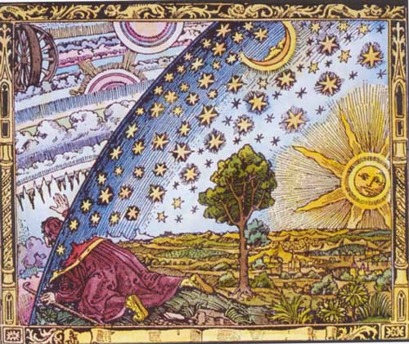
Cosmic-Ray escape and propagation near their sources
Alexandre Marcowith (Universe & Particles laboratory of Montpellier, France)

Slide 2
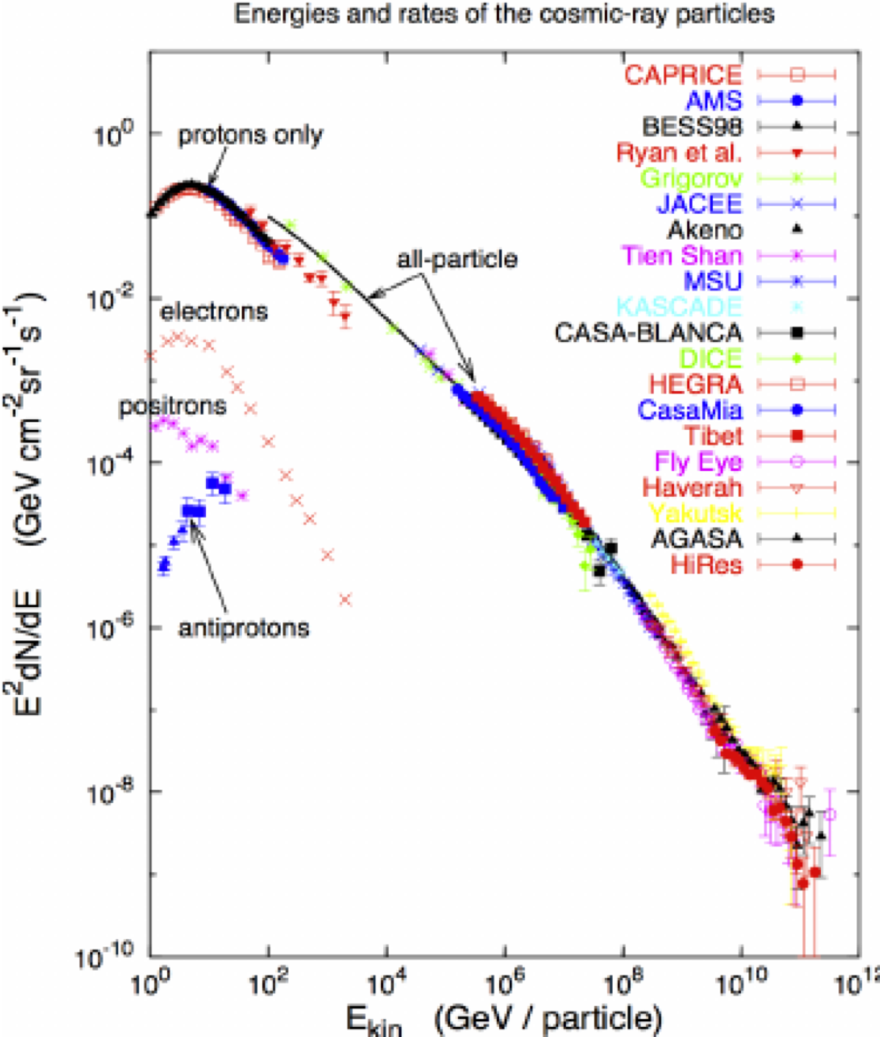
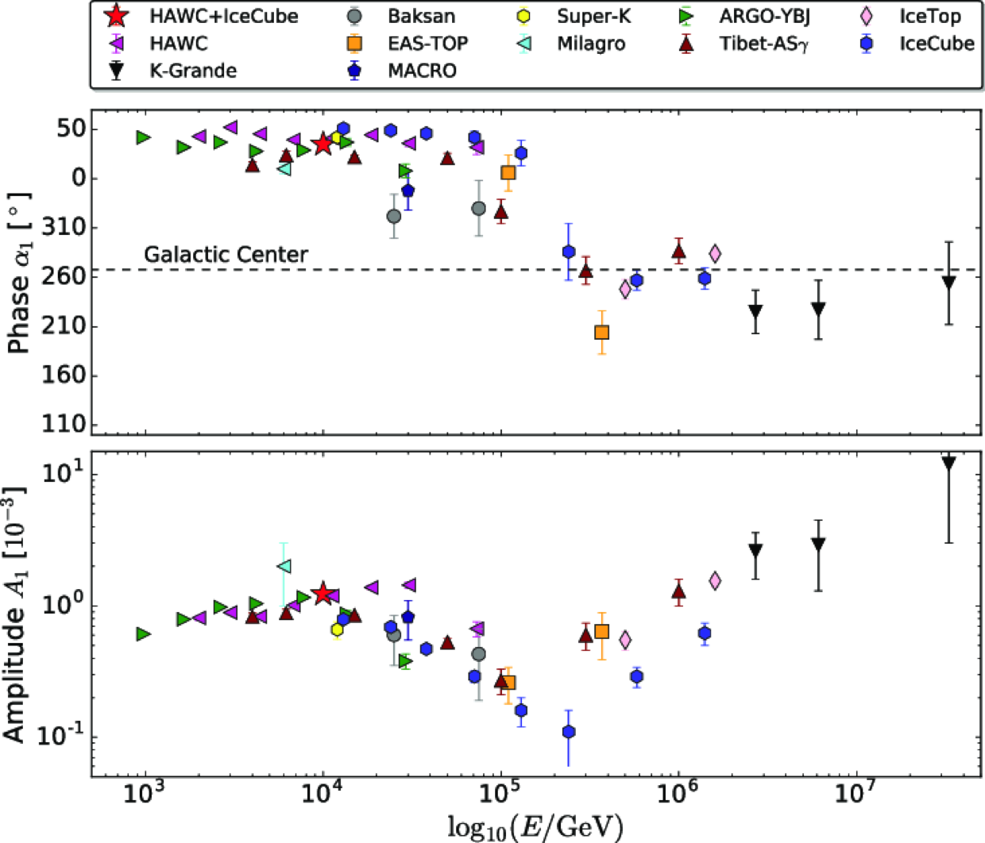
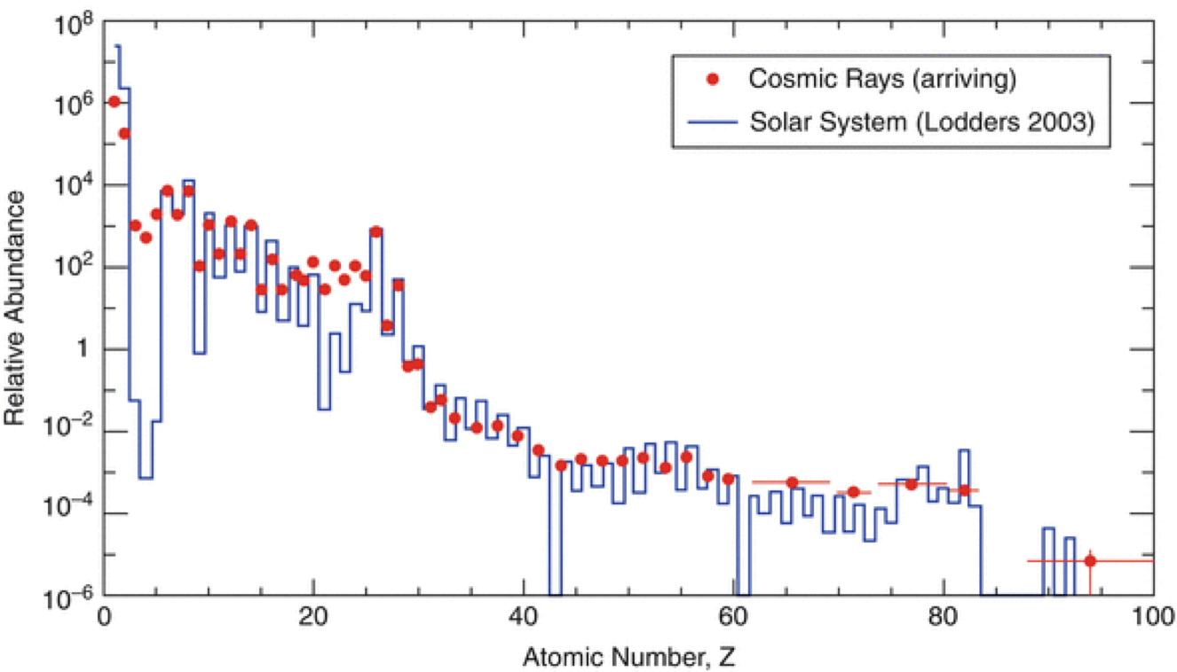
The three Cosmic-Ray (CR) spectra
Energy spectrum / Composition spectrum / Angular spectrum
Light element production by spallation
(here composition @ a few GeV/N)
High level of isotropy
(anisotropy increases at the highest energies)
From MeV to almost ZeV or 10²¹ eV

Slide 3
scientific context
Big questions : (still yet not fully answered)
  What are the CR sources ?
  How CR travel in the inter-stellar/inter-galactic medium (ISM/IGM) ?
  (but in between) How do they escape from their sources,
  subsidiary question : as sources are expected to inject more CRs than the ISM mean should we expect particular local dynamical impacts ? (Cosmic-Ray feedback)
Today’s talk will (start to) address the latter question on the microphysics side.
I will focus on galactic CRs mostly (so with kinetic energies < 100 PeV) and two types of sources: supernova remnants and pulsars.

Slide 4
Cosmic-Ray halos around supernova remnants (SNRs) : observations
No firm detection of gamma-ray halos around SNRs yet, but several observations tend to support it.
Other sources/publications: Reichardt+2012: (Fermi) HB21, Katagiri+2016: (Fermi) HB3, Abdallah+2018 (HESS): RX J 1713.7-3946.
Abdo + 2010 ApJ 718 348
Uchiyama + 2012 ApJ 749 L35
W44 Ferrmi residual map SNR radio (magenta), contours: CO data (molecular clouds), dashed: galactic plane
Fit of cloud gamma-ray data with an escape with different prescription of the diffusion coefficient. Amount of escaping CRs: 0.5 10⁵⁰ erg
W28 SNR Fermi data and HESS contours, W28 SNR is close to source N, tothers sources mark the presence of clouds / HII regions
Notes:
STC1-2 1(NE), 2(SW) clouds, delta = diffusion coefficient index = 0.6

Slide 5
Cosmic-Ray halos around supernova remnants : Theory
Several key difficulties:
  Maximum energy /escape at a given time is fixed by the level of magnetic turbulence at the shock precursor.
  Magnetic turbulence is a very complex phenomenon, requiring 3D description, it covers 8-9 orders of magnitude in length/time scales.
  Most of analytical/numerical models are usually 1-2D and have limited scale description.
  We rely on phenomenology : time-dependence of injection, magnetic field amplitude, far escape boundary (mimics 3D using 1D slab approach) : see Telezinsky+2012, Ohira+2012.
  We can use simplified escape treatment and investigate the propagation near CR sources (eg Malkov+2013, see next).

Slide 6
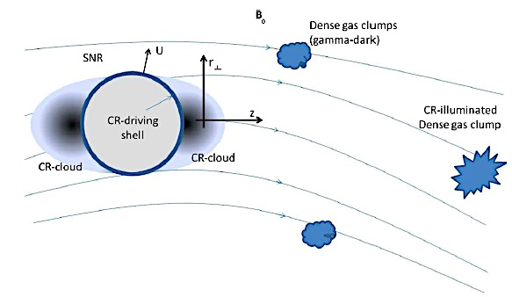
The Cosmic Ray cloud model
(Malkov + 2013 ApJ 768 73)
Model assumptions:
No escape modelling, but released CR energy amount W_{CR} and E^{-2.2} spectrum
Once released CRs propagate along the background mean magnetic field: 1D propagation
Better designed for type Ia SN, core-collapse SN shocks propagate into circum-stellar winds

Slide 7
Cosmic Ray cloud model: Model equations
Evolution Eqs for CR pressure at a given energy E : P_{CR}(E) wave perturbation energy density at a wave number k: I_{w}(k) = δB(k)²/B²
CRSPECTRA code by L. Brahimi (available on demand, backup)
V_{a} : Alfvén speed , it can be space, time and energy dependent,
Q_{CR} (E,t) : CR source term,
I_{w}⁰ : background interstellar magnetic turbulence.
κ: Cosmic Ray spatial diffusion tensor.
Γ_{g}^{w} : wave growth rate (function k), Γ_{d}^{w}: wave damping rate (function of k, depends on ISM properties

Slide 8
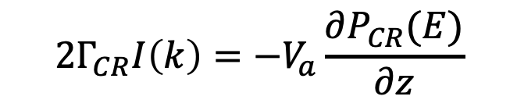
Resonant streaming instability
CRs drifting with speeds > local Alfvén speed trigger magnetic perturbations (extract momenta from CRs, and reduce the drift speed).
Resonant streaming instability triggers perturbations at wave numbers k r_{L}~ 1, r_{L} CR Larmor radius (E/ZeB).
In the quasi-linear theory of CR scattering the diffusion coefficient along the MF is:
(D similar as κ)
The linear wave growth rate is:
Nava + 2016 MNRAS 451 3552
$$2Γ_{CR}I\left(k\right)=−V_{a}\frac{∂P_{CR}(E)}{∂z}$$

Slide 9
The Cosmic Ray cloud model: interstellar medium phases effects
Warm ionized and neutral phases: Nava+2016,
Hot ionized phase: Nava+2019 MNRAS 484 2684,
Cold neutral and molecular phases: Brahimi+2020 A&A 633 A72.
The main effects are: wave damping processes, eventually radiative losses (not yet considered).
Three main damping processes: ion-neutral collisions in partially ionized phases, non-linear Landau damping and turbulence damping (interaction of CR self-generated turbulence with large-scale-injected turbulence), see Brahimi +2020.

Slide 10
ISM phases
= idealized gas distribution in our Galaxy
Brahimi PhD thesis 2019
HII: HII regions, WIM=warm ionized phase, WNM=warm neutral medium, CNM=cold neutral medium, DiM=diffuse molecular medium, DeM=dense molecular medium, DeC=dense cores.
X= ionization fraction, n_{T}=total gas density, μ_{i}=mean ion mass, μ_{n}=mean neutral mass.
+ HISM= 10⁶K, B~2μG, X=1, n_{T}=0.01 cm⁻³

Slide 11
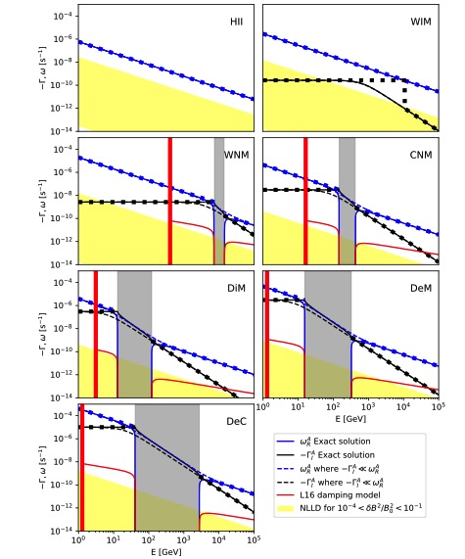
Damping processes
blue: AW dispersion relation
Damping processes in the different ISM
Red: turbulence damping (Lazarian 2016)
Yellow: Non-linear Landau damping (Kulsrud 1978)
Black: ion-neutral damping
Grey: non propagating zone of Alfvén waves due to ion-neutral collisions.
in partially ionized media
ion-neutral damping drops as E⁻² (Mc Ivor 1976)
in partially ionized phases: IN damping dominate except at high energy.
Notes:
Bleu: wave dispersion relation (real part), black: ion-neutral damping, red: Turbulent damping (vertical line dissipation scale), yellow : NLL damping

Slide 12
Special way to inject CRs
Half time for WIM and WNM
The “escape” time, is the time after which CR pressure is halved in the CR cloud = t_{1/2}.
For each radius at each energy we can calculate it (dashed/cont curves).
We compare it with SNR shock radius dynamics (solution by Truelove & McKee 1999) – intersection give t_{1/2}.

Slide 13
Results I : Ionized phases
Hot ionized phase
Warm ionized phase
CR pressure, diffusion coefficient
Diffusion coefficients can be reduced by a factor 10,
or more.
Timed-dependent CR spectrum
Complex time evolution for D
increases at high energies because R drops => higher flux.

Slide 14
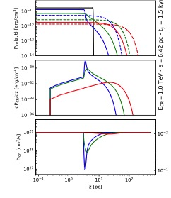
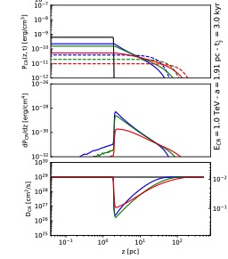
Results II : partially ionized phases
Warm neutral medium
Cold neutral medium
Diffuse molecular
CR Cloud is reduced in size, CR flux is enhanced and streaming growth rate increases but ion-neutral damping dominates and can be short ~ GeV, it drops above ~TeV, especially in DiM case => diffusion coefficients can get reduced for longer timescales at TeV.

Slide 15
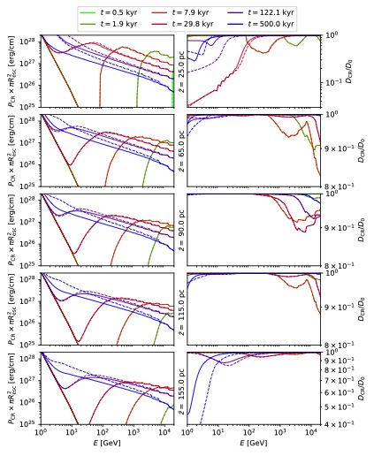
Towards more complex ISM
Z=z-z_{SNR}
All studies until now have considered homogeneous ISM, but ISM is not homogeneous at all.
examples of ISM
W= continuous
WC= dashed
WCD=dashed-dotted
effect of adiabatic losses

Slide 16
Cosmic-Ray feed back studies
CR feed back through resonant streaming instability: many works involving bi-fluid approach (eg Dubois+2019 A&A, 631 A121, Pfrommer et al, Hopkins et al).
Brahimi PhD 2019
Schroer+2021 ApJ, 914 L13
CR density
gas density
perpendicular MF
time dilution of CR injected from a merging supernova remnant (MHD simulations using RAMSES)
effect of the non-resonant streaming instability

Slide 17
Summary, key questions for the future and future work
Summary: CR injected from SNR can trigger the resonant streaming instability => reduced diffusivity, strongly dependant on the ISM properties (wave damping).
Back-reaction effects seem important to include using a kinetic model (see Schroer et al paper). CR pressure will likely inflate the magnetic flux tube. Vlasov-MHD approach (T. Inoue TaLab, Nagoya). Test other type of instabilities (CR pressure related).
Start from a more “realistic” ISM, SN explosion in a turbulent ISM, include 2D or spherical geometries (more code developments).
CR distribution => multi-wavelength emission from surrounding molecular clouds. Special interest for CTA.

Slide 18

Gamma-ray halos around pulsars: observations
Radial gamma-ray emission profile
HAWC significance map above 10 TeV
Abeysekara+2017 Science, 358 911.
Fit: $\frac{1}{r}\operatorname{erfc}\left(\frac{r}{r_{d}}\right), r_{d}=\sqrt{2κt}$
values are ~ 1/100 (Kolmogorov spectrum) wrt to standard ISM values.
Notes:
spectral energy index (Geminga=2.34), (Monogem=2.14), (0622=2.9)

Slide 19
LHAASO results
LHAASO coll. Aharonian+2021 PRL, 126 241103 (PSR J 0622 +3749).
radial profile
Diffusion coefficient @160 TeV: ~ 9 10²⁷ cm²/s.

Slide 20
Gamma-ray halos around pulsars: Theory
3 main explanations for the gamma-ray profiles
Standard turbulence but with reduced coherence scale / diffusion in SNR-generated turbulence (Fang+ 2019 MNRAS, 488 4074)
Combined ballistic – diffusive paths
Electron-positron pair resonant streaming instability
We use a numerical framework to investigate case 3) self-generated turbulence studies using combined particle-in-cell and particle-in-cell-magnetohydrodynamics techniques.
This is the GAMALO project (2020-2024).
Let’s go briefly through each of these explanations
Giacinti+2020

Slide 21
Standard diffusion with reduced coherence length
The coherence length of the turbulence is reduced wrt to the mean ISM (shift of the diffusion coefficient to the left in Diffusion-Rigidity space (Giacinti & Lopez-Coto MNRAS, 479 4526. (also impact of the mean MF strength over the normalization) ⬄effects of the local properties of the turbulence.
Kolmogorov E^{1/3}
Kraichnan E^{1/2}

Slide 22
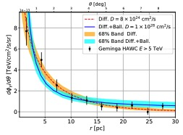
Transition between ballistic-diffusive regimes
Geminga halo fit
Data can also been explained by (Recchia+2021 arXiv:2106.02275)
Ballistic flight for times t < t_{diff} =R²/2D
Diffusion with a “standard “ diffusion coefficient D for t > t_{diff}

Slide 23
Pair driven streaming instability(ies)
Resonant streaming instability triggered by an outflow of electron-positron pairs (Evoli+2018 PRD, 98 3017)
Method: solve coupled kinetic Eqs particles + waves (see SNR escape pb).
Hawc
Kol= Kolmogorov damping
Kra= Kraichnan damping
α index of the injection spectrum Q(p) scales p^{-α}
Wave damping
(quasi-linear) Diffusion coefficient

Slide 24
Simulation techniques : I) particle-in-cell (PIC)
SMILEI (https://smileipic.github.io/Smilei/) (free access)
AM+2020, LRCA, 6, 1

Slide 25

Simulation techniques : II) particle-in-cell-magnetohydrodynamics (PIC-MHD)
MPI-AMR-VAC code (http://amrvac.org/) + PIC (cosmic rays) [Bai+2015 ApJ, 809 55, van Marle + 2018 MNRAS, 473 3394, Amano 2018, JCoP, 366, 366]. The electro-magnetic field is obtained from the combined MHD+Maxwell Eqs.
Specificity : Modified Ohm’s law (Bai+2015).
Ratio of the CR to background gas charge density (< 1 if MHD is to be ran).
$\vec{u_{NT}}$ : CR mean speed
MPI-AMR-VAC-PIC version: NRMHD (developed), SRMHD (developed), GRMHD (under development)

Slide 26
set-up
We use a common set-up for both codes (benchmarking)
  Maxwell-Juttner distribution for e-e pairs, T=10 mc²
  Pair drifting at v_{d}=10 v_{a} in an electron-proton background.
  Drift speed in terms of c : 0.1
  density ratio n_{NT}/n_{B}=0.01
  1D3V PIC simulations, quasi-1D3V (elongated box : 1x50 R_{L}) PIC-MHD simulations.
  m_{p}/m_{e}=100
  Boundary conditions: periodical

Slide 27
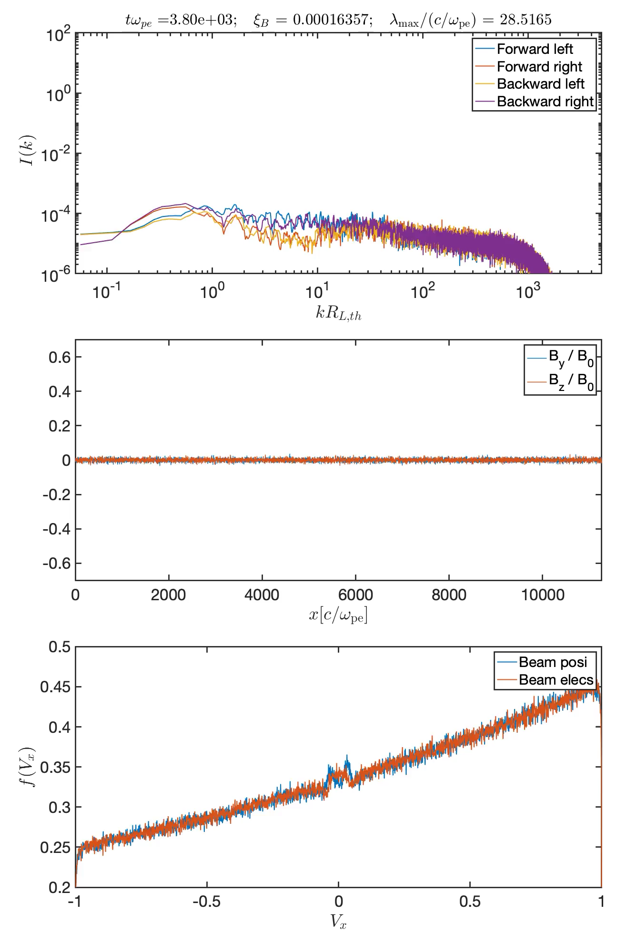
PIC: wave modes growth
Forward modes either right/left-handed polarization
Perpendicular MF components => mode polarisation
Beam electron/positron drift speeds

Slide 28
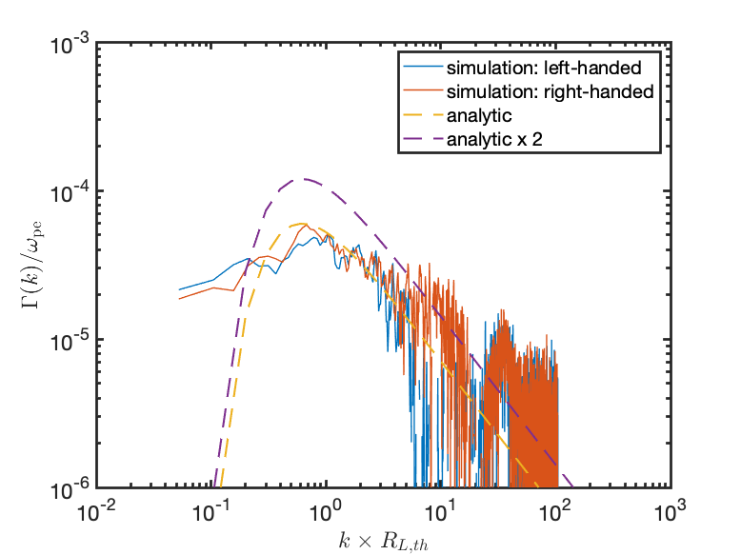
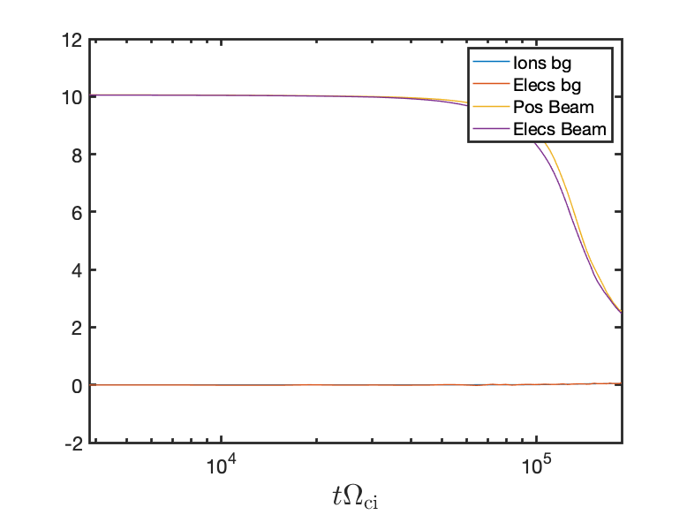
PIC results
growth rate
drift speeds/species as function of time
tΩ_{ce}

Slide 29
PIC-MHD results
Drift speed and magnetic energy as function of time
th.sat
tΩ_{ci} (PICMHD)=0.01 tΩ_{ce} (PIC)

Slide 30

Main results (up to now)
Resonant streaming instability is well reproduced with both simulations.
                $Γ\sim 0.8 \frac{π}{8}\frac{n_{e}}{n_{B}}\left[\frac{V_{d}}{V_{a}}−1\right]Ω_{i}\sim 0.03$ $Ω_{i}$
Theoretical magnetic field saturation is also well reproduced (see Bai+2019) [balance CR momentum density with wave momentum density].
$\left({\frac{δB}{B^{2}}}^{2}\right)\sim 1.3\frac{n_{e}}{n_{B}}\left(\frac{V_{D}}{V_{a}}−1\right)\frac{<p>}{m_{e }c}\sim 0.023$
Non-linear evolution under investigation : differential slowing positrons wrt to electrons …
Next steps: adding differential numbers of electrons/positrons, adding a proton component (Guépin+2018) => non-resonant streaming instability.

Slide 31
Conclusions
Development of semi-analytical 1D model, and PIC, PIC-MHD tools to investigate CR escape from their sources.
Supernova remnants: 1D model show that the diffusion coefficient can be reduced by a factor 10-100. Effects of the environment is important (wave damping). Grammage in/nearby the sources is not likely important (Recchia et al subm).
However pure 1D, flux-tube models can be questioned due to the dynamical back-reaction effects of CRs
Necessary to develop combined MHD + kinetic codes (eg PIC-MHD). PIC are useful to investigate the deep microphysics of CR driven instability.
Adapt the results to other objects: massive star clusters, galaxy starburst or jet backflows…

Slide 32
Reduced diffusivity around massive star clusters
Abeysekara + 2021 (HAWC), Nature Astronomy, 5 465 : Cygnus cocoon
hard GeV spectrum, cut-off ~ 10 TeV
diffusivity can also be reduced
Currently under test in the CTA collaboration, including also other clusters.

Slide 33
ご清聴ありがとうございました

Slide 34
Back-up

Slide 35
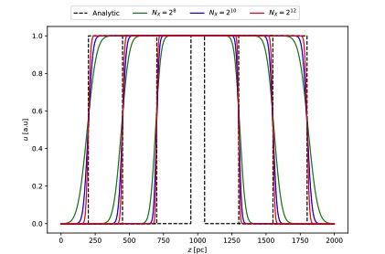
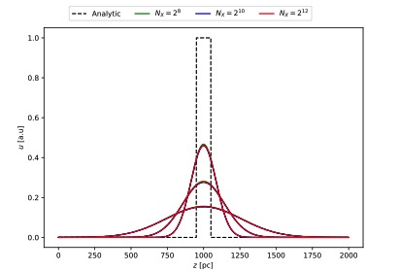
CR-SPECTRA toolkit (python/C++)
The CR/wave system:
advection: upwind-biased
diffusion: implicit

