Slide 1
連星進化で拓く重力波天文学
衣川智弥（東京大学 宇宙線研）

Slide 2
Outline
初代星からの重力波
重力波天文学でさぐるIa型超新星

Slide 3


自己紹介
出身地 山梨県
京大 天体核研究室（2011年4月～2016年3月）
東大宇宙線研（2016年4月～2018年3月）
東大天文（2018年4月～2019年12月）
研究テーマ 連星進化 初代星 重力波
趣味 古武術、ゲーム、映画、犬猫

Slide 4
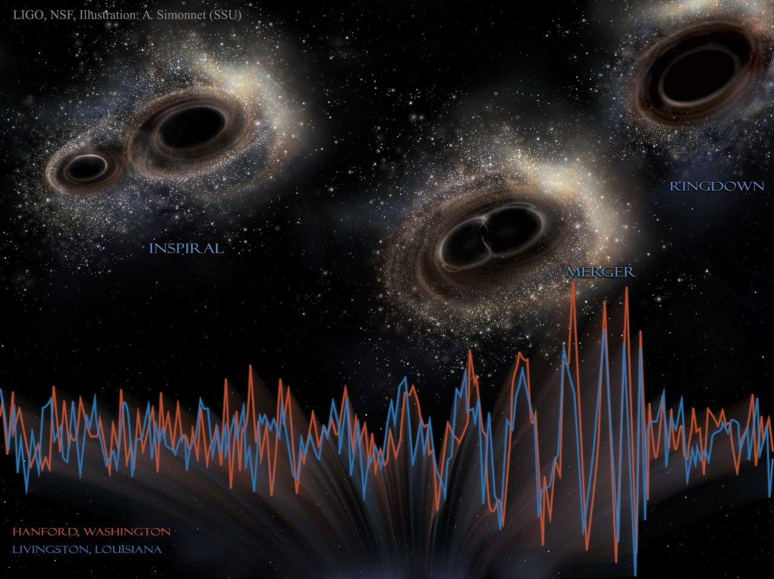
The remnants of first stars for gravitational wave sources
Tomoya Kinugawa
The University of Tokyo
collaborators: T. Nakamura, K. Inayoshi, K. Hotokezaka, D. Nakauchi
A. Miyamoto, N. Kanda, A. Tanikawa, T. Yoshida

Slide 5
Masses of GW events
GW events show that there are many massive BHs (≳30 Msun).
7/10 BBHs are massive BBHs
On the other hand, the typical mass of BHs in X-ray binaries is ~10 Msun.
The LIGO scientific collaboration 2018

Slide 6
Origin of massive BBHs
7/10 GW BBHs are massive BBHs
In order to explain the origin of such BBHs
Many theories exist such as
1)Pop II BBH (Belczynski’s talk)
2)Pop III BBH
3)Primordial Binary BH (PBBH)
4)N body origin from Globular Cluster
…………………….
No metal field binaries
Notes:
In order to explain the origin of GW150914, many theories exist such as these brbrbrbr.
Especially, the Low metal field binary origin has been invoked

Slide 7
Total mass distribution of BBH which merge within the Hubble time
Typical total mass
M～60 M
(30 M +30 M)
TK et al. 2014,2016
IMF:Flat
(10M<M<140M)
Z=0 (Pop III)
Z=1/200 Zsun
e.g. Pop I, Pop II
(Z=0.02,0.001,0.0001)
IMF:Salpeter
(1Msun<M<140Msun)
Typical mass ～10 M
Z=1/20 Zsun
Z=Zsun
Total mass [Msun]
Notes:
This is the result of binary population synthesis.
We calculate the 10 to 6 binaries for each metallicity.
This figure is the total mass distribution of BH-BH which merge within the Hubble time per 10 to 6th binary.
Black line is the first star binary.
The typical total mass of Pop III BBH is 60 solarmass
It mean s that in the case of Pop III star the efficiency of massive BBH formation is very high.
We had shown this features at 2014, before GW150914
In this talk , I will talk about why Pop III become 30 Msun BBH and the event rate.

Slide 8
Wind mass loss & IMF
If the progenitor of BH is Pop I (=Solar metal stars)
Typical mass is small (IMF∝M^{-2.35}, 0.1Msun<M<100Msun)
Stars lose a lot of mass due to the strong stellar wind
The orbit become wide due to stellar wind mass loss
Belczynski et al. 2010
Notes:
Why we consider low metal.
If the progenitor of BBH is pop I,
They lose a lot of mass due to wind mass loss.
Due to strong wind, They cannot become 30 Msun BH.
Furthermore, orbit become wide due to wind mass loss

Slide 9
Wind mass loss & IMF
New
If the progenitor is low metal,
Pop II (Metal<0.1SolarMetal)
Typical mass is same as Pop I
But, week wind mass loss
Pop III (No metal)
Pop III stars are the first stars after the Big Bang.
Typical mass is more massive than Pop I, II
MpopIII~10-100Msun
No wind mass loss due to no metal.
Old
Minitial: 8Msun<M<150Msun
Single stellar evolution
with 2 stellar wind models.
(Belczynski et al.2010,
Abbot et al.2016)
Notes:
If the progenitor is low metal they possibly become massive BH.
In the case of Pop II, they typical mass is same as Pop I, but the wind mass loss weaker than that of Pop I.
So if Pop II star born as massive star, they possibly become massive BH.
Furthermore, Pop III stars which are the first stars after the big bang are born as massive star and no wind mass loss due to no metal.
Thus, Pop III star are easier to be massive compact object

Slide 10
Binary interaction changes progenitor mass
Mass transfer
Common envelope
Common envelope
Red Giants tend to become CE
Mass transfer
Close binary or merge
Notes:
What do determine the BBH mass?
It is not only wind massloss, but also binary interactions such as mass transfer and the common envelope phase.
Mass transfer is this.
The donor star become big and the matter of donor are captured by the gravitational force od receiver star.
So the mass are transffered from donor to receiver.
Common envelope is unstable mass transfer.
Primary star becomes giant and primary radius becomes large.
Secondary star plunges in primary envelope.
The friction occurs between secondary and primary envelope and transfers angular momentum and energy from orbit to envelope. Due to orbital energy transfer separation decreases and envelope expands and will be expelled.
Binary becomes close binary or merges during CE.

Slide 11
Z=1/20Z(=Pop II)
Z=Z(=Pop I)
All star evolve via a red giant
Almost all binaries evolve via a similar evolution pass (common envelope)
Notes:
On the other hand, in the case of Pop I and Pop II cases, all stars evolve via a red giant, so almost all binaries evolve via the similar evolution pass.

Slide 12
Why Pop III binaries become 30Msun BH-BH
M>50Msun red giant
➝Mass transfer is unstable
➝common envelope
➝1/3~1/2 of initial mass
(~25-30Msun)
M<50Msun blue giant
➝Mass transfer is stable
➝mass loss is not so effective
➝2/3~1 of initial mass (25-30Msun)
Large radius
Small radius
Marigo et al. 2001
Notes:
Why do Pop III binaries become 30 Msun Binary black holes?
This is HR diagram of Pop III.
The pop III whose mass is larger than 50 solarmass evolve as the red giant.
The mass transfer of red giant is generally unstable and it becomes the common envelope phase.
Thus, they lose the envelope and they become light.
Therefore, the BH mass become about 30 solar mass.
On the other hand, the Pop III whose mass is less than 50 solar mass evolve as a blue giant.
The mass transfer is stable and mass loss is not so effective.
Thus, they become about 30 solar mass BH.
So, Due to these two evolution path, the peak of BHBH mass is about 30 solar mass.
It does not depend on the IMF and binary parameters.
It only depends on the Pop III stellar evolution.

Slide 13
Total mass distribution of BBH which merge within the Hubble time
Z=0
This shape reflects the influence of Pop III stellar evolution
Z=1/200Zsun
These shapes have the influence of IMF
and the influence of stellar wind mass loss
Z=1/20Zsun
Z=Zsun
Total mass [Msun]
Notes:
Thus, the peak mass of Pop III reflects the influence of Pop III stellar evolution.
On the other hand, the shape of Pop II BH-BH mass distribution reflect the influence of IMF due to similar evolution pass.
Pop I has the influence of stellar wind due to strong wind.

Slide 14
Transition from Pop III to Pop II
Preliminary
Maximum radius of 30Msun (Tanikawa, Yoshida, TK et al. in prep.)

Slide 15
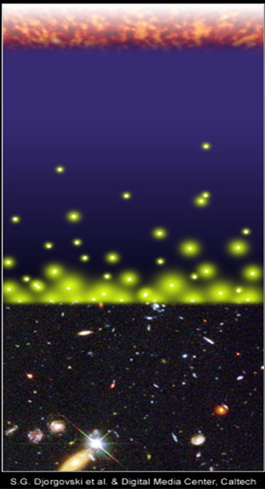
Pop III BBH remnants for gravitational wave
Pop III stars were born and died
at z~10 (~13.3Gyrs ago).
The typical merger time of compact binaries ~10⁸⁻¹⁰yr
dN/dt∝t⁻¹ (Kinugawa et al .214, Inayyoshi et al. 2017)
We might see Pop III BBH at the present day.
Predicted Pop III merger rate at the present day
~25 /yr/Gpc3 (Kinugawa et al. 2014)
BBH merger rate estimated by LIGO
9.7-101 [yr⁻¹ Gpc⁻³] (1811.12907)
Big Bang
merger
merger
time
Djorgovski et al.&Degital Media Center
Notes:
Someone are wondering why we can see such old star which are born at the earlyuniverse.
Pop III stars were born and died at z~10.
However, the typical merger time of compact binaries due to gravitational radiation is too long.
Thus, We might see the gravitational wave from first stars.

Slide 16
Pop III BBH?
ApJL Abbot. et al 2016
Notes:
30 Msun binary black holes have been already predicted by Pop III binary population synthesis.
Thus, LIGO paper said that “recently predicted BBH total masses agree astonishingly well with GW150914 and can have sufficiently long merger times to occur in the nearby universe (Kinugawa et al.2014)”

Slide 17
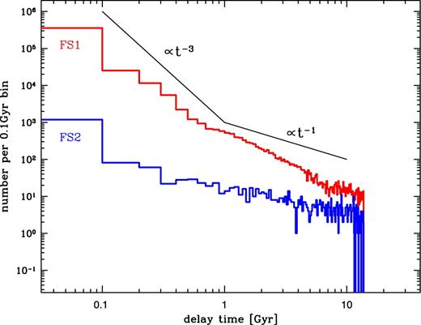
However....
After GW150914, there are 1 bad news and 1 objection for Pop III BBH mergers
Bad news:
decreasing expected Pop III SFR
Because of constraints by Planck τe
Objection
Cryzs Belczynski tried to calculate
Pop III BBH merger rate.
But, in his calculation, almost all Pop III
BBHs merge at the early univerce

Slide 18
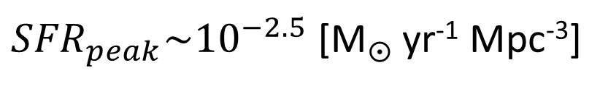
The star formation rate of Pop III
In order to calculate merger rate,
we need to know
・When were Pop III stars born?
・How many were Pop III stars born?
⇒Star formation rate
We adopt the Pop III SFR
by de Souza et al. 2011
Star formation rate [M yr⁻¹ Mpc⁻³]
${SFR}_{peak}\sim {10}^{−2.5}$ [M yr⁻¹ Mpc⁻³]
Redshift z
(de Souza et al. 2011)

Slide 19
Other Pop III SFRs
simulation
e.g. Johnson et al. 2013
SFR_{p}~ 10⁻³-10⁻⁴ Msun/yr/Mpc³
Constraints by Planck τ_{e}
e.g. Visbal et al.2015, Hartwig et al.2016,
Inayoshi et al.2016
→The merger rate decrease to ~1/3?

Slide 20
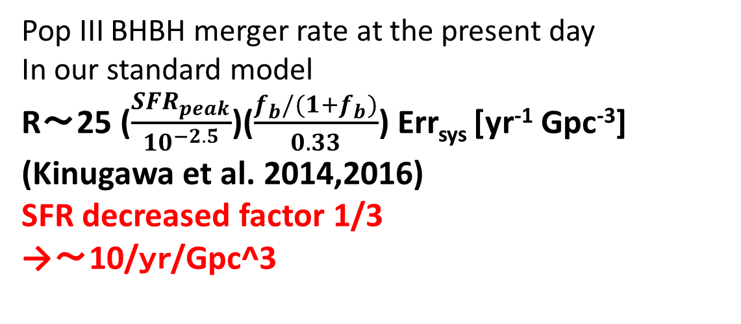
The Pop III BH-BH merger rate density
10⁻⁶
10⁻⁷
10⁻⁸
10⁻⁹
10⁻¹⁰
10⁻¹¹
10⁻¹²
10⁻¹³
10⁻¹⁴
IMF: Flat
Pop III BHBH merger rate at the present day
In our standard model
R～25 ($\frac{{SFR}_{peak}}{{10}^{−2.5}}$)($\frac{f_{b}/(1+f_{b})}{0.33}$) Err_{sys} [yr⁻¹ Gpc⁻³]
(Kinugawa et al. 2014,2016)
SFR decreased factor 1/3
→～10/ｙｒ/Gpc^3
R(t) [yr⁻¹ Mpc⁻³]
BBH merger rate estimated by LIGO
R=9.7-101 [yr⁻¹ Gpc⁻³]
(1811.12907)
Pop III star formation region
40 35 30 25 20 15 10 5 0
Redshift z

Slide 21
Difference between K14 and Belczynski’s Pop III calc.
Kinugawa 2014: use Pop III stellar evolution model (Marigo et al.2001)
Belczynski 2017: use modified Z=0.0001 model.
(radius is changed like Pop III, but MT stability is not changed)
red giant
blue giant
all giants treat as the red giant
→common envelope

Slide 22
Merger time distribution

Slide 23
Mass distributions of observable BBHs (KAGRA)
Pop I/II BBH (Dominik et al. 2012)
Pop III BBH (Kinugawa et al. 2016)
The mass distribution might distinguish Pop III from Pop I, Pop II
→The evidence of Pop III
Even if it cannot distinguish
→redshift dependence
(Miyamoto et al. 2017)
Notes:
This is miyamoto san’s result, the mass distribution can distinguish Pop III from Pop II.
but, recently, the maximum mass of Pop II is increasing by cris Belczynski’s work, and PopIII rate depend on the SFR of Pop III and there are uncertainty.
so Pop III peak possibly be buried under the Pop II BBHs.

Slide 24
Cumulative BBH merger rate
Log(events/yr)
Saturated at z≲3
Saturated at z≳10
Pop I and II BBH (≳5Msun)
(Belczynski et al. 2016)
(2 metallicity evolution models)
Pop III BBH (~30 Msun)
Redshift
Redshift
Notes:
These are the cumulative BBH merger rate of Pop III case and Pop I,II case.
The redshift dependence of Pop III is different from that of Pop I and II.
Thus, we can distinguish the Pop III BBH from Pop I and II
Of course, primordial Bh and the other progenitor have own redshift dependence.
We can check the progenitor of BH by the redshift dependence.

Slide 25
Merger time dependence of Pop III BBH spin distribution
Preliminary results
 | a1/M1<0.1 a2/M2<0.1 | a1/M1<0.1 a2/M2>0.9 | a1/M1>0.9 a2/M2<0.1 | a1/M1>0.9 a2/M2>0.9
Merger time <1Gyr | 25% | 36% | 0% | 23%
Merger time >10Gyr | 70% | 0.3% | 4% | 0%
If the origin of massive BBHs is Pop III,
high spin BBHs are easier to be detected at high redshift

Slide 26
Spinを決めるもの：Tidal, MT, CE
Tidal
Convective tide: red giantで起こるtide、星の変形応答がconvection で決まる。
Dynamic tide:主系列星、blue giantで起こるtide, g-modeとかで変形。これのefficiencyの計算が昔は雑で最近更新された（Kushnir et al. 2018）。Tidalの利き方が10^-2~10^-6ぐらい変わる。

Slide 27
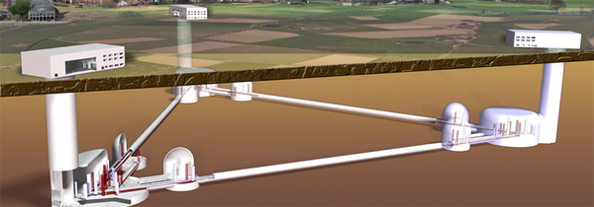
Future plan of GW observer :
ET, CE, B-DECIGO and DECIGO
Einstein telescope (ET): the next generation GW observatory of Europe
Cosmic explorer (CE) : the next generation GW observatory of US.
DECIGO: Japanese space gravitational wave observatory project
B-DECIGO: test version of DECIGO
ET, CE, B-DECIGO : z~10 (30 Msun BH-BH)
DECIGO can see Pop III BH-BHs
when Pop III stars were born (z~20)!
(Nakamura, Ando, Kinugawa et al. 2016)
Notes:
DECIGO is the Japanese space gravitational wave observatory project.
It has good sensitivity from 0.1 Hz to 10 Hz.
Pre-DECIGO is test version.
Pre-DECIGO might see such binary black holes up to redshift 30.
The expected detection rate is about 10 to fifth per yr.
The SFR of Pop III has the peak at z~10.
Thus, it can see pop III BHBH when they were born.
Furthermore, we check the redshift dependence of high mass BHBH mergers.

Slide 29
Detection rate for ET and aLIGO design sensitivity
Preliminary results

Slide 30



PopIII BH-BH
8 out of 10 BBHs are massive BHs
Low metallicity binaries are easier to become massive BBHs
Pop III binaries tend to become 30Msun+30Msun BH-BH
Pop III BBH merger rate density at present day.
R～25 ($\frac{{SFR}_{peak}}{{10}^{−2.5}}$)($\frac{f_{b}/(1+f_{b})}{0.33}$) Err_{sys} [yr⁻¹ Gpc⁻³]
The mass distribution or the redshift dependence might distinguish Pop III from Pop I,II.
DECIGO can see Pop III BH-BH mergers when they were born
Massive BBHs = the fossil of Pop III ?
Notes:
This is summary.

Slide 31
Other Pop III compact binaries cases
Pop III NSNS
Almost all binary NS (maybe) disrupt
Pop III NSBH
Notes:
In the Universe, there are massive black hole. This is a certain fact.
And its origin is low metal stars.
It might be Pop III.
Thus, we also the other compact binary from pop III.

Slide 32
Pop III NS progenitor evolution
blue giant
➝Mass transfer is stable
➝mass loss is not so effective
before supernova
Small radius
Notes:
Why do Pop III binaries become 30 Msun Binary black holes?
This is HR diagram of Pop III.
The pop III whose mass is larger than 50 solarmass evolve as the red giant.
The mass transfer of red giant is generally unstable and it becomes the common envelope phase.
Thus, they lose the envelope and they become light.
Therefore, the BH mass become about 30 solar mass.
On the other hand, the Pop III whose mass is less than 50 solar mass evolve as a blue giant.
The mass transfer is stable and mass loss is not so effective.
Thus, they become about 30 solar mass BH.
So, Due to these two evolution path, the peak of BHBH mass is about 30 solar mass.
It does not depend on the IMF and binary parameters.
It only depends on the Pop III stellar evolution.

Slide 33
Pop III NS-NS disrupt
For example, we consider NS and NS progenitor binary.
NS
(1.4-2M)
NS progenitor
(8-25M)
In the case of Pop III NS progenitor, wind mass loss and the mass loss due to binary interaction is not effective.
SN
When NS progenitor becomes supernova, NS progenitor suddenly loses mass and becomes NS.
Then, due to instant mass loss the binding energy of binary decreases and binary NS disrupts.
disrupt
Binary NS cannot survive!

Slide 34
Pop I and II NS-NS
For example, we consider NS and NS progenitor binary.
NS
(1.4-2M)
NS progenitor
(8-25M)
In the case of Pop I and II NS progenitor, wind mass loss and the mass loss due to binary interaction is effective.
NS progenitor can loses mass before SN.
Binary NS can survive!
SN
In our galaxy
(Kim et al .2015)

Slide 35
Other Pop III compact binaries cases
Pop III NSNS
Almost all binary NS (maybe) disrupt
Pop III NSBH
NSBH do not disrupt

Slide 36
Pop III NS-BH do not disrupt
For example, we consider BH and NS progenitor binary.
BH
(>30M)
NS progenitor
(8-25M)
In the case of Pop III NS progenitor, wind mass loss and the mass loss due to binary interaction is not effective.
SN
When NS progenitor becomes supernova, NS progenitor suddenly loses mass and becomes NS.
But, due to massive BH, NS do not disrupts.
NS BH can survive!

Slide 37
Merging NSBH chirp mass distribution

Slide 38
NSBH detection rate
 | Merger rate [/yr/Gpc^3] | aLIGO (design sensitivity) detection rate [/yr]
Pop I+II | 28.8 (Belczynski et al. 2016) | ~10
Pop III | 1.25 | 5.24(*)
*For simplicity, as the assumption of the chirp mass of Pop III NSBH,
we fixed Mc = 6M⊙ (Kinugawa et al.2016)
Notes:
For simplicity, we assume all Pop III

Slide 39
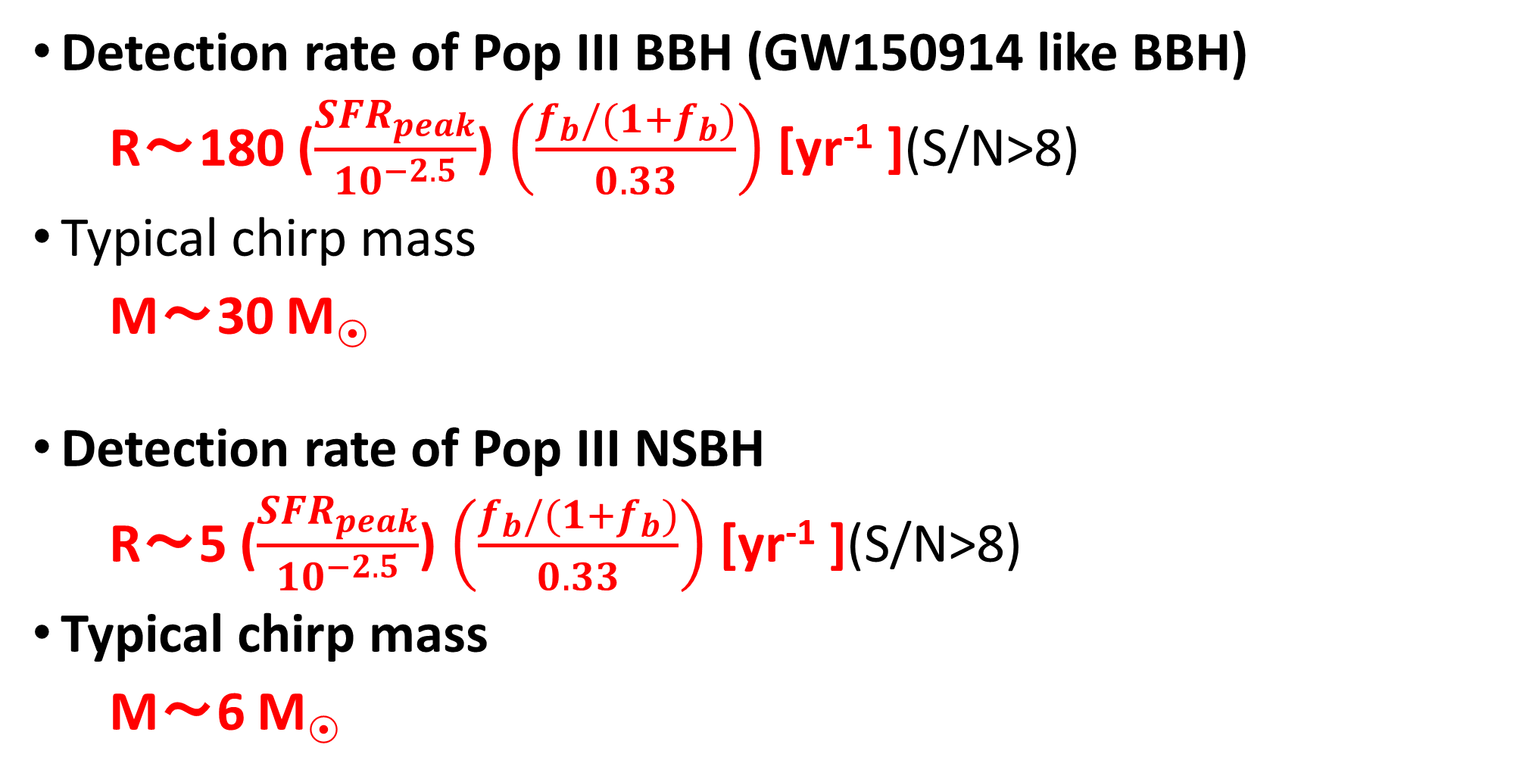
Pop III GW summery
Detection rate of Pop III BBH (GW150914 like BBH)
R～180 ($\frac{{SFR}_{peak}}{{10}^{−2.5}}$) $\left(\frac{f_{b}/(1+f_{b})}{0.33}\right)$ [yr⁻¹ ](S/N>8)
Typical chirp mass
M～30 M
Detection rate of Pop III NSBH
R～5 ($\frac{{SFR}_{peak}}{{10}^{−2.5}}$) $\left(\frac{f_{b}/(1+f_{b})}{0.33}\right)$ [yr⁻¹ ](S/N>8)
Typical chirp mass
M～6 M
We might detect (detected?) the Pop III BBH by GW
Notes:
We also considered detection rate of Pop III BBH.
The detection rate of original design aLIGO is 180 per year.
This value depends on the SFR and the binary fraction of Pop III.
The typical mass of Pop III BBH is 30 solarmass, so we can see QNM of merged BBH
Therfore, we might detect the Pop III BBH by GW.
And we might check GR by Pop III BH QNM.
Furthermore, the mass distribution might distinguish Pop III from Pop I, Pop II.
If the chirp mass distribution can not distinguish Pop III due to small SFR or so, we can confirm Pop III BHBH by redshift dipendence.

Slide 50
Other Pop III SFRs
simulation
e.g. Johnson et al. 2013
SFR_{p}~ 10⁻³-10⁻⁴ Msun/yr/Mpc³
Constraints by Planck τ_{e}
e.g. Visbal et al.2015, Hartwig et al.2016,
Inayoshi et al.2016
→The merger rate decrease to 1/3-1/10 ?

Slide 51
IMF
・Pop I
Salpeter
Pop III
Flat？
Log Flat？
Log N
Stacy & Bromm 2013
∝M^{-2.35}
0 2
Log M
Hirano et al.2014 Susa et al. 2014

Slide 52
Inayoshi et al. 2016

Slide 55
Difference between our code and Belczynski’s Pop III
Belczynski’s code
Modified Pop II (Z=10⁻⁴) evolution
The radius evolution is likely.
But, the mass transfer treatment is same as Pop II
→ all BBH evolved via
a common envelope (CE)
many binaries merge during a CE
Merger Rate of Pop III BBH decrease
and dN/dt change
evolve via a CE
in Belczynski’s code

Slide 56
Pop I & II merger rate (Belczynski et al. 2016)

Slide 58
Cumulative BBH merger rate
Log(events/yr)
Saturated at z≲5
Saturated at z≳10
Pop I and II BBH (≳5Msun)
(Belczynski et al. 2016)
(2 metallicity evolution models)
Pop III BBH (~30 Msun)
Redshift
Redshift
Notes:
These are the cumulative BBH merger rate of Pop III case and Pop I,II case.
The redshift dependence of Pop III is different from that of Pop I and II.
Thus, we can distinguish the Pop III BBH from Pop I and II
Of course, primordial Bh and the other progenitor have own redshift dependence.
We can check the progenitor of BH by the redshift dependence.

Slide 60
Spin
Typical spin ~0
But, some BHs maybe have a spin

Slide 61
Transition from Pop III to Pop II
Preliminary
Maximum radius of 30Msun (by T. Yoshida)

Slide 63
Why Pop III binaries become 30Msun BH-BH
Large radius
M>50Msun red giant
➝Mass transfer is unstable
➝common envelope
➝1/3~1/2 of initial mass
(~25-30Msun)
M<50Msun blue giant
➝Mass transfer is stable
➝mass loss is not so effective
➝2/3~1 of initial mass (25-30Msun)
Small radius
Notes:
Why do Pop III binaries become 30 Msun Binary black holes?
This is HR diagram of Pop III.
The pop III whose mass is larger than 50 solarmass evolve as the red giant.
The mass transfer of red giant is generally unstable and it becomes the common envelope phase.
Thus, they lose the envelope and they become light.
Therefore, the BH mass become about 30 solar mass.
On the other hand, the Pop III whose mass is less than 50 solar mass evolve as a blue giant.
The mass transfer is stable and mass loss is not so effective.
Thus, they become about 30 solar mass BH.
So, Due to these two evolution path, the peak of BHBH mass is about 30 solar mass.
It does not depend on the IMF and binary parameters.
It only depends on the Pop III stellar evolution.

Slide 64
Pop III binary population synthesis
We simulate 10⁶ Pop III-binary evolutions and estimate how many binaries become compact binary which merges within Hubble time.
×84 models (Kinugawa et al.2016)
Initial stellar parameters are decided by Monte Carlo method with initial distribution functions
Initial parameter (M1,M2,a,e) distribution in our standard model
M1 : Flat (10 M<M<100 M)
q=M2/M1 : P(q)=const. (0<q<1)
a : P(a)∝1/a (a_{min}<a<10⁶R)
e : P(e)∝e (0<e<1)
The same distribution functions adopted for Pop I population synthesis

Slide 65
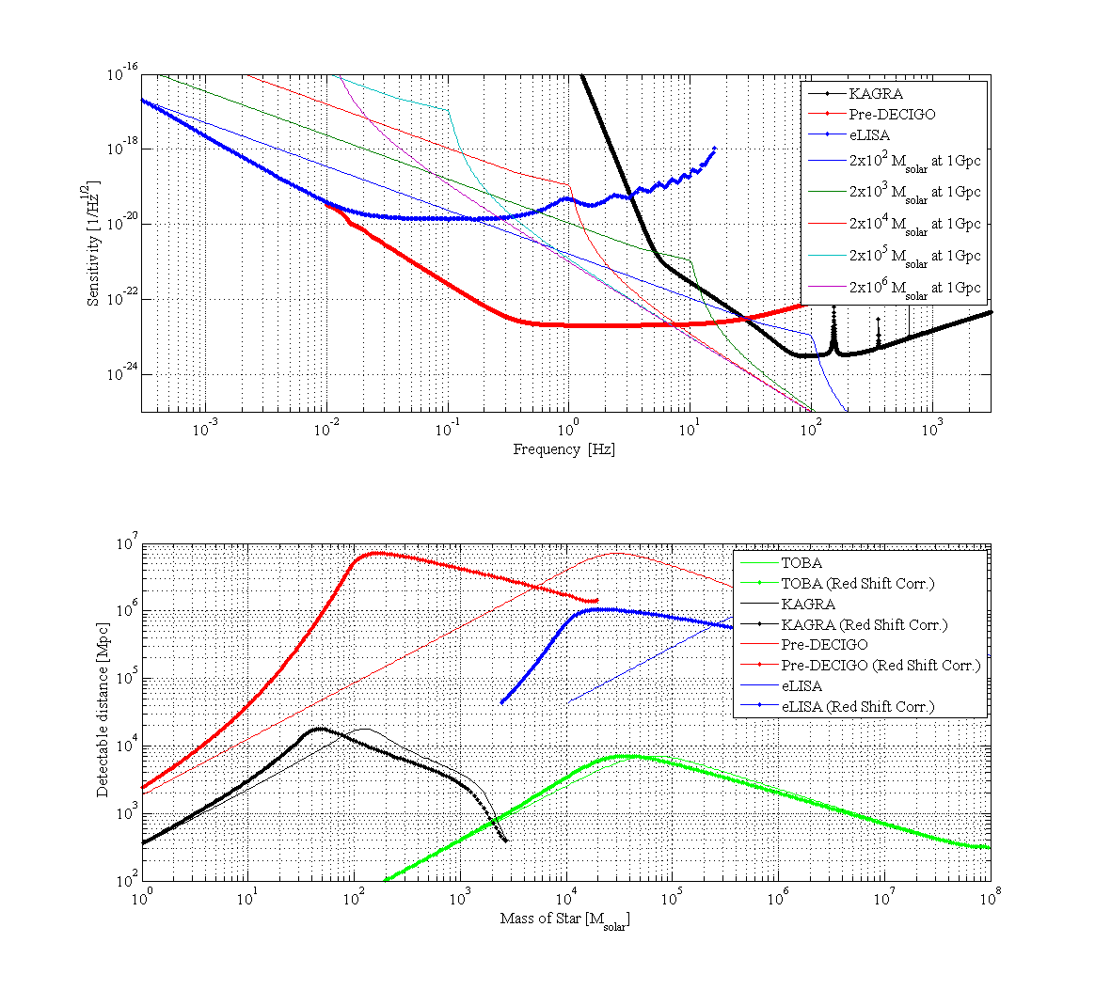

Slide 68
Effect of PPSN

Slide 69
Pop I and Pop II case (Dominik et al. 2015)
From 1/200 Zsun to 1.5 Zsun
BH-BH detection rate (Their standard model) ~300/yr
(+-1order changed by models)
25% of above rate is >20 Msun BHBH
Thus, Detection rate of high mass BHBH ~80/yr

Slide 70
How to calculate Pop III binaries?
1. Initial M1,M2,a,e determined
2. Stellar evolutions
Compact binary
4. Calculate merger time
Not compact binary
5. Repeat this calculation
survive
3. Binary interactions
M1,M2,a,e change
Stop calculation
Merge or disrupt
1. Initial stellar parameters are decided by Monte Carlo method with initial distribution functions
(primary mass: M1, secondary mass: M2, separation: a, orbital eccentricity: e)
2. We calculate evolution of stars
3. If star fulfills the condition of binary interactions (BIs), we calculate BIs and change M1, M2, a, e .
・If binary merges or disrupts due to BIs before binary becomes compact binary, we stop calculation.
・If binary survives from BIs, we calculate stellar evolutions again.
4.If binary becomes compact binary (NS-NS, NS-BH, BH-BH), we calculate when binary merge due to GW.
5.We repeat these calculations and take the statistics of compact binary mergers.

Slide 71
Binary Interactions
Tidal friction
Mass transfer
Common envelope
Supernova effect
Gravitational radiation
Tidal friction
Mass transfer
Change
M1,M2,a, e
Common envelope
SN
Supernova effect
Gravitational Waves
We need to specify some parameters to calculate these effects.
We use the parameters adopted for Pop I population synthesis in Our standard model.
Notes:
In order to calculate pop III binary population synthesis, we consider the binary interactions.
These binary interactions change binary parameters such as primary mass, secondary mass, separation and eccentricity.
We need to specify some parameters to calculate these effects.
We use the parameters adopted for Pop I population synthesis in our standard model.

Slide 72
Pop III binary population synthesis
We simulate 10⁶ Pop III-binary evolutions and estimate how many binaries become compact binary which merges within Hubble time.
×84 models (Kinugawa et al.2016)
Initial stellar parameters are decided by Monte Carlo method with initial distribution functions
Initial parameter (M1,M2,a,e) distribution in our standard model
M1 : Flat (10 M<M<100 M)
q=M2/M1 : P(q)=const. (0<q<1)
a : P(a)∝1/a (a_{min}<a<10⁶R)
e : P(e)∝e (0<e<1)
The same distribution functions adopted for Pop I population synthesis

Slide 73
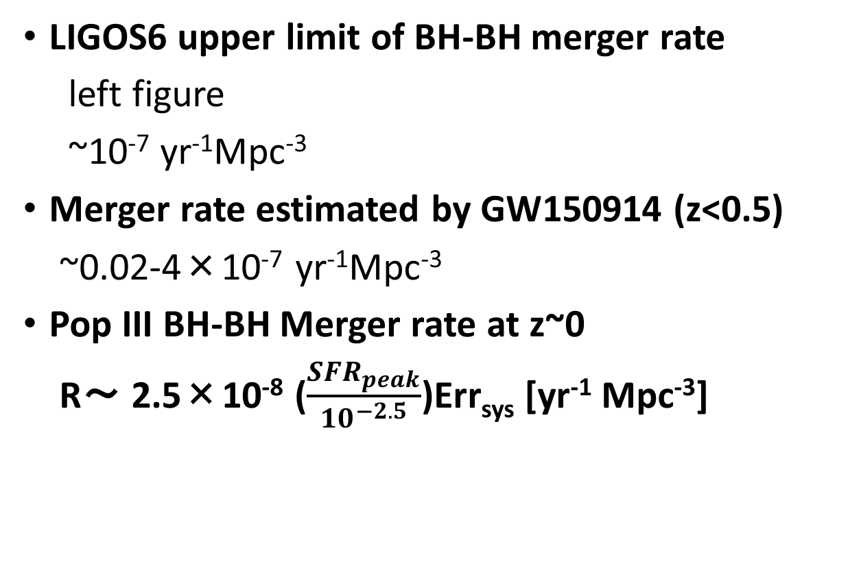
Consistency with LIGOS6 and Adv.LIGO
LIGOS6 upper limit of BH-BH merger rate
left figure
~10⁻⁷ yr⁻¹Mpc⁻³
Merger rate estimated by GW150914 (z<0.5)
~0.02-4×10⁻⁷ yr⁻¹Mpc⁻³
Pop III BH-BH Merger rate at z~0
R～ 2.5×10⁻⁸ ($\frac{{SFR}_{peak}}{{10}^{−2.5}}$)Err_{sys} [yr⁻¹ Mpc⁻³]
Our result is consistent with LIGO
Aasi, Abadie, Abbott et al. (2013)

Slide 74
The differences between Pop III and Pop I
 | Pop I stars (Sun like stars)
Metallicity | ２％
Radius | Large
Typical Mass | 1 Msun
Wind mass loss | effective
Pop III stars
0
Small
10-100 Msun
Not effective
Pop III binaries are easier to be massive compact binary
Notes:
This table shows the differences between Pop III and Pop I.
Pop III is no metal star.
The radius is small, the typical mass is large, and wind mass loss is not effective.
Thus, Pop III binaries are easier to be massive compact binary.

Slide 75
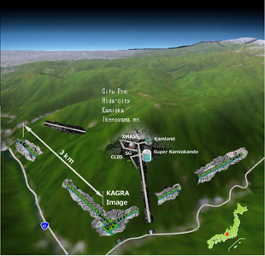
The main target of gravitational wave source
・Compact binary mergers
Binary neutron star (NS-NS)
Neutron star black hole binary (NS-BH)
Binary black hole (BH-BH)
©KAGRA
How many times can we detect compact binary mergers？
➝Estimated by the binary population synthesis
Notes:
First, I introduce the main target of GW source.
The main target of gravitational wave is the compact binary merger such as binary neutron star, neutron star black hole binary and binary black hole.
How many time can we detect compact binary mergers by gravitational wave detectors?
It is estimated by the binary population synthesis

Slide 76
Quasi normal mode
fc is frequency of QNM
Q is the quality factor of QNM which relate to the attenuation of QNM

Slide 81
DECIGOの感度曲線
Pop III のSFRのピークはz~9
Red shift chirp mass=(1+z)Mc
Pop III BHBH (z~9) ⇒300 Msun (10Hz)
Kawamura et al. 2011

Slide 82
How to calculate the event rate
NS-NS
We can get information from binary pulsar observations
・The empirical rate from pulsar observations (Kalogera et al. 2004,etc)
・Binary population synthesis(Belczynski et al. 2002, 2004, Dominik et al.2012,etc)
NS-BH,BH-BH
・Binary population synthesis
There is no observation.
Thus, there is no other way except binary population synthesis
Notes:
How to calculate the event rate?
In the case of NS-NS, there are two method to calculate detection rate.
There are binary pulsar observations.
Thus, we can estimate the empirical rate from binary pulsar observations.
The other method is a theoretical method, binary population synthesis.
On the other hand, in the case of NS-BH, BH-BH, there is no observation.
Thus, there is no other way except the binary population synthesis.
In this talk, I focus on the binary population synthesis.

Slide 83
merger rate calculated by population synthesis
Pop I galactic merger rate [Myr⁻¹]
Dominik et al.(2012)
These merger rates are calculated by Population synthesis (PS).
There are wide differences between models.
I will talk about what is PS and what determine the merger rates.
Notes:
This table is the galactic merger rates of Pop I compact binaries calculated by the binary population synthesis.
Pop I is a solar metal stars.
However, there are some uncertainties and there are wide differences between models.
The merger rate change by a factor of several hundreds.
I will talk about what is population synthesis and what determine the merger rates.

Slide 84
Why NS-NS disrupt
For example, we consider NS and NS progenitor binary.
NS
(1.4-2M)
NS progenitor
(8-25M)
In the case of Pop III NS progenitor, wind mass loss and the mass loss due to binary interaction is not effective.
SN
When NS progenitor becomes supernova, NS progenitor suddenly loses mass and becomes NS.
Then, due to instant mass loss the binding energy of binary decreases and binary NS disrupts.
disrupt
Binary NS cannot survive!

Slide 85
Binary Interactions
Supernova effect
Common envelope
Stable mass transfer
Orbital evolution
(Tidal friction, Gravitational radiation)
In this talk, I will explain these two binary interactions.
Notes:
I introduce the binary interactions
Supernova effect, common envelope, Stable mass transfer, orbital evolution such as tidal friction, gravitational radiation.
These binary interactions change binary parameters such as primary mass, secondary mass, separation and eccentricity.
In this talk, I will explain these two binary interactions

Slide 86
Supernova(SN) effect
For example, we consider NS and NS progenitor binary.
NS
(1.4-2M)
NS progenitor
(8-25M)
When NS progenitor becomes supernova, NS progenitor suddenly loses mass and becomes NS.
Then, due to instant mass loss the binding energy of binary decreases and binary NS disrupts.
SN
Binary NS cannot survive!
disrupt
But in fact binary pulsars have been observed.
Why can binary NS survive?
This reason is common envelope.

Slide 87
Common envelope (CE)
CE is unstable mass transfer phase.
Primary star becomes giant and primary radius becomes large.
Secondary star plunges in primary envelope.
The friction occurs between secondary and primary envelope and transfers angular momentum and energy from orbit to envelope. Due to orbital energy transfer separation decreases and envelope expands and will be expelled.
Binary becomes close binary or merges during CE.
4
1
2
3
Secondary
Primary

Slide 88
Can NS binary survive via CE?
We consider NS and NS progenitor binary again.
NS(1.4-2M)
8-20M
no CE
CE
SN
If CE occurs, envelope was already expelled before SN.
Thus, mass ejection at SN becomes smaller than SN mass ejection via no CE.
Due to small mass ejection at SN the loss of binding energy becomes small.
Binary can survive !
Therefore, Common Envelope is important.
2-6M
disrupt
SN

Slide 89
The treatment of CE
We assume the fraction of the orbital energy is used to expel envelope.
We use simple energy formalism in order to calculate separation after CE a_{f}
For given Mcore1, Menv1 M2, initial separation a_{i}
a_{i}
a_{f}
Assuming efficiency of
mass ejection
Final separation a_{f}
The loss of orbital energy
the energy required to expel envelope
α: the efficiency of energy transfer from orbit to envelope
λ: the binding energy parameter
These common envelope parameters are uncertain.
・How much the orbital energy can be used to expel envelope?
・How much the internal energy of envelope is used to expel envelope?
Notes:
I explain the treatment of CE.
We assume the fraction of the orbital energy is used to expel envelope.
We use simple energy formalism in order to calculate separation after CE af.
The left hand side is the loss of the orbital energy and the right hand side is the energy required to expel envelope.
Alpha is the efficiency of energy transfer from orbit to envelope.
Lambda is the binding energy parameter.
For given primary core mass, primary envelope mass, initial separation ai and assuming alpha and lambda, we canget the separation after common envelope.
However, these common envelope parameters are uncertain.
How much the orbital energy can be used to expel envelope?
How much the internal energy of envelope is used to expel envelope?

Slide 90
The rate dependence on CE parameters
The loss of orbital energy
the energy required to expel envelope
Separation after CE a_{f} is dependent on CE parameters.
For simplicity, α=1.
If λ is large i.e, the energy required to expel envelope is small,
the loss of orbital energy during CE becomes small and a_{f} is large.
If a_{f} is large, binary tend not to merge during CE and can survive.
However, if a_{f} is too large, binary cannot merge within Hubble time due to GW.
・The number of merger during CE Merger rates
・Merger timescale t_{GW}∝a⁴ Merger rates
λ
a_{f}

Slide 91
The dependence on CE parameters
For example, we consider how Pop I NS-NS merger rate depend on CE parameters.
Pop I NSNS merger rate [Myr⁻¹ galaxy⁻¹] Dominik et al.2012
αλ
a_{f}
・The number of coalescence during CE Merger rates
・Merger timescale t_{GW}∝a⁴ Merger rates
Notes:
Let consider the dependence on the CE parameters.
This table is the pop I binary NS merger rate.
We assume alpha is unity, and change the lamda from 0.01 to 10.
First, due to the number of coalescence during CE is decrease the merger rate increase.
However lambda become larger than 1, the merger timescale become too long. Thus the merger rate decrease.
Therefore, these parameter change merger rate by a factor of hundred.
This is the big problem of the population synthesis and binary evolution study.

Slide 92
Binary population synthesis
Population synthesis is a method of numerical simulation to research the population of stars with a complex evolutions.
Population synthesis can predict properties and merger rates of unobserved sources such as NS-BH, BH-BH
The common envelope of the key process of population synthesis
However, Common envelope parameters are uncertain.
This uncertainty change event rate by a factor of several hundreds.
We should reveal this uncertainty via comparison between result of population synthesis and observations such as GW and other observations and improve binary evolution theory

Slide 93
Example: CE dependence
We calculate αλ=0.01, 0.1, 1, 10 cases N_{total}=10⁶
The number of merged Pop III BH-BH change by a factor of several.
On the other hand, Pop I merger rates changed by a factor of several hundreds.
What is the reason?

Slide 95
IMF dependence

Slide 96
Uncertainties of Pop III binary population synthesis
Initial condition
IMF
mass ratio
separation
eccentricity
Binary interactions
Common envelope
Mass transfer
Supernova kick

Slide 97
eccentricity distributions
General eccentricity distribution (Heggie 1975)
P(e)∝e (Standard)
CygnusOB2 association（Kobulnicky et al. 2014）
P(e)=const.
Observations of O stars(M>15Msun) (Sana et al.2012)
P(e)∝e^{-0.5}

Slide 98
eccentricity dependence

Slide 99
Uncertainties of Pop III binary population synthesis
Initial condition
IMF
mass ratio
separation
eccentricity
Binary interactions
Common envelope
Mass transfer
Supernova kick

Slide 100

Mass transfer
β=0：conservative
1>β>0：non conservative
In Standard model, we use the fitting function
This is fitted for Pop I stars.
Thus, we check β=0,0.5,1 cases.
Secondary is MS or He-burning
(Hurley et al. 2002)
$$\dot{M_{2}}=\dot{−M_{1}}$$
Secondary is giant

Slide 101
Mass transfer dependence

Slide 102
Supernova kick
Pulsar kick ~200-500km/s
Pulsar observation suggest NSs have the natal kick at the SN.
BHXRBs have large distance from galactic plane.
Black hole natal kick? （Repetto,Davis&Sigurdsson2012）
⇒We check the kick dependence.
σ=0km/s (Standard)、σ=100km/s、σ=300km/s

Slide 103
SN kick dependence

