Slide 1
The Contribution of Pulsar Wind Nebulae to the Galactic High Energy Sky
Joseph (Yosi) D. Gelfand (NYUAD)
M. Abdelmaguid, J. Alford (NYUAD), Galactic TeV Collaboration: K. Mori (Columbia) ++

Slide 2
Outline
What produces the highest energy photons in the Milky Way?
Pulsar Wind Nebulae (PWNe) significant fraction of sources
Can PWNe produce such high energy photons?
Model for evolution of a PWN inside a SNR
Applications to observed PWNe
Kes 75 Magnetospheric γ-rays, progenitor of neutron star
G21.5-0.9 & G54.1+0.3 Underlying particle acceleration mechanism
HESS J1640-465 Nature of high TeV luminosity source
CTA 1 Origin of TeV halos
Summary & Future work

Slide 3
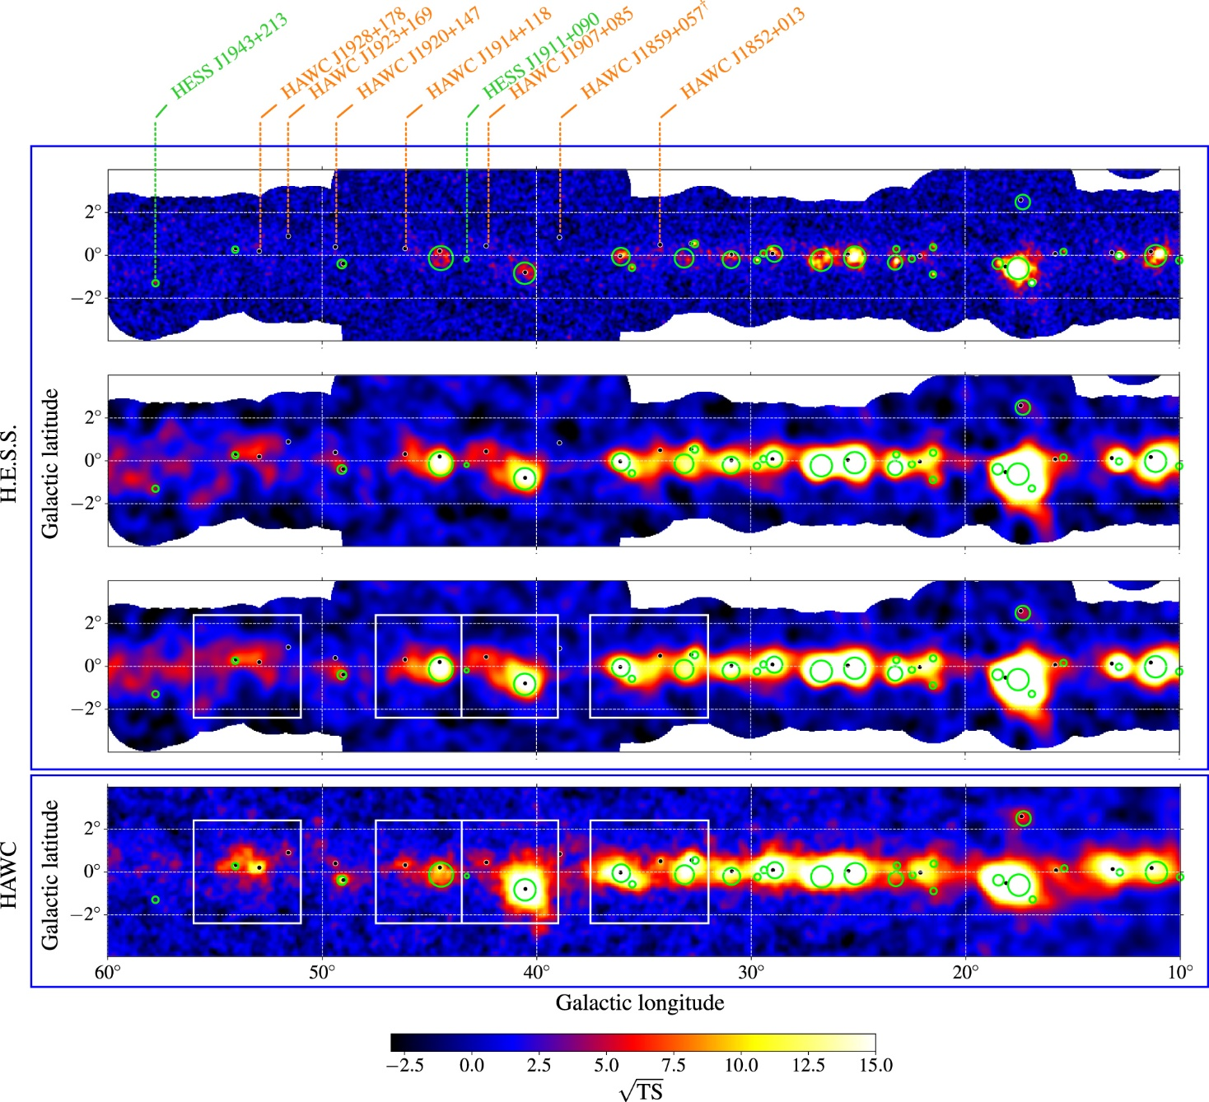
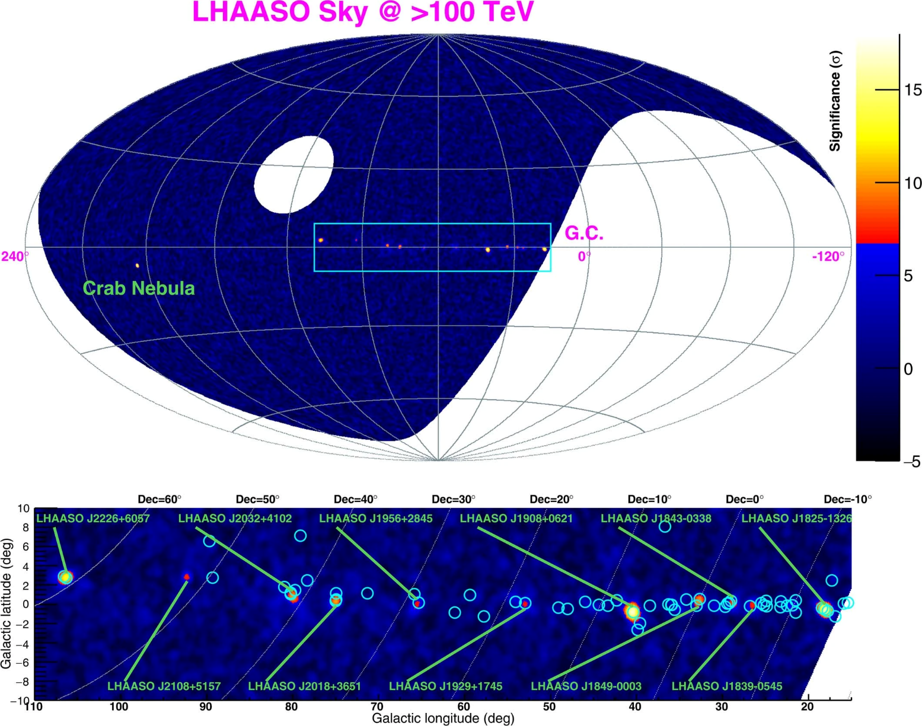
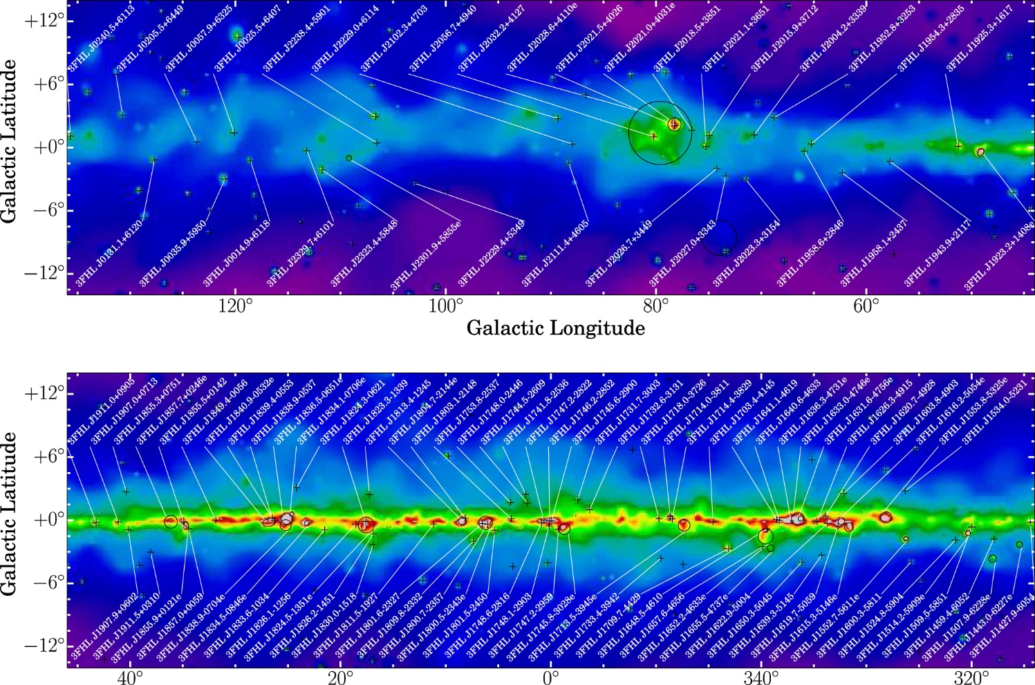
Galactic γ-ray sky
“New” observing facilities
GeV Fermi, AGILE
TeV HESS, VERITAS, MAGIC, CANGAROO
~0.1 PeV HAWC, Tibet AS-γ, LHAASO, MILAGRO
>0.1 PeV photons → >PeV particles
What are the Galactic PeVatrons?
(Abdalla+ 2021)
(Cao+ 2021)
(Ajello+ 2017)

Slide 4
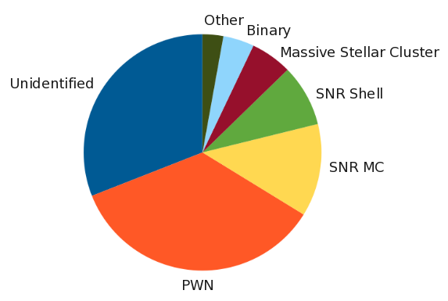
Pulsar Wind Nebulae (PWNe) = Pevatrons ?
(Alberts+ 2021)
Many Galactic γ-ray sources coincident with pulsars…
… observed to produce PWNe
Pulsars / PWNe significant fraction of Galactic γ-ray sources
UHE γ-rays “universal feature” of energetic pulsars?
PSR J1826−1256
(Carrigan+, HESS 2013)
(Burgess+ 2022)
(Burgess+ 2022)

Slide 5
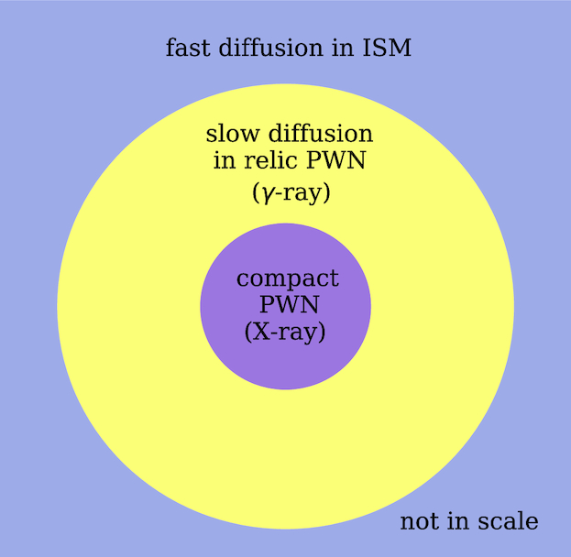
Pulsar / PWN – TeV γ-ray associations
Pulsars associated with TeV sources are:
energetic (high Ė), and
vary in “age” τ_{c} ~ 10³ – 10⁵ yr
“Older” pulsars often associated with TeV halos
TeV >> radio, X-ray extent
Particles escape from PWN, diffuse in ISM
Range in “ages” → Diversity in observed properties of PWN
(Abeysekara+ 2017)
(Abdalla+ 2018)
(Tang & Piran 2019)

Slide 6
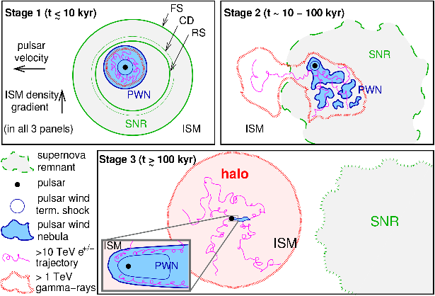
PWN Evolution
“Three” stages:
PWN freely expands within a SNR
PWN interacts with SNR reverse shock
Pulsar leaves SNR and creates “new” PWN in ISM
Long radiative lifetime → “Stage 3” PWN ≈ Remnants of Stages 1 & 2
(Giacinti+ 2020)

Slide 7
Schematic of a PWN inside a SNR
$$\dot{E}=\dot{E0}{\left(1+\frac{t}{τ}\right)}^{−\frac{p+1}{p−1}}$$
Neutron Star
Supernova Remnant
Pressure: P_{snr}(R_{pwn})
Velocity: v_{snr}(R_{pwn})
Density: ρ_{snr}(R_{pwn})
Ejecta mass: M_{ej}
Kinetic energy: E_{sn}
Density ISM: n_{ism}
Termination Shock
Magnetic Field: η_{B}Ė
Leptons (e⁺,e⁻): η_{e}Ė
Injection Spectrum
Pulsar Wind
Swept-up Material
Mass: M_{sw,pwn}
Velocity: v_{pwn}
Pulsar Wind Nebula
Pressure: P_{pwn}
Magnetic Field: B_{pwn}
(Gelfand et al. 2009, ApJ, 703, 2051)

Slide 8
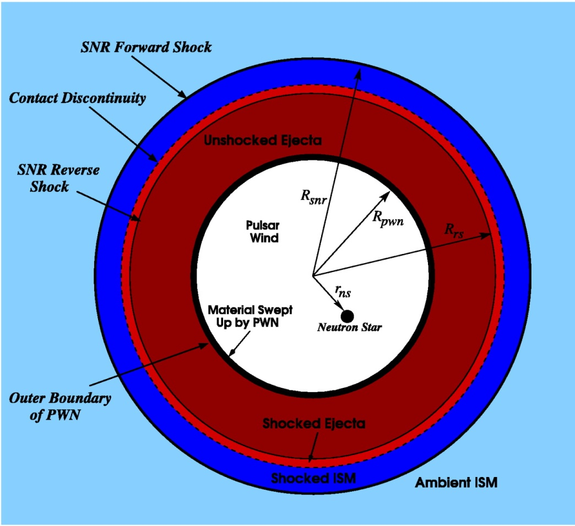
Evolutionary Model for a PWN Inside a SNR
Homogeneous ISM, PWN
One-zone model
Dynamical evolution determined by motion of swept-up material
Difference in pressure between PWN and SNR results in net force
PWN’s emission dominated by synchrotron radiation and Inverse Compton scattering of electrons off background photons
4πR_{pwn}²P_{pwn}
Pulsar Wind Nebula
4πR_{pwn}²P_{snr}(R_{pwn})
Supernova Remnant
(Gelfand et al. 2007, ApJ, 663, 468)
(Gelfand et al. 2009, ApJ, 703, 2051)

Slide 9
Evolutionary Model Parameters
Neutron Star
Initial Spin Period / Spin-down Luminosity
Spin-down Timescale
Braking Index
Pulsar Wind
Fraction of energy in magnetic fields, electrons / positrons
Acceleration mechanism: minimum and maximum particle energy, energy spectrum
Progenitor Supernova
Ejecta Mass
Initial Kinetic Energy
(Credit: X-ray: NASA/CXC/Eureka Scientific/M.Roberts et al.; Radio: NRAO/AUI/NSF)

Slide 10
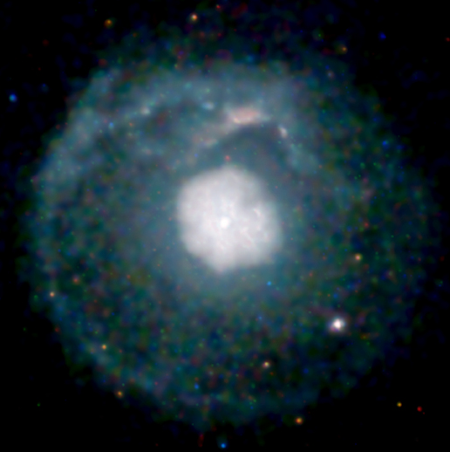
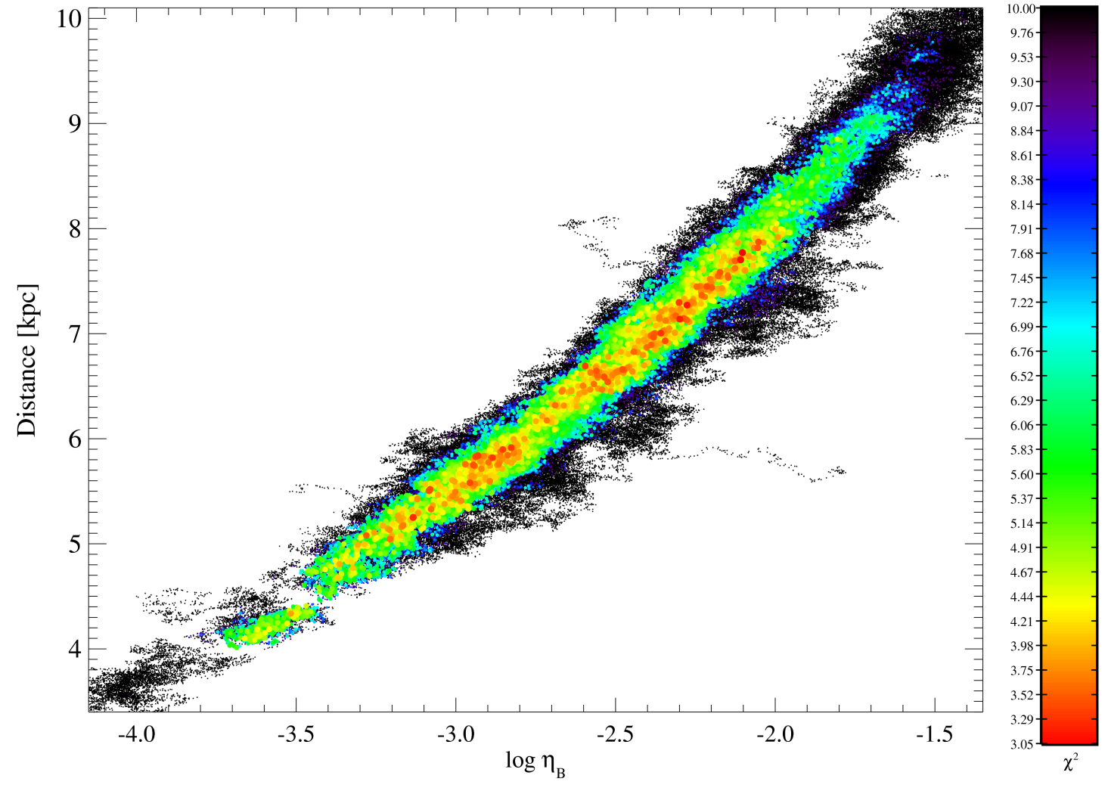
(Basic) Procedure
Measure volume-integrated properties of the PWN (SNR, pulsar)
Identify parameter combinations that reproduce observables
Significant degeneracies
Interpret results
10
Higher
χ²
9
Pulsar
8
7
Distance [kpc]
6
5
PWN
4
Lower
χ²
SNR
10⁻⁴
10^{-3.5}
10⁻³
10^{-2.5}
10⁻²
10^{-1.5}
Wind Magnetization η_{B}
(Credit: NASA/CXC/U.Manitoba/ H.Matheson & S.Safi-Harb)

Slide 11
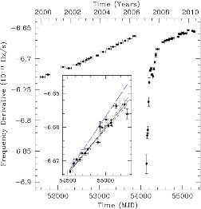
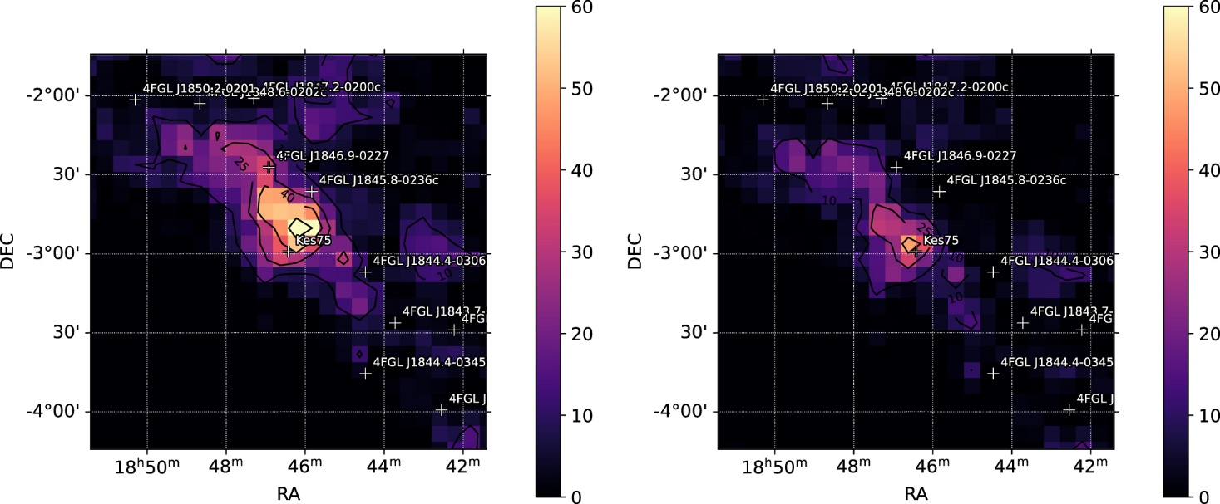
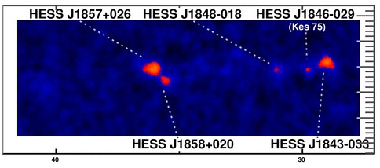
Kes 75: Young PWN in SNR (“Stage 1”)
Radio, X-ray bright PWN in center of SNR
Faint γ-ray source
Associated with very unusual PSR J1846-0258
Very young, high Ė
Strong B_{dip}~5×10¹³ G
Magnetar-like timing and flux variability
(Straal+ 2023)
(Livingstore+ 2011)
(Credit: X-ray: NASA/CXC/NCSU/S. Reynolds; Optical: PanSTARRS)
(https://www.mpi-hd.mpg.de/HESS/pages/home/som/2008/10/)
(HESS, Abdalla+ 2018)
(HESS, Abdalla+ 2018)

Slide 12
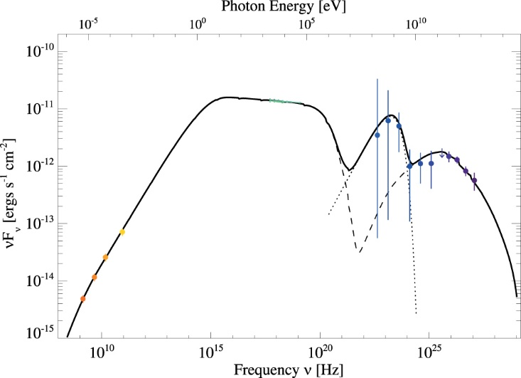
Kes 75: Model Results
Reproduced observed properties with model:
Radio → TeV γ-ray SED
Angular size of SNR
Angular size, expansion rate of PWN
Excellent fit
χ² = 2.4 with 4 d.o.f
(Straal+ 2023)

Slide 13
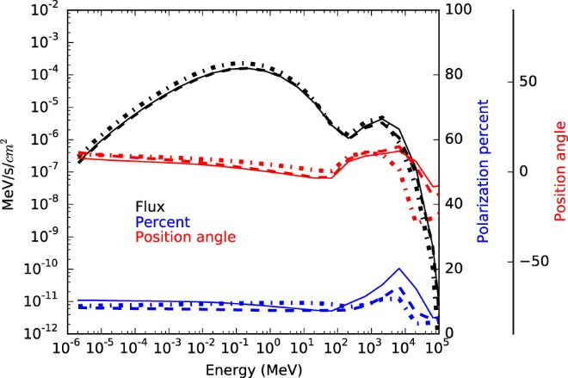
Kes 75: Magnetospheric γ-ray emission from PSR J1846-0258
Fit → 100 MeV – 10 GeV emission from pulsar
Assumed PL × Exp. Cutoff
Separate from claimed pulsed MeV emission (Kuiper+ 2018)
Two components consistent with theory
(Straal+ 2023)
(Harding & Kalapotharakos 2017)

Slide 14
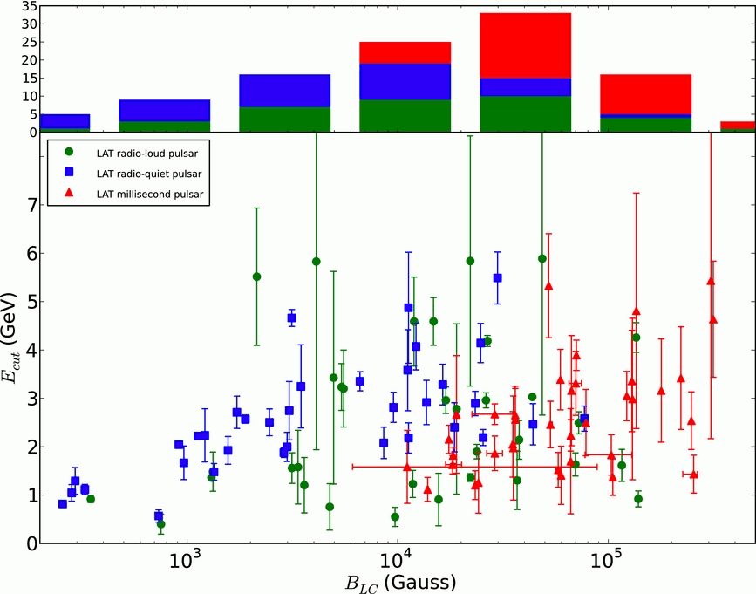
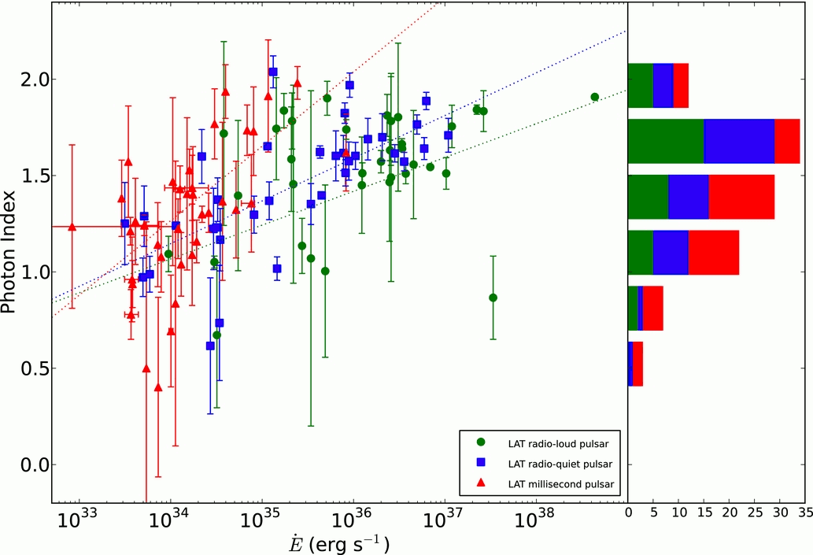
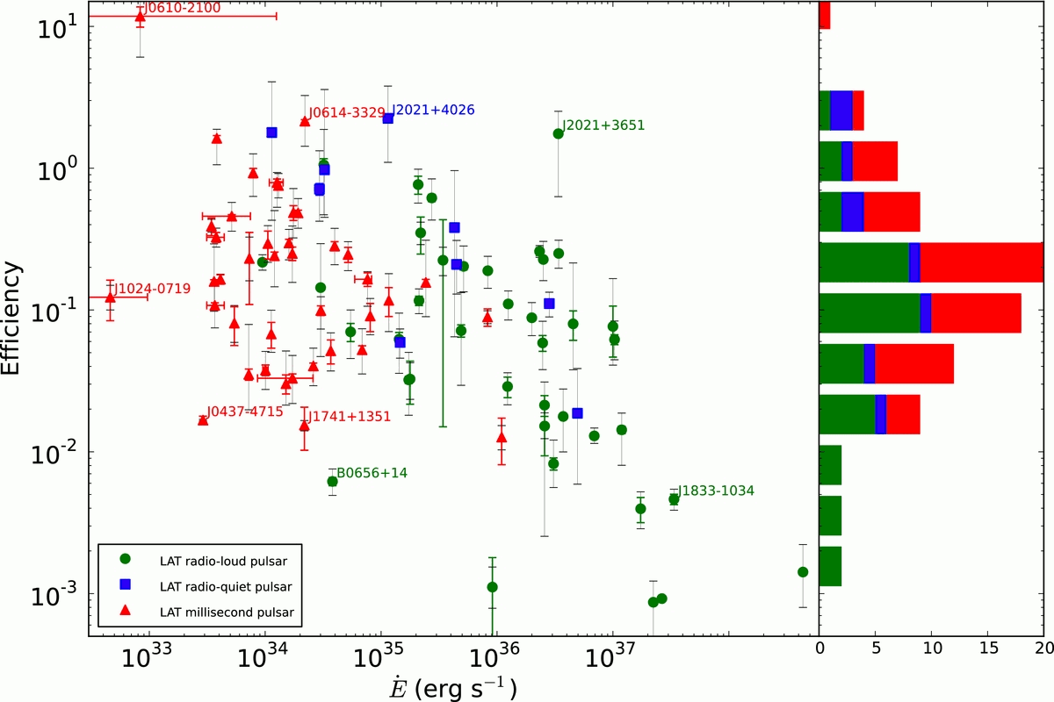
Kes 75: Magnetospheric γ-ray emission from PSR J1846-0258
Properties of “pulsed” γ-ray emission
Efficiency η_{g} ~ 1%
Photon index Γ_{psr} ~ 1.3
Cutoff Energy E_{cut}~1 GeV
Comparable to “normal” (rotation powered) pulsars
PSR J1846-0258
PSR J1846-0258
PSR J1846-0258
(Fermi 2PC; Abdo+ 2013)
(Straal+ 2023)
(Fermi 2PC; Abdo+ 2013)
(Fermi 2PC; Abdo+ 2013)

Slide 15
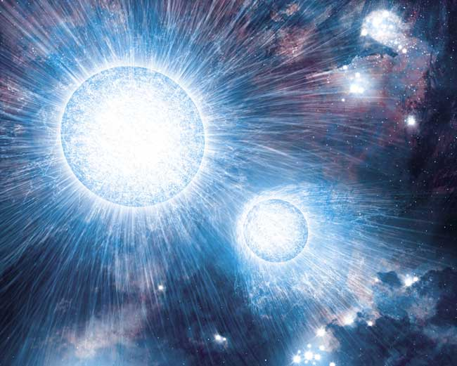
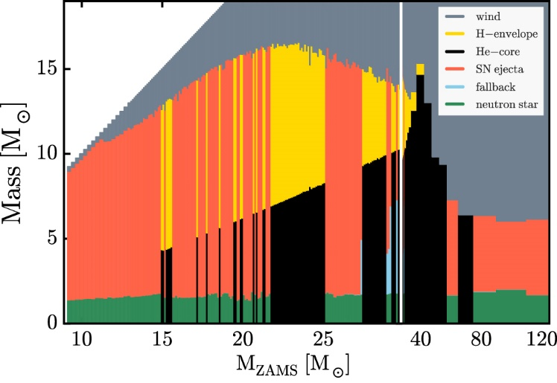
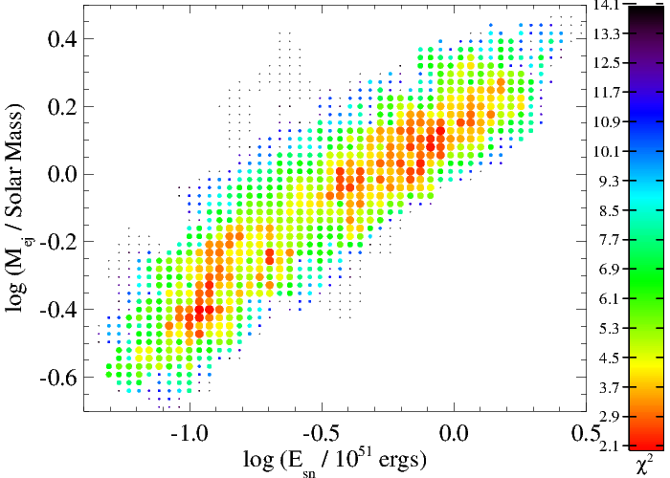
Kes 75: Progenitor Supernova / Star
Supernova ejecta mass very low
M_{ej} < 2 M☼
Physical implication
Massive star with extremely powerful winds?
Mass transfer to a binary companion?
(ESO)
(Sukhbold+ 2016)
(Straal, Gelfand+, in prep)

Slide 16
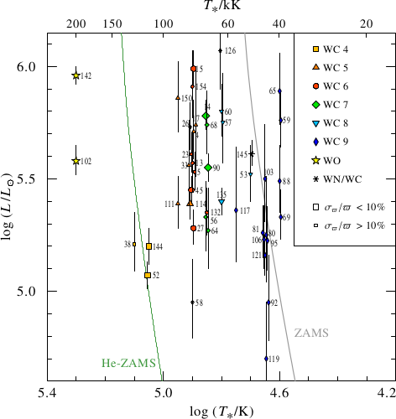
Kes 75: Wolf-Rayet Star inside PWN?
Background photon fields
CMB
T = 32 K, u = 15 eV / cm³
T=1.5×10⁵ K, u=3.4 keV/cm³
Origin of UV photon field?
T=1.5×10⁵ K, L = 6×10⁵ L☼ blackbody in PWN
Suprisingly similar to WO stars!
(Sander+ 2019)
(Straal+ 2023)

Slide 17
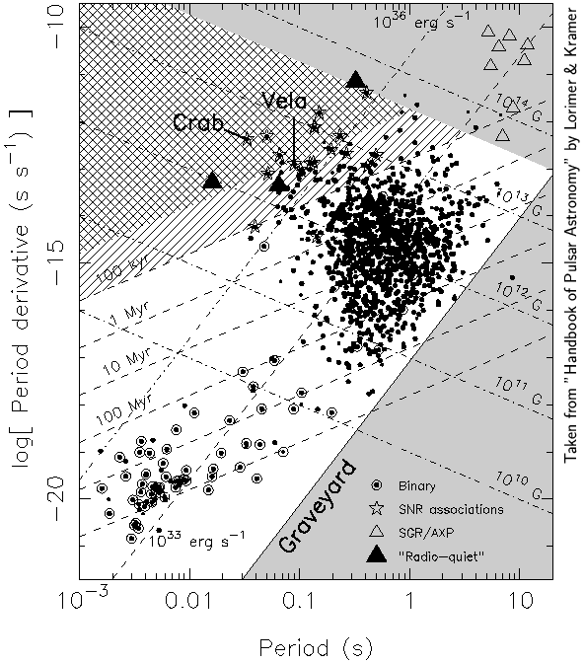
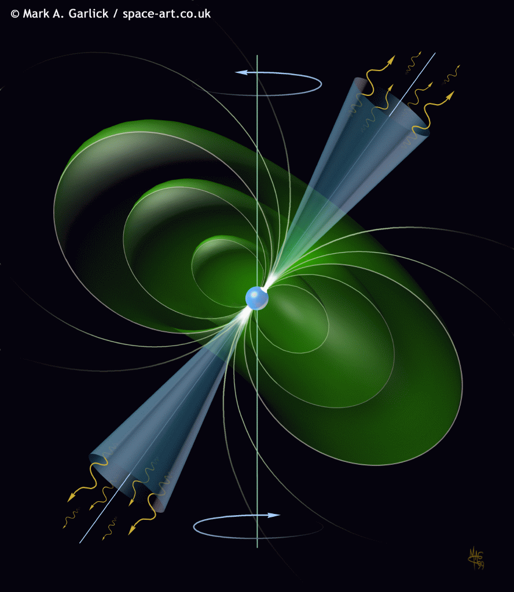
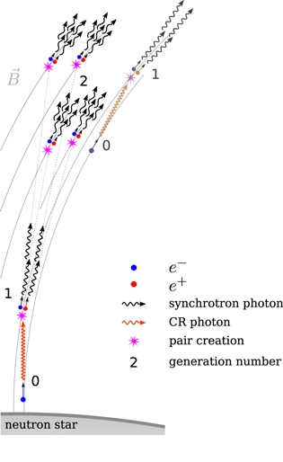
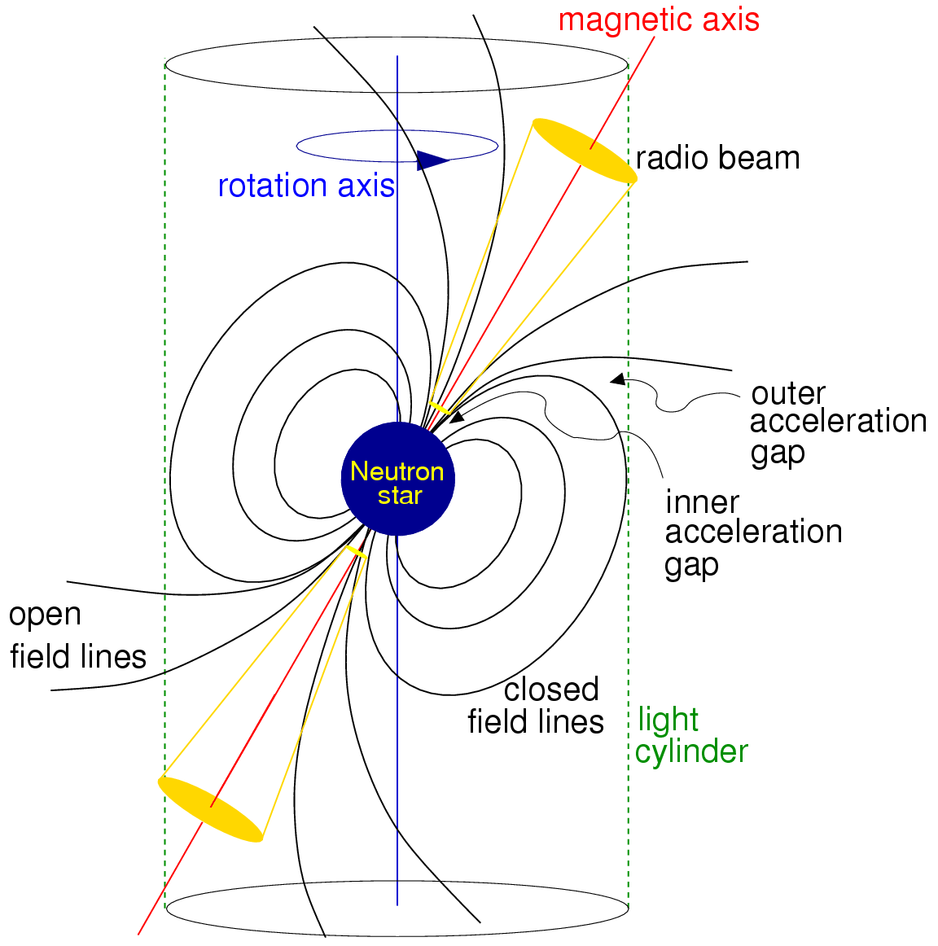
Pulsar = High V Battery → Powerful Current
(Young) neutron stars:
are rapidly rotating and
have strong surface magnetic fields,
Large Electric Potential
Charged particles “ripped” off surface at poles
pair produce in magnetosphere
Particles on open field lines leave magnetosphere
(Duncan & Lorimer, Handbook of Pulsar Astronomy)
(Timokhin & Harding 2015, ApJ, 810, 144)
(Duncan & Lorimer, Handbook of Pulsar Astronomy)

Slide 18
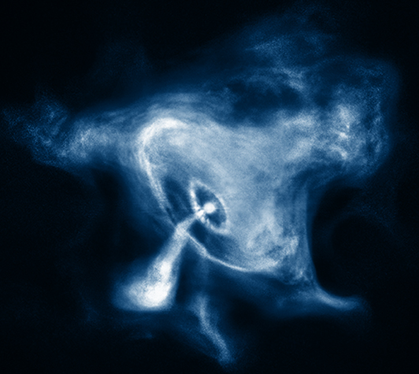
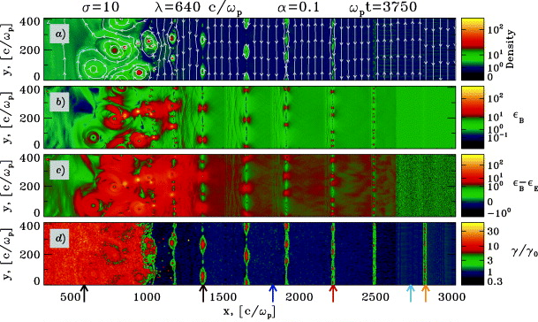
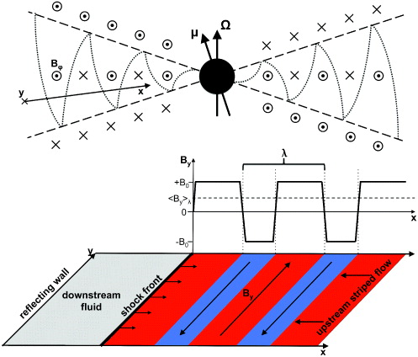
Unshocked → Shocked Pulsar Wind
Unshocked wind:
Primarily e±
Equatorial
Magnetically striped
Magnetically dominated
Confinement creates “termination shock”
Compression of striped wind
Particle acceleration
(Sironi & Spitkovsky, 2012, doi:10.1088/1749-4699/5/1/014014)
(Sironi & Spitkovsky, 2012, doi:10.1088/1749-4699/5/1/014014)
(Credit: X-ray: NASA/CXC/SAO)

Slide 19
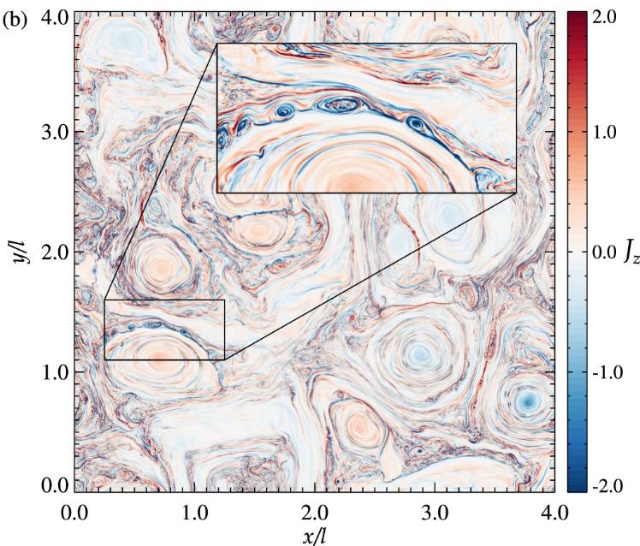
Particle Acceleration at Termination Shock
Kes 75
p₁ ~ 1.2 p₂ ~ 3.0
Shocked pulsar wind
Turbulent, highly relativistic, magnetized plasma
Acceleration mechanisms
Magnetic reconnection
Fermi acceleration
Observations → broken power-law injection spectrum
-p₁
E² × Number per Unit Energy
-p₂
E_{break}
E_{max}
E_{min}
Energy
(Comisso+ 2020)

Slide 20
Maximum Particle Energy
In general, E_{max} ≥ 1 PeV
and E_{max} > 0.2 eΦ_{psr}
Name | PSR | Ė_{psr} | eΦ_{psr} | E_{max}
G11.2-0.3 | J1811-1925 | 6.4×10³⁶ | 4.4 PeV | 1 – 30 PeV
Boomerang | J2292+6114 | 2.2×10³⁷ | 8.1 PeV | 3 – 4 PeV
G21.5-0.9 | J1833-1034 | 3.4×10³⁷ | 10 PeV | ~0.25 PeV
Eel | J1826-1256 | 3.6×10³⁶ | 3.3 PeV | 1.5 – 2.5 PeV
G54.1+0.3 | J1930+1852 | 1.2×10³⁷ | 6.0 PeV | ~0.3 PeV
HESS J1640-465 | J1640-4631 | 4.4×10³⁶ | 3.6 PeV | ~1.5 PeV
Kes 75 | J1846-0258 | 8.1×10³⁶ | 4.9 PeV | ~1 PeV
Why is E_{max} « eΦ_{psr} for G21.5-0.9 and G54.1+0.3?
Do these PWNe have different acceleration mechanisms?

Slide 21
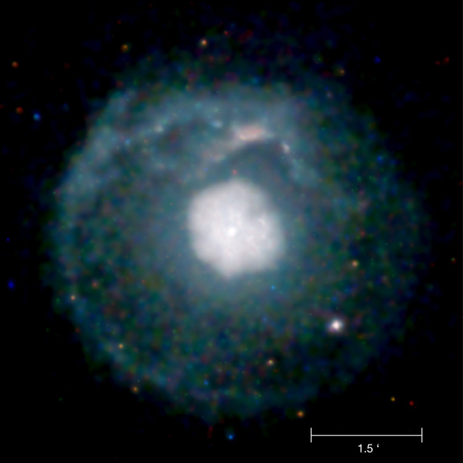
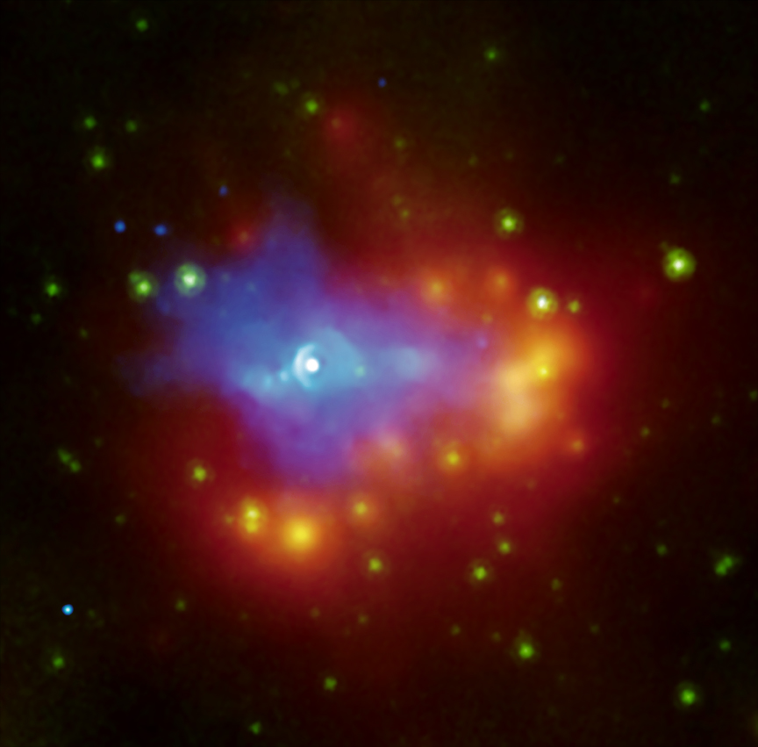
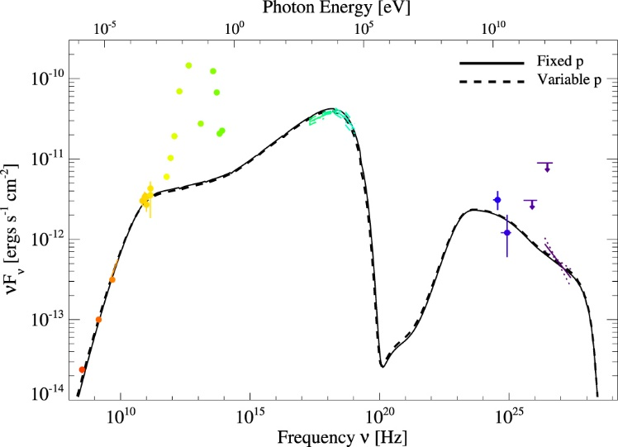
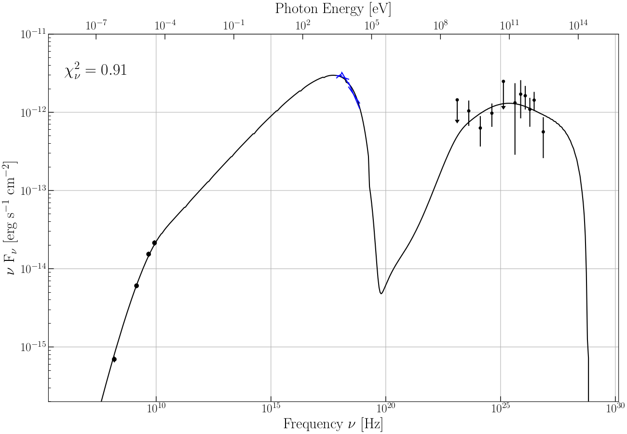
Particle Acceleration in Young PWNe
G21.5-0.0
G54.1+0.3
(Hattori+ 2020)
-p₂
-p₁
-p₁
E² × Number per Unit Energy
E² × Number per Unit Energy
p₁ ~ 2.9 p₂ ~ 2.5
(Alford+ in prep)
E_{max}
p₁ ~ 2.35
E_{max}
E_{min}
E_{break}
E_{min}
G21.5-0.0
Energy
G54.1+0.3
Energy
(Credit: NASA/CXC/U.Manitoba/H.Matheson & S.Safi-Harb)
(Alford+ in prep)
(Temim+ 2010)
(Hattori+ 2020)

Slide 22
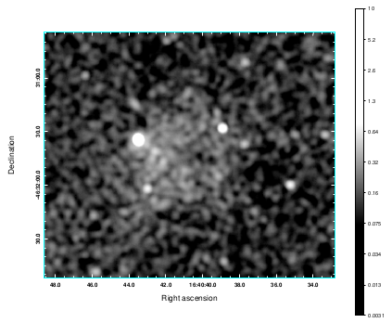
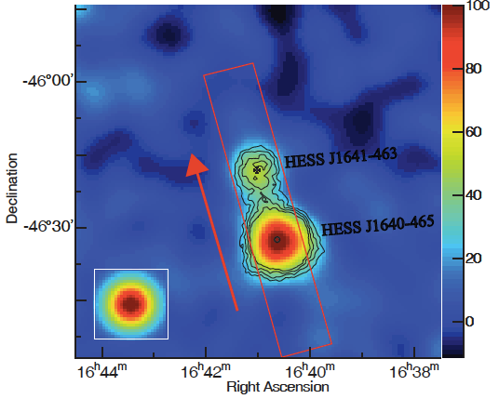
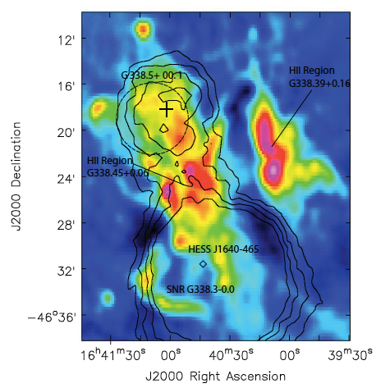
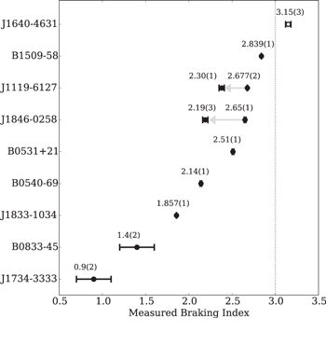
HESS J1640-465: “Stage 2” PWN in SNR
Most TeV luminous source in Galaxy
(possibly from a SNR)
Associated with:
a young, energetic pulsar
with an abnormably high braking index (p > 3),
and X-ray PWN offset from pulsar
(Abdelmaguid+ 2023)
(Gotthelf et al. 2014, ApJ ,788, 155)
( "Discovery of the hard VHE γ-ray source HESS J1641−463", H.E.S.S. Collaboration)
(R. F. Archibald et al. 2016, ApJL, 819, L16)
( "Discovery of the hard VHE γ-ray source HESS J1641−463", H.E.S.S. Collaboration)

Slide 23
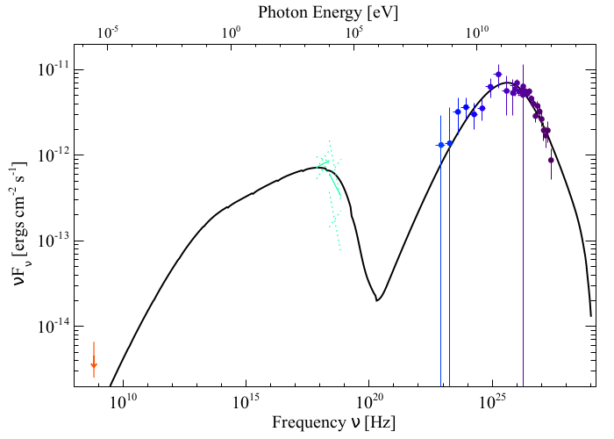
HESS J1640-465: γ-rays from a PWN or SNR?
Model reproduces SNR size, PWN size and SED
Why so TeV luminous?
Initial period P₀ ≈ 10 ms << current period P ≈ 206 ms
Initial spin-down luminosity Ė₀ ≈ 1.2×10⁴² ergs / s
Born spinning very rapidly
(Abdelmaguid+ 2023)

Slide 24
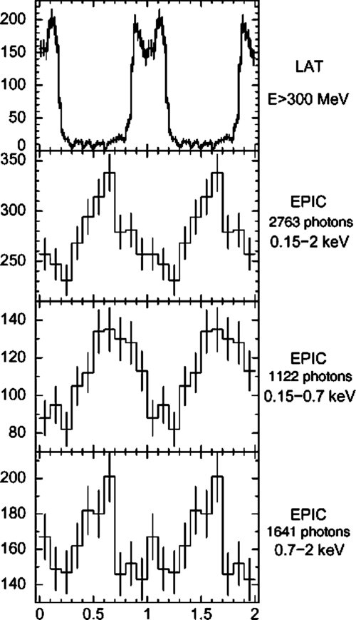
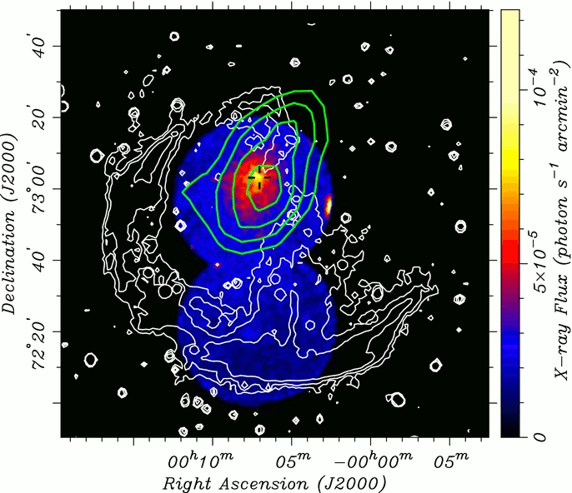
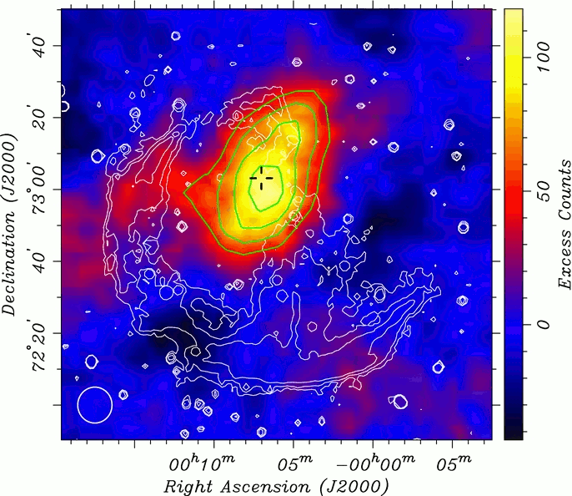
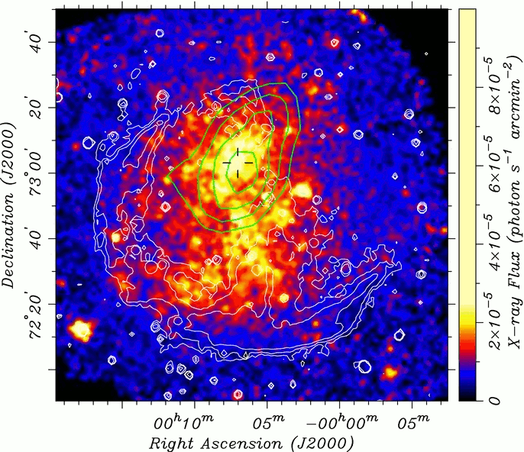
CTA 1: “Stage 2.5” PWN
“Mixed Morphology” SNR
Radio shell + central thermal X-rays
Energetic pulsar
Discovered in γ-rays
Associated with a PWN
Diffuse TeV emission
more extended than X-rays
(Caraveo+ 2010)
(Aliu+ 2013)
(Aliu+ 2013)
(Aliu+ 2013)

Slide 25
CTA 1: Structure of X-ray PWN (XMM)
Inner core (~5’)
Centered on pulsar
Fairly uniform surface brightness
Hard spectrum Γ ~ 2.0
Outer halo (>5’)
Sharp ~5× drop in surface brightness
Softer spectrum Γ ~ 2.1 – 2.5
Outer Halo = Particles escaping from inner core?
Escaped particles diffusing inside SNR → extended γ-rays?
(Alford+ in prep.)

Slide 26
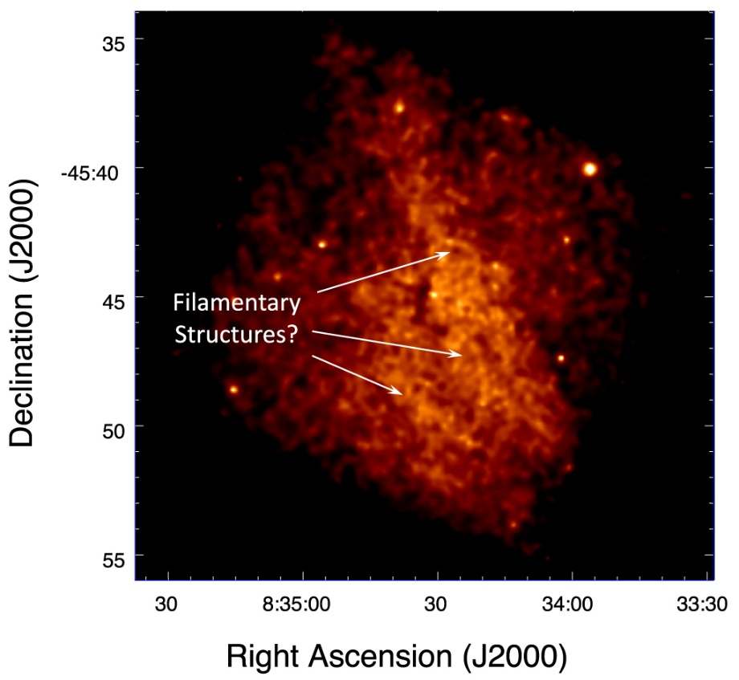
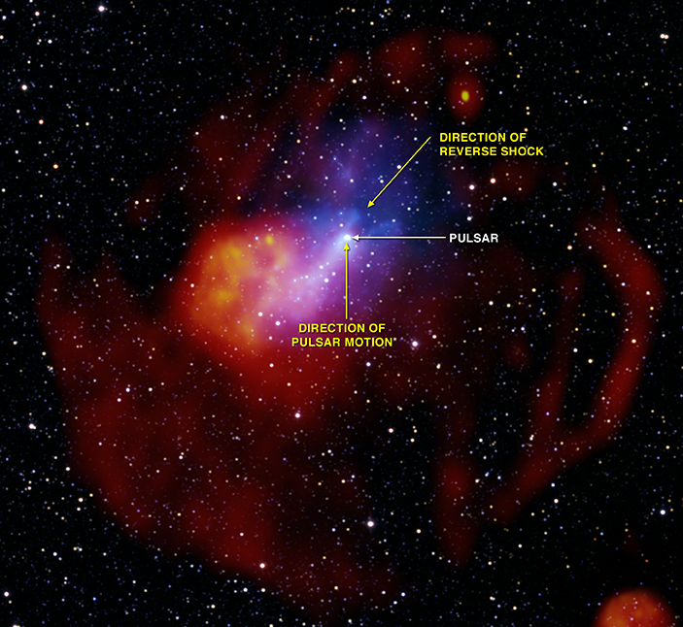
Sequence of “Stage 2” Particle Escape
(Aliu+ 2013)
(Slane+ 2018)
(Credit: X-ray: NASA/CXC/SAO/T.Temim et al, ESA/XMM-Newton; Radio: SIFA/MOST; Radio: CSIRO/ATNF/ATCA; Infrared: UMass/IPAC-Caltech/NASA/NSF/2MASS); Optical (DSS))

Slide 27
Summary / Conclusions
Studying PWNe offers a wealth of information on Galactic γ-ray sources
Variety of acceleration mechanisms
Injection of high-energy particles into ISM
Studying γ-rays provides important information on PWNe
Background photon fields → important environmental information
Crucial for constraining wind parameters (e.g., magnetization η_{B})
Hopefully more to come!

