Slide 1
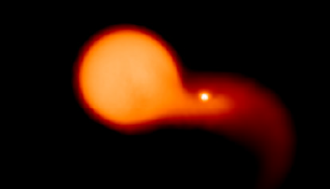


dy・;ypedyt
Ryosuke Hirai
Monash University
Collaborators
Ilya Mandel (Monash)
Mike Lau (Monash)
Philipp Podsiadlowski (Oxford)
ICRR seminar@ ICRR 14th Mar 2022

Slide 2
Multiplicity of massive stars
Most massive stars have 1 or more companions!
Sana et al. 2012
Moe & Di Stefano 2017
~70% of all massive stars have a companion close enough to interact

Slide 3
Diversity of massive binary evolution
Ongoing work
RH+’14,’15,’18,’20
Ogata,RH+’21
RH & Mandel ‘21
survival
1. Massive binary
2.1 Stable MT
3.1 Primary supernova
(type Ib/Ic/IIb supernova)
4.1 Wind accretion
(high mass X-ray binary)
envelope
ejection
disruption
Lau,RH+’22
RH+‘21
Ongoing work
stellar
merger
3.2 Rejuvenation
/rapid rotation
(blue stragglers,
luminous blue variables?)
4.2 Runaway stars
(hypervelocity stars)
2.2 Common envelope
envelope
ejection
My main area of research
stellar
merger
6.1 Compact binary
7. Case BB MT (?)
8. Secondary
supernova
(ultra-stripped supernova)
9. Double
compact object
(pulsar binaries,
gravitational wave sources)
5. Common envelope
6.2 Thorne-Zytkow object(?)

Slide 4
Wind accretion in close binaries
Asymmetrical acceleration of stellar winds

Slide 5
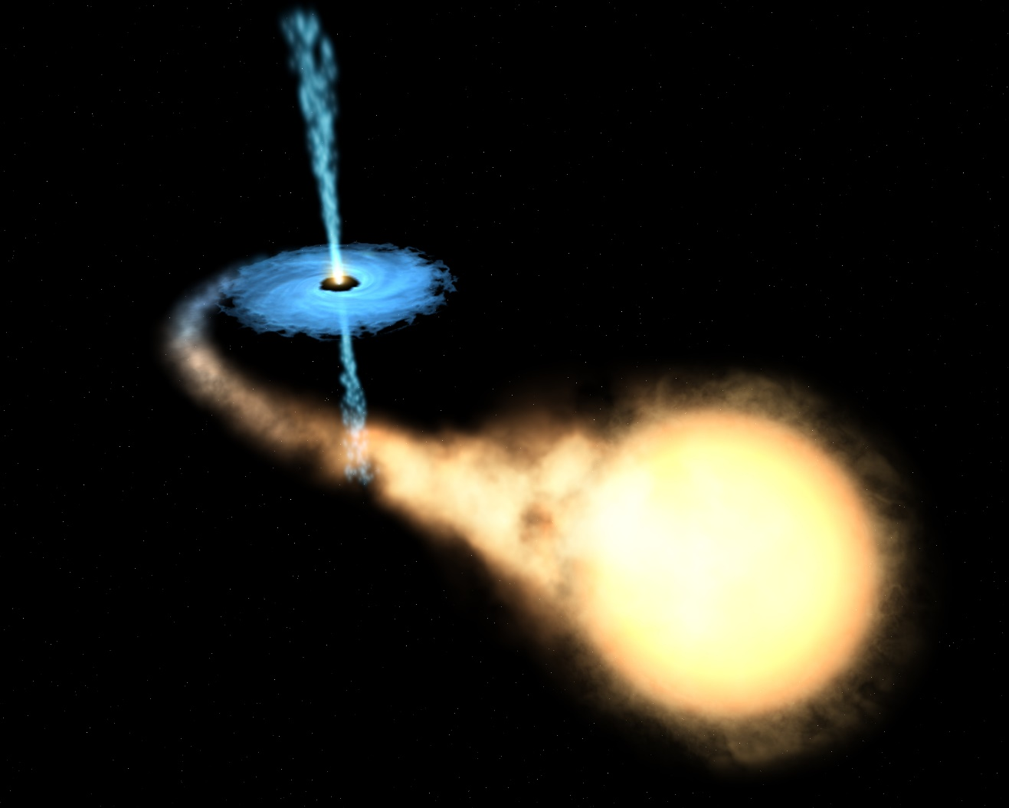
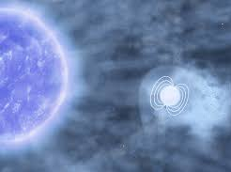
About X-ray binaries
X-ray binaries are binaries that consists of a compact object (neutron star or black hole) and a normal star
Low-mass X-ray binaries
Low-mass companions
  ≲ 1 M⦿, A-G type
Powered by Roche lobe overflow
e.g. Cen X-4, Sco X-1
High-mass X-ray binaries
Massive companions
  ≳ 4 M⦿, O-B type
Powered by wind accretion
(or Be decretion discs)
e.g. Cyg X-1, Vela X-1

Slide 6
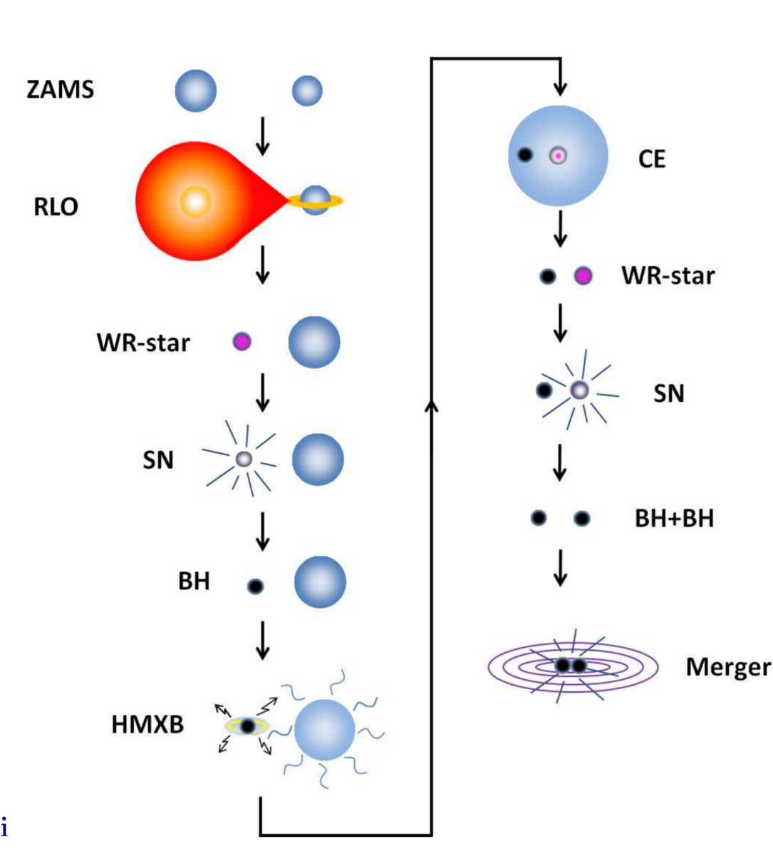
High-mass X-ray binaries (HMXBs)
A necessary step towards gravitational wave sources?
Many BBH mergers have been detected, meaning that there should be many HMXBs in the Universe
~53 in MW
Considering normal binary evolution, we expect ~33 BH-HMXBs to exist in the MW (Sen+2021)
~1 in MW
Tauris et al. 2017

Slide 7
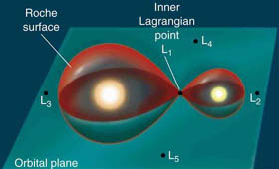
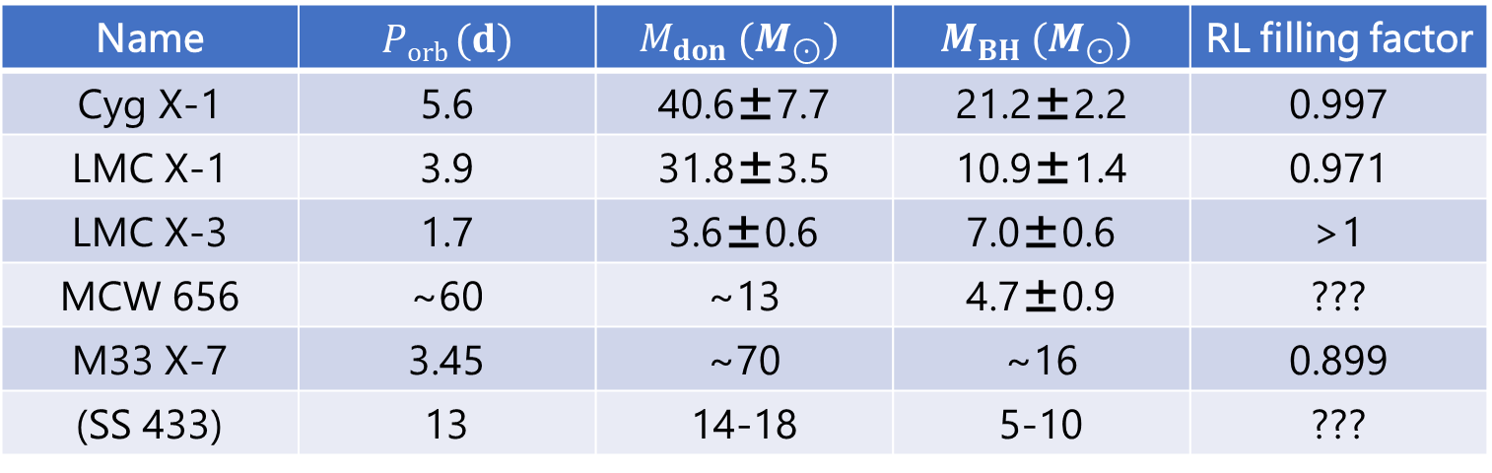
BH-HMXBs
There are only a handful of known HMXBs with black hole companions
Name | $Porb (d)$ | $$M_{don} (M_{⊙})$$ | $$M_{BH} (M_{⊙})$$ | RL filling factor
Cyg X-1 | 5.6 | 40.6±7.7 | 21.2±2.2 | 0.997
LMC X-1 | 3.9 | 31.8±3.5 | 10.9±1.4 | 0.971
LMC X-3 | 1.7 | 3.6±0.6 | 7.0±0.6 | >1
MCW 656 | ~60 | ~13 | 4.7±0.9 | ???
M33 X-7 | 3.45 | ~70 | ~16 | 0.899
(SS 433) | 13 | 14-18 | 5-10 | ???
Why are the RL filling factors all so high??
Is there a qualitative difference between high and low RL filling factors??
Known BH-HMXBs have relatively high Roche lobe filling factors

Slide 8
Wind accretion in close binaries
We discovered that the following 3 effects can alter the wind structure in close binaries
① Wind acceleration zone
② Escape velocity reduction
③ Gravity darkening

Slide 9


Line-driven winds
CAK theory (Castor, Abbott & Klein 1975)
  Opacity of UV spectral lines can be very high in an otherwise optically thin wind
Star
$$F_{λ}$$
$$λ$$
Emitting spectrum
Absorption spectrum (wind material)

Slide 10
Line-driven winds
CAK theory (Castor, Abbott & Klein 1975)
  Opacity of UV spectral lines can be very high in an otherwise optically thin wind
  Wind material efficiently captures photons from the stars due to
  “line deshadowing”
Star
$$F_{λ}$$
$$λ$$
Emitting spectrum
Absorption spectrum (wind material)

Slide 11
CAK theory (continued)
Cassinelli 1979
Equation of motion
parameters
continuum force
line force
optical depth parameter
The equations can be analytically solved under certain conditions, otherwise solved numerically
through “critical point analysis”

Slide 12
Wind accretion in close binaries
We discovered that the following 3 effects can alter the wind structure in close binaries
① Wind acceleration zone
② Escape velocity reduction
③ Gravity darkening

Slide 13
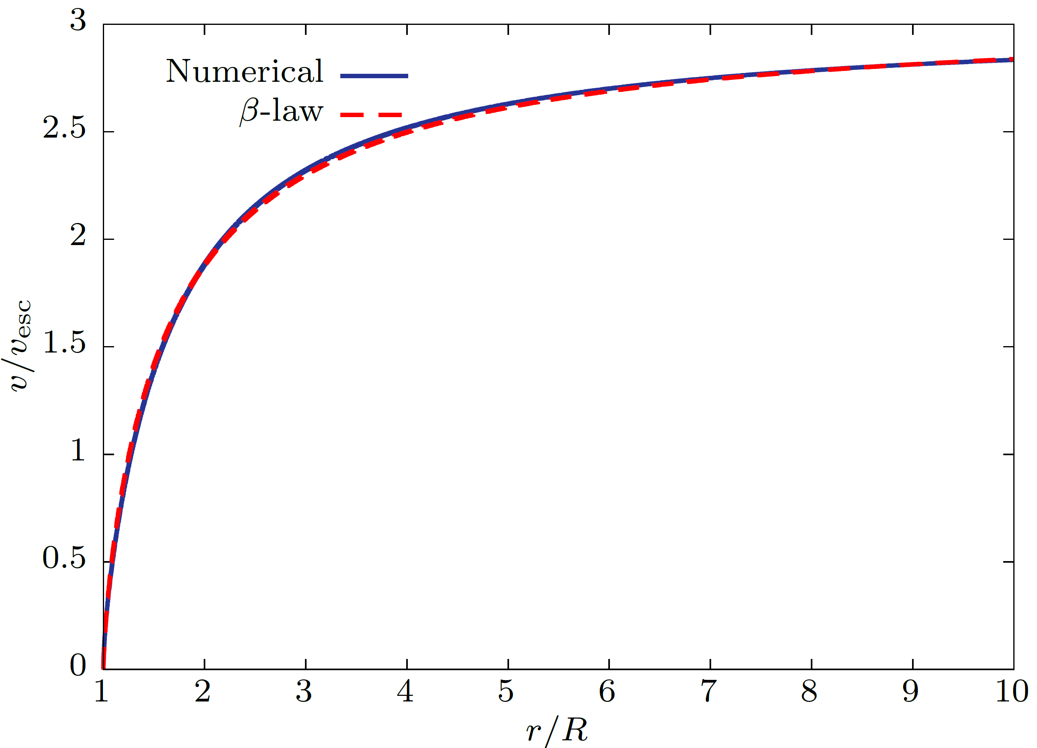
Wind acceleration zone
Winds are not emitted from the stellar surface with fast velocities, but are accelerated over some distance
Accreting wind can have a density gradient
The companion can be embedded in the slow part of the wind
El Mellah+2018

Slide 14
Wind accretion in close binaries
We discovered that the following 3 effects can alter the wind structure in close binaries
① Wind acceleration zone
② Escape velocity reduction
③ Gravity darkening

Slide 15
Rotation
Donor stars in close binaries can be rapidly rotating due to tidal locking
Owocki 2006
Wind terminal velocity scales with the effective escape velocity
Friend & Abbott 1986
Slower wind means larger Bondi radius=higher accretion rate

Slide 16
Wind accretion in close binaries
We discovered that the following 3 effects can alter the wind structure in close binaries
① Wind acceleration zone
② Escape velocity reduction
③ Gravity darkening

Slide 17
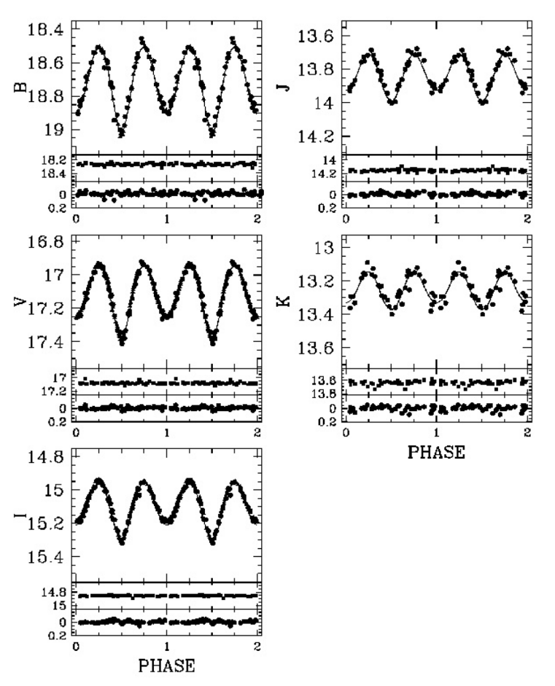
Gravity darkening
Altair
Stars can be highly asymmetric in close binaries
Monnier et al. 2007
Very dark towards the BH
Ellipsoidal variations
Lower radiative flux means
lower wind mass flux=lower accretion rate
Surface gravity distribution

Slide 18
Wind accretion in close binaries
We discovered that the following 3 effects can be important in close binaries
① Wind acceleration zone
② Escape velocity reduction
③ Gravity darkening

Slide 19
Method
Equation of motion for winds in binaries
Line acceleration
Velocity correction (VC)
Mass flux for line-driven winds
Gravity darkening (GD)

Slide 20
Results – wind streamlines
Wind streamlines for an almost Roche lobe filling case
Spherical driving
Anisotropic driving
A focused stream forms when the velocity correction is accounted for

Slide 21
Results – mass accretion rate
Mass accretion rate with the various additional effects switched on/off
RC and GD cancel out and end up with a similar value to normal Bondi accretion
Previous model
New model
←wide
close→

Slide 22
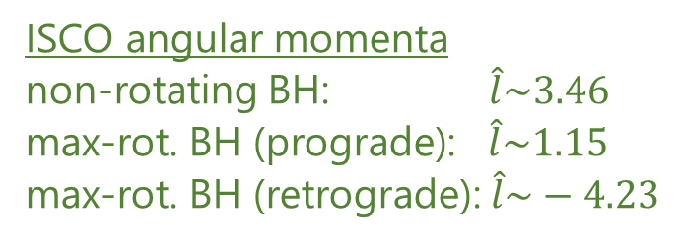
Results – angular momentum accretion
Change in accreted angular momentum with the various effects
Accretion disc
formation
Conversion formula from my weird units to accretor gravitational units
ISCO
Previous model
focused stream
New model
classical Bondi
ISCO
ISCO angular momenta
non-rotating BH: $\hat{l}\sim 3.46$
max-rot. BH (prograde): $\hat{l}\sim 1.15$
max-rot. BH (retrograde): $\hat{l}\sim −4.23$
←wide
close→
BH-HMXBs are only observable when the RL filling factor is f>0.8-0.9

Slide 23
Parameter study
Similar behaviours were found with different wind and binary parameters
Threshold for accretion disc formation is f>0.8-0.9?
Angular momentum
Critical condition for observability!

Slide 24
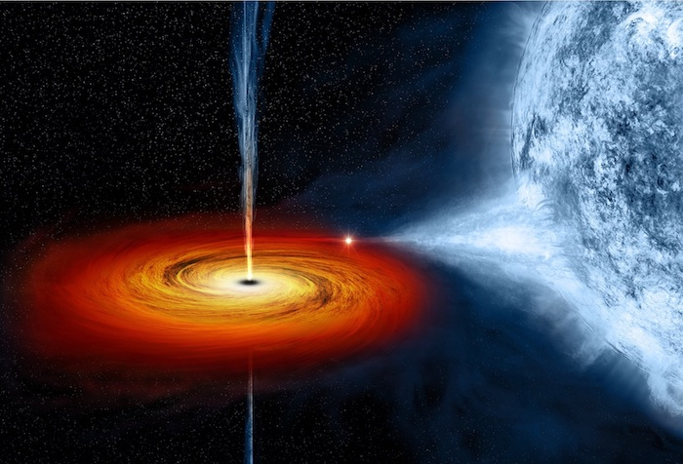
Conclusions
Observed number of BH-HMXBs are extremely small compared to the Galactic WR+O stars (progenitors of BH-HMXBs)
Wind flows in close binaries can be heavily influenced by the following three effects
  Wind acceleration zone
  Escape velocity reduction
  Gravity darkening
With all the additional effects combined,
  mass accretion rate is similar to Bondi-Hoyle accretion
  accreted angular momentum is strongly affected at high RL filling factors
There is a strong observational bias for RL filling factors f>0.8-0.9

Slide 25
Diversity of massive binary evolution
Ongoing work
RH+’14,’15,’18,’20
Ogata,RH+’21
RH & Mandel ‘21
survival
1. Massive binary
2.1 Stable MT
3.1 Primary supernova
(type Ib/Ic/IIb supernova)
4.1 Wind accretion
(high mass X-ray binary)
envelope
ejection
disruption
Lau,RH+’22
RH+‘21
Ongoing work
stellar
merger
3.2 Rejuvenation
/rapid rotation
(blue stragglers,
luminous blue variables?)
4.2 Runaway stars
(hypervelocity stars)
2.2 Common envelope
envelope
ejection
stellar
merger
6.1 Compact binary
7. Case BB MT (?)
8. Secondary
supernova
(ultra-stripped supernova)
9. Double
compact object
(pulsar binaries,
gravitational wave sources)
5. Common envelope
6.2 Thorne-Zytkow object(?)

Slide 26
Collisions between stars and NSs
Hypervelocity stars, pulsar planets, Thorne-Żytkow objects and peculiar transients

Slide 27
Supernovae in massive binaries
The majority of massive stars are in binary or multiple systems
companion
single
Has companion
Research topic
Investigate what happens when the new-born neutron star is directly kicked into the companion
We particularly focus on the formation of:
hypervelocity stars
pulsar planets
Zapartas et al. 2017

Slide 28
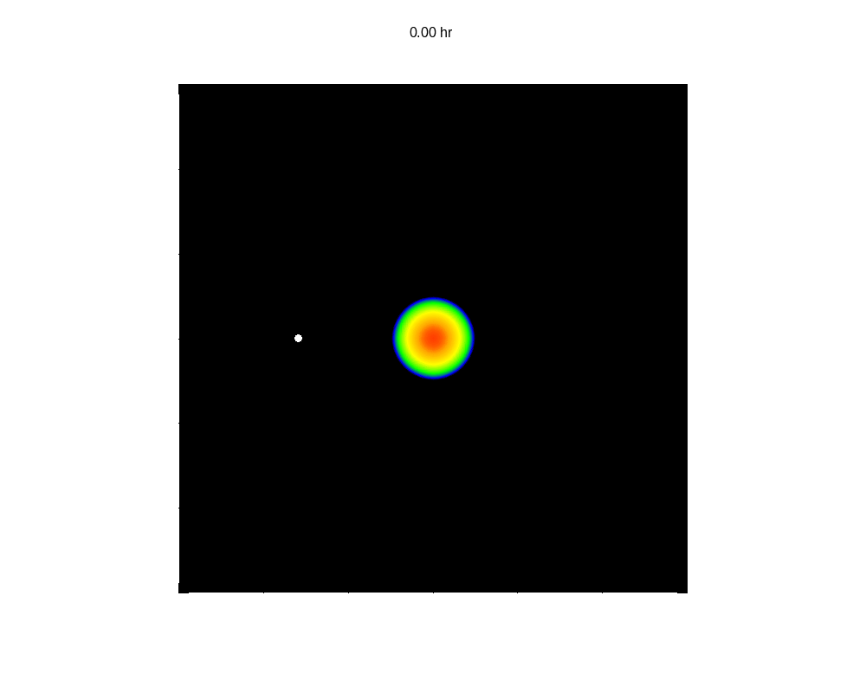
Hydrodynamical simulations
We carried out 3D hydro simulations of collisions between NSs and companion stars
Model parameters
SN progenitor mass：6 M_{ʘ}
NS mass：1.4 M_{ʘ}
Companion mass：5 M_{ʘ}
Orbital separation：8 R_{ʘ}
Kick speed：1000 km/s
Kick direction：Various
3 different outcomes
Penetrates star on unbound orbit
Penetrates star on bound orbit
Directly merges with companion
Penetrates envelope
Merger
(Tidally disrupts companion)

Slide 29
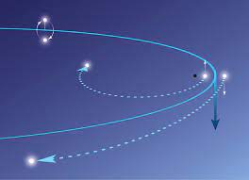
Hypervelocity stars
Many B stars (2.5-5M_{ʘ}) are being discovered with very high proper motions
SMBH
Hills mechanism
(Binary disruption by SMBH tides)
vs
Irrgang et al. 2018
Ejected from Galactic disc
Ejection velocity
Blaauw mechanism
(Binary disruption via SN)

Slide 30
Limit of the Blaauw mechanism
Runaway velocities for different kick angles
Bound
Tauris 2015
merger
Angle in orbital plane
Tauris 2015
Angle from orbital plane
Companions basically get kicked out with the orbital velocity
They can be accelerated/decelerated when the NS is kicked close to the star and causes a swing-by effect
There is an upper limit to the velocity achievable by this mechanism
→cannot explain the fastest hypervelocity star!

Slide 31
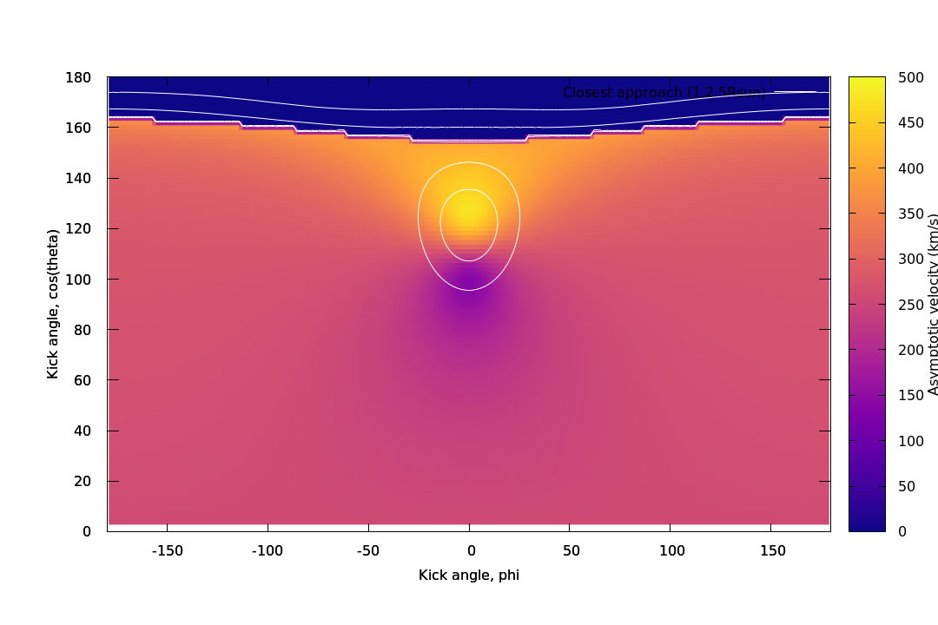
How to exceed the limit
Can we explain HVS5 within the Blaauw mechanism scenario?
Runaway velocities can be faster in simple 2-body problems
Envelope penetration
⇒The limit can be exceeded if the stars can avoid merger

Slide 32
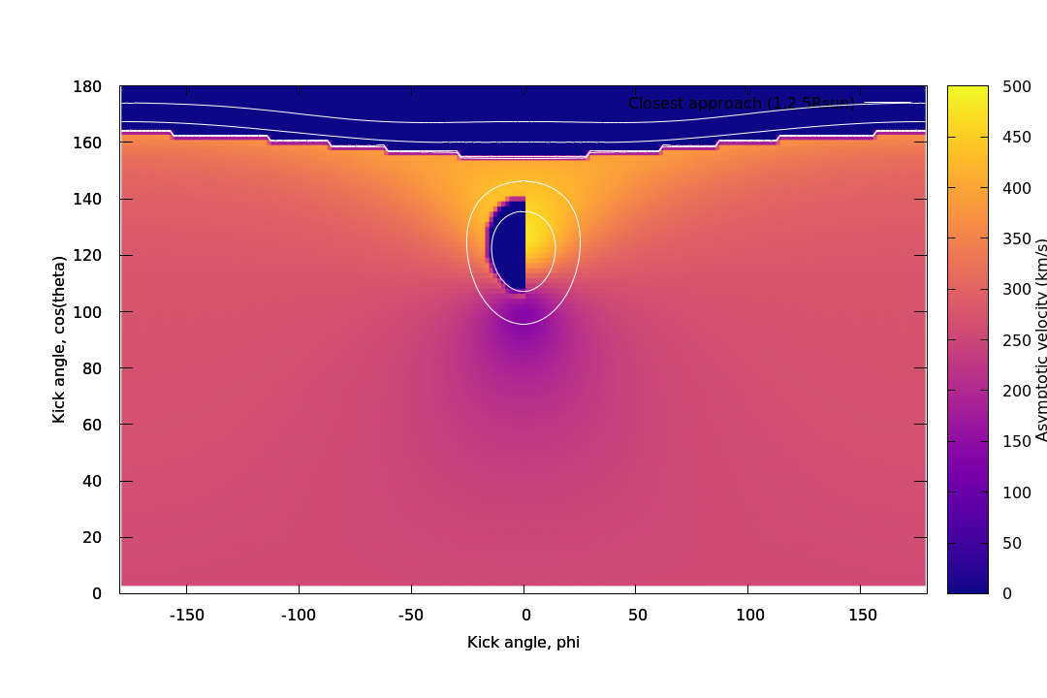
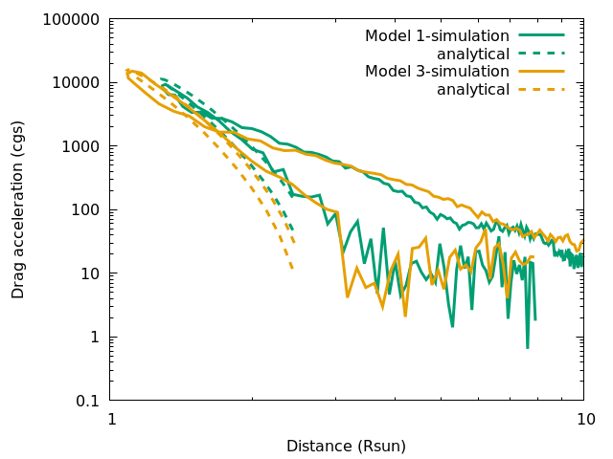
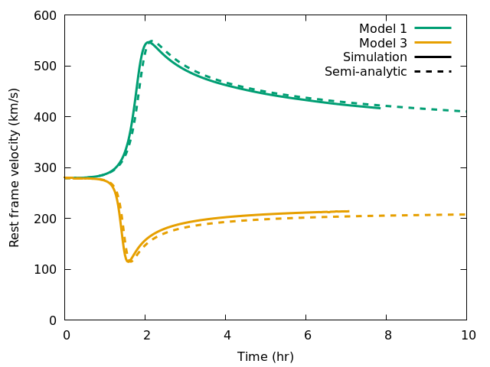
How fast can the companion get?
Fitted the drag force in the simulations with a semi-analytical model
We dynamically integrate the orbit with the drag model and calculate the runaway velocity
w/ drag
w/o drag
⇒Exceeded classical upper limit!!

Slide 33
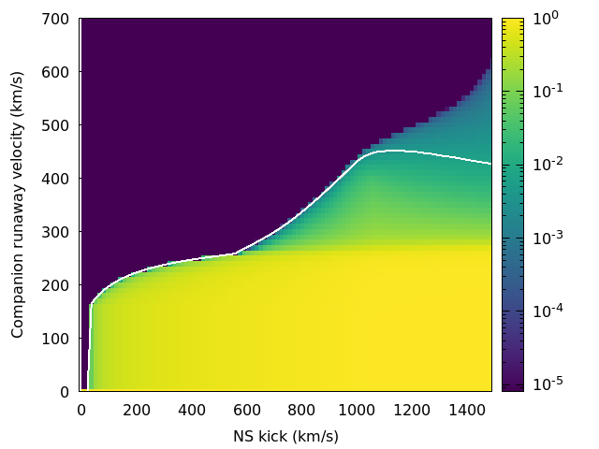
How fast can the companion get?
The classical limit can be exceeded by allowing envelope penetration
Classical limit
Runaway velocity（km/s）
Cumulative distribution
Kick velocity（km/s）

Slide 34
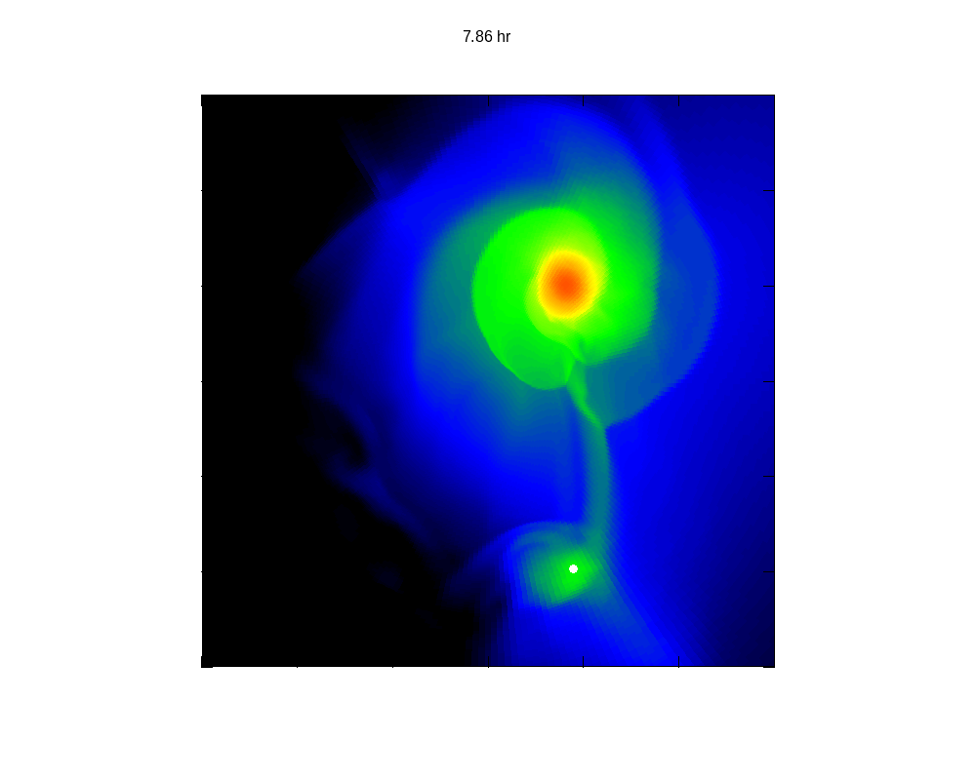
Origin of pulsar planets
The first discovered exoplanets were found around pulsars
e.g.
So far, >10 pulsar planets have been discovered
There are discoveries of protoplanetary discs around pulsars too
Origin scenarios
Dynamical capture
Steal planets from other stars in clustered environments
Evaporated companion
Evaporate a companion star via irradiation or pulsar winds
NS-WD merger
Create a protoplanetary disc by tidally disrupting a WD
Matter capture from companion
Capture part of the companion matter after SN to make a disc
Mercury orbit
B
A
コレ
PSR B1257+12
C

Slide 35
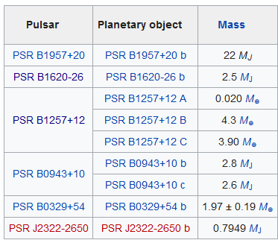
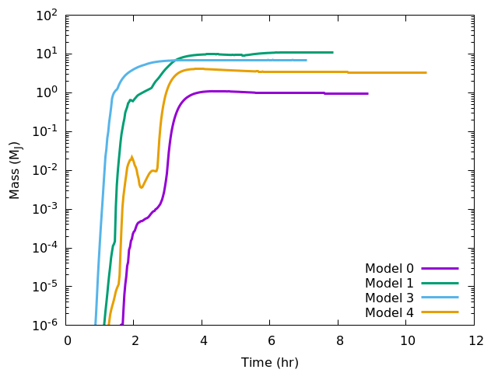
Mass captured by the new-born NS
In our simulation, the NS captured
1-10M_{J} of mass
Captured mass（M_{ʘ}）
From Wikipedia
Enough to explain the observed pulsar planet masses(?)
Time（hr）

Slide 36
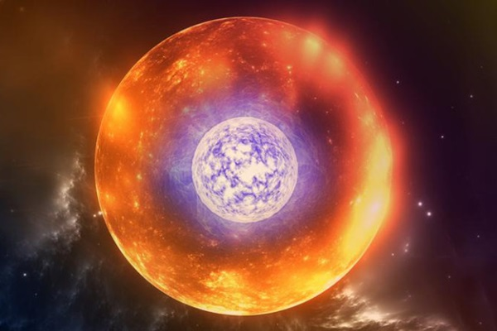
Thorne-Żytkow object formation
In the case of direct mergers, it may form a hypothetical star called Thorne-Żytkow objects (TŻOs)
Our scenario predicts that the TŻO formation rate may be lower than previously estimated

Slide 37
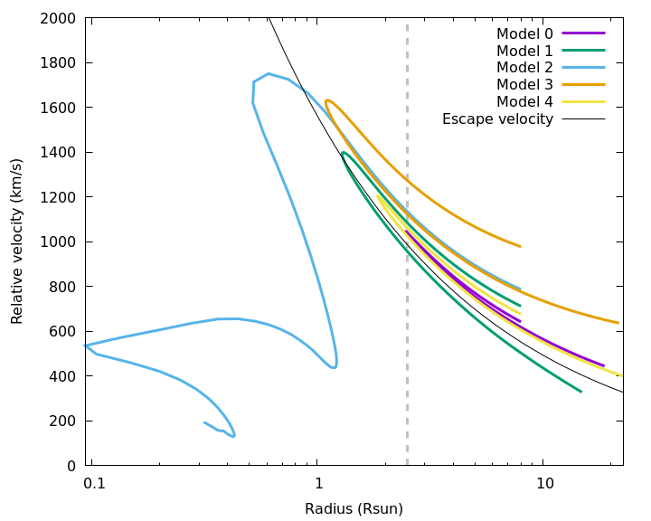
Peculiar transients
Mass accretion onto the NS may create some observable features
Optical: SN light curve may be partially powered by accretion
X-rays: Accretion disc may be visible if NS escapes into optically thin regions
Multiple penetrations may cause multiple peaks in the SN light curve?
Penetrates star but is sent on a bound orbit
Stellar radius
Arcavi et al. 2017

Slide 38
その他の天体や現象
降着で光る？
伴星を貫通するケースで、中性子星が持ち去る物質を降着する際にX線等で光る可能性がある。
超新星エジェクタがまだ光学的に厚いためX線は見えなくとも、内側からエネルギー供給をするfallback SNと似たような光度曲線が得られる可能性も？
今回シミュレーションした中で、一度貫通しつつもまだ束縛軌道にいるため複数回伴星と衝突しうるケースがあった。この場合は何度も伴星物質を持ち去ることができ、何度も光る可能性もあるかもしれない（iPTF14hls-like？）。
Thorne-Żytkow object形成
フィールド内衝突への応用
そのまんま中性子星と伴星が合体した場合、中性子星が中心に鎮座する巨星のような星＝Thorne-Żytkow objectを形成する。本研究で考えた伴星を貫通するケースを許すと、TŻO形成のためのパラメータ領域は狭まる。
連星内の超新星後に限らず中性子星と恒星との衝突は起きうる。疑似超新星SN2010daに付随したNGC300ULX-1の誕生はフィールド内での衝突によってNSをキャプチャしたケース？

Slide 39

Summary
We performed 3D hydrodynamical simulations of collisions between new-born NSs and companion stars
There were 4 different outcomes
  Envelope penetration+binary disruption
  Hypervelocity stars exceeding the classical theoretical limit can be produced by allowing envelope penetration
  Pulsar planets or peculiar transients may be created
  Multiple penetrations
  Transients with multiple peaks?
  Direct merger
  TZO formation rates may be lower than previously considered
  Tidal disruption
  May be observable as dim TDEs?

Slide 42
Diversity of massive binary evolution
Ongoing work
RH+’14,’15,’18,’20
Ogata,RH+’21
RH & Mandel ‘21
survival
1. Massive binary
2.1 Stable MT
3.1 Primary supernova
(type Ib/Ic/IIb supernova)
4.1 Wind accretion
(high mass X-ray binary)
envelope
ejection
disruption
Lau,RH+’22
RH+‘21
Ongoing work
stellar
merger
3.2 Rejuvenation
/rapid rotation
(blue stragglers,
luminous blue variables?)
4.2 Runaway stars
(hypervelocity stars)
2.2 Common envelope
envelope
ejection
stellar
merger
6.1 Compact binary
7. Case BB MT (?)
8. Secondary
supernova
(ultra-stripped supernova)
9. Double
compact object
(pulsar binaries,
gravitational wave sources)
5. Common envelope
6.2 Thorne-Zytkow object(?)

Slide 43
Common envelope evolution
Beyond the energy formalism

Slide 44
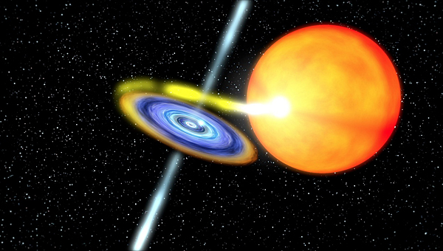
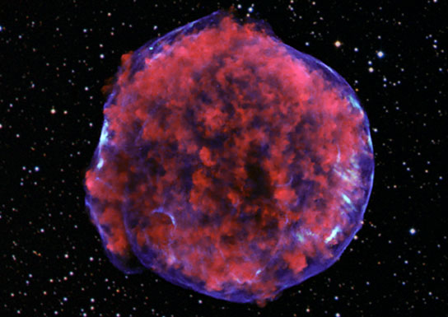
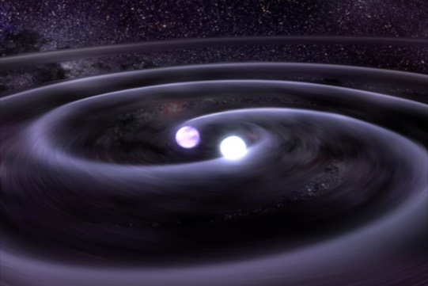
What is a common-envelope phase?
A vital process for many astronomical objects
RSG
MS
NS
RSG
Common envelope
more…
X-ray binaries
Type Ia supernova
Binary NS/BH

Slide 45
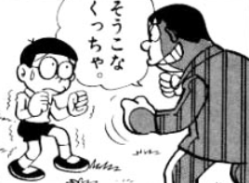


What do we want to know?
Goal:
To predict final state from initial conditions
secondary
primary
secondary
primary
separation
separation
Initial conditions
M_{1,i}, M_{2,i}, a_{i}, e_{i},
R_{1,i}, R_{2,i}, ω_{1,i}, ω_{2,i} , etc…
Common Envelope
α, λ, γ, etc…
Final state
M_{1,f}, M_{2,f}, a_{f}, e_{f}, R_{1,f}, R_{2,f}, ω_{1,f}, ω_{2,f} , etc…
Parametrization is needed for population synthesis

Slide 46

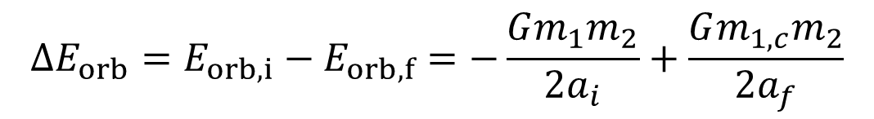

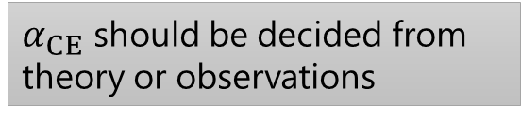
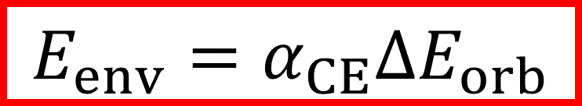






Energy formalism
“α-formalism” (Webbink 1984)
$$E_{env}=α_{CE}∆E_{orb}$$
$$∆E_{orb}=E_{orb,i}−E_{orb,f}=−\frac{Gm_{1}m_{2}}{2a_{i}}+\frac{Gm_{1,c}m_{2}}{2a_{f}}$$
$${2a}_{i}$$
Common envelope
$$m_{1}$$
$$m_{2}$$
$$m_{1,c}$$
$$2a_{f}$$
$$m_{2}$$
$α_{CE}$: efficiency of envelope ejection
$α_{CE}$ should be decided from theory or observations
$E_{env}$: binding energy of the ejected envelope

Slide 47
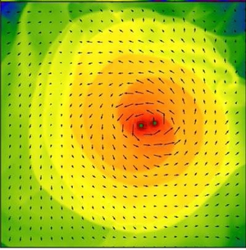
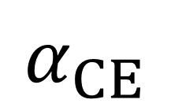
Common-envelope modelling
1D hydro
3D hydro
Passy et al. 2012
$$α_{CE}$$
Fragos et al. 2019
Ohlmann et al. 2016
Reichardt et al. 2019
Clayton et al. 2017
Iaconi et al. 2017

Slide 48
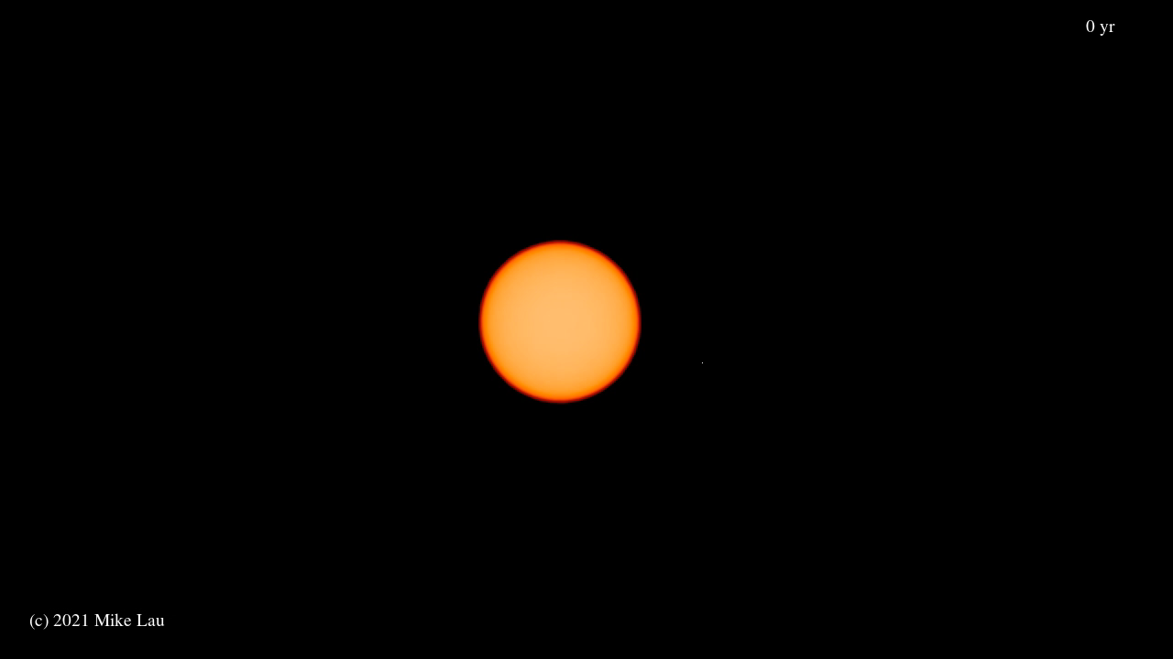

Our 3D hydrodynamical simulation
First massive star CE simulation
Code: Phantom (SPH)
Donor: 12Msun RSG
Companion: 3Msun MS
EoS: ideal gas
ideal gas+radiation
tabulated EoS
Mike Lau

Slide 49
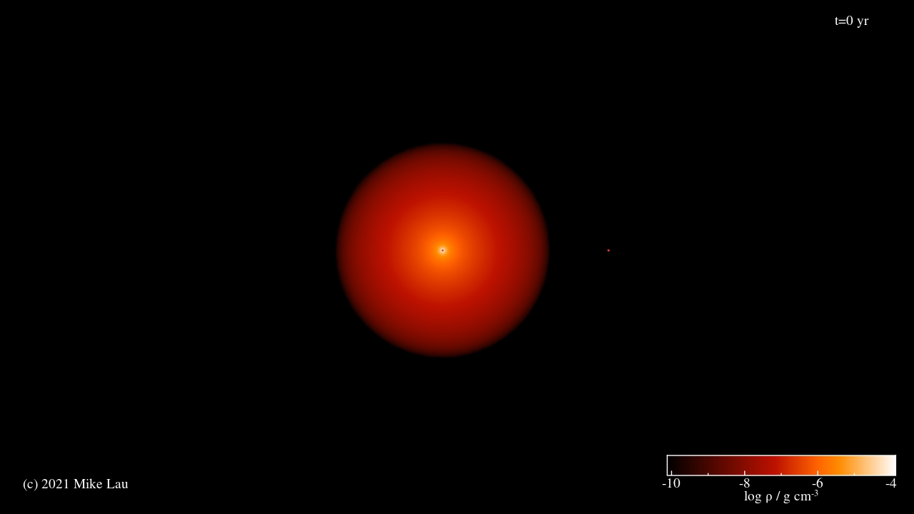
Results – movie on equatorial plane
Gas+rad EoS

Slide 50
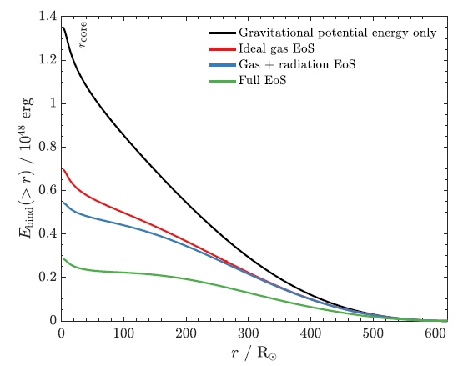
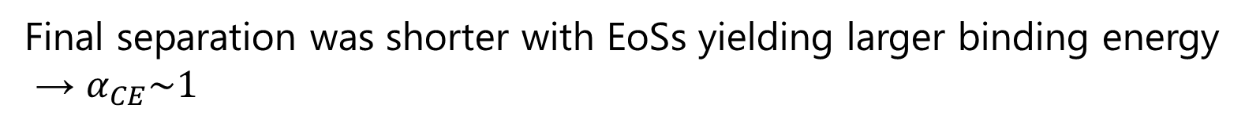
Results – final separation
Separation (Rsun)
-2 -1 0 1 2 3 4 5 6 7
Time (yr)
Final separation was shorter with EoSs yielding larger binding energy
→ $α_{CE}\sim 1$

Slide 51
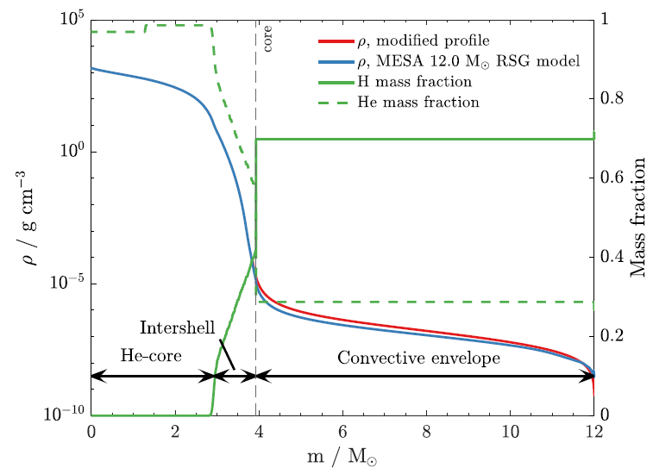
Caveats
We did not model the radiative part of the envelope, which has a much larger binding energy
We did not include radiation transport
The thermal timescale of the convective envelope is comparable to the spiral-in timescale
We have no nuclear burning source
The energy generation is non-negligible over our simulation timescale
We have no radiative cooling
Part of the recombination energy can possibly be radiated away
Energy formalism is useless for massive star common envelopes!

Slide 52
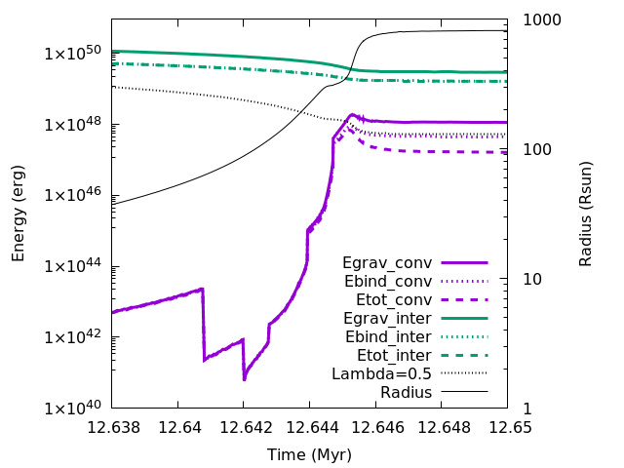
Common envelopes as a 2-step process
Energy formalism
Stable mass transfer
This new formalism predicts systematically wider post-CE separations
Discussing with Kinugawa-san whether this affects Pop III BBH predictions

Slide 53
Summary
We performed the first 3D common-envelope simulations in the world for massive stars
The equation of state plays an important role in determining the final separation
We found more caveats than results from our simulations…
The caveats led us to believe that the use of the energy formalism is not appropriate for massive stars
We are working on a new formalism assuming a 2-phase CE

