Slide 1



The EUSO projects and Roadmap for Ultra-High Energy Cosmic Ray Observation from Space
JPS
21/9/2014
M. Casolino,
The JEM-EUSO collaboration
RIKEN – GRO
INFN & University of Rome Tor Vergata

Slide 2
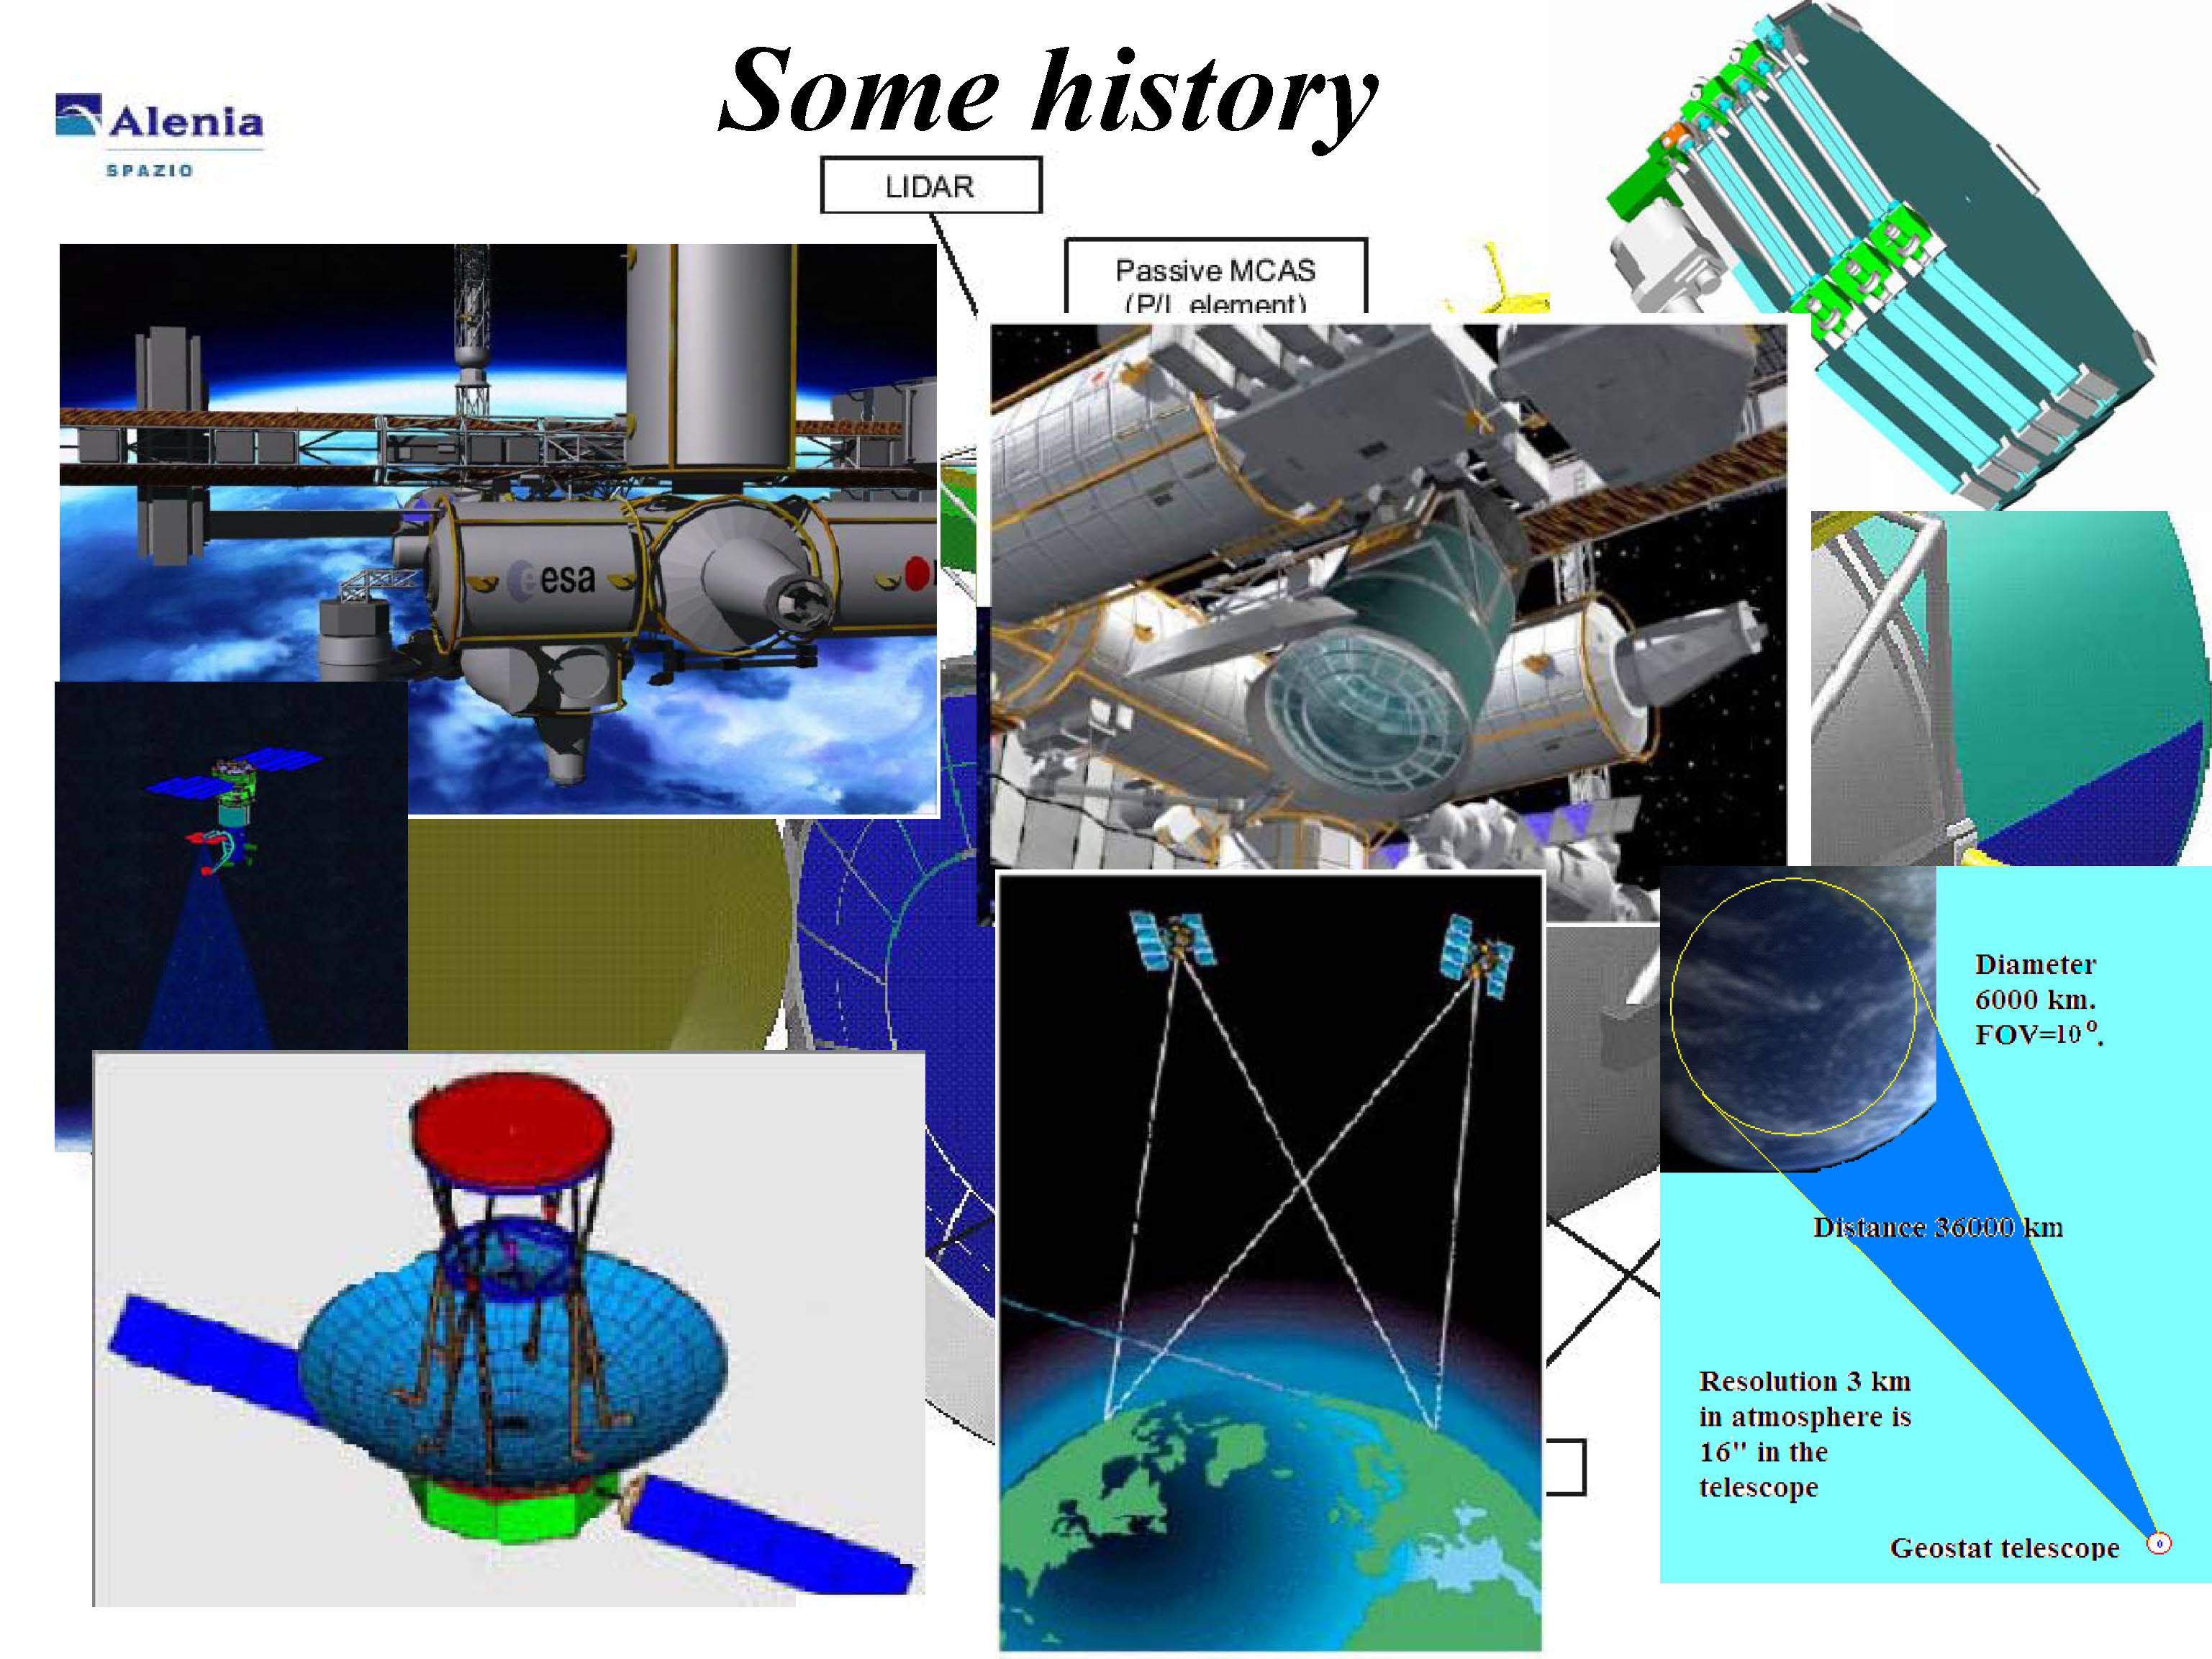
UHECR observation from Space

Slide 3
Advantages
Uniform distance from shower
Uniform sky coverage
Several orders of magnitude of active area
Disadvantages
Expensive, space constraints
Small signal → Large optics
Poor Xmax resolution

Slide 4
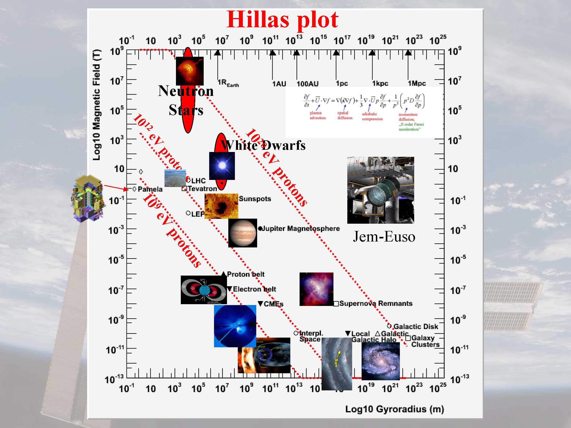

Slide 5
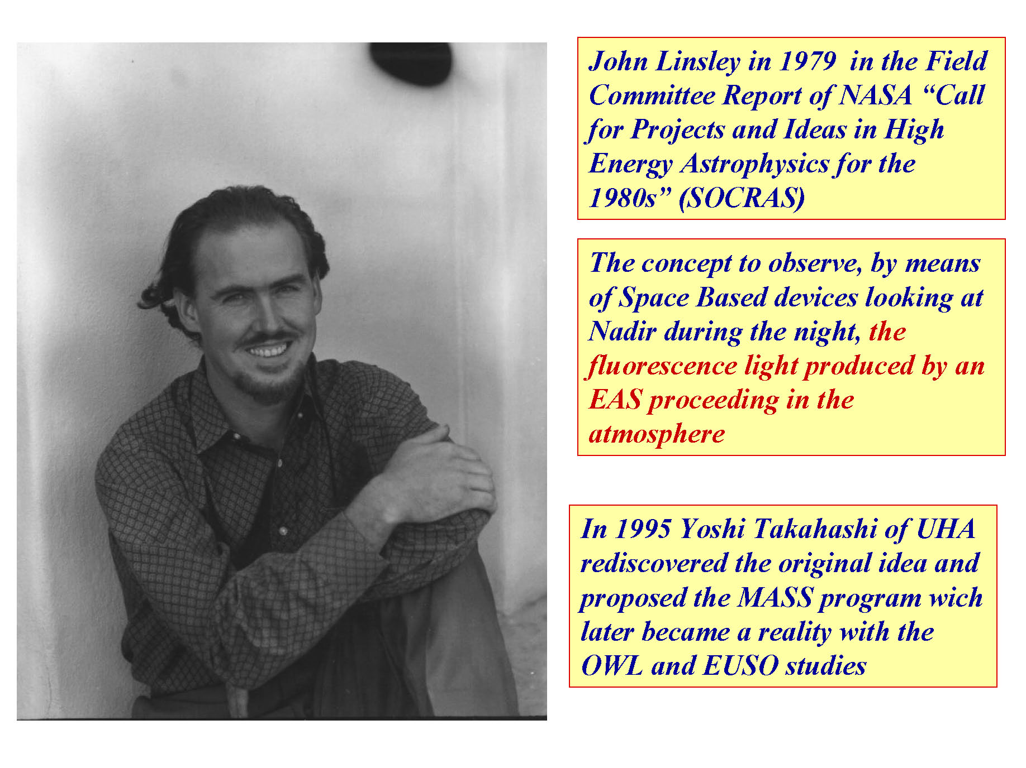
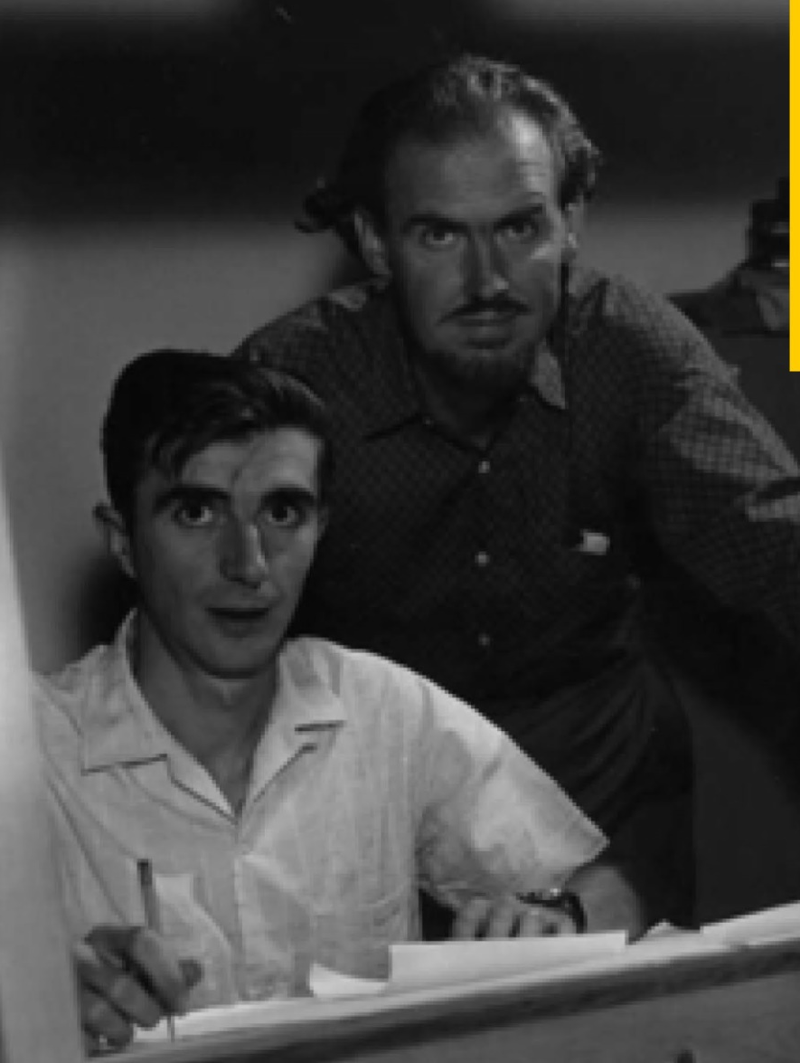
Historical notes

Slide 6

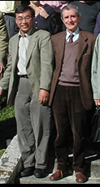
Historical notes (2)

Slide 7
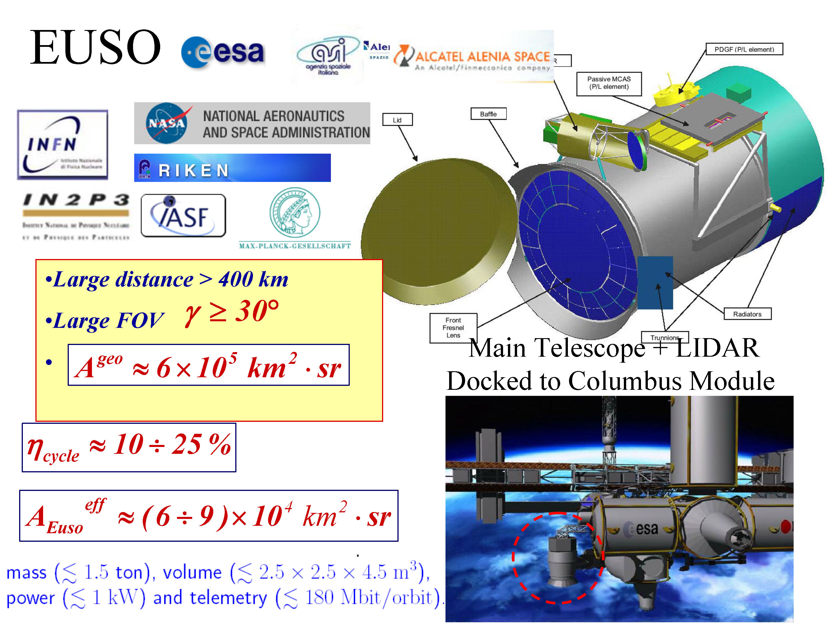
ESA-EUSO (Columbus module)

Slide 8
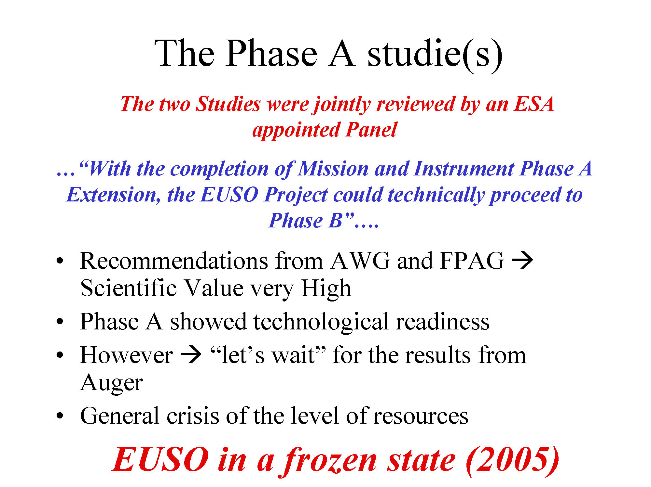

Slide 9
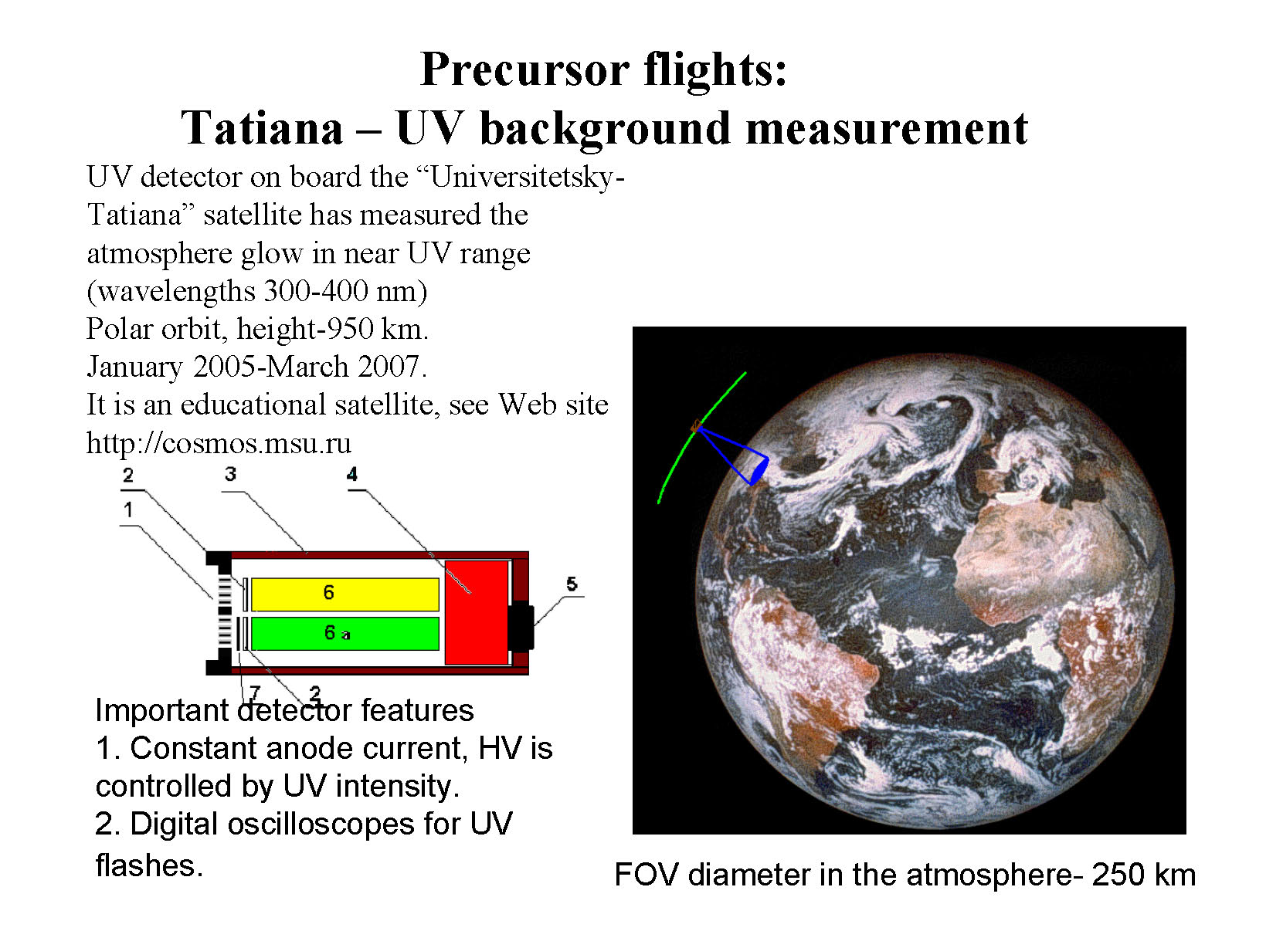

Slide 10
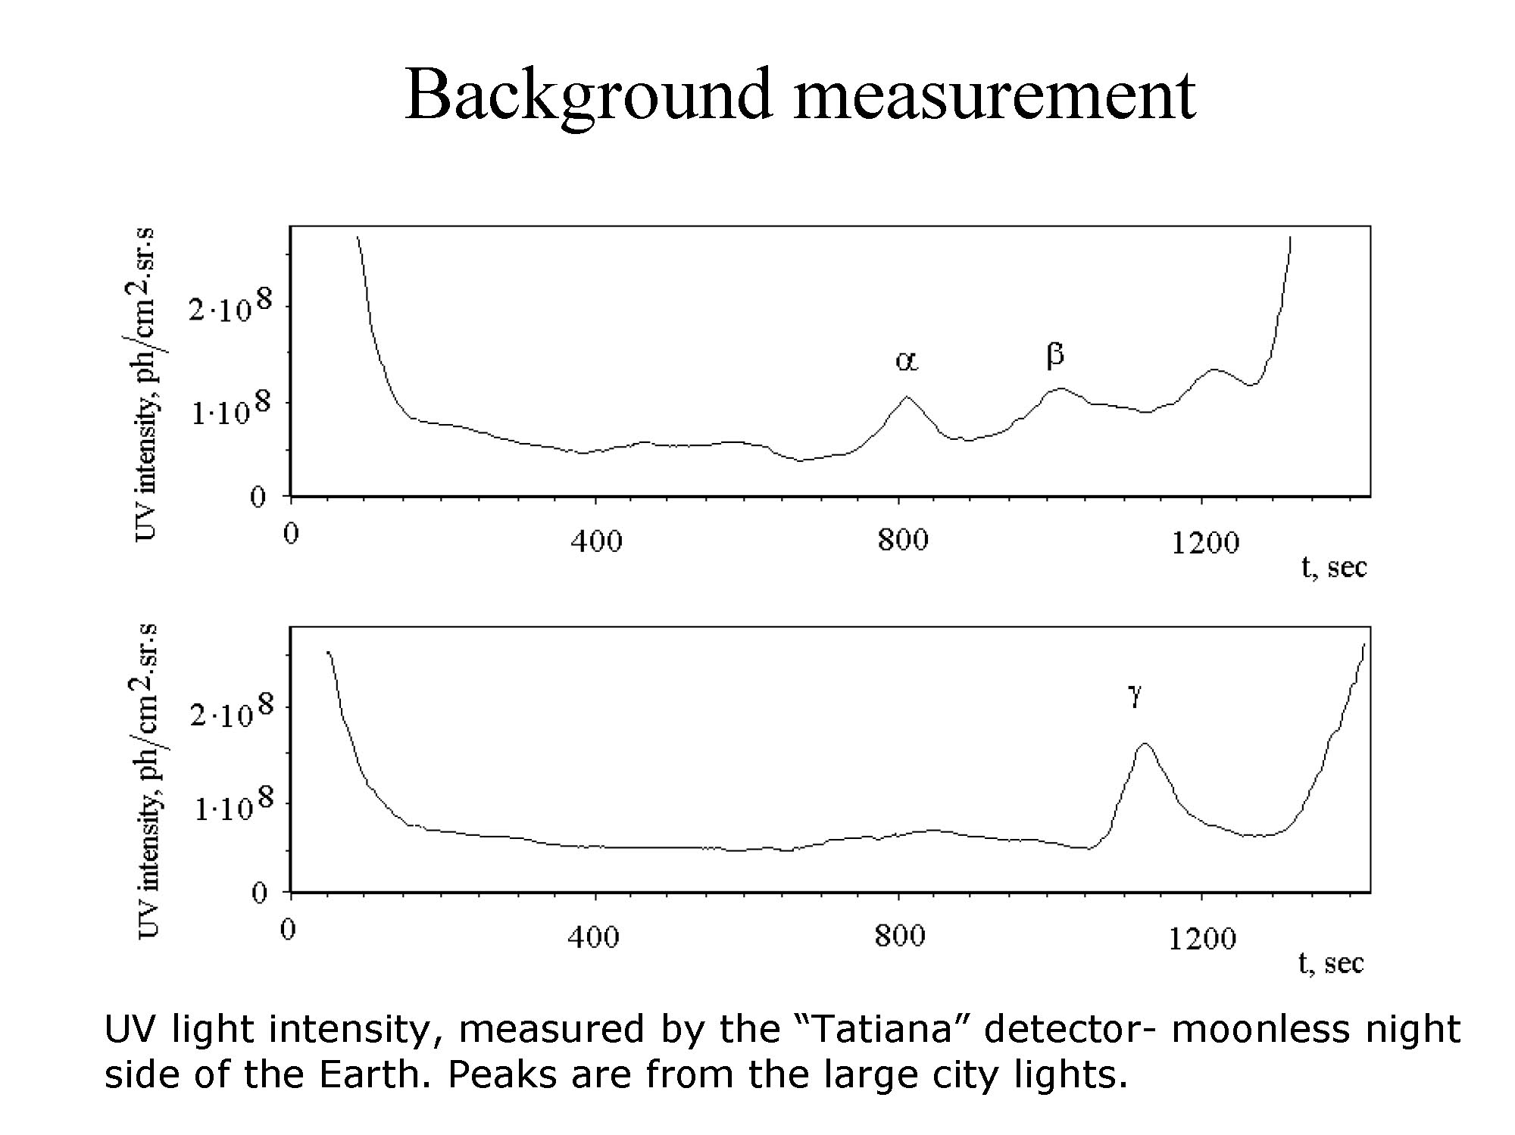

Slide 11
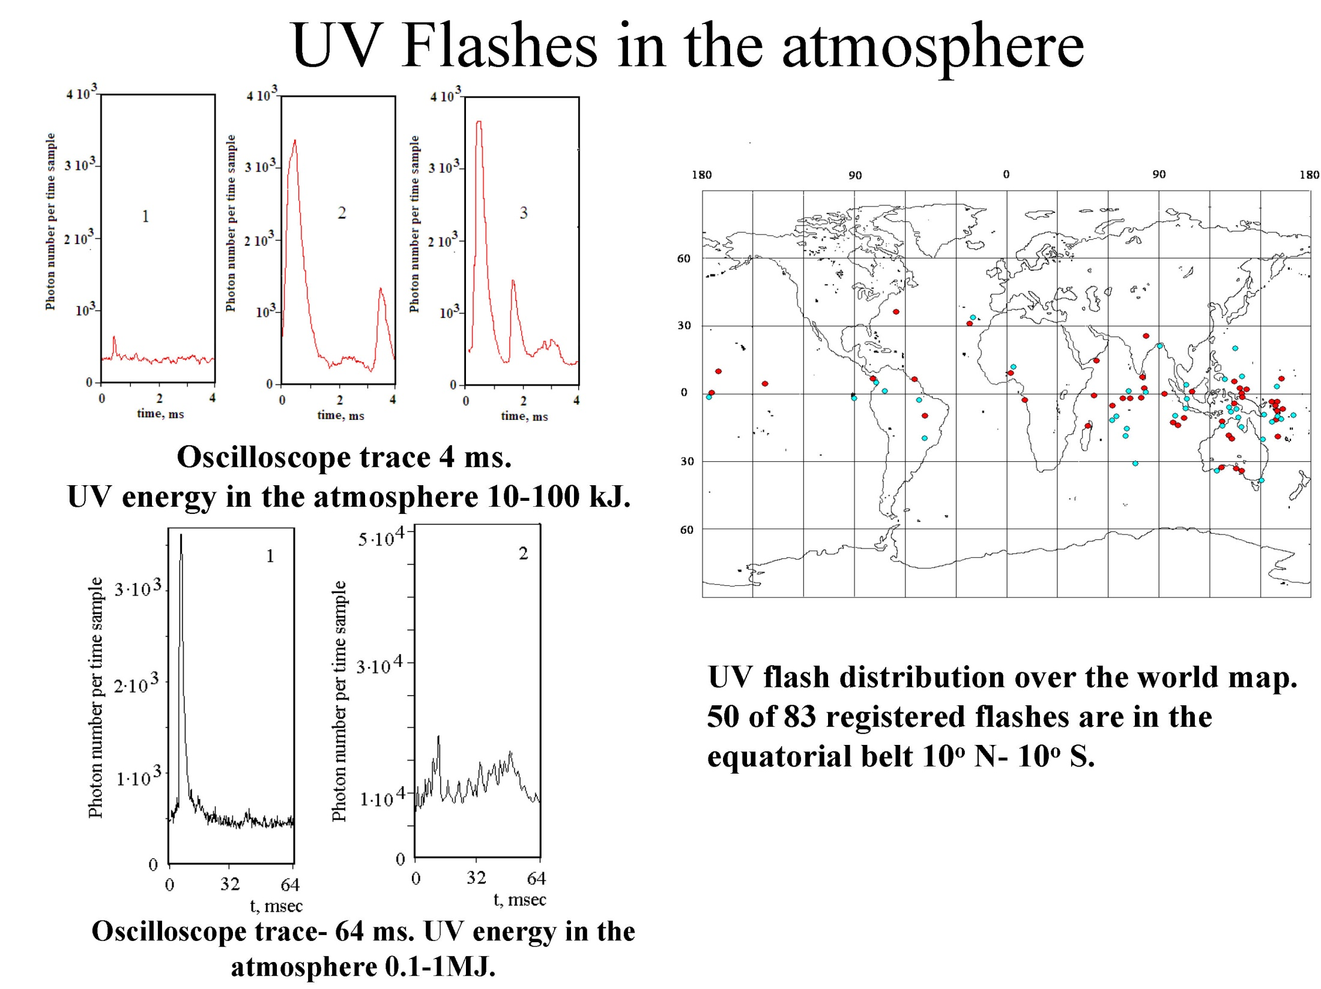

Slide 12
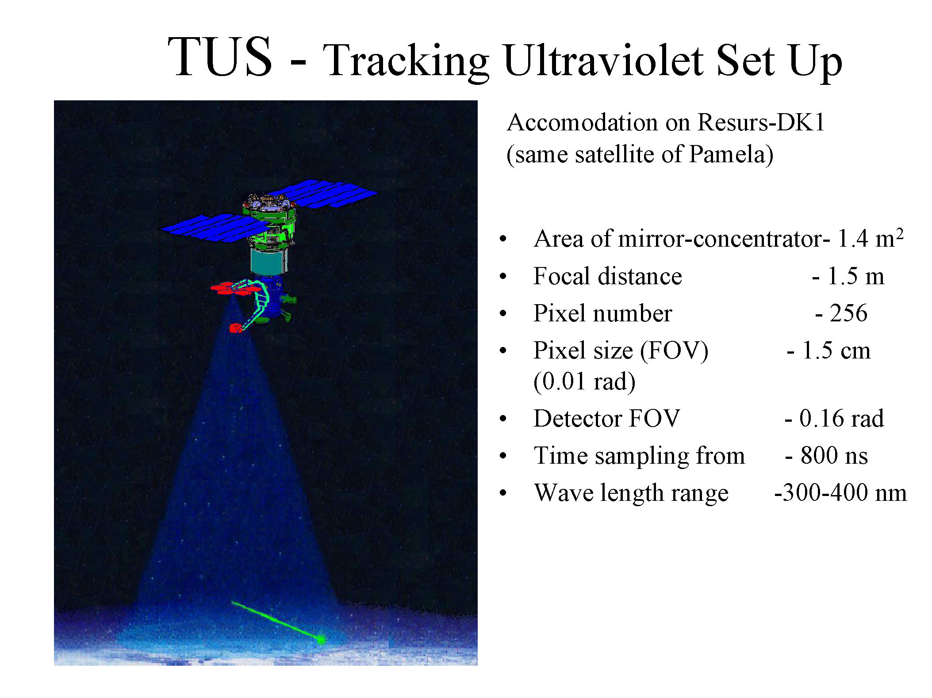
Launch foreseen in 2015 from new Russian cosmodrome, Vostochny

Slide 13
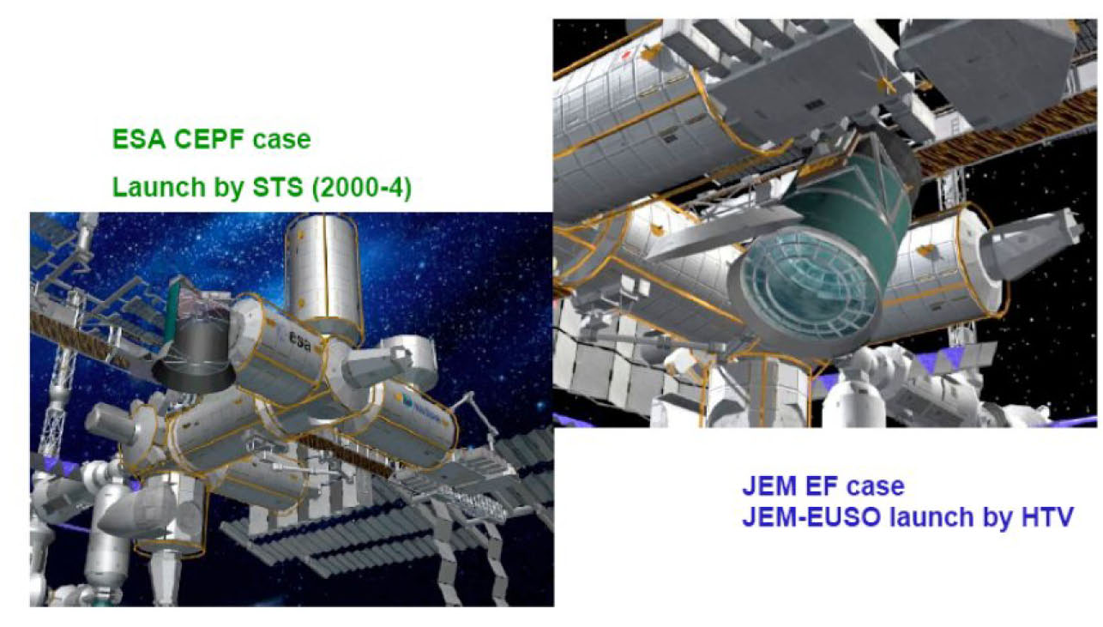
From EUSO to JEM-EUSO

Slide 14
















JEM-EUSO Collaboration
Japan, USA, Korea, Mexico, Russia, Algeria
Europe: Bulgaria, France, Germany, Italy, Poland, Romania, Slovakia, Spain, Switzerland, Sweden
16 Countries, 77 Institutions, more than 300 researchers
RIKEN: Leading institution
Notes:
The JEM-EUSO collaboration

Slide 15
International status
JEM-EUSO and its scientific case have been successfully reviewed by more than 10 panels of JAXA, ESA, NASA, ROSCOSMOS, CNES, INFN, IN2P3, MCCIN, and has been included in the Roadmap of the ESA’S FP-RMT, in the European ASPERA Roadmap, and the Roadmap of the world-wide Astro-particle Physics International Forum (APIF) of the OECD Global Science Forum.

Slide 16
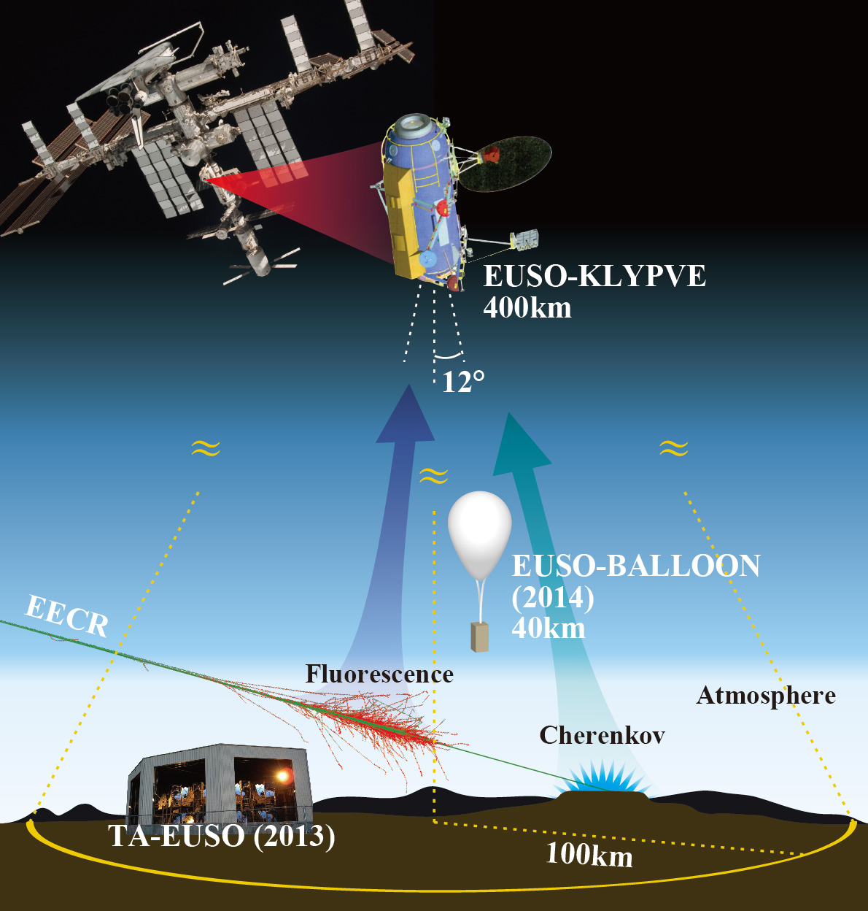
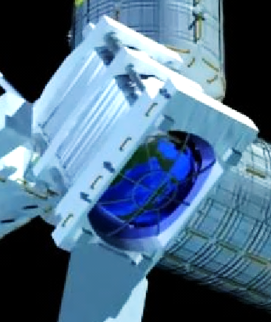
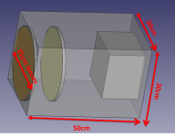
The EUSO program
JEM-EUSO
TA-EUSO: Ground detector at Telescope Array site: 2013-
EUSO-BALLOON: 1st balloon flight from Timmins, Canada (French Space Agency CNES) Aug 2014
MINI-EUSO (2016)
KLYPVE-EUSO (2018)
JEM-EUSO
(>2020+)
MINI-EUSO
14º

Slide 17
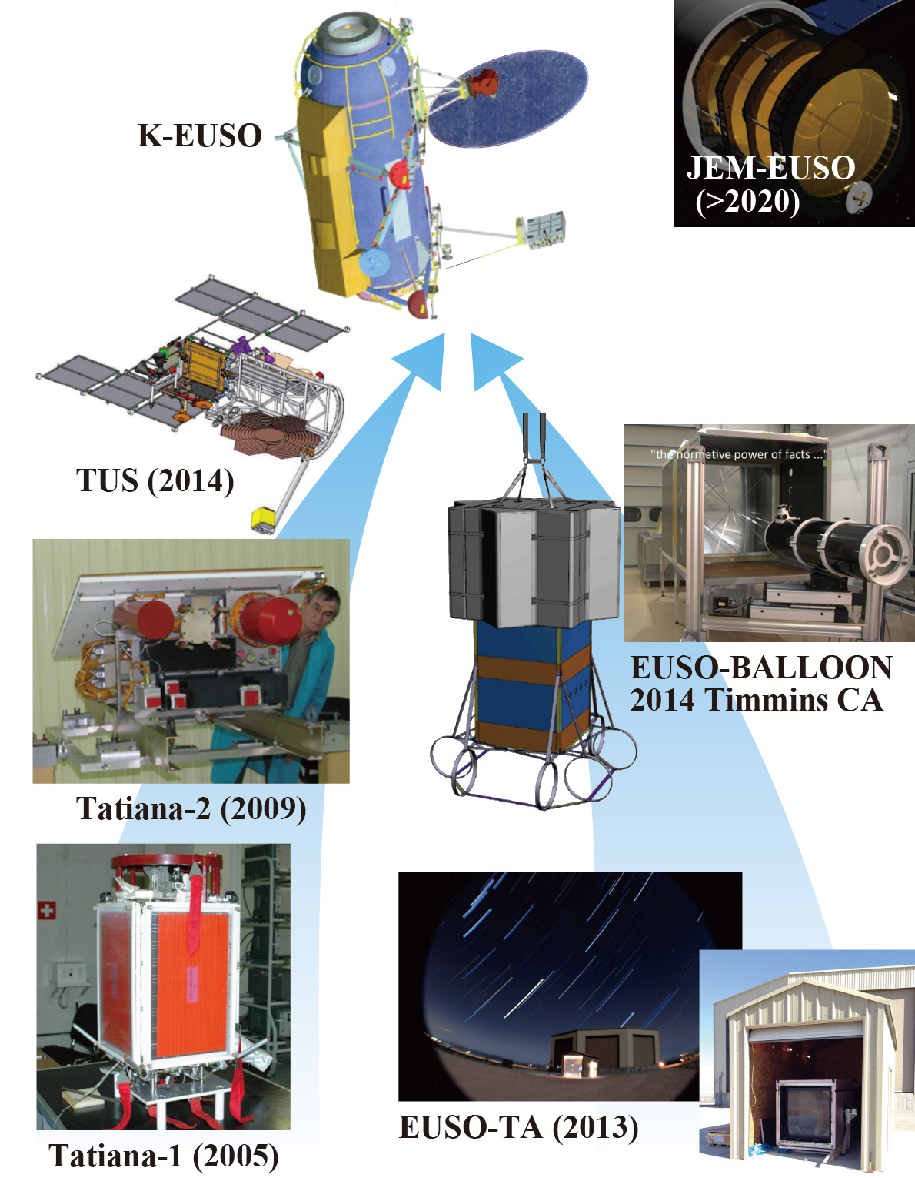
UHECR from space
International Roadmap
Precursors

Slide 18
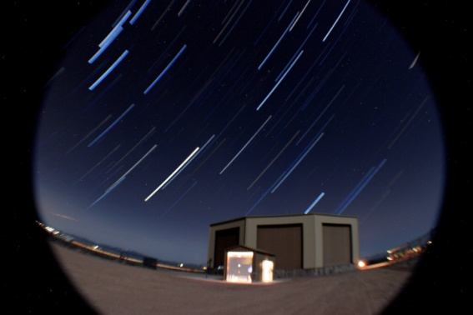
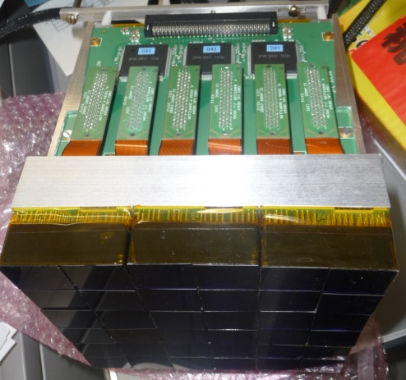
EUSO-TA
EUSO-TA: Lenses in Utah. Electronics in Japan
Used for FAST/Auger tests

Slide 19
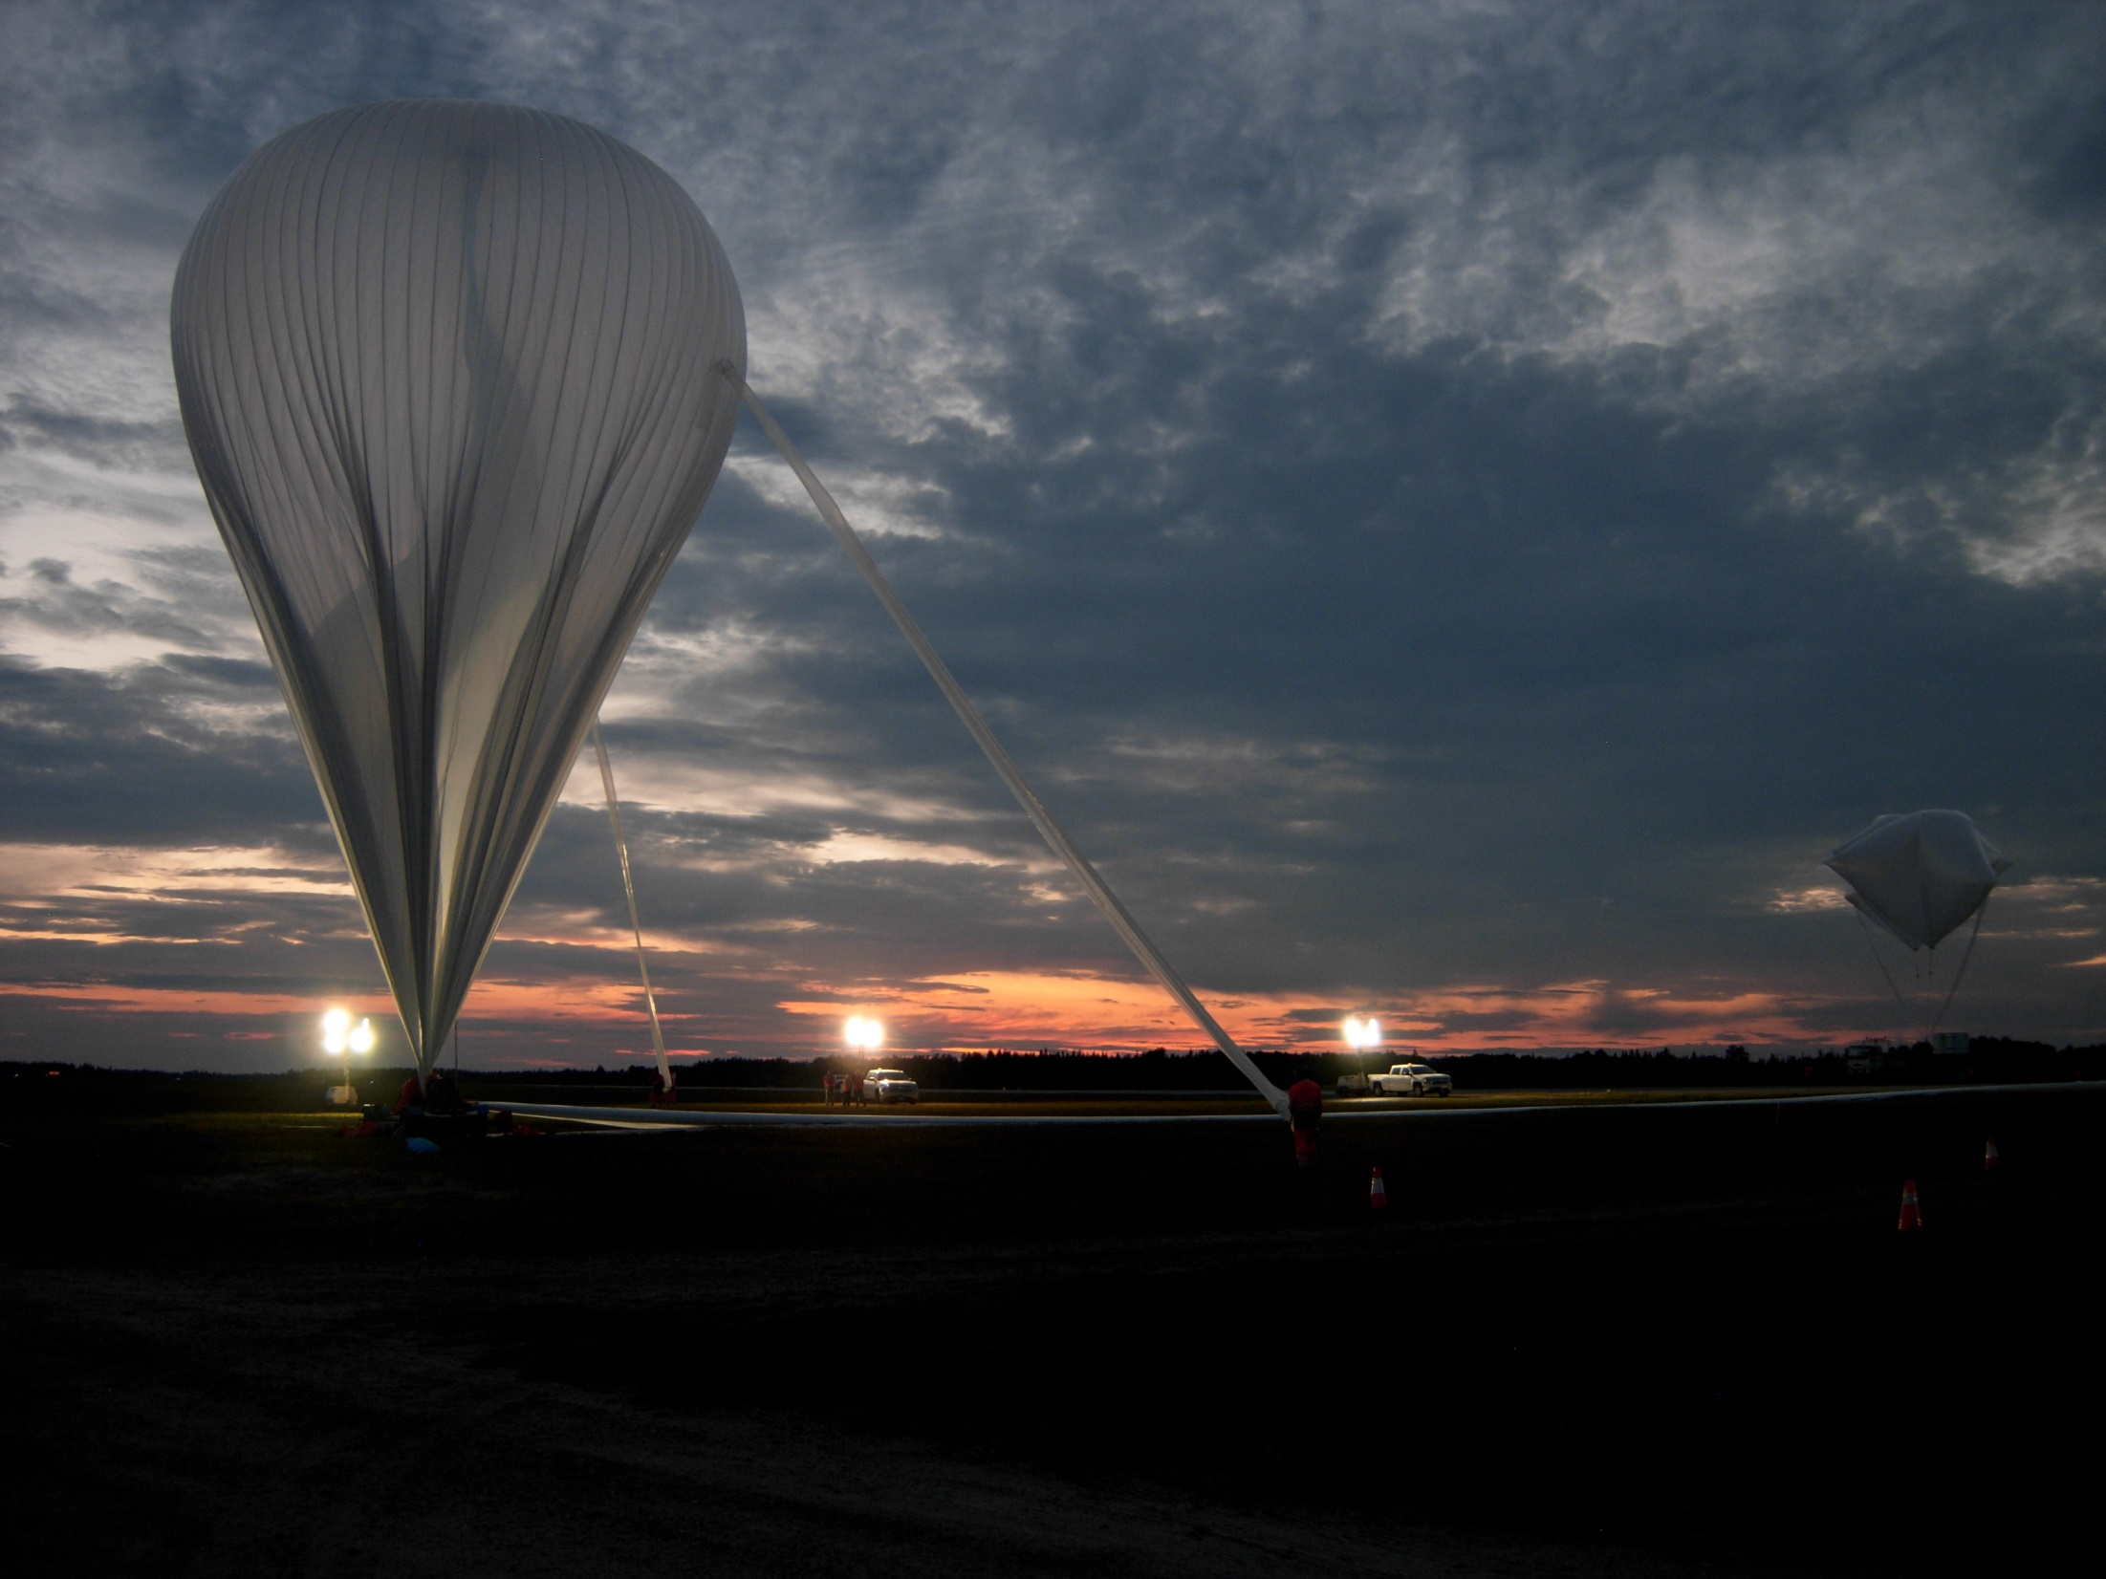
EUSO-Balloon
CNES (French Space Agency) mission
Full support of JEM-EUSO collaboration
Slides from G. Osteria, H. Miyamoto

Slide 20
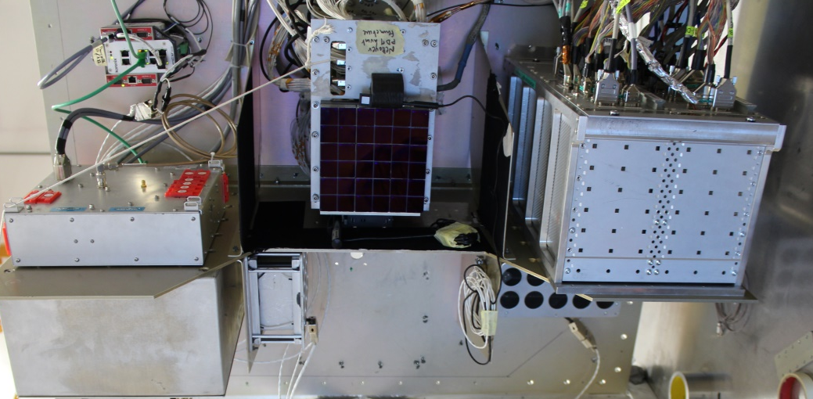
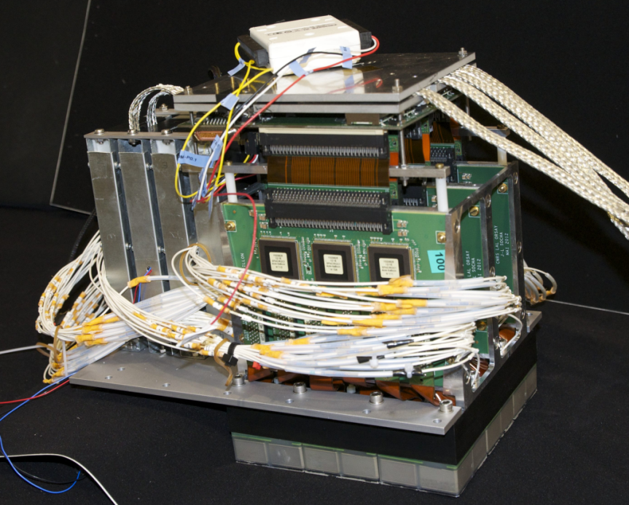
Optics and Electronics

Slide 21
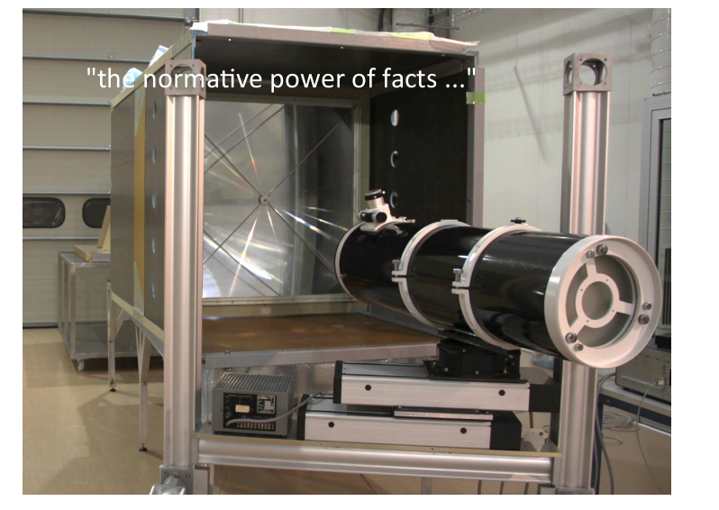
Lenses under test in Toulouse

Slide 22
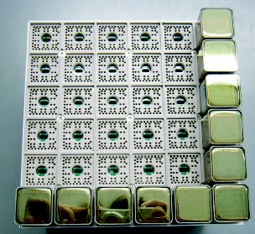
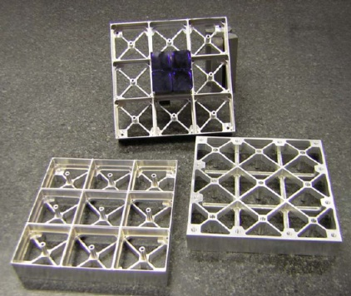
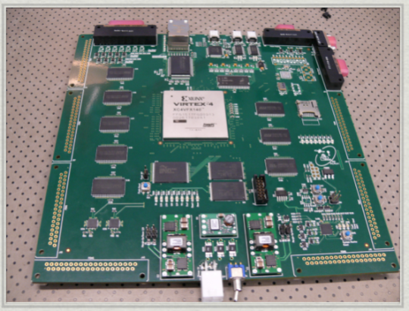
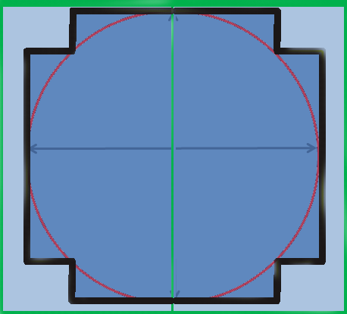
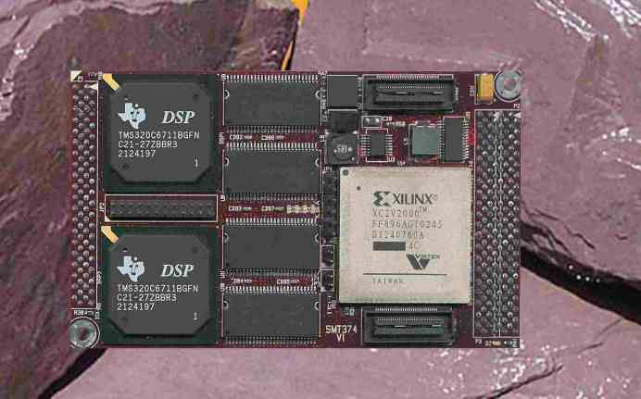
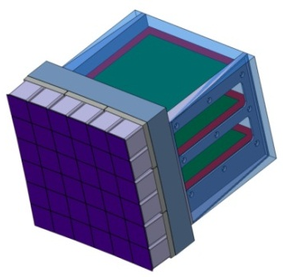
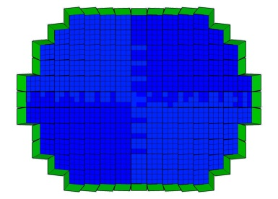
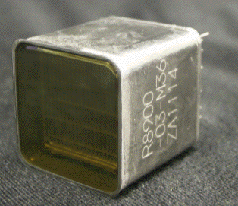
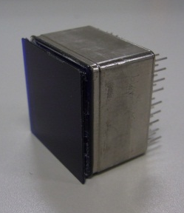
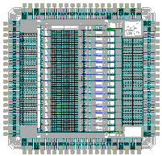
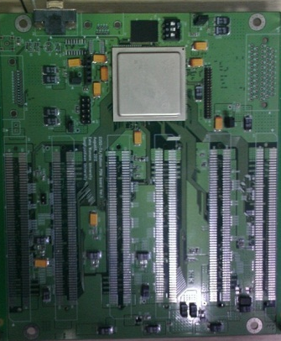
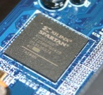
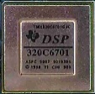
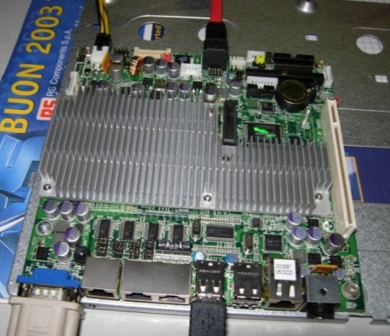
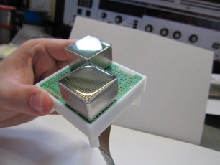
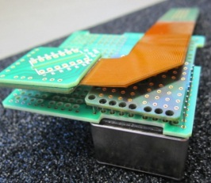
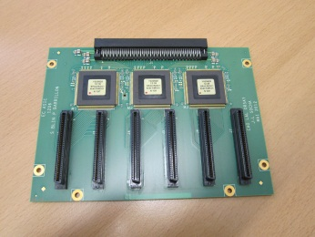
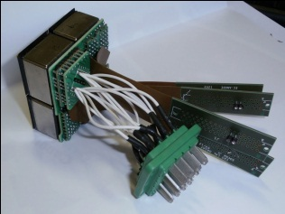
EUSO DAQ – CURRENT Electronic System scheme
45 GB/s (FS)
3*10⁻³ compression
10⁻³ compression
4 Tbyte/year
(transfer)
30 Mbyte/day
(downlink)
1 PDM
36 x 64 channels
45 PDM
New design
1
PMT
Telemetry
Interfaces
137 PDM Control Board
FPGA
Track Trigger
Cluster Control Board
FPGA
Fine Trigger
1 CPU
1 CLOCK
1GPS
Housekeeping
storage
45 PDM
1
12 CCB
6CCB
FEE
ASIC+FPGA
Count
45PDM
9EC
PhotoDetector Modules
2 Board
100kch
45 Boards
6+6 Board
1
36
36-3lay
6

Slide 23
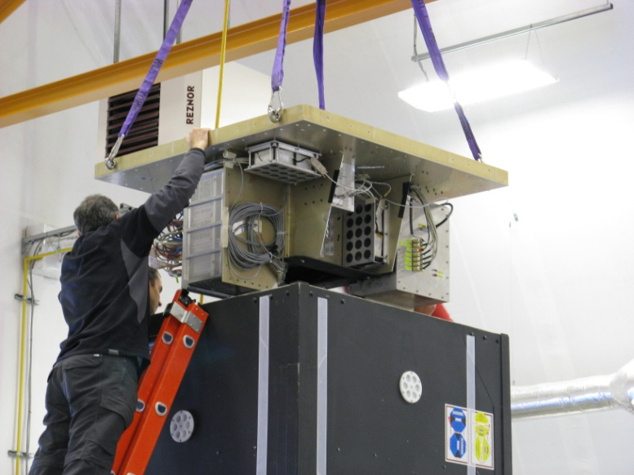
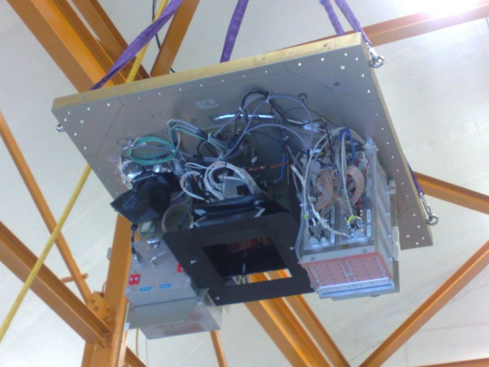
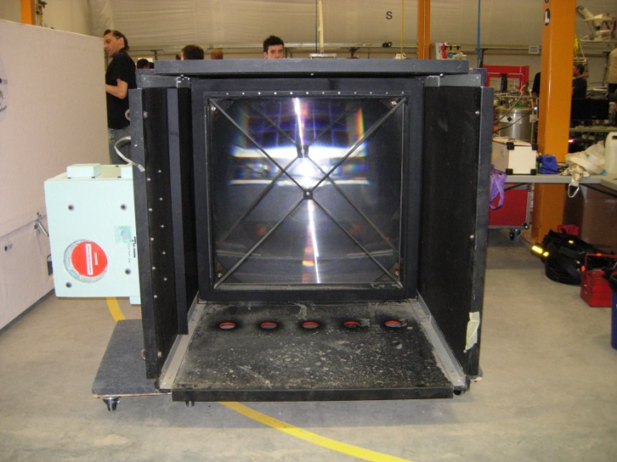
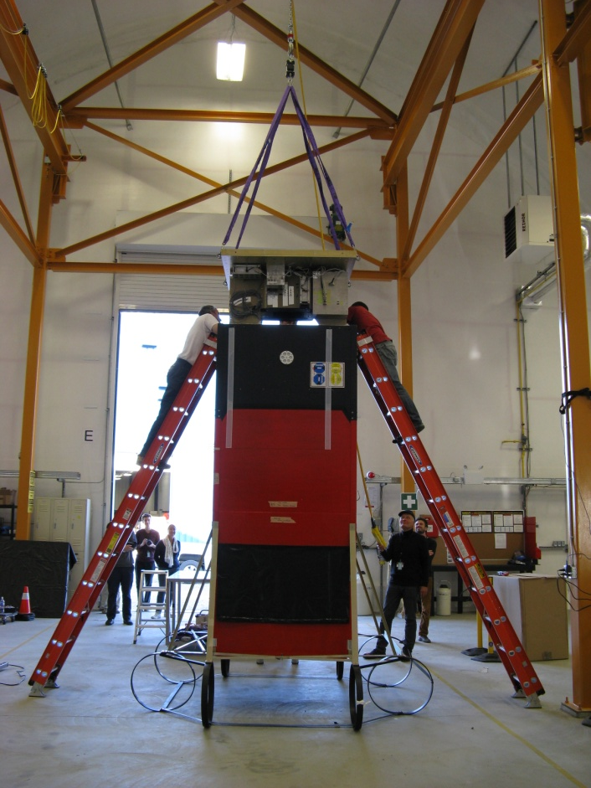
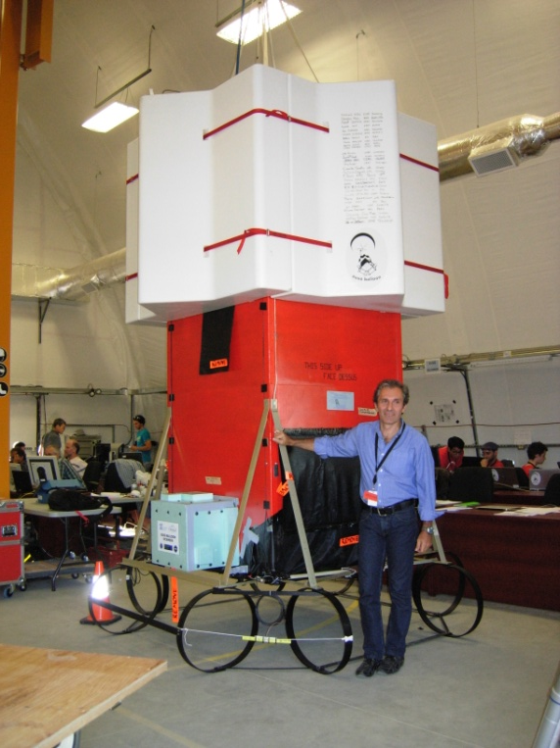
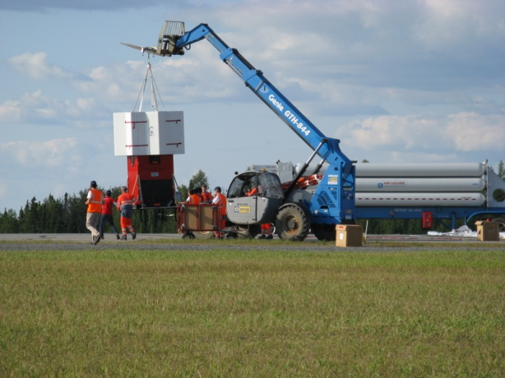
Integration
@Timmins
11-24 Aug 2014

Slide 24
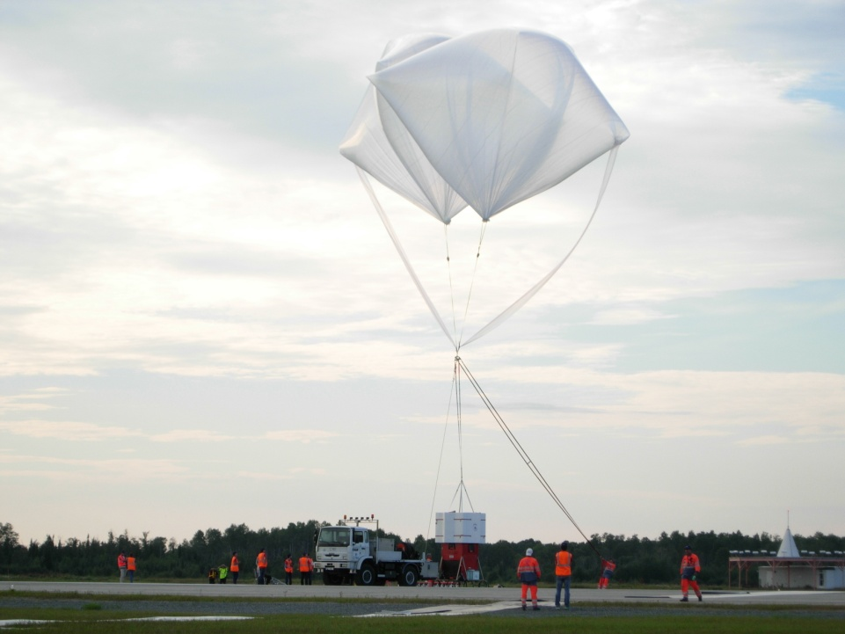
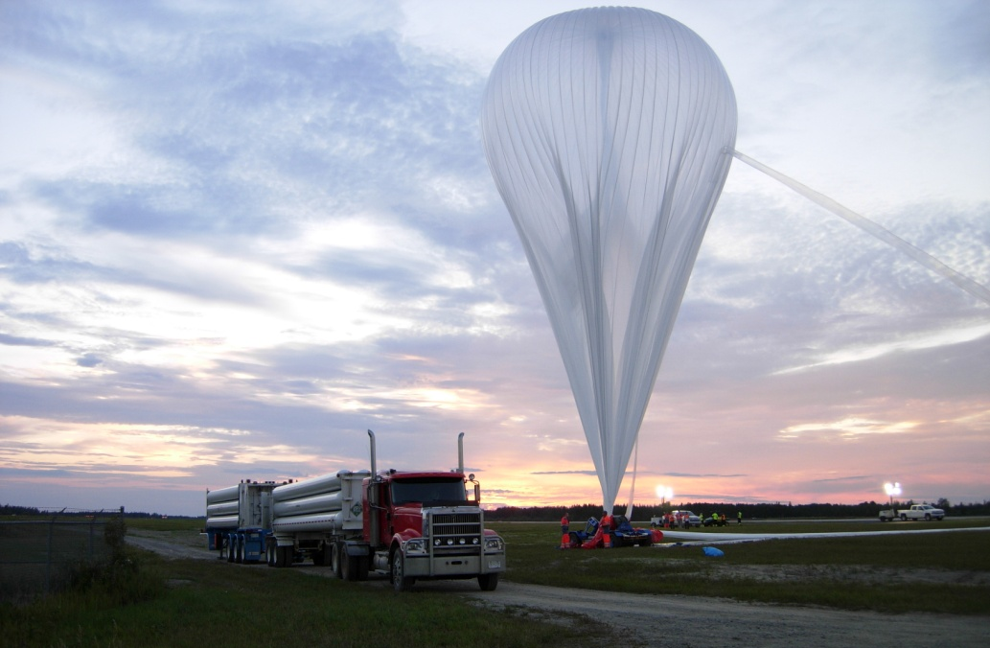
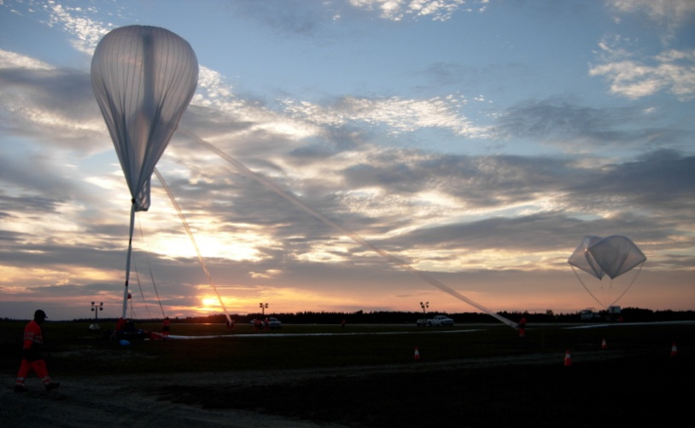

Slide 25
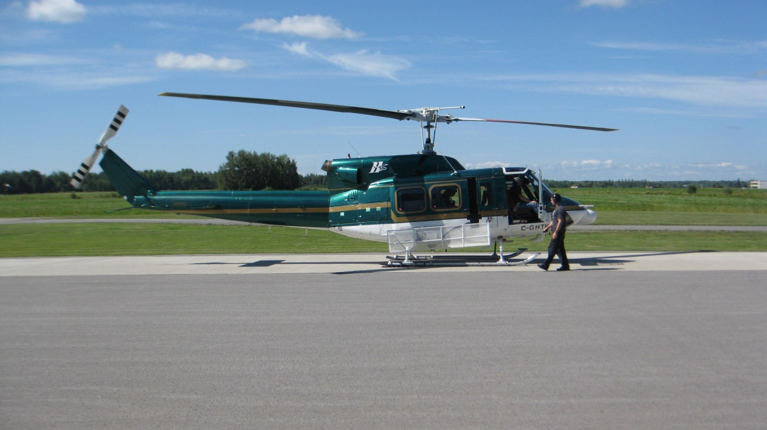


Helicopter equipped with laser and xenon flasher (NASA funding)

Slide 26

Laser flasher event

Slide 27


Laser track
Event profile

Slide 28


First Light: RAW data
(images of Timmins city light)
GoPro image
PDM CPU_TRIGGER data
2hrs after launch (2:54~2:55 UTC) Balloon altitude 33.5km

Slide 29

  Cosmic ray intensity (Geiger)

Slide 30


Balloon Flight Trajectory
Helicopter Trajectory

Slide 31





Landing and recovery

Slide 32
MINI-EUSO measurement of UV from ISS
Approved by
Italian space agency (vus-2)
Russian space agency
(UV atmosphera)
Launch end 2016

Slide 33

MINI-EUSO
Scientific objectives
a.1) UV emissions from night-Earth
    6.5 km resolution, from 2.5mus and above +-51°
    Noise from different lightning conditions, moon phase
    Noise from different inclinations
a.2) Map of the Earth in UV
a.3) Study of atmospheric phenomena
a.4) Bioluminescence of Animal and vegetal organisms
a.4) Study of meteors
    Search for Strange quark matter
    Space Debris assessment

Slide 34
MINI-EUSO
Technologial objectives
b.1) First use of Fresnel lenses in space
b.2) Optimization of characteristics and performances of EUSO
b.3) Raise the technological readiness level of the Hardware

Slide 35
Measure of UV background
Tabella 1: Caratteristiche principali dell’esperimento MINI-EUSO
Nessuna mappa UV notte
Tatiana 1 pixel
Fluttuazioni spaziali e temporali ms ms, s
Trigger su μs e ms
Variazioni a lungo periodo
  Terreno
  Fase lunare
  Nadir / Tilt (0-4 gradi)

Slide 36
Location

Slide 37


Mini-EUSO mechanics
Experiment “Relaxation” on the ISS
Mechanical interface with UV window could be similar.

Slide 38


UV transparent window

Slide 39



LAZIO and Alteino detectors on ISS (2005)
To ISS
Grounding
PCMCIA
card
28V power
supply
Alteino & Lazio detectors inside PIRS module of ISS
To Soyuz

Slide 40

KLYPVE
In the Russian Federal Space Program
Passed the stage of preliminary design (pre-phase A) with Roscosmoc
Technical requirements, accomodation, operations study performed by Energia space corporation

Slide 41


Location on ISS
Mini Research module MRM-1

Slide 42


Deployment module: MRM-1

Slide 43

K-Euso proposal
Keep mirror based design
Add corrective lens to upgrade KLYPVE design
Total mass | < 650 kg (delivery requirement)
Total power consumption | < 600 W (RS ISS limit)
Mirror diameter | 3600 mm (< 4000 mm)
Focal distance | 4000 mm
Parts size (mirror segments, photo detector clusters) | 1200×700 mm (airlock requirement)
Scientific information | >4 TB/year hard disk to ground
Telemetry information | 50 Mbytes per day
Focal Surface | 1200 mm diameter

Slide 44

K-EUSO exposure

Slide 45

Scientific objectives

Slide 46
Programmatic status
2013 MSU proposal of KLYPVE included in Russian space program
12-2013 MSU invited JEM-EUSO collaboration to join KLIPVE
06-2014 KLIPVE-EUSO approved by JE exec committee
2014 JAXA call mission of opportunity
2-2014 Proposal Submitted
8-2014 JAXA conditional approval pending definition of role sharing between the agencies and other countries
7. 9-2014 Signing of science protocol and role sharing between MSU and Riken

Slide 47





View from NASA: “Cosmic Ray Observatory on the ISS”
ISS-CREAM
Sp-X Launch 2014
AMS Launch
May 16, 2011
image from Drs.
Julie A. Robinson,
Program Scientist,
ISS, NASA &
W. Vernon Jones,
Senior Scientist,
SMD, NASA
JEM-EUSO
Launch Tentatively
planned for 2019
CALET on JEM
HTV Launch 2014

Slide 48


Slide 49

Japan contribution
(JAXA 2014 proposal)

Slide 50


General Role Sharing

Slide 51


Focal surface design

Slide 52
KLYPVE-EUSO DAQ – CURRENT Electronic System scheme
45 GB/s (FS)
3*10⁻³ compression
10⁻³ compression
4 Tbyte/year
(transfer)
30 Mbyte/day
(downlink)
1 PDM
36 x 64 channels
45 PDM
New design
1
PMT
Telemetry
Interfaces
137 PDM Control Board
FPGA
Track Trigger
Cluster Control Board
FPGA
Fine Trigger
1 CPU
1 CLOCK
1GPS
Housekeeping
storage
45 PDM
1
12 CCB
6CCB
FEE
ASIC+FPGA
Count
45PDM
9EC
PhotoDetector Modules
2 Board
100kch
45 Boards
6+6 Board
1
36
36-3lay
6

Slide 53


Conclusions
K-EUSO is a mission of opportunity with a concrete chance of realization in relatively short time
Can open the field of UHECR from space and deliver very interesting science results, paving the road for future missions.

