Slide 1
宇宙粒子線直接観測の新展開
柴田 徹
青学大理工
日本物理学会高知(22/Sep./2013)

Slide 2
飛翔体による宇宙粒子線観測の変遷
exposure
0) 1950以前: 発見の時代
1) 1950-1980: 中間子多重発生、宇宙線起源
<
1day
~
2) 1980-2005: 反粒子観測、宇宙線加速、伝播
day-week
3) 2005- …... : beyond the standard model ?
>
year
~

Slide 3
observables in AMS-02:
1) proton: 1GV-1.8TV
for two years exposure only
2) helium: 2GV-3.2TV
only 10% of total exp. !
3) B/C ratio: 0.5-670 GeV/n
4) electron: 0.5-500 GeV
5) positron: 0.5-350 GeV
6) e⁺, e⁻ : 0.5GeV-1TeV ?
in the near future ?
7) p/p ratio: ~ 1TeV ?
8) C- Fe: 1GeV/n-1TeV/n ?
9) B/C, subFe/Fe, : 0.5GeV/n-1TeV/n ?
10) ¹⁰Be/⁹Be, ²⁶Al/²⁷Al, . . : 10-20GeV/n ?
11) high energy γ: 0.5-1TeV ?

Slide 4
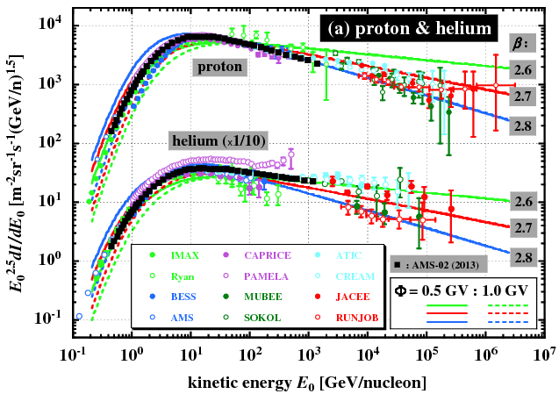
hadronic components:
γ :
2.27
2.37
2.47
2.27
2.37
2.47
source
(α=1/3)

Slide 5
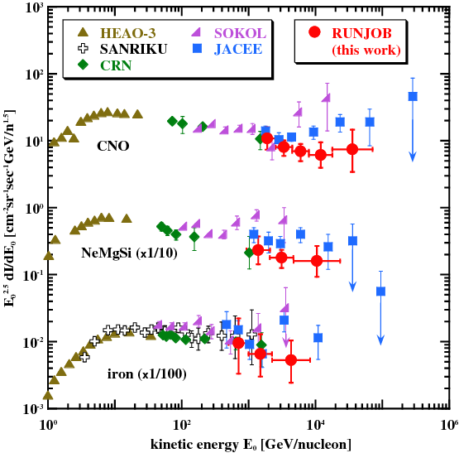
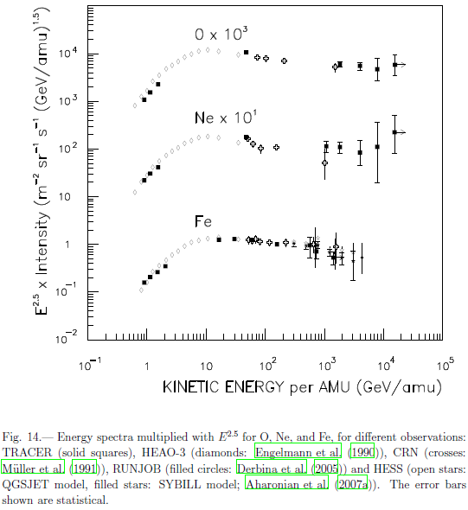
heavy components
(TRACER 2008)
(Derbina et al. 2005)
(arXiv:0801.0582v1 3 Jan 2008)

Slide 6

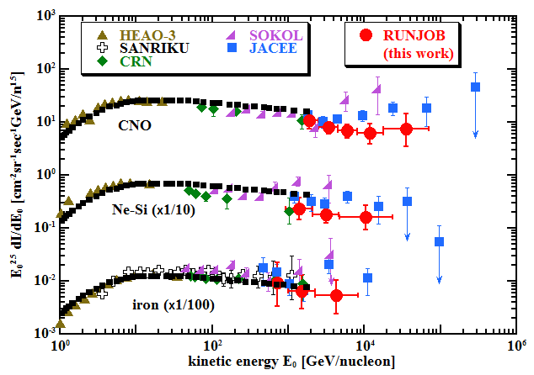
heavy components
: He by AMS-02
(flux in arbitrary units)
0.1~ 0.2

Slide 7
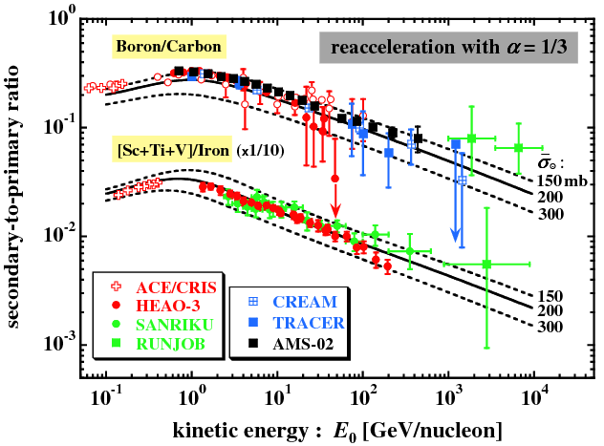
2ry-to-1ry ratio について
α = 1/2
?
anisotropy

Slide 8
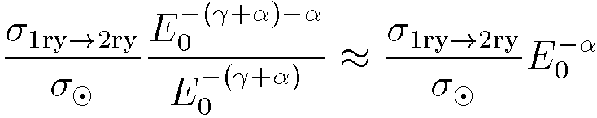






2ry-to-1ry ratio in HE and LE limits
(Simon & Heinrich 1986)
(Shibata et al. 2006)

Slide 9
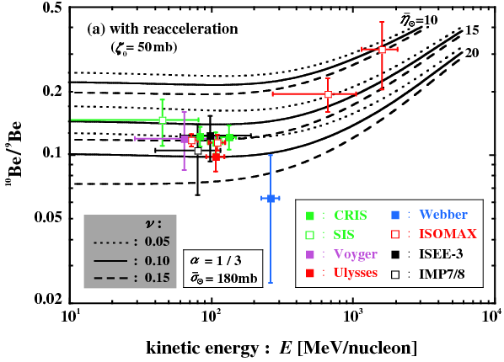
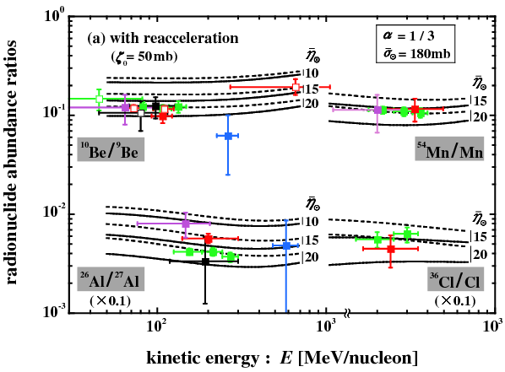
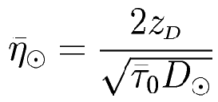




radio-nuclide abundance ratios
◎ , normalized to
: halo thickness
: isotope spread
Galactic plane

Slide 10
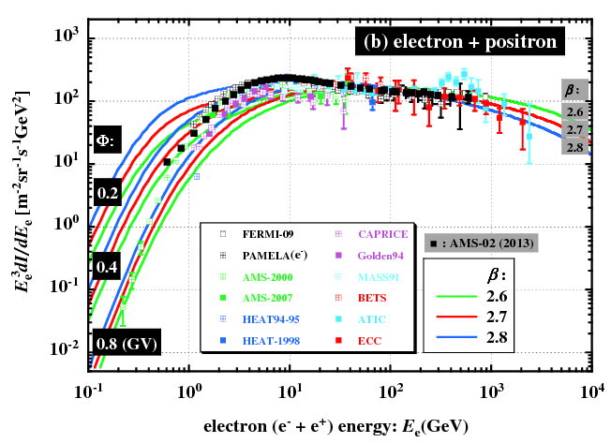
all electrons (e⁺ + e⁻)
β_{e}
3.2
3.3
3.4

Slide 11
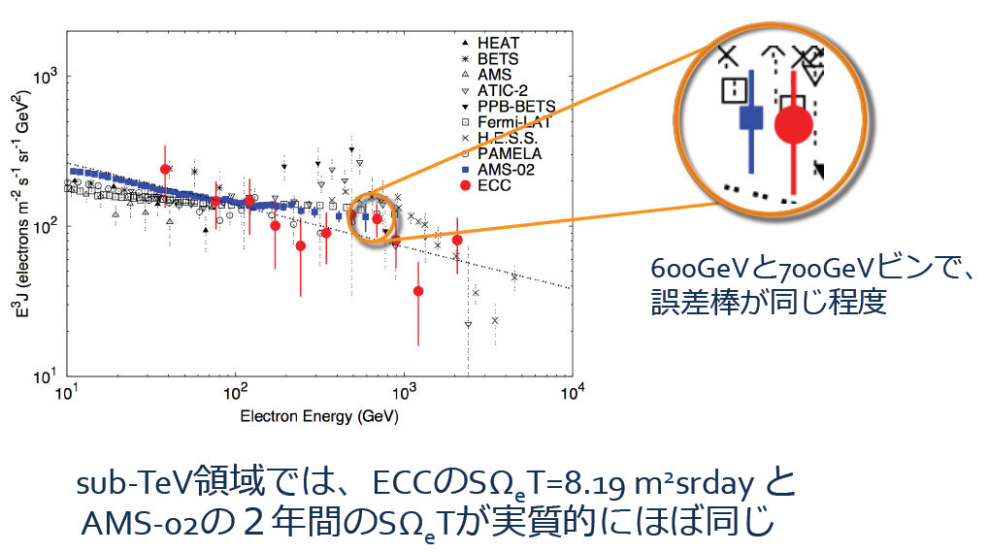
K. Yoshida (2013-CTA研究会より)

Slide 12
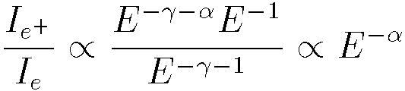
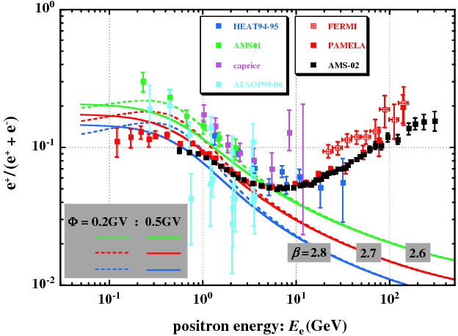
positron fraction

Slide 13
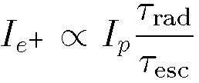
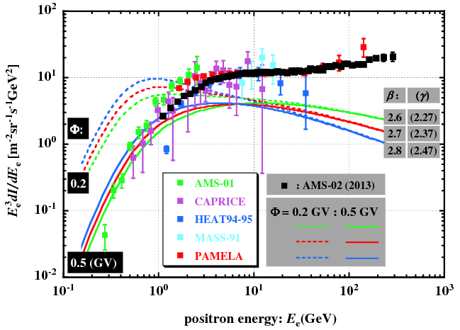
positrons

Slide 14
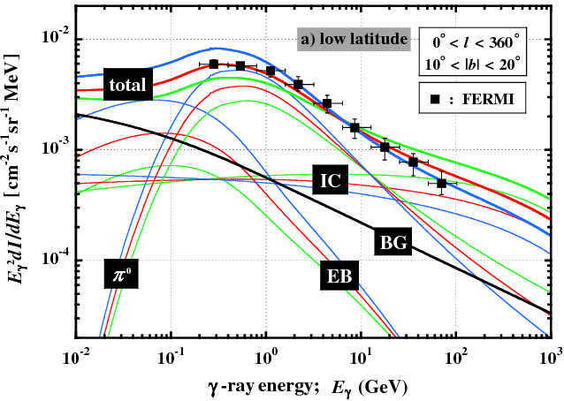
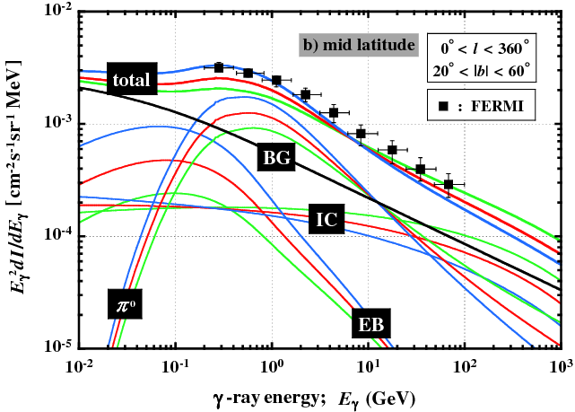
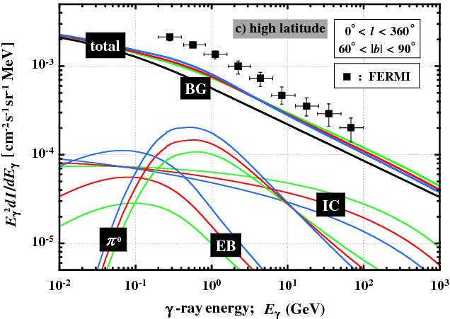
on diffused γ-rays

Slide 15
summary
the positron excess is experimentally established
Kolmogorov-type turbulence in ISM preferable
what is an origin of excess ?
cosmological origin
(DM-annihilation/decay) ?
astronomical origin
nearby pulsars ?
reacceleration in source ? (Blasi 2009)
dense gas cloud ? (Fujita et al. 2009)
. . . . .
absolute intensities in e⁺, p⁺, A; B/C; ¹⁰Be/⁹Be; . . .
_
_
excess in diffused-γ spectrum from galactic pole ?

Slide 16
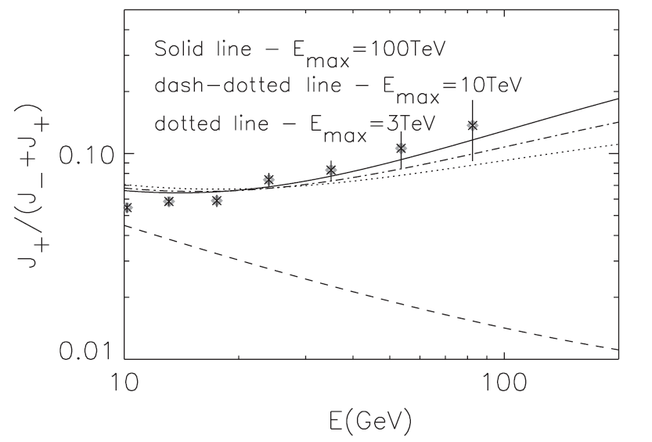
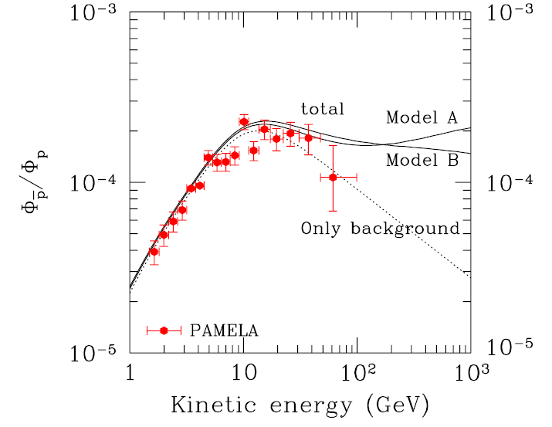
Fujita et al. (2009, Jul.)
Blasi (2009, Jul.)
Shibata et al. 2008

