Slide 1
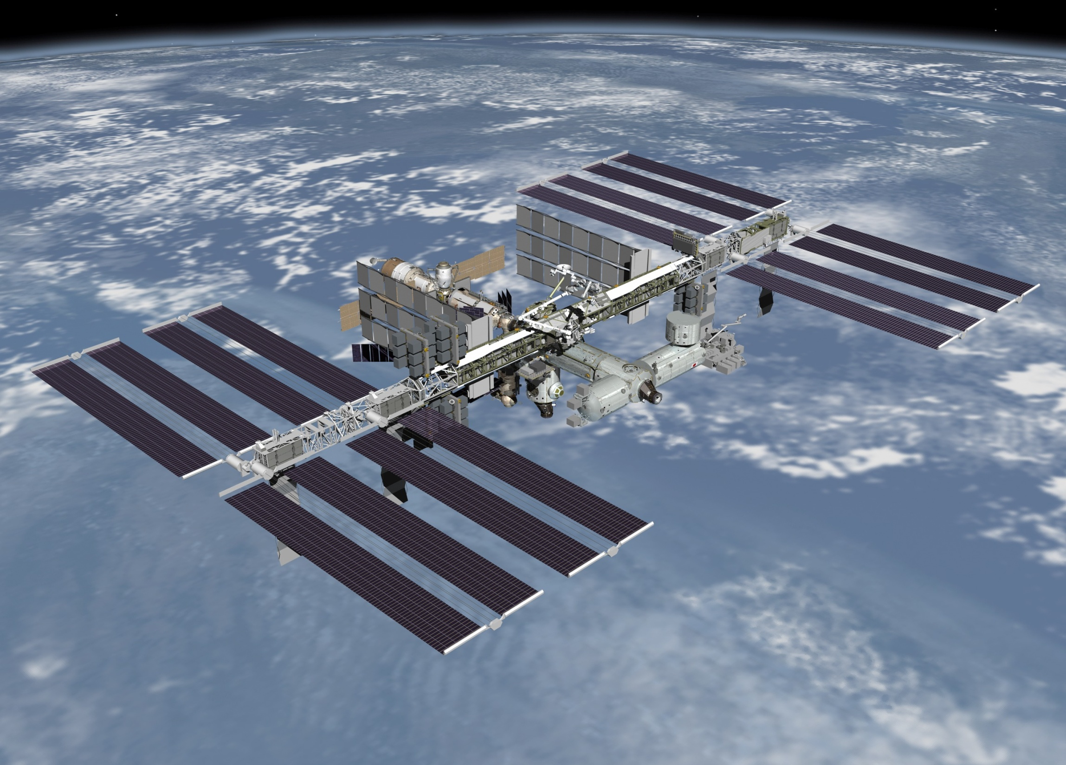



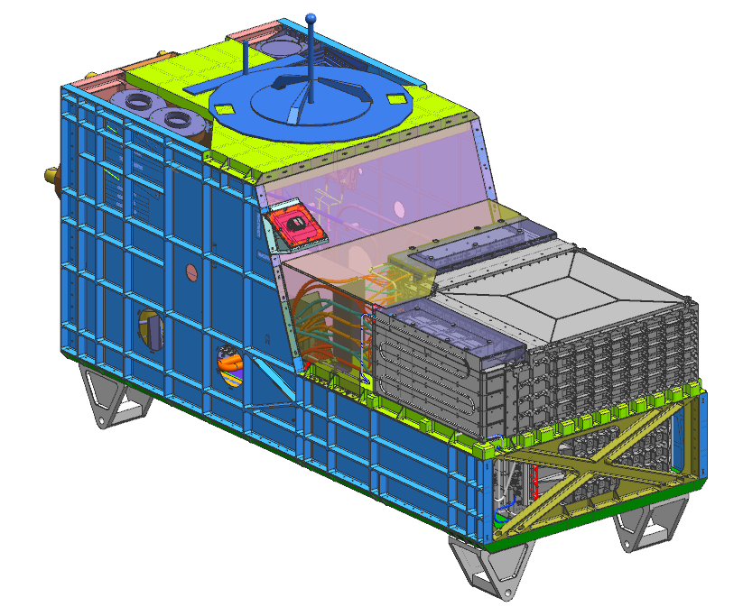
宇宙線・宇宙領域シンポジウム
ーAM-02の観測結果と今後の宇宙線研究ー
CALET実験と高エネルギー電子観測
(+ ガンマ線、陽子、重原子…)
CALET Project for Observing High Energy Electrons
（Gamma-rays, Protons, Heavy nuclei…)
鳥居祥二 他CALET チーム
Shoji Torii for the CALET Collaboration
早稲田大学理工学研究所
Waseda University
Research Institute for Science and Engineering
JAXA 宇宙環境利用センター
JAXA Space Environment Utilization Center
CALET
日本物理学会 ２０１３年９月２２日 高知大学

Slide 2



CALET Collaboration Team
JAXA NASA ASI
O. Adriani¹⁹,Y. Akaike³, K. Asano¹⁷, M.G. Bagliesi²², G. Bigongiari²², W.R. Binns²⁴, M. Bongi¹⁹, J.H. Buckley²⁴, G. Castellini¹⁹, M.L. Cherry⁹, G. Collazuol²⁶, K. Ebisawa⁵, V. Di Felice²¹, H. Fuke⁵, A. Gherardi¹⁹, T.G. Guzik⁹, T. Hams¹⁰, N. Hasebe²³, M. Hareyama⁵, K. Hibino⁷, M. Ichimura², K. Ioka⁸, M.H. Israel²⁴, A. Javaid⁹, E. Kamioka¹⁵, K. Kasahara²³, Y. Katayose^{4,25}, J. Kataoka²³, R. Kataoka¹⁷, N. Kawanaka⁸, M.Y. Kim²², H. Kitamura¹¹, Y. Komori⁶, T. Kotani²³, H.S. Krawczynski²⁴, J.F. Krizmanic¹⁰, A. Kubota¹⁵, S. Kuramata², T. Lomtadze²⁰, P. Maestro²², L. Marcelli²¹, P.S. Marrocchesi²², V. Millucci²², J.W. Mitchell¹⁰, S. Miyake²⁸, K. Mizutani¹⁴, A.A. Moiseev¹⁰, K. Mori^{5,23}, M. Mori¹³, N. Mori¹⁹, K. Munakata¹⁶, H. Murakami²³, Y.E. Nakagawa²³, S. Nakahira⁵, J. Nishimura⁵, S. Okuno⁷, J.F. Ormes¹⁸, S. Ozawa²³, P. Papini¹⁹, B.F. Rauch²⁴, S. Ricciarini¹⁹, Y. Saito⁵, T. Sakamoto¹, M. Sasaki¹⁰, M. Shibata²⁵, Y. Shimizu⁴, A. Shiomi¹², R. Sparvoli²¹, P. Spillantini¹⁹, M. Takayanagi⁵, M. Takita³, T. Tamura^{4,7}, N. Tateyama⁷, T. Terasawa³, H. Tomida⁵, S. Torii^{4,23}, Y. Tunesada¹⁷, Y. Uchihori¹¹, S. Ueno⁵, E. Vannuccini¹⁹, J.P. Wefel⁹, K. Yamaoka^{4,23}, S. Yanagita²⁷, A. Yoshida¹, K. Yoshida¹⁵, and T. Yuda³
1) Aoyama Gakuin University, Japan
2) Hirosaki University, Japan
3) ICRR, University of Tokyo, Japan
4) JAXA/SEUC, Japan
5) JAXA/ISAS, Japan
6) Kanagawa University of Human Services, Japan
7) Kanagawa University, Japan
8) KEK, Japan
9) Louisiana State University, USA
10) NASA/GSFC, USA
11) National Inst. of Radiological Sciences, Japan
12) Nihon University, Japan
13) Ritsumeikan University, Japan
14) Saitama University, Japan
15) Shibaura Institute of Technology, Japan
16) Shinshu University, Japan
17) Tokyo Technology Institute, Japan
18) University of Denver, USA
19) University of Florence, IFAC (CNR) and INFN, Italy
20) University of Pisa and INFN, Italy
21) University of Rome Tor Vergata and INFN, Italy
22) University of Siena and INFN, Italy
23) Waseda University, Japan
24) Washington University-St. Louis, USA
25) Yokohama National University, Japan
26) University of Padova and INFN, Italy
27) Ibaraki University, Japan
28)Tokiwa University, Japan

Slide 3
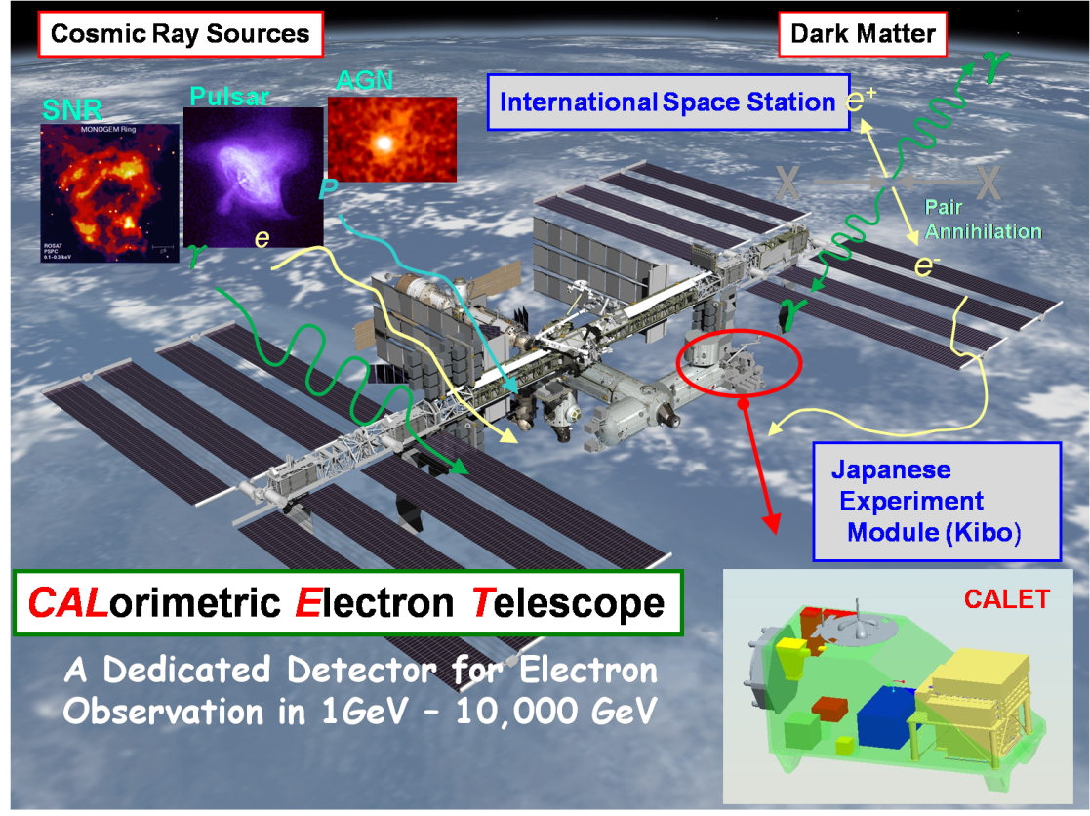
CALET Observation Targets
Calorimeter (CALET/CAL)
Electrons: 1 GeV – 20 TeV
Gamma-rays: 4 *GeV – 10 **TeV
(Gamma-ray Bursts: > 1 GeV)
Protons and Heavy Ions:
10’s of GeV – 1,000** TeV
Ultra Heavy (Z>28) Nuclei：
E> 600 MeV/nucleon
(* 50% efficiency, ** statistical dependent)
Gamma-ray Burst Monitor (CGBM)
X-rays/Soft Gamma-rays:
7keV – 20MeV
22pSP-10 Y.Kawakubo et al.
A Detector Dedicated to Electron Observations 1GeV-20,000GeV
Science Objectives | Observation Targets
Nearby Cosmic-ray Sources | Electron spectrum into trans-TeV region
Dark Matter | Signatures in 10 GeV – 10 TeV electron and gamma energy spectra
Origin and Acceleration of Cosmic Rays | p-Fe above several tens of GeV, Ultra Heavy Nuclei
Cosmic–ray Propagation in the Galaxy | B/C ratio to several TeV /nucleon
Solar Physics | Electron flux below 10 GeV
Gamma-ray Transients | Gamma-rays and X-rays 7 keV – 20 MeV

Slide 4
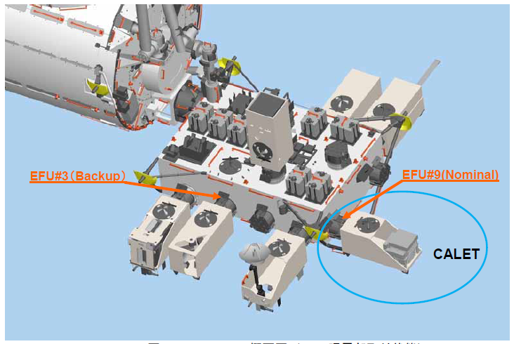
CALET Payload Overview
Japanese Experiment Module
Exposed Facility
CGBM/SGM
FRGF( Flight Releasable Grapple Fixture)
CGBM/HXM
ASC (Advanced Stellar Compass)
CAL/CHD
GPSR (GPS Receiver)
Launch carrier: HTV-5
Planned location: JEM Port 9
Launch target date: FY 2014
Mission period: More than 2 years
  (5 years target)
MDC (Mission Data Controller)
CAL/IMC
CAL/TASC
Data rate:
  Medium data rate: 300 kbps
  Low data rate: 35 kbps (20-50kbps)
Mass: 650kg (Max)
JEM/EF Standard Payload Size
(1850L×800W×1000H in mm)
Power: 650W (Nominal)

Slide 5
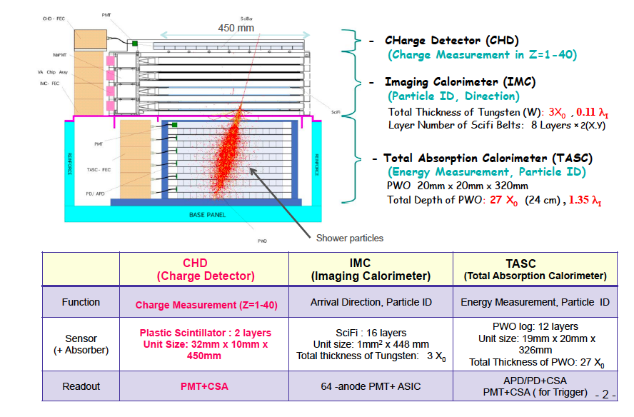
Overview of the CALET Instrument
Plastic Scintillator Paddle: 28
SciFi: 7168 MaPMT:112
19
326
PWO Log: 192
1 TeV electron shower

Slide 6
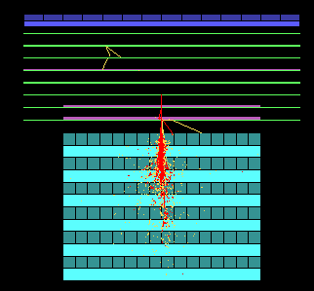
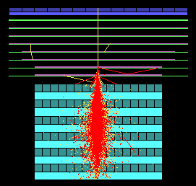
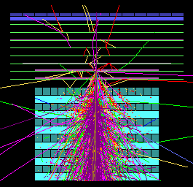

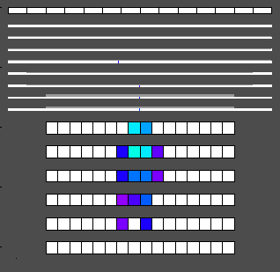
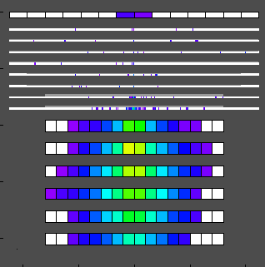
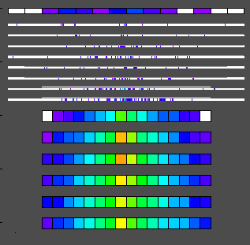
CALET/CAL Shower Imaging Capability (Simulation)
Gamma-ray 10 GeV
Electron 1 TeV
Proton 10 TeV
In Detector Space
Proton rejection power of 10⁵ can be achieved with IMC and TASC
shower imaging capability.
Charge of incident particle is determined to σ_{Z}=0.15-0.3 with the CHD.

Slide 7

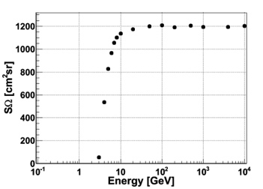
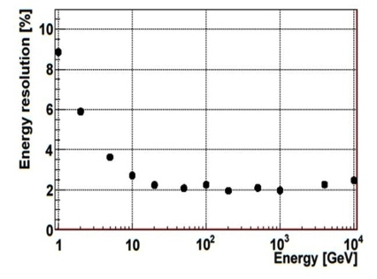
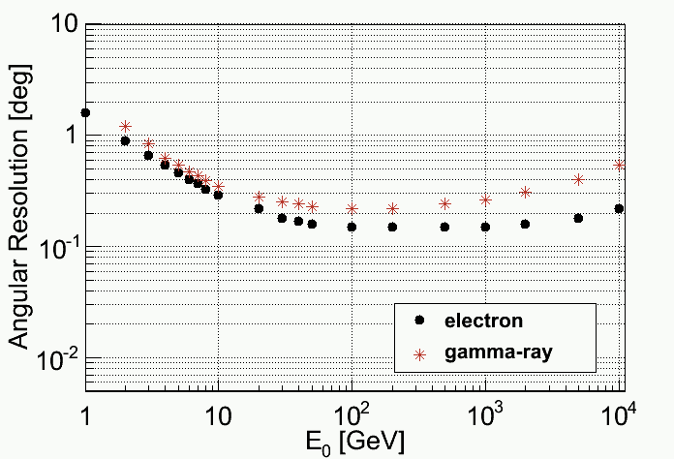
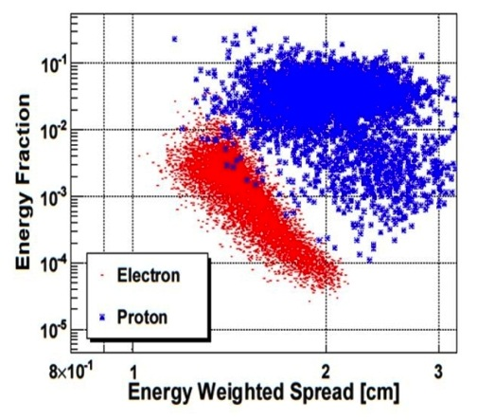
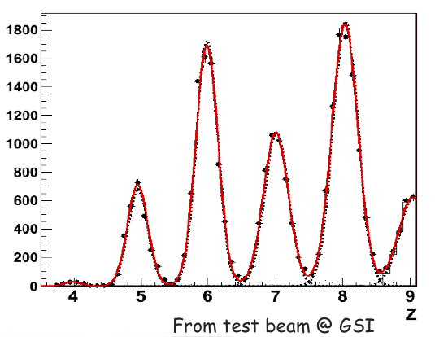
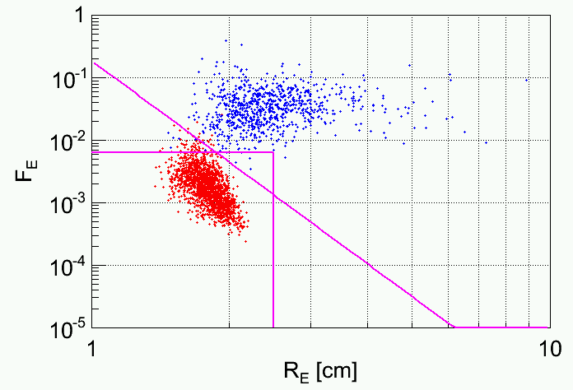
CALET Expected Performance by Simulations
Energy resolution for electrons (>10GeV) :
σ/m = ~2%
Angular resolution for gamma ray (10GeV-1TeV):
σ/m = 0.2-0.3 deg
Geometrical factor for electrons:
~1200 cm²sr
Experiment
CHD
Performance of the CALET Calorimeter becomes better at higher energy (>100 GeV) although the detection threshold is relatively high (>1GeV), and the capability is relatively poor at low energies.
Charge (positive or negative) can not be resolved.
22pSP-1 R.Katahira et al.
22pSP-8 S.Ozawa et al.
Charge resolution:
σ_{Z} = 0.15 – 0.3
Proton rejection power at 1TeV ≈10⁵ with 95% efficiency for electrons
electrons
protons
electrons
protons
Preliminary
Preliminary

Slide 8
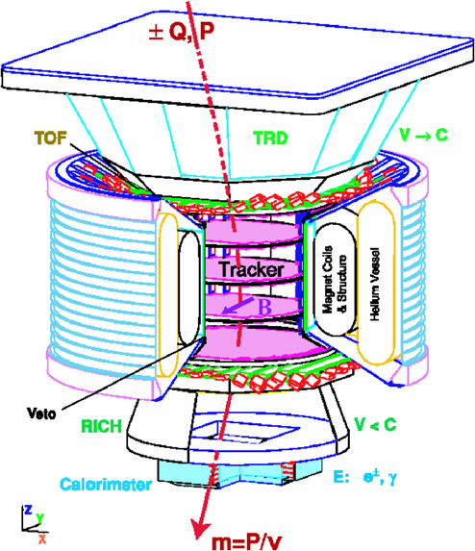
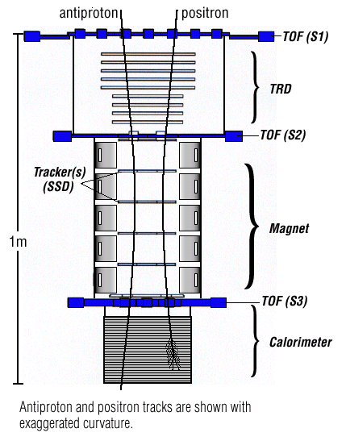
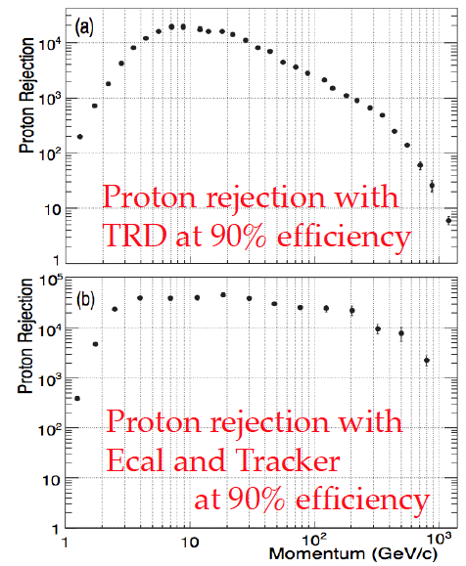
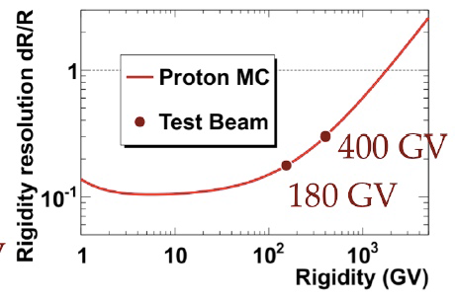
General Capability of Magnet Spectrometer
AMS02
PAMELA
Particle Identification with
Additional Detectors: AMS-02
~10@TeV
Maximum Detectable Momentum： Δp/p= 100 %
P_{MDM} ~ 2 (0.3BL²) / Δｘ
ex. AMS-02: P_{MDM}~2 TV
~1000@TeV
Geometical Factor(SΩ） for Full Performance
4500 cm²＠0.2TV => 300cm²sr@2.0TV
Magnet Spectrometer (ex. AMS-02) has
an excellent performance at low energies.
However, the capability is poor over TeV

Slide 9
Comparison of Space Experiment Performance for e⁺+e⁻
Payload (Launching Date) | Energy Region (GeV) | Energy Resolution | e/p separation | Instruments* | Exposure in 5 years** （m^{２} sr day) | Total Weight (kg)
PAMELA (2006) | 1-700 | 5 % @200 GeV | 10⁵ | Magnet Spectrometer (0.43T) + Sampling Calorimeter (Si＋W: 16 X₀) +TOF+ Neutron Detector | ~ 4 | 470
FERMI/LAT (2008) | 20-1,000 | 5-20 % (20-1000 GeV) | 10³-10⁴ (20-1000GeV) Increase with Energy | ACD Detector +Tracking Calorimeter (Si＋W: 1.5X₀) +CsI Cal. (8.6X₀) | 1500@TeV | 7.000
AMS-02 (2011) | 1-2,000 (~800) | ～10 ％ ＠100 GeV | 10⁴ -10⁵ | Magnet Spectrometer (0.15T) + Sampling Calorimeter (SciFi + Pb: 17X_{o}) +TOF+TRD+RICH | 55@2TeV (170@800GeV) | 7,000
CALET (2014) | 1-20,000 | ~2 % (>10 GeV) | ~10⁵ Mostly Energy Independent | Imaging Calorimeter (W+SciFi: 3 X_{o}) + Total Absorption Cal. (PWO : 27 X_{o}) ＋Charge Detector (SCN) | 220 | 650
DAMPE* (China：2015?) | 5-10,000 | ~1.5 % | ~10⁵ | Silicon Tracker +Total Absorption Cal. (BGO: ~31 X₀) +ACD Detector +Neutron Detector | 900 | 1,500
GAMMA-400* (Russia：2017?) | 1-3,000 | ~1 % (>100GeV) | ~10⁴ | Imaging Calorimeter (W+Si: 6X₀) +Total Absorption Cal. (PWO:22.5 X₀) | 1,280 | 1,700
*) Estimated from Presentations

Slide 10
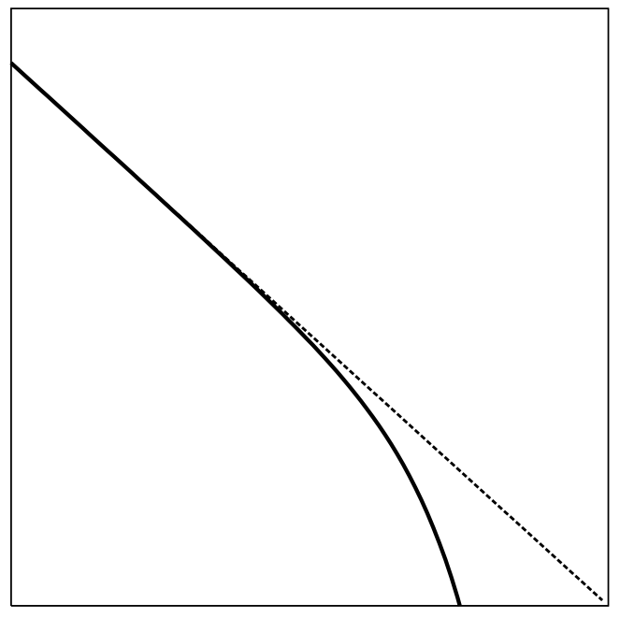
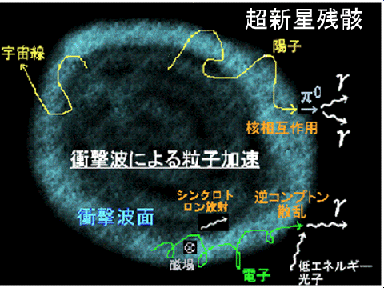
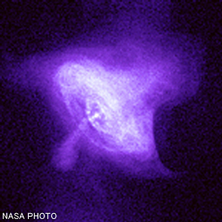
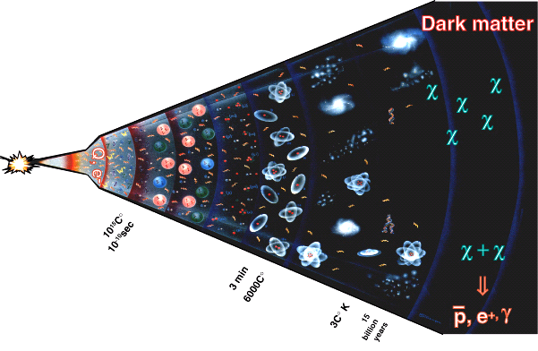
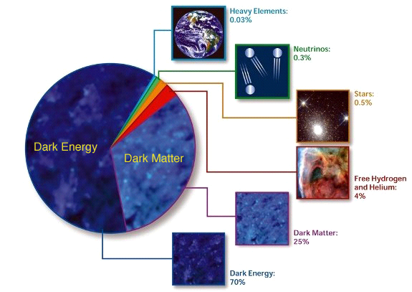
Electron & Positron Origins and Production Spectrum
Astrophysical Origin
Power Law Distribution
with a Cutoff
Shock Wave Acceleration in SNR
Acceleration in PWN
dN/dE ∝ E⁻²exp(-E/E_{c})
Log(dN/dE)
↑
Ec
e⁺+e⁻
etc.
Log(E)
Dark Matter Origin
Evolution of the Universe
Typical Distribution Depending
on the Mass and Type of DM
Constitutes of
the Universe
重元素
宇宙の質量構成比
Heavy Element
宇宙の質量構成比
重元素
重元素
0.03%
0.03%
0.03%
0.03%
ニュートリノ
Neutrino
0.3%
0.3%
ニュートリノ
ニュートリノ
0.3%
0.3%
星
Star
0.
0.
%
５
%
星
５
星
0.
0.
%
５
%
５
暗黒エネルギー
暗黒エネルギー
暗黒エネルギー
暗黒エネルギー
水素、
暗黒エネルギー
Hydrogen、
暗黒エネルギー
暗黒エネルギー
暗黒エネルギー
暗黒物質
暗黒物質
暗黒物質
暗黒物質
ヘリウム
水素、
Helium
暗黒物質
水素、
暗黒物質
暗黒物質
暗黒物質
%
Annihilation of Dark Matter（WIMP)
４
%
４
ヘリウム
ヘリウム
%
４
%
４
χχ→e⁺,e⁻
M_{χ}
暗黒物質
Dark Matter
暗黒物質
暗黒物質
25%
25%
2３%
25%
(ⅰ) Monoenergetic: Direct Production of e+e- pair
（ⅱ）Uniform：Production via Intermediate Particles
（ⅲ）Double Peak： Production by Dipole Distribution
via Intermediate Particles
暗黒エネルギー
Dark Energy
70%
7３%

Slide 11
e± Propagation in the Galaxy

Slide 12
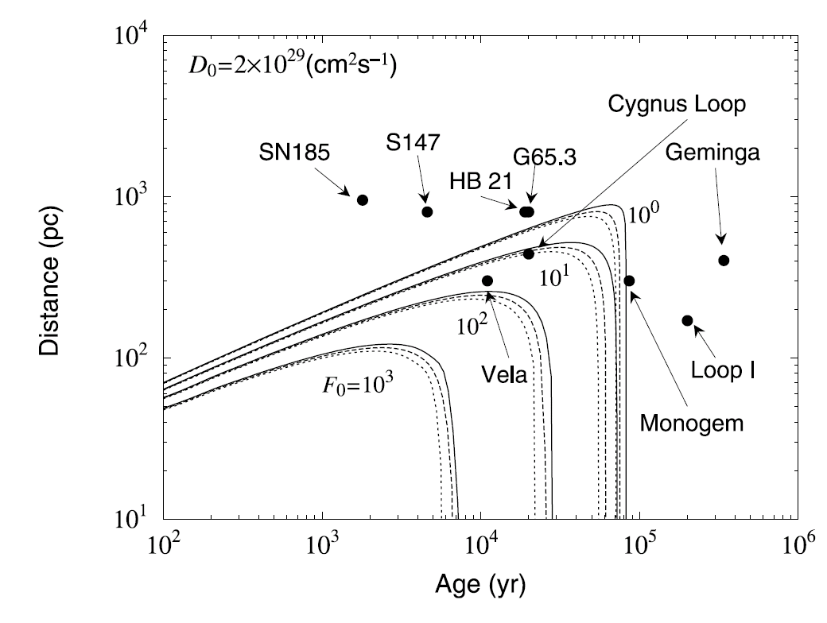
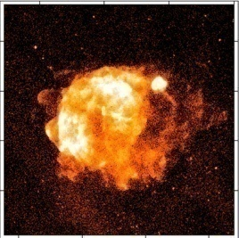
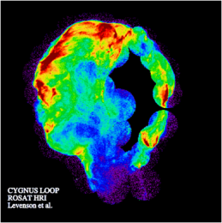
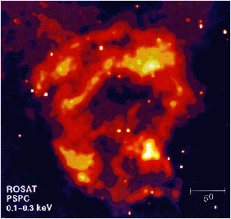
CALET Main Target: Nearby Sources of Electrons in TeV region
    T (age) = 2.5 ×10⁵ × (1 TeV/E) yr
    R (distance) = 600 × (1 TeV/E)^{1/2} pc
> 1 TeV Electron Source:
Age < a few10⁵ years
very young comparing
to ~10⁷ year at low energies
Distance < 1 kpc
nearby source
Source (SNR) Candidates :
Vela Cygnus Loop Monogem
Unobserved Sources?
Contribution to 3 TeV Electrons
from Nearby Source Candidates
(F₀: E³ x Flux at 3TeV)

Slide 13
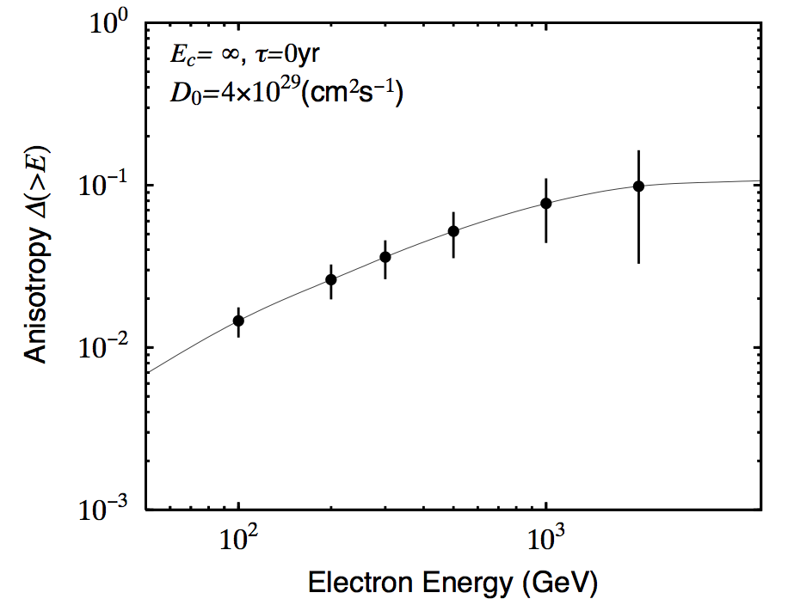
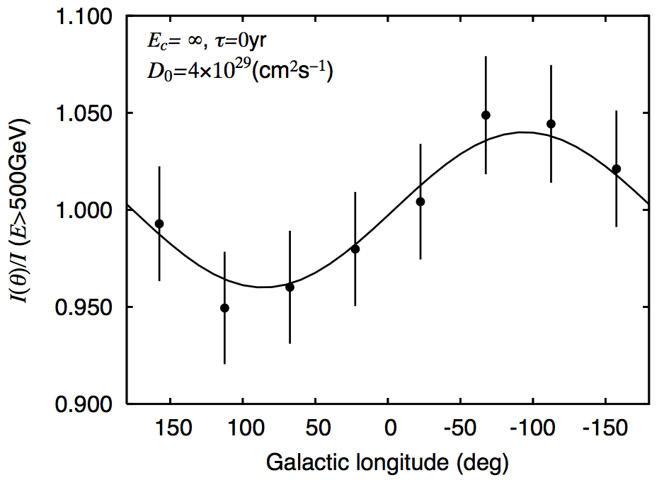
CALET Capability for Electron (+ Positron ) Observation : Nearby Sources
Expected Anisotropy
from Vela SNR
~10% @1TeV
Expected Flux
>1000 827 644
uniform source distribution
Monogem
Cygnus Loop
Vela

Slide 14
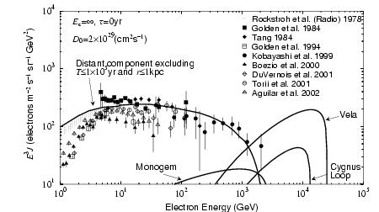
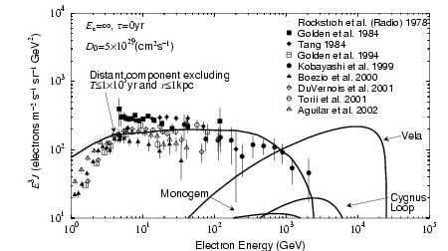
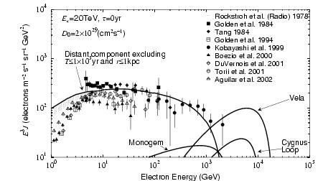
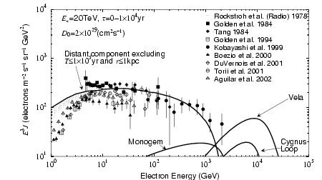
Model Dependence of Energy Spectrum and Nearby Source Effect
Ec: Cutoff Energy ΔT: Acceleration Period D: Diffusion Constant at 1 TeV (∝E^{0.6})
Ec=∞、 ΔT=0 yr、 Do=2x10²⁹ cm²/s
Do=5 x 10²⁹ cm²/s
uniform source distribution
Ec= 20 TeV
Ec=20 TeV、 ΔT=10⁴ yr
Kobayashi et al. ApJ (2004)

Slide 15
Recent results of electron and positron observations 1-1000 GeV
Something interesting in the electron energy spectrum below 1 TeV
is revealed by accurate measurements with high statistics
AMS-02
It is now relatively well established that there is an enhancement in the electron energy spectrum in the 200 ~1000 GeV energy range, which is not expected for a uniform distribution of sources in Galaxy. Source candidates are suggested to be nearby pulsars or dark matter.
ATIC, Fermi-LAT and HESS all see an enhancement, but experiment limitations preclude a complete characterization of the feature.
Recent AMS-02 observations are consistent with Fermi-LAT above 100 GeV, but a systematic discrepancy exists in the 10-100 GeV range .
The exact shape of the spectral feature needs to be refined and details of this shape may help identify the source of the energetic electrons.

Slide 16
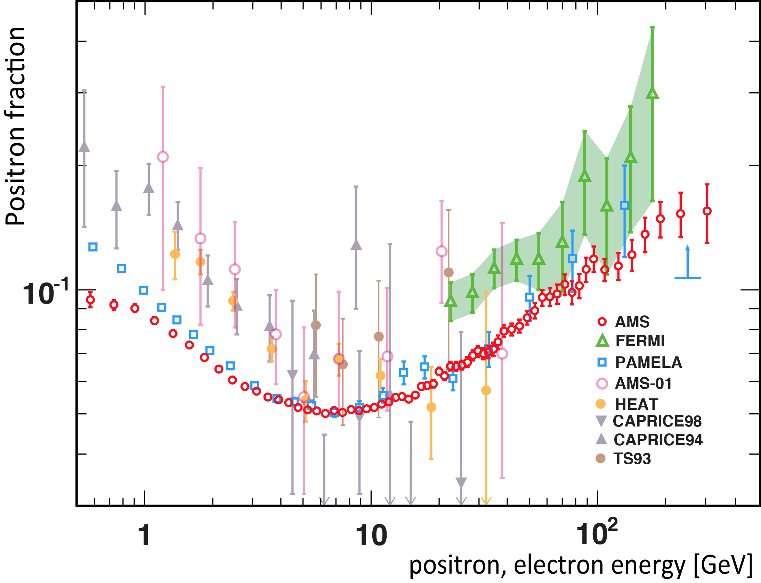
Positron fraction from AMS-02
AMS-02 observed:
Steady increase from 10 to ~ 250 GeV with slope decreasing by an order of magnitude
No fine structure, consistent with sum of diffuse spectrum and a single common power law source.
The positron fraction is higher by about one-order of magnitude at 100 GeV than predicted for secondary positrons by a widely used CR propagation model.
Possible solutions:
New primary sources of positrons
- Annihilation of dark matter
- Positron production and acceleration by pulsars
Modifications of Galactic cosmic-ray
propagation model

Slide 17
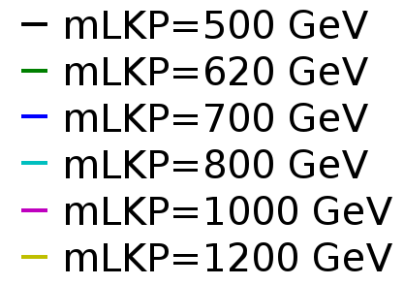
Consistent understanding of the e⁺+e⁻ spectrum with the positron fraction
Background: power law (different for electron and positron) with exp. cutoff
+ case A) Dark Matter: Lightest Kaluza Klein Dark Matter (LKP) in the mUED scenario
– Branching ratios: 20% e+e-, 20% μ+μ-, 20% τ+τ, 11% uu, 11% cc, 11% tt, 2% hh
+ case B) GSS: Generic Source Spectrum (say, Nearby Pulsars: power law with cutoff)
-
-
-
Fits of the Generic Source Spectrum (dashed red line, background flux solid red line) and Kaluza Klein Dark Matter of different masses, calculated using the annihilation and propagation routines of DarkSUSY, to positron fraction (right plot) data from AMS-02 (red) and total flux (left plot) measured by Fermi, including systematic error (green).
χ² is below 95% CL exclusion for all the cases except m(LKP)=500 GeV, thus proving that both Dark Matter annihilation and local accelerators are valid hypotheses within the constraints of current experiments.

Slide 18
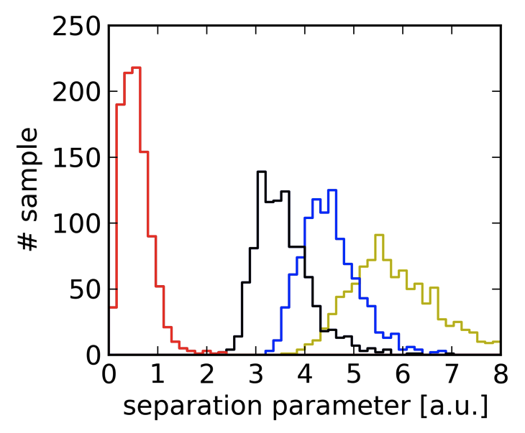
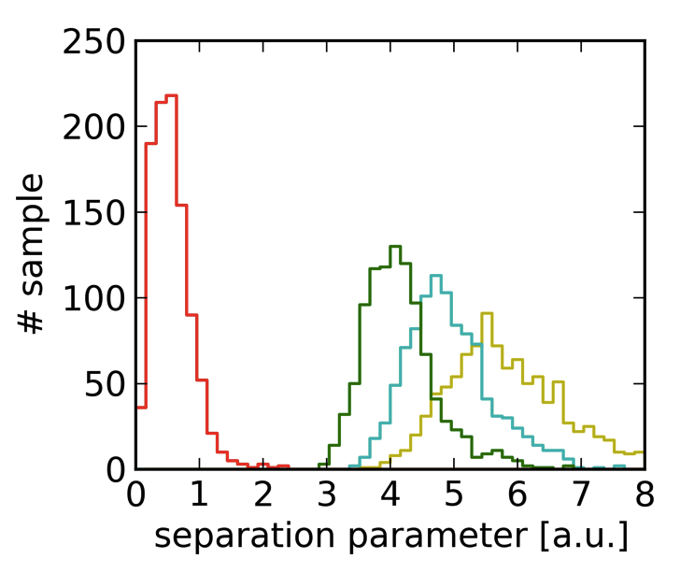
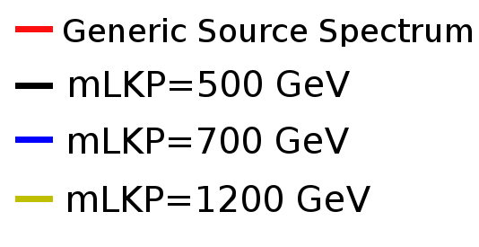
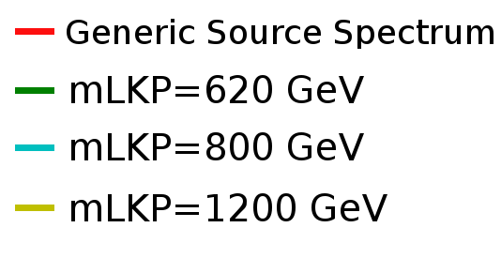
CALET capability to separate
the generic source spectrum and Dark Matter cases
The expected 2yr-signal in CALET was calculated for each case, based on the detector’s simulated properties. An unbinned analysis by least square fit based on the event distribution in energy was developed, which is able to separate the Generic Source Spectrum (GSS) and Dark Matter cases. Specifically it identifies the drop in the spectrum at the mass of the Dark Matter particle, allowing reconstruction of the mass with high precision.
Distribution of a fit parameter used for separation
between Dark Matter and GSS for 1000 simulated samples of each case.
22pSP-4 H.Motz et al.
Clear Separation between local accelerators (Generic Source Spectrum – GSS) and
Kaluza Klein Dark Matter Annihilation possible with 2-yr CALET data.
Mass of Lightest Kaluza Klein Particle can be reconstructed with high resolution
(σ〜11.6GeV).

Slide 19
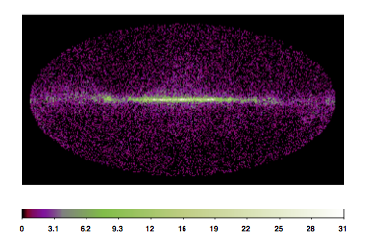
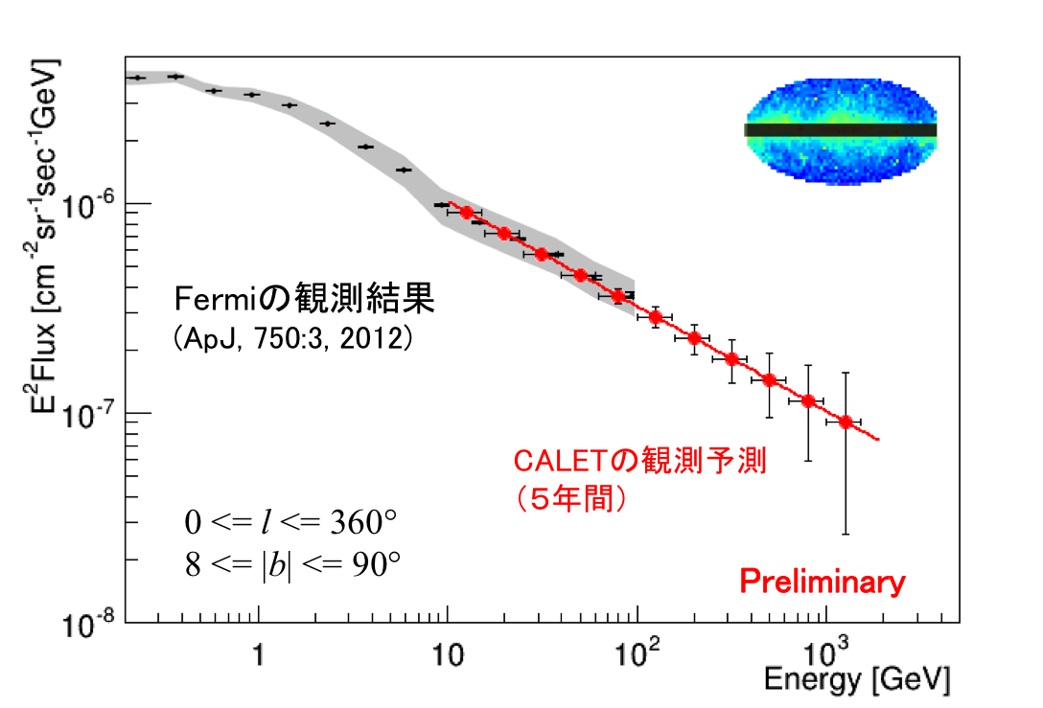
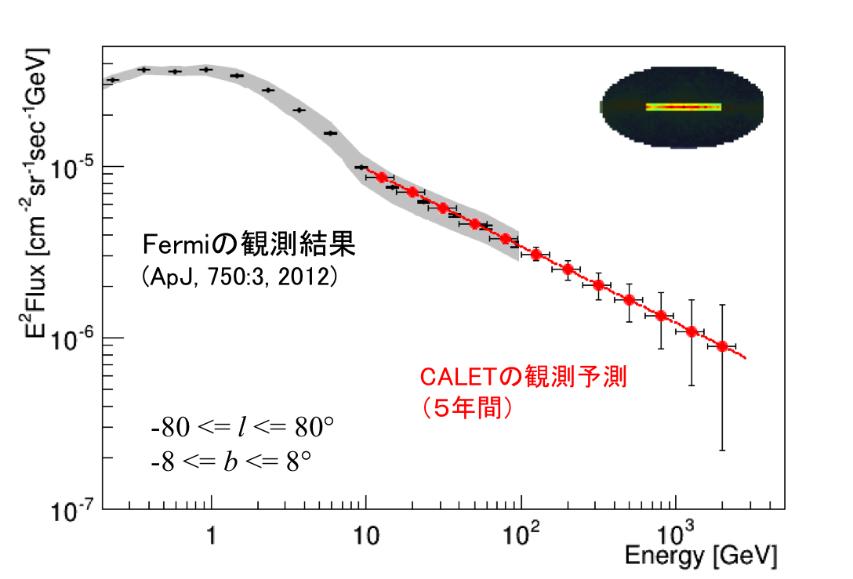
Detection of High Energy Gamma-rays
Performance for Gamma-ray Detection
Simulation of Galactic Diffuse Radiation
Energy Range | 4 GeV-10 TeV
Effective Area | 600 cm² (10GeV)
Field-of-View | 2 sr
Geometrical Factor | 1100 cm²sr
Energy Resolution | 3% (10 GeV)
Angular Resolution | 0.35 ° （10GeV)
Pointing Accuracy | 6′
Point Source Sensitivity | 8 x 10⁻⁹ cm⁻²s⁻¹
Observation Period (planned) | 2014-2019 (5 years)
~25,000 photons are expected per one year
*) ~7,000 photons from extragalactic
γ-background (EGB) each year
Expected flux of diffuse gamma-rays observations in five year
extragalactic
galactic
22pSP-3 Y.Akaike et al.
Preliminary

Slide 20
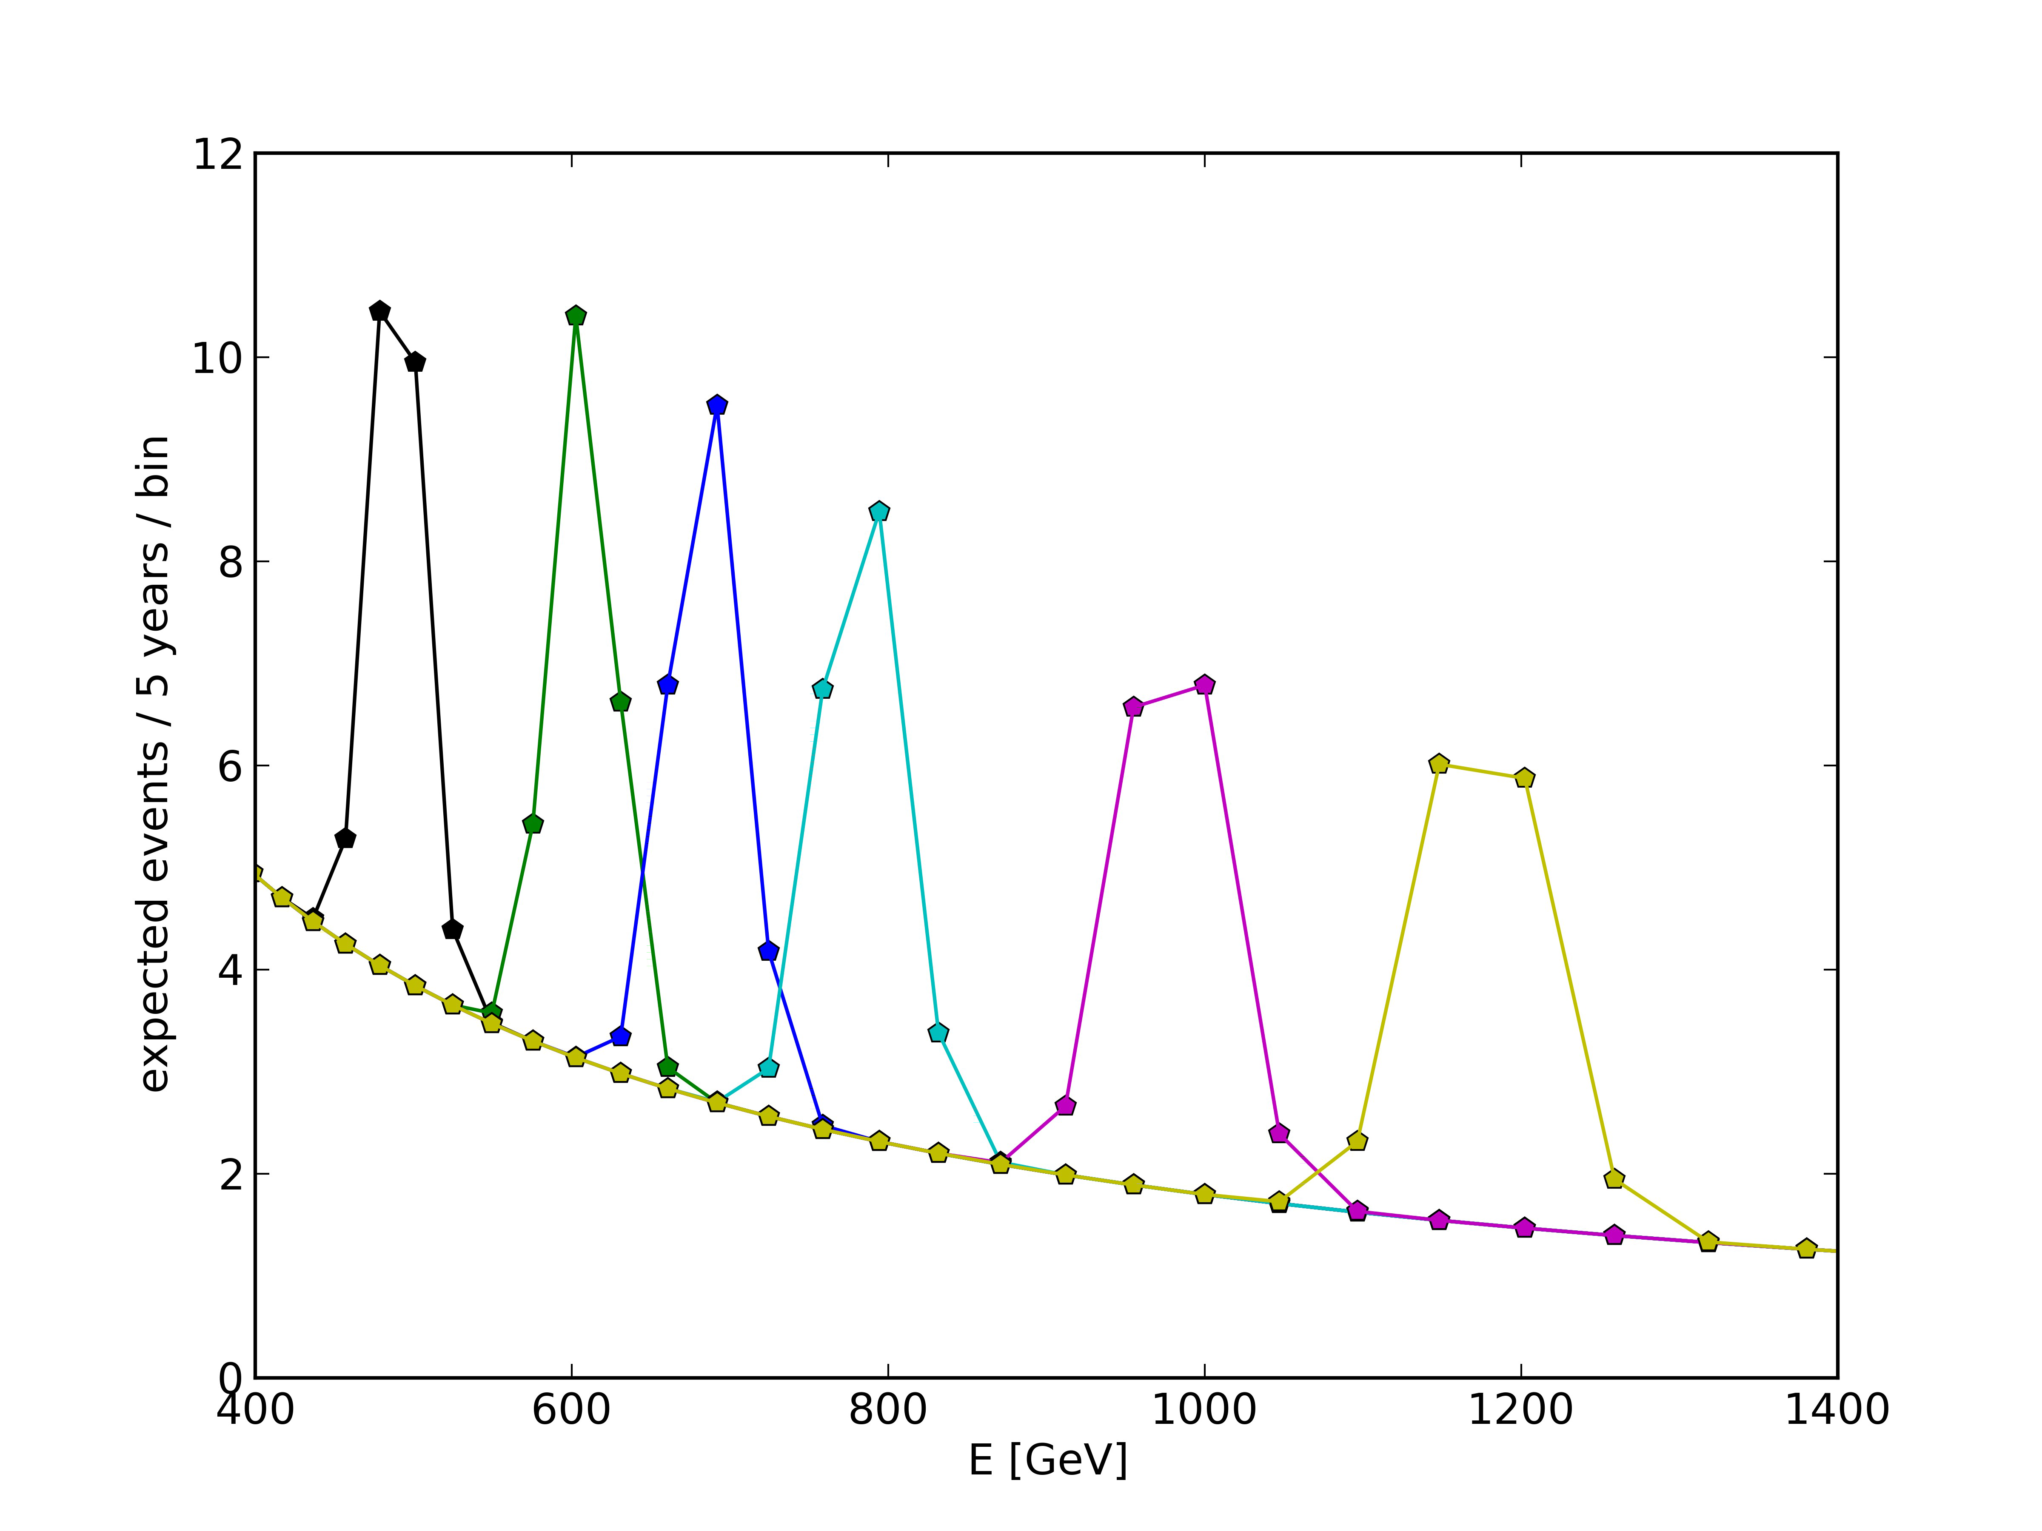
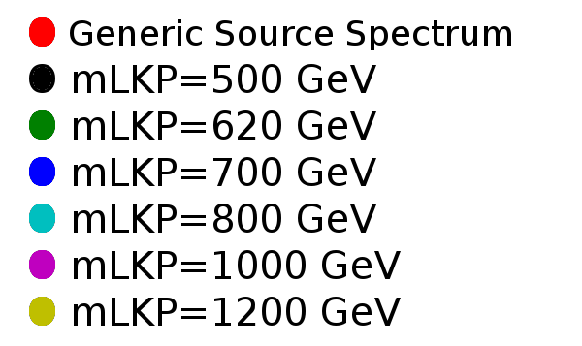
CALET Capability for Detection of Gamma-ray Lines from Dark Matter
Monochromatic gamma-ray signals from WIMP dark matter annihilation would provide a distinctive signature of dark matter, if detected. Since gamma-ray line signatures are expected in the sub-TeV to TeV region, due to annihilation or decay of dark matter particles, CALET, with an excellent energy resolution of ~ 2 % above 100 GeV, is a suitable instrument to detect these signatures .
22pSP-4 H.Motz et al.
● Parameters taken from Kaluza-
Klein Dark Matter “Best Fit” to
e⁺ and e⁻data explaining the
positron excess
=> BF × <σv> [10⁻²²cm³/s]:
0.962 , 1.379 , 1.687 ,
2.093 , 2.971 , 3.926
● Branching ratios:
γγ: 5x10⁻³ , Zγ: 5x10⁻⁴
● CALET 5 year signal for all sky
except galactic plane (b>5), only
extragalactic γ-flux as background
=> possible confirmation of a signal in
electron/positron flux
Eγ = mLKP Energy resolution 2%

Slide 21
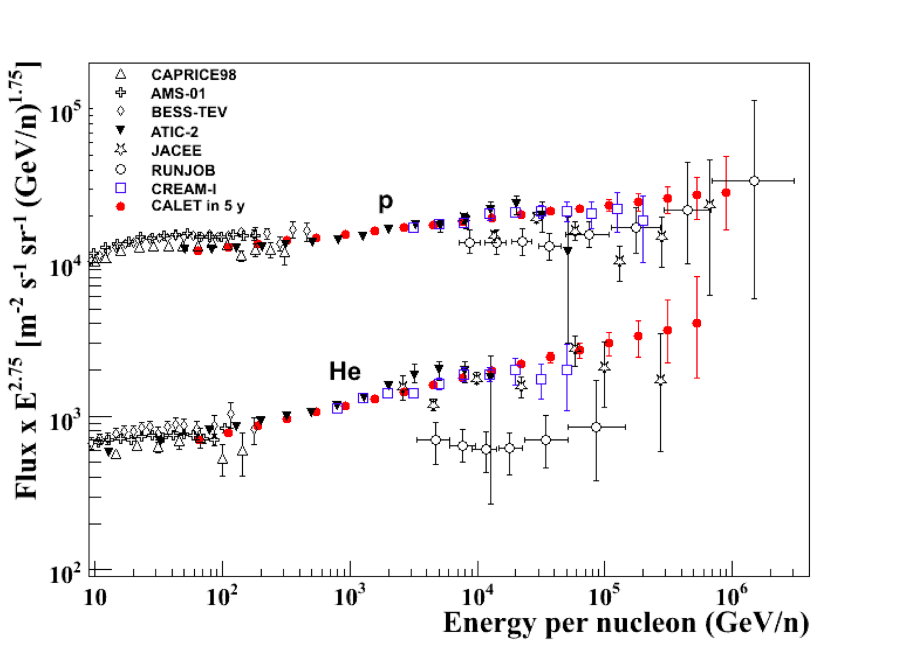
P and He Observation
Multi –TeV Region
Proton and He slopes are different ?
Single power law or curvature.
Is there a proton cutoff below 1 PeV ?
CALET expected in 5 y (red points)
Requirements for calorimetry:
Proton interaction requires > 0.5 λ_{INT}
Energy Measurement at 100 TeV scale
requires confinement of the e.m. core of
the shower, i.e. > 20 X₀
 | λ_{INT} | X₀ (nominal incidence)
CALET | 1.5 | 30
CREAM | 0.5+0.7 | 20
AMS-02 | 0.5 | 17
Energy reach in 5 years:
Proton spectrum to ≈ 900 TeV
He spectrum to ≈ 400 TeV/n

Slide 22
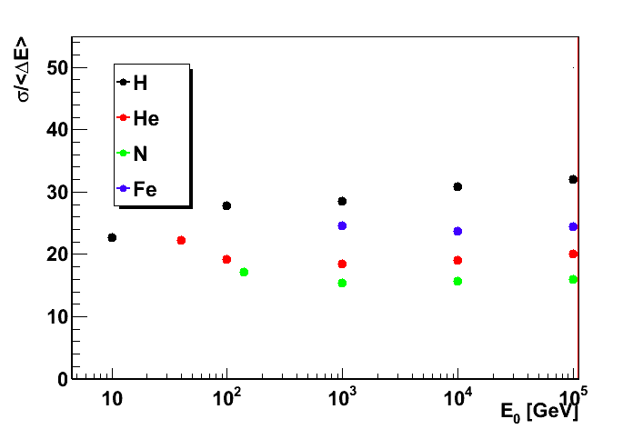
Intermediate nuclei to Fe Observation
CALET expected in 5 y (red points)
Is there a spectral cutoff below 1 PeV ?
single power law or
spectrum concavity ?
Energy resolution for nuclei
Spectra of C, O, Ne, Mg, Si to ≈ 20 TeV/n
B/C ratio to ≈ 4-6 TeV/n
Fe spectrum to ≈ 10 TeV/n
CALET energy reach
(5 years)

Slide 23
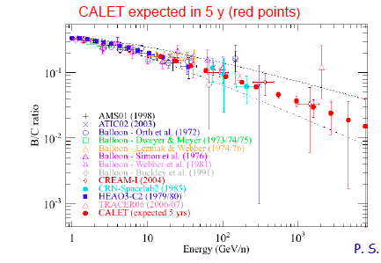
Expected Measurements of B/C ratio and Ultra-heavy Particles
Ultra-heavy (Z>26) Particles
E ^{–δ}
δ＝0.3
δ=0.6
P.S. Morrocchesi ICRC2013
B.Rauch ICRC2013
CALET should obtain 2-4× the statistics of TIGER in expected 5 year mission.
Assumption that results for vertical cutoff rigidities represent average of East-West effect is not valid.
CALET measurements in orbit will require less correction for nuclear interactions.
CALET will measure the B/C ratio to over 1 TeC/nucleon and provide an exact value of the energy exponent δ within an accuracy of ~0.05

Slide 24








CERN Beam Test using the Structure & Thermal Model (STM)
Beam Test Results
Charge Detector: CHD
Schematic Side View of the Beam Test Model
ΔE-E_{beam}
Imaging Calorimeter: IMC
Electron shower
transition curve
in TASC
22pSP-7 T.Tamura et al.
The Beam Test Model at CERN SPS H8 Beam Line
Total Absorption Calorimeter: TASC
Angular resolution
for electrons

Slide 25






Pre-Flight Model Production
TASC Structure
(Production and tests completed)
Acoustic Test of Full Structure
・ JEM/EF Payload Structure – PFM
・ Calorimeter Structure – STM
IMC/CHD Structure
(Production in progress)
CHD
CFRP Structure
22pSP-9 Y.Shimizu et al.
IMC
TASC(Completed)

Slide 26

Concept of Data Downlink Stream
NASA Link
Real-Time Connection
> 50 % (max. 17 hr/day)
Data Archive Center
in JAXA, NASA, ASI
CALET
Waseda Univ.
CALET Mission
Science Center
JAXA ICS Link
Real-Time Connection
~20 % (5 hr/day)
International
Collaboration
Organization

Slide 27

Summary and Future Prospects
CALET is primarily dedicated to observing electrons into the trans-TeV region to provide crucial information on nearby astrophysical sources and dark matter.
  Electrons from 1 GeV to 20,000 GeV
  Gamma-rays from 10 GeV to 10,000 GeV
  Protons and heavy ions (Z < ~28) from 10’s of GeV to ~1,000 TeV
  Ultra Heavy ion ( 28 < Z < ~40) for energy greater than ~600 MeV/n
  Gamma ray bursts 7keV to 20 MeV with HXM & SGM and ~1 GeV to 10 TeV with Calorimeter
The CALET detectors are based on designs proven during balloon flights (BETS, bCALET) and accelerator beam tests.
Development of the CALET flight hardware is now well underway.
The CALET project has been approved for launch in FY2014 by HTV-5 to the Japanese Experiment Module (Kibo).
The target mission is 5 years -> electron exposure = 220 m² sr days

Slide 28
CALET 関連発表
９月２２日SP会場 ２２pSP （１３：３０〜）
1. シミュレーション計算によるCALETの電子陽子識別性能 片平亮 (早大）
2. シミュレーション計算によるCALETの重粒子観測性能 村田彬 （早大）
3. CALETで期待されるガンマ線観測性能 赤池陽水（宇宙線研）
4. Expected Sensitivity of CALET to Dark Matter Annihilation Holger Motz（早大）
5. CALET検出器の軌道上キャリブレーション方法の開発 仁井田多絵（早大）
6. TASC性能試験用レーザー照射システムの開発 塚原一樹（早大）
7. CERN-SPS加速器実験におけるCALET観測性能実証 田村忠久（神奈川大）
8. CERN-SPS重粒子照射によるCALET電荷検出装置の性能テスト 小澤俊介（早大）
9. CALETのカロリメータプロトフライトモデル開発報告 清水雄輝（JAXA/SEUC)
10. CALETガンマ線バーストモニター開発の現状報告 川久保雄太(青学大）

